Slide 1
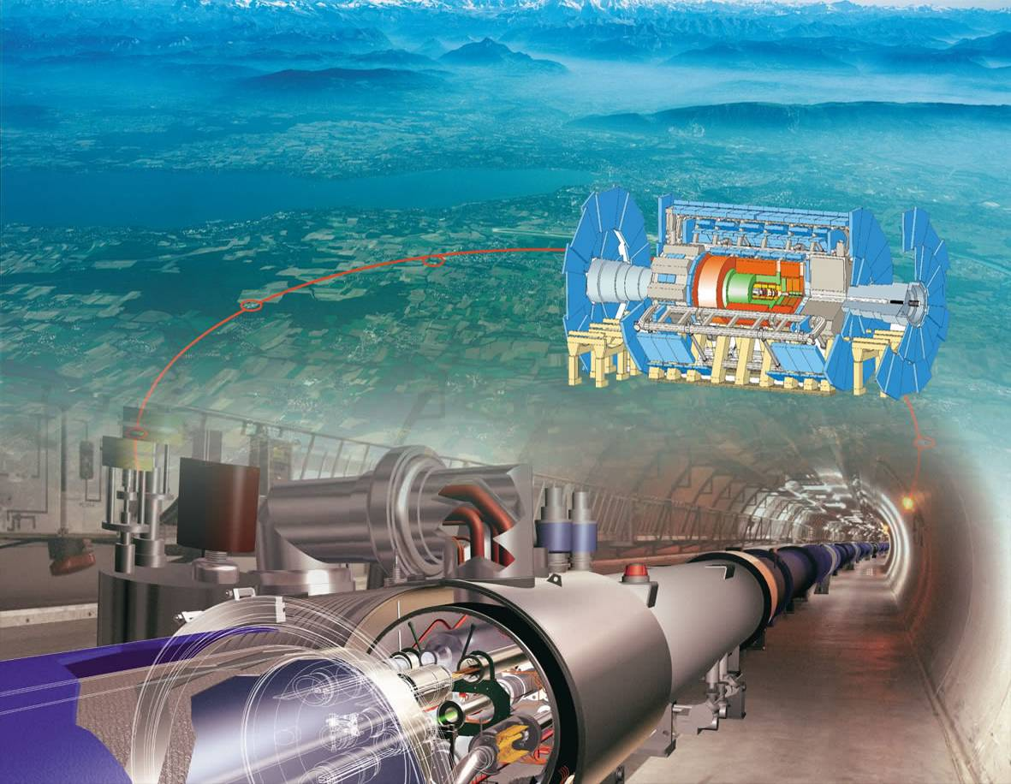
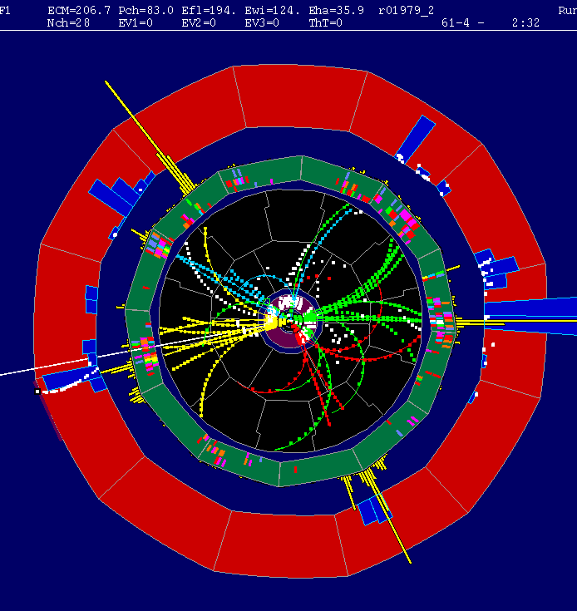
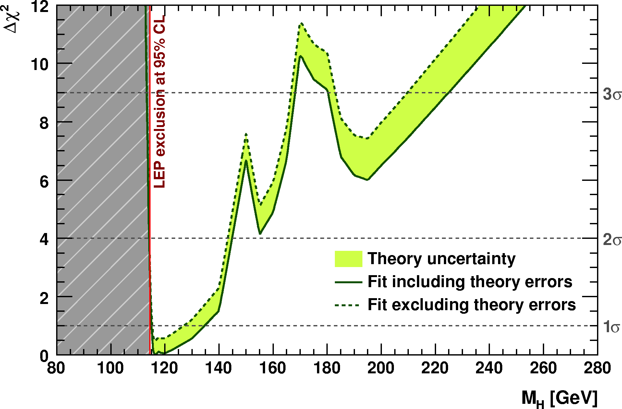
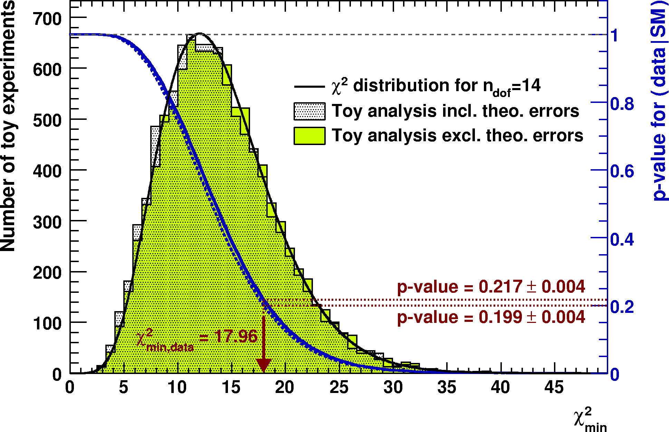
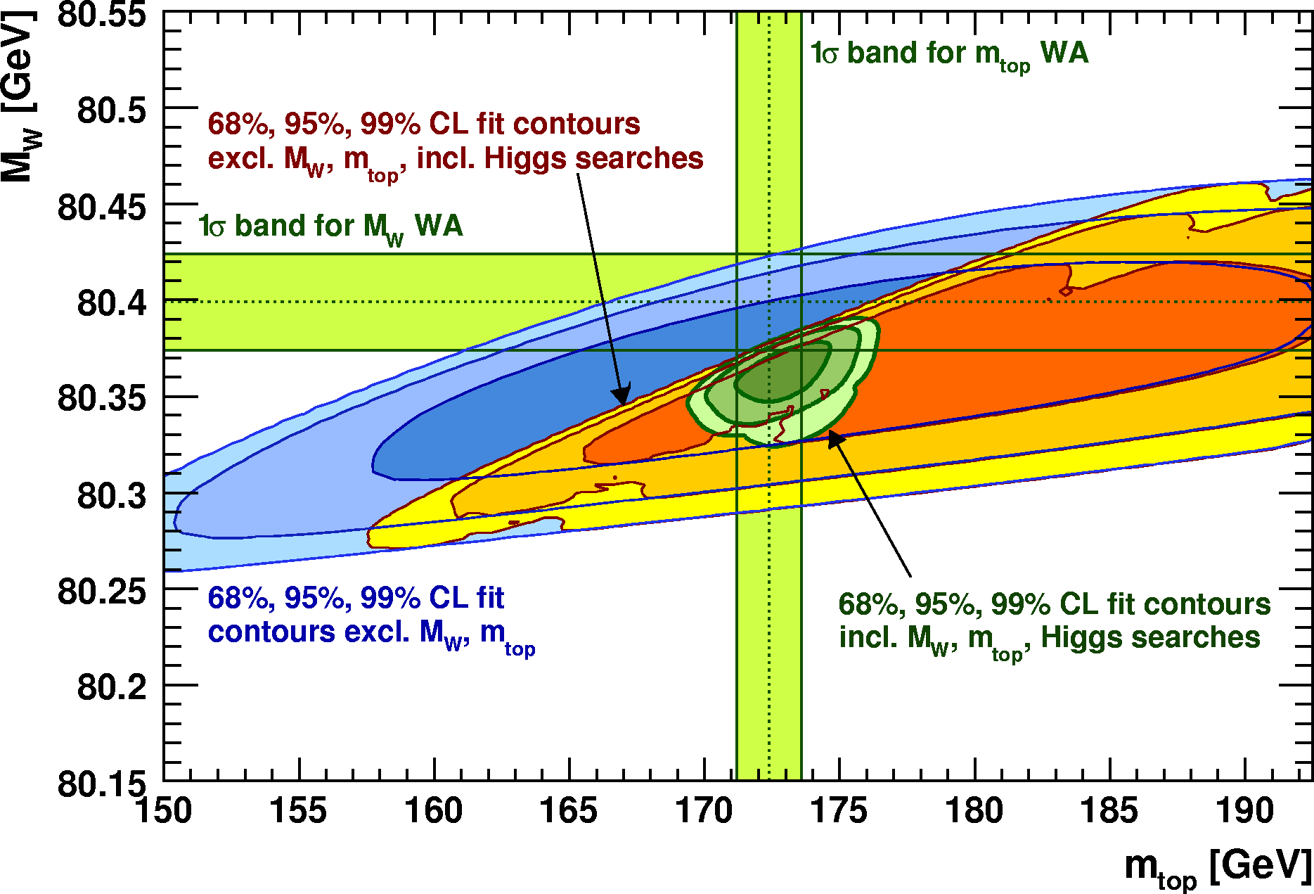
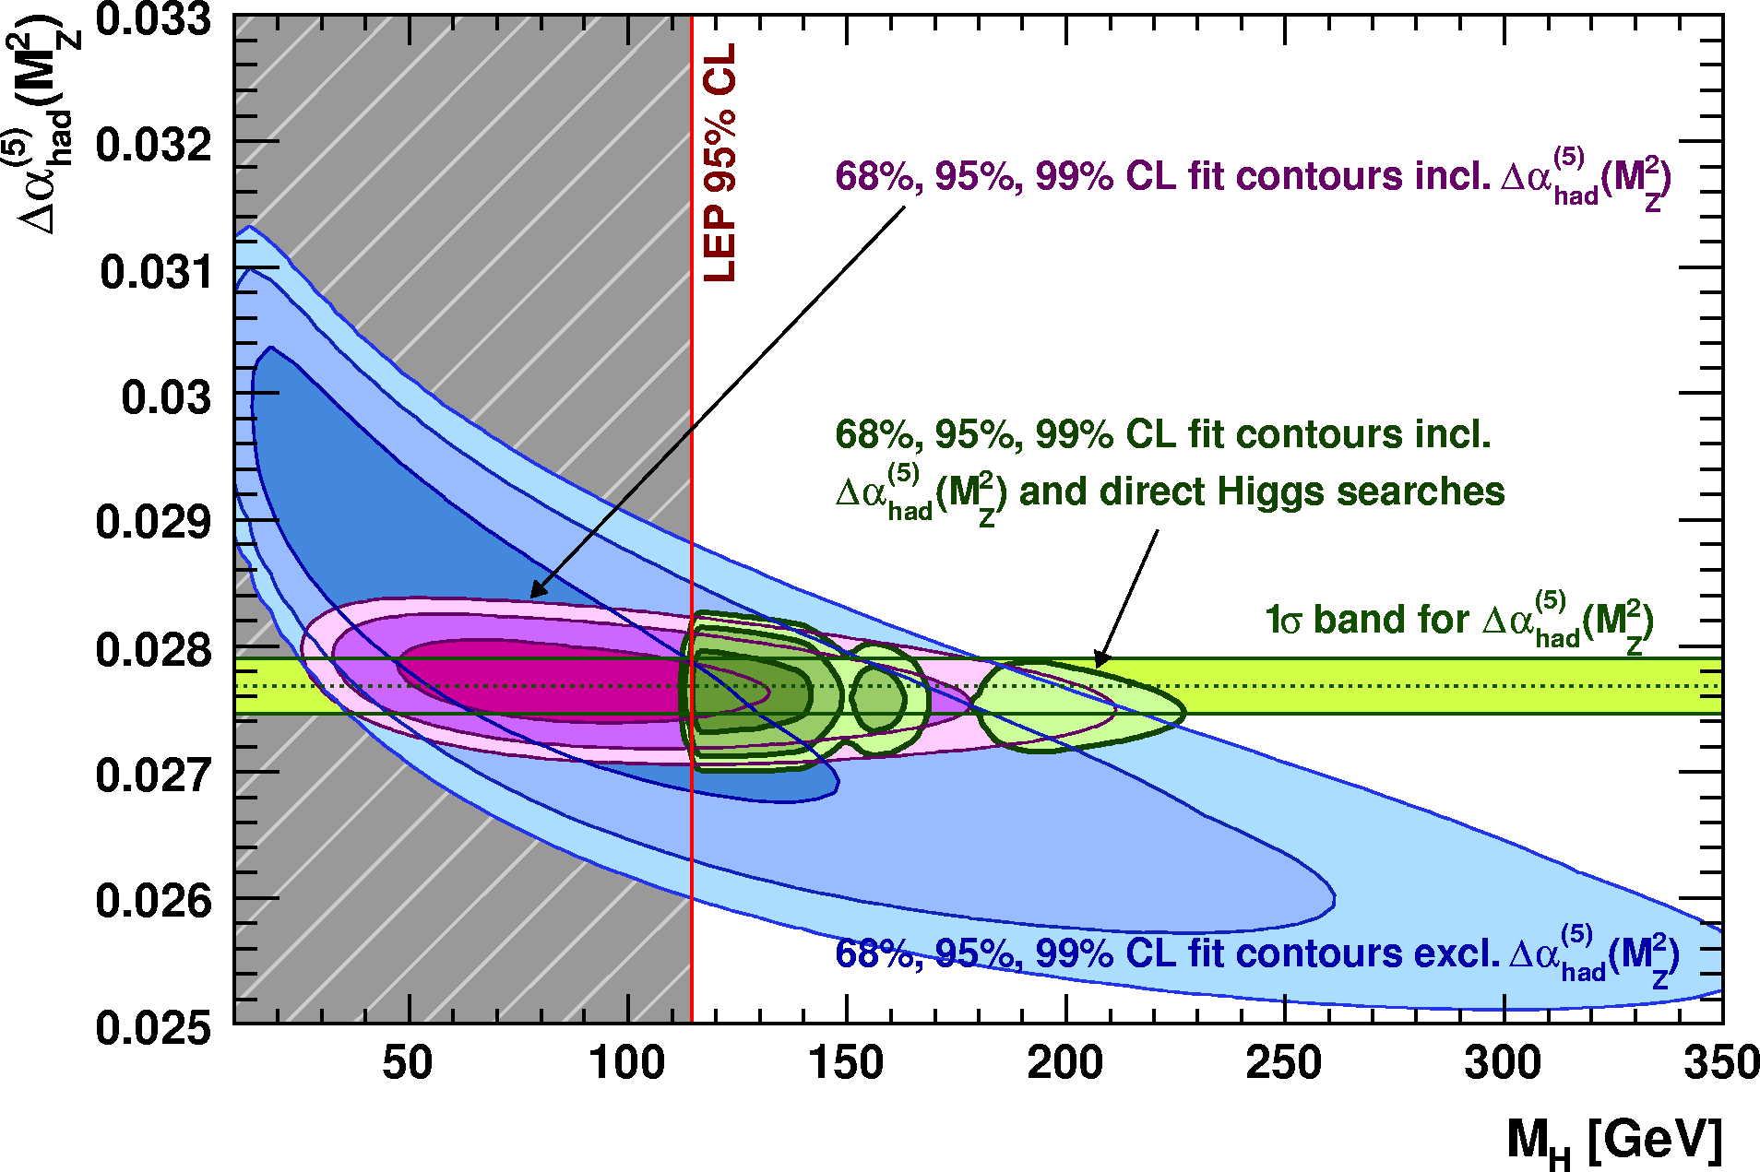
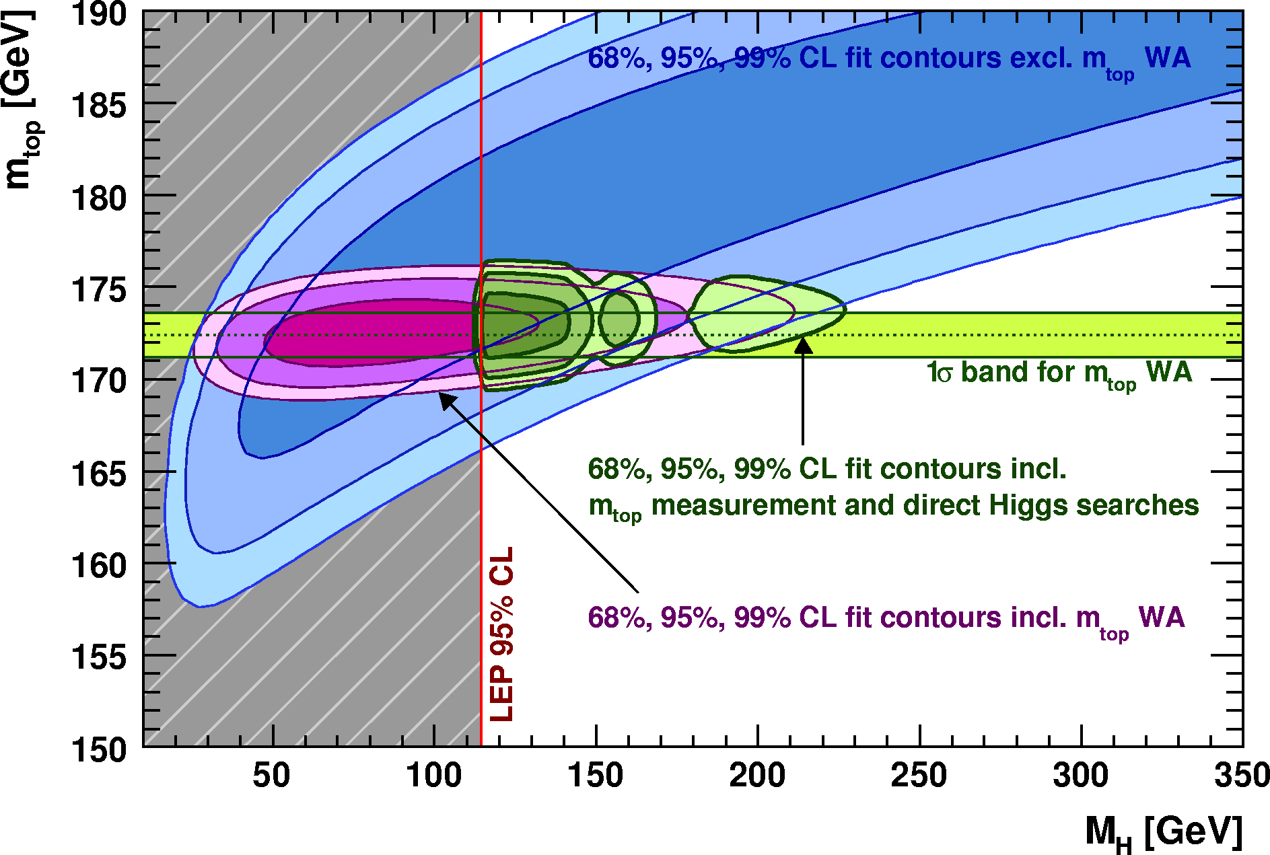
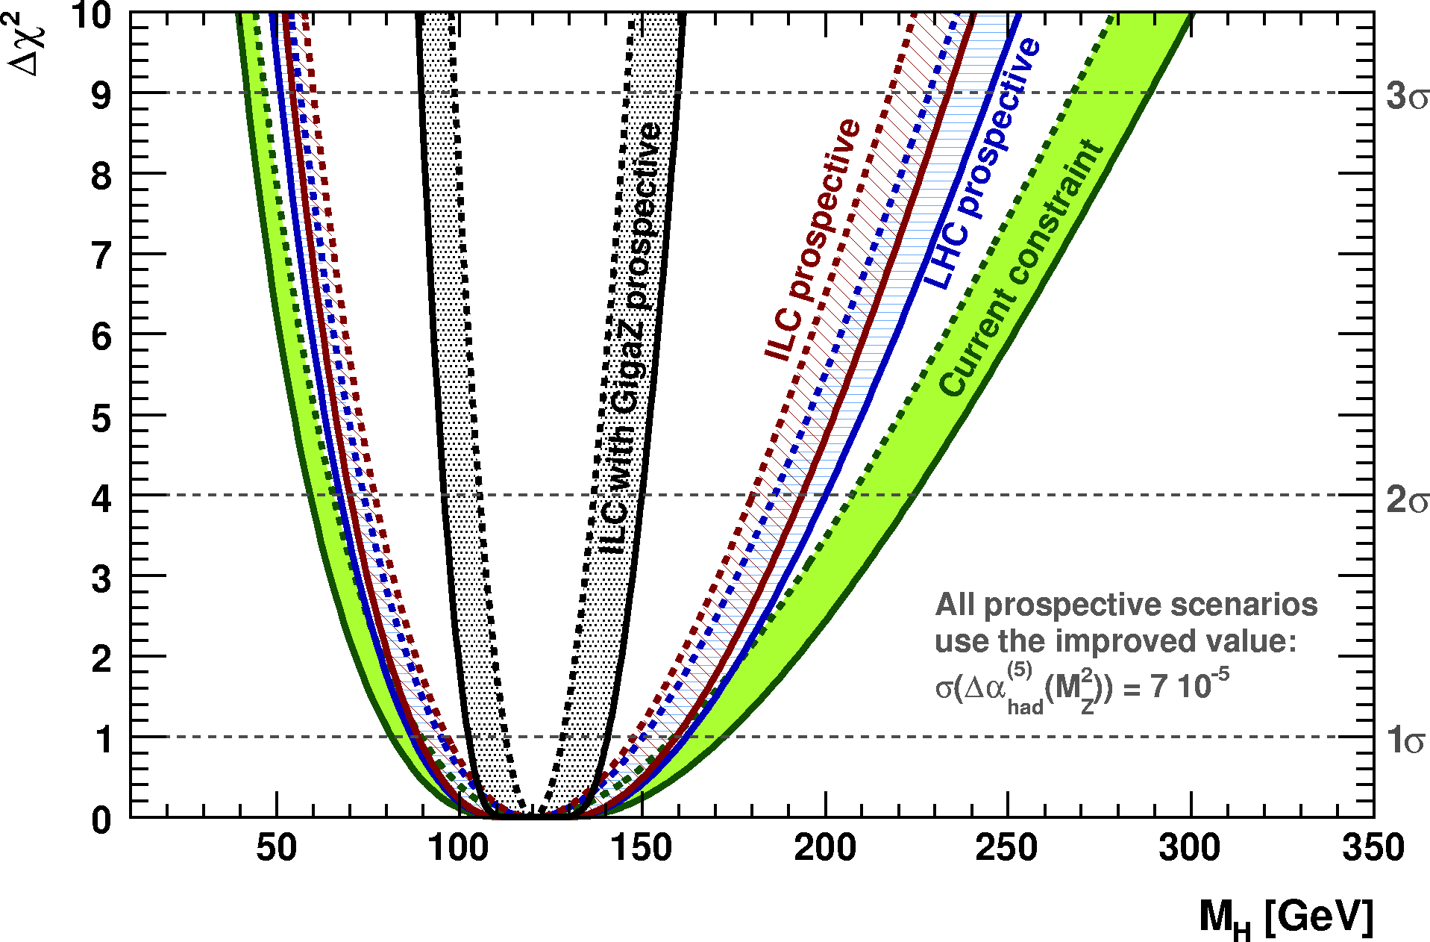
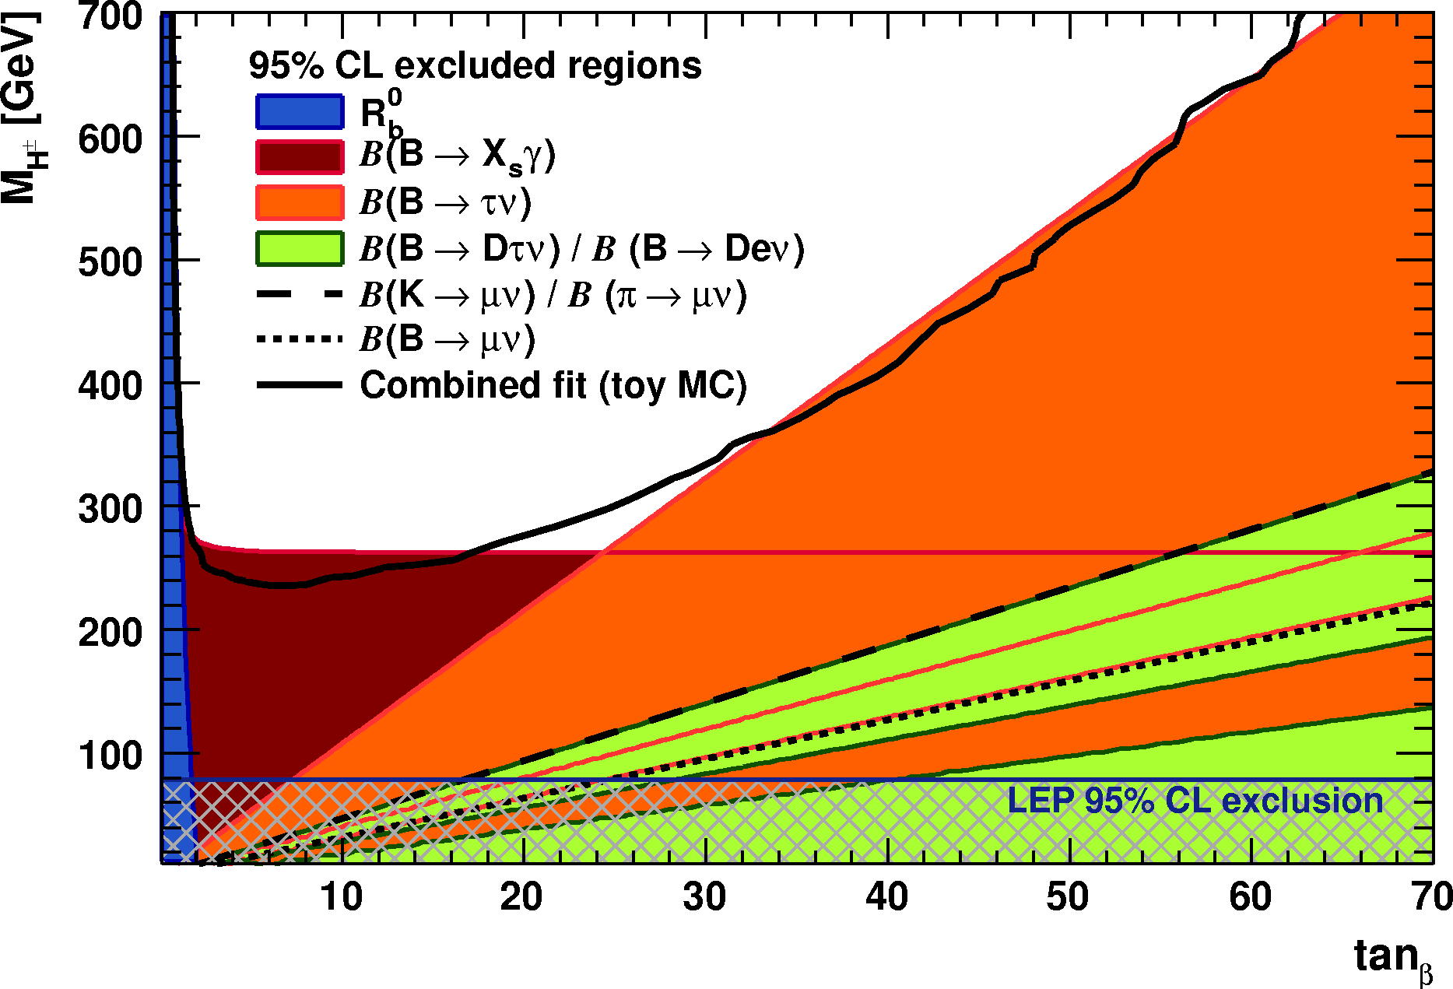
Electroweak Constraints on Higgs Boson
Andreas Hoecker (CERN)
Higgs Hunting Workshop, Orsay, July 29 – 31, 2010

Slide 2
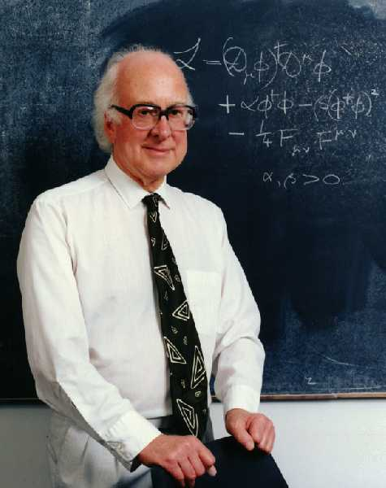
Indirect Constraints on the Higgs
from Electroweak Precision Data
Since the Z⁰ boson couples to all fermion-antifermion pairs, it is an ideal laboratory for studying electroweak and strong interactions

Slide 3

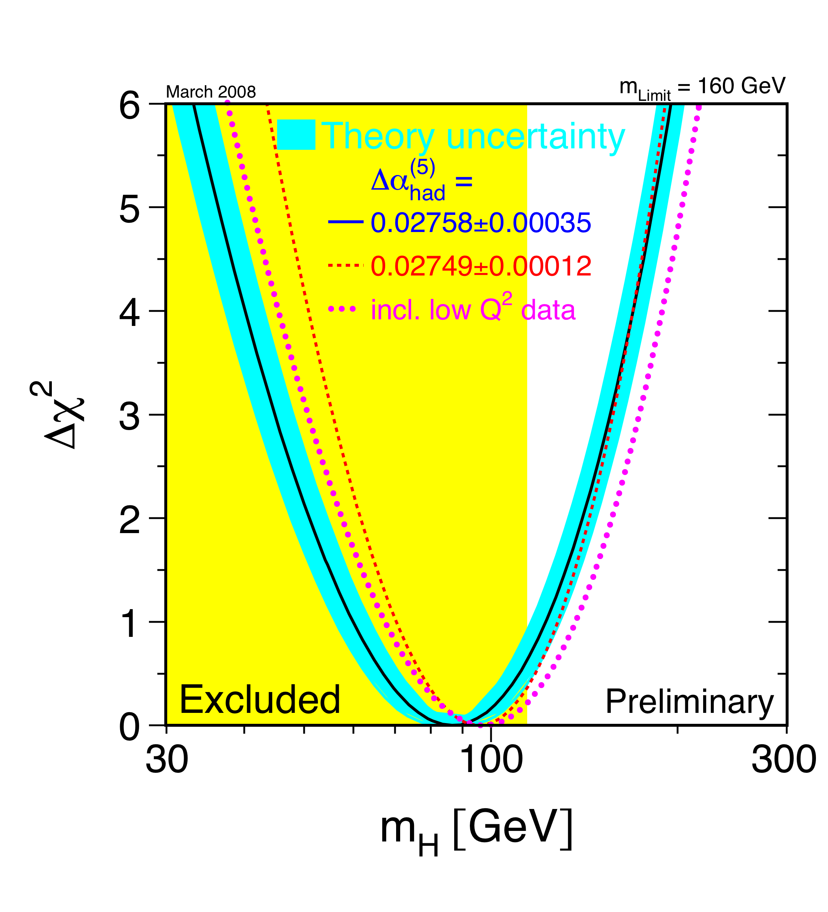
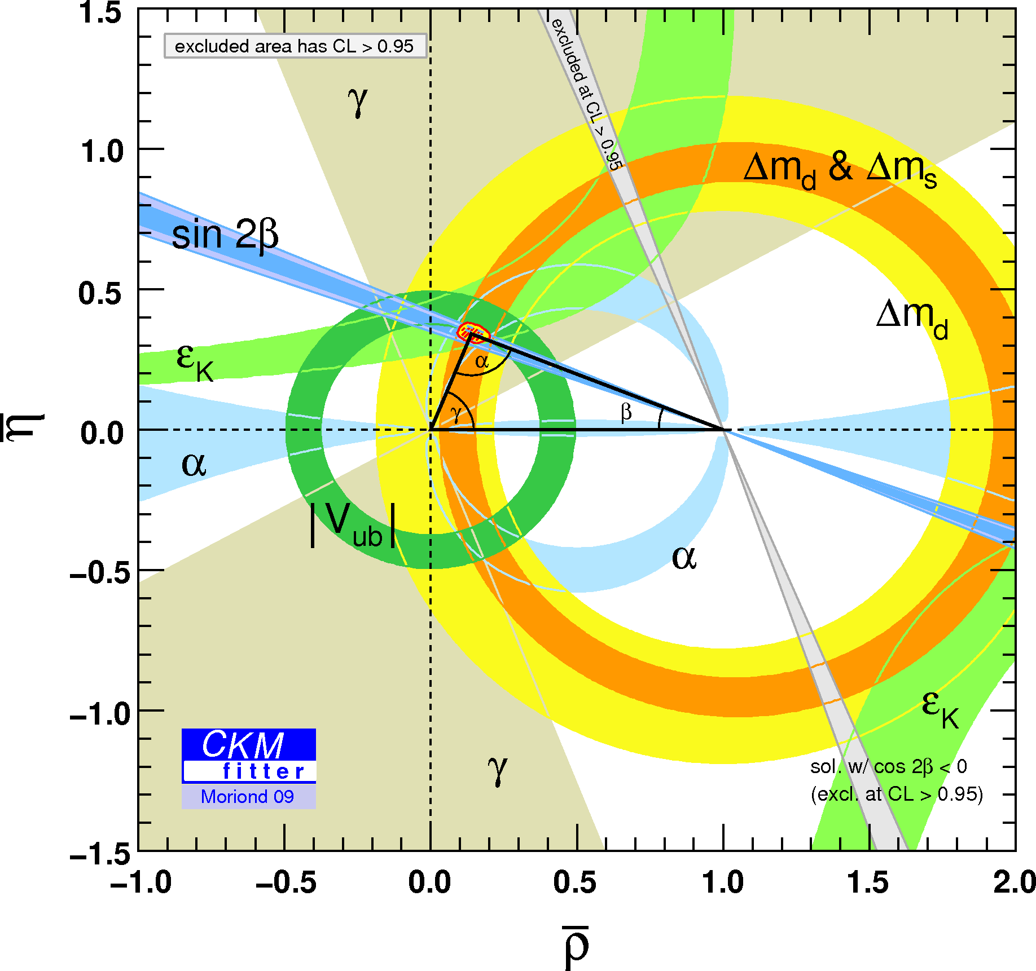
Electroweak fits have a long history …
Based on a huge amount of preparatory work
Needed to understand importance of loop corrections
Precise Standard Model (SM) predictions and measurements required
EW fits routinely performed by many groups
D. Bardinet al. (ZFITTER), G. Passarinoet al. (TOPAZ0), LEP EW WG (M. Grünewald, K. Mönig et al.), J. Erler (GAPP), …
Important results obtained !
Global SM fits also used at lower energies
CKMfitter (J. Charles et al.), UTfit (M. Bona et al.), …
Mostly concentrating on CKM matrix
Also many groups pursuing global beyond-SM fits

Slide 4
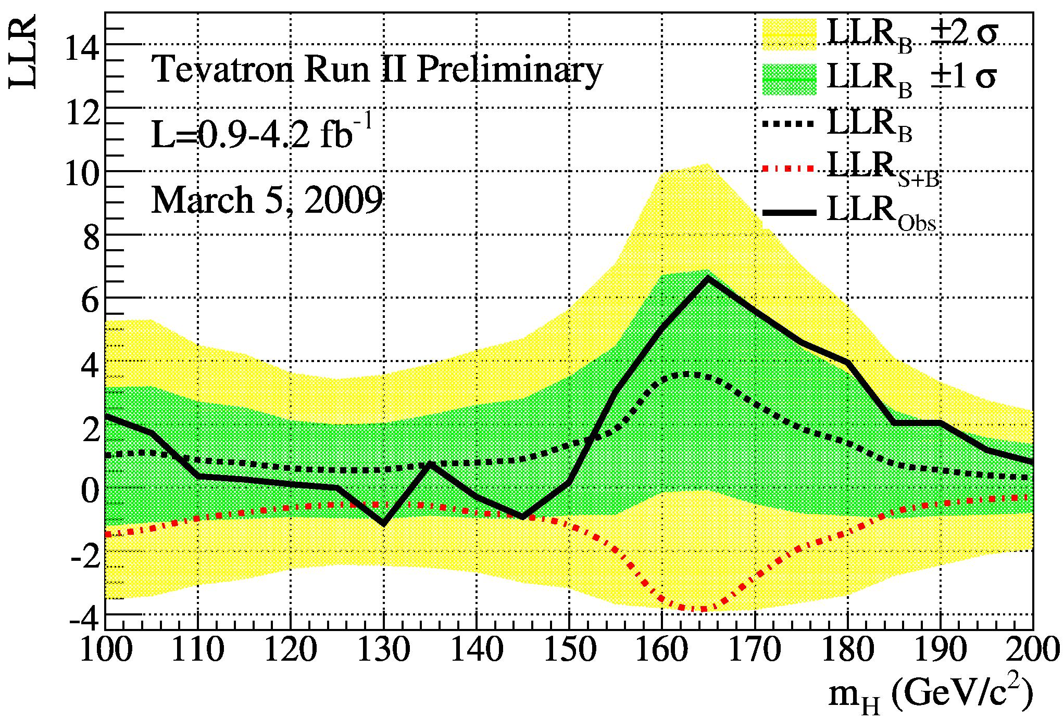
Fit Inputs

Slide 5
Measurements at the Z Pole
A look at the theory – tree level relations
Vector and axial-vector couplings for Z → ff in SM:
Electroweak unification: relation between weak and electromagnetic couplings:
Since uncertainty on G_{F} and M_{Z} small, relation often used to eliminate direct M_{W} dependence:
Gauge sector of SM on tree level is given by 3 free parameters, e.g.: α, M_{Z}, G_{F}

Slide 6
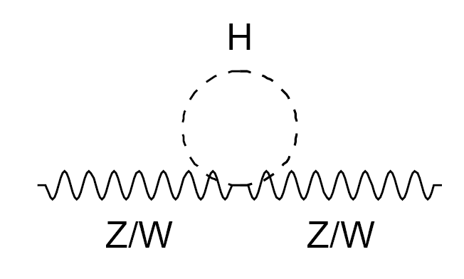
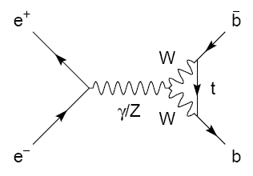
Measurements at the Z Pole
Radiative corrections – modifying propagators and vertices
Significance of radiative corrections can be illustrated by verifying tree level relation:
Using the measurements:
one predicts:
which is 19σ away from the experimental value obtained by combining all asymmetry measurements:

Slide 7
Measurements at the Z Pole
Radiative corrections – modifying propagators and vertices
Parametrisation of radiative corrections: “electroweak form-factors”: ρ, κ, Δr
Modified (“effective”) couplings at the Z pole:
Modified W mass:
  ρ : overall scale
  κ : on-shell mixing angle

Slide 8
Measurements at the Z Pole
Radiative corrections – modifying propagators and vertices
Leading order terms (M_{H} ≪ M_{W})
ρ_{Z} and κ_{Z} can be split into sum of universal contributions from propagator self-energies:
and flavour-specific vertex corrections, which are very small, except for top quarks, due to large |V_{tb}| CKM element

Slide 9
Measurements at the Z Pole
Radiative corrections – modifying propagators and vertices
Leading order terms (M_{H} ≪ M_{W})
ρ_{Z} and κ_{Z} can be split into sum of universal contributions from propagator self-energies:
Radiative corrections allow us to test the SM
and to constrain unknown SM parameters
and flavour-specific vertex corrections, which are very small, except for top quarks, due to large |V_{tb}| CKM element

Slide 10
Measurements at the Z Pole
Total hadronic cross section – measurement and prediction
Total cross-section (from cosθ symmetric terms) expressed in Breit-Wigner form:
Corrected for QED radiation
Partial widths add up to full width: Γ_{Z} = Γ_{ee} + Γ_{μμ} + Γ_{ττ} + Γ_{hadronic} + Γ_{invisible}
Measured cross sections depend on products of partial and total widths
Highly correlated set of parameters !
Instead: use less correlated set of six measurements
Z mass and width: M_{Z}, Γ_{Z}
Hadronic pole cross section: σ ⁰_{had}
Three leptonic ratios (use lepton-univ.):
Hadronic width ratios:
Taken from LEP:
precise √s
high statistics
Include also SLD:
higher effi./purity for heavy quarks

Slide 11
Measurements at the Z Pole
Partial width – sensitive to QCD and QED corrections
Partial width are defined inclusively, i.e., they contain final state QED and QCD vector and axial-vector corrections via “radiator functions”: R_{A,f} , R_{V,f}
QCD corrections only affect final states with quarks
To first order in α_{S} corrections are flavour independent and identical for A and V
3NLO (!) calculation available [P.A. Baikov et al., Phys. Rev. Lett. 101 (2008) 012022]
QED corrections similar:
(though much smaller due to α ≪ α_{S})

Slide 12
Measurements at the Z Pole
Asymmetry and polarisation – quantify parity violation
Distinguish vector and axial-vector couplings of the Z (i.e., sin²θ ^{f}_{eff})
Convenient to use “asymmetry parameters”:
  dependent on sin²θ ^{f}_{eff} :
Via final state (FS) angular distribution in unpolarised scattering (LEP)
Forward-backward asymmetries:
LEP measurements:
Via IS polarisation (SLC):
Left-right, and left-right forward-backward asymmetries:

Slide 13
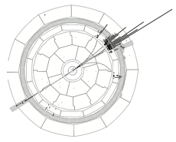
Measurements at the Z Pole
Asymmetry and polarisation – quantify parity violation
Distinguish vector and axial-vector couplings of the Z (i.e., sin²θ ^{f}_{eff})
Convenient to use “asymmetry parameters”:
  dependent on sin²θ ^{f}_{eff} :
Via final state polarisation (LEP):
Tau polarisation:
Measure τ spin versus from energy and angular correlations in τ decays
Fit at LEP determines: A_{τ} , A_{e}
ALEPH
Z → τ ⁺τ – candidate

Slide 14
Measurements at the Z Pole
Asymmetry and polarisation – quantify parity violation
Distinguish vector and axial-vector couplings of the Z (i.e., sin²θ ^{f}_{eff})
Convenient to use “asymmetry parameters”:
  dependent on sin²θ ^{f}_{eff} :
Via final state polarisation (LEP):
Tau polarisation:
Measure τ spin versus from energy and angular correlations in τ decays
Fit at LEP determines: A_{τ} , A_{e}
The measured asymmetries are corrected for QED radiation, γ−Z interference to give “pole” quantities ⁽⁰⁾.
In case of e⁺e– final state, must also take into account t-channel scattering.
ALEPH
Z → τ ⁺τ – candidate

Slide 15
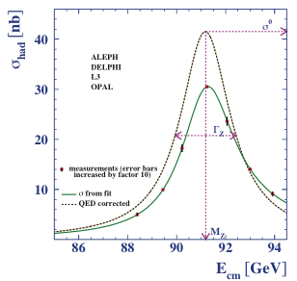
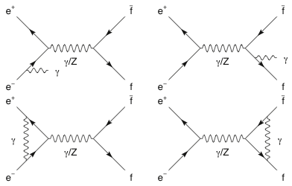
Measurements at the Z Pole
Initial and final state QED radiation
Measured cross-section and asymmetries are modified by initial and final state QED radiation
Effects are corrected for by the collaborations (using the programs TOPAZ0 and ZFITTER)
Very large corrections applied in some cases!
Measured observables become “pseudo-observables”
E.g., hadronic pole-cross section σ⁰_{had}
Convolution of kernel cross section by QED radiator function
corrected lineshape
36% increase!
100 MeV shift in peak
In the electroweak fit the published “pseudo-observables” are used
Important: these QED corrections are independent of the electroweak corrections discussed before!
measured lineshape

Slide 16
All Observables Entering the Fit
Experimental results:
  Z-pole observables: LEP/SLD results (corrected for ISR/FSR QED effects)
  [ADLO & SLD, Phys. Rept. 427, 257 (2006)]
  Total and partial cross sections around Z: M_{Z}, Γ_{Z}, σ⁰_{had}, R_{l}⁰, R_{c}⁰, R_{b}⁰
  Sensitive to the total coupling strength of the Z to fermions
  Asymmetries on the Z pole: A_{FB}^{0,l}, A_{FB}^{0,b}, A_{FB}^{0,c}, A_{l}, A_{c}, A_{b}, sin²θ^{l}_{eff} (Q_{FB})
  Sensitive to the ratio of the Z vector to axial-vector couplings (i.e. sin²θ_{eff}) → parity violation
  M_{W} and Γ_{W} : LEP + Tevatron average
  [ADLO, hep-ex/0612034] [CDF, Phys. Lett. 100, 071801 (2008)]
  [CDF & D0, Phys. Rev. D 70, 092008 (2004)] [CDF & D0, arXiv:0908.1374v1]
  m_{t}: latest Tevatron average [CDF & D0, new combination for ICHEP 2010, arXiv:1007.3178]
  m_{c}, m_{b}: world averages [PDG, Phys. Lett. B667, 1 (2008) and 2009 partial update for the 2010 edition]
  Δα_{had}(M_{Z}): [K. Hagiwara et al., Phys. Lett. B649, 173 (2007)] + rescaling mechanism to account for α_{s} dependency
  Direct Higgs searches at LEP and Tevatron (2009 Tev. average, and ICHEP 2010 average)
  [ADLO: Phys. Lett. B565, 61 (2003)] [CDF & D0: arXiv:0911.3930] [FERMILAB-CONF-10-257-E]
_
_

Slide 17
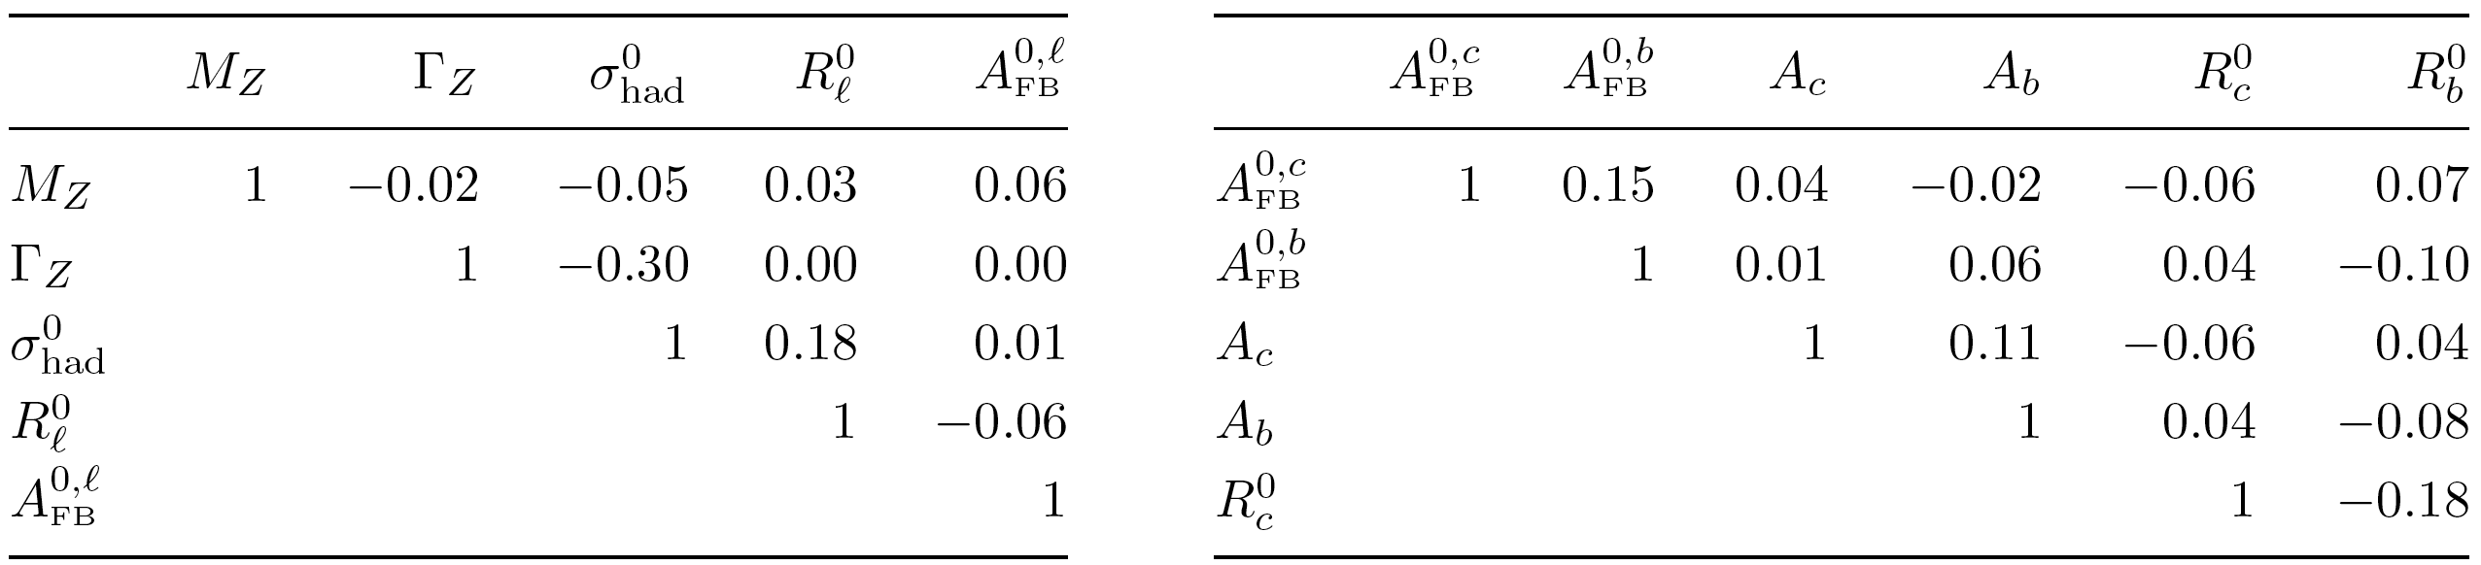
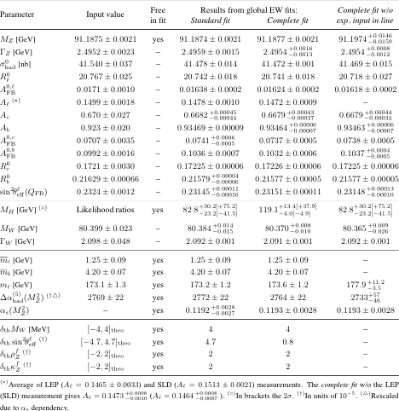
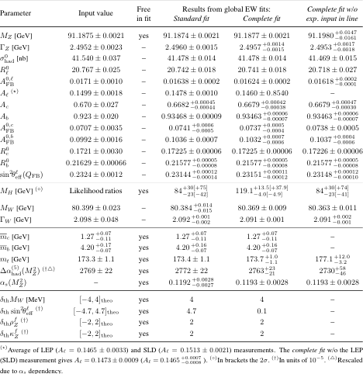
LEP
LEP & Tevatron
SLC
Tevatron
Experimental Input
LEP
SLC
Correlations for observables from Z lineshape fit
Correlations for heavy-flavour observables at Z pole

Slide 18
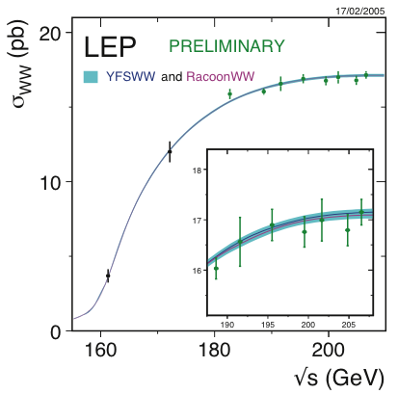
Precision Measurement of the W mass
Results from LEP-2:
10 pb^{–1} per experiment recorded close to the WW threshold
  M_{W} from σ_{WW} measurements
  Much less precise result than kinematic W reconstruction (200 MeV statistical error)
700 pb^{–1} per experiment above the threshold
  M_{W} directly reconstructed from invariant mass of observed leptons (dominant) and jets
  Large “colour reconnection” systematics in hadronic channel (35 MeV)
  Combination: M_{W} = (80.376 ± 0.025 ± 0.022) GeV
4 × 700 pb^{–1} taken for √s = 161–209 GeV between 1996 and 2000 at LEP-2
Results from Tevatron:
Using leptonic W decays
  M_{W} from template fits to the transverse mass or transverse momentum of lepton
  Extremely challenging, systematics dominated measurement (energy calibration)
  Combination (2009): M_{W} = (80.420 ± 0.031) GeV

Slide 19
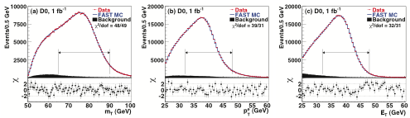
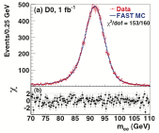
Precision Measurement of the W mass
Recent D0 measurement of M_{W} in W → eν
Analysis relies on energy calibration with Z → ee
Result: M_{W} = (80.401 ± 0.021 ± 0.038) GeV
Greatly deserves the label “precision measurement”
The (a) m_{T} , (b) p^{e}_{T} , and (c) E_{T,miss} distributions for data and fastmc simulation with backgrounds. The χ values are shown below each distribution where χ_{i} = [N_{i} − (fastmc_{i})]/σ_{i} for each point in the distribution, N_{i} is the data yield in bin i and only the statistical uncertainty is used. The fit ranges are indicated by the double-ended horizontal arrows.

Slide 20
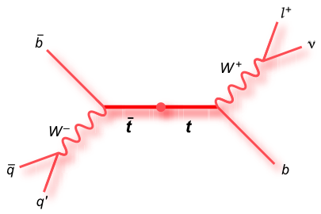
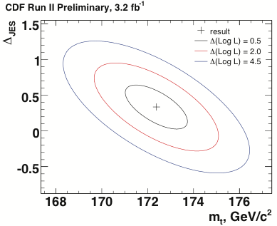
Measurement of the top mass
Top quark mass is measured in di-lepton (4%), lepton-jets (30%), and jets-jets (46%) modes
Analysis relies strongly on identification of b-jets for background suppression and reduction of jet combinatorics
Use multivariate methods to suppress backgrounds
“In situ” jet energy scale (JES) calibration in modes with jets
The lepton-jets channel provides most precise m_{t} measurment
Fit method: parameterise templates depending on top mass and JES for sensitive variables (e.g., M_{jet-jet}, M_{letp-jet}, …), construct and maximise overall likelihood function

Slide 21
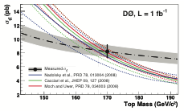
Measurement of the top mass
Top quark mass is measured in di-lepton (4%), lepton-jets (30%), and jets-jets (46%) modes
Analysis relies strongly on identification of b-jets for background suppression and reduction of jet combinatorics
Use multivariate methods to suppress backgrounds
“In situ” jet energy scale (JES) calibration in modes with jets
The lepton-jets channel provides most precise m_{t} measurment
Fit method: parameterise templates depending on top mass and JES for sensitive variables (e.g., M_{jet-jet}, M_{letp-jet}, …), construct and maximise overall likelihood function
Can also extract m_{t} from top cross section measurement
Complementary method [ PRD 80, 071102 (2009) ]
Unambiguous definition of running top mass, but limited by precision on luminosity

Slide 22
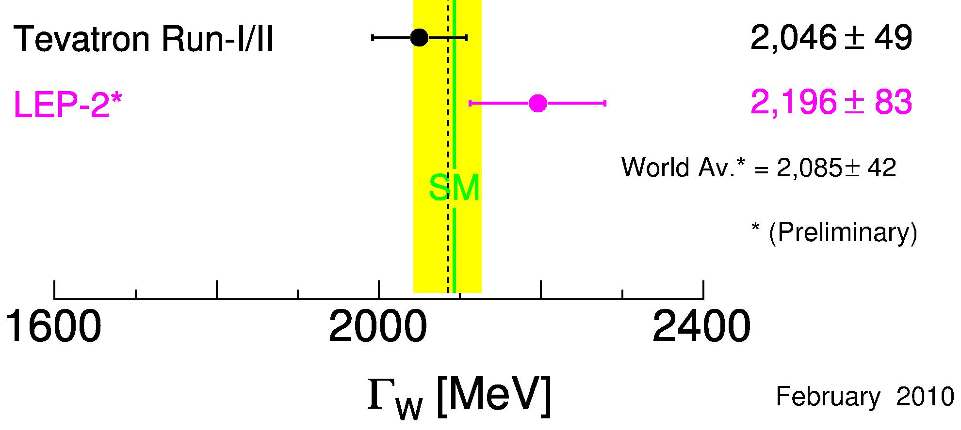
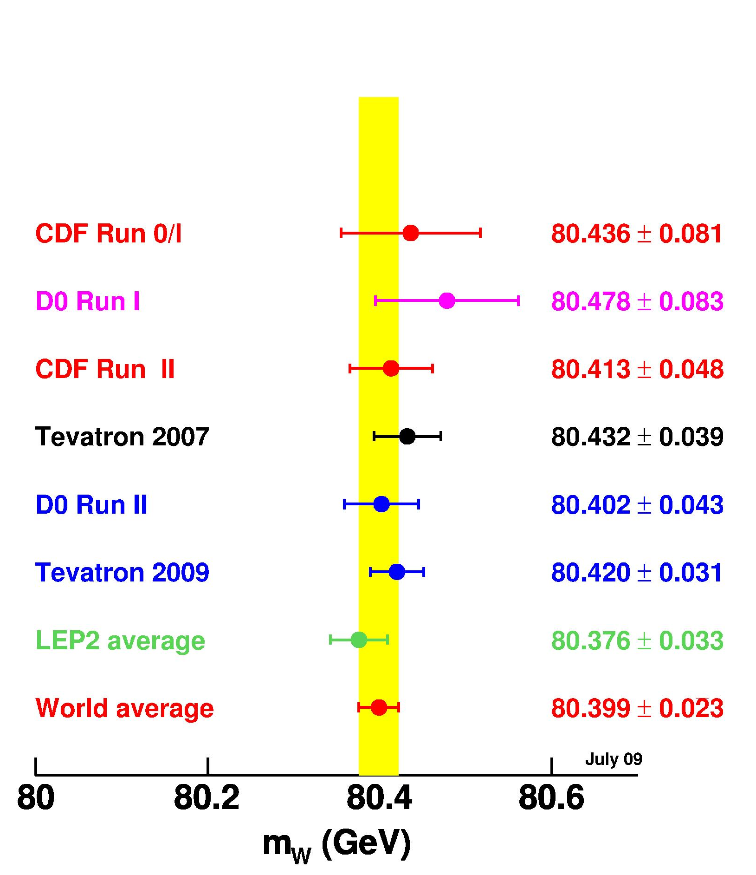
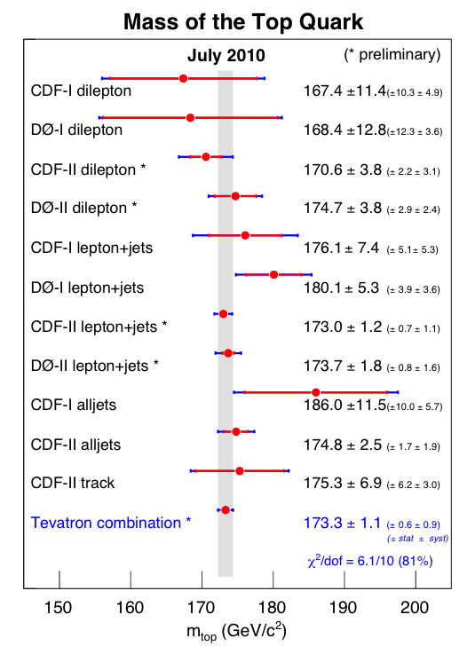
2009 Γ_{W}, M_{W} (left) and m_{top} (right) world averages
[CDF + D0, up to 1 fb–1, 0908.1374, width: D0 Note 6041-CONF]
[CDF + D0, up to 5.6 fb^{–1}, arXiv:1007.3178]
New Tevatron top mass combination just out:
(173.3 ± 0.6 ± 0.9) GeV
[arXiv:1007.3178]

Slide 23
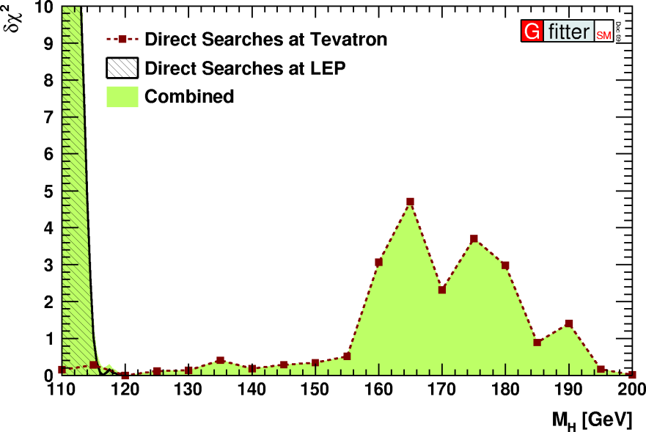
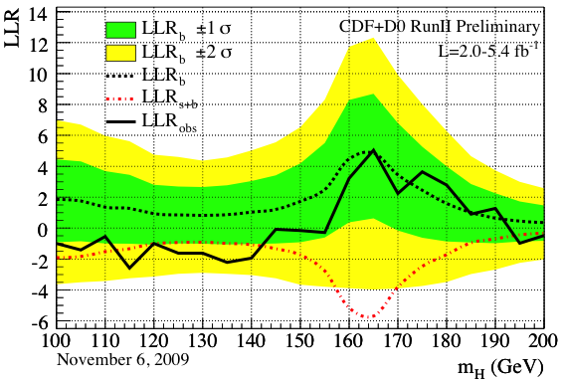
Direct Higgs Searches
Combined δχ ² input to EW fit:
[ADLO: Phys. Lett. B 565, 61 (2003)]
Statistical interpretation in fit: two-sided CL_{s+b}
  Experiments measure test statistics LLR = –2lnQ, where Q = L_{s+b} / L_{b}
  LLR is transformed by experiments into CL_{s+b}
  We transform 1-sided CL_{s+b} into 2-sided CL_{s+b}
  Alternatively also directly use Δχ ² ≈ LLR: Bayesian interpretation, lacks pseudo-MC information
(measure deviation from SM)

Slide 24
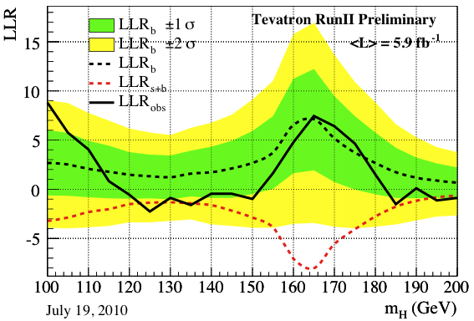
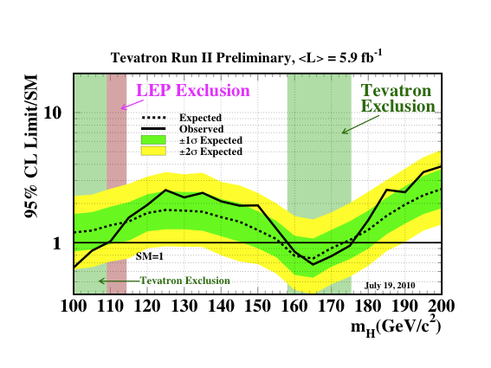
Direct Higgs Searches – New Combined Result from Tevatron
Up to 6.7 fb^{–1}. Conference Note FERMILAB-CONF-10-257-E
95% CL exclusion: 158 < M_{H} < 175 GeV
Main fit results based on 2009 combination (CL_{s+b} values not yet available).
Will show impact of new result.

Slide 25
The Global Electroweak Fit
Theory predictions – state-of-the art calculations, in particular:
  M_{W} and sin²θ^{f}_{eff} : full two-loop + leading beyond-two-loop form factor corrections
  [M. Awramik et al., Phys. Rev D69, 053006 (2004) and ref.] [M. Awramik et al., JHEP 11, 048 (2006) and refs.]
  Radiator functions: 3NLO prediction of the massless QCD cross section
  [P.A. Baikov et al., Phys. Rev. Lett. 101 (2008) 012022]
  Theoretical uncertainties: M_{W} (δ_{theo}(M_{H}) = 4–6 GeV), sin²θ ^{l}_{eff} (δ_{theo} = 4.7·10^{–5})
Fit parameters
  In principle, all parameters used in theory predictions are varying freely in fit
  Masses of leptons and light quarks fixed to world-averages from PDG
  Free are running charm, bottom and top masses → m_{t} strongest impact on fit !
List of freely varying parameters in the SM fit:
Δα_{had}⁽⁵⁾(M_{Z}), α_{S}(M_{Z}), M_{Z}, M_{H}, m_{c}, m_{b}, m_{t}

Slide 26

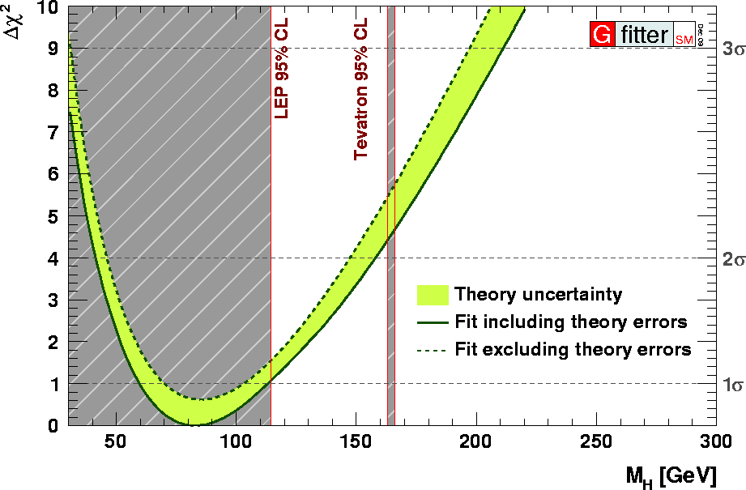
http://cern.ch/Gfitter
Fit Results
⁽*⁾
⁽*⁾ Status: July 2010
Distinguish two fit types:
  Standard Fit: all data except for direct Higgs searches
  Complete Fit: all data including direct Higgs searches

Slide 27
Experimental Input and Fit Results

Slide 28
Correlation coefficients of free fit parameters
Experimental Input and Fit Results

Slide 29
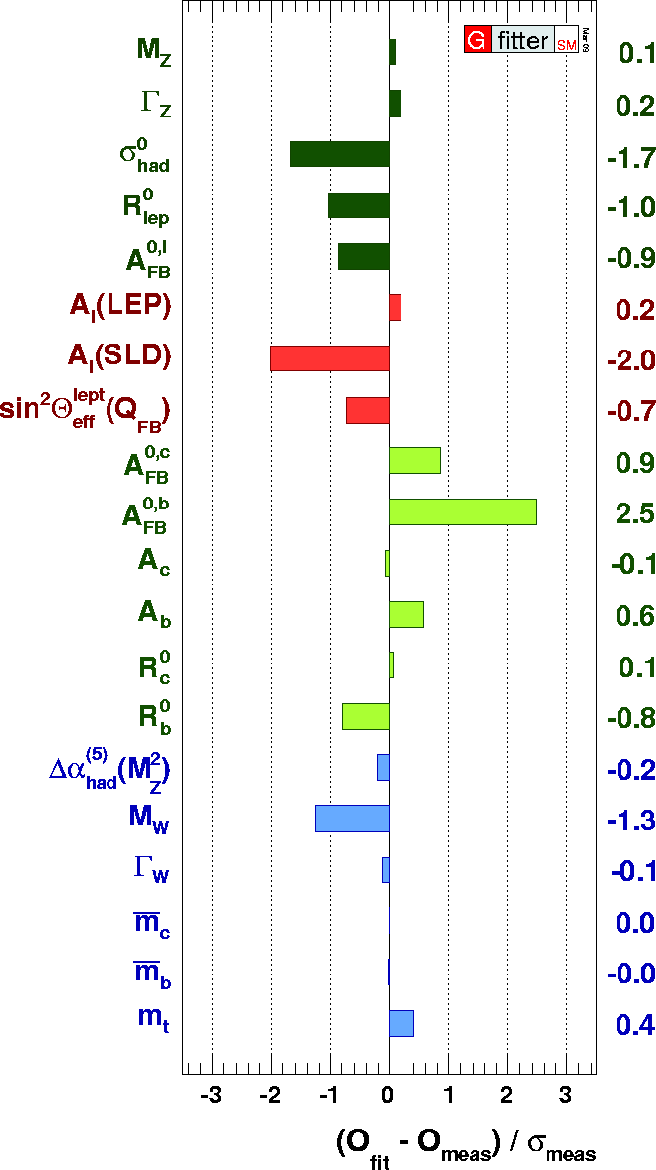
Goodness-of-Fit
Goodness-of-fit:
Standard fit: χ ²_{min} = 16.4 → Prob(χ²_{min},13) = 0.23
Complete fit: χ ²_{min} = 17.9 → Prob(χ²_{min},14) = 0.21
No requirement for new physics
Pull values for complete fit (right figure →)
  No individual pull exceeds 3
  FB(b) asymmetry largest contributor to χ ²_{min}
  Small contributions from M_{Z}, ^{had}(M_{Z}), m_{c}, m_{b} indicate that their input accuracies exceed fit requirements → parameters could have been fixed in fit
  Can describe data with only two floating parameters (α_{S}, M_{H})

Slide 30
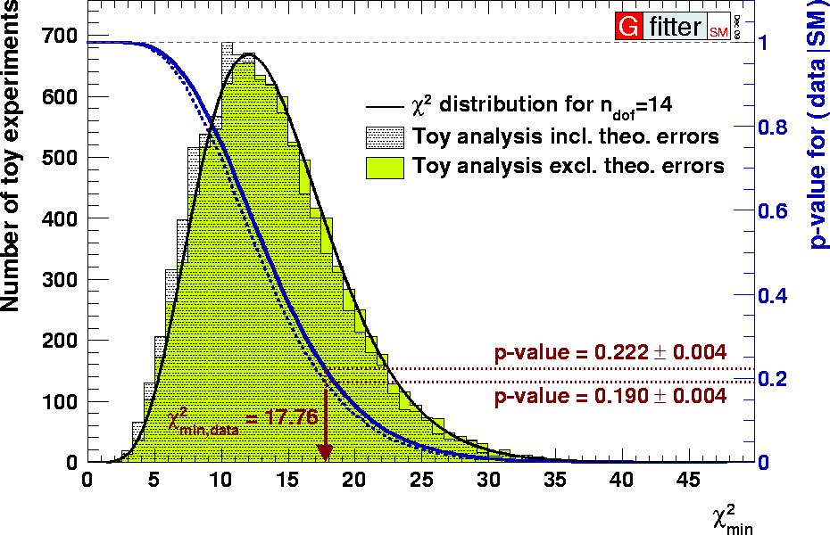
Goodness-of-Fit
Toy analysis: p-value for wrongly rejecting the SM = 0.23 ± 0.01–0.02_{theo}
Results for complete fit

Slide 31
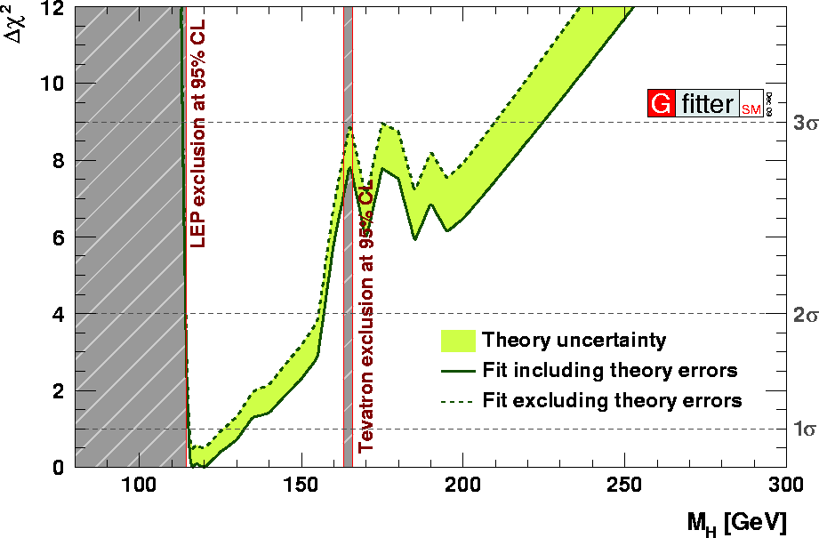
Higgs Mass Constraints
M_{H} from Standard fit:
Central value ±1σ:
2σ interval: [42, 158] GeV
M_{H} from Complete fit:
Central value ±1σ:
2σ interval: [114, 157] GeV
Green band due to Rfit treatment of theory errors, fixed errors lead to larger χ²_{min}
Standard fit
Complete fit

Slide 32
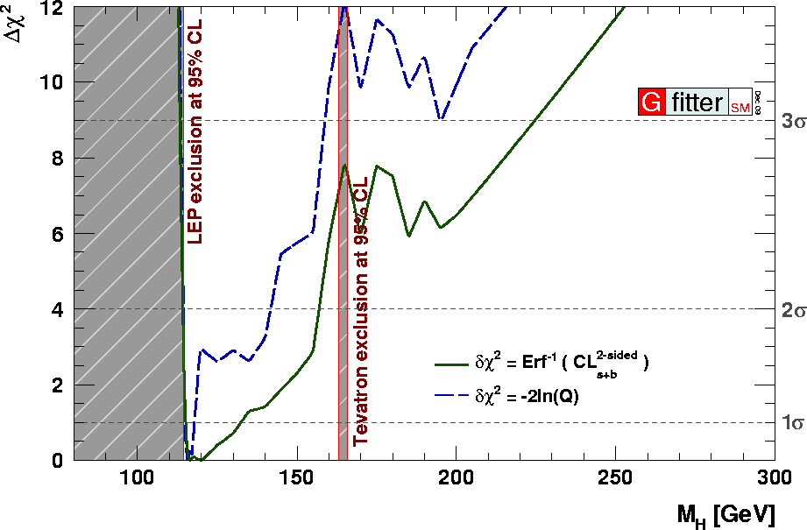
Higgs Mass Constraints
M_{H} from Standard fit:
Central value ±1σ:
2σ interval: [42, 158] GeV
M_{H} from Complete fit:
Central value ±1σ:
2σ interval: [114, 157] GeV
Green band due to Rfit treatment of theory errors, fixed errors lead to larger χ²_{min}
Comparison with Bayesian interpretation of LLR
Standard fit
Complete fit

Slide 33
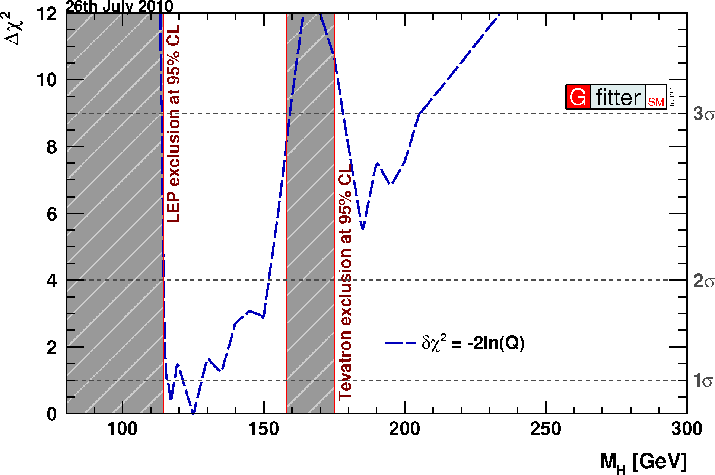
Higgs Mass Constraints
M_{H} from Standard fit:
Central value ±1σ:
2σ interval: [42, 158] GeV
M_{H} from Complete fit:
Central value ±1σ:
2σ interval: [114, 157] GeV
Green band due to Rfit treatment of theory errors, fixed errors lead to larger χ²_{min}
New Tevatron combination, ICHEP 2010
Standard fit
Complete fit
2σ interval:
114 < M_{H} < 152 GeV

Slide 34
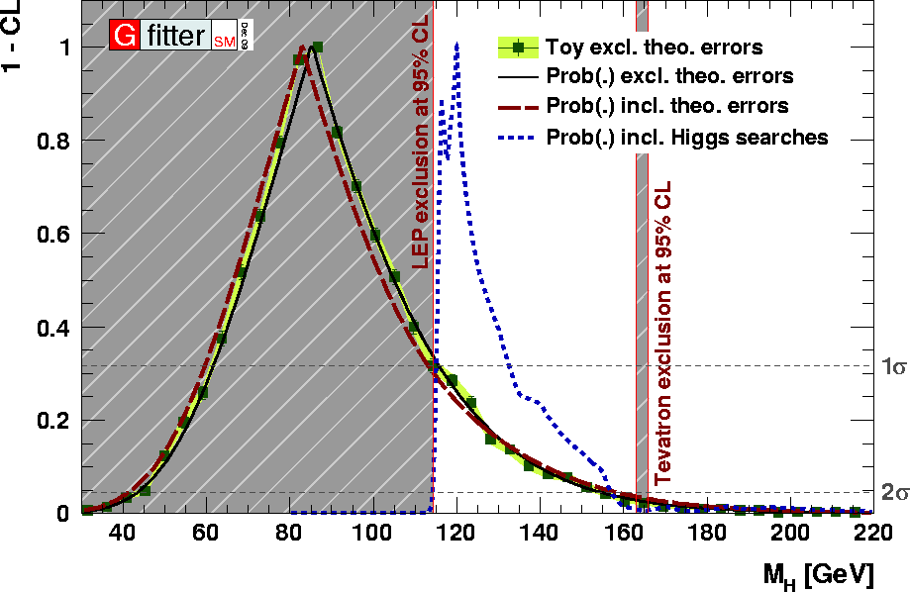
Higgs Mass Constraints
M_{H} from Standard fit:
Central value ±1σ:
2σ interval: [42, 158] GeV
M_{H} from Complete fit:
Central value ±1σ:
2σ interval: [114, 157] GeV
Green band due to Rfit treatment of theory errors, fixed errors lead to larger χ²_{min}
Verification of “Prob” approximation with pseudo-MC experiments
Verify Gaussian Prob(Δχ²,1) approximation
Fix M_{H}, perform two fits and calculate Prob(Δχ²(M_{H}) = χ²_{min}(M_{H}) − χ²_{min},1)
Generate pseudo experiments (“toy MC”) using fitted values for M_{H} with experimental errors
For each toy experiment perform two fits and compute Δχ²_{toy}(M_{H}) exactly as in real data
Compute 1−CL at M_{H} by integrating normalised Δχ²_{toy}(M_{H}) distribution from Δχ²(M_{H}) to infinity
Assumes that Δχ²_{toy}(M_{H}) distribution is independent of nuisance parameters !

Slide 35
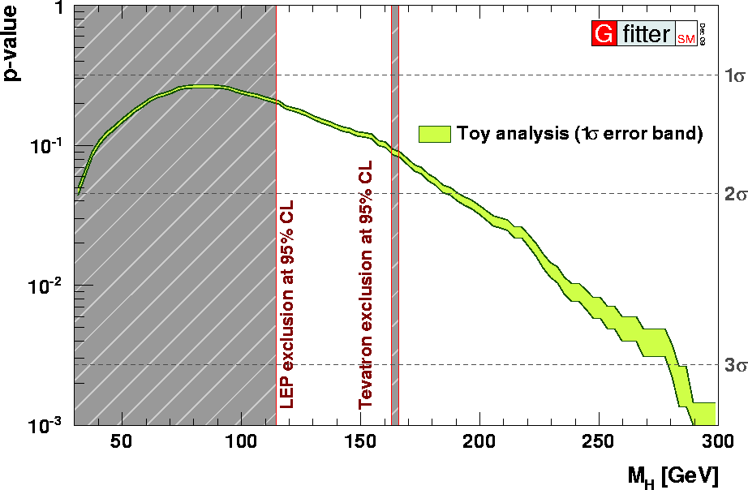
Higgs Mass Constraints
M_{H} from Standard fit:
Central value ±1σ:
2σ interval: [42, 158] GeV
M_{H} from Complete fit:
Central value ±1σ:
2σ interval: [114, 157] GeV
Green band due to Rfit treatment of theory errors, fixed errors lead to larger χ²_{min}
Curve gives the probability of wrongly rejecting SM hypothesis assuming a certain value for M_{H}
Verification of “Prob” approximation with pseudo-MC experiments
Absolute p-value of fit versus Higgs mass

Slide 36
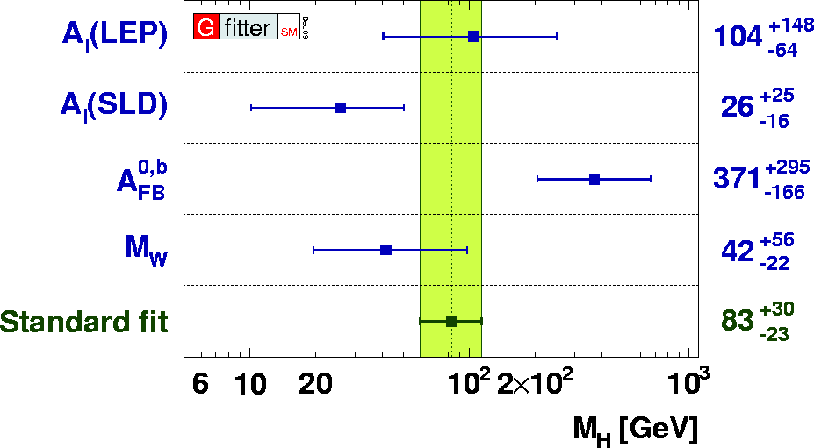
Higgs Mass Constraints
Known tension between A^{0,b}_{FB} and A_{lep}(SLD) and M_{W} :
Pseudo-MC analysis to evaluate
“Probability to observe a Δχ² = 8.0 when removing the least compatible input ”
→ accounts for “look-elsewhere effect”
Find: 1.4% (2.5σ)
Fits include only the given observable

Slide 37
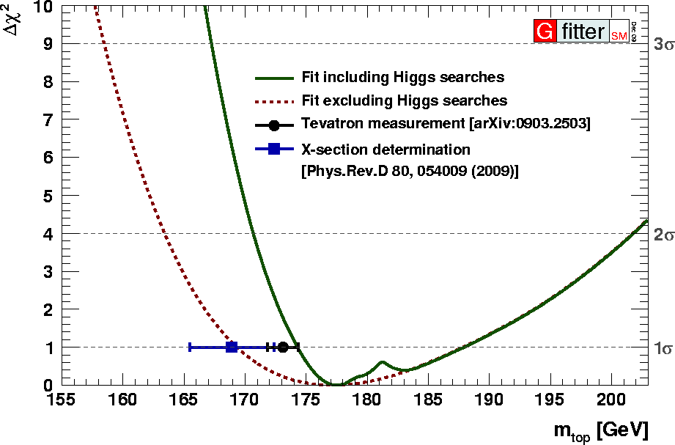
Top Mass
Quadratic sensitivity to m_{top}
Standard fit:
Complete fit:
Tevatron average: (173.1 ± 1.3) GeV
Note: profile of the standard fit exhibits an asymmetry opposite to the naïve expectation from ~m_{t}² dependence of loop corrections
  Reasons: floating Higgs mass and its positive correlation with m_{t}

Slide 38
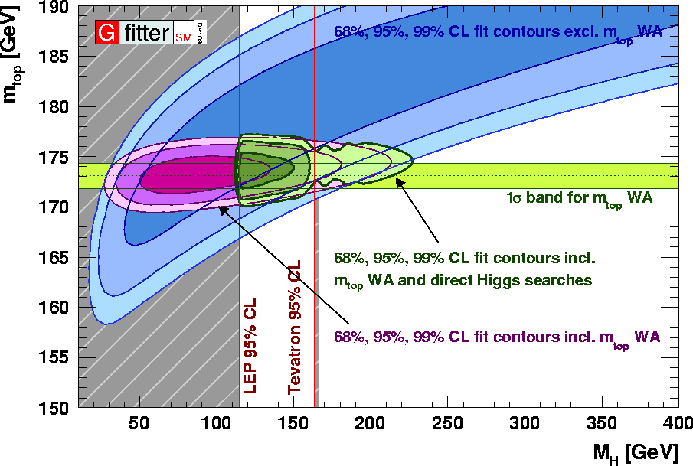
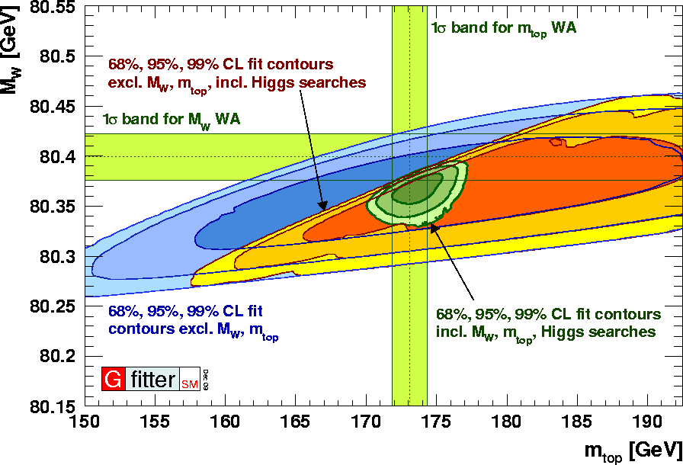
Top Mass
Quadratic sensitivity to m_{top}
Standard fit:
Complete fit:
Tevatron average: (173.1 ± 1.3) GeV
Fit (i.e. excluding the Higgs searches and the respective measurements)
Fit + Higgs searches
Fit + Higgs searches + direct measurements → best knowledge of SM
Fits include only the given observable

Slide 39
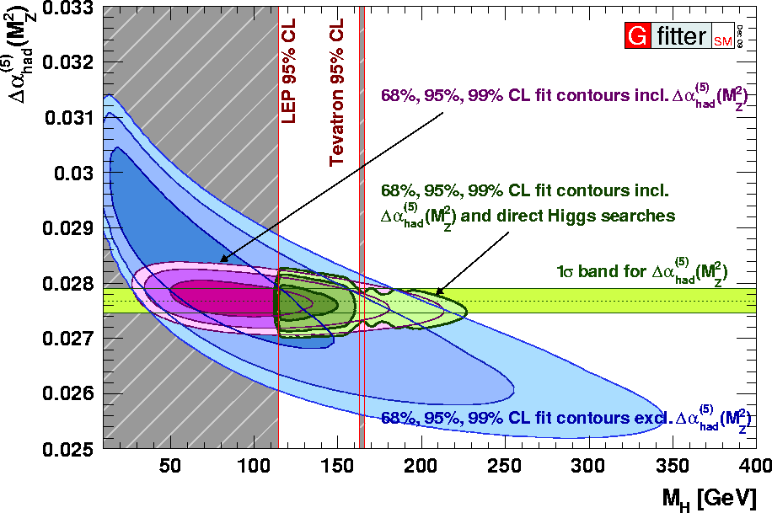
Δα_{had}(M_{Z})
Strong sensitivity to Δα_{had}(M_{Z})
Complete fit:
Phenomenological value: (277.2 ± 2.2) 10^{–4}
Fit (i.e. excluding the Higgs searches and the respective measurements)
Fit + Higgs searches
Fit + Higgs searches + direct measurements → best knowledge of SM
Fits include only the given observable
The structures reflect presence of local minima in (Δχ² vs. M_{H})-plot
Today’s precision in m_{t} and Δα_{had}(M_{Z}) sufficient for the EW fit

Slide 40
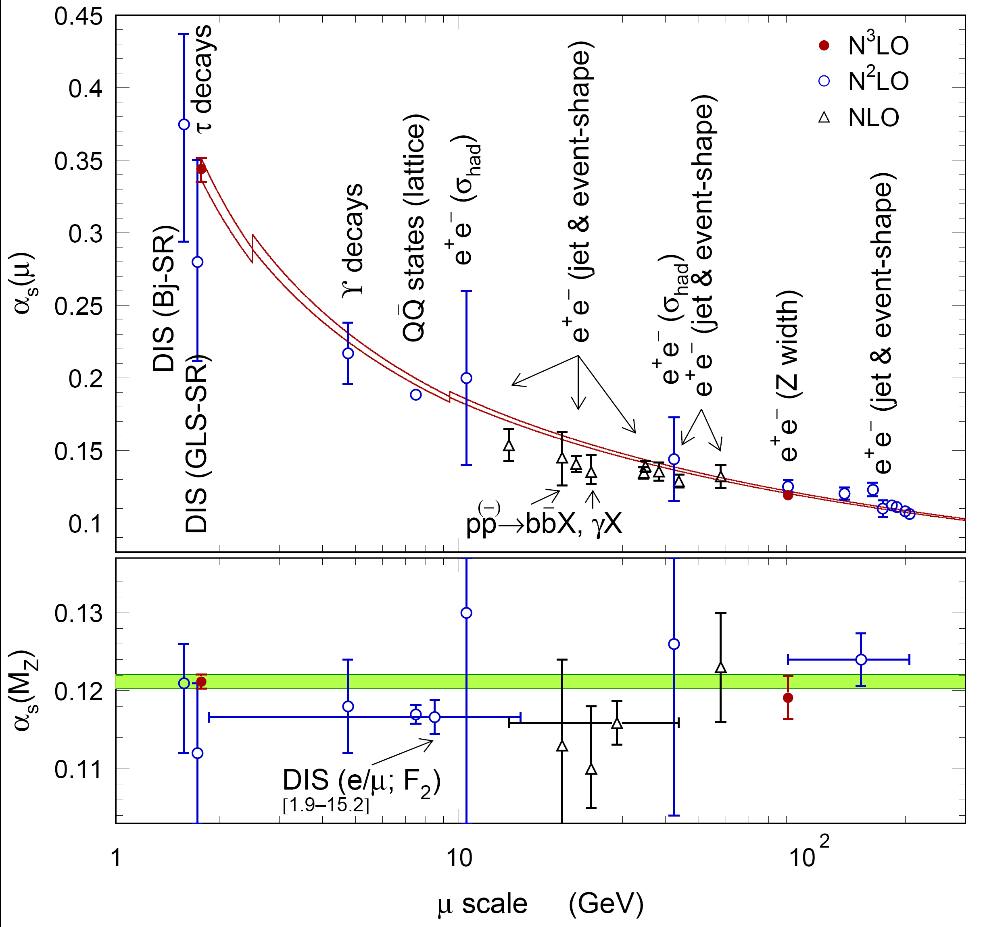
3NLO Determination of _{s}
4-loop RGE evolution of α_{s}(μ) with measurements [arXiv:0803.0979]
From Complete Fit:
α_{s}(M_{Z}) = 0.1193 ± 0.0028 ± 0.0001
First error experimental
Second error theoretical (!)
[ incl. variation of renorm. scale from M_{Z}/2 to 2M_{Z} and massless terms of order/beyond a_{S}⁵(M_{Z}) and massive terms of order/beyond a_{S}⁴(M_{Z}) ]
Excellent agreement with N³LO result from hadronic τ decays
[M. Davier et al., arXiv:0803.0979]
α_{s}(M_{Z}) = 0.1212 ± 0.0005_{exp}
± 0.0008_{theo}
± 0.0005_{evol}
Best current test of asymptotic freedom property of QCD !

Slide 41

The Fate of the Standard Model
New physics at TeV scale
No new physics at TeV scale

Slide 42
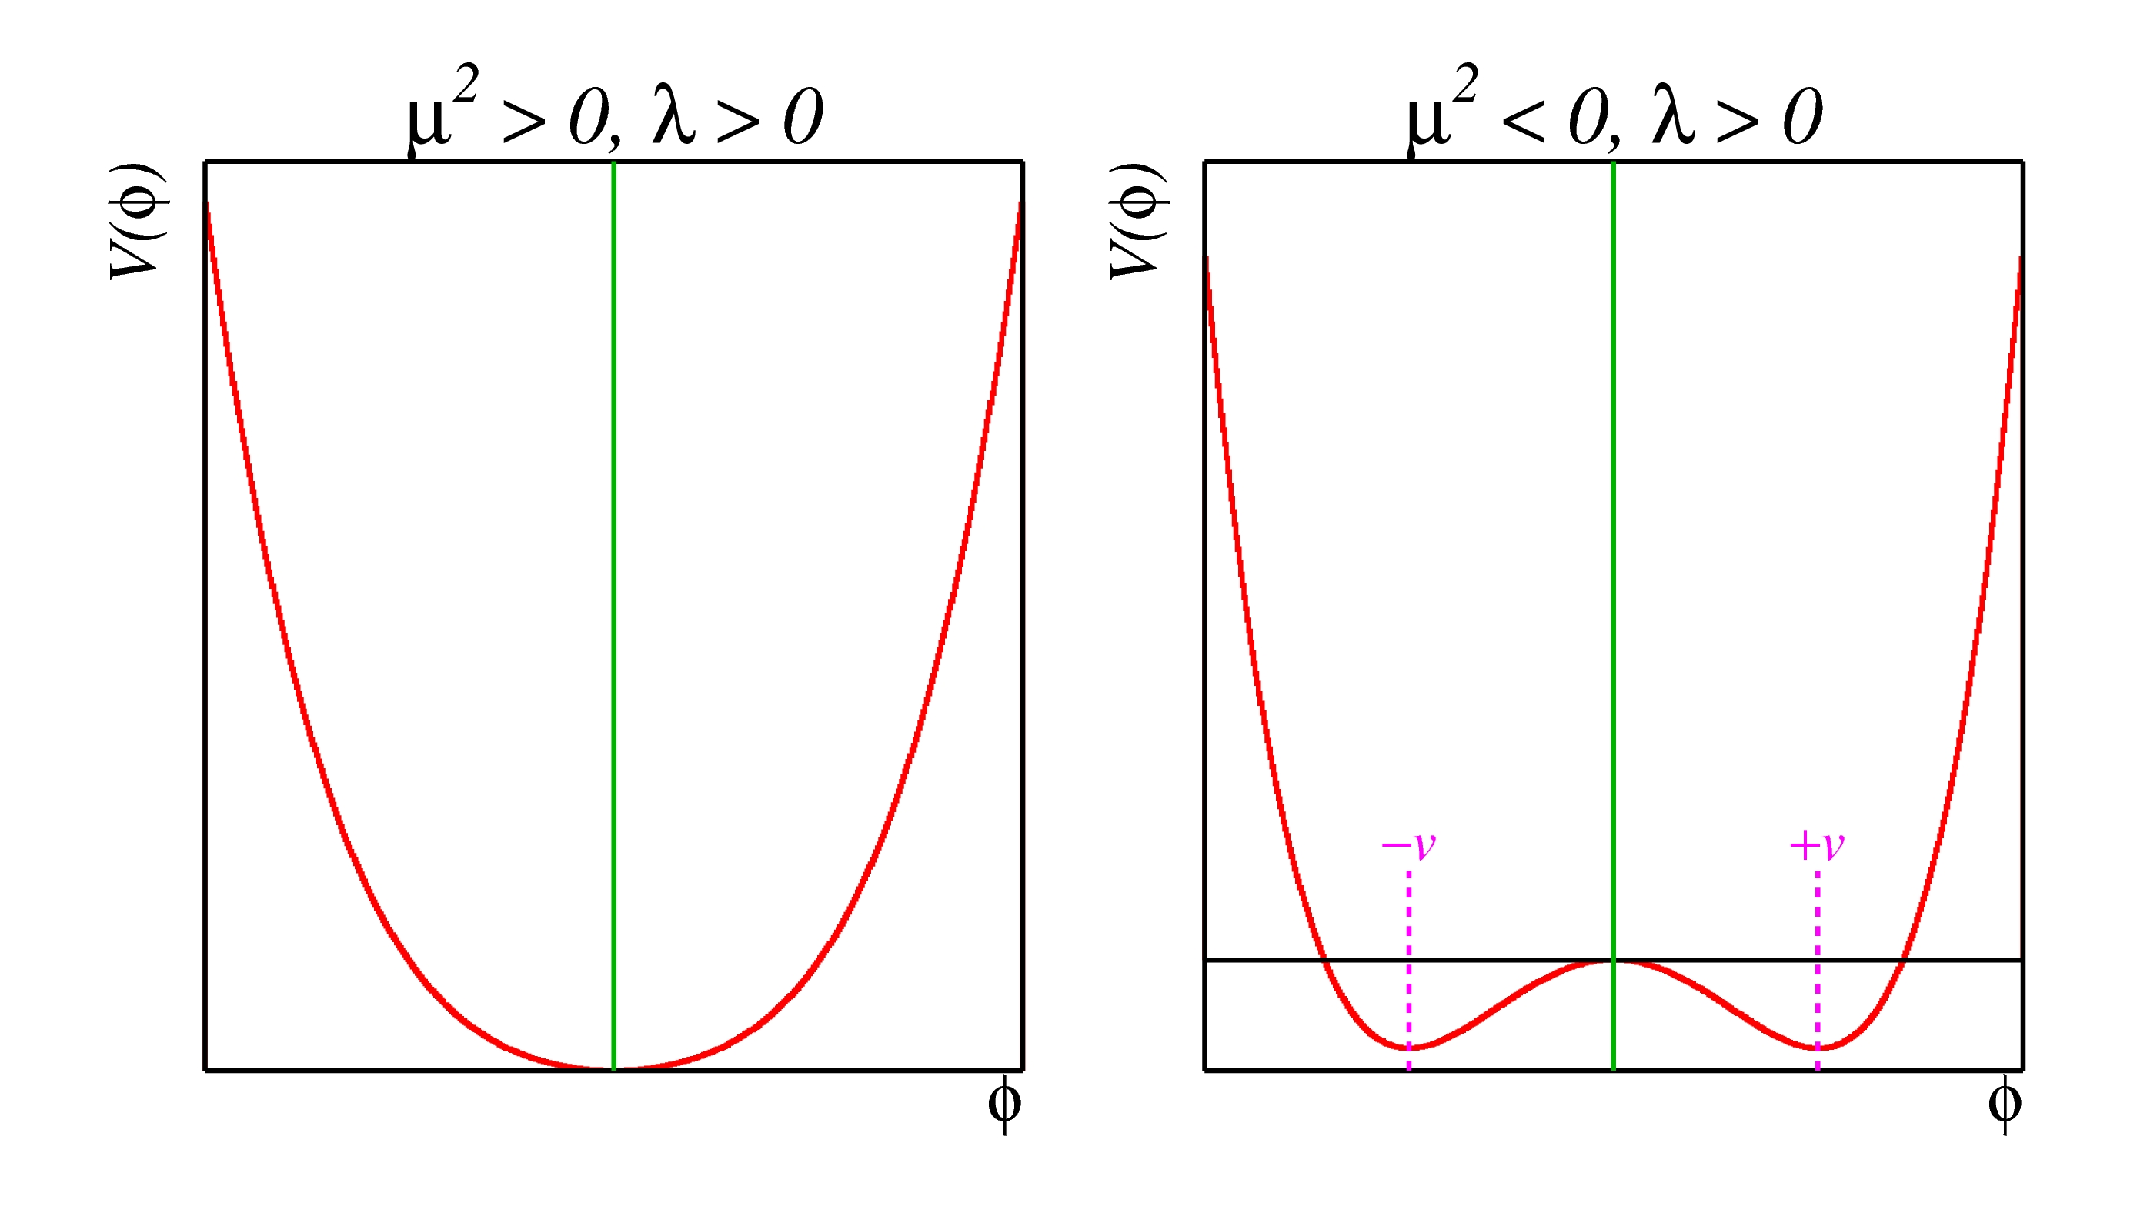
Driving the SM to M_{Planck}
The behaviour of the quartic Higgs couplings as function of the cut-off scale Λ puts bounds on M_{H}
For too large M_{H}, the couplings become non-perturbative (“triviality” or “blow-up” scenario)
For too small M_{H}, the vacuum becomes unstable

Slide 43
Driving the SM to M_{Planck}
The behaviour of the quartic Higgs couplings as function of the cut-off scale Λ puts bounds on M_{H}
For too large M_{H}, the couplings become non-perturbative (“triviality” or “blow-up” scenario)
For too small M_{H}, the vacuum becomes unstable
The “unstable” region is not necessarily incompatible with our existence, as long as the electroweak vacuum survives for a time longer than the age of the universe, before quantum tunneling.
Its probability is given by
and V_{U} is space-time volume of the past light cone of the observable universe, and τ_{U} = 13.7 Gyrs. For the bound, one requires p < 1.

Slide 44
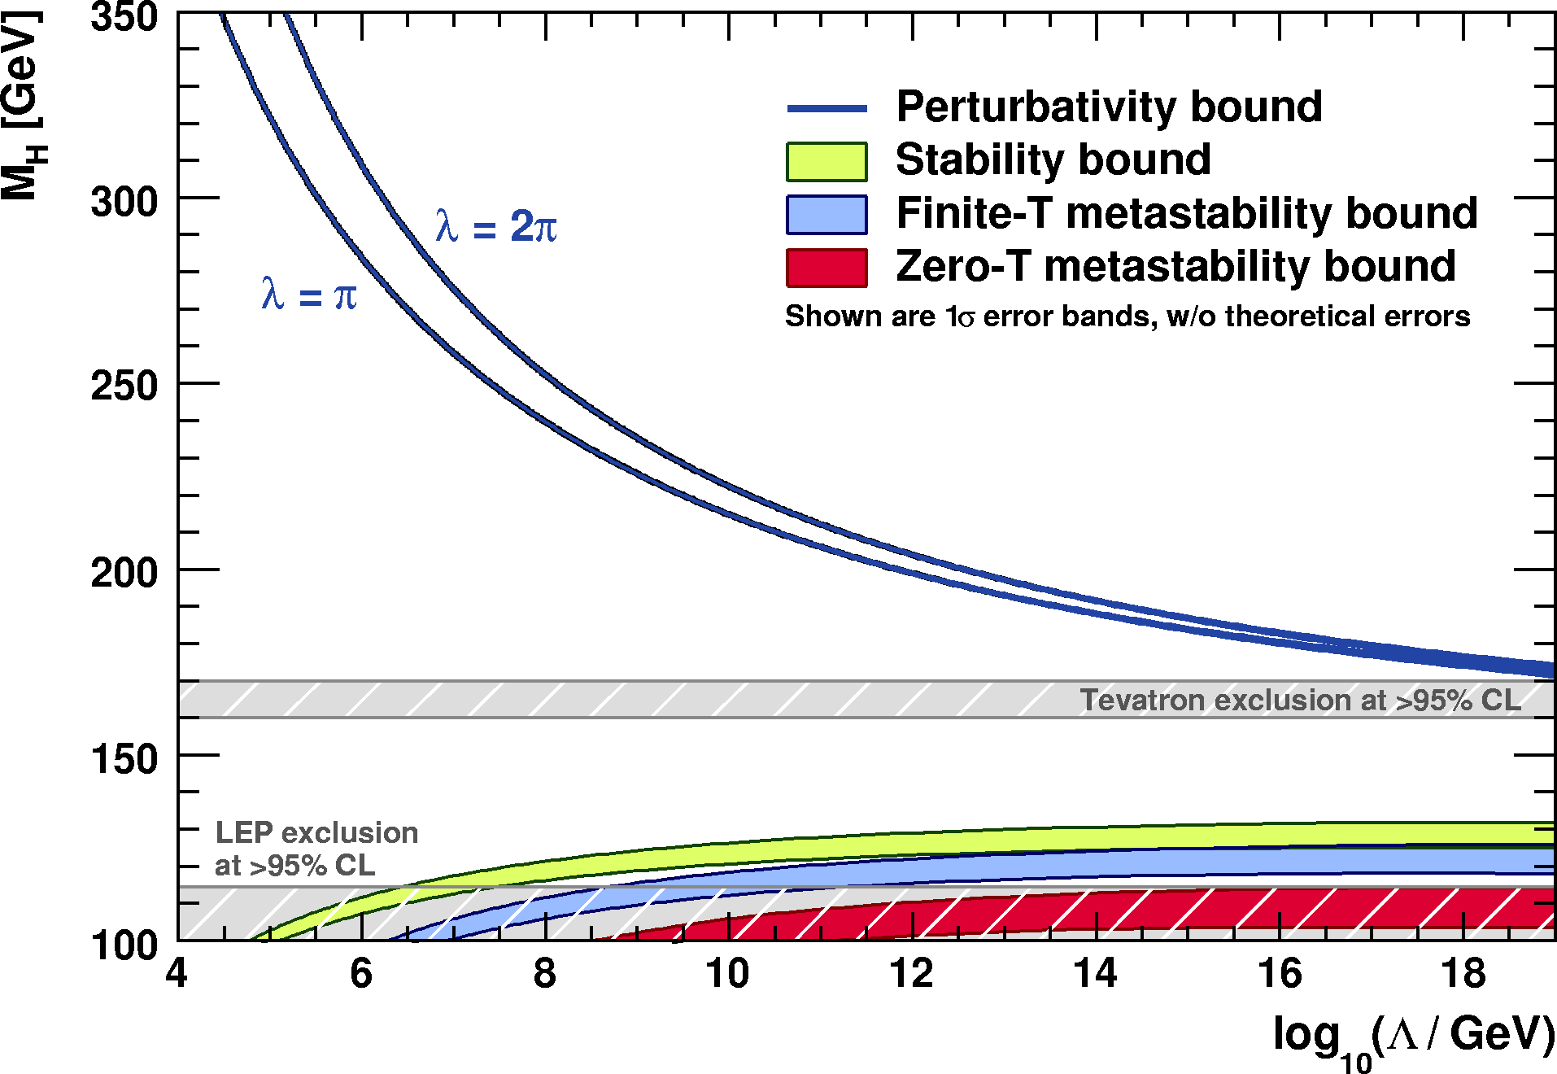

Driving the SM to M_{Planck}
The behaviour of the quartic Higgs couplings as function of the cut-off scale Λ puts bounds on M_{H}
For too large M_{H}, the couplings become non-perturbative (“triviality” or “blow-up” scenario)
For too small M_{H}, the vacuum becomes unstable
→ obtain three lower bounds on M_{H} from different requirement: absolute stability, finite-T and zero-T metastability
Status early 2009
[J. Ellis et al., arXiv:0906.0954]
Allowed
Not allowed

Slide 45
Driving the SM to M_{Planck}
  Requiring that the SM cannot develop a minimum deeper than the electroweak vacuum up to the Planck scale (i.e., λ(μ ) > 0, for all μ < Λ) gives the stability bound :
Theoretical error from missing higher order corrections in the RGE

Slide 46
Driving the SM to M_{Planck}
  Requiring that the SM cannot develop a minimum deeper than the electroweak vacuum up to the Planck scale (i.e., λ(μ ) > 0, for all μ < Λ) gives the stability bound :
  Requiring that the local EW vacuum survives for a time longer than the age of the universe, before quantum tunneling into the deeper vacuum, gives zero-T metastability bound :
  Requiring the local SM minimum to be stable against thermal fluctuations up to temperatures as large as the Planck scale translates into finite-T metastability bound :

Slide 47


Convolve Bounds with M_{H} Constraints
Can we obtain likelihoods on vacuum stability (or, likewise, the cut-off = new physics scale Λ) from constraint on M_{H} ?
Non-perturbativity excluded at 95.7% CL → raise to 99.1% with Tevatron Higgs searches !
Cannot distinguish between vacuum stability, metastability or collapse scenarios
→ requires M_{H} > 122 GeV to exclude collapse scenario at 95% CL
[J. Ellis et al., arXiv:0906.0954]
Standard Fit
Complete Fit

Slide 48


Convolve Bounds with M_{H} Constraints
Can we obtain likelihoods on vacuum stability (or, likewise, the cut-off = new physics scale Λ) from constraint on M_{H} ?
Requiring absolute vacuum stability (at all times), one can obtain upper bound Λ
  Left plot: case for precise M_{H} measurement of 120 GeV
  Right plot: case for precise M_{H} measurement of 115 GeV
[J. Ellis et al., arXiv:0906.0954]

Slide 49
Precision Tests and Higgs Beyond the SM
In the same way as the EW precision data constrain unknown SM parameters, they can be used to constrain beyond the SM models
© H. Murayama

Slide 50


The Two-Higgs-Doublet Model (2HDM)

Slide 51
Two-Higgs-Doublet Model
Extend SM by adding another scalar Higgs doublet (2HDM)
Type-II 2HDM: one doublet couples to up-type and the other one to down-type fermions only
6 free parameters: M_{h}, M_{A0}, M_{H0}, M_{H±}, tanβ = v₂ / v₁, α (governing h–H⁰ mixing)
Resembles Higgs sector of MSSM
Look, e.g., at processes sensitive to charged Higgs: M_{H±}
Interaction has similar structure as W boson
Left-handed coupling: 1/tanβ, right-handed coupling: tanβ
Sensitive parameters are M_{H±} and tanβ
LEP limit: M_{H±} > 78.6 GeV (95% CL), for any value of tanβ
Sensitive observables mostly from B-physics sector, but also c and s

Slide 52
Two-Higgs-Doublet Model
Observables used to constrain charged Higgs in 2HDM
Observable | Input value | Exp. Ref. | Calculation
R_{b}⁰ | 0.21629 ± 0.00066 | [ADLO, Phys. Rept.427, 257 (2006) | [H. E. Haber and H. E. Logan, Phys. Rev. D62, 015011 (2000)]
BR (B → X_{s}γ) | (3.52 ± 0.23 ± 0.09)·10^{–4} | [HFAG, latest update] | [M. Misiak et al., Phys. Rev. Lett. 98, 022002 (2007)]
BR (B → τν) | (1.73 ± 0.33)·10^{–4} | [P.Chang, Talk at ICHEP 2008] | [W. S. Hou, Phys. Rev. D48, 2342 (1993)]
BR (B → μν) | (–5.7±6.8±7.1)·10^{–4} | [E. Baracchini, Talk at ICHEP 2008] | [W. S. Hou, Phys Rev. D48, 2342 (1993)]
BR (K → μν) / BR(π → μν) | 1.004 ± 0.007 | [FlaviaNet,, arXiv:0801.1817] | [FlaviaNet, arXiv:0801.1817]
BR(B → Dτν) / BR(B → Deν) | 0.416 ± 0.117 ± 0.052 | [Babar, Phys. Rev. Lett 100, 021801 (2008)] | [J. F. Kamenik and F. Mescia, arXiv:0802.3790]

Slide 53


R_{b}⁰ and B → X_{s}γ
Z-vertex correction ∝ cot²β
Penguin dipole-moment of B → X_{s}γ allows combination of left and right-handed Higgs couplings.
Wilson coefficient:
b
t
Z
H ±
R_{b}⁰ sensitive to small tanβ only
t
b
Fits include only the given observable → 1–CL = Prob (Δχ2,1)
γ
W – / H –
b
t
s

Slide 54

R_{b}⁰ and B → X_{s}γ
Z-vertex correction ∝ cot²β
Penguin dipole-moment of B → X_{s}γ allows combination of left and right-handed Higgs couplings.
Wilson coefficient:
b
t
Z
H ±
R_{b}⁰ sensitive to small tanβ only
t
b
Fits include only the given observable → 1–CL = Prob (Δχ2,1)

Slide 55


B → τ ν
b
τ –
W – / H –
Weak annihilation process. BR proportional to |V_{ub}|² and B decay constant-squared f_{B}²
–
u
ν
–
Quadratic solution
Strength of effect ∝ tanβ
Conflict (2.6σ) between direct BR measurement and SM prediction governed by CKM angle β
Measurement
CKM prediction

Slide 56


B → τ ν
b
τ –
W – / H –
Weak annihilation process. BR proportional to |V_{ub}|² and B decay constant-squared f_{B}²
–
u
ν
–
Quadratic solution
Strength of effect ∝ tanβ
Compare BR predictions based on direct measurements of |V_{ub}| (left) with CKM fit (right)
Finetuned solution

Slide 57


Other measurements with tree level contributions
Weak upper limit on BR(B → μν)
Favored solution of BR(B → τν) excluded by combination of:
  BR(B → X_{s}γ)
  BR(B → Dτν) / BR(B → Deν)
  BR(K → μν) / BR(π → μν)

Slide 58

Other measurements with tree level contributions
Weak upper limit on BR(B → μν)
Favored solution of BR(B → τν) excluded by combination of:
  BR(B → X_{s}γ)
  BR(B → Dτν) / BR(B → Deν)
  BR(K → μν) / BR(π → μν)

Slide 59

2HDM – Combined Fit
Fit minimum: χ² = 3.9 for M_{H±} = 858 GeV and tanβ = 6.8
Excluded at 95% CL
  Small tanβ
  M_{H+} < 240 GeV for all tanβ
  M_{H+} < 780 GeV for tanβ = 70 (mostly from B → τν)

Slide 60



2HDM – Combined Fit
Full 2HDM analysis also performed by CKMfitter group: arXiv:0907.5135
Include also neutral B-meson mixing (similar as R_{b}, excludes very small tanβ values)
Similar results as Gfitter analysis
1 – CL for M_{H+}, irrespective of tanβ
M_{H+} < 316 GeV
excluded at 95% CL

Slide 61
New Physics via Oblique Corrections

Slide 62

Oblique Corrections
At low energies, BSM physics appears dominantly through vacuum polarisation
Aka, oblique corrections
Direct corrections (vertex, box, brems-strahlung) generally suppressed by m_{f} / Λ
Oblique corrections reabsorbed into electroweak parameters Δρ, Δκ, Δr
Electroweak fit sensitive to BSM physics through oblique corrections
In direct competition with Higgs loop corrections
Oblique corrections from New Physics
described through STU parameters
[Peskin-Takeuchi, Phys. Rev. D46, 381 (1992)]
  O_{meas} = O_{SM,ref}(M_{H},m_{t}) + c_{S}S + c_{T}T + c_{U}U
    S : (S+U) New Physics contributions
    to neutral (charged) currents
    T : Difference between neutral and
    charged current processes –
    sensitive to weak isospin violation
    U : Constrained by M_{W} and Γ_{W}. Usually very small in NP models (often: U=0)
H
  Also considered: correction to Z → bb
  coupling, and extended parameters (VWX)
  [Burgess et al., PLB 326, 276 (1994), PRD 49, 6115 (1994)]
Z
Z

Slide 63

The Oblique Parameters in the Standard Model
STU references in SM obtained from fit to EW observables
SM_{ref} chosen at:
M_{H} = 120 GeV and m_{t} = 173.1 GeV
This defines (S,T,U) = (0,0,0)
Results from Standard Model fit:
S = 0.02 ± 0.11
T = 0.05 ± 0.12
U = 0.07 ± 0.12
 | S | T | U
S | 1 | 0.88 | –0.47
T |  | 1 | –0.72
U |  |  | 1
Current experimental constraint
S, T depend logarithmically on M_{H}
Preference for low M_{H} values
Accommodate large M_{H} values by shifting T (S) positive (negative)
SM prediction

Slide 64
[Hubisz et al., JHEP 01, 135 (2006)]
Little Higgs Models (LHM)
LHM: solves hierarchy problem, possible explanation for EWSM
  SM contributions to Higgs mass cancelled by new particles
Non-linear sigma model, broken Global SU(5) / SO(5) symmetry
  Higgs = lightest pseudo Nambu-Goldstone boson
  New SM-like fermions and gauge bosons at TeV scale
T-parity = symmetry similar to SUSY R-parity (note: not time-invariance !)
  Forbids tree-level couplings of new gauge bosons (T-odd) to SM particles (T-even)
  LHM provides natural dark matter candidate
Two new top states: T-even T₊ and T-odd T–
One-loop oblique corrections from LH top sector with T-parity:
t, T₊
t, T ₊, t, T –
W
W
Z
Z
b
t, T ₊, T₊, T –

Slide 65


Little Higgs Models (LHM)
STU predictions (oblique corrections) inserted for Littlest Higgs model
[Hubisz et al., JHEP 0601:135 (2006)]
Parameters of LH model:
f : symmetry breaking scale (new particles)
s_{λ} ≅ m_{T–} / m_{T+}
Coefficient δ_{c} – depends on detail of UV physics.
Treated as theory uncertainty in fit: δ_{c}= [–5,5]
F : degree of finetuning
Results: Large f : LH approaches SM and SM M_{H} constraints. Smaller f : M_{H} can be large.
Due to strong s_{λ} dependence, no absolute exclusion limit

Slide 66

Little Higgs Models (LHM)
STU predictions (oblique corrections) inserted for Littlest Higgs model
[Hubisz et al., JHEP 0601:135 (2006)]
Parameters of LH model:
f : symmetry breaking scale (new particles)
s_{λ} ≅ m_{T–} / m_{T+}
Coefficient δ_{c} – depends on detail of UV physics.
Treated as theory uncertainty in fit: δ_{c}= [–5,5]
F : degree of finetuning
Results: Large f : LH approaches SM and SM M_{H} constraints. Smaller f : M_{H} can be large.
Due to strong s_{λ} dependence, no absolute exclusion limit

Slide 67

Little Higgs Models (LHM)
STU predictions (oblique corrections) inserted for Littlest Higgs model
[Hubisz et al., JHEP 0601:135 (2006)]
Parameters of LH model:
f : symmetry breaking scale (new particles)
s_{λ} ≅ m_{T–} / m_{T+}
Coefficient δ_{c} – depends on detail of UV physics.
Treated as theory uncertainty in fit: δ_{c}= [–5,5]
F : degree of finetuning
Results: Large f : LH approaches SM and SM M_{H} constraints. Smaller f : M_{H} can be large.
Due to strong s_{λ} dependence, no absolute exclusion limit

Slide 68

[G. Weiglein: arXiv:hep-ph/9712226v1]
[S. Heinemeyer, W. Hollik, G. Weiglein: arXiv:hep-ph/0412214v1]
MSSM (SUSY) with mSUGRA
mSUGRA: highly constrained SUSY breaking mechanism at GUT scale,
determined by 5 parameters:
m_{1/2}, m₀ – fermion/scalar masses at GUT scale
tanβ – ratio of two Higgs vev’s
A₀ – trilinear coupling of Higgs
sgn(μ) – sign of Higgsino mass term
Oblique corrections dominated by weak isospin violation in:
By construction of the oblique parameters → T parameter has dominant contribution
Fits use external code interfaced to Gfitter: FeynHiggs, MicrOMEGAs, SuperIso, SOFTSUSY

Slide 69


[H. He et al., Phys. Rev. D 64, 053004 (2001)]
Fourth Fermion Generation
Introduce new lepton and quark states
Free parameters:
  Assume: no mixing of extra fermions
Shift ΔS ≈ 0.21 from heavy generation
Sensitive to mass difference between up- and down-type fields (not to absolute mass scale)
Results:
With appropriate mass differences: fourth fermion model consistent with EW data
    In particular a large M_{H} is allowed
5+ generations disfavored
Data prefer a heavier charged lepton / up-type quark (which both reduce size of S)
M_{H} = 120 GeV

Slide 70

[H. He et al., Phys. Rev. D 64, 053004 (2001)]
Fourth Fermion Generation
Introduce new lepton and quark states
Free parameters:
  Assume: no mixing of extra fermions
Shift ΔS ≈ 0.21 from heavy generation
Sensitive to mass difference between up- and down-type fields (not to absolute mass scale)
Results:
With appropriate mass differences: fourth fermion model consistent with EW data
    In particular a large M_{H} is allowed
5+ generations disfavored
Data prefer a heavier charged lepton / up-type quark (which both reduce size of S)
M_{H} = 350 GeV

Slide 71

[H. He et al., Phys. Rev. D 64, 053004 (2001)]
Fourth Fermion Generation
Introduce new lepton and quark states
Free parameters:
  Assume: no mixing of extra fermions
Shift ΔS ≈ 0.21 from heavy generation
Sensitive to mass difference between up- and down-type fields (not to absolute mass scale)
Results:
With appropriate mass differences: fourth fermion model consistent with EW data
    In particular a large M_{H} is allowed
5+ generations disfavored
Data prefer a heavier charged lepton / up-type quark (which both reduce size of S)
M_{H} = 600 GeV

Slide 72


[Appelquist et al., Phys. Rev. D67, 055002 (2003)]
[Gogoladze et al., Phys. Rev. D74, 093012 (2006)]
Universal Extra Dimensions (UED)
All SM particles can propagate into ED
Compactification → KK excitations
Conserved KK parity (LKK is DM candidate)
Model parameters:
d_{ED}: number of ED (fixed to d_{ED}=1)
R ^{–1}: compactification scale (m_{KK} ~ n/R)
Contribution to oblique parameters:
From KK-top/bottom and KK-Higgs loops
Results:
Large R ^{–1}: UED approaches SM (exp.)
Small R ^{–1}: large M_{H} required
Excluded: R ^{–1} < 300 GeV and M_{H} > 800 GeV

Slide 73


[L. Randall, R. Sundrum, Phys. Rev. Lett. 83, 3370 (1999)]
[M. Carena et al., Phys. Rev. D68, 035010 (2003)]
Warped Extra Dimensions (Randall-Sundrum)
RS model characterized by one warped ED, confined by two three-branes
One brane contains SM particles
Extension: SM particles also in bulk
SM particles accompanied by towers of heavy KK modes.
Model parameters
L: inverse warp factor
M_{KK}: KK mass scale
Results:
Large values of T (linear in L)
Large L requires large M_{KK} (and small M_{H})

Slide 74


[K. Agashe et al., hep-ph/0308036]
Warped Extra Dimensions w/ Custodial Symmetry
Goal: avoid large T values
Introduce so-called custodial isospin gauge symmetry in the bulk
Extend hypercharge group to SU(2)_{R}×U(1)_{X}
Bulk group: SU(3)_{C}×SU(2)_{L}×SU(2)_{R}×U(1)_{X}
Broken to SU(3)_{C}×SU(2)_{L}×U(1)_{Y} on UV brane
IR brane SU(2)_{R} symmetric
Right-handed fermionic fields are doublets
Results: only small M_{H} allowed

Slide 75

What the Future Brings … (for the EW Fit)
What happens with the EW fit if we build new exciting accelerators…

Slide 76
Prospects for LHC, ILC and ILC with Giga-Z
New colliders (LHC/ILC) will increase precision in electroweak observables
Improvement of the predictive power of the fit
Higgs discovery → testing goodness-of-fit → sensitivity to new physics
Expected improvement from LHC (10 fb^{–1}):
δM_{W} : 25 MeV → 15 MeV (at least)
δm_{t} : 1.2 GeV → 1.0 GeV
Expected improvement from ILC:
From threshold scan δm_{t} = 50 MeV, translates to 100–200 MeV on the running mass
Expected improvement from GigaZ:
From WW threshold scan: δM_{W} = 6 MeV
From A_{LR}: δsin²θ ^{l}_{eff} : 17·10^{–5} → 1.3·10^{–5}
δR_{l}⁰: 2.5·10^{–2} → 0.4·10^{–2}
Improved determination of Δα_{had}⁽⁵⁾(M_{Z}) will become necessary
  Needs improvement in hadronic cross section data around cc resonance.
  Expected uncertainty of 7·10^{–5} (today 22·10^{–5}) if relative cross-section precision below J/Ψ at 1% [Jegerlehner, hep-ph/0105283]
  Experiments with better acceptances and control of systematics needed
  Promising: ISR analyses at B and Φ factories; new data from BES-III

Slide 77

Prospects for LHC, ILC and ILC with Giga-Z
Fit inputs and results under various conditions
Input from: [ATLAS, Physics TDR (1999)] [CMS, Physics TDR (2006)] [A. Djouadi et al., arXiv:0709.1893][I. Borjanovic, EPJ C39S2, 63 (2005)] [S. Haywood et al., hep-ph/0003275] [R. Hawkings, K. Mönig, EPJ direct C1, 8 (1999)] [A. H. Hoang et al., EPJ direct C2, 1 (2000)] [M. Winter, LC-PHSM-2001-016]

Slide 78

Prospects for LHC, ILC and ILC with Giga-Z
Results on M_{H}, including (solid) and excluding (dotted) theoretical errors

Slide 79
Prospects for LHC, ILC and ILC with Giga-Z
Results on M_{H}, including (solid) and excluding (dotted) theoretical errors
That was it – thank you !
Take away message: don’t stop searching for heavy Higgs !
[ BSM physics often comes with positive sign of T,
cancelling negative contributions from heavy Higgs ]

Slide 80
Additional slides

Slide 81
Oblique Parameters and Corrections
Definitions of S,T,U,V,W,X :
[STU parameters suffice when (q/M)² small, so that linear approximation is accurate]
  [Burgess et al., PLB 326, 276 (1994), PRD 49, 6115 (1994)]

Slide 82
Oblique Parameters and Corrections
Dependence of electroweak observables on S,T,U,V,W,X.
[The numerical values are based on α^{–1}(M_{Z}) = 128 and sin²θ_{W}=0.23]
  [Burgess et al., PLB 326, 276 (1994), PRD 49, 6115 (1994)]

