Slide 1
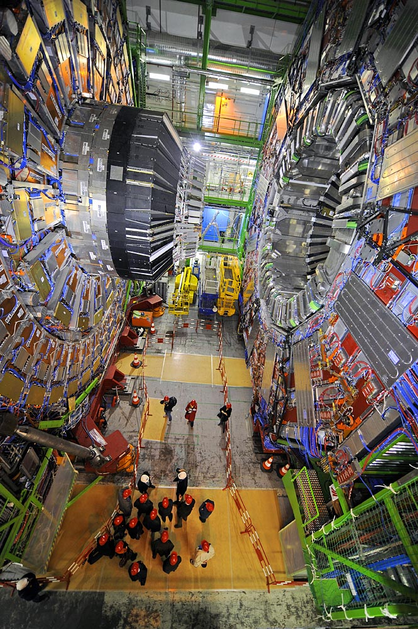
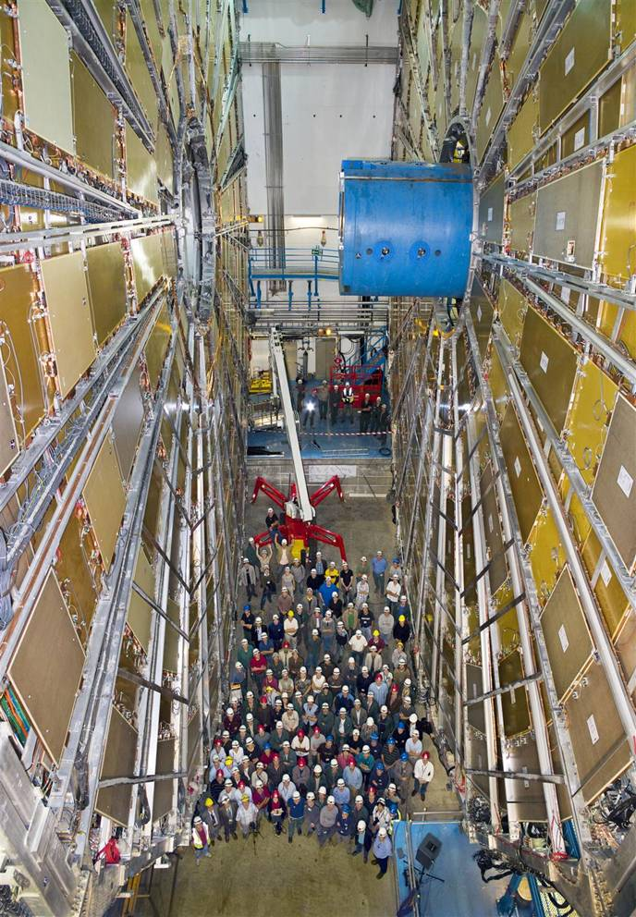
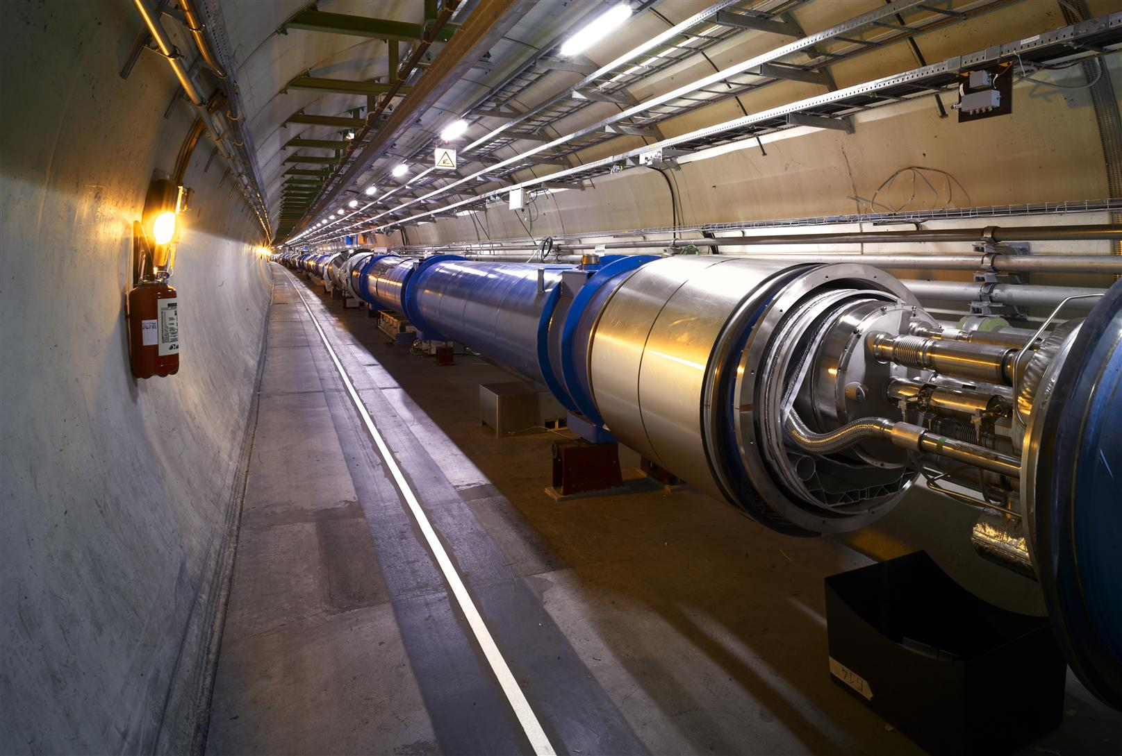
The LHC: Looking Ahead
Tejinder S. Virdee
CERN/Imperial College
The Science
A brief look back
The bilan of the start
Looking ahead

Slide 2
Physics Outlook: Questions
G. Altarelli

Slide 3
EW Symmetry Breaking and Unitarity
Unbroken Gauge Theory a
Massless Gauge Bosons
EW Theory a
Massive W±, Z
Massless γ l
SSB
Physics of Spontaneous Symmetry Breaking must produce observable consequences on W_{L}W_{L} →a Z_{L}Z_{L} scattering
Unitarity is violated if Λ_{SSB} is ≥ 1.5 TeV
A similar situation arose earlier in ν_{μ} e →a ν_{e} μ scattering
Scattering amplitude grows quadratically with energy and would have violated unitarity at ~ 1 TeV (Λ_{F} < √[2√2π/G_{F}]
BUT was ‘regulated’ by W boson exchange.
4-fermion interaction replaced by W exchange
Perturbation theory can be used - M_{W} << I TeV !

Slide 4
Physics Outlook: Questions
1. SM contains too many apparently arbitrary features - presumably these should become clearer as we make progress towards a unified theory.
2. Clarify the e-w symmetry breaking sector
SM has an unproven element: the generation of mass
Higgs mechanism ? or other physics ?
Answer will be found at LHC energies
e.g. why M_{γ} = 0
M_{W}, M_{Z} ~ 100,000 MeV!
3. SM gives nonsense at LHC energies
Probability of some processes becomes greater than 1 !! Nature’s slap on the wrist!
Higgs mechanism provides a possible solution
4. Identify particles that make up Dark Matter
Even if the Higgs exists all is not 100% well with SM alone: next question is “why is (Higgs) mass so low”?   If a new symmetry (Supersymmetry) is the answer, it must show up at O(1TeV)
5. Search for new physics at the TeV scale SM is logically incomplete – does not incorporate gravity
Superstring theory a dramatic concepts: supersymmetry , extra space-time dimensions ?
Notes:
The main problems of the SM show up in the Higgs sector.

Slide 5
Alternatives ……(incomplete set)
Fundamental Higgs unattractive in all but SUSY theories
If no fundamental Higgs boson found at FNAL/LHC then SSB may proceed via a dynamical mechanism
QCD inspired
Identify W_{L} and Z_{L} with ‘pions’ of a new interaction
rescale f_{π} to 1/√G_{F} leading to strong interaction in TeV range
V_{L}- V_{L} scattering is a replica of π - π scattering
Technicolour
Dampening of Higgs-less SM via a techni-ρ
Wealth of new states predicted
Strong breaking of E-W symmetry
No Higgs boson but a triplet of massive bound states - vector bosons V⁰, V± (similar to techni-ρ)
Transparency from the early 90’s

Slide 6
Experimentally at LHC
Find new particles/new symmetries/new forces?
Origin of Mass - Higgs boson(s)
Supersymmetric particles - a new zoology of particles, dark matter particle? …
Extra space-time dimensions: gravitons, Z’ etc. ?
The Unexpected !!
Studies of CP Violation and Quark Gluon Plasma

Slide 7
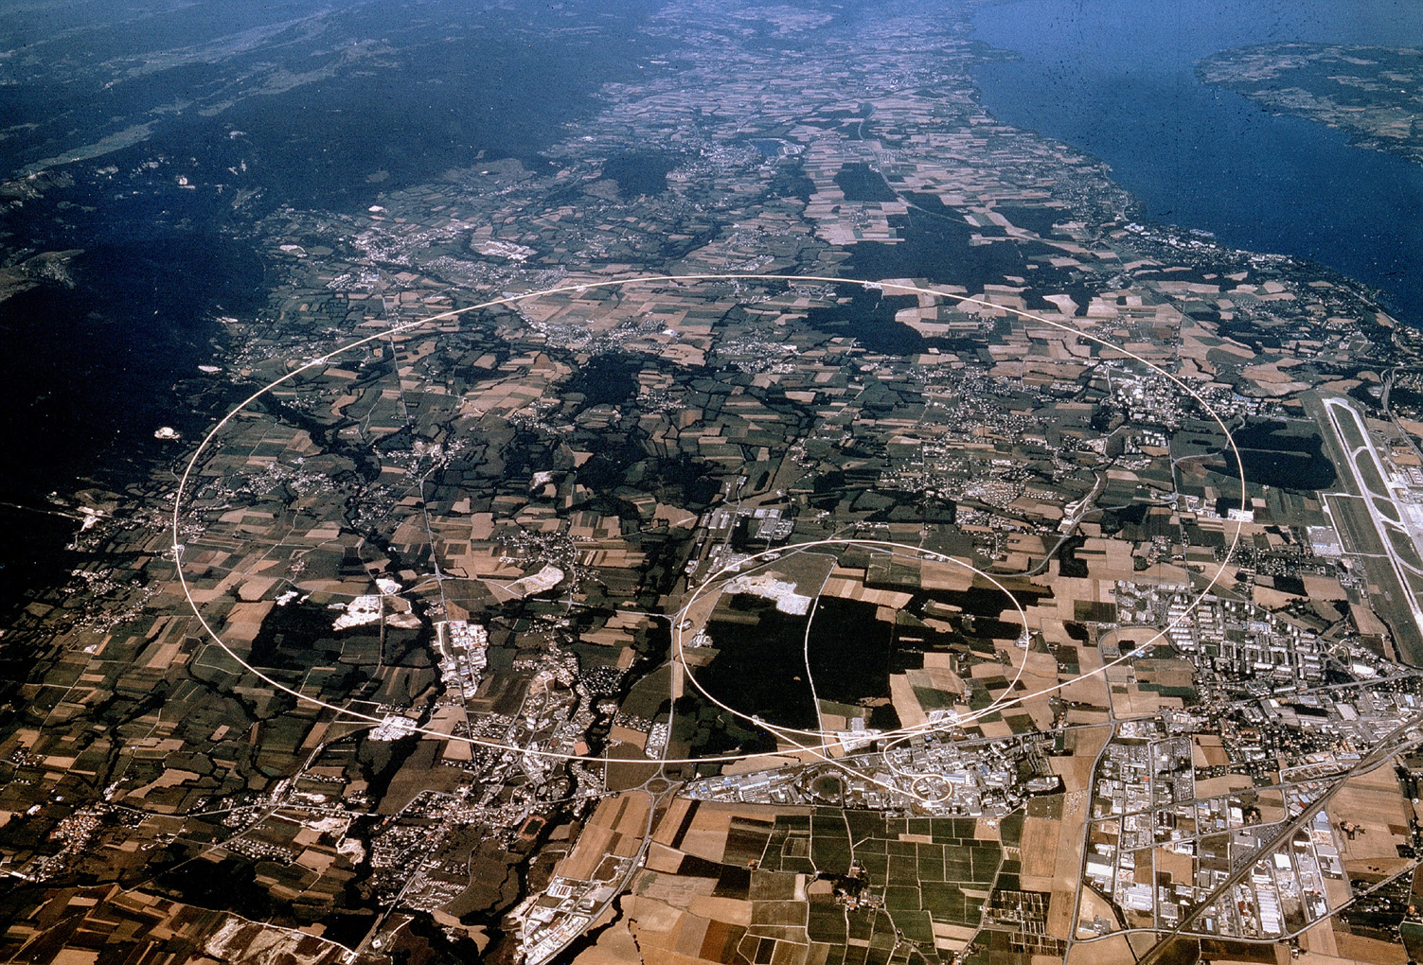
The LHC Project
Large Hadron Collider
27 km circumference
Lake Geneva
CMS
LHCb
ALICE
ATLAS

Slide 8
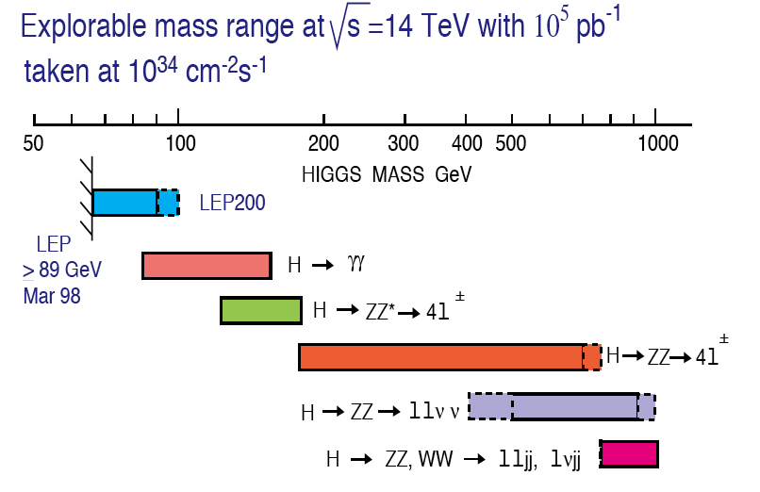
Higgs as Benchmark for Detector Design
Natural Width 0.01 1 10 100 GeV
Transparency from the early 90’s

Slide 9
Physics Criteria Driving Design of LHC Experiments
Very good muon identification and momentum measurement
Trigger efficiently and measure sign of TeV muons dp/p < 10%
High energy resolution electromagnetic calorimetry
~ 0.5% @ E_{T} ~ 50 GeV
Powerful inner tracking systems
Momentum resolution a factor 10 better than at LEP
Hermetic calorimetry
Good missing E_{T} resolution
(Affordable detector)
Transparency from the early 90’s

Slide 10
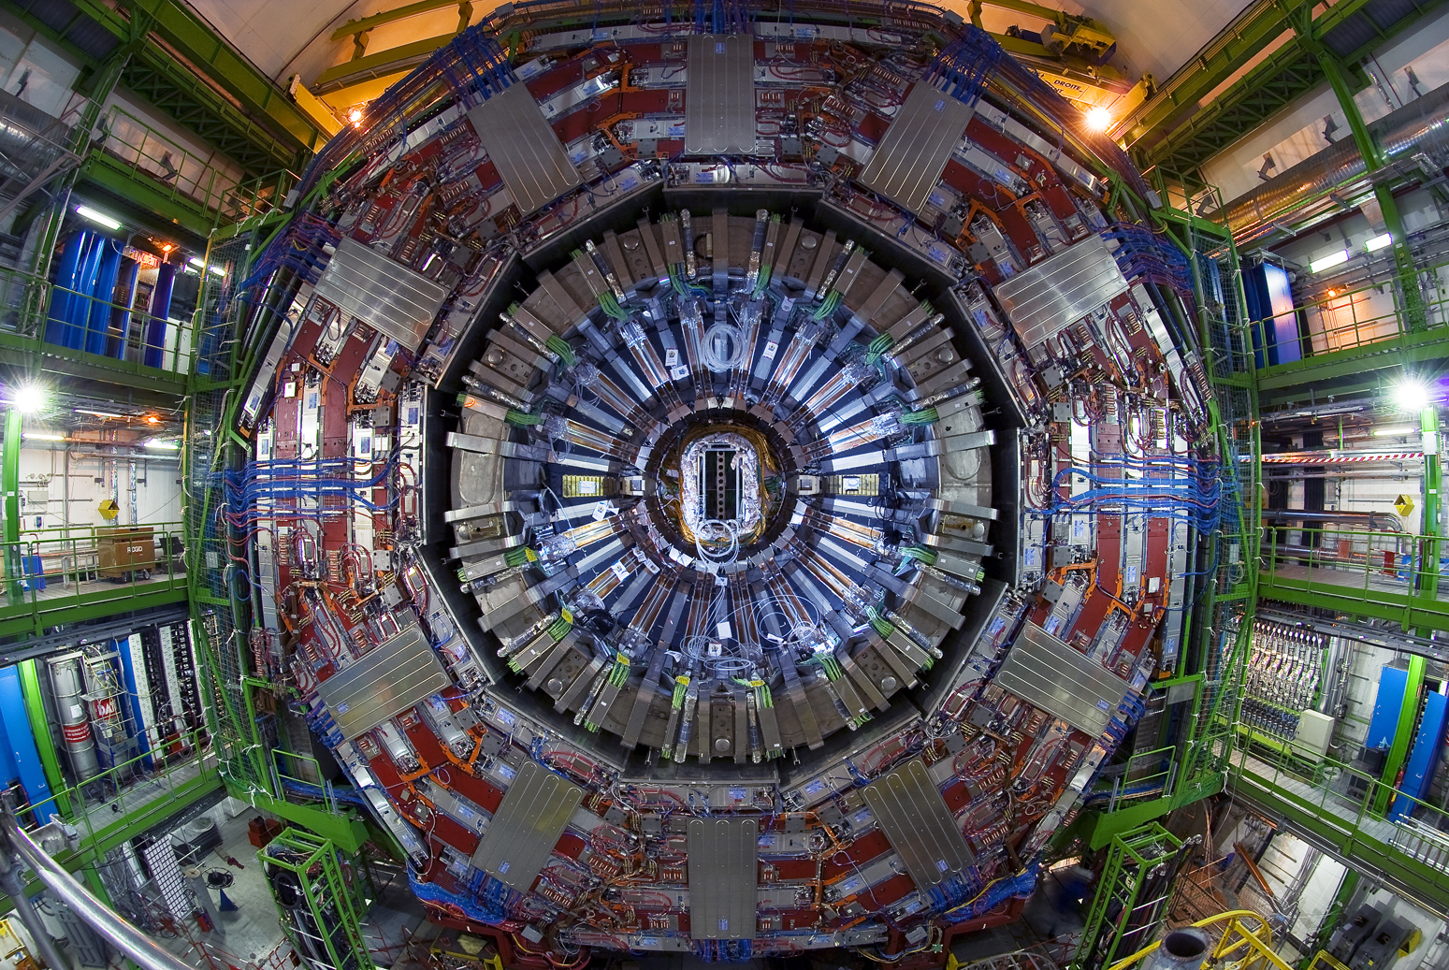
CMS Detector
4T Superconducting Solenoid
1st Layer: Silicon Tracker (pixels and microstrips)
2nd Layer: Lead tungstate electromagnetic calorimeter
3rd Layer: Hadron Calorimeter
4th Layer: Muon system
Notes:
Physics requirements drive the design
Analogy with a cylindrical onion:
Technologically advanced detectors comprising many layers, each designed to perform a specific task. Together these layers allow scientists to identify and precisely measure the energies and directions of all the particles produced in collisions.

Slide 11
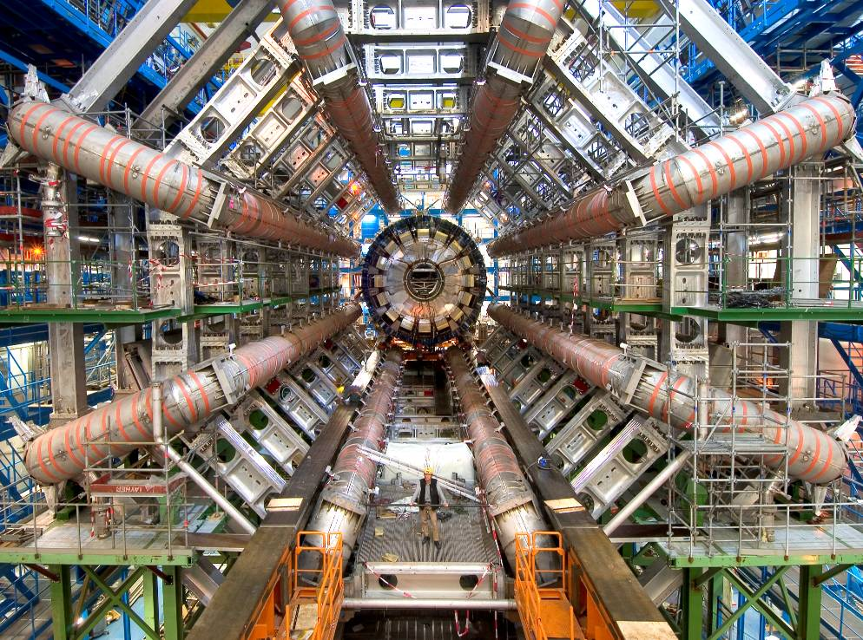

Slide 12
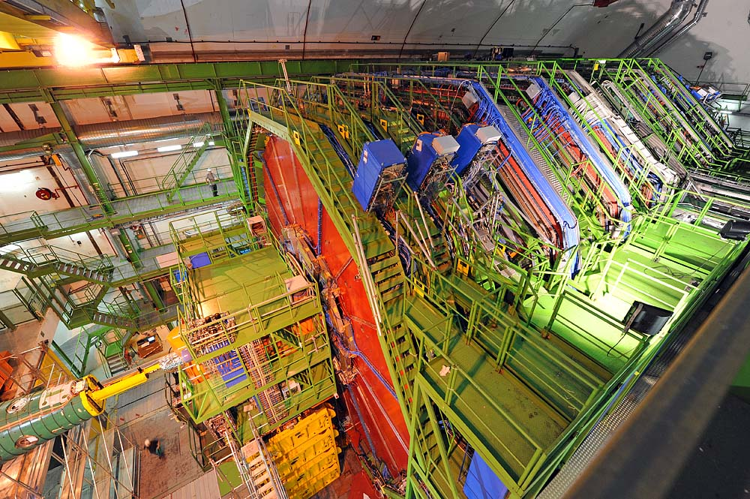
LHC Detectors Ready for Beam in Sept’08

Slide 13
Commissioning the Detectors

Slide 14
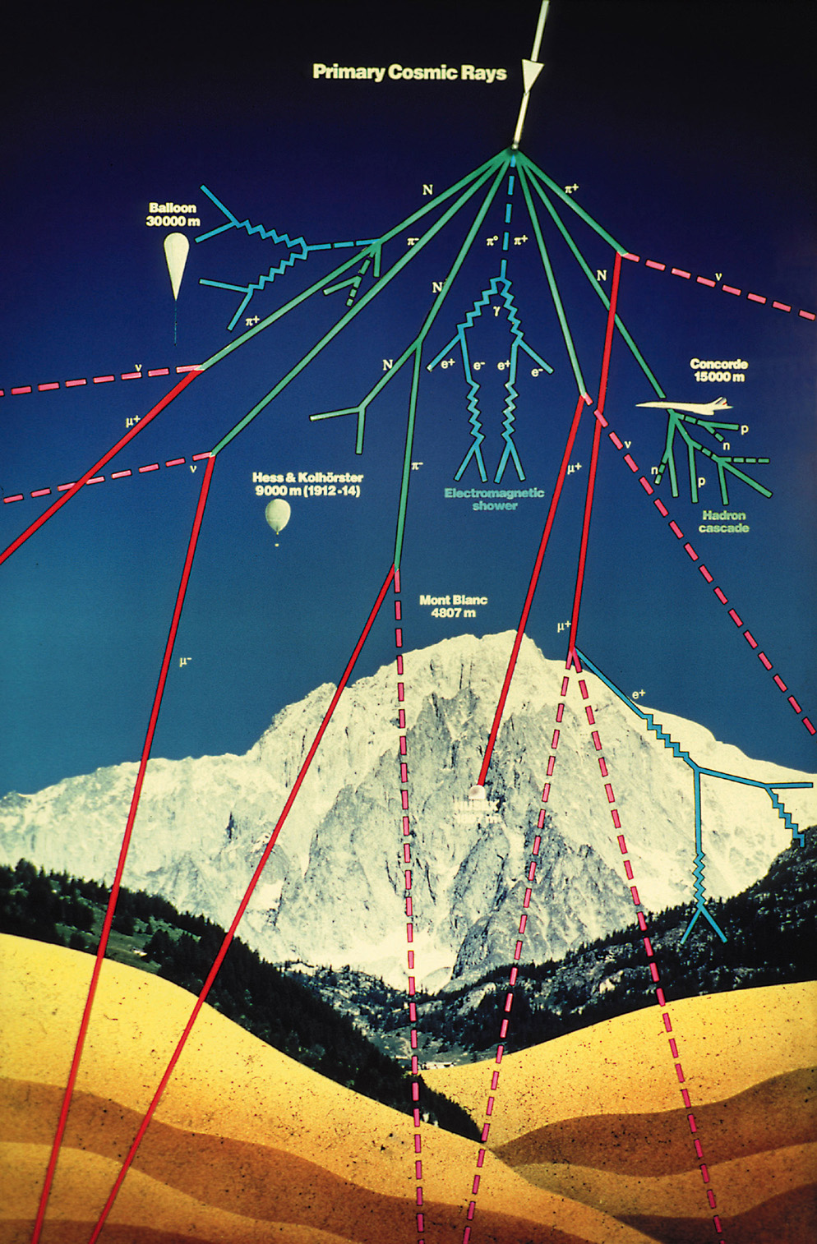
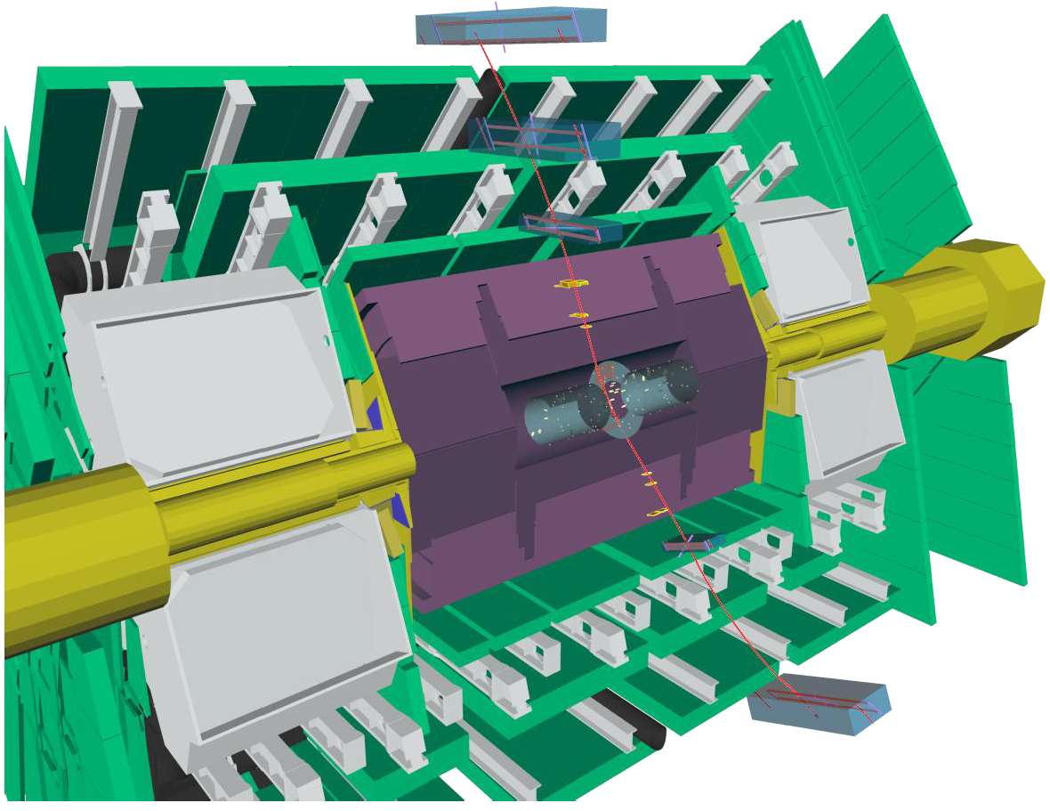
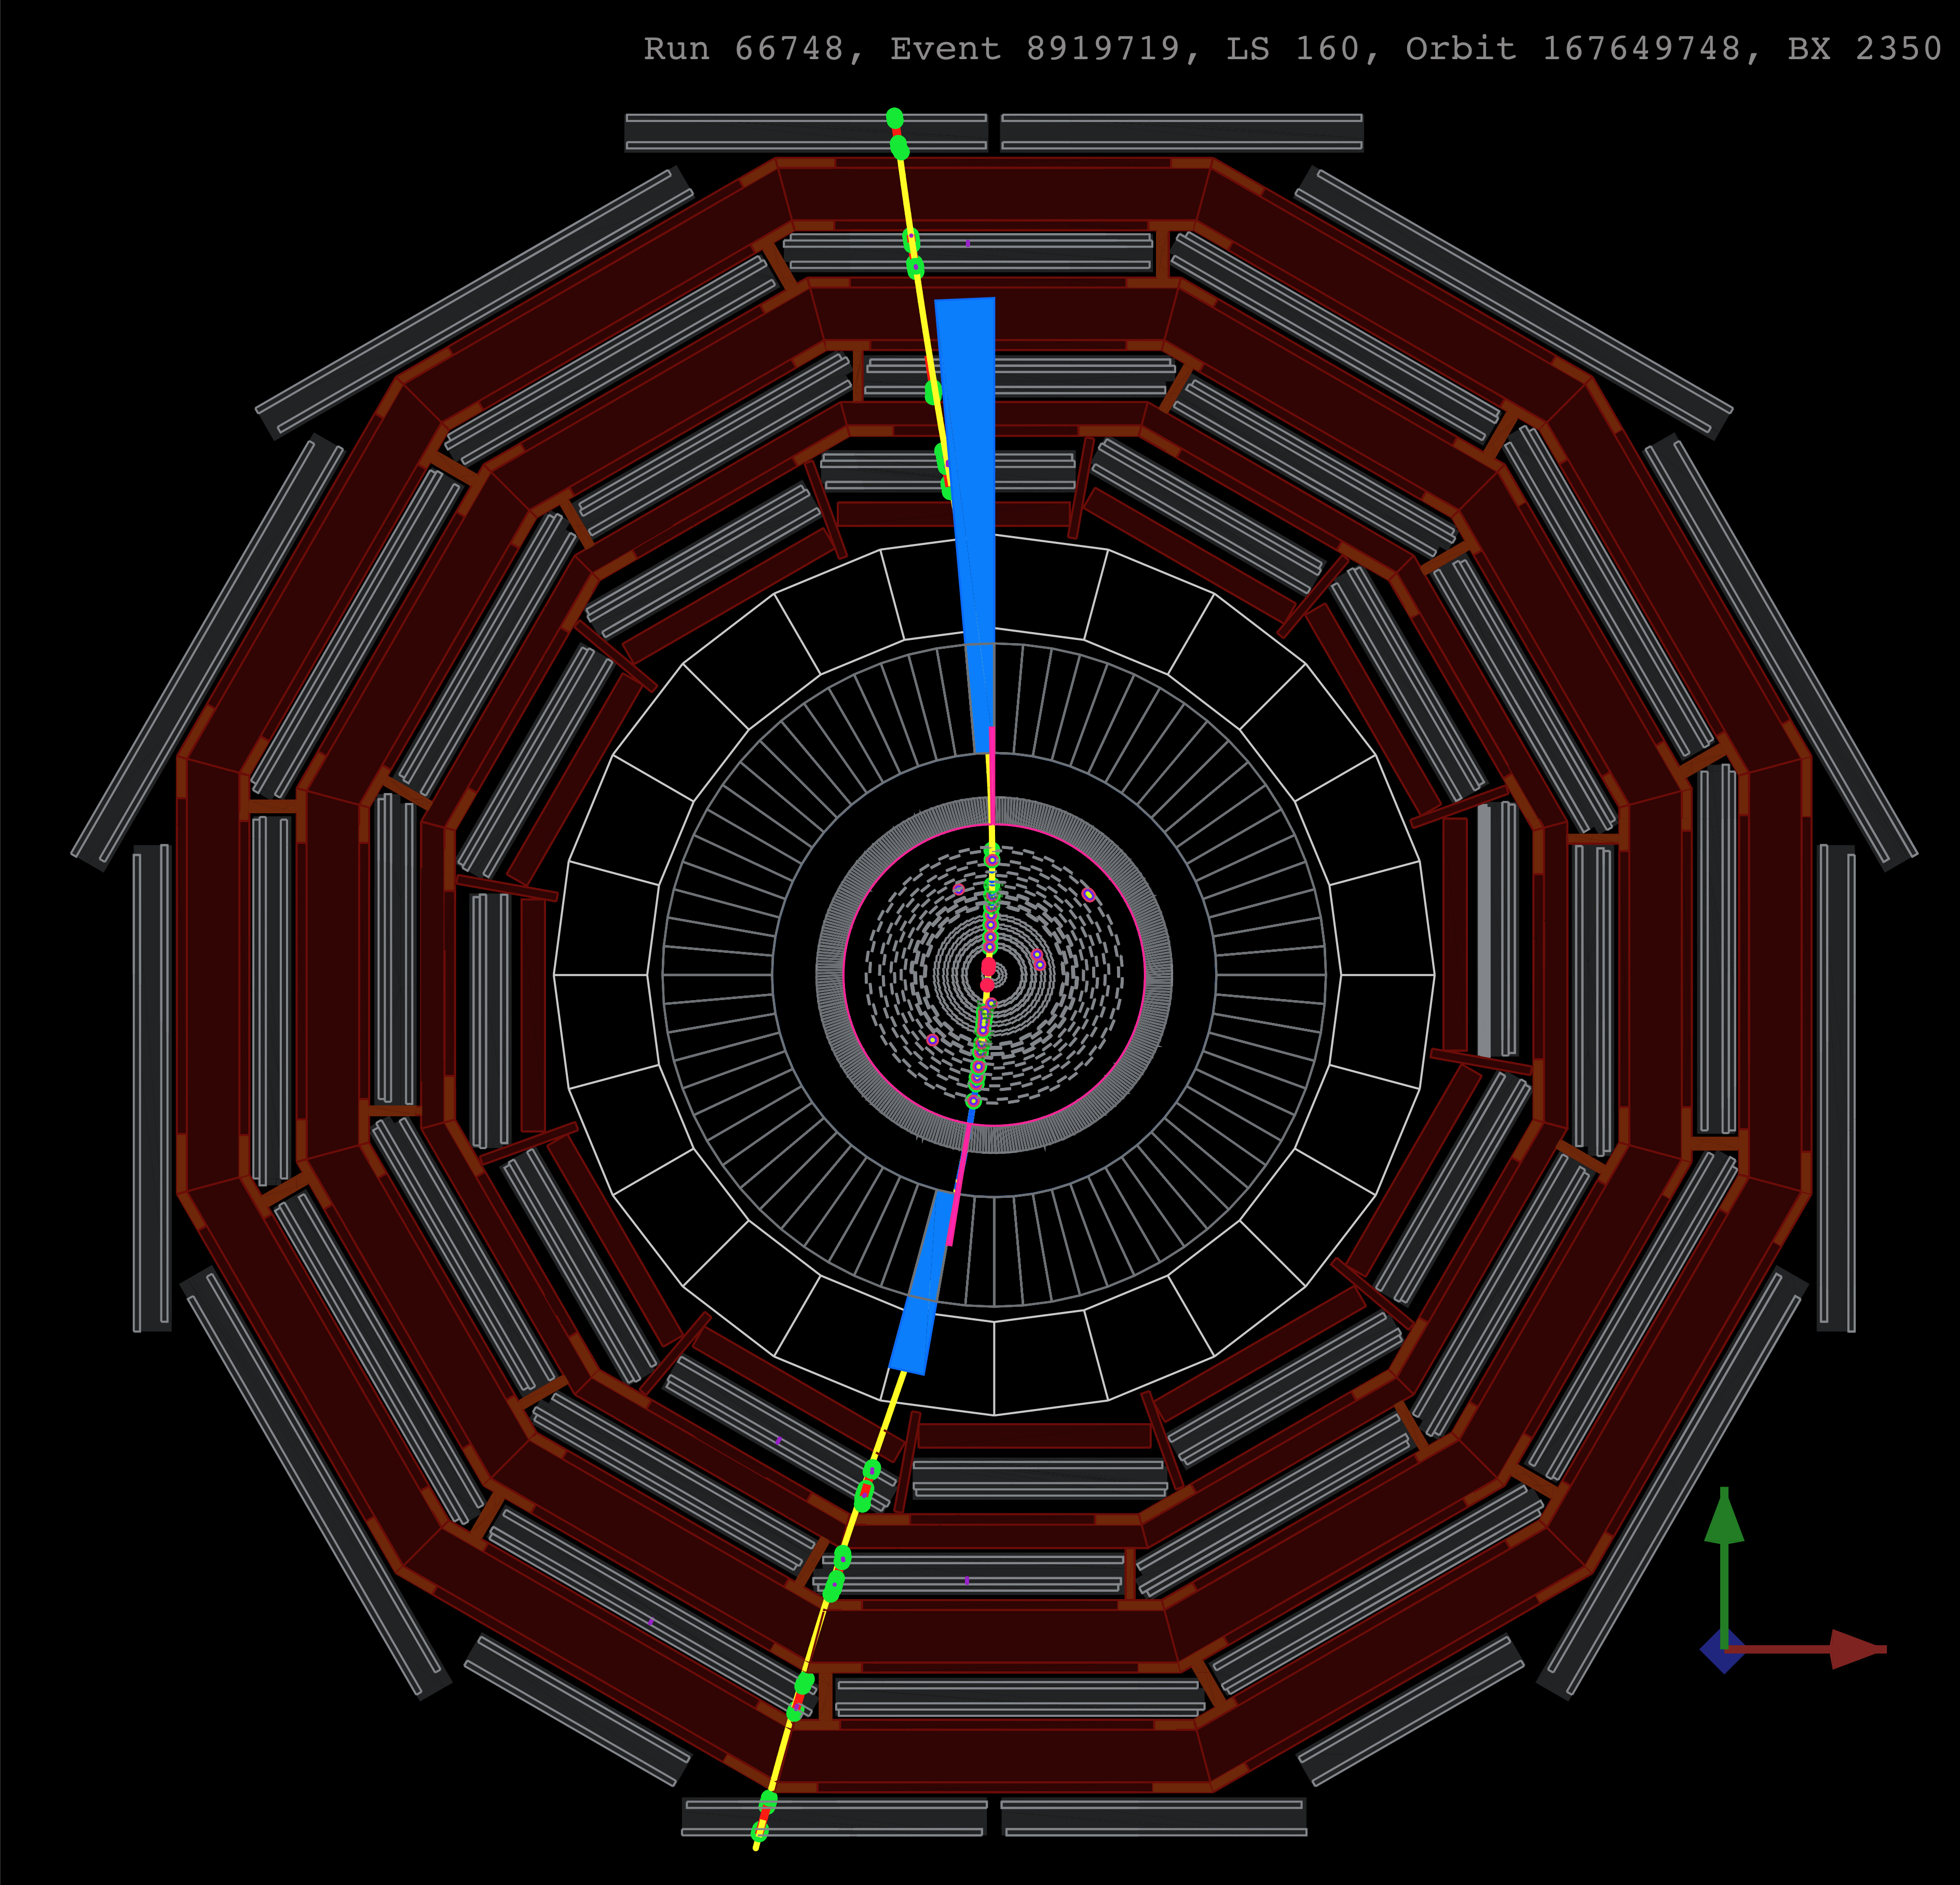
Cosmic Commissioning

Slide 15
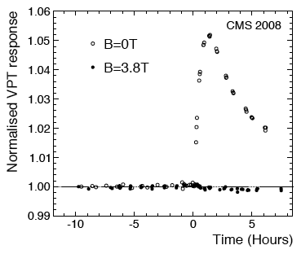
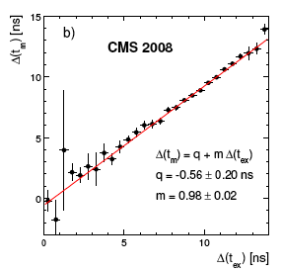
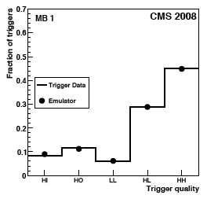
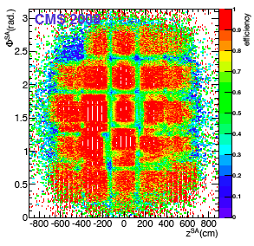
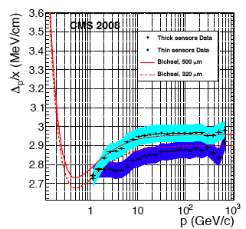
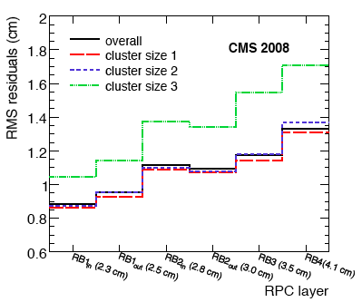
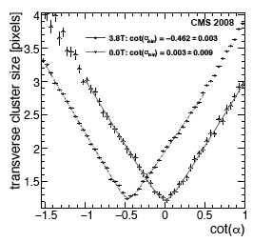
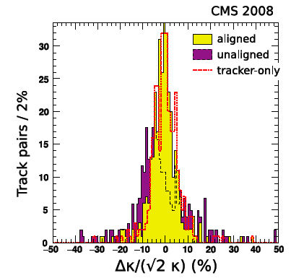
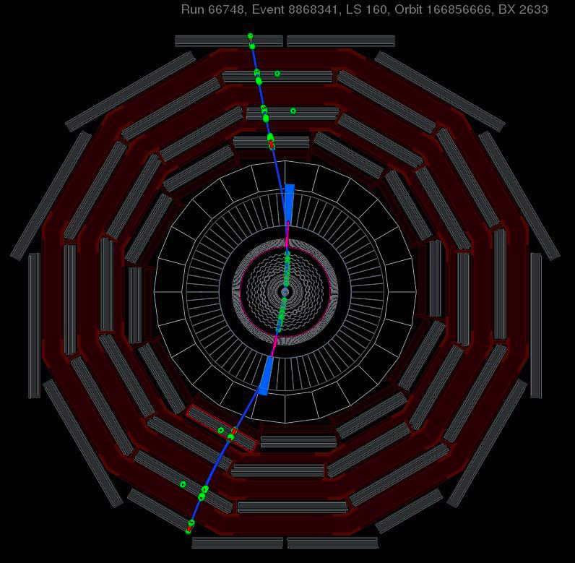
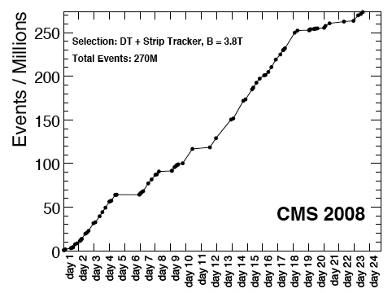
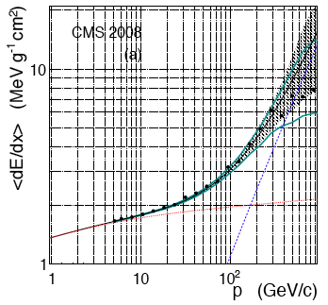
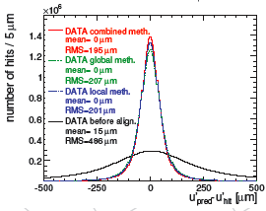
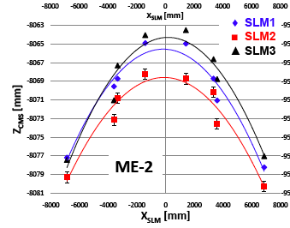
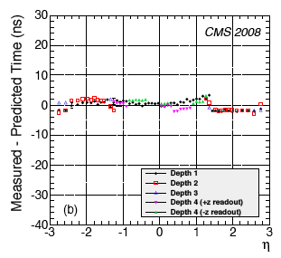
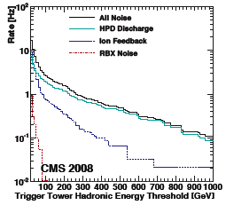
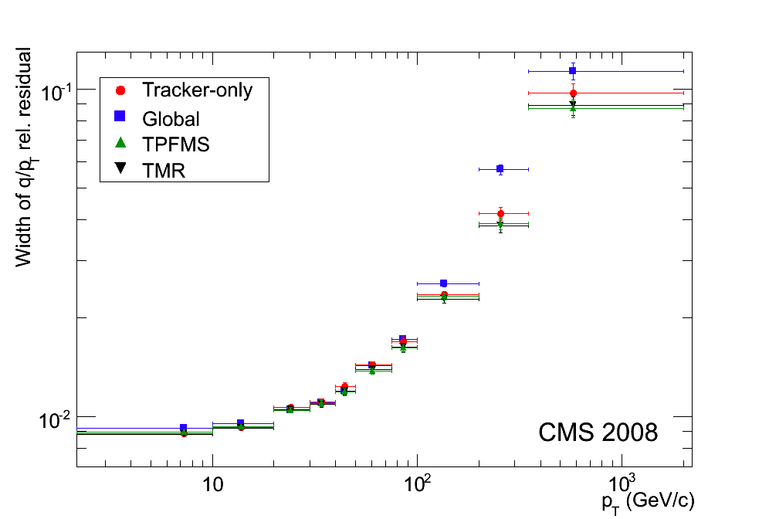
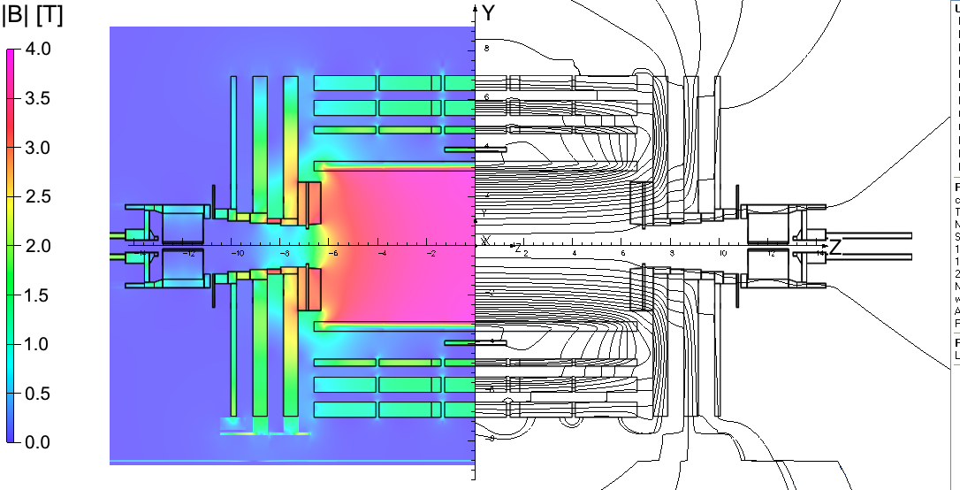
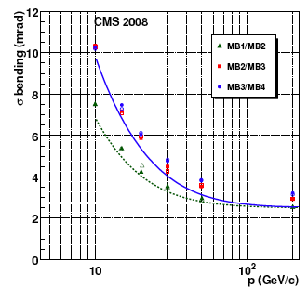
Example: CMS – 25 Performance papers published

Slide 16
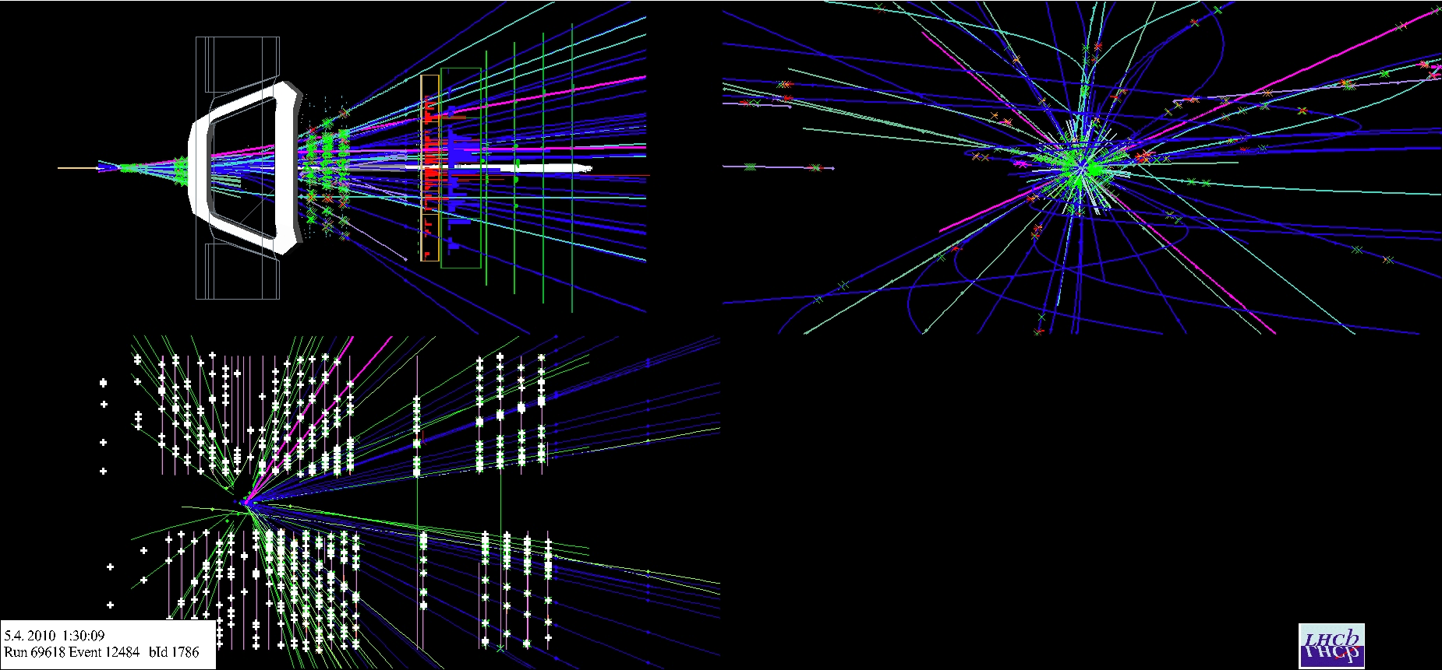
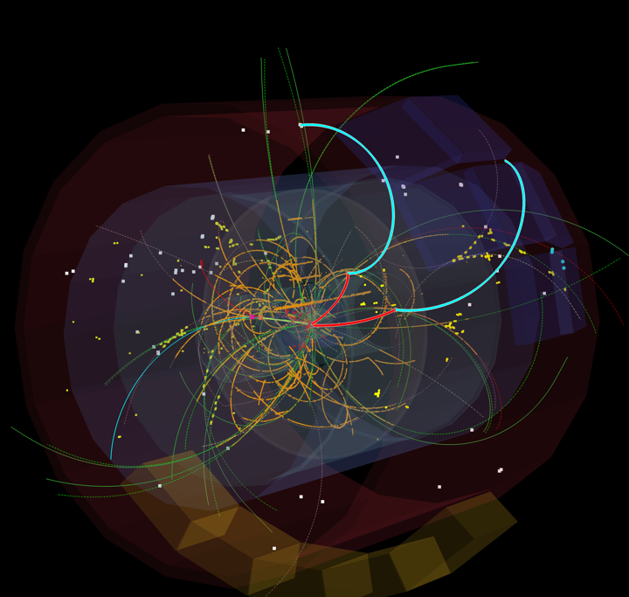
Collisions at 7 TeV!

Slide 17
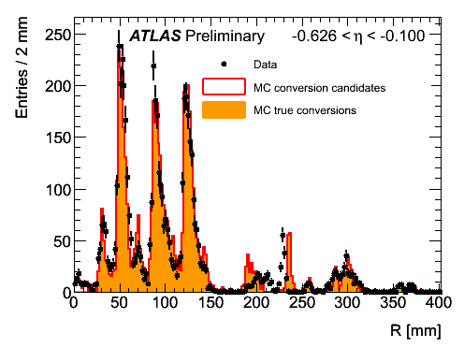
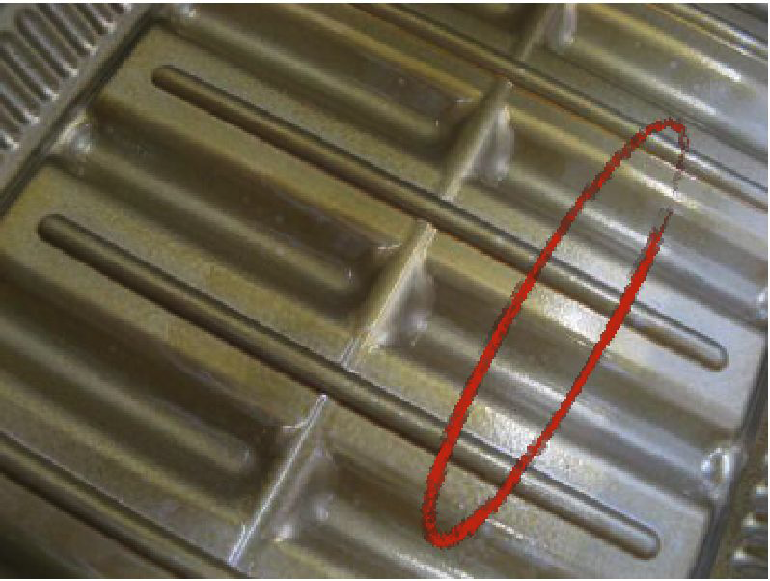
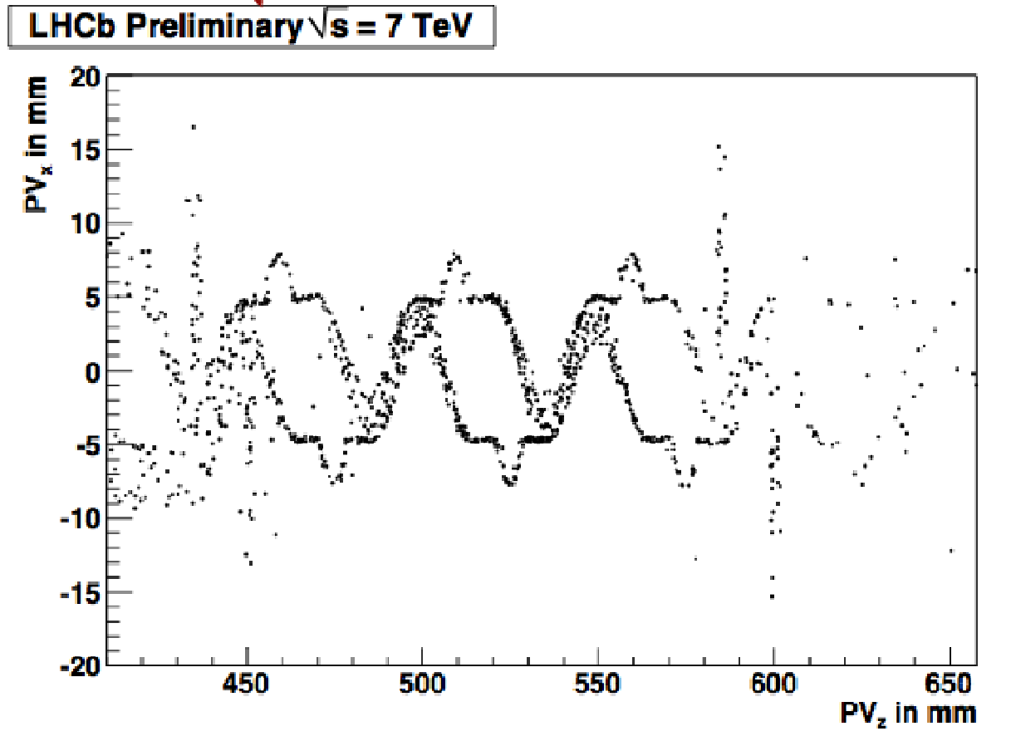
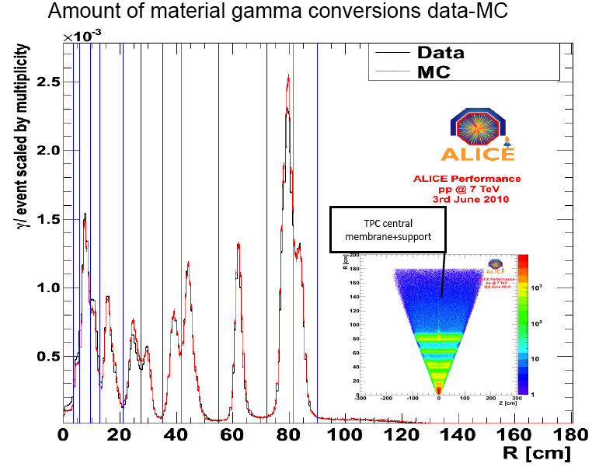
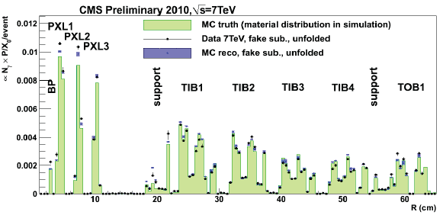
LHC Detectors are well-described in simulation e.g. Tracking - Material
Pixel 1
RF foils of both halves ~ touching
Pixel 2
Pixel 3
Beam pipe
SCT 1
sensor
SCT 2

Slide 18
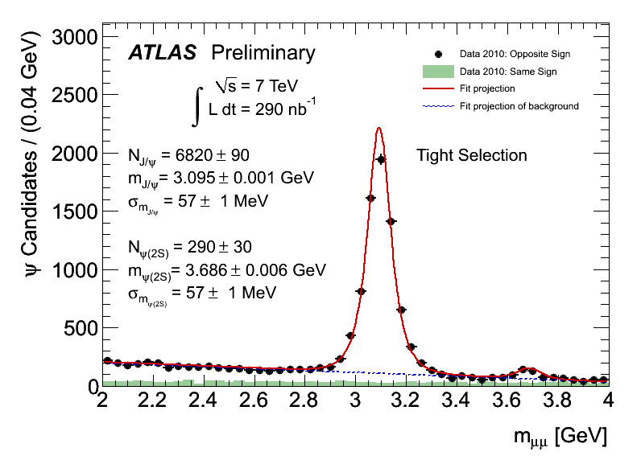
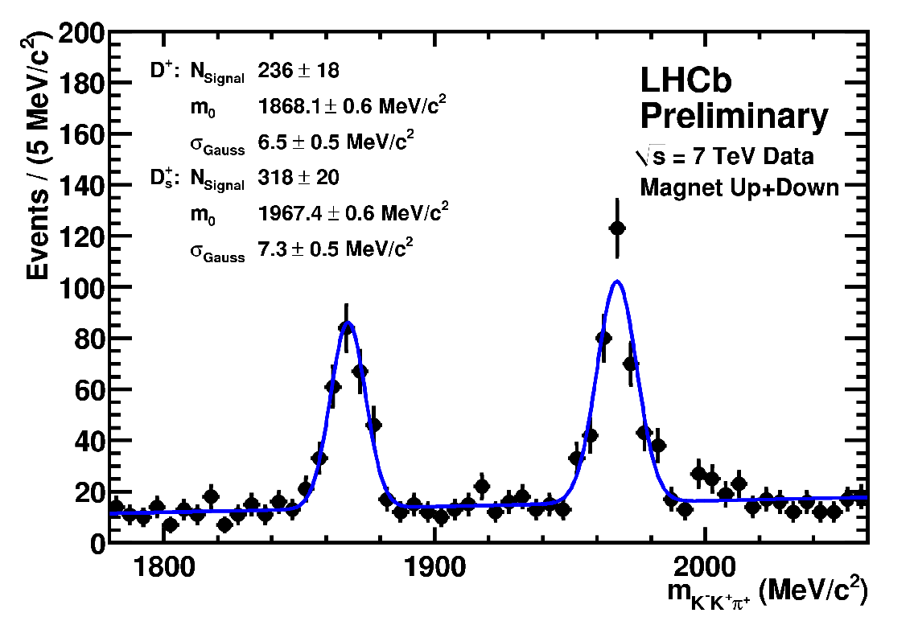
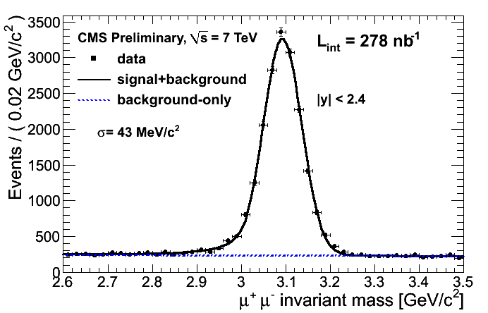
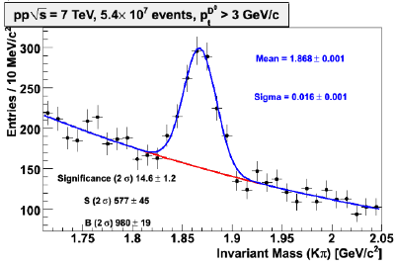
Commissioning with Beam : Tracking- Resonances
D_{s}/D⁺ to Kπ π
ALICE
Magnetic field, momentum scale, track reconstruction efficiency;
all remarkably well understood for this early stage

Slide 19
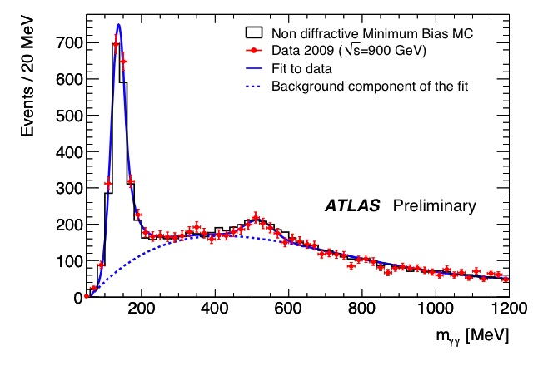
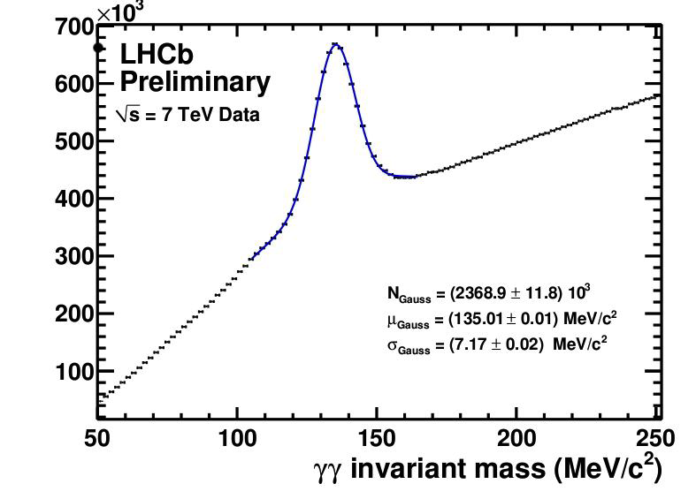
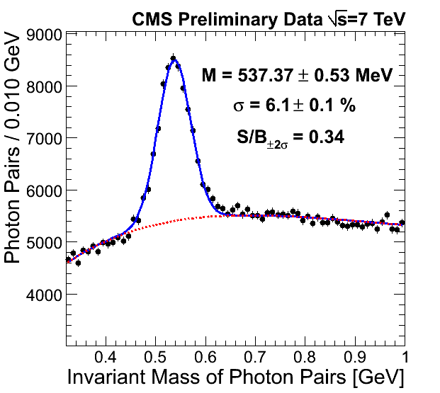
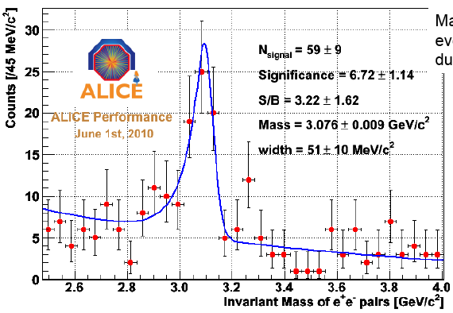
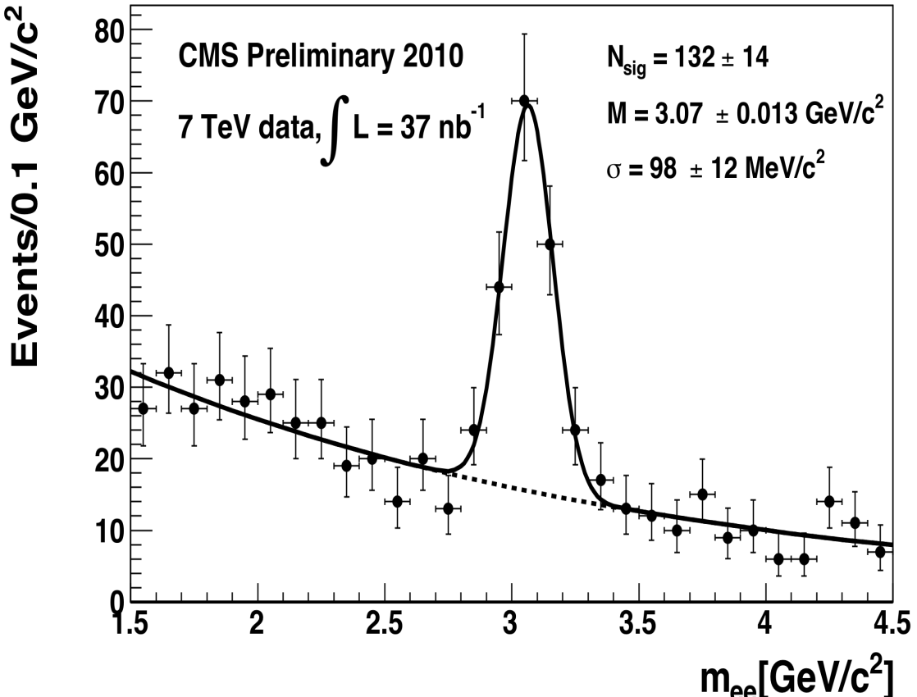
Commissioning with Beam : Tracking-ECALs
Electromagnetic calorimeters “out of the box” calibration at >≈ 1%

Slide 20
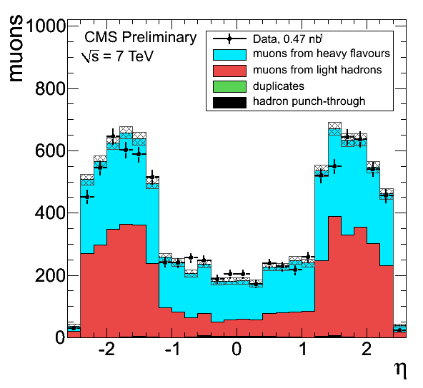
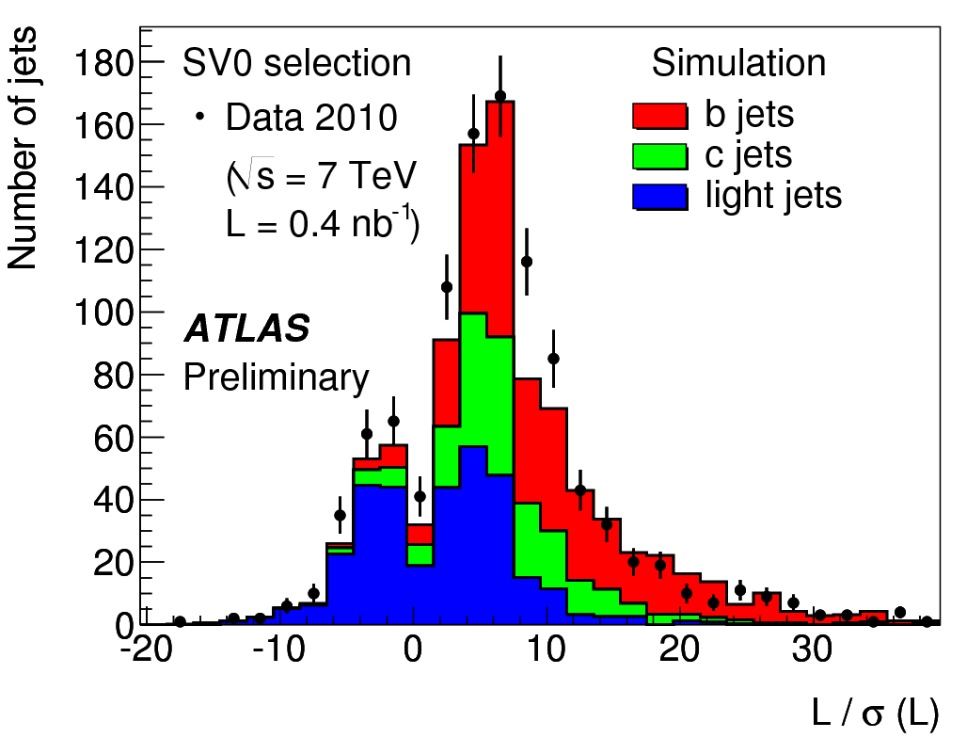
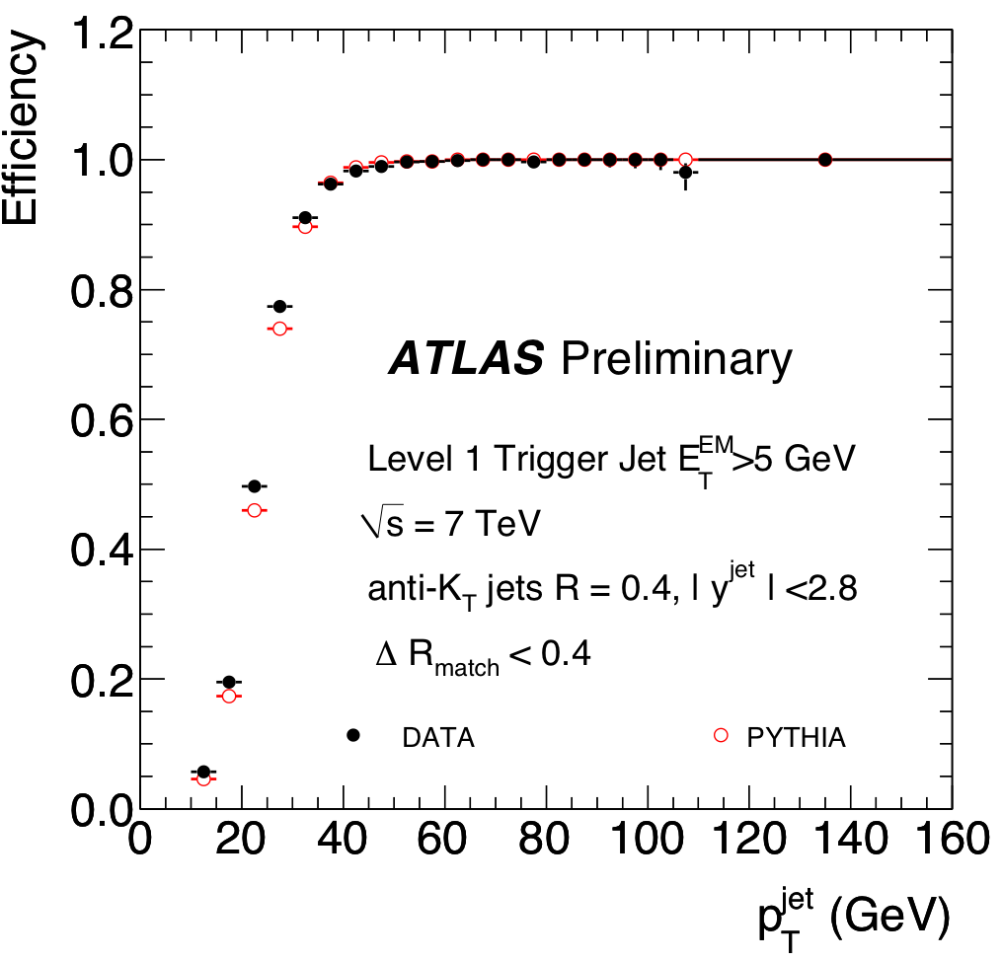
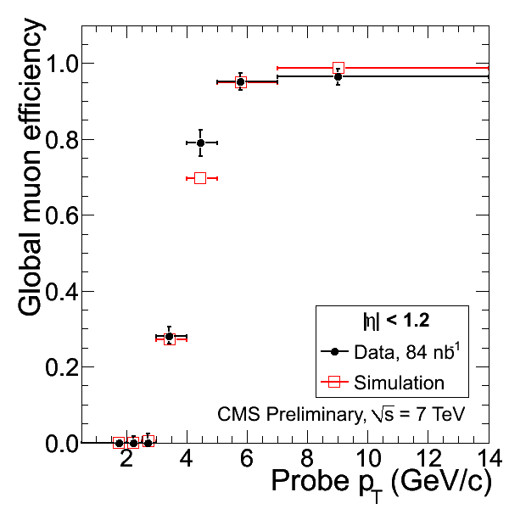
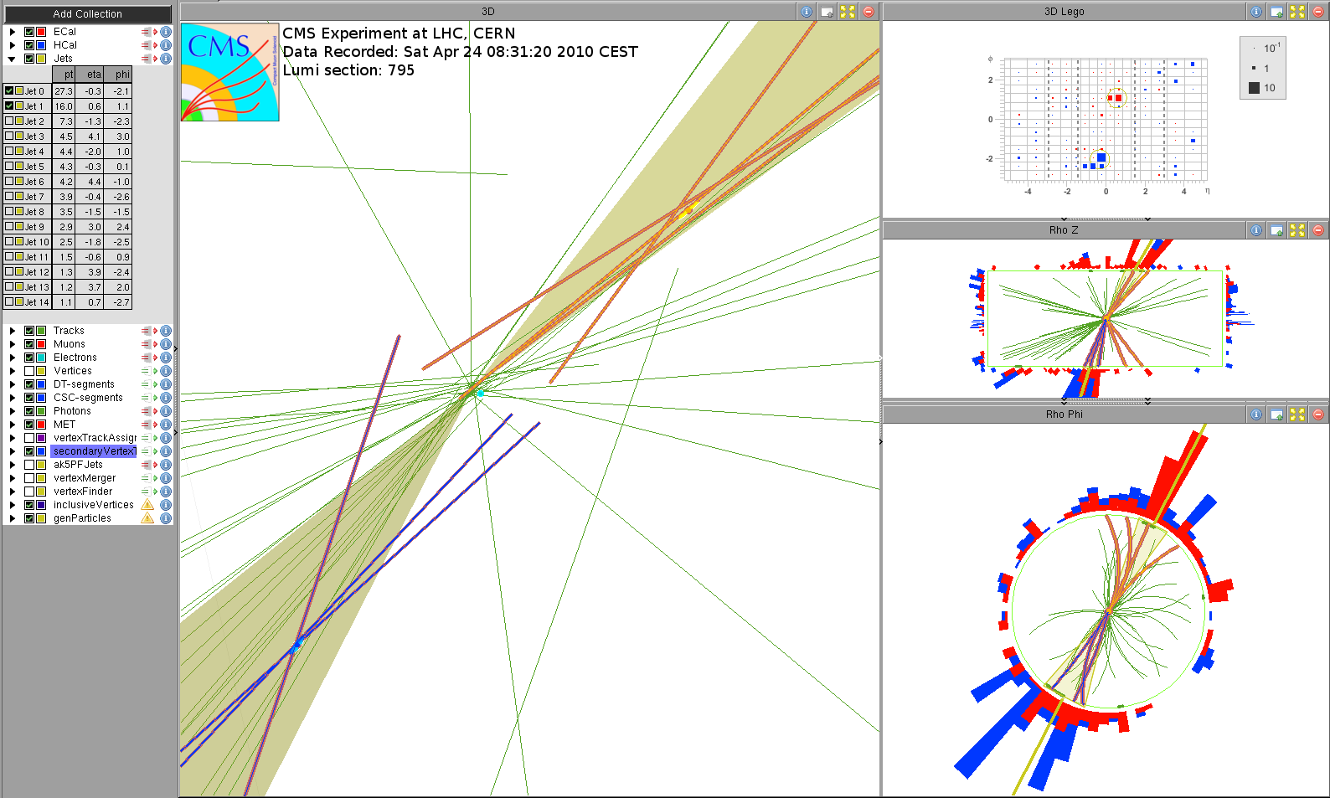
Commissioning with Beam: Understanding Muons, b-tagging, Triggers
LVL1 jet trigger efficiency
Muons remarkably well understood, b-tagging progressing well,
newer triggers being rapidly understood as luminosity increases

Slide 21
Combining All Information: Particle Flow
Candidate Multi Jet Event at 2.36 TeV

Slide 22
Combining Calorimetry and Tracking
Particle Flow -reconstruct all stable particles in the event
Charged hadrons
Neutral hadrons
Photons
PFMET (1.9 GeV)

Slide 23
Analysing Complex Events
PFJet 1
pT 41.5 GeV/c
PFJet 2
pT 37.5 GeV/c
PFJet 3
pT 21.8 GeV/c
PFMET (1.9 GeV)
(η,φ) view of a particle-flow reconstructed event. Reconstructed particles are represented as circles
with a radius proportional to their pT. The direction of the MET computed from all particles is drawn
as a solid horizontal straight line. Particle-based jets with pT> 20 GeV/c are shown as thinner circles
representing the extension of the jet in the (η,φ) coordinates.

Slide 24
Beam Commissioning: Calorimetry
Calibrated
MET distributions exponential over >5 orders of magnitude;
augurs well for searches

Slide 25
50 Years of Particle Physics; e.g. CMS
Ω⁻
π⁰
N
N
Top
J/psi
W
N
N
Sophisticated software and computing systems in place and functioning

Slide 26
Rediscovering the SM and Beyond

Slide 27
Reach
https://projects.hepforge.org/mstwpdf
1 fb⁻¹ at 7 TeV
100 million W’s
20 million Z’s
500k ttbar
1000 evts (1fb⁻¹@7TeV)
ATLAS or CMS with 1fb⁻¹
~ 0.5 million Z →ee
cf CDF or D0 with 10fb⁻¹
~ 0.5 million Z →ee

Slide 28
Comparing Tevatron and LHC (7 TeV)
Use parton luminosties to
illustrate the gain:
Example: mainly gg
Higgs: pp → H, H→WW and ZZ
Factor ~15
Example: gg and qq
Top: (85% qq, 15% gg at Tevatron)
Factor: 0.85 x 5 + 0.15 x 100
➔ ~ 20
Squarks: ~350 GeV (assume top):
Factor: 0.85 x 10 + 0.15 x 1000
~ 150 to 200
Z’: ~1 TeV (qq)
Factor: ~ 50 to 100
O. Buchmuller

Slide 29
W Z
■ ATLAS
■ ATLAS

Slide 30
Top ATLAS – an e μ candidate
p_{T} (tracks) > 1 GeV
p_{T}(μ)= 48 GeV p_{T}(e)=23 GeV
E_{T}^{miss}=77 GeV, H_{T}=196 GeV
p_{T} (b-tagged jet) = 57 GeV
Secondary vertex:
-- distance from primary: 3.8 mm
-- 3 tracks p_{T} > 1 GeV
-- mass=1.56 GeV

Slide 31
Top candidates in CMS
At least 1jet b-tagged
ee+jets/μe+jets/μμ+jets
e+jets and
μ+jets combined

Slide 32
BSM Reach
Zoltan Ligeti (ICHEP10)

Slide 33
Jets+E_{T}^{miss} Signature
Low mass SUSY(m_{gluino}~500 GeV) shows excess in many channels for O(1) fb⁻¹
Time for discovery determined by:
• Time to understand the detector performance, E_{T}^{miss} tails, jet energy scale, lepton id etc.
• Time collect SM control samples such as W+jets, Z+jets, top..
LM0/SU4
M_{g}≈M_{sq}≈400 GeV
95% CL exclusion for all-hadronic search (≥ 3 jets + MET + e/μ veto)
Systematic uncertainty of 50% assumed on Standard Model background
Sensitivity significantly beyond previous experiments (~50/pb to surpass Tevatron)
Notes:
95% CL exclusion for all-hadronic search (≥ 3 jets + MET + e/μ veto)
Systematic uncertainty of 50% assumed on Standard Model background
Sensitivity significantly beyond previous experiments (~50/pb to surpass Tevatron)

Slide 34
SUSY Topology Searches
Define Topologies
Simple categorisation in numbers of leptons and jets
Even after pre-selection cuts a good S/B for most channels (200 pb⁻¹ @ 10 TeV ~ 700 pb⁻¹ @ 7 TeV) can be achieved but...
Backgrounds straight from Monte Carlo
ATL-PHYS-PUB-2009-084
Pre-selection Cuts:
Jet ET > 100 (40) GeV
ΔΦ(jeti,MET) > 0.2 rad
Lepton ET > 20 (10) GeV
MET > 80 GeV
Meff = ΣET^{jet} + ΣET^{lep} + MET
MET > 0.2-0.3 x Meff
MT > 100 GeV

Slide 35
ATLAS + CMS: Supersymmetry @ 14 TeV
M (TeV)
2.5
2
1.5
J.J. Blaising et al, input to
Eur. Strategy workshop
1
ATLAS + CMS
1
10
100
100 pb⁻¹
Luminosity/expt (fb⁻¹)

Slide 36
From the Possible to the Unexpected
Large zoo of models that predict different incarnations of New Physics at the LHC
Contact Interaction
/Excited Quarks?
New Gauge Bosons?
Split Susy?
Technicolour?
14 TeV
14 TeV
10 TeV
Little Higgs?
Hidden Valley??
Extra Dimensions?
Black Holes???
14 TeV
O. Buchmuller
Non exhaustive list (by far)

Slide 37
Dilepton Resonances (Example Z’)
Predicted in many SM extensions (Extra Dimensions, Technicolour, Little Higgs)
Low, well understood background dominated by DY
95% CL exclusion O(100/pb) at 1 TeV
Sensitivity beyond the Tevatron (1 TeV SSM Z’) with ~100 pb⁻¹
95% exclusion in μμ
5σ discovery in the μμ channel
CMS PAS SBM-07-002,
scaled to 7 TeV
ATLAS Preliminary
95% CL
@1 TeV

Slide 38
Z’ Reach at 14 TeV
Z′→μμ production
CMS 5σ

Slide 39
Standard Model (like) Higgs: TeVatron

Slide 40
Standard Model (like) Higgs: LHC at 7 TeV
1 fb⁻¹ at 7 TeV
SM Higgs expected excluded range approx: 140-200 GeV
discovery range approx: 160-170 GeV
Probably conservative as normally one does better by learning from data themselves

Slide 41
ATLAS +CMS: SM Higgs @14 TeV
Needed ∫Ldt (fb⁻¹)
per experiment
J.J. Blaising et al, input to
Eur. Strategy workshop
10
--- 98% C.L. exclusion
≤ 1 fb⁻¹ for 98% C.L. exclusion
≤ 5 fb⁻¹ for 5σ discovery
over full allowed mass range
1
Events / 0.5 GeV
ATLAS + CMS
preliminary
10⁻¹
m_{H} (GeV)

Slide 42
LHC Operation in 2010
2009 | 2010 | 2011
Repair of Sector 34 | 1.18 TeV | nQPS 6kA | 3.5 TeV I_{safe} < I < 0.2 I_{nom} β* > 2 m | Ions |  | 3.5 TeV ~ 0.2 I_{nom} β* ~ 2 m | Ions
No Beam | B |  | Beam |  | Beam
R. Bailey
Today
Energy limited to 3.5 TeV
2010
Intensity carefully increased to collimation limit
β* pushed as low as possible
Target luminosity 10³² cm⁻²s⁻¹
2011
Run at established limits
Target integrated luminosity 1 fb⁻¹
Energy | TeV | 3.50 | 3.50 | 3.50 | 3.50
Bunch intensity | 1.E+10 | 10.0 | 10.0 | 10.0 | 10.0
Bunches per beam |  | 4 | 24 | 432 | 792
Emittance | µm | 3.75 | 3.75 | 3.75 | 3.75
β* | m | 3.50 | 3.50 | 3.50 | 3.50
Luminosity 1 and 5 | cm-2 s-1 | 1.0E+30 | 6.1E+30 | 1.1E+32 | 2.0E+32
Total inel X section | cm2 | 6.0E-26 | 6.0E-26 | 6.0E-26 | 6.0E-26
Event rate | Hz | 6.1E+04 | 3.7E+05 | 6.5E+06 | 1.2E+07
Event rate / Xing | Hz | 1.4 | 1.4 | 1.3 | 1.3
Protons |  | 4.0E+11 | 2.4E+12 | 4.3E+13 | 7.9E+13
% nominal |  | 0.1 | 0.7 | 13.4 | 24.5
Current | mA | 0.7 | 4.3 | 77.7 | 142.5
Stored energy | MJ | 0.2 | 1.3 | 24.2 | 44.4
Beam size 1 and 5 | um | 59.3 | 59.3 | 59.3 | 59.3

Slide 43
LHC Machine Shutdowns
The shutdowns required are
2012
To finish repairs to allow the machine to reach full energy (splices, consolidation, …)
A full year shutdown
~2016
To install components needed to reach design luminosity and slightly beyond
Connection of Linac 4, PSB energy increase, PS and SPS consolidation, ….)
Installation of additional collimators
a full year shutdown
~2020
Major changes to the machine to reach highest possible luminosity in the LHC (inner triplets, crab cavities, …)
Probably a two year shutdown

Slide 44
Physics Case for HL-LHC
Discoveries at the LHC will clearly define the physics of the HL-LHC
Standard Model:
Multi-W,Z couplings
Rare top decays
Higgs physics:
Light Higgs: measure couplings, rare decays, self-coupling
Heavy Higgs: discover!
New physics:
Supersymmetry: sensitivity to heavy sparticles
Z’
compositeness
De Roeck, J.Ellis, Gianotti: hep-ph/0112004
Gianottii, Mangano, Virdee: hep-ph/0204087

Slide 45
Examples of Physics at HL-LHC
Gianotti
(Elba)

Slide 46
LHC/HL-LHC Reach
Z’→ ll: m=6TeV
Compositeness: Λ= 60 TeV
SUSY: m_{sq,gl} > 3 TeV
TeV scale resonances from WW scattering
SUSY: m_{sq,gl} > 2.5 TeV
Leptoquarks: m=1.5TeV
Compositeness: Λ= 30 TeV
Xtra Dim: G→ ll m_{G}=1TeV
H: m_{H}=115 GeV
14 TeV
Z’→ l:, m=1TeV
SUSY: m_{sq,gl} > 0.8TeV
Top observed?
2010 2015 2020 2025 2030 2035
a la Gianotti et al

Slide 47
CMS Upgrades
Aim to maintain (or if possible improve) today’s baseline performance
2012 Shutdown
Install forward muon systems (Forward RPCs and ME4/1 CSCs)
HCAL-Outer: HO SiPMs
HCAL Forward: HF PMTs
Pixels Luminosity Telescope
~ 2016 Shutdown
Install new beampipe
Install new pixel detector
Install HB/HE photo-detectors
Install new trigger system
~ 2020 Shutdown
Install new tracking system
Major consolidation/replacement of electronics systems
Including potentially ECAL electronics

Slide 48
ATLAS Upgrades

Slide 49
Conclusion “a la Altarelli”

Slide 50
Outlook at the LHC
After twenty years spent on the design, R&D, prototyping, construction, assembly and commissioning of the experiments (and the machine) the second half of the journey involving the extraction of physics has started in earnest. A new era in modern physics has been truly launched.
The LHC is delivering high energy collisions.
The accelerator and the experiments are now operating and all systems are performing very well – the experiments are already approaching design performance!
It is just the beginning - but gives tremendous encouragement for the future. A long and very interesting journey, no doubt rich in physics, lies ahead.

Slide 51
The Coming Decade …..
PLANCK
LHC
The coming decade will see revolutionary advances in our knowledge of the Universe and of the fundamental laws that govern it.

Slide 52
Combining Calorimetry and Tracking
Particle Flow aims at reconstructing all stable particles in the event, i.e., electrons, muons, photons & charged and neutral hadrons from the combined information from all CMS sub-detectors, to optimize the determination of particle types, directions and energies
CMS is particularly suited for this:
- Powerful Si tracker
EM calorimeter with fine granularity & small Moliere radius
( NB: CMS has 4T B-field & HCAL has moderate performance)

Slide 53
Data Distribution
MB/s
per day
Jan
Feb
March
April
May
June
July
Data and MC
reprocessing
6 GB/s
Start of
10¹¹ p/bunch
operation
2009 data
reprocessing
Start of
7 TeV
data-taking
MC reprocessing
~2 GB/s
(design)
Peaks of 10 GB/s achieved
GRID-based analysis in June-July 2010:
> 1000 different users, ~ 11 million analysis jobs processed
Notes:
7/31/10
53

Slide 54
Data Transfers, CPU, Analysis (jobs, people,..) ...
1 M jobs/day
~100 k cores
CMS
Peaks of 1M jobs/day now
Use ~100k cores equivalent
Tier 2s heavily used wrt Tier 1s

Slide 55
Supersymmetry – a New Zoology of Particles ?

