Slide 1
Leptonic B and D decays at the B-factories
Guglielmo De Nardo
Napoli University and INFN
7th Meeting on B Physics, Orsay, France, October 4th 2010

Slide 2
Outline
Motivation
Brief description of the “Recoil Method” technique
B ➝ τ ν measurements
D ➝e ν, μ ν, τ ν measurements
B ➝ μ ν and B ➝ μ ν γ

Slide 3
B ➝l ν decays in the SM
b
l⁺
+
W⁺
B⁺
u
ν_{ℓ}
Helicity suppression
Experimental sensitivity to f_{B} assuming V_{ub}
Can be used to measure the B meson decay constant f_{B} assuming V_{ub}
Vub (exp.+theo) and f_{B} (theo) uncertainties dominate the SM expectation uncertainty:
Using f_{B} = 190 ± 13 MeV * and V_{ub} = (3.5 ± 0.4 ) × 10⁻³ ** BF_{SM}(B →τν) = (0.80 ± 0.20) × 10⁻⁴
*HPQCD collaboration arXiv:0902.1815v2
** UTFit and CKM fitter collaborations

Slide 4
B ➝l ν decays beyond the SM
b
l⁺
b
l⁺
+
H⁺
W⁺
B⁺
B⁺
u
ν_{ℓ}
u
ν_{ℓ}
Additional tree level contribution from a charged Higgs
It does not suffer from helicity suppression, but gets the same m_{l} dependence from Yukawa coupling
Branching fraction theoretical expression depends on the NP model
W. S. Hou, Phys. Rev. D 48 (1993) 2342.
A.G. Akeroyd and S.Recksiegel J.Phys.G29:2311-2317,2003
B ➝ τν measurement already allows 90% exclusion plots in the plane of NP parameters M_{H} × tan β

Slide 5
B tagging
Weak signal signature
Decay with missing momentum (many neutrinos in the final state)
Indirect detection of a τ in final state
background rejection improved identifying the companion B (tag)
Look for signal in the rest of the event
Expect to find nothing more than a single charged track and no activity in the calorimeter
Tag this B
Then look for signal
e⁺,μ⁺
X⁻
ν_{μ,} ν_{e}
ϒ(4S)
B⁻
B⁺
τ⁺
ν_{τ}
D^{(*)0}
ν_{τ}
Reconstructed τ decays 72%
τ➝
0
20
4o
60
80
100
Branching Fraction ( %)

Slide 6
Two kind of tags exploited
Fully reco this side
Then look for signal this side
Semileptonic B decays
PRO: Higher efficiency ε_{tag} ∼ 1.5% CON: more backgrounds, B momentum unmeasured
Hadronic B decays with charm
PRO: cleaner events, B momentum reconstructed CON: smaller efficiency ε_{tag} ∼ 0.15%
e⁺,μ⁺
ν
ν_{μ,} ν_{e}
l⁻
ϒ(4S)
B⁻
B⁺
τ⁺
ν_{τ}
D^{(*)0}
ν_{τ}
X⁰
e⁺,μ⁺
X⁻
ν_{μ,} ν_{e}
ϒ(4S)
B⁻
B⁺
τ⁺
ν_{τ}
D^{(*)0}
ν_{τ}

Slide 7
Tag reconstruction

Slide 8
B ➝ τν
Both tag reconstruction techniques used at B-factories
4 independent measurements of the BF

Slide 9
Signal Selection
Exploit kinematics and topology of in the signal side
Single charged tracks passing particle identification criteria
Requirement on CMS momentum for 1 prong modes
More constraints for τ gππ⁰
Most discriminating variable residual energy in the calorimeter (E_{extra})
Defined as the total energy of clusters passing a minimum energy requirement
Used in a maximum likelihood fit to determine the branching fraction
E_{extra} distribution validated with the use of double tagged events
Simultaneous fit of the BF to E_{extra}

Slide 10
Hadronic tags BaBar
arXiv:1008.0104[hep-ex]
Fit to E_{extra} distribution show an excess of events
excluding null hypothesis at 3.3 σ
PRELIMINARY
Likelihood profile
MC modelling of E_{extra} checked with
Double tags
3.6 σ (stat. only)
signal
background

Slide 11
Hadronic tags Belle
Phys. Rev. Lett. 97, 251802 (2006)
Fit to E_{extra} distribution show an excess of events
excluding null hypothesis at 3.5 σ
MC modelling of E_{extra} checked with
Double tags

Slide 12
Analysis with Semi-leptonic tags
Similar technique with semi-leptonic B tags
Fully reco this side
e⁺,μ⁺
signal
ν_{μ,} ν_{e}
D^{(*)0}
ϒ(4S)
B⁻
B⁺
τ⁺
Analysis Sample
ν_{τ}
ν
ν_{τ}
l⁻
l⁺
D^{(*)0}
ϒ(4S)
ν
B⁻
B⁺
Control Sample
ν
D^{(*)0}
l⁻

Slide 13
BaBar SL tags results
Phys. Rev. D 81,051101(R) (2010)
B( B gτν ) = (1.7 ±0.8 ± 0.2)×10-4
Excluding null hypothesis at 2.3 σ

Slide 14
Belle SL tags
arXiv:1006.4201[hep-ex]
Excluding null hypothesis at 3.6 σ

Slide 15
BF summary
BABAR Hadronic tags
arXiv:1008.0104[hep-ex]
BABAR Semi-leptonic tags
Phys. Rev. D 81,051101(R) (2010)
BABAR combined
BELLE Hadronic tags
Phys. Rev. Lett. 97, 251802 (2006)
BELLE Semi-leptonic tags
arXiv:1006.4201[hep-ex]
HFAG average:
HFAG does not use the 2006 Belle hadronic tag result

Slide 16
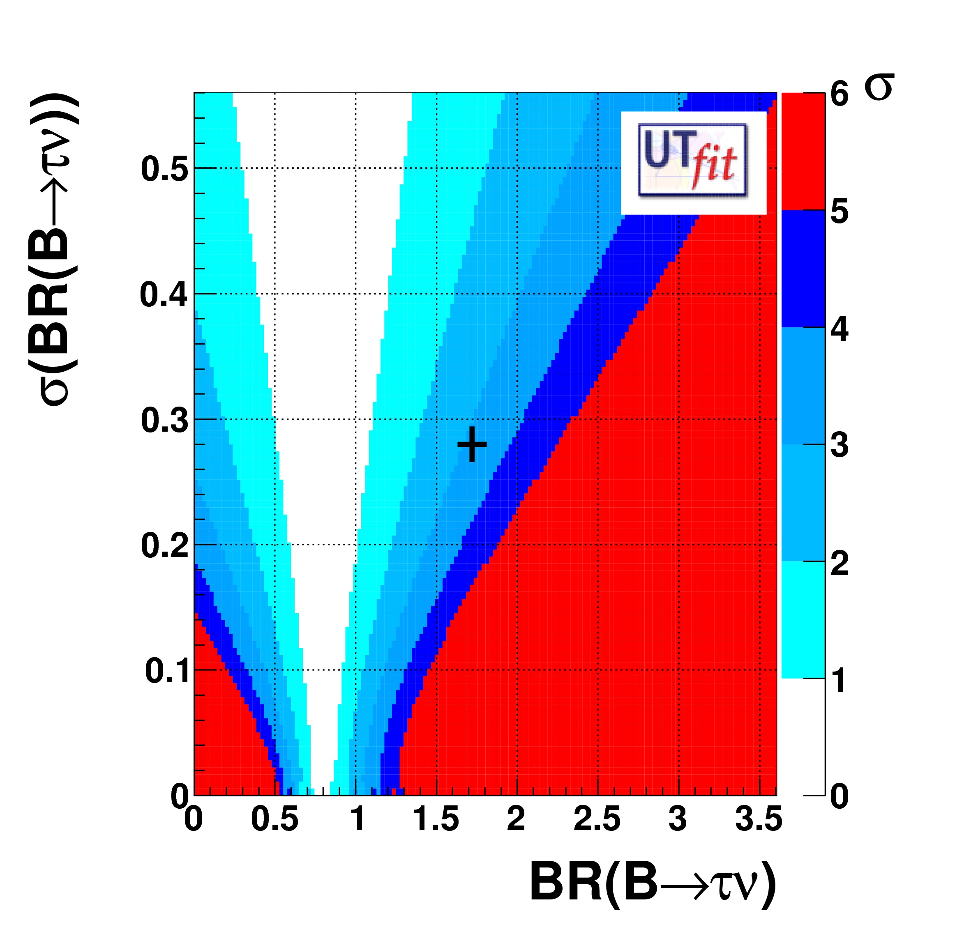
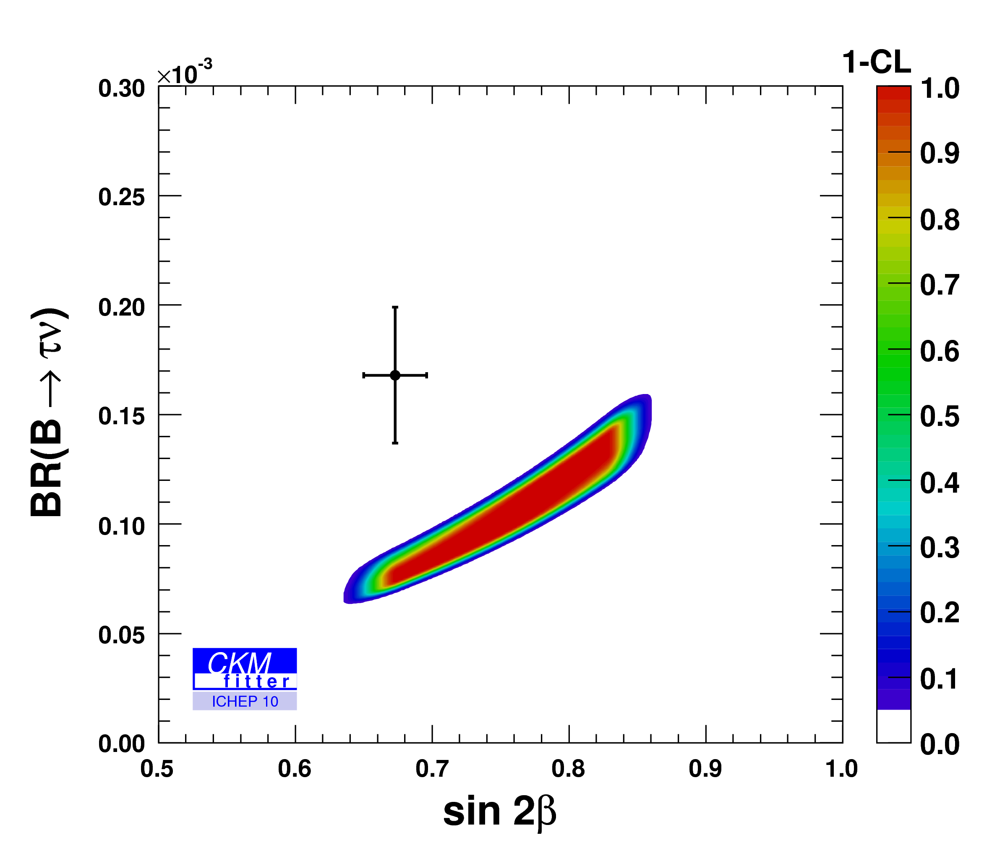
CKM fits compatibility
www.utfit.org
ckmfitter.in2p3.fr
HFAG

Slide 17
Ds ➝ μν at Belle
Phys. Rev. Lett. 100,241801 (2008)
Full event reconstruction
e+e- ➝ D K X D*s , D*s ➝ Ds γ
X is a system of n pions
Recoil mass M_{rec}(DKXγ) identifies the Ds
Require a μ and fit to the missing mass M_{rec}(DKXγμ)
B( Ds ➝ μν ) = (6.64 ± 0.76 ±057) × 10⁻³
f_{Ds} = (275 ± 16 ± 12) MeV

Slide 18
Ds ➝ μν at BaBar
arXiv:1008.4080 [hep-ex]
Same tagging as in Belle
B( Ds➝ μν ) = (6.02 ± 0.38 ±0.34)×10⁻³

Slide 19
Ds ➝ τν at BaBar
arXiv:1008.4080 [hep-ex]
Look for τ ➝ e ν ν or τ ➝ μ ν ν
Missing mass consistent with multiple neutrinos M²_{rec}(DKXμγ)>0.5 GeV²
Fit to extra unassigned energy in the calorimeter

Slide 20
Comparison with lattice QCD
From Xin talk at CKM 2010
Still a 2 σ difference
between Lattice QCD
and experiment.

Slide 21
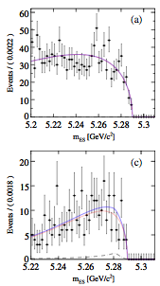
B ➝eν,μν untagged
Phys. Rev. D 79,091101 (2009) BABAR
Phys. Lett. B 647 (2007) 67 BELLE
Monocromatic (in B rest frame) electron or muon
Exploit kinematics and and topology of the r.o.e.
No significant signal seen
90% C.L. limits:
BF( B → eν ) < 1.9 × 10⁻⁶ BABAR
BF( B → eν ) < 0.98 × 10⁻⁶ BELLE
BF( B → μν ) < 1.0 × 10⁻⁶ BABAR
BF( B → μν ) < 1.7 × 10⁻⁶ BELLE

Slide 22
B ➝ lνγ, hadronic tags
Small excess for muon channel consistent with a 2.1 σ background fluctuation
Phys. Rev. D 80, 111105 (2009)
Missing mass
 | B➝eνγ | B➝μνγ
Expected bkg | 2.7 ± 0.3 ±0.4 | 3.4 ± 0.7 ±0.7
Observed events | 4 | 7
Signal efficiency | (7.8 ± 0.1 ±0.3) % | (8.1 ± 0.1 ±0.3)%
FC confidence belt | <17 × 10⁻⁶ | <26 × 10⁻⁶
 | <15 × 10⁻⁶

Slide 23
Conclusions
B g τν measurement well established
4 independent measurements consistent among each other
Ignoring (small) correlations, I compute the naïve average as BF( B g τν ) = ( 1.67 ± 0.31 ) × 10⁻⁴
More than 2 σ with rest of CKM
The experimental accuracy may even improve in near term
Full dataset (Belle) and improved techniques (Belle & Babar)
No signal seen in the leptonic B decay modes
B-factories produce a lot of charm, as well
Contribute to f_{Ds} average
2 σ with difference with lattice QCD calculations

