Slide 1
b and c production in CMS and ATLAS
Francesco Fiori
on behalf of CMS and ATLAS collaborations
VII Meeting on B-physics (LAL)

Slide 2
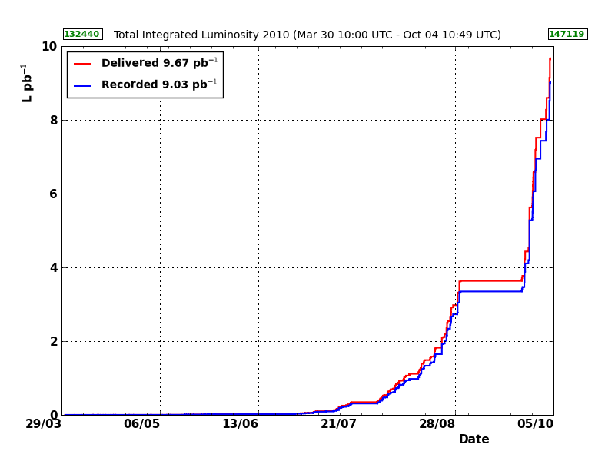
LHC luminosity evolution
LHC startup in March 2010
9.67 pb⁻¹ delivered lumi
5 pb⁻¹ certified lumi
6 pb-1 in the last 2 weeks
Inst. lumi 10²⁶ -> 5 10³¹cm⁻²s⁻¹
Now up to ~ 500 nb⁻¹/day
No explosions so far ☺

Slide 3
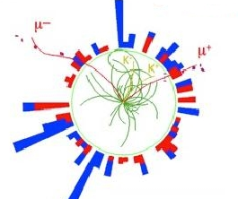
b and c physics @ LHC
The study of heavy quark production is of main interest in LHC:
  Quarkonia production (J/psi, Y)
  Test of QCD (NRQCD)
  CP violation (B-mesons)
  Higgs (if light enough)
Huge programme (already started):
  Quarkonia and b cross section (already in place)
  Charmed mesons properties ( 1-100 pb⁻¹)
  Quarkonia polarization
  B-mesons properties
  (limits to) BR of rare decays (FCNC) ( > 1 fb⁻¹)
Need of high performance tracking detectors (b-tagging) and efficient lepton triggers
B_{s}→J/ψ φ candidate in CMS

Slide 4


CMS and ATLAS
Performant inner tracking detectors (based on Si pixels and strips)
Fast and redundant muon identification system (Mu triggers)
Extended coverage with respect to Tevatron detectors (|η|≤ 2.5)
Very different configuration of B field, in the inner region superconducting solenoids are used by both (2 vs 4 T)
3 Levels for trigger decision (L1 Hardware, L2/L3 software)

Slide 5
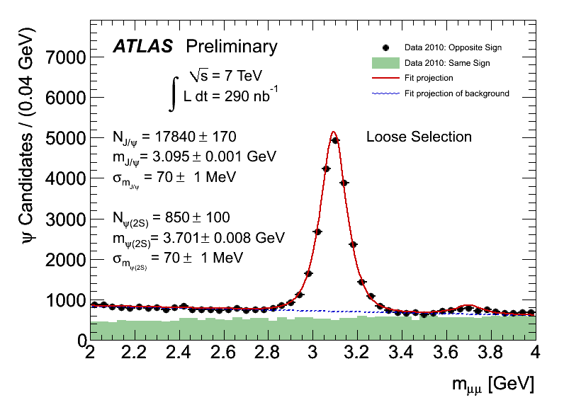
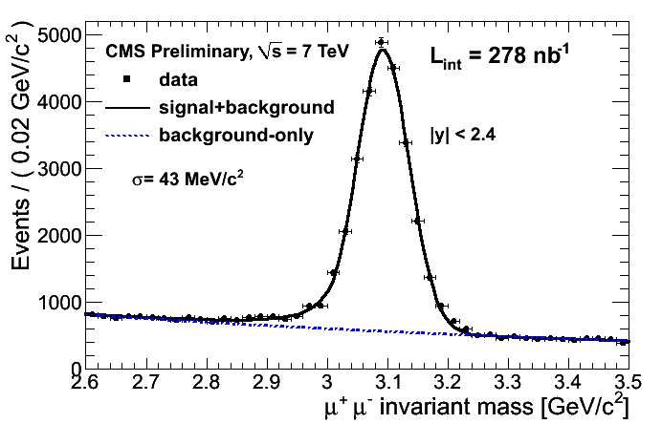
J/ψ
Fit : 24229 +/- 345
Mean : 3.095 GeV +/- 0.002
Very inclusive trigger paths:
  ATLAS: MinBias + L1 single Muon
  CMS: L1 Double Muon + single Mu (pT>3 GeV/c)
Pairs of opposite charge muons
Good primary vertex and secondary vertex by the two muons
Quality cuts (n° of hits, χ2 fit ... See backup)
Yields extracted by MLL fits to data:
CMS: CB + Exp
ATLAS: Gauss + Linear

Slide 6
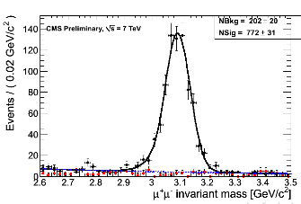
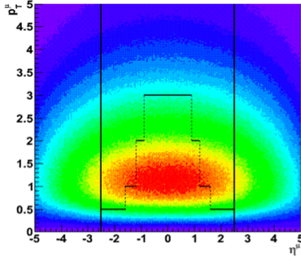
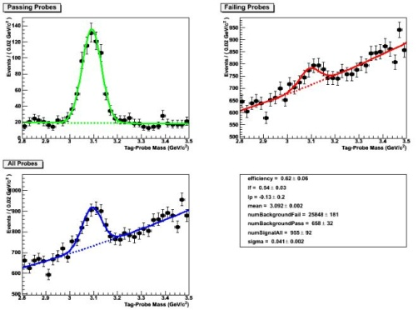
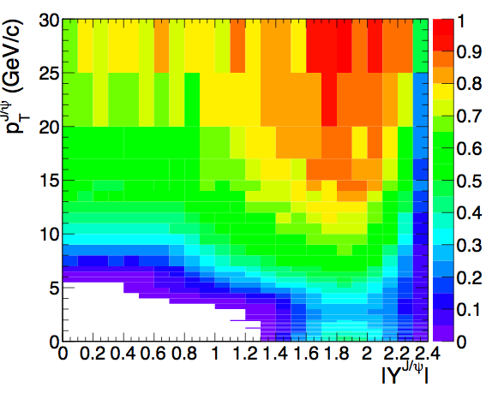
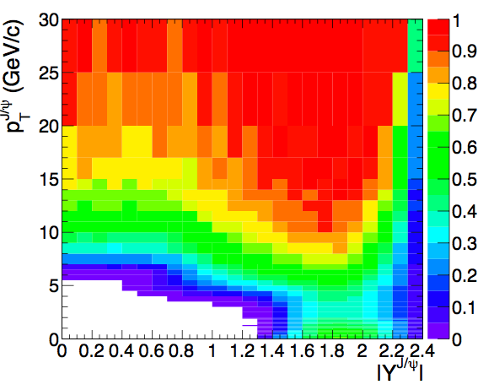
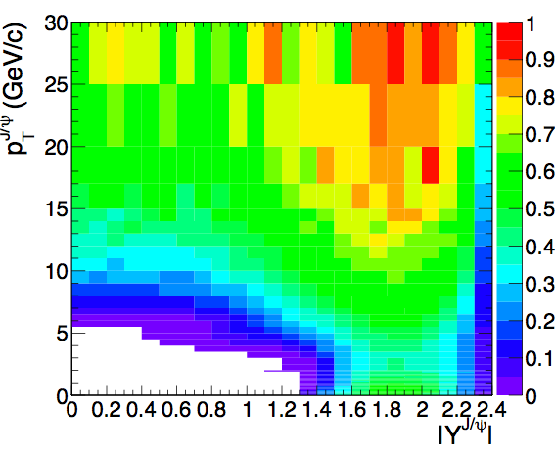
Cross Section
From fit to data (MLL)
from MC
From data , T&P (for CMS)
ATLAS weights event by event with 1/Aε (efficiency taken by simulation)
CMS correct the yields in each bin with 1/<A ε>
The acceptance is strongly dependent by the polarization, 5 scenarios considered: ATLAS include in systematic error , CMS quotes 5 Xsections
isotropic
Helicity fully long.
Collins-Soper fully long.

Slide 7
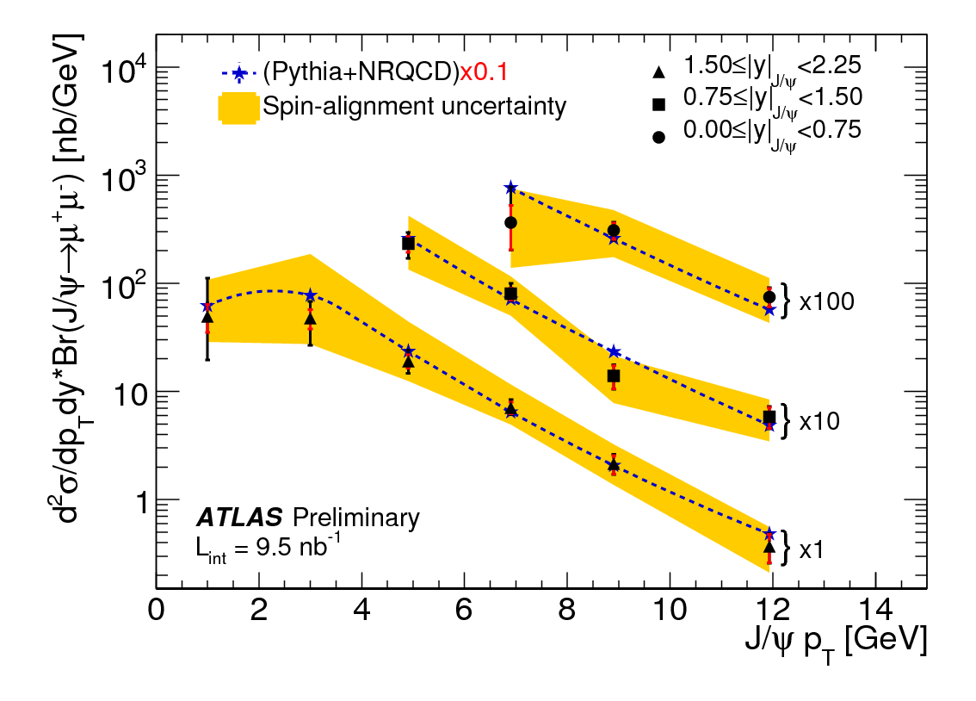
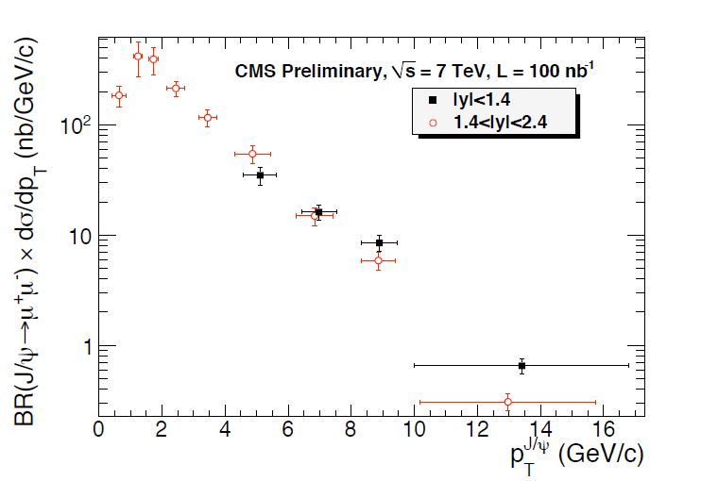
Differential Cross Section
Systematics:
Signal (background) PDF (1-8%)
Single Mu efficiencies (10-15%)
Momentum scale (>1%)
FSR (1-2%)
Polarization (not included in sys.)
Total production cross section in 4 < pT<30 and |y| <2.4:
289.1 ±16.7(stat) ±60.1(syst) nb
For details on J/psi see:
ATLAS
CMS

Slide 8
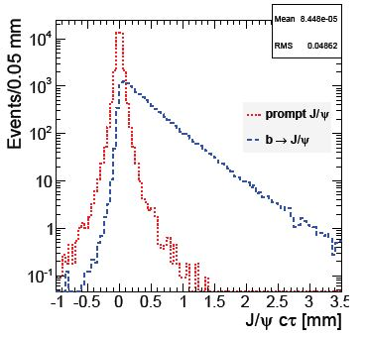
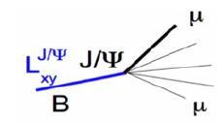
B-Fraction
pseudo-proper decay length
Prompt J/ψ: triple Gaussian resolution function
Simultaneus MLL fit to the mass and lifetime distributions
B-hadron component, two approaches:
MC template of true pseudo-decay length, convoluted with the same resolution function extracted from prompt decays (used as reference)
Assume a convolution of an exponential decay with two resolution functions:
  A Boost resolution function to account for differences between the B-hadron and the J/Psi boost
  Decay length resolution R (assumed to be the same of prompt J/Psi)
(The difference is taken as systematic)

Slide 9
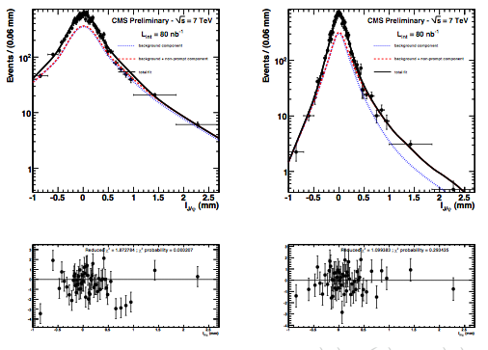
Lifetime Fits
Resolution:
Barrel
pT 4.0-6.0 (85 ± 15) um
pT 6.0-10.0 (46 ± 5) um
pT 10.0-30.0 (39 ± 7) um
Forward
pT0.0-2.0 (253 ± 9) um
pT2.0-4.0 (141 ± 6) um
pT4.0-6.0 (74 ± 4) um
pT6.0-10.0 (55 ± 4) um
pT10.0-30.0 (37 ± 6) um
0<pT<2
forward
2<pT<4
forward
Total cross secion x Br for B hadron decays in 4< pT< 30 and|y|<2.4:
56.1±5.5(stat)±7.2(syst) nb

Slide 10
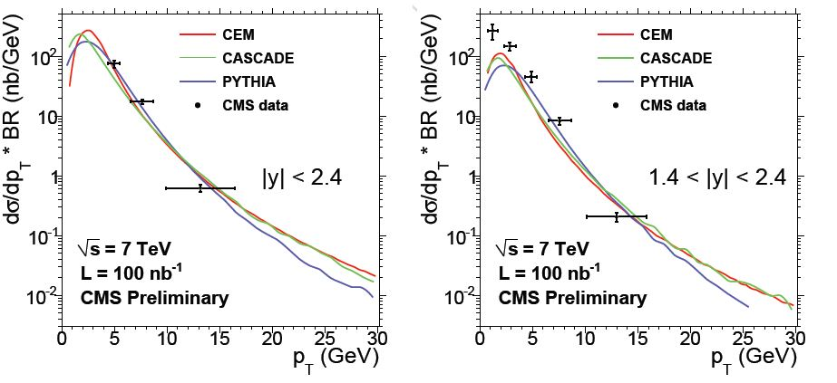
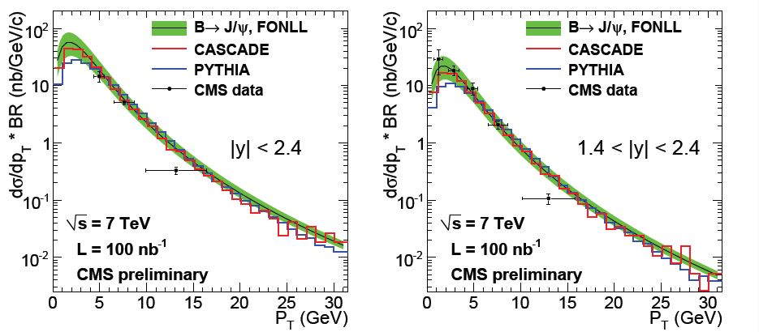
Comparison with predictions
prompt
Non prompt

Slide 11
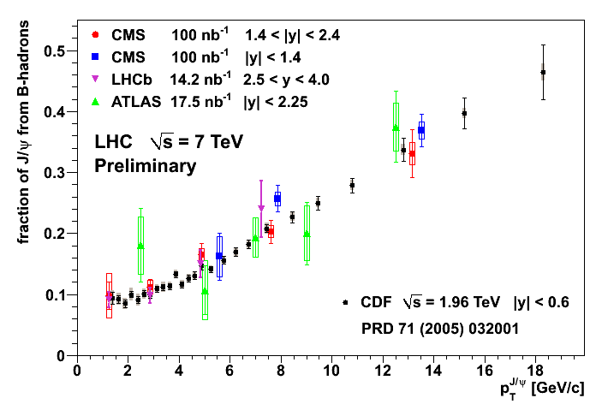
... and with other experiments
compilation by Hermine Woehri

Slide 12
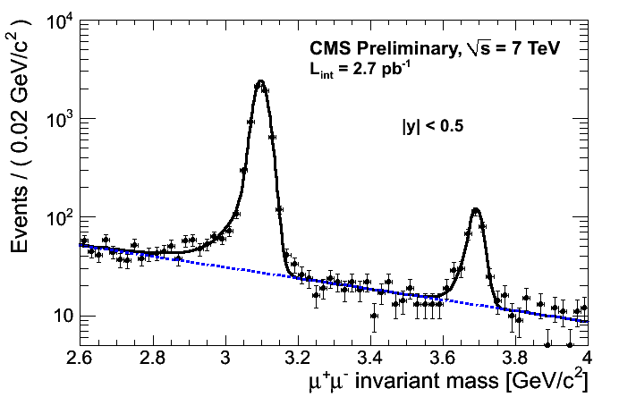
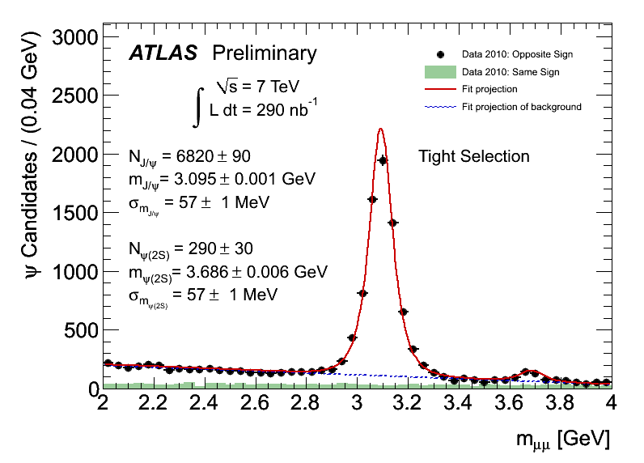
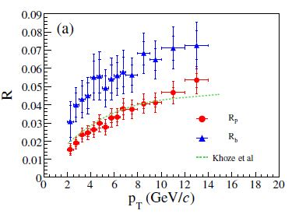
Ψ(2S)
N J/psi: 7010 +/- 108
Resolution J/psi: 20 MeV +/- 0.6
Mean J/psi: 3.097 GeV +/- 0.0003
N psi(2S): 311 +/- 23
Resolution psi(2S): 18 MeV +/- 2
Mean psi(2S): 3.691 GeV +/- 0.001
CDF
R= N(psi(2S))/N(J/psi):
R_{CMS} = 0.044 ± 0.004 (<p_{T}>=11.7 GeV/c)
R_{ATLAS} = 0.042 ± 0.005

Slide 13
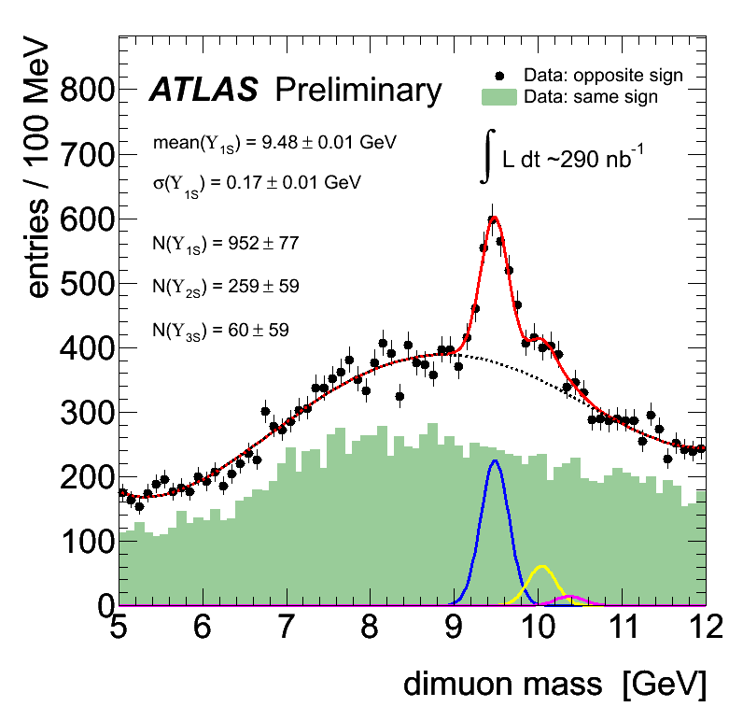
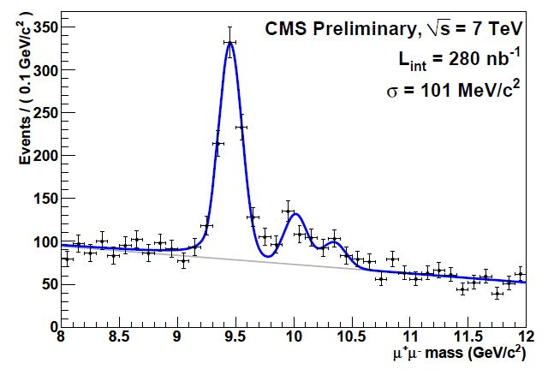
Y family
NY(1S) = 678 ± 38
NY(3S) = 81 ± 21
NY(2S) = 158 ± 24
Y family well visible in CMS and ATLAS data
CMS already published a pT differential cross section
The selection of events is the same of the J/psi

Slide 14
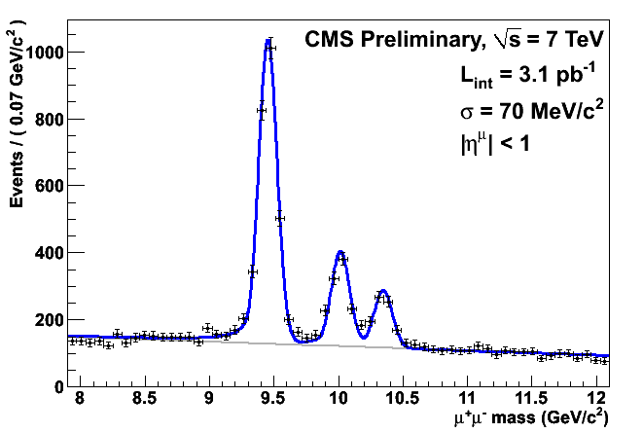
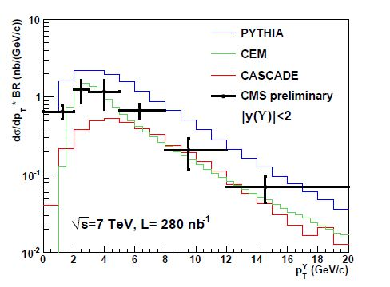
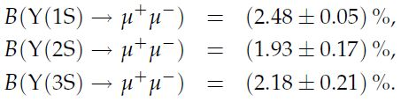

Y production in CMS
Trigger: Double Muon at L1
Fit: 3 Gaussians + Linear
Dominant source of systematics is the efficiency computation
(statistical origin)
Barrel only
Full Stat.
5 cross sections quoted for the different polarizations
Stat. Lumi. sys.
R= [σ(Y_{2S}) + σ(Y_{3S})]/σ(Y_{1S})
Deatails here

Slide 15
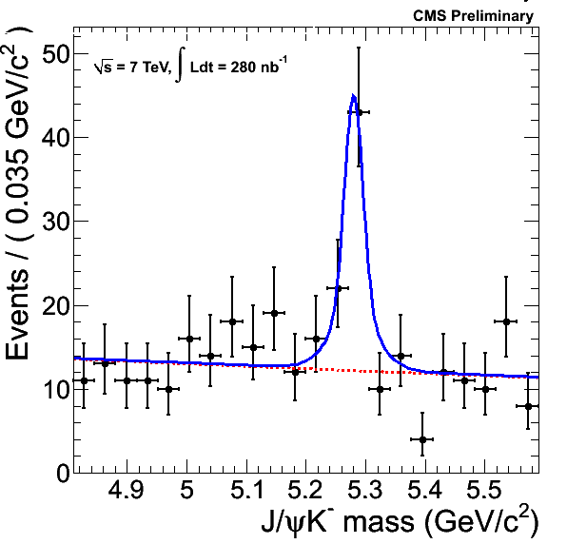
B±-mesons in CMS
Single Mu trigger (pT> 3GeV/c)
Opposite sign di-muon combinations, if more than one chose the one with mass closest to the J/psi mass
di-muon vertex Probability >0.1%
Combine J/psi candidate with tracks (pT>0.9 GeV/c)
Kinematic fit with J/psi mass constraint
Require vertex probability > 0.1%
If multiple candidates/event, choose highest pT B⁻ candidate
cτ(J/ψK)/Δcτ > 1
N_sig= 48 ± 8
Mean= 5.280 GeV/c²
Resolution= 32 MeV/c²
Details here

Slide 16
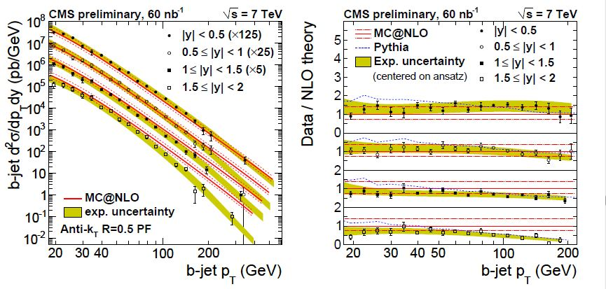
Inclusive b-jet production in CMS
CMS measured a double differential cross section for b-jet production and the ratio to inclusive jet production in the kinematic range |y|<2 and 18 < J_{pT} < 300 GeV/c
b-tag: The secondary vertex is fitted with at least three charged particle tracks.
A selection on the reconstructed 3D decay length significance is applied, corresponding to about 0.1% efficiency to tag light flavor jets and 60% efficiency to tag b jets at pT = 100 GeV.
Purity and mistag probability taken from MC (Pythia)
Trigger: MinBias + single-jet

Slide 17
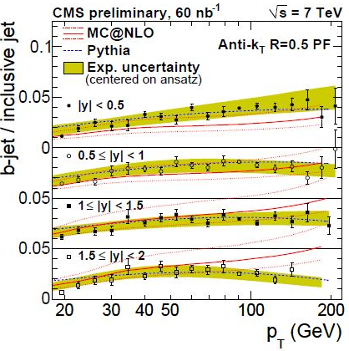
b-jets/inclusive-jets
The ratio reduces the uncertainties on JES and luminosity
Good agreement with Pythia
NLO calculations are in agreement at low pT, with very different shape at high pT
Leading systematics:
  b-tagging efficiency (20%)
  Mistag (1-10%)
Details here

Slide 18
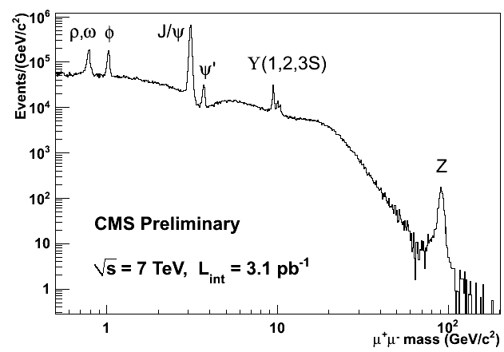
Conclusions
After 6 months from the LHC start up ATLAS and CMS have produced good quality physics results
New results with much more statistics coming soon (weeks)
J/psi X section measurement in place for both experiments
More refined B-physics studies require more data however the collaborations seem very reactive.
The re-discovery of the
Standard Model is just started

Slide 19
Back up

Slide 20
Selection I
Event selection:
  Good Vertex, Anti Scraping [+L1 tech bits (only for runs<136086)]
Mu selection:
  Use GlobalMuons and TrackerMuons
    see next slide for selection details
    No Mu cleaning (does not affect x-section once using trigger bits)
Triggers used:
  HLT_L1DoubleMuOpen (pT<4 GeV/c) + HLT_Mu3 (pT>4 GeV/c)
    strategy: keep the loosest unprescaled trigger path and that gives the smallest systematics
Analysis is performed on GG+GT+TT
  In case more than a combination use the GG; if both are GG, GT or TT take the one with larger pT
    Given the small number of events the three categories are lumped into a single category.

Slide 21
Selection II
Both muons in acceptance
Muon tracker tracks:
  χ2/ndof < 4.0
  |d0| < 3.0 cm (calculated w.r.t. PV)
  |dz| < 15.0 cm (calculated w.r.t. PV)
  number of valid hits (pixel + strips) > 11
  number of pixel layers with hits ≥ 2
Global muons:
  χ2/ndof (global fit) < 20.0
  number of valid muon hits > 0
  also tracker muons arbitrated and passing TMLastStationAngTight selector
Tracker muons:
  arbitrated and passing TMLastStationAngTight
a secondary vertex must be found with P(χ2) > 0.1%

Slide 22
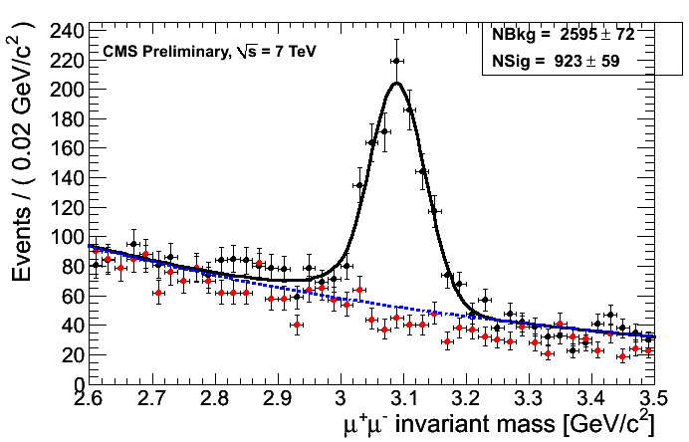
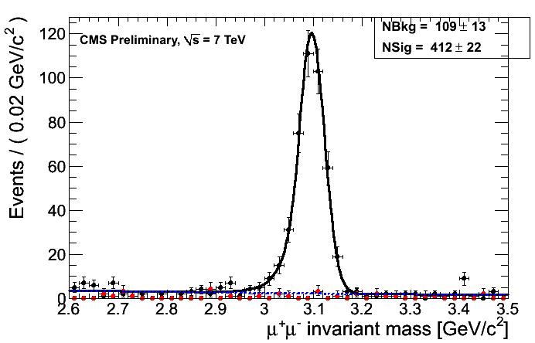
Mass Fit
CB signal + Exponential background
Example of two (very) different bins:
High background level, worse resolution
Practically no background
1.4 <|y|<2.4
0 < pT < 1
|y|<1.4
8 < pT < 10
L1DoubleMuOpen
HLT_Mu3
Fit : 923 +/- 59
Resolution : 45.2 +/- 2.4 MeV/c²
Mean : 3.090 +/- 0.002 GeV/c²
S/B= 1.4
Fit : 412 +/- 22
Resolution : 26.1 +/- 1.4 MeV/c²
Mean : 3.097 +/- 0.001 GeV/c²
S/B= 26.5
we have considered a CB+Gauss for the signal and a linear fit for the background to estimate for systematics

Slide 23
Efficiencies
Determined by T&P (single muon)
From single mu to J/ψ:
From data
For double Mu trigger
All the single muon efficiency computed on data
For single Mu trigger
Triggers used:
  L1DoubleMuOpen (Forward region for pT<4 GeV/c)
  HLT_Mu3 (For pT>4 GeV/c, gives a better S/B)

Slide 24
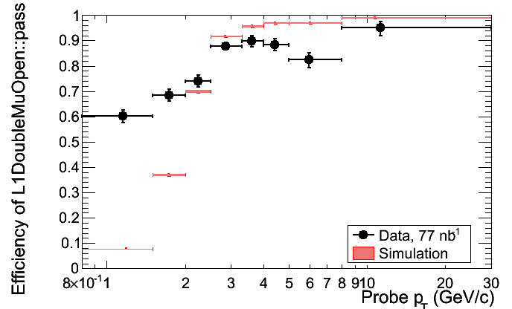
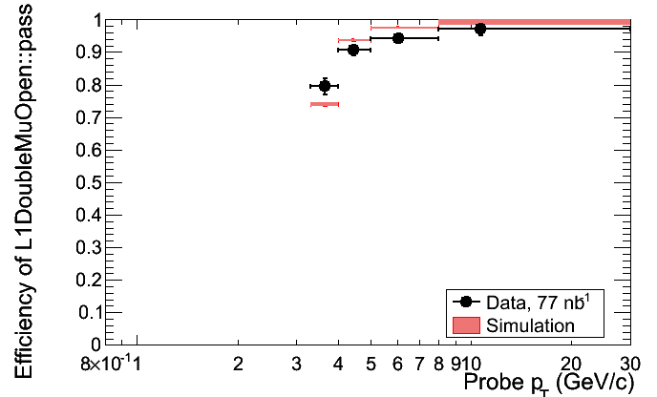
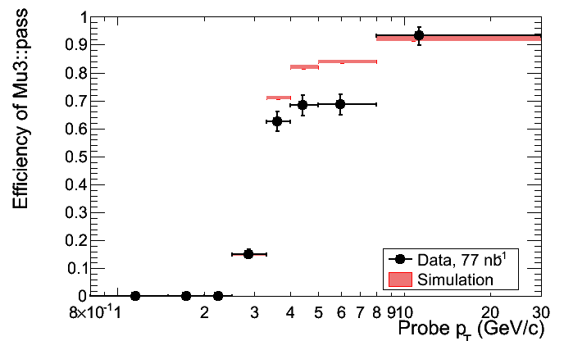
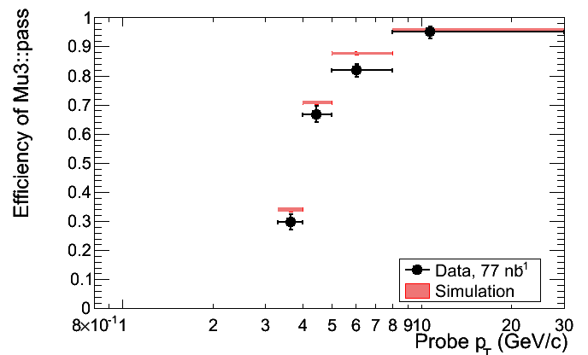
Trigger efficiency (T&P)
DoubleMuOpen
HLT_Mu3

Slide 25
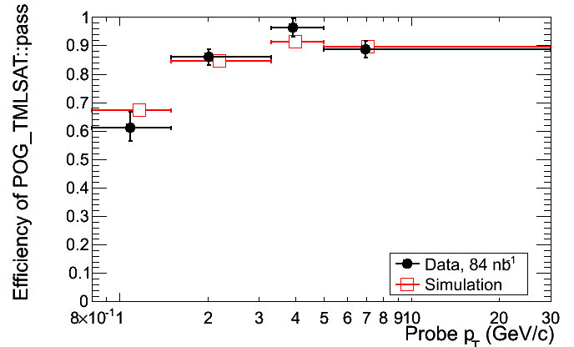
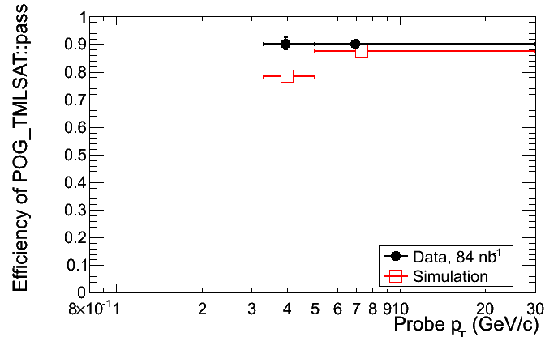
Id and Tracking
Muon Id
Tracking: use the T&P from PAS TRK-10-002.
  assumed that the pT behaviour is the same between the data and MC. Correct for phi-eta dependence.

Slide 26
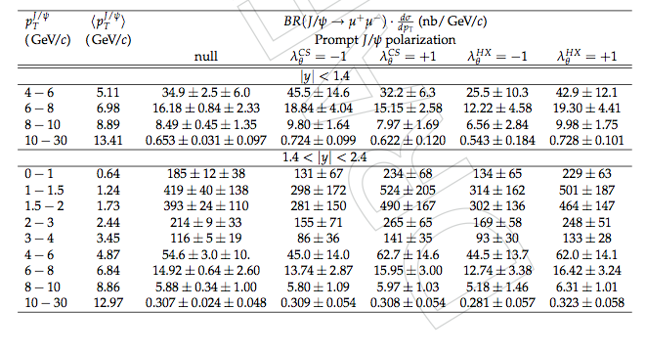
Inclusive Xsection
As the data sample grows, it will become possible to measure the polarization and re-evaluate the corresponding cross section.

Slide 27
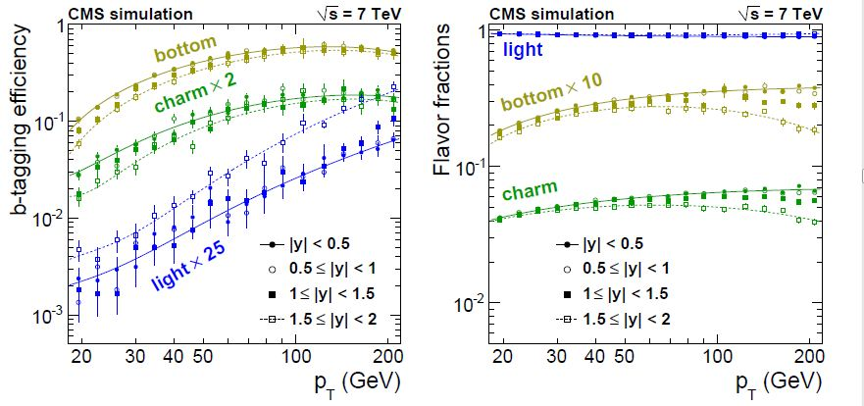
B-tagging efficiency

Slide 28
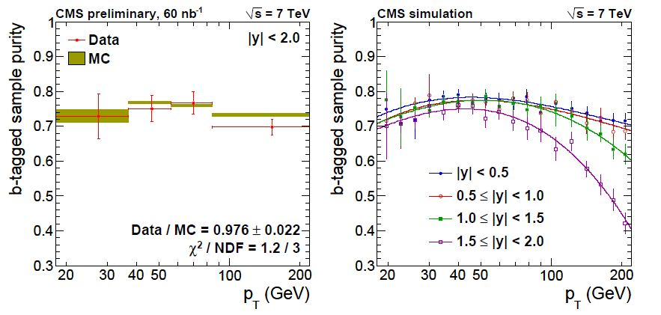
Purity

