Slide 1
Daniel Fournier & NA31
Ken Peach
University of Oxford
delivered at the
Cérémonie de Remise du Prix J. Ricard à Daniel Fournier
February 17th 2012
Credit: Hans Taureg/CERN

Slide 2
In the beginning …
Ideas for NA31 formed in 1980/1981
measure ε’/ε to a precision of a few per mille
Theoretical expectations were ε’/ε could be ~2%
The proposal was approved by CERN in 1982
Theoretical expectations were ε’/ε could be ~0.2%!
The full Collaboration was
CERN-Dortmund-Edinburgh-Orsay-Pisa-Siegen
.

Slide 3
ε’/ε and the Double Ratio Technique
ε’/ε excites the theorists
Relates to fundamental (quark-level) processes
experiment measures something different
|η₊₋|² =
CP violating
Γ(K_{L}→π⁺π⁻)
Γ(K_{S}→π⁺π⁻)
CP conserving
η₊₋ = ε + ε′
η₀₀ = ε - 2 ε′
R_{η} = ⏐η₀₀/η₊₋⏐² = 1 − 6ℜ(ε′/ε)

Slide 4
Experimental considerations
R_{η}=
R_{η}=
Γ(K_{L}→π⁰π⁰)
Ν(K_{L}→π⁰π⁰)
Γ(K_{S}→π⁺π⁻)
Ν(K_{S}→π⁺π⁻)
Γ(K_{S}→π⁰π⁰)
Ν(K_{S}→π⁰π⁰)
Γ(K_{L}→π⁺π⁻)
Ν(K_{L}→π⁺π⁻)
Γ^{xy} ≈ N^{xy} / [F^{xy} × A^{xy} × (1 + C^{xy})]
Events
Flux
Acceptance
Corrections
In order for R to be simply related to the quad ratio of the event numbers
F, A and C must cancel either between K_{L} and K_{S} or between 2π⁰ and π⁺π⁻

Slide 5
Principles of the Experiment
Concurrent detection of 2π⁰ and π⁺π⁻
Flux cancels
‘Symmetrical’ cuts against additional activity
Accidental effects cancel
Reduction of backgrounds
and estimate remaining backgrounds from data
Reduction of reliance on Monte Carlo simulation
Acceptance
The Acceptance is a strong function of Energy & Vertex
Analyse the data in energy ranges so that residual spectral differences between K_{L} and K_{S} are small
Make the K_{L} and K_{S} vertex distributions similar, and analyse in vertex ranges so that residual differences are small

Slide 6
‘How K_{s} can decay with K_{L} lifetime’
Decays
K_{L}
Fiducial region
z
Decays
K_{S}
z

Slide 7
The beam, detector & LAr cal.

Slide 8
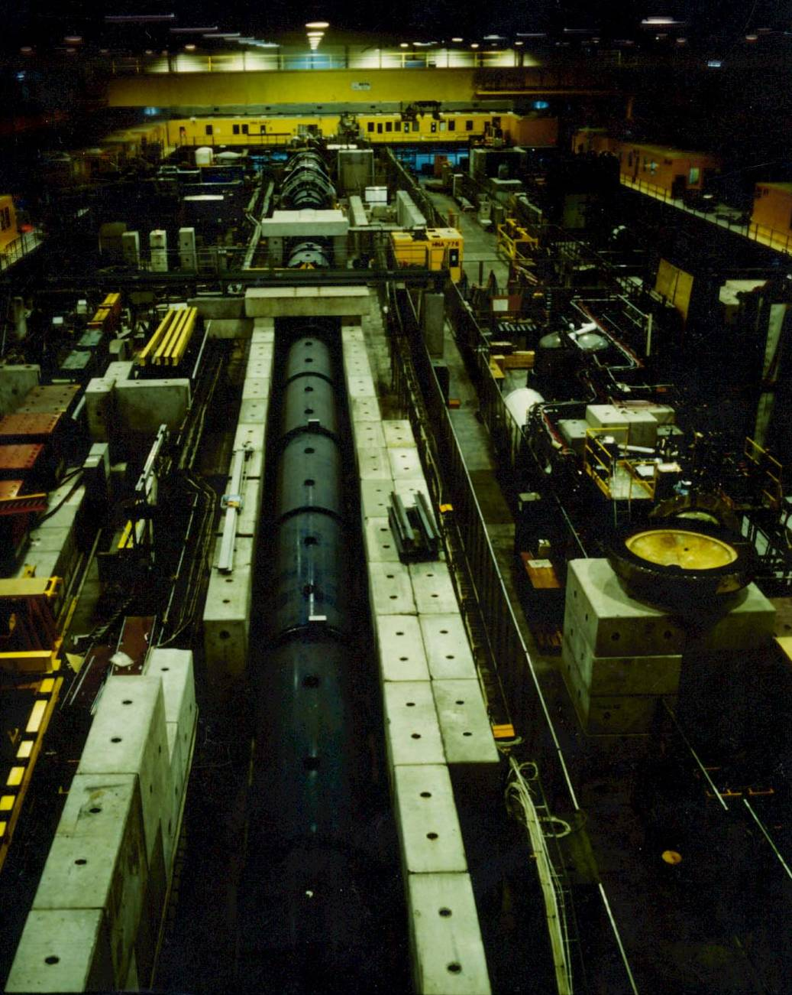
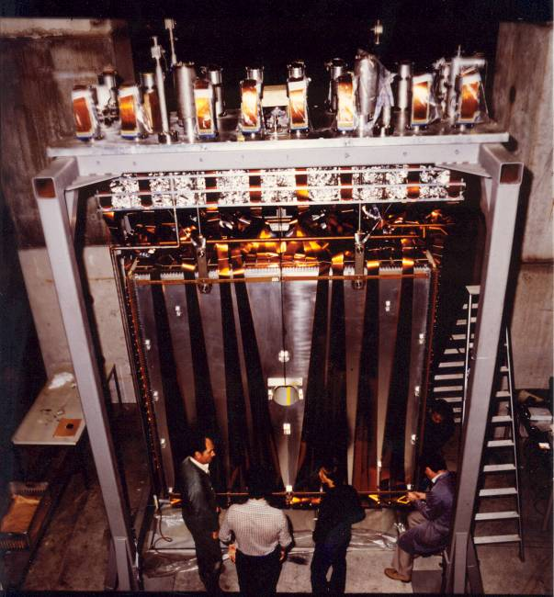
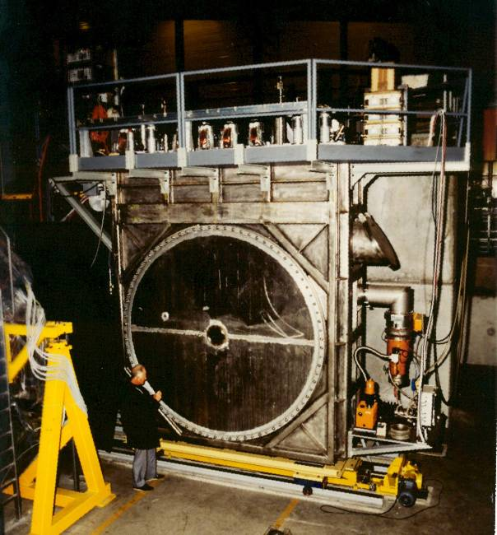
The detector
Credit:
CERN

Slide 9
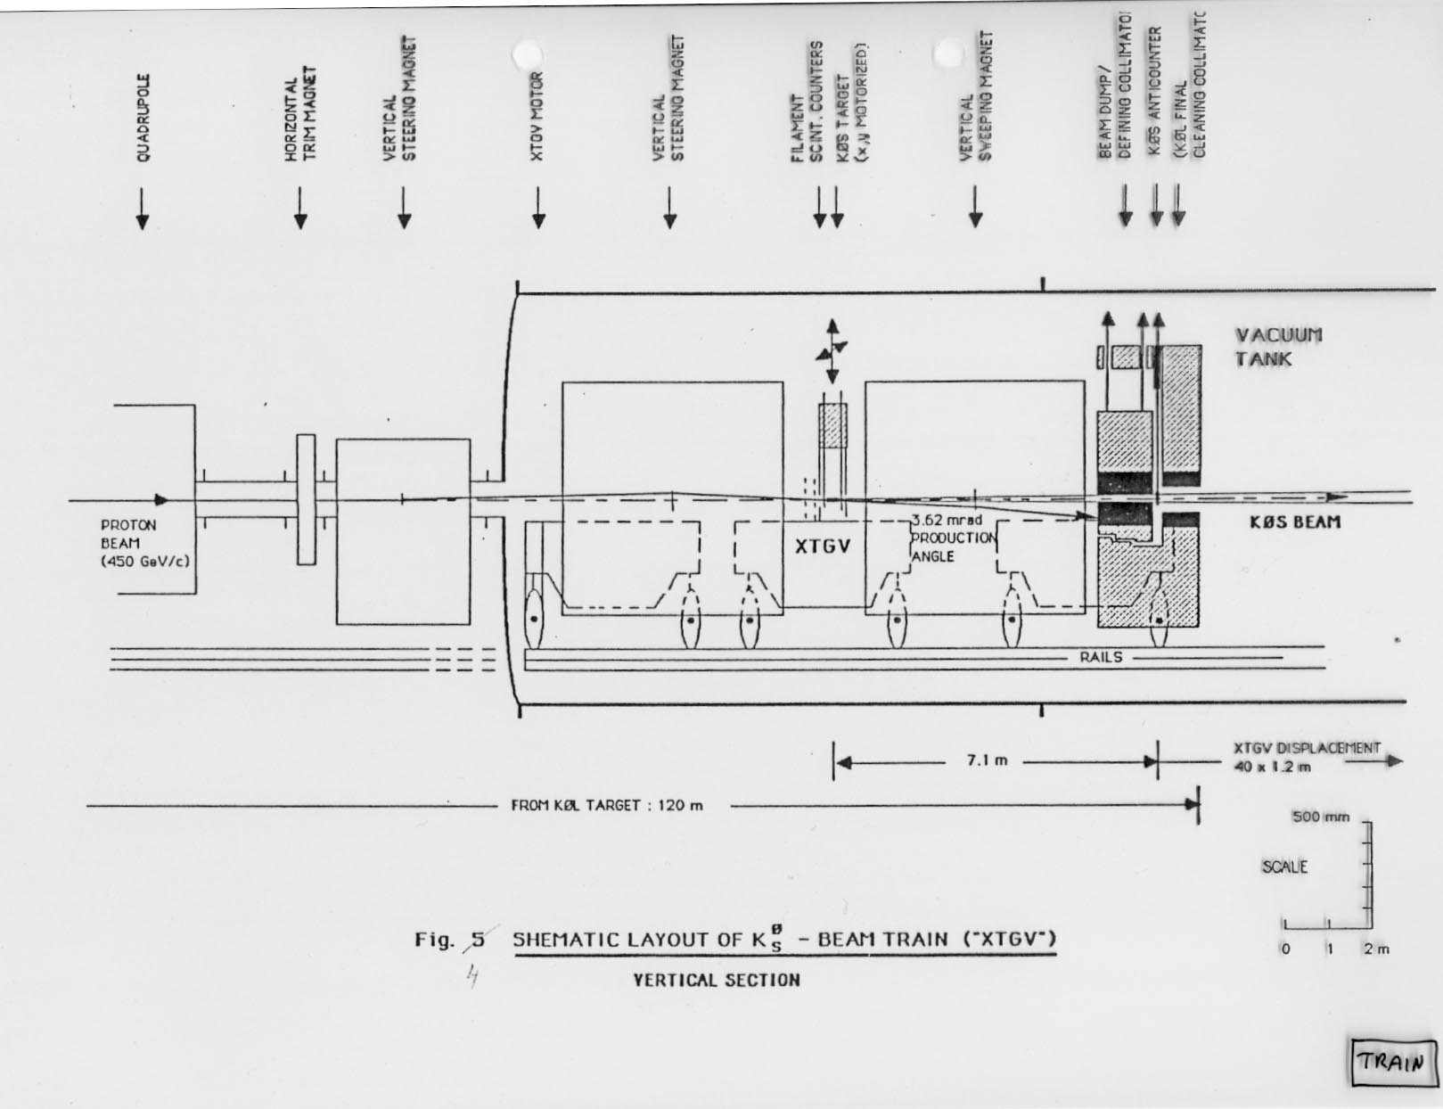
…& the target train

Slide 10
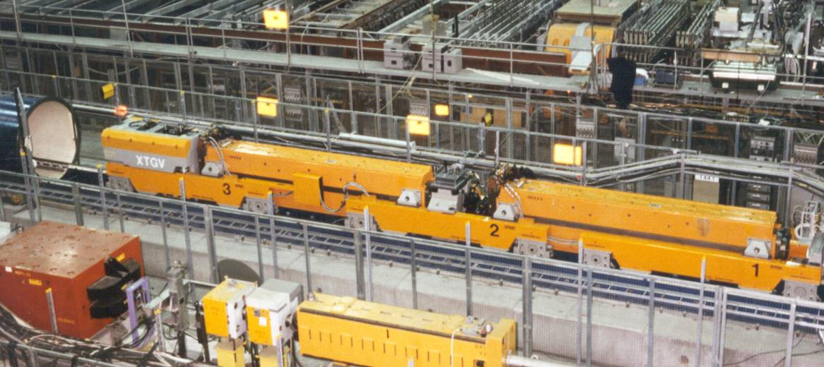
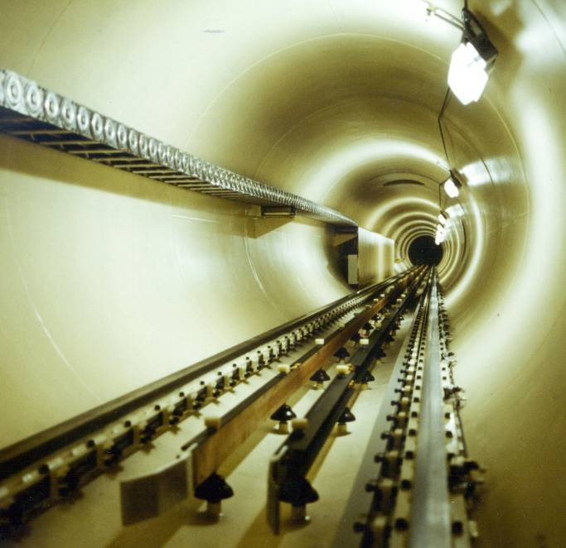
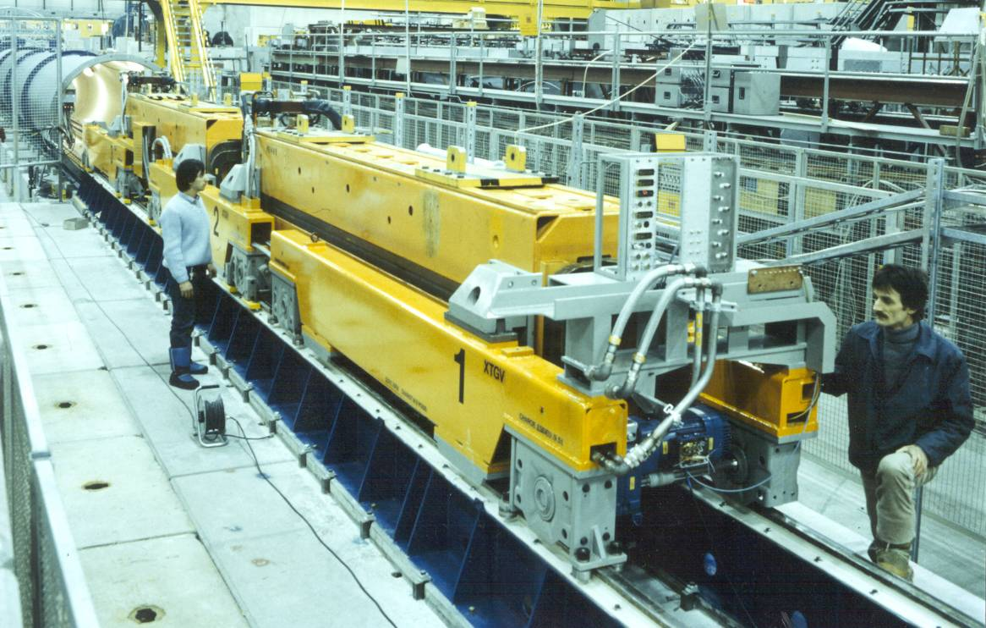
The target train …
XTGV!!!
Credit: CERN

Slide 11
The Orsay contribution
The Liquid Argon Calorimeter readout
Orsay
NA31 chose Fastbus
Adopted by LEP
We would
“get a lot of help that we otherwise would not get”
Bob Chase remarked
“we will need a lot of help that we otherwise would not need”

Slide 12
LAr signals and resolution

Slide 13
In the Control Room (1985)
Credit: Hans Taureg/CERN

Slide 14
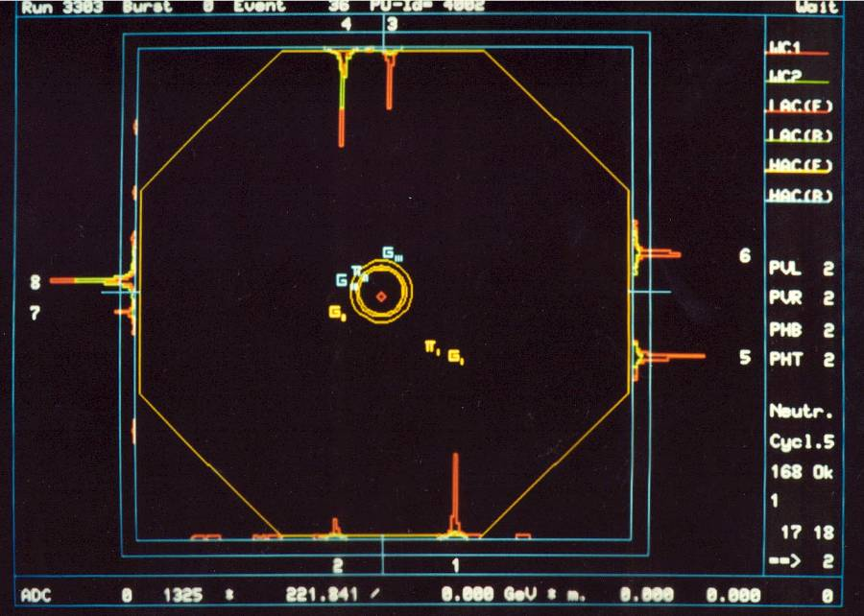
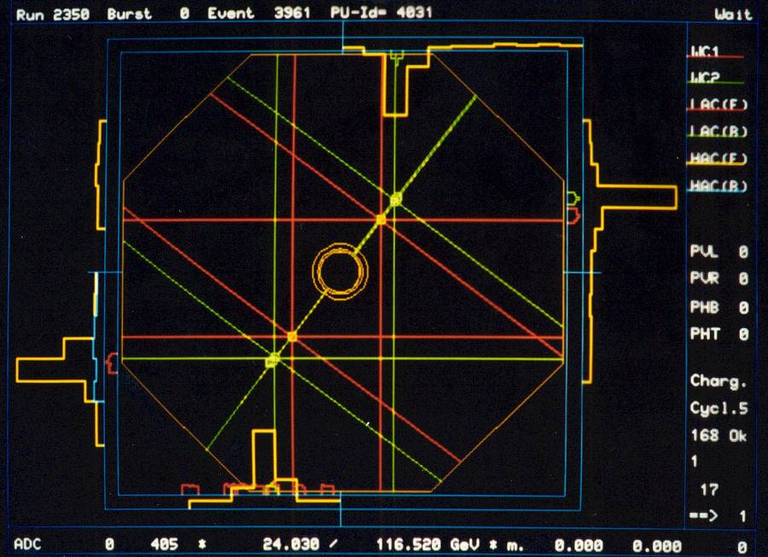
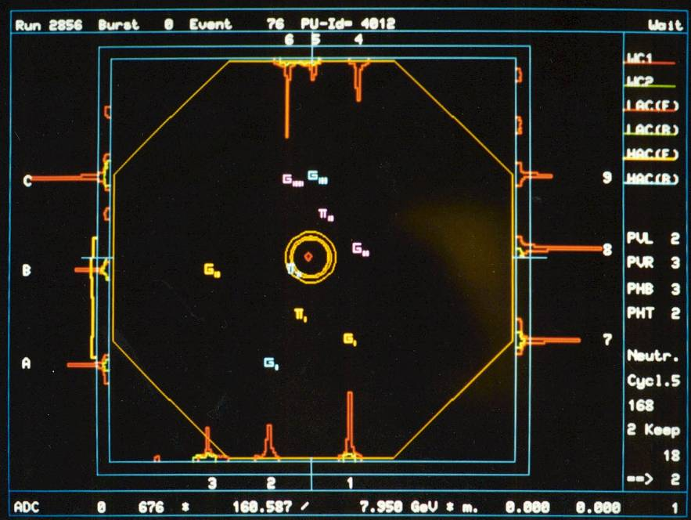
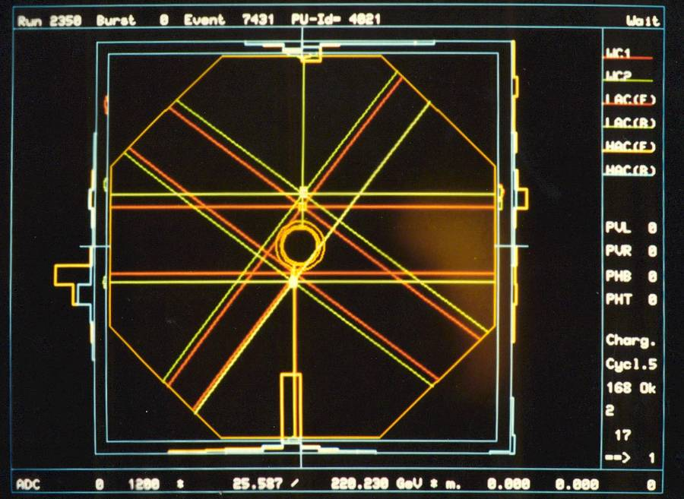
Some events (Orsay Event Display)
π⁺π⁻
2π⁰
π⁺π⁻
3π⁰

Slide 15
Data Taking
1982 Test beam work
1983 Test beam work
1984 First data with full beam (no LAr)
1985 Full beam & detector, limited readout
1986 First run of the complete experiment
1987 Special phase difference run
Preliminary result announced in July
ε’/ε = 0.0033 ± 0.0011
1988 More ε’/ε running
1989 Final ε’/ε run

Slide 16
End of Run 1986
Credit: Hans Taureg/CERN

Slide 17
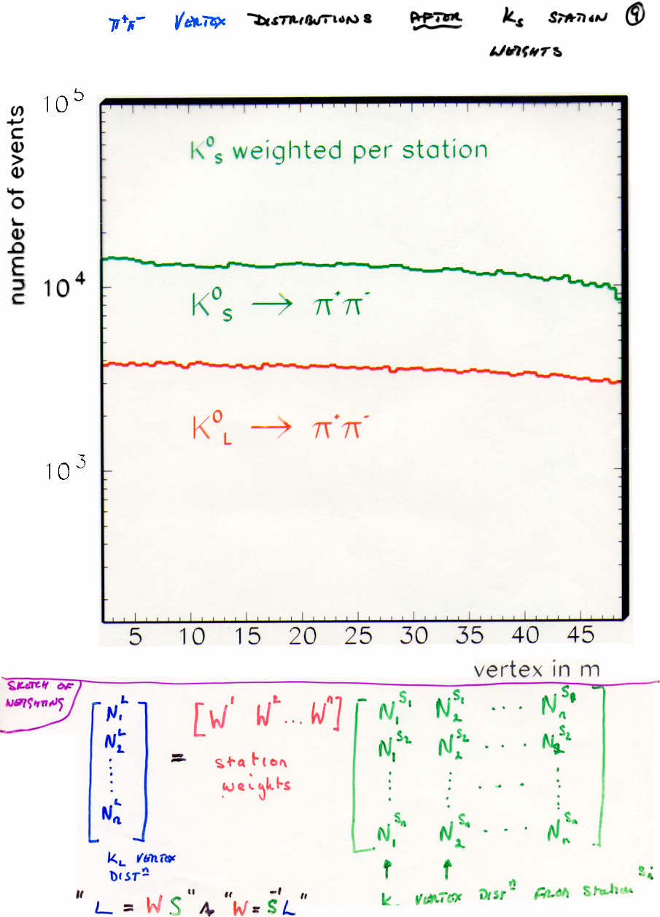
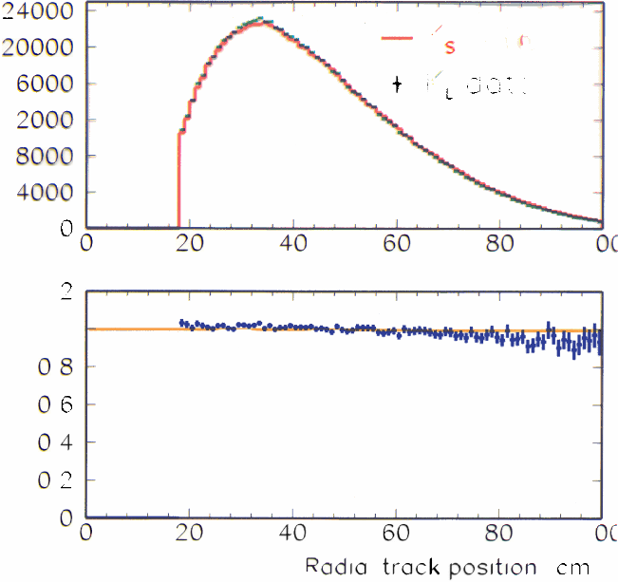
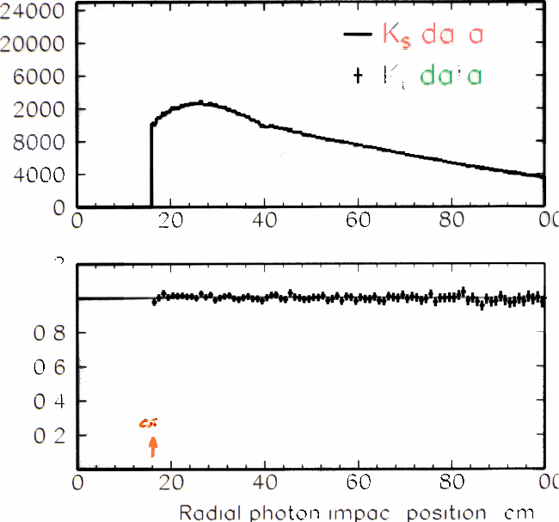
Making the cancellation happen

Slide 18
For both modes

Slide 19
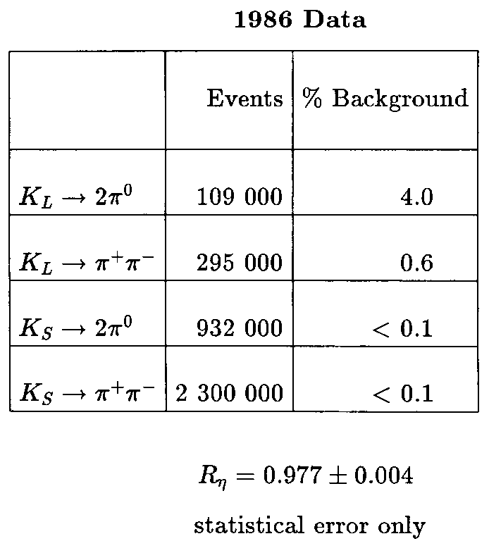
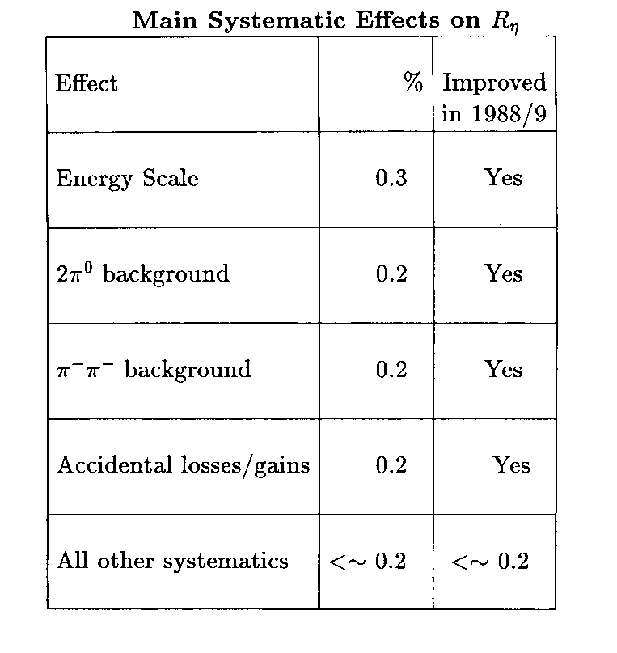
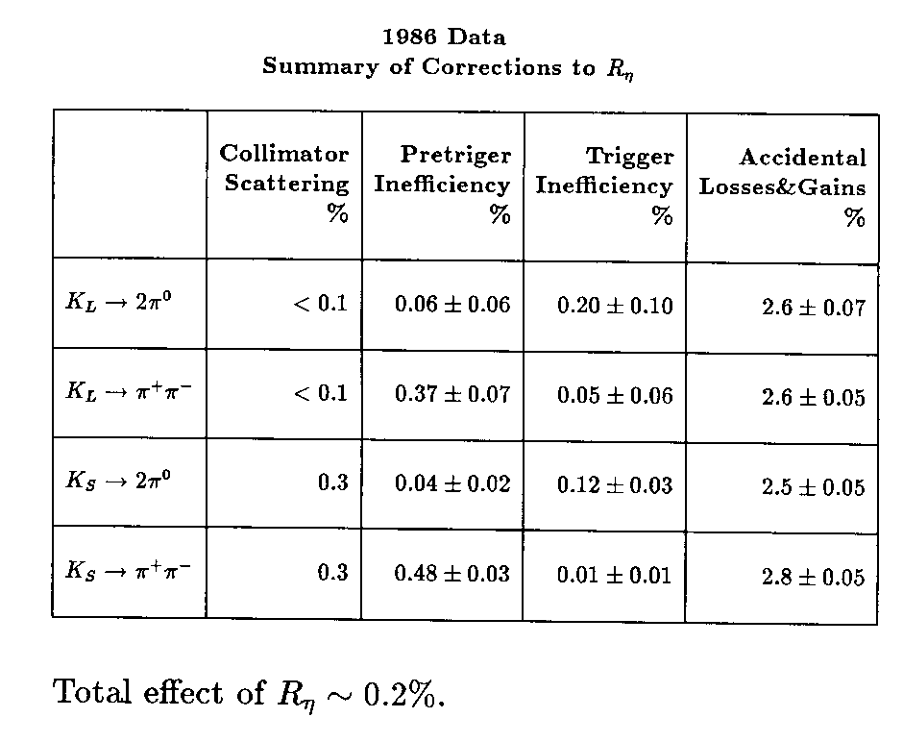
From a contemporary seminar
Simple Ratio
0.912
Becomes
0.977
after binning in
energy & vertex

Slide 20
Other physics
1987
First observation of K_{S}→γγ
New measurement of K_{L}→γγ
1988
Search for K_{L}→π⁰e⁺e⁻
Measurement of K_{L}→π⁰e⁺e⁻
1989
Search for K_{L}→π⁰h⁰ ; h⁰→e⁺e⁻
1990
Measurement of the phases φ₊₋ and φ₀₀, and the phase difference
Measurement of K_{L}→e⁺e⁻ γ
Observation of K_{L}→π⁰γγ
1991
Observation of K_{L}→e⁺e⁻e⁺e⁻
1992
Measurement of K_{L}→π⁰γγ
1993
New (final) measurement of ε’/ε
Search for K_{S}→π⁰e⁺e⁻
1994
Search for K_{L}→π⁰π⁰γ
1995
Branching Ratios Γ(K_{L}→2π⁰)/ Γ(K_{L}→π⁺π⁻π⁰) and Γ(K_{L}→3π⁰)/ Γ(K_{L}→πeν),
Measurement of K_{L}→e⁺e⁻e⁺e⁻ & parity of the K_{L}
Search for K_{L}→γγγ
1997
Measurement of the K lifetime
Measurement of K_{L}→e⁺e⁻γγ
ε’/ε = 0.00230 ± 0.00065
ε’/ε = 0.0033 ± 0.0011 [1987]

Slide 21
Other Orsay innovations
The “Massbox”
Calculated in real time the kaon mass from the LAr digitised signals
The TRD readout
Improved the electron rejection
The ZTDC (Zero-crossing TDC)
Reduced the accidental γ background

Slide 22
An Improved NA31 (1988-9)
2π⁰ measurement
High precision
Well known background (K_{L})
π⁺π⁻ detection & measurement
Quite large errors
Either
Significant background (K_{e3})
or
Large cuts (π⁺π⁻)
in K_{L}

Slide 23
Backgrounds in K_{L}→πeν

Slide 24
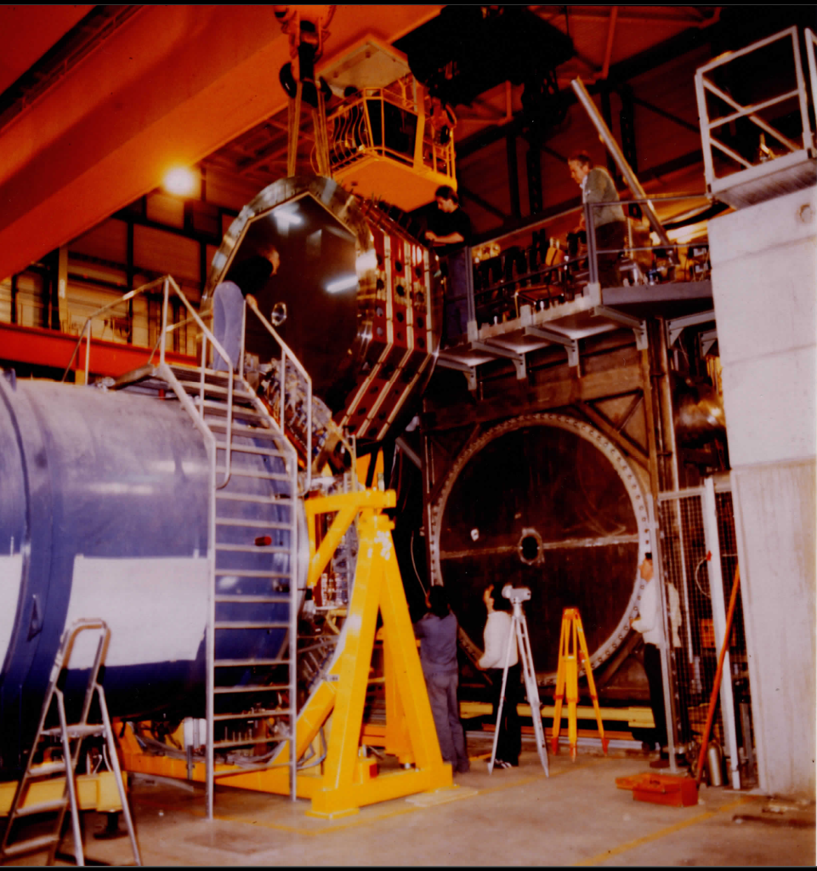
The Transition Radiation Detector (1988)
Credit: CERN

Slide 25
The performance of the TRD
90% electron rejection
2% pion loss
Thesis: L Iconomidou-Fayard

Slide 26
The Zero-crossing TDC (ZTDC)
Simple Principle
Designed & built at Orsay
Pulse shape
Preserves 0 crossing
Use this
Precise timing
Accidental (γ) hits
Out of time
(mostly low Energy)
Conceived
In the control room
DF & KP
Early morning shift!
Built in < 1 year
Reduced accidentals
Thesis: O Perdereau

Slide 27
1st & Last NA31 publications on ε/ε′

Slide 28
Where are we now?
PDG 2011

Slide 29
Summary
NA31 was a pioneering experiment
First evidence for “direct” CP violation
Final significance 3.5σ
Many other results
First observations of decay modes
Improved measurements and limits
Novel beam, detector, DAQ and triggering
Daniel Fournier was a true pioneer

Slide 30
Congratulations
Credit: Hans Taureg/CERN

