Slide 1
Parton Distributions and Higgs Production at the LHC and the Tevatron
James Stirling
Cambridge University
introduction: overview and
recent developments
LHC Higgs cross sections
and correlations
summary
Higgs Hunting 2012, Paris, 18-20 July 2012

Slide 2
parton distribution functions
introduced by Feynman (1969) in the parton model, to explain Bjorken scaling in deep inelastic scattering data; interpretation as probability distributions
according to the QCD factorisation theorem for inclusive hard scattering processes, universal distributions containing long-distance structure of hadrons; related to parton model distributions at leading order, but with logarithmic scaling violations (DGLAP)
obtained by fitting a wide variety of high-precision deep inelastic and other hadron collider data (‘global PDF fits’)
key ingredients for LHC phenomenology

Slide 3
δσ_{th} = δσ_{UHO} ⊕ δσ_{PDF} ⊕ δσ_{param} ⊕ …

Slide 4
PDFs from global fits
many groups now extracting PDFs from ‘global’ data analyses (MSTW, CTEQ, NNPDF, HERAPDF, AKBM, GJR, …)
broad agreement, but differences due to
choice of data sets (including cuts, corrections and weighting) and treatment of data errors
definition of ‘PDF uncertainties’
treatment of heavy quarks (s,c,b), FFNS, ZM-VFNS, GM-VFNS,
treatment of α_{S} (fitted or fixed)
parametric form at Q₀
(hidden) theoretical assumptions (if any) about flavour symmetries, x→0,1 behaviour, etc.
HERA-DIS
FT-DIS
Drell-Yan
Tevatron jets
Tevatron W,Z
other
LHC
... and all now with NLO and NNLO* sets
new
*not ‘true’ NNLO fits when collider inclusive jet data are included, since NNLO pQCD corrections not yet known

Slide 5
recent global or quasi-global PDF fits
PDFs | authors | arXiv
AB(K)M | S. Alekhin, J. Blümlein, S. Klein, S. Moch, and others | 1202.2281,1105.5349, 1007.3657, 0908.3128, …
CT(EQ) | H.-L. Lai, M. Guzzi, J. Huston, Z. Li, P. Nadolsky, J. Pumplin, C.-P. Yuan, and others | 1007.2241, 1004.4624, 0910.4183, 0904.2424, 0802.0007, …
(G)JR | M. Glück, P. Jimenez-Delgado, E. Reya, and others | 1011.6259,1006.5890, 0909.1711, 0810.4274, …
HERAPDF | H1 and ZEUS collaborations | 1012.1438,1006.4471, 0906.1108, …
MSTW | A.D. Martin, W.J. Stirling, R.S. Thorne, G. Watt | 1007.2624, 1006.2753, 0905.3531, 0901.0002, …
NNPDF | R. Ball, L. Del Debbio, S. Forte, A. Guffanti, J. Latorre, J. Rojo, M. Ubiali, and others | 1207.1303, 1110.2483, 1108.1758, 1107.2652, 1102.3182, 1101.1300, 1012.0836, 1005.0397, …

Slide 6
benchmark cross sections at 7 TeV from 6 fitting groups
Chapter 8: Parton Distribution Functions (S. Forte et al.)

Slide 7
See also ....
and many plots at ...
http://projects.hepforge.org/mstwpdf/pdf4lhc/

Slide 8
parton luminosity functions
a quick and easy way to assess the mass and collider energy dependence of production cross sections, and to compare different PDF sets
a
√s X
b
i.e. all the mass and energy dependence is contained in the X-independent parton luminosity function in [ ]
useful combinations are
and also useful for assessing the uncertainty on cross sections due to uncertainties in the PDFs

Slide 9
... more plots like this at www.hep.phy.cam.ac.uk/~wjs/plots/plots.html

Slide 10
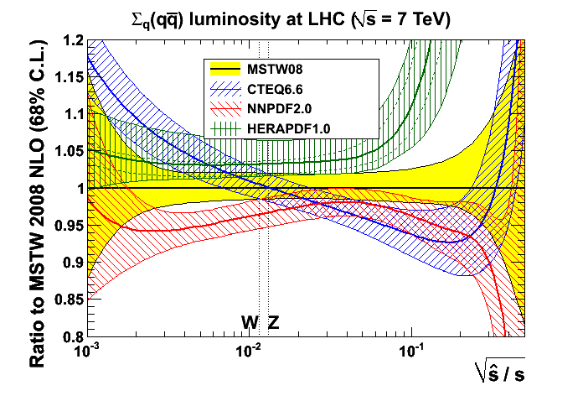
convergence of pdfs!
plots from Graeme Watt
2010
2011
... although still some differences with ABKM, GJR, HERAPDF

Slide 11
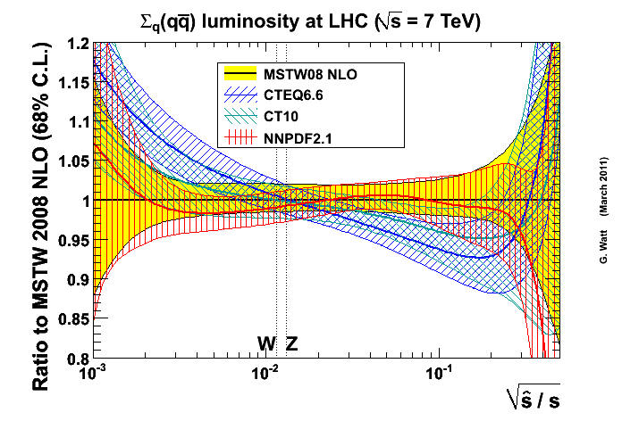
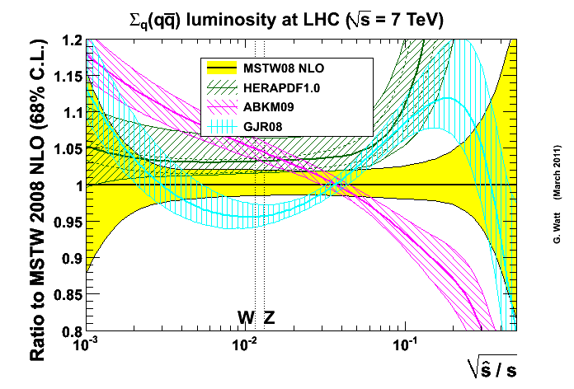
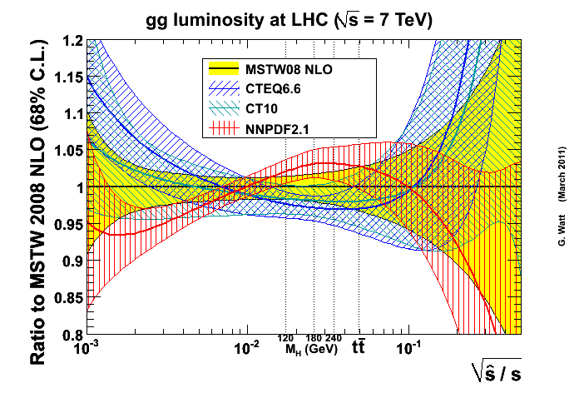
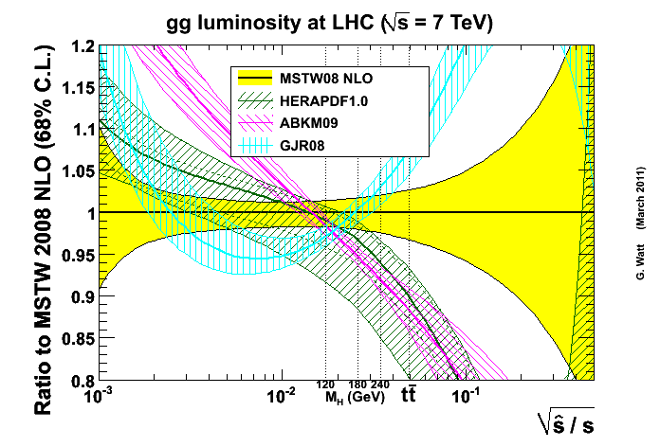
comparison of NLO parton luminosity functions at 7 TeV LHC

Slide 12
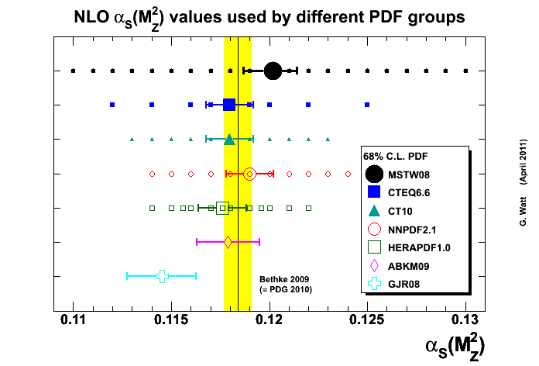
PDFs and α_{S}(M_{Z}²)
MSTW08, ABKM09 and GJR08: α_{S}(M_{Z}²) values and uncertainty determined by global fit
NNLO value about 0.003 − 0.004 lower than NLO value, e.g. for MSTW08
CTEQ/CT10, NNPDF, HERAPDF choose standard values and uncertainties
world average (Bethke 2012)
note that the PDFs and α_{S} are correlated!
e.g. gluon – α_{S} anticorrelation at small x and quark – α_{S} anticorrelation at large x

Slide 13
NNPDF update* 2012
NNPDF 2.1→ 2.2 → 2.3 global fit now including LHC 7 TeV (W, Z, jet) data and improved minimization methodology → small reductions in PDF uncertainties, σ(H) unchanged within uncertainties
*R.D. Ball et al, arXiv:1207.1303
σ(125 GeV Higgs)

Slide 14
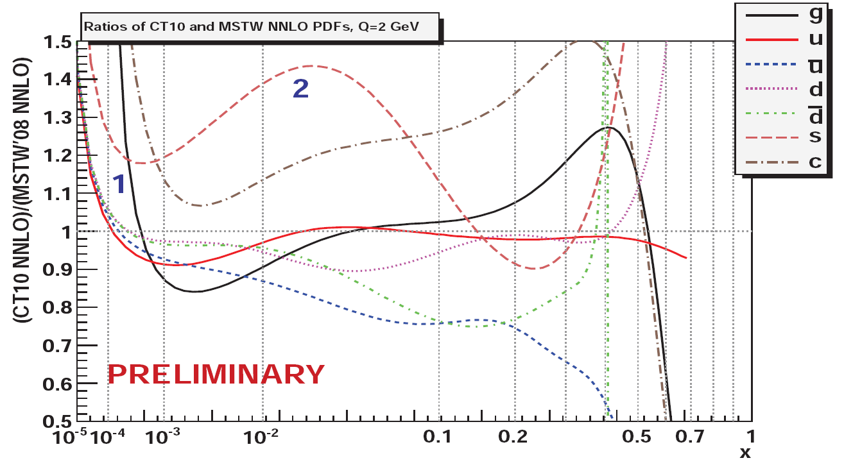
CT(EQ) update* 2012
CTEQ6.6 → CT10: Tevatron Run II jets + extended parametrisation + ...
CT10 global fit now at NNLO: similar to MSTW NNLO apart from (1) harder gluon at small x (positivity constraint) and (2) larger strange at medium x
*CTEQ website: hep.pa.msu.edu/cteq/public/

Slide 15
... and similar cross section predictions

Slide 16
MSTW update 2012
MSTW PDFs in Monte Carlo approach (G. Watt and R. Thorne, arXiv:1205.4024): validate correctness of “dynamic tolerance” approach, and generate “random” PDF sets directly from parameters and variation from eigenvectors
Adding two more parameters to valence quark starting distributions + minor adjustment to deuterium corrections → improved global fit and excellent description of LHC W asymmetry data (MSTW + Arnold Mathijssen and Ben Watt in preparation, see talk by R. Thorne at PDF4LHC, 23rd May 2012)
new CP and Cpdeut fits

Slide 17
AB(K)M update 2012
ABKM09 → ABM11 PDFs: new/final HERA structure function data, theoretical improvements relating to heavy quarks in DIS (running mass etc.)
σ_{gg→H}(NNLO, 8TeV)
ABM11
MSTW08
JR09
NNPDF2.1
ABM11 gluon harder than ABKM09, but softer than MSTW08, NNPDF2.1, also smaller α_{S}(M_{Z})= 0.1134
*S. Alekhin, J. Blümlein, S. Moch, arXiv:1202.2281, 1202.4642

Slide 18
updated luminosity plots for 8 TeV
Stefano Carrazza and Juan Rojo

Slide 19
PDF fitting at LHC
LHC can provide complementary (and in some cases new) information on PDFs, particularly from well measured, generally inclusive, Standard Candle cross sections (W, Z, jets, top,…)
... but also for more exclusive process like W+c-jet as a measure of the strange PDF
including LHC data in global fits has already started (see below)
jets,
Higgs,
top, W,Z,
…
γ* ?
proton
X
proton
x₁P
x₂P

Slide 20
discriminating power of LHC W and Z measurements

Slide 21
the LHC high p_{T} jet data are now beginning to constrain the PDFs ...

Slide 22
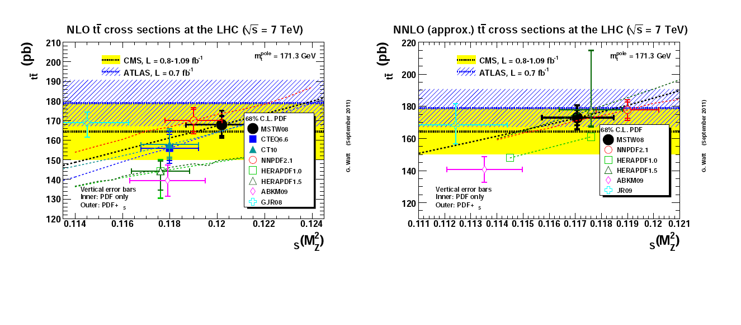
the top cross section is another good PDF discriminator ...
α
α

Slide 23
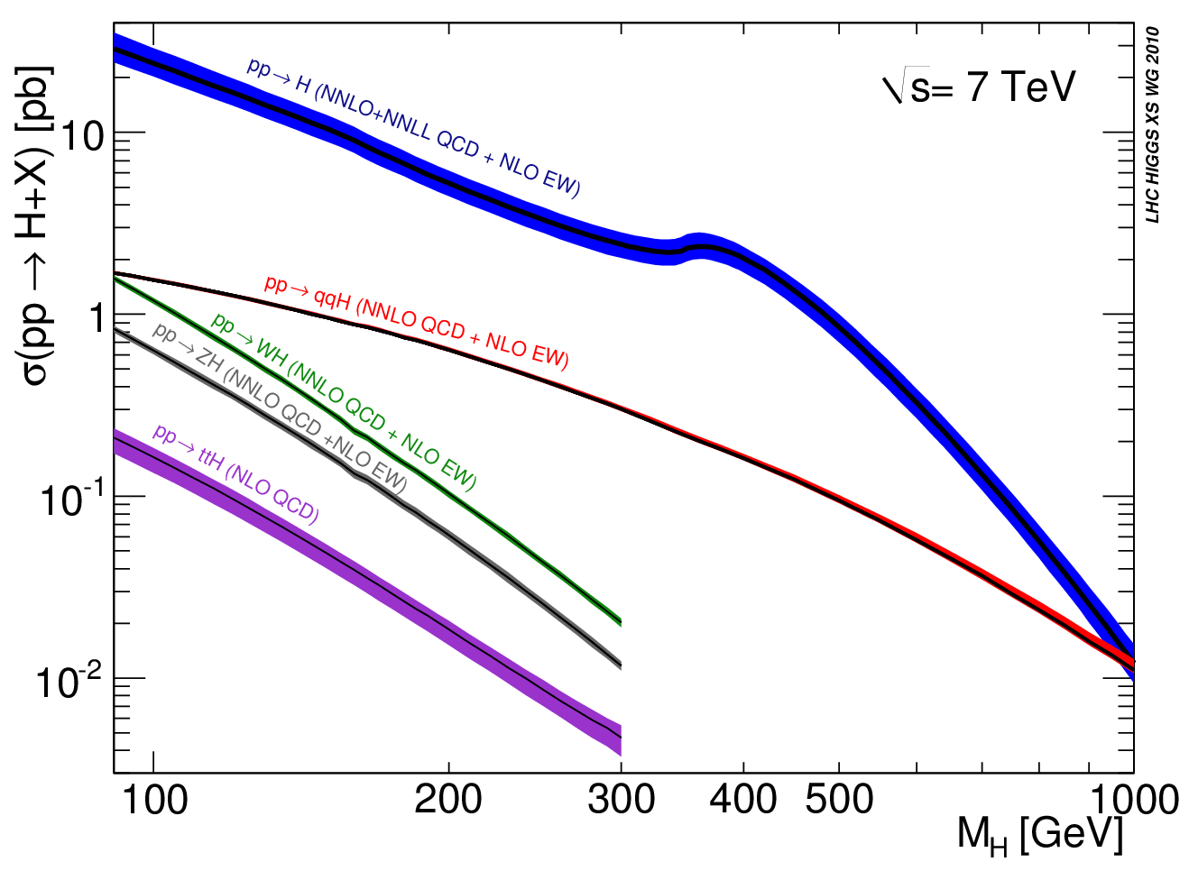
Higgs cross sections

Slide 24
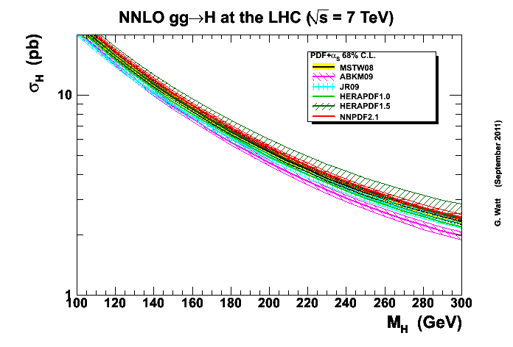
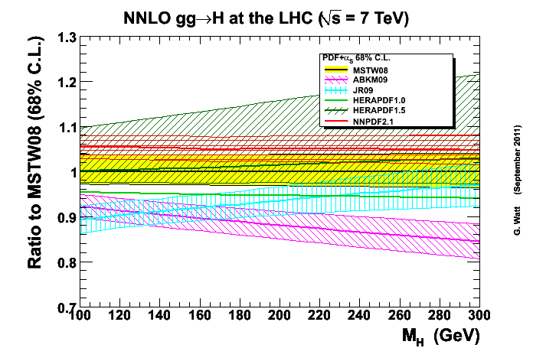

Slide 25
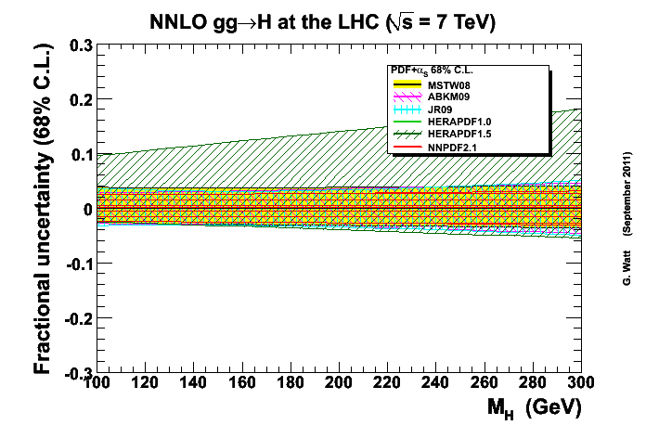
- with the exception of HERAPDF1.5, the uncertainties are very similar, in the ±3-4% range for light M_{H}

Slide 26
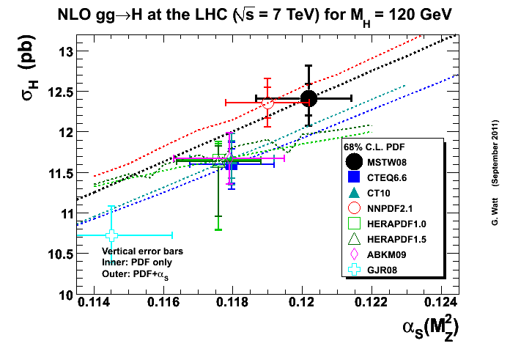
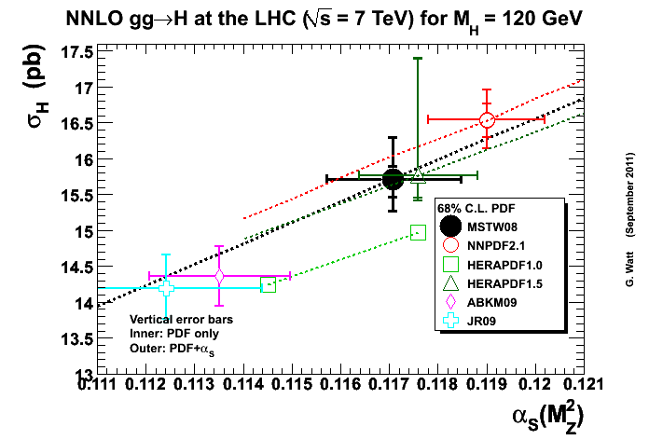
Note the impact of the different α_{S} values associated with the different PDF sets!

Slide 27
The ‘PDF4LHC recommendation’* for combining best fits and uncertainties from different PDF sets into a single prediction
NLO
NNLO
“For the calculation of uncertainties at the LHC, use the envelope provided by the central values and PDF+α_{s} errors from the MSTW08, CTEQ6.6, and NNPDF2.0 PDFs, using each group’s prescriptions for combining the two types of errors. We propose this definition of an envelope because the deviations between the predictions can sometimes be as large as their uncertainties. As a central value, use the midpoint of this envelope. We follow the PDF4LHC prescription and recommend that a 68% CL uncertainty envelope be calculated and the α_{s} variation suggested is consistent with this. Note that the CTEQ6.6 set has uncertainties and α_{s} variations provided only at 90% CL and thus their uncertainties should be reduced by a factor of 1.645 for 68% CL. Within the quadratic approximation, this procedure is exact.”
“As a central value, use the MSTW08 prediction. As an uncertainty, take the same percentage
uncertainty on this NNLO prediction as found using the NLO uncertainty prescription given above.”
2011 update: CTEQ6.6 → CT10, NNPDF2.0 → NNPDF2.1
*S. Forte, J. Huston, K. Mazumdar, R.S. Thorne and A. Vicini, Section 8, in Report of the LHC Higgs Cross Section Working Group, arXiv:1101.0593

Slide 28
The ‘PDF4LHC recommendation’* for combining best fits and uncertainties from different PDF sets into a single prediction
NLO
NNLO
“For the calculation of uncertainties at the LHC, use the envelope provided by the central values and PDF+α_{s} errors from the MSTW08, CTEQ6.6, and NNPDF2.0 PDFs, using each group’s prescriptions for combining the two types of errors. We propose this definition of an envelope because the deviations between the predictions can sometimes be as large as their uncertainties. As a central value, use the midpoint of this envelope. We follow the PDF4LHC prescription and recommend that a 68% CL uncertainty envelope be calculated and the α_{s} variation suggested is consistent with this. Note that the CTEQ6.6 set has uncertainties and α_{s} variations provided only at 90% CL and thus their uncertainties should be reduced by a factor of 1.645 for 68% CL. Within the quadratic approximation, this procedure is exact.”
The existence of this “recommendation”, developed in response to a specific request from the experimental community relating to Higgs cross sections, should NOT prevent or discourage experiments from using any individual PDF set to compare with their data. Only by doing this will we make progress!
“As a central value, use the MSTW08 prediction. As an uncertainty, take the same percentage
uncertainty on this NNLO prediction as found using the NLO uncertainty prescription given above.”
2011 update: CTEQ6.6 → CT10, NNPDF2.0 → NNPDF2.1
*S. Forte, J. Huston, K. Mazumdar, R.S. Thorne and A. Vicini, Section 8, in Report of the LHC Higgs Cross Section Working Group, arXiv:1101.0593

Slide 29
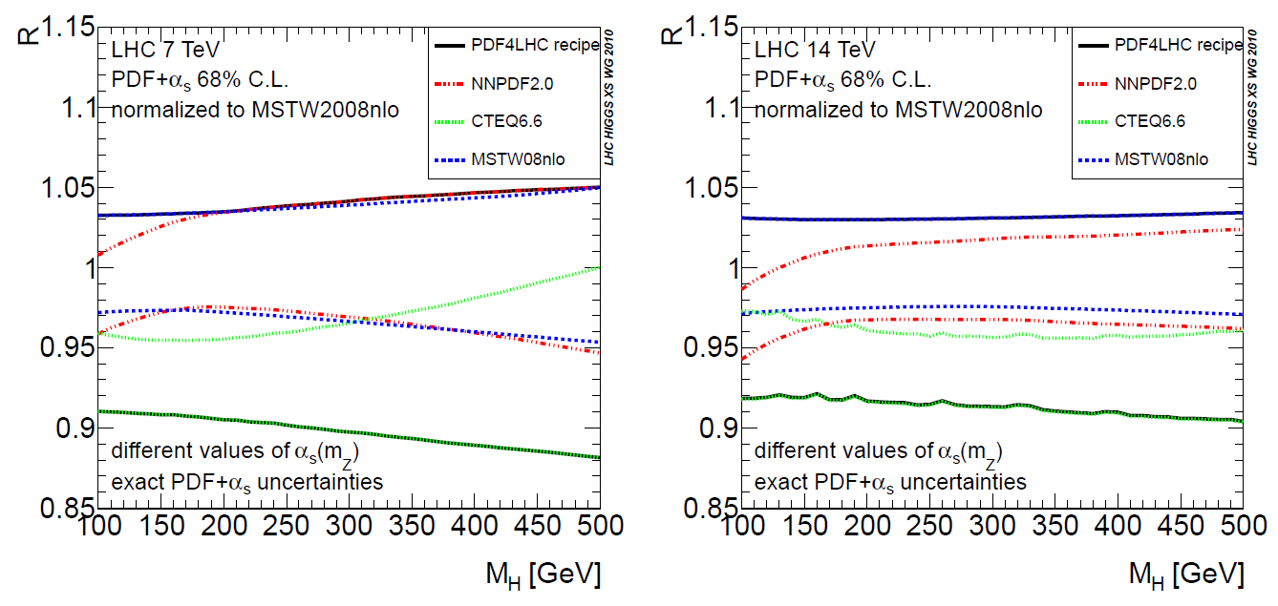
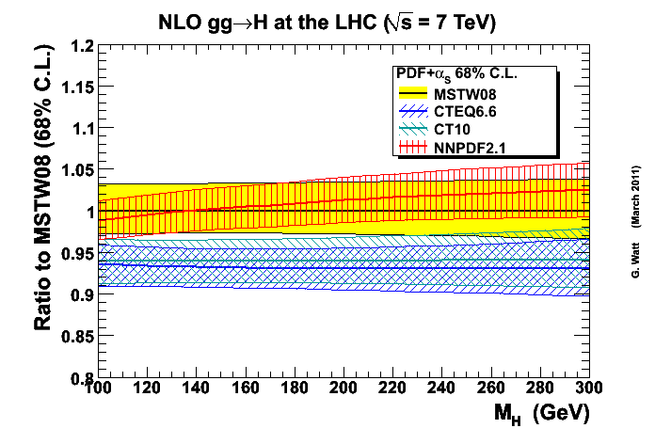
largely unchanged by NNPDF2.0→2.1 and CTEQ6.6→CT10

Slide 30
±9%
±7%
largely unchanged by NNPDF2.0→2.1 and CTEQ6.6→CT10

Slide 31
PDF + α_{S} uncertainties: Tevatron vs. LHC
the slightly larger uncertainty at the Tevatron can be understood in terms of the gg luminosity plot

Slide 32
from “Handbook of LHC Higgs cross sections: 1. Inclusive observables”
NNLO gg→H
7 TeV LHC
±7%→ ± 9%
(100 GeV → 500 GeV)

Slide 33
from “Handbook of LHC Higgs cross sections: 1. Inclusive observables”
NNLO WH, ZH
7 TeV LHC
±3-4%

Slide 34
from “Handbook of LHC Higgs cross sections: 1. Inclusive observables”
NLO VBF
7 TeV LHC
±3%→ ± 5%
(100 GeV → 500 GeV)

Slide 35
δσ_{th} = δσ_{UHO} ⊕ δσ_{PDF} ⊕ δσ_{param} ⊕ …

Slide 36
correlations between Higgs and other cross sections at 7 TeV LHC
a simple example: σ_{gg→H} vs. σ_{top}
a detailed study is presented in the second LHC Higgs cross section working group Yellow Report (arXiv:1201.3084)
Define the degree of correlation:
for two (e.g. cross section) quantities X and Y, using a particular PDF set “0” with its uncertainty sets “i”:
ρ = 0, +1(-1) for uncorrelated, completely (anti-)correlated quantities

Slide 37
PDF4LHC average correlations: Higgs vs. Higgs and Higgs vs. other SM
strong correlation:
tt vs. ggH_{heavy}, ttH_{light}
WZ vs. WH
tb vs. WH
- same PDFs, similar x
weak correlation:
ttH vs. WH
- different PDFs, different x
anticorrelation:
ggH vs. VBF
W, Wγ vs. ttH
- hi/lo x
LHC Higgs Cross Section Working Group
arXiv: 1201.3084

Slide 38
summary
knowledge of PDFs continues to improve, NNLO now the norm
the ‘global fit’ sets (MSTW, CT, NNPDF) are becoming more similar; origin of residual differences largely understood
sets fitted without Tevatron jets (HERAPDF, GJR, ABKM) tend to give smaller high-x gluons → visible differences in LHC cross section predictions (e.g. top, Higgs)
PDF4LHC Workshops have provided an extremely valuable forum for understanding and comparing PDFs
PDF dependence of 7 TeV LHC cross sections and correlations has been studied; new (NNLO) benchmark study at 8 TeV is underway; fitting to LHC data has already begun
for gg→H with M_{H}~125 GeV, combined PDF+α_{S} uncertainty is ~ ±7%; uncertainty increases with M_{H} and is similar for NLO and NNLO
for qqbar → WH,ZH with M_{H}~125 GeV, combined PDF+α_{S} uncertainty is ~ ±3.5%, slightly anticorrelated with gg→H (ρ = -0.2)

Slide 39
extra slides

Slide 40
parton luminosity functions
note that, neglecting pQCD scaling violations, the luminosity functions depend only on the dimensionless ratio M_{X}/√s, e.g.
... and so 125 GeV @ 8 TeV ≡ 109.4 GeV @ 7 TeV

Slide 41
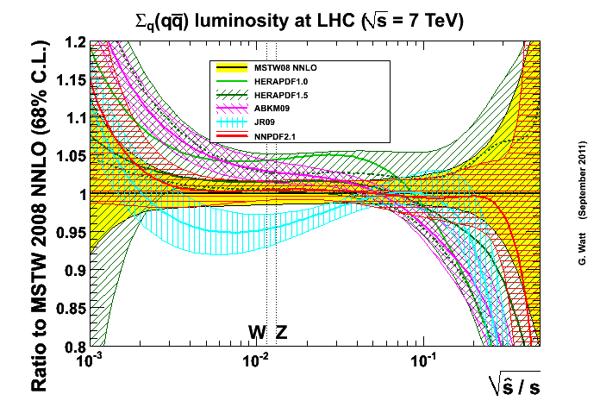
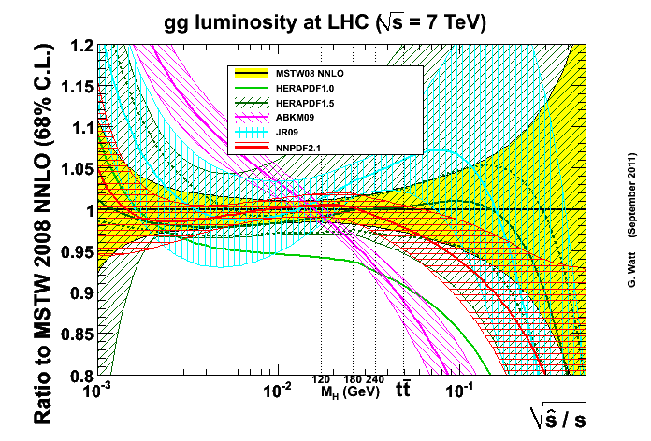
comparison of NNLO parton luminosity functions at 7 TeV LHC

Slide 42
r_{gg}(8/7) = 1.28 for M_{X} = 125 GeV, cf. r_{Z}(8/7) = 1.17

Slide 44
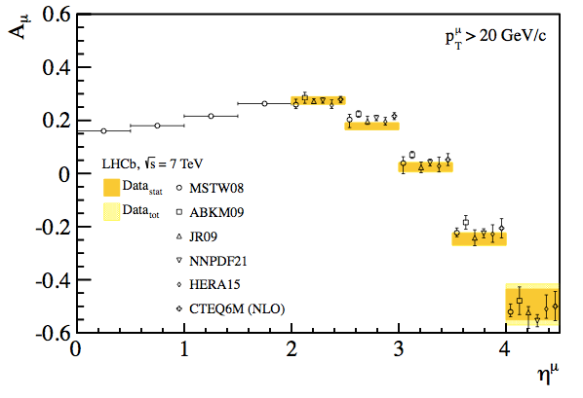
the MSTW08 valence quarks need to be retuned (can easily be achieved with a slightly extended parametrisation)
LHCb extends the reach to high rapidity

Slide 45
PDF + α_{S} uncertainties in jet cross sections

Slide 46
MSTW input parametrisation
Note: 20 parameters allowed to go free for eigenvector PDF sets, cf. 15 for MRST sets

Slide 47
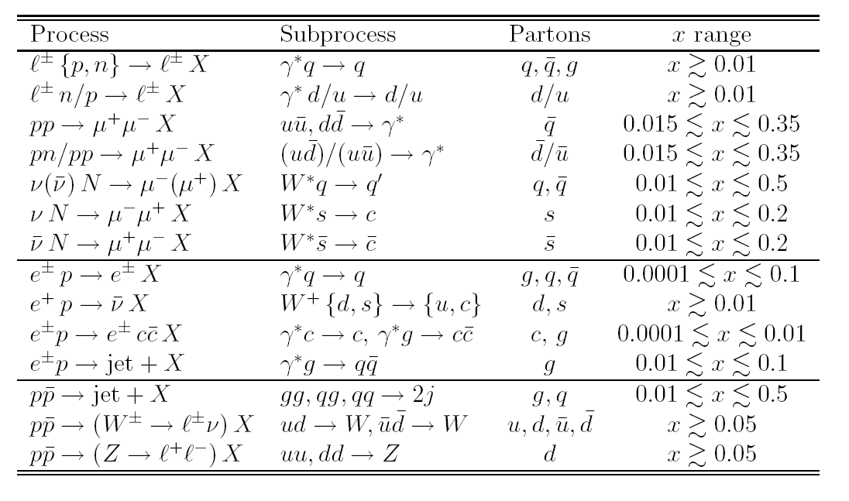
which data sets determine which partons?

Slide 48
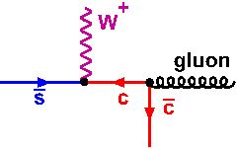
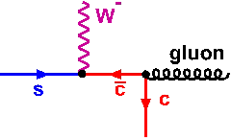
probing heavy quark pdfs
take advantage of (a) qg dominates W,Z + jet production, (b) heavy quark suppression becomes weaker at high Q², small x, (c) ability to tag c,b jets
CMS: “W production in association with c jets” (CMS-PAS-EWK-11-013)
sbar / s
sbar + s
Z
differences at level of exptl.
systematic error!
Also: Z + c as a measure of charm pdf

Slide 49
α_{S} - PDF correlations
care needed when assessing impact of varying α_{S} on cross sections ~ (α_{S} )^{n} (e.g. top, Higgs)
MSTW: arXiv:0905.3531

