Slide 1



CERN Grand Vision and Future
Markus Schumacher
27. 7. 2013
Higgs Hunting 2013

Slide 2
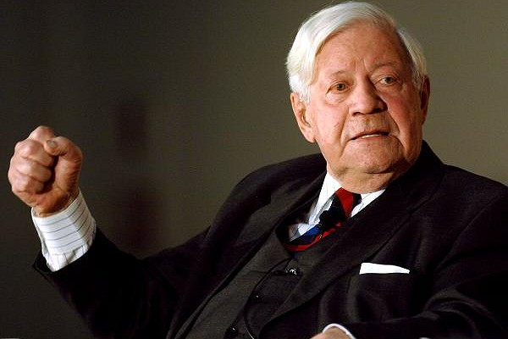
Helmut Schmidt
Former chancellor
Now 94 years old
„Wer Visionen hat, sollte zum Arzt gehen.“
„Who has visions, should consult a physician“

Slide 3
Prospects for Investigating
Electroweak Symmetry Breaking
with Circular Colliders
(pp and e⁺e⁻)
Markus Schumacher
27. 7. 2013
Higgs Hunting 2013
Disclaimer:
Not discussing accelerator and detector challenges
and not commenting performance numbers quoted
Biased choice of choosing and citing phenomenology and theory papers.
Apologies in advance for not mentioning similar studies by other authors.
Including some personal remarks and questions
not representing any community or on behalf of any collaboration
Prospects at linear e⁺ e⁻ colliders will be discussed in next talk

Slide 4
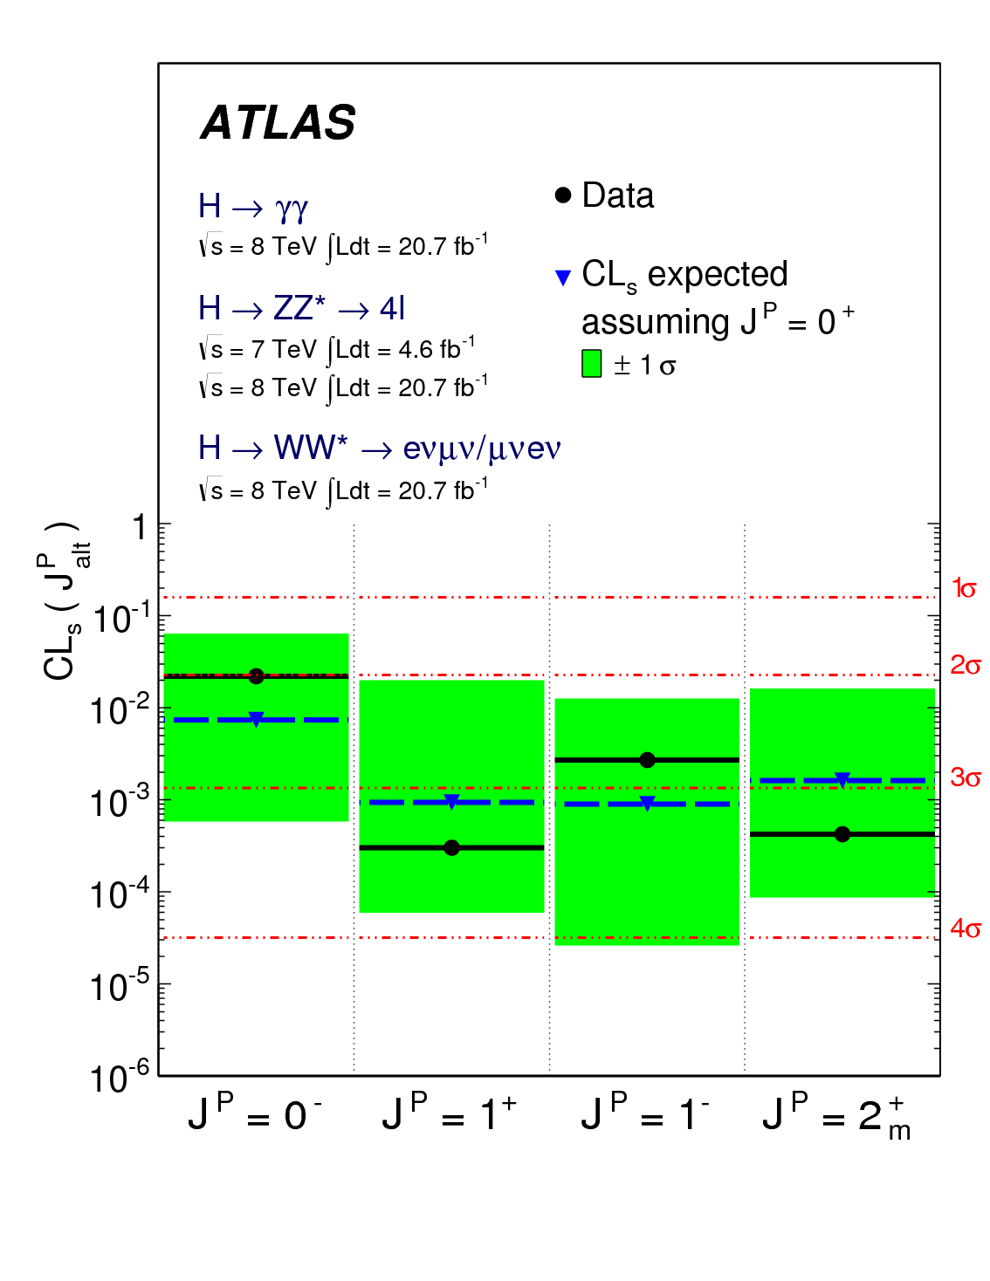
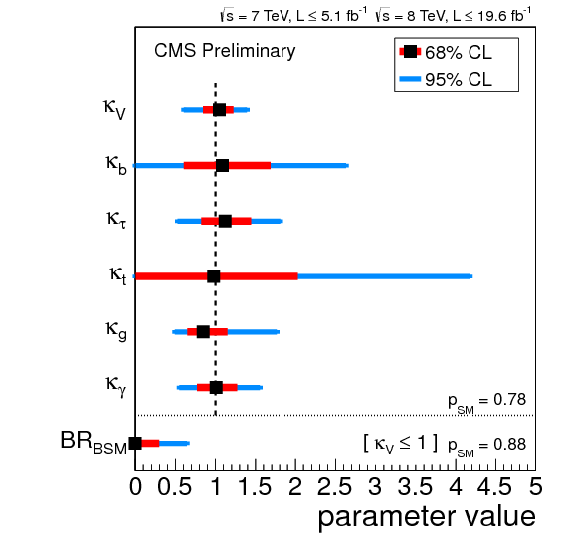
Status of Our Knowledge About the Higgs-Boson
Coupling strength scale factors in various benchmarks agree with SM expectation
Spin zero and positive parity preferred
(but only one minimal spin 2 model considered)

Slide 5
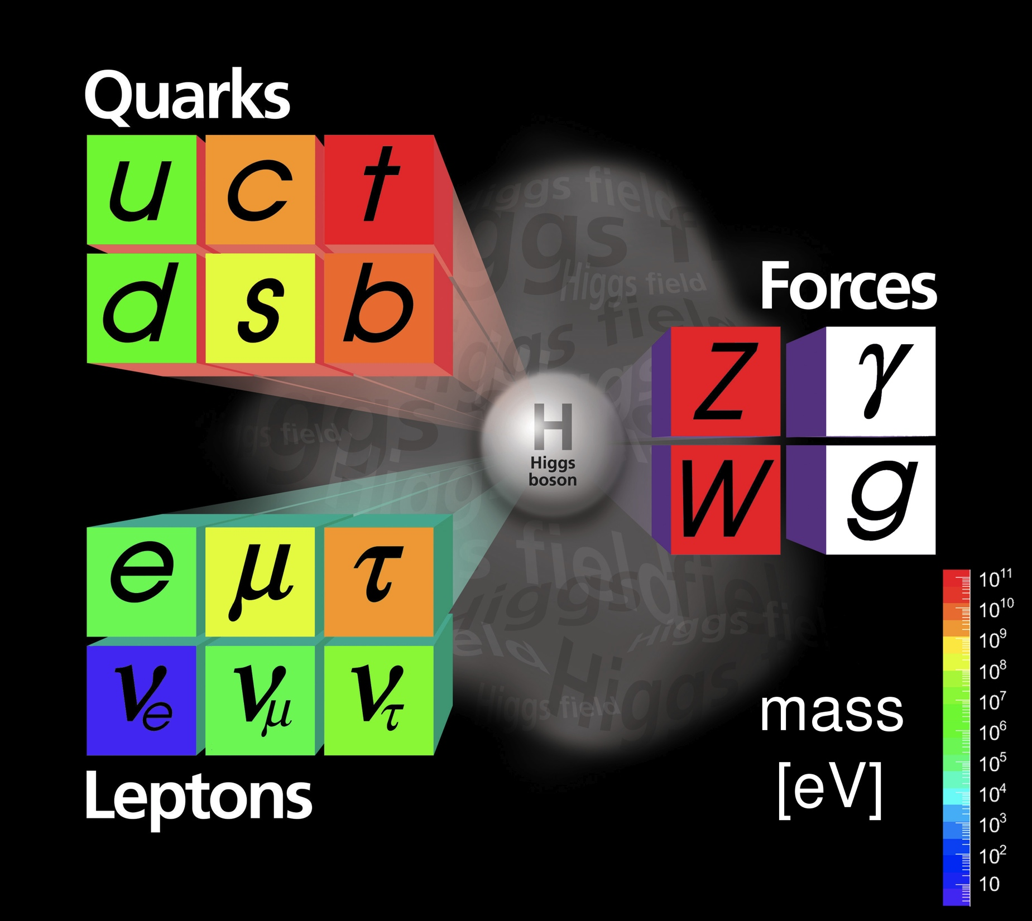

The Programme
Investigation of the Higgs boson at
Check consistency of the picture
of EWSB e.g. via
study of vector boson scattering (VBS)
2001
Search for additional
Higgs bosons
Search for other
new particles
and symmetries

Slide 6

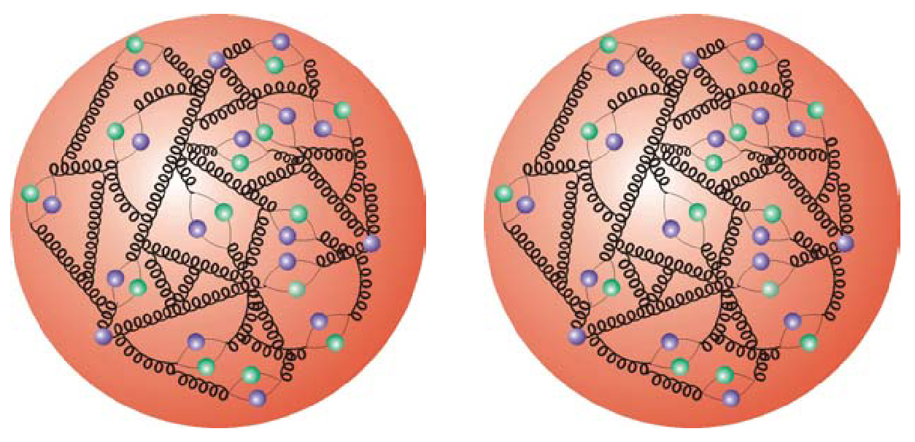



The Tools
Proton proton collisions
~ 100 fb⁻¹ @ 14 TeV by 2017
~ 300 fb⁻¹ @ 14 TeV by 2021
~3000 fb⁻¹ @ 14 TeV by 2030
p
p
HE-LHC <300fb⁻¹/yr @ ≤ 33 TeV >2035
VHE-LHC @ 42-100 TeV >2035
(80 km tunnel, B dipole = 8 to 20 T)
Electron positron collisions
Linear colliders:
250...500...1000 GeV
50 fb-1/yr start @ 250 GeV < 2030?
e⁺
e⁻
250...1400...3000 GeV
start > 2030
Circular colliders:
LEP3 90..240GeV
TLEP 90..240..350GeV
(Plus other options: γγ→H at linear collider or SAPHIRE, ep→H+X, μμ→H)

Slide 7
The Tools
Very important:
Plus even more precise predictions and tools from theory!
Proton proton collisions
~ 100 fb⁻¹ @ 14 TeV by 2017
~ 300 fb⁻¹ @ 14 TeV by 2021
~3000 fb⁻¹ @ 14 TeV by 2030
p
p
HE-LHC <300fb⁻¹/yr @ ≤ 33 TeV >2035
VHE-LHC @ 42-100 TeV >2035
(80 km tunnel, B dipole = 8 to 20 T)
Electron positron collisions
Linear colliders:
250...500...1000 GeV
50 fb-1/yr start @ 250 GeV < 2030?
e⁺
e⁻
250...1400...3000 GeV
start > 2030
Circular colliders:
LEP3 90..240GeV
TLEP 90..240..350GeV
(Plus other options: γγ→H at linear collider or SAPHIRE, ep→H+X, μμ→H)

Slide 8
Future of LHC: Timeline
 | Run1 | Run 2 | Run 3 | HL-Run
years | 2010-12 | 2015-17 | 2019-21 | 2024--xx
int. Lumi. (fb⁻¹) | 25 | 75-100 | 300 | 3000 (by 2030)
inst. lumi (10⁻³⁴ cm⁻²-s ⁻¹) | 0.7 | 1.0 | 2.0 | 5
pile up | ~20 | ~25 | ~50 | ~128
center of mass energy | 7/8 | 13-14 | 14 | 14
Would be nice to have projections also for other integrated. luminosities e..g 100 fb⁻¹

Slide 9
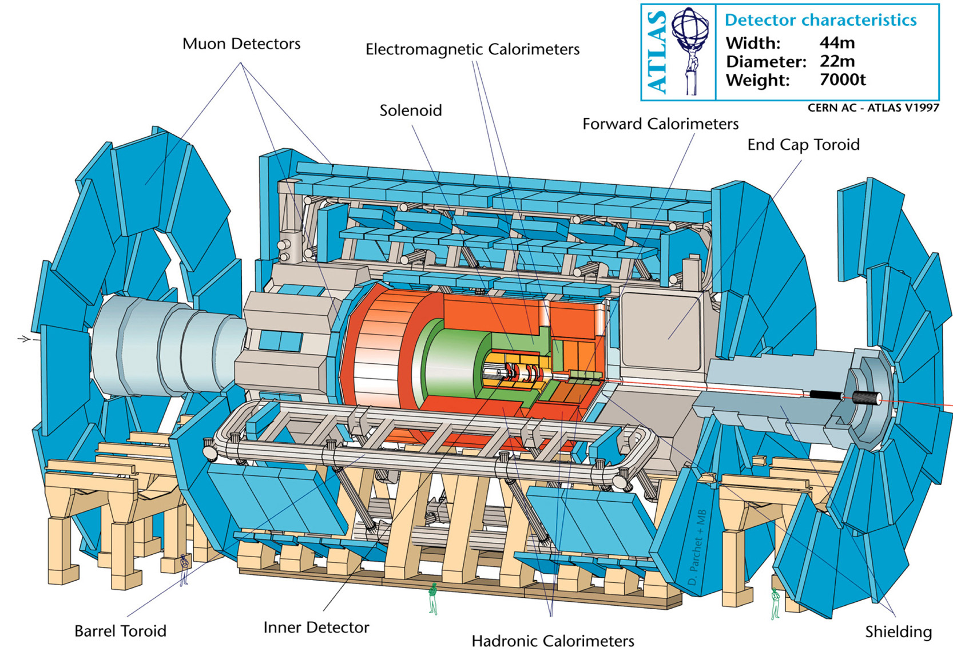
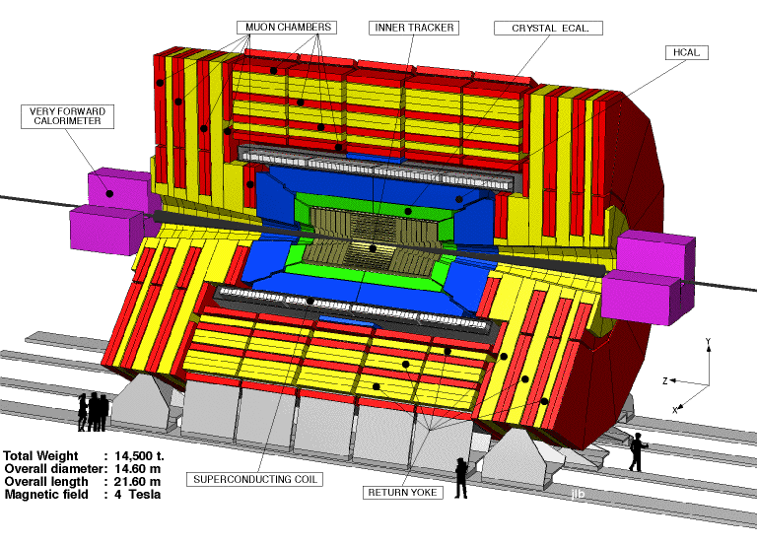
Upgrade Plans for ATLAS and CMS
Challenges: - Higher event rates (factor 2 from increase √s, rest from pile up )
→ improved DAQ, trigger, computing
- Higher track and energy densities → better granularity, radiation harder
Both plan to: - Insert additional pixel layer /replace tracking system
- Improve trigger (including implementation of track trigger)
- New forward calorimeters / new read out for remaining calorimeters
- Extend coverage of muon detector system
- …
Experience has shown: Very often due to sophisticated algorithms and selections
performance better then assumed in projections
For details see e.g. talks by Jason Nilsen and Jim Olsen at Snowmass Energy Frontier Workshop, Seattle.

Slide 10
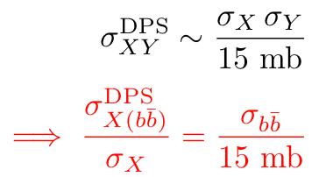
One Slide on HE-LHC
Here: 300 fb⁻¹ at √s=33 TeV
Of course significant increase
in reach for new discoveries
Probably good prospects to
measure ttH and HHH coupling
More studies needed
CMS
A few facts to note:
For √s ≥ 33 TeV ttH 3rd largest
cross section after gg→H, VBF
Higgs pair production always
challenging σ_{HH}/σ_{tt} ~ 10⁻⁴
independent on energy
Probability for overlayed bbar from double parton scattering:
20% at
√s = 100 TeV

Slide 11
What Do We Want to Measure?
a) Discriminate models with extended
Higgs sectors from SM Higgs sector?
b) Determine remaining (effective)
parameters in SM Lagrangian
(Higgs couplings and
quartic gauge boson couplings) ?
+ L_{BSM} (eventually)
a) Ratio of partial width sufficient?
b) Absolute couplings require knowledge of total width
- LHC further assumption needed: e.g. no undetectable decays, g_{V}< g_{V}(SM),
from interference effects assuming one Higgs boson? (Dixon et al, Melnikov et al)
- e+e- colliders: key issues is determination of g_{Z} in Higgs-strahlung

Slide 12
More Generally: Tensor Structure
From YR3 of the LHCHXSWG
In a perfect world: measure all 30+6 couplings of the effective field theory.
In particular if deviation from SM observed but no new particles discovered.
Rejecting different spin and CP hypothesis is just the start.
No convincing systematic experimental study yet. Need guidance by theorists.

Slide 13
Which Precision ?
Rule of thumb for deviation from SM Higgs boson coupling strength
δ up to ~10 % depending on model and particle (and on what you want to sell)
Precisions to (sub-) per cent level very valuable
In ratio of couplings cancellation
of systematic uncertainties and
perhaps increased effect
Would be nice to have theory predictions for ratio of couplings / partial width
Examples for deviations from SM (M. Peskin, arXIV108.5152, HH 2012 summary)
MSSM:
Composite Higgs:
Little Higgs
Gupta, Rzehak, Wells
arXiv:1206.3569
arXiv:1305.6397

Slide 14
Uncertainties in SM Predictions for M_{H}=126 GeV
Partial width uncertainties (%)
pp cross section uncertainties (%)
Values from YR3 of the LHCHXSWG
 | α_{s} | m_{b} | m_{c} | m_{t} | THU
H→bb | 2 | 3 | 0 | 0 | 2
H→ττ | 0 | 0 | 0 | 0.1 | 2
H→μμ | 0 | 0 | 0.1 | 0 | 2
H→cc | 7 | 0.1 | 6.2 | 0.1 | 2
H→gg | 4 | 0.1 | 0 | 0.2 | 3
H→ γγ | 0 | 0 | 0 | 0 | 1
H→Zγ | 0 | 0 | 0.1 | 0.1 | 5
H→WW | 0 | 0 | 0 | 0 | 0.5
 | QCD scales | α_{s}+PDF
gg→H | +7-8 | +7-8
VBF | <1 | ±3
WH | ±1 | ±3
ZH | ±3 | ±3
ttH | +4-9 | ±8
Varying QCD scales by ½ to 2 is not
equivalent to theory uncertainty
even if often used as it was
THU: estimate for missing higher orders
Question to theory friends: how much improvement on which timescale?
Question to experimentalists: are they considered in all projections? Depends!
Question to all: will they limit our final precision? I am afraid yes
THU more than only σ_{inc} and BRs: P_{T}-Spectra, categorisation e.g. by nr. of jets, …
→ acceptance uncertainties

Slide 15
CMS: Procedure of Deriving Sensitivity
Signal and background efficiencies (and their uncertainties)
from actual 8 TeV analysis applied to 14 TeV cross-sections
Two different scenarios for systematic uncertainties considered
Scenario 1: systematic uncertainties (exp. and theo.) unchanged
Scenario 2: experimental uncertainties scale with 1/√Lumi.
theoretical uncertainties reduced by a factor 2
Reasoning:
detector and algorithms
up-grade will mitigate
effects of pile-up
theorists are very brave
personal opinion: factor ½ on theory uncertainties is very challenging

Slide 16
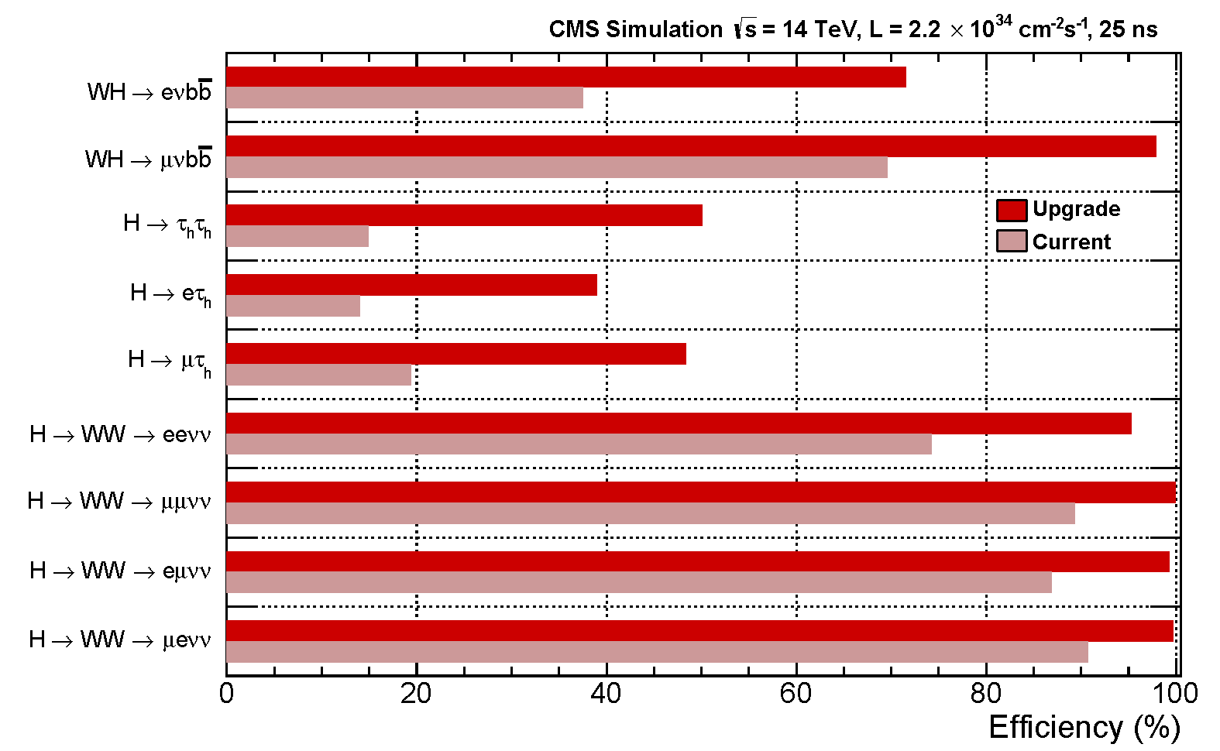
CMS: Impact of Upgrade Plans on Higgs Physics
Upgraded trigger gives significant higher efficiency for several final states e.g.
factor 2 gain for WH→ eνbb and H→τ_{e}τ_{had}
Increased selection efficiency for some final states
ZH→μμ bb: efficiency increased by 65%

Slide 17
CMS: Input Channels and Benchmark
 | H→ZZ | H→WW | H→γγ | H→ ττ | H→bb
gg→H | x | x | x
VBF | x | x | x | x
VH |  |  | x | x | x
ttH |  |  | x |  | x
6 parameter fit: coupling to photon, gluon, W/Z, top, bottom, tau
assuming no undetectabe and invisible contributions to total width
treating k_{b}, k_{t}, k_{τ}
as 3 independent
parameters

Slide 18
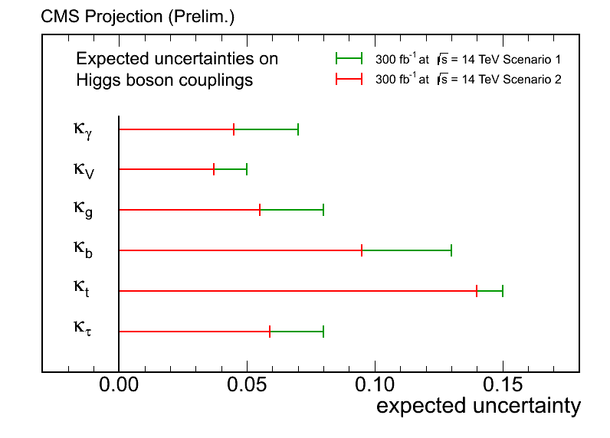
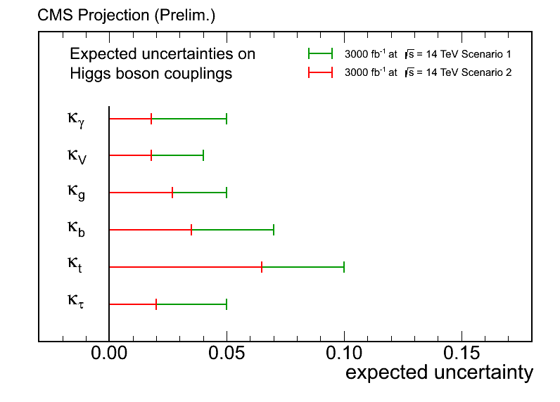
CMS: Projection of Sensitivity
Scenario 1: uncertainties from 7/8 TeV Scenario 2: exp. uncertainty ~ 1/√Lumi., THU=1/2
300 fb⁻¹
3000 fb⁻¹
(4 – 15)%
(2 – 10)%
 |  | photon | W/Z | gluon | b | t | tau
300 fb-1 | Sc1 | 7% | 5% | 8% | 13% | 15% | 8%
 | Sc2 | 5% | 4% | 6% | 10% | 14% | 6%
3000 fb-1 | Sc1 | 5% | 3% | 5% | 7% | 10% | 5%
 | Sc2 | 2% | 2% | 3% | 4% | 7% | 2%
7/8 TeV data 5/20 fb⁻¹ (4/12) | 68% CL | 0.77- 1.27 | 0.84- 1.23 | 0.65- 1.15 | 0.61-1.69 | 0.00- 2.03 | 0.82- 1.45

Slide 19
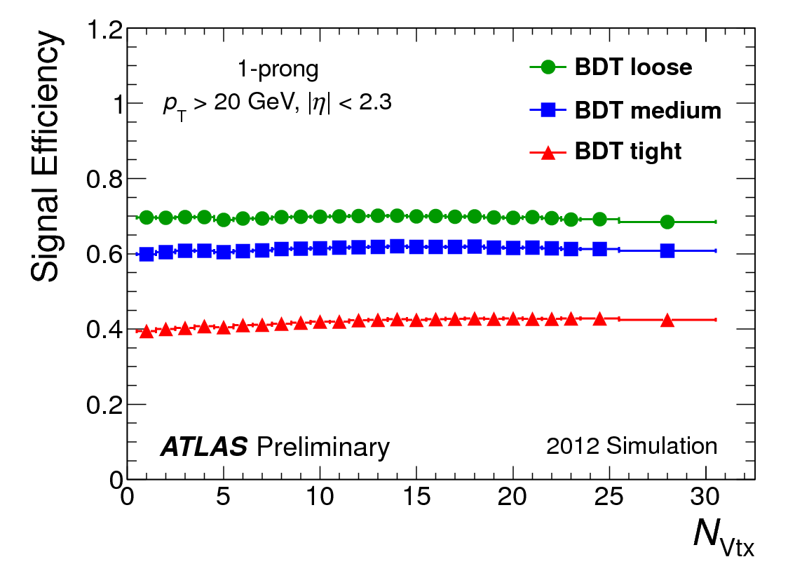
ATLAS: Procedure of Deriving Densitivity
Physics simulation at parton/hadron level at 14 TeV
Parametrized detector response function (resolutions, energy scales, efficiencies and misidentification probabilities) derived from full simulation and data
including appropriate pile-up levels (+ significant extrapolation so far )
Procedure validated in comparison with actual 7/8 TeV analysis
Systematic uncertainties kept constant (unless data driven constraints)
τ identification
b-quark tagging
resolution for missing transverse energy

Slide 20
ATLAS: Input Channels Considered
 | H→ZZ | H→WW | H→γγ | H→ ττ | H→ μμ
gg→H | x | x | x |  | x
VBF |  | x | x | x
VH |  |  | x
ttH |  |  | x |  | x
H→bb not yet included
jet energy scale and
b-tagging uncertainties
not ready for boosted topology at HL-LHC
H→μμ inclusive
(3000 fb⁻¹, signficance > 6σ )
ttH, H→γγ inclusive
(3 ab⁻¹, S/B=0.2, better than ZH)

Slide 21
ATLAS: Sensitivity for Signal Strength
Status today
Projections (fall 2012)
Hatched area includes
theory uncertainties
With 3000 fb⁻¹:
H→μμ may be key
fermionic channel
High rate channels
e.g. gg → H
limited by current
theory uncertainties
H→WW limited by
background systematics
Conservative assumptions (e.g. no correlation of exp. uncertainties)
For H→WW expected uncertainty already superseded by new results
with 7/8 TeV data (July 2012)

Slide 22
ATLAS: Ratio of Partial Width and Simple Benchmark
Two parameter fit (K_{F}, K_{V})
assuming no undetectable decays and
no BSM contribution to loops
 | 300 fb⁻¹ |  | 3000 fb⁻¹
 | w/o THU | w/ THU | w/o THU | w /THU
K_{V} | 3.0 % | 5.6 % | 1.9 % | 4.5%
K_{F} | 8.9 % | 10 % | 3.6 % | 5.9%
THU = theory uncertainty
K_{V} already limited by THU with 300 fb⁻¹
Both limited by THU with 3000 fb⁻¹
300 fb⁻¹ → 3000 fb⁻¹ :
factor 2 to 3 improvement
Ratios including Γ_{g with} with significant contribution from theory uncertainty with 3000 fb⁻¹
Current ATLAS results (7+8 TeV data)
at 68% CL
Similar contribution from stat.+exp.
and theory uncertainties.

Slide 23
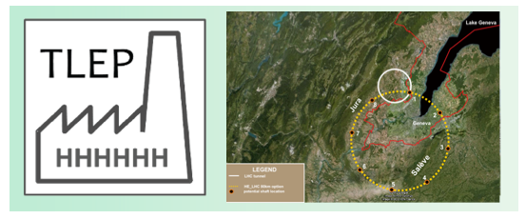
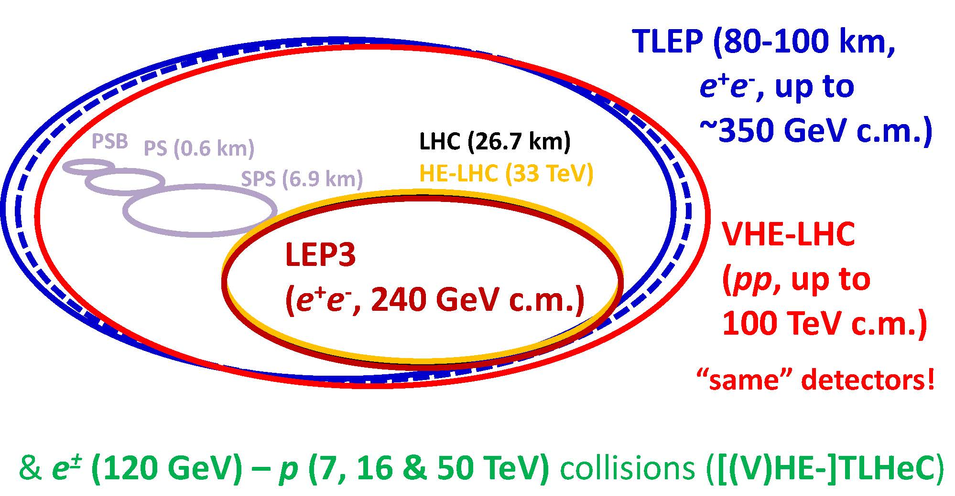
TLEP
mostly extracted from talks
by A. Blondel and P. Janot
TLEP
e+-e- up to √s = 350 GeV
proposed start ~ 2030
running for 12 to 15 years
VHE-LHC
pp at √s = 42/80/100 TeV
(dipoles at B = 8.3/16/ 20 T)
design study started
part of CERN MTP
the key point is the luminosity
→ two ring structure due to limited beam-life time of 15 min
ring 1: accelerator (ramp from 2 to 120 GeV in ~ 10 s)
ring 2: collider with up to 4 interaction points (IPs)
continuously fed by ring 1

Slide 24
Accessible Processes at Various e+ e- colliders
TLEP will allow to investigate
ZH and VBF production,
but not ttH and HHX
Plus precision physics
at √s= M_{Z}, 2xM_{W}, 2 M_{top}
 | TERA-Z | Oku-W | Mega-Top
nr. of events | 10¹² Z/yr | 2.5x10⁷ WW/yr | 10⁶ tt / 5 yrs
exp. exp. precision | < 0.1 MeV for Γ_{Z}, M_{Z} | 0.5 MeV for M_{W} | 10 MeV for M_{top}
very stringent test of SM
(if supported by theory precision)
Advantages w.r.t. linear collider with 4 IPs (as given by TLEP community):
Luminosity larger w.r.t to ILC (~30 x at √s= 24(5)0 GeV, ~ 8 x at √s= 350 GeV)
Several interaction points (IPs) possible (4 proposed)
Negligible beam strahlung due to different beam parameters
…

Slide 25
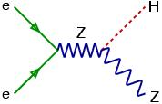
TLEP: Precision on Higgs Event Rates and Width
Full simulation of CMS detector, however LC-style detector considered for future
Numbers for BR(H→cc) and BR(H→gg) extrapolated from ILC study
→ requires better vertex detector than current CMS one
Only statistical sensitivity: - exp. systematic uncertainties considered controllable
- theory uncertainties hoped to be small by start of TLEP
Precision in ZH production after 5 years at 240 GeV, 4 IPs with 2.5 ab⁻¹ each
σ _{ZH} / σ _{ZH} = 0.4%
decay mode independent
(theo. uncertainty ~ 0.5 %)
1year, 1 detector
individual final states: Δ σ_{ZH}xBR(H→XX) ~ Δ ILC/√30 (x 8 (lumi) x 4 IPs)
e.g. σ(ZH→ Xbb) = 0.2% (compare to current THU on Γ(H→bb) = 4%)
Precision on total and invisible width ( 5 years at √s=240 GeV + 5 years at √s= 350 GeV)
=
=

Slide 26
TLEP: Precision on Higgs Boson Couplings
(copied from P. Janot’s Seattle talk)
M. Bachtis
Following M. Peskin’s fit in arXiv:1207.2516
W/o assumption g_{w/Z} < g_{W/Z} (SM)
Theory uncertainties not included
Precision goals
as given in design
study kick-off
document
( 5 yrs at 240 GeV
+ 5 yrs+ 350 GeV )
5 years of running (4 IPs at TLEP)
Comparison to HL-LHC
Assuming no BSM decay modes
Relate coupling of c-quark to t-quark
ILC numbers from ILC TDR
HL-LHC numbers for 3000 fb⁻¹ from CMS projection (only 1 experiment)
5 years of running (4 IPS at TLEP)

Slide 27
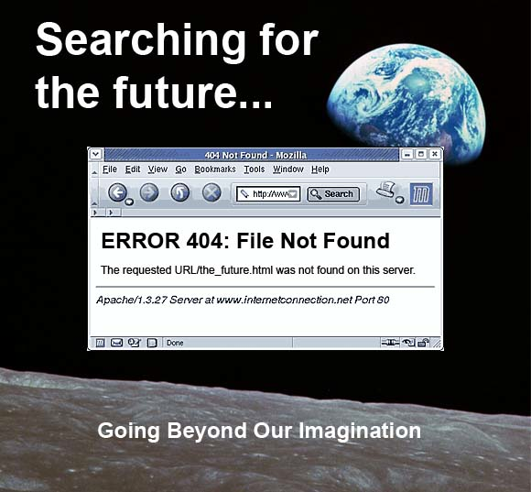
Conclusions

Slide 28
Conclusions and Naïve Personal Remarks
LHC and HL-LHC have a great potential to measure ratio of couplings and with mild assumption absolute couplings (including the coupling to top quarks)
to the level of 5 to 10% (or even better)
- A full exploration of the sensitivity requires huge efforts on the theory side
- Measurement of ratio may be enough to observe deviations from the SM
and to discriminate between different models
Model independent measurement of couplings require an e+ e- collider.
The key issue to obtain (sub-)per-cent level precision is the luminosity.
For the investigation on the 126 GeV Higgs boson √s= 24(5)0/350 GeV
seems to be the optimal machine (no determination of top and self coupling)
- Circular colliders with various IPs provide a huge integrated luminosity
- A full exploration of the sensitivity requires huge efforts on the theory side
Model independent determination of top quark coupling requires an e+ e- collider operating at √s > 500 GeV (or σ(ttH)xBR(H→xx) from LHC + BR(H→xx)
from e+e- collider at √s = 250) K. Desch, M.S. hep-ph/0407159 )
Determination of the triple Higgs self coupling with precision of < 20%
requires huge data set at √s=500 GeV or large data sets (multi) TeV
e+ e- collider. Prospects for (HL-LHC), HE-LHC, VHE-LHC not bad. .

Slide 29
Naïve Personal Questions
What to measure:
Ratio of partial width or absolute couplings?
Which theory assumption are mild enough?
All absolute couplings including top / Higgs self-coupling?
Only coupling strength or all couplings in effective field theory approach?
I am not aware of a systematic comparison or different colliders.
For which energies to obtain precision at per-cent level (at e+ e- colliders) ?
- Only for √s ≤ 350 GeV ? (as so far no physics discovered btw. vev and 1 TeV)
- To live with smaller luminosity and hence less precision but possibility of
extension to larger energies in order to study newly discovered particles?
How to proceed if only/no deviation from SM Higgs prediction observed
at (HL-LHC) and e+e- with √s ≤ 350 GeV?
Your believe: is there new physics and at which energy scale?
how many machines will get funding (0,1,2,3,…)?
A CERN Grand Vision also includes (I believe) : “Fixed Target Programme”
“Flavours Physics”, “Heavy Ion Physics”. “Neutrino Physics”, etc.

Slide 30
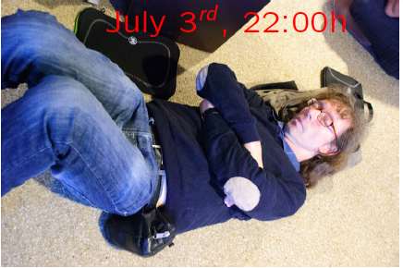
Someone had/has a dream …
Well we know where we are going, but we don’t know where we’ve been ...
And the future is certain, give us time to work it out.
(from “Road to Nowhere” by Talking Heads)

Slide 31
ATLAS: Prospects for VBS
ZZ→ 4l
WZ→ 3l ν
W⁺W⁺→l⁺l⁺νν
all three operators do not effect di-boson production
they probe different aspects of VBS w/ or w/o contribution from Higgs boson
some clear guidance from theorists appreciated for choice of operators
4 Lepton Mass
3 l 1 ν Mass
2 Jet 2 Lepton Mass

Slide 32
ATLAS: Prospects for VBS – Statistical Sensitivity
ZZ→ 4l
WZ→ 3l ν
W⁺W⁺→l⁺l⁺νν
Discovery reach:
from 300 fb⁻¹ to 3000 fb⁻¹: factor 2 improvement in sensitivity

