Slide 1
ILC and the Prospect starting with Higgs Factory
Akira Yamamoto
KEK
Higgs Hunting 2013, Orsay/Paris, July 27, 2013

Slide 2
Outline
ILC Technical Status to prepare for starting at Higgs Factory
  Design update at Technical Design Report (TDR’12)
  Technical progress in research & development
  Phase: “Design to Reality”
Alternate Higgs Factory Options
Comparison of ILC with other projects

Slide 3
Requirements from Physics Exp.
Basic requirements：
  Luminosity : ∫Ldt = 500 fb⁻¹ in 4 years
  E_{cm} : 200 – 500 GeV and the ability to scan
  E stability and precision: < 0.1%
  Electron polarization: > 80%
Extend-ability：
  Energy upgrade: 500 → 1,000 GeV
5GeV e-, e+ Damping Ring (3.2km)
E+ production
Bunch compression
Bunch compression
e- ML
E+ ML
IP
E- production
Notes:
3

Slide 4
Physics Prospects with ILC
K. Kawagoe
Integrated Luminosity
(ab⁻¹)
2
HHZ
Physics confident:
  - Higgs and Top Quark
New Physics beyond SM, such as
  - Direct or indirect search for DM
1
HZ
ννH
ttH
tt
E _{cm} (GeV)
200
300
400
500
600
Notes:
This is the physics scenario I can imagine now. If the light Higgs is there, we will have guaranteed physics of the Higgs boson and the top quark.
In addition, the ILC has many possibilities to explore the physics beyond the Standard Model.

Slide 5


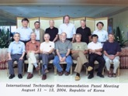
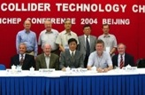
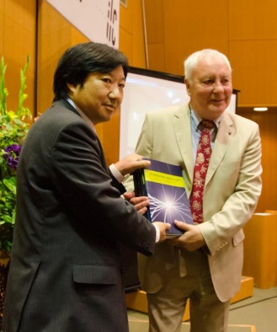

ILC Time Line
1980’ ~ Basic Study
2005
2006
2007
2008
2009
2010
2011
2012
2013
2004
ILC-GDE
LCC
Ref. Design (RDR)
TDR
Tech. Design：TDP1
TDP 2
completion
LHC
Higgs
discovered
Selection of SC Technology
2013.6.12
126 GeV
2012.12.15

Slide 6
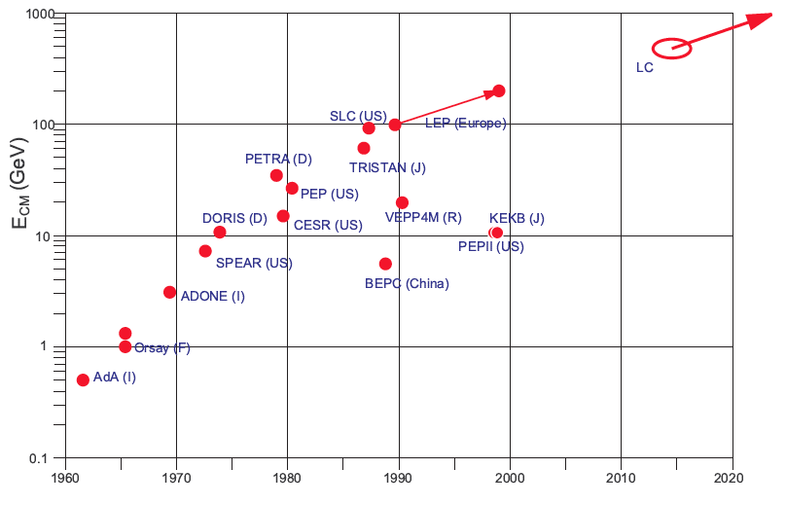


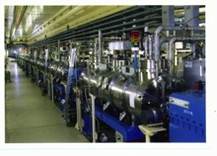
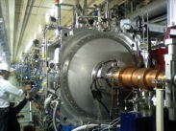

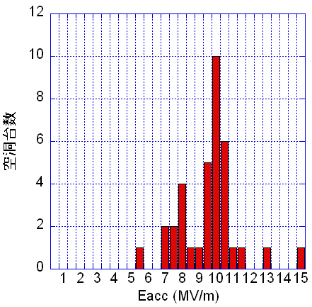
Development of e-/e+ Colliders
KEK and CERN, pioneering for SCRF beam acceleration TRISTAN→KEKB and LEP in 1980

Slide 7
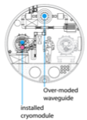
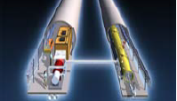
RDR (2007) to TDR (2012)
Cost Containing Effort
Single acc. Tunnel
Reducing # bunches
  w/ smaller damping rings
Allowing gradient spread
  31.5 MV/m +/- 20 %,
Site-dependent RF system:
  Clustered on surface (KCS),
  Distributed in tunnl (DKS)
RDR’07 →
(Reference Design Rep.)
TDR’12
(Technical Design Rep.)
5 m
Flat-land or Mountainous Tunnel Design

Slide 8
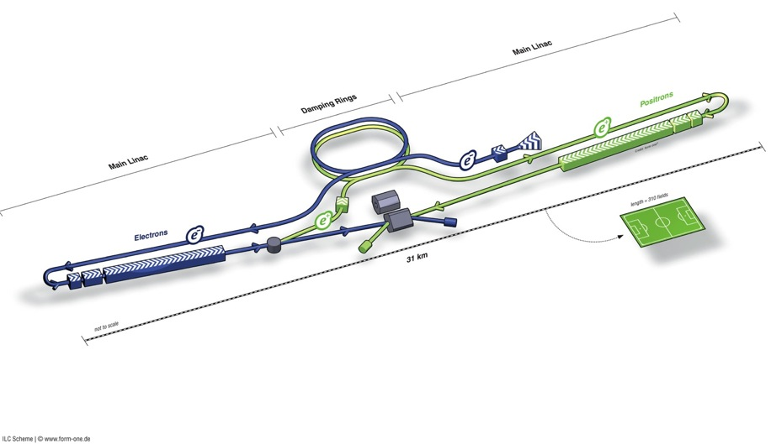
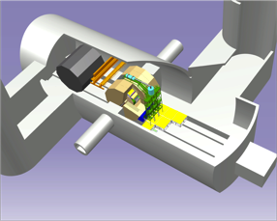
ILC TDR Layout
Damping Rings
Polarised electron source
Ring to Main Linac (RTML)
(including
bunch compressors)
e+ Main Linac
e- Main Linac
Parameters | Value
C.M. Energy | 500 GeV
Peak luminosity | 1.8 x10³⁴ cm⁻²s⁻¹
Beam Rep. rate | 5 Hz
Pulse duration | 0.73 ms
Average current | 5.8 mA (in pulse)
E gradient in SCRF acc. cavity | 31.5 MV/m +/-20% Q₀ = 1E10
E+ source

Slide 9
Known Physics and Possible Staging
~125 GeV ‘that new boson’
  125+91=216 GeV cm → 250 GeV
173 GeV Top quark
  2x173=346 GeV cm → 350-400 GeV
Higgs self coupling (t-coupling) ???
  ≥ 500 CM (up to 650 ??)
TeV and beyond….?
Staging / Upgrading

Slide 10
250 GeV staged (scenario 1)
15.4 km
1.1 km
5.1 km
1.3 km
2.2 km
Main Linac
BDS
e+ src
IP
bunch comp.
central region
Half the linac
Full-length BDS tunnel & vacuum (TeV)
½ BDS magnets (instrumentation, CF etc)
½ RTML LTL
Extended tunnel/CFS already 500 GeV stage
10Hz mode e- linac

Slide 11
250 GeV staged (scenario 2) → most recommended
15.4 km
1.1 km
5.1 km
1.3 km
2.2 km
Main Linac
BDS
e+ src
IP
bunch comp.
125 GeV transport
central region
Half the linac
Full-length BDS tunnel & vacuum (TeV)
½ BDS magnets (instrumentation, CF etc)
1 RTML LTL
5km 125 GeV transport line
Extended tunnel/CFS already 500 GeV stage
10Hz mode e- linac
quasi-adiabatic energy upgrade?

Slide 12
TDR 500 GeV Baseline
15.4 km
(site length ~31 km)
1.1 km
10.8 km
1.3 km
2.2 km
Main Linac
BDS
e+ src
IP
bunch comp.
Main Linac
<G_{cavity}> = 31.5 MV/m
G_{eff} ≈ 22.7 MV/m
(fill fact. = 0.72)
central region
Cost: 100%
P_{AC}: 161 MW

Slide 13
ILC Published Parameters
Luminosity Upgrade
Centre-of-mass independent:
Collision rate | Hz | 5
Number of bunches |  | 1312 | 2625
Bunch population | ×10¹⁰ | 2
Bunch separation | ns | 554 | 366
Pulse current | mA | 5.8 | 8.8
Beam pulse length | ms | 730 | 960
RMS bunch length | mm | 0.3
Horizontal emittance | mm | 10
Vertical emittance | nm | 35
Electron polarisation | % | 80
Positron polarisation | % | 30
http://ilc-edmsdirect.desy.de/ilc-edmsdirect/item.jsp?edmsid=D00000000925325

Slide 14
ILC Published Parameters
Centre-of-mass dependent:
v
Centre-of-mass energy | GeV | 200 | 230 | 250 | 350 | 500
Electron RMS energy spread | % | 0.21 | 0.19 | 0.19 | 0.16 | 0.12
Positron RMS energy spread | % | 0.19 | 0.16 | 0.15 | 0.10 | 0.07
IP horizontal beta function | mm | 16 | 16 | 12 | 15 | 11
IP vertical beta function | mm | 0.48 | 0.48 | 0.48 | 0.48 | 0.48
IP RMS horizontal beam size | nm | 904 | 843 | 700 | 662 | 474
IP RMS veritcal beam size | nm | 9.3 | 8.6 | 8.3 | 7.0 | 5.9
Vertical disruption parameter |  | 20.4 | 20.4 | 23.5 | 21.1 | 24.6
Enhancement factor |  | 1.83 | 1.83 | 1.91 | 1.84 | 1.95
Geometric luminosity | ×10³⁴ cm⁻²s⁻¹ | 0.25 | 0.29 | 0.36 | 0.45 | 0.75
Luminosity | ×10³⁴ cm⁻²s⁻¹ | 0.50 | 0.59 | 0.75 | 0.93 | 1.8
% luminosity in top 1% ΔE/E |  | 92% | 90% | 84% | 79% | 63%
Average energy loss |  | 1% | 1% | 1% | 2% | 4%
Pairs / BX | ×10³ | 41 | 50 | 70 | 89 | 139
Total pair energy / BX | TeV | 24 | 34 | 51 | 108 | 344
http://ilc-edmsdirect.desy.de/ilc-edmsdirect/item.jsp?edmsid=D00000000925325
Notes:
General observations:
Factor of 2 in L from enhancement – relatively large disruption parameter -> tight tolerances on collisions to IP (feedback)

Slide 15
ILC Published Parameters
Centre-of-mass dependent:
Centre-of-mass energy | GeV | 200 | 230 | 250 | 350 | 500
Electron RMS energy spread | % | 0.21 | 0.19 | 0.19 | 0.16 | 0.12
Positron RMS energy spread | % | 0.19 | 0.16 | 0.15 | 0.10 | 0.07
IP horizontal beta function | mm | 16 | 16 | 12 | 15 | 11
IP vertical beta function | mm | 0.48 | 0.48 | 0.48 | 0.48 | 0.48
IP RMS horizontal beam size | nm | 904 | 843 | 700 | 662 | 474
IP RMS veritcal beam size | nm | 9.3 | 8.6 | 8.3 | 7.0 | 5.9
Vertical disruption parameter |  | 20.4 | 20.4 | 23.5 | 21.1 | 24.6
Enhancement factor |  | 1.83 | 1.83 | 1.91 | 1.84 | 1.95
Geometric luminosity | ×10³⁴ cm⁻²s⁻¹ | 0.25 | 0.29 | 0.36 | 0.45 | 0.75
Luminosity Upgrade | ×10³⁴ cm⁻²s⁻¹ | 1.00 | 1.18 | 1.50 | 1.86 | 3.6
% luminosity in top 1% ΔE/E |  | 92% | 90% | 84% | 79% | 63%
Average energy loss |  | 1% | 1% | 1% | 2% | 4%
Pairs / BX | ×10³ | 41 | 50 | 70 | 89 | 139
Total pair energy / BX | TeV | 24 | 34 | 51 | 108 | 344
http://ilc-edmsdirect.desy.de/ilc-edmsdirect/item.jsp?edmsid=D00000000925325

Slide 16
TeV upgrade: Construction Scenario
500GeV operations
start civil construction
BC
Main Linac
BDS
e+ src
IP
civil construction + installation
500GeV operations
BC
Main Linac
BDS
e+ src
IP
Installation/upgrade shutdown
BC
Main Linac
BDS
e+ src
IP
final installation/connection
removal/relocation of BC
Removal of turnaround etc.
Installation of addition magnets etc.
Commissioning / operation at 1TeV
BC
Main Linac
BDS
e+ src
IP
Notes:
An obvious possible approach to minimizing downtime for physics.
Assume something like a total of 5 year construction with perhaps 12-18 months with no physics??

Slide 17
Major R&D Efforts in TD Phase
SCRF technology and beam acceleration：
  Cavity Gradient required：31.5 MV/m
    ILC SCRF cavity R&D
      Gradient Progress ： < 37 MV/m
      → achieved
      System engineering： S1-Global program with global effort
      → successfully completed
Electron Cloud Mitigation
Nano-beam handling :
  ILC requiring a beam size ~ 6 nm (vertical) and stability ~2nm:
    Progress in KEK-ATF:
      achieving ~70 nm (at 1.3 GeV),
      corresponding to 10 nm (at 250 GeV, ILC)

Slide 18
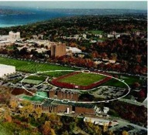
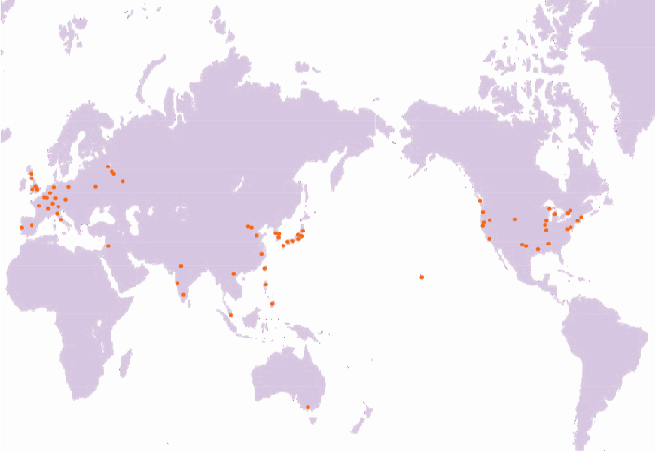
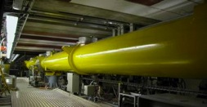
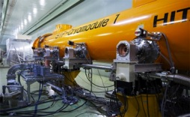
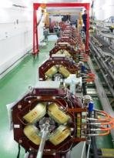
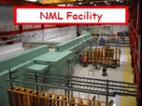
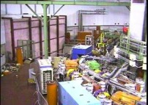
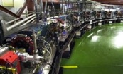
Global Cooperation for ILC Accelerator Beam Demonstration
TTF/FLASH (DESY) ~1 GeV
ILC-like beam ILC RF unit
(* lower gradient)
STF (KEK) operation/construction
ILC Cryomodule test： S1-Gloabal
Quantum Beam experiment
CesrTA (Cornell)
electron cloud
low emittance
DESY
◉
◉
INFN Frascati
KEK, Japan
FNAL
◉
◉
Cornell
◉
ATF & ATF2 (KEK)
ultra-low emittance
Final Focus optics
KEKB electron-cloud
NML facility ILC RF unit test
Under construction
DA^{f}NE (INFN Frascati)
kicker development
electron cloud

Slide 19

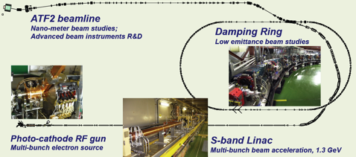
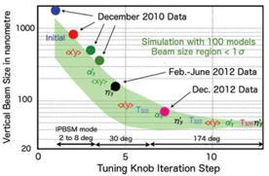
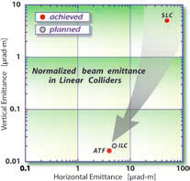
KEK-ATF：Progress
Ultra-small beam
Low emittance : KEK-ATF
  Achieved the ILC goal (2004).
Small vertical beam size : KEK ATF2
  Goal = 37 nm,
    160 nm (spring?, 2012)
    ~70 nm (Dec. 2012) at low beam current

Slide 20
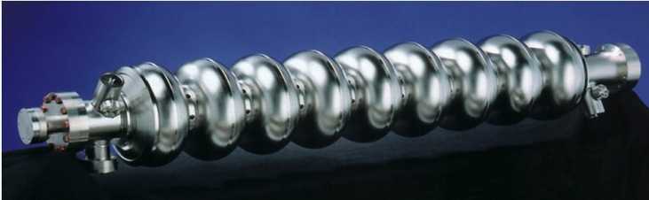
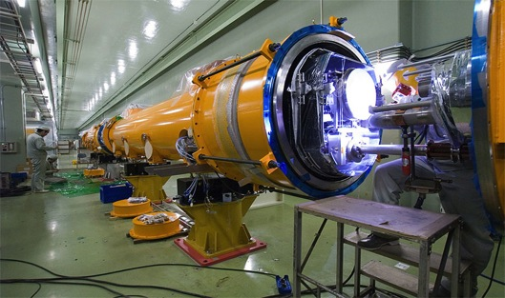
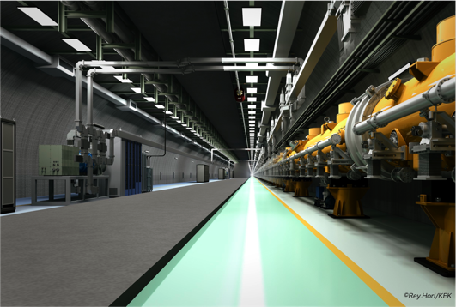
SCRF Linac Technology
1.3 GHz Nb 9-cellCavities | 16,024
Cryomodules | 1,855
SC quadrupole pkg | 673
10 MW MB Klystrons & modulators | 436 / 471 *
* site dependent
Approximately 20 years of R&D worldwide
→ Mature technology, overall design and cost

Slide 21
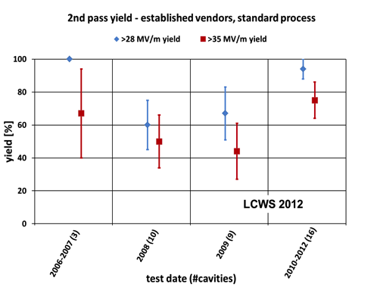
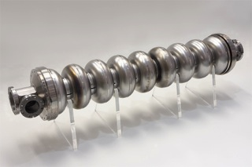
Progress in SCRF Cavity Gradient
Production yield:
94 % at > 35+/-20%,
Average gradient:
37.1 MV/m
reached (2012)

Slide 22
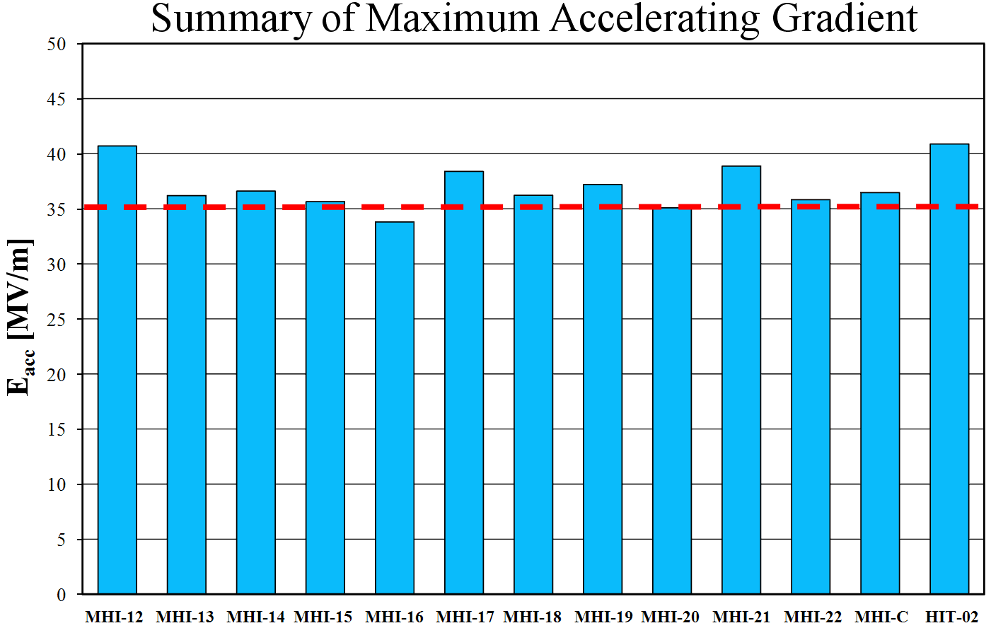
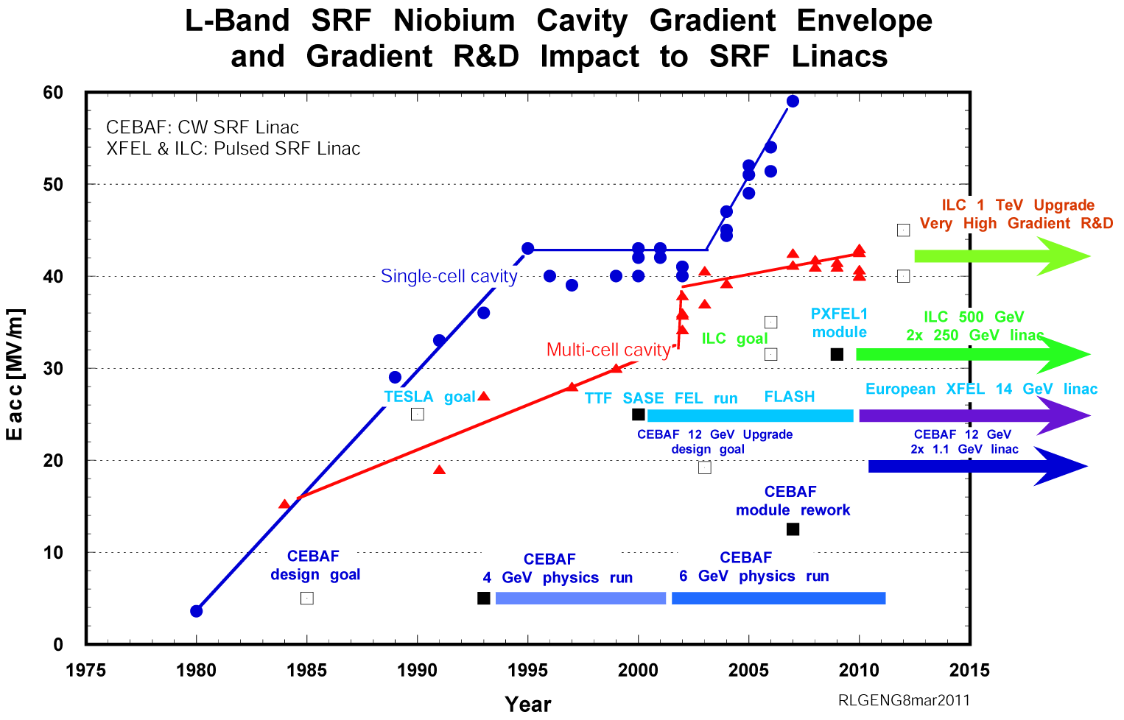
Further Effort for Gradient for Effective Perfromance/cost
Gradient achieved at KEK-STF: > ~ 35 MV/m
Progress: > 90 % → Coming 5 years: ~ 100 %

Slide 23
Progress in 1.3 GHz ILC Cavity Production
year | # 9-cell cavities qualified | Capable Lab. | Capable Industry
2006 | 10 | 1 DESY | 2 ACCEL, ZANON
2011 | 41 | 4 DESY, JLAB, FNAL, KEK | 4 RI, ZANON, AES, MHI,
2012 | (45) | 5 DESY, JLAB, FNAL, KEK, Cornell | 5 RI, ZANON, AES, MHI, Hitachi
Progress in EXFEL (800 cavity construction as of 2012/10):
(courtesy by D. Reschke: the 2nd EP at DESY)
  RI: 4 reference cavities with Eacc > 28 MV/m, (~ 39 MV/m max.)
  Zanon: 3 reference cavities with Eacc > 30 MV/m ( ~ 35 MV/m max.)

Slide 24
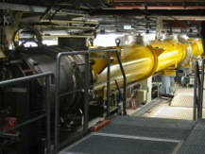
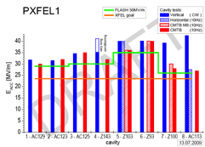
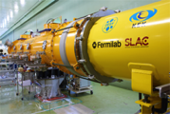
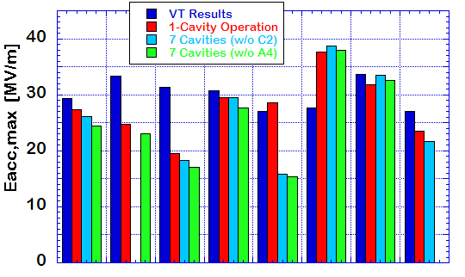

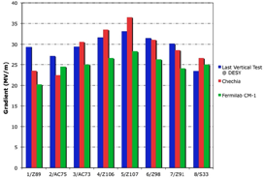
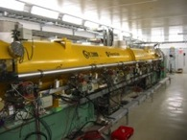
SCRF Beam Acceleration Test
DESY: FLASH
SRF-CM string + Beam,
  ACC7/PXFEL1 < 32 MV/m >
9 mA beam, 2009
800μs, 4.5mA beam, 2012
KEK: STF
S1-Global: complete, 2010
  Cavity string : < 26 MV/m>
Quantum Beam : 6.7 mA, 1 ms,
CM1 & beam, 2014 ~2015
FNAL: NML/ASTA
CM1 test complete
CM2 operation, in 2013
CM2 + Beam, 2013 ~ 2014

Slide 25
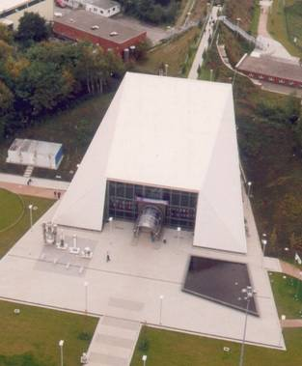
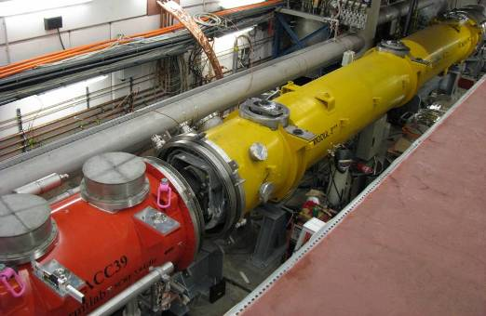
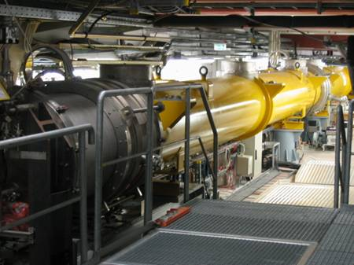
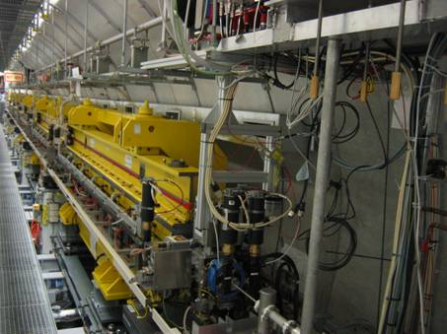
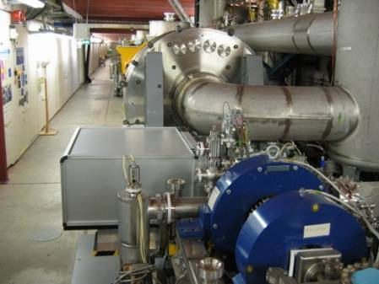
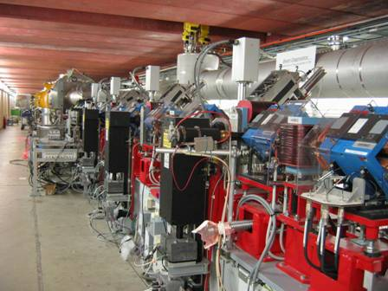
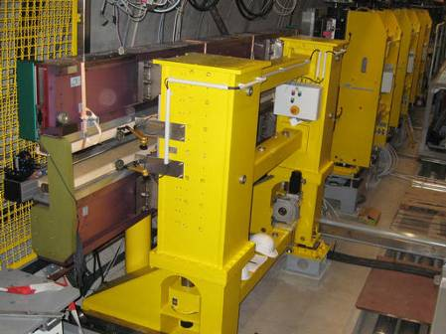
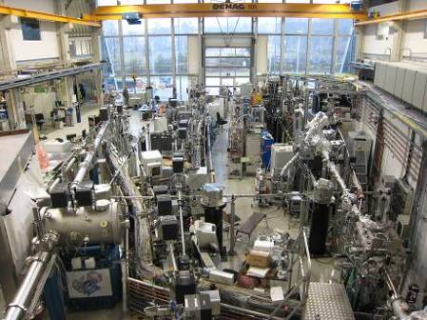
FLASH layout
Diagnostics
Accelerating Structures
sFLASH
Undulators
Bunch Compressor
Bunch Compressor
FEL Experiments
5 MeV
160 MeV
500 MeV
1200 MeV
Bypass
315 m

Slide 26
FLASH 9mA Experiment
 |  | XFEL | ILC | FLASH design | 9mA studies
Bunch charge | nC | 1 | 3.2 | 1 | 3
# bunches |  | 3250 | 2625 | 7200* | 2400
Pulse length | μs | 650 | 970 | 800 | 800
Current | mA | 5 | 9 | 9 | 9

Slide 27
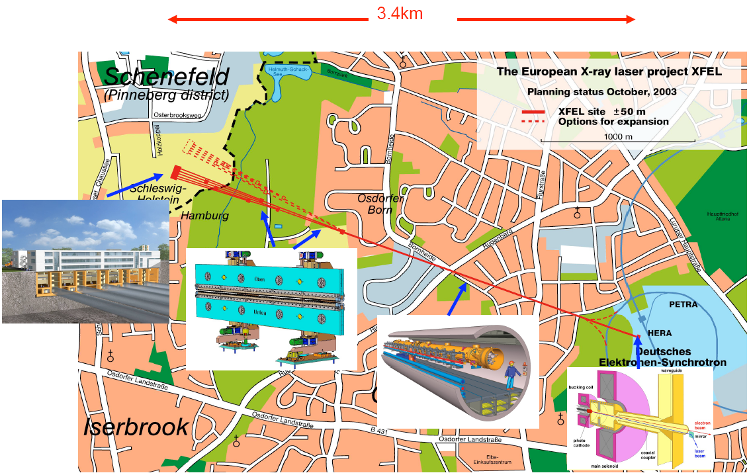
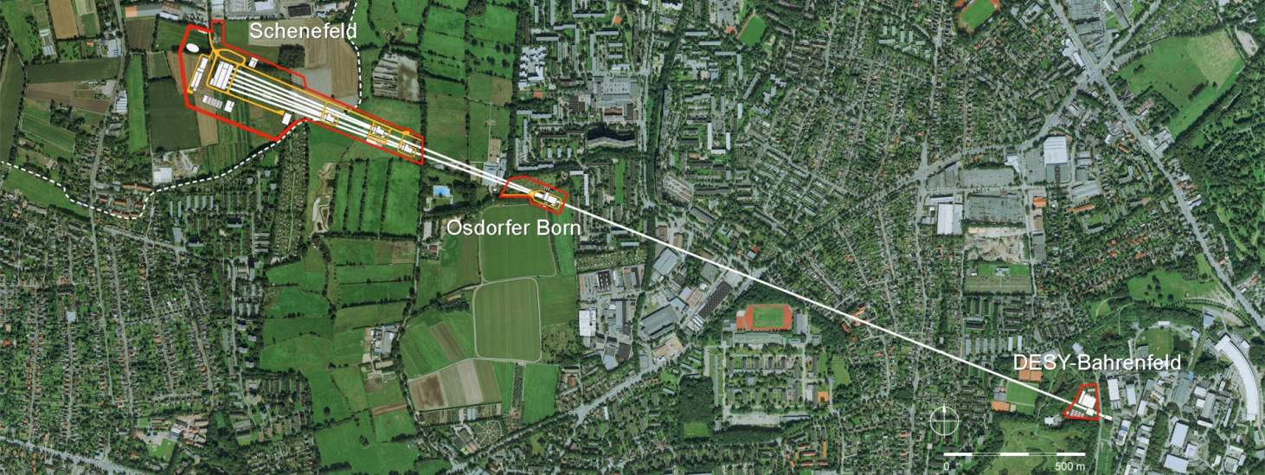
European XFEL
Some specifications
Photon energy 0.3-24 keV
Pulse duration ~ 10-100 fs
Pulse energy few mJ
Superconducting linac. 17.5 GeV
10 Hz (27 000 b/s)
5 beamlines / 10 instruments
  Start version with 3 beamlines and 6 instruments
Several extensions possible:
  More undulators
  More instruments
  …….
  Variable polarization
  Self-Seeding
  CW operation
First beam late 2015

Slide 28
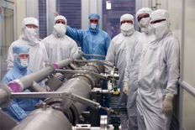
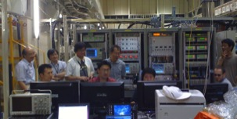
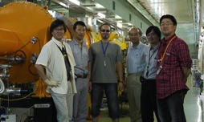
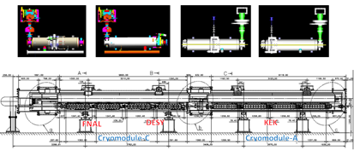
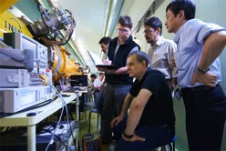




S1-Global hosted at KEK:
Global cooperation to demonstrate SCRF system
DESY, FNAL, Jan., 2010
DESY, Sept. 2010
FNAL & INFN, July, 2010
INFN
and
FNAL
Feb.
2010
March, 2010
DESY, May, 2010
June, 2010 ~

Slide 29
S1-Global hosted at KEK:
Global cooperation to demonstrate SCRF system
DESY, FNAL, Jan., 2010
DESY, Sept. 2010
FNAL & INFN, July, 2010
INFN
and
FNAL
Feb.
2010
Successful global cooperation hosted by KEK
with variety of cavity design
March, 2010
DESY, May, 2010
June, 2010 ~

Slide 30



ILC beam condition demonstrated at QB
Quantum-Beam Accelerator
Starting as starting of KEK-STF-2
Beam acceleration (40 MV) and transport for 6.7 mA, 1 ms, succeeded in 2012
High-flux X-ray by Inverse-Comton scattering
10mA electron beam （40MeV, １ｍｓ, ５Ｈｚ）
4-mirror laser resonator cavity
head-on collision with beam
photocathode RFgun
Capture cryomodule ( 2 SC cavities )
collision point
(Laser, electron beam)

Slide 31

ILC Road Map
Preparation Period
Construction

Slide 32

Linear Collider Collaboration: LCC
Chair: S. Komamiya
Director : L. Evans
Deputy Director H. Murayama
R&D to be
extended
Preparation
Preparation

Slide 33
ILC startig with the Light Higgs Factory
ILC (500 GeV) machine already “contains” a light Higgs factory (LHF)
  Luminosity: 7.5×10³³ cm⁻² s⁻¹
  (Possible to upgrade by factor 2)
Starting at 250 GeV with LHF, keeping extend-ability
  Reduces cost by ~75% (P_{AC} ~ 120 MW)
  Reduces schedule by 12-18 months
Really makes sense as part of a first-stage machine
  Scope of complete project still ~500 GeV
  TeV upgrade remains optional

Slide 34
Possible Ways for Higgs Factories
e⁺e⁻ Linear Colliders
  ILC, CLIC
e⁺e⁻ Ring Colliders
  LEP3, TLEP, Super-TRISTAN, FNAL site-filler, CHF, …
μ⁺μ⁻ Collider
γ-γ Collider

Slide 35



e+e- Ring Colliders ?
To create Higgs by e+e- → ZH requires E_{CM}~240GeV
This is not too high compared with the final energy 209GeV at LEP
VLCC (233km)
SuperTRISTAN (40km, 60km)
FNAL site filler (16km)
pp collider
PSB
PS (0.6 km)
SPS (6.9 km)
LHC (26.7 km)
e⁻e⁺ Higgs Factory
LEP3
(e⁺e⁻, 240 GeV c.m.)
CHF (China) (50km, 70km)
LEP3 (27km), TLEP (80km)

Slide 36
TLEP: Aspects in Proposal
Luminosity should be 5 x higher at 240GeV (TLEP-H)
L = 10³⁶ cm⁻²s⁻¹ at Z-pole (TLEP-Z)
Luminosity at t-t_{bar} threshold (TLEP-t) to be equivalent to ILC
Multiple interaction points capable
Well experienced
  Luminosity for sure
Should be less expensive than ILC (→ ?)
  Injector up to 20 GeV existing
  Used to be said “~half of ILC?”
  Recently being revised to be equivalent or even higher
Tunnel to be re-used for pp collider
----------
However, ECFA recently discussed
  “not to be an e-/e+ collider option for near future in Europe”

Slide 37
Luminosity vs. Energy
Yokoya,
Arlington, Oct.2012
An example with:
Momentum band
dp/p: η=2%
Tune shift:
ξ_{y}=0.15
geom. emitt.:
ε_{gy}=0.1nm
SR loss:
100MW

Slide 38




Various Possibilities of γγ Colliders
e+e- linear collider (ILC, CLIC) may be converted to γ-γ collider
80GeV e- on 80GeV e- converted by laser with x=4.83 gives 66GeV on 66 GeV γ-γ collider (lowest energy to produce H except muon collider)
CLICHE (2003)
SAPPHiRE (2012)
SAPPHiRE
CLICHE
SLC-type
ERL γγ

Slide 39
Summary and Overview for HFs
Linear Colliders (ILC, CLIC)
  ILC is technically practical to prepare for “construction”
  ILC: obvious for 250~500GeV Higgs Factory
    Cost and staging issues
Ring Colliders (LEP3, TLEP)
  Technology not trivial (SR loss, beam-beam effect)
  LEP3 (27km, 240GeV) & TLEP (80km, 350GeV) at the edge of feasibility
  Could be a choice, if higher energy with e⁺e⁻ was not needed at all
γ-γ Colliders
  Technology immature
  Good target as a second stage of linear colliders
Ref:
Yokoya, Arlington, Oct.2012

Slide 41
Technical Issues of TLEP (1)
Optics
  Low emittance
  Large momentum bandwidth (> 3%) with βy* ~ 1mm
  Saw-tooth effects
Machine configuration
  Pretzel needed to avoid parasitic collisions? (TLEP-Z)
    2 collider rings needed?
  Top-up ring must bypass the detectors
RF
Arc
RF
Arc
ΔE/E
positron
electron
saw-tooth effect

Slide 42
Technical Issues of TLEP (2)
Beam dynamics
  Beam-beam interaction
    with multiple IPs
    Significant hour-glass
    Very rapid synchrotron oscillation
  Instabilities due to long RF section of ~600m (in particular for TLEP-Z)
RF
  power coupler >~200kW CW
    >100MW into 600m cavity section
    Same for TLEP-Z, TLEP-H, TLEP-t
    1.3GHz is not appropriate. 700MHz may be OK. Need R&D.
Vacuum
  Shielding of synchrotron radiation in particular at TLEP-t (critical energy ~1.5MeV → neutron)

Slide 43
Power consumption for TLEP at 175 GeV (MW)
 | TLEP
Wall-plug RF power | 218 ⁽¹⁾ [181 w/o RF feedback]
RF cryo power | 24 ⁽²⁾
Magnet system power | 6 ⁽³⁾
Cooling and ventilation | 60 ⁽⁴⁾
Experiments | 25 ⁽⁵⁾
General services | 15 ⁽⁵⁾
SPS & PS as pre-injectors (20 & 3.5 GeV) | 5 ⁽⁶⁾
e-/e+ source & pre-pre-injector | 1⁽⁷⁾
Total | 354 [318 w/o RF feedback]
(1): wall power efficiency: power converters: 95%; klystron efficiency: 65%; transmission losses 7%; overall 55% (from the LHeC design report); includes 36 MW for RF feedback margin (which may not be necessary)
(2): 60% of LHeC ; cryo power depends on cavity Q₀ (34 kW at 2 K for 1200 cavities with Q₀ =2.5e10)
(3): from LHeC ring-ring magnet design; power for 1 magnet (5.4 m, 0.075 T) = 270 W; assuming 2x80 km of magnets at 0.065 T (dipole field for 175 GeV beam energy)
(4): TLEP three times more than LHC; maximum capacity for LEP
(5): as for LHC (see appendix)
(6): conservative estimate scaled from higher-energy proton operation
(7): L. Rinolfi, private communication
TLEP WS, Apr.2013
Mike Koratzinos & F.Z.

Slide 44
TLEP cost breakdown – extremely rough (GEuro)
 | TLEP
Bare tunnel | 3.1 ⁽¹⁾
Services & Additional infrastructure (electricity, cooling, ventilation, service cavern, RP, surface structure, access roads) | 1.0⁽²⁾
RF system | 1.0 ⁽³⁾
Cryo system | 1.0 ⁽⁴⁾
Vacuum system & RP | 0.5⁽⁵⁾
Magnet system for collider & injector ring | 0.8⁽⁶⁾
Pre-injector complex SPS reinforcements | 0.5
Total | 7.9
preliminary – not endorsed by anybody
(1): J. Osborne, Amrup study
(2): very rough guess, conservative escalated extrapolation from LEP
(3): B. Rimmer, SRF cost per GeV or per Watt for CEBAF upgrade, 2010
(4): ½ LHC system [also, possibly some refurbished LHC plants could be reused]
(5): factor 2.5 higher than KEK (K. Oide) estimate for 80 km ring
(6): 24,000 magnets for collider & injector; cost per magnet 30 kCHF (LHeC); 10% added; no cost saving from mass production assumed
Note: detector costs not included
Zimmermann, TLEP WS, Apr.2013

Slide 45
Parametric ‘value’ costing for TeV–class machines (KILCU)*:
M. Ross
Civil Construction: 35 / m
Utilities: 5000 / MW
Superconducting RF 180 / m (inclusive)**
‘Conventional Acc.’ 35 / m
 |  | TLEP-t quantity | MILCU | ILC quantity | MILCU
Civil Construction | km | 80 | 3000 | 34 | 1200
Power and cooling | MW | 416 | 2000 | 162 | 800
SRF (incl. packing) | km | 1.2 / .7 | 250 | 22 | 4000
‘Conventional’ | km | 160* | 5500 *** | 12 | 800
Installation | km | 80 | 100 | 34 | 100
Total |  |  | 11000** |  | 7800
* Assume two collider rings
** cryogenics not included – reuse LHC assumed; 900 MILCU included for ILC
*** Conventional Acc. (Magnets, vacuum, etc) cost – scale reduced 2x for ring
Institutional Labor is part of the project cost and must also be analyzed.

Slide 46
Collider ‘Wall Plug’ AC Power use:
M. Ross
ILC and 80 km ring: | ILC -H | ILC-nom | Ring - H | Ring - t
E_cm (GeV) | 250 | 500 | 240 | 350
SRF Power to Beam (MW) | 5.2 | 10.5 | 100 | 100
Eff. RF Length (m) | 7,837 | 15,674 | 600 | 1200
RF klystron peak efficiency (%) | 65 | 65 | 65 | 65
klystron operating margin, HVPS, Klystron Aux and klystron water cooling (% inefficiency) | 30 + 20 Additional inefficiency due cavity fill-time |  | 20* | 20
Overall system RF efficiency (%) | 10 | 14 | 45 | 45
Cryo (MW) | 16 | 32 | 20 | 40
Normal Conducting (exc. Injector complex) (MW) | 6 | 10 | 120** | 120
Injector complex | 32 | 32 | 16*** | 16
Conventional (Air, lighting, ..) | 6 | 6**** | 18 | 18
Total (exc. detector) | 112 | 153 | 396 | 416
* 5% for operating margin, 2% for auxiliaries, 3% for HVPS and 10% for water cooling
** assume 1.5 kW / m tunnel inclusive (ILC avg. 3 kW / m)
*** from SSC / Fermilab injector (linac + LEB + MEB); assumes LHC not needed
**** 6 MW for 30 km beam tunnel complex; ~3x more for 80 ring
Assume two separate collider rings – similar to B Factories

Slide 47
Luminosity Scaling Law
RF→beam power efficiency
Beamstrahlung
(physics)
Vertical emittance

Slide 48
The Luminosity Issue
High current (n_{b} N)
High efficiency
(P_{RF} →P_{beam})
High Beam Power
Small IP vertical
beam size
Small emittance ε_{y}
strong focusing
(small β*_{y} , σ*_{y} ~ nm)

Slide 49

CLIC: in R&D at CERN

Slide 50
LEP3/TLEP parameters -1
soon at SuperKEKB:
β_{x}*=0.03 m, β_{Y}*=0.03 cm
 | LEP2 | LHeC | LEP3 | TLEP-Z | TLEP-H | TLEP-t
beam energy Eb [GeV] circumference [km] beam current [mA] #bunches/beam #e−/beam [10¹²] horizontal emittance [nm] vertical emittance [nm] bending radius [km] partition number J_{ε} momentum comp. α_{c} [10⁻⁵] SR power/beam [MW] β∗_{x} [m] β∗_{y} [cm] σ∗_{x} [μm] σ∗_{y} [μm] hourglass F_{hg} ΔE^{SR}_{loss}/turn [GeV] | 104.5 26.7 4 4 2.3 48 0.25 3.1 1.1 18.5 11 1.5 5 270 3.5 0.98 3.41 | 60 26.7 100 2808 56 5 2.5 2.6 1.5 8.1 44 0.18 10 30 16 0.99 0.44 | 120 26.7 7.2 4 4.0 25 0.10 2.6 1.5 8.1 50 0.2 0.1 71 0.32 0.59 6.99 | 45.5 80 1180 2625 2000 30.8 0.15 9.0 1.0 9.0 50 0.2 0.1 78 0.39 0.71 0.04 | 120 80 24.3 80 40.5 9.4 0.05 9.0 1.0 1.0 50 0.2 0.1 43 0.22 0.75 2.1 | 175 80 5.4 12 9.0 20 0.1 9.0 1.0 1.0 50 0.2 0.1 63 0.32 0.65 9.3
SuperKEKB:ε_{y}/ε_{x}=0.25%
even with 1/5 SR power (10 MW) still > L_{ILC}!
Zimmermann, TLEP WS, Apr.2013

Slide 51
LEP3/TLEP parameters -2
LEP2 was not beam-beam limited
 | LEP2 | LHeC | LEP3 | TLEP-Z | TLEP-H | TLEP-t
V_{RF,tot} [GV] δ_{max,RF} [%] ξ_{x}/IP ξ_{y}/IP f_{s} [kHz] E_{acc} [MV/m] eff. RF length [m] f_{RF} [MHz] δ^{SR}_{rms} [%] σ^{SR}_{z,rms} [cm] L/IP[10³²cm⁻²s⁻¹] number of IPs Rad.Bhabha b.lifetime [min] ϒ_{BS} [10⁻⁴] n_{γ}/collision Δδ^{BS}/collision [MeV] Δδ^{BS}_{rms}/collision [MeV] | 3.64 0.77 0.025 0.065 1.6 7.5 485 352 0.22 1.61 1.25 4 360 0.2 0.08 0.1 0.3 | 0.5 0.66 N/A N/A 0.65 11.9 42 721 0.12 0.69 N/A 1 N/A 0.05 0.16 0.02 0.07 | 12.0 5.7 0.09 0.08 2.19 20 600 700 0.23 0.31 94 2 18 9 0.60 31 44 | 2.0 4.0 0.12 0.12 1.29 20 100 700 0.06 0.19 10335 2 37 4 0.41 3.6 6.2 | 6.0 9.4 0.10 0.10 0.44 20 300 700 0.15 0.17 490 2 16 15 0.50 42 65 | 12.0 4.9 0.05 0.05 0.43 20 600 700 0.22 0.25 65 2 27 15 0.51 61 95
LEP data for 94.5 - 101 GeV consistently suggest a beam-beam limit of ~0.115 (R.Assmann, K. C.)
Zimmermann, TLEP WS, Apr.2013

Slide 52


Tentative time line
Zimmermann, TLEP WS, Apr.2013
1980
1990
2000
2010
2020
2030
2040
LHC
Design,
R&D
Proto.
Constr.
Physics
HL-LHC
Design,
R&D
Constr.
Physics
LHeC
& SAPPHiRE?
Design,
R&D
Constr.
Physics
TLEP
Design,
R&D
Constr.
Physics
VHE-LHC
Design,
R&D
Constr.
Physics

Slide 53

TeV Upgrade : From 500 to 1000 GeV
<26 km ?
(site length <52 km ?)
1.1 km
<10.8 km ?
10.8 km
1.3 km
2.2 km
Main Linac
BDS
e+ src
IP
bunch comp.
Assume Higher Gradient
Main Linac
<G_{cavity}> = 31.5 MV/m
G_{eff} ≈ 22.7 MV/m
(fill fact. = 0.72)
central region
Snowmass 2005 baseline recommendation for TeV upgrade:
G_{cavity} = 36 MV/m ⇒ 9.6 km
(VT ≥ 40 MV/m)
Based on use of low-loss or re-entrant cavity shapes
N.Walker, granada

Slide 54
TeV Parameters (2 sets)
P_{AC} constrained ≤300 MW
shorter bunch length
(within BC range)
horizontal focusing main difference
low and high beamstrahlung

Slide 55
Cooperation of ILC host- and hub-laboratories with worldwide industry (proposed)
ILC Host-Lab
Technical Coordination
for Lab-Consortium
Regional Hub-Lab:
A
Regional Hub-Lab:
E, & …
World-wide
Industry responsible to
‘Build-to-Print’ manufacturing
Regional Hub-Lab:
B
Regional Hub-Lab:
D
Regional Hub-Lab:
C: responsible to
Hosting System Test and Gradient Performance
Regional hub-laboratories responsible to regional procurements to be open for any world-wide industry participation
: Technical
coordination link
: Procurement link

