Slide 1
125 GeV Higgs and BSM physics

Slide 2
Mh=125 GeV → NOT SUCH A BIG SURPRISE
PRE-LHC LANDSCAPE
PRECISION FITS IN THE SM
LEP LIMIT
ITS COUPLINGS ARE WITHIN ~20% CONSISTENT
WITH THE SM COUPLINGS
HIGGS SELF-COUPLING
WELL WITHIN PERTURBATIVE REGIME

Slide 3
GIVEN THAT APPARENT FINAL SUCCESS OF THE SM AND THE ABSENCE OF ANY EVIDENCE FOR NEW PARTICLES (SO FAR)—
HAS THE CASE FOR BSM PHYSICS CHANGED?
THE MOTIVATION AND THE GUIDELINES REMAINS INTACT:
THE (UN)NATURALNESS OF THE SM HIGGS POTENTIAL
AND (EVEN MORE SO)
THE QUESTION ABOUT THE ORIGIN OF THE FERMI CONSTANT

Slide 4
WITH THE ABOVE GUIDELINE, THERE ARE TWO MAIN DIRECTIONS:
SUPERSYMMETRY COMPOSITE HIGGS MODELS
(HIGGS DOUBLET AS A NAMBU- GOLDSTONE
BOSON OF A NEW STRONG SECTOR, WITH A
SPONTANEOUSLY BROKEN EXTENDED
GLOBAL SYMMETRY)
4

Slide 5
SUPERSYMMETRY COMPOSITE HIGGS
BOTH:
LINK THE FERMI SCALE TO THE LARGE TOP QUARK YUKAWA COUPLING AND NEW MASS SCALES IN A PERTURBATIVE WAY
CAN ACCOMMODATE 125 GeV MASS
5

Slide 6
SUPERSYMMETRY
COMPOSITE
(FERMION-BOSON SYMMETRY)
FERMION SYMMETRY IN THE STRONG
SECTOR
TREE LEVEL
CRUCIAL ROLE PLAYED BY RADIATIVE CORRECTIONS
WITH
FOR COMPOSITE

Slide 7
RADIATIVE CORRECTIONS
SUPERSYMMETRY COMPOSITE HIGGS
(EFFECTIVE DESCRIPTION)
QUADRATIC DEPENDENCE EITHER ON THE STOP MASS OR ON THE HEAVIEST FERMION IN THE COMPOSITE SO(5) MULTIPLET (RESTORING SO(5) INVARIANCE)

Slide 8
SUPERSYMMETRY- THE HEAVIER THE HIGGS THE MORE FT IN THE VEV BECAUSE
IN
TOO SMALL (MSSM), LARGE LOG NEEDED
COMPOSITE: EASY TO GET 125 WITH THE FREE PARAMETER
PUTTING NUMBERS IN SIMPLE MODELS: 125 IMPLIES
IN THE RANGE OF 1 TeV!
(THE LIGHTEST FERMION IN THE SO(5) MULTIPLET)

Slide 9
COMPOSITE MODELS ARE IN PRINCIPLE DOING WELL FOR THE HIGGS POTENTIAL AND 125 GeV, AS GOOD AS SUPERSYMMETRY
BUT,
A LOT OF ARBITRARINESS ,
NO EASY UV COMPLETIONS
RENORMALISABILITY – NO LONGER AN ISSUE?
11

Slide 10
NEW SCALARS AND FERMIONS
CONSTRAINTS FROM 125 GeV HIGGS (MASS+ COUPLINGS)
COMPOSITE: GENERIC PREDICTION IS
1)A LIGHT (1 TeV) FERMION
2)NARROWER HIGGS BOSON AND WEAKER SIGNAL
STRENGTH
FOR ALL CHANNELS
This is because the Higgs couples non-linearly and the coupling to the SM particles is suppressed by
(for fermions more model dependent but also suppressed)
12

Slide 11
IMPLICATIONS OF 125 HIGGS (MASS AND COUPLINGS)
FOR SUPERSYMMETRY
MSSM: DJOUADI,MAIANI, MOREAU, POLOSA, QUEVILLON, RIQUER
NMSSM (FAYET, ELLWANGER,..)

Slide 12
LESSONS FROM
(MSSM)
WE ARE BOTHERED BY ABOUT O(5 GeV) „TOO HIGH” MASS
IN MSSM WITH Msusy=1 TeV, LARGE LEFT-RIGHT STOP „MIXING” NEEDED (BETTER POSITIVE THAN NEGATIVE)
HIGGS COUPLINGS CLOSE TO THEIR SM VALUES → ONE IS CLOSE TO THE DECOUPLING LIMIT ,
IN TeV RANGE
MSSM STILL REMAINS TO BE A SERIOUS CANDIDATE FOR BSM THEORY
16

Slide 13
NMSSM: 3 CP-even scalars
LET’S FOCUS ON THE CASE
LEP BOUNDS ON SIGNAL STRENGTH
b-PHOBIC
?
ESCAPED DETECTION SO FAR?

Slide 14
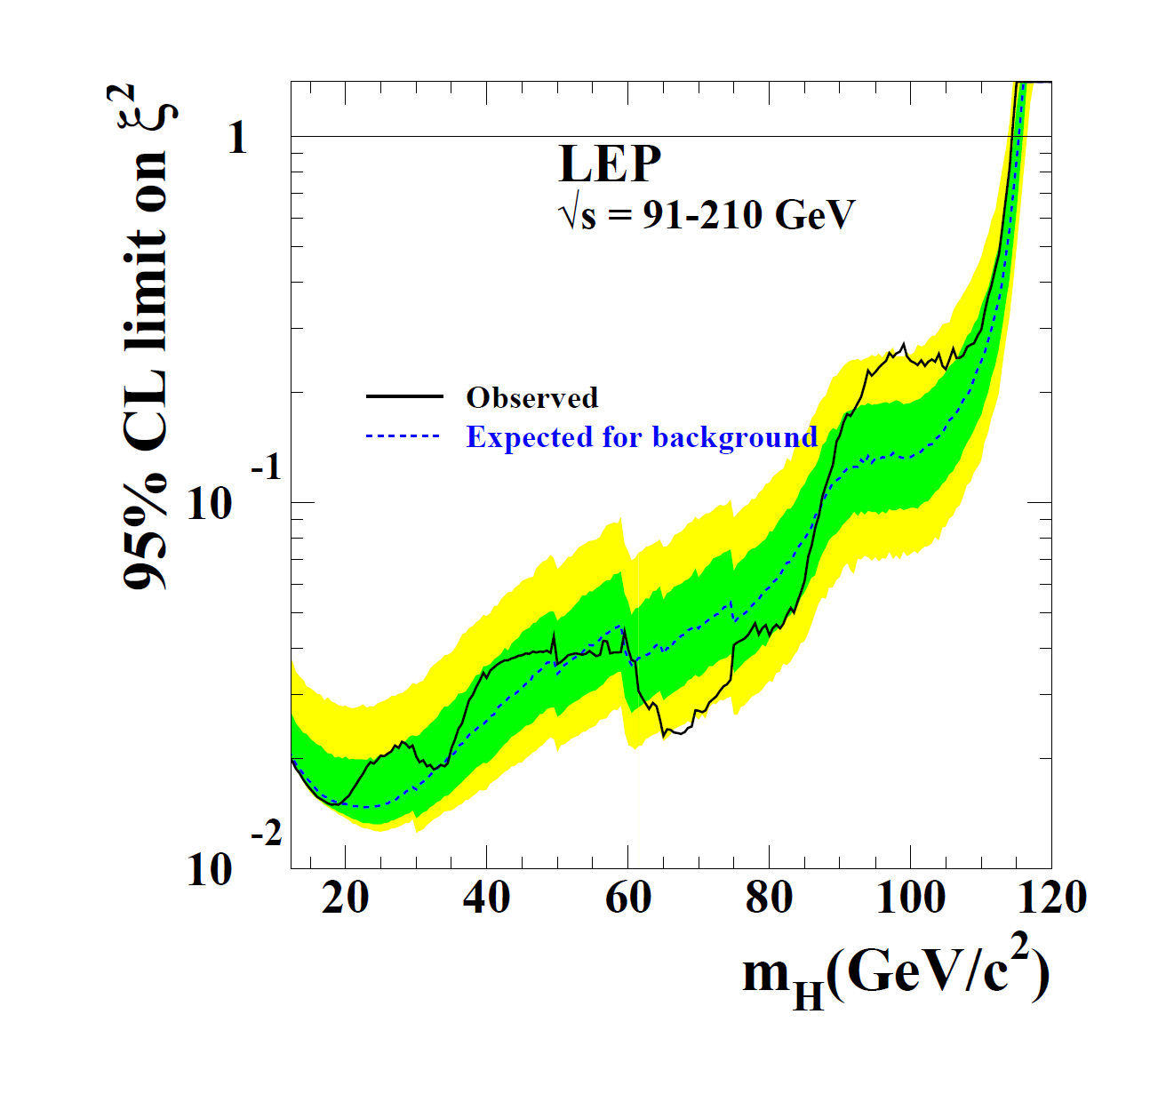

Slide 15
b-PHOBIC LIGHT SCALAR IS A REALISTIC POSSIBILITY IN NMSSM
A NUMBER OF WELL IDENTIFIED PARAMETER REGIONS,
FOR INSTANCE
SMALL
AND
(MOST OFTEN CONSIDERED)
AND

Slide 16
b-PHOBIC LIGHT SCALAR IS A REALISTIC POSSIBILITY IN NMSSM
CP-even Higgs fields
CONVENIENT BASIS
HAS THE SAME COUPLINGS AS THE SM HIGGS
MASS EIGENSTATES

Slide 17
b-PHOBIC LIGHT SCALAR AS AN EFFECT OF THE 3x3 MIXING
BADZIAK, OLECHOWSKI, SP archiv 1304.5437 (JHEP)
BARBIERI, BUTTAZZO, KANNIKE, SALA, TESI archiv 1307.4937
(OBVIOUSLY, ONLY THREE
INDEPENDENT)
19

Slide 18
SIGNAL OF b-PHOBIC
ONE HAS TO SIMULTANEOUSLY
CONSIDER h PROPERTIES FROM THE LHC SINCE THEY ARE CORRELATED;
ALSO CORRELATED ARE THE H PROPERTIES

Slide 19
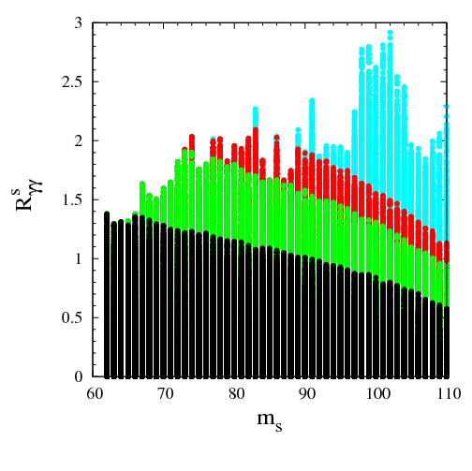
BLACK, GREEN, RED → WITHIN
OF THE h SIGNAL STRENGTH

Slide 20
NMSSM AS A SOURCE OF O(5 GeV) CORRECTION?
MIXING EFFECTS
ENHANCED FOR b-PHOBIC

Slide 21
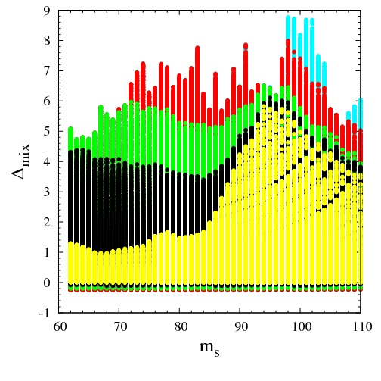

Slide 22
SUMMARY (AFTER 125 HIGGS)
NO REASON YET TO:
GIVE UP THE QUESTION ABOUT THE ORIGIN OF THE FERMI SCALE AS A GUIDING PRINCIPLE FOR THE BSM PHYSICS*
TO RUSH TO THE LANDSCAPE PICTURE FOR THE FERMI SCALE
THE EXPERIMENTAL EXPLORATION OF THE TeV SCALE IS STILL IN A
VERY PRELIMINARY STAGE
MEANWHILE:
INCREASE PRECISION OF THE SM PREDICTIONS AND EXP RESULTS FOR THE h
FILL IN EXPERIMENTAL LOOPHOLES LIKE E.G. A LIGHT SCALAR SEARCH IN PHOTON-PHOTON
CHANNEL
*) SHOULD WE BECOME MORE OPEN MINDED, E.G. WITH RESPECT TO THE QUANTIFICATION OF THE CONCEPT OF NATURALNESS OR IN SEARCHING FOR NON-MINIMAL MODELS;

Slide 23
EVADE LEP BOUNDS BASED ON THE IDENTIFICATION OF b QUARKS
BY SUPPRESING THE bb and tau tau decay channels
THE COMPONENT IN , GIVEN BY IS THEN BOUNDED BY THE LEP BOUNDS BASED ON THE IDENTIFICATION OF TWO HADRONIC JETS

Slide 24
RADIATIVE CORRECTIONS
SUPERSYMMETRY: SOFTLY BROKEN BY PARTICLE-SPARTICLE MASS SPLITTING; TOP AND STOP COUPLE TO THE HIGGS WITH YUKAWA COUPLING
COMPOSITE:
TAKE EFFECTIVE SO(5)/SO(4) AS AN EXAMPLE; SCALAR
AND
FERMION
5-PLETS
SO(5) INVARIANT TERMS
AFTER SPONTANEOUS BREAKING
-SCALE OF
SPONTANEOUS
BREAKING
THE LIGHTER, E.G
THE HEAVIER

Slide 25
COMPOSITE (cont..): SO(5) EXPLICITLY BROKEN BY THE MIXING OF THE SM FERMIONS WITH
SINCE THE HIGGS DOUBLET (GOLDSTONE) COUPLES TO SO(5) FERMIONS
WITH
,
AFTER DIAGONALISATION OF THE MASS MATRIX ONE GETS
AND SOME ADDITIONAL CONTRIBUTIONS TO
THE VECTOR-LIKE FERMION MASSES

Slide 26
M. BADZIAK ET AL

Slide 27
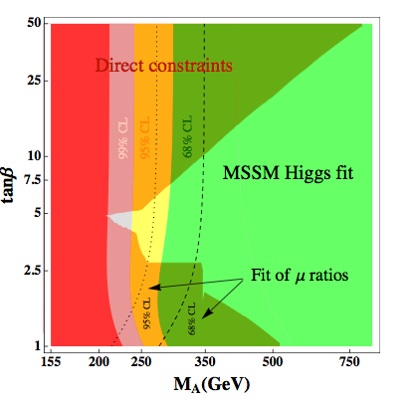
DJOUADI,MAIANI, MOREAU, POLOSA, QUEVILLON, RIQUER
15

Slide 29
DIAGONAL IN THE BASIS

Slide 31
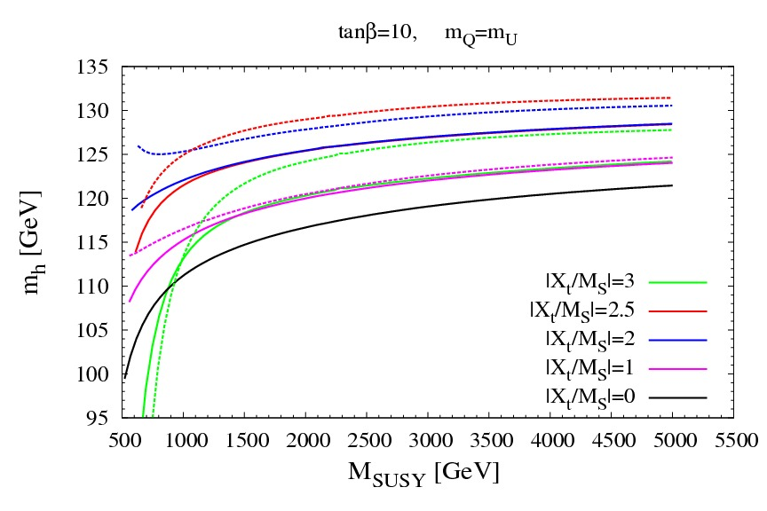

Slide 32
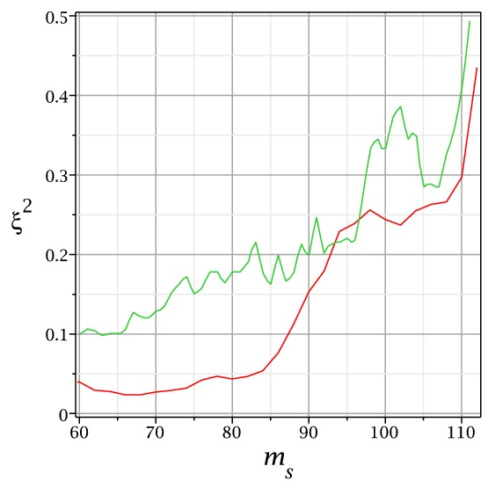

Slide 33
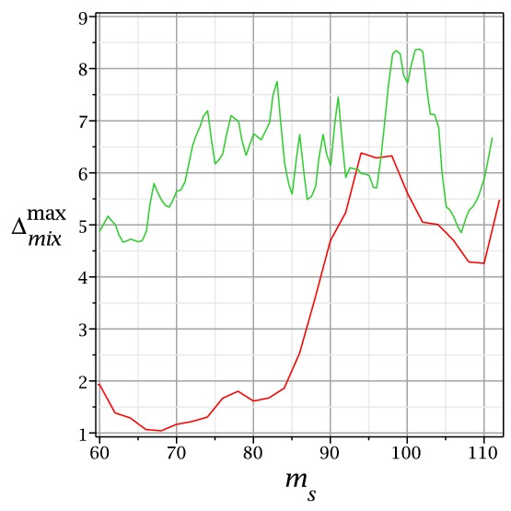

Slide 34
MSSM

Slide 35
DECOUPLING LIMIT:
------→ SM COUPLINGS
H,A heavier than 500 GeV
ADD INFO ON H AND A AS A FUNCTION OF THE HIGGS COUPLINGS

Slide 36
SM
WELL WITHIN PERTURBATIVE REGIME
NO LANDAU POLE UP TO THE PLANCK SCALE

Slide 37
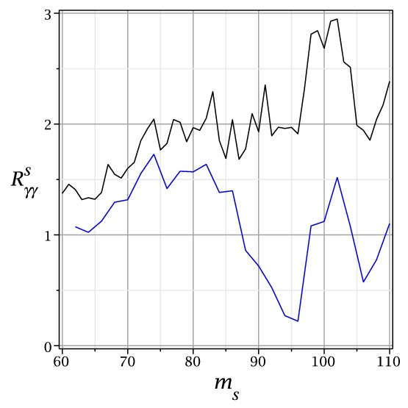

Slide 38
CONCLUSIONS ON THE HIGGS POTENTIAL:
SUPERSYMMETRY- THE HEAVIER THE HIGGS THE MORE FT IN THE VEV;
IN
TOO SMALL, LARGE LOG NEEDED
COMPOSITE: EASY TO GET 125 WITH THE FREE PARAMETER
PUTTING NUMBERS IN SIMPLE MODELS: 125 IMPLIES
IN THE RANGE OF 1 TeV!
IT DOES NOT AUTOMATICALLY IMPLY LARGE FT:
IN FACT, FOR SPLIT MULTIPLETS, THE HEAVIER THE HIGGS THE LESS FT IN VEV

