Slide 1
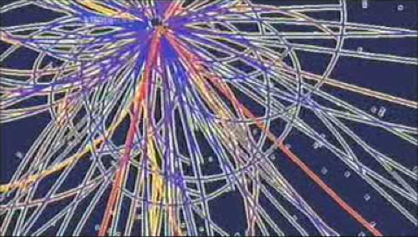
Higgs Hunting 2013, July 25-27, 2013, Orsay, France
Tevatron Constraints on the Higgs Boson
Aurelio Juste
ICREA/IFAE, Barcelona
For the CDF and DØ Collaborations

Slide 2
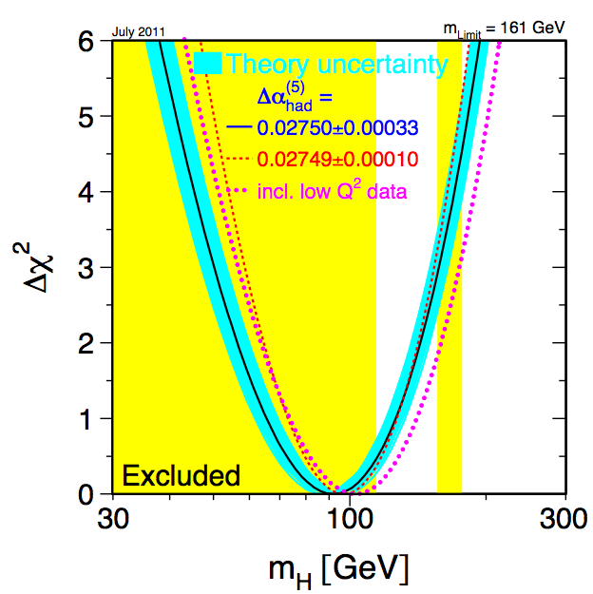
Historical Perspective
Before direct constraints from hadron colliders all we knew about the SM Higgs boson came from:
direct searches at LEP
m_{H}>114.4 GeV @ 95% CL
indirect constraints from precision electroweak observables (*)
m_{H}<152 GeV @ 95% CL
(*) using latest m_{t} and M_{W} measurements from the Tevatron
➔ The Tevatron is expected to be sensitive precisely in this mass range!
➔ Searches for the SM Higgs boson have been a priority at the Tevatron.
July 2011
Over the last decade the outstanding performance of the accelerator and CDF and DØ detectors, together with continuous improvements to the searches, allowed to start placing direct limits beyond LEP and eventually reach SM sensitivity in the preferred mass range.

Slide 3
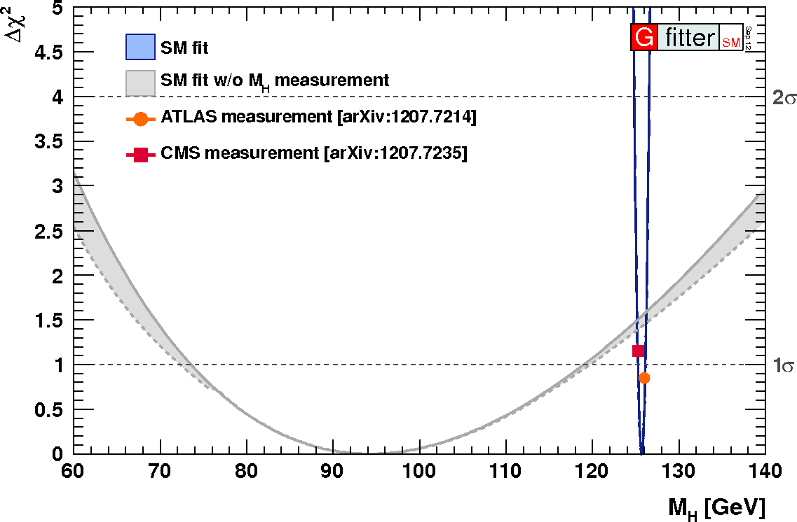
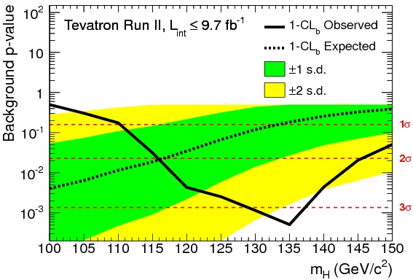
Historical Perspective
Over the last two years, the LHC has excluded most of the remaining allowed mass range and observed a new boson with mass ~125 GeV, primarily in γγ and ZZ→4l final states.
The Tevatron experiments independently reported evidence for a new particle decaying into bb with compatible mass.
Since the observation, Higgs studies at the Tevatron have focused on the measurement of Higgs properties (rates in different decay modes, couplings, J^{P}).
In addition, Tevatron measurements of key electroweak parameters (m_{t} and M_{W}) will play an increasingly important role to help unravel the nature of the discovered boson and point to potential new physics effects.
A remarkably consistent picture!
Phys. Rev. Lett. 109, 071804 (2012)

Slide 4
Today’s Presentation
Introduction
Direct constraints on the Higgs boson
➔ Here will just give a quick overview of SM Higgs boson searches.
For more details see talks by S. Shalhout and G. Davies.
➔ Will not discuss BSM Higgs boson searches.
For an overview see talk by J. Hays.
Indirect constraints on the Higgs boson: m_{t} and m_{W}
➔ Main focus of this talk
Summary and outlook

Slide 5
Direct Constraints

Slide 6
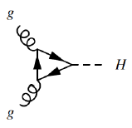
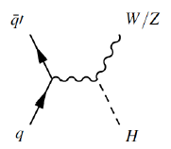
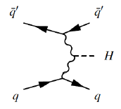
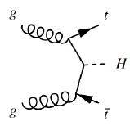
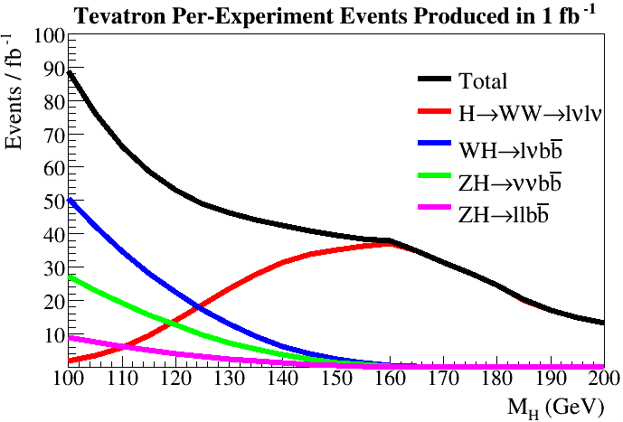
Search Strategies
Defined by a combination of theoretical and experimental considerations (large σxBR but experimentally feasible: trigger, backgrounds….).
H→bb
H→τ⁺τ⁻
H→γγ
H→W⁺W⁻
For m_{H}=125 GeV, ~1000 Higgs events produced at the Tevatron in the main search channels with 10 fb⁻¹!

Slide 7
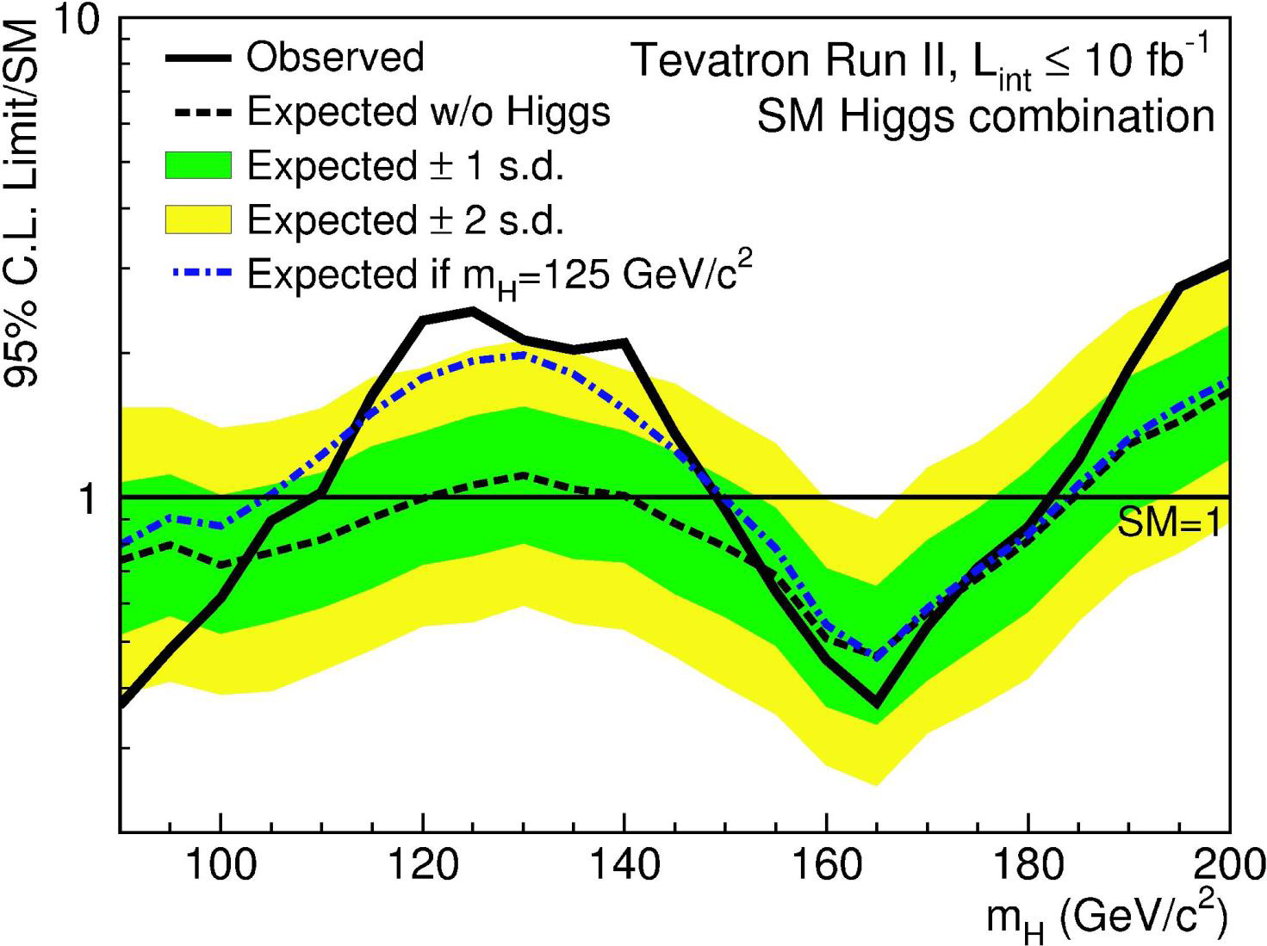
Tevatron Combined Results
arXiv:1303.6346
Expected exclusion: 90 < m_{H} < 120 GeV, 140< m_{H} < 184 GeV
Observed exclusion: 90 < m_{H} < 109 GeV, 149 < m_{H} < 182 GeV
95% CL limit at m_{H}=125 GeV: 1.06xSM (expected), 2.44xSM (observed)

Slide 8
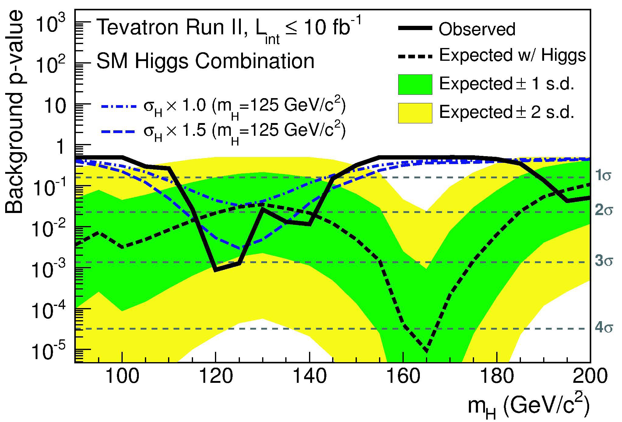
Quantifying the Excess: p-values
Local p-value distribution for background-only hypothesis:
arXiv:1303.6346
Median expected p-value for B-only hypothesis
Median expected p-value for S+B hypothesis (for m_{H}=125 GeV)
Median expected p-value for S+B hypothesis
Minimum local p-value at m_{H}=120 GeV: 3.1σ (2.0σ expected)
p-value at m_{H}=125 GeV: 3.0σ (1.9σ expected)

Slide 9
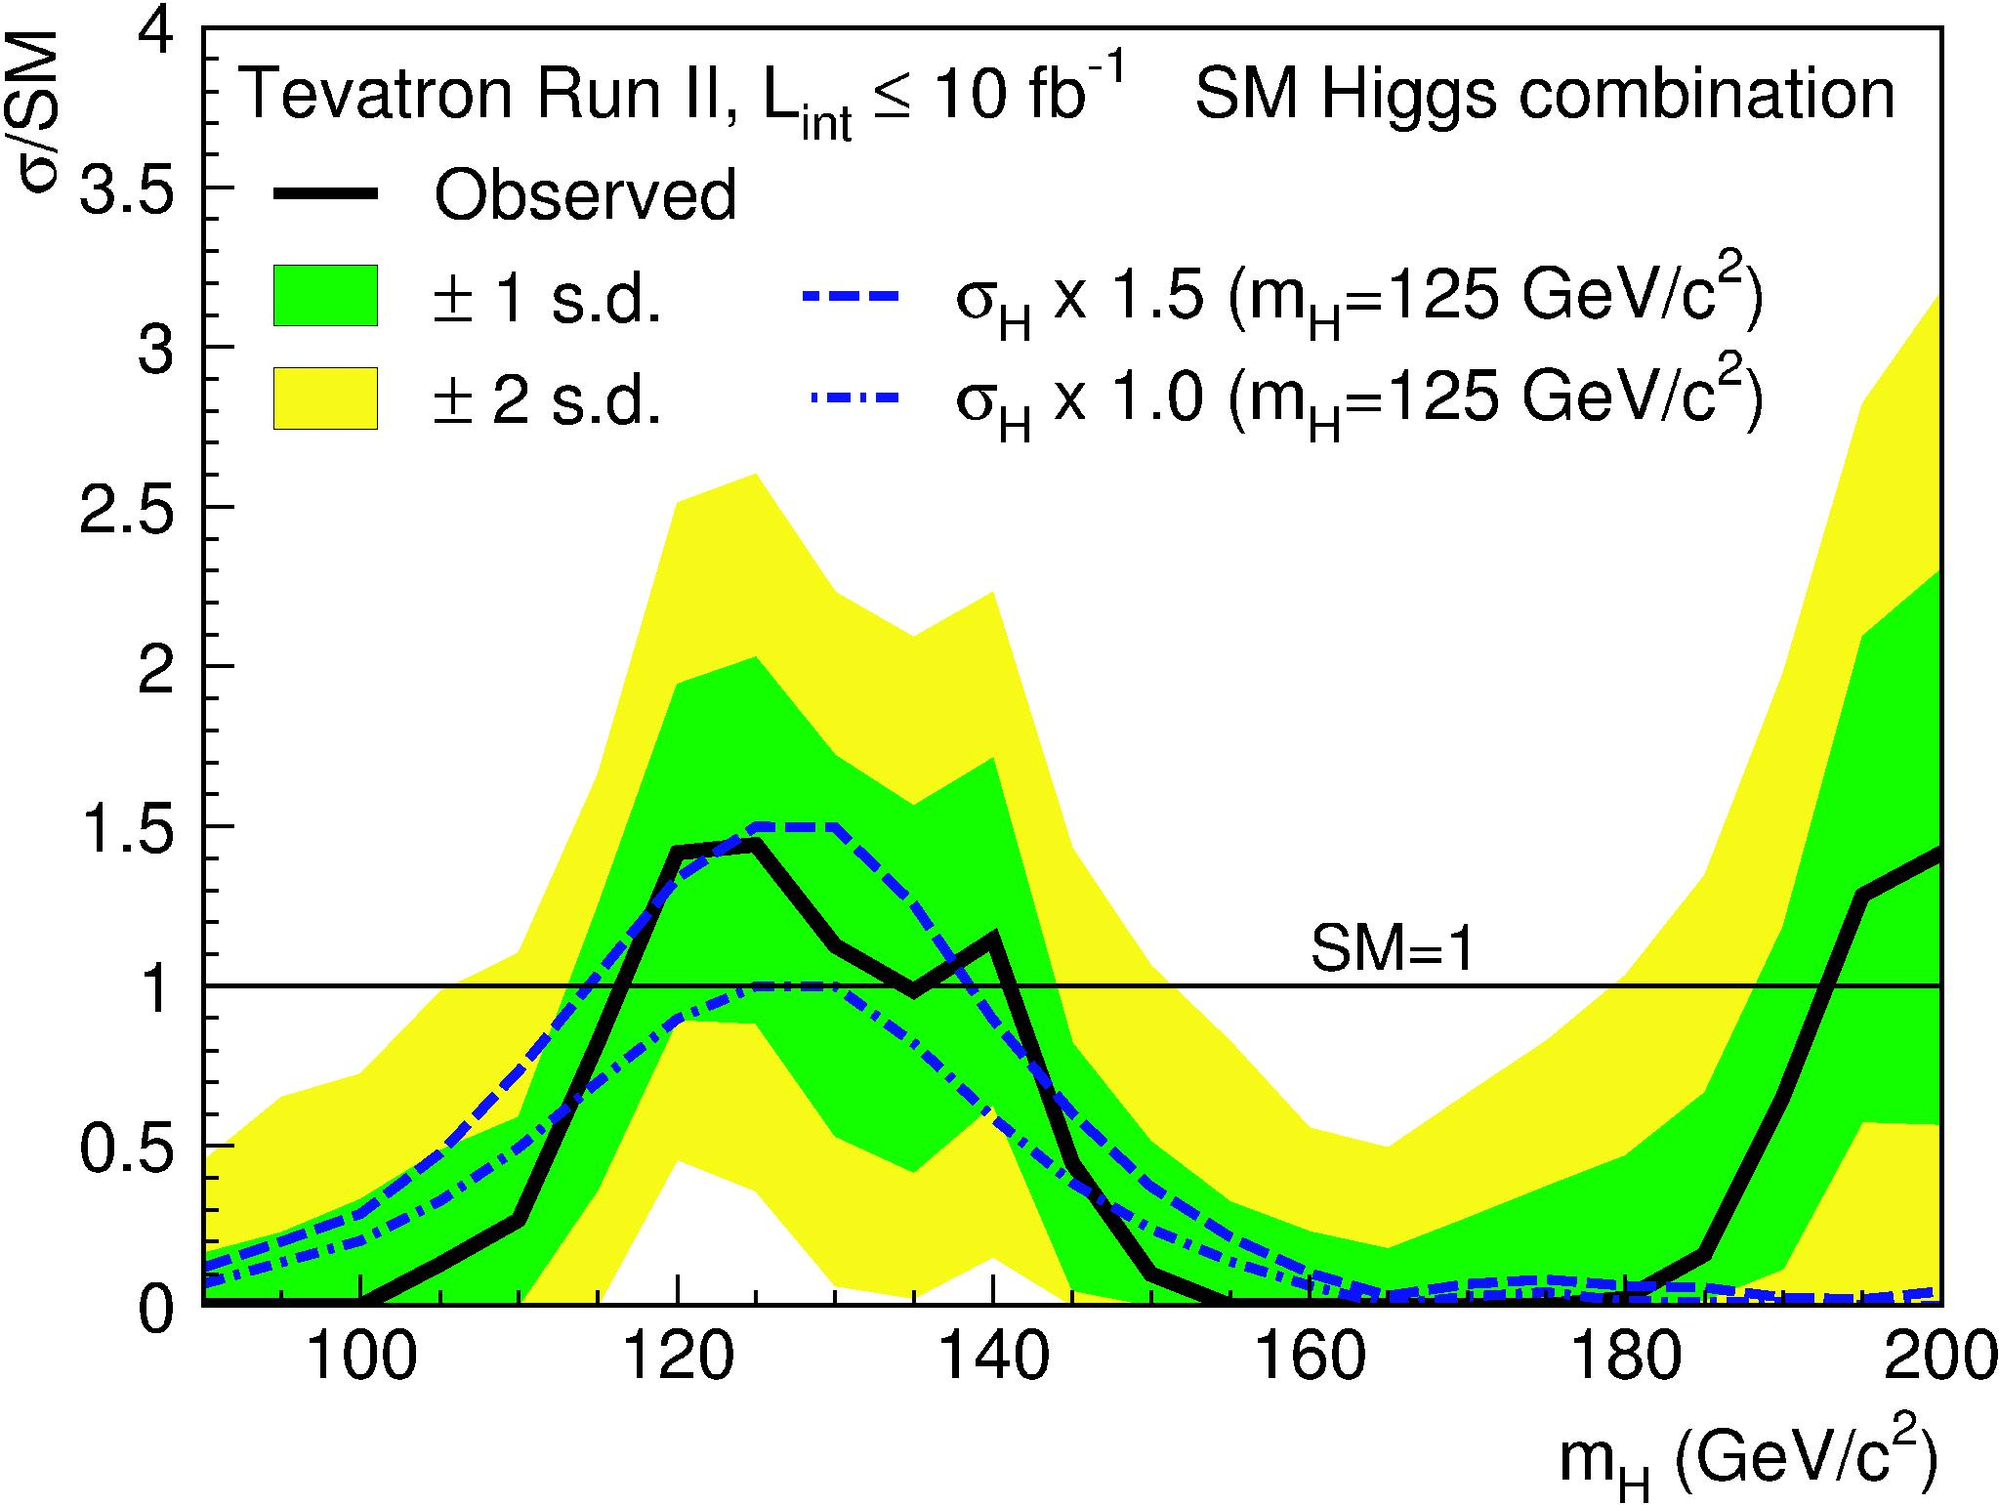
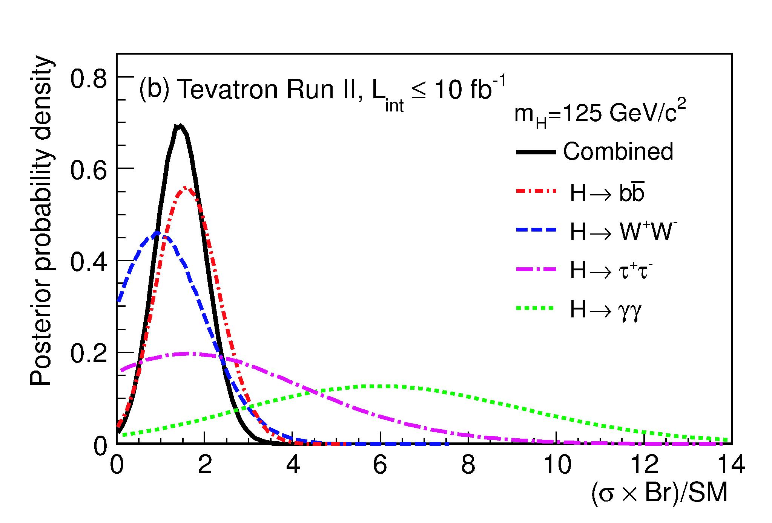
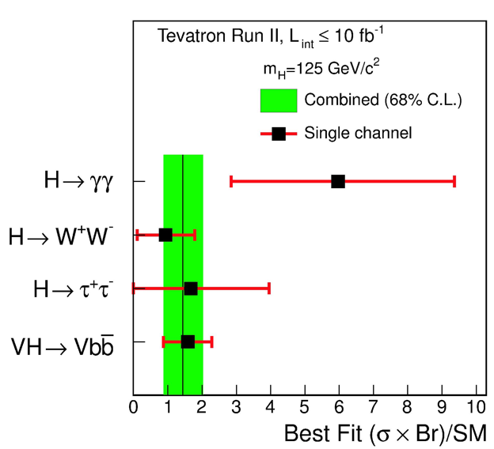
Quantifying the Excess: Best Fit Signal Rate
arXiv:1303.6346
Maximum likelihood fit to data with signal rate as free parameter.
Best-fit signal rate at m_{H}=125 GeV:
Consistent with SM Higgs.
Reasonably consistent across channels.

Slide 10
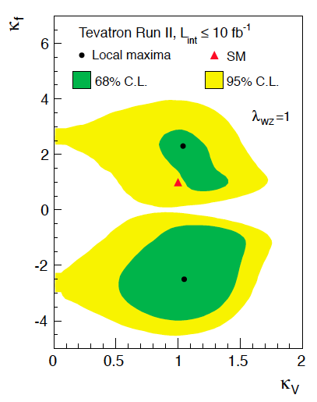
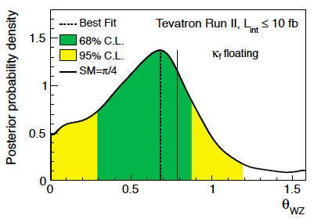
Probing Higgs Boson Couplings
Benchmark I:
Probe SU(2)_{V} custodial symmetry by measuring the ratio λ_{WZ}=κ_{W}/κ_{Z}.
Assume all fermion couplings are scaled by a common free parameter (κ_{F}).
Benchmark II:
Consider two independent multiplicative factors: common to all couplings to vector bosons (κ_{V}) and common to all couplings to fermions (κ_{f}). Assume λ_{WZ}=1.
Measure κ_{f} and κ_{V} simultaneously.
arXiv:1303.6346
Measurements consistent with the SM prediction

Slide 11
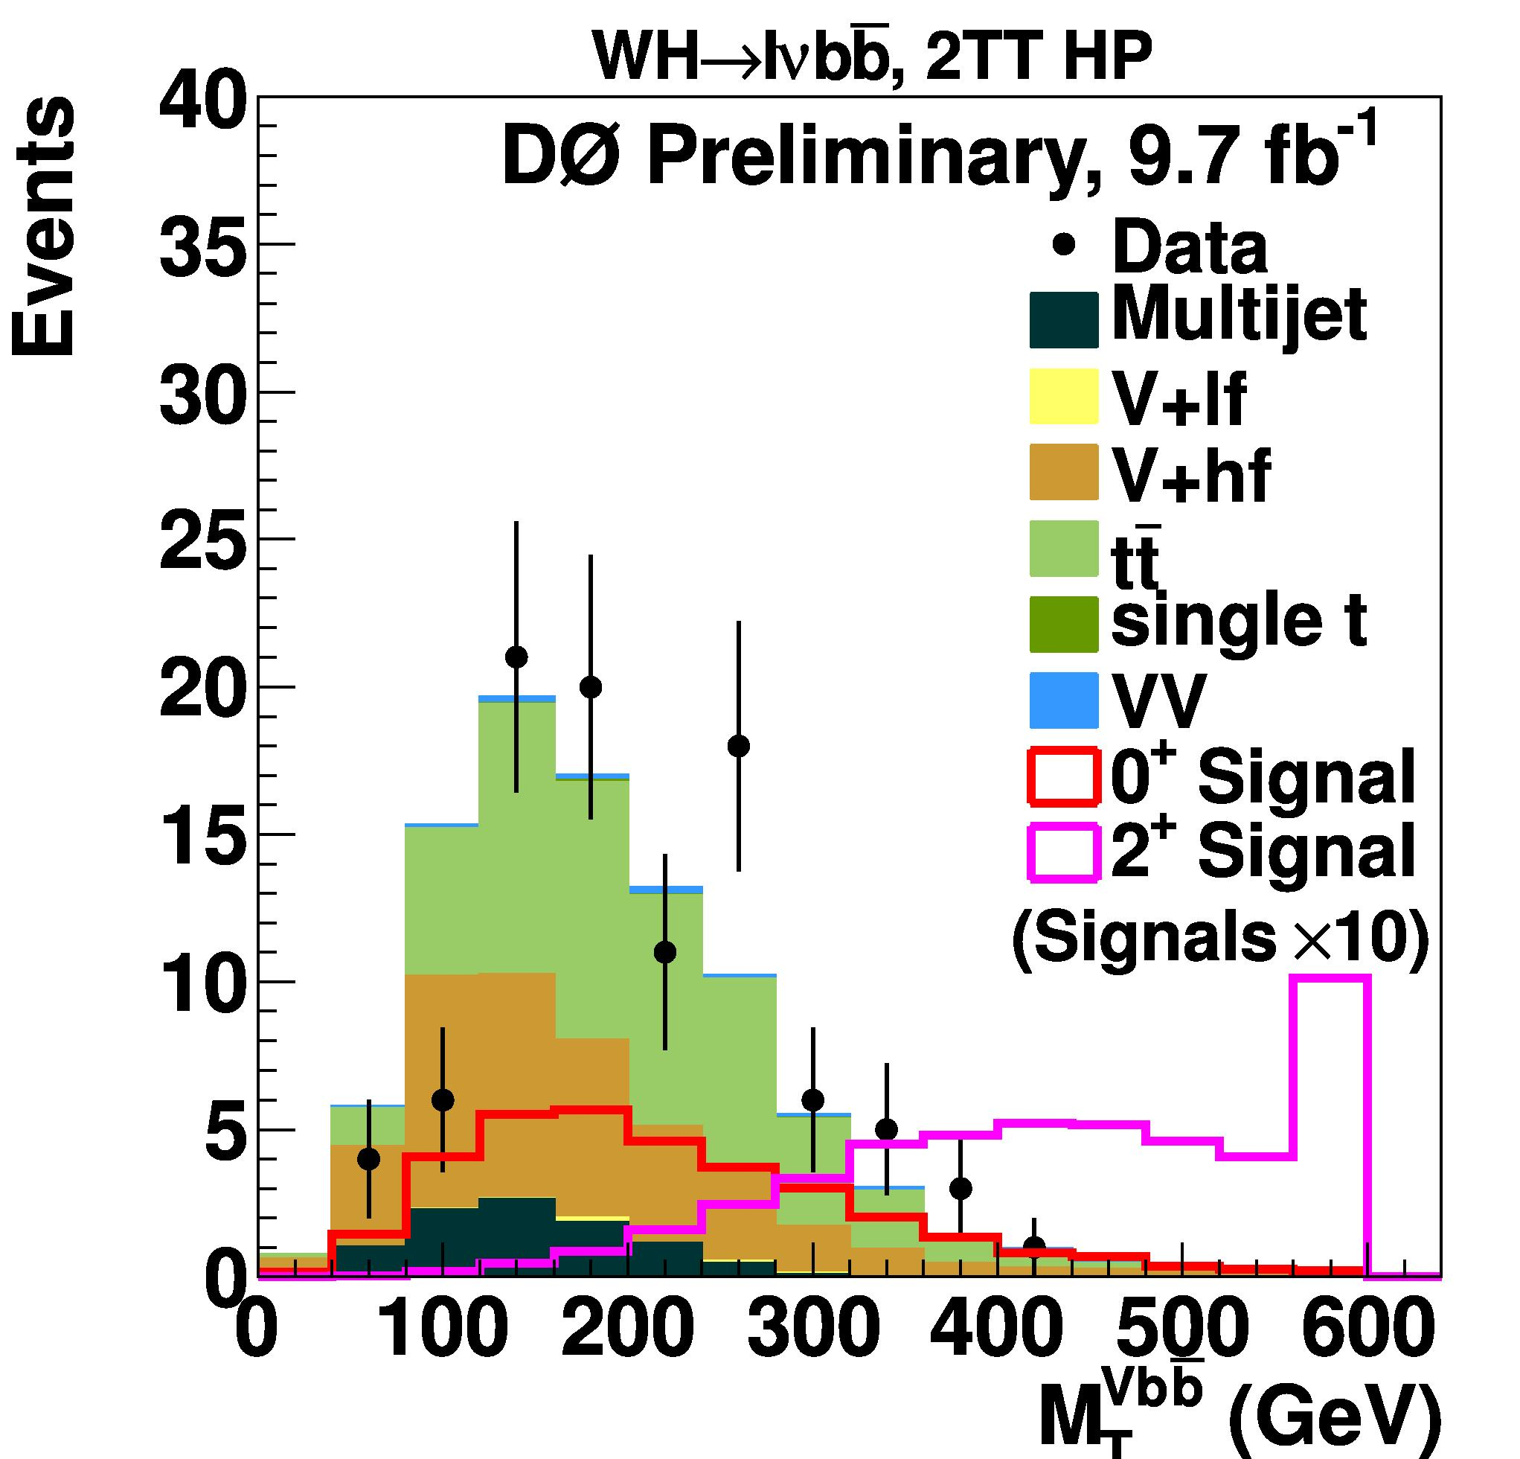
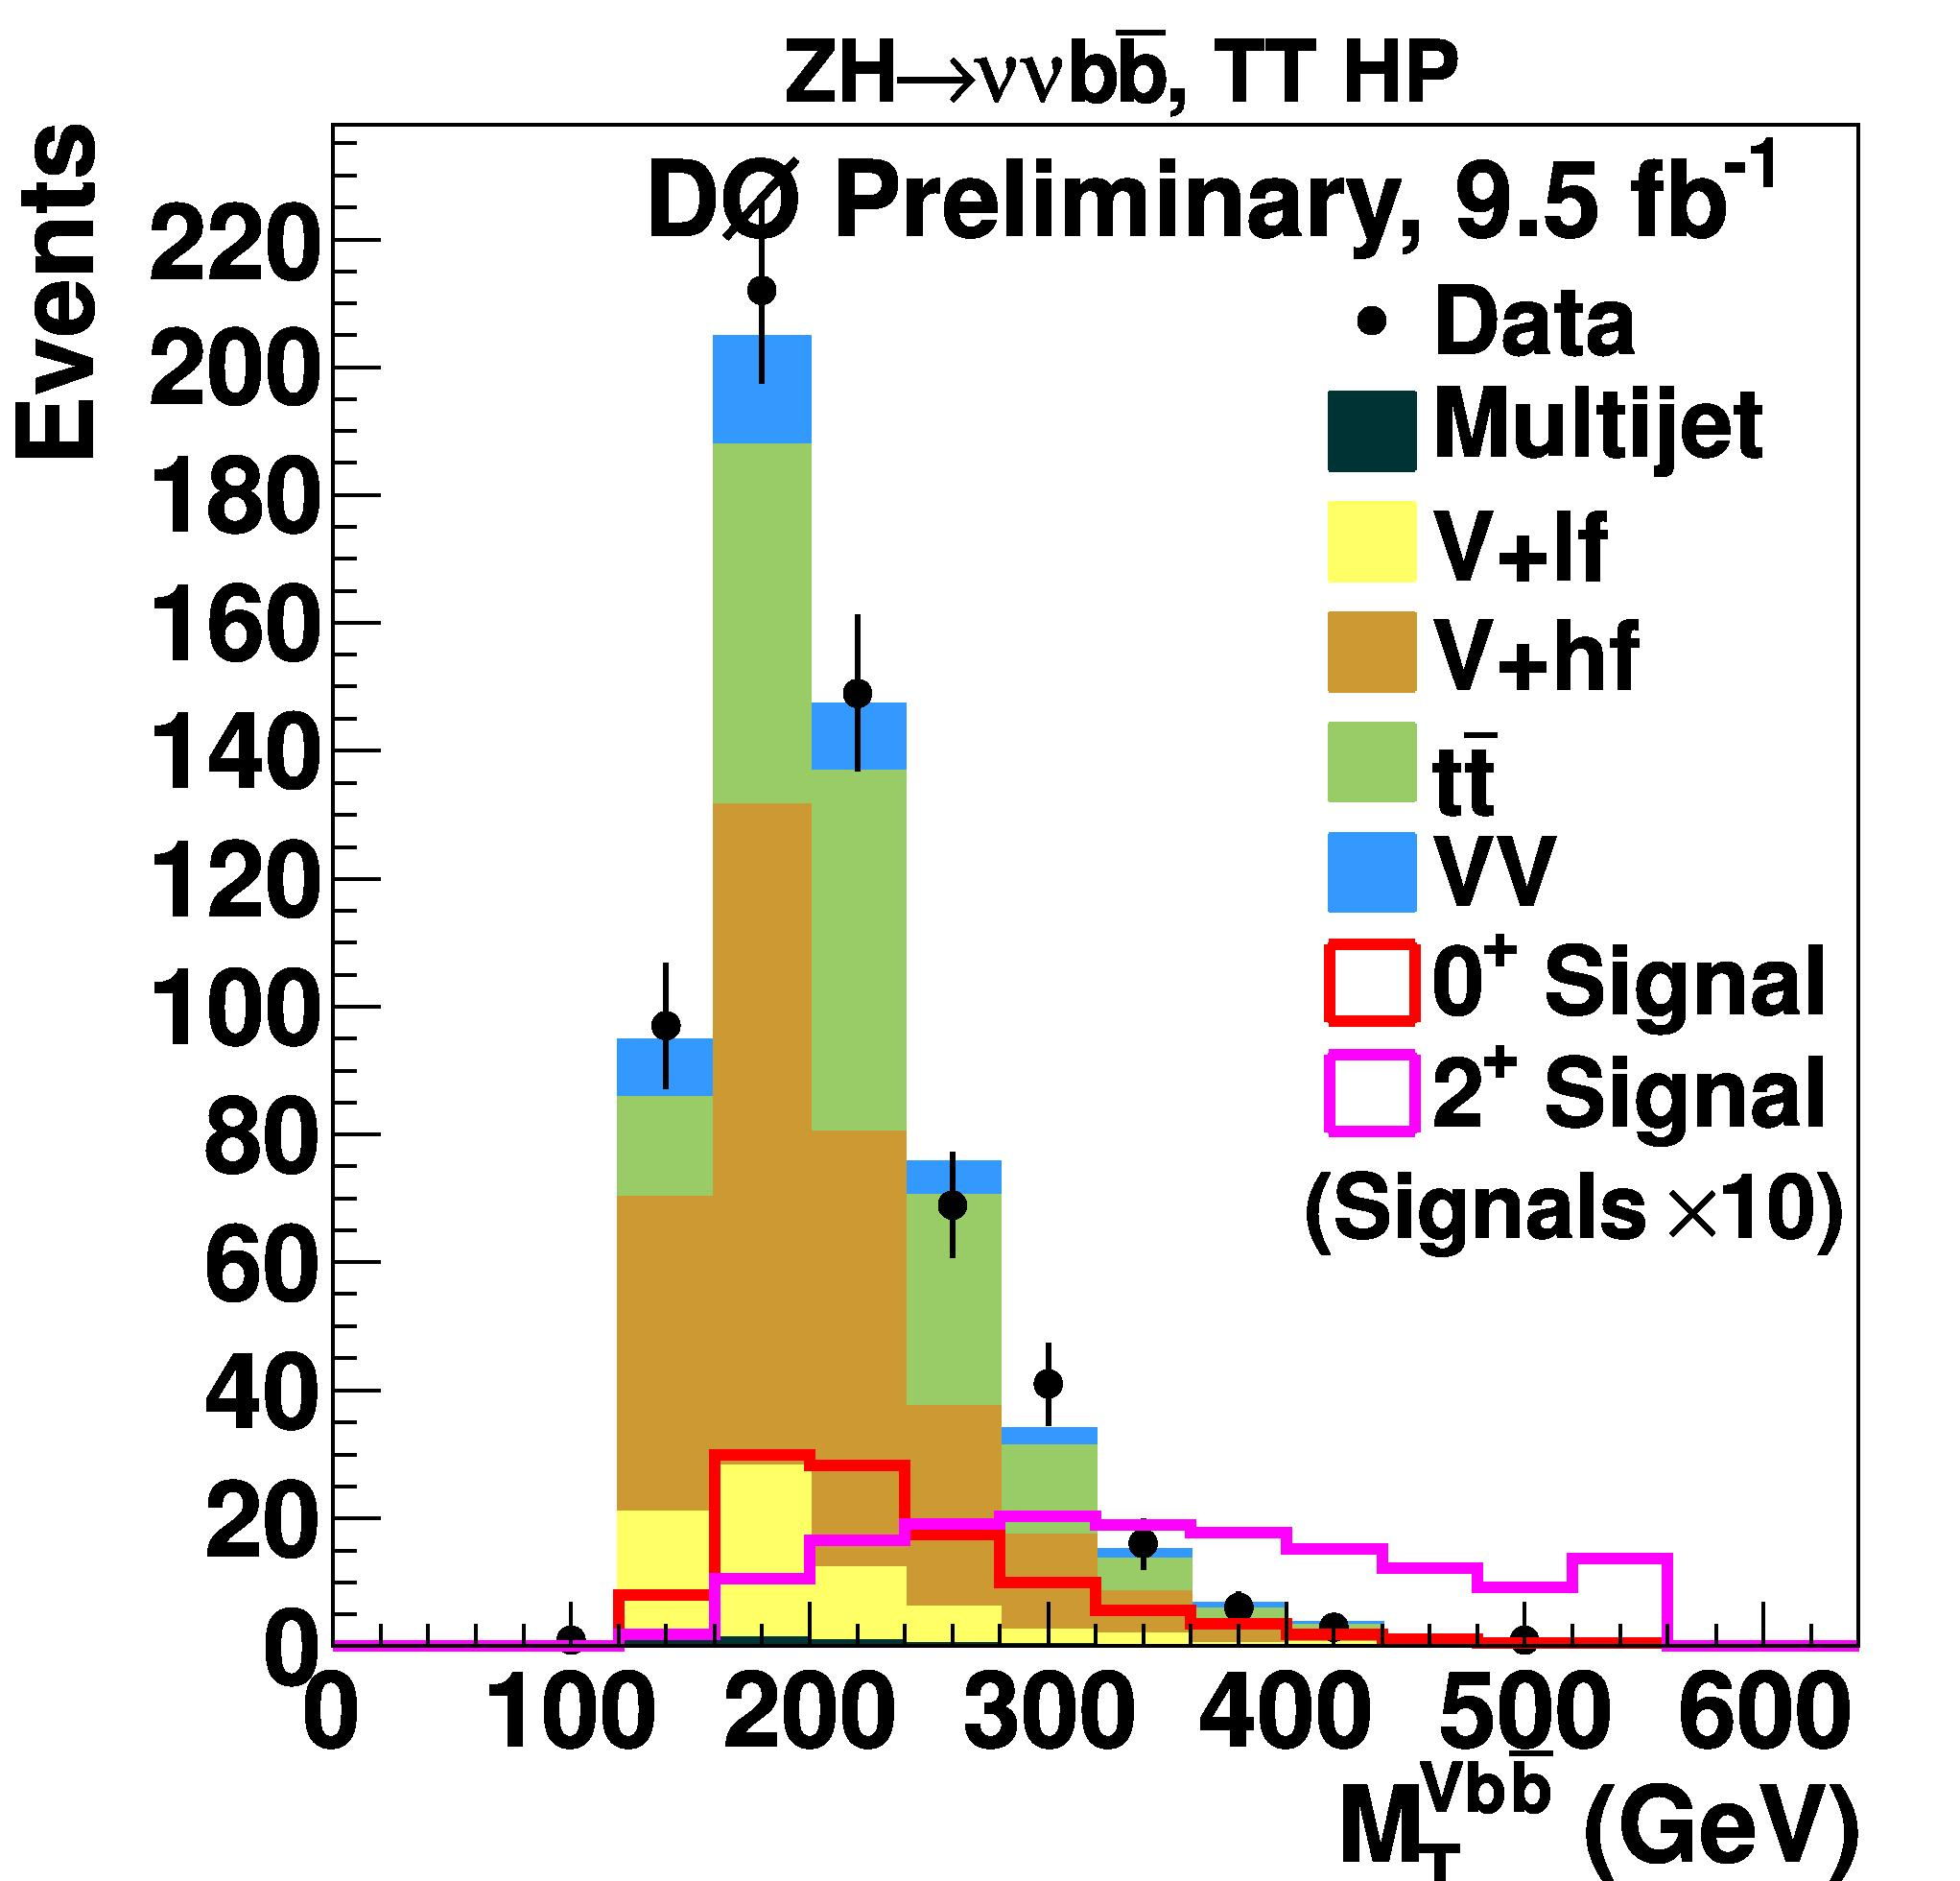
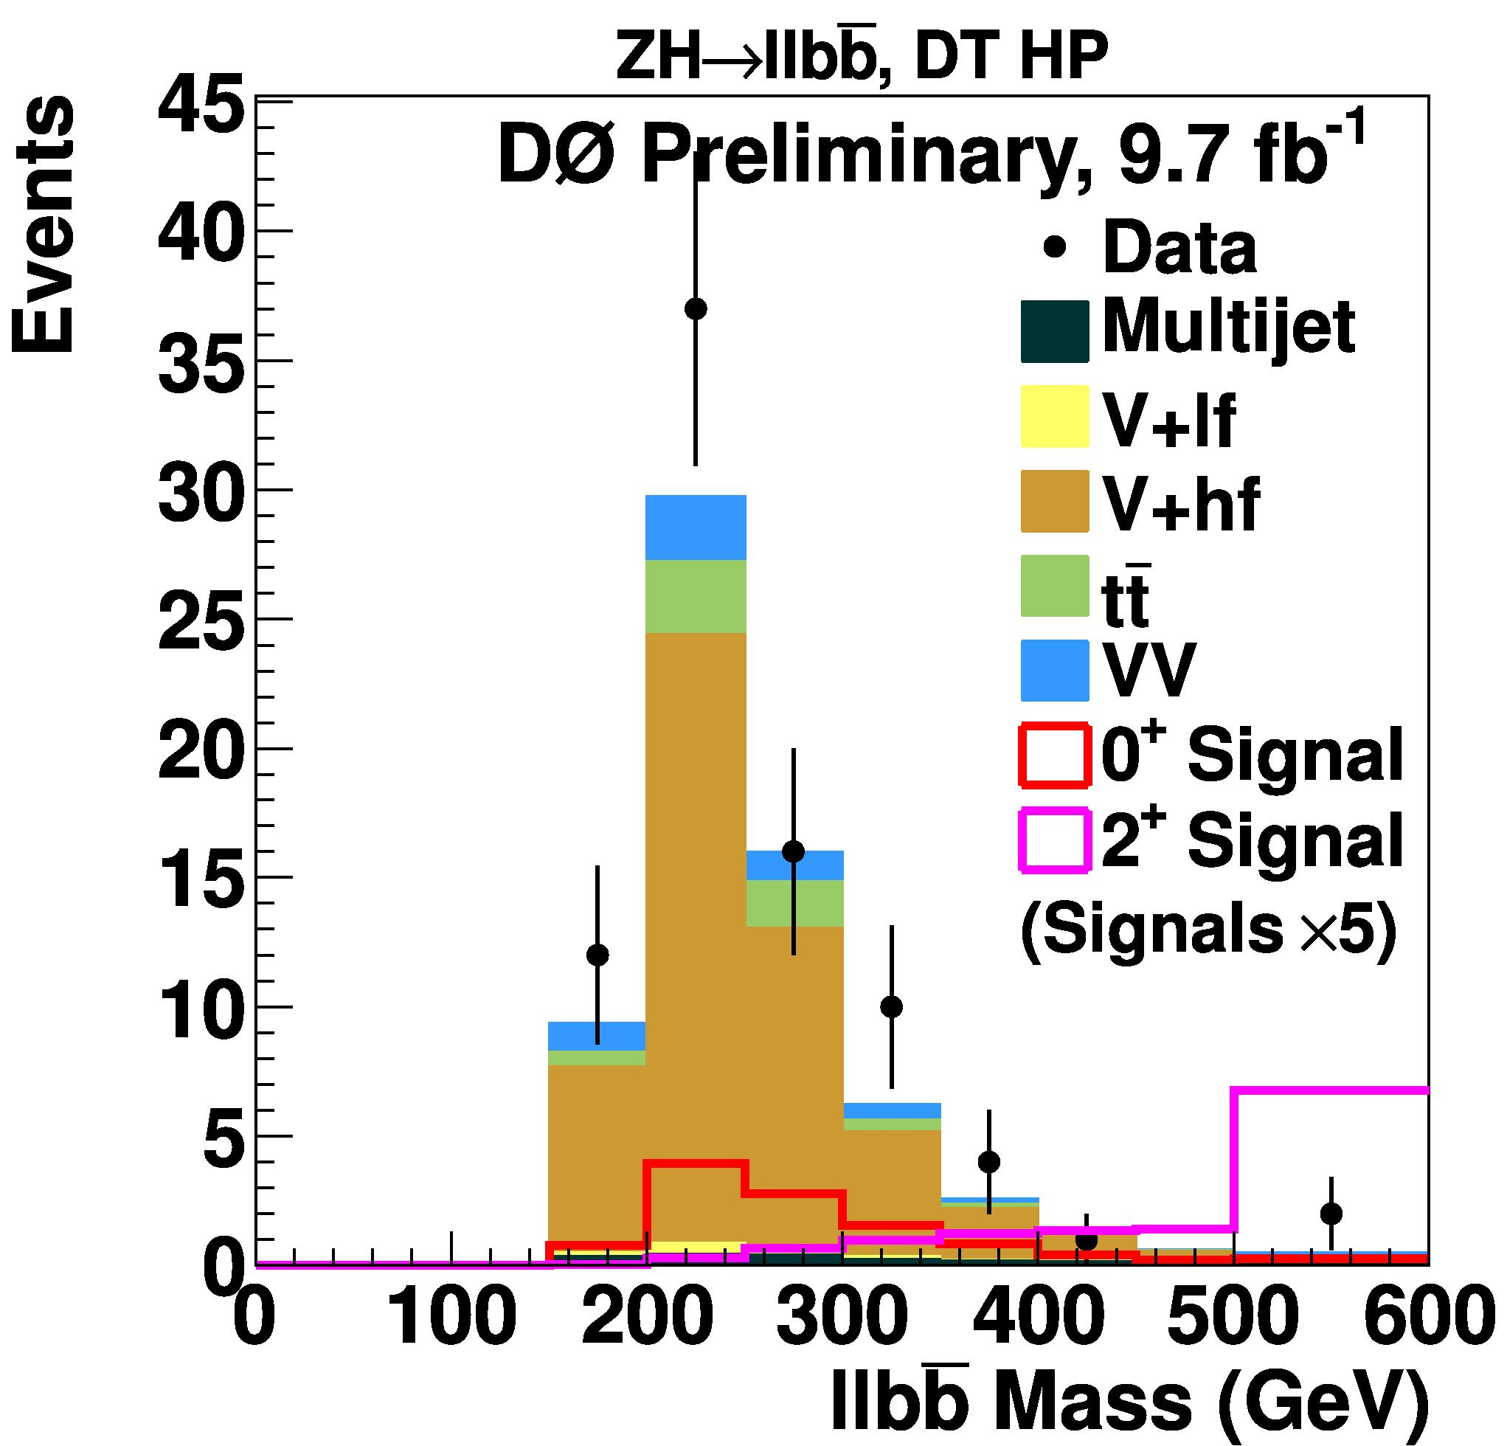
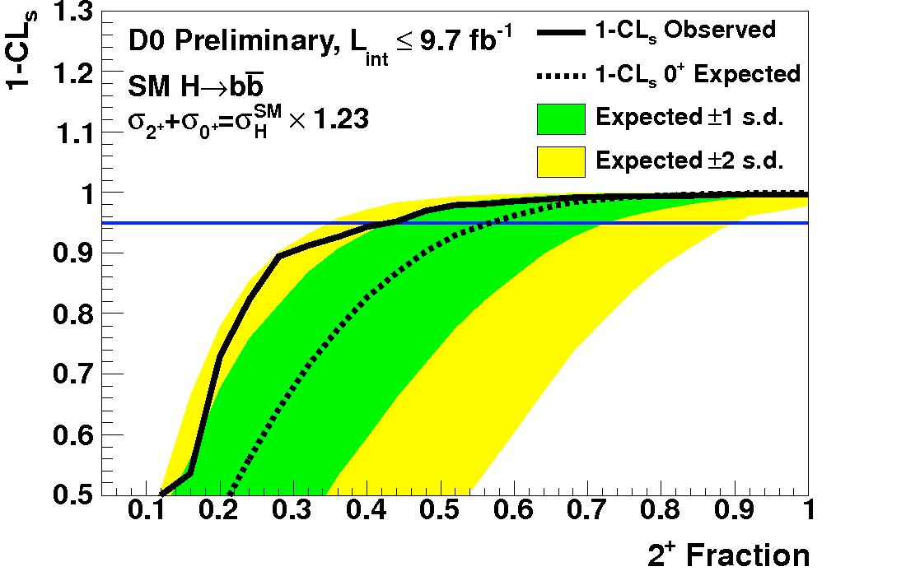
Spin/Parity
LHC results in bosonic decay modes consistent with J^{P}=0⁺ hypothesis.
Tevatron can check J^{P} in VH(H→bb) production (J. Ellis et al., JHEP 1211, 134 (2012)).
So far results from DØ on 0⁺ vs 2⁺ (graviton-like couplings). 0⁺ vs 0⁻ and Tevatron combination upcoming.
DØ Note 6387-CONF
For μ=1.23 (DØ measured rate):
Exclude 2⁺ at 99.9% CL (in favor of 0⁺).
Assuming the excess results from a superposition of a 0⁺ and 2⁺ particle:
Exclude a 2⁺ fraction f₂₊>0.42 at 95% CL (in favor of pure 0⁺).

Slide 12
Indirect Constraints

Slide 13
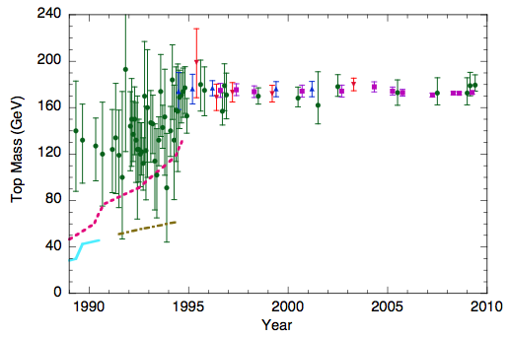
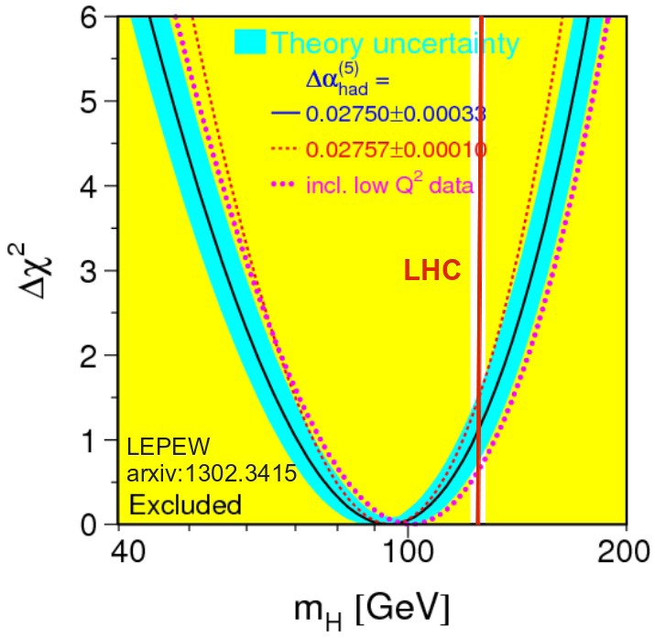
Precision Electroweak Observables
Experimental and theoretical precision achieved allow to test the electroweak theory at the quantum level.
Early M_{W} measurements allowed to infer m_{t}
Top discovery
Precision EW observables, along with m_{t}, allow to infer M_{H} (M_{W} is one of the most sensitive measurements)

Slide 14
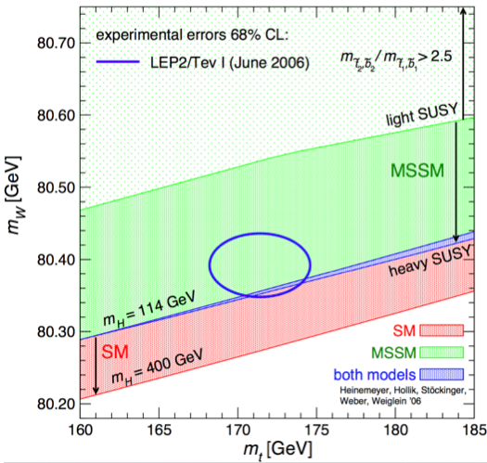
Precision Electroweak Observables
Experimental and theoretical precision achieved allow to test the electroweak theory at the quantum level.
Status early in Run II
Δm_{t}~2 GeV (from early Tevatron Run II meas.)
ΔM_{W}~30 MeV (dominated by LEP2)

Slide 15
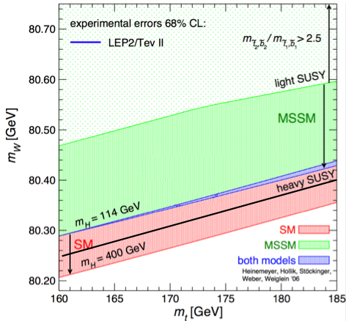
Precision Electroweak Observables
Experimental and theoretical precision achieved allow to test the electroweak theory at the quantum level.
A Hypothetical Scenario in 2012
Higgs boson with M_{H}=160 GeV discovered at Tevatron or LHC
Δm_{t}~1 GeV (~ultimate Tevatron precision)
ΔM_{W}~15 MeV (dominated by Tevatron)

Slide 16
Precision Electroweak Observables
Experimental and theoretical precision achieved allow to test the electroweak theory at the quantum level.
A Hypothetical Scenario in 2012
Zoom in
Higgs boson with M_{H}=160 GeV discovered at Tevatron or LHC
Δm_{t}~1 GeV (~ultimate Tevatron precision)
ΔM_{W}~15 MeV (dominated by Tevatron)

Slide 17
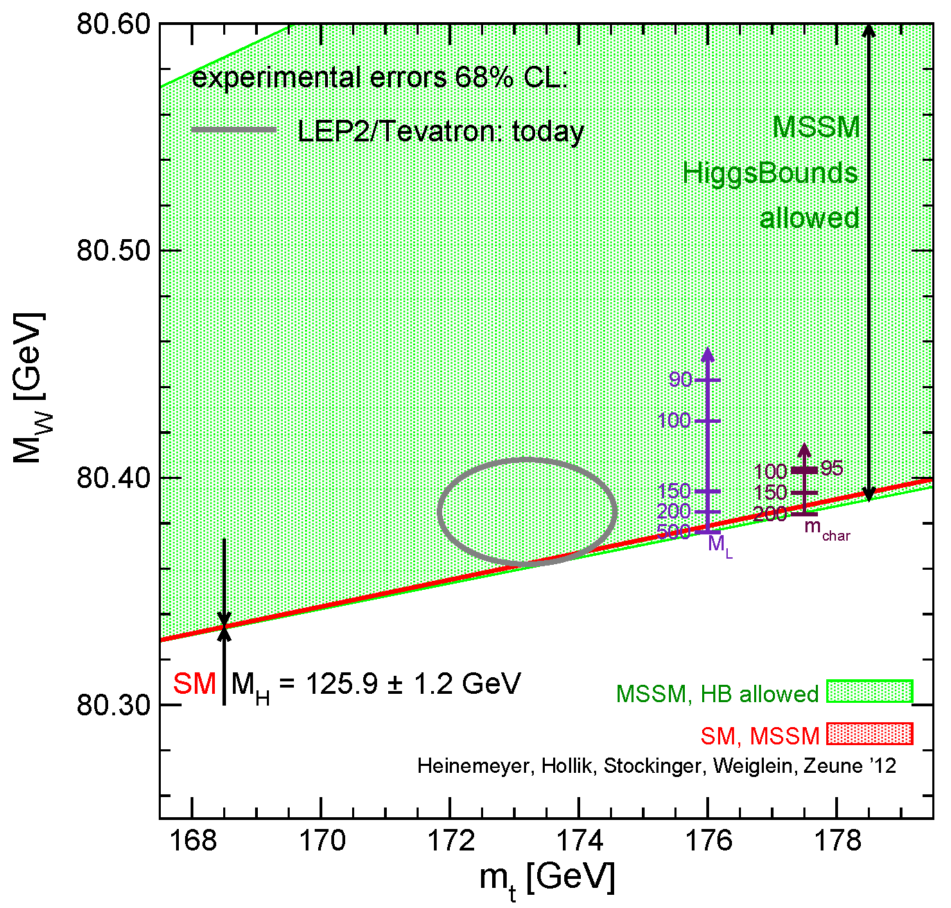
Precision Electroweak Observables
Experimental and theoretical precision achieved allow to test the electroweak theory at the quantum level.
Actual Scenario in 2012
Updated from hep-ph/0604147
Higgs boson with M_{H}~125 GeV discovered at LHC
Δm_{t}~0.94 GeV (still improving)
ΔM_{W}~15 MeV (still improving)

Slide 18
Precision Electroweak Observables
Experimental and theoretical precision achieved allow to test the electroweak theory at the quantum level.
Following the Higgs boson discovery, the SM loops are determined and so can effectively start constraining NP models.
Actual Scenario in 2012
Updated from hep-ph/0604147
SUSY loops can contribute ~100 MeV to M_{W}!

Slide 19
Top Quark Mass

Slide 20
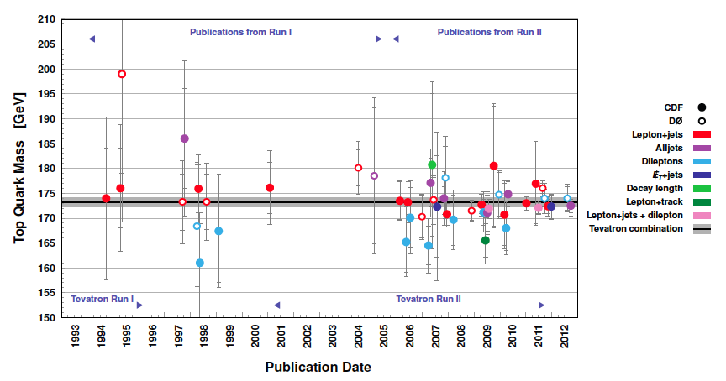
Top Quark Mass
Precision on top quark mass measurements has improved by one order or magnitude since Run I:
Best single measurement in Run I: Δm_{t}/m_{t}~7%
Best single measurement in Run II: Δm_{t}/m_{t}~0.7%
This has been possible, not only to the much large available statistics, but also to the development of novel experimental techniques, most of which have been adopted by LHC experiments.

Slide 21
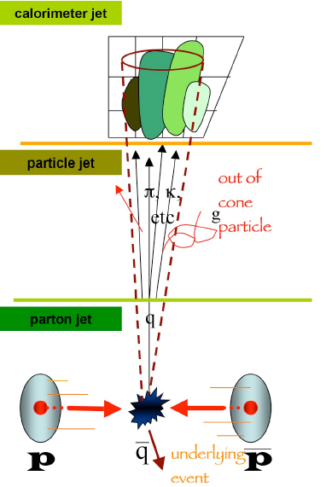
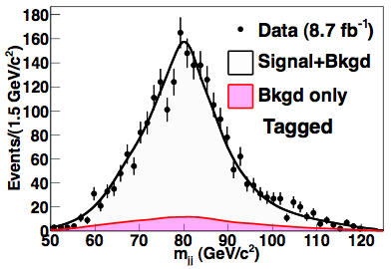
Handles for a Precise Measurement
Jet Energy Scale (JES)
Top mass measurement requires precise mapping between reconstructed jets and original partons ➔ correct for detector, jet algorithm and physics effects.
What’s crucial is the relative energy calibration between data and MC jets:
ΔE_{jet}/E_{jet}~1% ➔ Δm_{t} ~ 1 GeV
Handles:
dijets, photon+jets, Z+jets
W mass from W→jj in top quark decays (in-situ calibration)
B-tagging: reduction of physics as well as combinatorial background
Sophisticated mass extraction techniques: maximize statistical sensitivity; minimize some systematic uncertainties (e.g. JES)
Simulation: accurate detector modeling and state-of-the-art theoretical knowledge (gluon radiation, b-fragmentation, etc) required.

Slide 22
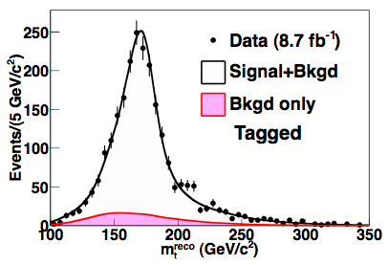
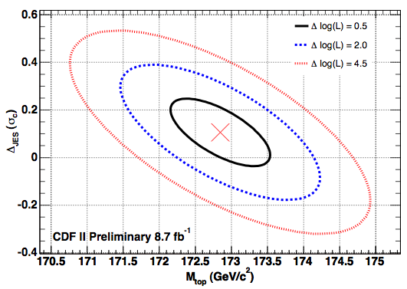
Mass Extraction Techniques: Template Methods
Identify kinematical variables strongly correlated with m_{t}. Compare data and MC with different m_{t} hypotheses.
Example: reconstructed m_{t} from kinematic fit in lepton+jets channel.
Usually pick solution with lowest χ².
Reduce JES systematic by using in-situ hadronic W mass in tt events: simultaneous determination of m_{t} and JES scaling factor from reconstructed m_{t} and M_{W} templates.
PRL 109, 152003 (2012)

Slide 23
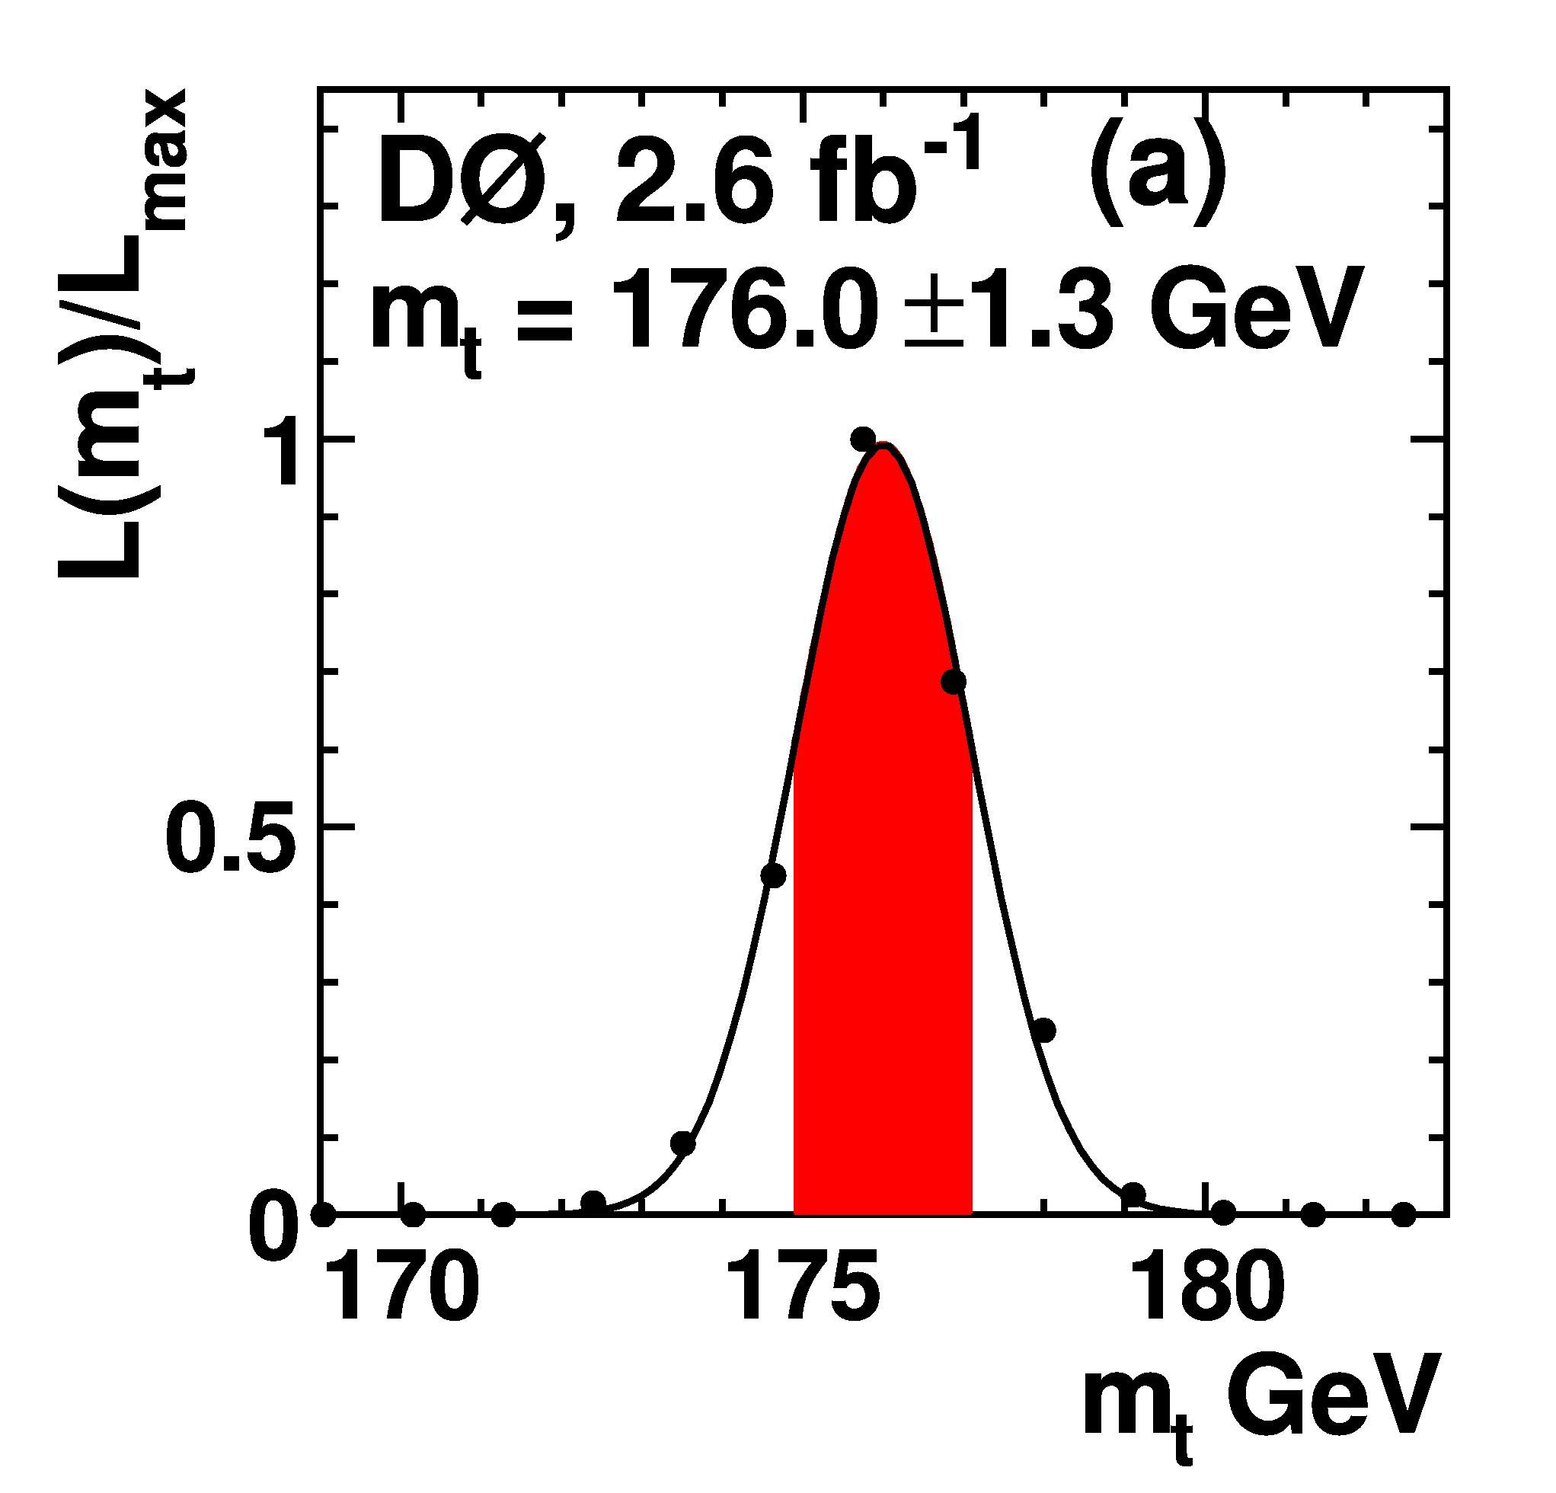
Mass Extraction Techniques: Dynamic Methods
Compute event-by-event probability as a function of m_{t} making use of all reconstructed objects in the events (integrate over unknowns). Maximize sensitivity by:
summing over all permutations of jets and neutrino solutions
allowing better measured events to contribute more.
Example: matrix element method
Also incorporate in-situ JES calibration.
parton distribution functions
differential cross section (LO matrix element)
transfer function: mapping from
parton-level variables (y) to
reconstructed-level variables (x)
PRD 84, 032004 (2011)

Slide 24
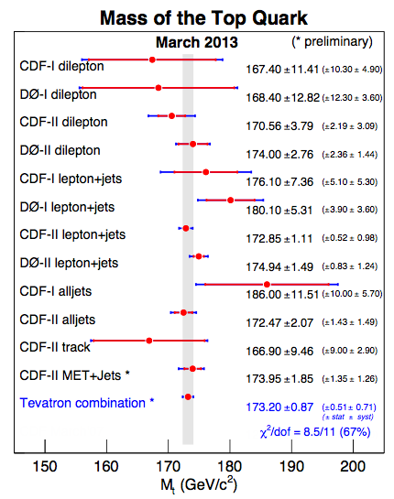
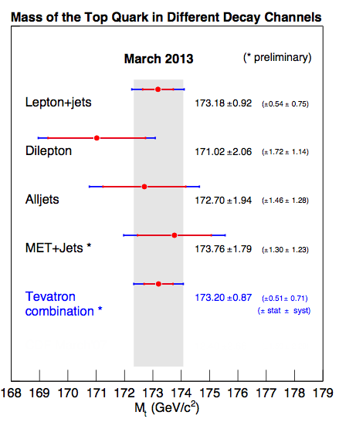
Tevatron Summary
arXiv:1305.3929
m_{t} = 173.20 ±0.51(stat) ±0.71(syst) GeV
Χ²/NDF = 8.5/11 (prob=67%)
0.5% overall precision! Statistical and systematic uncertainties comparable.
Consistent measurement across decay channels.

Slide 25
Tevatron Summary
Uncertainty Source | Δm_{t} (Gev)
In-situ JES | 0.36
Light-jet response (1) | 0.16
Light-jet response (2) | 0.15
Model of b jets | 0.11
Response to b/q/g jets | 0.09
Out-of-cone correction | 0.01
Total JES | 0.44
Signal model | 0.52
Jet model | 0.08
Lepton model | 0.05
Background data | 0.13
Background MC | 0.06
Multiple interactions | 0.07
Method calibration | 0.06
Total systematic | 0.71
Statistical | 0.51
Total | 0.87
m_{t} = 173.20 ±0.51(stat) ±0.71(syst) GeV
Χ²/NDF = 8.5/11 (prob=67%)
0.5% overall precision! Statistical and systematic uncertainties comparable.
Dominant systematics:
In-situ JES: scales like 1/√L
Signal modeling
Prospects: DØ measurements being updated to the full dataset:
Increased statistics by x2 (dileptons), x3 (lepton+jets)
Alljets measurement for first time.
Reduced systematics
Tevatron combination may reach ultimate precision ~0.7-0.8 GeV.

Slide 26
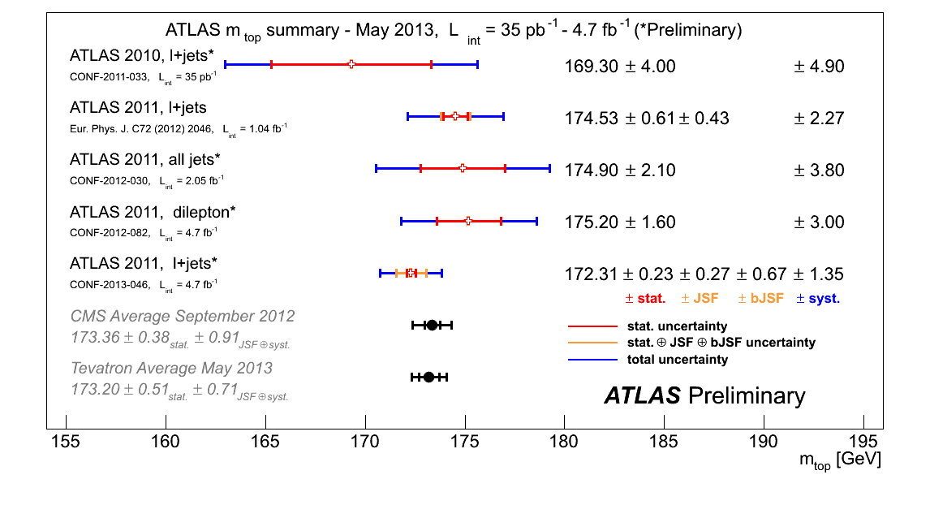
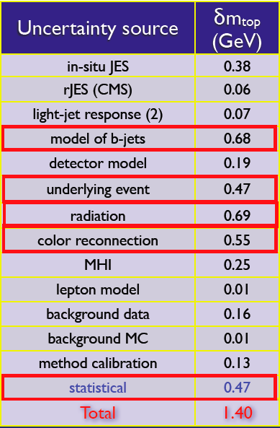
LHC Summary
July 2012 LHC Combination:
Latest results:
m_{t} = 173.3 ±0.5(stat) ±1.3(syst) GeV
Χ²/NDF = 2.5/6 (prob=87%)
LHC experiments are making fast progress and starting to reach precision competitive with the Tevatron.
Promising future owing to large available samples, allowing for in-situ x-checks and reduction of systematic uncertainties (e.g. via MC tuning).
Still, hard to imagine going below 0.5 GeV.
ATLAS-CONF-2012-095 CMS PAS TOP-12-001

Slide 27
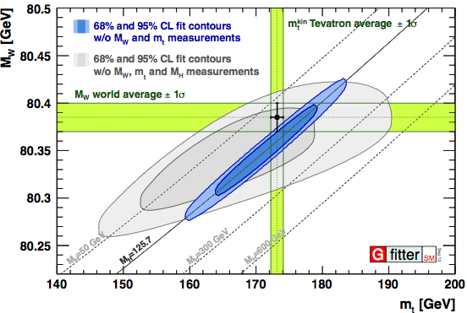
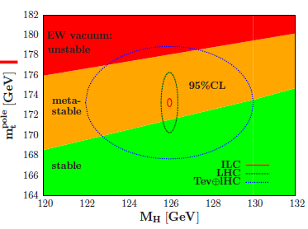
What Top Quark Mass?
What’s really being measured is the top quark mass in whatever MC generator was used to extract it. But different MCs include different radiative corrections!
Naively one expects it to be close to the pole mass.
It’s important to know since there is a ~10 GeV shift between pole and MSbar mass!
Tevatron average interpreted as MSbar mass

Slide 28
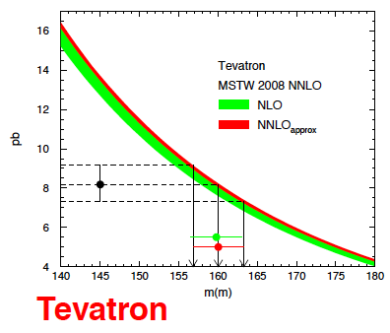
A Partial Check
arXiv:1207.0980
Compare measured tt cross section
to theoretical prediction (approx NNLO)as a function of MSbar mass.
Estimated MSbar mass:
translated to pole mass (conversion known to 3-loops in QCD):
➔ In good agreement with Tevatron average for m_{t}!
➔ supports direct measurements close to pole mass definition but comparison only good to O(3 GeV).

Slide 29
W Boson Mass

Slide 30
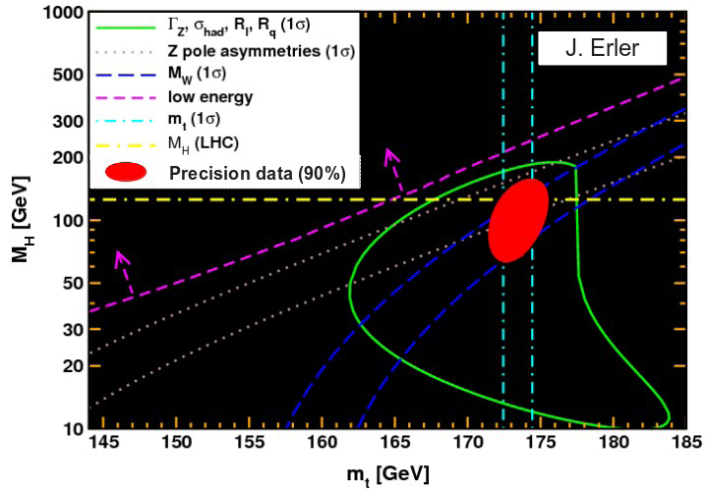
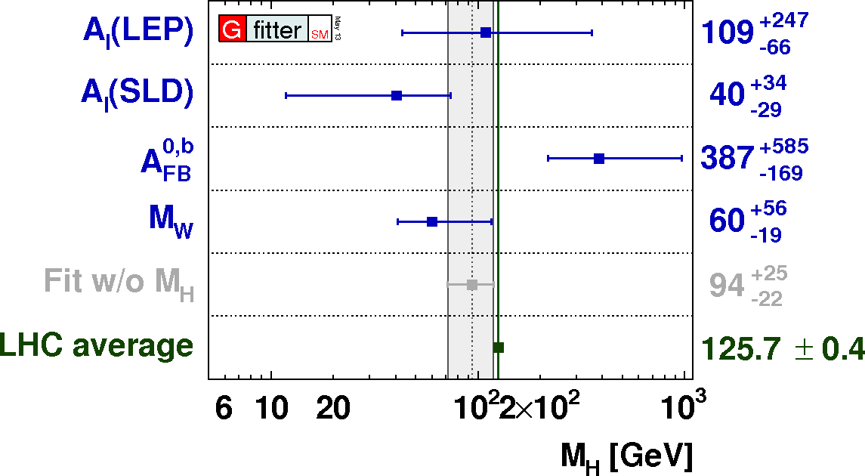
Motivation
Most sensitivity to M_{H} comes from M_{W} and sin²θ_{eff} (via Z-pole asymmetries).
For equal contribution to the Higgs mass uncertainty need: ΔM_{W}=0.006Δm_{t}
Latest Tevatron combination: Δm_{t}~0.9 GeV ➔ would need ΔM_{W}~5 MeV!
Before Run II had: ΔM_{W}~30 MeV (driven by LEP2 measurements).
Given current precision on m_{t}, progress on ΔM_{W} would have the biggest impact on
precision EW fit.

Slide 31
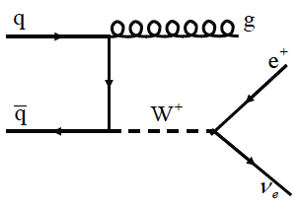
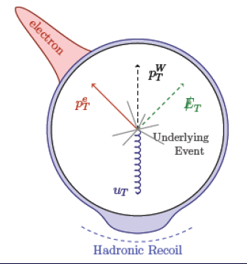
Measurement: Basic Strategy
In principle just need to:
measure:
charged lepton
hadronic recoil
build from MC templates of sensitive kinematic variables:
W transverse mass
lepton p_{T}
missing p_{T}
perform a binned likelihood fit to data as a function of M_{W}
qq dominates (80%)
O(50 GeV)
O(5 GeV)

Slide 32
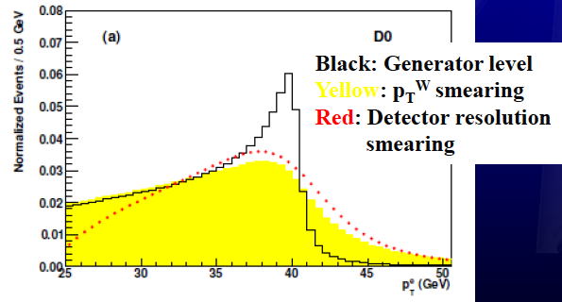
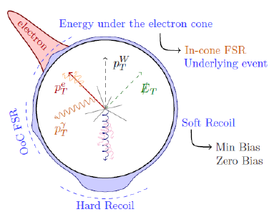
Measurement: Basic Strategy
In practice need to :
measure:
charged lepton to 0.01% precision
hadronic recoil to <1% precision
understand in great detail energy flow in event, driven by multiple physics and instrumental effects that affect each other
employ state-of-art theoretical predictions for W boson production and decay, including radiative effects
develop a parameterized fast MC implementing all relevant effects
build from MC templates of sensitive kinematic variables:
W transverse mass
lepton p_{T}
missing p_{T}
perform a binned likelihood fit to data as a function of M_{W}
O(50 GeV)
O(100 MeV)
Electron shower leakage O(50 MeV)
O(200 MeV)
O(5 GeV)

Slide 33
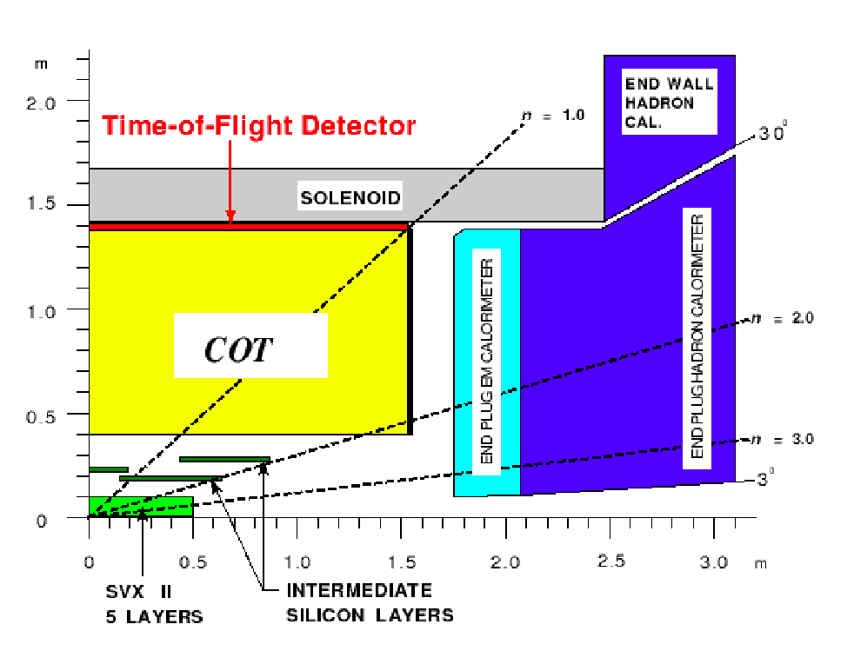
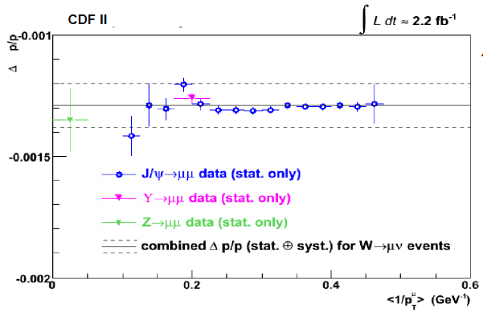
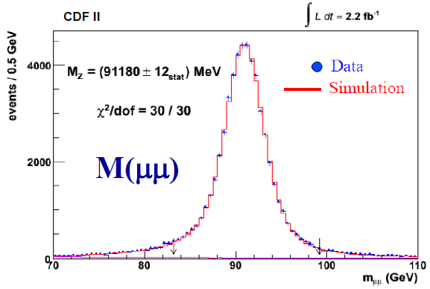
Measurement: Different Tactics
CDF and DØ employ different tactics, especially in terms of fast MC simulation and calibration, capitalizing on the strengths of their detectors.
Central tracking provides very good lepton momentum measurement
Muon Δp_{T}/p_{T}~3.2% at p_{T}=45 GeV
Detailed tracker model
Focus on momentum scale calibration
Using J/Ψ→μμ, ϒ→μμ, Z→μμ
Use E/p peak from W→eν to calibrate EM calorimeter
➔ Measurement on W→eν and W→μν events

Slide 34
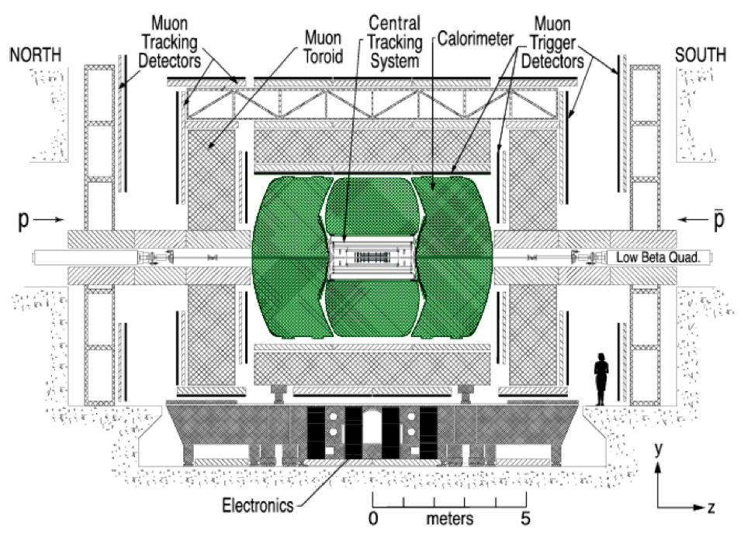
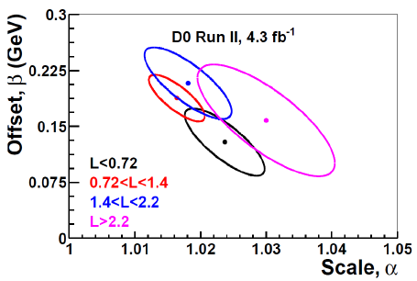
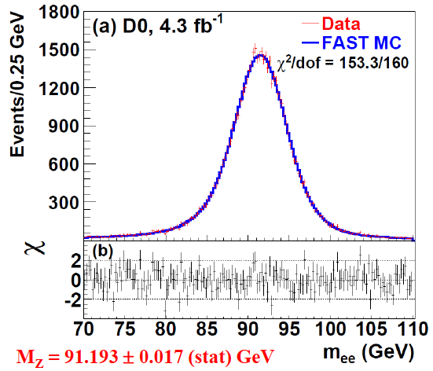
Measurement: Different Tactics
CDF and DØ employ different tactics, especially in terms of fast MC simulation and calibration, capitalizing on the strengths of their detectors.
EM calorimeter provides very good electron energy measurement
Muon ΔE/E~3.3% at E_{T}=45 GeV
Detailed calorimeter, E-flow model
Focus on calorimeter energy scale calibration
Using Z→ee
➔ Measurement on W→eν events

Slide 35
Systematic Uncertainties
Breakdown of systematic uncertainties for m_{T} measurement:
2.2 fb⁻¹
5.3 fb⁻¹

Slide 36
DØ Results
PRL 108, 151804 (2012)

Slide 37
CDF Results
PRL 108, 151803 (2012)
Best single measurement!

Slide 38
New World Average
arXiv:1204.0042
arXiv:1302.3415
World average dominated by Tevatron combination.
PDF uncertainties are now the main limitation.

Slide 39
Constraints on the Higgs Boson Mass
arXiv:1209.2716
Good consistency between direct and indirect measurements of M_{W} and m_{t} (w/ and w/o direct M_{H} measurement).
Indirect M_{H} determination consistent (1.3σ) with direct measurement at LHC (taken to be M_{H}=125.7±0.4 GeV).

Slide 40
Constraints on the Higgs Boson Mass
arXiv:1209.2716
Good consistency between direct and indirect measurements of M_{W} and m_{t} (w/ and w/o direct M_{H} measurement).
Conversely, the test can be “turned around” and use electroweak fit, together with direct M_{H} measurement, to determine M_{W}:
Indirect measurement:
Direct measurement:
Desirable to further improve it!

Slide 41
Future Prospects
PRL 101, 211801 (2008)
Main improvements expected:
Use of full 10 fb⁻¹ dataset (so far 2.2 fb⁻¹ used by CDF and 5.3 fb⁻¹ used by DØ).
Reduction of PDF uncertainties:
include in PDF fits measurements at Tevatron and LHC that can constrain PDF uncertainties: W charge asymmetry, Z rapidity,…
extend η coverage to end-cap calorimeters (DØ): sensitivity to PDF uncertainties introduced through η acceptance cuts.
Will also reduce correlation on PDF uncertainty between CDF and DØ.
PRL 102, 181801 (2009)
New full dataset results coming soon!

Slide 42
Future Prospects
Main improvements expected:
Use of full 10 fb⁻¹ dataset (so far 2.2 fb⁻¹ used by CDF and 5.3 fb⁻¹ used by DØ).
Reduction of PDF uncertainties:
include in PDF fits measurements at Tevatron and LHC that can constrain PDF uncertainties: W charge asymmetry, Z rapidity,…
extend η coverage to end-cap calorimeters (DØ): sensitivity to PDF uncertainties introduced through η acceptance cuts.
Will also reduce correlation on PDF uncertainty between CDF and DØ.
LEP2/Tevatron/LHC: future (ΔM_{W}=7 MeV, Δm_{t}=0.5 GeV)
Projected M_{W} uncertainty:
CDF: 10 MeV
DØ: 15 MeV
Combination: <10 MeV

Slide 43
Summary and Outlook
Latest Tevatron results based on full Run II dataset in most search channels.
Tevatron has achieved SM sensitivity over most of the accessible mass range.
Excess in 115<m_{H}<140 GeV region with local p-value at m_{H}=125 GeV corresponding to 3.0σ significance. So far emerging picture consistent with discovered boson at the LHC.
Early results on Higgs couplings and spin/parity are consistent with a SM Higgs boson. Tevatron combination on spin/parity tests upcoming.
Exciting prospects for precise measurements of m_{t} and M_{W} at the Tevatron, which will be key to capitalizing on precision measurement in the Higgs sector.
LEP2/Tevatron/LHC: future (ΔM_{W}=7 MeV, Δm_{t}=0.5 GeV)
Stay tuned!

Slide 44
Backup

Slide 45
The Tevatron
Proton-antiproton collider at √s=1.96 TeV
Tevatron accelerator: 6.5 km circumference
Two general-purpose experiments: CDF and DØ
10-year long Run II ended Sept. 30th, 2011
Total integrated luminosity delivered in Run II:
~12 fb⁻¹ (per experiment)

Slide 46
CDF and DØ Detectors
Multipurpose detectors:
Central tracking system embedded in a solenoidal magnetic field:
Silicon vertex detector
Tracking chamber (CDF) Fiber tracker (DØ)
Preshowers
Electromagnetic and hadronic calorimeters
Muon system
Include multi-level trigger systems to efficiently select events with topologies of interest.
Data taking efficiency: ~90%.
Recorded up to 10 fb⁻¹ in Run II.
All main search channels used full dataset

Slide 47
SM Higgs Production at Hadron Colliders

Slide 48
SM Higgs Decay Modes
m_{H}=135 GeV
m_{H}<135 GeV: H→bb dominates
m_{H}>135 GeV: H→W⁺W⁻ dominates
Main mode
Supporting mode
LHC
Tevatron
Many decay modes being explored to increase the sensitivity of the
search to the SM Higgs boson, but also to a non-SM one!

Slide 49
The Stairway to the Higgs
Higgs boson searches at the Tevatron are background-dominated.
Instrumental backgrounds: measured directly from data
QCD multijet production with mismeasured jets leadings to missing transverse energy or jets misidentified as leptons.
Physics backgrounds: estimated using simulation and state-of-art theoretical predictions, and further calibrated to data whenever possible
W/Z+jets production (w/ real or misidentified heavy flavor jets)
Diboson production
Double and single top quark production
Experiments have established a solid foundation to search for the Higgs boson through precise measurements of SM processes.

Slide 50
Searching for H→bb
Highest sensitivity channel at the Tevatron for m_{H}<130 GeV.
Identify events consistent with leptonic W/Z decays in association with jets. Require b-tagging to significantly improve the S/B ratio.
Main backgrounds: W+jets, tt
Most important discriminant variable: dijet mass.
Before b-tagging
=1 b-tag
≥2 b-tags
S:B ~ 1:4000
S:B ~ 1:400
S:B ~ 1:75

Slide 51
Searching for H→bb
Highest sensitivity channel at the Tevatron for m_{H}<130 GeV.
Identify events consistent with leptonic W/Z decays in association with jets. Require b-tagging to significantly improve the S/B ratio.
Main backgrounds: W+jets, tt
Most important discriminant variable: dijet mass.
Improve sensitivity via sophisticated multivariate techniques.
Validate search strategy by measuring WZ/ZZ (Z→bb).
See talk by XXX
arXiv:1303.6346
ZH→llbb
σ_{meas}(VZ) = (0.7 ± 0.2) σ_{SM}

Slide 52
Summary of H→bb Results
95% CL Limits at m_{H} = 125 GeV
CDF WH→lνbb (9.4 fb⁻¹)
Channel | Exp/obs Limit (σ/SM)
WH→lνbb (9.4 fb⁻¹) | 2.8/4.9
ZH→ννbb (9.4 fb⁻¹) | 3.3/3.1
ZH→l⁺l⁻bb (9.4 fb⁻¹) | 3.6/7.2
WH→lνbb (9.7 fb⁻¹) | 4.7/5.2
ZH→ννbb (9.5 fb⁻¹) | 3.9/4.3
ZH→l⁺l⁻bb (9.7 fb⁻¹) | 5.1/7.1
VH/VBF→jjbb (9.4 fb⁻¹) | 11.0/9.0
ttH→l+jets (9.4 fb⁻¹) | 12.4/17.6
ttH→jets (5.7 fb⁻¹) | 26.2/36.2
Limits from individual VH, H→bb channels at ~2-3xSM at m_{H}=125 GeV and quickly degrading towards high mass.
Important to consider additional channels with different mass dependence.

Slide 53
Searching for H→WW→lνlν
Highest sensitivity channel in m_{H}~130-200 GeV range.
Clean dilepton+ signature.
Main backgrounds after cut: WW, W/Z+jets,Wγ
After final selection expect (m_{H}=165 GeV):
~7 signal events/fb⁻¹/experiment with S:B~1:50-1:100
Exploit spin correlation between dibosons.
➔ Small angular separation between leptons
Before cut
After cut

Slide 54
Searching for H→WW→lνlν
Signal composition
To increase the sensitivity:
Consider all signal production modes.
Categorize events in channels with different S:B (by jet multiplicity, lepton flavor/quality, etc) and combine at the end.
Build multivariate discriminants against:
Z/γ*→l⁺l⁻ ((DØ): increase signal acceptance in event selection.
Remaining background: final discriminant.
Background composition

Slide 55
Searching for H→WW→lνlν
To increase the sensitivity:
Consider all signal production modes.
Categorize events in channels with different S:B (by jet multiplicity, lepton flavor/quality, etc) and combine at the end.
Build multivariate discriminants against:
Z/γ*→l⁺l⁻ ((DØ): increase signal acceptance in event selection.
Remaining background: final discriminant.
Include searches for same-sign dilepton and trilepton final states.
Validate search strategy by measuring WW→lνlν.

Slide 56
Low Mass Results from H→WW,ττ,γγ
95% CL Limits at m_{H} = 125 GeV
Channel | Exp/obs Limit (σ/SM)
H→WW→lνlν (9.7 fb⁻¹) | 3.2/3.3
H→WW→lνlν (9.7 fb⁻¹) | 3.4/4.1
H+X→ττ+jets (8.3 fb⁻¹) | 14.8/11.7
H+X→ττjj (9.7 fb⁻¹) | 9.0/11.3
VH→ττl(l) (6.2 fb⁻¹) | 23.3/26.5
VH→ττμ (8.6 fb⁻¹) | 13.0/19.4
H→γγ (10.0 fb⁻¹) | 11.7/20.5
H→γγ (9.7 fb⁻¹) | 8.5/12.7
Additional channels contribute useful sensitivity
at low/intermediate m_{H}:
H→WW→lνlν: improving towards high m_{H}.
H+X→ττjj, H→γγ : ~flat vs m_{H}.
➔ Combination of all contributing channels crucial

Slide 57
Combined Limits on SM Higgs Production
Combination of multiple channels (and experiments!) yields the greatest sensitivity.
Assumes SM prediction for ratio of production cross sections and branching ratios.
More than 200 different sources of systematic uncertainties are considered (including correlations among channels and experiments), and constrained in sidebands.
Use different techniques to cross check calculations (Bayesian, modified frequentist)
➔ results agree within ≤5%.

Slide 58
CDF and DØ Individual Results
arXiv:1301.6668
arXiv:1303.0823
Observed 95% CL exclusion:
90 < m_{H}< 102 GeV, 152 < m_{H} < 172 GeV
Observed 95% CL exclusion:
90 < m_{H}< 101 GeV, 157 < m_{H} < 178 GeV
At m_{H} = 125 GeV:
Exp. limit: 1.5 x SM
Obs. limit: 2.9 x SM
At m_{H} = 125 GeV:
Exp. limit: 1.7 x SM
Obs. limit: 2.9 x SM

Slide 59
Results by Channel
H→W⁺W⁻
H→τ⁺τ⁻ and H→γγ:
Expected sensitivity at m_{H}~125 GeV of ~6-7xSM.
No significant excess.
H→WW:
Expected sensitivity at m_{H}~125 GeV of ~2.1xSM.
Very broad excess, consistent with both B-only and S+B hypotheses (m_{H}=125 GeV).

Slide 60
Results by Channel
H→τ⁺τ⁻
H→γγ
H→τ⁺τ⁻ and H→γγ:
Expected sensitivity at m_{H}~125 GeV of ~6-7xSM.
No significant excess.

Slide 61
Results by Channel
H→W⁺W⁻
H→bb
H→τ⁺τ⁻ and H→γγ:
Expected sensitivity at m_{H}~125 GeV of ~6-7xSM.
No significant excess.
H→WW:
Expected sensitivity at m_{H}~125 GeV of ~2.1xSM.
Very broad excess, consistent with both B-only and S+B hypotheses (m_{H}=125 GeV).
H→bb:
Expected sensitivity at m_{H}~125 GeV of ~1.4xSM.
Broad excess, somewhat above S+B hypothesis (m_{H}=125 GeV).

Slide 62
Probing Higgs Boson Couplings
Several production and decay mechanisms contribute to signal rates per channel
➔ interpretation is difficult
A better option: measure deviations of couplings from the SM prediction (arXiv:1209.0040).
Basic assumptions:
there is only one underlying state at m_{H}~125 GeV,
it has negligible width,
it is a CP-even scalar (only allow for modification of coupling strengths, leaving the Lorentz structure of the interaction untouched).
Additional assumption made in this study:
no additional invisible or undetected Higgs decay modes.
Under these assumptions all production cross sections and branching ratios can be expressed in terms of a few common multiplicative factors to the SM Higgs couplings. Examples:

Slide 63
Probing Higgs Boson Couplings
Benchmark I:
Assume all fermion couplings are scaled by a common free parameter (κ_{F}).
Measure the parameters κ_{W} and κ_{Z} independently.
Probe SU(2)_{V} custodial symmetry by measuring the ratio λ_{WZ}=κ_{W}/κ_{Z}.
Measurements consistent with the SM prediction

Slide 64
Probing Higgs Boson Couplings
Benchmark II:
Consider two independent multiplicative factors: common to all couplings to vector bosons (κ_{V}) and common to all couplings to fermions (κ_{f}). Assume λ_{WZ}=1.
Measure κ_{f} and κ_{V} simultaneously.
Measurements consistent with the SM prediction

Slide 65
What Top Quark Mass?
Parameters of Lagrangian have no unique physical interpretation. Radiative corrections require definition of renormalization scheme.
Ex. Heavy-quark self-energy:
Conversion between pole and MSbar schemes known to 3-loops in QCD.
Example: 1-loop QCD
Pole Mass:
Based on (unphysical) concept of top quark being a free parton.
Coincides with pole of propagator at each order:
Definition of pole mass ambiguous up to corrections O(Λ_{QCD}).
Bound from lattice QCD:
Δm_{t}≥200 MeV
MSbar Mass:
Based on 1-loop minimal subtraction
MSbar scheme induces scale dependence: m(μ)

Slide 66
What Top Quark Mass?
What’s really being measured is the top quark mass in whatever MC generator was used to extract it. But different MCs include different radiative corrections!
PS
PS
PS
PYTHIA

Slide 67
What Top Quark Mass?
What’s really being measured is the top quark mass in whatever MC generator was used to extract it. But different MCs include different radiative corrections!
PS
ALPGEN, MADGRAPH

Slide 68
What Top Quark Mass?
What’s really being measured is the top quark mass in whatever MC generator was used to extract it. But different MCs include different radiative corrections!
PS
MC@NLO, POWHEG

Slide 69
Systematic Uncertainties
Theoretical:
Signal simulation (PDFs, MC generator, hadronization model)
Event modeling and environment (underlying event, color reconnection, QCD radiation, pileup)
Experimental:
Physics objects and detector modeling (jet reconstruction/resolution/scale, b-tagging, E_{T}^{miss},…)
Background contamination
Can exploit data to verify proper modeling and/or further constrain size of systematic uncertainties.

Slide 70
Projected DØ Uncertainty

Slide 71
Projected CDF Uncertainty

