Slide 1
Marketplace and Appliance Management
Charles (Cal) Loomis & Mohammed Airaj
LAL, Univ. Paris-Sud, CNRS/IN2P3
24-25 October 2013

Slide 2
Appliances (a.k.a Images)
Appliances
Essentially a snapshot of an installed machines disk(s)
Just a large file (~10 GB) containing disk image(s)
“Appliance” usually implies a base OS plus customized services
Appliances are “opaque” → detailed analysis to understand contents
Can be created by users as well as administrators
Security Concerns
Users will have root access to the virtual machines
Most users are not competent system administrators
As usual, must balance security against utility of cloud service

Slide 3
Marketplace & Appliance Handling
Priorities
Mechanism for sharing and trusting images
Possible to distribute fixed, read-only data sets as well
Split the storage of image metadata (~KB) and image contents (~GB)
Have VM images of common OSes available
Implementation
Marketplace API: Proprietary REST API for create, read, search
Marketplace acts as image registry and handles only metadata
Image contents can be located on any public (web) server
‘Private’ images can also be held in cloud storage
StratusLab images: CentOS, Ubuntu, OpenSuSE, Debian, Fedora, ScientificLinux

Slide 4
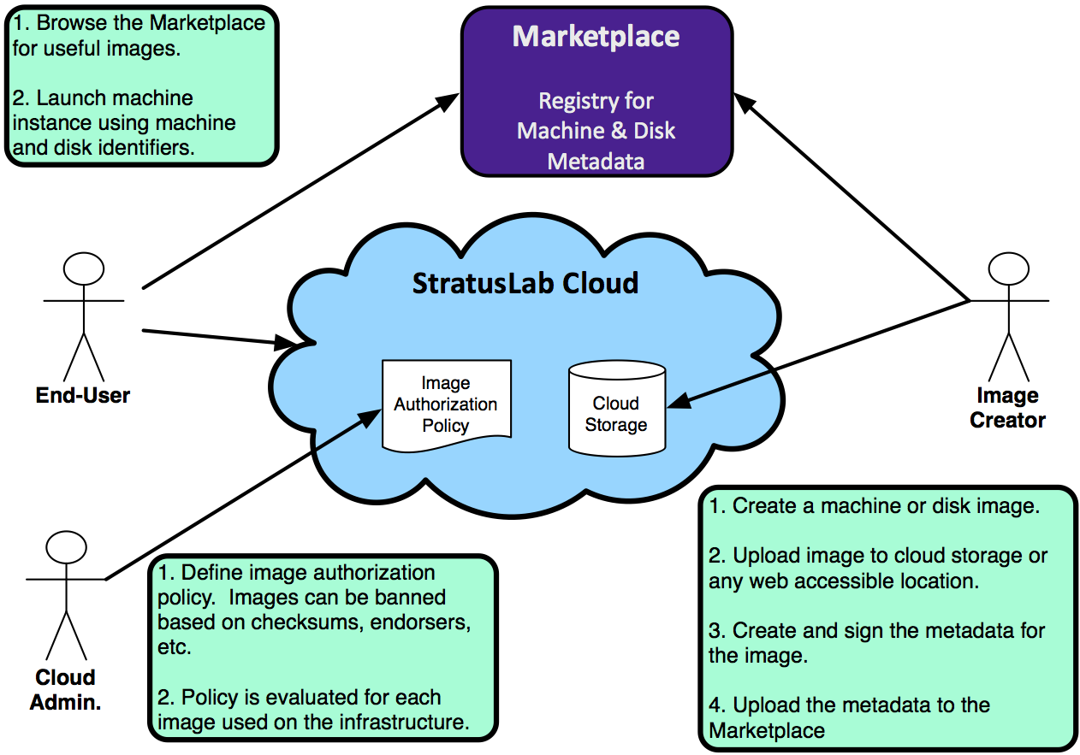
Appliance Workflows

Slide 5
Marketplace Details
Marketplace
daemon | marketplace
purpose | registry for appliances
ports | 8443
language | java (deployed in Jetty container)
external requirements | none
config. files | /etc/stratuslab/marketplace.cfg
logs | /opt/stratuslab/marketplace/logs/*

Slide 6
Marketplace
Installation
Configuration
Default configuration should be fine
Start
Check
Connect to your instance with a browser: https://mkplace:8443/
Ensure it functions like the central Marketplace
$ yum install -y stratuslab-marketplace
$ service marketplace start
$ service marketplace start

Slide 7
Coming Soon
Redundancy
Coordinated distributed instances with failover
Likely to share Marketplace entries via git
Failover with DNS round robin and intelligent clients
Federation
Ability to aggregate information from different instances for a cloud
Allows deployment and use of public and private Marketplaces
Likely to be done via “machine image” resources in CIMI

Slide 8
Exercises
Browse primary Marketplace to see what appliances exist.
Install your own Marketplace on the frontend.
Connect to your instance and make sure it works correctly.
Download some metadata descriptions from central Marketplace and upload into your Marketplace

Slide 9
Questions and Discussion
website | http://stratuslab.eu
twitter | @StratusLab
support | support@stratuslab.eu
StratusLab source | http://github.com/StratusLab
SlipStream source | http://github.com/slipstream

