Slide 1
Cloud Federation
Charles (Cal) Loomis & Mohammed Airaj
LAL, Univ. Paris-Sud, CNRS/IN2P3
24-25 October 2013

Slide 2
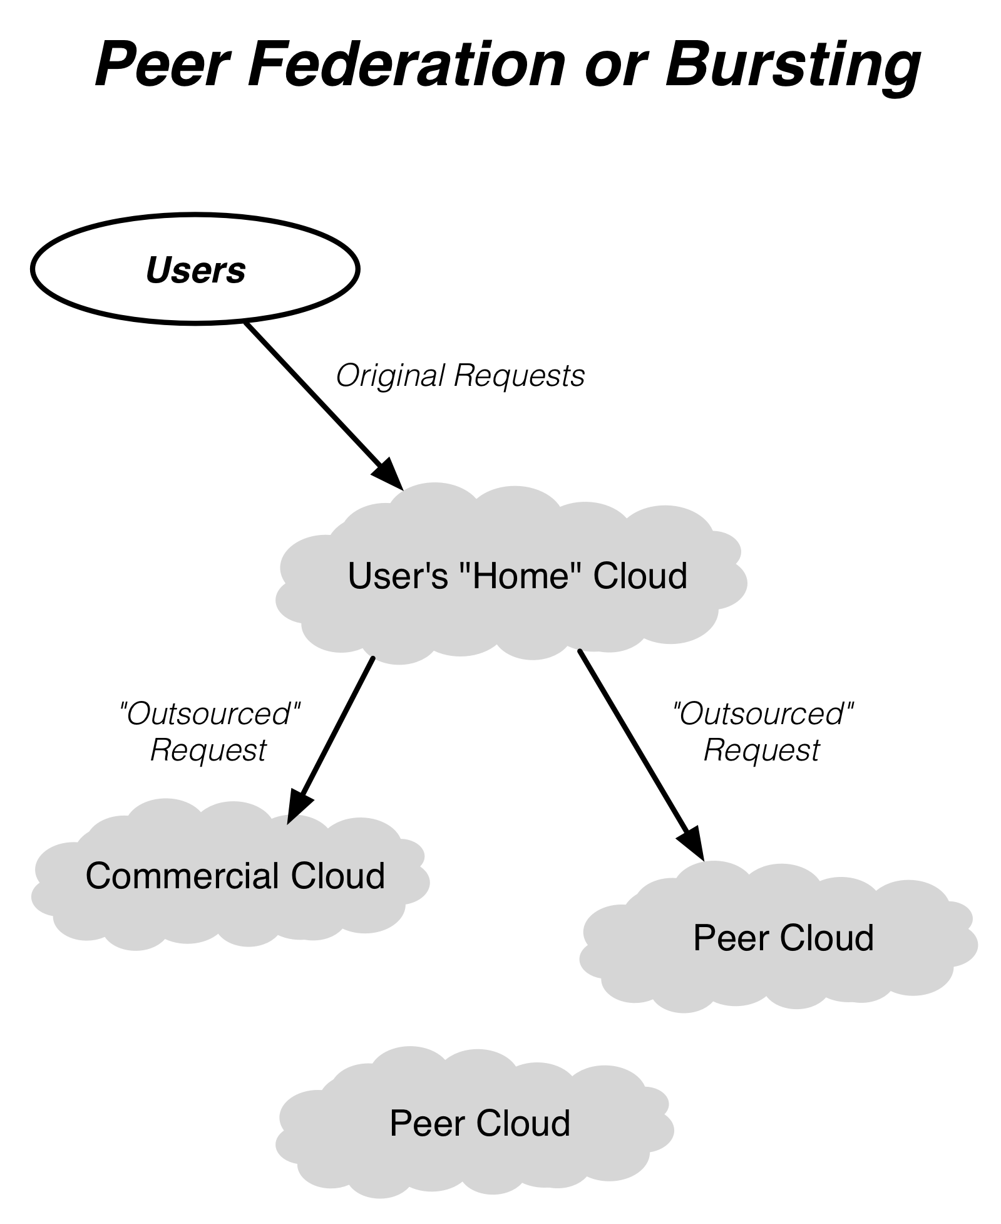
Federation Models (Hybrid Cloud & “Sky” Computing)
Transparent Federation
Site operators “outsource” to other providers
Completely transparent to end users
Difficult to achieve in practice because of concerns about data protection, network access and performance

Slide 3
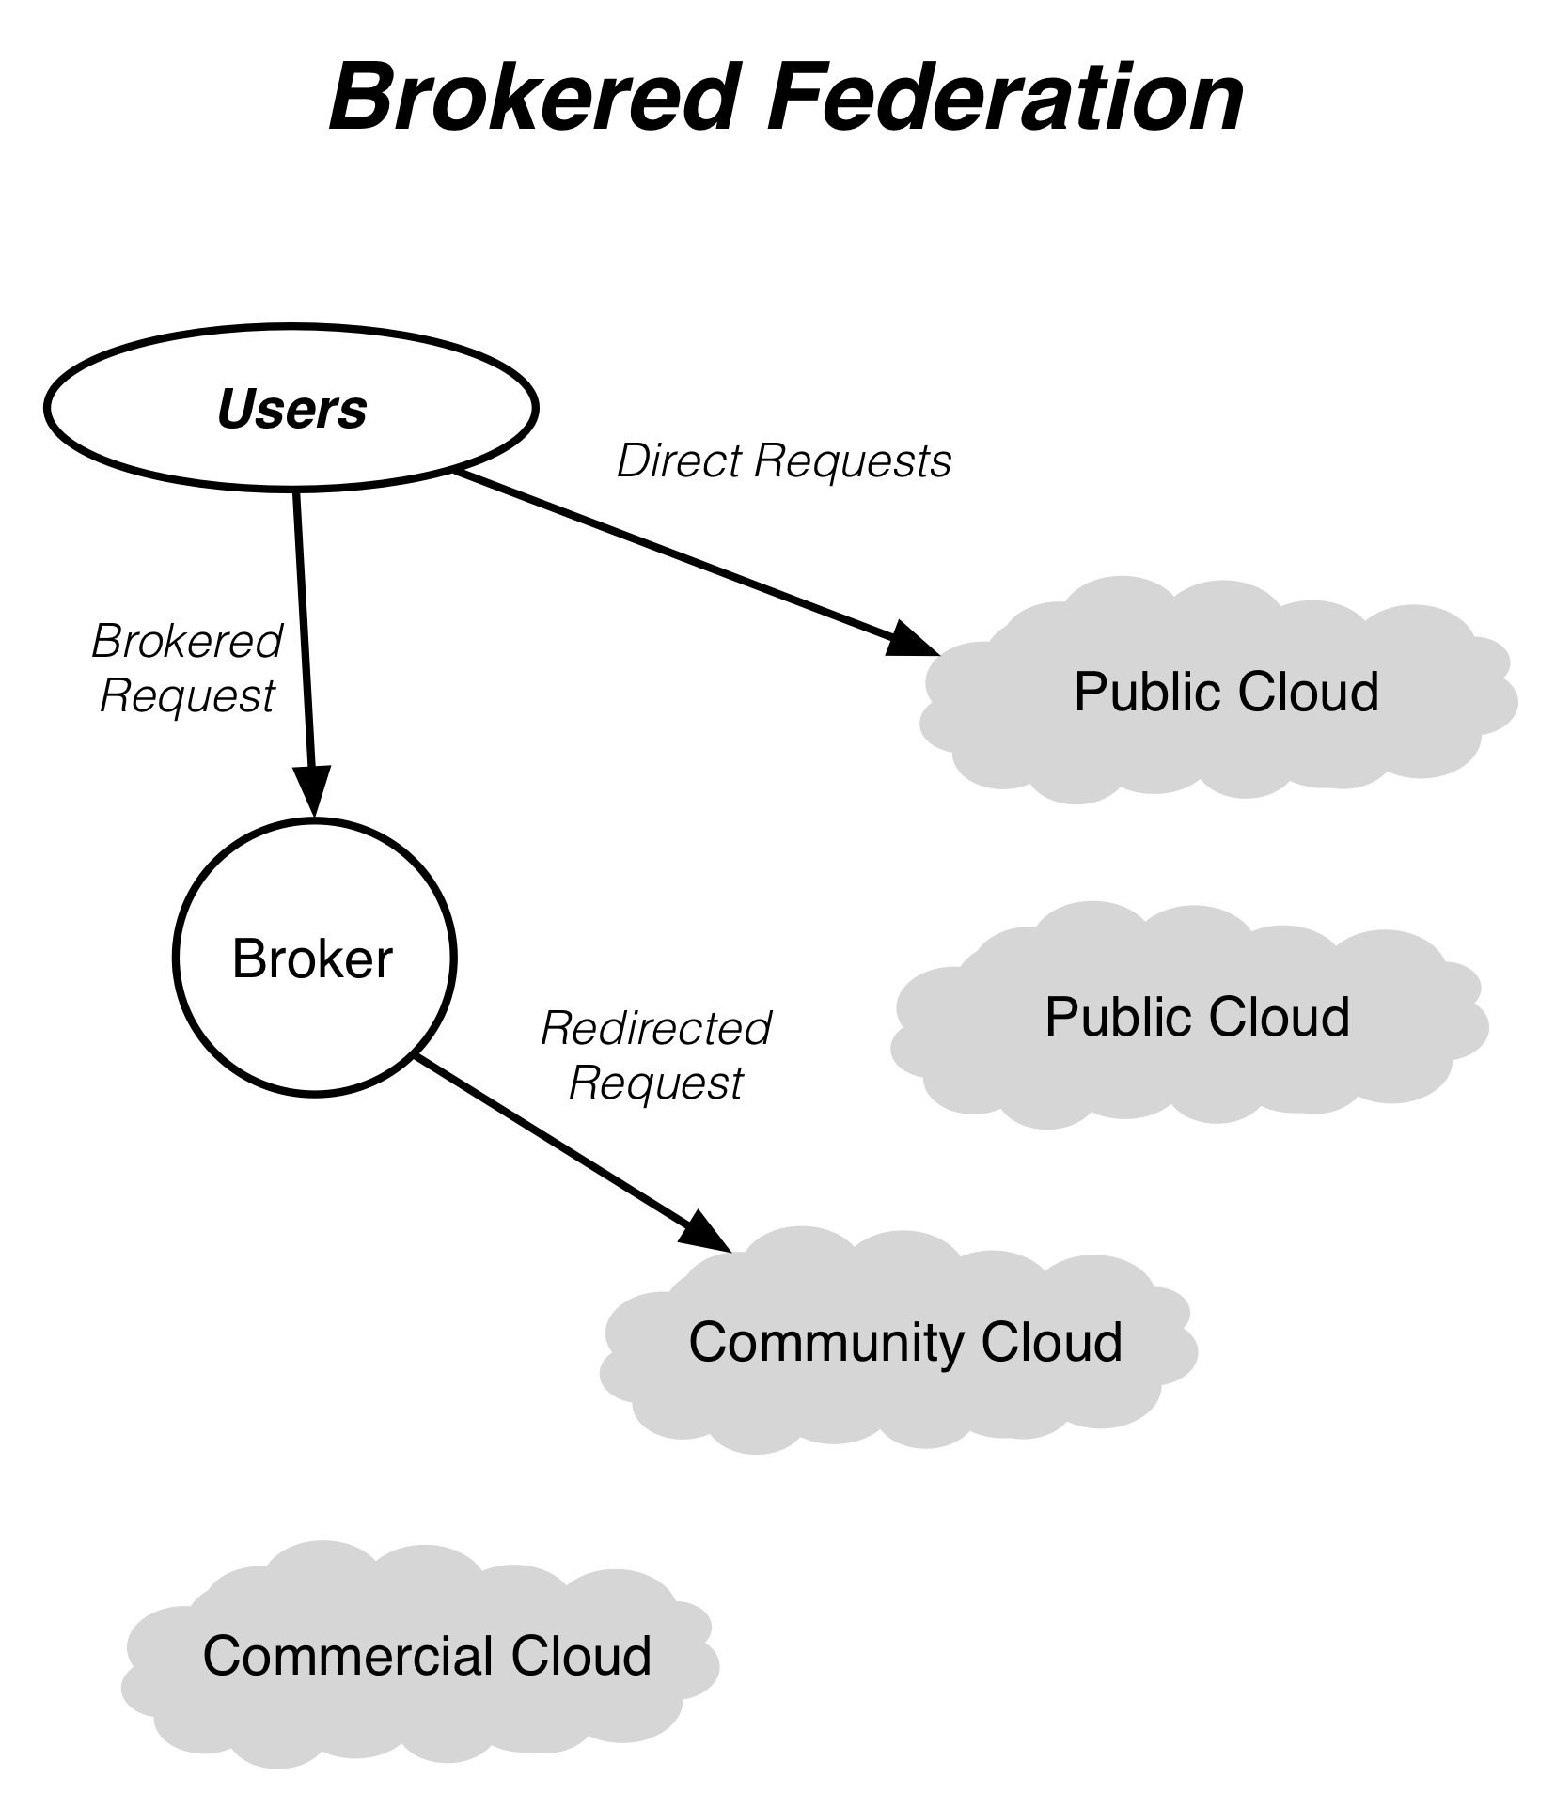
Federation Models (Hybrid Cloud & “Sky” Computing)
Brokered Federation
Variety of different cloud infrastructures are visible to users
Users choose to place virtual machines in particular locations
Simple clients can handle federation if differences are small
Orchestrators are needed for larger differences between clouds
Both Helix Nebula and EGI take the brokered approach

Slide 4
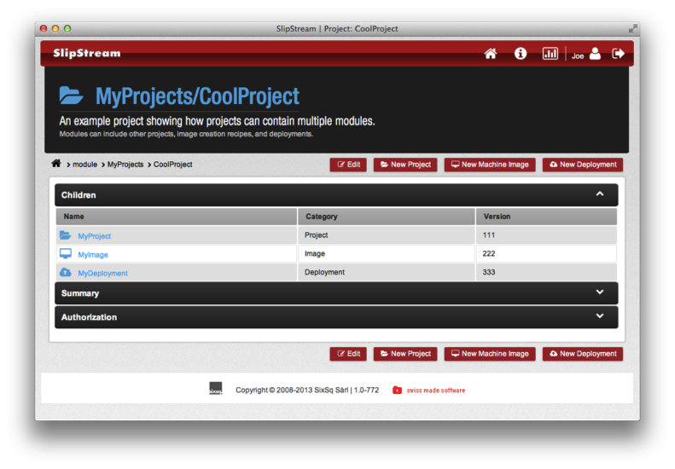
SlipStream
Cloud orchestrator and deployment engine
Facilitates testing, deployment, and maintenance of complex systems
Transparent access to multiple cloud infrastructures
Allows automated multi-cloud deployment of systems

Slide 5
SlipStream Installation
Installation
Development version of SlipStream in StratusLab repository
Install server with yum
Start Database
Ignore errors coming from startup script…
Start SlipStream
Browse to interface: https://your-machine/
$ yum install -y slipstream-server
$ service hsqldb start
$ service cimi stop # CIMI and SlipStream conflict on 443!
$ service slipstream start

Slide 6
SlipStream Configuration
Log in as Superuser
Username: ‘super’
Password: ‘siXsQsiXsQ’
Should change passwords for all standard accounts!
Documentation
All docs are available through SlipStream interface
Configure for StratusLab
Connector for StratusLab is already installed
Go to configuration page via “wrench” icon at top
Provide values for all parameters
Use “pdisk” for msg. type, pdisk endpoint for msg. endpoint

Slide 7
SlipStream Configuration
Try it out
Log in a normal user
Configure normal user parameters with StratusLab credentials
Examples
Launch VM: quick start for a single machine
Run RStudio: R-based analysis server
Torque Cluster: deployment of full batch cluster

Slide 8
Federation
Configure for Second Cloud
Log in a superuser
Add configuration for a second cloud
Launch Multi-cloud Deployment
As a normal user
Copy the multi-cloud deployment
Modify copy to put one machine in each cloud
Launch deployment
Verify that machines are accessible in both clouds

Slide 9
Exercises
Install SlipStream on your frontend
Configure for use on your own cloud
Try out launching of machines and deployments
Configure to federate your neighbor’s cloud
Verify that multi-cloud deployments work

Slide 10
Conclusions
In scientific settings, SlipStream provides interesting capabilities:
Provide pre-configured services for admins and users
Allow users to federate resources on multiple infrastructures
Graphical interface to cloud infrastructures
Upcoming Features
Autoscaling of deployments
Unified dashboard for configured clouds
Support for wider variety of clouds

Slide 11
Questions and Discussion
website | http://stratuslab.eu
twitter | @StratusLab
support | support@stratuslab.eu
StratusLab source | http://github.com/StratusLab
SlipStream source | http://github.com/slipstream

