Slide 1
StratusLab: Darn Simple Cloud
Charles (Cal) Loomis & Mohammed Airaj
LAL, Univ. Paris-Sud, CNRS/IN2P3
29 August 2013

Slide 2
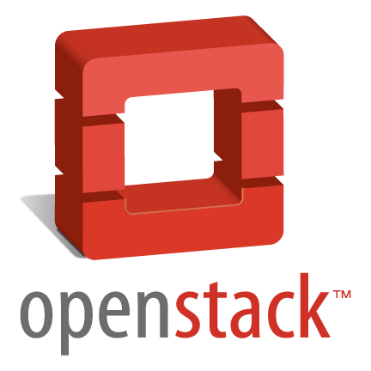
StratusLab
What is it?
Complete IaaS cloud distribution
Open source (Apache 2 license)
Works well for production private and public IaaS clouds
Focus: Darn Simple Cloud
Simple to install on commodity hardware
Simple to use, from any client machine
Scales down as well as up!
Infrastructure as a Service (IaaS)
Customized environment
Dynamic (scalable) provisioning
Easy access
Variety of APIs and interfaces
Image creation is tedious
Single machine granularity

Slide 3
Why are cloud technologies useful?
Users
Custom environment: no more porting, revalidation of code
Pre-installed and configured applications
Rapid, dynamic provisioning of resources
Complete control over the requested resources
Developers
Simple access: use of REST and RPC over HTTP(S)
Elasticity to respond to peaks in demand for applications
Administrators
Flexible management: separate mgt. of machines and services
Separation of responsibilities: Hardware / Services / Platforms / Users
Resource Providers
Better utilization of shared resources
Federation (outsourcing) possible

Slide 4
State of the Art
Commercial Provider: Amazon Web Services (AWS)
Leading and largest IaaS service provider
Improving and adding new services at a phenomenal rate
Providers differentiate based on price, SLAs, location, etc.
Commercial Cloud Distribution: VM-ware
Extremely good and complete
Very expensive, except for ESXi hypervisor (free)
Open Source Cloud Distributions: Many!
Essentially none in 2007; now easily a dozen different distributions
StratusLab, …, OpenStack, OpenNebula, CloudStack
Very different levels of maturity, stability, scalability, etc.
IaaS cloud providers all use similar semantics, but different APIs, etc.

Slide 5
Where did it start?
Informal collaboration to investigate running grid services on Amazon EC2 (2007)
Identified need for open source cloud distribution.
StratusLab Project (6/2010 to 5/2012) co-funded by EC with 6 partners from 5 countries
Production dist. with academic & commercial deployments.
Open collaboration to continue the development and support of the StratusLab software
Website: http://stratuslab.eu
Twitter: @StratusLab
Support: support@stratuslab.eu
Source: http://github.com/StratusLab

Slide 6
Releases
Post-Project Releases
V2.1 (16/10): Streamlined release; improved IO perf. with virtio drivers
V2.1.1 (29/11): Bug fixes; storage upload; better Windows support
V13.02 (31/1): Support for CloudInit contextualization and bug fixes
V13.05 (18/6): Initial steps towards new architecture
V13.09 (30/9): CIMI and new architecture
Release Policy
Quarterly timed releases (13.02, 13.05, …)
Intermediate bug fix releases as needed
Roadmap (6-month) available describing the StratusLab evolution
Support Policy
Best-effort support for all recent releases, emphasis on latest

Slide 7
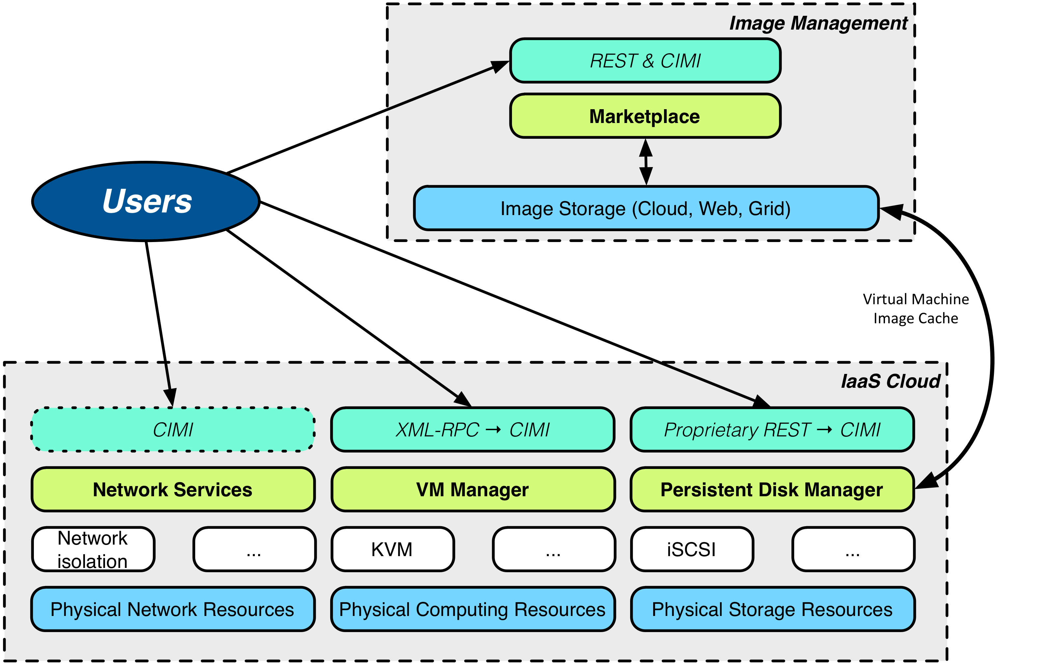
StratusLab Services

Slide 8
StratusLab
Services
Compute: Virtual machine management (currently uses OpenNebula)
Storage: Volume-based storage service
Network: Simple configuration for public, local, and private VM access
Image mgt.: Complete system for trusted sharing of VM images
Tools
Python CLI and APIs (Libcloud) to facilitate use of cloud
CLI to facilitate the installation of services

Slide 9
Service Details

Slide 10
Compute
Features
Fast provisioning of VMs, with low latency start-up
Contextualization
HEPiX & OpenNebula CDROM contextualization by default
CloudInit (disk based) also supported
Implementation
API: XML-RPC interface of OpenNebula
OpenNebula (C++, Ruby) with customized hooks
Hooks primarily for caching, snapshots, and storage access

Slide 11
Storage
Features
Volume abstraction for storage service
Provide users with persistent storage for data
Serves also as cache of images for VM instances
(No file-based or object-based storage service)
Implementation
API: Proprietary REST interface with CRUD actions
Java-based service using MySQL database for state information
Can use iSCSI or shared file system for physical storage
Can use simple files or LVM volumes for disk content

Slide 12
Network
Features
Support 3 specific use cases: public service (public), batch system (local), and BOINC-like worker (private)
Dynamic configuration of network switches not needed
Uses usual services for VM network configuration
Implementation
No API: manual, static configuration of network
Rec. configuration: VLAN for cloud services separate VLAN for VMs
All classes of IP addresses are optional, can create other classes
Uses DHCP for VM network configuration
Users responsible for protecting their machines

Slide 13
Marketplace & Image Handling
Priorities
Mechanism for sharing and trusting images
Possible to distribute fixed, read-only data sets as well
Split the storage of image metadata and image contents
Availability of VM images of common operating systems
Implementation
Marketplace API: Proprietary REST API for create, read, search
Marketplace acts as image registry and handles only metadata
Image contents can be located on any public (web) server
‘Private’ images can also be held in cloud storage
CentOS, Ubuntu, OpenSuSE, Debian, Fedora, ScientificLinux images created and supported by StratusLab

Slide 14
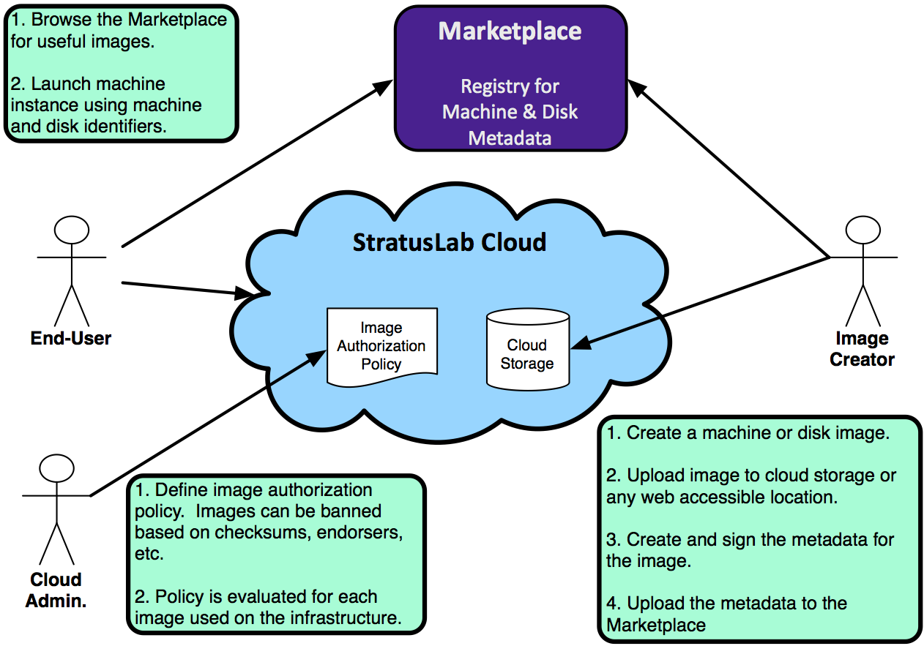
Image Handling Workflow

Slide 15
Tools
Command Line Client
Administrator: simplifies StratusLab installation
Users: access StratusLab cloud from anywhere
Administration
Quarantine for stopped virtual machines
Monitoring of cloud activity and resources
Authentication and Authorization
Supports username/password, certificates, cert. proxies
Specification in local file and/or LDAP

Slide 16
Support
Information
Web site documentation
Recorded tutorials
Mailing List
support@stratuslab.eu
Meetings
Live tutorials (usually 2-3 per year)
Workshops (2+ per year)

Slide 17
Priorities for Evolution
Interfaces
Adopt CIMI as the standard interface to services
Provide complete browser interface for all services
Simplicity, Scalability, & Robustness
Direct use of libvirt as VM manager
Distributed database (Couchbase) as information ‘bus’
Better services for system administrators
Improved overview and monitoring of infrastructure
Fine-grained accounting for all resources
Migration control

Slide 18
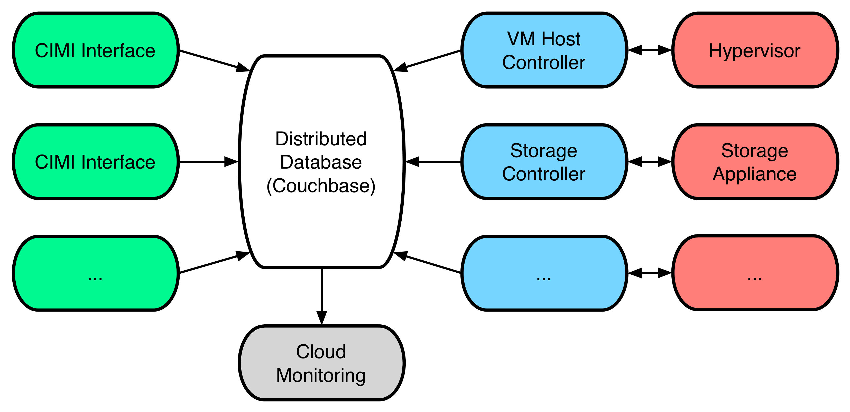
New Architecture

Slide 19
Running Clouds in Production

Slide 20
StratusLab Deployments
Reference Cloud Services
(~)Open infrastructures for using StratusLab and providing feedback
Operated on a first-come, first-serve, best-effort basis
In production 2+ years, with 250+ registered users
Two sites: LAL (Orsay, France) and GRNET (Athens, Greece)
Other deployments…
Academic: France, Ireland, UK, Vietnam, South Africa, …
Commercial: Atos, Helix Nebula, …
Building on top…
SlipStream from SixSq: cloud based systems deployment and testing

Slide 21
Cloud Experience at LAL
Private cloud for laboratory services
Works well, plan to migrate all services including grid worker nodes and experiment-specific servers
Services switched to VMs without users being aware of change
Very different way of working, need to change administrator habits
Have seen some stability issues related to SL6 kernel/virtualization
Public cloud open to university
Very positive reaction to cloud; LAL resources nearly 100% used
Fields: biology, software eng., stats, astrophysics, bioinformatics, …
After initial introduction, users require only low level of support
Other labs offering StratusLab training without our direct involvement
Majority of problems from machine room & hardware, not software.

Slide 22
Federated Clouds

Slide 23
Federation Models (Hybrid Cloud & “Sky” Computing)
Transparent Federation
Site operators “outsource” to other providers
Completely transparent to end users
Difficult to achieve in practice because of concerns about data protection, network access and performance

Slide 24
Federation Models (Hybrid Cloud & “Sky” Computing)
Brokered Federation
Variety of different cloud infrastructures are visible to users
Users choose to place virtual machines in particular locations
Simple clients can handle federation if differences are small
Orchestrators are needed for larger differences between clouds
Both Helix Nebula and EGI take the brokered approach

Slide 25
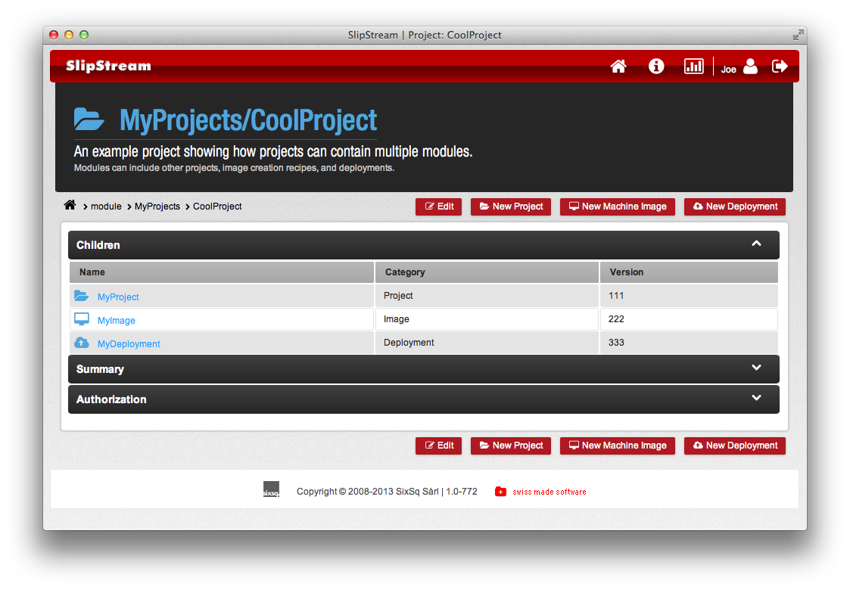
SlipStream
Cloud orchestrator and deployment engine
Facilitates testing, deployment, and maintenance of complex systems
Transparent access to multiple cloud infrastructures
Allows automated multi-cloud deployment of systems

Slide 26
Conclusions
StratusLab Cloud Distribution
Supported, stable, and production-quality IaaS cloud distribution
Used for reference cloud service for 2+ years
Other academic and commercial deployments
Defined, ambitious roadmap for the its continued evolution
Frequent administrator and user tutorials and workshops
StratusLab Collaboration
New collaborators welcome: developers and documenters!
Weekly phone conference between developers
Biannual StratusLab workshops

Slide 27
Questions and Discussion
website | http://stratuslab.eu
twitter | @StratusLab
support | support@stratuslab.eu
StratusLab source | http://github.com/StratusLab
SlipStream source | http://github.com/slipstream

