Slide 1
FCC – hh
Daniel Schulte
Higgs hunting – July 2014

Slide 2
Rational for Parameter Choice
Put together something that is reasonable
  Somewhat conservative
  With some aggressive choices to avoid excessive cost
  To criticise and improve
  To guide the design work and identify challenges
  Seed of the baseline
More aggressive choices will be considered as alternatives
  When more R&D is required
  When they involve a performance/cost trade-off
  http://indico.cern.ch/event/282344/material/3/
Authors:
A. Ball, M. Benedikt, L. Bottura, O. Dominguez, F. Gianotti, B. Goddard,
P. Lebrun, M. Mangano, D. Schulte, E. Shaposhnikova, R. Tomas, F. Zimmermann

Slide 3
Physics Parameters
 | LHC | HL-LHC | HE-LHC | FCC-hh
Cms energy [TeV] | 14 |  | 33 | 100
Luminosity [10³⁴cm⁻²s⁻¹] | 1 | 5 | 5 | 5
Bunch distance [ns] | 25 |  |  | 25 (5)
Background events/bx | 27 | 135 | 147 | 170 (34)
Bunch length [cm] | 7.5 | 7.5 | 7.5 | 8
Cms energy
Luminosity
Two main experiments sharing the beam-beam tuneshift
  Two reserve experimental areas not contributing to tuneshift
Currently assume 25ns as baseline
  May be able to reduce bunch spacing and background
Might be able to increase bunch length
  Will explore this if experiments find it useful
80% of circumference filled with bunches

Slide 4
Basic Machine Parameters
 | LHC | HL-LHC | HE-LHC | FCC-hh
Dipole field [T] | 8.33 |  | 20 | 16 (20)
Magn. Aperture [mm] | 56 |  | 40 | 40
Arc fill factor [%] | 79 |  | 79 | 79
Straight section | 8x0.5km |  |  | 16.8km
Total length | 26.7km |  |  | 100(83)km
Need to determine overall layout
  LHC-type with 12 insertions (1.4km average, pairwise same length)
  Racetrack-type with two almost straight sections (each 8.4km)
Fill factors include dispersion suppressors (80.5% in the cell)
Ambitious magnet strength goal 16T (Ni₃Sn) or 20T (with high temperature superconductor)

Slide 5
Beam Parameters
 | LHC | HL-LHC | HE-LHC | FCC-hh
Bunch charge [10¹¹] | 1.15 | 2.2 | 1 | 1 (0.2)
Norm. emitt. [μm] | 3.75 | 2.5 | 1.38 | 2.2(0.44)
IP beta-function [m] | 0.55 | 0.15 | 0.35 | 1.1
IP beam size [μm] | 16.7 | 7.1 | 5.2 | 6.8 (3)
RMS bunch length [cm] | 7.55 | 7.55 | 7.55 | 8
Values in brackets for 5ns spacing
Same values for 16T and 20T design
Beam-beam tuneshift for two IP 0.01
Beta-function at IP scaled with sqrt(E) from one LHC insertion line design with 0.4m (some safety margin)
  Beam current
  Bunch charge
  Emittance as function of bunch charge

Slide 6
Synchrotron Radiation
 | LHC | HL-LHC | HE-LHC | FCC-hh
Dipole field [T] | 8.33 | 8.33 | 20 | 16 (20)
Synchr. Rad. in arcs [W/m/aperture] | 0.17 | 0.33 | 4.35 | 28 (44)
Eng. Loss p. turn [MeV] | 0.007 |  | 0.2 | 4.6 (5.9)
Crit. eng. [keV] | 0.044 |  | 0.575 | 4.3 (5.5)
Total synr. Power [MW] | 0.0072 | 0.0146 | 0.2 | 4.8 (5.8)
Long. Damp. Time [h] | 12.9 |  | 1.0 | 0.54 (0.32)
Transv. Damp. Time [h] | 25.8 |  | 2.0 | 1.08 (0.64)
Values in brackets for 20T magnet field
Radiation given by beam energy and dipole field
Leads to damping of the longitudinal and transverse emittance
Leads to significant power load on the beam screen

Slide 7
Operation
 | FCC-hh
Luminosity lifetime [h] | 19.1 (15.9)
Turn-around time [h] | 5
Optimum run time [h] | 12.1 (10.7)
Int. lumi / day [fb⁻¹] | 2.2 (2.1)
Values in brackets for 20T magnet field
Beam lifetime due to burn-off considered
Assume to keep transverse emittance proportional to charge
Assume longitudinal emittance is kept constant
Average luminosity is about 50% of maximum

Slide 8

Layout and Design
Overall layout remains to be determined
  Racetrack
  LHC-type
Need to design all su-systems
  E.g. arcs, …
Fit into landscape and geology
Match injectors
Impact on lepton collider design

Slide 9
Parameter Drivers
Cost
  Main direct cost driver are the arcs
  Main part of the circumference
  Dipoles are the single most expensive component
Luminosity performance
  Experimental insertion design
  Beam-beam effects
  Current limitations
  …
Robustness
  Clean conditions for the experiments and stable machine
  Collimation, machine protection
  …
Cost optimisation will put stress on performance and robustness

Slide 10
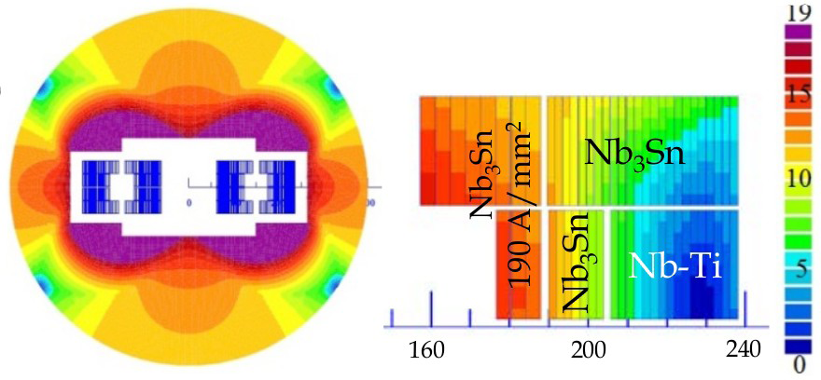
Cost Effective Magnet Design
Nb₃Sn is much more costly than Nb-Ti
Use both materials
Coil sketch of a 15 T magnet with grading, E. Todesco

Slide 11
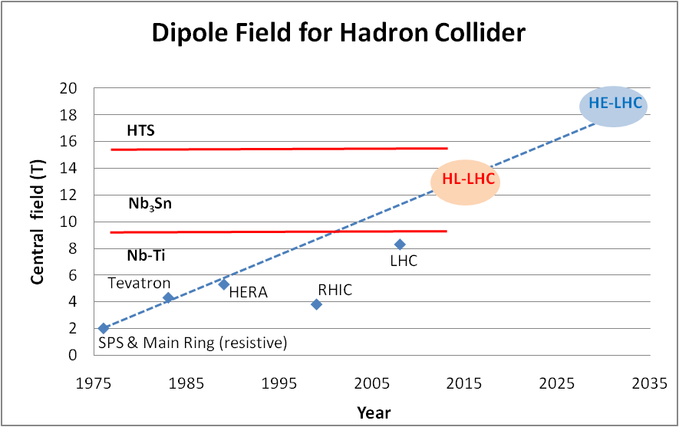
Development of Dipole Fields
Looking at performance offered by practical SC, considering tunnel size and basic engineering (forces, stresses, energy) the practical limits is around 20 T. Such a challenge is similar to a 40 T solenoid (μ-C)
LBNL, with large bore
Spring 2013
Nb-Ti operating dipoles;
Nb3Sn cosϑ test dipoles
Nb3Sn block test dipoles

Slide 12
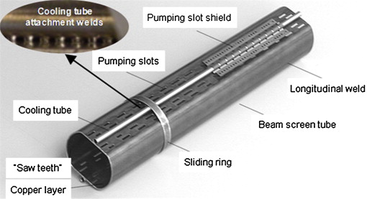
LHC-Type Beam Pipe Design
Current goal
beam aperture: 2x13mm
High impedance
magnet aperture: 2x20mm
Space for shielding: only 7mm
Synchrotron radiation in arcs
28 W/m/beam for 16T
44 W/m/beam for 20T
Total 4.8-5.8MW
Most of the power will be cooled at the beam screen, i.e. at its temperature
A part is going into the magnets, i.e. cooled at 2-4K

Slide 13
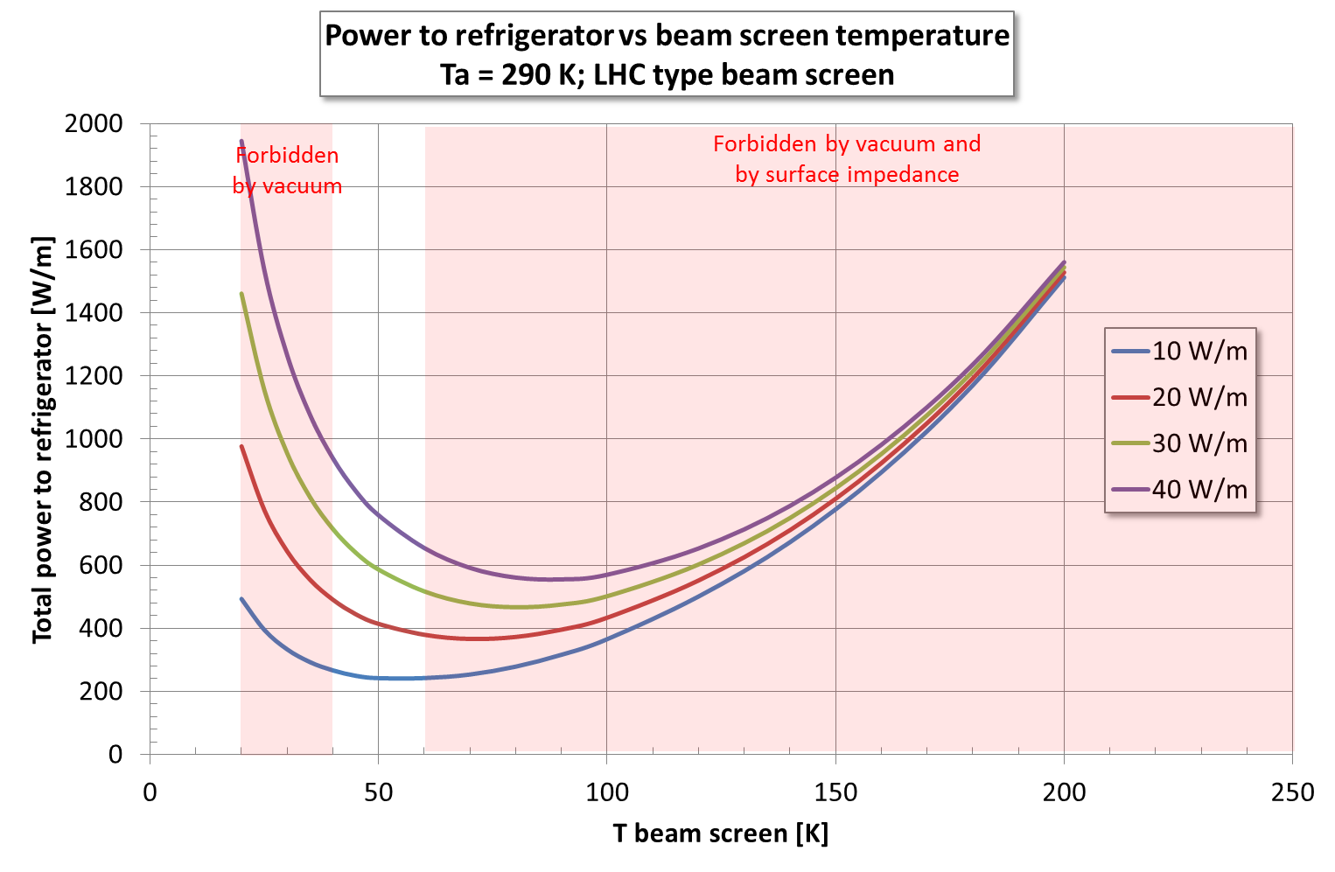
Power for Cooling
Can only use some temperatures in order to maintain good vacuum
<20, 40K-60K, 100K-120K, >190K
Ph. Lebrun
But at 100K the impdance is about twice as hight as at 50K
Choose 50K
Need 100MW for cooling

Slide 14
First Estimates of Impedance Effects
N. Mounet, G. Rumolo
Need feedback within 10 turns
Challenge for RF and instrumentation
Or increase the beam screen radius
Or decrease beam current
TMCI is less important
10 turns
20 turns
20 turns
Many more impedance studies required
Multi-bunch effect at 50K and injection (worst case)
Only resistive wall (infinite copper layer assumed)

Slide 15
Electron Cloud
O. Dominguez Sanchez De La Blanca
Potential show stopper
Critical energy 4.3keV
similar to KEKB
i.e. 100 times LHC
Photon capture efficiency?
Beam stability?
10
W/m
0.001
1
3.1
Need hardware studies, simulation studies and beam experiments
Will have an impact on range of possible bunch spacing

Slide 16
Interaction Region and Final Focus Design
Proof of principle:
L* = 46m (maybe shorter?)
β∗ = 0.8m (goal <1.1m)
1100m long (goal <1400m)
R. Tomas
Consistent with current baseline and a bit of margin
But other designs being studied

Slide 17
Interaction Region and Final Focus Design II
R. Tomas
Alternative improved design:
L* = 38m (goal >25m)
β∗ = 0.3m (goal <1.1m)
It is easier to obtain small beta-functions with shorter L*
Will have a tendency to reduce L*
Need to understand requirements as soon as possible
Many issues need to be addressed
Magnet performance
Radiation effects
Space constraints from experiments
Beam-beam effects and mitigation
…

Slide 18
Luminosity During the Run
The longitudinal and transverse emittances are damped
Heat the longitudinal plan to keep bunch length constant
Heat transverse to keep beam-beam tuneshift constant (i.e. emittance proportional to charge)
Maybe can decrease IP beta-function with reduced emittance
Need to develop operation scenario

Slide 19
Some Performance Issues
Many technology and beam dynamics issues are also important
Beam-beam effects
  Head-on
  Parasitic
Beam current limitations
  E.g. arc impedance, collimator impedance
  Feedback
Magnet imperfections
Emittance measurement/control
Losses, radiation, machine protection, …
…

Slide 20
Machine Protection and Friends
Energy of each circulating beam above 8GJ (= 1 Airbus 380 at 720km/h)
  Hydrodynamic tunnelling
    Probably 300m penetration in matter (guestimate R. Schmidt)
  Huge machine protection issue
Collimation to protect the experiments and machine
  Background/quench in the arcs
Protection of magnets and beam against quenches
  High energy stored in each magnet and in the whole sector
  Higher beam energy could lead to higher losses to the magnets
Beam loss at injection
Beam dump(s)
High radiation at IP

Slide 21
Radiation in Interaction Region
Shield (TAS)
Magnets
But need to open aperture
Total power of background events 100kW per experiment
Already a problem in LHC and HL-LHC
Very much improved shielding is required

Slide 22
Injection
Consider using an injector in the tunnel of
  SPS
  LHC
  FCC collider ring
Need geometric matching at the site
Want a fast turn-around time to maximise physics/risk
Important challenge to fill the FCC circumference with bunches
  Beam is lost at injection from time to time
  Limits the amount of beam injected
  Need to have gap between injected batches

Slide 23
Very First Ion Considerations
See M. Schaumann in breakout session
 | Unit | LHC Design | FCC-hh | FCC-hh
Operation mode | - | Pb-Pb | Pb-Pb | p-Pb
Number of bunches |  | 592 | 432 | 432
Part. P. bunch | [10⁸] | 0.7 | 1.4 | 115(1.4)/1.4
β-function at the IP | [m] | 0.5 | 1.1 | 1.1
RMS beam size at IP | [um] | 15.9 | 8.8 | 8.8
Initial luminosity | [10²⁷cm⁻²s⁻¹] | 1 | 3.2 | 267(3.2)
Peak luminosity | [10²⁷cm⁻²s⁻¹] | 1 | 12.7 | 5477(3356)
Integr. lumi. per fill | [μb⁻¹] | <15 | 83 | 30240
Total cross-section | [b] | 515 | 597 | 2
Initial luminosity lifetime | [h] | <5.6 | 3.7 | 3.2 (10.6)
Much more work to be done: Improved injectors, integration into interaction region, …

Slide 24
Conclusion
Have a first baseline parameter list
  Technological challenges need to be addressed to prove its feasibility
  But currently consider it reasonable risk
Many issues need to be addressed
  Work is starting, forming global collaboration
  Cost is critical -> everything will be pushed to the limit
Need to start to think more about machine detector interface
  L*
  Radiation
  Time structure, …

Slide 25
Reserve

Slide 26
General Luminosity Considerations
Luminosity scales as
Cannot increase the beam current very much
  For the machine would like to reduce it
Should be able to reduce the beta-function
Might be able to accept a somewhat higher beam-beam tuneshift
  Could be used to increase luminosity
  Or/and to reduce beam current
Larger luminosity leads to more radiation in the IPs and more background

Slide 27
General Luminosity Considerations II
Many machine issues depend on the beam current
  Machine protection
  Arc and magnet design
  Cooling and power consumption
  Collective effects
  Fraction of the ring that can be filled with bunches
  …
  Need to study where the limits are
In the end there will be a cost associated with luminosity
  E.g. magnet aperture
For the moment the luminosity goal appears realistic
More might be possible but would keep this for alternative

Slide 28
Average Luminosity

Slide 29
Arcs
Dipoles are critical for FCC-hh design and cost
  Achievable dipole field
  Cost as a function of aperture (and field)
    Strong cost increase with increasing aperture
    Practical minimum aperture is likely 40mm (L. Bottura)
    Use this as an ambitious target
  Tolerances and field quality important for the beam and cost
    In particular field quality at injection energy
    Dynamic aperture, alignment, …
Currently consider four beam pipe design approaches
  LHC-type copper coated beam screen (baseline)
  LHC-type beam screen coated with high temperature superconductor
  Use of photon stops
  Open midplane magnets

Slide 30
Beam Pipe, Vacuum, Cryogenics
Need to understand how to operate in the 40-60K temperature window, if heat load changes
Transparency of beam screen is important for vacuum quality and impedance
Shielding of magnets from synchrotron radiation load
  Try to use less space than in LHC but with higher load
  This appears very challenging
High temperature superconductor (HTS) coating?
Electron cloud (photon absorption, secondary emission yield of HTS, …)
Potentially photon stops, …

Slide 31
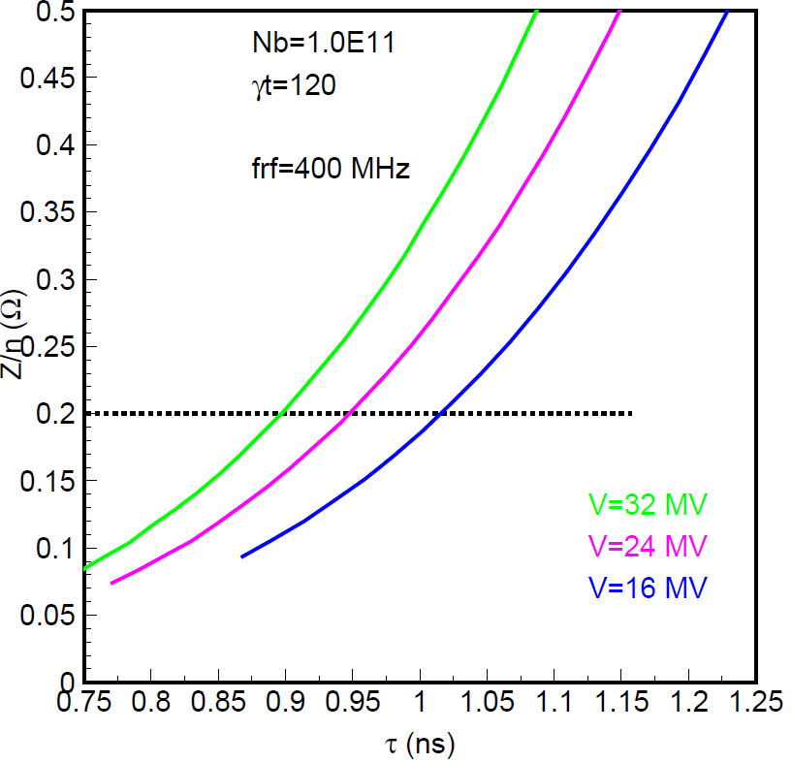
RF Design Considerations
E. Shaposhnikova
400.8 MHz seems a good baseline
16MV minimum with no margin
32MV seems fine
200MHz appear somewhat low
Needs higher voltage (>100MV)
Or longer bunches (12cm)
800MHz appears too high
Combination of 200 and 400MHz?
Assumed impedance (x2)
32MV
24MV
16MV
Bunch length
Feedback design is critical
Emittance control also

Slide 32
Overall Layout
Arc design
  Magnet performance dependent
  One of the main parameter drivers
Layout of insertion lines
  Experiment insertions
  Collimation
  Injection and extraction
  Others (RF, additional experiments)
Geometry
  Racetrack vs. LHC-type layout
In the first stage, need to determine required lengths for beam lines and identify and address the main issues

Slide 33
Lattice Scaling
Using the same components and transverse dimensions
This allows to stay with the same quadrupole gradient and dipole strength
Change of technology modifies this, e.g. for FODO cell

Slide 34
Interaction Region and Final Focus Design
Goal:
L* >= 25m, need to iterate with the experiment
β∗ = 1.1m
Total length < 1400m
Rogelio’s approach
Based on LHC IR design
Scaled according to energy and length

Slide 35
Interaction Region and Final Focus Design
R. Tomas

Slide 36
Interaction Region and Final Focus Design
R. Tomas
L* = 46m
Achieves β∗ = 0.8m
About 1100m long
Need to verify separation
Some iterations useful
Improvements possible
Excellent start
Baseline appears possible
Note: small beta-function can reduce synchrotron radiation

Slide 37
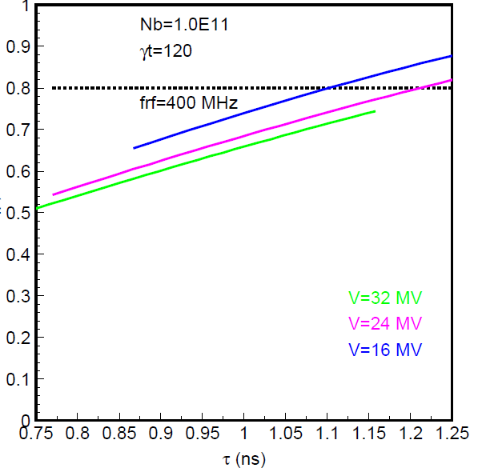
400MHz Option
Loss of Landau damping
Filling factor in momentum
Need enough voltage to keep beam stable
Filling factor should not exceed 0.8
E. Shaposhnikova

Slide 38
Electron Cloud
O. Domingues Sanches De La Blanca
10
10
W/m
W/m
1
0.001
1
2.8
1
3.1
Need to quantitatively asses physics parameters
Flux of photons increases with B, 1.3x10¹⁷m⁻¹s⁻¹, i.e. twice LHC
Critical energy 4.3keV, i.e. 100 times LHC, similar to KEKB, photoemission yield?
Photon capture efficiency?
Likely need mitigation techniques
Need hardware studies, simulation studies and beam experiments

Slide 39
Operation and Head-on Beam-beam Effects
Have chosen total tuneshift of 0.01
  Should be conservative value
Damping will decrease emittance and increase tuneshift
Need to explore how we can control the luminosity and emittance
  Noise into feedback, kickers, small beam-beam offsets, …
  Need to measure emittance in collision
Can we live with larger tuneshift like in a lepton ring?
  Can we just wait for an equilibrium?
  Can the luminosity be controlled, i.e. not too high?
  The beams will probably tend to become flat. What are the consequences?
Which experiments do we need?

Slide 40
Collective Effects and Mitigation
Likely will have more parasitic crossings than in LHC
  Longer L*
  Potentially shorter bunch spacing (down to 5ns)
  Study impact and mitigation techniques
    Choice of beam parameters
    Crab cavity
    Wires
    Electron lenses
Impedances
  Collimators
  …
Feedback
Tolerances and single particle effects
Much to be learned from the LHC

