Slide 1
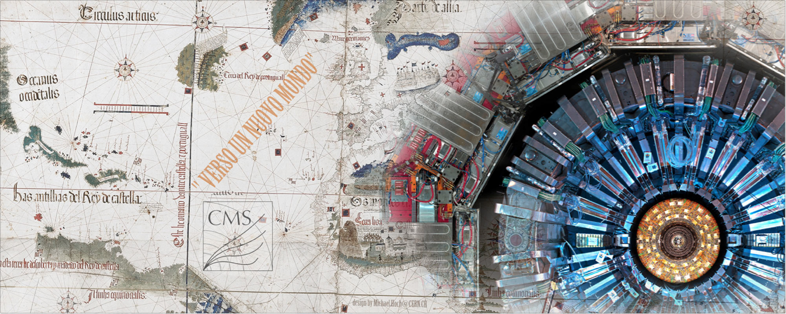
Discussion on future accelerator facilities
Fabiola’s slides ( apologies from her)
A few questions to stimulate discussion

Slide 2
Discussion session
Slides from Fabiola: A compendium of future colliders parameters, challenges and physics objectives. I have them posted for reference and as possible background material for the discussion
I have compiled a set of questions ( not always asked )… will try to dedicate ~10 minutes discussion each

Slide 3
Future e⁺e⁻ colliders
L~ 10³⁴-10³⁵ cm⁻² s⁻¹
√s (GeV) Main physics goals
90 Z-pole precision EW measurements beyond LEP, SLC
180 WW precision physics (mass at threshold)
250 Higgs precision physics (HZ)
350 Higgs precision physics (HZ, Hνν), top precision physics (mass at threshold)
500-3000 ttH, HH (including self-couplings), direct searches for new physics
Complementary
Linear colliders Circular colliders
√s reach multi-TeV limited to < 500 GeV
by synchrotron radiation SR ~ E⁴_{beam}/R
Luminosity low repetition rate large number of continuously
→ L from squeezing circulating bunches → larger beam size
beams to ~ nm size → smaller beamstrahlung
→ large beamstrahlung → cleaner environment, smaller E spread
Injection fresh bunches need to short L lifetime (~ 30’) due to burn-off
be injected at each cycle → continuous top-up e± injection
L vs √s increases at high E increases at low E
(beam emittance decreases) (less SR → RF power accelerates more bunches)
Number of 1 several
interaction regions (shared by 2 detectors push/pull?)

Slide 4
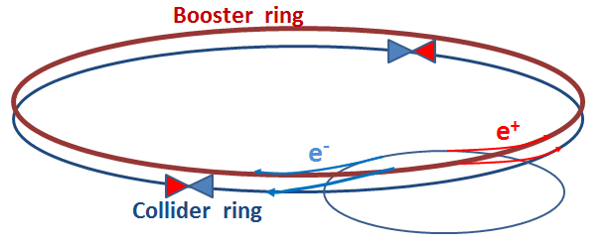
CepC FCC-ee
Ring (km) 53.6 100
√s (GeV) 240 240 350 90
E loss per turn (GeV) 3 1.7 7.5 0.03
Total RF voltage (GV) 6.9 5.5 11 2.5
Beam current (mA) 16.6 30 6.6 1450
N. of bunches 50 (one ring!) 1360 98 16700
L (10³⁴ cm⁻² s⁻¹)/IP 1.8 6 1.8 28
e±/bunch (10¹¹) 3.7 0.46 1.4 1.8
σ_{y}/σ_{x} at IP (μm) 0.16/74 0.045/22 0.045/45 0.25/121
Interaction Points 2 4 4 4
Lumi lifetime (min) 60 21 15 213
SR power/beam 50 MW 50 MW
Main challenges:
FCC ring size
Synchrotron radiation → 100 MW RF system
with high efficiency
Beam polarization for beam energy calibration at Z-pole and
WW threshold to <100 keV to measure m_{Z}, m_{W} to < MeV at FCC-ee
Machine design with large energy acceptance over full √s span
Note: Super-KEKB is an excellent “prototype”, with more stringent requirements on
positron rate, momentum acceptance, lifetime, β_{y}*

Slide 5
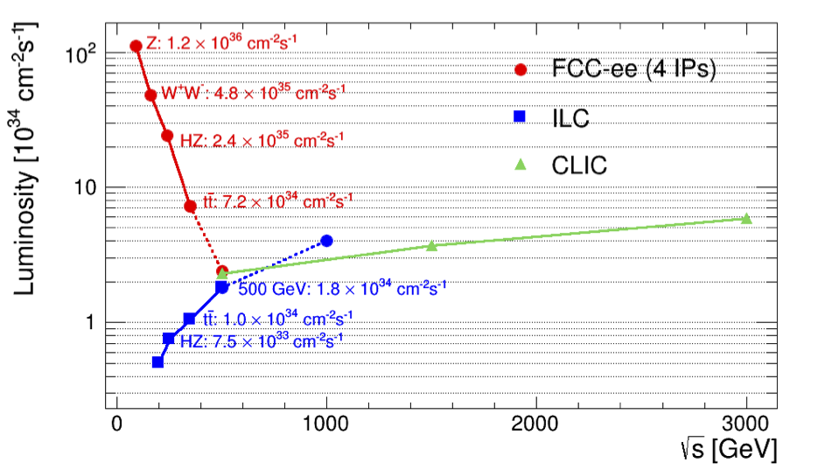
Summary of e⁺e⁻ colliders main parameters
CepC (2 IPs)
Circular
Modified from original version:
http://arxiv.org/pdf/1308.6176v3.pdf
Linear
Some typical energy points only
Size √s RF L per IP Bunch/train σ_{x} σ_{y} Lumi within Long. polarisation
km GeV MV/m 10³⁴ x-ing rate(Hz) μm nm 1% of √s e⁻/e⁺
CEPC 54 240 20 1.8 4x10⁵ 74 160 >99% considered
FCC-ee 100 240 20 6 2x10⁷ 22 45 >99% considered
ILC 31 250 14.7 0.75 5 0.7 7.7 87% 80%/30%
ILC 31 500 31.5 1.8 5 0.5 5.9 58% 80%/30%
CLIC 48 3000 100 6 50 0.04 1 33% 80%/considered

Slide 6
Future pp colliders
Pioneering work in the US as of 1998
with VLHC: http://vlhc.org/vlhc/
Ring (km) Magnets (T) √s (TeV) L (10³⁴)
LHC 27 8.3 14 up to 5
HE-LHC 27 16-20 26-33 5
SppC-1 50 12 50 2
SppC-2 70 19 90 2.8
FCC-hh 100 16 100 ≥ 5
Nb₃Sn ok up to 16 T;
HTS needed for 20 T
May reach ~10³⁵
More parameters of 100 TeV FCC-hh
HL-LHC FCC-hh
Bunch spacing 25 25
N. of bunches 2808 10600
Pile-up 140 170
E-loss/turn 7 keV 5 MeV
SR power/ring 3.6 kW 2.5 MW
Interaction Points 4 4
Stored beam energy 390 MJ 8.4 GJ
5 ns also considered
to mitigate e-cloud
Challenges (many, daunting, ...):
magnet technology, tunnel excavation,
stored beam energy, …
As an Airbus 380 at full speed

Slide 7
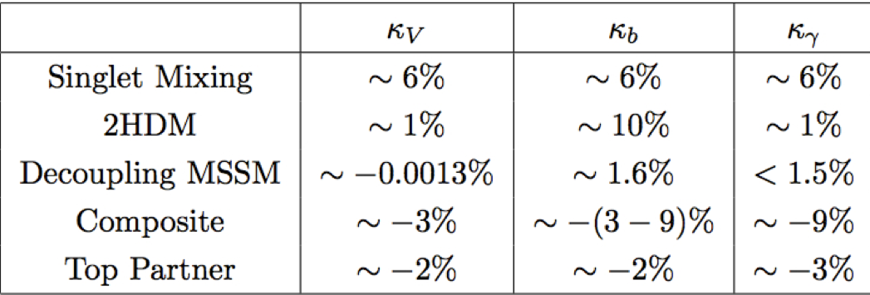
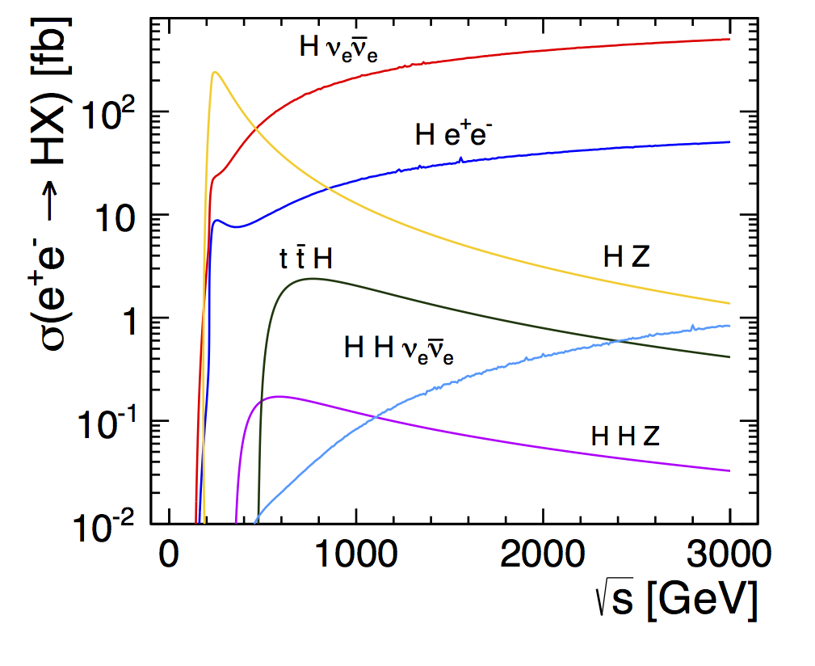
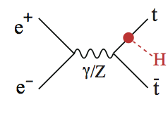
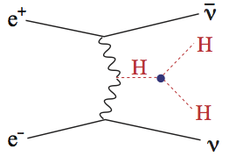
How precisely do we need to know the Higgs boson ?
Effect of New Physics on couplings:
Scenarios with no new particles observable at LHC
Δκ/κ ~ 5%/Λ²_{NP} (Λ_{NP} in TeV)
0.1-1% precision needed for discovery
Integrated luminosities correspond to 3-5 years of running
at each √s for e⁺e⁻ and 5 years with 2 experiments for pp
√s (TeV) L (ab⁻¹) N_{H} (10⁶) N_{ttH} N_{HH}
FCC-ee* 0.24+0.35 10 2 -- --
ILC 0.25+0.5 0.75 0.2 1000 100
ILC-1TeV 0.25+0.5+1 1.75 0.5 3000 400
CLIC 0.35+1.4+3 3.5 1.5 3000 3000
→ ttγγ, tt4l → bbγγ
HL-LHC 14 3 180 3600 ttγγ 250
FCC-hh 100 6 5400 12000 tt4l 20000
* 4 IP
<10% of events usable

Slide 8
Coupling HL-LHC FCC-ee ILC (500) ILC (1000) CLIC
√s → 14000 240 +350 250+500 250+500+1000 350+1400+3000
Int. L → 6000 10000+2600 250+500 250+500+1000 500+1500+2000
K_{W} 2-5% 0.19% 1.2% 1.2% 2.1%
K_{Z} 2-4% 0.15% 1.0% 1.0% 2.1%
K_{g} 3-5% 0.80% 2.3% 1.6% 2.2%
K_{γ} 2-5% 1.5% 8.4% 4.0% <5.9%
K_{μ} ~7% 6.2% -- 16% 5.6%
K_{c} -- 0.71% 2.8% 1.8% 2.2%
K_{τ} 2-5% 0.54% 2.4% 1.8% <2.5%
K_{b} 4-7% 0.42% 1.7% 1.3% 2.1%
BR_{invis} <10 % <0.19% <0.9% <0.9% na
K_{t} ~5% 13%indirect 14% 3.2% <4.5%
K_{HH} (self) ? -- -- 26% (13% ultimate) 10%
rare decays → HL-LHC
is competitive
FCC-hh:
K_{t}: few percent ??
K_{HH} ~ 8%
LHC: ~20% today → 5-10% in ~2020 (14 TeV, 300 fb⁻¹)
HL-LHC:
-- factor ~ 2 better than LHC @300 fb⁻¹
-- first direct observation of couplings to top (ttH) and 2nd generation fermions (H→ μμ)
-- model dependent measurements: Γ_{H} and σ (H) from SM
e⁺e⁻:
-- model-independent: σ(HZ) and Γ_{H} from data: ZH → μμX recoil mass (σ, Γ_{H}), Hvv → bbvv (Γ_{Z})
-- all decay modes accessible (fully hadronic, invisible, exotic)
Best precision (few 0.1%) at circular colliders (luminosity !), except for heavy states
(ttH and HH) where high energy (linear colliders, FCC-hh) needed
Note: theory uncertainties, e.g. presently O(1%) on BR, need to be improved to match
expected superb experimental precision and sensitivity to new physics

Slide 9

Where do we go from here ?
LHC Run-1 brought us a certitude: the Higgs boson as the key of EWSB
H(125) needs to be studied with the highest precision → door to new physics ?
→ Low m_{H} makes H accessible to both circular and linear colliders, with different pros/cons
complete exploration of EWSB needed (HH production, V_{L}V_{L} scattering, look for possible
new dynamics, etc. ) → requires multi-TeV energies
LHC Run-2 and beyond may (hopefully !) bring additional no-lose theorems:
if new (heavy) physics is discovered
→completion of spectrum and detailed measurements of new physics likely
require multi-TeV energies
if indications emerge for the scale of new physics in the 10-100 TeV region
(e.g. from dijet angular distributions → Λ compositeness)
→ need the highest-energy pp collider to probe directly the scale of new physics
Regardless of the detailed scenario, and even in the absence of theoretical/experimental preference for a specific E scale, the directions for future high-E colliders are clear:
highest precision → to probe E scales potentially up to O(1OO) TeV and smallest couplings
highest energy → to explore directly new territories and get crucial information to interpret results from indirect probes
Thanks also to great technology progress, many scientifically strong opportunities
are available: none of them is easy, none is cheap.
Decision on how to proceed, and the time profile of the projects, depends on science (LHC
results), technology maturity, cost and funding availability, global (worldwide) perspective

Slide 10
There is challenging work for everybody to make the “impossible” possible !
Accelerator R&D (few examples …):
High-field accelerator-quality Nb₃Sn superconducting magnets ready for massive industrial production starting mid-end next decade. Continue to push HTS (still in dreamland …) for farther-term future.
Normal- and super-conducting high-Q RF cavities reaching higher field at lower cost
(e.g. Nb₃Sn coating for SCRF; lower breakdown rates for NCRF)
Higher-efficiency RF sources
Novel ideas to reach GV/m acceleration gradients, allowing factor ~10 shorter Linacs:
e.g. laser- and beam-driven plasma wakefield acceleration (FACET@SLAC, BELLA@LBNL,
AWAKE@CERN, LAOLA@DESY, FLAME@LNF)
MW-class proton sources and high-power targets for longer-term opportunities
(muon colliders ?)
Detectors (few examples …):
ultra-light, ultra-fast, ultra-granular, rad-hard, low-power Si trackers
10⁸ channel imaging calorimeters (power consumption and cooling at high-rate machines,..)
big-volume 5-6 T magnets (~2 x magnetic length and bore of ATLAS and CMS,
~50 GJ stored energy) to reach momentum resolutions of ~10% for p~20 TeV muons
Theory: improved theoretical calculations (higher-order EW and QCD corrections) needed
to match present and future experimental precision on EW observables, Higgs mass and
branching ratios. Work together with experiments on model-independent analyses
in framework of Effective Field Theory (see S.Dittmaier’s talk)

Slide 11
From Lyn Evans presentation at ICHEP
At the beginning of the1960’s a debate was raging about the next step for CERN. Opinions were sharply divided between a “large PS”, a proton machine of 300 GeV energy or a much more ambitious colliding beam machine.
In February 1964, 50 physicists from among Europe’s best met at CERN. They decided to transform themselves into the European Committee for Future Accelerators (ECFA) under the chairmanship of Eduardo Amaldi.
It took another 2 years before a consensus was formed. In December 1965 the CERN Council approved the construction of the ISR.

Slide 12
Nothing new under the HEP sun
It is part of our tradition to have (sometimes very heated) debates about which way to go whenever we had to decide which new facilities to built
However: in the past, the discussion was mostly limited to a single laboratory, e.g. CERN or FNAL. [CERN was always unique in being the only place where several community/funding agencies aggregated]. The major new element: nowadays the debate is global, involving the major HEP laboratories

Slide 13
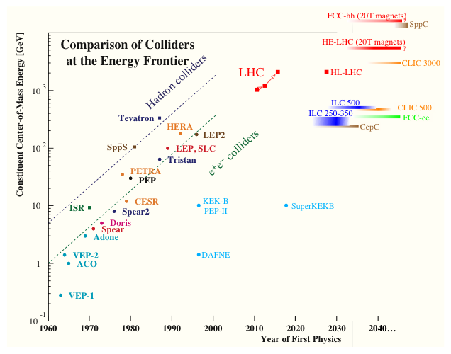
The facilities being discussed
e⁺e‑ Linear Colliders
HE e⁺e‑ Storage Rings
HE pp Colliders
Borrowed fron Nick Walker
Notes:
But no funding!

Slide 14
Question:HL HLC
HL LHC has got the formal priority flag from both Europe and US and, at least in words, is agreed by all other players as being the thing to do. It is the ‘highest-priority near-term large project’
Are we defining correctly its scope ?
  We have been cornered in using Higgs coupling as THE future objective …or ‘promising’ dark matter
  Do we agree that HL-LHC is not only about decreasing the Higgs coupling error bars by a factor two? And that we can do more than Nobel prize level discovery?

Slide 15
Question: ILC
The ILC is a mature concept : recent production of SC cavities for XFEL is proof that major technological hurdle is OK
We are dealing for the first time with justifications where ‘political’ opportunity seems at times to take prevalence over scientific issues
The Japanese review of the ILC has given the community ~ 2 years to reach a consensus about ( personal wording)
  Consensus in the scientific community that the ILC is the thing to do
  Consensus in the (local) constituencies that the iLC is the best way to invest the resources in view of promoting growth
  Consensus in the world community to commit to contribute
Do we believe that such level of ‘global’ consensus is achievable ?

Slide 16
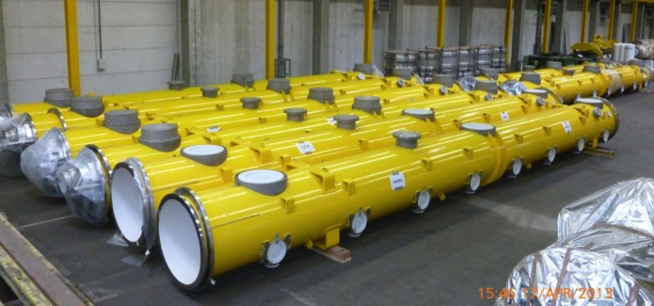

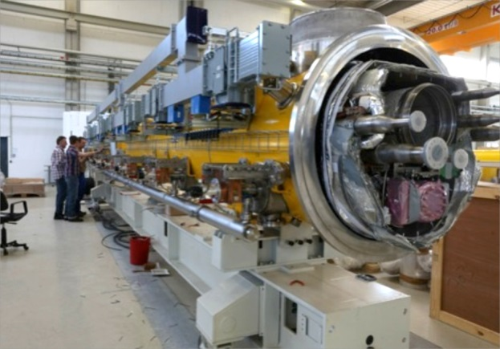
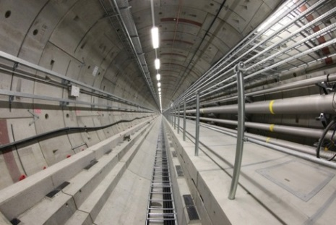
SC cavities quality for XFEL

Slide 17
Question: what next ?
Should we decide the “next steps” in a piece-meal fashion, i.e. one project at a time [ILC, neutrinos in the US, FCC, etc] ? Or should we push as community to have one big package deal?
It is more difficult because of the timescales, but avoids making decisions that then “mortgage” the other future projects.

Slide 18
Question: the human factor
Some of the new challenging projects are ‘green field’ projects.
Integration of international community into the new ‘sites’ will be different from the ‘traditional’ migration into historical labs which have grown ‘progressively’ over many years like FNAL , CERN…
As the international participation is a must for any of the future projects and that will imply massive migration of ‘human resource’ : is it correct to take this for granted?

Slide 19
Question: diversity
The focus of all discussions is about VERY large projects ( FCC,ILC, LBNF, CepC)
In the background Japan and China have a very rich complementary program ( superB, Neutrino programs..)
Should Europe/CERN also consider (cheaper !) diverse programs ? ( beyond NA62… SHIP is an example )

