Slide 1
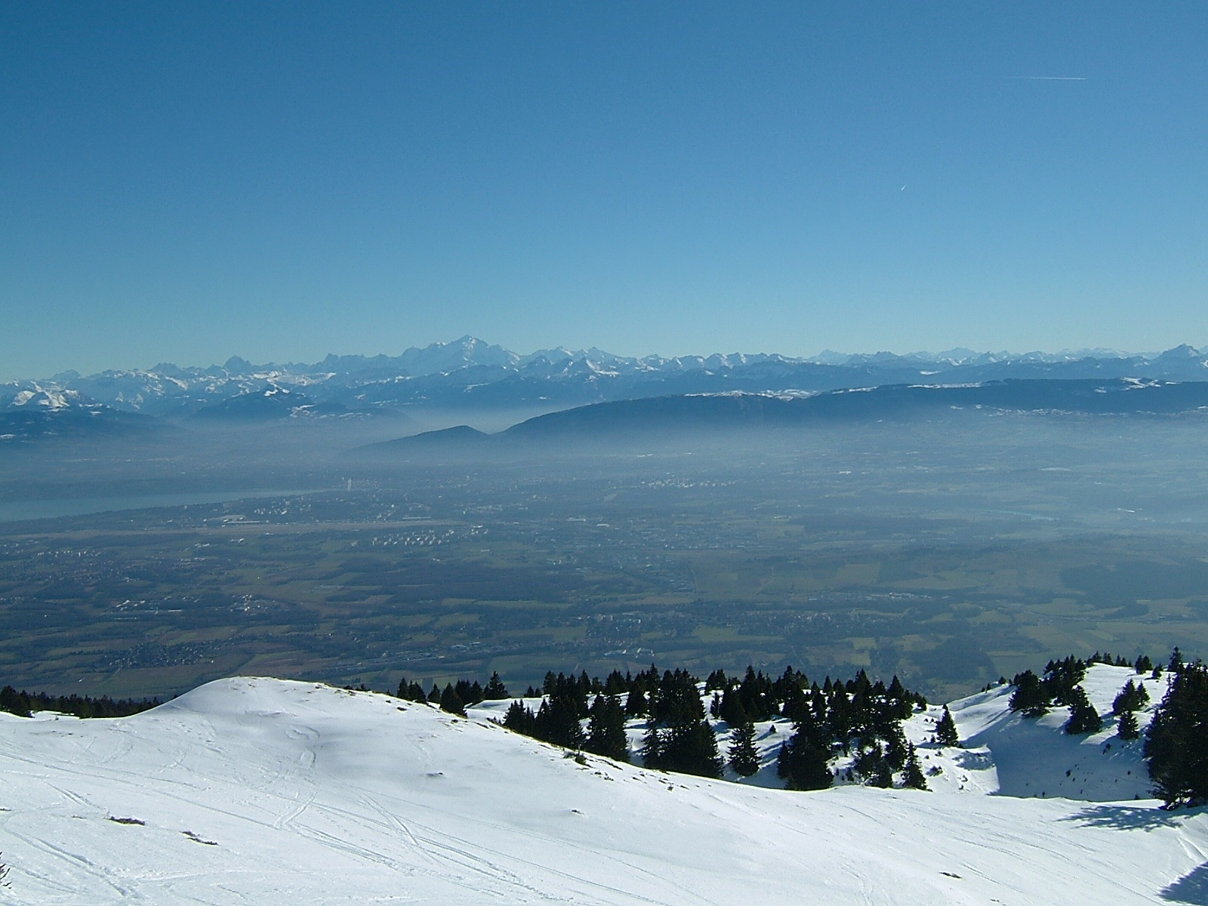
FCC-ee as Higgs Factory
Future Circular Collider Study
Jörg Wenninger
CERN Beams Department
Operation group - LHC
Acknowledgments to my FCC-ee colleagues from CERN and BINP

Slide 2
Future Circular Collider study
pp collider (FCC-hh) – 50 TeV* – defines infrastructure.
B = 16 T ⇒ 100 km
B = 20 T ⇒ 80 km
e⁺e⁻ collider (FCC-ee/TLEP) – 40-175 GeV* – as potential intermediate step.
e-p option.
Organized as an international collaboration.
Infrastructure in Geneva area.
CDR and cost review for the next European Strategy Update in 2018
*beam energy

Slide 3
Physics goals of FCC-ee
Provide highest possible luminosity for a wide physics program ranging from the Z pole to the $t\overline{t}$ production threshold.
Beam energy range from 45 GeV to 175 GeV.
Main physics programs / energies (+ scans around central values):
Z (45.5 GeV): Z pole, ‘TeraZ’ and high precision M_{Z} & Γ_{Z},
W (80 GeV): W pair production threshold,
H (120 GeV): ZH production threshold ,
t (175 GeV): $t\overline{t}$threshold.
The machine will be optimized for operation at 120 GeV
All energies quoted in this presentation refer to BEAM energies

Slide 4
Layout
1, 2 or 4 experiments.
8 or 12 Long(er) Straight Sections (LSS): L ≈ 1500 m (some flexibility).
Injection, beam dump, RF, wigglers. RF must be distributed.
Circumference 80 to 100 km.
Arc bending radius ρ = 11 km.
2 rings.
Layout and design of common sections to be defined.
The rings should be side-by-side: polarization, vertical emittance.
Machine should be planar: polarization.
The layout is far from finalized, it must be compatible with all options (ee, pp, ep)

Slide 5
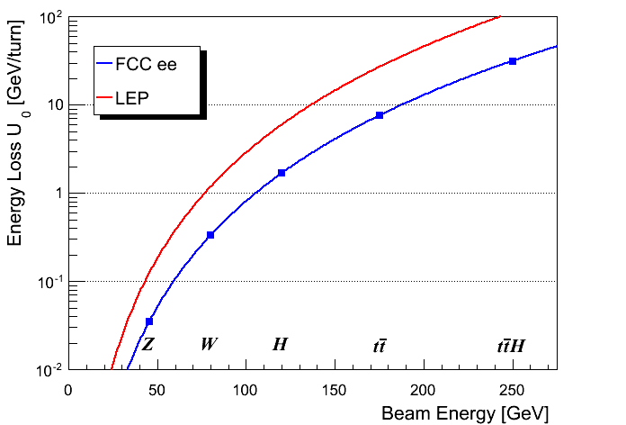
Synchrotron radiation power
The maximum synchrotron radiation (SR) power P_{SR} is set to 50 MW per beam – design choice ⇔ power dissipation.
defines the maximum beam current at each energy.
Note that a margin of a few % is required for losses in straight sections.
ρ = 3.1 km
V_{RF} ~35 GV
V_{RF} ~10-11 GV
ρ = 11 km

Slide 6
Luminosity
H ≤ 1
Hour-glass
F ≤ 1
Crossing angle
2Φ
Beam-beam parameter

Slide 7
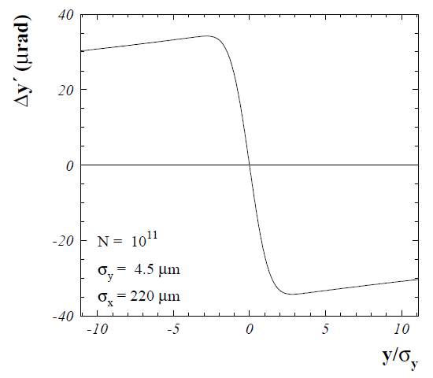
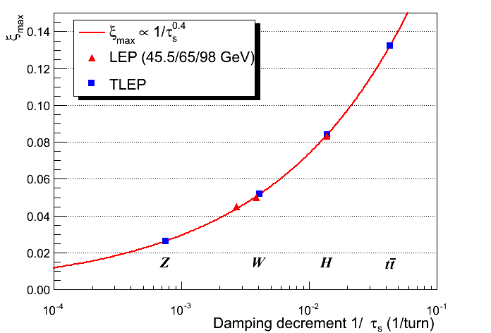
Beam-beam parameter
The beam-beam parameter ξ measures the strength of the field sensed by the particles due to the counter-rotating bunch.
Beam-beam parameter limits are empirically scaled from LEP data (also 4 IPs).
In reasonable agreement with first simulations for FCC ee
The beam-beam limit may be raised significantly with Crab-Waist schemes !

Slide 8
Beamstrahlung
Hard photon emission at the IPs, ‘Beamstrahlung’, can become a lifetime / performance limit for large bunch populations (N), small hor. beam size (σ_{x}) and short bunches (σ_{s}) .
e
γ
e
ρ : mean bending radius at the IP (in the field of the opposing bunch)
η : ring energy acceptance
Lifetime expression by V. Telnov
To ensure an acceptable lifetime, ρ×η must be sufficiently large.
Flat beams (large σ_{x}) !
Bunch length !
Large momentum acceptance of the lattice: 1.5 – 2% required.
LEP had < 1% acceptance, SuperKEKB ~ 1-1.5%.

Slide 9
IR parameters
At the IP the smallest possible β* must be obtained – see L formula. The target for β*_{y} is set to 1 mm. Such a small β* requires a local chromaticity correction scheme.
Design taken over from linear collider IR. But with the complexity that the beam does not pass the IR only once → effects of optical aberrations is very critical.
Requires bending magnets close to the IP → SR fan !
The distance between IP and front-face of the first quadrupole is currently set to L* ≥ 2 m (SuperKEKB ~1 m).
Acceptance for experiments, luminosity measurement. To be studied.
The combination of very small β_{y}* and large acceptance is a challenge for the optics design !

Slide 10
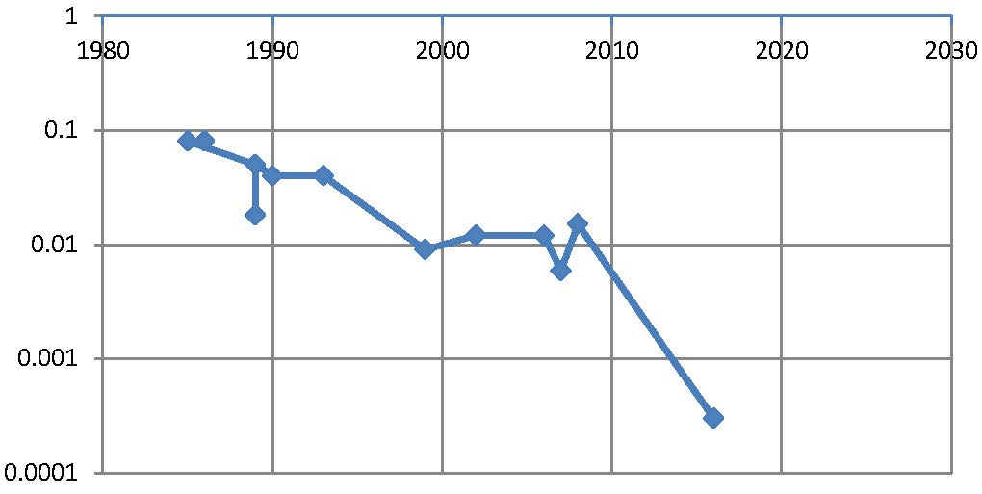
β* evolution
β* [m]
year
SPEAR
PEP, BEPC, LEP
F. Zimmermann
PETRA
TRISTAN
DORIS
CESR-c, PEP-II
BEPC-II
CESR
DAFNE
KEKB
6 mm
FCC-ee
SuperKEKB
1 mm
0.3 mm
SuperKEKB will be a FCC-ee demonstrator for ceratin optics aspects !

Slide 11
Main baseline parameters
Different optimizations are possible within ΔL/L ~30-50%.
No. bunches ⇔ bunch population, emittances …
Parameter | Z | W | H | t | LEP2
E (GeV) | 45 | 80 | 120 | 175 | 104
I (mA) | 1400 | 152 | 30 | 7 | 4
No. bunches | 16’700 | 4’490 | 1’330 | 98 | 4
β*_{x/y} (mm) | 500 / 1 | 500 / 1 | 500 / 1 | 1000 / 1 | 1500 / 50
ε_{x} (nm) | 29 | 3.3 | 1 | 2 | 30-50
ε_{y} (pm) | 60 | 7 | 2 | 2 | ~250
ξ_{y} | 0.03 | 0.06 | 0.09 | 0.09 | 0.07
L (10³⁴ cm⁻²s⁻¹) | 28 | 12 | 6.0 | 1.8 | 0.012
The actual intensities and luminosities will be lowered somewhat by SR losses around the experimental regions (change < 10%).

Slide 12
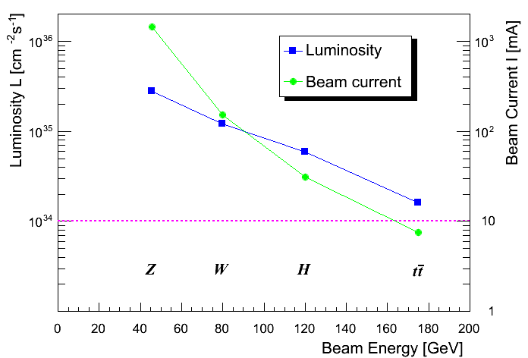
Luminosity
Number of bunches : ~17’000 at 45 GeV ⇒ ~100 at 175 GeV
The large number of bunches at Z, W & H requires 2 rings
/ IP
CEPC*
(*) Y. Wang FCC kickoff

Slide 13
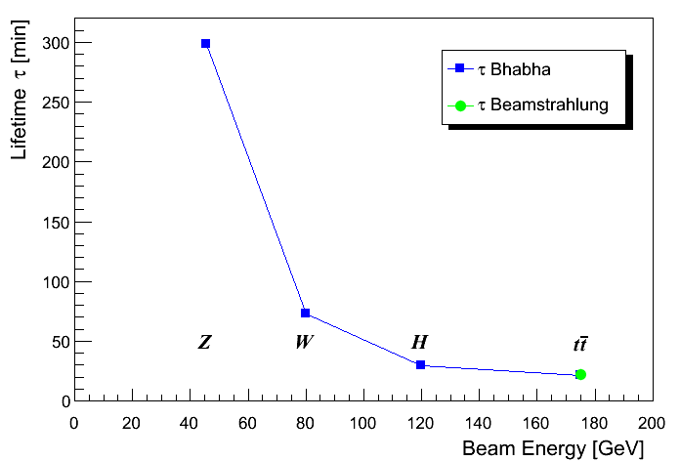
Luminosity lifetime
Lifetime from luminosity depends on radiative Bhabha scattering total cross-section σ_{ee} ≈ 0.15 (b) for η=2% ≈ independent of energy.
⇒ Lifetimes down to ~15 minutes.
Continuous injection (top-up)
n_{ip} = 4

Slide 14
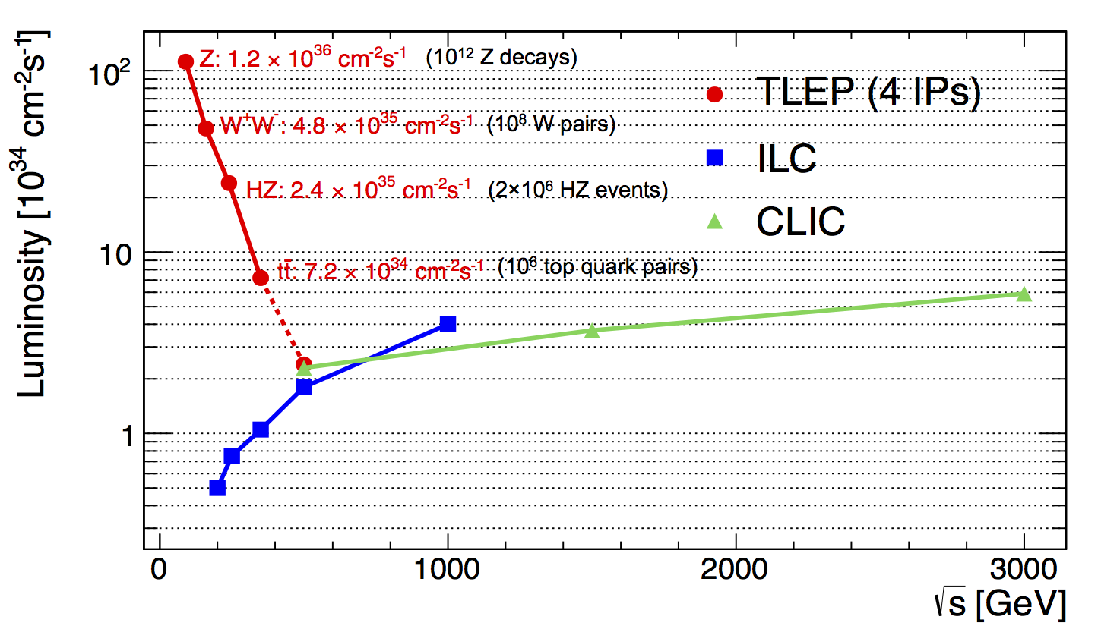
Performance overview
CEPC (2 IPs)
High potential of the rings at ‘low’ energy (includes ZH)
ILC has a TDR while FCC aims for a CDR in a few years – ILC is evidently more advanced in demonstrating its ‘feasibility’.

Slide 15
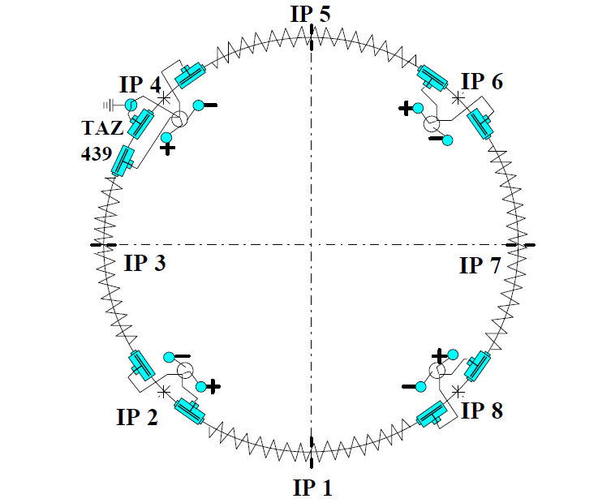
Single ring option
With a single ring electrostatic fields must be used to separate and recombine the beams.
Such ‘Pretzel’ schemes were used at many colliders (CESR, LEP, SppS, Tevatron).
The max. number of bunches is much smaller than for 2-ring factories.
Constraints on arc optics.
Head-on collisions !
The number of bunches would probably be limited to k~50-500.
Luminosity reach for H and $t\overline{t}$ not far from baseline figures, significantly lower luminosity at Z and W.
LEP Pretzel scheme
Design: k=36
Operation: k=8
Not the baseline option for FCC-ee !

Slide 16
Double ring IR
Large crossing angle – nano-beam / crab-waist concepts.
Favorable from the beam-beam perspective ⇒ larger ξ, larger L.
Strong dipoles near IPs ⇔ synch. radiation, machine-detectors interface.
Bunch length σ_{s} >> β*_{y} , σ_{s} ≈ 4-6 mm (→ RF frequency of 400 MHz).
Luminosity loss from large crossing angle ( F <<1) must be compensated by smaller emittances and higher bunch currents.
Overlap region ~ β*_{y}<< σ_{s}
DAΦNE
SuperKEKB
H~1, F << 1
2Φ ~10-40 mrad
A new parameter set for 2Φ ~ 30 mrad will be prepared to replace the current baseline

Slide 17
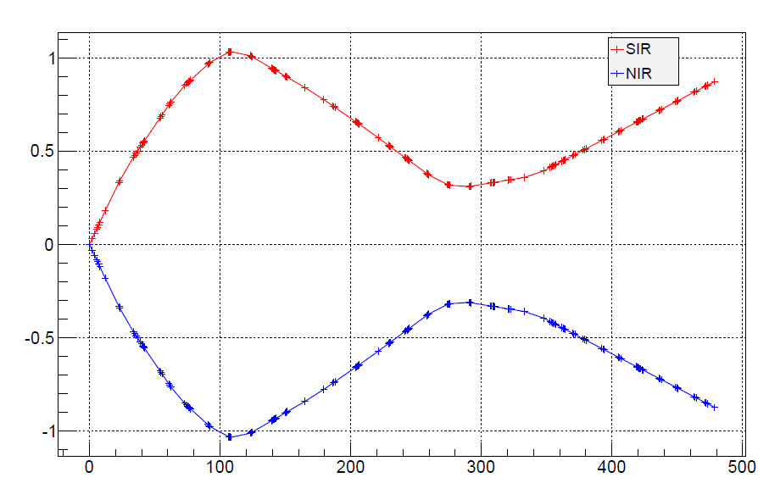
IR layout – double ring
IP
½ IR designed by BINP
x (m)
θ = 30 mrad
2m
s (m)
Issues that have to be tackled:
Dynamic aperture (momentum acceptance), we are not there…
Strong dipoles → SR radiation power ~ MW / beam / IR.
For crossing angles and local chromatic corrections (the later also applies for single ring) – careful optimization required.
Machine-detector interface (solenoid, L monitoring…).
Transverse size →tunnel diameter.

Slide 18
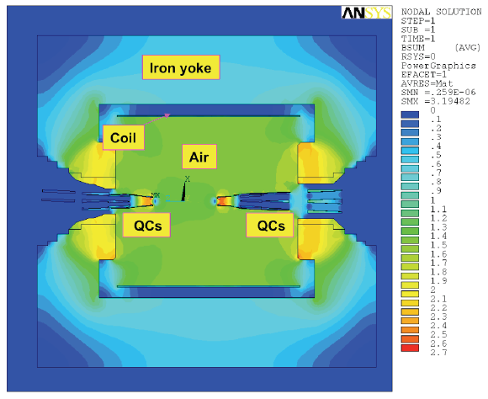
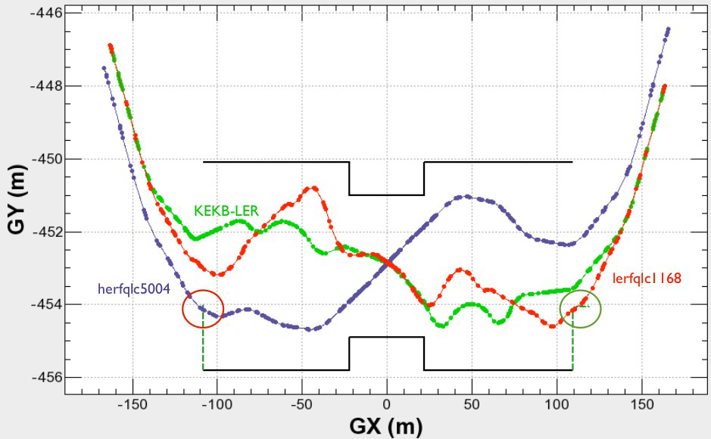
SuperKEKB IR
IR layout of SuperKEKB – the only straight thing is the tunnel.
‘Wiggling’ of the beam paths ⇔ local chromatic corrections.
K. Oide
H. Sugimoto
The last focusing quadrupoles are installed deep inside the BELLE detector.
Shielded from the BELLE solenoidal field with anti-solenoids.

Slide 19
SC RF System
RF system requirements are characterized by two different regimes.
High gradients for H and $t\overline{t}$ – up to ~11 GV.
High beam loading with currents of ~1.5 A at the Z pole.
The RF system must be distributed over the ring to minimize the energy excursions (~4.5% energy loss @ 175 GeV).
Optics errors driven by energy offsets, effect on η.
Aiming for SC RF cavities with gradients of ~20 MV/m.
RF frequency of 400 or 800 MHz (current baseline).
Nano-beam / crab waist favors lower frequency, e.g. 400 MHz.
Conversion efficiency (wall plug to RF power) is critical. Aiming for 75% or higher → R&D !
An important item for the FCC-ee power budget.~65% was achieved for LEP2.

Slide 20
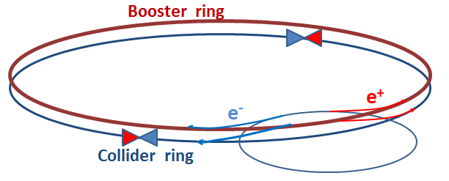
Injection
Besides the collider ring(s), a booster of the same size (same tunnel) must provide beams for top-up injection.
Same size of RF system, but low power (~ MW).
Top up frequency ~0.1 Hz.
Booster injection energy ~20 GeV.
Bypass around the experiments.
Injector complex for e⁺ and e⁻ beams of ~20 GeV.
Super-KEKB injector ~ almost suitable (needs boost of energy).

Slide 21
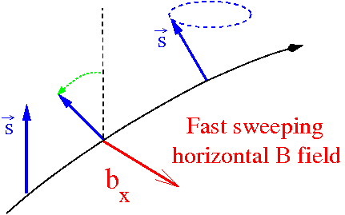
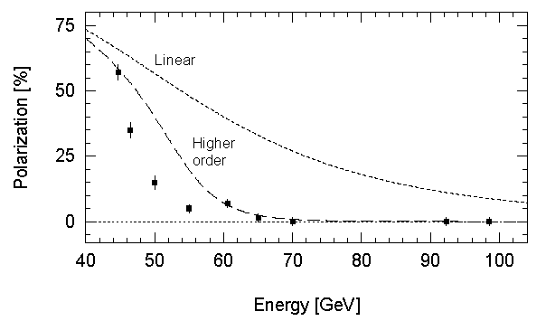
Polarization
Two main interests for polarization:
Accurate energy calibration using resonant depolarization ⇒ measurement of M_{Z}, Γ_{Z}, M_{W}
Nice feature of circular machines, δM_{Z}, δΓ_{Z} ~ 0.1 MeV
Physics with longitudinally polarized beams.
Transverse polarization must be rotated in the longitudinal plane using spin rotators (see e.g. HERA).
Precession frequency ∝ E
Scaling the LEP observations :
polarization expected up to the WW threshold !
loss of polarization due to growing energy spread
$$σ_{E}∝{E^{2}}/{\sqrt{ρ}}$$
LEP
Integer spin resonances are spaced by 440 MeV:
energy spread should remain below ~ 60 MeV

Slide 22
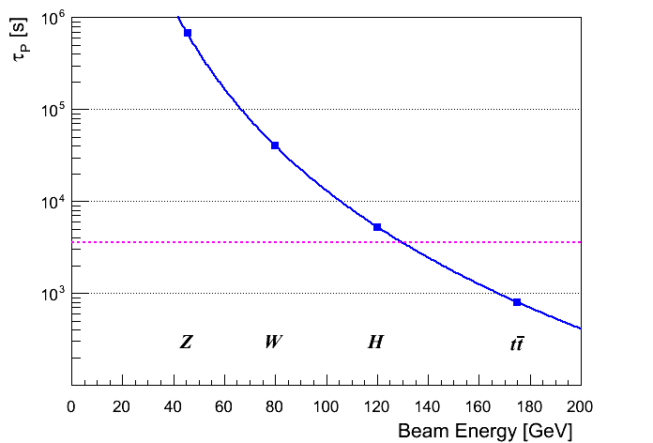
Polarization build up
Transverse polarization build-up (Sokolov-Ternov) is very slow at FCC-ee (large bending radius ρ).
Build-up is ~40 times slower than at LEP
τ_{p} ≈190 hours @ Z
Wigglers may lower τ_{p} to ~12 h, limited by σ_{E} ≤ 60 MeV and power.
Due to power loss the wigglers can only be used to pre-polarize some bunches (before main injection).
1 hour
≈ OK for energy calibration (few % P sufficient)
Longitudinal polarization: levels of ≥ 40% required on both beams. Excellent resonant compensation needed.
Expected to be difficult, requires spin rotators or snakes, most likely only possible at lower intensity and luminosity.

Slide 23
CEPC
Y. Wang at FCC kickoff meeting
54 km ~ 2 × LEP/LHC
(centre-of mass !)
A lot of synergies between FCC-ee and CEPC !

Slide 24
Conclusion
FCC-ee is designed to be a Z, W, H and t factory – with design emphasis on H - 120 GeV / beam. CDR to be prepared for ~2017.
This machine has a lot of potential, but also many challenges:
high power and high gradient RF system,
loads of synchrotron radiation,
a double ring and a booster (plus an injector chain),
optics with very low β*, large acceptance,
low lifetime and beamstrahlung,
4 experiments to serve… and much more.
We can build on the experience of past colliders, and soon from SuperKEKB that aims for similarly pushed IP focusing.
This is just the beginning, but the potential is high !

