Slide 1

Compact muon radiography system for investigation of nuclear reactor fuel status
LAL seminar May23,2013
K. Hara (Univ. of Tsukuba)
Period 1&2 data: H. Fujii et al., Prog. Theor. Exp. Phys. (2013) 073C01
Stereo view periods: paper in preparation

Slide 2
Timeline
11 Mar. 2011 Gigantic earthquake followed by Tsunami
7 Apr. 2011 Proposal by K. Nagamine to KEK director A. Suzuki
Members of KEK (led by F. Takasaki) started investigation
Sep. 2011 U. Tsukuba joined, started design and construction of 1mx1m trackers using 1cm wide scintillators
Mar. 2012 Detector#2 (Det#1 is by Nagamine using 3cm wide scintillators) started data taking at a Nuclear Plant.
Position and elevation angle of Det#2 changed after 3-4 month data taking
Feb. 2013 Detector#3 set at 90deg wrt Det#2
Dec. 2013 End of experiment at the Plant
May.2014 Started discussion on application at FD

Slide 3
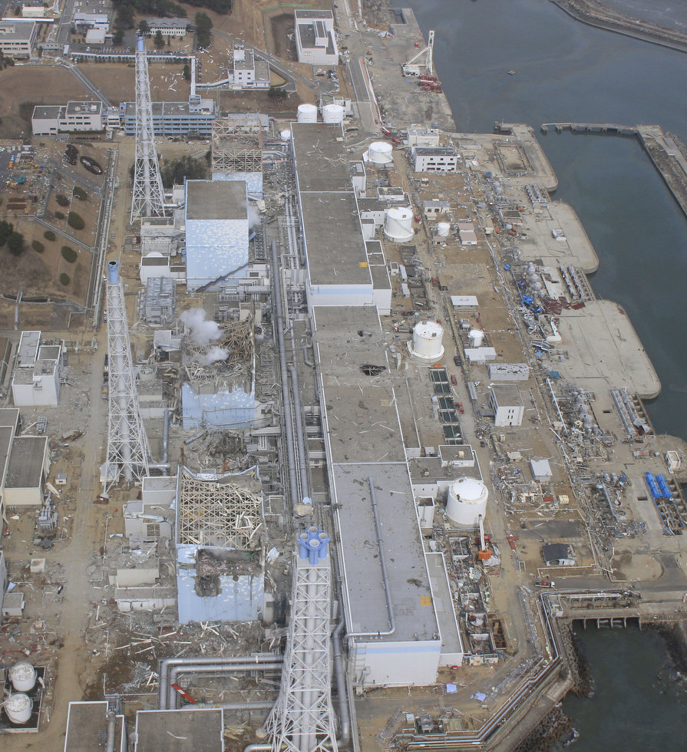
Unit1-3 reactor damaged
Unit1,3,4 roof damaged
Fuels in storage pools are safe

Slide 4
Muon flux
integral
differential

Slide 5
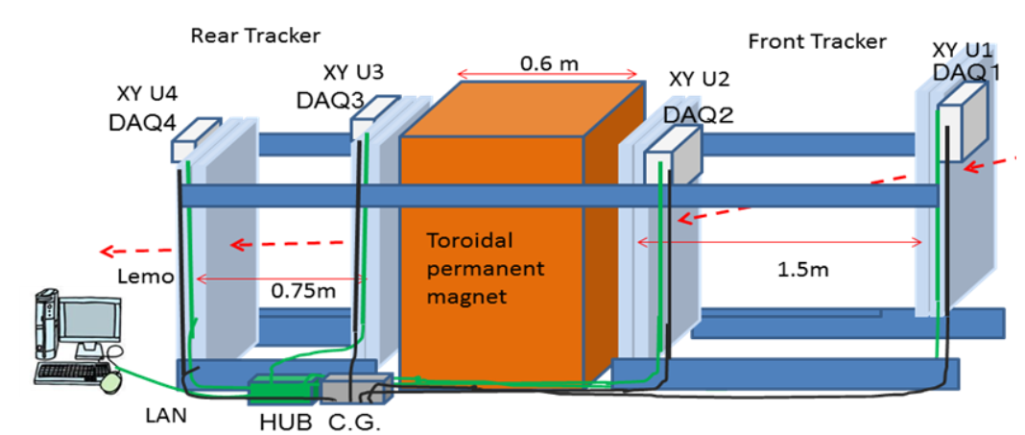
Detector system 2
XY units: 0.2 t
Toroid: 5.3 t
Container others: 3.5 t
Placed in a 20-ft shipping container
Clocks in 4 DAQ boxes are synchronized every 1 μs

Slide 6
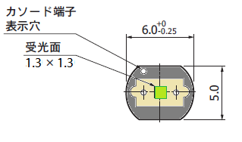
Scintillator + WLS fiber + MPPC
scintillator（１m ｘ １cm ｘ 6mm) Eljin EJ-200
Wavelength shifting (WLS) fiber
(Kuraray Y11:200ppm 1mm dia）
Al reflector
MPPC
(1.3mm□sensor）
10mm
TiO2 between gaps （0.5mm）
White reflective sheets for signal isolation
Multipixel photon counter
(Hamamatsu Photonics)
Scintillator + WLS fiber : CDF endcap tile/fiber calorimeter
MPPC : ILC calorimeter

Slide 7
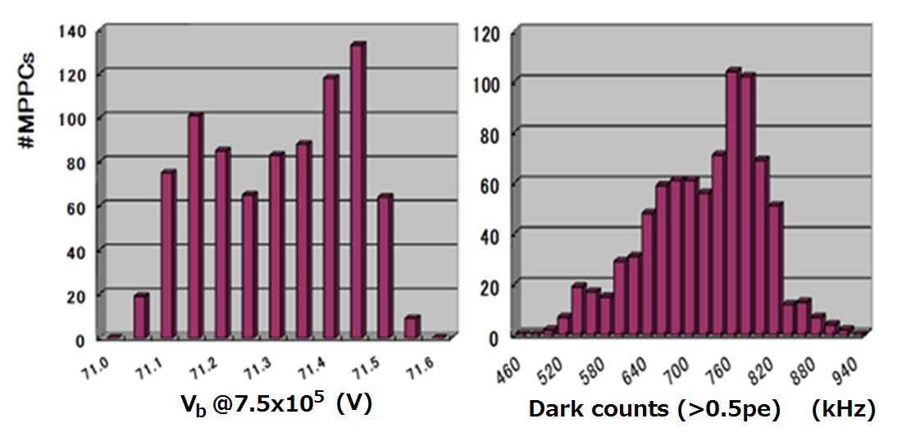
MPPC gain uniformity & noise rate
@room temperature

Slide 8
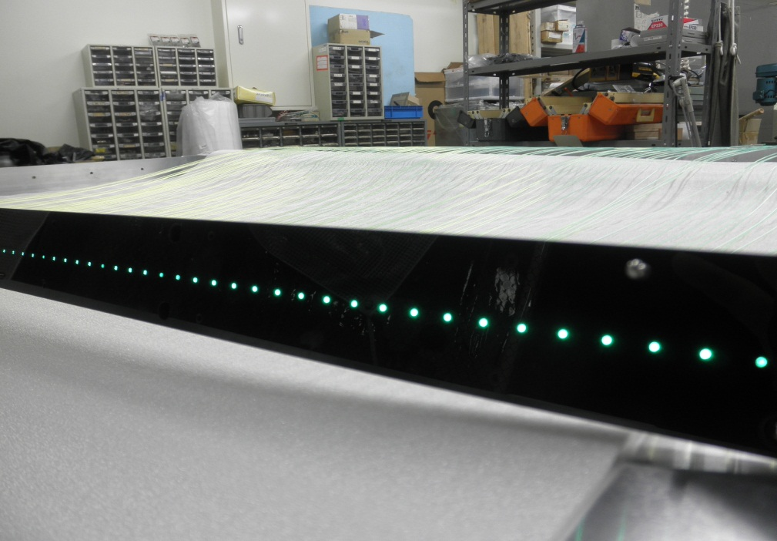
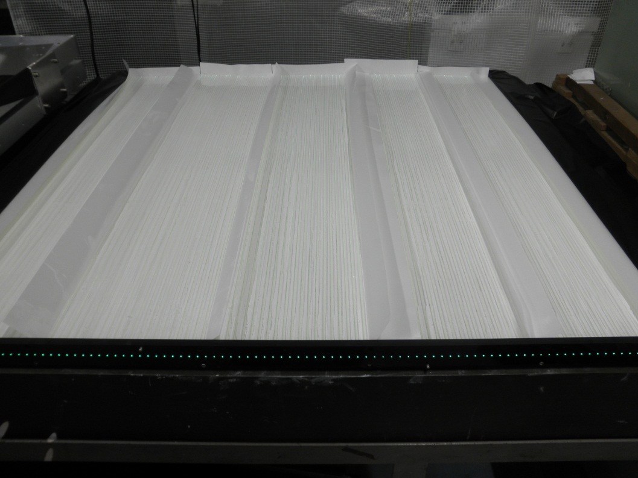
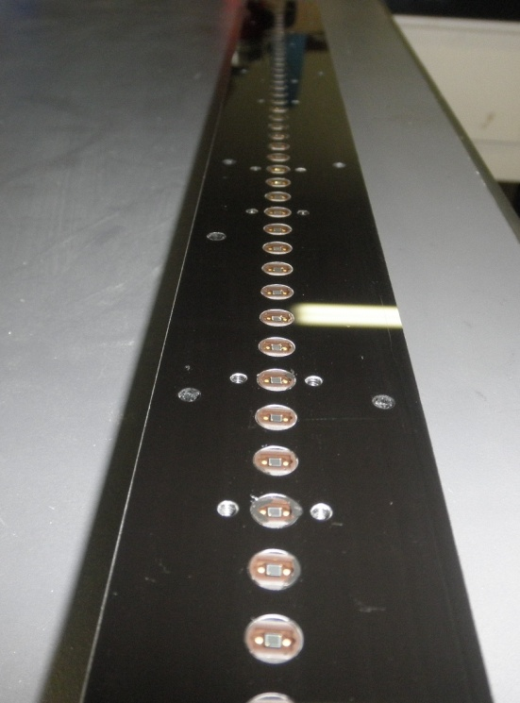
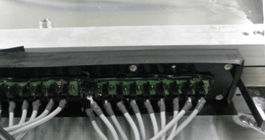
1mx(1cmx100) scintillator plane

Slide 9
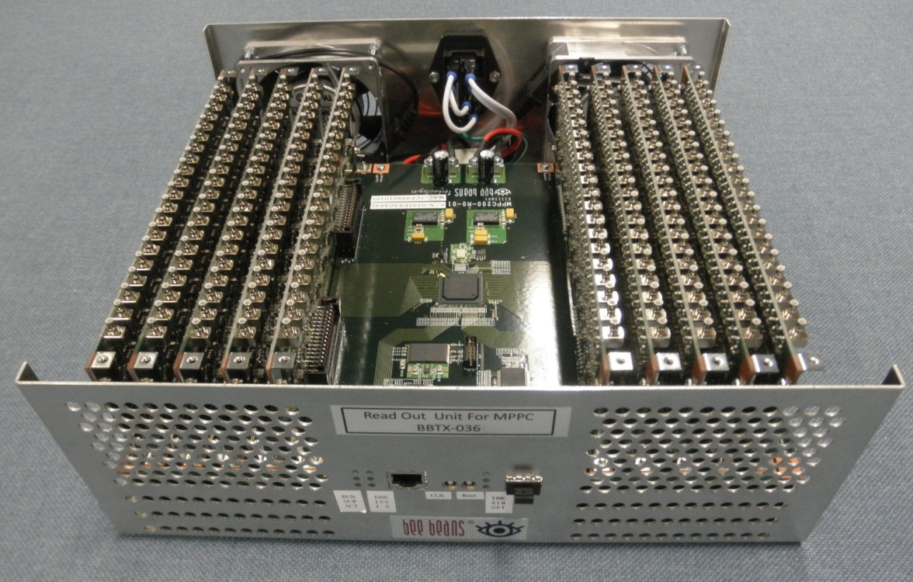
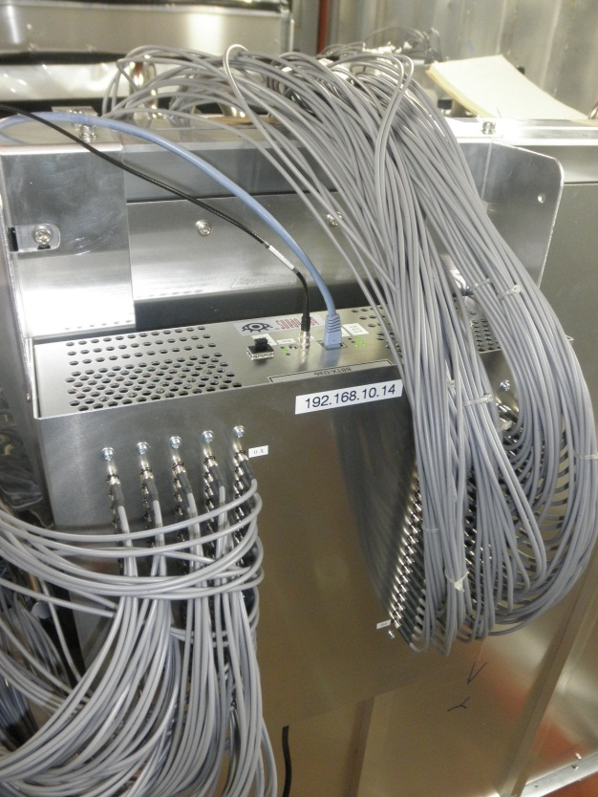
MPPC DAQ System
Provide biases (~71V) to 200 MPPCs
Look for coincidence of XY planes
(single cluster in each allowed)
Clock: 125Mhz →１GHz
200 SMB coaxial cables/unit

Slide 10
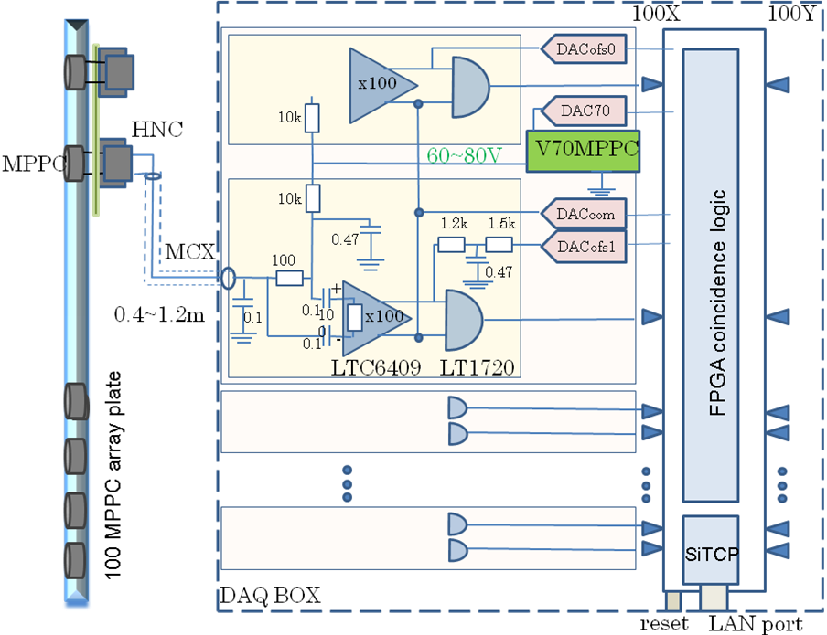
DAQ system diagram
amp f=15k-70MHz DACcom(16bit):0-1.6V DACofs(16bit):0-1.6V DAC70(16bit):61-79V
FPGA coincidence window: 8ns-1.024us; area=1-4 consecutive hits in X/Y; 1GHz time stamp

Slide 11
XY Unit with DAQ box

Slide 12
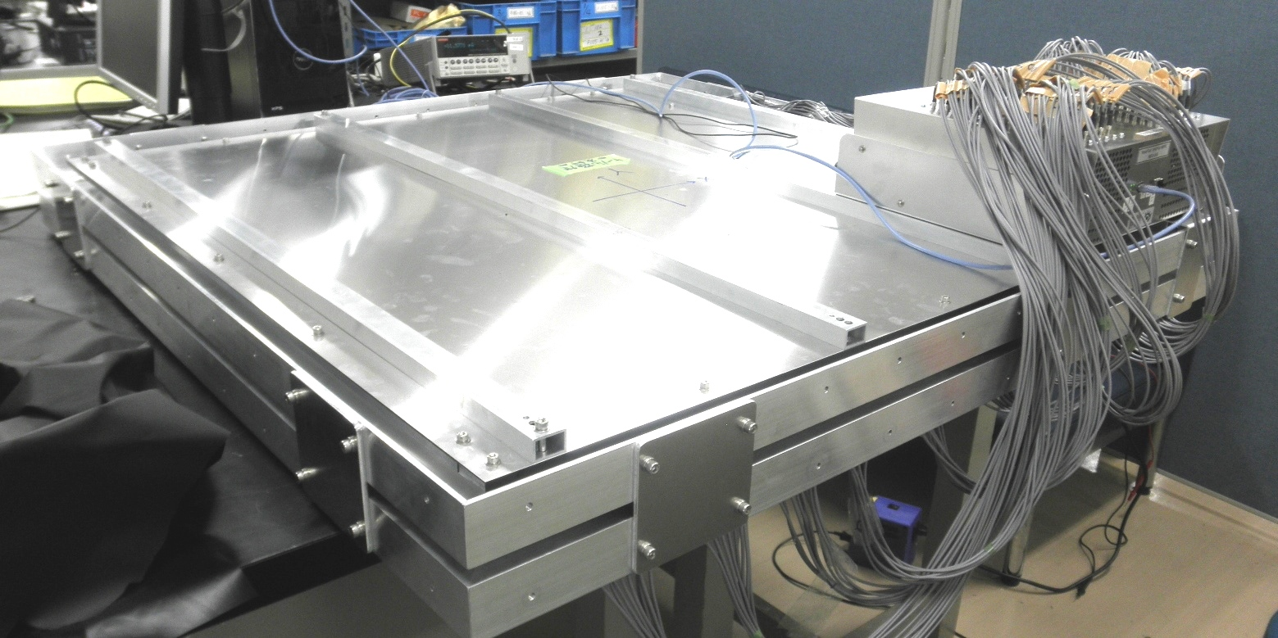
XY Unit with DAQ box
DAQ box
116.9cm
116.9cm
10.65cm

Slide 13
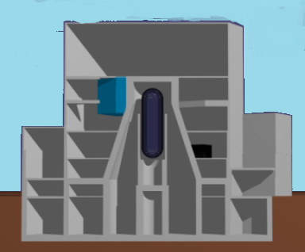
Typical GE Mk-II reactor
Building above ground
40-50m cubic
Dryer separator pool
(not drawn)
Fuel storage pool
Pressure vessel (PVC)
Containment vessel
Fuel object to load
(4m) cubic
(not drawn)

Slide 14
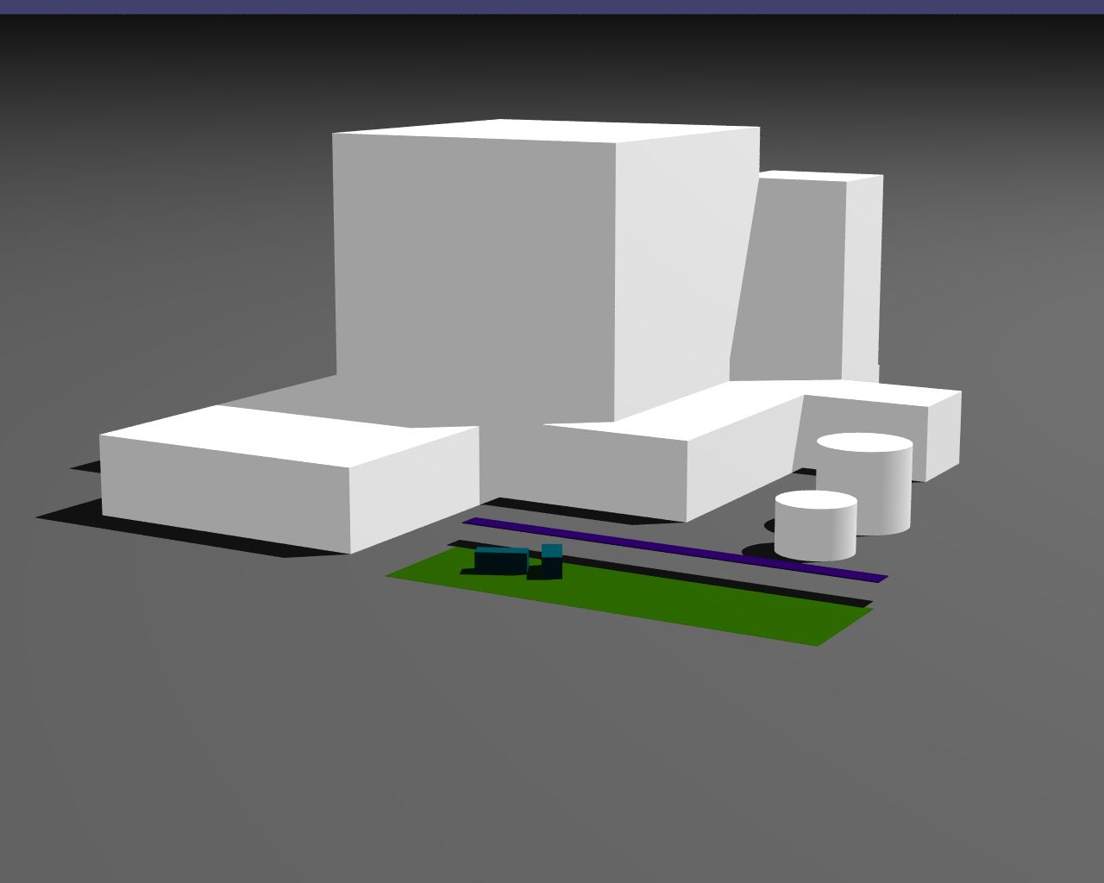
First two Periods
64m from the reactor center

Slide 15
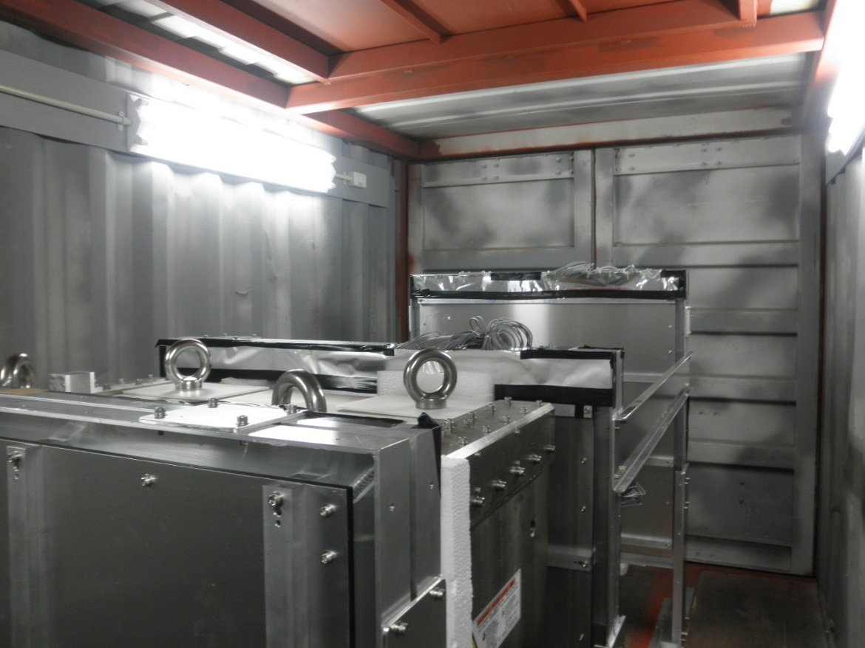
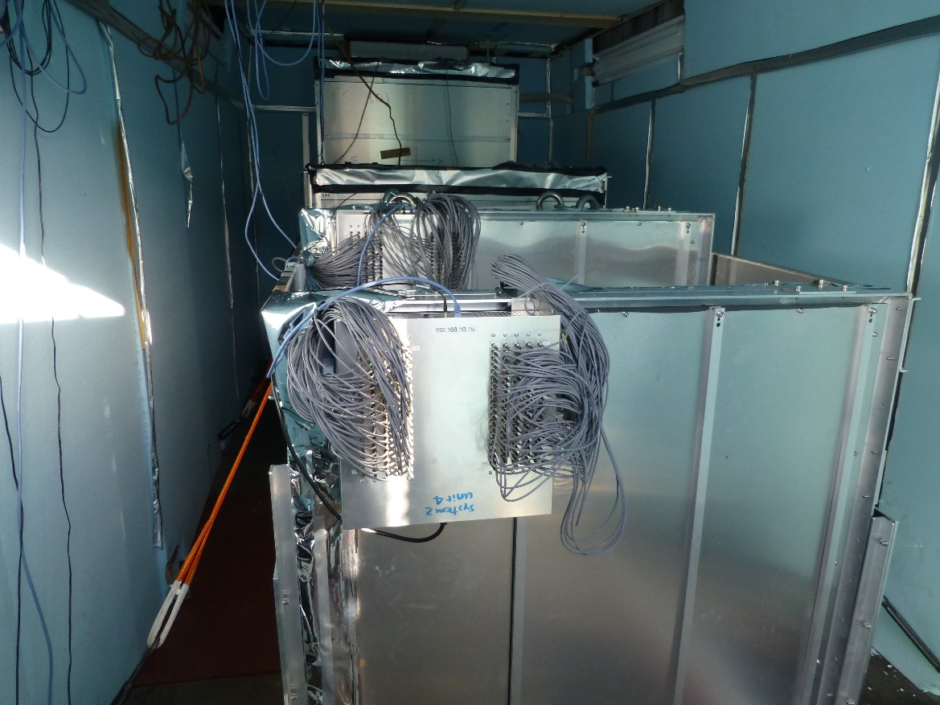
System located in 20’ container
PERIOD1:
U1-U2=20cm
Targeting fuel loading zone
PERIOD2:
Thermal insulation is placed on walls

Slide 16
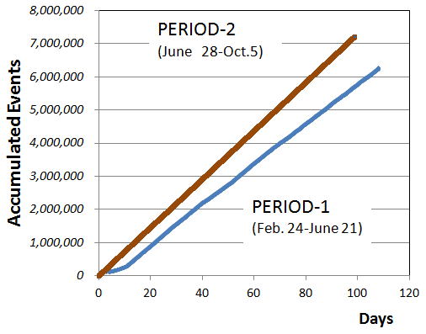
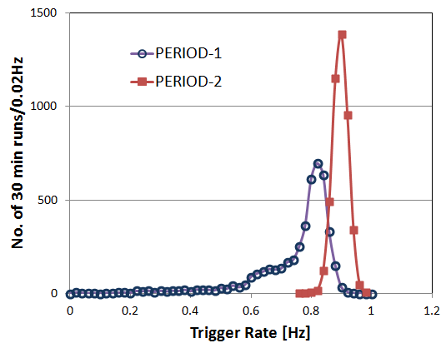
First data taking periods
Period-1: targeting fuel loading zone Y(U1-U2)=20cm with L(U1-U2)=1.5m
Period-2 : targeting fuel storage pool Y(U1-U2)=60cm with L(U1-U2)=1.5m
Spread of the trigger rate in Period-1 caused by temperature variation due to insufficient isolation
→ added isolation, temperature threshold correction applied at start of run

Slide 17
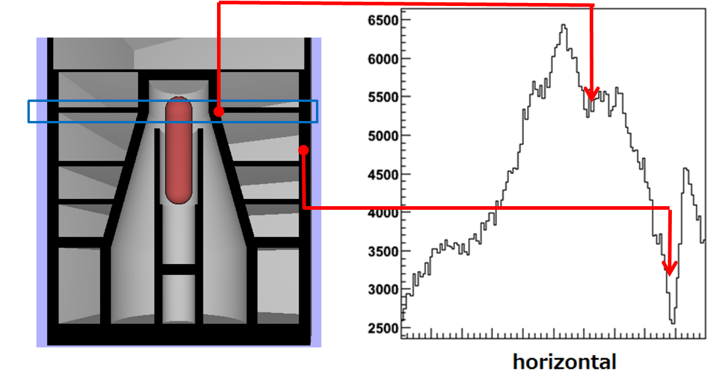
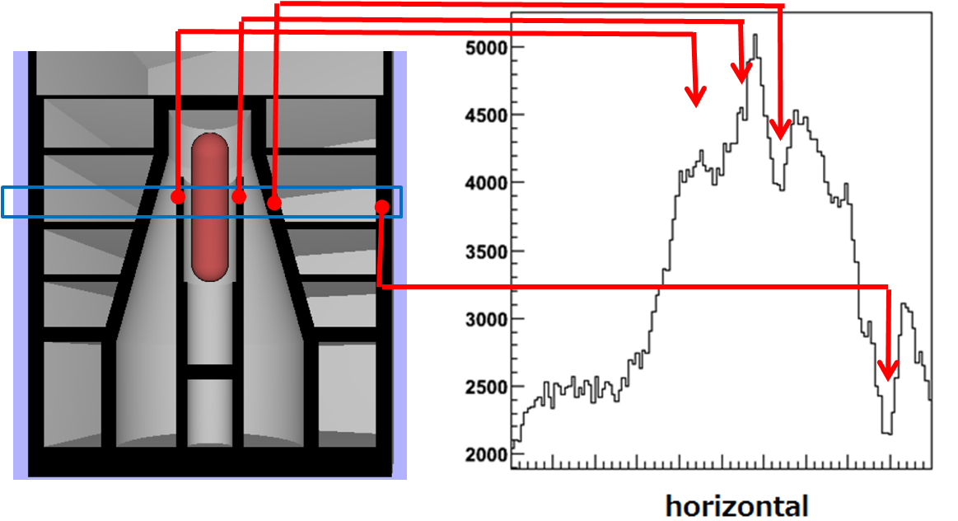
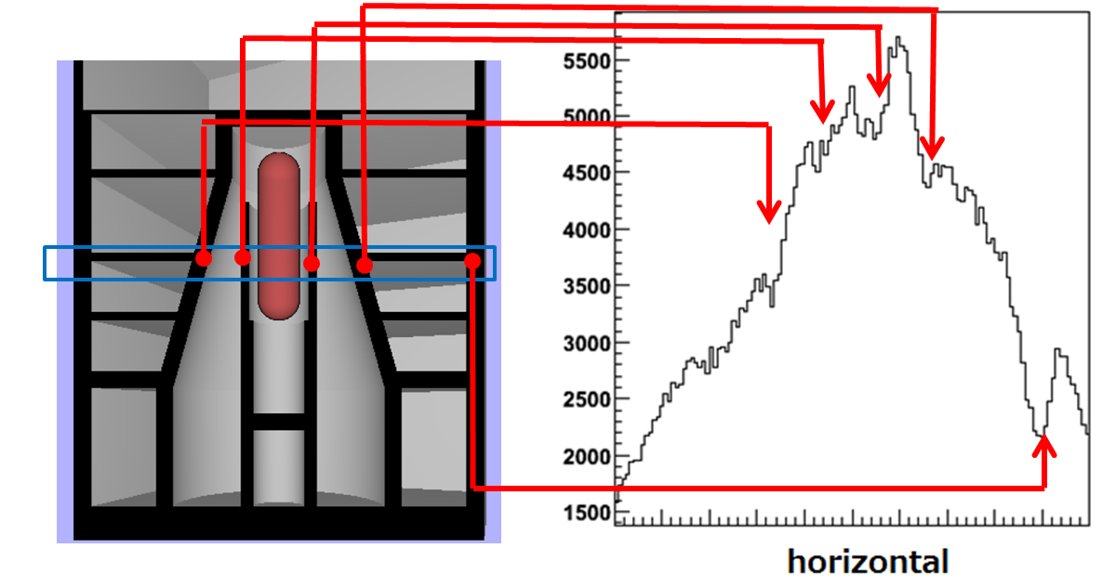
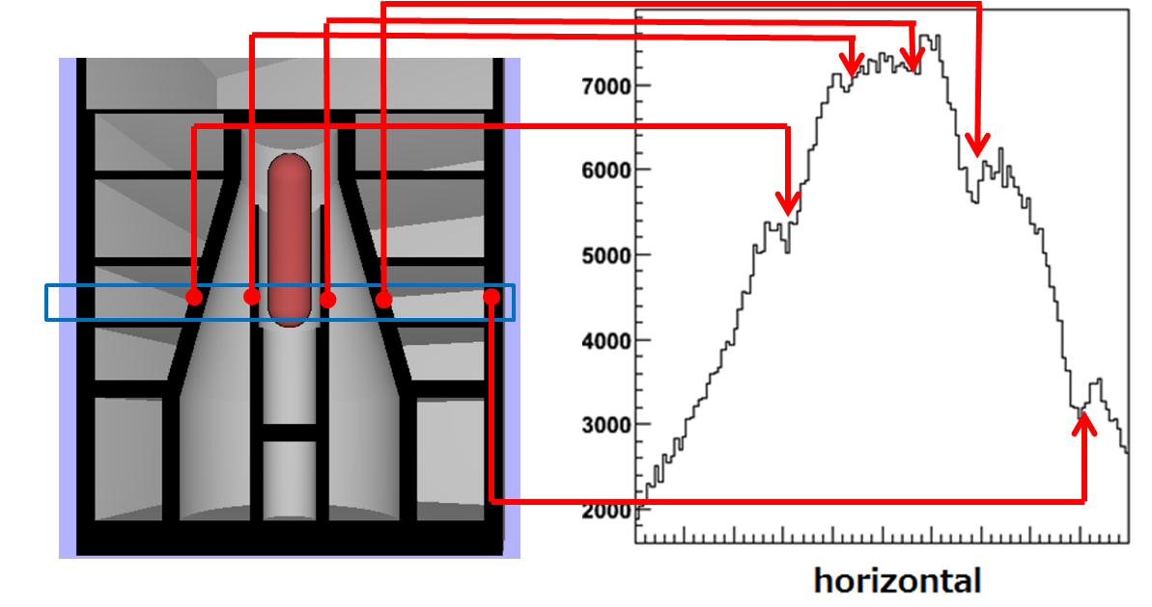
Horizontal Distributions (Period-1 ) in Vertical slices

Slide 18
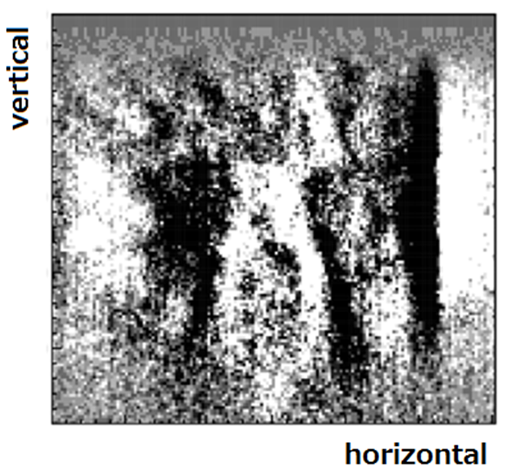
2D image (Period 1)
Acceptance effect is removed by subtracting low-frequency components in Fourier series

Slide 19
2D image (Period 1)
19
2D image (Period 1)
Fuel storage pool
Dryer separator pool
Building wall
(projective)
Fuel loading zone
Containment vessel
Pressure vessel (PVC)

Slide 20
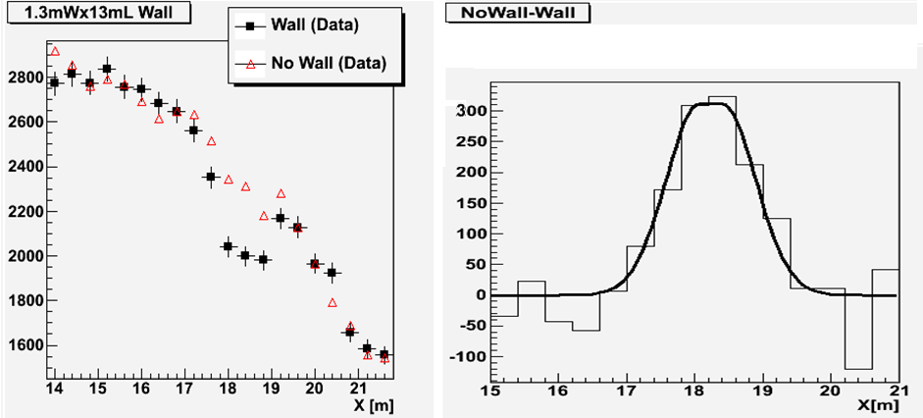
Resolution study (1)
Almost projective wall supporting the Dryer Separator pool (Depth~13m)
Fitted resolution:
49.1 ± 2.7 cm

Slide 21
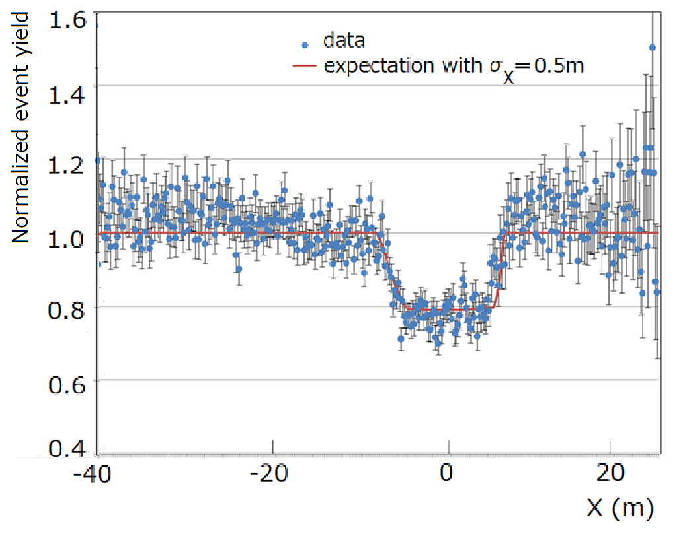
Resolution study (2)
We found a change of the water level in DSP (details in next pages)
Event yield (nominal water level/reduced water level)
Shape well reproduced by σx=50 cm assumption

Slide 22
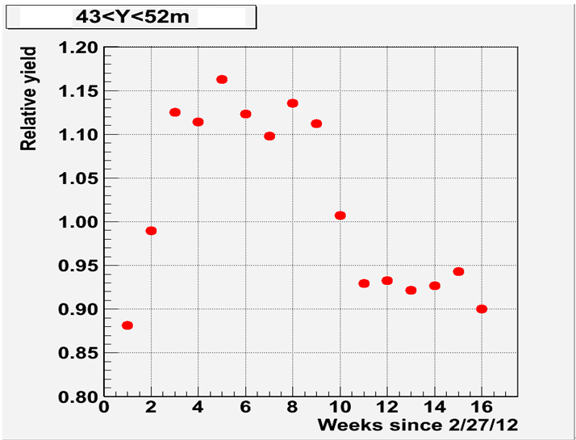
Detected yield variation
Reduced water level
Back to nominal
Start of Period-1
Weekly tracking of the yield detected a yield variation in DSP region
→plant representative provided us the record of water levels in DSP

Slide 23
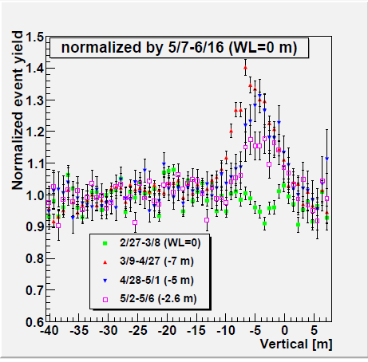
Change of water level in DSP
Change of water level follows as provided
(a few days for some of the data periods )
Yields normalized here

Slide 24
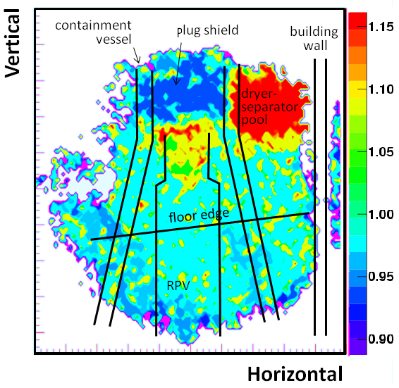
What happened in whole view
31days/45days, normalized
(note: view targeting fuel loading zone)
During DSP water level is reduced
Water level in RPV is reduced
Plug shield is placed

Slide 25
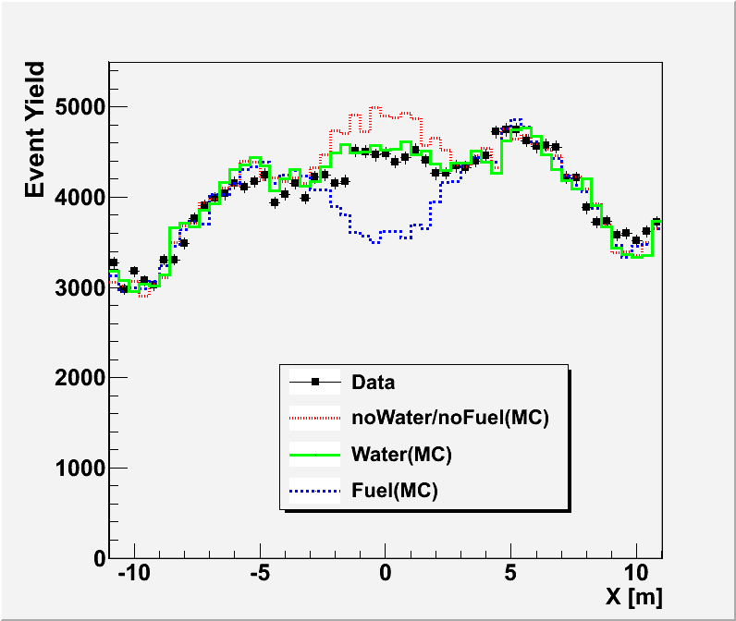
Absence of the fuel
PRV region compared with GEANT
assuming:
fuel is loaded
fuel is not loaded but filled with water
nothing inside
fuel = UO with 2.5g/cc density
Data distribution around the CV walls is well reproduced by GEANT with the assumption that fuel is absence
The plant has been not in operation since 11.3.2011

Slide 26
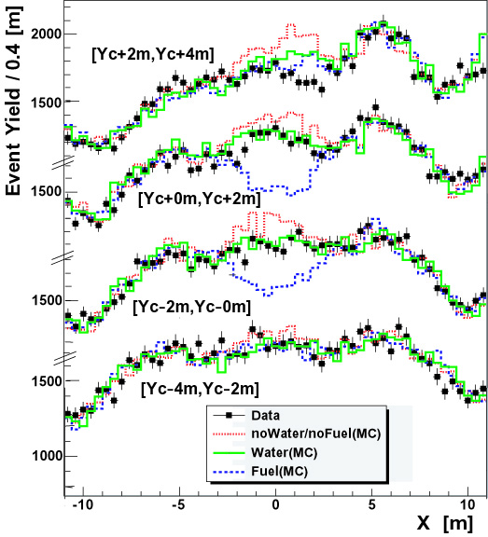
Comparison in other Y-slices
Fuel loading zone height

Slide 27
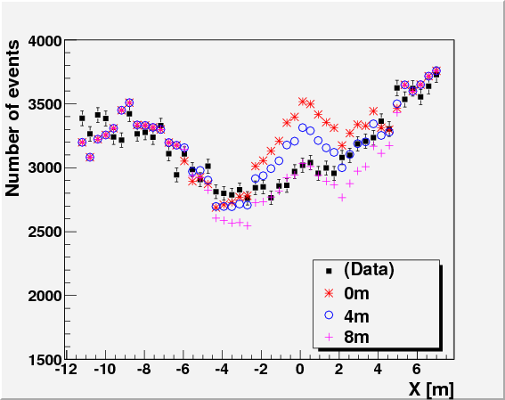
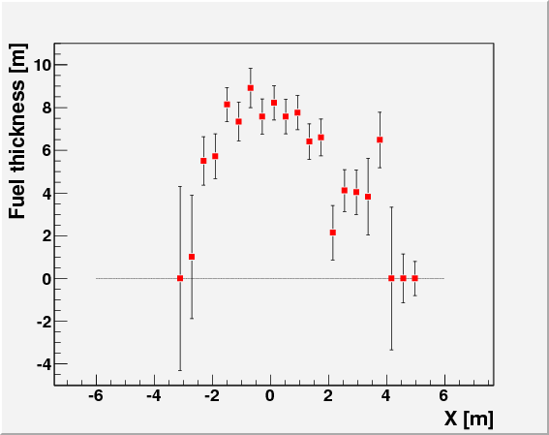
Period-2 distribution
Data in fuel storage pool region compared with GEANT with assumed fuel thicknesses
(0,4,8m in depth) → evaluate the depth
profiled high density material (can not explained by water only=0m assumption)
Up to 8m in depth.
Clustered in two?

Slide 28
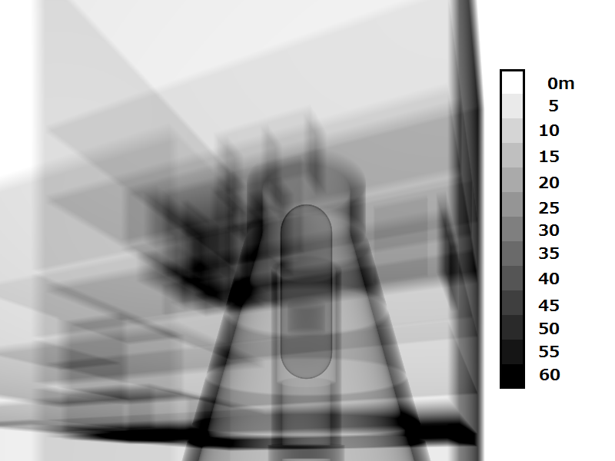
Density-length distribution
WEL

Slide 29
Stereo View Periods
Detectors-3
30m
Detector-2-2
Detector-2-1
61m
64m

Slide 30
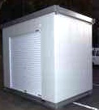

Detector system 3
2 units 100kg
Support 30kg
Air-cond 70kg
PC others 20kg
House 300kg
XY unit 1
DAQ1
XY unit 2
DAQ2
1.5m
1600
1.8x2.7x2.4m
1300
1900
Super house

Slide 31
Stereo View Periods
Fuel Storage Pool
Containment
Vessel
Detector 2 Point 2
Periods 1&2
XY unit 1
XY unit 2
DAQ1
DAQ2
1.5m
Detector 3 Point 3
Detector 2 Point 1
1600
1300
1900

Slide 32
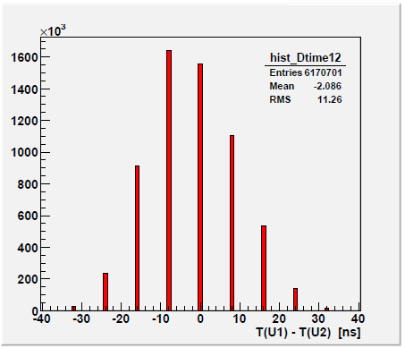
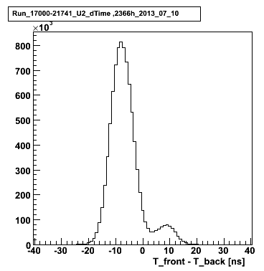
Improved DAQ Timing
front coming
back coming
8ns in Period-1
1ns version
Front
(reactor)
X
Signal stretched to 8ns x N to evaluate coincidence
Y
Unit time stamp (8ns→1ns)

Slide 33
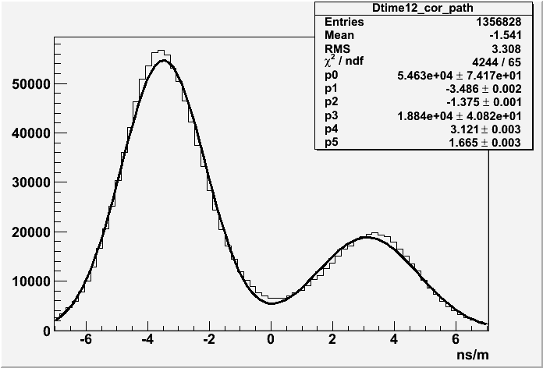
Timing resolution
Corrected for track angle and signal propagation
Timing resolution=1.4-1.7 ns

Slide 34
New planes with FNAL scintillator bars
Scintillator (1m ｘ 1m ｘ 10mm)
TiO2 paint
MPPC
(1.3 mm□sensor）
WLS fiber
(1mm dia）
10mm
9.5mm□ scintillator, extruded with 3mm dia hole
4 sides coated with TiO2
Scintillator bars w/ paint fabricated by FNAL (group of Anna-Pla)

Slide 35
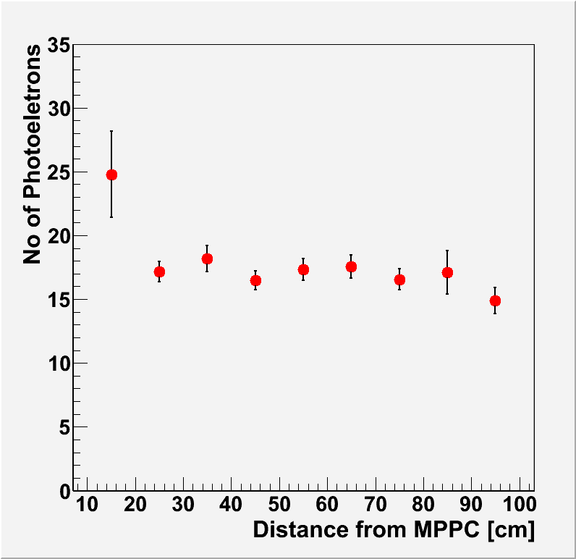
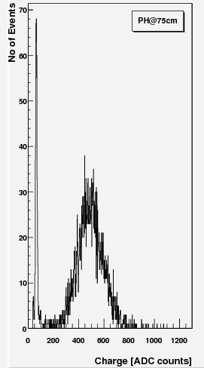
Light yield
Light yield was measured using penetrating Sr-90 β-rays
D=75cm
white paint
Sr-90
MPPC
to amp&ADC
5x10
to amp&ADC gate
MPPC

Slide 36
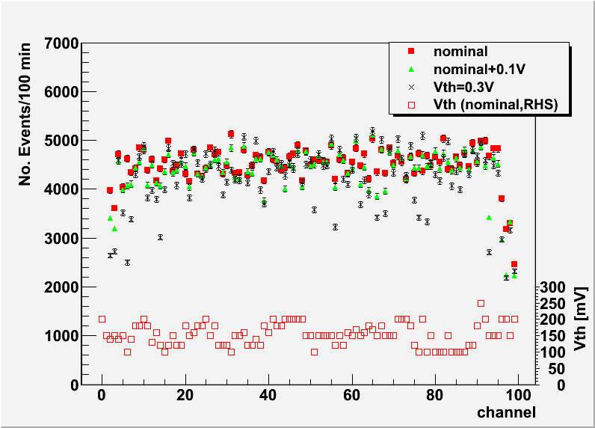
Plane uniformity, example
X
Y
Unit placed horizontally
Vth of Y set low when X was in investigation
Vth was determined to suppress noise

Slide 37
In-situ efficiency measurement
Select hits in U1,U2,U4
|U2-(U1+U4)/2|<5cm
Overall efficiency of U3:
88-89% in good area

Slide 38
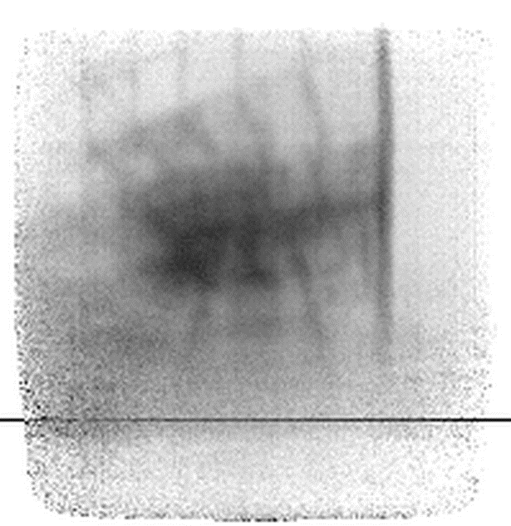
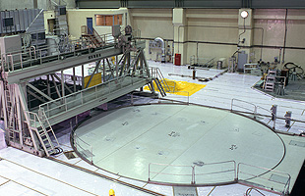
Point 1 View
Timber
Building Wall
Beam
Containment Vessel
Pressure Vessel
Horizontal Plane
Acceptance corrected (assuming cos²θ)
Darkness~ ln(observed/expected)
measured empty at KEK

Slide 39
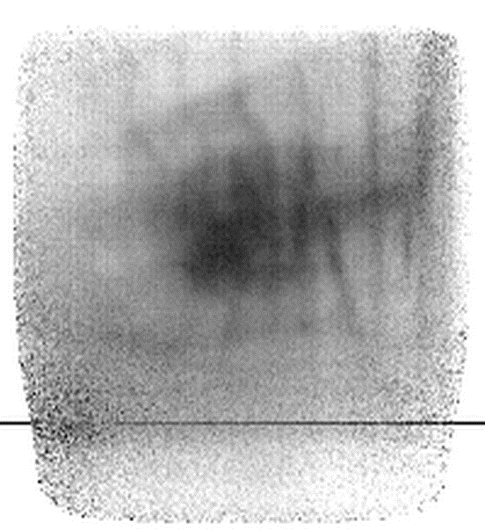
Point 2 View
Wall of the
Reactor Building
Container Vessel
Pressure Vessel
Horizontal Plane

Slide 40
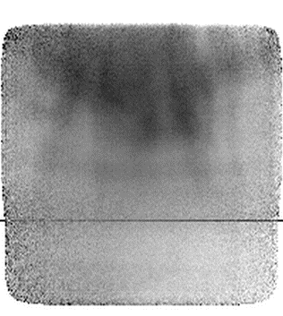
Point 3 View
Container Vessel
Horizontal Plane

Slide 41
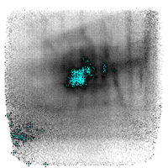
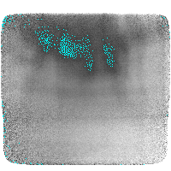
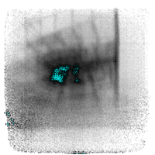
Area with large absorption
Point-1 (173days,1524kEv)
Point-2
(94days,722kEv)
Point-3
(208days,816kEv)
Points with larger absorption, -ln(Nobs/Nexp)>1.35,1.4,1.9, distribute inside the fuel storage pool
Mesh the pool at (1m)³ and color the mesh if two of the three say “heavy”

Slide 42
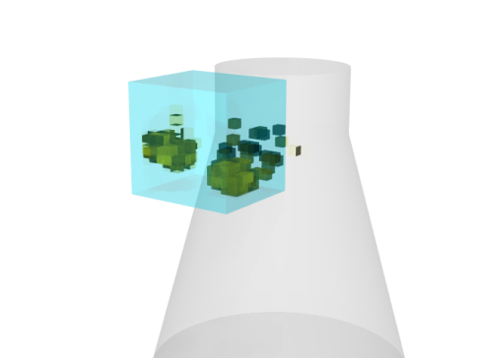
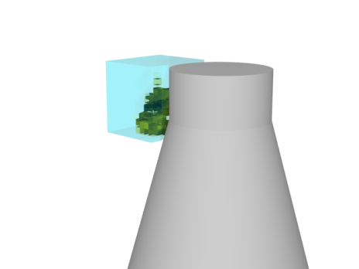
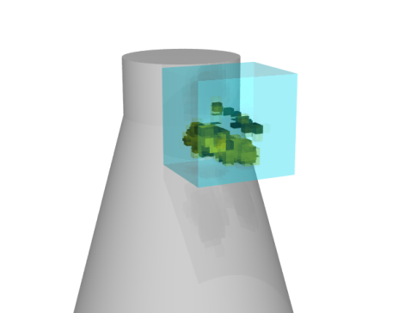
Distributions of heavy objects
Period-2 view
Period-2 view (behind)
Reconstructed distribution of heavy objects

Slide 43

Discussion with TEPCO started
two detectors for U1; get result in FY2014 (by Mar 2015)
scattering method detector for U2; be ready in FY2015

Slide 44


Radiation levels
http://www.tepco.co.jp/nu/fukushima-np/f1/surveymap/images/f1-sv-20140410-j.pdf

Slide 45

Possible system for Fukushima Daiichi

Slide 46




View at 30 m
front
-12º
unit-to-unit = 2m (fine view)
unit-to-unit = 1m (coarse view)

Slide 47

Effect of Fe shield
Image viewed by rear tracker set behind 61-cm thick iron
Data corresponds to 10 days
GEANT simulation resulted:
No deterioration in image
10% of events associated with >1 hits

Slide 48
Noise coincidence
Noise coincidence rate was measured using Co-60 γ.
Radiation level evaluated using film budges
Pb+Fe
Pb+Fe (~2mSv/h)
Noise rate increases linearly with the coincidence time window: Purely accidental

Slide 49

Radiation effects in tracking
No shield
5cm Fe shield
10cm Fe shield
15cm Fe shield
Nominal Vth=0.30 V
Noise rate measured under C-60 irradiation
*be compared with event rates (0.3-1 Hz)
largely relaxed for three unit system

Slide 50


GEANT: Absorption by Cubic Fuels
(Period-1 condition)
Assume S>5 to identify

Slide 51

Days to identify cubic objects
(extrapolated from Period-1 condition)
Period-1: ~ ideal condition to investigate the fuel status in loading zone
floors not to obstacle
64 m from the center
elevation angle is not too small
(~0.34 rad)
3months
yield
64m->30-40m x (4.6-2.56)
0.34->0.30-0.20 x (0.79-0.35)
1 ->2 systems x 2
x (7- 1.8)-fold increase

Slide 52
Summary and Outlook
We have demonstrated effectiveness of compact muon radiography systems to investigate the fuel status
The system is compact (10-ft container), least constraint in locating
System is designed operational in radiation environment (~1mSv/h)
Application scenario under discussion
view the fuel loading zone of Unit 1 using multiple (=two) systems and evaluate the fuel shape
dropped fuel is harder to identify
  Dig holes
  From Turbine building
  (constraints need to discuss and solved)

Slide 54
Momentum information
Al cover
鉄ヨーク
１ｘ１ｘ0.6m
Nd-Magnet
Fe yoke
1ｘ1ｘ0.61m
670
1400
1200
810
yoke 4.7t
others 0.6t
total 5.3t

Slide 55
Momentum model in GEANT
Momentum distribution: θ=75º by Jokisch et al
Θ dependence: Tsujii
GEANT Gen(no obstacles)& Rec
* Data obtained at KEK (no obstacles)
GEANT generated
Reconstructed
Momentum distribution model used in GEANT is reliable

Slide 56


