Slide 1



Machine Learning for
Personalized Genomics
Jean-Philippe Vert
Paris-Saclay Center for Data Science kick-off meeting
LAL, Saclay, June 30, 2014

Slide 2
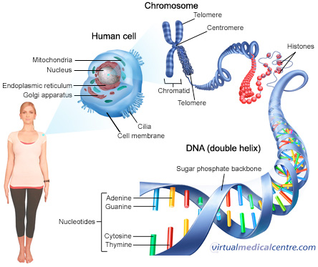
1 body = 100 trillions cells
1 cell = 6 billions ACGT in DNA

Slide 3
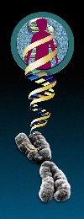
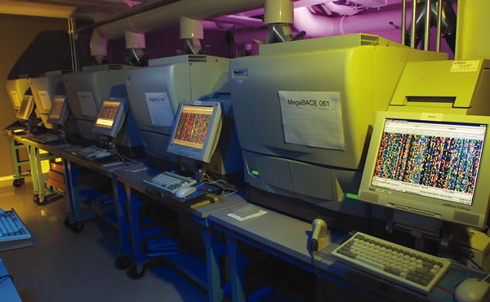
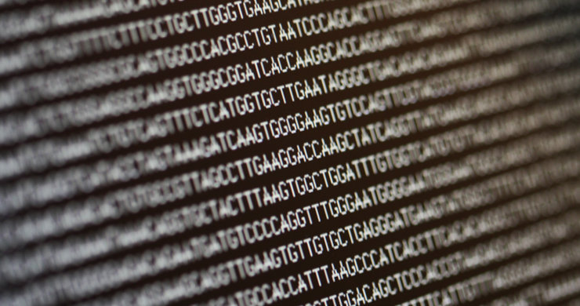
Human genome project (1990-2003)
Goal: sequence the 3,000,000,000 base pairs of the human genome
Consortium of 20 laboratories, 6 countries
13 years, $3,000,000,000

Slide 4
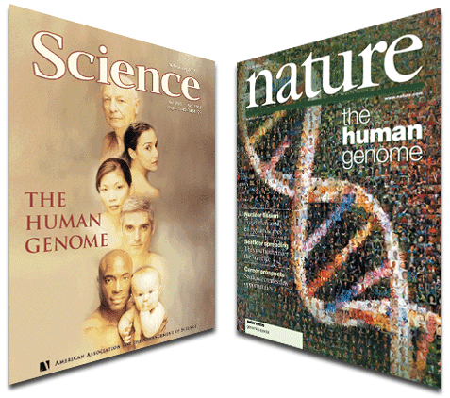
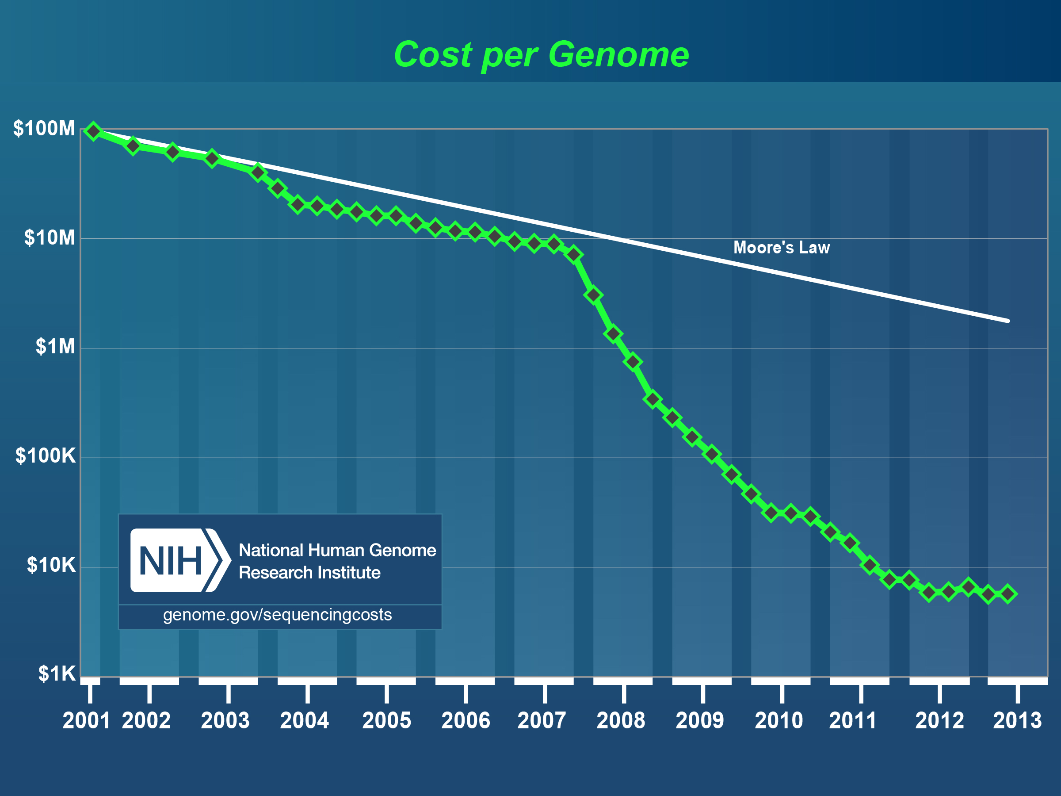
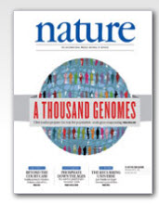
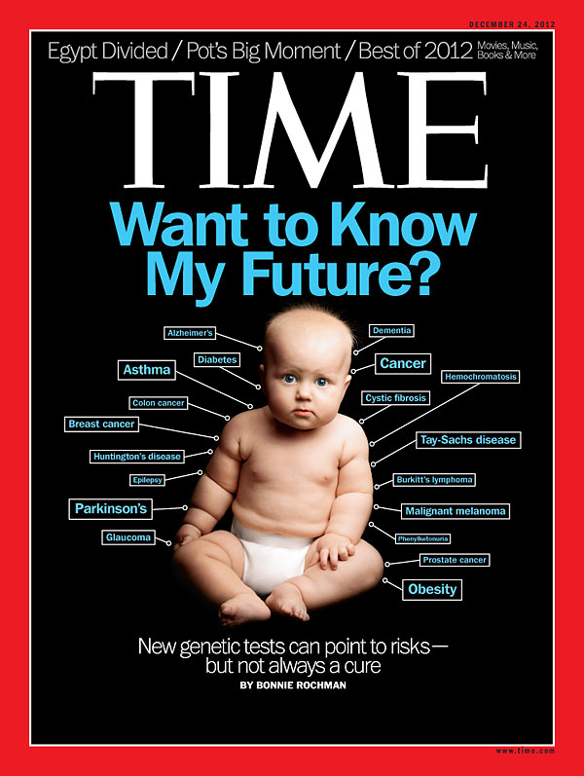
The second revolution

Slide 5

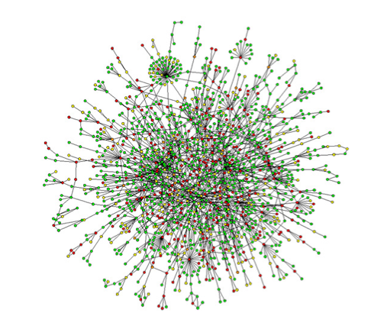
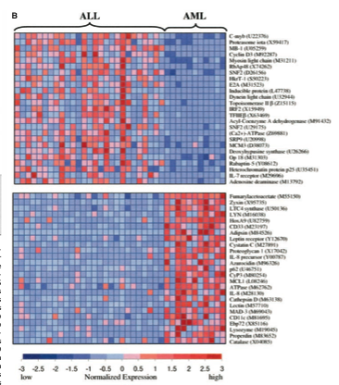
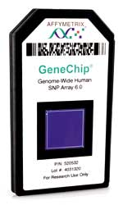
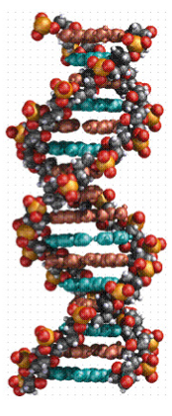
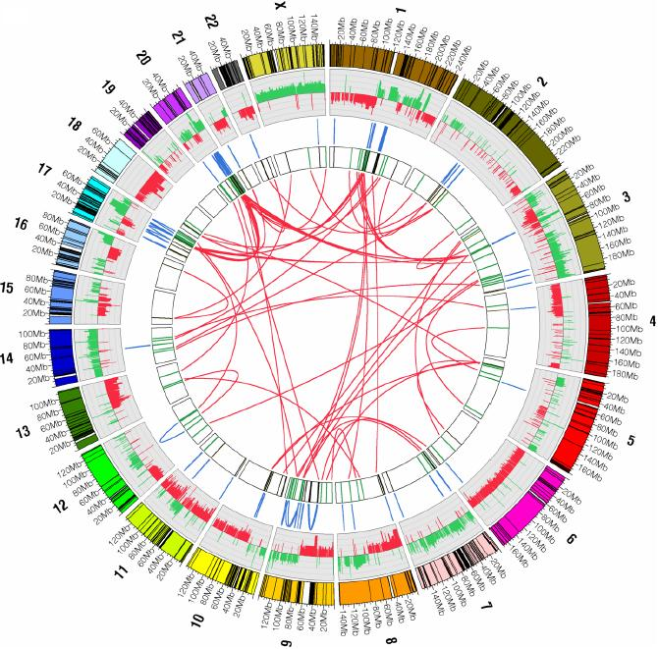
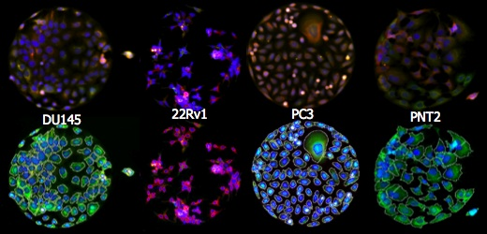
A flood of omics data
Publications
Interactome
Transcriptome
Genome
Epigenome
Mutations
Structural variations
Phenome

Slide 6
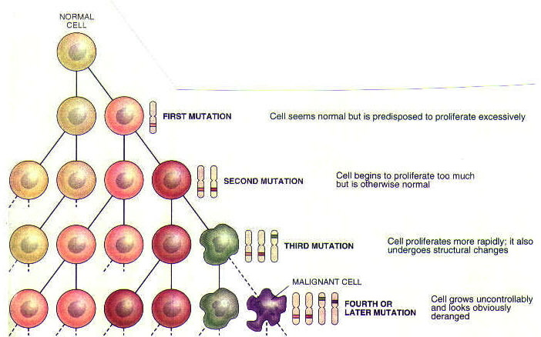
All cancers are different

Slide 7
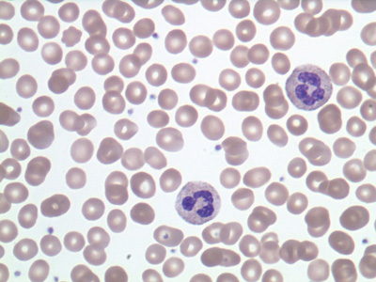
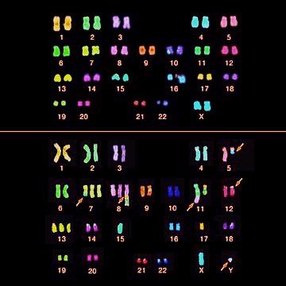
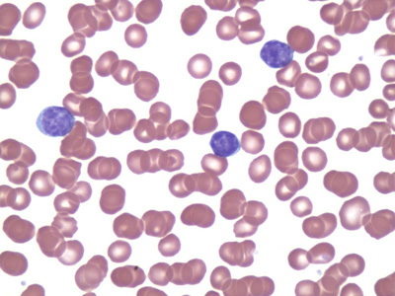
Cancer: different views

Slide 8
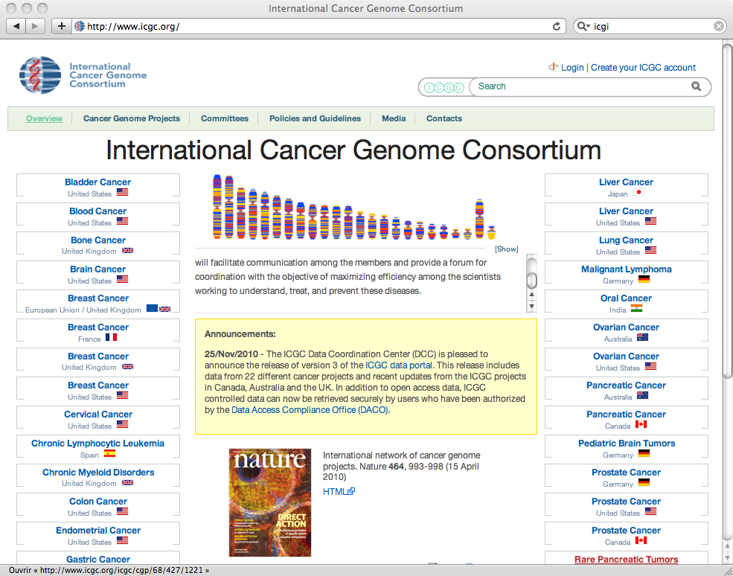
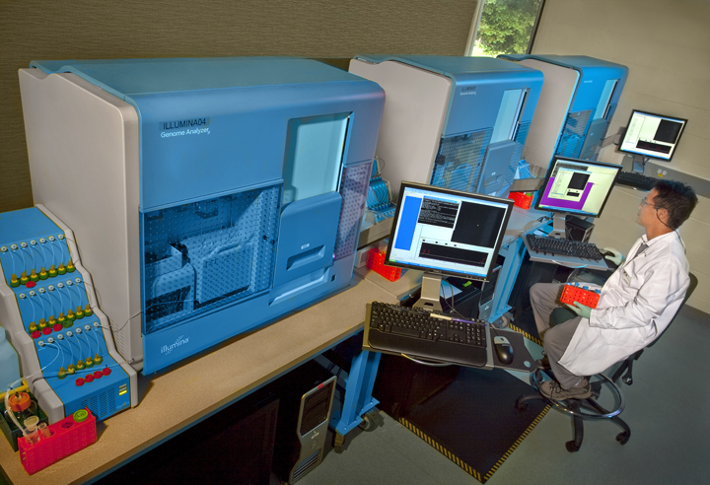

Big data!
http://aws.amazon.com/1000genomes/

Slide 9
Opportunities
New drug targets and therapies
  By analyzing specificities of cancer cells at the molecular level
Precision medicine
  By developing predictive models for diagnosis, prognosis, response to drugs…

Slide 10
« Understanding cancer »
Vogelstein et al. (Science, 2013)
Cancer genome Landscapes

Slide 11
Finding « cancer genes »
Vogelstein et al. (Science, 2013)
Cancer genome Landscapes

Slide 12
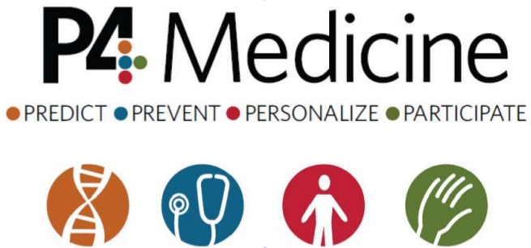


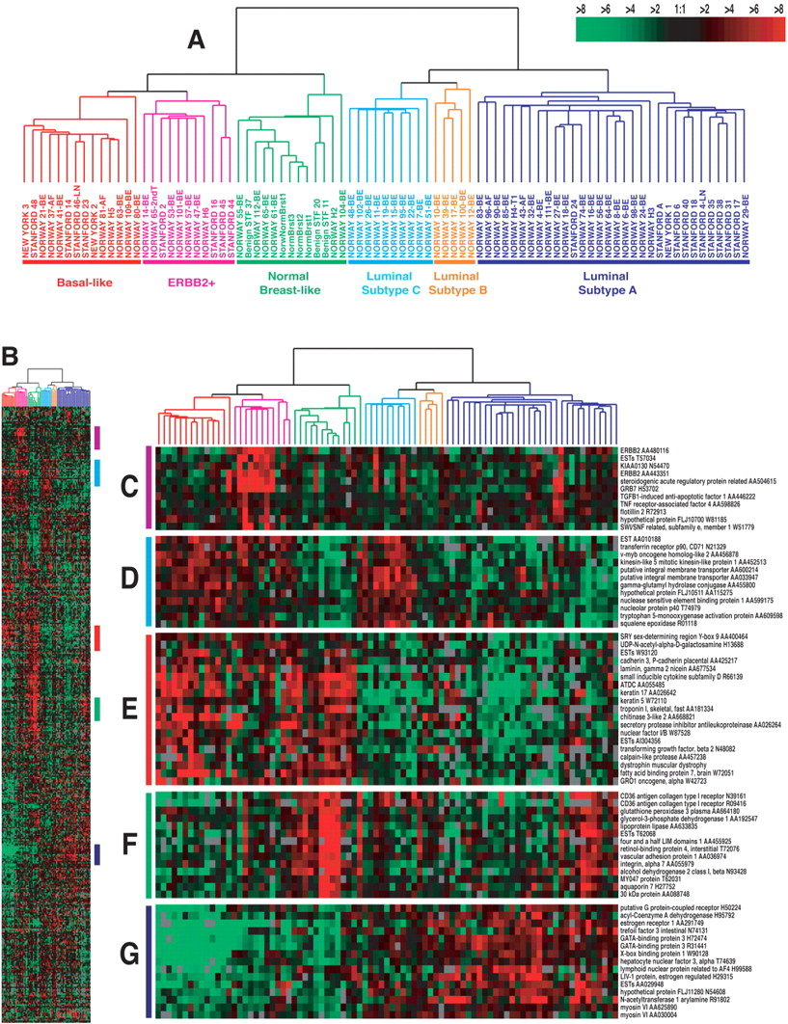
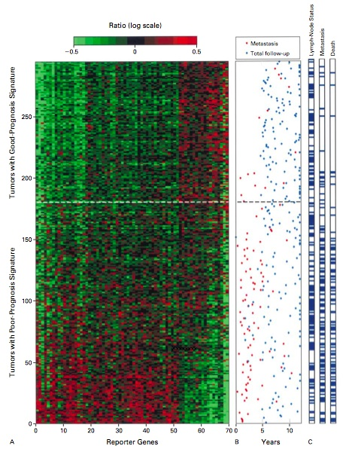
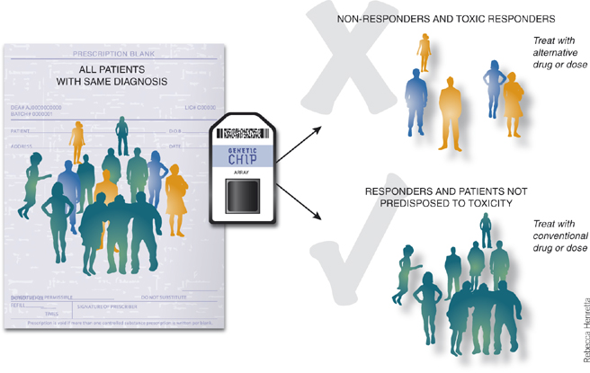
Predictive
Opportunities
Prognosis
Response to drugs
Diagnosis

Slide 13
Supervised machine learning
Challenges
High dimension
Few examples
Structured data
Efficient algorithms
Interpretability

Slide 14
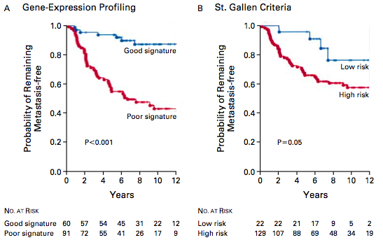
Example:
Breast cancer prognostic signature
(Van de Vijver et al 2002)

Slide 15
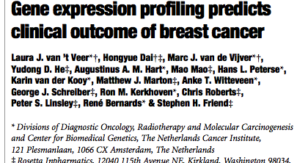
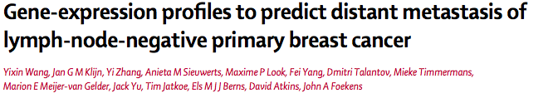
Two signatures have less than 5% genes in common…

Slide 16
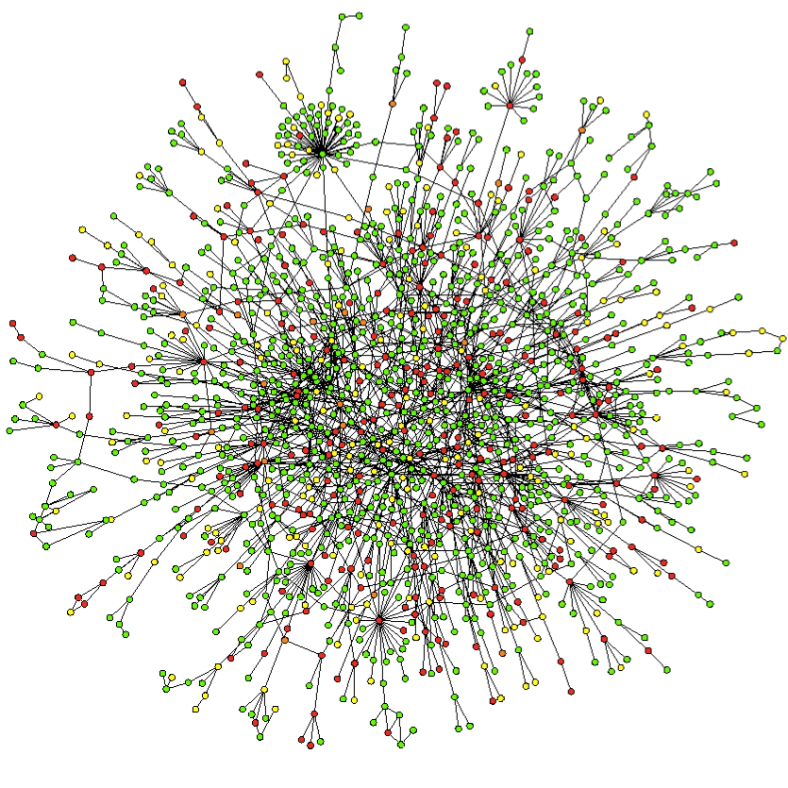
Prior knowledge: gene network
Can we « force » the signature to be « coherent » with a known network?

Slide 17
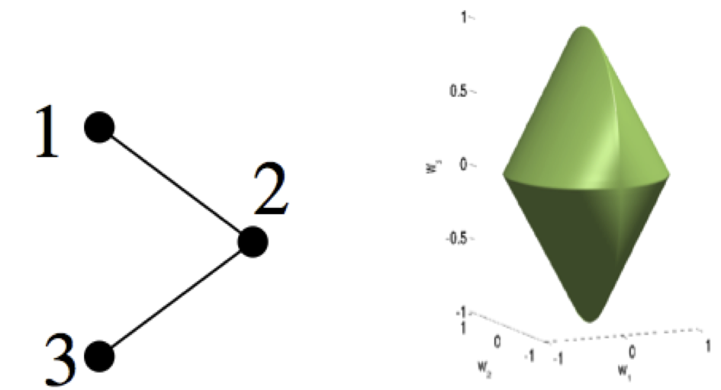
Example: the graph lasso
Step 1: Using the network, define a subset of « candidate » signatures
Step 2: Among the candidates, find the best signature to explain the data
(Jacob et al 2009)

Slide 18
Classical signature

Slide 19

The graph lasso signature

Slide 20
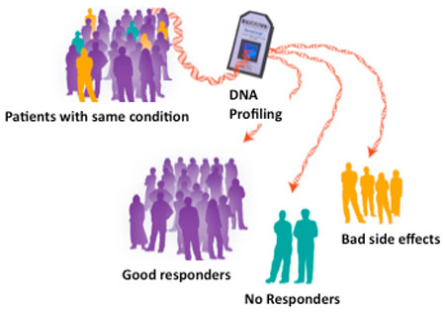
Example:
Pharmacogenomics / Toxicogenomics

Slide 21
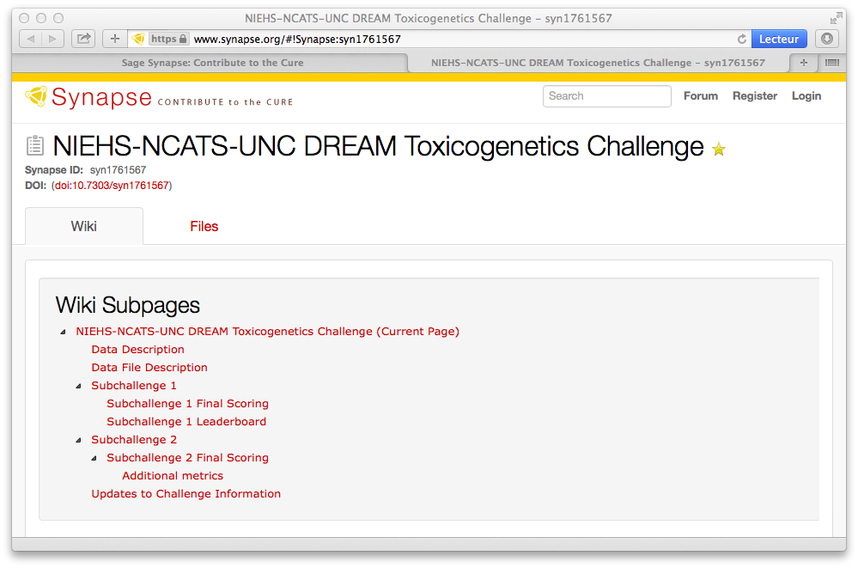
Crowd-sourcing initiatives

Slide 22
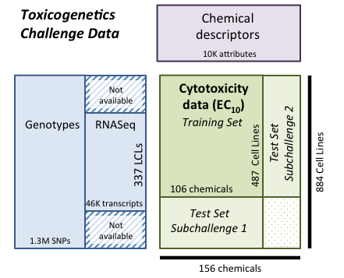
DREAM8 challenge (jun-sep 2013)
Genotypes from the 1000 genome project; RNASeq from the Geuvadis project

Slide 23
Our approach

Slide 24
Cell line descriptors (30 kernels)

Slide 25
Chemical descriptors (49 kernels)
Descriptors of chemical structures
Multitask kernels
Empirical correlation
Integrated kernel

Slide 26
Learning occurs…

Slide 27
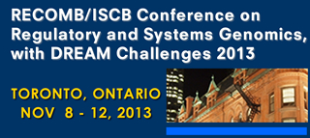
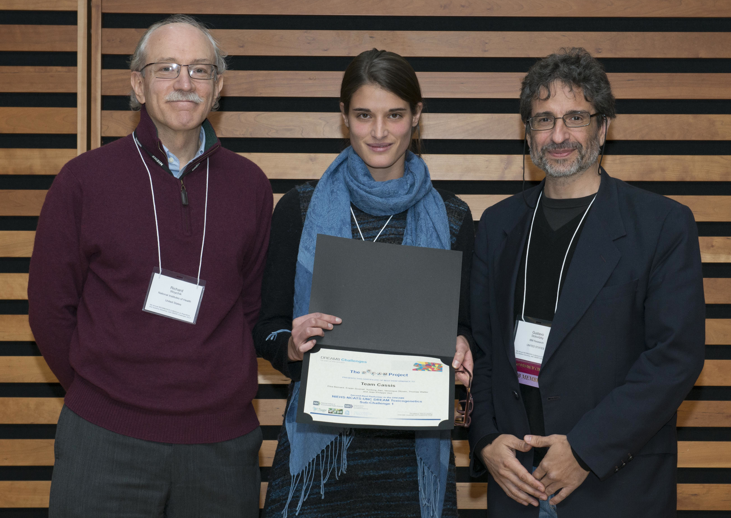
Final submission (ranked 2nd)

Slide 28
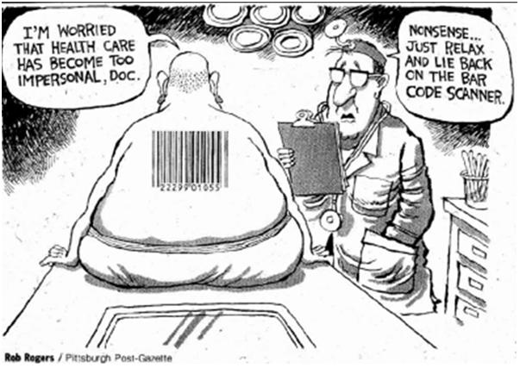
Conclusion
Lots of data due to technological progress
Opportunities: precision medicine, quantitative biology
Challenges: « small N », weak signal, complex systems

