Slide 1

Accelerators to study THE BOSON X(125)
LEP3…
…3LEP
and Muon Collider
will not cover ILC/CLIC
many thanks to F. Zimmermann, M. Koratzinos, P. Janot. M. Zanotti and LEP3 proto-collaboration members

Slide 2
Strategic Questions:
Now X(125) really exists!
A can LHC study X(125) and answer enough questions
or do we need a complementary machine?
shopping list:
branching ratios, invisible width
mass, total width, spin-parity
HH self couplings
……
B if yes what is really the complementary machine one needs?
the red ones are difficult at LHC…

Slide 3
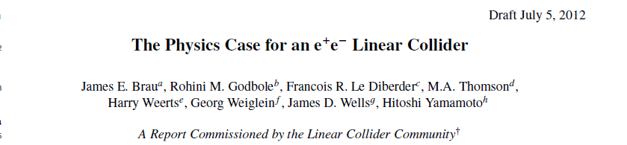
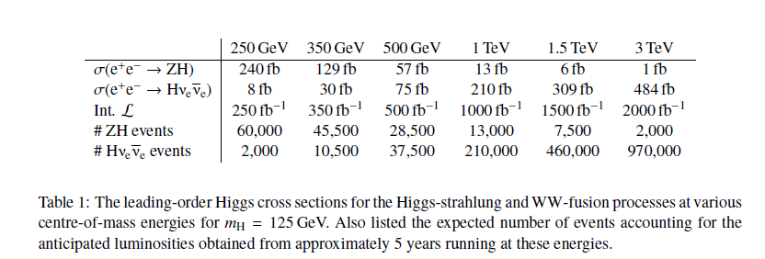
this has been studied for many years.
see later for precision on Higgs boson couplings and self couplings
difficulty: Linear collider is know to be very expensive (15G$, 7G€) and
very power-hungry (300MW is typical beam power consumption)
even at low energy

Slide 4
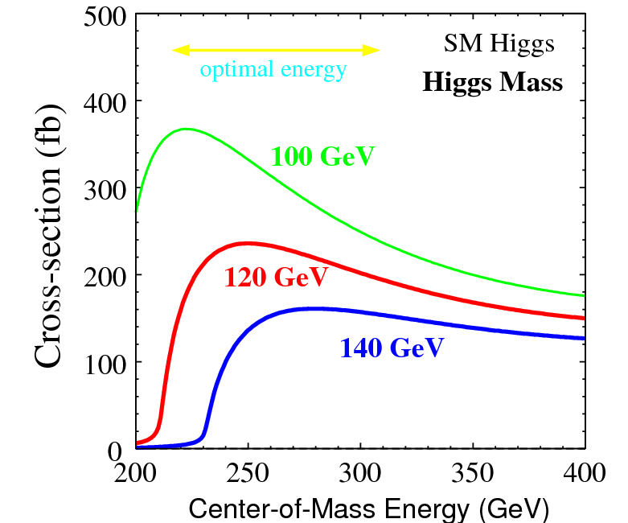
Higgs production mechanism
Assuming that the Higgs is light, in an e⁺e– machine it is produced by the “higgstrahlung” process close to threshold
Production xsection has a maximum at near threshold
10³⁴/cm²/s ➔ 20’000 HZ events per year.
e⁻
H
Z*
e⁺
Z
For a Higgs of 125GeV, a centre of mass energy of 240GeV is sufficient
➔ kinematical constraint near threshold for high precision in mass, width, selection purity

Slide 5
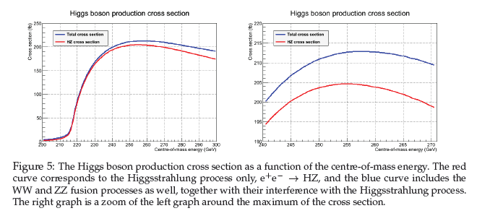
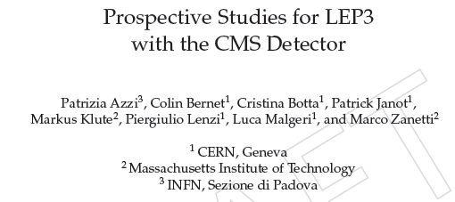

Slide 6
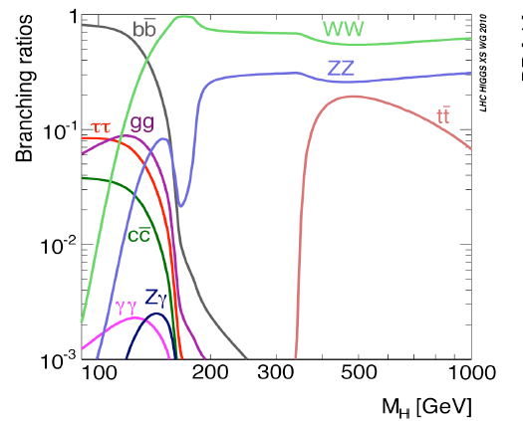
Fabiola’s favorite:
125 GeV is really a good place to be:
‾bb , WW, gg, ττ, ZZ, ‾cc are all above a few % and γγ is ~maximal

Slide 7
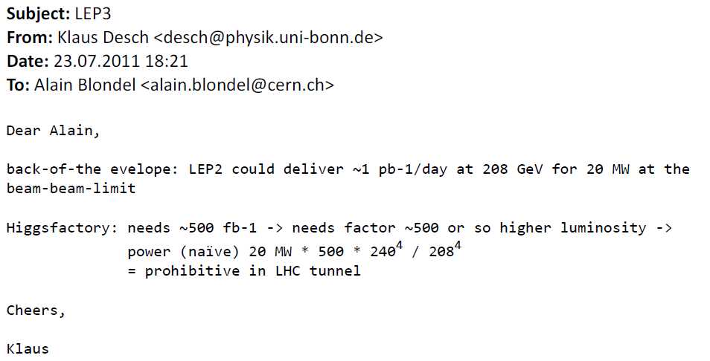
Genesis
As the Higgs became cornered below 140 GeV/c² the question was raised
around the corridors ‘what about a new e+e- colliding ring’ ?
Raised the ‘LEP3’ at the EPS-HEP ECFA session in Grenoble (July 2011)
and got such feedback: (from ILC Higgs WG convener)
the end?
or
the challenge?

Slide 8
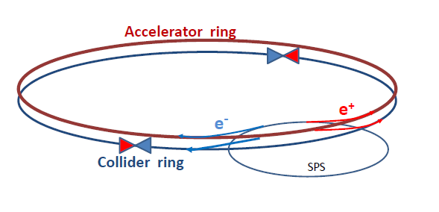
How can one increase over LEP 2 (average) luminosity by a factor 500
without exploding the power bill?
Answer is in the B-factory design: a very low vertical emittance ring with
higher intrinsic luminosity
electrons and positrons have a much higher chance of interacting
➔ much shorter lifetime (few minutes)
➔ top-up beam consituously with a ancillary accelerator

Slide 9
Extrapolating from LEP2
(remarkably scarce) litterature on last year of LEP2 says:
went up to 104.5 GeV per beam
beam lifetime was ~100 minutes, burned by interactions
beam power was 20MW (would be 45 MW at 120 GeV/beam)
β* was 5cm and beam-beam tuneshift ξ* was 0.12
➔ LEP2 was NOT at the beam beam limit
Excel spread sheet says:
with β*= 2mm and reducing horizontal emittance you can get to ξ* =0.15
and a life time of O(minutes) (you need higher frequency RF → ILC !)
➔ instantaneous luminosity is 100 times higher ☺!
but this machine is unuseable unless … one refills all the time
➔ B factory – which I realized at the ICFA meeting in October 2011
refilling continuously gives you the other factor 5.
At that point I needed professional help; Franck Zimmermann
got all excited, and quickly confirmed (3 days!) that he could apply the
LHeC optics to get the desired result! (see his presentation)

Slide 10
PARAMETER LISTS

Slide 11
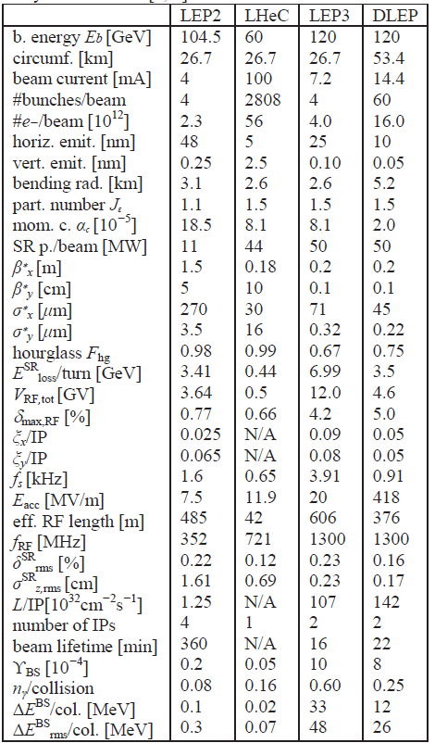
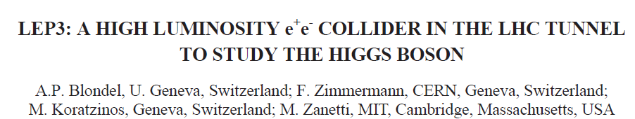

IPAC 2012 Paper
This takes into account modifications required to take care of the beamstrahlung effect pointed out by I. Telnov and K. Yokoya
-- energy aperture has been increased to ±4%
-- but energy spread at IP does not increase significantly
NB: This allows multibunch operations at lower than maximum energy

Slide 12
Punchline:
An e⁺e⁻ storage ring collider can be built in the LEP/LHC tunnel
which would provide
10³⁴/cm²/s Average Luminosity in 2 experiments i.e. 2x500fb⁻¹
2x20’000 ZH events per year.
Challenges:
-- low vertical emittance must be maintained while fitting in the
existing tunnel
-- beam-beam interaction is somewhat extreme (but nothing like LC!)
-- Most components are ‘off-the-shelf’
except RF power source operating in CW mode
-- first use of a large system of ILC cavities (8% of ILC@250 GeV)
By-products
-- By multibunching one would be able to reach luminosities of
O(~5 10³⁵)/cm²/s at the Z pole (Tera-Z)
O(~5 10³⁴) /cm²/s at the W pair threshold (Mega W)
ΔM_{W} < 1 MeV, ΔM_{Z} ,Γ_{Z} << 1 MeV, sin²θ_{W}^{eff} <<0.0001 (to be studied)
beam transverse polarization easier than LEP
because of low transverse emittance (in collision?)

Slide 13
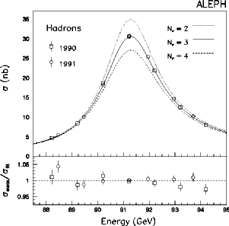
1989 The Number of light neutrinos
is this 2σ effect
an indication of
massive sterile neutrinos?
ALEPH+DELPHI+L3+OPAL in 2001 N_{ν} = 2.984 ±0.008
Error dominated by systematics on luminosity.

Slide 14
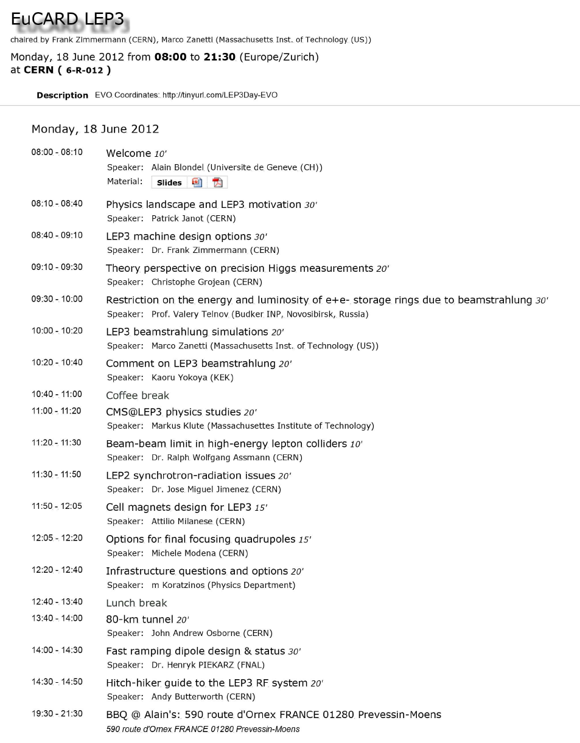
https://indico.cern.ch/conferenceDisplay.py?confId=193791

Slide 15
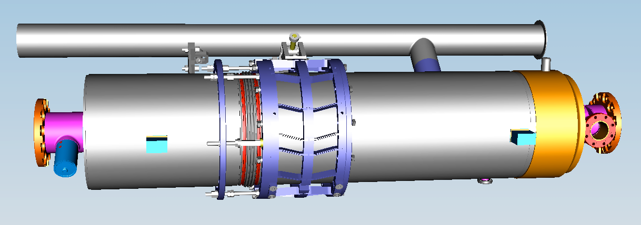
The RF system
The energy loss per turn of a single electron at 120GeV is 7GeV (3.5 GeV at LEP2)
A good candidate for the RF system would be ILC-developed SC accelerating cavities at a frequency of 1.3 GHz RF and gradient of 18MV/m
help reduce the bunch length, thus enabling a smaller β_{y}*.
The total length of the RF system is therefore around 500m, similar to that of LEP2.
Cryo power needed is less than half that of the LHC.

Slide 16
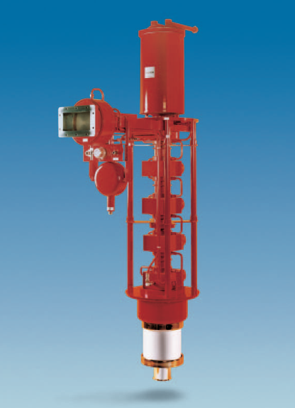
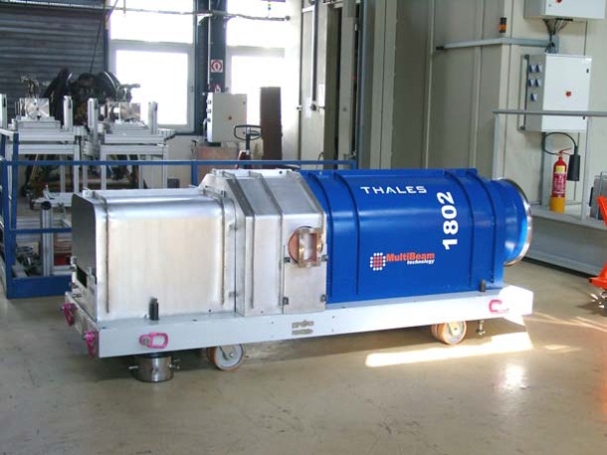
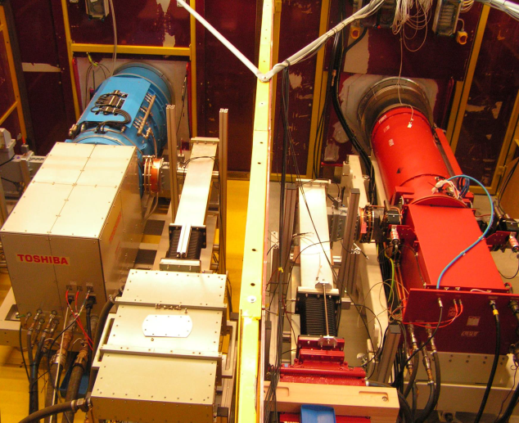
Available 1.3 GHz klystrons
J. Butterworth
1.3GHz ILC – FNAL-KEK (TH2104)
  U_{cat}/ I_{cat} : 128kV/88A
  duty cycle: 2ms / 10Hz
  gain / η: 50dB / 45%
  av. Power ≤ 200 kW
  Cost estimate: 240kEuros/tube
10MW 1.3GHz MBK – FLASH/XFEL
  U_{cat}/ I_{cat} : 140kV/155A
  duty cycle: 1.5ms / 10Hz
  gain / η: 50dB / 50%
  av. Power ≤ 150 kW
  Cost estimate: 400kEuros/tube
THALES
DESY
DESY
Need to develop a klystron for CW operation
P_{CW} ~450kW feasible? → 2 cavities/klystron

Slide 17
LHeC space considerations
: LHeC
: Space reserved for future e⁺e– machine
The LHeC ring is displaced due to the requirement of keeping the same circumference as the LHC ring. LEP3 has no such requirement

Slide 18
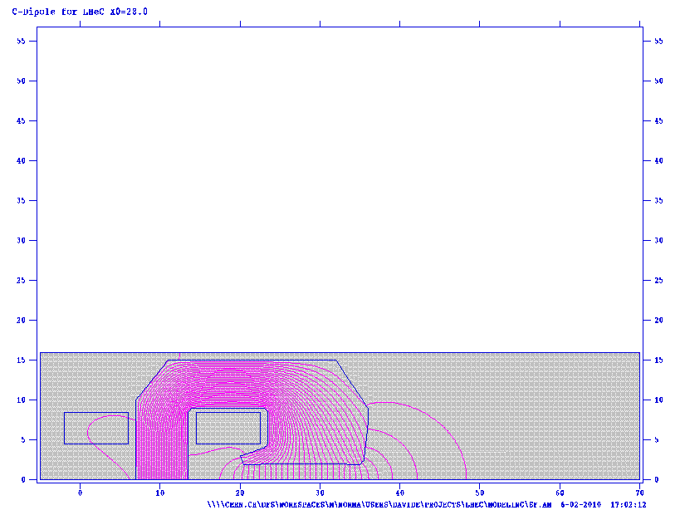
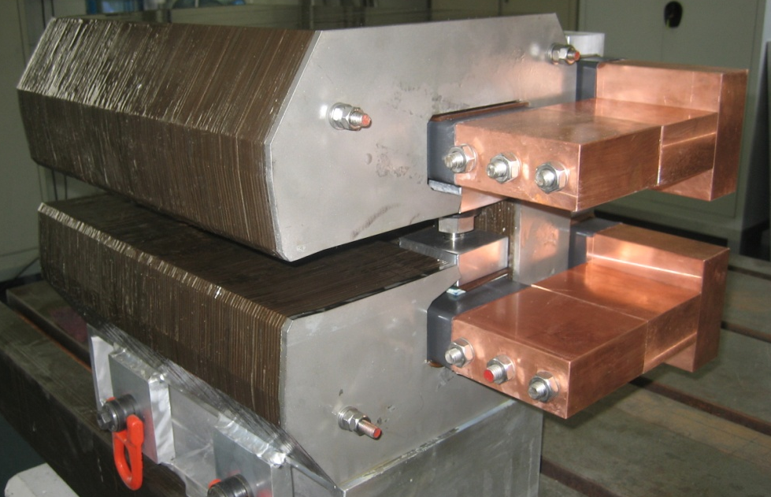
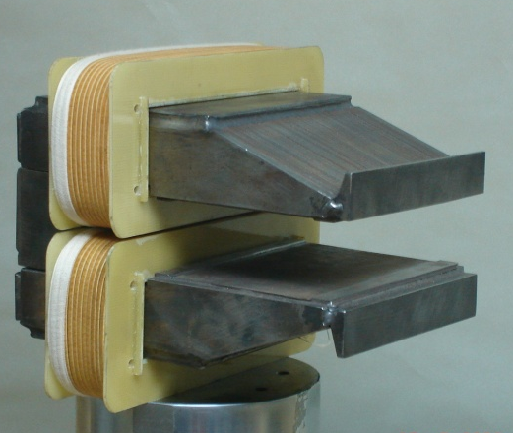
The low field dipoles (0.13 T)
Another synergy with LHeC, although LEP3 wold require a “double decker” magnet
LEP3 Artist’s impression
BINP short model
Prototypes of LHeC designs: Compact and lightweight to fit in the existing tunnel, yet mechanically stable
CERN 400 mm long model

Slide 19
Experimental conditions
-- Working group in CMS started some work on this.
➔ luminosity is obtained with many BB intereactions
perfect for TPC or for CMS. Easier situation than ILC/CLIC
➔ Beamstrahlung conditions and beam disruption are small
➔ CM energy spread is O(0.15%) (LC 2-5%)
➔ Luminosity measurement
in order to reduce β*_{y} large aperture 17cm quads needed 4m from IP
This requires minimum angle of 100mrad → 1nb Bhabha cross section
(was 30-120nb at LEP) but still perfectly sufficient >10⁸ Bhabhas/year
➔ Beam calibration: at the Z peak, beam polarization should be ‘easy’ for
non colliding bunches (not known if polarization in collision can be done)
continuous energy calibration for M_{Z} ,Γ_{Z} measurements
➔ at high energy: beam energy reproducibility ➔ calibration on Zγ events
or on resonant depolarization with MeV precision (a weak point of LC)

Slide 20
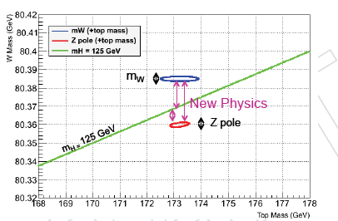
Azzi, Janot et al.. NOT CMS OFFICIAL (yet)
Precision measurements: once M_{H} is known (already 125.3±0.6 GeV!)
all EW precision measurements become sensitive to WINP
(Weakly Interacting New Physics – by opposition to sterile neutrinos)

Slide 21
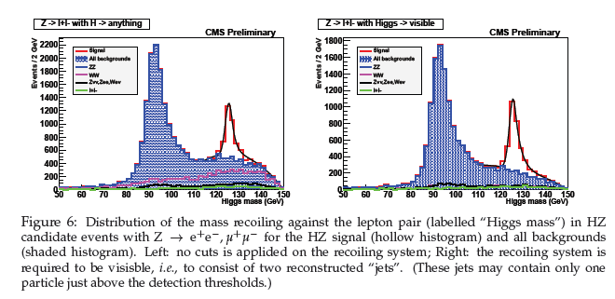
e+ e- → Z + H gives « missing mass » inclusive signature

Slide 22
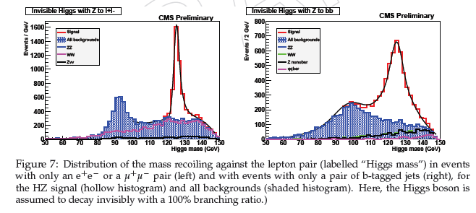
Azzi, Janot et al.. NOT CMS OFFICIAL (yet)
Invisible Higgs signals (here assume 100% invisible ☺ ….)

Slide 23
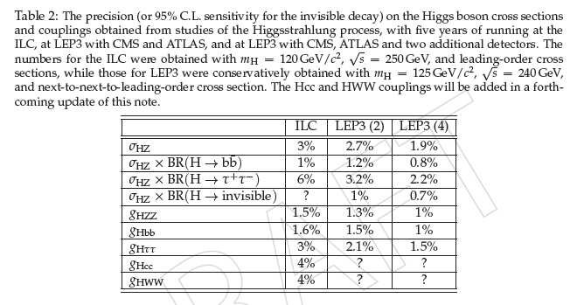
Azzi, Janot et al.. NOT CMS OFFICIAL (yet)
Invisible width measurement is main selling argument for any e+e- machine
difference: -- LC has only one IP, and 250fb⁻¹ in 5 years @250 GeV E_{CM}
-- here simulation of CMS (a real detector) not LC detector

Slide 24
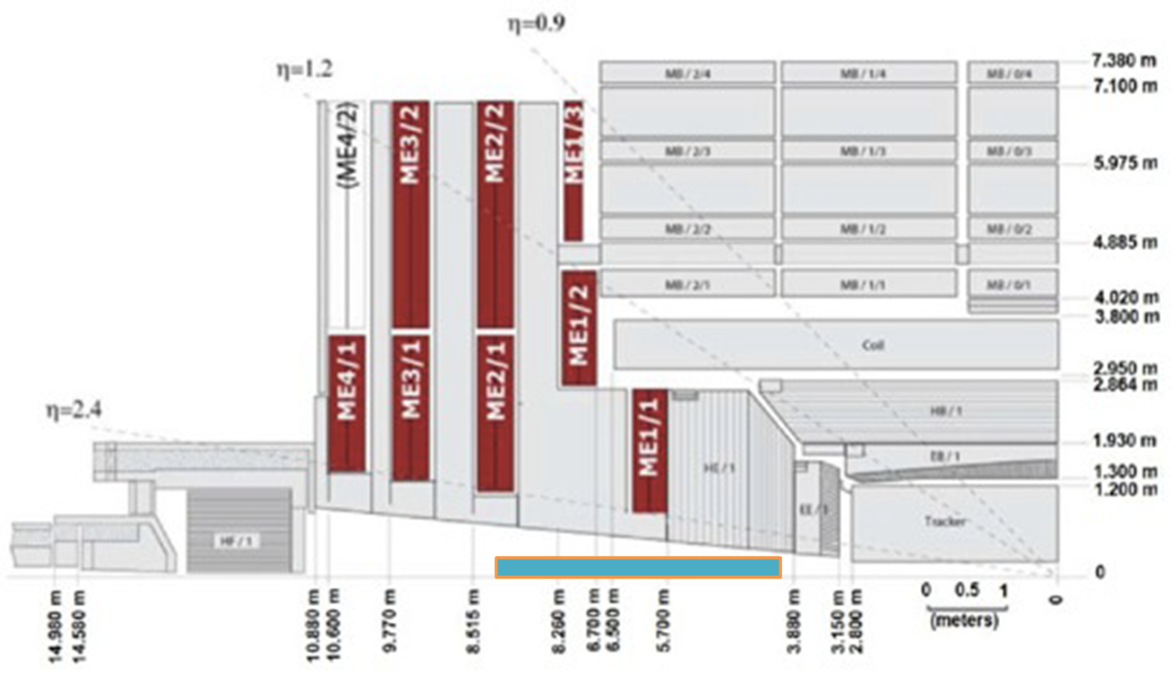
Azzi, Janot et al.. NOT CMS OFFICIAL (yet)
QUADS insertions in the CMS detector

Slide 25
3LEP
A possible longer time view… (under study)
80km tunnel around Geneva could be fit avoiding Jura, Vuache and Salève…
Then as a first step a « 3LEP » 350 GeV e+e- ring
-- still significantly cheaper than the LC of the same energy
-- reaching 175 GeV/beam (top threshold) with 6x10³³ /cm²/s luminosity.
The top threshold is interesting for precision measurements of top mass, (rare) top decays and precise constraint on α_{S}
This machine would have luminosity at ZH threshold of > (2?) 10³⁴ /cm²/s
And as second step a new exploratory Hadron collider
(80/27) * (20T/8T) * 14 TeV >≈ 100 TeV E_{CM}

Slide 26
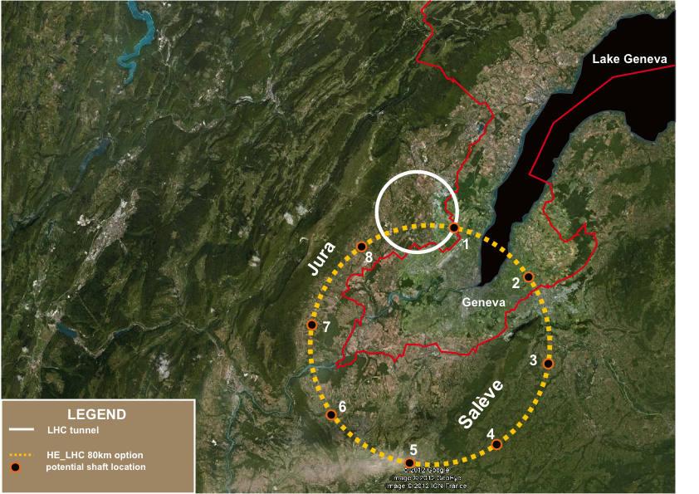

Slide 27
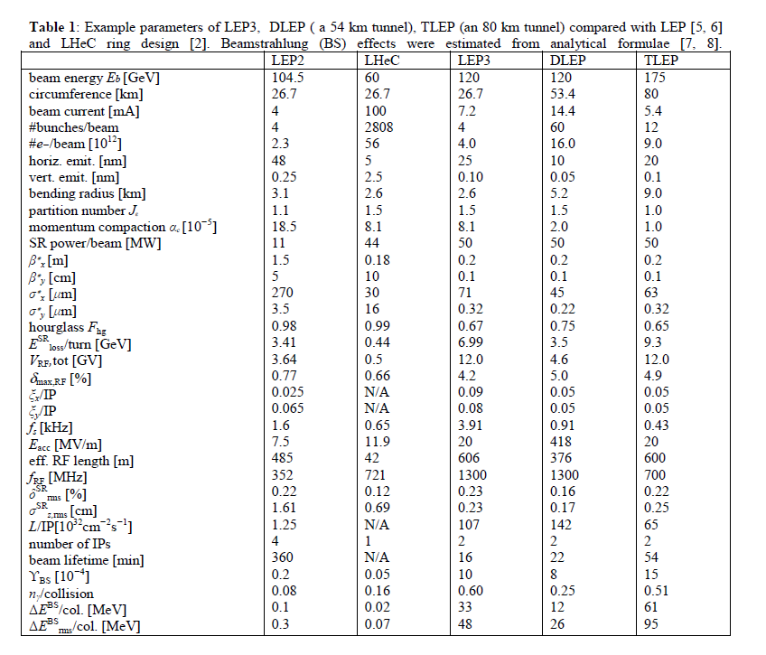

Slide 28
Objections
Objections have come primarily from the ILC/CLIC community.
-- circular machine is not upgradable to higher energies
-- the choice really depends on what LHC finds, can or cannot do!
-- raised issue with the beamstrahlung reducing the life time
-- we had not thought of it…
Frank Zimmermann solved that problem by enlarging
the energy acceptance of the ring.

Slide 29
Quite a few people find that
LEP3 is exciting!
It provides an economical (or even feasible) solution
-- to study the X(125) with high precision
-- and to perform many precision measurements on H, W, Z (top)
within our lifetimes.
The machine is not ‘easy’ but should be reasonably ‘safe’
from the point of view of achieving the performance

Slide 30
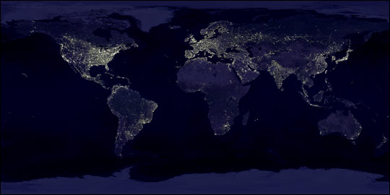
LEP3 2011
LEP3 on LI, 2012
SuperTristan 2012
LEP3 in Texas, 2012
circular Higgs factories become
popular around the world

Slide 31
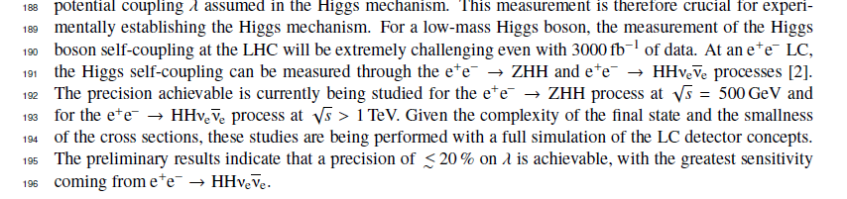
HIGGS self-coupling
This measurement will be difficult at all machines.
it requires a > 1TeV e+e- machine!
It is crucial to understand if it can be done at HL-LHC!
or: is there a precision measurement or radiative correction that can be used to constrain it?
(CF WW couplings from LEPI)

Slide 32
Questions: II ACCELERATOR
Among the many questions that should be addressed in more detail:
1) a comparison of cost and performance for the proposed double ring separating the accelerator and collider and for a single combined ring;
2) a total of about 15 GV of RF acceleration is needed : 9 GV for the storage ring and 6 GV for the accelerator - it will be necessary to determine the optimum RF gradient as a compromise between cryopower and space requirement, and the optimum RF frequency with regard to impedance, RF efficiency and bunch length [in this paper we consider the use of high-frequency ILC-type cavities];
3) the LHeC lattice has reduced the effective bending radius compared with LEP while one would rather like to increase it instead;
4) the performance may perhaps be further improved by using even smaller value of β*y and e.g. the technique of crab waste-crossing[15];
6) the performance at 91.2 Ecm (the Z peak), possibly with polarized beams
7) the co-habitation of such a double machine with the LHC would require careful examination of the layout of both machines - for the single LHeC ring no show-stopper has been found [7];

Slide 33
9) the ramping speed of the accelerator ring;
10) the positron source;
11) the limit on the single bunch charge;
12) the top-up scheme, e.g. injecting new bunches at full intensity or refilling those already colliding;
and
13) the alternative possibility of building a new larger tunnel and storage ring(s) with thrice the LEP/LHC circumference, which we call 3LEP. Possible 3LEP parameters are listed in Table 2, alongside those for LEP3. Naturally, in the long-distant future a 3LEP tunnel could also house a proton collider ring with a beam energy about ten times higher than the LHC

Slide 34
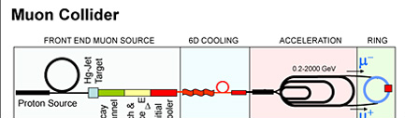
Muon
Collider
-- muons couple directly to Higgs Boson as m_{μ}²
-- s-channel μ⁺μ⁻ → H possible → 62.5+62.5 GeV muon collider.
-- small machine!
-- energy calibration ‘perfect’ by g-2 analysis of muon decays
-- very difficult and demanding on beam cooling: energy spread of beam
must be smaller that Higgs boson width (5 MeV) ➔ Δp/p <= 4 10⁻⁵ !
-- muon cooling R&D ongoing (Fermilab, RAL)
-- synergetic with neutrino factory (proposal ~2018)
but much more difficult

Slide 35
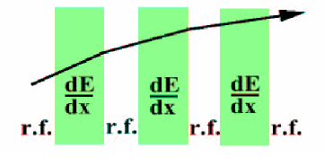
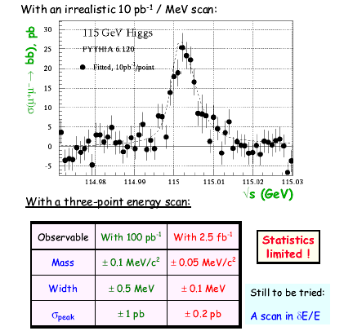
COOLING -- Principle is straightforward…
Longitudinal:
Transverse:
Similar to radiation damping in an electron storage ring: muon momentum is reduced in all directions by going through liquid hydrogen absorbers,
and restored longitudinally by acceleration in RF cavities. Thus transverse emittance is reduced progressively.
Because of a) the production of muons by pion decay and b) the short muon lifetime,
ionization cooling is only practical solution to produce high brilliance muon beams
Emittance exchange involves ionization
varying in space which cancels the dispersion of energies in the beam.
This can be used to reduce the energy
spread and is of particular interest for
muon collider μ⁺ μ⁻ → H (125)
since the Higgs is very narrow (~5MeV)

Slide 36
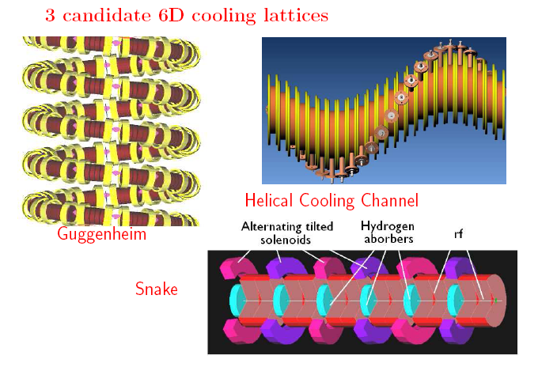
COOLING -- Principle is straightforward…
Longitudinal:
Transverse:
Similar to radiation damping in an electron storage ring: muon momentum is reduced in all directions by going through liquid hydrogen absorbers,
and restored longitudinally by acceleration in RF cavities. Thus transverse emittance is reduced progressively.
Because of a) the production of muons by pion decay and b) the short muon lifetime,
ionization cooling is only practical solution to produce high brilliance muon beams
Emittance exchange involves ionization
varying in space which cancels the dispersion of energies in the beam.
This can be used to reduce the energy
spread and is of particular interest for
μ⁺ μ⁻ → H (125)
since the Higgs is very narrow (~5MeV)
Practical realization is not!
MICE cooling channel (4D cooling)
6D candidate cooling lattices

Slide 37


MICE SCHEDULE
update: June 2012
μ
Run date:
STEP I
COMPLETED
EMR run Feb 2013
STEP IV
Q2 2013
till
Q2 2014
Under construction:
STEP VI
NB: target date 2016

Slide 38
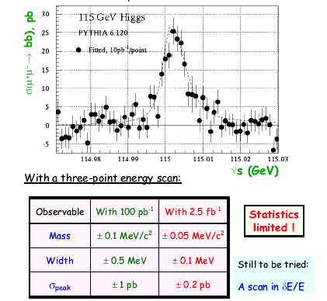
Murray
Muon collider
Janot

Slide 39
Next events:
1. Papers prepared for European strategy:
ILC, LEP3,
CMS study,
{TLEP, TLHC}
2. ICFA beam dynamics workshop on
"Accelerators for Higgs Factory: Linear vs. Circular" (HF2012) from
November 14 to 16, 2012 at Fermilab.
3. Higgs Factory Collider workshop December 6 and 7, 2012 at UCLA
4. if people interested in dedicated LEP3 WG please contact
alain.blondel@cern.ch
or frank.zimmermann@cern.ch (accelerator)
or patrick.janot@cern.ch (CMS)

Slide 40
Conclusions
If the LHC measurements are not complete enough an lepton collider will be
necessary.
In particular it is important to understand if the HH coupling can be
addressed at LHC – it is not easy at the e+e- machine either!
Other measurements such as the invisible width can be done much better
with an e+e- collider just above the ZH threshold (240-260 GeV)
For this purpose a ring e+e- collider LEP3 or 3LEP can provide
an economical solution
-- to study the X(125) with high precision
-- and to perform many precision measurements on H, W, Z (top)
within our lifetimes.
A muon collider provides specific measurements (muon couplings) that are
very difficult otherwise. It may be the better solution for the
lepton collider above TeV.

Slide 41
LEP2/3 References:
[1] A. Blondel, F. Zimmermann, ‘A High Luminosity e+e- Collider in the LHC tunnel to study the Higgs Boson,’ V2.1-V2.7, arXiv:1112.2518v1, 24.12.2011
[2] C. Adolphsen et al, ‘LHeC, A Large Hadron Electron Collider at CERN,’ LHeC working group, LHeC-Note-2011-001 GEN.
[3] H. Schopper, The Lord of the Collider Rings at CERN 1980- 2000, Springer-Verlag Berlin Heidelberg 2009
[4] K. Oide, ‘SuperTRISTAN - A possibility of ring collider for Higgs factory,’ KEK Seminar, 13 February 2012
[5] R.W. Assmann, ‘LEP Operation and Performance with Electron-Positron Collisions at 209 GeV,’ presented at 11th Workshop of the LHC, Chamonix, France, 15 - 19 January 2001
[6] A. Butterworth et al, ‘The LEP2 superconducting RF system,’ NIMA Vol. 587, Issues 2-3,
2008, pp. 151
[7] K. Yokoya, P. Chen, CERN US PAS 1990, Lect.Notes Phys. 400 (1992) 415-445
[8] K. Yokoya, Nucl.Instrum.Meth. A251 (1986) 1
[9] K. Yokoya, ‘Scaling of High-Energy e⁺e⁻ Ring Colliders,’ KEK Accelerator Seminar, 15.03.2012
[10] V. Telnov, ‘Restriction on the energy and luminosity of e⁺e⁻ storage rings due to beamstrahlung,’ arXiv:1203.6563v, 29 March 2012
[11] H. Burkhardt, ‘Beam Lifetime and Beam Tails in LEP,’ CERN-SL-99-061-AP (1999)
[12] R. Bossart et al, ‘The LEP Injector Linac,’ CERN-PS-90-56-LP (1990)
[13] P. Collier and G. Roy, `Removal of the LEP Ramp Rate Limitation,’ SL-MD Note 195 (1995).

