Slide 1
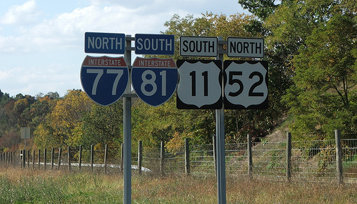
Tevatron Roadmap for the Higgs
Gregorio Bernardi, LPNHE Paris
On behalf of CDF and D∅
July 30th 2010
Where are we?
What can still be done, assuming
1) Data ends end 2011 / results Moriond 2012
2) Data ends end 2012 / results Moriond 2013
3) Data ends end 2014 / results end 2014
Thanks to Y. Enari, W. Fisher, T. Junk, B. Kilminster, M. Kirby, K. Peters and all cdf & d0 colleagues

Slide 2
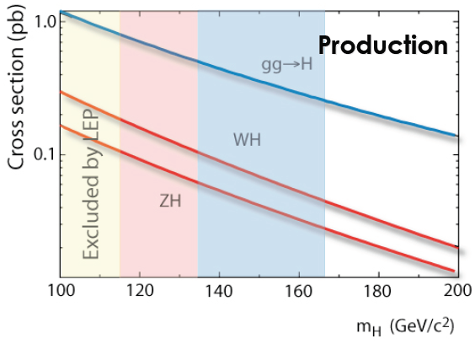
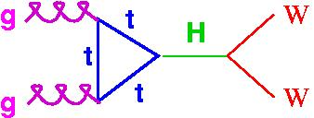
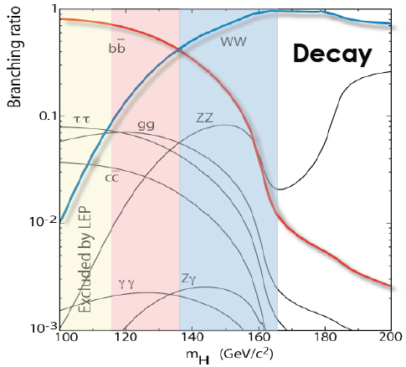
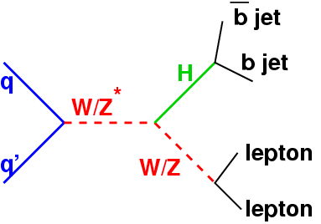
Higgs Production and Decay at the Tevatron
High mass (m_{H} > 135 GeV) dominant decay:
Low mass (m_{H} < 135 GeV) dominant decay:
use associated production modes to get better S/B
These are the main search channels, but there is an extensive program of measurement in other channels to extend the SM and BSM sensitivities.
2

Slide 3
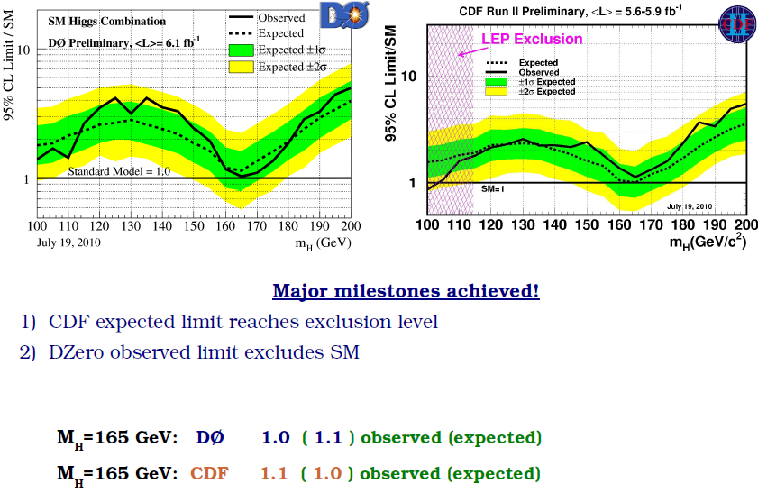
CDF and D0 limits
New Milestones achieved for ICHEP 2010:
CDF expected limit reaches exclusion level
Dzero observed limit reaches exclusion level

Slide 4
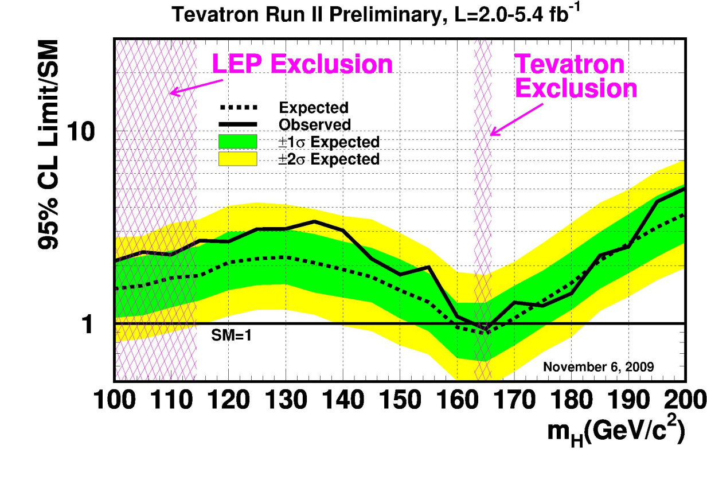
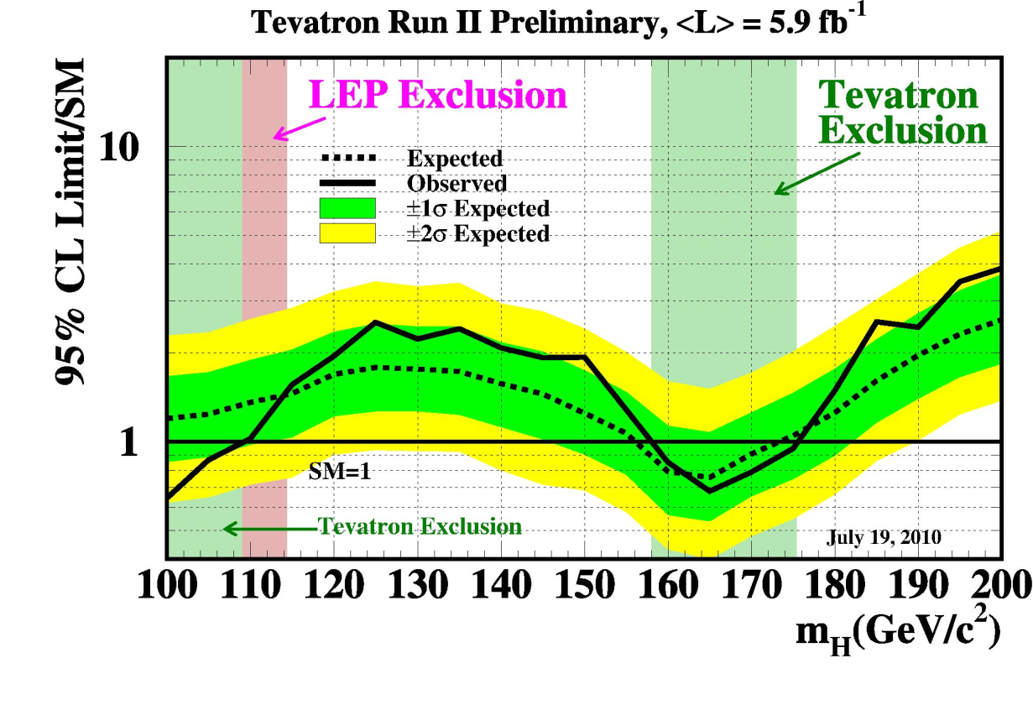
SM combined Higgs Limits, 8 months later
Joint CDF/DØ publication on 1st Higgs exclusion above the limit set by LEP
First time also an expected exclusion range ➔ from 159 to 168 GeV
Better than 2.2 x σSM sensitivity for all mass points below 185 GeV
1.8 x σSM sensitivity @ mH = 115 GeV (average lumi ~3.6/fb)
Lumi/improvements expected exclusion now ➔ from 156 to 173 GeV
Better than 1.8 x σSM sensitivity for all mass points below 185 GeV
1.45 x σSM sensitivity @ mH = 115 GeV (average lumi ~5.8/fb)
New: exclusion at low mass <109 GeV
ALL 6 LOW mass channels have more lumi, sometimes significantly more
Perspectives of Higgs Searches

Slide 5
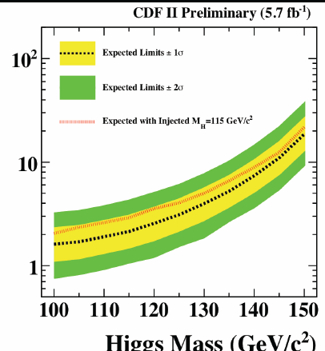
Luminosity increases
CDF
nu nu bb 5.7 fb-1 (60% more luminosity)
L L bb 5.7 fb-1 (40% more)
WH 5.7 fb-1 (30% more)
H→WW 5.9 fb-1 (25% more)
D0
nu nu bb 6.4 fb-1 (25% more luminosity)
L L bb 6.2 fb-1 (45% more)
WH 5.3 fb-1 ( 5% more)
H→WW 6.7 fb-1 (25% more)
+ improvements in analysis techniques.
We still observe DATA EXCESS at low mass (115-155 GeV)
Is this consistent with a 115 GeV signal, as injected here
Difficult to compare: no high mass channels in the
Comparison, CDF only (half stat), 1sigma fluctuations
are not uncommon from point to point

Slide 6
What happens at 115?
But must integrate all bins!

Slide 7
Events
Use color flow between jets to enhance signal

Slide 8
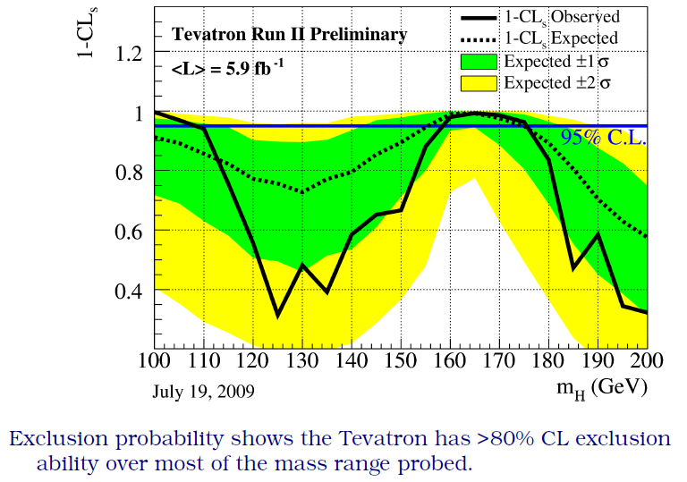
Confidence Level for Exclusion
Tevatron has already >70% C.L. expected exclusion from 100 to 190 GeV
We exclude 165 GeV at 99.3% C.L !!!

Slide 9
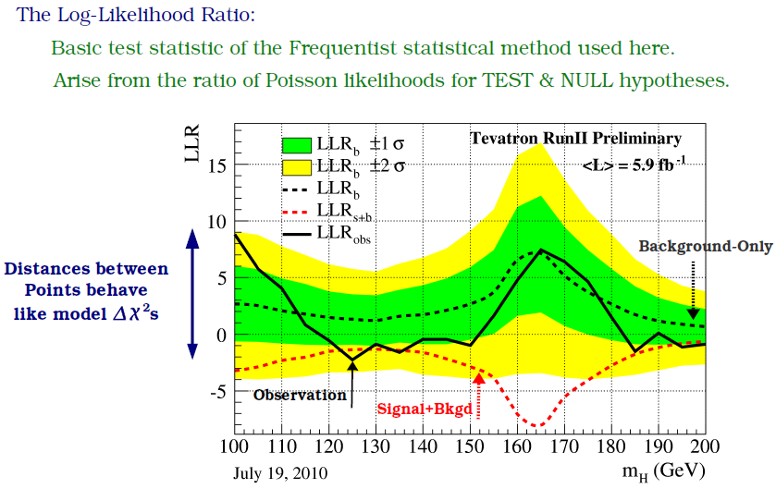
Current Sensitivity
If Higgs was at 165 GeV, we could be seeing a ~3 σ excess

Slide 10
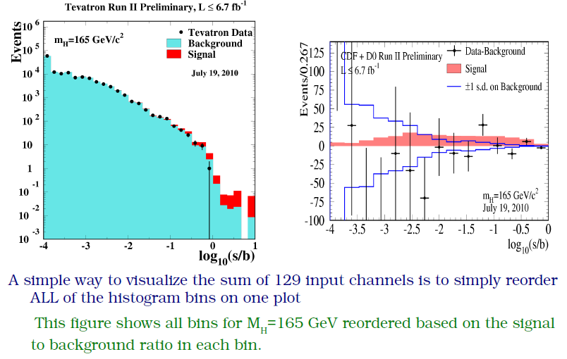
S/B at high mass
At High Mass, good agreement data/mc at all s/b,
if anything, a small “negative fluctuation” of data for high s/b

Slide 11
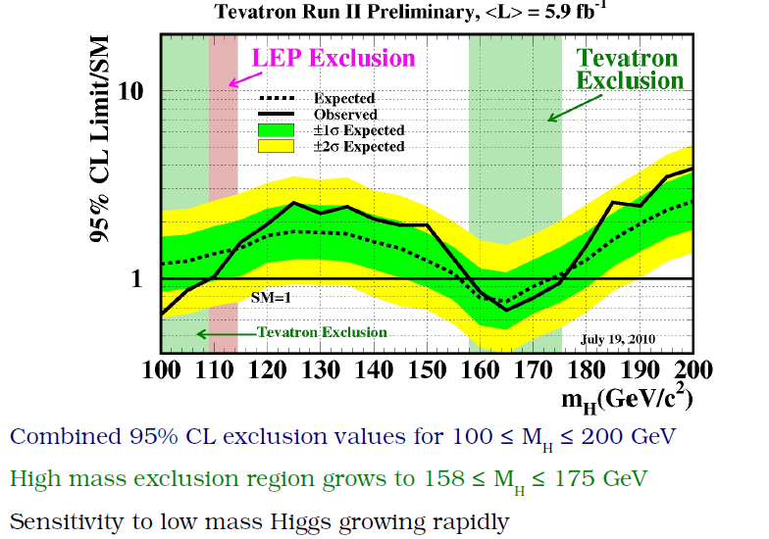
ICHEP 2010
Assume (for a test) ~ -20% less on gg→H, don’t forget W/ZH,VBF
High mass exclusion between 158 and 175 GeV
The dependence on the theoretical x-section is weak: with 20% less on gg→H the exclusion would still be ~ 160-172 GeV, effect of large systematics even weaker.
In any case, no hint of a signal in the 155-175 GeV region where you would expect a > 2 sigma excess

Slide 12
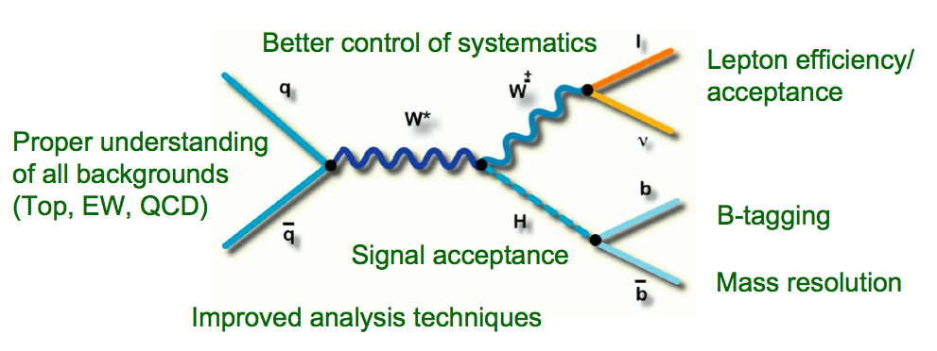
Improvement Perspectives
Continue to make improvements over a wide range of areas
Perspectives of Higgs Searches

Slide 13
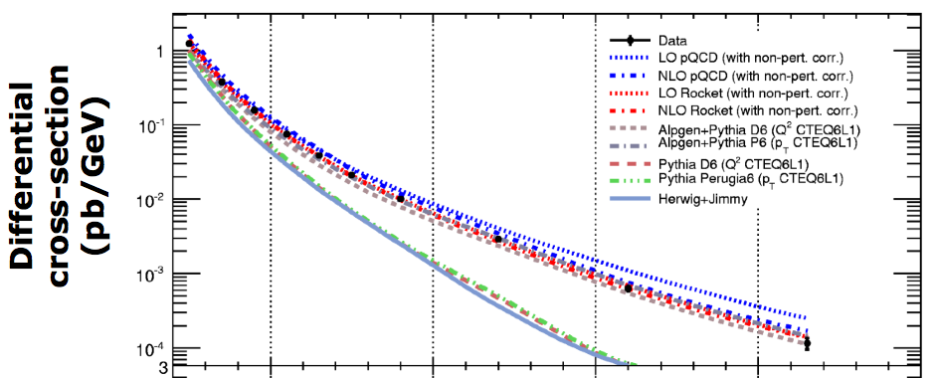
Modeling of V+HF jets
Normalization from MCFM (N)NLO and sideband fit to data
Shapes from MC
Different choices for scale, underlying event and showering
V+HF cross section measurements
(W+jets, Z+jets, W+c, W+b…) allow to control theoretical models & cross-sections
Particle jets comparison
W+2 jets
Next to Leading jet Pt
Perspectives of Higgs Searches

Slide 14
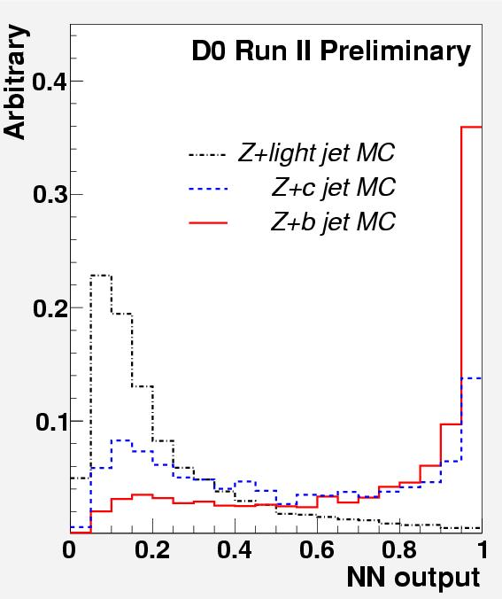
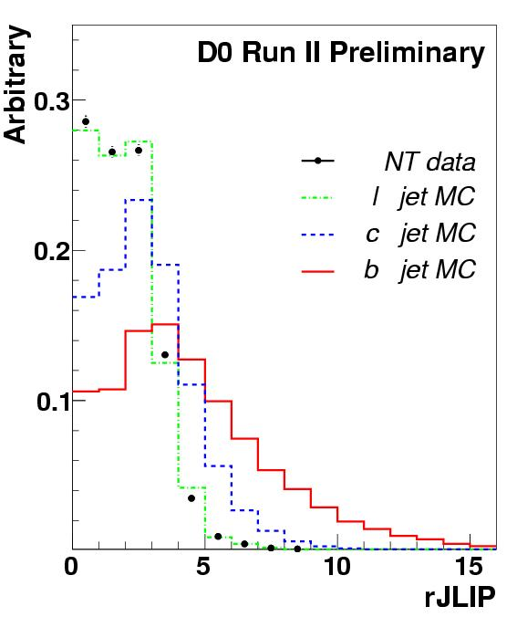
σ(Z+b)/σ(Z+jet) ratio measurement
Event Selection:
Dilepton mass 70 ≤ M ≤ 110 GeV
At least one jet
p_{T} > 20 GeV; |η| < 1.1
Tagged Sample:
Apply Neural Network tagging algorithm on jets to enrich b content
Use rJLIP variable to discriminate between b, c and light jets
rJLIP calculates probability for a jet to come from the primary vertex
Use data for light jet template, Pythia+Alpgen for b, c templates
Use log likelihood fit to extract Z+b fraction
➔ Ratio consistent with SM
14

Slide 15
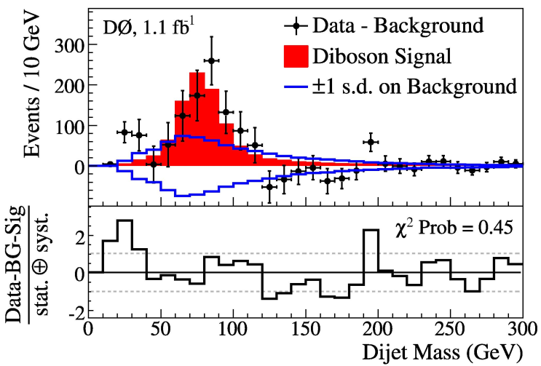
VZ observation by CDF and D0
WV→lvqq provides a benchmark measurement of a dijet mass resonance similar to the Higgs
But no b-tagging
Main benchmark for our low mass Higgs searches: observation of WZ(bb)/ZZ(bb)
VZ(bb) = ~4 x VH(115), but more backgrounds. Combine 3 search channels (llbb, vvbb, lvbb)
➔ perfect test if we observe VZ(bb) in the three low mass channels and in combination with CDF (Moriond 2011?).
Perspectives of Higgs Searches

Slide 16
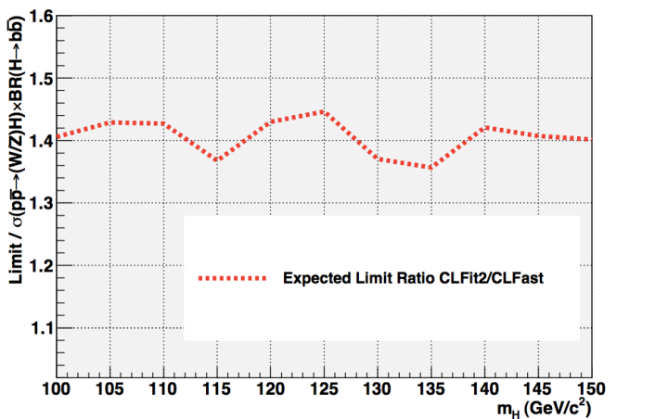
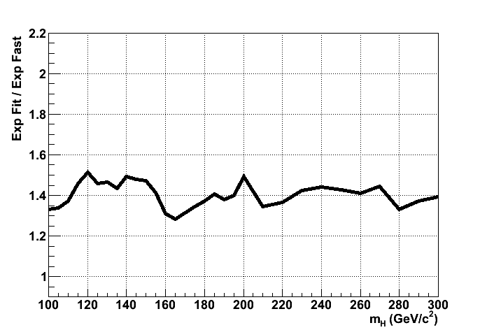
Systematic uncertainties
Play a bigger role as the data sample grows (ie, statistical uncertainty falls) and as we get closer to SM sensitivity
Need to continue improving our understanding of all the relevant systematic
Especially the modeling of our signal and main backgrounds: Higher order corrections, different choices for scale and matching parameters
Significant degradation of sensitivity due to systematic uncertainties
Limiting the degrading effect of systematic uncertainties allows to improve the sensitivity on the 10% level
Obtain a better understanding of the modeling of our backgrounds instead of using large systematic uncertainties
An important part of algorithm improvements can be to reduce systematic errors associated to them (i.e. large degradation from b-tagging uncertainties)
ZH → ννbb
H → WW → emu
Limit degradation
vs Higgs mass

Slide 17
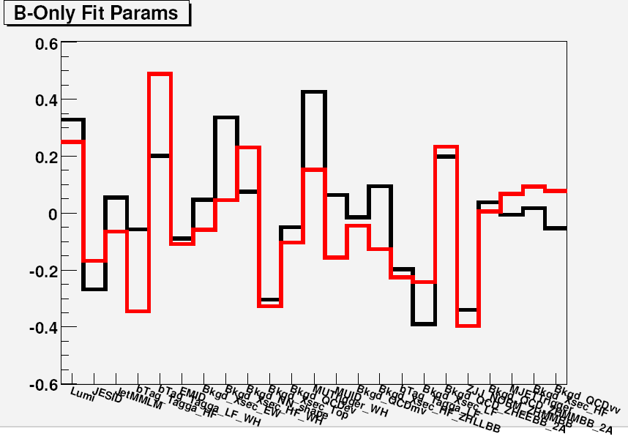
Best fit for nuisance parameters
DØ Higgs SM combination ‘07
Centered close to 0 → good
shift in units of systematic uncertainty
- Error correlations between channels and experiments taken into account
-“shape error” used in many background or signal modeling uncertainties, strong impact on the limits.

Slide 18
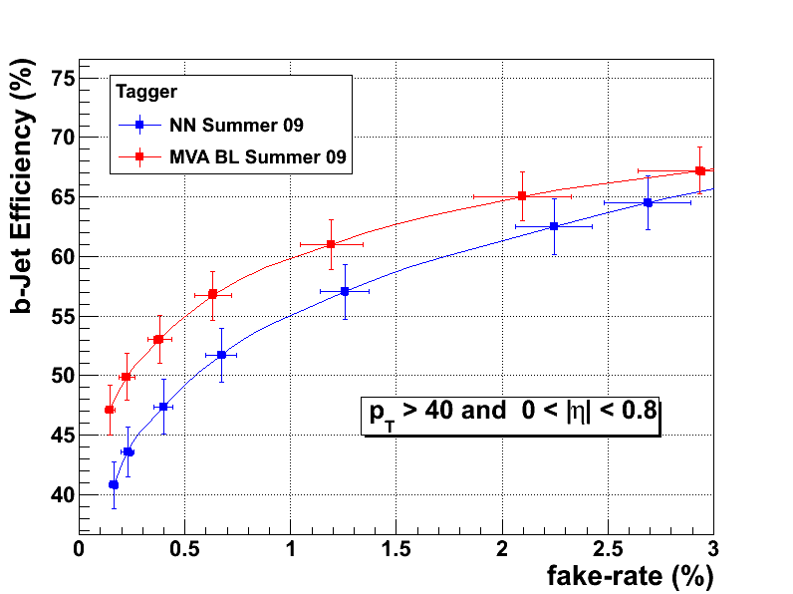
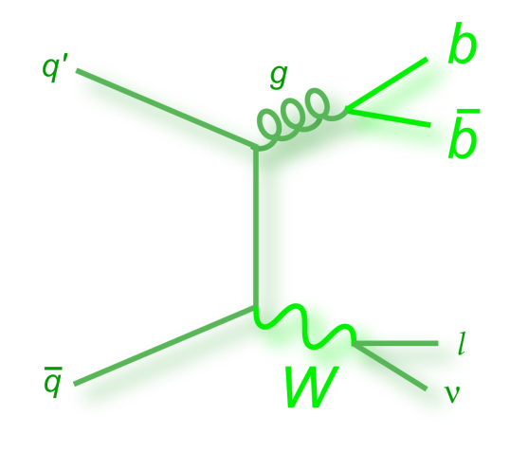
Algorithm improvements: b-tagging
Improved b-tagging algorithms (b vs light jet discrimination)
~10% increase in b-jet efficiency at same fake rate
New, additional algorithms
b vs. c discrimination
b vs. bb (merged) discrimination
Not yet in recent Higgs results
DØ
+13% signal
Perspectives of Higgs Searches

Slide 19
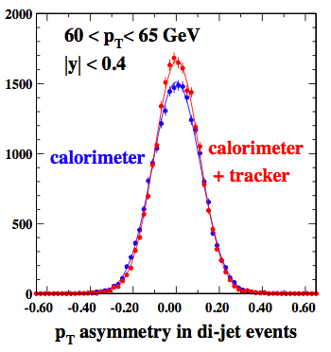
Jet energy Resolution
Lots of work in the past years to improve the jet energy resolution,
Still progress is being made
Preshower correction
Track-cal jets
Neural Nets (using also b-tag information)
Combined correction
Dijet mass remains the best discriminating variable at low mass
high priority to maximize the gain from these algorithms
Perspectives of Higgs Searches

Slide 20
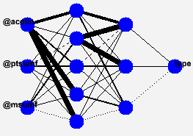
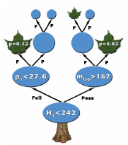
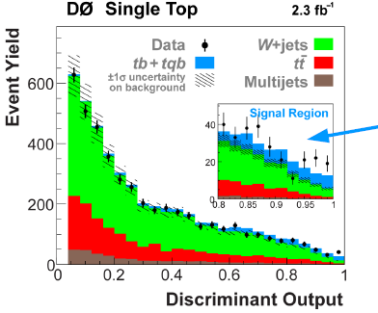
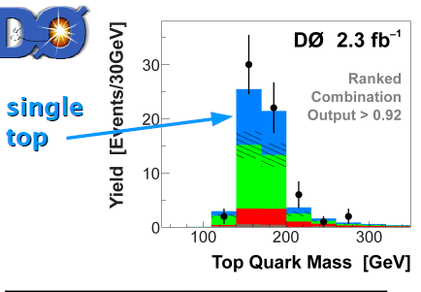
Multivariate Analysis (MVA)
In order to maximize sensitivity
Neural Network (NN)
Boosted Decision Tree (BDT)
BDT can handle larger number of
inputs → less dependent on the
selection of input variables
Matrix Element (ME)
Event probability can be obtained by integrating ME
Input is four-momentum vector of each object
Main Inputs at low mass:
- Dijet mass, p_{T} of dijet
- W p_{T,} Z p_{T,} Sphericity
- ΔR_{jj} , Δφ_{jj}. Δη_{jj}
These three approaches are often combined by Neural Net / BDT
➔Experimentally tested on Single Top observation by CDF/DØ
20
Notes:
Other tool is multivariate technique.
In order to maximize sensitivity, we often use these technique, NN, BDT and ME.
Good point of BDT is it can handle large number of inputs.
Of course bunch of parameter need to be test, basically we don’t need to chose variables.
Other approach is ME, we can obtain event probability on each process by integrating matrix element.
It needs huge CPU power, but this is strong tool.
We often combine these outputs by NNet or BDT with additional step.

Slide 21
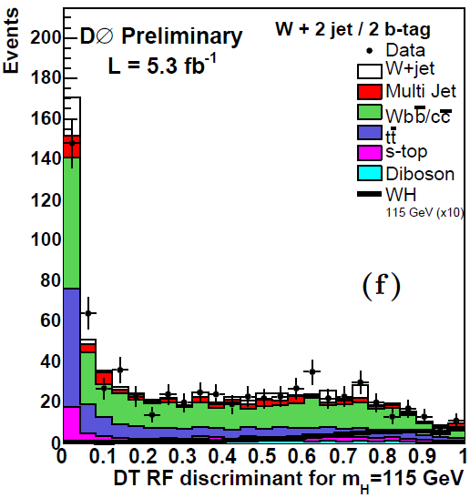
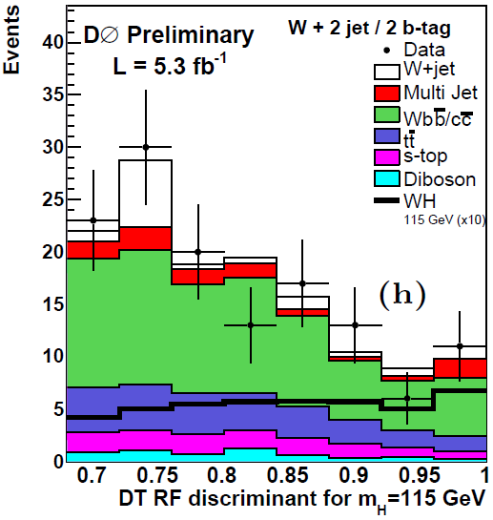
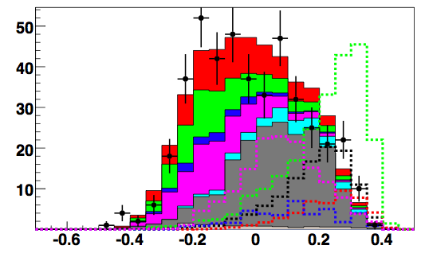
Final Discriminant
Refining the work on final discriminant, leads to sensitivity improvements
Example WH → lνbb:
Upgrading from NN to RF allowed for a ~10% gain in sensitivity
Example ZH → ττjj:
Combine several BDTs instead of cuts gives
~10% sensitivity gain
Perspectives of Higgs Searches

Slide 22
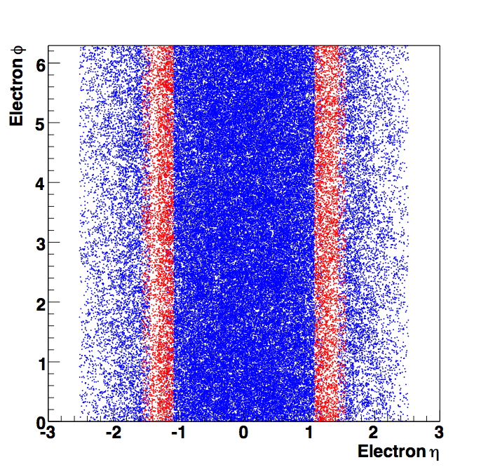
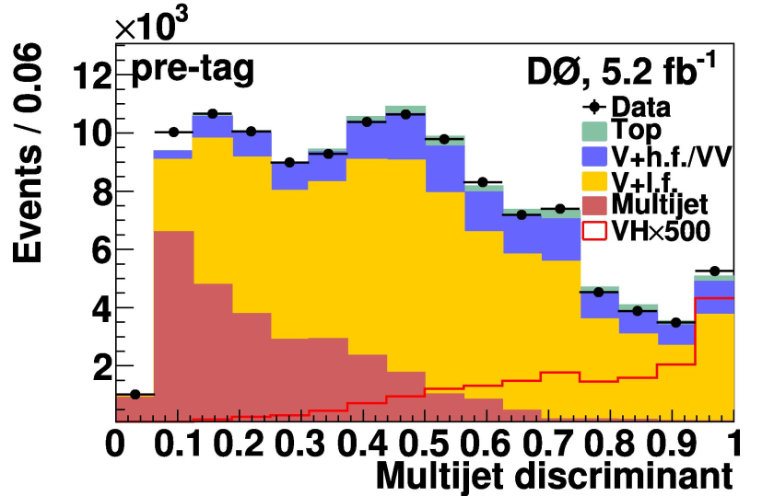
Signal Acceptance
Continue to work to maximize signal acceptance
Example: ZH channels
Replace several cuts on kinematic variables by cut on discriminant
Electrons in inter calorimeter regions
mu+track
Already got ~8% increase in signal yields per lepton
➔ sensitivity improvement
Perspectives of Higgs Searches

Slide 23
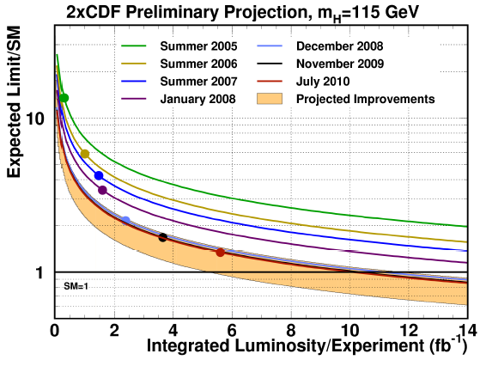
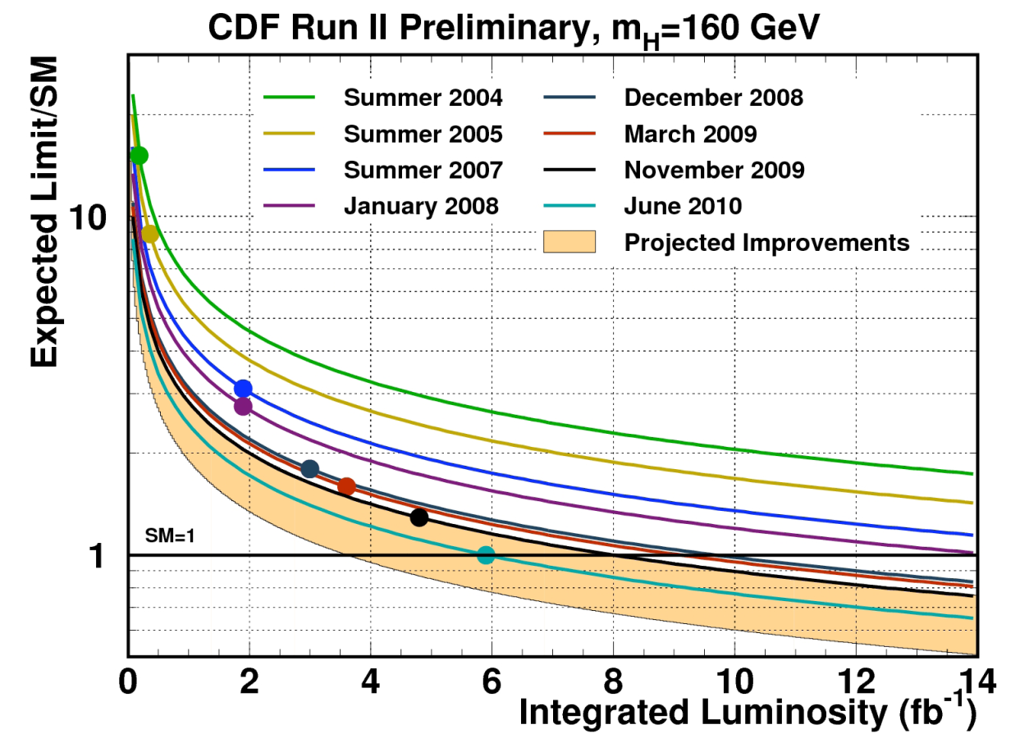
Improvements beyond luminosity verified on Data
Good progress in particular at high mass ➔

Slide 24
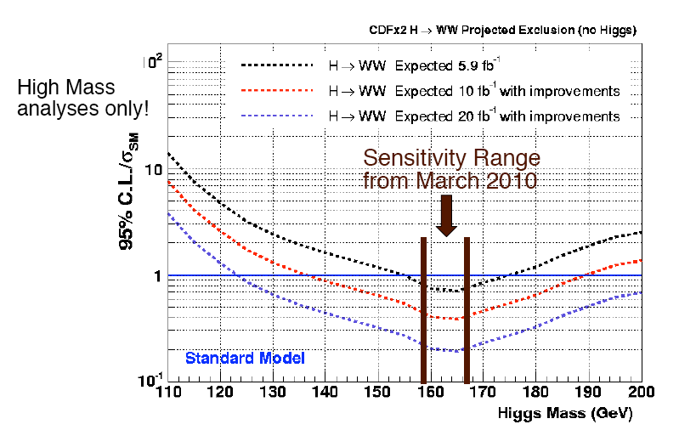
Exclusion at the end of 2011
-
If No SM Higgs, expect exclusion from 140 to 190

Slide 25
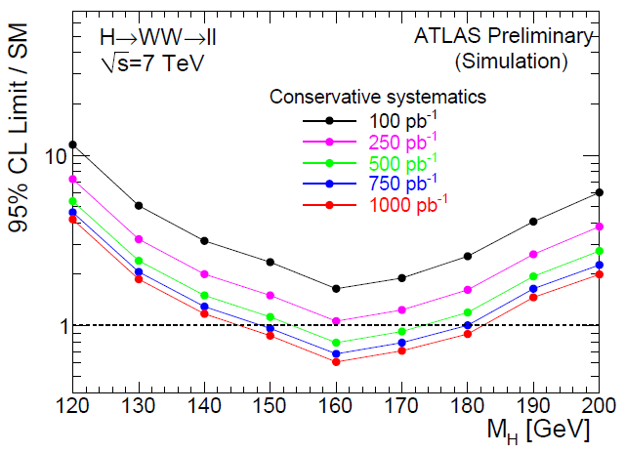
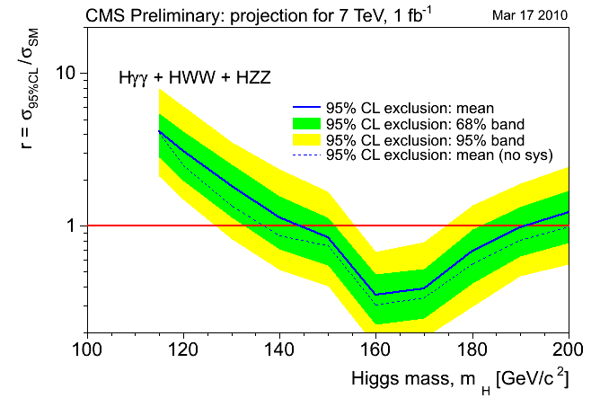
LHC first projections shown at ICHEP
Both foresee an exclusion 145-185 GeV with 1 fb⁻¹
➔Need to improve and/or combine
to be competitive with Tevatron.

Slide 26
From 2011 to 2014 @ Tevatron
Expect 2 fb-1 of recorded data for each year after 2011
➔ 12 fb-1 analyzed end of 2012
➔ 16 fb-1 analyzed end of 2014
2004
End of 2011

Slide 27
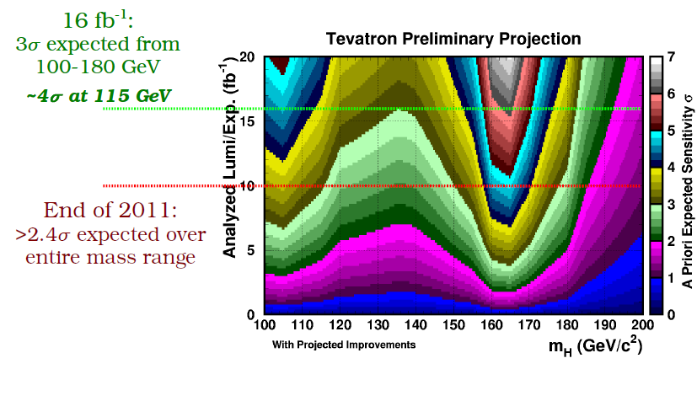
Sensitivity projections

Slide 28
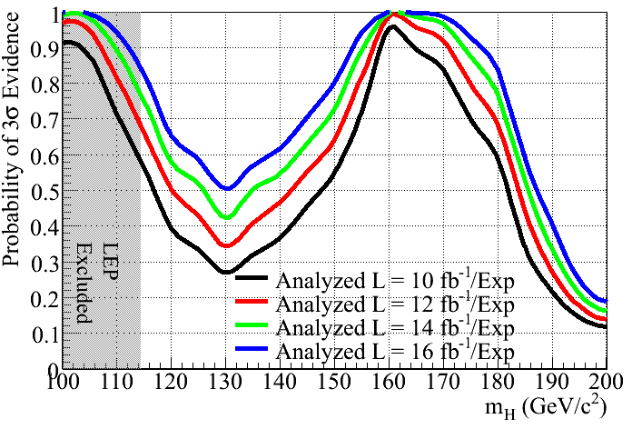
Projections in Higgs Sensitivity
Using P5 plots we extended combined projected Tevatron Higgs sensitivity for 3 sigma evidence to luminosities above 10 fb⁻¹
28

Slide 29
5 SM Scenarios (personal view)
Heavy SM Higgs (above 185 GeV)
good for LHC run II (>2013), Tevatron can try up to ~200 GeV
not likely scenario though given E-W fits.
145 GeV SM Higgs
➔ ~ 50% probability to have 3 σ evidence @ Tevatron-2011
➔ similar at LHC with 1 fb⁻¹ (combining or improving)
130 GeV SM Higgs
➔ ~ 25% probability to have 3 σ evidence @ Tevatron-2011
➔ ~ 50% probability to have 3 σ evidence @ Tevatron-2014
➔ LHC needs > 2 fb⁻¹ (even combining and barring significant improvements)
115 GeV SM Higgs
~ 50 (80)% (probability to have 3 σ evidence @ Tevatron-2011 (2013), good chances to reach 4 σ (if lucky and 2014, 5 σ observation!)
LHC needs significant time in Run II
No SM Higgs
➔ Tevatron exclude 115-185 GeV @ Tev-2011, LHC confirms down to 140 GeV

Slide 30
Conclusions
We’re getting into the crucial moments for the SM Higgs if Tevatron continue running beyond end of 2011… else there is a serious danger to have to wait until >2014 to discover a light SM Higgs.
We need to validate the b-bbar observation mode at the Tevatron, with WZ/ZZ CDF-D0 combined observation
We need to keep searching for Susy Higgses to make sure we don’t let them slip away (another talk ;))
Tevatron could very well be the best place to measure HWW and HZZ couplings if Higgs is at low mass.

