Slide 1
The Paris Saclay Initiative
Guy Wormser (LAL)
P2IO Scientific Council , June 27-28 2012

Slide 2
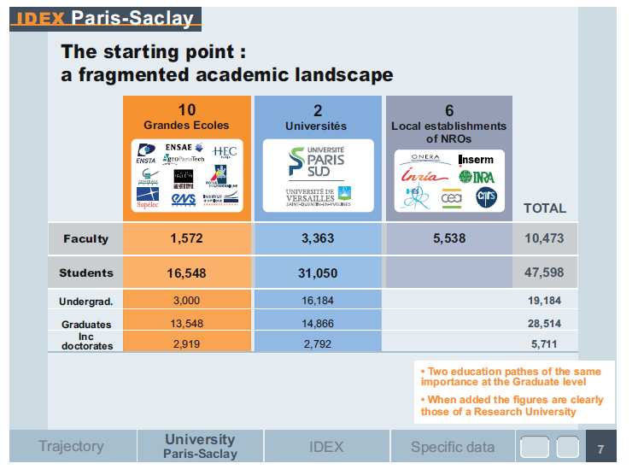
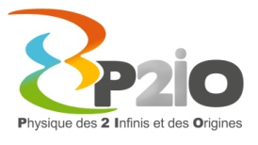

Slide 3
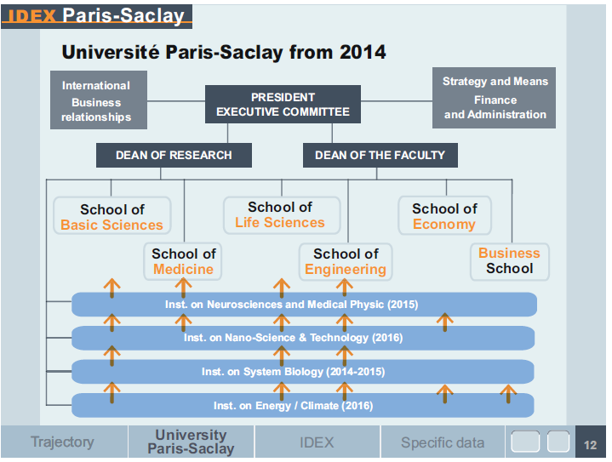
The future structure of UPSa

Slide 4
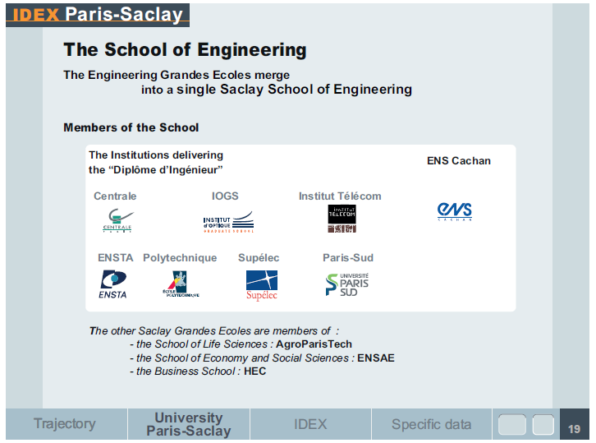
A new entity quite interesting for P2IO

Slide 5
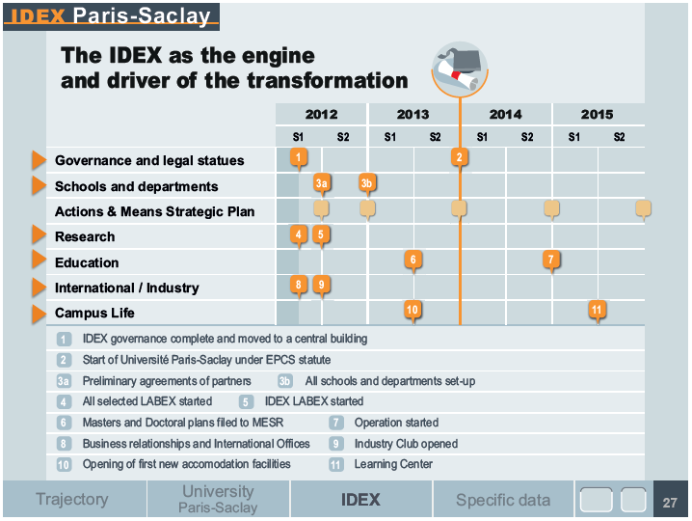
UPSa schedule

Slide 6
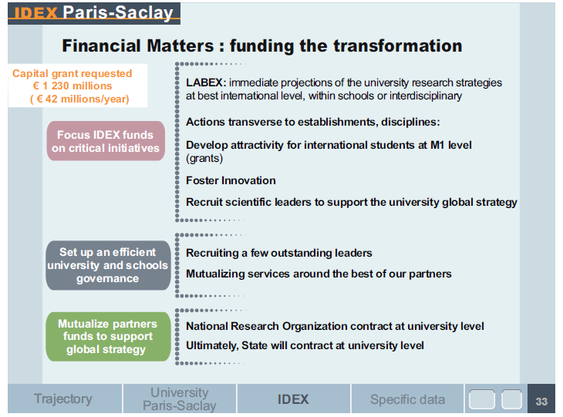
IDEX budget relatively limited but still …

Slide 7
P2IO role in UPSa
LABEX key role in setting up the project (May 2011-September 2011)
P2IO key player in the School of Basic Sciences (GW WG coordinator)
P2IO members key players in IDEX pre-academic Senate
P2IO can become a UPSa « thematic institute » since it integrates all UPSa activities in a given (and important!) field

Slide 8
UPSa impact on P2IO
Closer integration of IDEX Engineering schools in P2IO research and teaching programs
Interdisciplinary actions through school of basic sciences and other schools
Targeted postoral calls and platforms support

Slide 9
Conclusion
Very strong scientific potential in Saclay area but in a very complex and fragmented shape
IDEX UPSa is a very ambitious attempt to create a new integrated University , among the top 10 on the world
P2IO is an ideal instrument to play a leading role in this initiative and to benefit from it!

