Slide 1



High Energy and Very High Energy astronomy
J-F. Glicenstein
IRFU/SPP, CEA-Saclay

Slide 2
Outline
present and future high energy instruments
present and future very high energy instruments
physics with HE and VHE γ ray detectors
  cosmic ray acceleration
  fundamental tests
  dark matter indirect searches
  cosmology

Slide 3
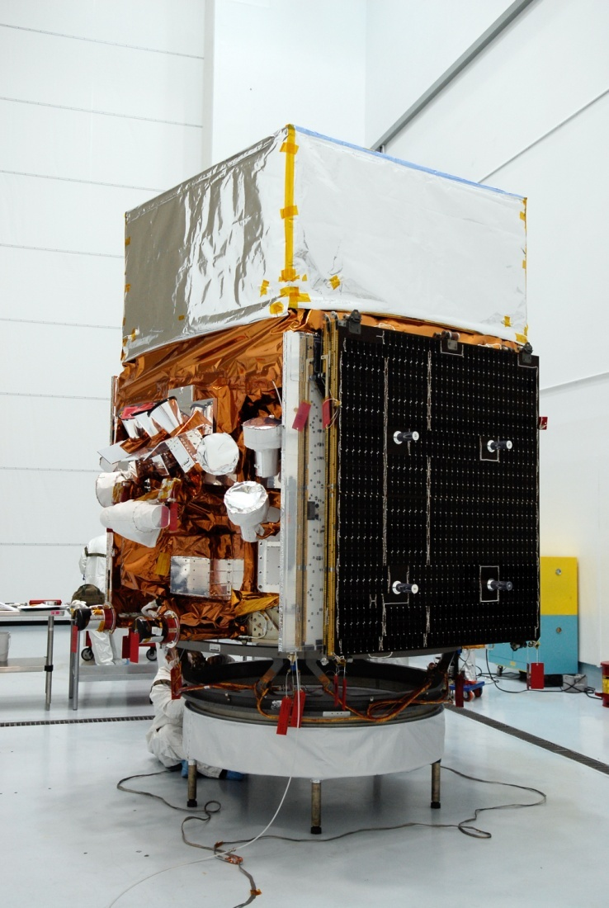
High Energy γ ray astronomy: present
collaboration to Fermi-LAT
international team,> 400 scientists
satellite-based CsI(Tl) calorimeter
30 MeV < E < 300 GeV
major competitor: AGILE
launched 08/2008
Fermi-LAT @ Paris-Saclay:
LLR: 5 physicists
(IRFU: 4 physicists)

Slide 4
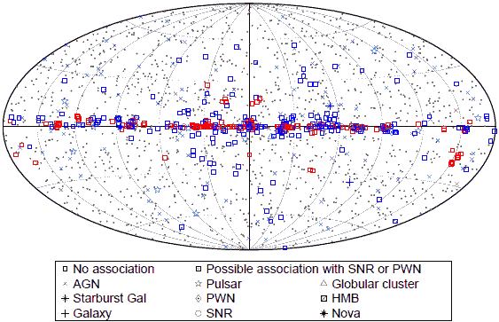
HE gamma ray astronomy: catalog of sources
2FGL catalogue published in 2012
1873 sources, mostly pulsars/PWN/SNR (~100), AGNs (~1000)
575 unidentified sources

Slide 5
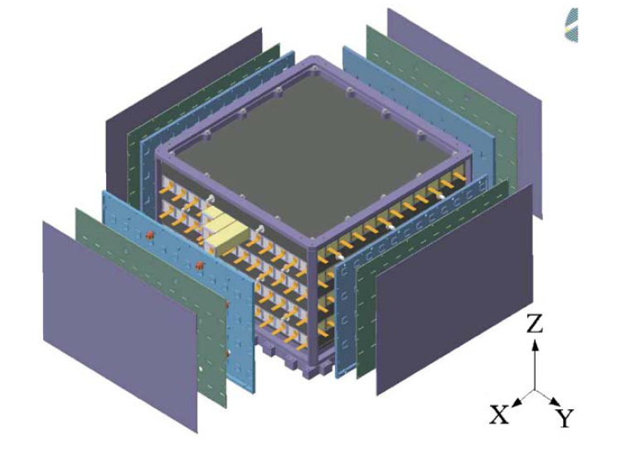
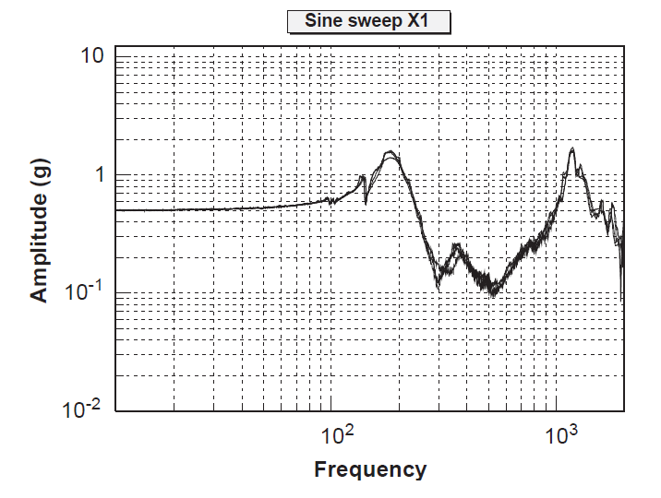
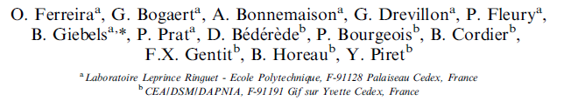
Designing and testing the LAT calorimeter
IRFU/LLR collaboration on the design and tests of the LAT calorimeter
(“environmental tests”, response).
(NIMA, 2004)

Slide 6
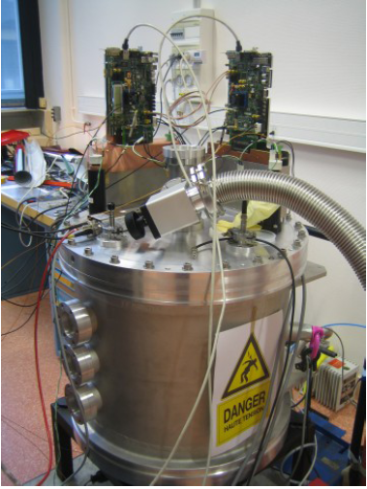
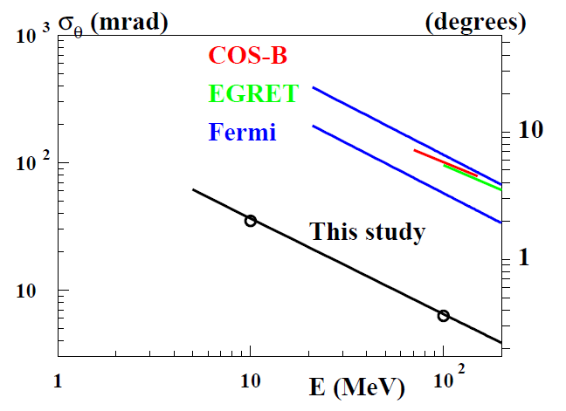
HE γ ray astronomy: after Fermi-LAT
HARPO project
High pressure TPC
High angular resolution+ polarimetry
1 MeV < E < 1GeV
validation with polarized photons
(SPring8, Japan)
LLR/IRFU collaboration

Slide 7
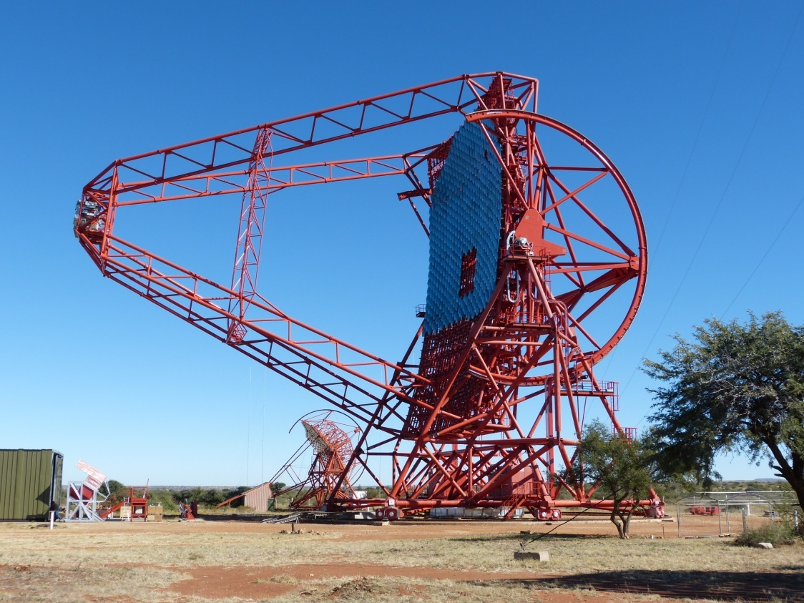
VHE γ ray astronomy: present
participation to H.E.S.S
international team, ~ 130
members
4+1 IACT (Cherenkov)
array in Namibia
50 GeV < E < 50 TeV
major competitors:
MAGIC, VERITAS
data taking started 2003
HESSS @ Paris-Saclay:
LLR: 10 physicists/engineers
IRFU: 9 physicists/engineers

Slide 8
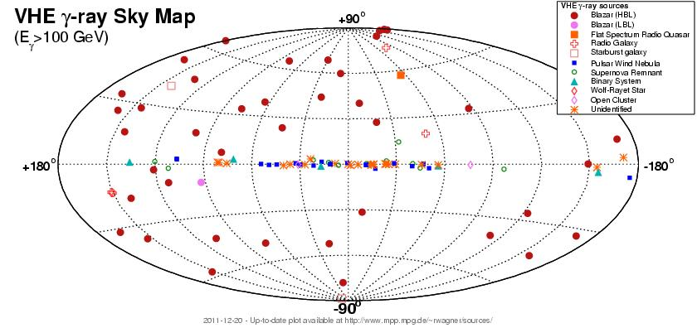
VHE gamma-ray astronomy: catalog of sources
The VHE gamma-ray sky (November 2011)
http://www.mppmu.mpg.de/~rwagner/sources/
~100 sources (60 galactic)

Slide 9
Study of the 2FGL unidentified sources
2FGL unidentified sources list could be searched as dark matter
clump candidates or “dark accelerators”
H.E.S.S.2 can provide a very large exposure on these sources and could
help associating them to known objects
Opportunity of a Fermi (LLR)/HESS (IRFU) collaboration
Proposal submitted to P2IO:
“Unidentified high energy Fermi sources and HESS2: dark matter
or dark accelerator?”

Slide 10
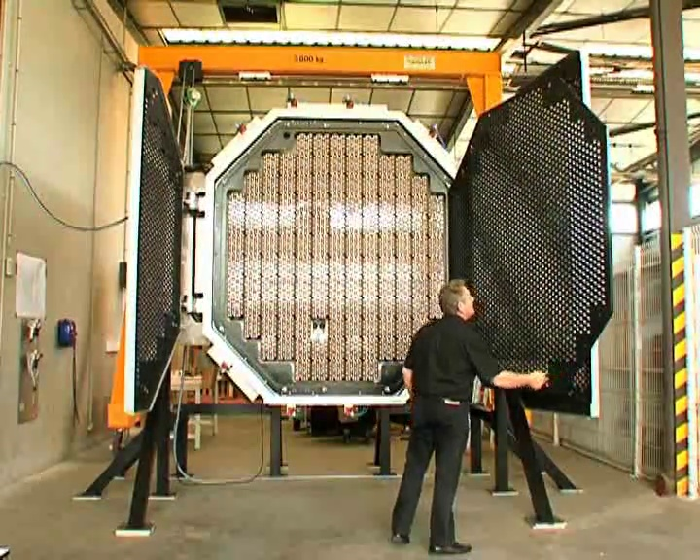
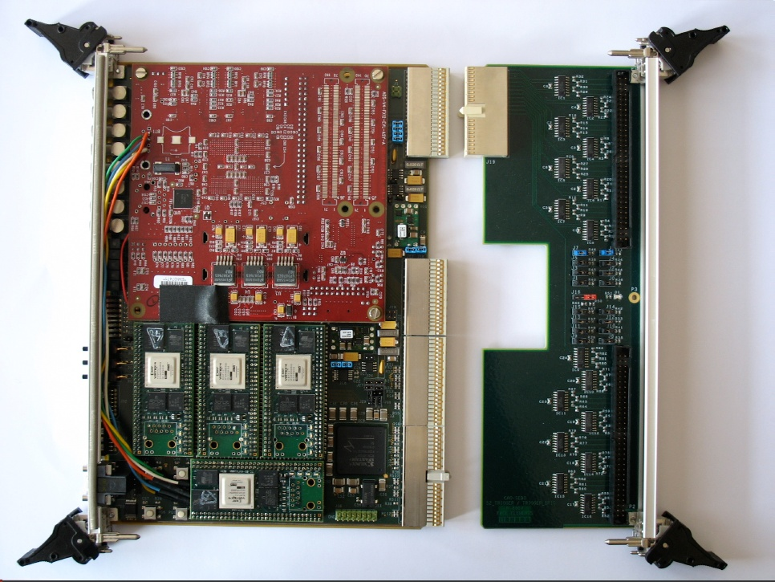
Technical activities on HESS2
mechanical design of the HESS/HESS2 camera by the LLR
contribution of the IRFU to the FE electronics of the camera (SAM chip)
IRFU/LLR collaboration of the Level2 trigger board
Front of the HESS2 camera
Level 2 trigger board of HESS2

Slide 11
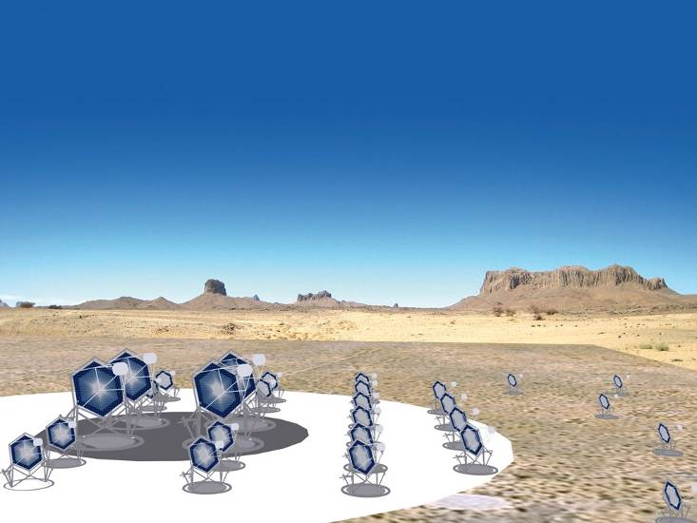
The next generation of IACTs: CTA (2015)
2 arrays: north+south
→ all-sky coverage
core array
100 GeV-10 TeV
23 ø=12 m telescopes
low energy section
E_{thresh} ~ 10 GeV
4 ø=23 m telescopes
high energy section
32 ø=5-6 m tel.
on 10 km² area

Slide 12
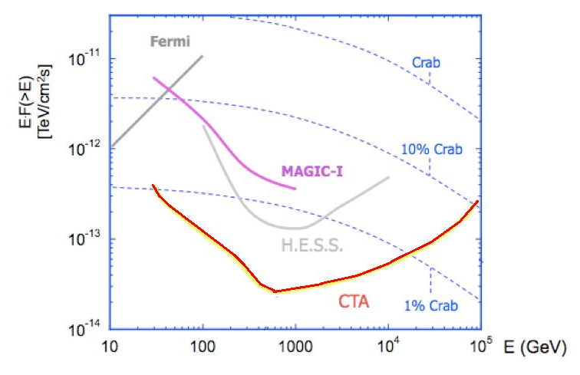
Sensitivity of CTA
energy range increase
x 10 flux sensitivity gain
Flux sensitivity for a 50 h observation

Slide 13
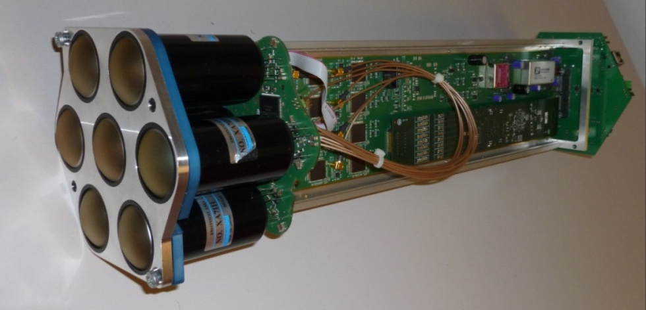
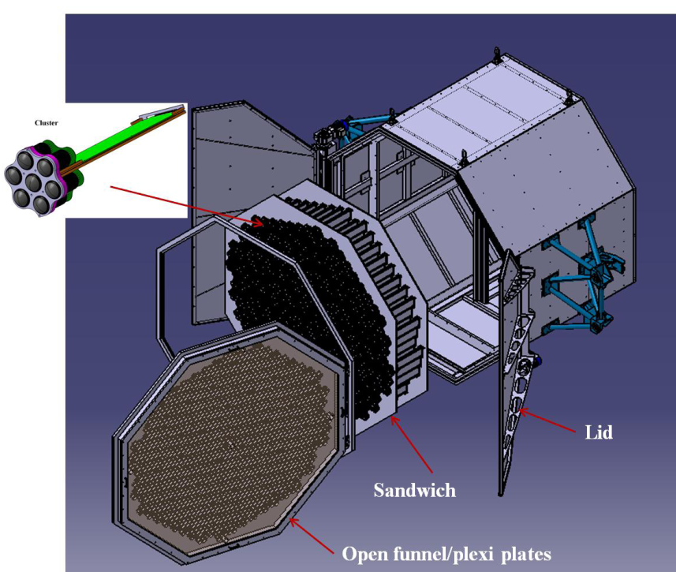
Cherenkov Telescope Array
NECTAr module (IRFU/LPNHE/LUPM/Barcelona)
Very large international project
(> 1000 members,27 countries)
Large french involvement (~ 35 FTE)
CTA@Paris-Saclay:
IRFU: ~20 physicists/engineers
LLR:~10 physicists/engineers
Technical involvement:
-IRFU: NECTAr project (camera modules)
mirrors, MST telescope design, site..
-LLR: MST camera,..
-IRFU/LLR collaboration on the NECTArCam
camera project
NECTArCam camera

Slide 14
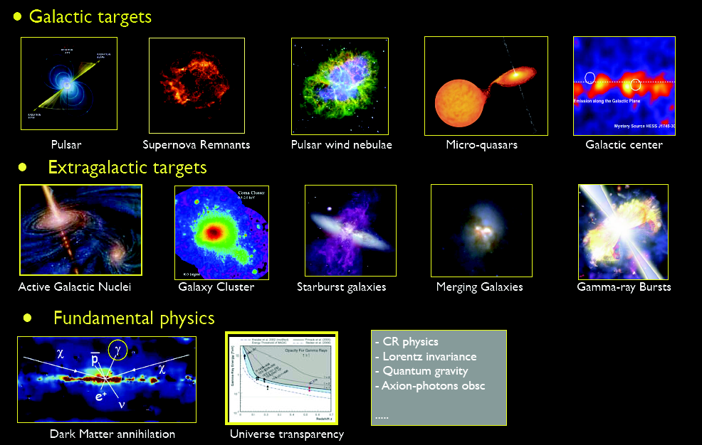

Slide 15
Physics with the HE/VHE photons
Cosmic ray acceleration
Black holes
« Symétries dans le monde subatomique »
Lorentz invariance
« Composants sombres de l'Univers »
Indirect searches for dark matter
Searches for exotic particles and objects (axions, primordial
black holes)
Cosmology:
  compact objects, gravitational lenses..
  extragalactic background light

Slide 16
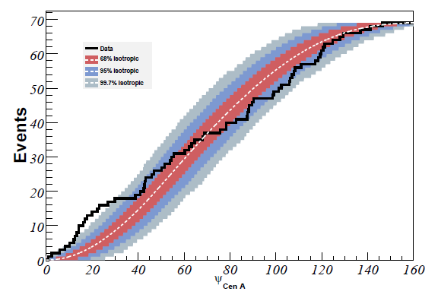
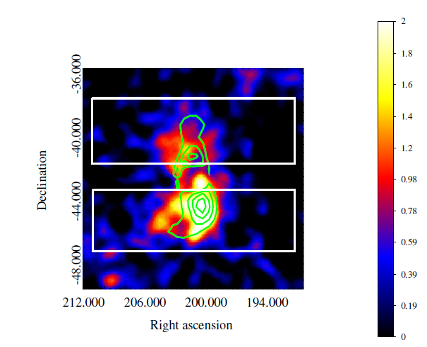
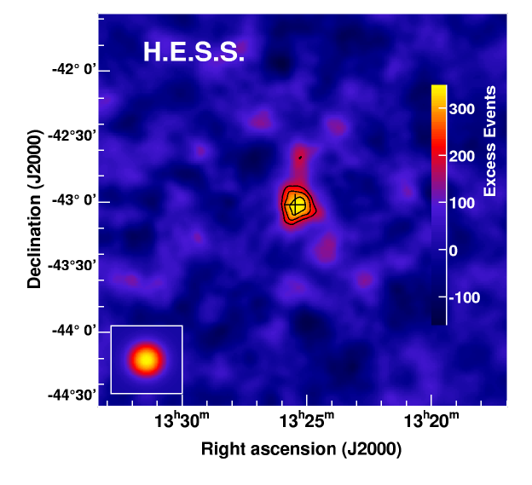
Understanding the origin of UHE cosmic rays
Excess UHE cosmic rays seen around
Cen A radiogalaxy by AUGER
possible source: lobes of Cen A
multiwavelength observation with
HESS, Fermi
Exemple of a possible collaboration
between AUGER (IPN), HESS and
Fermi (LLR,IRFU)
Auger
Fermi

Slide 17
Tests of Lorentz invariance
Tests of the energy dependence of the photon velocity (expected in
some quantum gravity theories)
Parametrization:
(with M_{1,2} ~ M_{planck} )
One expects an energy dependent arrival time of photons (simultaneous
emission asumed).
Sensitivity to M₁ (M₂):
AGN with Cerenkov telescopes, z~0.1, Δ t ~ 1mn, E~1 TeV,
M₁~10¹⁸ GeV
GRB with Fermi, z ~ 1, Δ t ~ 1s, E~30 GeV,
M₁~10¹⁹ GeV

Slide 18
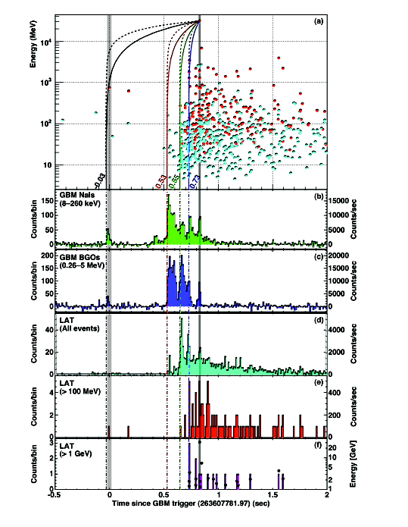
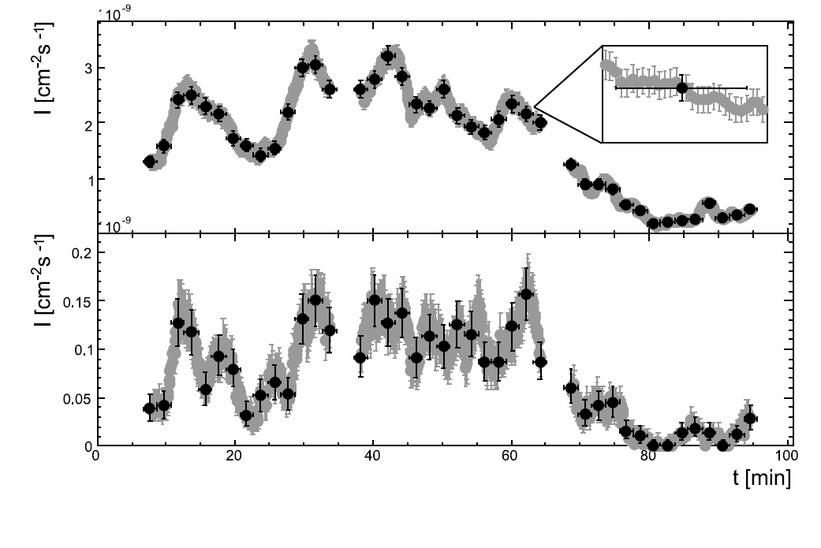
Lorentz invariance tests in practice
AGN PKS 2155-304 (HESS)
M₁ > 2.1 10¹⁸ GeV
Observation of GRB (Fermi), M₁ > 1.4 10¹⁹ GeV

Slide 19
Indirect DM searches with IACTs
WIMP annihilation flux into γ rays observed by an IACT:
particle model
f^{AP}: dark halo model
Most current particle models:
  neutralinos (MSSM)
  U Extra Dimensions (Servant, Tait 2003) boson B
  leptophilic models (PAMELA excess)
  decaying dark matter
Astrophysical factor:
⇒ dense targets
Galactic Center
nearby dwarf galaxies, globular clusters
galaxy clusters (Fornax)
dark matter clumps

Slide 20
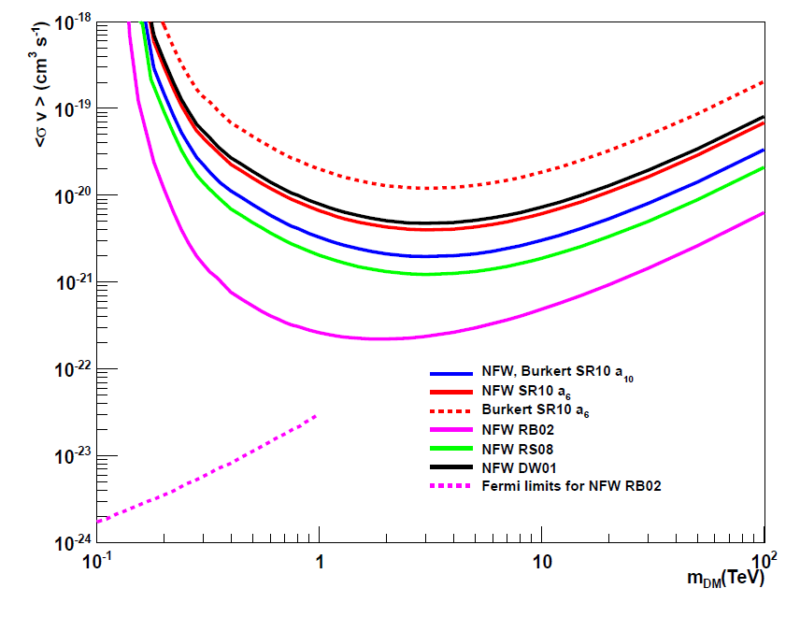
H.E.S.S. results on Fornax cluster: WIMPs exclusion
A. Abramovski et al. (HESS collaboration), ApJ 2012

Slide 21
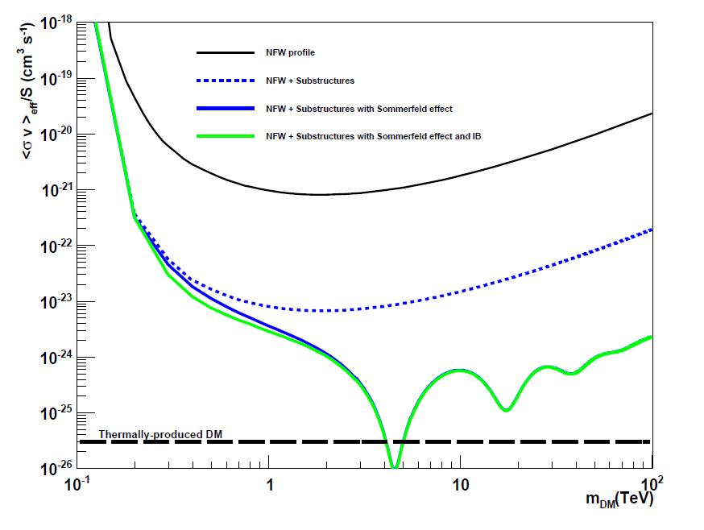
H.E.S.S. results on Fornax cluster with boosts
Excluded 95% CL

Slide 22
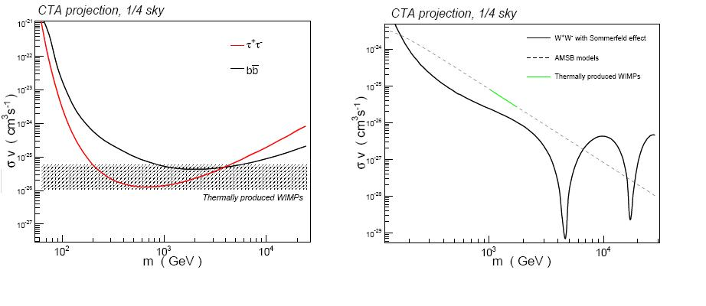
Expected <σv> limits with clumps and CTA (1/4 sky)
1/4 survey in ~ 370 hours
assume 5 10⁻¹³ cm⁻²s⁻¹ sensitivity (5 hour/bin)
number of subhalos: 3907±324
thermal WIMPs region reachable
P.Brun, E.Moulin,J.Diemand, J-F.G, PRD 83, 015003 (2011)

Slide 23
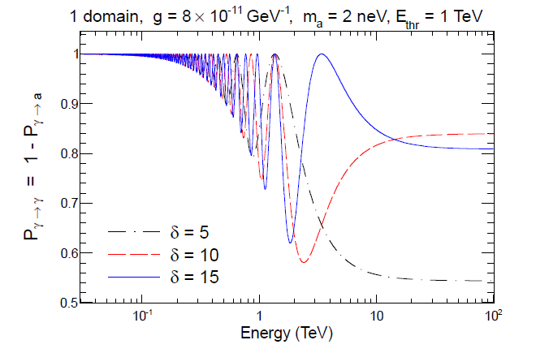
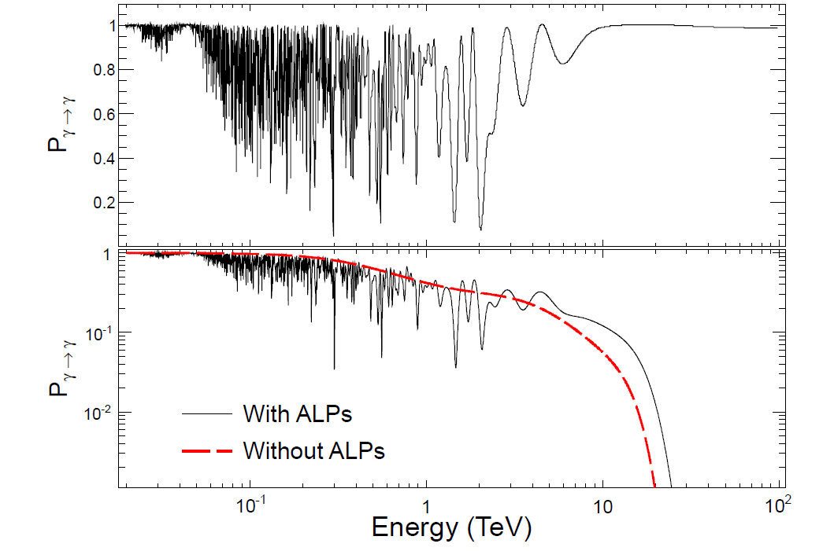
Cosmic signatures of axion-like particles
Cosmic magnetic fields affect the propagation of high energy photons
if coupled to hypothetic axions.
Signature of axion-photon coupling: “rugged” spectra
(Wouters and Brun 2012)
might provide a hint or a constraint on axions if the cosmic magnetic
field is modeled properly.

Slide 24
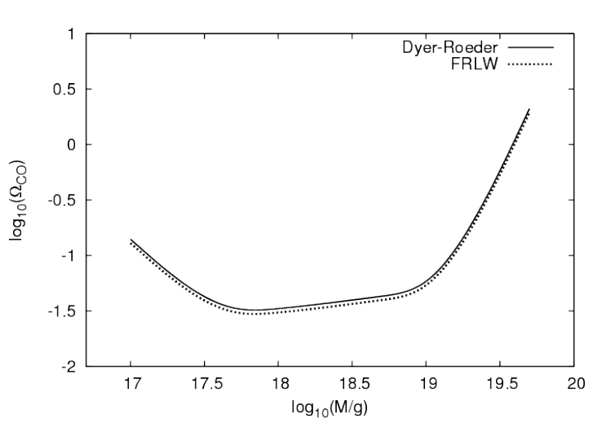
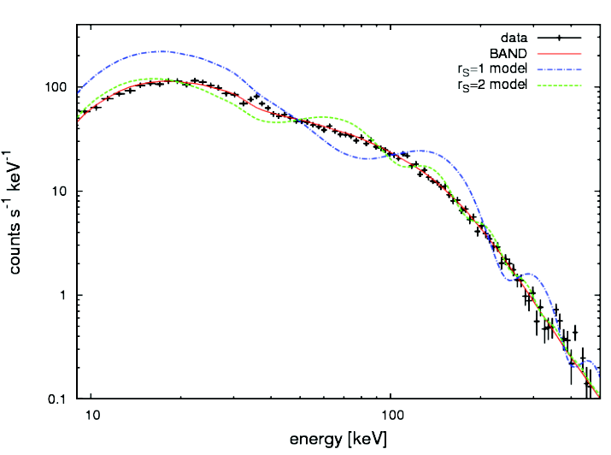
Cosmology with gravitational lensing
  Hubble constant from macrolensing time delays
First gravitational lens system (PKS1830) seen with Fermi-LAT
(A.Barnacka et al, ApJ 2011)
improvement of time delay due to the large time coverage of Fermi
improvement in measurement of H0 from lenses.
Density of very low mass compact objects (PBHs) from femtolensing
(A.Barnacka et al, 2012, PRD sub. )
large number of GRB detected by Fermi-GBM
improved spectral reconstruction
Excluded 95% CL
Simulated femtolensed GRB
density of compact objects

Slide 25
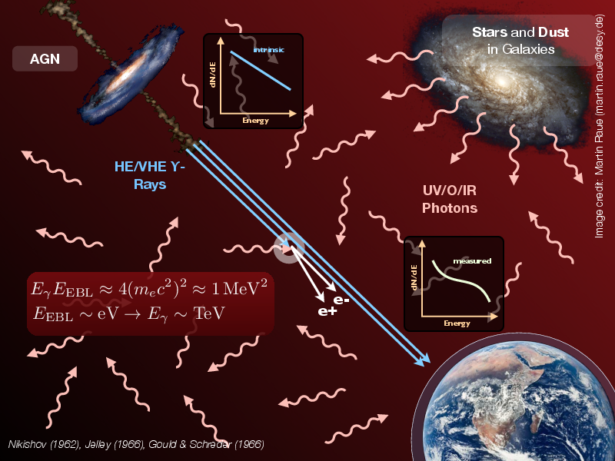
Cosmology: Extragalactic background light

Slide 26
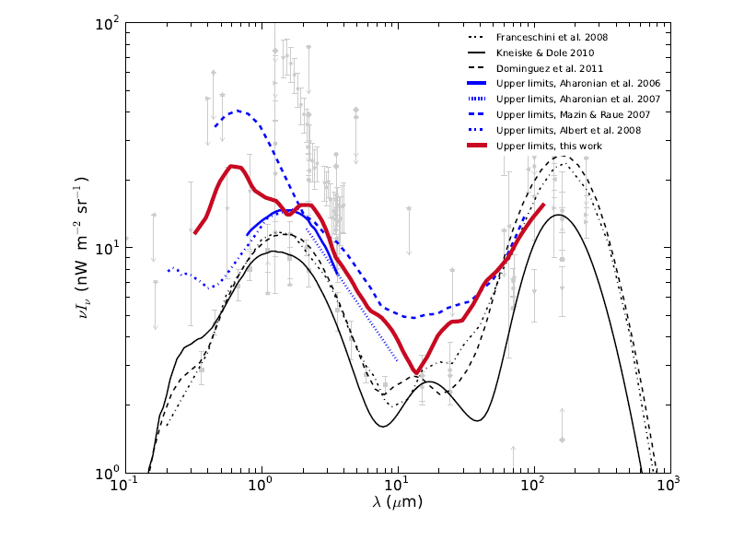
The EBL “crisis”
Upper limits from TeV blazars
predictions
Meyer et al (2012)
predictions from IR light close to UL from TEV blazars
⇒ Universe seems more transparent to TeV γ than previously thought
“conventional” explanation: population evolution in galaxies
other more exotic explanation:
Lorentz invariance violation, axions-γ oscillation

Slide 27
Conclusion and outlook
Labs from the Paris-Saclay campus, mostly IRFU and LLR have been
involved in HE/VHE astronomy for 25 years, successfully collaborating
in projects such as Fermi-LAT, HESS and CTA.
The main physics goals are the study of cosmic ray acceleration and
black holes.
Some physics goals of HE/VHE astronomy are contained in 2 of the
scientific themes of P2IO:
  fundamental tests (Lorentz invariance)
  dark components of the Universe (Dark Matter, axions, cosmology)
Strong collaborations can be easily reinforced between IRFU and LLR
with subjects such as the study of unidentified objects from HE catalogs
Collaborations with other teams from the Paris-Saclay campus could be
developed on themes such as the study of UHE cosmic rays.

