Slide 1
Presentation of the thematic
P2 (dark components of the Universe)
F. Couchot (LAL) & H. Dole (IAS)
with a help from E. Armengaud, Ph. Brax, C. Charmousis, N. Palanque-Delabrouille... and extra slides from rencontres de prospective 2012 Irfu/In2p3 – Giens
P2IO Scientific Council , June 27-28 2012

Slide 2
CSPD – P2
Eric Armengaud (Edelweiss – Irfu)
Christos Charmousis (LPT)
François Couchot (Planck – LAL)
Hervé Dole (Planck – IAS)
about 40 post-doc applications/yr (22% for P2)
~8 post-doc funded/yr (2/13=15% for P2)

Slide 3
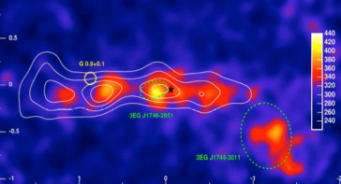
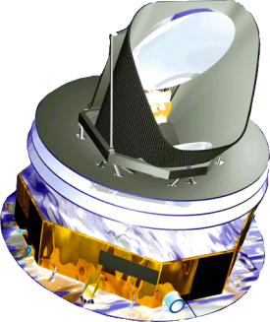
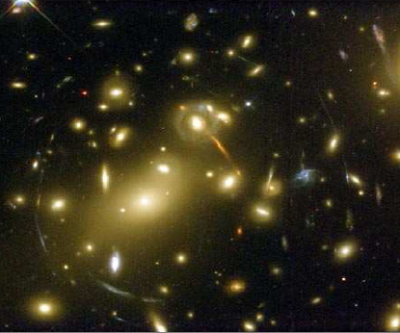
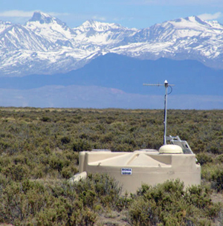
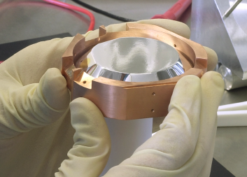
P2IO-P2 Dark stuff
JEM-Euso
HESS/CTA
EUCLID
Planck
LSST
BOSS
eBOSS
BigBOSS
AUGER
SNLS
Edelweiss/Eureca
 | Theory | Direct searches | Indirect searches | Observ. cosmo | TOTAL
CSNSM |  | 8 |  |  | 8
LAL |  |  | 5 | 20 | 25
IRFU | 7 | 5 | 4 | 18 | 34
LPT | 10 |  |  |  | 10
IPHT | 7 |  | 1 |  | 8
LLR |  |  | 13 |  | 13
IPN |  |  | 5 |  | 5
IAS |  | 3 |  | 22 | 25
TOTAL | 24 | 16 | 28 | 60 | 128
Notes:
expériences en cours (blanc) ou à venir (jaune)

Slide 4
Cosmological probes:
CMB, BaO, weak lensing, SN1a,
BBN
Large Scale Structure Formation
Recombination
Tests of gravitation at all scales
Constrains on • properties of components of the universe
• variations of fundamental constants
first generation of stars - Reionization
Inflation

Slide 5
SN - Irfu
SNLS @ CFHT uses Irfu-made MegaCam
arXiv:1104.1443v1
perspective:
full data set (5 years) to be published in 2015

Slide 6
CMB – IAS,Irfu & LAL
Planck P2IO PIship (IAS – J.L. Puget)
early papers Jan. 2011
first release + temp. cosm. paper spring 2013
full release + cosm. paper incl. polar. 2014
1 post-doc P2IO on S/Z clusters
Partnership with Space agencies (CNES, ESA)

Slide 7
Free electrons
Seen in WMAP and Planck LFI bands due to synchrotron radiation in galactic magnetic field
Seen by Fermi due to inverse Compton effect of photons from the InterStellar Radiation Field (ISRF) on the same electrons
Confirmation of galactic haze already seen by WMAP and Fermi (see Gregory Dobler arXiv:1109.4418v2)
Planck - F.C. - BLOIS 2012
Notes:
publications passées et à venir

Slide 8
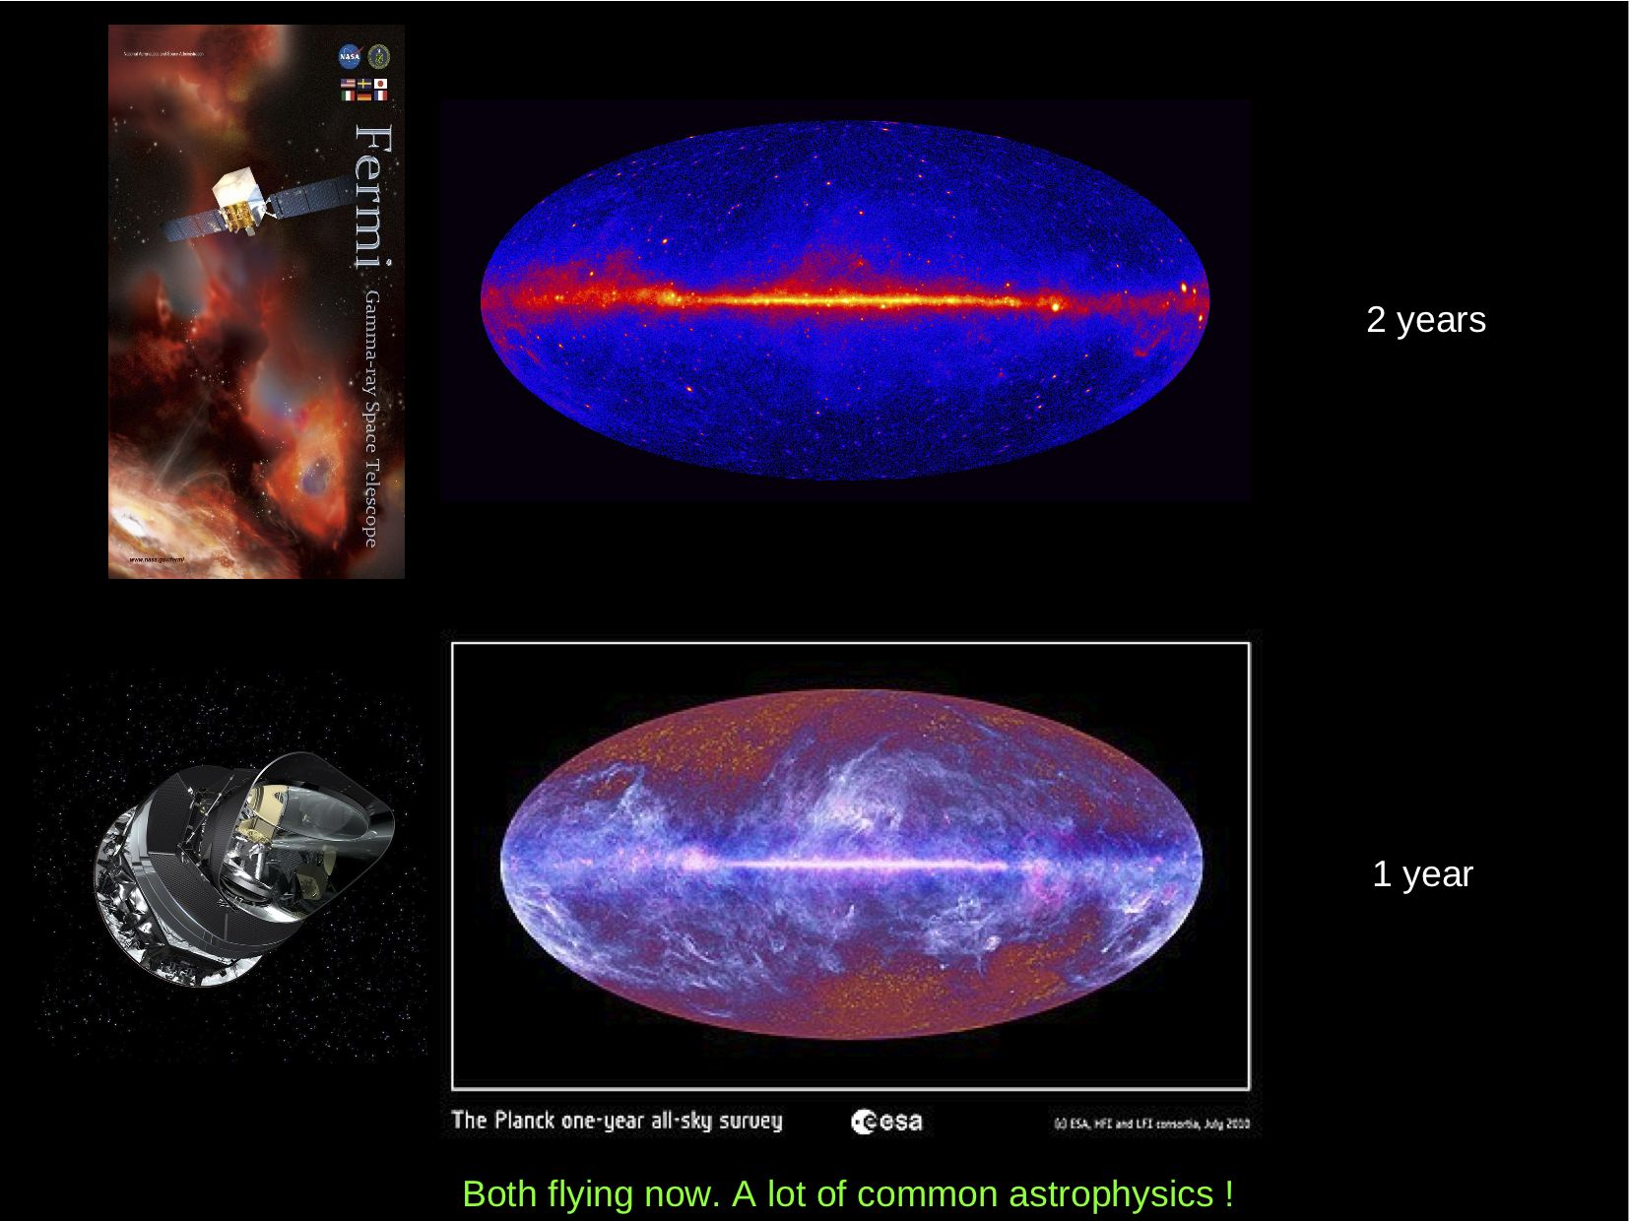
Slide taken from Planck Paris 2011
Planck - F.C. - BLOIS 2012
Notes:
publications passées et à venir

Slide 9
Planck - F.C. - BLOIS 2012
Borrowed from Planck 2012 – Bologna – K. Gorski
Notes:
publications passées et à venir

Slide 10
BOSS-Irfu
first papers July 2012
data taking until 2014

Slide 11
Future BAO

Slide 13
Euclid & LSST (IAS, Irfu, LAL)

Slide 14
Dark matter annihilation in our Galaxy (Fermi/Planck)
Dark matter annihilation in galactic haloes
Dark matter direct search on Earth
DM annihilation
in early universe
(Planck)
+ Cosmic ray origin & multi-messenger searches

Slide 15
Dark matter direct search
Edelweiss – Irfu/Csnsm – P2IO strong
Edw-II data taking ended 2010. Published in 2011, combined edw-cdms limit
Edw-III goal 3000 kg.days sensibilité 5x10⁻⁹ pb ~ Xenon100 goal. Present work: upgrade cryo/electronics/shielding + Detector fab. & optim.
Physics results expected in 2013.
P2IO post-doc.
R&D light+heat bolometers IAS-CSNSM P2IO funding.

Slide 20
Dark matter indirect searches
Cosmic rays: Irfu & LRR, IPN&LAL
CMB

Slide 22
Theory / IPhT & LPT - CPHT
Gravitation & Cosmology
primordial inflation – CMB, non gaussianities
Grav. waves prod. beyond SM
Cosmological magnetic fields
Clustering induced by Dark energy
modified gravitation
effects on Large Scale Struct. form.
astro/cosmo & laboratory tests
math class. gravitation
Higher order effects of perturb.
astroparticles & extra dim. phenomenology
Dark matter models & indirect det.

Slide 23
P2IO actions - P2
Post-docs
1 for Planck/Clusters
1 for DM
R&D
S. Marnieros Bolometry new generation
V. Tatischeff Compton telescope new generation
D. Bernard gamma ray Polarimetry
1 one-year position "Attractivity"
B. Van Tant (LPT) : Modified gravity and cosmological perturbations (P2)
Scientific animation: Dark Energy Workshop (LAL, dec. 2011)

Slide 24
Conclusion
Very active fields
Well balanced groups between subthemes
New commonalities between ≠ probes
Future projects on the way (e.g. recent Euclid selection by ESA)

Slide 25
Irfu, LRR

Slide 26
IPN, LAL

Slide 27
LAL

Slide 28
LAL

