Slide 1
Presentation of the Accelerators’ Thematics
B. Launé IN2P3/IPNO
P2IO Scientific Council , June 27-28 2012

Slide 2
Scope of R&D on Accelerators
Guides:
Energy, Intensity/luminosity, Efficiency, Reliability, Applications
Challenges :
High Gradient, High Magnetic Fields, High Intensity
R&D, Participation to projects
Breakthroughs within 10 years : reliable operation of high intensity accelerators, 13 T magnet successful test, reproducible laser/wake field acceleration

Slide 3
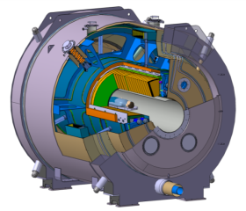
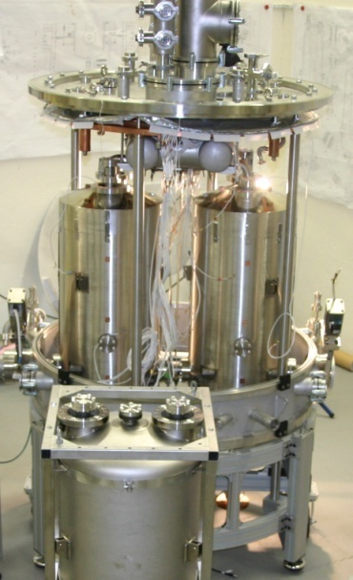
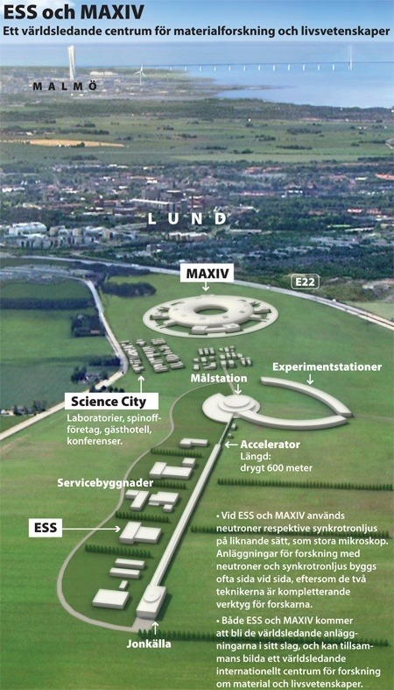
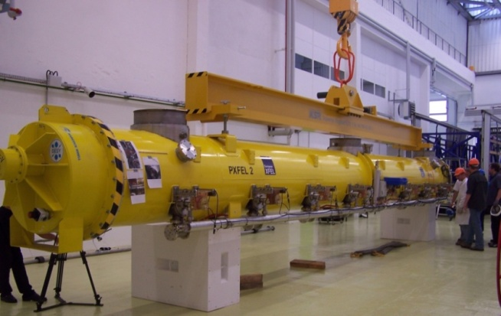
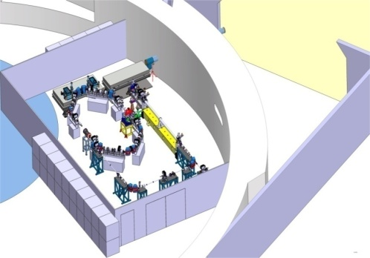
Main projects in which P2IO labs are involved
Main projects: SPIRAL2, XFEL, FAIR, CERN, ESS, Andromede, ThomX, CILEX, IFMIF/EVEDA, MYRRHA
P2IO teams main partners in these projects
CEA/CNRS « Pôle Accélérateur » : coordination for CERN and FAIR
Coordinated action for ESS
R&D : high magnetic fields (IRFU), hign intensity (IRFU, IPNO), high brightness (LAL), high field (IRFU, IPNO), Laser/wake field (IRFU, LAL, LLR)
Application: ThomX, Andromede (EQUIPEX)

Slide 4
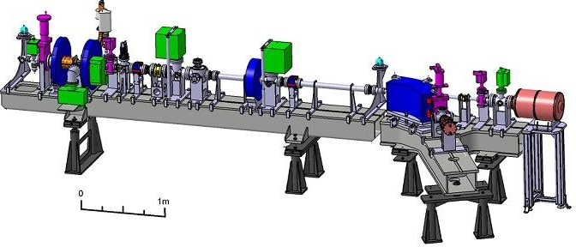
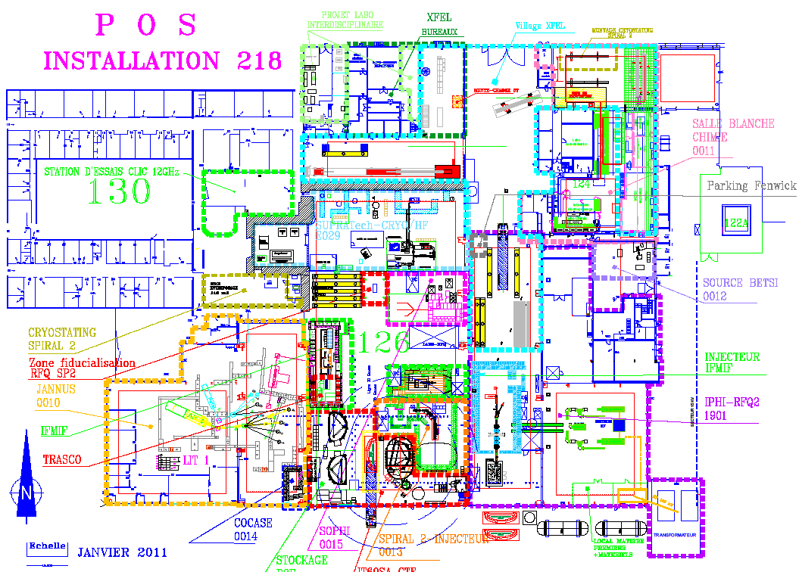
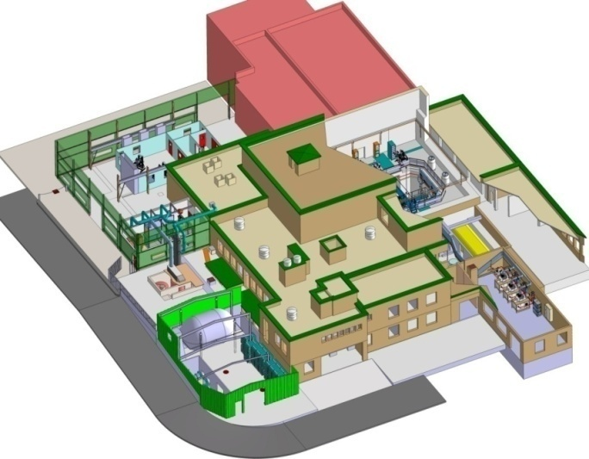
P2IO strengths in the domain
Around 200 persons involved in accelerators
Most of Accelerator R&D in France
Most R&D Platforms (SUPRATech-Orsay/Saclay, PHIL, ALTO IPHI….)
Synergy between P2IO labs through CEA/IRFU and CNRS/IN2P3
Common strategy
IPNO, LAL, IRFU, CSNSM, LLR involved
Most fields and expertises covered
Teaching at master level

Slide 5
P2IO actions (ongoing and future)
Support by P2IO for post-docs and projects
Three accelerator R&D projects funded by P2IO in 2011
One post-doc for accelerator projects funded by P2IO in 2011
Next international conference on Superconducting RF
Taking advantage of P2IO impulse

Slide 6
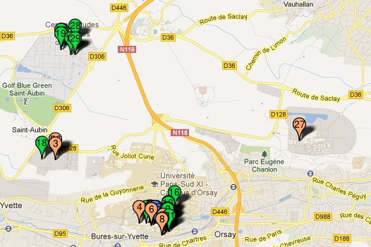
Conclusion
Strong involvement in R&D for accelerators
High percentage of the manpower and Technical platforms for accelerator R&D
Clear roadmap for the coming years
Strengthen collaborations through P2I0

