Slide 1
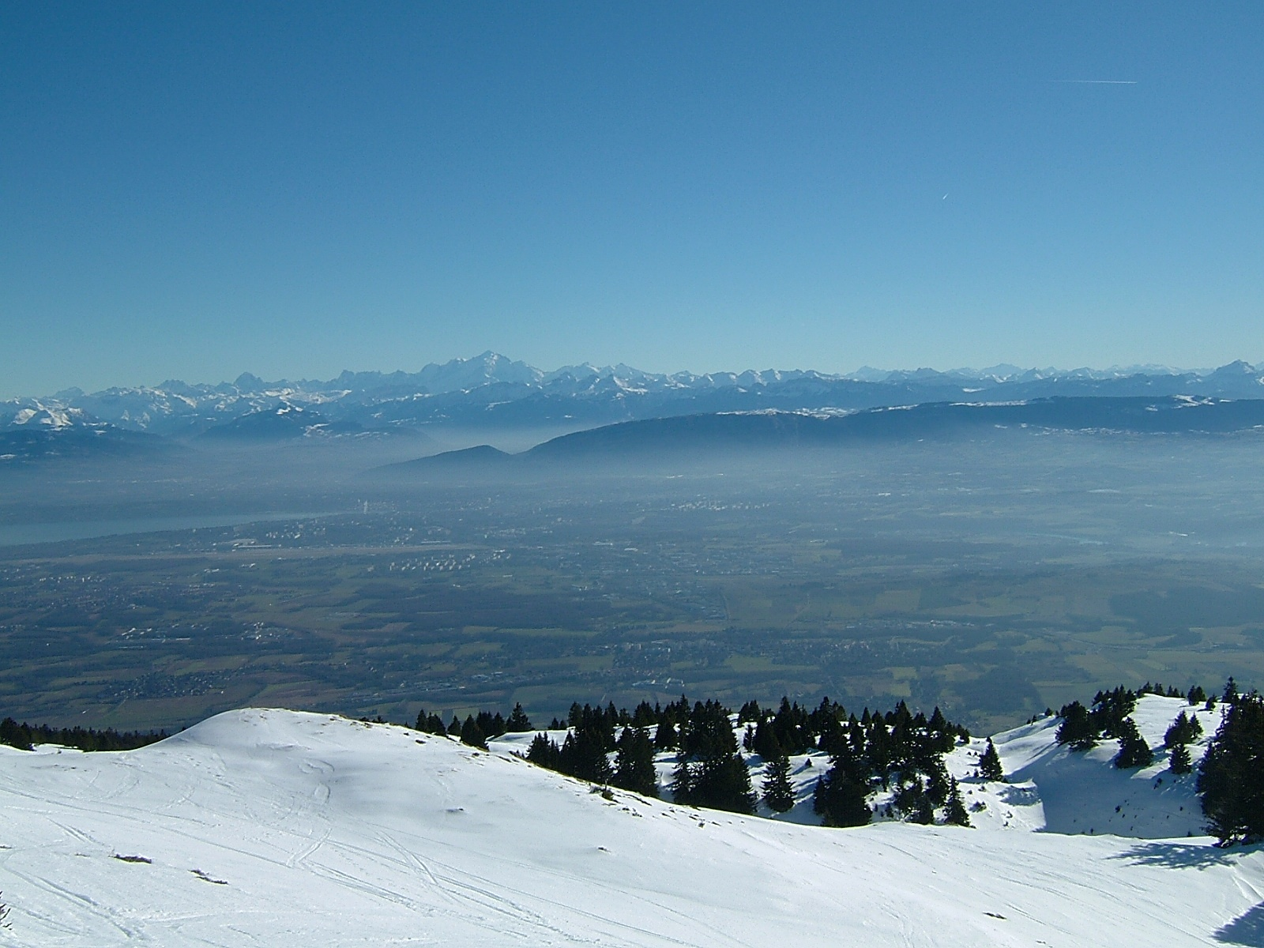
The LHC Machine
Jörg Wenninger
CERN Beams Department
Operations group
GIF 2012 – Physique au LHC

Slide 2
Outline
LHC machine
High luminosity ingredients
High intensity issues
Performance 2010-2012
Proton-Lead
LHC after long shutdown

Slide 3

The Large Hadron Collider LHC
Installed in 26.7 km LEP tunnel
Depth of 70-140 m
Lake of Geneva
LHC ring
CMS, Totem
LHCb
Control Room
SPS ring
ATLAS, LHCf
ALICE

Slide 4
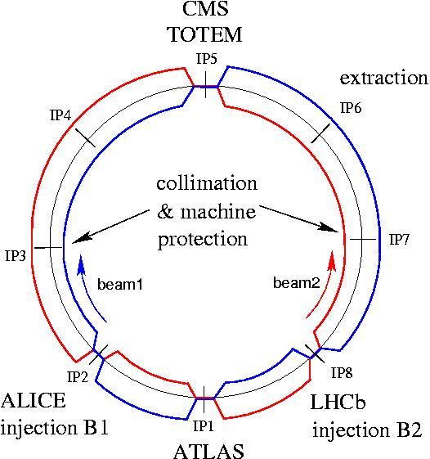






LHC layout and parameters
RF
Total length 26.57 km, in the former LEP tunnel.
8 arcs (sectors), ~3 km each.
8 long straight sections (700 m each).
beams cross in 4 points.
2-in-1 magnet design with separate
vacuum chambers → p-p collisions.

Slide 5
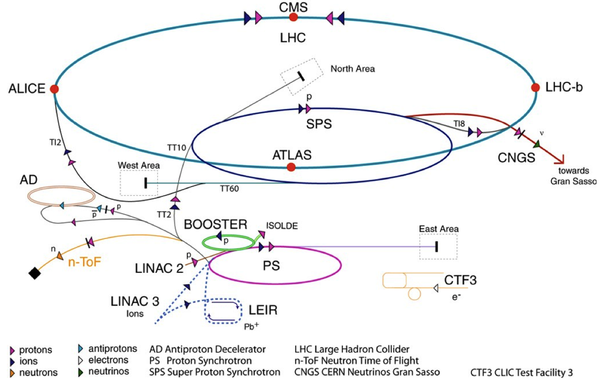
LHC accelerator complex
≥ 7 seconds from source to LHC
Beam 1
Beam 2
TI8
TI2
 | Max. P (GeV/c) | Length / Circ. (m)
LINAC2 | 0.050 | 30
Booster | 1.4 | 157
PS | 26 | 628=4 x PSB
SPS | 450 | 6’911=11 x PS
LHC | 7’000 | 26’657=27/7 x SPS
LHC proton path

Slide 6
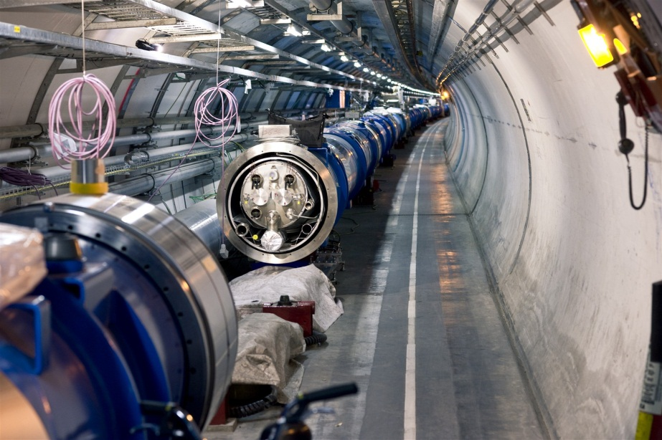
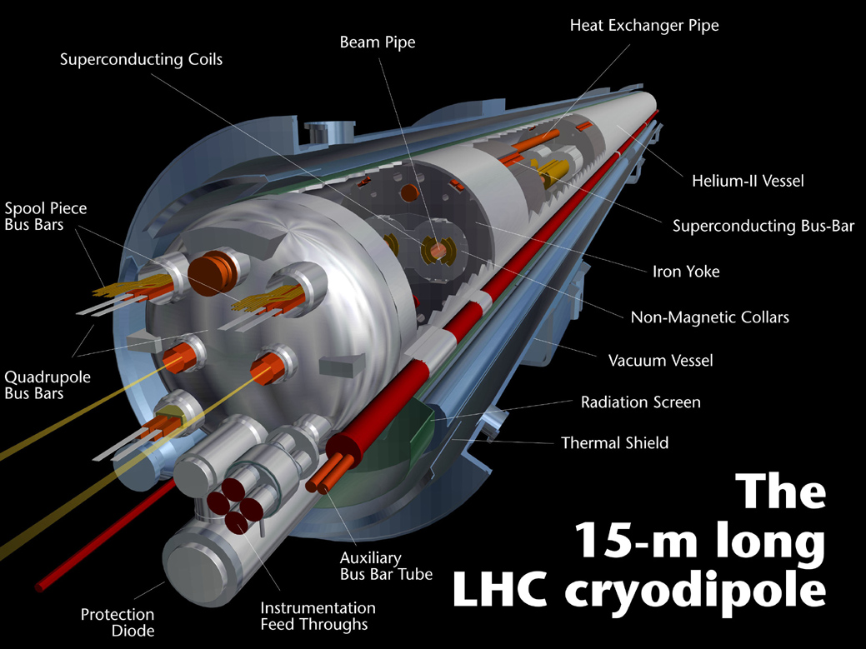
LHC dipole magnet
1232 dipole magnets.
B field 8.3 T (11.8 kA) @ 1.9 K (super-fluid Helium)
2 magnets-in-one design : two beam tubes with an opening of 56 mm.
Operating challenges:
  Dynamic field changes at injection.
  Very low quench levels (~ mJ/cm³)

Slide 7
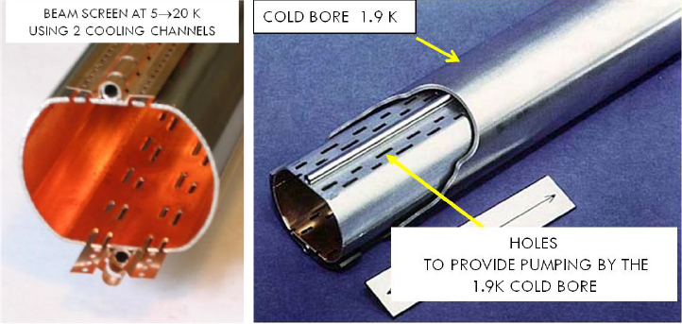
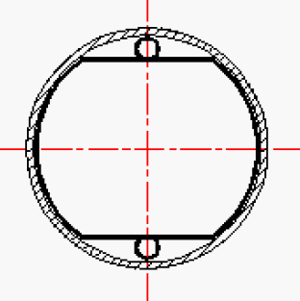
Vacuum chamber
The beams circulate in two ultra-high vacuum chambers, P ~10⁻¹⁰ mbar.
A Copper beam screen protects the bore of the magnet from heat deposition due to image currents, synchrotron light etc from the beam.
The beam screen is cooled to T = 4-20 K.
Beam screen
Magnet bore
Cooling channel (Helium)

Slide 8
LHC energy: the way down
When
Why
All main magnets commissioned for 7TeV operation before installation
Detraining found when hardware commissioning sectors in 2008
  5 TeV poses no problem
  Difficult to exceed 6 TeV
Machine wide investigations following S34 incident showed problem with joints
Waiting for new
Quench Protection System
(nQPS)
7 TeV
2002-2007
Design
12 kA
5 TeV
Summer 2008
Detraining
9 kA
3.5 TeV
Late 2008
Joints
Spring 2009
6 kA
1.18 TeV
Nov. 2009
nQPS
2 kA
450 GeV

Slide 9
LHC target energy: the way up
When
What
Train magnets
  6.5 TeV is in reach
  7 TeV will take time
Repair joints
Complete pressure relief system
Taking a slightly higher risk
  Excellent experience in 2010/11
Commission nQPS system
7 TeV
2014/5
Training
6 TeV
Good joints
2013
4 TeV
2012
3.5 TeV
2011
nQPS
2010
1.18 TeV
2009
450 GeV

Slide 10
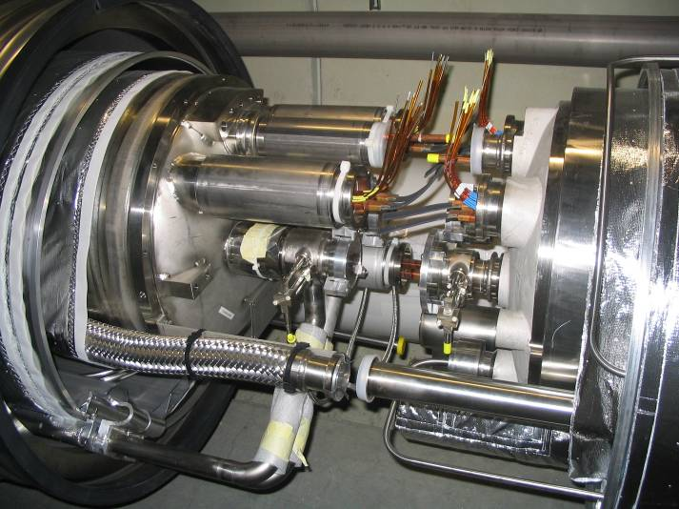
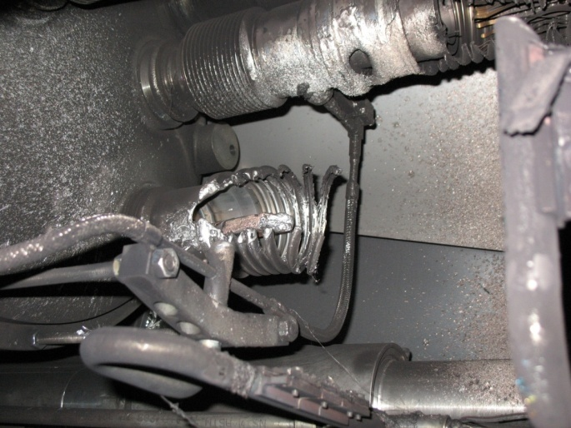
Magnet Interconnection
Melted by arc
Dipole busbar

Slide 11

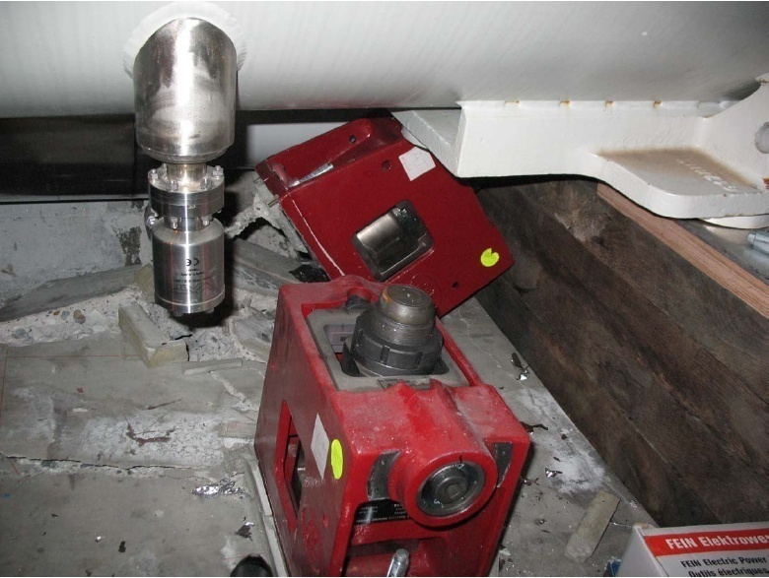
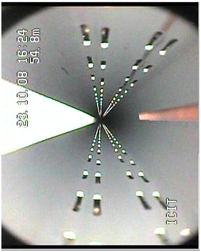
Collateral damage
Quadrupole-dipole interconnection
Quadrupole support
Sooth clad beam vacuum chamber
  Main damage area covers ~ 700 metres.
  39 out of 154 main dipoles,
  14 out of 47 main quadrupoles
  from the sector had to be moved to the surface for repair (16) or replacement (37).

Slide 12
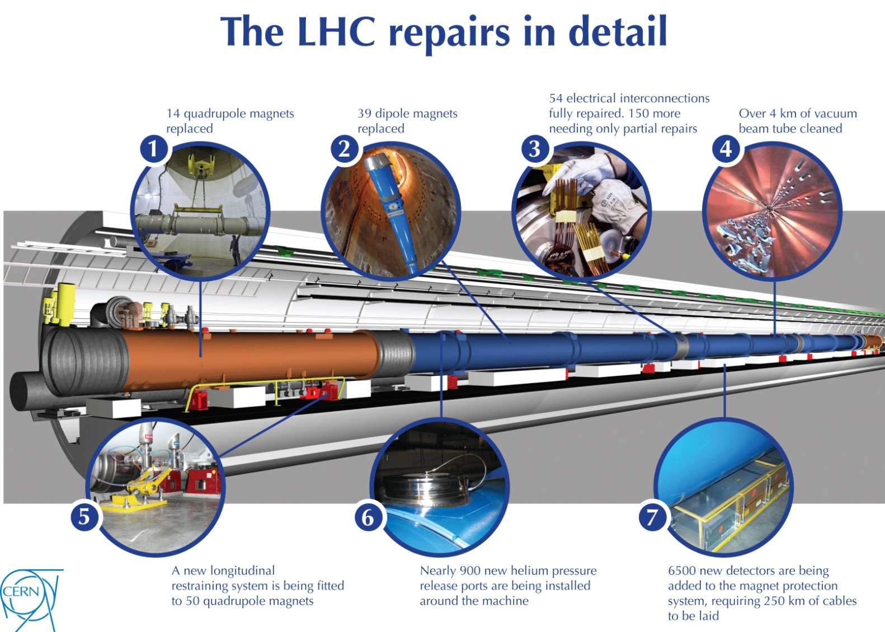
LHC repair and consolidation
14 quadrupole magnets replaced
39 dipole magnets replaced
204 electrical inter-connections repaired
Over 4km of vacuum beam tube cleaned
New longitudinal restraining system for 50 quadrupoles
Almost 900 new helium pressure release ports
6500 new detectors and 250km cables for new Quench Protection System to protect from busbar quenches
Collateral damage mitigation

Slide 13
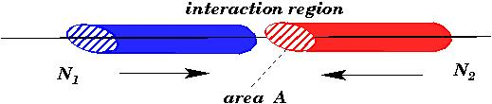
Luminosity figure-of-merit
The event rate N for a physics process with cross-section σ is proprotional to the collider Luminosity L:
Design
k = number of bunches = 2808
N = no. protons per bunch = 1.15×10¹¹
f = revolution frequency = 11.25 kHz
σ*_{x},σ*_{y} = beam sizes at collision point (hor./vert.) = 16 μm
  To maximize L:
  Many bunches (k)
  Many protons per bunch (N)
  Small beam sizes σ*_{x,y}= (β *ε)^{1/2}
  β * : beam envelope (optics)
  ε : beam emittance, the phase space volume occupied by the beam (constant along the ring)
High beam “brillance” N/ε
(particles per phase space volume)
→ Injector chain performance !
Optics property
Small envelope
→ Strong focusing !
Beam property

Slide 14
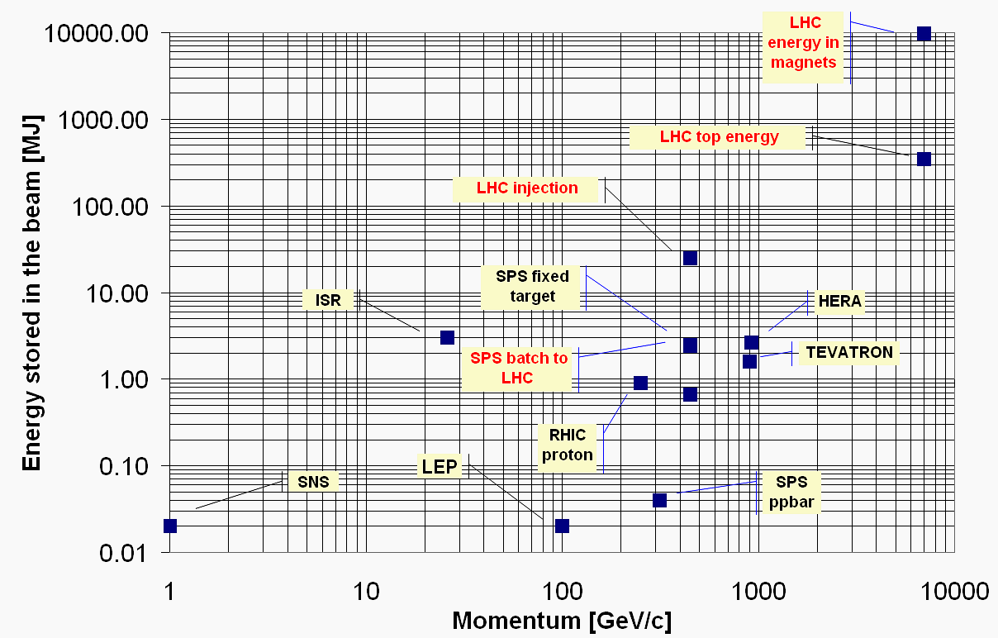
Stored energy
Increase with respect to existing accelerators :
A factor 2 in magnetic field
A factor 7 in beam energy
A factor 200 in stored beam energy
LHC 2012
Damage threshold

Slide 15

To set the scale…
A few cm long groove in a SPS vacuum chamber after the impact of ~1% of a nominal LHC beam (2 MJ) during an ‘incident’

Slide 16
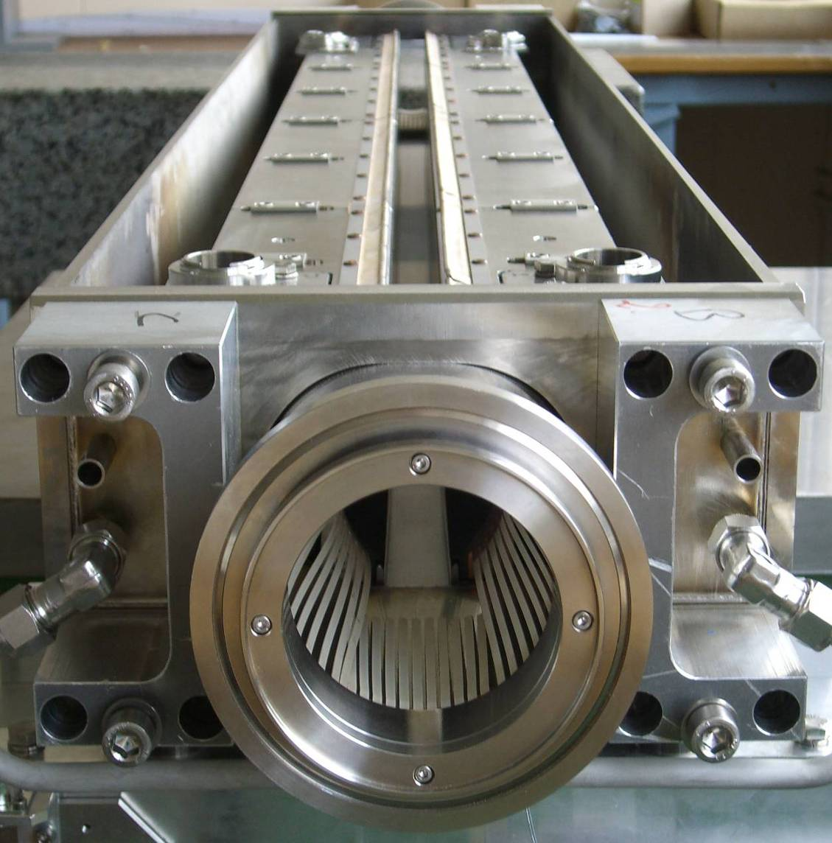
Collimation
To operate at nominal performance the LHC requires a large and complex collimation system
  Previous colliders used collimators mostly for experimental background conditions - the LHC can only run with collimators.
Ensure ‘cohabitation’ of:
  100’s of MJ of stored beam energy,
  super-conducting magnets with quench limits of few mJ/cm³
Almost 100 collimators and absorbers.
Alignment tolerances <0.1 mm to ensure that over 99.99% of the protons are intercepted.
Primary and secondary collimators are made of Carbon to survive large beam loss.
1.2 m
beam

Slide 17
Collimation system
TCLA7
TCS6/
TCDQ
TCT
Aperture
σ calculated with emittance = 3.5μm
TCP
TCS7
Kicked
beam
5.7 σ_{n} 8.5 σ_{n} 17.7 σ_{n} 9.3 σ_{n} 15.0 σ_{n} 17.5 σ_{n}
5.7 σ_{n} 8.5 σ_{n} 17.7 σ_{n} 9.3 σ_{n} 11.8 σ_{n} 14.1 σ_{n}
4.3 σ_{n} 6.3 σ_{n} 8.3 σ_{n} 7.1 σ_{n} 9.0 σ_{n} 10.5 σ_{n}
6.0 σ_{n} 7.0 σ_{n} 10.0 σ_{n} 7.5 σ_{n} 8.3 σ_{n} 8.4 σ_{n}
2010, β*=3.5m, 3.5 TeV
2011, β*=1.0m, 3.5 TeV
2012, β*=0.6m, 4 TeV
Nom, β*=0.55m, 7 TeV
Primary halo
beam
Secondary
halo
Courtesy of R. Bruce
Tertiary
halo
Complex and high performance multi-stage collimation system.
Collimator position hierarchy has to be respected in order to achieve satisfactory protection and beam halo cleaning.
  Excellent performance of collimation at LHC – not a single magnet was quenched from beam losses, low backgrounds.

Slide 18
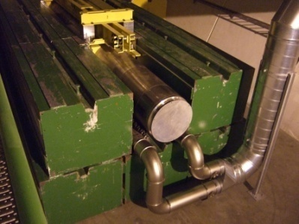
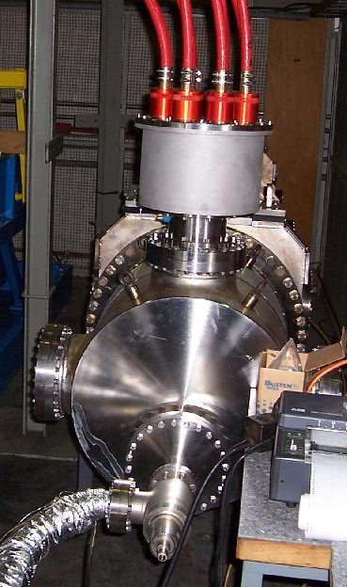
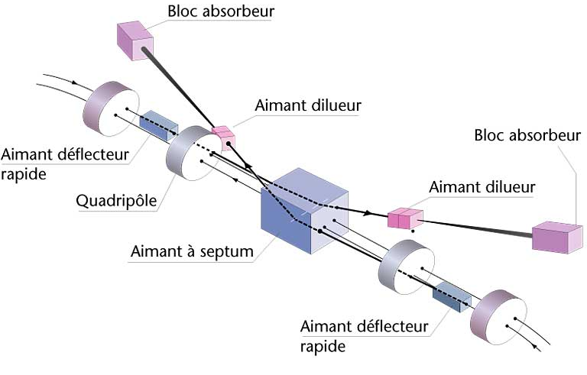
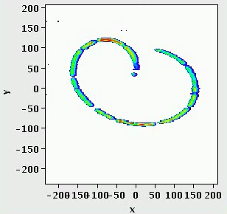
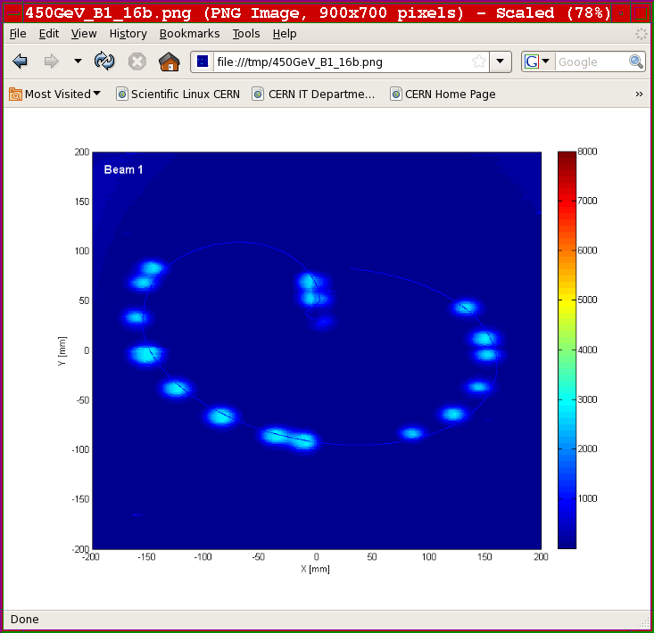
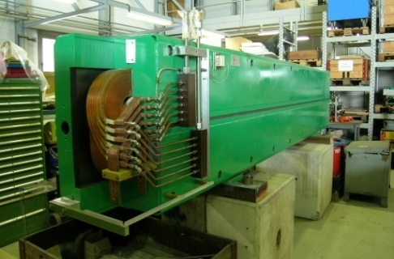
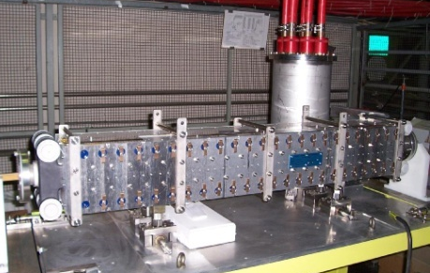
Beam dumping system
The dump is the only LHC element capable of absorbing the nominal beam.
  Beam swept over dump surface (power load).
Dump block
Ultra-high reliability and fail-safe system.
Dilution kickers
700 m
Extraction septum magnets
Extraction kickers
30 cm

Slide 19
Outline
LHC machine
High luminosity ingredients
High intensity issues
Performance 2010-2012
Proton-Lead
LHC after long shutdown

Slide 20
From the basis…
The luminosity formula (head-on collision,round beams):
  f is the revolution frequency (11.25 kHz), γ = E/m,
  k is the number of colliding bunch pairs,
  N is the bunch population,
  F is a geometric (loss) factor (≤ 1) from the crossing angle,
  ε is the normalized emittance, β* the betatron (envelope) function at the IP,
  σ is the beam size at IP:
(Round beams)

Slide 21
Interaction regions geometry
In the IRs, the beams are first combined into a single common vacuum chamber and then re-separated in the horizontal plane,
The beams move from inner to outer bore (or vice-versa),
The triplet quadrupoles are used to focus the beam at the IP.
Machine geometry in H plane
D2
D2
beam1
D1
D1
beam2
Triplet
Triplet
IP
194 mm
~ 40 m
beam2
beam1
~ 260 m
D1,D2 :
separation/recombination dipoles
Common vacuum chamber

Slide 22
Separation and crossing
To prevent undesired parasitic collisions in the region where the beams circulate in the common vacuum chamber:
Parallel separation in one plane (mostly effective at the IP), which is collapsed to 0 when the beams are colliding,
Crossing angle in the other plane.
 | α (μrad)
ATLAS | -145 / ver.
ALICE | 145 / ver.
CMS | 145 / hor
LHCb | 90 / ver
4 mm (450 GeV)
1.3 mm (4 TeV)
4 TeV / 2012 !
~ 8 mm
α
Not to scale !

Slide 23
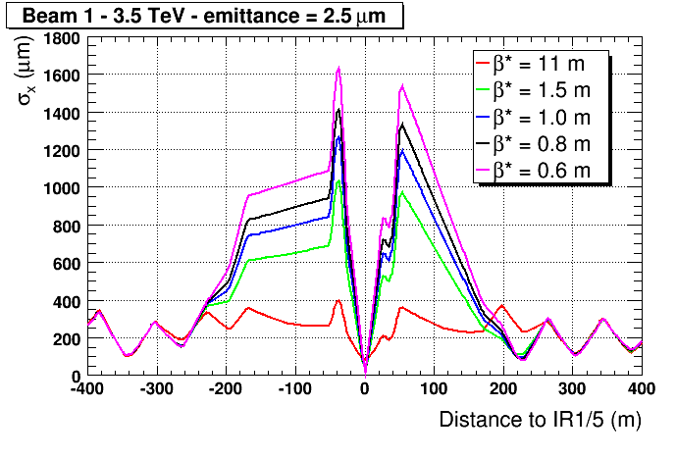
β* and beam size at IP
The focusing at the IP is defined by β* , which describes the beam envelope (optics) and which relates to the beam size σ.
  Note that the beam size shrinks with energy !
β* is limited by the aperture of the triplet quadrupoles around the collision point and by the retraction margins between collimators.
  Smaller σ at the IP implies:
  → Larger beam divergence (phase space conservation !)
  Faster beam size growth in the space from IP to first quadrupole !
  Larger beam size around the IP

Slide 24
Limits on β*
In the high luminosity IRs, the triplet quadrupoles define the machine aperture limit for squeezed beams, and β* is constrained by:
  the beam envelope,
  a margin between the tertiary collimators (TCT) and the triplet ,
    ⇒ must fit in the overall collimator hierarchy
  the crossing angle – separation of the beams at the parasitic encounters.
TCT
Triplet
Triplet
TCT
≥10.5 σ
9 σ
~ 8 mm
TCT
TCT=Tertiary Collimator

Slide 25
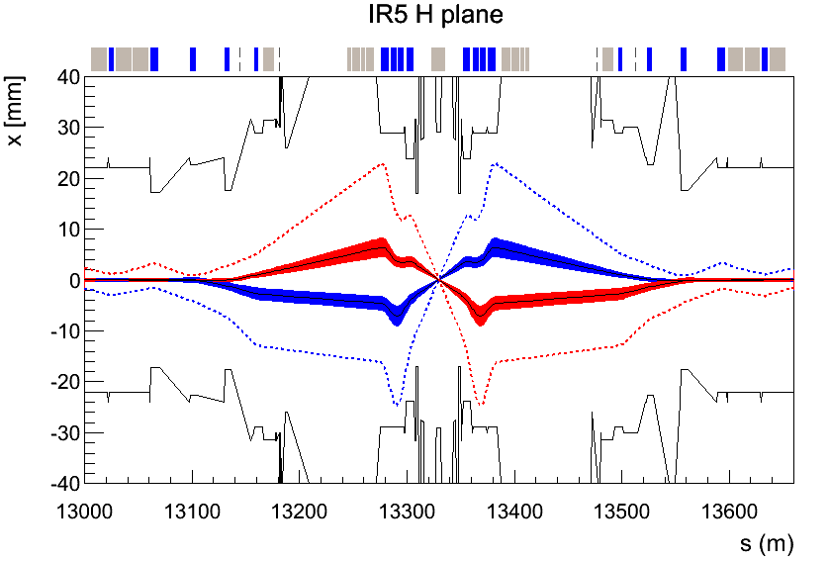
β* evolution
Date | β* (m) | Reason
Startup 2011 | 1.5 | Interpolation of aperture measurement at 450 GeV
Sept. 2011 | 1.0 | Aperture measurement at 3.5 TeV
2012 | 0.6 | 4 TeV (-0.1 m) and tighter collimator settings
TCT @ 9 σ
TCT @ 9 σ
  1σ beam envelopes
  9σ extreme beam envelopes
  1.5σ margin to triplet
  emittance = 3.5 μm,
  β* =0.6m

Slide 26
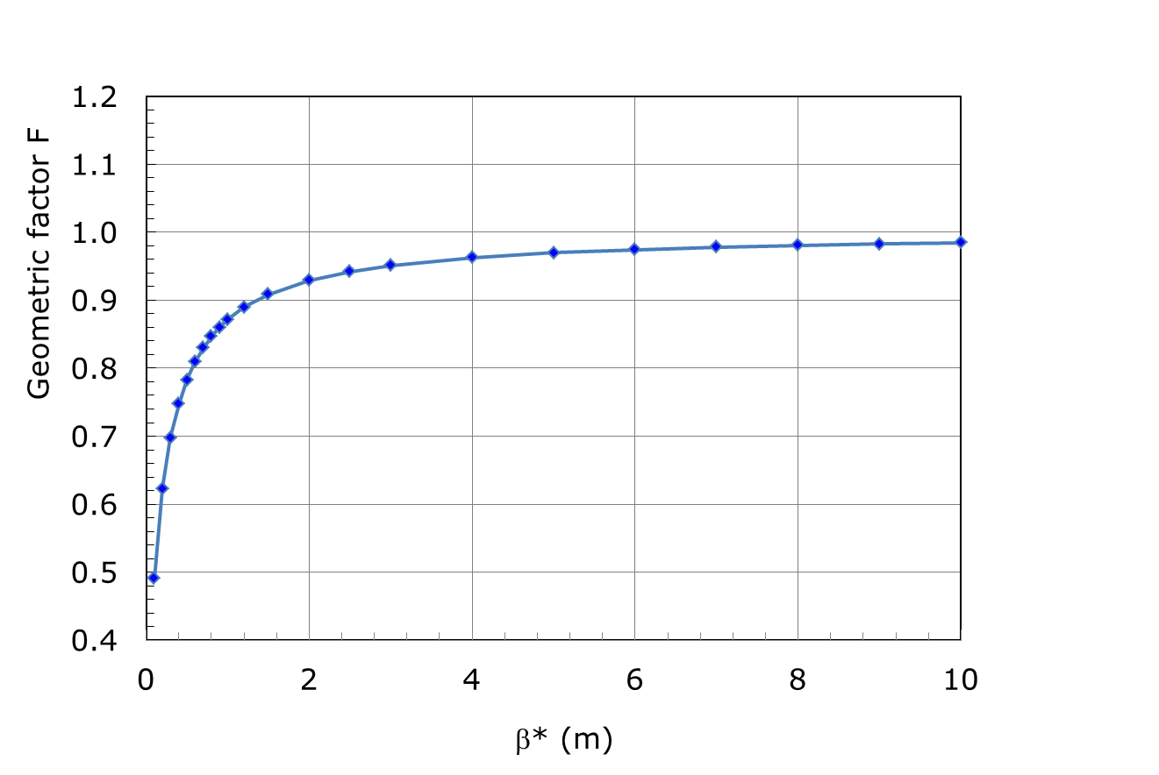
Geometric luminosity factor
With the current low emittances and small β* the geometric reduction factor due to bunch length σ_{s} and crossing angle becomes significant.
  Will get even stronger at 6.5-7 TeV.
  Fix with ‘Crab cavities’ (maybe !) for HL-LHC.
β* = 0.6 m → F = 0.81
x/y
s
ε = 2.3 μm
α = 145 μrad
2α

Slide 27
Bunch filling schemes
The LHC 400 MHz Radio-Frequency system provides 35’640 possible bunch positions every 2.5 ns (0.75 m) along the LHC circumference.
  A priori any of those positions could be filled with a bunch…
The smallest bunch-to-bunch distance is fixed to 25 ns: max. number of bunches is 3564 (- some space for the dump kicker beam free region).
The LHC can operate with isolated bunches or with trains of closely spaced bunches.
  Startup 2010 : up to 50 isolated bunches (separation ≥ 1 μs).
  Fall 2010 : 150 ns spacing - up to 368 bunches.
  2011 : start-up with 75 ns spacing, now 50 ns (1380 bunches).
2.5 ns
…
25 ns
= filled position
= bunch position
27

Slide 28
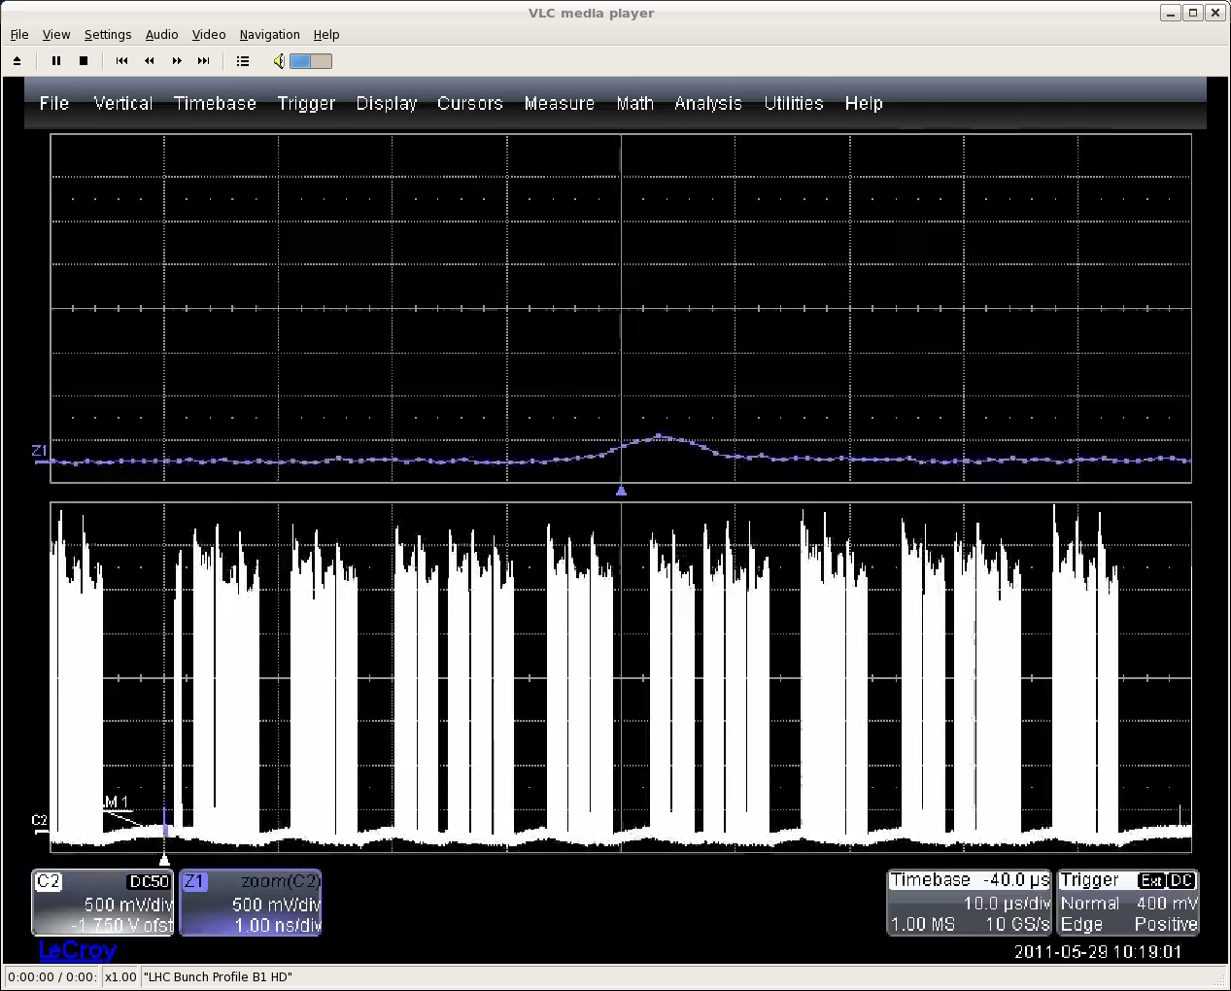
1092 bunches with 50 ns spacing
Beam 1
Beam abort
gap (3 μs)
6 or 12 bunch intermediate injection
RMS bunch length ~ 9 cm
LHC circumference

Slide 29
Bunch spacing
50 ns bunch spacing is used operationally since April 2011.
  Progressive increase of the bunch number and the bunch intensity over 2011 and 2012 (intensity).
The 50 ns beam has the highest luminosity potential.
  25 ns beam is more difficult to operate (→ see later).
LHC beam parameters (SPS extraction)
Spacing | N (p/bunch) | ε [μm] | Relative bunch luminosity
150 ns | 1.1 x 10¹¹ | 1.6 | 1.5
75 ns | 1.2 x 10¹¹ | 2.0 | 1.4
50 ns | 1.65 x 10¹¹ | 1.8 | 2.9
25 ns | 1.2 x 10¹¹ | 2.8 | 1

Slide 30
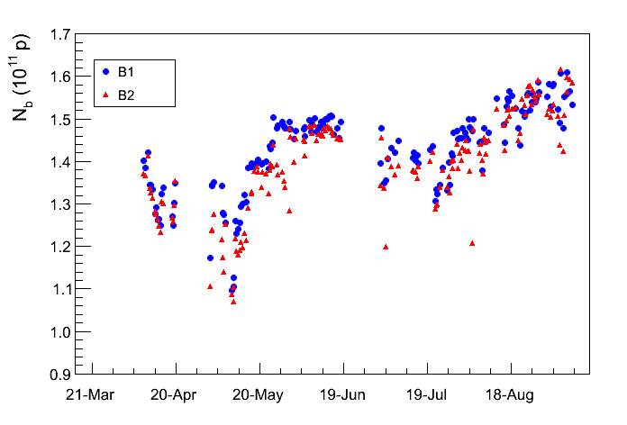
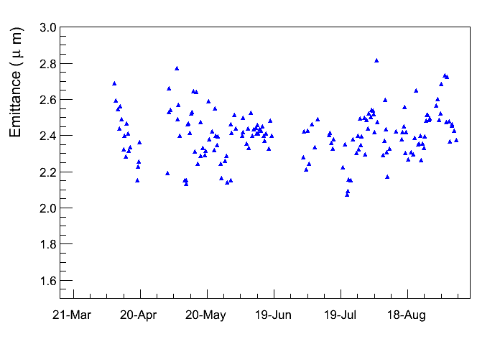
Bunch parameters 2012
1.5×10¹¹
Bunch intensities when beams are brought in collisions are now > 1.5×10¹¹ p.
  But we are at the limit of what can be delivered out of the PS.
Emittances are relatively stable around 2.4 μm.
2.4
450 GeV: 1.6 - 1.9 μm

Slide 31
Outline
LHC machine
High luminosity ingredients
High intensity issues
Performance 2010-2012
Proton-Lead
LHC after long shutdown

Slide 32
High intensity beam issues
  With 50 ns operation and with stored intensity of ≥ 2x10¹⁴ protons (1380 bunches), issues related to high intensity and tight collimators have affected LHC operation in 2011 and 2012:
    Vacuum pressure increases,
    Heating of elements by the beam induced fields (injection kickers, collimators, lately also synchrotron light mirrors),
    Losses due to dust particles falling into the beam (UFO),
    Beam losses due to tails,
    Beam instabilities leading to emittance blow-up.
  The last 2 issues had an important impact on machine efficiency in 2012, leading to a number of total beam losses.
    2012: Lost 35 fills due to those issues.
    2011: Only 1 fill lost.

Slide 33
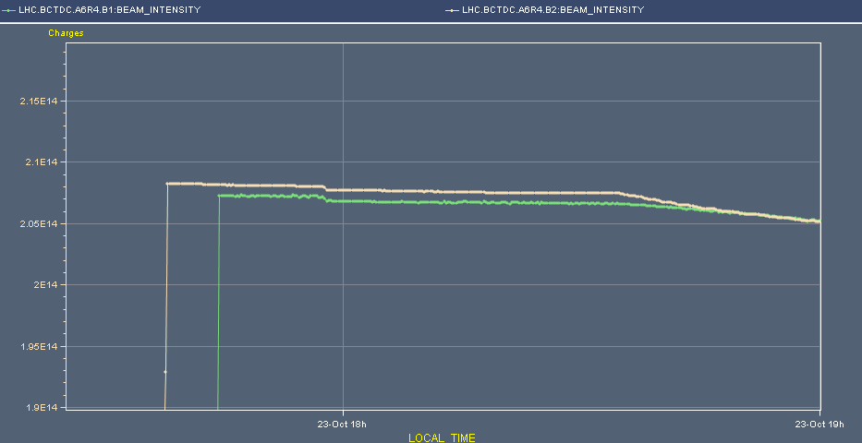
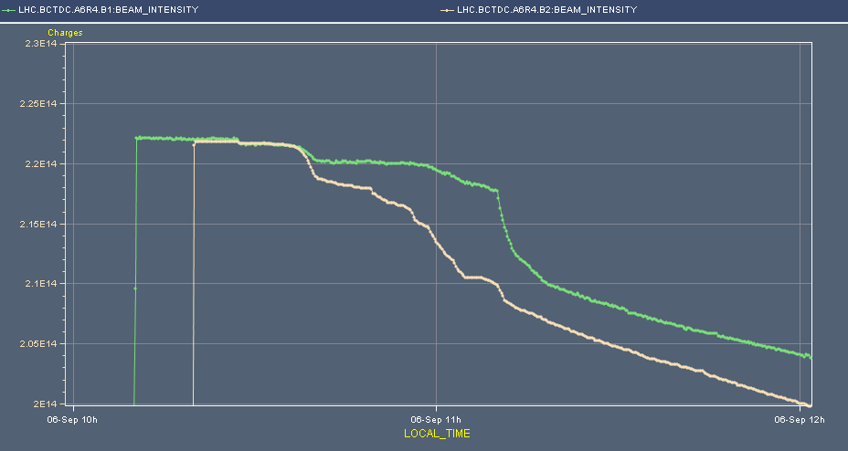
Tighter collimators
To be able to reduce β* from 1 m to 0.6 m in 2012, the collimators had to be set closer to the beams.
  The primary collimator openings were reduced from ±5.7σ to ±4.3σ (σ = rms beam size).
As a consequence, we are now very sensitive to the beam tails.
  Losses in the cycle after injection have increased a lot with respect to 2011.
  A lot of beam, ~ few %, in the tails (not Gaussian !!)
Intensity
2011
<1% losses
2012
Comparison of losses between start of ramp and start of collisions
Beam 2
5% losses
Beam 1

Slide 34
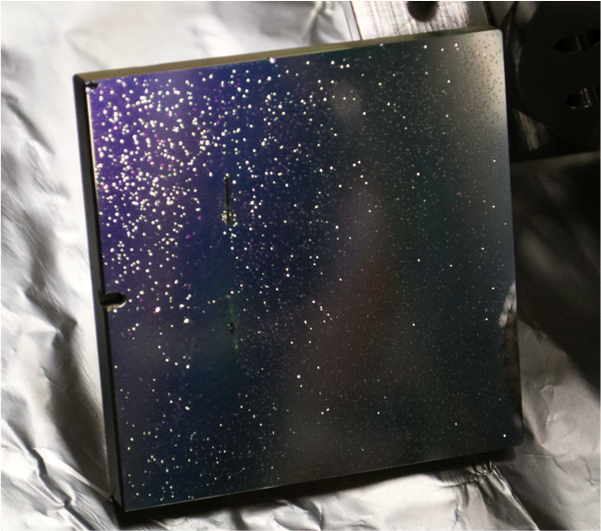
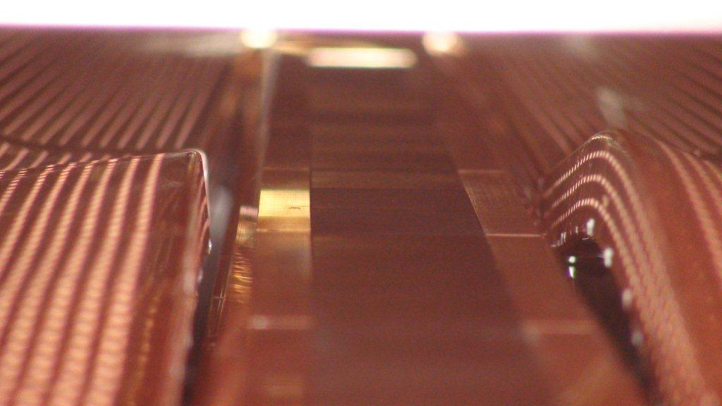
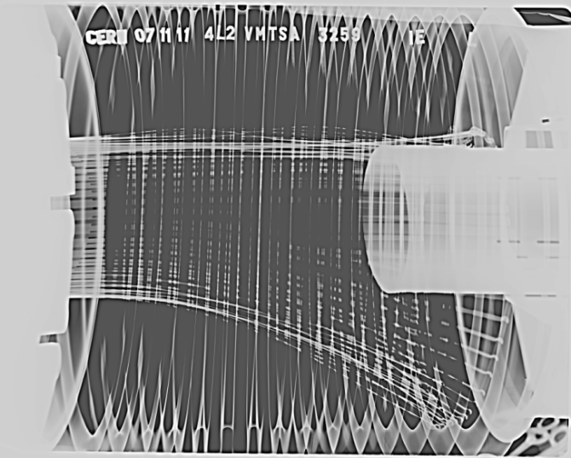
Heating damage
High intensity beams may deposit large amounts of power in incorrectly shielded components.
  Design, manufacturing or installation errors may lead to partial or total damage of accelerator components.
  So far they have not limited, could be fixed or mitigated.
BS
BS
Collimator jaw
Damaged RF fingers
Damaged beam screen (BS) in an injection protection device
Damaged mirror of the synchrotron light telescope

Slide 35
Beam instabilities for pedestrians
The 50 ns high intensity beams can be seen as a complex system of coupled oscillators,
  Particles oscillating within bunches (single bunch modes),
  Bunches oscillating with respect to each other (coupled bunch modes), within one beam and between the 2 beams.
Bunch n
n+1
n+2
n+3
Coherent oscillations and instabilities are driven by:
  Longitudinal motion within a bunch (head-tail motion),
  Fields induced in vacuum chamber elements that act back on the beam (‘impedance’, e.g. tight collimators …),
  Head-on and long range interaction between the 2 beams in the common vacuum chamber regions (‘beam-beam’).
  …

Slide 36
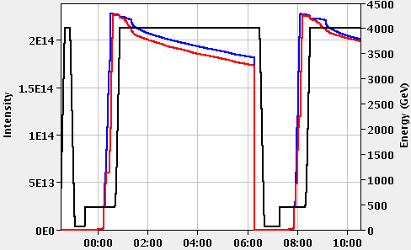
Beam instabilities
In 2012 instabilities have become more critical due to higher bunch intensity and tighter collimators settings. Cures:
  Transverse feedback (‘damper’) that measures the oscillations and sends corrective deflections,
  Non-linear magnetic fields (sextupoles, octupoles, beam-beam interaction at the collision points) that produce a frequency spread among particles:
    - Particles at different amplitudes oscillate at different frequencies → prevents coherent motion (‘Landau damping’).
Things are now ~ under control, but we are operating on the ‘edge’.
  And we have more losses on beam 2 – not understood.

Slide 37
And what about 25 ns beams?
Between 2010 and 2012 we have reduced the bunch spacing for regular operation to 50 ns.
But the nominal 25 ns beams have not been used so far for normal operation because:
  50 ns beams provide higher peak luminosity, at the price of high pile-up,
  25 ns beams suffer much more from electron cloud effects.
    ⇒ estimate 10 days (scrubbing, etc) to be ready for operation.
Successful tests of 25 ns beams were performed at injection (~2000 bunches stored) and 3.5 Tev (pilot fill with 60 bunches) in 2011.
In 2012 the tests will continue in order to prepare operation with 25 ns beams at 6.5-7 TeV.

Slide 38
Electron clouds
… affect high intensity beams with positive charge and closely spaced bunches.
Electrons are generated at the chamber surface by particle impacts, photons…
If the probability to emit secondary e- (SEY) is high enough, more e- are produced and accelerated by the fields of following bunches if those bunches arrive sufficiently close in time. Multiplication starts…
  Electron energies are in the 10- few 100 eV range.
The cloud of e- can induces pressure rise (liberates gas from the surface) , beam instabilities and possibly overload the cryogenic system by the heat deposited on the chamber walls !
Bunch N+2 accelerates the e-,
more multiplication…
Bunch N+1 accelerates the e-,
multiplication at impact
Bunch N liberates an e-
e-
e-
++++++
++++++
++++++
N+2
N+1
N
e-

Slide 39
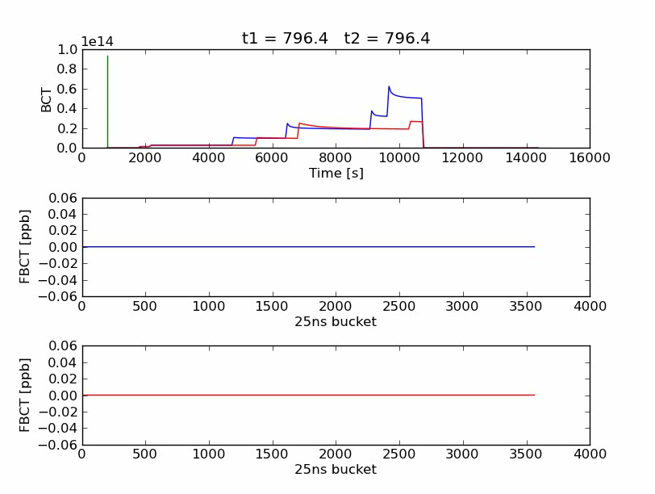

2012 25 ns tests (10 July 2012)
Courtesy of G. Rumolo
Beam 1
Beam 2
Bunch-by-bunch intensity
Beam 1
Bunch-by-bunch intensity
Beam 2

Slide 40
Beam scrubbing
The e-cloud can ‘cure itself’: the impact of the electrons cleans the surface (Carbon migration), reduces the electron emission probability and eventually the cloud disappears.
‘Beam scrubbing’ consists in producing e-clouds deliberately with the beams in order to reduce the SEY until the cloud ‘disappears’.
  Done at 450 GeV where fresh beams can be injected easily.
In April 2011 50 ns beams were used to ‘scrub’ the vacuum chamber at 450 GeV to prepare operation at 3.5 TeV.
  Further slow improvement during operation at 3.5 TeV and 4 TeV.
  More scrubbing time to come for 25 ns beam.
  Secondary Emission Yield (SEY) evolution in LHC arcs:
    2.2 1.7 ~1.5 1.3
Initial
After 50 ns
scrubbing
Present
Requirement for
25 ns operation

Slide 41

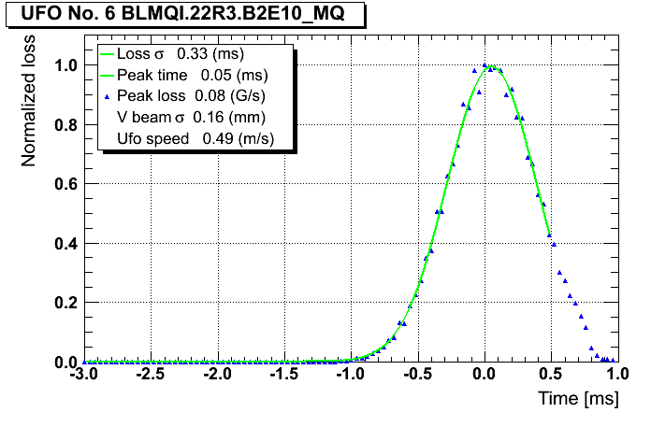
Surprise, surprise !
Very fast beam losses (time scale of ~millisecond) in the super-conducting regions of the LHC have been a surprise for the LHC – nicknamed UFOs (Unidentified Falling Object). If the loss is to high, the beams are dumped to avoid a magnet quench.
  2010: 18 beam dumps,
  2011: 17 beam dumps,
  2012: 13 beam dumps so far.
We are now certain that the UFOs are small (10’s μm) dust particles falling into the beam.
  Triggered by the presence of the fields of the beam. Mechanism for removing the dust from the surface is not fully understood.
Time evolution of beam loss signal

Slide 42
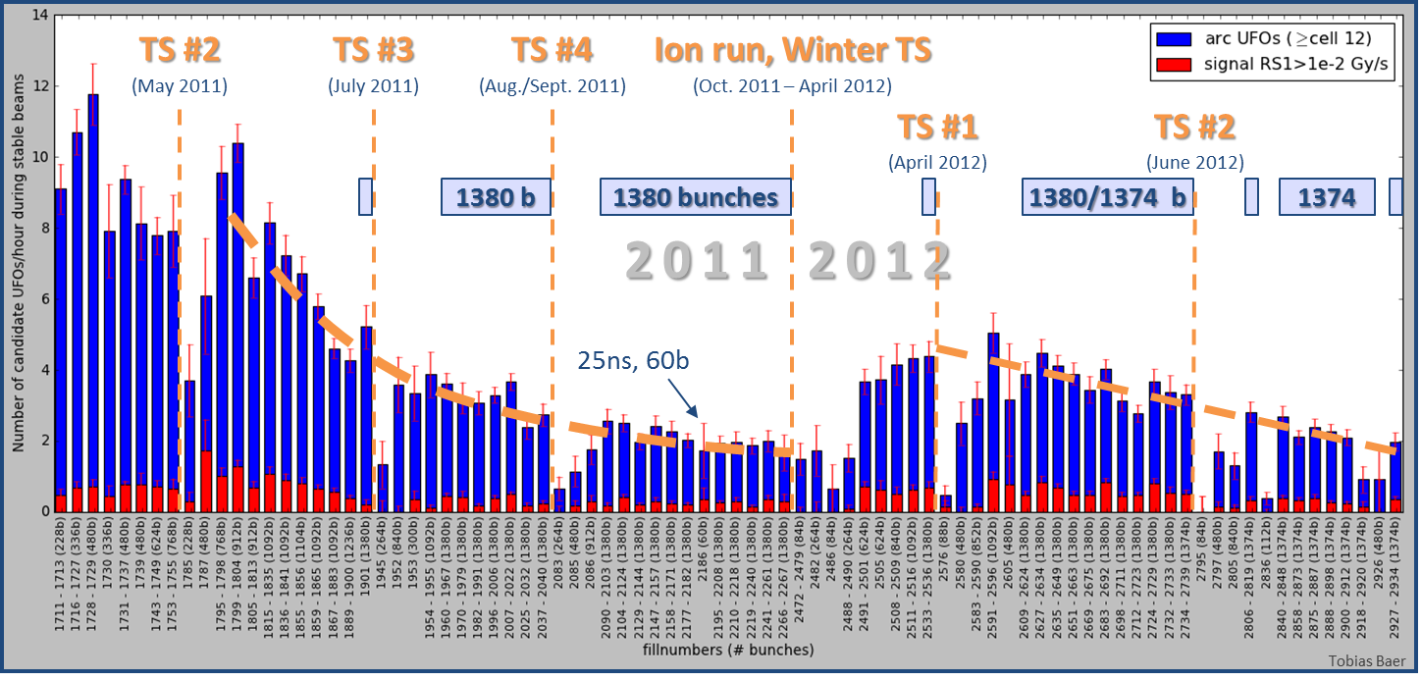
Arc UFO rate
No. UFOs/hour
Courtesy of T. Baer
2011: Decrease from ≈10 UFOs/hour to ≈2 UFOs/hour.
2012: Initially, about 2.5 times higher UFO rate compared to October 2011. UFO rate decreased since then to 2011 level.
5836 candidate arc UFOs during stable beams since 14.04.2011. Fills with at least 1 hour stable beams are considered. Signal RS04 > 2∙10⁻⁴ Gy/s.

Slide 43
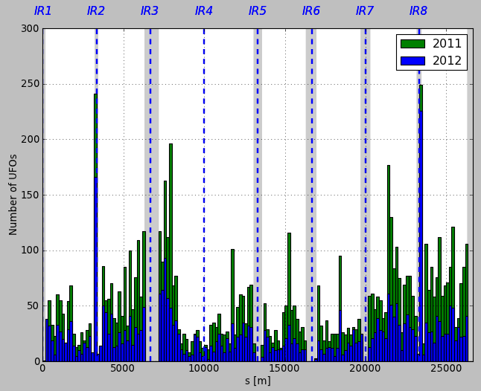
Spatial UFO distribution
Spatial distribution around the ring very similar in 2011 and 2012.
Many UFOs around injection kickers (MKIs).
  Al oxide particles produced during the machining of the inner ceramic tube of those fast kicker magnets.
Some arc cells with significantly increased number of UFOs.
  We do not know what dust is actually falling into the beam in the arc regions.
Courtesy of T. Baer
MKI
MKI

Slide 44
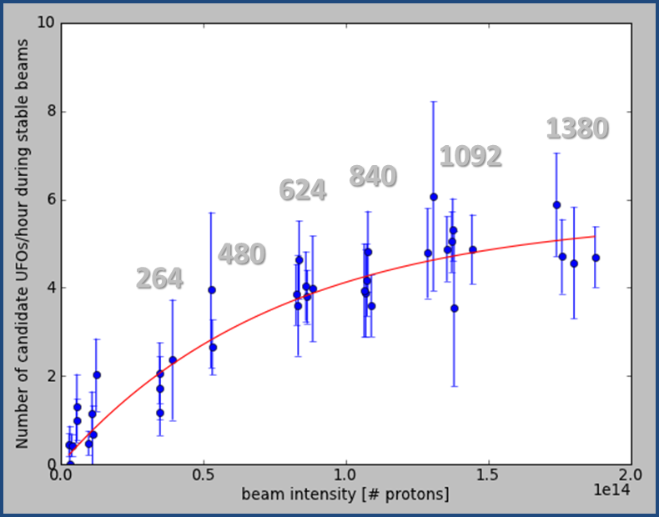
Intensity dependence and 7 TeV
The rate of events increases with beam intensity.
A large increase was observed with 25 ns beams – to be confirmed this year.
UFO rate /h
No bunches
At 7 TeV:
Intensity
The losses induced in the magnets by the UFOs will increase by a factor 3 (density at shower max in the magnets),
The tolerable loss will go down by a factor 5 (higher B field),
→ scaling the rate and amplitudes of 2012 one predicts at least one beam dump per DAY !! Could become a serious issue !!

Slide 45
Outline
LHC machine
High luminosity ingredients
High intensity issues
Performance 2010-2012
Proton-Lead
LHC after long shutdown

Slide 46
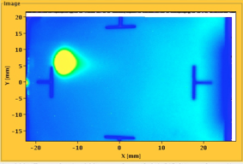
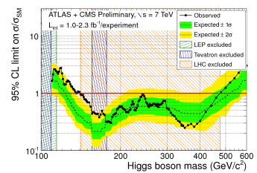

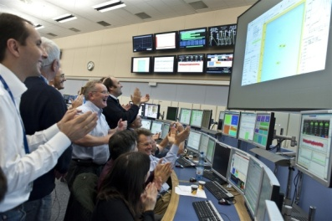
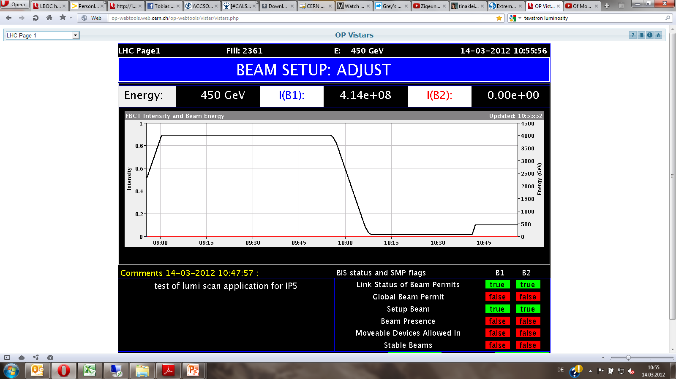

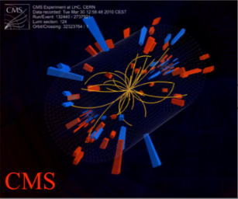
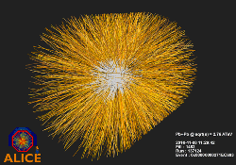
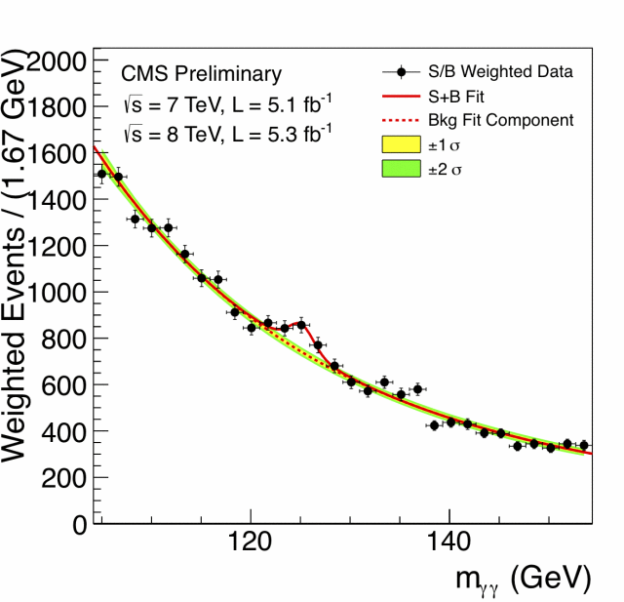
The LHC timeline
August 2008
First Injection tests
December, 2011
3.6e33, 5.6 fb⁻¹
4 TeV
June, 28 2011
1380 bunches
March, 2012
4 TeV
September, 10 2008
Both beams circulating
November 29, 2009
Beams back
1380
2008
2009
2010
2011
2012
November 2010
Ion run
July 4,
2012
Higgs boson search update
September, 19 2008
Incident
Accidental release of 600 MJ stored in one sector of LHC dipole magnets
March 30, 2010
First collisions at 2·3.5 TeV

Slide 47
Evolution of parameters: 2010 to 2012
Parameter | 2010 | 2011 | 2012 | Nominal
Energy (TeV) | 3.5 | 3.5 | 4.0 | 7.0
N ( 10¹¹ p/bunch) | 1.2 | 1.45 | 1.58 | 1.15
k (no. bunches) | 368 | 1380 | 1374/ 1380 | 2808
Bunch spacing | 150 | 75 / 50 | 50 | 25
Stored energy (MJ) | 25 | 112 | 140 | 362
ε (μm rad) | 2.4-4 | 1.9-2.4 | 2.2-2.5 | 3.75
β* (m) | 3.5 | 1.5 → 1 | 0.6 | 0.55
L (cm⁻²s⁻¹) | 2×10³² | 3.5×10³³ | 7.6×10³³ | 10³⁴

Slide 48
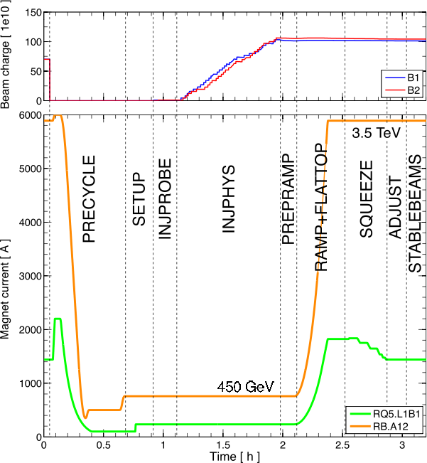
Operational cycle
Cycle:
  Injection
  Ramp
  Squeeze
  Collide beams
  Stable physics beams
  Ramp down/cycle
In 2012 a good turn around is performed in 3 hours – best ~2h 15.
Beam charge
(example for ions)
Magnet current [A]
During the ‘squeeze’ phase, the betatron function at the collision points (β*) is reduced to increase the luminosity.
  Cannot be done at injection – the beam is too large !
Courtesy S. Redaelli

Slide 49
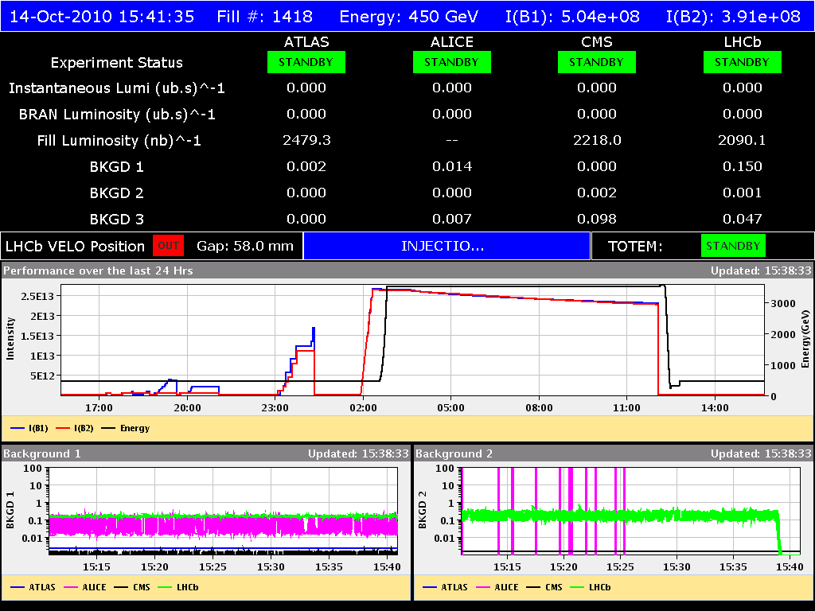
Operational cycle
http://op-webtools.web.cern.ch/op-webtools/vistar/vistars.php?usr=LHC1

Slide 50
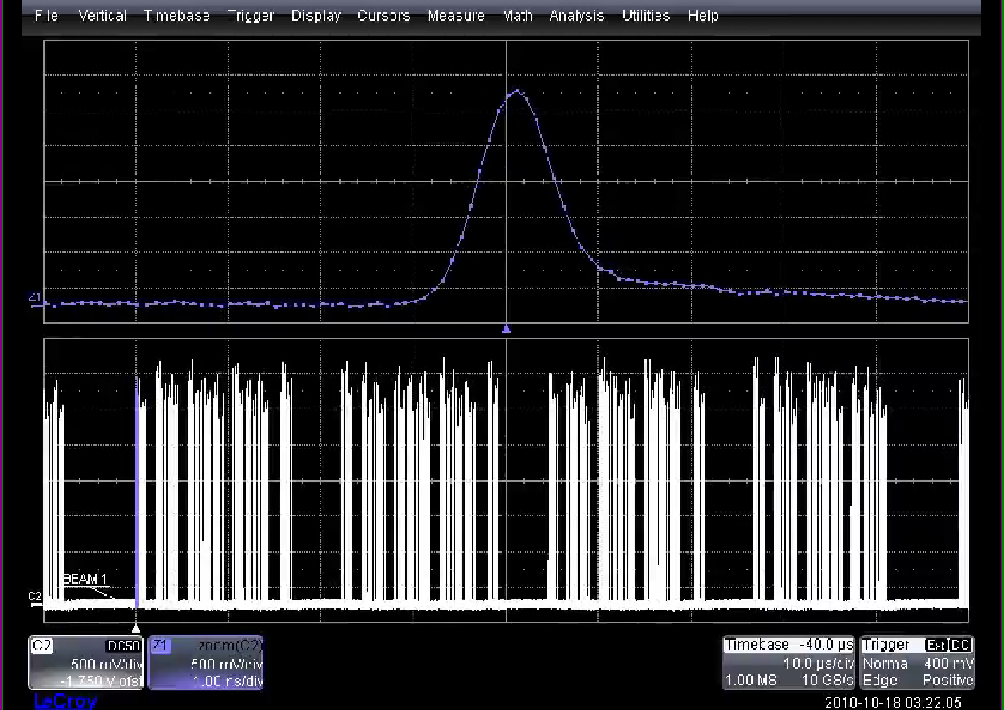
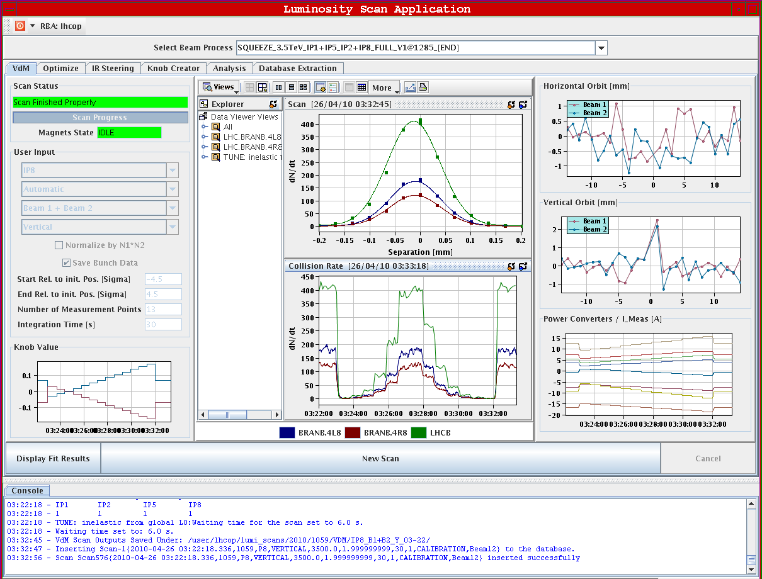




Operational cycle
Filling
Beams dumped
Beams in collision
Ramp
down
Flat-top adjust.
and squeeze
Pre-injection
flat bottom
Ramp up
Injection
plateau
STABLE BEAMS

Slide 51

LHC luminosity progress in 2010-12
Low bunch intensity operation, first operational exp. with MPS
Ramping up to 1 MJ, stability run at 1-2 MJ
Reach out for the fb’s !
2011
2012
Peak luminosity evolution
2010

Slide 52


High luminosity IRs 2012
Integrated luminosity ATLAS/CMS in 2012 ~ 14.7 fb⁻¹
  Fast ramp up possible based on 2011 experience
  Best week: 1.35 fb⁻¹, theoretical max close to 2 fb⁻¹
  Expect ~22-25 fb⁻¹ at the end of 2012
  Peak L = 7.6×10³³ cm⁻²s⁻¹

Slide 53


LHCb versus ATLAS/CMS
The LHCb luminosity is limited to 4×10³² cm⁻²s⁻¹ (detector limitations on rate and pileup).
The transverse offset Δ between beams is adjusted regularly while colliding to maintain a constant luminosity – luminosity leveling.
Δ

Slide 54


Efficiency
Spent 37% of scheduled time with stable beams in 2012
  Compared to 33% in 2011
Average fill
length: 6.0 hours
Fill lengths comparable in 2011 and 2012.
  Fill length determined mostly by ‘failures’.
  Only ~25% of fills are dumped by operation.

Slide 55
Outline
LHC machine
High luminosity ingredients
High intensity issues
Performance 2010-2012
Proton-Lead
LHC after long shutdown

Slide 56
Proton-Lead operation
Filling the LHC with 2 different ion species is a special challenge, as they do not have the same speed and revolution frequencies.
  At injection and in the ramp the beams never remain synchronized at the IPs – tricky mode.
At 4 TeV (or higher), the difference in speed is small enough: it is possible to ensure synchronous beam encounters by moving the protons (faster) on an orbit with larger radius, while the ion (Pb, slower) is moved on a orbit with smaller radius.
  Possible to provide colliding beams.
p
Orbits at 4 TeV
Schematically….
Pb
~0.5 mm

Slide 57


Proton-Lead test and run
A test with 13 colliding p and Pb bunches was done last week with few hours of first p-Pb collisions.
A 4 week long run will be made in Jan/Feb 2013.
  200 ns spacing proton and Pb beams, ~350 bunches / beam,
  Bunch intensities ~1-2x10¹⁰ for p, 5-10x10⁹ charges for Pb,
  p in B1 + Pb in B2, as well as Pb in B1 and p in B2,
  Target β* 0.8 m for ALICE, ATLAS and CMS.
  Luminosity ~ 6x10²⁸ cm⁻²s⁻¹.
ALICE p-Pb event

Slide 58
Outline
LHC machine
High luminosity ingredients
High intensity issues
Performance 2010-2012
Proton-Lead
LHC after long shutdown

Slide 59

10 year plan
LS1
PHYSICS AT 6.5/7 TeV
≈ 300 fb⁻¹
at 6.5-7 TeV
LS2
“ULTIMATE” PHYSICS
LS3
HL-LHC
NB: not yet approved

Slide 60
LS1 and LS2
  2013 – 2014: Long Shutdown 1 (LS1) consolidate for 6.5 / 7TeV
  Measure all splices and repair defective splices,
  Consolidate interconnects with new design (clamp, shunt),
  Finish installation of pressure release valves (DN200),
  Magnet consolidation,
  Measures to further reduce radiation to electronics: relocation, redesign, …
  Install collimators with integrated button BPMs (tertiary collimators and a few secondary collimators),
  Experiments consolidation/upgrades.
  Luminosity ≈ 10³⁴ cm⁻²s⁻¹ at 6.5-7 TeV
  2018: LS2 to prepare for ‘ultimate LHC’:
  Phase II collimation upgrade,
  Major injectors upgrade (LINAC4, 2GeV PS Booster, SPS coating, …).
  Luminosity ≈ 2×10³⁴ cm⁻²s⁻¹ at 6.5-7 TeV.

Slide 61

Bus-bar joint (splice)
  ~24’000 bus-bar (=current conductors) joints in the main circuits.
    After the incident 2008, a new protection system had be to design and installed for the joints.
  ~10’000 joints are at the interconnection between magnets.
Nominal joint resistance:
1.9 K 0.3 nΩ
300K ~10 μΩ

Slide 62

Joint quality
The copper stabilizes the bus bar in the event of a cable quench (=bypass for the current while the energy is extracted from the circuit).
    Protection system in place in 2008 not sufficiently sensitive.
A copper bus bar with reduced continuity coupled to a badly soldered superconducting cable can lead to a serious incident.
Solder
No solder
wedge
bus
U-profile
bus
X-ray of joint
During repair work in the damaged sector, inspection of the joints revealed systematic voids caused by the welding procedure.

Slide 63

Joint consolidation
The main objective of LS1 is to repair defective joints and to consolidate all the joints.
  An example of the consolidated joint.
4 top shunts
4 bottom shunts (2 not visible)

Slide 64

New LHC LS1 schedule
Courtesy of Katy Foraz

Slide 65
Operational challenges at 7 TeV
Performance and startup at 7 TeV may be impacted by:
Electron cloud effects with 25 ns beams,
UFOs at higher energy and with 25 ns beams,
Emittance growth and instabilities in the cycle,
Magnets operated much closer to quench limit,
Total intensity limitations in the LHC,
Radiation to electronics,
And the things that we will discover…

Slide 66
Energy after LS1
In 2008 attempts to commission the first LHC sector to 7 TeV revealed a problem on the magnets from one manufacturer.
  The magnets that had been trained on test stands started to quench again.
  The number of quenches increased rapidly beyond 6.5 TeV.
Extrapolations showed that the number of training quenches required to reach 7 TeV is too large.
  Time and risk to the magnets.
Courtesy of E. Todesco
For those reasons we will most likely restart at 6.5 TeV, or slightly above depending on time and experience during the re-commissioning.

Slide 67
Injector beams after LS1
New ideas and concepts will be implemented in the PS to produce beams with higher intensity and smaller emittance.
Possible beams after LS1 (not yet demonstrated).
Nominal
 |  | 50 ns | 50 ns | 25 ns | 25 ns
PS ejection | Bunches / train | 32 | 24 | 48 | 72
SPS ejection | Bunch intensity | 1.7⋅10¹¹ | 1.7⋅10¹¹ | 1.15⋅10¹¹ | 1.2⋅10¹¹
 | Emittance [μm] | 1.5 | 1.2 | 1.4 | 2.8
No bunches in LHC |  | ~1340 | ~1300 | ~2600 | 2808
Relative luminosity |  | 2 | 2.4 | 1.85 | 1
Relative pile-up |  | 4.1 | 5.2 | 2 | 1
Courtesy of H. Damerau
The quoted emittance values (and luminosities) do not include any blowup in the LHC (presently ~ +0.6 μm).

Slide 68

β* reach at 6.5-7 TeV
The β* reach depends on:
  The collimator settings and margins between collimators and with respect to apertures (we have a few scenarios…),
  The beam type & emittance (25 ns / 50 ns) → crossing angle.
Possible range of smallest β* at 6.5-7 TeV:
  0.4 m ≤ β* ≤ 0.5 m for 25 ns beams,
  0.3 m ≤ β* ≤ 0.4 m for 50 ns beams.
ε = 2 μm
α = 170 μrad
Loss of ~40-50% due to geometrical effect (crossing angle) !
2α

Slide 69
Luminosity at 6.5 TeV
3 out of many possible scenarios…
 | k | N_{b} [10¹¹ p] | ε [μm] | β* [m] | L [10³⁴ cm⁻²s⁻¹] | Pile-up | Int. L [fb⁻¹]
50 ns | 1380 | 1.70 | 1.5 | 0.4 | 2.05 | 104* | ~30
25 ns low emit | 2600 | 1.15 | 1.4 | 0.4 | 1.73 | 47* | ~50
25 ns standard | 2800 | 1.20 | 2.8 | 0.5 | 1.02 | 25 | ~30
The 50 ns beam pile-up is too high. The luminosity must be leveled down to limit pile-up. Assuming max. pile-up of 40.
The integrated Luminosity is based on 120 days of production, 35% efficiency.

Slide 70


Performance comparison
Standard 25 ns and
50 ns with levelling…
…are equivalent in integrated luminosity for fill lengths up to 5-6 hours.
Low emittance 25 ns provides higher performance due to higher luminosity for same or lower pile-up.

Slide 71
Scenario for startup after LS1
    It is quite likely that the machine will start up with 50 ns in order to deliver rapidly some integrated luminosity.
    Easy to reach high luminosity (even if limited by pile-up),
    Lower stored energy,
    Less / no e-clouds, fewer UFOs,
    Long and good operational experience at 3.5/4 TeV.
    Then, unless there is a major problem, we will probably devote some time (~2 weeks) to prepare the machine for 25 ns beams.
      E-cloud reduction by scrubbing,
    … before switching to 25 ns beams.
      Ramping up of the number of bunches and of bunch intensity.
Wait and see !!

Slide 72

Summary
    The LHC is doing incredibly well, even if we are operating close to the edge of what can be done.
    A few years ago, we were making plans based on luminosities of 2x10³² cm⁻²s⁻¹ in 2011 – which we managed to beat by more than a factor 10 !
    We have achieved a lot more than what we hoped for in our wildest dreams – hopefully a good omen for > 6.5 TeV !
    But operation at 7 TeV will be a new challenge for the LHC machine groups – cross fingers !

