Slide 1
Top and WW final states
Harry Weerts
For LC working group
Introduction to this topic
Townhall Meeting, Paris, France
16 May 2012

Slide 2
Introduction & Background
Purpose of this short talk:
---Stimulate discussion ---
Short overview of what is in “official documents”
ILC: LOIs CLIC: CDR
There is more information -- how to use it
How do we find it?
How to agree to use?
Short, but focused “Top at LCs” workshop yesterday
Will show some of this
What to do with it?
Consensus yesterday: “top” could be represented better
Give us your feedback on direction……..
This is not complete !!

Slide 3
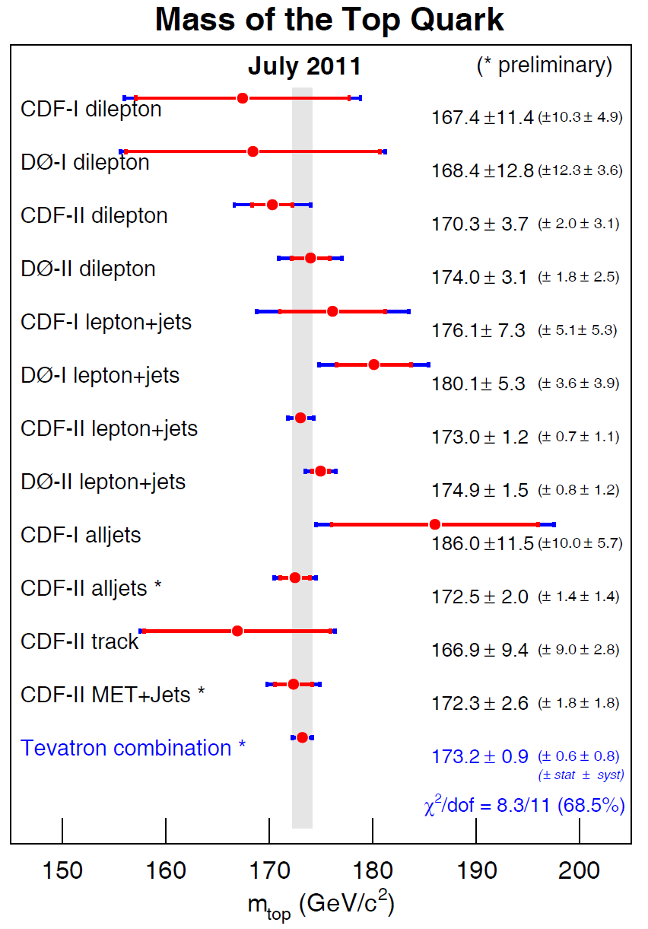
Top mass I
Hadron collider status:
Tevatron:
173.2 ± 0.6 ± 0.8 GeV/c²
ATLAS( recent arXiv):
174.5 ± 0.6 ± 2.3 GeV/c²
CMS ( last year):
173.4 ± 1.9 ± 2.7 GeV/c²
LHC just beginning… may be out of date already
Statistical error will go down.
Guess: at least down to 200MeV by time there is a LC
This does not go in our report
This is a Pythia mass

Slide 4
LC top mass I
Summary from LOI & CDR
Use all hadronic final state ( bqq bqq) and semi leptonic (blν bqq) l=e,μ
All use 500GeV; fit invariant mass all with roughly same techniques
Mass | Concept | Lum [fb⁻¹] | bqq bqq | blν bqq | Comment
ILC | SiD | 500 | 50
ILC | SiD | 500 | 38 |  | template
ILC | ILD | 100 | 90 | 120
ILC | ILD | 500 | 30
CLIC | ILD | 100 | ~85 | ~95
Mass errors in [MeV]
Width | Concept | Lum [fb⁻¹] | bqq bqq | blν bqq
ILC | ILD | 100 | 60 | 100
ILC | ILD | 500 | 22
CLIC | ILD | 100 | ~225 |  | ~265
Width errors in [MeV]
??

Slide 5
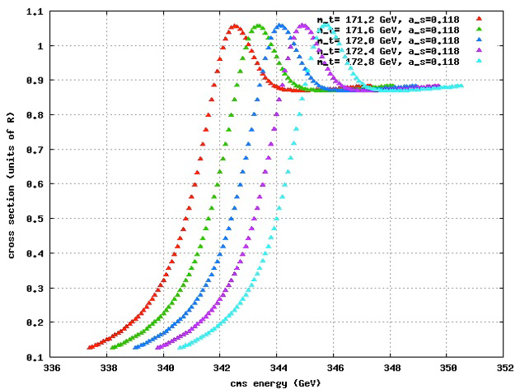
Top mass from threshold scan
Not in LOIs & CDR in progress
How to handle ?
From Frank Simon at workshop yesterday

Slide 6
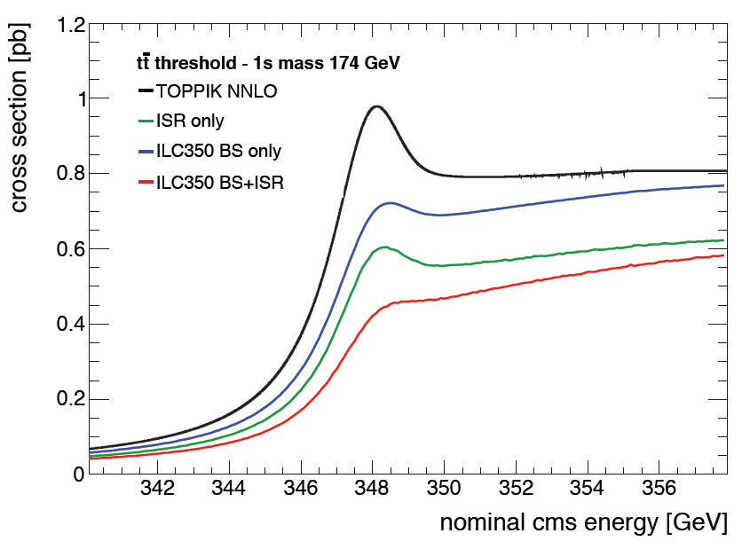
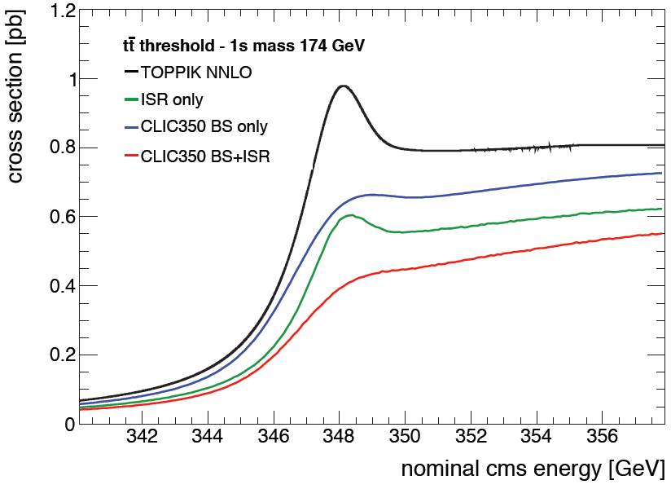
Top mass from threshold scan
Not in LOIs & CDR in progress
How to handle ?
From Frank Simon at workshop yesterday
ILC
CLIC

Slide 7
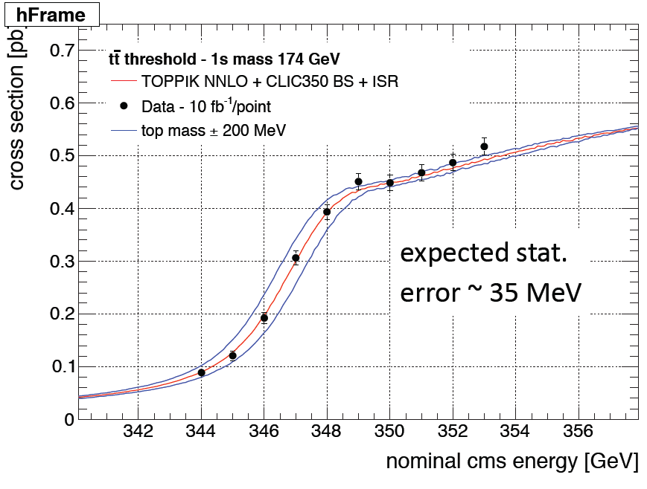
Top mass from threshold scan
Not in LOIs & CDR in progress
From Frank Simon at workshop yesterday
Illustration of what is possible.
No hard numbers yet
Previous thorough study:
TESLA; 10 points @ 30fb⁻¹/point
16 MeV for top mass error
32 MeV on width
How to handle ?

Slide 8
ttbar Asymmetries
Summary from LOI & CDR ?
renewed by top-antitop forward-backward charge asymmetry measurement at Tevatron
~2.2-2.4 σ
Need model to test sensitivity; on going work ( Marcel Vos yesterday)
In LOI found numbers from SiD for A_{FB} for b from top decays and A_{FB} for top, based on momentum weighted vertex charge and momentum weighted jet charge methods.
b: 0.272 ± 0.015 top: 0.342 ± 0.015
Useful ?
in progress ( See yesterday)
How to handle ?

Slide 9
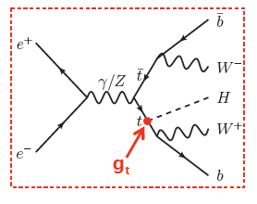
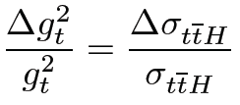
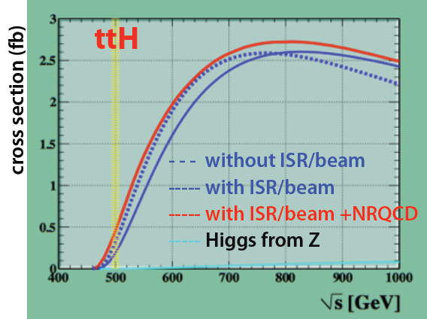
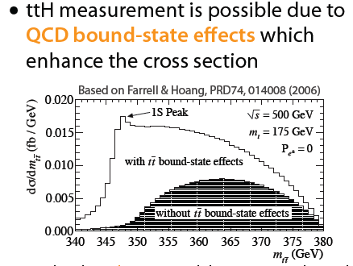
Top Yukawa coupling
Not in LOIs & CDR in progress
Presented yesterday at “Top” workshop
Measure error on :
At 500GeV, already done at ~700GeV

Slide 10
Top Yukawa coupling
Not in LOIs & CDR in progress
From: Katsumasa Ikematsu:
How to handle ?

Slide 11
WW final states– WW scattering
“Not” in LOIs & CDR not in progress
W⁺W⁻ -> W⁺W⁻
Only mention is in ILD LOI:
At 1 TeV, 1 ab⁻¹
W⁺W⁻ -> Z Z
Final states:
e⁺e⁻ -> ν_{e}ν_{e} qq qq
Used to check capability of separating W and Z all hadronic final states
More interesting:
Look for deviations from SM predictions in case SM Higgs is found or not found at ~125GEV.
???
ILD LOI sensitivity study:
Assume SM i.e. quartic couplings a₄=a₅=0 and test sensitivity with above sample
-1.38 < a₄ < +1.10
-0.92 < a₅ < +0.77
What accuracy do we need ?
Not studying this or ?
Should we/can we ?

Slide 12
Discussion
What is missing ?
What to do different?
What to use as input ?
Feedback ……….
Questions in case not brought up
How well do we need to measure the “top” mass?
Missing in discussion yesterday
What do we learn from improving over hadron colliders ?
What is accuracy we need to make progress ?

