Slide 1
Building European Scientific Cloud Computing Infrastructure
An overview
by Marc-Elian Bégin, SixSq

Slide 2
What is Helix Nebula?

Slide 3
Strategic Goal
Helix Nebula, the Science Cloud
a partnership to support the massive IT requirements
of European scientists
and create a Cloud computing market
for the public sector in Europe.

Slide 4
A European Cloud Computing Partnership big science teams up with big business
Email:contact@helix-nebula.eu Twitter: HelixNebulaSC Website: http://www.helix-nebula.eu/

Slide 5
Why?

Slide 6
The Science Cloud: INPUT
The Science Cloud: a unique mine of scientific data
Biological &
Medical Sciences
Physical
Sciences &
Engineering
Social
Sciences
Environmental
Sciences
Materials
The Science Cloud
Energy
In-situ
data
Processed
data
Space
data
Simulation
data

Slide 7
The Science Cloud: OUTPUT
The Science Cloud: a unique opportunity for Scientists to comprehend major challenges
Disease treatment
Climate Change
Geo hazards
Apps & tools
Water, food, energy
The Science Cloud
Ageing population
Breakthrough in Science
Increased number of New Patents
Publications cross communities/domains

Slide 8
The Context?

Slide 9
Addressing actions of the “Digital Agenda for Europe”
Helix Nebula strongly supports the Commission’s Digital Agenda for Europe:
Stresses a unified approach to data protection regulations and lightweight, efficient governance
Ambitions to support European economic development by making its services available to the wider community
Digital Agenda @DigitalAgendaEU is now following you (@HelixNebulaSC).
DigitalAgendaEU Digital Agenda
This is the official account of the EU's Digital Agenda policy flagship - providing all the news you need about maximising the potential of ICT in Europe.
Notes:
CC plan page 9 EC spending

Slide 10
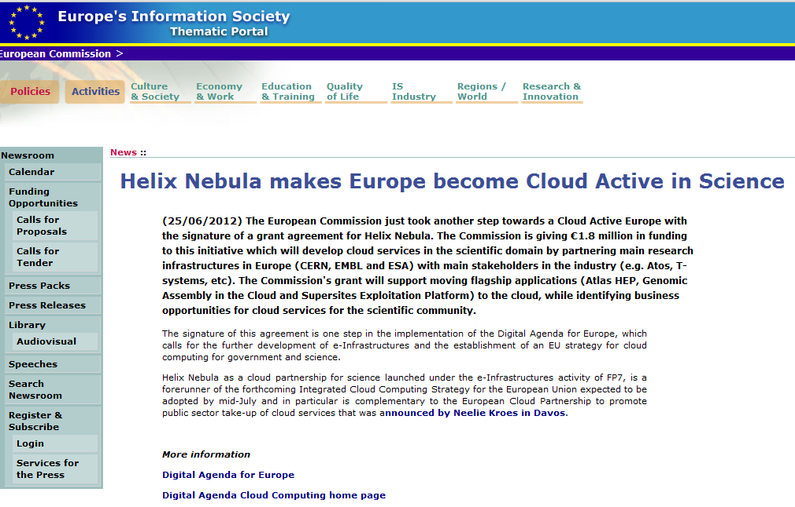
EC is strongly supporting Helix Nebula

Slide 11
Notes:
New commers, Alcatel Lucent, Universities, …….
11

Slide 12
How to get there?

Slide 13
How to get there?
Set up a cloud computing infrastructure for European Research Area
Identify and adopt policies for trust, security and privacy on a European-level
Create a light-weight governance structure involving all stakeholders
Define a short and medium term funding scheme

Slide 14
Timeline
Proof of Concept End 2012
Deploy flagships,
Analysis of functionality, performance & financial model
More applications, More services, More users,
More service providers

Slide 15
Governance Model during Proof of Concept in the Pilot Phase
Tech Arch group
Serv Arch group
Activities covered by NDA
Notes:
user board is with ESA, since it was recognized that the idea initiated form ESA. The User board leader represents the entire science community of GEohazard, CERN, and Microbiology towards industry. However due to lack of strategy within ESA no action's are done

Slide 16
Consortium Membership
Consortium includes all participating supply-side and demand-side companies/organisations
Member status and adopter status
All sign a non-disclosure agreement
“interested parties” can also register
Procedure to become a new member is on Helix-Nebula website http://www.helix-nebula.eu/

Slide 17
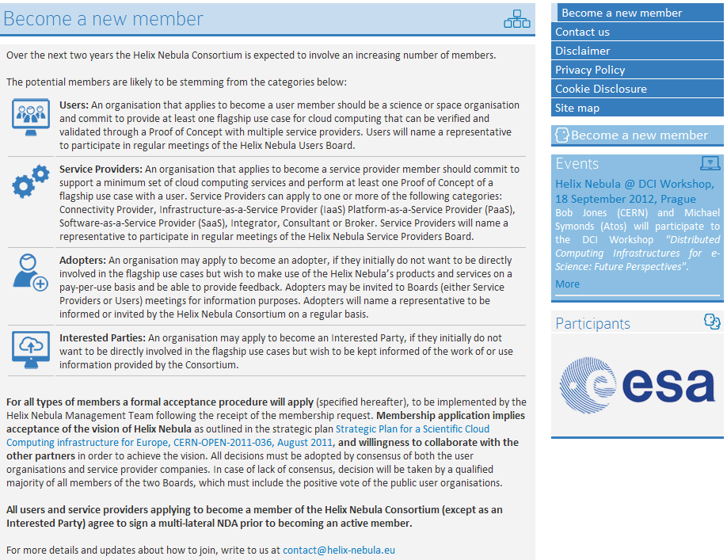
Become a new member !
as:
Users
Service
Providers
Adopters
Interested
Parties

Slide 18
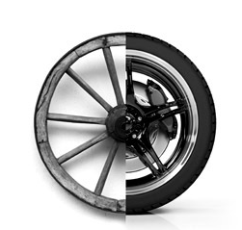
Helix Nebula Pilot Phase Flagship use cases

Slide 19
Pilot Phase Goals
Explore/push a series of perceived barriers to Cloud adoption:
Security
Reliability
Data privacy
Scalability/Elasticity
Network performance
Integration
Vendor lock-in
Legal concerns
Transparency

Slide 20
Flagship use cases
Use-cases addressing scientific challenges with societal impact
High-profile applications that catch the public imagination and encourage others to use the services
Show need for significant scale of resources, federation/aggregation of data sets, long-term archiving and on-demand processing
Bring people and data together: Building communities and stimulating innovation
Use the Cloud for what it is good for!

Slide 21
Initial Flagship Use Cases

Slide 22
Flagship use cases
 | ATLAS H.E.P. Cloud Use (CERN) | Genomic Assembly in the Cloud (EMBL) | SuperSites Exploitation Platform (ESA/CNES/DLR)
Scientific goal/society impact/photogenic | • | • | •
Scale of resources used | • | •
Federation/Aggregation of datasets |  | • | •
Long-term archiving of data |  |  | •
On-demand processing | • | • | •
Impact on community & benefits | • | • | •
Potential increase of users | • | • | •
Interoperability | • | • | •
Data security | • | • | •
Maturity | • | • | •
Access to license-controlled sw |  |  | •

Slide 23
Helix Nebula Latest Results

Slide 24
Flagship deployments First results - 1
Proof of Concept stage within the Pilot Phase started January 2012
Each flagship has been deployed with a series of providers independently:
CERN, EMBL and ESA succeeded in deploying scientific applications each involving tens of thousands of jobs running at data centres operated by Atos, CloudSigma, Interoute and T-Systems

Slide 25
Flagship deployments First results - 2
CERN was able to run simulations previously executed on the Worldwide LHC Computing Grid by quickly deploying ATLAS experiment flagship application on the Cloud.
EMBL successfully deployed and tested their novel software pipeline for large-scale genomic analysis using real world large genomic data sets.
ESA successfully tested large-scale data processing and dissemination for its radar satellites using different cloud provider infrastructure.

Slide 26
Flagship deployments First results - 3
The PoC extensively evaluated scalability, performance and on-demand provisioning of resources for high performance computing and fast data storage in the cloud computing resources provided by Atos, CloudSigma, Interoute and T-Systems
In addition to the infrastructure providers, SME’s such as SixSq, Terradue and The Server Labs were vital to get the flagship applications up and running

Slide 27
What’s Next?

Slide 28
What’s next for the Collaboration?
Process for new Suppliers / new Users to join is starting:
New comers can either submit flagships that propose some innovation in terms of functionality, performance, scope, business opportunities or impact of the European Cloud Computing infrastructure, or use the HN platform as is.
The flagship use cases must be sponsored by user organisations and Service Providers. Will be selected so as to be complementary and maximise coverage of the objectives outlined in the Strategic Plan

Slide 29
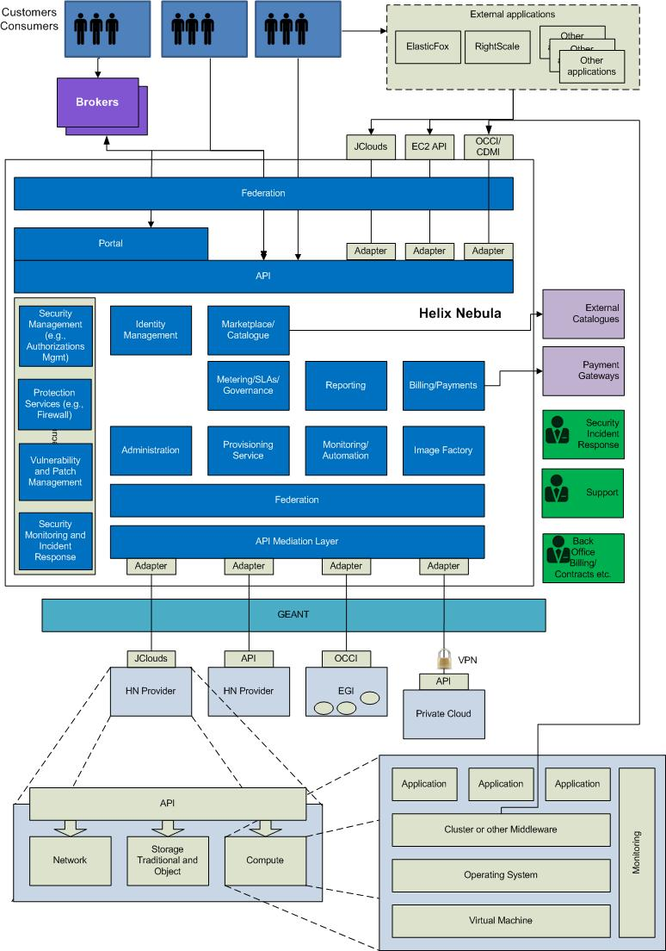
Unified Access to Helix Nebula

Slide 30
What’s next for the Pilot Phase?
Building on the lessons learned from the PoC
Before the next wave of deployments…
Now focussing on identifying a common set of interfaces for suppliers and users

Slide 31
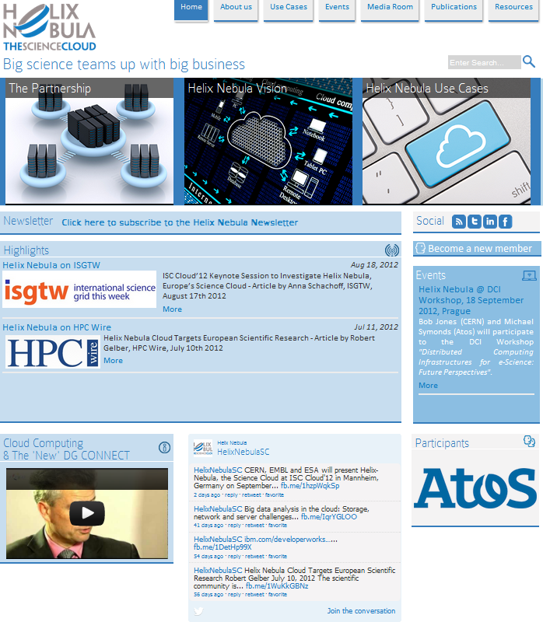
Stay tuned on :
http://www.helix-nebula.eu/

