Slide 1
Clouds for Scientific Computing and Big Data
Clouds pour le Calcul Scientifique : Ressources et Enjeux pour Paris Sud
Dr Charles LOOMIS (LAL)
27 November 2012

Slide 2
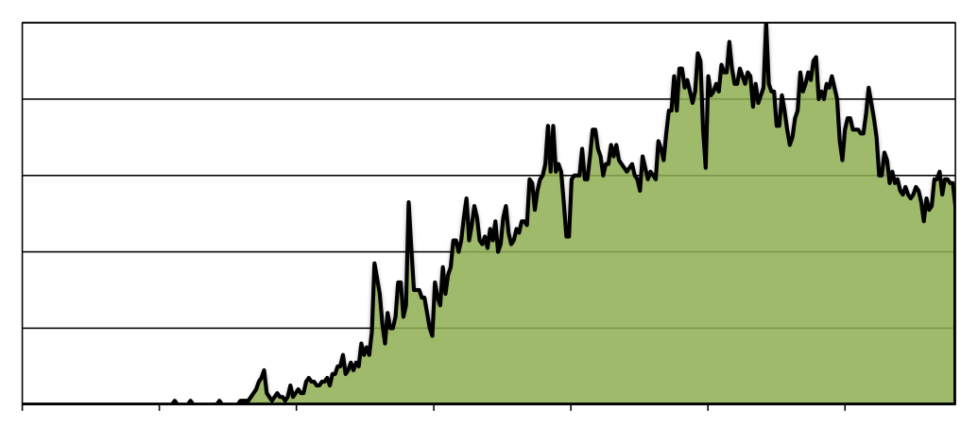
Cloud Hype
Is cloud technology useful for scientific computing?
media hype
Mature Virtualization
Simple APIs
Excess Capacity
EBS
EC2
2006
2007
2008
2009
2010
2011
2012

Slide 3
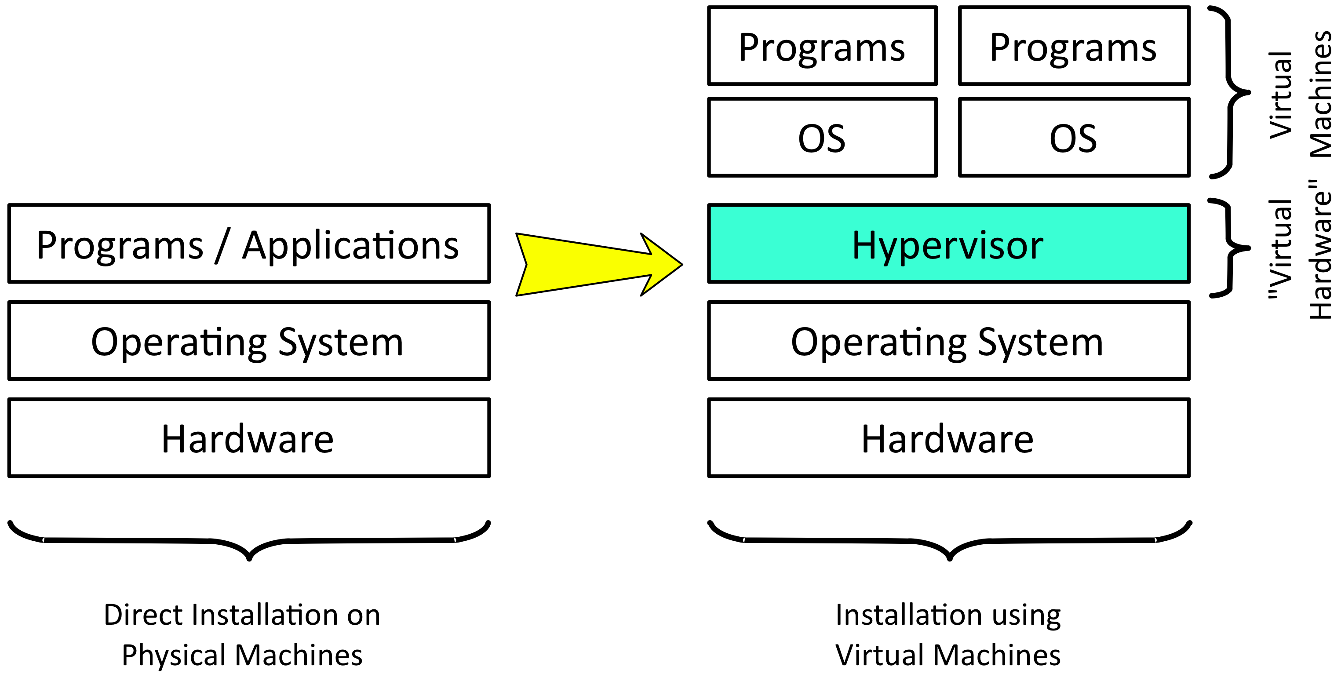
Virtualization
Performance cost generally very low.
Allows resource sharing without a priori agreement on environment.

Slide 4
Web Service Interfaces
SOAP
REST, XMLRPC, …
Prioritizes easier service implementation by developers
Complex specifications, limited interoperability
Complex tooling
RPC architectures only
Focus on easy access by service clients
Embraces HTTP protocol semantics
Universal support from programming languages
RPC and ROA possible
Simple access to, and integration of different services.

Slide 5
Excess Computing Capacity
Amazon
Data Centers
Dimensioned to handle Christmas rush
Idle machines/resources other times of year
Monetize investment in these services
Allowed resources to be offered at excellent prices
Moved from monetizing existing investment to profit center
Now Amazon and others have dedicated centers for the cloud!
Economies of scale offer potential cost savings.

Slide 6
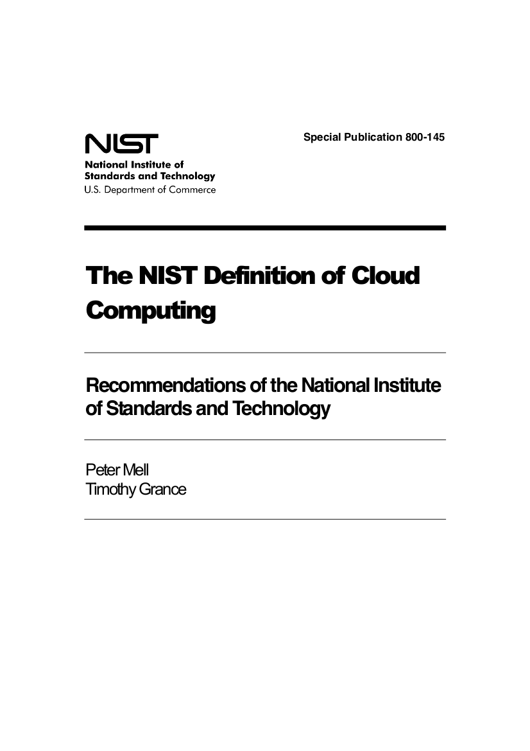
What is a Cloud?
NIST: Best Definitions
Essential characteristics
Service models
Deployment models
Just 2 pages of text!
http://csrc.nist.gov/publications/nistpubs/800-145/SP800-145.pdf

Slide 7
Essential Characteristics
How to distinguish a cloud from other computing resources?

Slide 8
Cloud Characteristics
Broad network access
Fast, reliable access to remote (cloud) resources via the network
Resource pooling
Multi-tenant sharing of resources
Measured service
Control and optimization of resources through measured use
On demand, self-service
Users provision computing resources without human intervention
Rapid elasticity
Ability to scale the resources rapidly based on application needs
Notes:
Indicate that characteristics on the left are really typical of any distributed computing resource. The unique features of clouds are the characteristics on the right.

Slide 9
Other Distributed Computing Systems
Remote Services
RackSpace, etc.
Separates service management from hardware management
Grid Computing
European Grid Infrastructure (EGI), Open Science Grid (OSG)
Federating distributed data centers for easier access, better efficiency
Batch Systems
LSF, PBS, etc.
Permits worker nodes on different sites, but centrally managed
Volunteer Computing
BOINC, XtremWeb, etc.
Takes advantage of idle, private, and volatile resources
Notes:
Federation of resources in grid and volunteer computing is really something that isn’t in the original idea of clouds. This is something that immediately comes up in scientific computing because of its collaborated and distributed nature.

Slide 10
Service Models
What functionality does a cloud provide to users?

Slide 11
Software as a Service
Software as a Service (Saas)
End-users
Platform as a Service (Paas)
Infrastructure as a Service (Iaas)
Advantages
Disadvantages
Simple use: web interface; no software installation
Very accessible: laptop, smartphone, …
Data questions: access, ownership, reliability, etc.
Integration (mash-up) is often difficult

Slide 12
Platform as a Service
Software as a Service (Saas)
Developers
Platform as a Service (Paas)
Infrastructure as a Service (Iaas)
Advantages
Disadvantages
Programmers can forget about low-level plumbing
Load balancing; automatic failover, etc.
Restricted number of languages
Applications not portable between different providers

Slide 13
Infrastructure as a Service
Software as a Service (Saas)
Service Providers
Platform as a Service (Paas)
Infrastructure as a Service (Iaas)
Advantages
Disadvantages
Full control over machine; access as “root”
Customized environment, down to operating system
Multiple APIs
No std. machine format
VM creation is time-consuming and difficult
Notes:
My opinion is that IaaS services are the most relevant for generic scientific computing platforms. Some of the following transparencies show a bias towards IaaS-type clouds.

Slide 14
Deployment Models
Who are the targeted users?

Slide 15
Deployment Models: Private
private
community
public
Single administrative domain, limited number of users
Informal resource allocation via ‘hallway conversations’
E.g. running cloud for site services, managed by group of system administrators

Slide 16
Deployment Models: Public
private
community
public
People outside of cloud provider’s institute; aimed at the general public
Resource allocation by payment
E.g. Amazon Web Services (EC2, S3, …)

Slide 17
Deployment Models: Community
private
community
public
Different administrative domains but with common interests and procedures
‘Horse trading’ used to allocate resources between individuals and groups
E.g. high-energy physics community

Slide 18
Deployment Models: Hybrid
private
community
public
hybrid
Combination of other deployment models
Used for redundancy and/or peaks in demand
“Sky” computing, brokered federation, bursting, …

Slide 19
Clouds for Scientific Computing
Are there benefits in using a cloud?

Slide 20
Features of Scientific Computing
Diversity of people writing code
Diversity of application environments
Collaboration: Sharing data and expertise
Competition: Producing unique, novel results
Customization of analysis, adding data or code.
Variability: Conference cycle, …
Large datasets (PB)
Variety of access patterns
Long-term curation of data
Notes:
Collaborative aspects of science put a premium on being able to federate resources—cloud resources or otherwise. Following benefits are those seen from a IaaS level. Some benefits come from people creating specific platforms over IaaS services.

Slide 21
Customized Environment
Operating systems suited to your application
Your applications preinstalled and preconfigured
CPU, memory, and swap sized for your needs

Slide 22
Dynamic Provisioning
New storage and compute resources in minutes (or less)
Resources freed just as quickly to facilitate sharing
Create temporary platforms for variable workloads

Slide 23
Flexible Service Deployment
Deploy user-level, network-accessible services
Create domain-specific analysis platforms
Redundant, scalable services easily deployed

Slide 24
Agile Scientific Computing
Faster analyses
Quick deployment of preconfigured virtual machines
Lower learning curves via customized VMs/services
Fewer failures
Less interference between processes on machine
Avoiding misconfigurations and incomplete OS installations

Slide 25
Should we just use Amazon?
Is outsourcing the computing infrastructure the solution?

Slide 26
Why not use Amazon?
Cost—always a toss up!
Institutes with existing infra., probably more expensive
Institutes without, probably cheaper and certainly faster
Serious concerns around data
Privacy
Reliability
Efficient storage
Efficient access
…

Slide 27
Big Data
Can scientific data be handled efficiently in the cloud?

Slide 28
Big Data Challenges
Legal constraints for some types of data
EC working with member states to harmonize rules
Protection guarantees provided by some public clouds
“National” clouds avoid cross-border constraints
Reasonable network access
Large datasets require large bandwidth
Co-located computing only partial solution
Commercial world does not enjoy fast RENATER network
Notes:
These challenges are really provoked by moving to cloud infrastructures because “location” becomes technically irrelevant.

Slide 29
Big Data Challenges
Data curation
Long-term storage of data → hierarchical storage
Preservation of data for access by others → metadata also!
Large volumes
Ability to store data affordably
Applications must expect errors in stored data
Data access model(s)
Huge variety of different access models
Cassandra, Hadoop, MySQL, SRM, …
Notes:
Only the last point really is specific to clouds. Here the flexibility to deploy a variety of services over a common set of storage resources makes it easier to adapt to the wide variety of access models inherent in scientific computing.

Slide 30
“Academic” Cloud Challenges
Scheduling
Initial placement of machines
Migration of machines
“Infinite” capacity
Amazon can be “infinite”; LAL (CNRS, …) cannot be
How to maintain illusion with finite resources?
Image management
Must understand and trust “opaque” images
Notes:
Much research has been done on batch systems for scheduling. Most of this can be applied to cloud scheduling as well. However, there are nuances. First we need instantaneous scheduling of machines. Scheduling iterations (e.g. every minute) are a significant part of VM startup latency. Second both the placement and migration must be scalable solutions that will rely on imperfect information.
The “opaque” images involve knowing the composition, configuration, provenance, etc. of those images. This is difficult information to maintain in just a filename; more difficult to maintain with some level of confidence.

Slide 31
Conclusions
Agile scientific computing with clouds
Cloud promises lower barriers, fewer failures, and more efficient multi-disciplinary sharing
Already significant examples of scientific analyses using cloud services
Evolution required to meet challenges
Data management questions: protection, reliability, …
Computing challenges as well: image mgt., scheduling, …

Slide 32
Way Forward?
private
community
public
Short Term
Medium Term
Long Term
Convert existing resources to clouds to benefit from more flexible allocation and use.
Aggregate resources at institute and university levels to benefit from better elasticity and scalability.
Outsource resource management; concentrate on scientific aspects of computing.

Slide 33
Questions...
This work is licensed under the Creative Commons Attribution 3.0 Unported License (http://creativecommons.org/licenses/by/3.0/).
Copyright © 2012, Charles Loomis

