Slide 1
Using Storage with VMs
StratusLab Tutorial (Orsay, France)
28 November 2012

Slide 2
Storage Services
Volatile (Read-Write) Disks
Useful for temporary (!) data storage
Data will disappear when VM instance is destroyed
Static (Read-Only) Disks
Useful for distribution of quasi-static databases
Handled and shared like VM images via Marketplace
Persistent (Read-Write) Disks
Allows the storage of service state or user data
Mounted as a disk on VMs
Disks are persistent and have a lifecycle independent of a single VM
Can be mounted by single VM at any time
Only available within a single cloud instance

Slide 3
Volatile Storage
Use: Storage of large temporary data files.
Declare Volatile Disk
When starting machine use option: --volatile-disk SIZE_GB
Raw disk can be found using the command fdisk -l
Use of Disk
Disks are not formatted! Use: mkfs.ext4 /dev/xxx
Mount disk: mount /dev/xxx /mnt/volatile
Use normally: touch /mnt/volatile/mydata
Data is Volatile!
Disk and data will survive reboots of the machine instance
Disk and data will be destroyed once the machine is halted or killed

Slide 4
Static Disk
Use: Distribution and caching of fixed/versioned data
Declare Static (Read-Only) Disk
When starting machine use option: --readonly-disk MKTP_ID
Disk will be available when machine starts
Use of Disk
Disks appear exactly as in reference image, formatting included
Mount disk: mount /dev/xxx /mnt/readonly
Use normally: touch /mnt/readonly/mydata
Data is fixed!
Disk and data cannot be modified
Disk must be registered in the Marketplace

Slide 5
Persistent Disks with VMs
You’ve seen the full persistent disk lifecycle, but it isn’t very interesting unless you can use the disk with a VM!
Create a disk and start a machine with it:
$ stratus-create-volume --size=5 --tag=with-vm
DISK d862e974-d785-47bd-b814-d27269eb610a
$ export TTYLINUX_ID=BN1EEkPiBx87_uLj2-sdybSI-Xb
$ stratus-run-instance \
--persistent-disk=d862e974-d785-47bd-b814-d27269eb610a \
${TTYLINUX_ID}
:::::::::::::::::::::::::
:: Starting machine(s) ::
:::::::::::::::::::::::::
:: Starting 1 machine
:: Machine 1 (vm ID: 183)
Public ip: 134.158.75.219
:: Done!

Slide 6
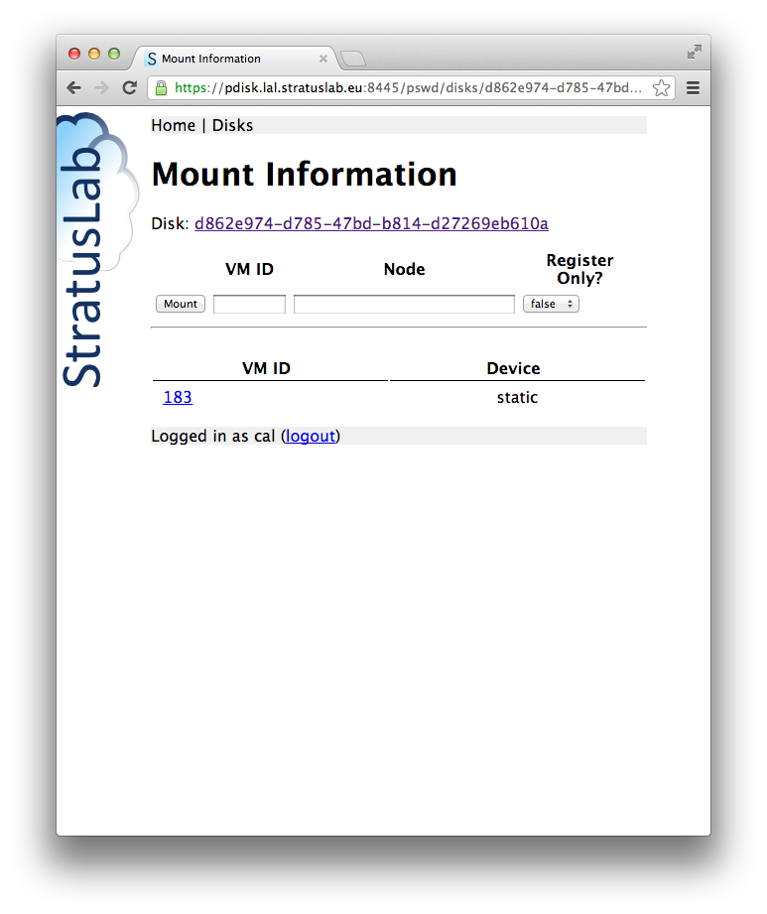
Mount Information (Web)
Disk UUID
Manual mount
Active mount
Disks mounted at deployment time will be marked as “static”.
Dynamically mounted disks will have device ID (to be taken with a bit of skepticism!).

Slide 7
Prepare Persistent Disk for Use
Log into the VM and find disk:
Use fdisk to find the unformatted volume with correct size.
Format disk:
Disk can also be partitioned, but this isn’t necessary.
$ ssh root@vm-219.lal.stratuslab.eu
#
# fdisk -l
...
Disk /dev/hdc: 5368 MB, 5368709120 bytes
255 heads, 63 sectors/track, 652 cylinders
Units = cylinders of 16065 * 512 = 8225280 bytes
Disk /dev/hdc doesn't contain a valid partition table
# mkfs.ext4 /dev/hdc
mke2fs 1.42.1 (17-Feb-2012)
...
Creating journal (32768 blocks): done
Writing superblocks and filesystem accounting information: done

Slide 8
Mount Disk and Store Data
Mount the disk:
Create directory for mount point and mount the disk there
Store some data on the disk:
We will check later that the data is preserved.
Unmount disk afterwards
# mkdir /mnt/pdisk
# mount /dev/hdc /mnt/pdisk
# ls /mnt/pdisk
lost+found
# echo "TESTING PERSISTENT DATA" > /mnt/pdisk/my-persistent-data
# cat /mnt/pdisk/my-persistent-data
TESTING PERSISTENT DATA
# umount /mnt/pdisk/
# ls /mnt/pdisk/
#

Slide 9
Second VM with Same Disk?
Start a new machine with same disk:
Why did this fail?
Disk is unmounted in first machine, but…
The machine is still active and the disk is still allocated to it!
It cannot be allocated to more than one machine.
Kill first machine, then retry.
$ stratus-run-instance --quiet \
--persistent-disk=d862e974-d785-47bd-b814-d27269eb610a \
${TTYLINUX_ID}
184, 134.158.75.220
$ stratus-describe-instance -v 184
...
id state vcpu memory cpu% host/ip name
184 Failed 1 0 0 vm-220.lal.stratuslab.eu one-184
Error deploying virtual machine: Could not create domain from /var/lib/one//184/images/deployment.0

Slide 10
Validate Data in New Instance
Start a new machine with same disk:
Check that the data is still on the disk:
$ stratus-run-instance --quiet \
--persistent-disk=d862e974-d785-47bd-b814-d27269eb610a \
${TTYLINUX_ID}
190, 134.158.75.226
$ stratus-describe-instance
id state vcpu memory cpu% host/ip name
190 Running 1 131072 5 vm-226.lal.stratuslab.eu one-190
# mkdir /mnt/pdisk
# mount /dev/hdc /mnt/pdisk
# ls /mnt/pdisk
lost+found my-persistent-data
# cat /mnt/pdisk/my-persistent-data
TESTING PERSISTENT DATA

Slide 11
Hot-Plug Disks
Dynamic mounting of persistent disks:
Volumes can be attached and detached from virtual machines while the machine is running.
This can be accomplished with both the command line or web interfaces.
Commands are: stratus-{attach/detach}-volume
Feature needs OS support:
OS must have the acpiphp kernel module available and loaded.
The ttylinux does not support this!
All other StratusLab maintained images have this enabled by default.

Slide 12
Attach Disk to Ubuntu VM
Disk UUID
Manual mount
Active mount
Mounts are visible on the web interface.
Mounts can be made via the web interface as well.

Slide 13
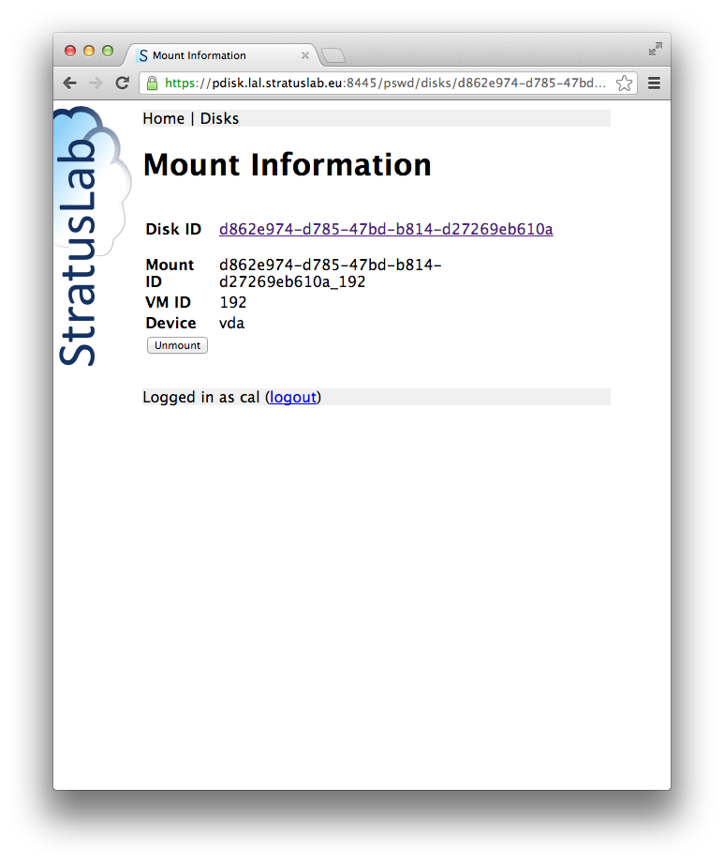
Mount Information (Web)
Mount details

Slide 14
Mount Information (Web)
Unmount the disk inside machine:
To avoid corruption, unmount file systems before detaching disk
To detach: stratus-detach-volume --instance VM_ID DISK_ID
# umount /mnt/pdisk
# exit
logout
Connection to vm-228.lal.stratuslab.eu closed.
$ stratus-detach-volume --instance 192 d862e974-d785-47bd-b814-d27269eb610a
DETACHED d862e974-d785-47bd-b814-d27269eb610a from VM 192 on /dev/vda

Slide 15
Detach Disk from Ubuntu VM
Unmount the disk inside machine:
To avoid corruption, unmount file systems before detaching disk
To detach: stratus-detach-volume --instance VM_ID DISK_ID
# umount /mnt/pdisk
# exit
logout
Connection to vm-228.lal.stratuslab.eu closed.
$ stratus-detach-volume --instance 192 d862e974-d785-47bd-b814-d27269eb610a
DETACHED d862e974-d785-47bd-b814-d27269eb610a from VM 192 on /dev/vda

Slide 16
Questions and Discussion

Slide 17
Exercises: Storage
Volatile Disks
Create VM with volatile disk.
Verify that disk space is present and usable.
Use persistent disk with a virtual machine
Verify that disk can be remounted on another machine
Verify that data on disk is preserved
Verify that disk can be mounted/unmounted from running VM (warning: use Ubuntu or CentOS, ensure acpiphp module is loaded!)

