Slide 1
Introduction to Cloud Technology
StratusLab Tutorial (Orsay, France)
28 November 2012

Slide 2
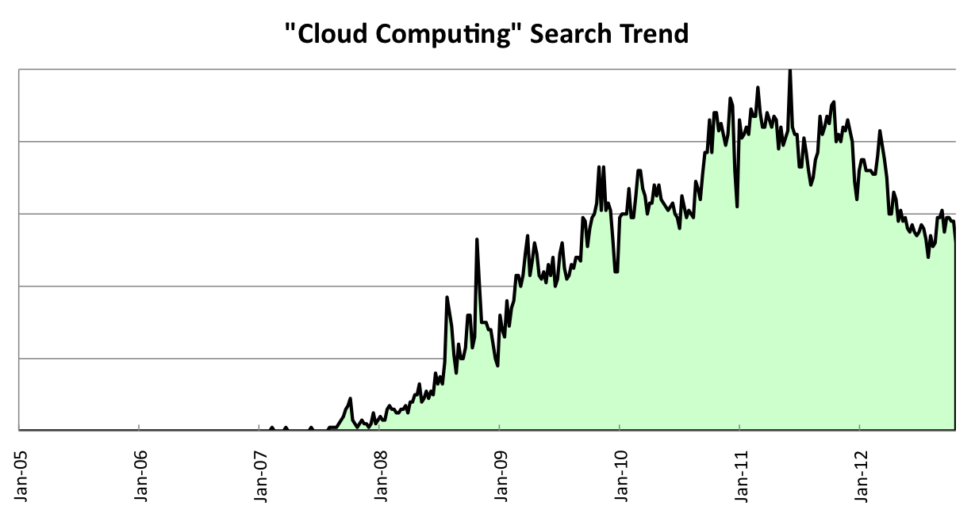
Cloud Marketing
“Cloud” is currently very trendy, used everywhere
Many definitions that are often incompatible
Used (often) to market pre-existing (non-cloud) software
Utility Computing (IBM, HP, …)
Commodity Computing (Sun)
Amazon EC2
Amazon EBS
Mature Virtualization
Simple APIs
Excess Capacity

Slide 3
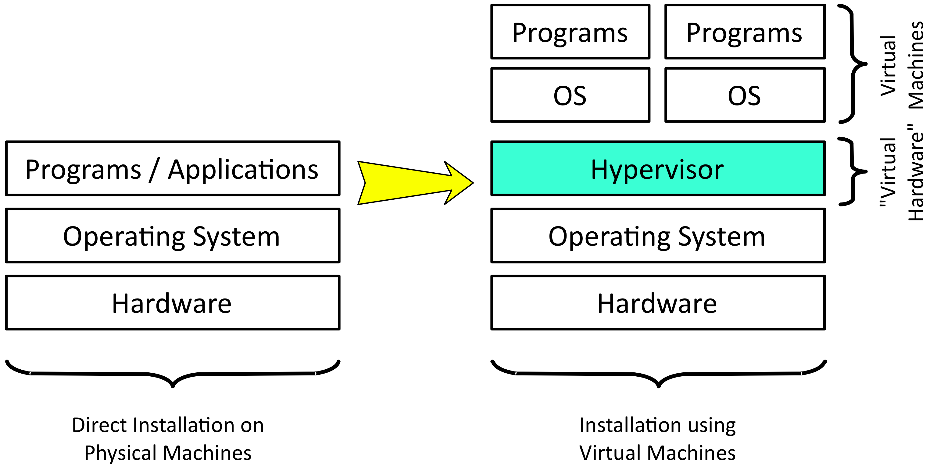
Virtualization
Different Maturity Levels
CPU: No perf. cost; transparent; ubiquitous
Storage: Some perf. penalty; config. touchy
Network: Least mature; expensive HW avail.

Slide 4
Web Service Interfaces
‘Traditional’ Web Services
Prioritizes easier implementation by developers
Very complex specifications, with (sadly) limited interoperability
Similarly complex tooling for developers
Supports only RPC architecture
REST, XMLRPC, HTTP Query APIs
Prioritizes easy access by clients
Universal language support by relying on std. HTTP protocol
Both RPC and Resource Oriented Architectures possible

Slide 5
Excess Computing Capacity
Amazon
Dimensioned to handle Christmas rush
Idle machines/resources other times of year
Monetize investment in these services
Allowed resources to be offered at excellent prices
Dedicated Data Centers
Moved from monetizing existing investment to profit center
Now Amazon and others have dedicated centers for the cloud!

Slide 6
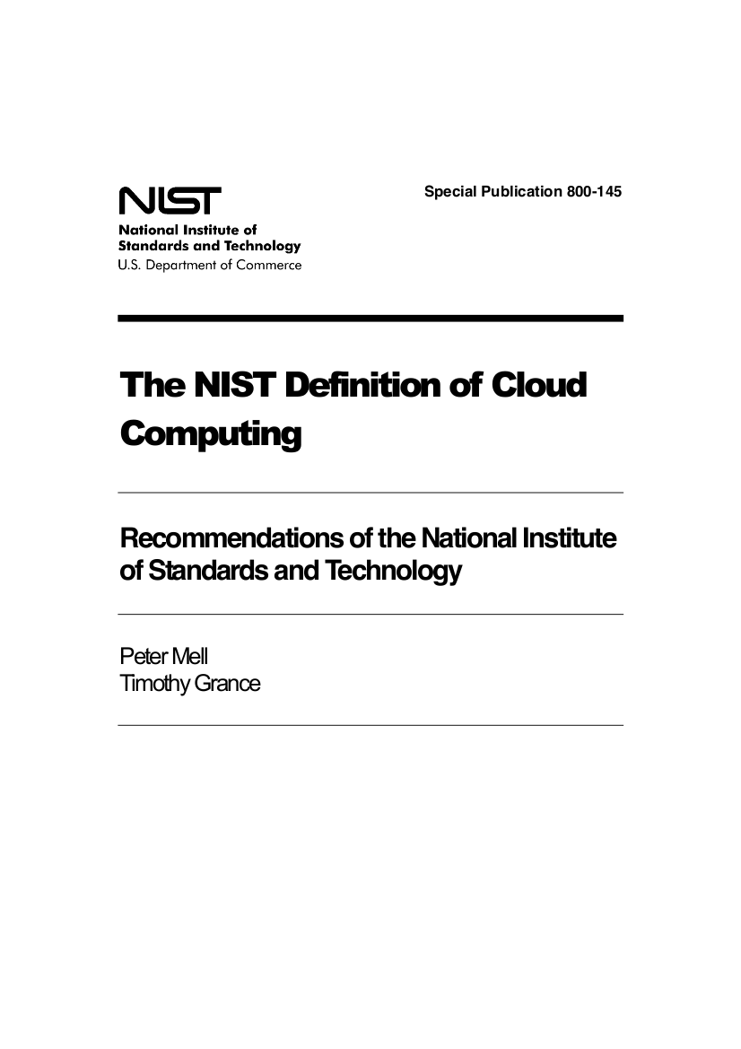
What is a Cloud?
NIST: Best Definitions
Essential characteristics
Service models
Deployment models
Just 2 pages of text!
http://csrc.nist.gov/publications/ nistpubs/800-145/SP800-145.pdf

Slide 7
Essential Characteristics
On-demand self-service
Users provision computing resources without human intervention
Broad network access
Fast, reliable access to remote (cloud) resources via the network
Rapid elasticity
Ability to scale the resources rapidly based on application needs
Resource pooling
Multi-tenant sharing of resources
Measured service
Control and optimization of resources through measured use

Slide 8
Other Distributed Computing Systems
Remote Services
RackSpace, etc.
Separates service management from hardware management
Volunteer Computing
BOINC, XtremWeb, etc.
Takes advantage of idle, private, and volatile resources
Batch Systems
LSF, PBS, etc.
Permits worker nodes on different sites, but centrally managed
Grid Computing
European Grid Infrastructure (EGI), Open Science Grid (OSG)
Federating distributed data centers for easier access, better efficiency

Slide 9
Service Models
What resources are offered to customers or clients?

Slide 10
Service Models
Vendor Lock-In
Software as a Service (SaaS)
Flexibility
Platform as a Service (PaaS)
Infrastructure as a Service (IaaS)

Slide 11
Software as a Service (SaaS)
Abstraction
Essentially web-hosting
Aimed at End-users
Advantages
Very simple use: web interface with no software installation
Very accessible: laptop, smartphone, …
Disadvantages
Questions about data: access, ownership, reliability, etc.
Integration of different services and novel uses of data are often difficult
Software as a Service (SaaS)
Platform as a Service (PaaS)
Infrastructure as a Service (IaaS)

Slide 12
Platform as a Service (PaaS)
Abstraction
Platform and infrastructure for creating web applications
Aimed at developers
Advantages
Load balancing, automatic failover, etc.
Programmers can forget about the low-level “plumbing”
Disadvantages
Restricted number of languages
Applications are not portable between different providers
Software as a Service (SaaS)
Platform as a Service (PaaS)
Infrastructure as a Service (IaaS)

Slide 13
Infrastructure as a Service (IaaS)
Abstraction
Access to remote virtual machines
Aimed at service providers
Advantages
Customized environment
Simple and rapid access
Access as “root”
Pay-as-you-go model
Disadvantages
Non-standardized and multiple interfaces (vendor lock-in)
Virtual machine creation is difficult and time-consuming
Software as a Service (SaaS)
Platform as a Service (PaaS)
Infrastructure as a Service (IaaS)

Slide 14
Deployment Models
Who are the users and what ties them together?

Slide 15
Deployment Models
Private
Single administrative domain, limited number of users
Resource allocation usually ‘informal’, hallway conversations
E.g. site uses cloud for standard site services, managed by sysadmins
Community
Different administrative domains but with common interests/procedures
Resource allocation usually formalized ‘horse trading’
E.g. high-energy physics community
Public
People outside of institute’s administrative domain, general public
Resource allocation by payment
E.g. Amazon Web Services (EC2, S3, …)
Hybrid
Combination of other deployment models to federate resources

Slide 16
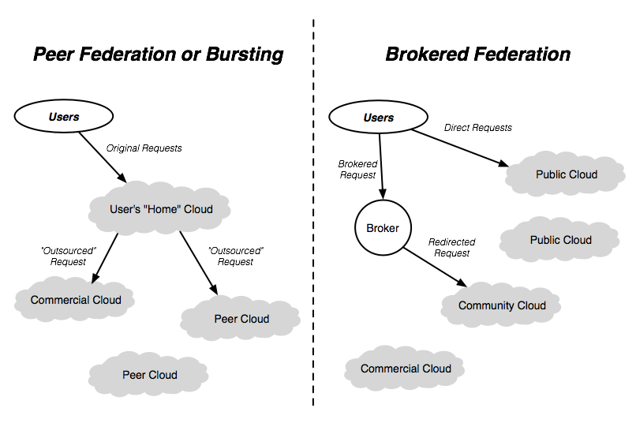
Hybrid Clouds and “Sky” Computing

Slide 17
Questions and Discussion

Slide 18
Exercise: Your Interest in Clouds
Researchers and Engineers (End-users)
Use existing academic and/or commercial software on cloud
What scientific domains?
Developers
Modify existing software to use cloud resources
Create new software for the cloud
What types of software?
Administrators
Provide cloud resources to researchers, engineers, and/or developers
What types of users? Local, multi-institute, …?

Slide 19
Exercise: Commercial Services
What are the characteristics of clouds?
Are these clouds: gmail, facebook, twitter, dropbox, iCloud?
What characteristics does each have?
What limitations does each have?
How would these work with scientific computation?

