Slide 1
Virtual Machine Lifecycle
StratusLab Tutorial (Orsay, France)
28 November 2012

Slide 2
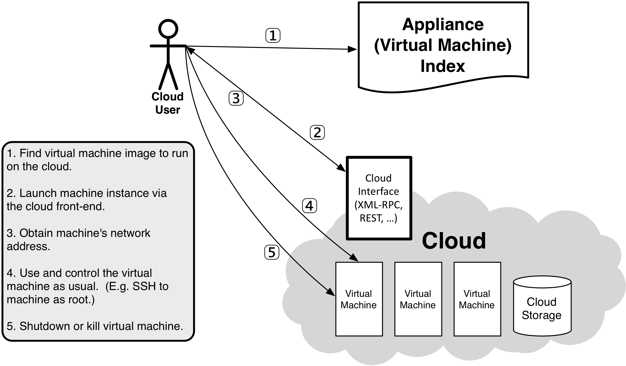
Virtual Machine Lifecycle

Slide 3
Virtual Machine Lifecycle Commands
Lifecycle consists of these commands:
Deploy: stratus-run-instance Marketplace_ID
Describe: stratus-describe-instance VM_ID
Login: ssh root@134.158.75.xxx OR stratus-connect-instance VM_ID
Delete: stratus-kill-instance VM_ID

Slide 4
Deploy a VM from the Marketplace
Find ttylinux machine image in Marketplace:
Browse the Marketplace: https://marketplace.stratuslab.eu
export TTYLINUX_ID=BN1EEkPiBx87_uLj2-sdybSI-Xb
Deploy your virtual machine:
stratus-run-instance ${TTYLINUX_ID}
Response should give the VM ID and Public IP address:
$ export TTYLINUX_ID=BN1EEkPiBx87_uLj2-sdybSI-Xb
$ stratus-run-instance ${TTYLINUX_ID}
:::::::::::::::::::::::::
:: Starting machine(s) ::
:::::::::::::::::::::::::
:: Starting 1 machine
:: Machine 1 (vm ID: 165)
Public ip: 134.158.75.201
:: Done!

Slide 5
Status of Virtual Machines
List all active machines:
stratus-describe-instance
State of a single machine:
stratus-describe-instance VM_ID
More details with -v, -vv, and -vvv options
Verbose options especially helpful when machines fail!
$ stratus-describe-instance
id state vcpu memory cpu% host/ip name
165 Running 1 0 0 vm-201.lal.stratuslab.eu one-165
166 Pending 1 0 0 vm-202.lal.stratuslab.eu one-166
$ stratus-describe-instance 165
id state vcpu memory cpu% host/ip name
165 Running 1 131072 1 vm-201.lal.stratuslab.eu one-165

Slide 6
Connect to the Virtual Machine
Ping machine to see when machine is accessible:
ping VM_NAME
Log into machine as root:
ssh root@VM_NAME
OR stratus-connect-instance VM_ID
$ ping vm-201.lal.stratuslab.eu
PING vm-201.lal.stratuslab.eu (134.158.75.201): 56 data bytes
Request timeout for icmp_seq 0
64 bytes from 134.158.75.201: icmp_seq=1 ttl=63 time=0.876 ms
64 bytes from 134.158.75.201: icmp_seq=2 ttl=63 time=0.761 ms
64 bytes from 134.158.75.201: icmp_seq=3 ttl=63 time=0.850 ms
...
$ ssh root@vm-201.lal.stratuslab.eu
#
# echo $USER
root
#

Slide 7
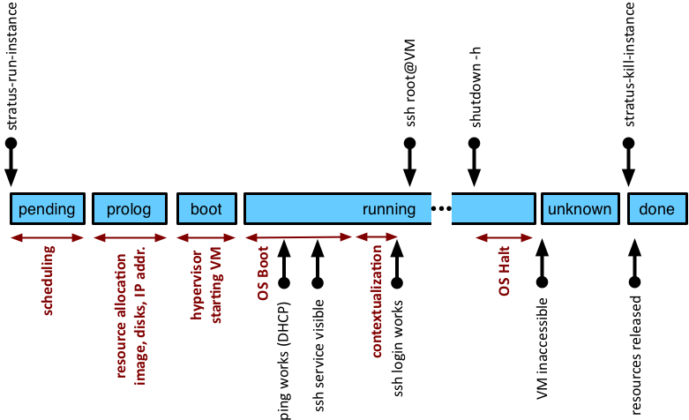
Machine Timeline and States
Failed: Problem starting/running VM.

Slide 8
Graceful Shutdown
Safely stop all services and halt machine:
From within machine: shutdown –h
Kill (remove) machine when in “unknown” state or no longer visible:
This mechanism ensures that resources (esp. data volumes) are shut down cleanly and released.
# shutdown -h
#
Connection to vm-201.lal.stratuslab.eu closed by remote host.
Connection to vm-201.lal.stratuslab.eu closed.
$ stratus-describe-instance 165
id state vcpu memory cpu% host/ip name
165 Unknown 1 131072 0 vm-201.lal.stratuslab.eu one-165
$ stratus-kill-instance 165
$

Slide 9
Forced Machine Halt
Kill (remove) the machine immediately:
stratus-kill-instance VM_ID
Information can be obtained from completed machines, but the VM ID needs to be known.
$ stratus-kill-instance 166
$
$ stratus-describe-instance 166
id state vcpu memory cpu% host/ip name
166 Done 1 131072 0 vm-202.lal.stratuslab.eu one-166

Slide 10
Resources Allocated to VMs
You control the number of CPUs, amount of RAM and swap space allocated to the VM.
StratusLab has a number of predefined machine configs.:
stratus-run-instance --list-type
Default is marked with an asterisk!
Maximum values determined by the largest single physical machine.
$ stratus-run-instance --list-type
Type CPU RAM SWAP
c1.medium 1 CPU 256 MB 1024 MB
c1.xlarge 4 CPU 2048 MB 2048 MB
m1.large 2 CPU 512 MB 1024 MB
* m1.small 1 CPU 128 MB 1024 MB
m1.xlarge 2 CPU 1024 MB 1024 MB
t1.micro 1 CPU 128 MB 512 MB

Slide 11
Non-standard Machine Types
What happens when you need resource allocations different from the predefined types?
Use resource options to override the defaults:
--cpu for changing number of CPU cores
--ram for changing the available memory (in MB)
--swap for changing the available swap space (in MB)
Can also edit machine template for full control:
$HOME/stratuslab/share/vm/schema.one
NOTE: Machine images must be capable of using multiple CPUs, additional RAM, etc.

Slide 12
Deploy a Large VM
Deploy a VM of type “m1.xlarge”:
stratus-run-instance --type=m1.xlarge ${TTYLINUX_ID}
CPUs and memory can be seen from the command line
Swap space can be seen from within the machine
(Note: ttylinux doesn’t use swap space!)
$ stratus-run-instance --quiet --type=m1.xlarge ${TTYLINUX_ID}
167, 134.158.75.203
$ stratus-describe-instance 167
id state vcpu memory cpu% host/ip name
167 Running 2 1048576 5 vm-203.lal.stratuslab.eu one-167

Slide 13
Questions and Discussion

Slide 14
Exercises: Deploy Machines
Deploy Virtual Machines
Try different operating systems (ttylinux, Ubuntu, CentOS) using the recommended image identifiers
Change the machine types and allocated resources and ensure that the resources are actually allocated
Try both graceful shutdowns and kills
It is often useful to have a custom name for a machine. What option allows this? Does it work?
Create a Web Site
Deploy virtual machine with a web server
Customize landing page or other content
Verify that you can access the site with your browser, showing the customized content

