Slide 1
Persistent Storage
StratusLab Tutorial (Orsay, France)
28 November 2012

Slide 2
Persistent Disk (Volume)
Use: Persistent storage of data with lifecycle independent of a single virtual machine instance.
Workflow
Create a disk with a given size via command line or web interface
Launch a machine instance referencing that image
Format (mkfs) the disk via the running VM
Store data to the disk as usual
Unmount the disk
Halt the machine instance or detach disk from machine
Disk with persistent data is available for use by another VM
Only format disk the first time it is used!

Slide 3
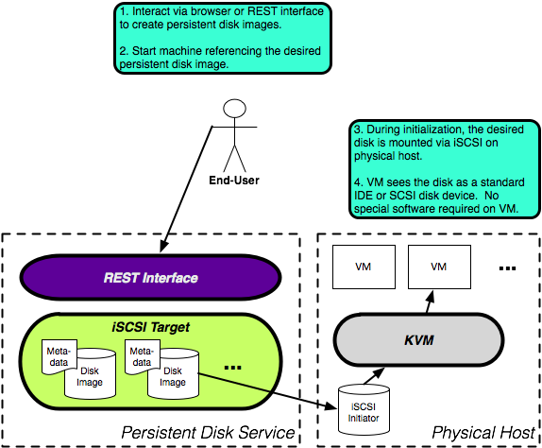
Persistent Storage Architecture

Slide 4
Using a Persistent Disk
Client Configuration
Persistent disk service endpoint defaults to VMM endpoint
If on another machine, the service endpoint must be given explicitly
For LAL use: pdisk.lal.stratuslab.eu

Slide 5
Create Persistent Disk (CLI)
Provide size for disk and other options to create:
stratus-create-volume --size=SIZE --tag=TAG
All volumes have a unique identifier (UUID) associated with them
UUID is used to control the given volume
Get information about volume(s)
stratus-describe-volumes [UUID]
Command works just like stratus-describe-instance does
$ stratus-create-volume --size=2 --tag=mydisk
DISK 9682962d-4082-47df-bfe7-4e41a2fd0463
$ stratus-describe-volumes 9682962d-4082-47df-bfe7-4e41a2fd0463
:: DISK 9682962d-4082-47df-bfe7-4e41a2fd0463
count: 0
owner: cal
tag: mydisk
size: 2

Slide 6
Disk Access
Restrictions
Volume can only be mounted on one machine at a time
Volume cannot be deleted when in use
Primitive Access Control:
By default, created disks are “private” (--private option), with only the owner able to read, write and delete the volume.
Disks marked as “public” (use --public option) can be read and written by anyone; only owner can delete it
More elaborate (and useful) access control will appear when general groups and roles are implemented for all services

Slide 7
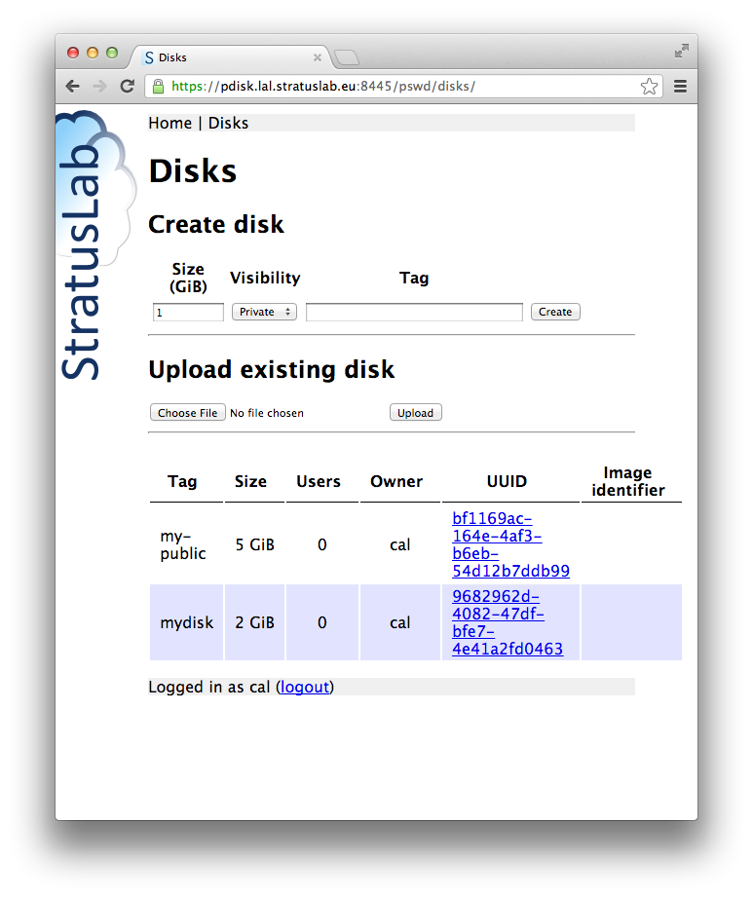
Create Persistent Disk (Web)
Log into interface with your username/password.
Cancel requests for a certificate!
Create new volumes
List of available volumes
https://pdisk.lal.stratuslab.eu:8445/pswd/disks/

Slide 8
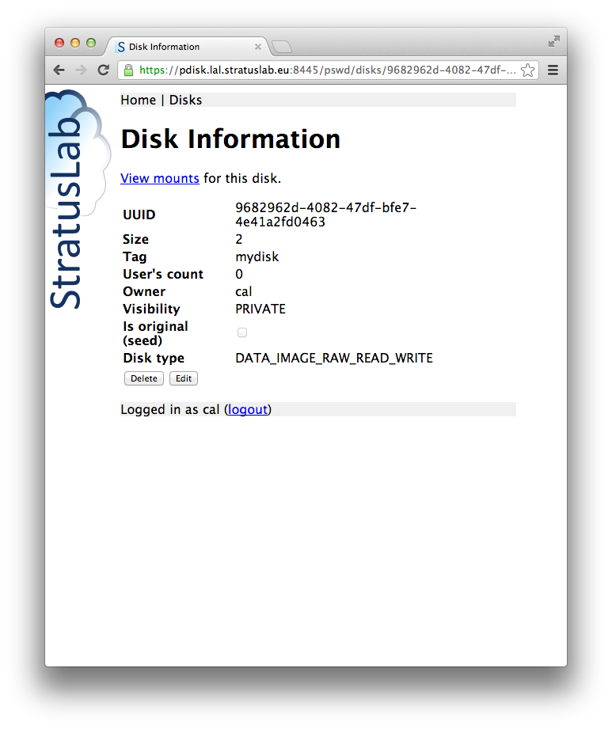
Disk Detail (Web)
Mount info.
Volume info.
Control volume

Slide 9
Delete Persistent Disk
Note
Volume cannot be deleted when in use!
Web interface:
Click the delete button for the disk
Caution: there is no “Confirm?” dialog!
CLI:
Use: stratus-delete-volume UUID
$ stratus-delete-volume bf1169ac-164e-4af3-b6eb-54d12b7ddb99
DELETED bf1169ac-164e-4af3-b6eb-54d12b7ddb99

Slide 10
Questions and Discussion

Slide 11
Exercises: Persistent Storage
Persistent Disk Lifecycle
Run through entire lifecycle without using a VM
Do this both via the command line interface and via the browser

