Slide 1




LHC Status & Plans
Frank Zimmermann, CERN/BE
LAL, 28 June 2013
Work supported by the European Commission under the FP7 Research Infrastructures project EuCARD, grant agreement no.~227579

Slide 2
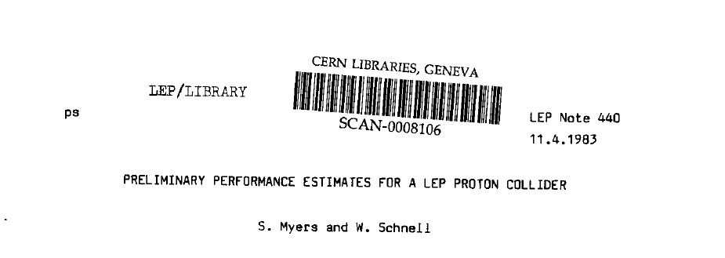
short LHC history
1983 LEP Note 440 - S. Myers and W. Schnell propose
twin-ring pp collider in LEP tunnel with 9-T dipoles
1991 CERN Council: LHC approval in principle
1992 EoI, LoI of experiments
1993 SSC termination
1994 CERN Council: LHC approval
1995-98 cooperation w.Japan,India,Russia,Canada,&US
2000 LEP completion
2006 last s.c. dipole delivered
2008 first beam
2010 first collisions at 3.5 TeV beam energy
2015 collisions at ~design energy (plan)
we are already late if we want
to get a new machine by ~2040!
>30 years!

Slide 3
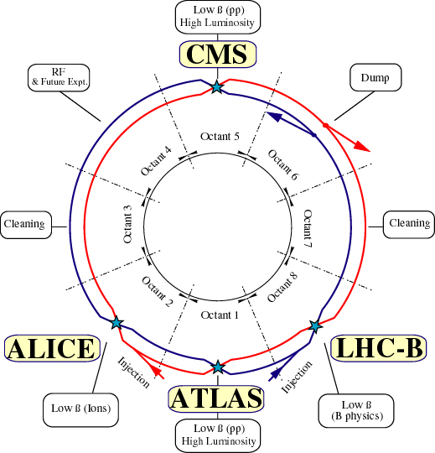
LHC: highest energy pp, AA, and pA collider
design parameters
c.m. energy = 14 TeV (p)
luminosity =10³⁴ cm⁻²s⁻¹
1.15x10¹¹ p/bunch
2808 bunches/beam
360 MJ/beam
γε=3.75 μm
β*=0.55 m
θ_{c}=285 μrad
σ_{z}=7.55 cm
σ*=16.6μm

Slide 4
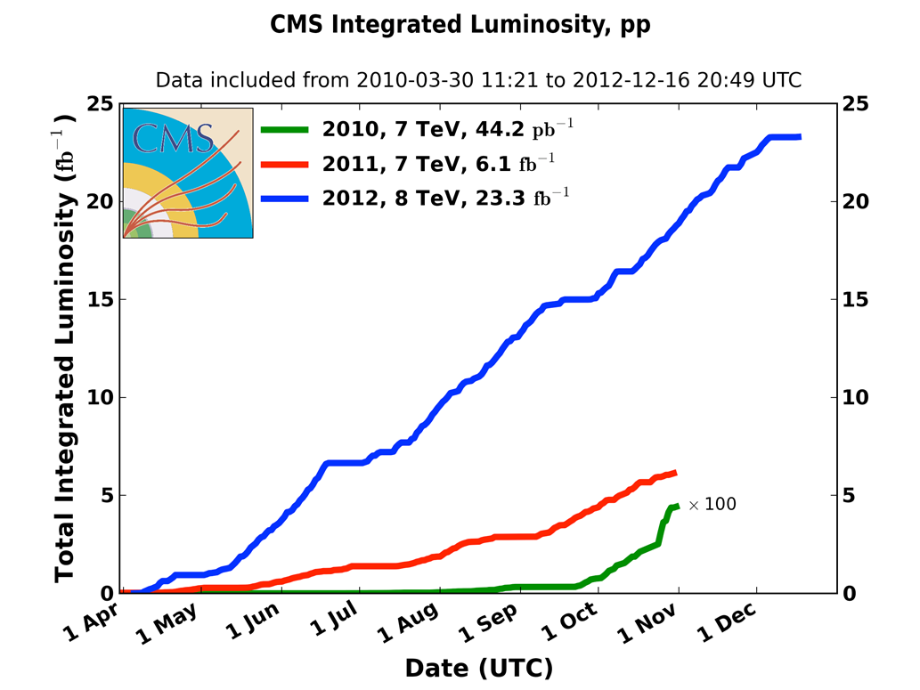
integrated pp luminosity 2010-12
2010: 0.04 fb⁻¹
  7 TeV CoM
  Commissioning
2011: 6.1 fb⁻¹
  7 TeV CoM
  Exploring the limits
2012: 23.3 fb⁻¹
  8 TeV CoM
  Production
M. Lamont, IPAC’13

Slide 5
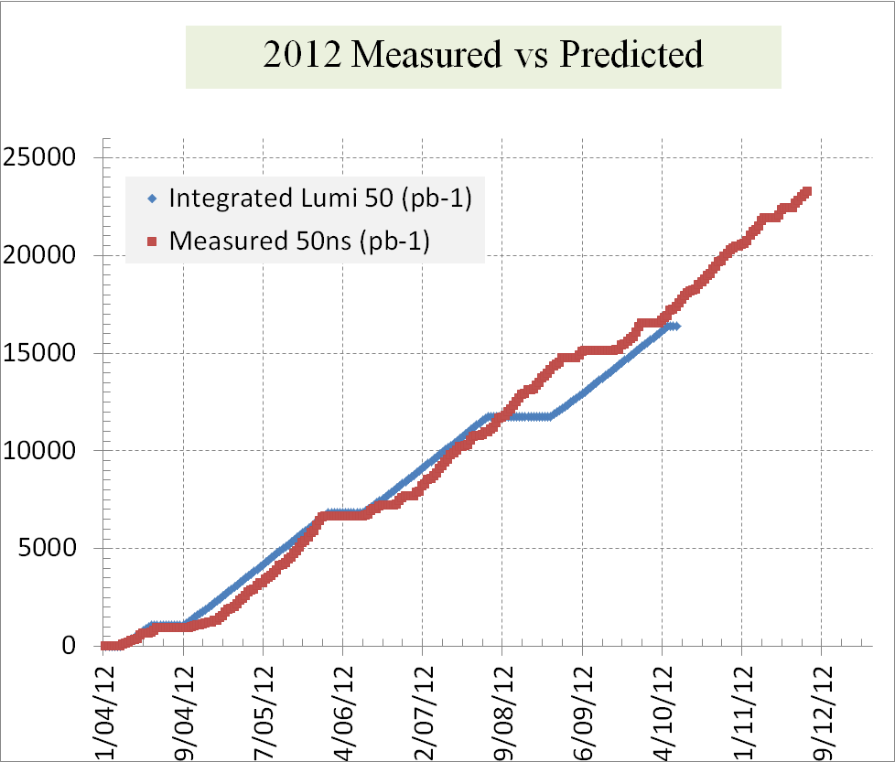
reliable luminosity forecasts

Slide 6
peak performance through the years
 | 2010 | 2011 | 2012 | Nominal
bunch spacing [ns] | 150 | 50 | 50 | 25
no. of bunches | 368 | 1380 | 1380 | 2808
beta* [m] ATLAS and CMS | 3.5 | 1.0 | 0.6 | 0.55
max. bunch intensity [protons/bunch] | 1.2 x 10¹¹ | 1.45 x 10¹¹ | 1.7 x 10¹¹ | 1.15 x 10¹¹
normalized emittance [mm-mrad] | ~2.0 | ~2.4 | ~2.5 | 3.75
peak luminosity [cm⁻²s⁻¹] | 2.1 x 10³² | 3.7 x 10³³ | 7.7 x 10³³ | 1.0 x 10³⁴
>2x design when scaled to 7 TeV!
M. Lamont, IPAC’13

Slide 7
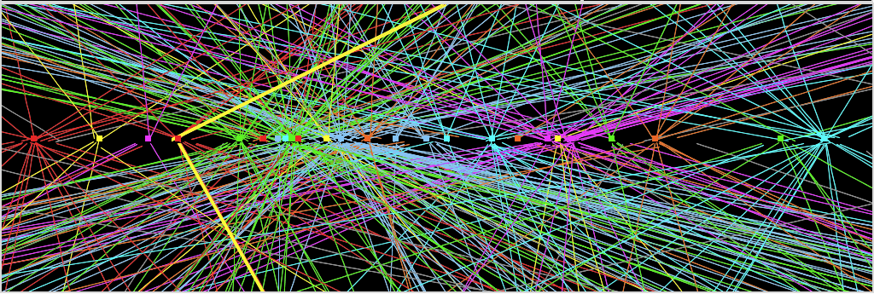
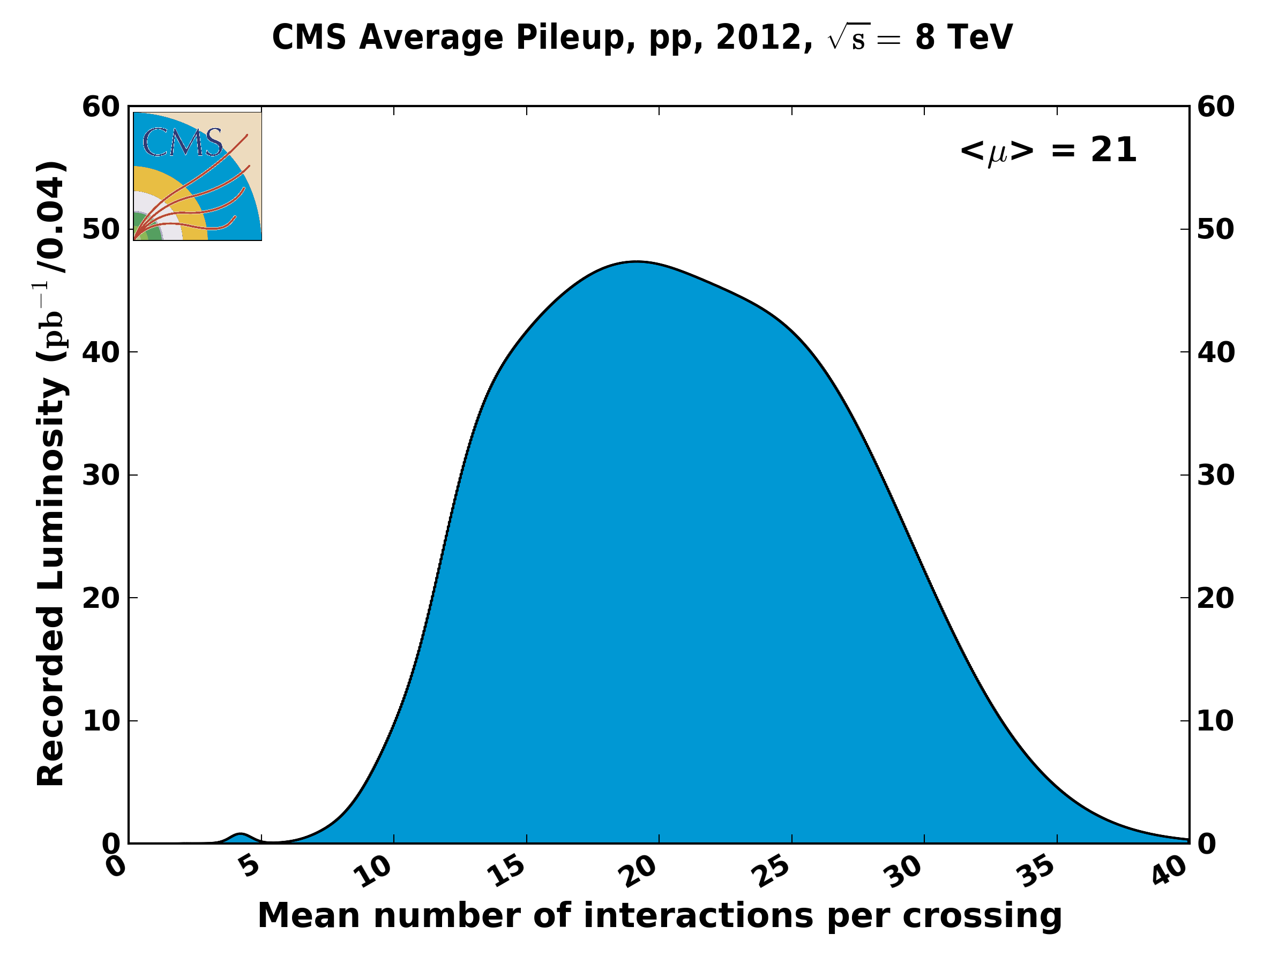
Z→ μμ event from 2012 data with 25 reconstructed vertices
Huge efforts over last months to prepare for high lumi and pile-up expected in 2012:
optimized trigger and offline algorithms (tracking, calo noise treatment, physics objects)
→ mitigate impact of pile-up on CPU, rates, efficiency, identification, resolution
in spite of x2 larger CPU/event and event size → we do not request additional computing
resources (optimized computing model, increased fraction of fast simulation, etc.)
ATLAS
7
pile up
will increase
at higher energy
→
experiments
request
25 ns
operation
in 2015
M. Lamont, IPAC’13

Slide 8

ATLAS & CMS pp physics

Slide 9
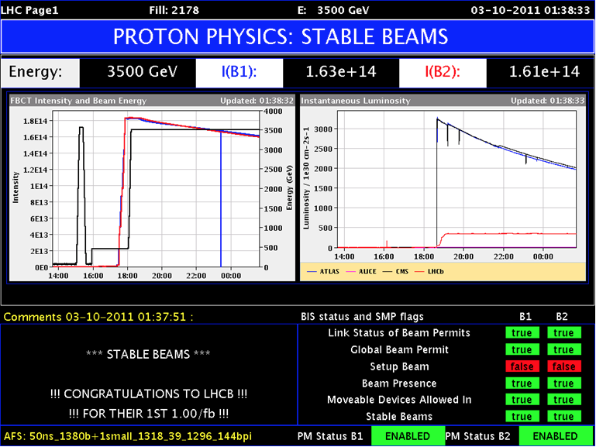
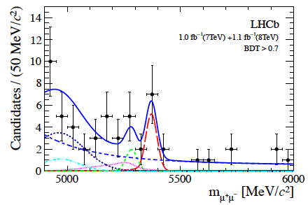
LHCb
luminosity levelling at around 4e32 cm⁻²s⁻¹ via transverse separation
(with a tilted crossing angle)
ATLAS/CMS
LHCb
not completely trivial!
first evidence for the decay B_{s} -> μ⁺ μ⁻
M. Lamont, IPAC’13

Slide 10
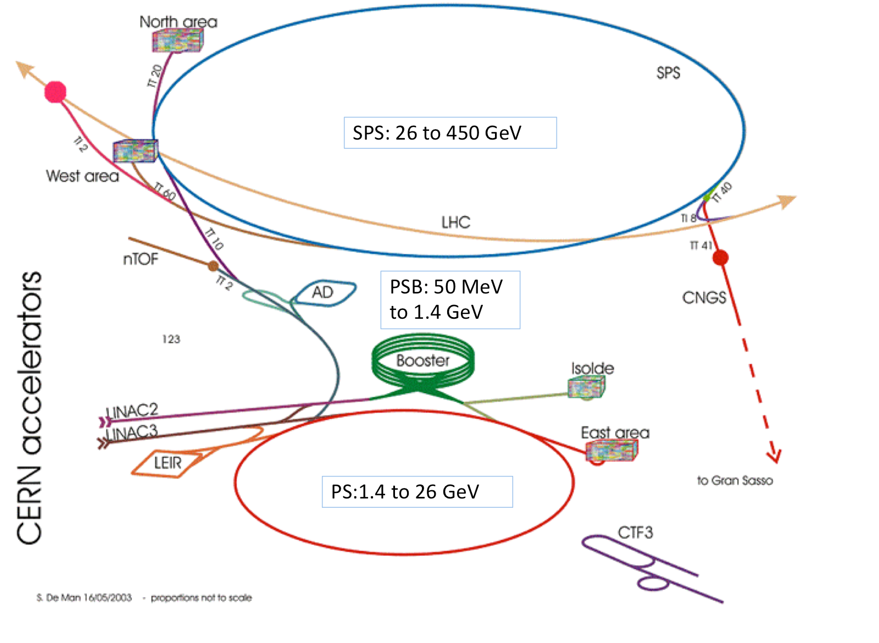
LHC injector complex
M. Lamont

Slide 11
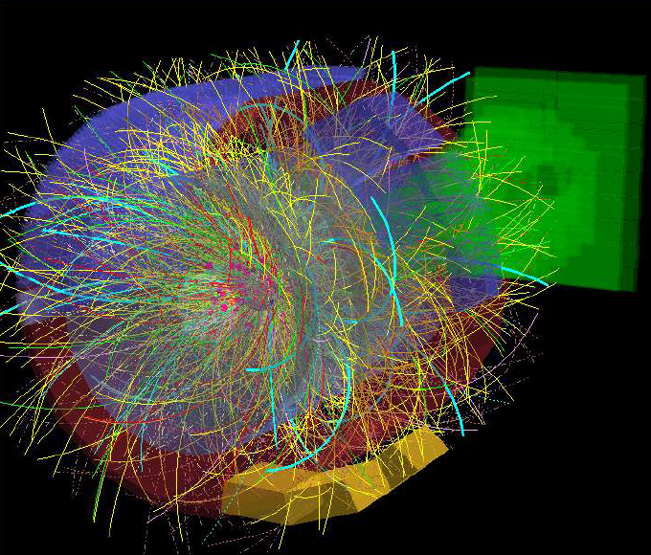
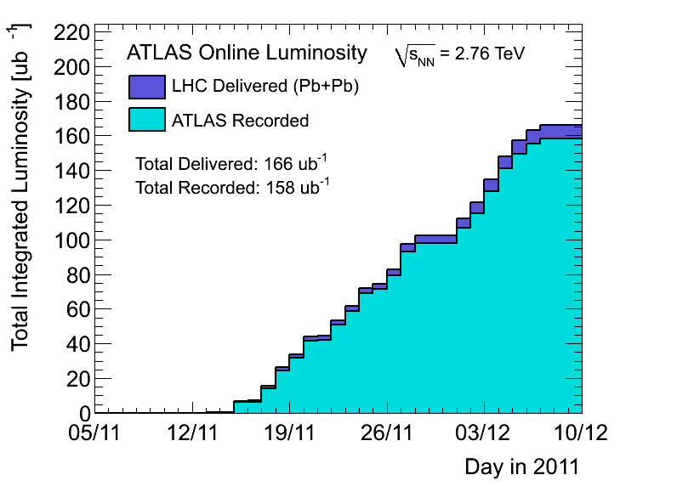
Pb-Pb
good performance from the injectors - bunch intensity and emittance
preparation, Lorentz’ law: impressively quick switch from protons to ions
peak luminosity around 5 x 10²⁶ cm⁻²s⁻¹ at 3.5Z TeV (2011) – nearly twice design when scaled to 6.5Z TeV
M. Lamont, IPAC’13

Slide 12
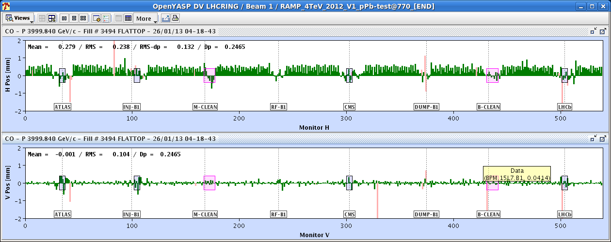
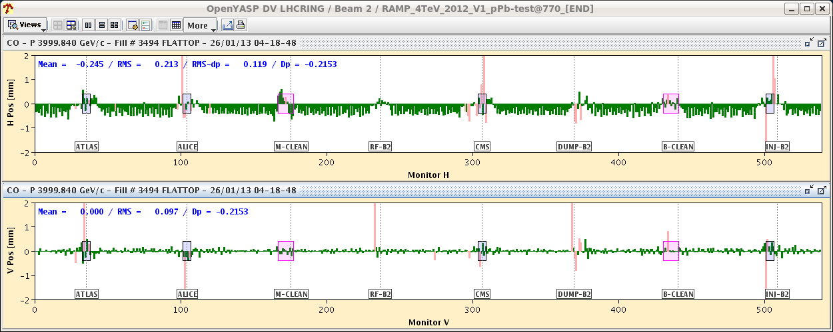
proton-lead
beautiful result in early 2013
final integrated luminosity above experiments’ request of 30 nb⁻¹
injectors: average number of ions per bunch was ~1.4x10⁸ at start of stable beams, i.e. around twice the nominal intensity
B1(p)
B2(Pb)
H(mm)
H(mm)
V(mm)
V(mm)
beam orbits at top energy with RF frequencies locked to Beam 1
M. Lamont, IPAC’13

Slide 13
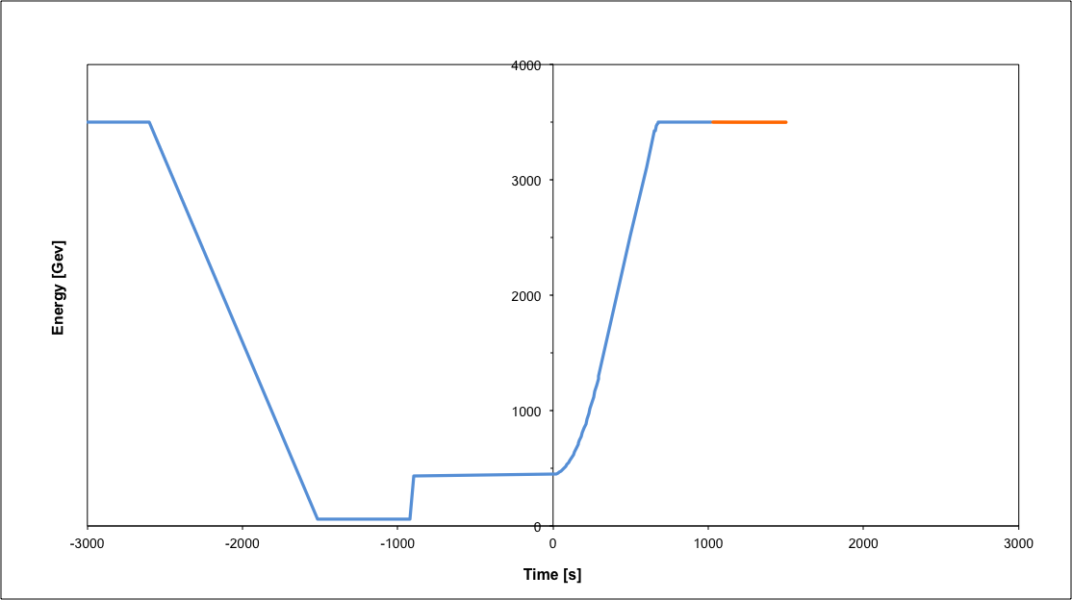
operational cycle
Beam dump
Squeeze
Stable beams
Collide
Ramp
Ramp down/precycle
Ramp down | 35 mins
Injection | ~30 mins
Ramp | 12 mins
Squeeze | 15 mins
Collide | 5 mins
Stable beams | 0 – 30 hours
Injection
turn around 2 to 3 hours on a good day
M. Lamont, IPAC’13

Slide 14
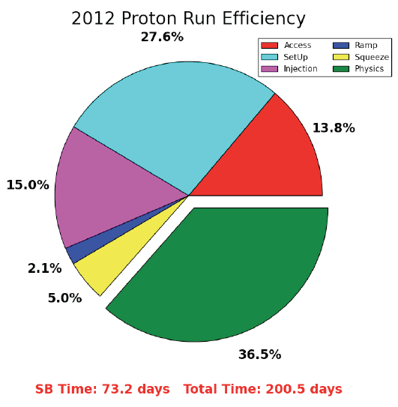
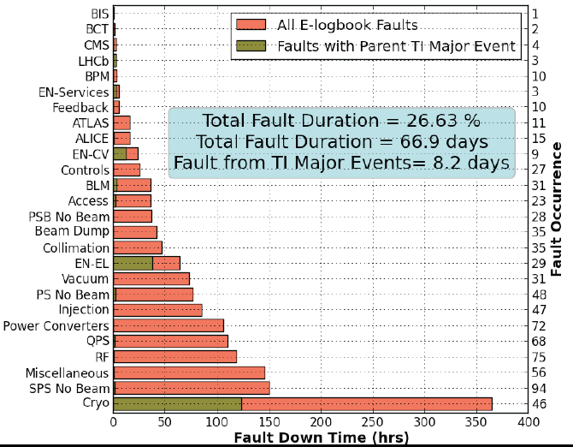
availability
“There are a lot of things that can go wrong – it’s always a battle”
Pretty good availability considering the complexity and principles of operation
Cryogenics availability in 2012: 93.7%
M. Lamont, IPAC’13

Slide 15
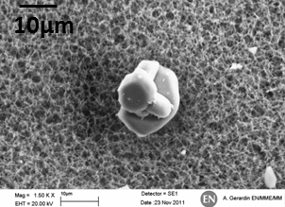
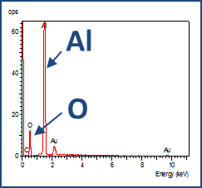
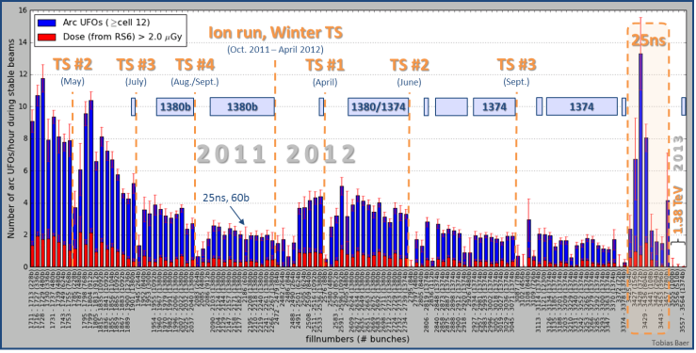
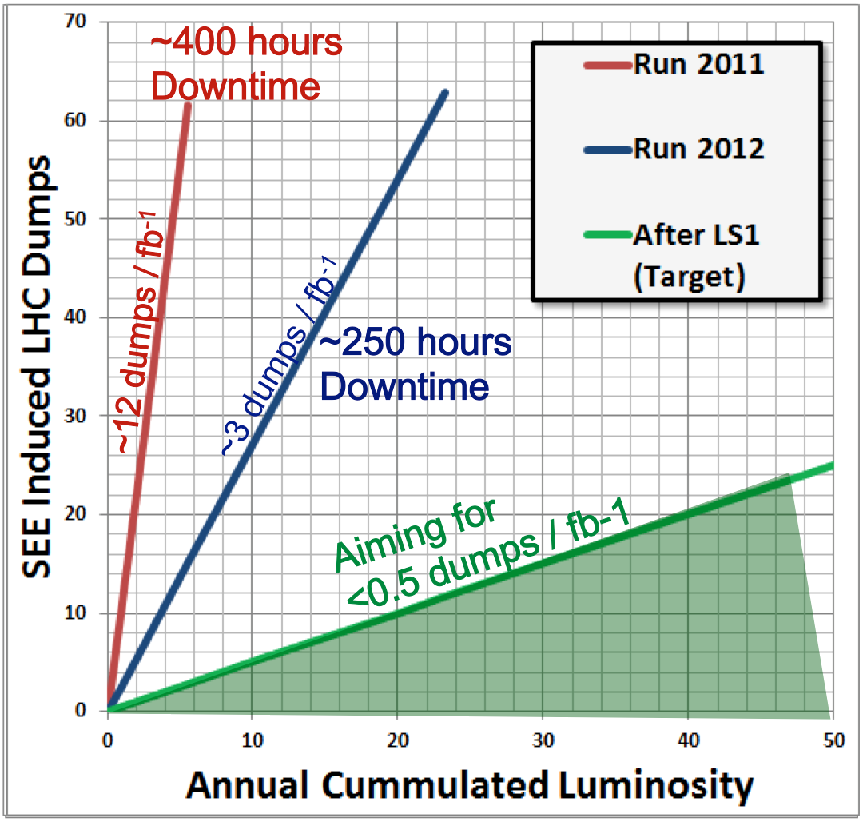
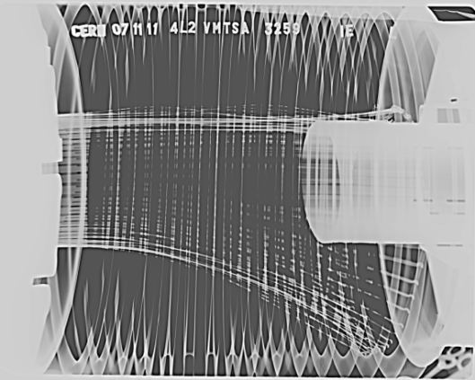
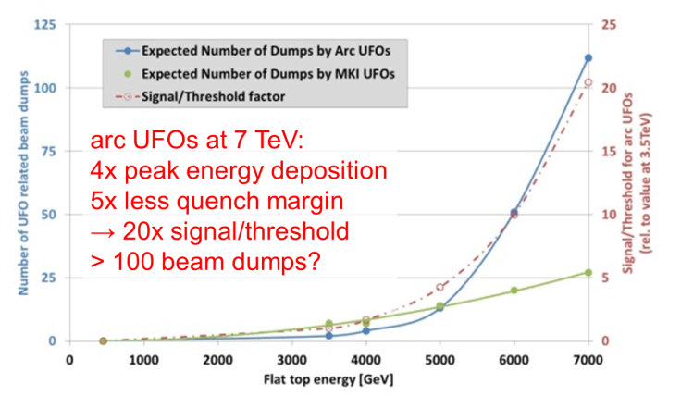
some issues in 2011-12 operation
Beam induced heating
Local non-conformities (design, installation)
  injection protection devices
  sync. Light mirrors
  vacuum assemblies
UFOs
20 dumps in 2012
time scale 50-200 µs
conditioning observed
worry about 6.5 TeV and 25 ns spacing
Radiation to electronics
concerted program of mitigation measures (shielding, relocation…)
premature dump rate down from 12/fb⁻¹ in 2011 to 3/fb⁻¹ in 2012
T. Baer

Slide 16



earlier this week –
“All Clear” for LHC UFOs?
phys.org

Slide 17
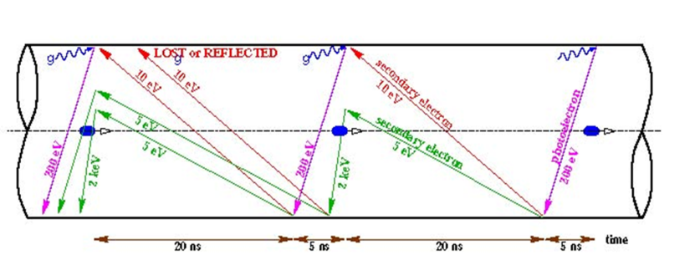
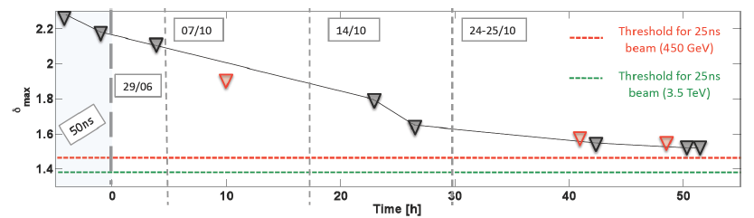
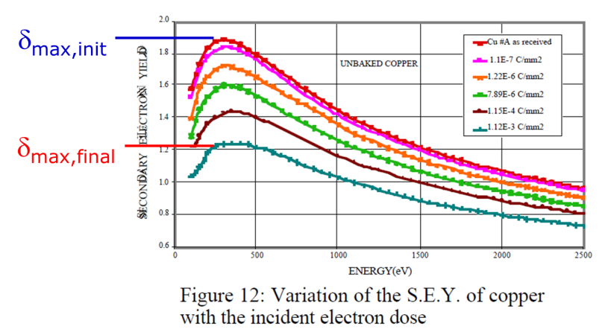
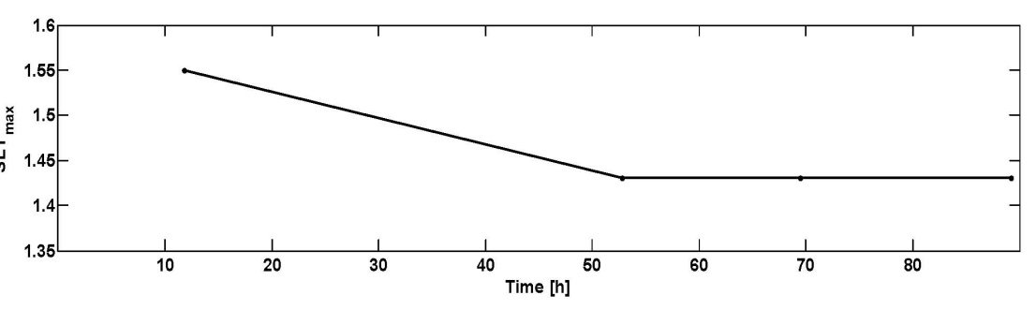
another issue in 2011-12 operation
Electron cloud
beam induced multipactoring process, depending on secondary emission yield
LHC strategy based on surface conditioning (scrubbing runs)
worry about 25 ns (more conditioning needed) and 6.5 TeV (photoelectrons)
25-ns scrubbing in 2011 – decrease of SEY
25-ns scrubbing in 2012 – conditioning stop?
G. Iadarola, G. Rumolo

Slide 18
Long Shutdown 1 - motivation
after 2008 incident partial consolidation
& related problem of imperfect Cu
stabilizer continuity discovered
in 2010-12 LHC operated at 7 & 8 TeV c.m.
beam energy to avoid any risk
presently: Long Shutdown 1 (LS1) ~2 yr
to prepare LHC for 13-14 TeV c.m.,
detector upgrades in parallel

Slide 19
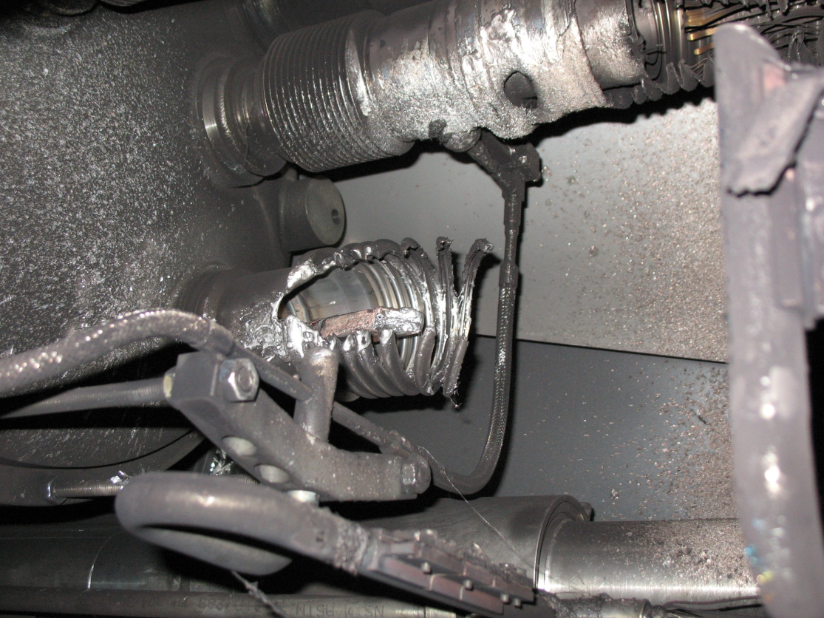
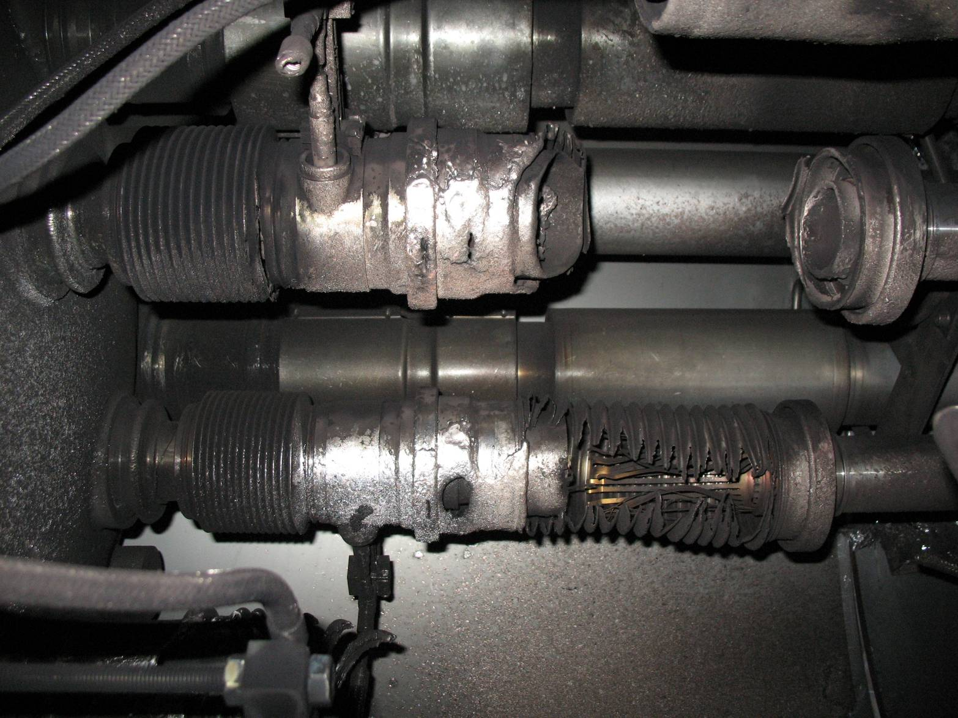
2008 “incident”
A faulty bus-bar (SC splice) in a magnet interconnect failed, leading to an electric arc which dissipated some 275 MJ
This burnt through beam vacuum and cryogenic lines, rapidly releasing ~2 tons of liquid helium into the vacuum enclosure
R. Veness

Slide 20
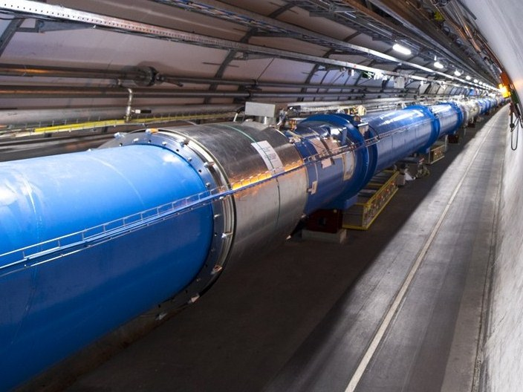
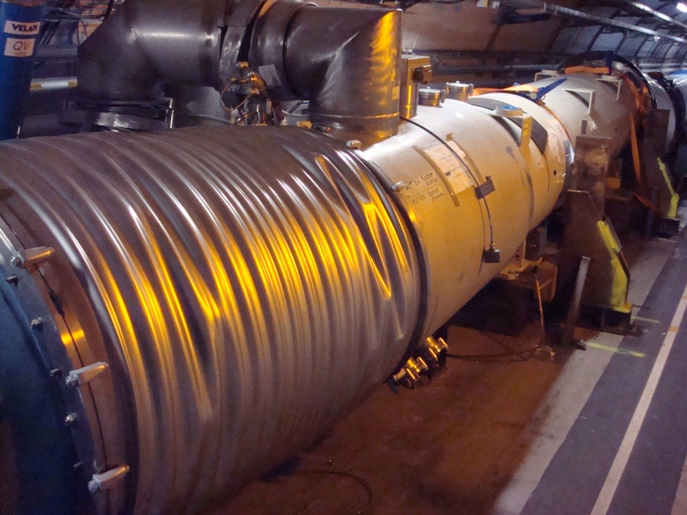

Slide 21
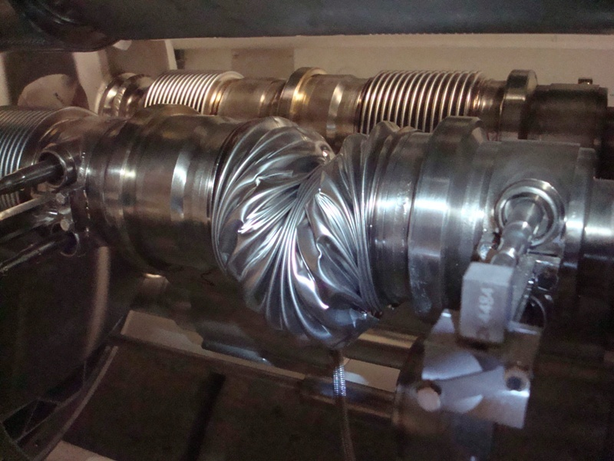

Slide 22
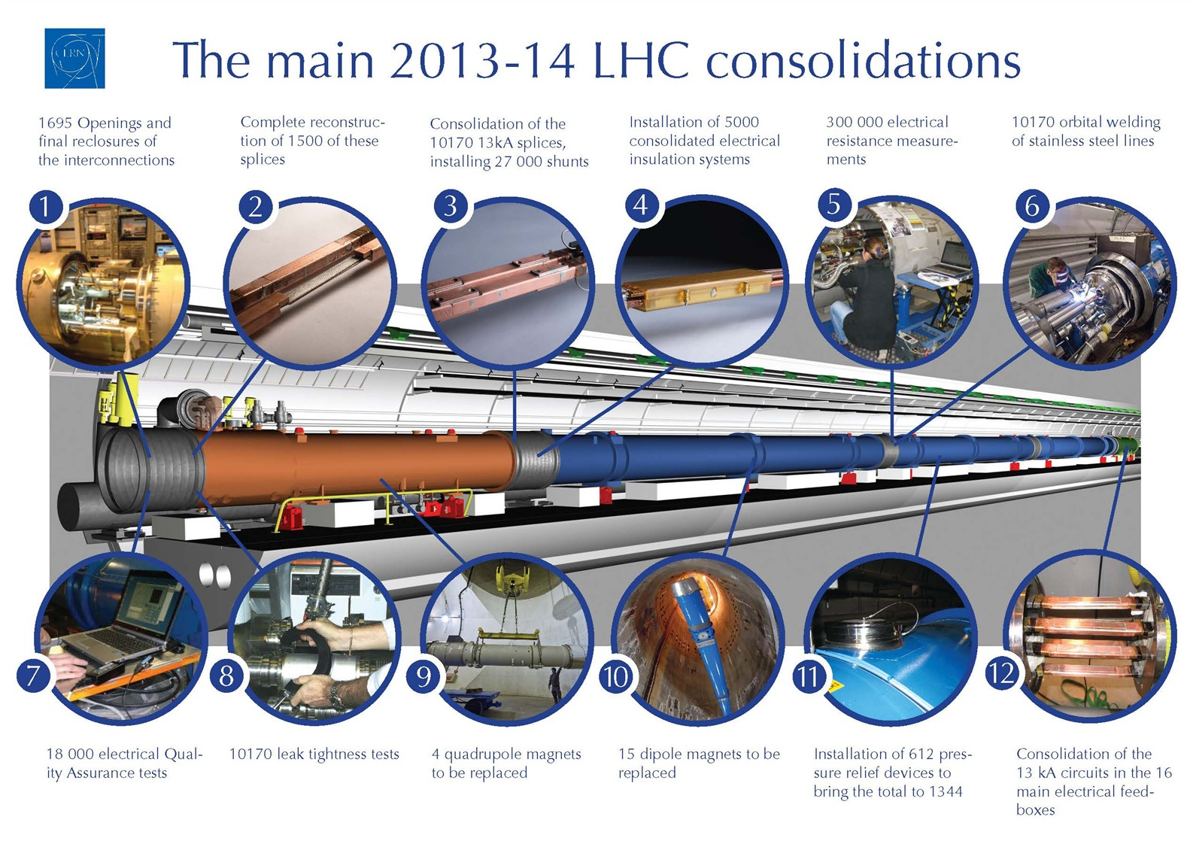

Slide 23
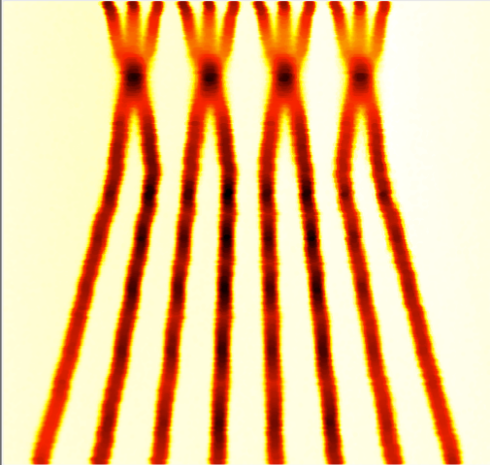
2015 – post LS1
energy: 6.5 TeV (magnet retraining)
bunch spacing: 25 ns
  pile-up considerations
injectors potentially able to offer nominal intensity with even lower emittance
BCMS = Batch Compression and Merging and Splitting
 | Number of bunches | Ib LHC FT[1e11] | Emit LHC [um] | Peak Lumi [cm-²s⁻¹] | ~Pile-up | Int. Lumi per year [fb⁻¹]
25 ns low emit | 2520 | 1.15 | 1.9 | 1.7e34 | 52 | ~45
expected maximum luminosity
from inner triplet heat load
(collisions debris) 1.7×10 ³⁴ cm⁻²s⁻¹ ±20%

Slide 24
uncertainties for 2015:
electron cloud
UFOs
both get more difficult at 25 ns &
at higher energy
energy (limited by retraining)

Slide 25
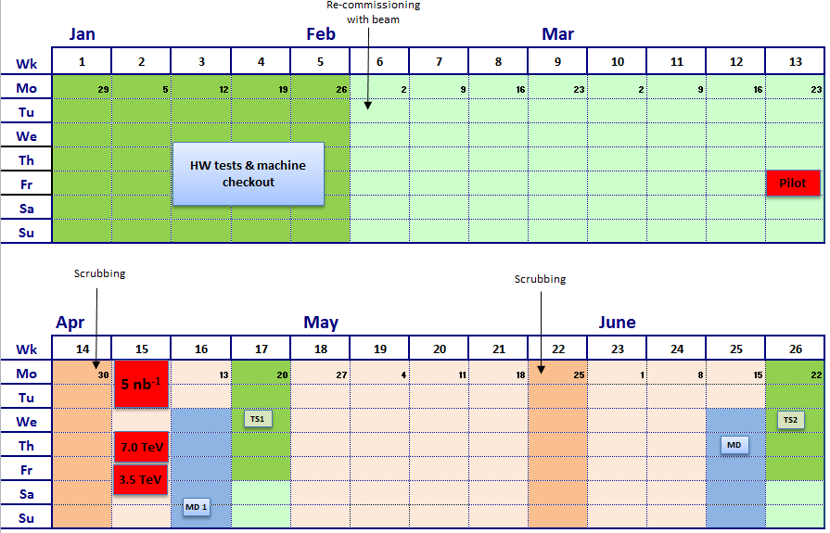
draft early 2015 schedule
in red beam time requested by LHCf

Slide 26
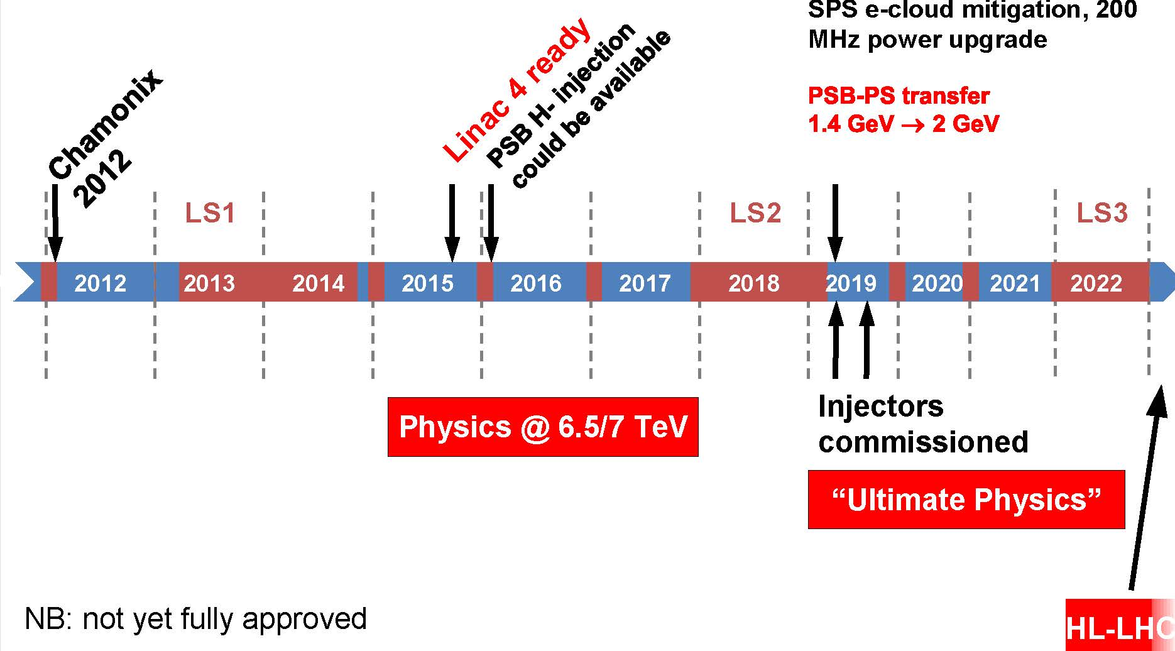
example LHC time line – next ten years
Ralph Steinhagen, ICHEP2012

Slide 27
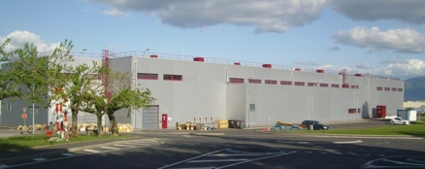
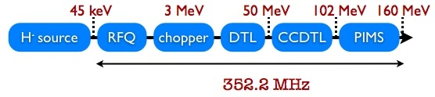
Linac4 (160 MeV H⁻ instead of 50-MeV p)
Linac4 could double the beam brightness injected into the booster, but there may be other bottlenecks downstream (e.g. PS injection)

Slide 28
RLIUP 2013 “Review of LHC and injector upgrade plans”, CERN, October 2013
discussion elements concerning next 10 years
next long shutdowns LS2 & LS3 – needs & dates
regular Christmas stops (13 weeks?)
“LS1.5” for CMS – 4.5 months in 2016/17?
- exchange of CMS pixel tracker
extended 3-months ion run in 2016?
connecting Linac4 (6-7 months) during ion run
& LS1.5?
400/fb by 2021?

Slide 29
LHC luminosity forecast
~30/fb at 3.5 & 4 TeV
~400/fb at 6.5-7 TeV
~3000/fb at 7 TeV
2012 DONE
2021 goal (?)
2035 goal (??)
to obtain 3000/fb by 2035
we need the HL-LHC

Slide 30
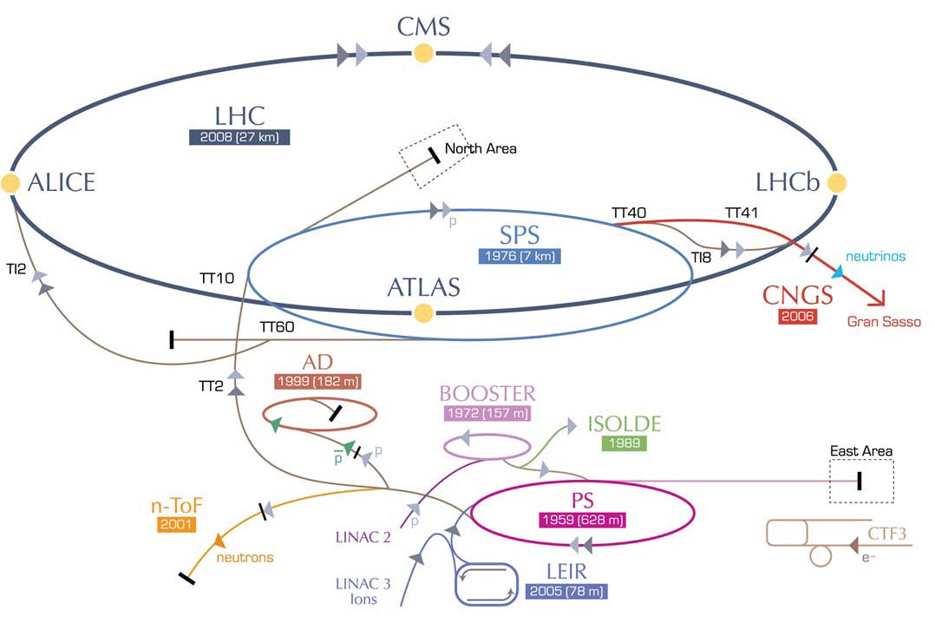
HL-LHC – modifications
IR upgrade
(detectors, low-β quad’s, crab cavities, a few high-field dipoles, etc)
~2022
SPS enhancements
(anti e-cloud coating?,RF,
impedance), 2012-2022
Booster energy upgrade
1.4 → 2 GeV, ~2018
Linac4,
~2015

Slide 31
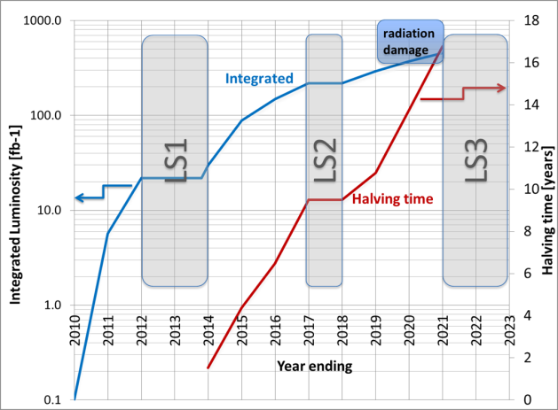
(HL-)LHC Time Line
Shut down for interconnects to overcome energy limitation (LHC incident of Sept. 2008) and R2E
Full upgrade
Shut down to overcome beam intensity limitation (Injectors, collimation and more…)
two reasons for HL-LHC: performance & consolidation

Slide 32
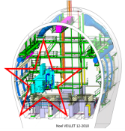
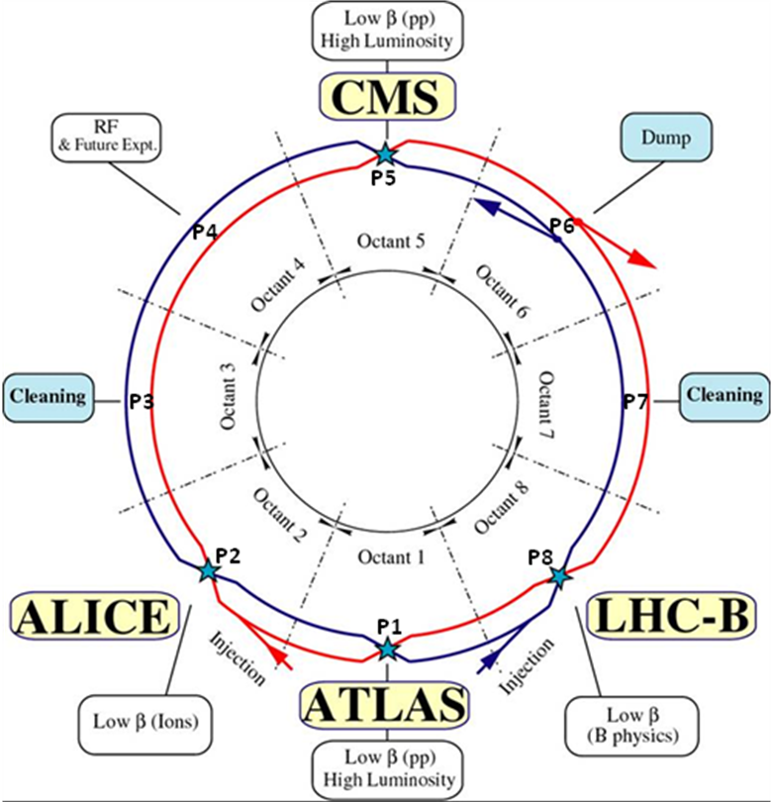
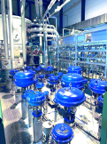
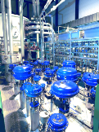
in LHC: 1.2 km of new equipment …
6.5 kW@4.5K cryoplant
2 x 18 kW @4.5K cryoplants for IRs

Slide 33
HL-LHC Official Beam Parameters
Parameter | nominal | 25ns | 50ns
N | 1.15E+11 | 2.2E+11 | 3.5E+11
n_{b} | 2808 | 2808 | 1404
beam current [A] | 0.58 | 1.12 | 0.89
x-ing angle [μrad] | 300 | 590 | 590
beam separation [σ] | 10 | 12.5 | 11.4
β* [m] | 0.55 | 0.15 | 0.15
ε_{n} [μm] | 3.75 | 2.5 | 3.0
ε_{L} [eVs] | 2.51 | 2.5 | 2.5
energy spread | 1.20E-04 | 1.20E-04 | 1.20E-04
bunch length [m] | 7.50E-02 | 7.50E-02 | 7.50E-02
IBS horizontal [h] | 106 | 20.0 | 20.7
IBS longitudinal [h] | 60 | 15.8 | 13.2
Piwinski parameter | 0.68 | 3.1 | 2.9
geom. reduction | 0.83 | 0.35 | 0.33
beam-beam / IP | 3.10E-03 | 3.9E-03 | 5.0E-03
Peak Luminosity | 1 10³⁴ | 7.4 10³⁴ | 8.5 10³⁴
Virtual Luminosity | 1.2 10³⁴ | 21 10³⁴ | 26 10³⁴
6.2 10¹⁴ and 4.9 10¹⁴
p/beam
(Leveled to 5 10³⁴ cm⁻² s⁻¹
and 2.5 10³⁴ cm⁻² s⁻¹)
27
Events / crossing (peak & leveled L) | 19 | 210 | 475 | 140 | 140

Slide 34
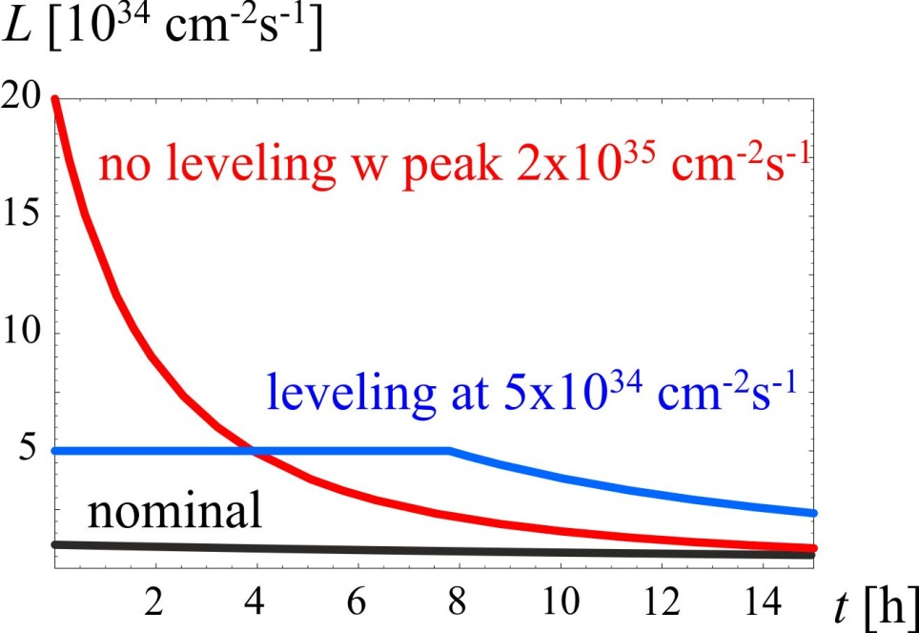
luminosity leveling at the HL-LHC
example: maximum pile up 140
(σ_{inel}~85 mbarn)

Slide 35
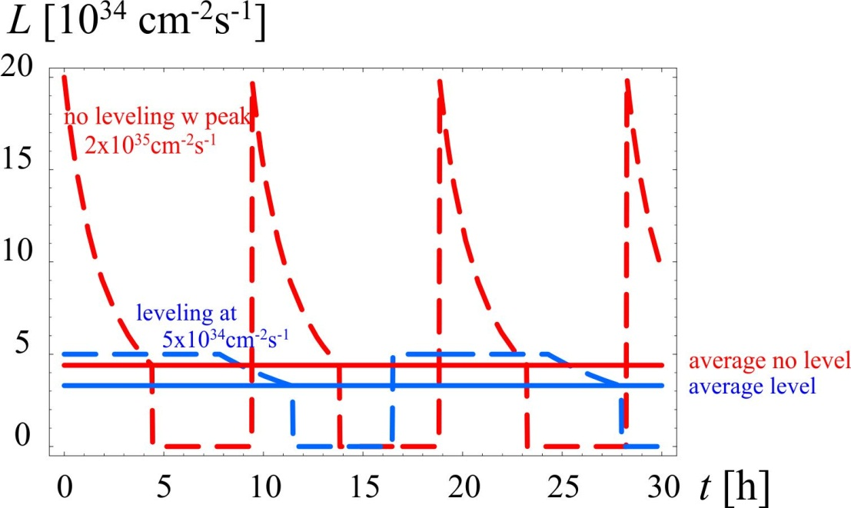
luminosity leveling at the HL-LHC
example: maximum pile up 140

Slide 36
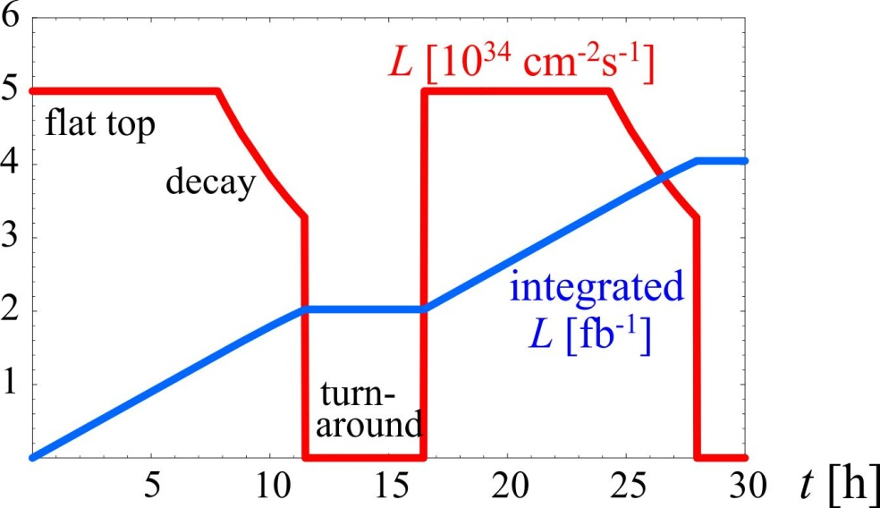
luminosity & integrated luminosity during 30 h at the HL-LHC
example: maximum pile up 140
4 fb⁻¹ per day,
with 40% of efficiency
~250 fb⁻¹ /year

Slide 37
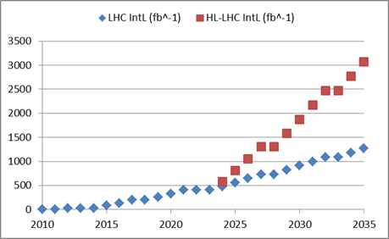
final goal : 3000 fb⁻¹ by 2030’s…
Full project
Enhanced consolidation

Slide 38



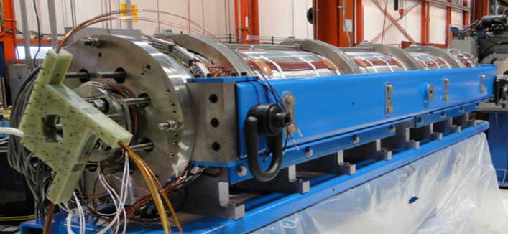
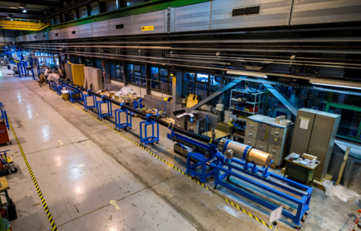
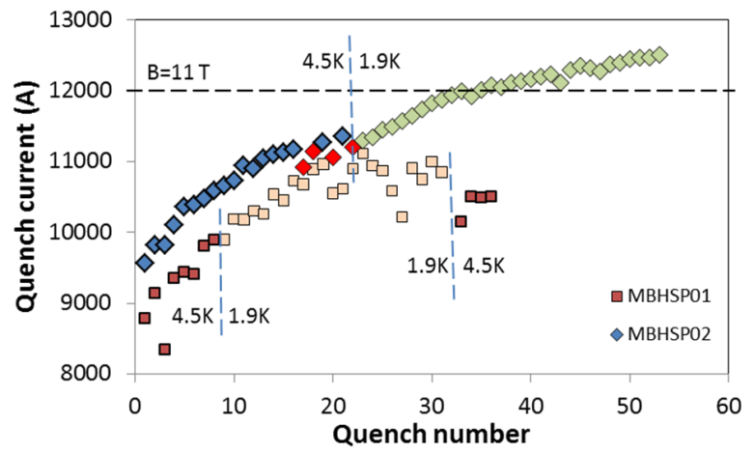

some HL-LHC ingredients
new final quadrupoles
Nb₃Sn instead of Nb-Ti
larger aperture
allowing smaller β*
11-T dipoles for dispersion suppressors
Nb₃Sn instead of Nb-Ti
provide space for extra
collimators catching off
-energy protons or ions
at ALICE, collimator
sections, ATLAS & CMS
SC link
move radiation
sensitive power
converters away from
machine
first prototype, 20 m – 20 kA, under test at CERN!
also of interest for electrical power distribution
LQS03 (90 mm ap., 3.7 m long):
208 T/m@4.6 K, 210 T/m@1.9 K
T. Baer
June 2013
HQ02a (120 mm, 1.5 m long):
150 T/m@4.6 K, 170 T/m@1.9 K
1-m model tested in April 2014,
B_{nom}=11 T achieved!
tests of novel MgB₂ and HTS (YBCO and BSCCO) cables
Goal: 150 mm ap, 140 T/m
Next: 2-m single bore, then 2-in-1

Slide 39

HL-LHC optics
S. Fartoukh
  Achromatic Telescopic Squeeze (ATS), «fully proven» MDs (β* = 15 cm «easy», room for β* ~ 10-12 cm)
squeeze through
the arcs to enhance
effective sextupole
strength;
tested with beam
in LHC MDs of
2011 & 2012
typical ATS collision optics with IR1 & IR5 squeezed down to β*=10 cm

Slide 40

luminosity reduction due to crossing angle
is more pronounced at smaller β*
“Piwinski angle”
luminosity reduction factor
θ_{c}/2
nominal
LHC
crab cavities
eff. beam size:
σ∗_{x,eff} ≈ σ_{x}∗/R_{θ}
HL-LHC
~1/β*

Slide 41
schematic of crab crossing
θ_{c}
RF crab cavity deflects head and tail in opposite direction so that collision is effectively “head on” for luminosity and tune shift
bunch centroids still cross at an angle (easy separation)
1st proposed in 1988, used in operation at KEKB since 2007
until recently plan was to vary crab cavity voltage for leveling, but this would change
size of luminous region & is disliked by experiments (instead leveling by β* or offset?)

Slide 42



HL-LHC needs compact crab cavities
only 19 cm beam separation, but long bunches
Final down-selected compact cavity designs for the LHC upgrade: 4-rod cavity design by Cockcroft I. & JLAB (left), λ/4 TEM cavity by BNL (centre), and double-ridge λ/2 TEM cavity by SLAC & ODU (right).
Prototype compact Nb-Ti crab cavities for the LHC: 4-rod cavity (left) and double-ridge cavity (right).

Slide 43


breaking news – PoP double-ridge cavity achieved 7 MV deflecting voltage cw
J. Delayen
S. De Silva
et al -
ODU,
SLAC,
JLAB,
Niowave
2.0 K
Expected
Q₀ = 6.7×10⁹
  At R_{S} = 22 nΩ
  And R_{res} = 20 nΩ
Achieved
Q₀ = 4.0×10⁹
Achieved fields
  E_{T} = 18.6 MV/m
  V_{T} = 7.0 MV
  E_{P} = 75 MV/m
  B_{P} = 131 mT
4.2 K
Quench
HL-LHC goal:
3.3 MV in operation
better than required!
J. Delayen, LARP CM20

Slide 44

HL-LHC preliminary budget estimate
 | Improving Consolidation | Full performance | Total HL-LHC
Mat. (MCHF) | 476 | 360 | 836
Pers. (MCHF) | 182 | 31 | 213
Pers. (FTE-y) | 910 | 160 | 1070
TOT (MCHF) | 658 | 391 | 1,049

Slide 45
RLIUP 2013
“Review of LHC and injector upgrade plans”
CERN, 29-31 October 2013
3 scenarios | PICs Performance Improving Consolidations | US1 Upgrade Scenario 1 | US2 Upgrade Scenario 2
 |  | +HHRF?+DS collimators? | +crab cavities, e-lens,…
integrated luminosity by 2035 | 1000-1200/fb | 2000/fb | 3000/fb
physics needs & motivation?; also, reasons to go >3000/fb?

Slide 46

beyond HL-LHC?

Slide 47
High-Energy LHC
HE-LHC
20-T dipole magnets
S-SPS?
higher energy
transfer lines
2-GeV Booster
Linac4

Slide 48

20-T dipole magnet
beam
pipe
E. Todesco, L. Rossi, P.. McIntyre

Slide 49

VHE-LHC
VHE-LHC
VHE-LHC-LER

Slide 50

80-km tunnel for VHE-LHC – “best” option
«Pre-Feasibility Study for an 80-km tunnel at CERN»
John Osborne and Caroline Waaijer,
CERN, ARUP & GADZ, submitted to ESPG
the same tunnel could host an e⁺e⁻ Higgs factory
“TLEP” (LAL seminar 22 March 2013) and a
highest-luminosity highest-energy e-p/A collider
even better
100 km?

Slide 51

TLEP/VHE-LHC tunnel site visit (?!)
on Lake Geneva 12 June 2013

Slide 52

HE-LHC & VHE-LHC parameters – 1
O. Dominguez, L. Rossi, F.Z.

Slide 53

HE-LHC & VHE-LHC parameters – 2
O. Dominguez, L. Rossi, F.Z.

Slide 54


VHE-LHC: time evolution with p burn off
& controlled blow up during physics store
luminosity
& bunch intensity
Transverse & longitudinal
emittances
controlled blow up is applied in transverse & longitudinal planes, maintaining ΔQ_{x,y}= 0.01 and constant bunch length, respectively
O. Dominguez

Slide 55
HE-LHC &VHE-LHC luminosities could greatly improve for bunch spacings < 25 ns, e.g. by factor 5 for 5 ns, and make better use of strong radiation damping!
are 5 ns spacing & 2.5x10³⁵cm⁻²s⁻¹ acceptable for the (V)HE-LHC detectors?
first indications:
not inconceivable for ~2040

Slide 56

pp Higgs factories
1 M Higgs produced so far – more to come!
15 H bosons / min – and more to come
LHC is the 1st Higgs factory!
E_{CM}=8-14 TeV,$\hat{ L}\sim$10³⁴cm⁻²s⁻¹
HL-LHC (~2022-2030):
E_{CM}=14 TeV,$L\sim$5x10³⁴cm⁻²s⁻¹ (leveled)
HE-LHC: in LHC tunnel (2035-?)
E_{CM}=33 TeV,$L=5$x10³⁴cm⁻²s⁻¹
VHE-LHC in new 80-100 km tunnel (2040?)
E_{CM}=84-104 TeV,$L=5$x10³⁴cm⁻²s⁻¹
10x more Higgs
6x higher cross section
for H self coupling
42x higher cross section
for H self coupling

Slide 57


pp Higgs coupling cross sections vs c.m. energy
➔ high statistics studies of ttH
… and, at long last, HHH couplings
H
H
H
VHE-LHC is ultimate machine to measure Higgs self coupling!
(~2-5% level)

Slide 58
TLEP - circular e⁺e⁻ colliders to study
the «Higgs boson» X(126)
A. Blondel
a relatively young concept (2011)

Slide 59

Higgs factory performances
Precision on couplings, cross sections, mass, width, Summary of the ICFA HF2012 workshop (FNAL, Nov. 2012) arxiv1302:3318
TLEP Circular e⁺e⁻ Higgs Factory goes to
precision at few permil level.
see seminar of 22 March

Slide 60


SuperKEKB
– TLEP demonstrator!
beam commissioning will start in early 2015
β_{y}*=300 μm (TLEP: 1 mm)
lifetime 5 min (TLEP: ~15min)
ε_{y}/ε_{x}=0.25% (~TLEP)
off momentum acceptance
e⁺ production rate

Slide 61




VHE-LHC + TLEP
L. Rossi
HE-LHC-LER (0.17→1.5 T)
TLEP collider (0.07 or 0.05T)
TLEP injector (0.007→0.05/7 T)
transmission line magnet
(B. Foster, H. Piekarz)
20 mm thick shield around cable
Gaps: 2 x V30xH60 mm
HE-LHC
(20 T)
super-resistive cable
multipurpose
tunnel
based on MgB₂ SC
only 12 MEuro/100 km!

Slide 62


GMS-2T (TLEP)
common modular detectors for e⁺e⁻ and pp collisions!?
GMS-4T (VHE-LHC)
E. Meschi

Slide 63
conclusions - LHC
LHC running well & predictably; 2 years 3 months from 1st collisions to Higgs; foundations for run II
in 2015 LHC will operate close to design energy with peak luminosity likely to exceed the design
new performance limits will be encountered (e.g. triplet cooling limit)
baseline for 2015 is 25 ns, but uncertainties with regard to e-cloud and UFOs; backup option: 50 ns with leveling (pile up)
plans & schedules for injector upgrade and longer shutdowns till~2022 to be reviewed this fall

Slide 64
conclusions – HL-LHC & beyond
well defined, key prototypes successfully tested
plan & goals for HL-LHC under review
- budget considerations & LHC results
HL-LHC develops the technology (Nb₃Sn magnets, 20-kA HTS cables) for future higher energy pp colliders: HE-LHC (33 TeV c.m.) and/or VHE-LHC (100 TeV c.m.)
TLEP, in VHE-LHC tunnel, being studied as highest-luminosity e⁺e⁻ Higgs factory
- excellent energy resolution, & superb performance at Z pole , W & top threshold
glorious future ahead of us with right strategy

Slide 65
possible long-term strategy
TLEP (80-100 km,
e⁺e⁻, up to
~350 GeV c.m.)
PSB
PS (0.6 km)
LHC (26.7 km)
HL-LHC
SPS (6.9 km)
VHE-LHC
(pp, up to
100 TeV c.m.)
“same” detectors!?
& e± (120 GeV)–p (7, 16 & 50 TeV) collisions ([(V)HE-]TLHeC)
≥50 years of e⁺e⁻, pp, ep/A physics at highest energies

Slide 66


possible long-term time line
1980
1990
2000
2010
2020
2030
2040
LHC
Design,
R&D
Proto.
Constr.
Physics
HL-LHC
Design,
R&D
Constr.
Physics
TLEP
Design,
R&D
Constr.
Physics
VHE-LHC
Design,
R&D
Constr.
Physics

Slide 67

TLEP design study: http://cern.ch/tlep
where you can subscribe for work, information, newsletter , etc…
R. Aleksan,
A. Blondel,
P. Janot,
M. Koratzinos,
et al
welcome on board!
Global endeavour: collaborators from Europe, US, Japan, China ,…
Next events: TLEP workshops 25-26 July 2013, Fermilab
16-18 October, CERN
Joint VHE-LHC+ TLEP kick-off meeting in February 2014

