Slide 1
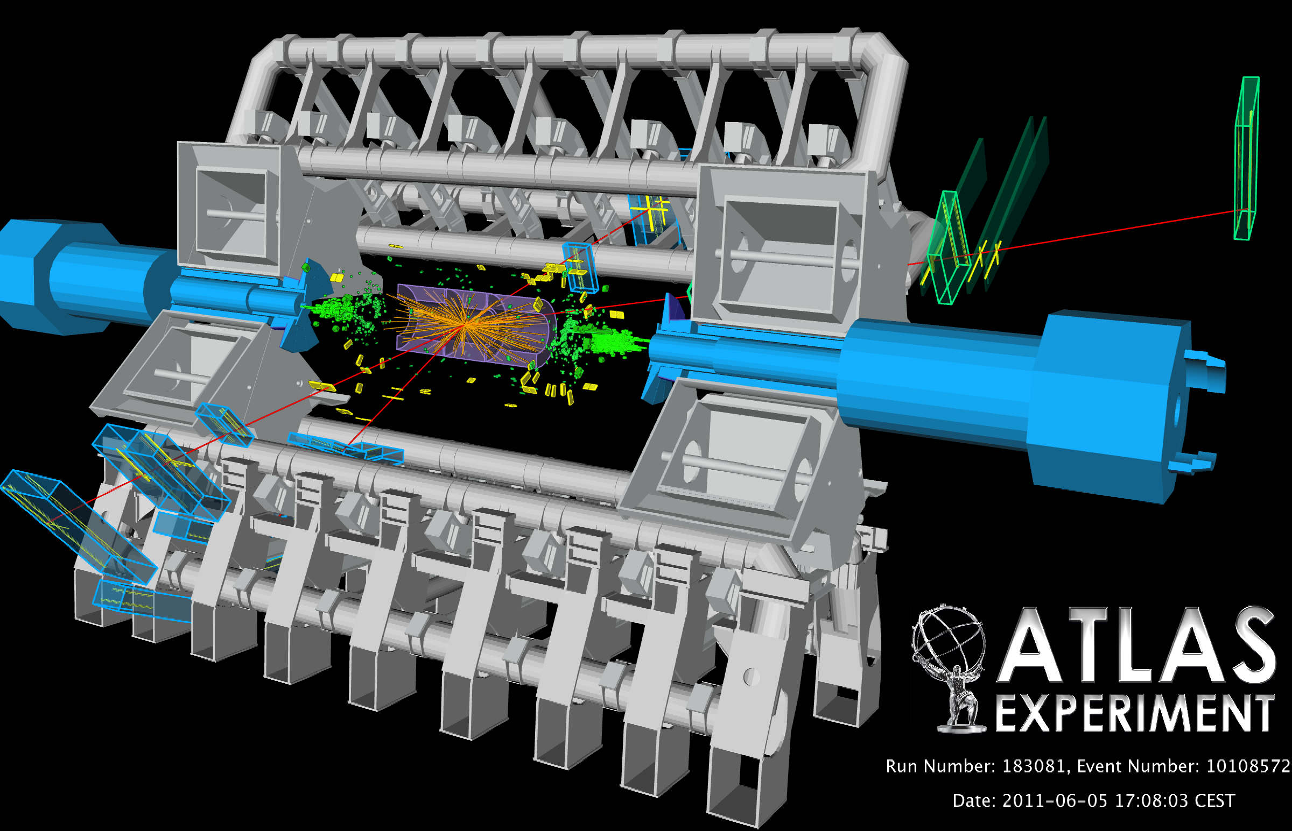


Happy Birthday
I o g s g o s n
Spin and Couplings in ATLAS:
Birth of a Higgs Boson
Tony Doyle
on behalf of the ATLAS Collaboration

Slide 2
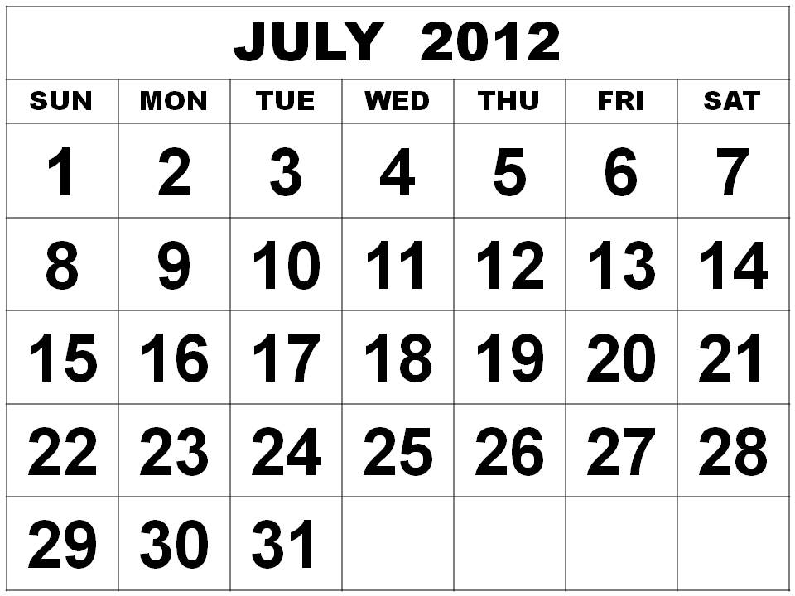
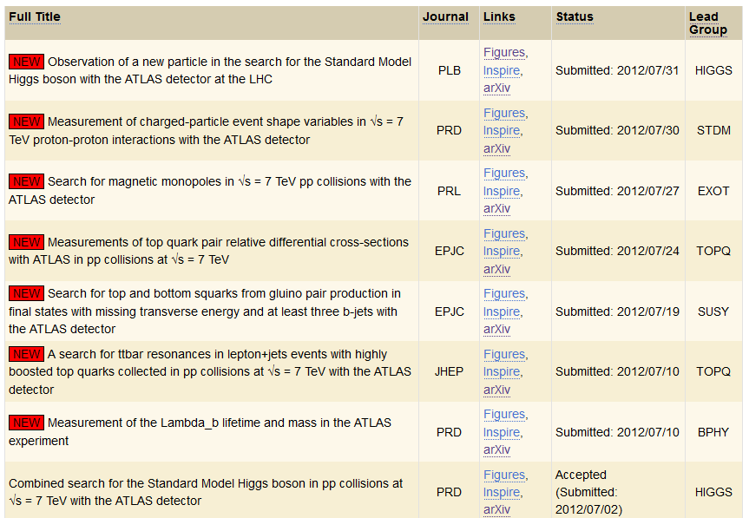



July 2012 Revolution
NewWorld
Old World

Slide 3
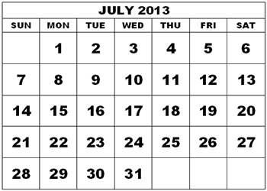
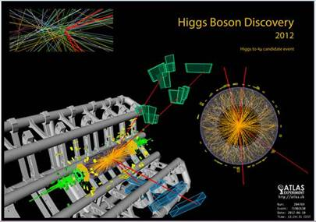
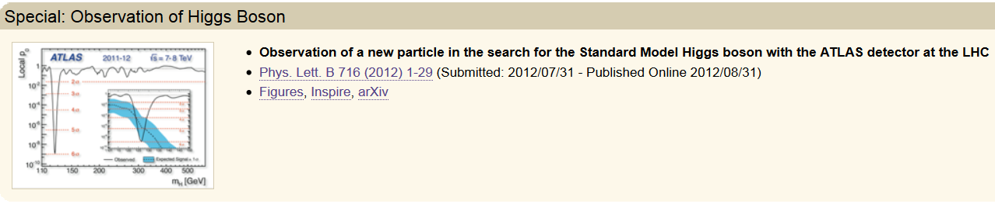
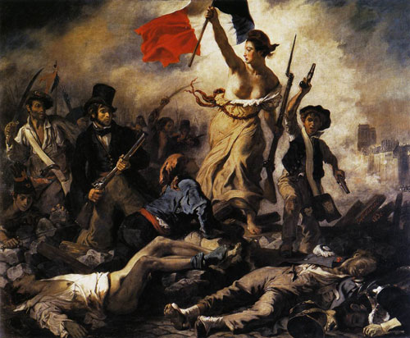

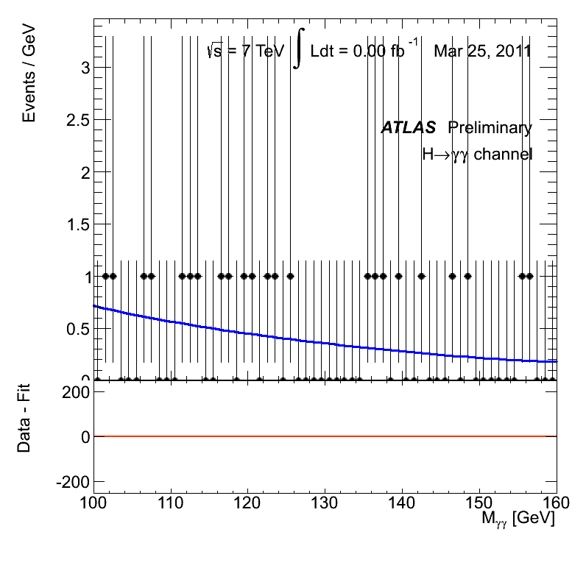
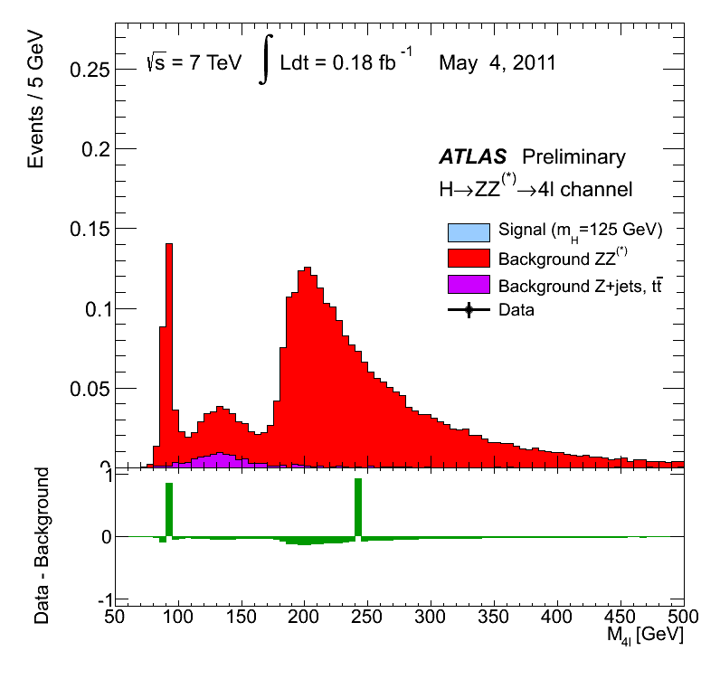
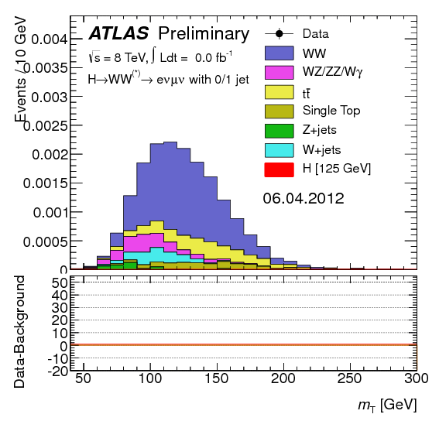
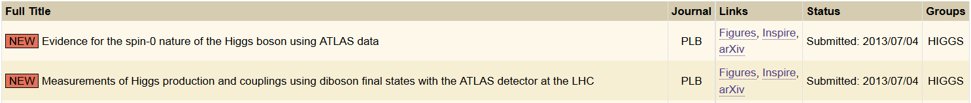

One year on from the July Revolution..
Old World
1830 French Revolution.. Trois Glorieuses.. Three Glorious signals..
NewWorld
1831 French Foreign Legion.. Marche ou crève.. Standard Model?

Slide 4


Outline
H→ γγ, ZZ*, WW* analysis updates
based on full 2011-2012 dataset
(4.6 fb⁻¹ @ 7TeV, 20.7 fb⁻¹ @ 8TeV)
Higgs mass from H→γγ and H→ZZ*→4l
Signal strengths (μ)
Sensitivity to vector boson fusion (VBF)
Comparison of decay rates
Couplings
Spin and parity
Attempting to blow out the Higgs Standard Model candle..
References:
arXiv:1307.1427 Sub. Phys. Lett. B (Couplings)
arXiv:1307.1432 Sub. Phys. Lett. B (Spin)
ATLAS-CONF-2013-012 (γγ)
ATLAS-CONF-2013-013 (ZZ*)
ATLAS-CONF-2013‐031 (WW*)
ATLAS-CONF-2013-040 (Spin)
ATLAS-CONF-2013-079 (VH → bb)
ATLAS-CONF‐2012‐160 (H → ττ)
ATLAS-CONF-2013‐075 (WW*)
ATLAS-CONF-2013-029 (γγ)
“Do you hear the people sing
Lost in the valley of the night?
It is the music of a people
Who are climbing to the light.”
Victor Hugo, Les Misérables

Slide 5
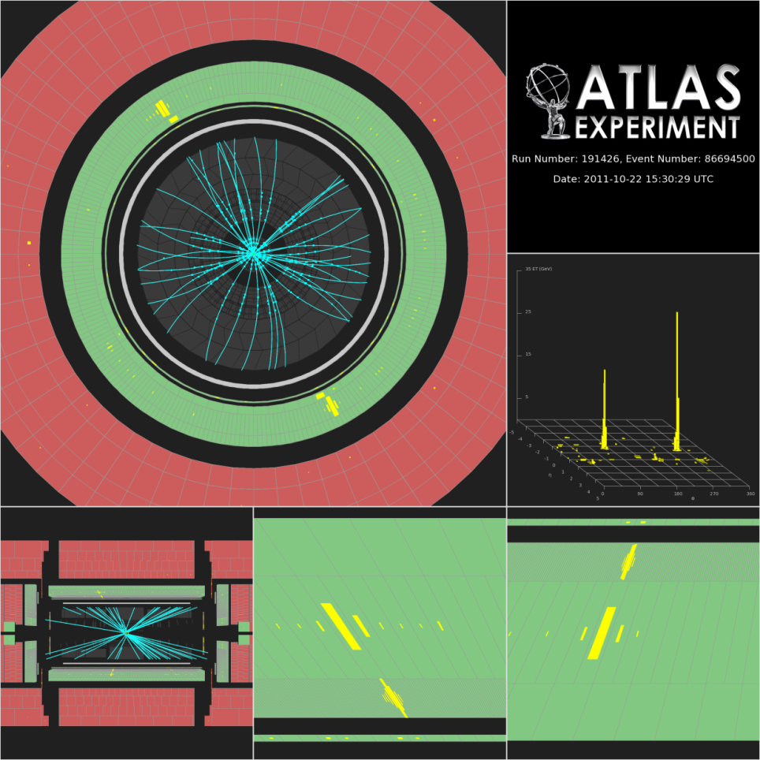
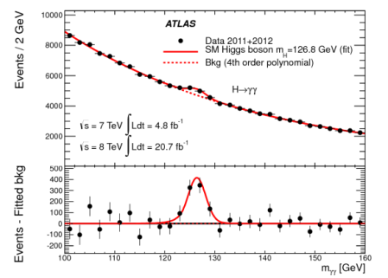
H → γγ Update
Since “Discovery Paper”
Phys. Lett. B 716 (2012) 1-29
arXiv:1307.1427
(Submitted to Phys. Lett. B on 4 Jul 2013)
SM expectation: σ_{vis} ~ 20 fb with relatively low experimental purity ~ 3% (√s=8 TeV)
Simple signature: two high-p_{T} isolated photons - E_{T} (γ₁, γ₂) > 40, 30 GeV (√s=8 TeV)
Main background: γγ continuum (irreducible, smooth, ..) as well as γj and jj
Events divided into categories based on η-photon (e.g. central, rest, …) converted/unconverted, p_{T}^{γγ} along thrust axis (varying s/b)
Events divided into ggF or VH (lepton+E_{T}^{miss}) or VBF (two-jet) categories (√s=8 TeV)
Main channel with sensitivity to VBF production
Significance 7.4σ (4.3σ expected), mass resolution 1.4 – 2.5 GeV
Observed (√s=8 TeV, m_{H}^{rec} = 126.8 GeV ±2σ) | <Expected purity> s/s+b (√s=8 TeV) | Main backgrounds | ∫Ldt (√s=7 & 8 TeV)
13931 | 370/13575 = 2.7% | γγ,γj and jj | 4.8 & 20.7 fb⁻¹

Slide 6
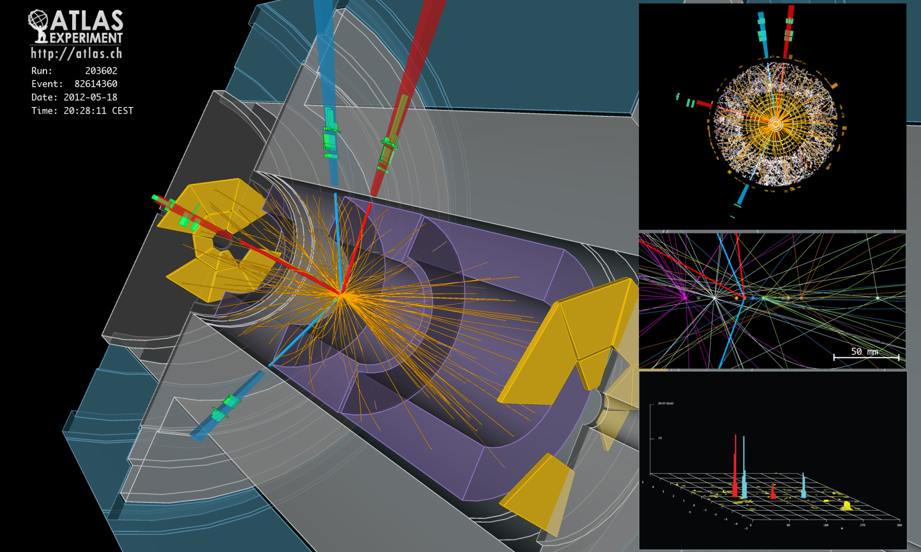
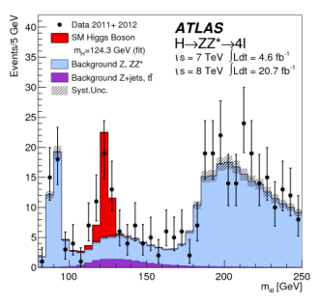
H → 4l
arXiv:1307.1427
SM expectation: σ_{vis} ~ 1.3 fb with high experimental purity ~ 60%
Good lepton reconstruction and identification: p_{T1}, p_{T2}, p_{T3}, p_{T4} = 20, 15, 10, 7 (6) GeV for e (μ)
Good lepton energy/momentum → m_{H}^{rec} resolution: 4μ, 2e2μ, 4e = 1.6, 1.9, 2.4 GeV
Good control of reducible backgrounds (Zbb, Z+jets, tt) in low-mass region:
→ cannot rely on MC alone (theoretical uncertainties, b/q-jet → lepton modelling, ..)
→ need to compare MC to data in background-enriched control regions (but low statistics ..)
Divided into ggF or VBF (two-jet, Δη > 3, m^{rec} > 350 GeV) or VH (addl. lepton ) categories
Significance 6.6σ (4.4σ expected), mass resolution 1.6 – 2.4 GeV (with m_{Z} constraint)
Observed (m_{H}^{rec} = 125 ±5 GeV) | Expected purity s/s+b(√s=7&8 TeV) | Main backgrounds | ∫Ldt (√s=7 & 8 TeV)
32 | 15.9/27.2 = 58% | ZZ, Z+jets, top | 4.6 & 20.7 fb⁻¹

Slide 7
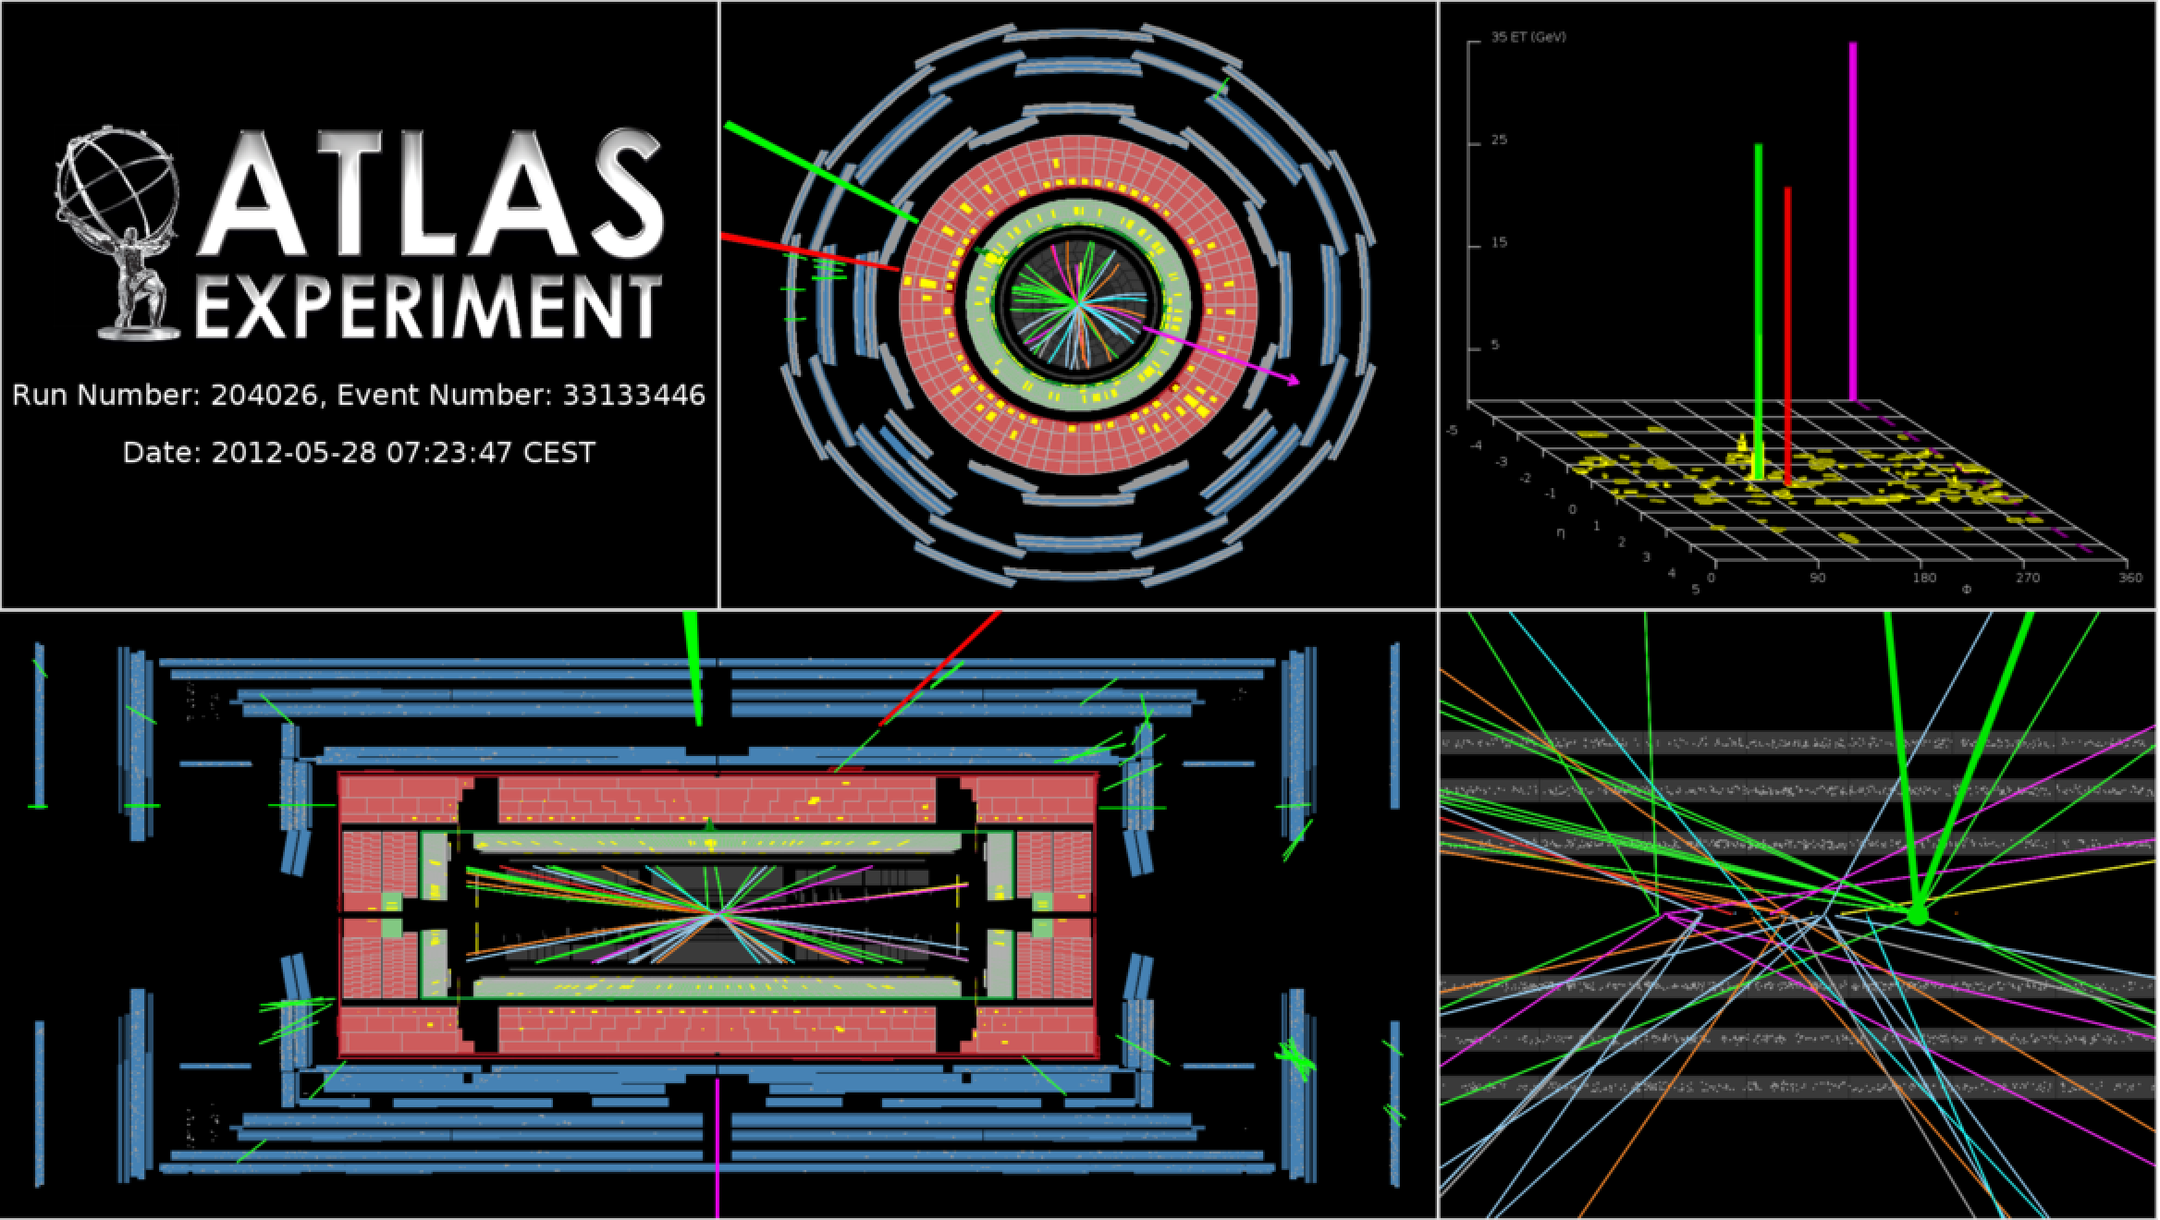
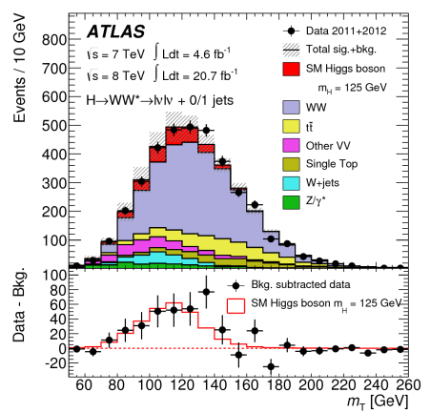
H → WW⁽*⁾
arXiv:1307.1427
SM expectation: σ_{vis} ~ 7 fb with experimental purity ~ 13% (√s=8 TeV)
ee,eµ,μμ + 2ν final state: two isolated opposite-sign leptons, large E_{T}^{miss}
Challenging: 2ν → “counting channel”
N_{jet} classification (0,1, >= 2 jet) to separate ggF and VBF (2%, 1%, 81%) processes
Main backgrounds: WW, Wt, top, W+jets, Z+jets
→ m_{ll} ≠ m_{Z}, b-jet veto, …
→ Topological cuts against “irreducible” WW bkgd: p_{Tll}, m_{ll}, Δϕ_{ll} (smaller for scalar Higgs), m_{T} (ll, E_{t}^{miss}_{(rel)})
Significance 3.8σ (3.8σ expected) for assumed m_{H} = 125.5 GeV (m_{H}^{WW} ~ 140 ± 15 GeV)
~80% of overall significance from eμ channel (DY background for ee and μμ channels)
Observed (N_{jet} = 0, 1, >=2) | Expected purity s/s+b (√s=8 TeV) | Main backgrounds | ∫Ldt (√s=7 & 8 TeV)
831, 309, 55 | 152/1188 = 12.8% | WW, Wt, W+jets, top, etc… | 4.6 & 20.7 fb⁻¹

Slide 8
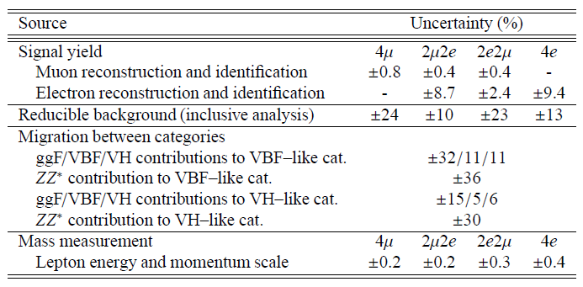
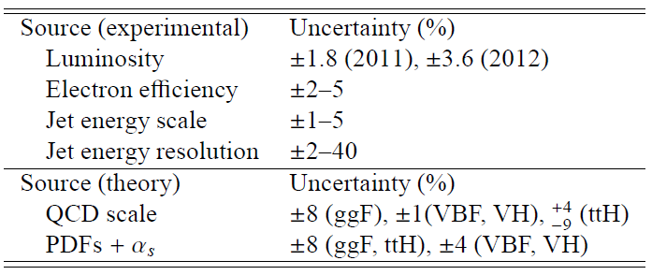


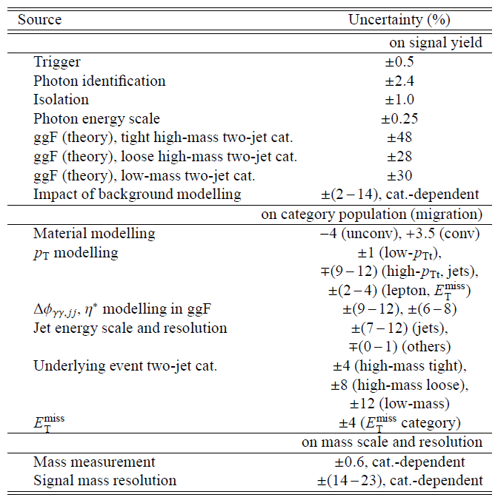
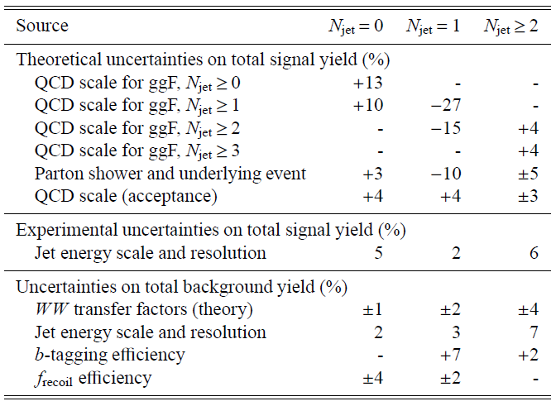
Systematics
H → ZZ⁽*⁾ → 4l (statistics)
Common
H → γγ (theory+modelling)
H → WW⁽*⁾ → lνlν
(theory + modelling)

Slide 9
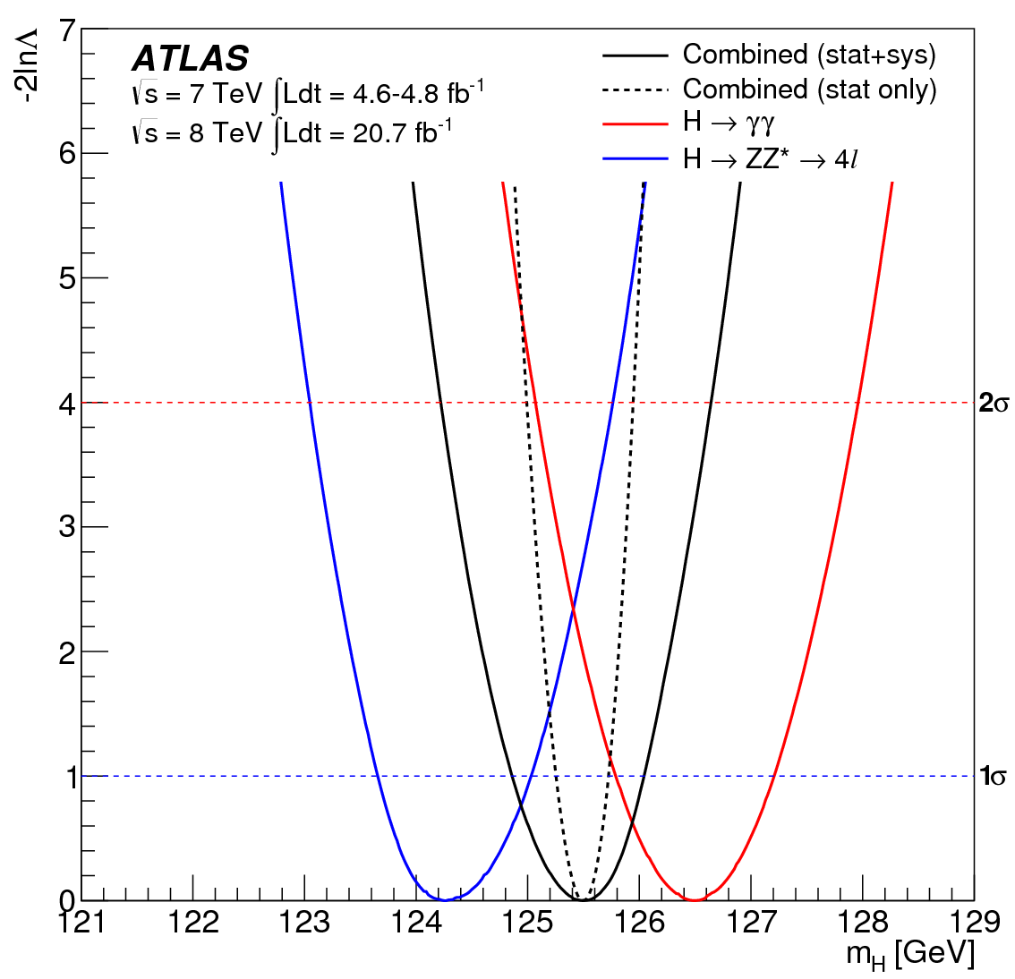

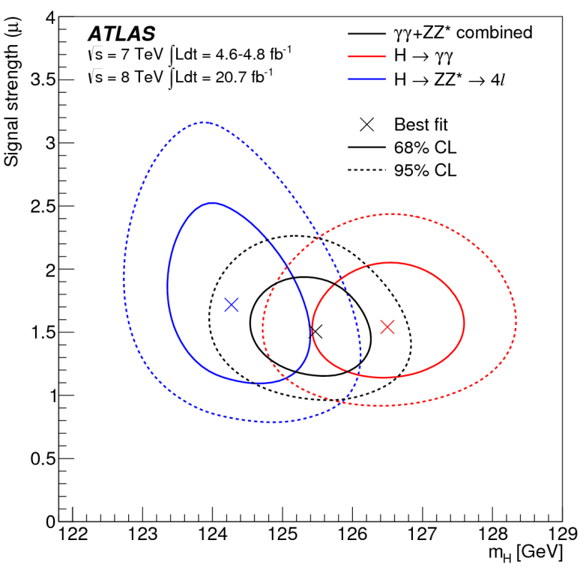
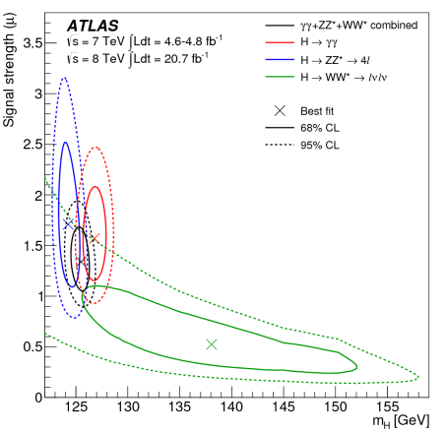
Higgs Mass
H → γγ
H → ZZ⁽*⁾ → 4l
  Combine γγ and 4l mass measurements
  Signal strengths, μγγ and μ4l, allowed to vary independently
  Don’t assume SM couplings (but ratio constrained)
  Δm_{H}=2.3 +0.6-0.7(stat) ±0.6 GeV
  2.4σ deviation
  H → WW consistent
m_{H}=125.5 ± 0.2 (stat) +0.5-0.6 (sys) GeV
See talk by Yohei Yamaguchi

Slide 10
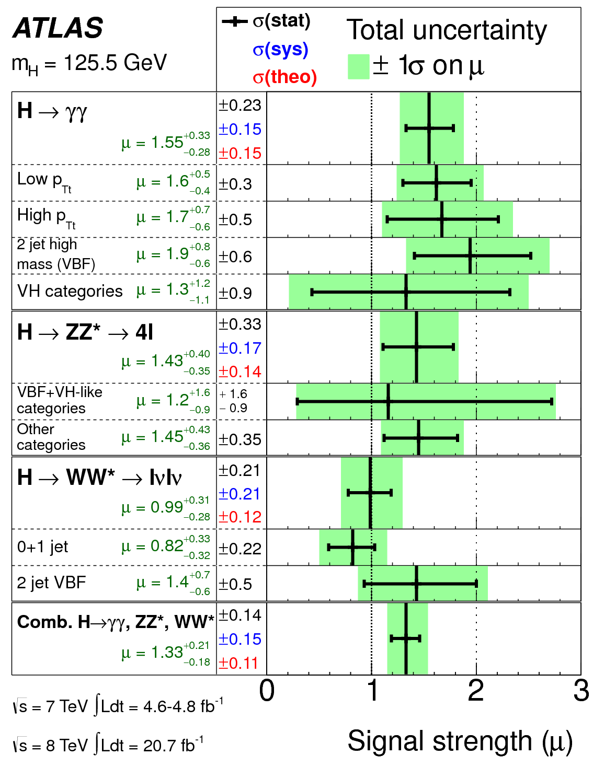
Signal Strength
Signal strength μ = σ/σ_{SM}
Combination of diboson final states
H → γγ
H → ZZ(*) → 4l
H → WW(*) → lνlν
measured assuming m_{H}=125.5 GeV
Variation due to m_{H} uncertainty: ±3%
Compatibility with SM (μ=1): 7%
Largest deviation μ_{γγ}: 1.9 σ
Including preliminary μ_{bb}, μ_{ττ}: μ=1.23 ± 0.18
ATLAS also sets preliminary (95%CL) limits:
H → μμ: μ<9.8 (20.7 fb⁻¹)
H → Zγ: μ<18.2 (4.6 fb⁻¹ + 20.7 fb⁻¹)
μ = 1.33 ± 0.14 (stat) ± 0.15 (sys) ± 0.11 (theo)

Slide 11
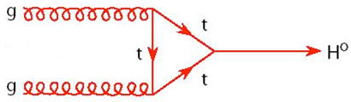
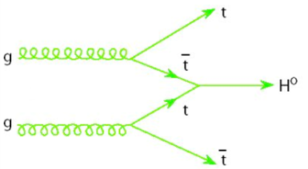
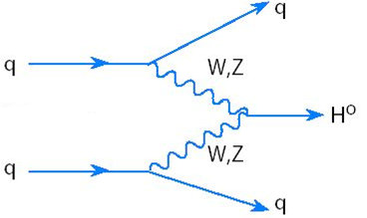
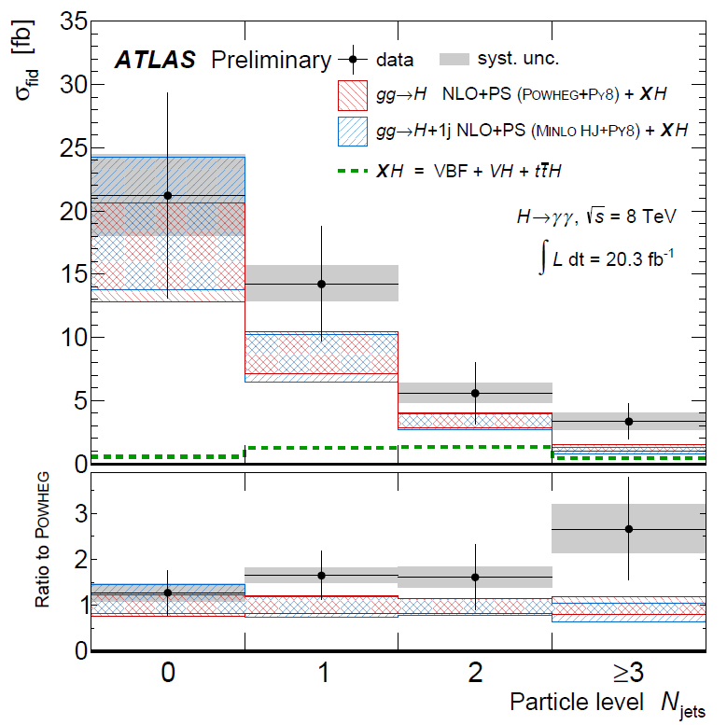
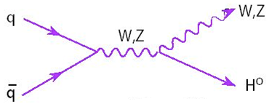
Higgs Production <x> = 1/64=0.016; m_{H} = 125 GeV, √s = 8 TeV
Fermion-Higgs coupling: μ_{ggF+ttH} ≡ μ_{ggF} = μ_{ttH}
Process | σ (pb) ± scale ± PDF
ggF | 19.5 ± 1.5 ± 1.5
ttH | 0.13 ± 0.008 ± 0.008
VBF | 1.58 ± 0.01 ± 0.06
VH | 1.09 ± 0.01 ± 0.04
Vector Boson-Higgs coupling: μ_{VBF+VH} ≡ μ_{VBF} = μ_{VH}
σ_{tot} = 22.3 ± 1.5 ± 1.5
Cross section dominated by ggF:
Explore sensitivity to VBF (and VH) via data
Associated H→γγ+jet (and H→WW*+lepton) production
Now constrained by H → γγ N_{jet} (+ jet veto fractions , p_{T})
Higgs new dawn of σ measurements

Slide 12
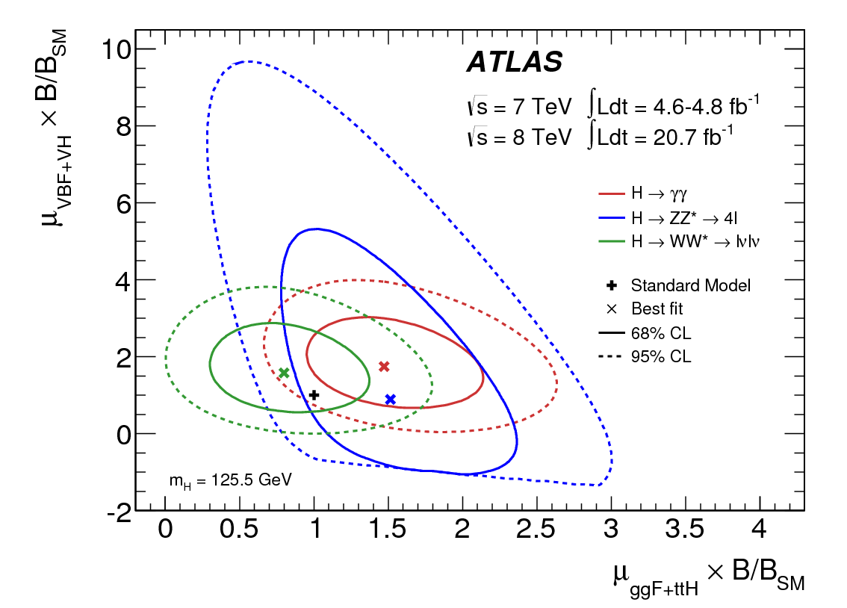
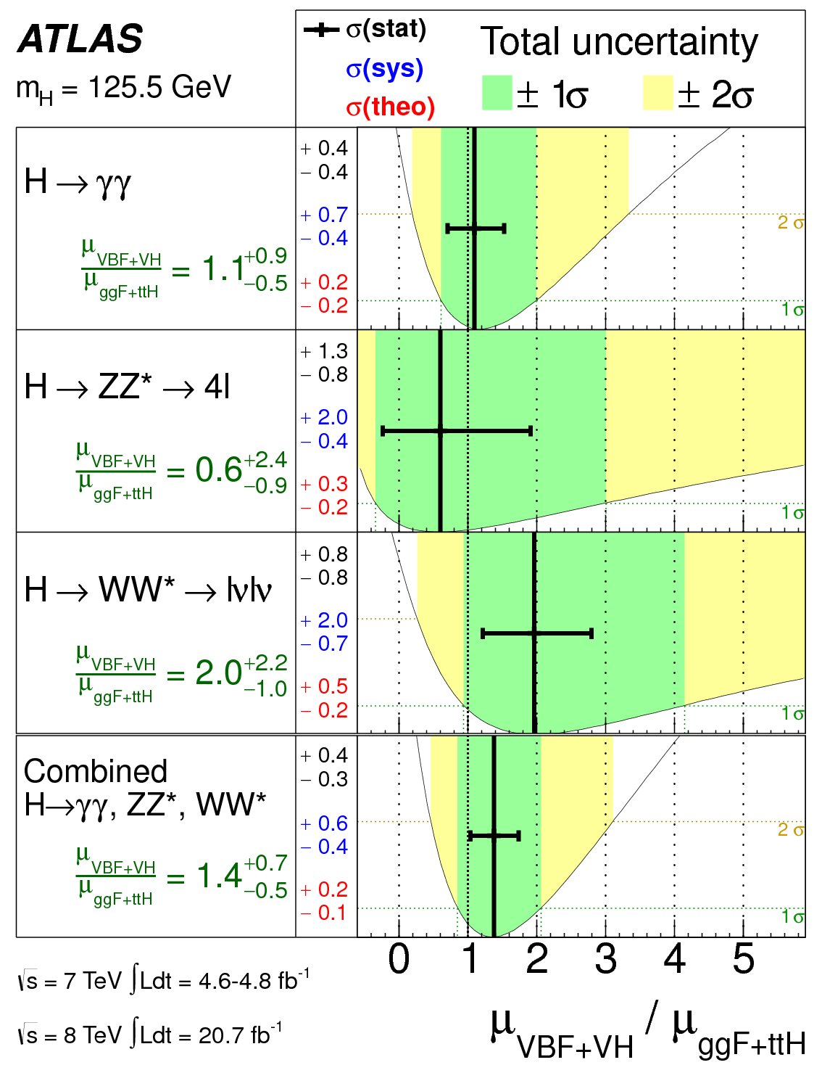
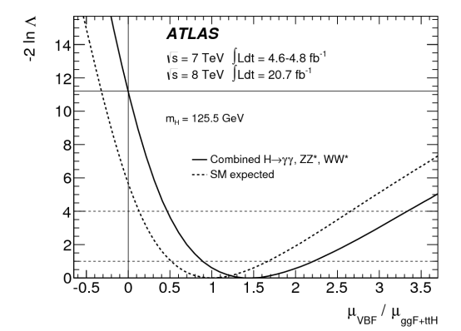
VBF Production
μ_{VBF+VH} vs μ_{ggF+ttH} potentially modified by B/B_{SM}
Good agreement with SM
3.3σ evidence
for VBF
production
(driven by H → γγ)
μ_{VBF+VH} / μ_{ggF+ttH} = 1.4+0.4-0.3(stat)+0.6-0.4(sys)

Slide 13
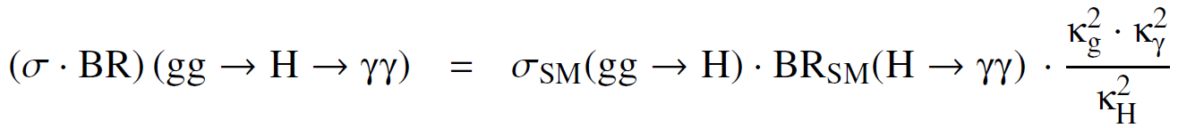
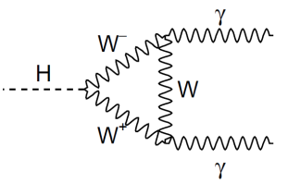
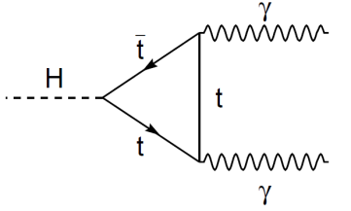
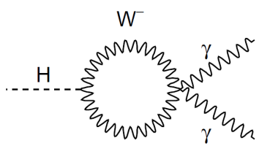
Higgs Decay, m_{H} = 125.5 GeV
Process | BR ± 5% rel. unc.
H → γγ | 2.28 x 10⁻³
H → ZZ⁽*⁾ → 4l | 1.25 x 10⁻⁴
H → WW⁽*⁾ → lνlν | 0.01
e.g. H → γγ
  where κg and κγ are loop coupling scale factors
  and κ_{H} is the total Higgs boson width scale factor
  Functions of κt, κW,...:
Assume single narrow resonance:
→ σ·BR(ii→H→ff) = σii·Γff / ΓH
Test modifications to couplings magnitude:
→ CP even scalar at this stage
Not all couplings accessible with current data, so test 5 benchmark models (LHC-XS-WG)
-
+

Slide 14
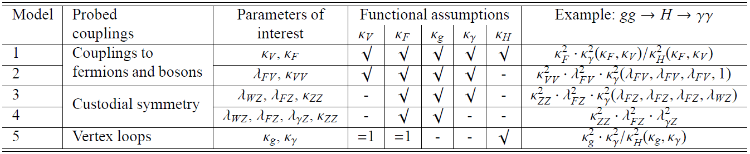
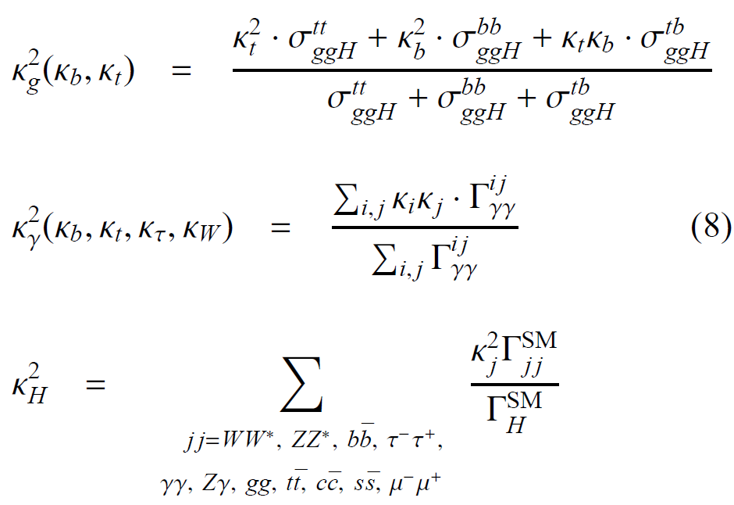
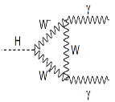
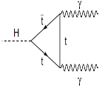
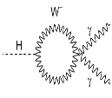
Coupling Measurements
Sensitivity to couplings, κ_{i},
given σ^{ij}_{ggH}, Γ^{ij}_{gg} and ΓSM_{ff} from theory
Equation represents dominant
contributions only
Test various benchmark models
using the profile likelihood ratio, Λ(κ)
κ_{j} treated as parameters of interest or
nuisance parameters
+
-
(8)

Slide 15
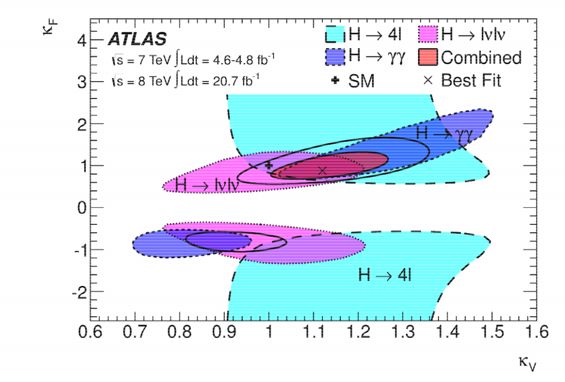




Coupling to fermions and bosons
κ_{F} for fermions
κ_{V} for bosons (κ_{V} > 0 assumed,
some sensitivity to +ve sign via t+W interference,
mainly from H →γγ decay loops)
κ_{F} $∈$ [0.76, 1.18] (68% CL)
κ_{V} $∈$ [1.05, 1.22] (68% CL)
Model 1
2D Compatibility with SM: 12%
κ_{F} mainly via gg → H loop
Assumes no contribution from
BSM particles
If SM constraint relaxed,
can constrain the ratios
λ_{FV} = κ_{F} /κ_{V} or κ_{VV} = κ_{V}κ_{V}/κ_{H}
λ_{FV} $∈$ [0.70, 1.01] (68% CL)
Model 2
κ_{VV} $∈$ [1.13, 1.45] (68% CL)

Slide 16
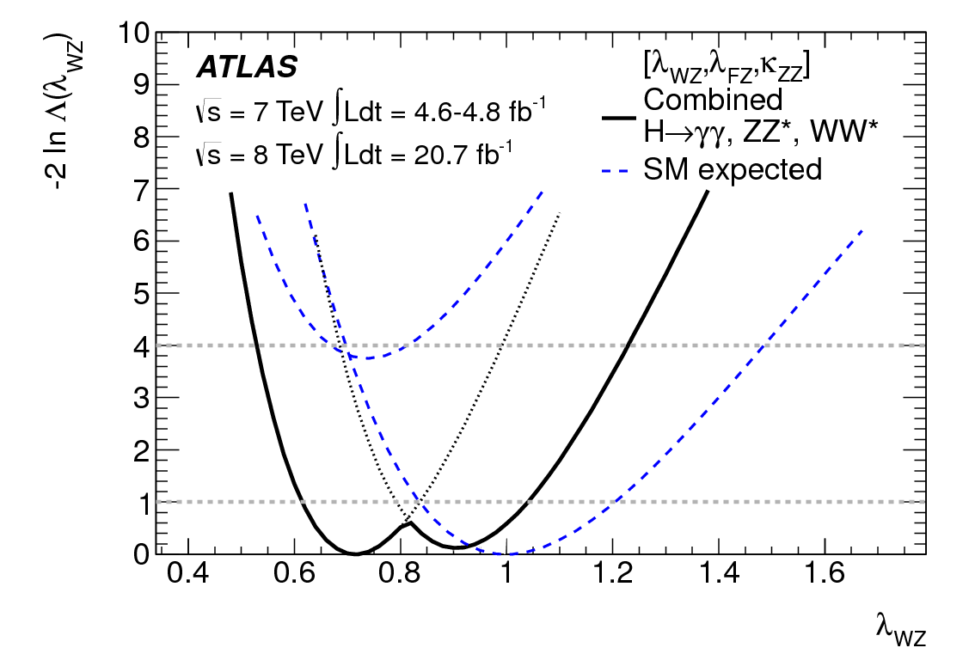

Ratio of W/Z couplings
λ_{WZ}² = B (H → WW*)/B (H → ZZ*)
B_{SM}(H → WW*)/B_{SM}(H → ZZ*)
Simplest method from measured
H → WW* and H → ZZ* rates
with μ_{ggF+ttH} . B(H → ZZ*)/B_{SM}(H → ZZ*)
and μ_{ggF+ttH}μ_{VBF+VH}/μ_{ggF+ttH} profiled:
Slightly improved sensitivity using
WH and ZH (VBF) production
(75% W-fusion: 25% Z-fusion)
as well as H → γγ rate
3D Compatibility with SM: 19%
Removing H → γγ rate and adding
λ_{γZ} = κ_{γ} /κ_{Z} to absorb possible BSM effects
4D Compatibility with SM: 20%
Fermion couplings grouped together,
total width left free
λ_{WZ} = κ_{W} /κ_{Z} (SM λ_{WZ} = λ_{FV} = κ_{ZZ} = 1)
λ_{FV} = κ_{F} /κ_{V} (profiled in fit)
κ_{ZZ} = κ_{Z} κ_{Z}/κ_{H} (profiled in fit)
λ_{WZ} =0.81+0.16-0.15
λ_{WZ} $∈$ [0.61, 1.04] (68% CL)
Model 3
Model 4
λ_{WZ} =0.82 ± 0.15
λ_{FZ} > 0
λ_{FZ} < 0

Slide 17
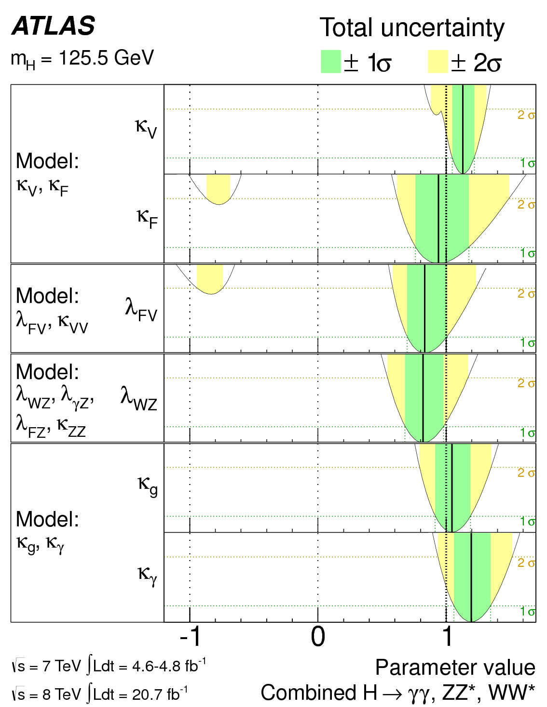
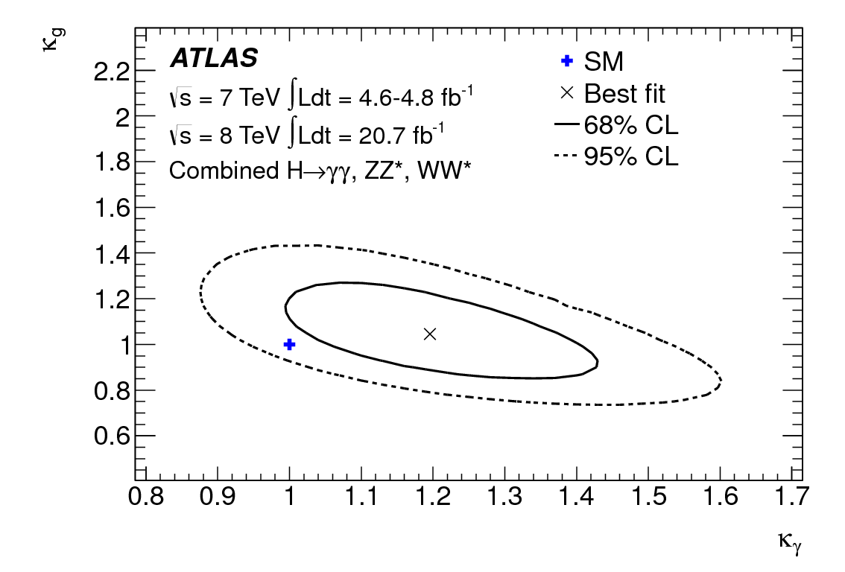
Constraints on BSM loops and Summary
New heavy particles may contribute to loops
Assume negligible contribution to width
Assume SM particles have SM couplings
Effective scale parameters
κ_{g} and κ_{γ}
2D Compatibility with SM: 14%
Model 5
κ_{g} =1.04 ± 0.14
κ_{γ} =1.20 ± 0.15
Couplings tested for anomalies w.r.t.
fermion and boson, W/Z and vertex loop
contributions at ±10-15% precision
Consistent with SM

Slide 18
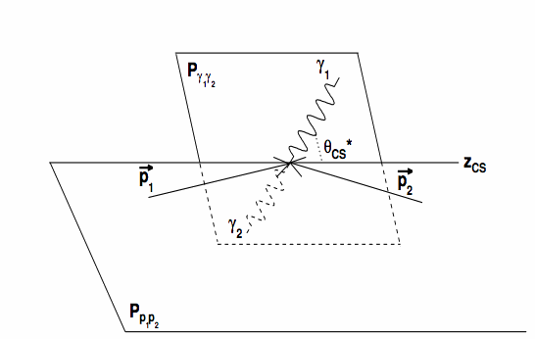
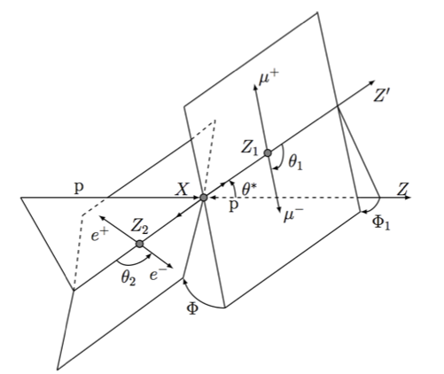
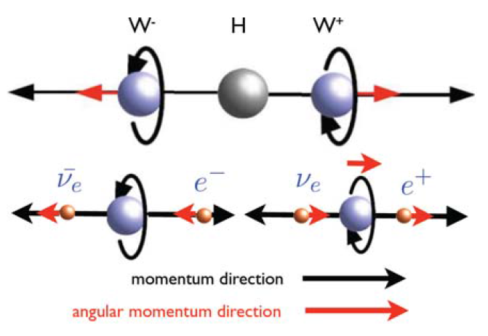
Combined Spin Analysis
Process | J^{P} test | Discriminants
H → γγ | 2⁺_{m} | m_{γγ} |cos θ*|
Alternative spin-parity hypotheses 0⁻, 1⁺, 1⁻,2⁺ tested compared to o⁺
Models generated using JHUGen
(Gao et al: arXiv1001.3369)
Use discriminants sensitive to spin and parity
J = 1 → 1+1 ruled out (Landau Yang theorem)
2⁺_{m} Graviton-inspired tensor with minimal SM couplings chosen
(ggF production polarisations ± 2, qq annihilation ± 1)
H → ZZ* → 4l | 0⁻, 1⁺, 1⁻, 2⁺_{m} | e.g. cos θ₁ m₃₄ → BDT (MELA)
Full reconstruction of 4l final state
Five angles θ₁, θ₂, θ *, Φ₁, Φ
and two masses m₁₂(m_{Z}^{rec}), m₃₄(m_{Z*}^{rec})
H →WW*→ eνμν | 1⁺, 1⁻, 2⁺_{m} | e.g. m_{eμ} Δφ_{eμ} → BDT
Reduced background for eμ channel
Combine all three channels to maximise sensitivity
μ⁻
e⁺

Slide 19
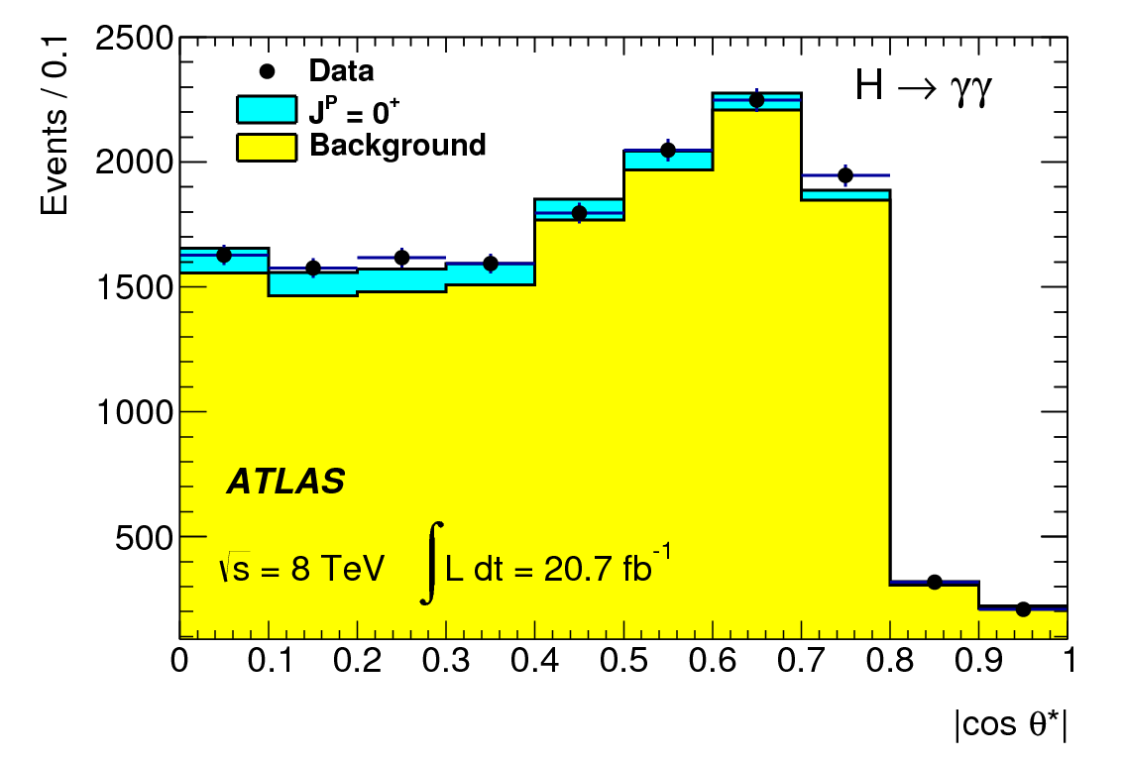

H → γγ Spin Analysis
122 < m_{γγ} < 130 GeV
105 < m_{γγ} < 122 GeV
130 < m_{γγ} < 160 GeV
Simultaneous fit to m_{γγ} and |cos θ*|
|cos θ*| for spin and m_{γγ} to control background
Large background derived from sideband data
Optimised cuts (p_{T}^{γ1} > 0.35 m_{γγ} and p_{T}^{γ2} > 0.25 m_{γγ} )
Residual correlations at 0.6% (2%) level for |cos θ*| < (>)0.8
Correction for gg → γγ bkgd + Higgs spin-0 interference esp. for |cos θ*| > 0.8
(none available for 2+ hypothesis)
Collins-Soper Frame
(Higgs Rest Frame)

Slide 20





H → γγ Spin Analysis
0⁺ vs 2⁺ after background subtraction
General Approach
Binned likelihood using discriminants
e.g. m_{γγ} and |cos θ*|
Poisson probability given a
signal S scaled by strength μ
and background B with
nuisance parameters θ and constraints from auxiliary
measurements A for each channel
Ratio of likelihoods test statistic
q = log(L (0⁺)/L (J^{P}_{alt}))
with μ fixed for a given J^{P}
Exclusion using CL_{S}
CL_{S} = p₀ (J^{P}_{alt}) / (1-p₀(0⁺))
Observed 2⁺ exclusion 99.3% (1-CL_{S})
observed
p₀(0⁺)
p₀(2⁺)
Comprehensive analysis vs qq fraction (4% in LO QCD, but higher-order corrections possible):

Slide 21





H → 4l Spin Analysis
0⁺ vs 0⁻
0⁺ vs 1⁺
BDT using five angles and two masses
BDT trained and evaluated separately for each hypothesis
115 < m_{4l} < 130 GeV
Statistics limited, but sensitive to each J^{P}
High purity (121 < m_{4l} < 127 GeV) and lower purity
{115 < m_{4l} < 121 GeV, 127 < m_{4l} < 130 GeV} evaluation
Observed 0⁻ exclusion 97.8% Observed 1⁺ exclusion 99.8%

Slide 22




H → WW* Spin Analysis
0⁺
Increasing signal expected
Sensitive to 1⁺, 1⁻, 2⁺_{m} via shapes
Reduced background for eμ events
BDTs using m_{eμ} , Δφ_{eμ} , p_{T}^{eμ} , m_{T}^{eμ}
Detailed study of inputs and correlations
WW background evaluated from data control regions
Two BDTs are used to distinguish (a) 0⁺ from J^{P}_{alt} and (b) 0⁺ from the sum of backgrounds
(BDT histograms are 1-D mapping of 2-D distributions with bins ordered by increasing signal)
Observed 2⁺ (qq=0%) exclusion 95.2% Observed 2⁺ (qq=100%) exclusion 99.96%
2⁺ (qq=100%)

Slide 23


Combined Spin Analysis
H → γγ largest contributions H → WW*
Combined 2⁺_{m} exclusions at 3-4σ level
Combined exclusions generally at 2-3σ level
All observations consistent with SM Higgs Boson

Slide 24




Conclusion
Important diboson measurements now submitted at √s = 7 and 8 TeV
H→ γγ, ZZ*, WW*
Results consistent with SM
m_{H} from H→γγ and H→ZZ*→4l :
Signal strength:
Evidence for vector boson fusion (VBF) at 3.3σ level
Couplings tested: fermion and boson, W/Z and vertex loop contributions at ±10-15% precision
Spin and parity: combined exclusions for 0⁻, 1⁺, 1⁻,2⁺ generally at 2-3σ level
A Higgs Boson is born
m_{H}=125.5 ± 0.2 (stat) +0.5-0.6 (sys) GeV
μ = 1.33 ± 0.14 (stat) ± 0.15 (sys) ± 0.11 (theo)
Early days, but the Standard Model first birthday candle is proving difficult to blow out..
“Do you hear the people sing
Lost in the valley of the night?
It is the music of a people
Who are climbing to the light.”
Victor Hugo, Les Misérables

Slide 25

Backups

Slide 26


VH production with H → bb
ATLAS-CONF-2013-079
Also 7 TeV analysis of tt+H, with H → bb [ATLAS-CONF-2012-135]
ATLAS-CONF-2013-079, see talk by Jason Lee
Require 2 b-tags and distinguish 0, 1, 2 lepton channels
Diboson fit where theoretical uncertainties are constrained
Higgs discrimination based on m_{bb}, resolution of ∼16%, improved by including muons and partial neutrino correction
Combined limit 1.4 x SM (1.3 expected):
μ (125 GeV) = 0.2 ± 0.5(stat) ± 0.4(syst)

Slide 27


Signal Strength
Latest combination of five final states
W, Z H → bb
H → ττ
Including preliminary μ_{bb}, μ_{ττ}: μ=1.23 ± 0.18

Slide 28




H → γγ associated jet production cross sections
ATLAS-CONF-2013-029, see talk by Giovanni Calderini
Initial state jet radiation used to constrain production mechanism
Higgs new dawn of σ measurements

Slide 29

Higgs Production m_{H} = 125 GeV, √s = 8 TeV
Fermion-Higgs coupling: μ_{ggF+ttH} ≡ μ_{ggF} = μ_{ttH}
Process | σ (pb) ± scale ± PDF
ggF | 19.5 ± 1.5 ± 1.5
ttH | 0.13 ± 0.008 ± 0.008
VBF | 1.58 ± 0.01 ± 0.06
VH | 1.09 ± 0.01 ± 0.04
Vector Boson-Higgs coupling: μ_{VBF+VH} ≡ μ_{VBF} = μ_{VH}
σ_{tot} = 22.3 ± 1.5 ± 1.5
Cross section dominated by ggF:
Explore sensitivity to VBF (and VH) via data
Associated 2-jet (and lepton) production
e.g. H → γγ simulation breakdown by categories

Slide 30
H → γγ and H → 4l Mass Scale Systematic Uncertainties
Main Mass Scale systematic uncertainties:
Further investigation and extensive checks
lead to additional sources of systematic uncertainties:
- LAr Strips relative calibration (0.2%)
- Photon energy resolution (0.15%)
- Calibration of the high gain (0.15%)
- Mis-classification due to fake conversions (0.13%)
- Backgound modeling (0.1%)
- Lateral shower development simulation (0.1%)
- Effect of PV choice (0.03%)
Main 4l Mass Scale systematic uncertainties:
Further investigation and extensive checks have not led to additional substantial sources of systematic uncertainty:
- Measurement with MS and ID alone
- Local detector biases checked event by event
- Local resolution effects checked using event- by-event error;
- kinematic distributions in agreement with expectation
- FSR simulation
- Different mass reconstruction using Z-mass constraint (+400 MeV shift)
Source | Relative Mass Scale Effect
Absolute Energy scale calibration from Z | 0.3%
Upstream material simulation inaccuracies | 0.3%
Pre-Sampler energy scale | 0.1%
Source | Relative Mass Scale Effect
Absolute Energy scale calibration from Z | 0.4%
Low transverse energy electrons | 0.2%
Muon momentum scale | 0.2%

Slide 32
H → γγ Normalization Systematic Uncertainties
Main systematics on Yield and Migration
Theory (PDF, scales, α_{s}) | ~12% (overall)
g Efficiency | 5.3%
Background Model | ~3%
Luminosity | 3.9% and 3.6%
Trigger | 0.5%
Isolation | 1%
Energy Scale | 0.5%
JES | 4% - 19% (HM 2-jets)
pTt Modelling | 0.8%
Material mis-modelling | ~4%
UEPS | 7% - 30% (LM HM 2-jets)
Leptons | ~2%

Slide 33



Fermions
HIG-12-044
Mild excess of 2.2 σ building up
Coherent picture between the sub channels Z(ll)H(bb); Z(νν) H(bb); W(lν) H(bb) need more statistics
VH → Vbb
HIG-12-043
H → τ τ
All including VH
VH → Vτ τ
Very small contribution
HIG-12-051
Very mild excess is building up at 1.3 σ level

Slide 34

H → ττ
Reoptimised 7+8 TeV analysis
ATLAS-CONF-2012-160
H → τ_{had}τ_{had} candidate in VBF channel (m_{MMC} = 131 GeV)
ττ channel basic facts sheet :
Signal (SM) | Signal purity s/b | Main backgrounds | Production | 7 & 8 TeV
~330 | 0.3% - 30% | ZZ, Z+jets, top | VBF, Hgg, VH | 4.9 & 13 fb⁻¹

Slide 35



H → ττ
Reoptimised 7+8 TeV analysis
- Search in exclusive categories: lep-lep, lep-had, had-had and jets: 0, 1 (boosted or not), 2 (VBF, VH)
- Background modeling is critical especially in specific environments such as VBF production : Use embedding
- Use of MMC mass
σ(m_{ττ}) = 13% ∼ 20%
- Most powerful channel VBF
μ(125) = 0.7 ± 0.7
95% CL limit (125): 1.9 [ exp: 1.2 ] × SM
Significance (125): 1.1σ [ exp: 1.7σ ]

Slide 36

VH production with H → bb
Combined and reoptimised 7+8 TeV analysis
VH(bb) channel basic facts sheet :
Signal (SM) | Signal purity s/b | Main backgrounds | Production | 7 & 8 TeV
~50 | ~1% - 10% | Wbb,Zbb, top, etc… | VH | 4.9 & 20 fb⁻¹

Slide 37







A.Djouadi Phys.Rept.457:1-216
Huge progress in theory: signals and (complex) backgrounds
Major achievement of the theory community; very fruitful discussions with the experiments (e.g. through LHC Higgs x-sn WG,LPCC..)
GF H → WW , ZZ , γγ , bb,ττ
VBF H → WW, ZZ , γγ , ττ
Typical uncertainties on cross-section
gg +15 -20 % NNnLO
VBF 5% NLO
WH,ZH 5% NNLO
ttH 15% NLO
H → WW, γγ, bb
These production cross sections are used
with the decays bb , ττ , WW , ZZ , γγ
H → WW, γγ, bb

Slide 38

Muon Spectrometer (|η|<2.7) : air-core toroids with gas-based muon chambers
Muon trigger and measurement with momentum resolution < 10% up to E_{μ} ~ 1 TeV
3-level trigger
reducing the rate
from 40 MHz to
~200 Hz
38 Countries 174 Institutions
3000 Scientists 1000 Students
Length : ~ 44 m
Radius : ~ 12 m
Weight : ~ 7000 tons
~10⁸ electronic channels
3000 km of cables
Inner Detector (|η|<2.5, B=2T):
Si Pixels, Si strips, Transition Radiation detector (straws)
Precise tracking and vertexing,
e/π separation
Momentum resolution:
σ/p_{T} ~ 3.8x10⁻⁴ p_{T} (GeV) ⊕ 0.015
ATLAS Detector
EM calorimeter: Pb-LAr Accordion
e/γ trigger, identification and measurement
E-resolution: σ/E ~ 10%/√E
HAD calorimetry (|η|<5): segmentation, hermeticity
Fe/scintillator Tiles (central), Cu/W-LAr (fwd)
Trigger and measurement of jets and missing E_{T}
E-resolution: σ/E ~ 50%/√E ⊕ 0.03

