Slide 1




Metal Foil Detectors for Beam monitoring at HERA-B and LHCb
V.M. Pugatch
Institute for Nuclear Research
NASU, Kiev
LAL-KINR Seminar
22-24 May, 2013, Orsay

Slide 2
Metal Detectors. Applications
Metal Foil Detector technology allows for Building any size beam monitoring systems:
HERA-B Luminosity monitoring,
LHCb Radiation Monitoring system
BPM for 21 MeV proton beam (tandem MPIfK)
BPM for the LHCb (ST) test beam studies
21 keV Synchrotron BPM at HASYLAB
5 MeV Electron beam BPM – KINR
150 KeV Synchrotron BPM at ESRF
Metal detectors are suitable for measuring and imaging beams of charged particle in the energy range from keV to TeV as well as synchrotron radiation.
2
The EURISOL-NET
23.05.2013

Slide 3
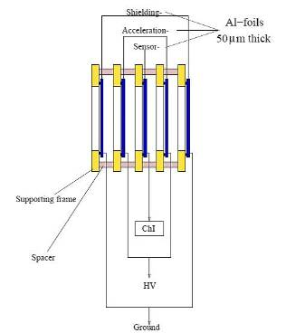
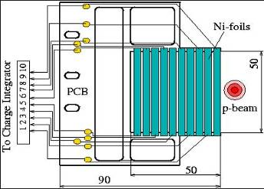
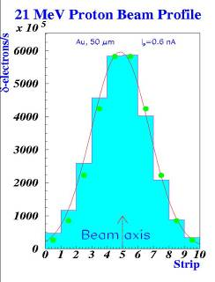
Metal Detector. Technical realization.
Metal Foil Detector technology allows for
Building any size beam monitoring systems:
HERA-B Luminosity monitoring,
LHCb Radiation Monitoring system
BPM for 21 MeV proton beam (tandem MPIfK)
BPM for the LHCb (ST) test beam studies
19 keV Synchrotron BPM at HASYLAB
5 MeV Electron beam BPM - KINR

Slide 4
HERA-B

Slide 6
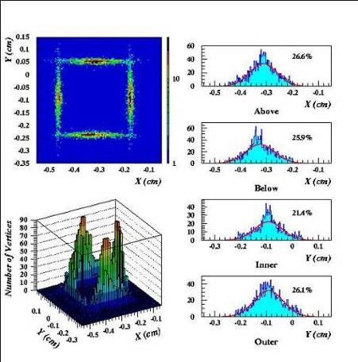
Metal Detectors at HERA-B
Proton beam 920 GeV.
Illustration of the equalization of the Interaction rates among 4 IPs by means of the Metal Detectors-Targets.
Shown are number of events reconstructed by Vertex Detector (~ 25 % pro target).
6
The EURISOL-NET
23.05.2013

Slide 7
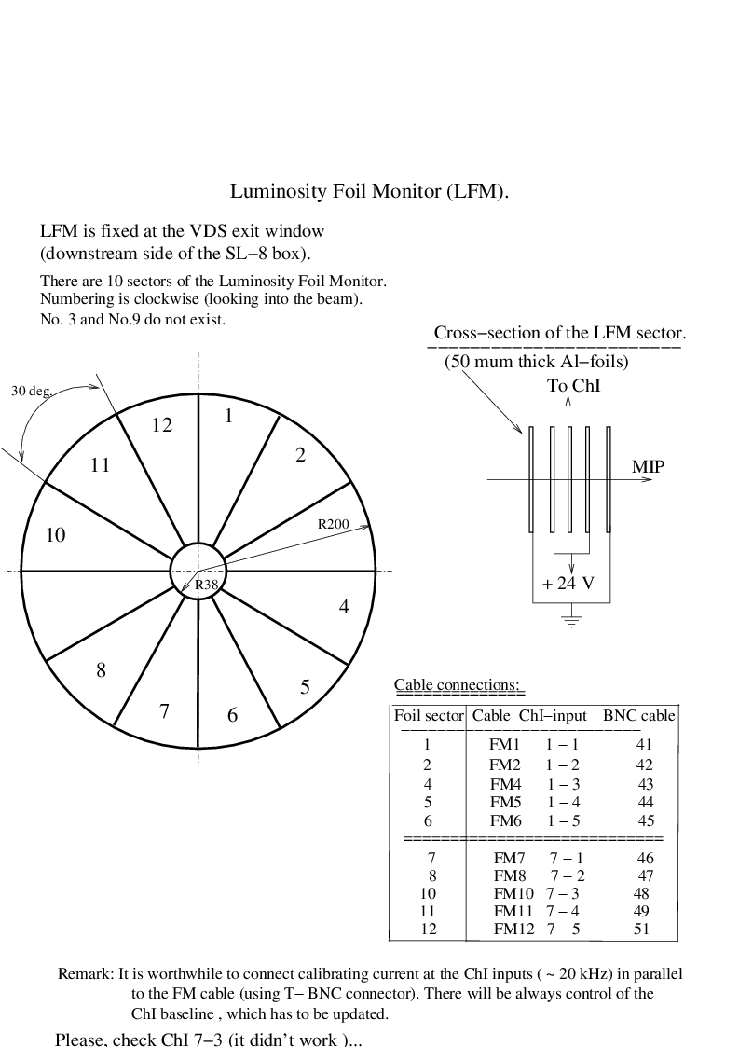
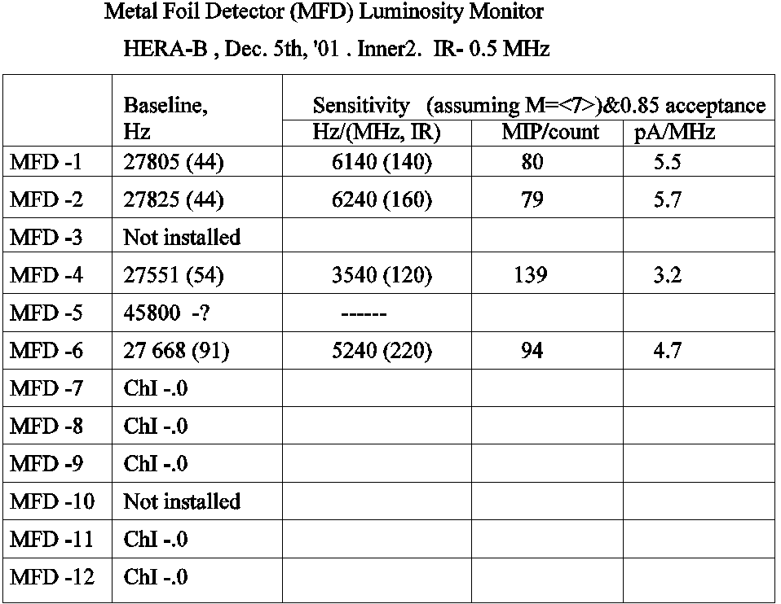
MFD at HERA-B.
Luminosity and background monitoring

Slide 8
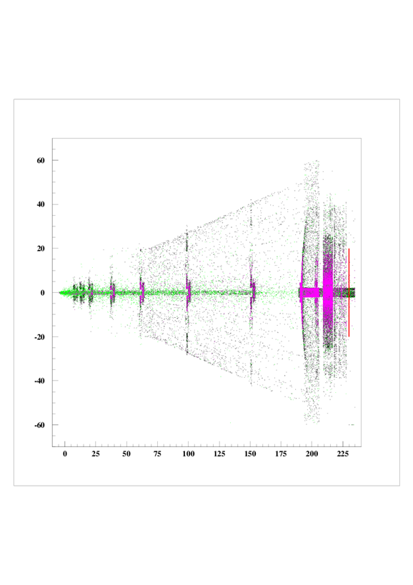
Multi-layer structure of Metal Foil detector
HERA-B. Vertex detector.

Slide 9
Performance of MFD at HERA-B.
Luminosity and background monitoring

Slide 10


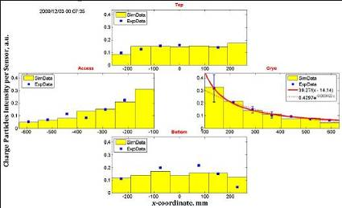
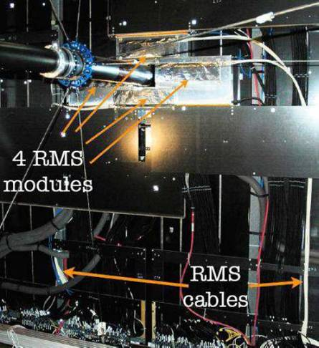
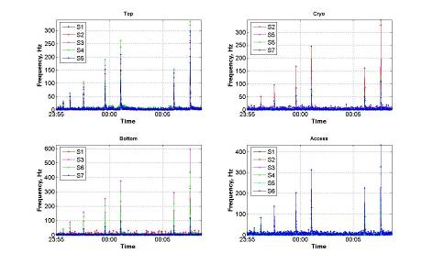
Metal Detectors at LHCb.
Charged particles with TeV energies
Radiation Monitoring System.
Silicon Tracker, LHCb.
M.I.P.

Slide 11
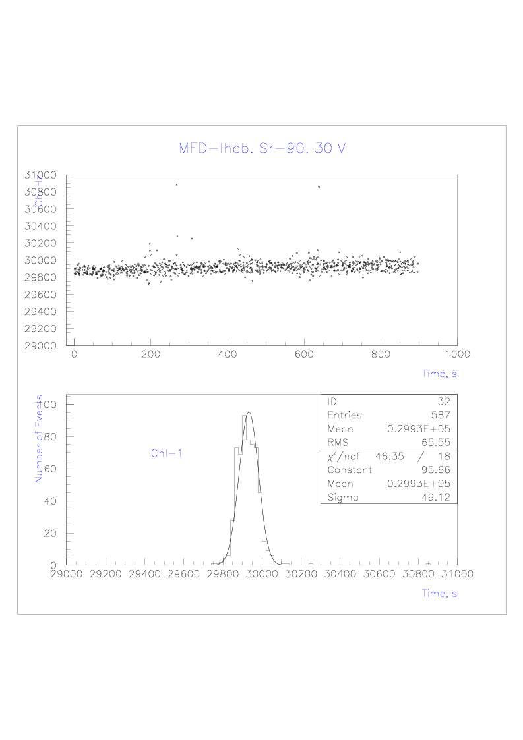
MFD technology for Radiation Monitoring System at LHCb

Slide 12
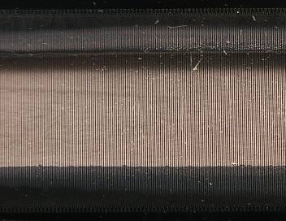
Metal Microstrip-Detectors (MMDs)
Advantages of the MMD:
High Radiation tolerance (10-100 MGy)
Nearly transparent sensor – 1 μm thickness
the thinnest detector ever made
for the particle detection
Low operation voltage (20 V)
Perfect spatial resolution (5 – 25 μm)
Unique, well advanced production technology
Commercially available readout hardware
and software.
Photo of ММD-1024.
1024 Ni strips: 1.5 µм thick, 40 µм wide, 60 µм pitch
MMD potential applications
Micro-beam Profile Monitoring for Particles and Synchrotron Radiation
Detectors at the focal plane of mass-spectrometers and electron microscopes
Imaging sensors for X-ray and charged particle applications
Precise dose distribution measurements for micro-biology, medicine (mammography, dental treatment, hadron-therapy) etc.
Industrial applications: micro-metallurgy, micro-electronics, etc.
Notes:
12

Slide 14
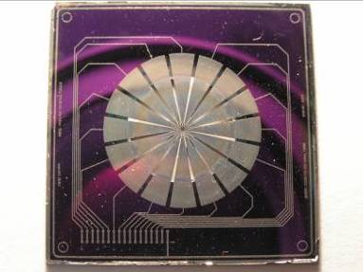
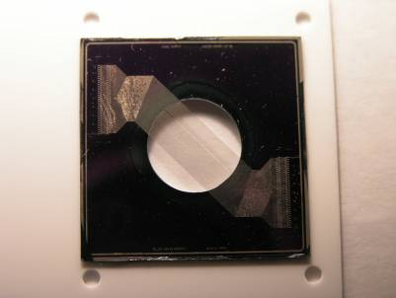
Metal Micro Detectors for BPM
Advantages of the MMD:
High Radiation tolerance (10-100 MGy)
Nearly transparent sensor – 1 μm thickness
Low operation voltage (20 V)
Spatial resolution (5 – 25 μm)
Well advanced production technology
Commercially available readout hardware
and software.
MMD- 16 sector pixels
MMD-64.
64 strips,
100 μm pitch,
40 μm width,
1 μm thick

Slide 15
MMD @
DIAMOND - UK
  Beam Imaging, Measurement of the dose distribution absorbed in real time – unique features of the MMD are needed
    radiation hardness
    Transparency
  Fast Positioning of the X-ray beam with a size of 20 – 50 μm

Slide 16
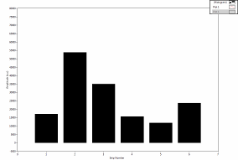
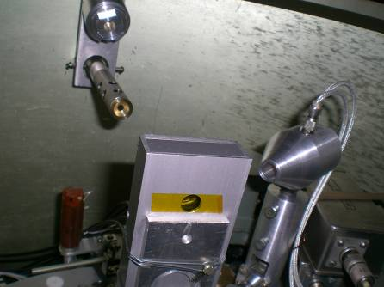
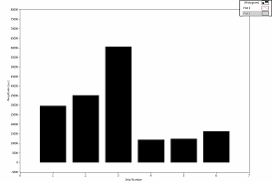
3 MeV Proton beam profile.
Tandem-generator at INR (Kiev).
Metal Microstrip Detector
For low Energy Ion Beams
Y-axis detector moving
16

Slide 17
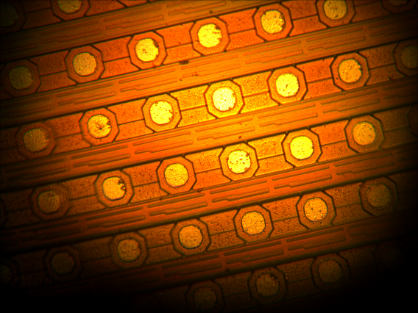
TimePix – металевий детектор
Напруга подається на сіточку, яка натягнута над поверхнею детектора, для того, щоб детектор працював як металевий детектор, по принципу вторинної електронної емісії
Фото пікселів чіпу MEDIPIX-2

Slide 18
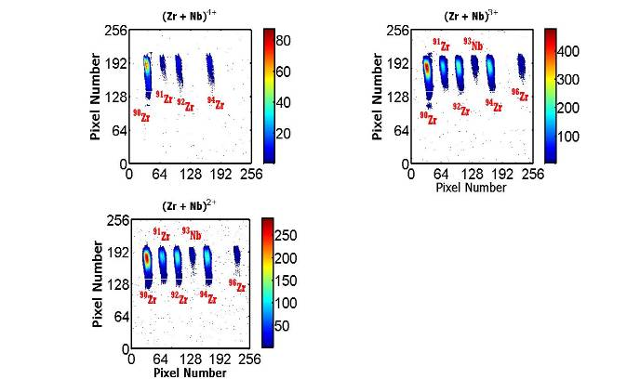
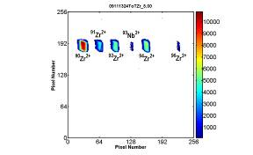
TimePix - metal detector of low energy ions
at the focal plane of the laser mass-spectrometer
Energy of ions: 4 – 40 keV.
Zr (Nb) isotopes abundance measured by TimePix.
The TimePix data
were used to improve
focusing: the vertical size
is ~ 3 times less, now!

Slide 19
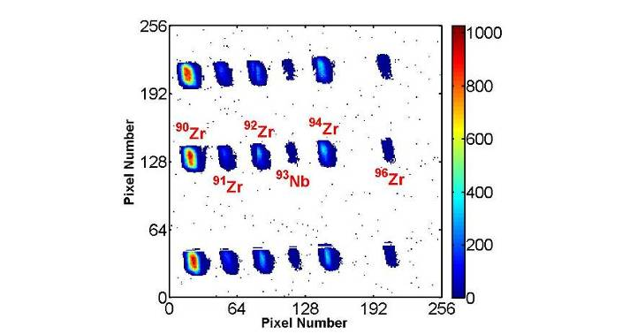
TimePix (METAL-2) in the focal plane of the laser mass-spectrometer
Mapping isotope population over the sample area
by scanning it with laser or charged particle micro-beam might be useful for applications in material technology, microbiology,
medical diagnostics etc.
TimePix (Metal-2) Response
at different positions of 2⁺ ion beams
TimePix chip was readout by the PIXELMAN hardware/software
(IEAP, Prague).
Real-time digital information, high speed communication and data transfer are essential features of TimePix

Slide 20
MMD @
ESRF - France/Grenoble
Beamline ID17
  Beam Imaging, Measurement of the dose distribution absorbed in real time – unique features of the MMD are needed
    radiation hardness
    Transparency
Beamline ID23
  Fast Positioning of the X-ray beam with a size of 20 – 50 μm

Slide 21
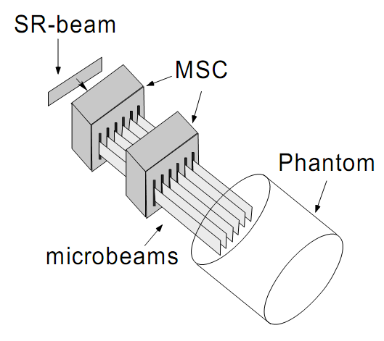
TimePix (Metal) and Gafchromic films measuring dose distribution at the Bio-medical beamline ID17
(ESRF, Grenoble, November 2010).
X rays
Energy range:
from 50 to 600 keV
Intensity:
2,7×10¹¹ photons/(c×mm²)
Multi-Slit-Collimator
for producing spatially
fractionated minibeams
Conventional dose distribution measurement
(gafchromic films) using scanning
microscope technique
takes up to 24 hours.
Timepix - real time 2D measurements of the dose
delivered by minibeams of synchrotron radiation
shaped in space and time
accordingly to the plan of the Minibeam radiation therapy.

Slide 22
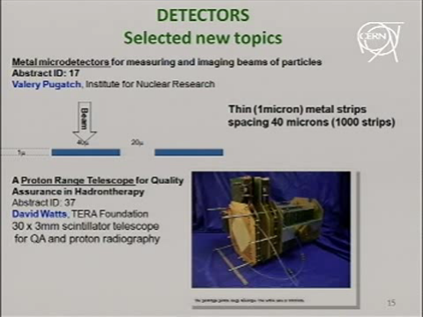
MMD could be helpful in Particle Therapy
MMD – an ideal monitoring device:
present in the beam, permanently
does not disturb a beam
measures X-Y dose distribution
provides self-control of functionality
operates reliable over high doses
  From : Ken Peach (UK)
  Summary talk at the Physics for Health in Europe.

Slide 23
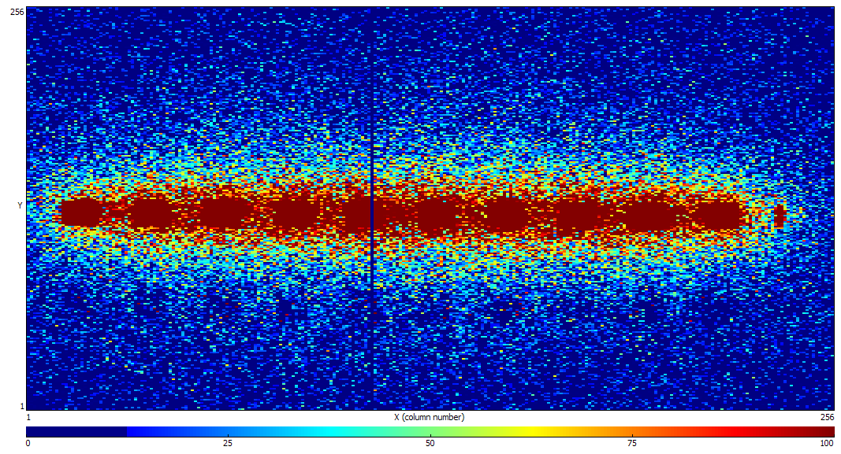
Metal TimePix detector performance at the Bio-medical beamline ID17
(ESRF, Grenoble, November 2010)
Irradiation impact – ‘memory’ of the beams

Slide 24
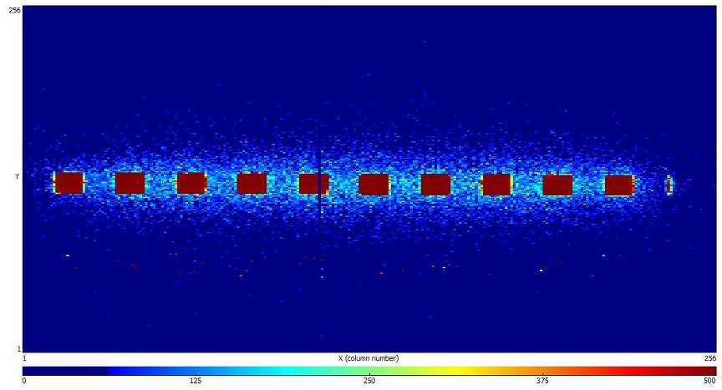
Metal TimePix detector performance at the Bio-medical beamline ID17
(ESRF, Grenoble, November 2010)
Irradiation impact – ‘memory’ of the beams

Slide 25
Metal Microstrip-Detector bump-bonded to TimePix
-Radiation Hard Assembly
Metal Micro-strip Detector MMD-766
Supporting frame silicon – (45 x 45) mm²
500 mu thick.
2 mu thick Ni, 766 metal strips free hanging
in the operating window (10 x 45) mm^{2.}
Silicon wafer is etched out by the plasma-chemistry, completely.
Strip pitch – 55 mu, width – 30 mu
TimePix readout chip is bump bonded to the
766 pads laid out to the 766 metal strips .
Such MMD-TpX assembly is radiation hard
up to 10 MGy (at least).

Slide 26
Current Technical data
Micro-strip Metal Detector
Signal – positive charge created by the electron emission under the impinging particles.
  Conversion factor – electrons/particle: ranges from 0.1 (for MIP) to few hundreds (for the fast Heavy Ion)
Noise – thermoelectric emission, r/f pickup, fluctuation of the leakage current, …
  Determined by the connecting cable and readout electronics:
  ENC: (100 – 500) electrons
Thickness – 1 μm (transparent, non-destructive device for the measured beam)
Position resolution – 10 μm
26
The EURISOL-NET
23.05.2013

Slide 27
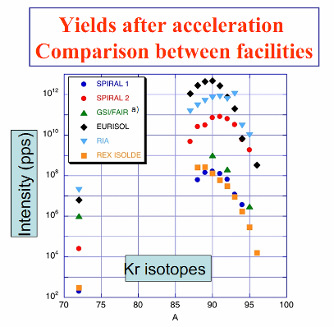
Current Technical data
Micro-strip Metal Detector
Radiation hardness - more than 100 MGy
Stable operation at X-ray intensity
- up to 4,5·10¹⁴ photons·s⁻¹·mm⁻²
Stable operation at proton beam intensity
- up to 10⁸ protons/bunch/strip
The EURISOL-NET

Slide 28
Metal Micro Detectors for BPM
Advantages of the MMD:
High Radiation tolerance (10-100 MGy)
Nearly transparent sensor – 1 μm thickness
Low operation voltage (20 V)
Spatial resolution (5 – 25 μm)
Well advanced production technology
Commercially available readout hardware
and software.
MMD- 16 sector pixels
MMD-64.
64 strips,
100 μm pitch,
40 μm width,
1 μm thick

Slide 29
Conclusions
Metal detectors are prospective elements of radiation hard measuring systems.
The prototype of “electronic plate” has been successfully tested with low energy ions at mass-spectrometer as well as a part of the X-ray beams imaging device.

Slide 30
Conclusions.
Metal strip sensor is the only object interacting with the ion beam in the working area
This is achieved due to the developed original technology combining photo-lithography and plasma-chemistry etching.
Besides creation in this way ideal conditions for the charge production/collection in a sensor its metal nature provides the highest possible radiation hardness of a device.
MMD (currently available in Ukraine, only) are the thinnest (1 μm) sensors ever existed for measuring particles fluxes.
MMD are ideally suitable for monitoring intensive of charged particles and synchrotron radiation.

Slide 31
Acknowledgements
This work has been carried out in collaboration with co-authors from HERA-B, LHCb and MEDIPIX Collaborations.
Many thanks are also to:
M. Campbell, L. Tlustos, X.Llopart , CERN
S. Pospisil, IEAP, Prague
V. Storizhko, V. Eremenko, S. Homenko, A. Shelekhov, IAP NASU, Sumy
Y. Prezado, M. Renier (ESRF).
A. Chaus, O.Kovalchuk, O. Okhrimenko, D. Storozhik, INR NASU, Kiev

