Slide 1
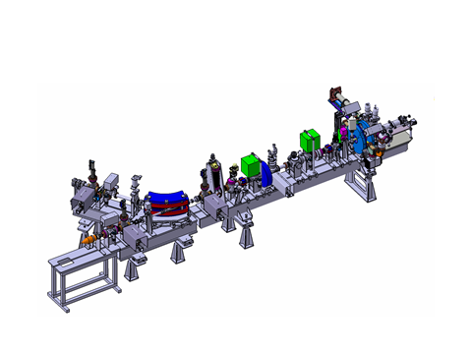



PHIL
Photoinjecteur au LAL
H. Monard
For PHIL Team

Slide 2
ACCDEP context
R&D photo-injectors : futur e- accelerators = very bright sources
Users interested in low energy, good quality electron beam
local accelerator : technical plateform developp know-how and test stand for LAL others accelerator project (THOMX )
training of personnal & students

Slide 3
LAL Rf gun experience
Rf gun made in LAL
Year | Name | ncell | Application
1988 | CANDELA | 1.5 | R&D Rf gun
2000 | Elyse | 1.5 | Pulse Radiolysis (LCP)
2002 | Alpha-x | 2.5 | RX Production (Univ Starchlyde) → Daresbury (EBTF)
2007 | CERN/PHIN 1 | 2.5 | CLIC (CERN)
2010 | LAL/PHIN3 | 2.5 | Phil : R&D rf gun
2013 | ThomX | 2.5 | RX production
2014 ? | LAL/C4 | 4.5 | R&D rf gun
f = 3 GHz
Building and running of RF gun in LAL
(workshop, assembling, measurements,conditionning, running)

Slide 4
Photo-injection Principle
RF (EM Wave)
F = q Ef
Charged particle Acceleration
Electron Production with
photoemission
(cathode inside RF cavity)
Laser
electrons
Ef
Temporal structure
electron – laser
are identical
Cylindrical cavity
Stationnary wave TM010
Short pulses: ps (fs)
Efforts on Photocathode & Laser
Ef ~ 80 MV/m → E ~ 4 MeV over 10 cm (@3 GHz)

Slide 5
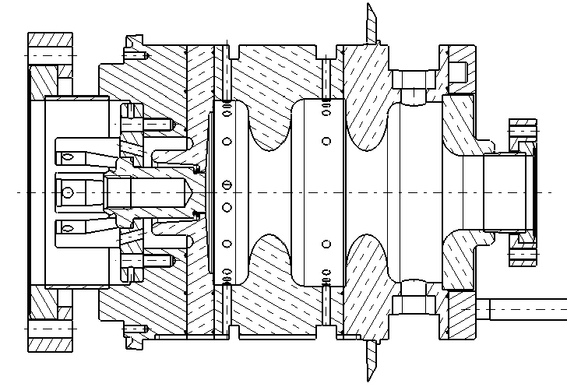
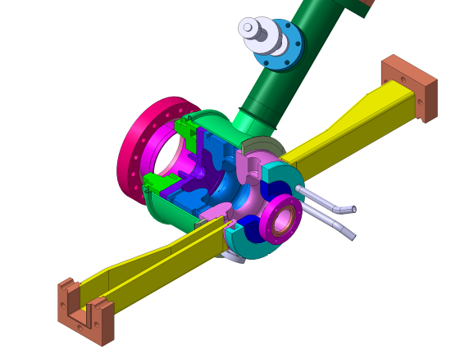
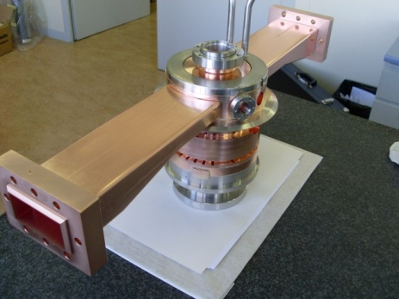
PHIN RF gun
Used today in PHIL
possible cathode change
gun 2.5 cells
Made in LAL
F = 2998.5 MHz
RF coupling

Slide 6
Photo-injection Principle
Electron dynamics
« Wrong » phase
one electron on axis (r = 0)
Optimisation of energy
2.5 cells Rf gun
E(z,t) = Eo cos(kz) sin(ωt+φ)
Eo = 90 MV/m
« good » phase
2.7 MeV
E field decelerating
Energy E/Es
enveloppe Ez
E seen by electron
5.7 MeV

Slide 7
Photo-injection Principle
Energy & dispersion
One electron on axis (r = 0)
energy out of the rf gun = f(phase)
e- getting out
E < 0 : e- back to photocathode (secondary emission)
Dispersion of energy : dE/dφ minimum when energy is maximum

Slide 8
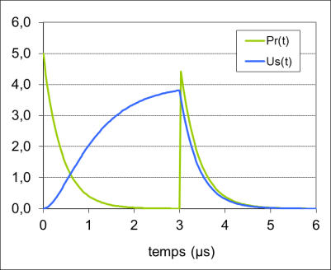
PHIL RF source
RF source
Pik
CIRCULATOR
Prk
SF6
pump
Pic
Prc
MODULATOR
KLYSTRON
pump
PA
RF GUN
Pmax = 14 MW t = 3µs

Slide 9
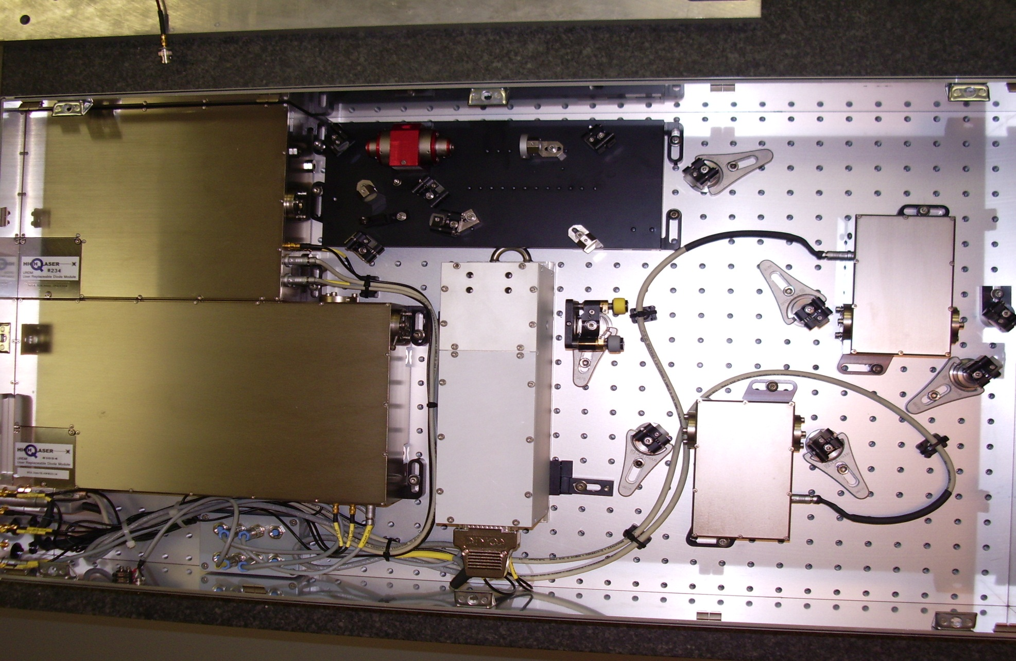
PHIL laser
Oscillator Nd-YLF
F= 74,963750MHz
W/impulsion: 2 nJ
X 2
1 mJ
Amplification Nd-YLF
gain ~ 10⁶
Pockels
cell
80 µJ
X 2
1064 nm
532 nm
266 nm

Slide 10
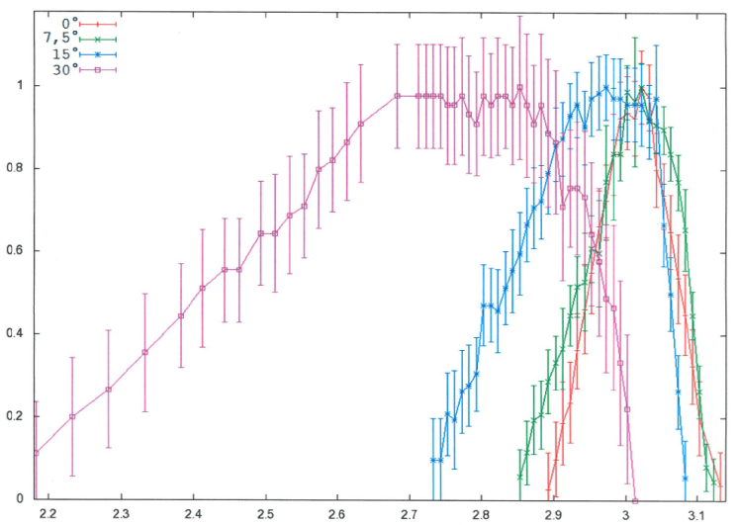
Some measurements on PHIL
Mg Cathode (alphax gun)
Cu cathode dark current
92 MV/m
Energy & dispersion
Charge – Phase (Cu cathode)
Intensity (mormalized)
Energy (MeV)

Slide 11
PHIL yearly
2009
2010
2011
2012
2013
2014
Alphax Rf gun
PHIN Rf gun
Thomx RF gun
1st beam
YAG2,3,4
1st user
FLUO spectrum
YAG1
Ez max = 92 MV/m
E ~ 5 MeV
Mg test
ThomX RF gun
Ez max ~ 45 MV/m
E < 3 MeV isolator !
LEETECH start
Ez max ~ 60 MV/m
E ~ 4 MeV
FLUO 1st spectrum

Slide 12
Salle bleue
Amphi LAL
PHIL inside LAL
Contrôl
Room
7,2 m
Laser
galerie
25 m
5,1 m
4 m
10 m
13.5 m
9.0 m
5 m
Beam direction
Non climatisée
Modulator
Klystron

Slide 13
PHIL today
RF input
1 m
ICT2
YAG3
ICT1
RF gun
YAG 1
YAG2
Al exit window
BPM
Transfert arm
laser
Cerenkov
User area
solenoids
slit
Virtual Cathode
YAG4
Beam stop

Slide 14
PHIL today
RF input
1 m
ICT2
YAG3
ICT1
RF gun
YAG 1
YAG2
Al exit window
BPM
Transfert arm
laser
Cerenkov
User area
solenoids
slit
Virtual Cathode
YAG4
Beam Parameters
10 pC < Q < 300 pC (Cu) with Mg Q ~ 1.4 nC
1.5 MeV < E < 4 MeV dE/E = 0.2% for 100pC@3 MeV
Pulse Duration ? (7 ps FWHM) Emittance ~ 4 to 10 mm.mrad
F = 5 Hz Imoy ~ 1 nA
Beam stop

Slide 15
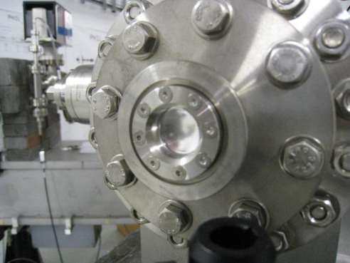
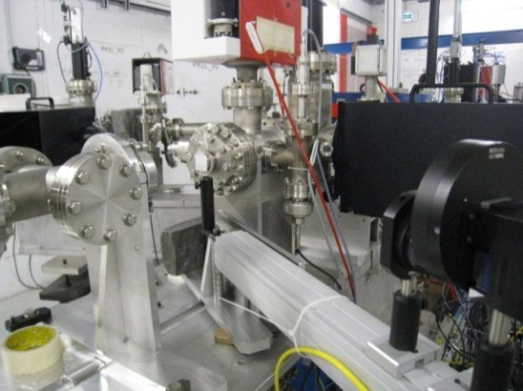
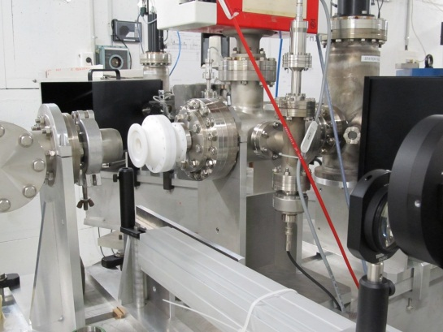
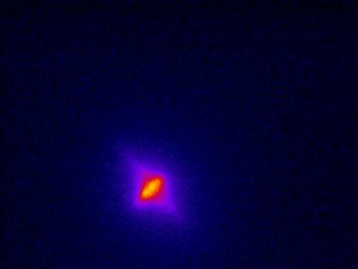
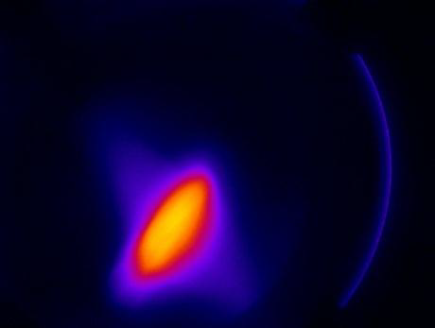
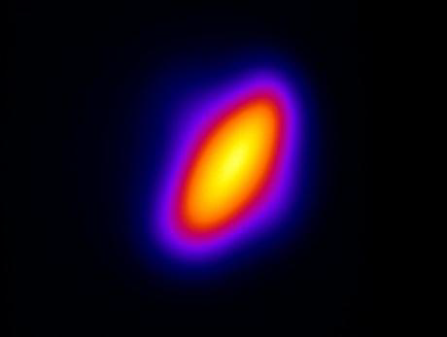
Beam Exit window of PHIL
window : Al 18 µm Ø16 mm
Lanex screen
Fluorescence sphere
Beam on YAG screens & Lanex (in l’air)
Distance = 5 cm
YAG2
YAG3
Lanex

Slide 16
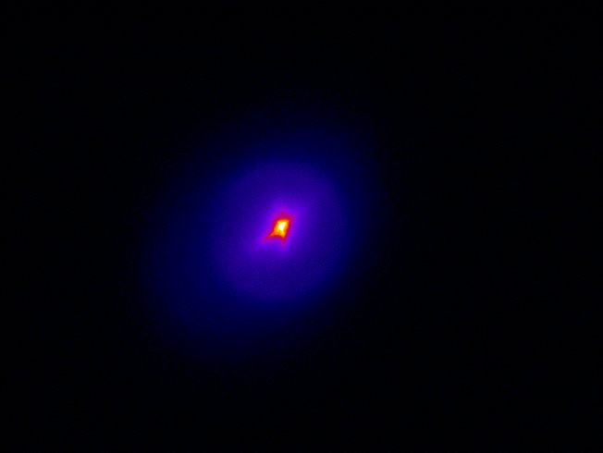
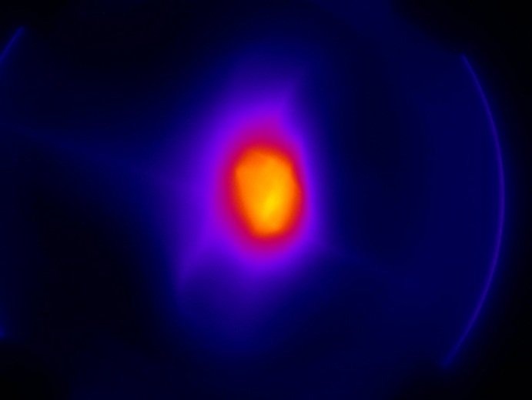
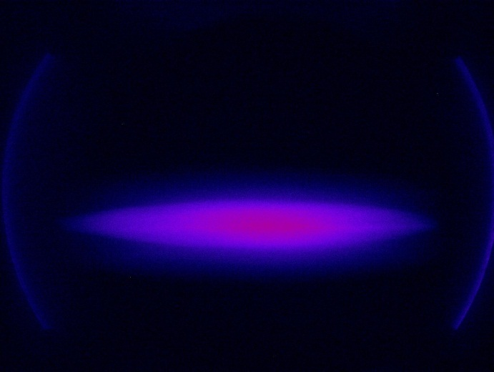
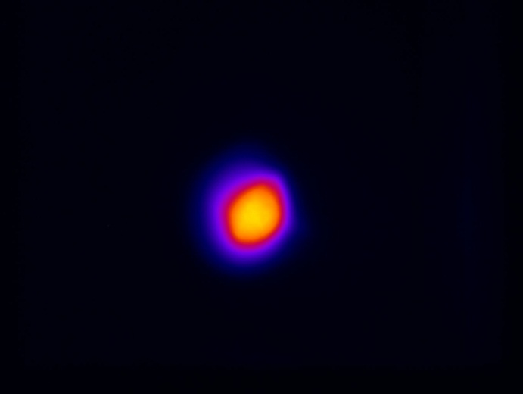
Examples Beam Images
Transport conditions are different
YAG2
YAG3
YAG4
Lanex
(outside)

Slide 17
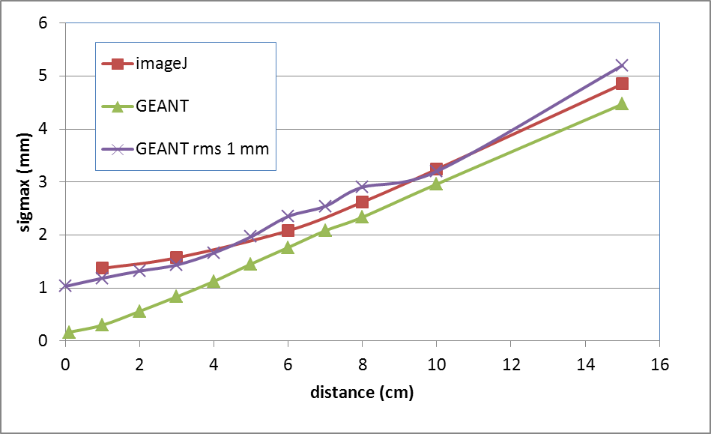
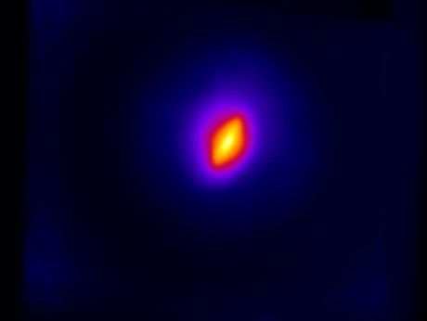
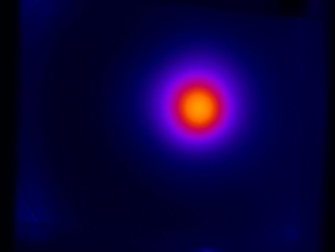
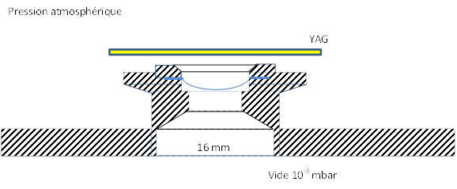
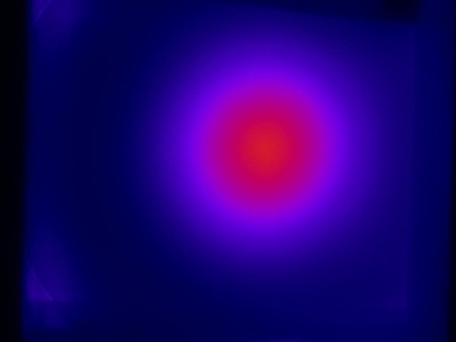
Beam size outside beam pipe
Beam size outside beam pipe
D = 1 cm
e- beam
Vacuum 10⁻⁷ mbar
D = 6 cm
air 10³ mbar
D
YAG screen
miror
CCD
D = 15 cm

Slide 18
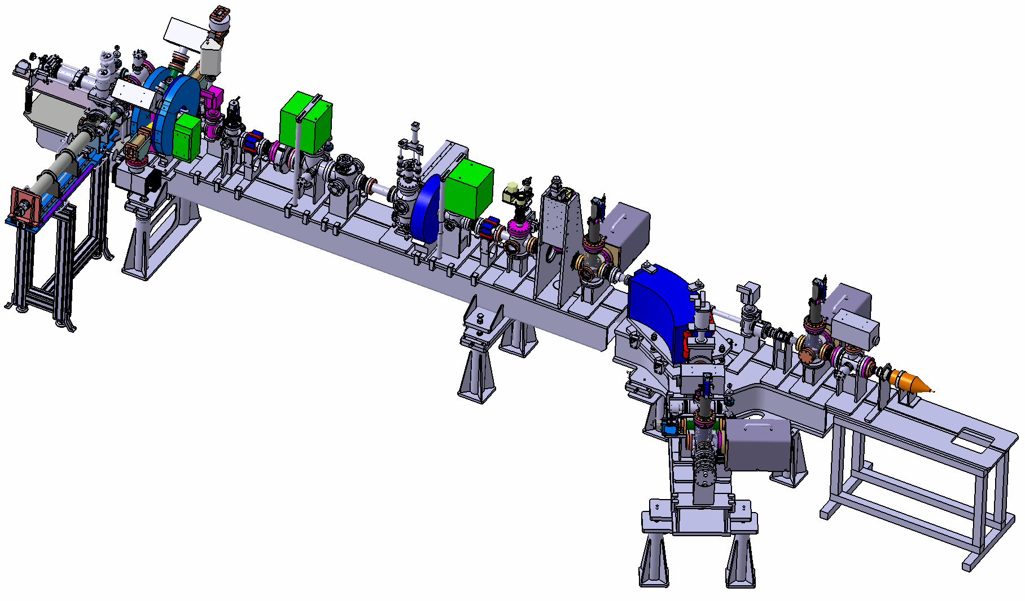
PHIL tomorrow
Emittance
(slits H&V + screen)
Not installed
YAG 1
YAG2
YAG3
User area
Cathode transfert
+ cathode reservoir
Duration measure
(Cerenkov)
YAG4

Slide 19
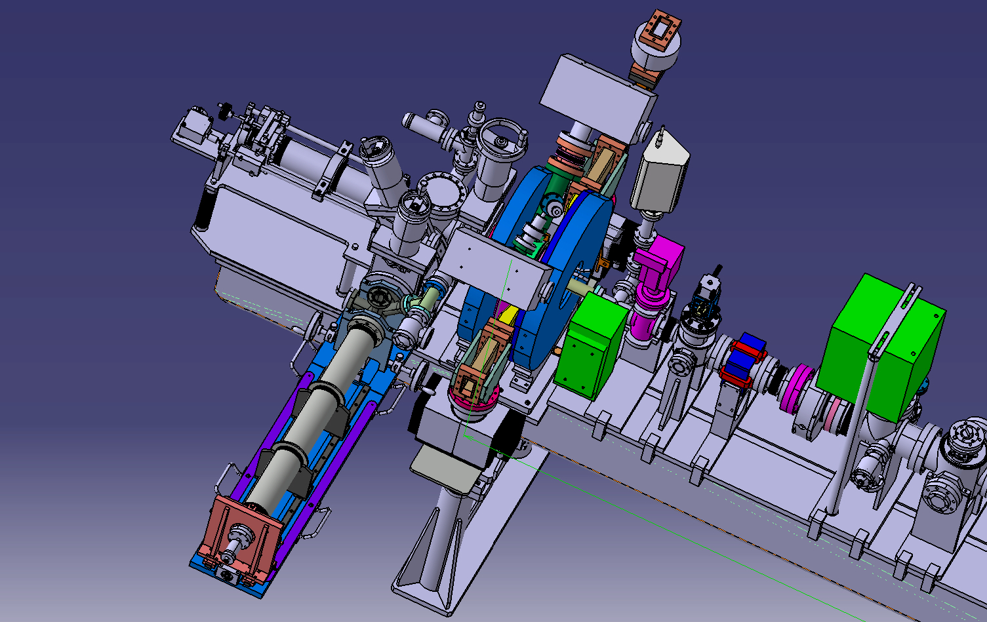
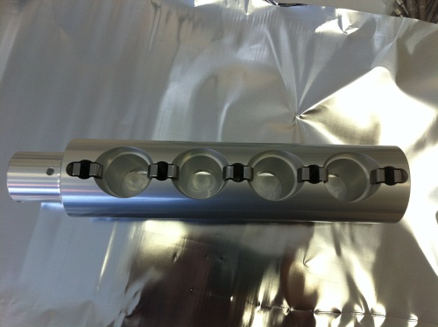
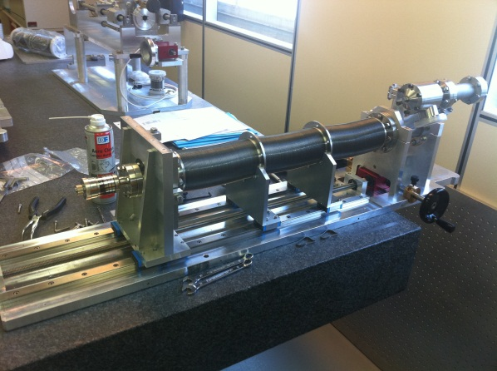
Photocathodes transfer
4 Cathodes holder
Transfer arm
« Diplomatic
Suitcase »
Cathodes
Collaboration with CERN/CTF

Slide 20
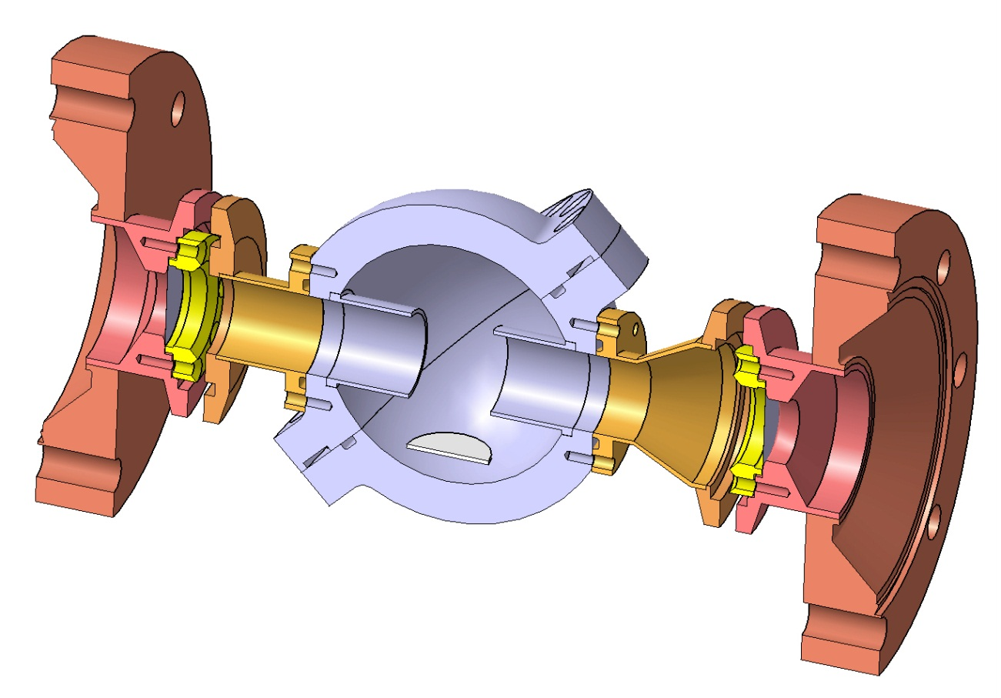
First users :
fluorescence of air
JEM/EUSO
Japanese Experiment Module
EXtreme Universe Space observatory
Light created by secondary particles from cosmic rays in high atmosphere
Primaries energy estimated with flourescence of
Air with precision of 20% → improved to < 5%
LAL / APC
Desired Caractéristics
Charge > 100 pC
measurement 2%
E ~ MeV
Electron beam
P = 10⁻⁸ mbar
P = 1 mbar à Patm
T = -50°C à 20°C
window Al 18 µm
D. Monnier, P Gorodetsky

Slide 21
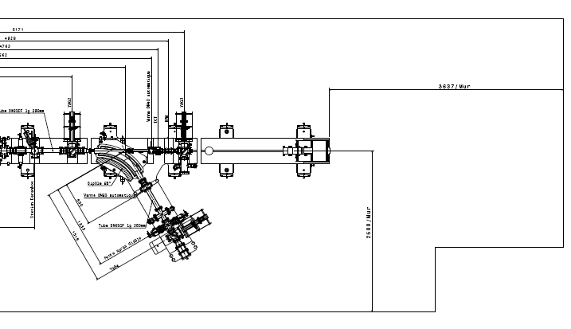
LEETECH @PHIL
3,6 m
2,5 m

Slide 22
Tomorrow’s PHIL changes ?
  Shorter laser pulses (100 fs)
    need new laser
  4.5 cell RF gun
    Reduce energy upgrade costs
  magnetic chicane (2 dipoles)
    beam transport study+magnets
  Upgrade to 10 Hz
    decrease acquisition time
  Cathode preparation chamber
    LAL own production for PHIL and ThomX ?
  More users

Slide 23
PHIL Users
Fluorescence of air High atmosphere conditions
(LAL D. Monnier) – first results
Diamond detector (LAL P. Bambade)
X ray source (100 eV) (UPMC P Jonnard) – october ?
Irradiation of electronic diodes (Univ Cherbourg )
LEETECH - Micromegas (LAL - S Barsuk)
- N electron < 100
Carbon nanotubes cathode tests ? (TRT-Thales)
…

Slide 24
PHIL after tomorrow ?
RF input
ICT1
YAG 1
YAG2
ICT2
YAG3
User 1
laser
ICT3
Canon RF
4.5 cellules
Beam stop
User 2
- 9 MeV
- Better charge transmission
- 2 users aera : 2 dipoles
Dark current < 1% in user 2

Slide 25
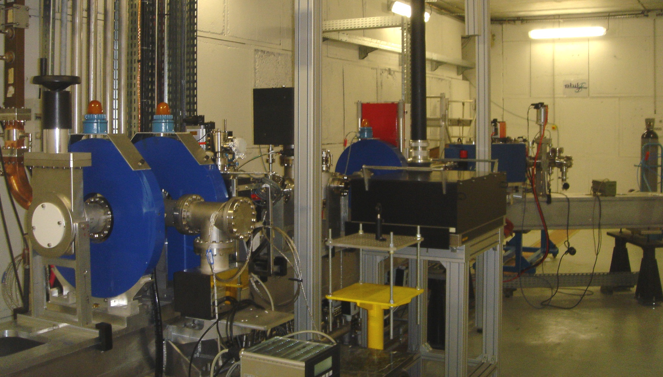
Thanks to all PHIL team !

Slide 26
Synchronisation
5 Hz
LASER
Master Oscillator
75 MHz
EM source (klystron ~ 15 MW)
3 GHz
laser
Cavity= RF gun
electrons
PhotoCathode
Electric field E = Eo cos(kz) sin(ωt+φ))

Slide 27
Photoinjector R&D issues
Parameter | Laser | photocathodes | RF gun
Energy (9 MeV) Dispersion (< 1%) | Energy Distribution (x,y) | Homogeneity QE(x,y) | 2.5 à 4.5 cell or Booster
High curent (> 1 kA) | Very short pulse ( 100 fs) | High QE (>10%) | high gradient (> 100 MV/m)
low emittance (< 5 µm.rad) | Energy Distribution (x,y) | Homogeneïty QE(x,y) | high gradient (> 100 MV/m)
high gradient (> 100 MV/m) |  | Electrical continuity | Surface state, geometry
Repetition rate (> 10 Hz) | Synchronization | Life time | cooling
Short pulse ( < 1 ps) | 100 fs | Response time ? | high gradient (> 100 MV/m)

Slide 28
PHIL facts
- Test 1st klystron (24133) : HS
- Cooling of RF gun (temperature regulation)
- Test 2nd klystron (24137) : Htmax 15 kV –
Pik = 13 MW
- Fire inside Modulateur !
- Alphax RF gun conditionning
- YAG1 installation (beam diameter)
- Fisrt beam 4/11/09
- Pre-amp problem
Q = 100 pC, ionic pump perturbation-
(HT = 12.5 kV)
- Ez max alphax Rf gun = 90 MV/m
- Installation YAG2,3 , 4 screens + ict2
- Laser problem
- Energy Slit installation
- Long stop for modulator
2009
2010
- Control room moved
- Beam with 5 MeV, RF noise
- Power coupler change Pic/Prc
- Cathode Change,
- Installation ict1 (charge measurement)
- Arcing in RF isolator ! (HT > 13 kV)
- Mg cathode test (Q> 1 nC)
- Isolator repair
- aluminum exit window (18 µm)
- PHIN RF gun conditionning
- New LAL electronic for ict2
- 1st user : FLUO : 1st spectrum !
2011
2012

