Slide 1
PERFORMANCE OF THE METAL RADIATION MONITORING SYSTEMS
Oleksandr Okhrimenko
Institute for Nuclear Research NAS of Ukraine, Kiev

Slide 2
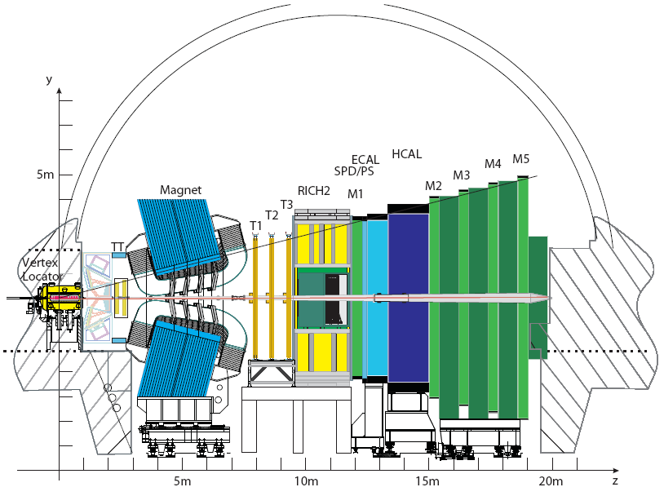
Introduction: LHCb
Muon:
μ/h distinguish,
Trigger
RICH:
р/К/π identification
RMS
Beam 1
Beam 2
Trackers
Calorimeters:
h/e/γ distinguish, Trigger
LHCb – forward spectrometer, located at LHC.
Proton-proton interaction at √s = 14 TeV, L = 2×10³² cm⁻²s⁻¹.
Goal: CP violation and rare decays of B-mesons.

Slide 3
Introduction: RMS
The RMS is based on the Metal Foil Detector technology developed in Kiev
The RMS (detection part) comprises 4 Boxes (access, cryo, top, bottom) fixed at the IT-2 station
7 MFD sensors
(110x75 mm²) in each
Dimensions of sensors are close to Inner Tracker ones
Main function: to monitor radiation load on Silicon Tracker sensors

Slide 4
Introduction: MFD
MFD is a metal foil connected to the sensitive Charge Integrator (ChI)
Principle of operation – Second Electron Emission from metal foil surface (10-50 nm) caused by projectile charge particles
Positive charge created in metal foil is integrated by Charge Integrator - converted into a frequency, measured by a scaler

Slide 5
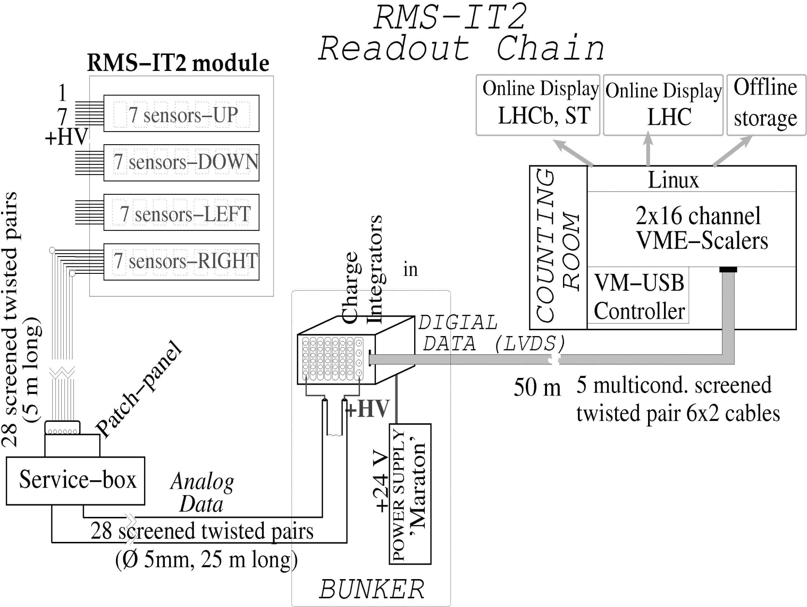
Introduction: RMS

Slide 6
Introduction: RMS
The calibrating current at the input of the charge integrators is set to 250 pA, determines a baseline of 25 kHz for output frequency (10 fC – 1 count).
One count in the charge integrator is generated by ~ 10³–10⁴ charged particles hitting sensor per second (depending upon their charge, energy etc.):
Linear response – up to 1,2 MHz output frequency.
RMS allows to monitor the luminosity by 2 orders exceeding the LHCb nominal one.

Slide 7
What do we expected at IT-2?
Based on FLUKA simulation:
Charged hadron fluxes at IT-2 station 10⁴–10⁵ cm⁻²s⁻¹ (up to 10¹² MIP/cm² per year) as result 60 kGy of Absorbed Doses by IT sensors during 10 years of nominal operation (L=2*10³² cm⁻²s⁻¹)
MFD is acceptable to measure such fluences.

Slide 8
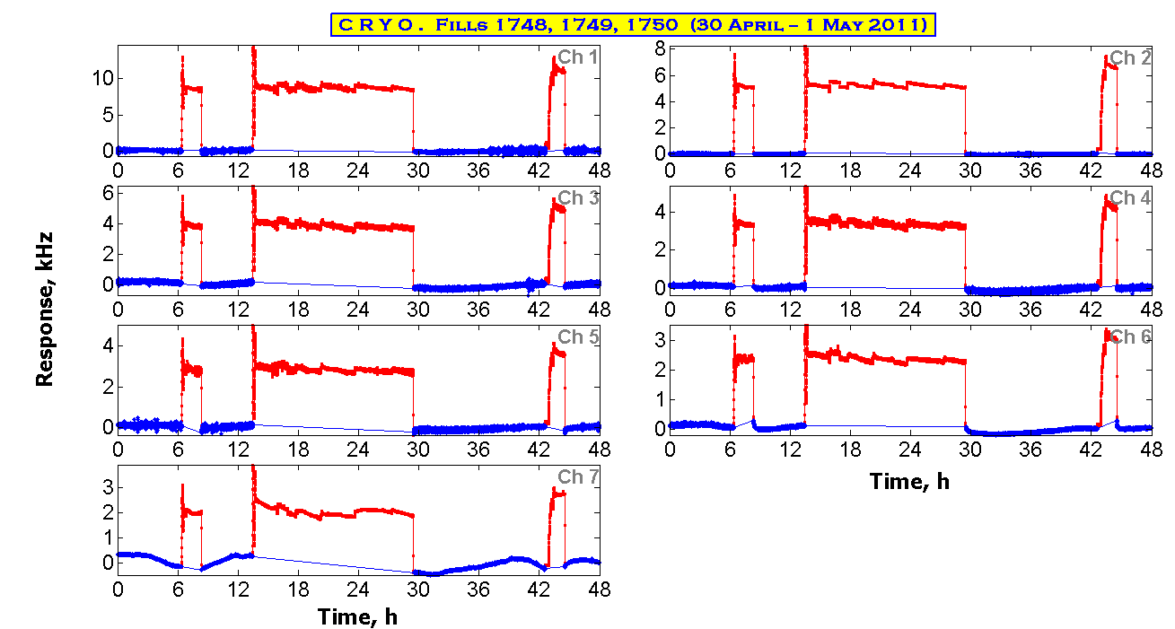
RMS During Proton Collisions at IP8
Impact of the pp-collisions - in red color. Interpolation of the baseline is needed to get correct fluence/dose absorbed by the Si-sensor. h
Contribution from the calibrating current (~ 25 kHz) is subtracted.

Slide 9
Fluence Distribution Over ST Sensors
Measured fluence for 2 years (3.3/fb) is (2–6)*10¹² MIP/cm² – agree well with FLUKA prediction.

Slide 10
MC Prediction for RMS Response
Comparison of response distribution over RMS sensors with MC-simulated one (Gauss).

Slide 11
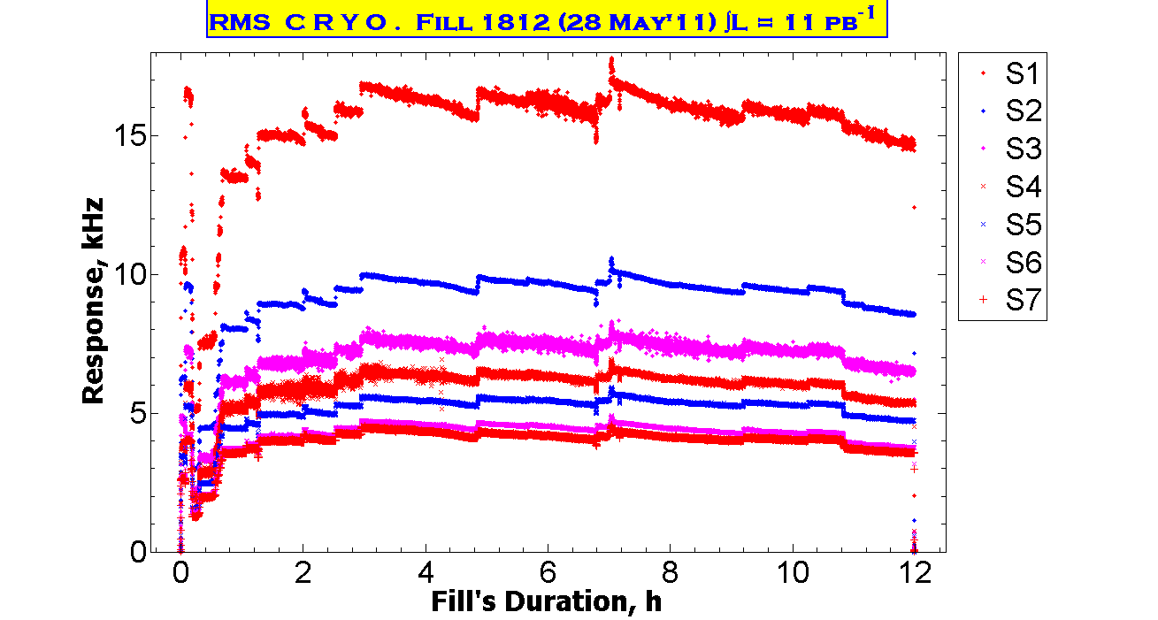
RMS: Luminosity Measurement
Fill 1812.
May 28, 2011
Integrated Luminosity –11/pb
RMS (upper plots)
&
LHCb Luminosity measurement (bottom plot).
Good correlation of data.
Stable Beam

Slide 12
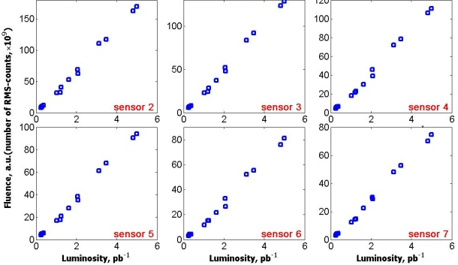
RMS: Luminosity Measurement
Calibration of RMS for Luminosity measurement was made.
This allow to extrapolate RMS data (fluences) on “non-detected by RMS” fills.

Slide 13
RMS: Luminosity Measurement
Evolution of the Delivered Luminosity at LHCb measured by RMS in comporison with LHCb data.

Slide 14
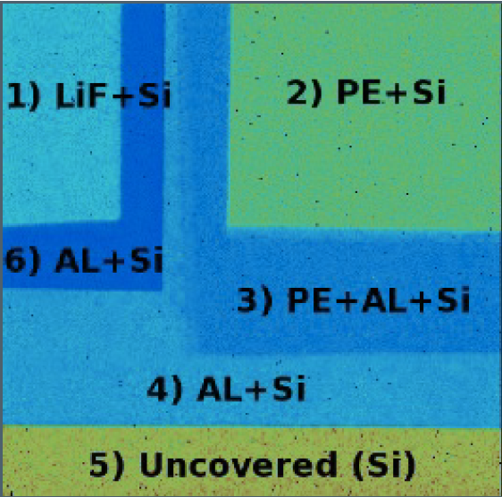
Medipix as Radiation Monitor
Two types of radiatorіs LiF and PE is used to detect thermal (< 100 keV, ⁶Li(n,α)H³) and fast ( < 15 MeV, ¹H(n,n)p) neutrons.
Al-layers is used to attenuate photons and electrons
Uncovered region – to subtract background

Slide 15
Conclusions
RMS characteristics are allowed to measure charged particles fluences over IT Si-sensors
RMS is used as Beam and Background Tools to monitor Radiation Background – very important during beam injection to avoid radiation damages.
RMS is able to measure Integrated Luminosity.

Slide 16
Outlook
Improving of readout part with microchips instead of ChIs to reduce ~30 m of “analog way” – reduce r/f pick-up influence on the baseline values.
Improving of the RC-filters (install capacitors near sensors instead on patch-panel (5 m)) on HV (24 V) line.
Neutron measuring with Metal as well as Medipix detectors.

Slide 17
Thank You for attention!

