Slide 1
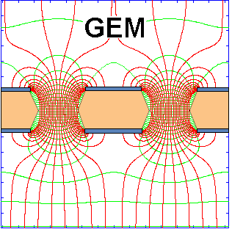
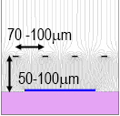

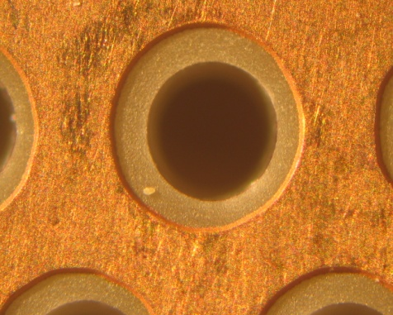
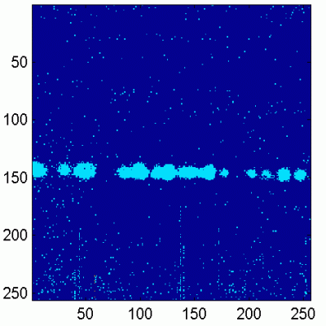
50 μm
140 μm
Trends and Perspectives for Gaseous Detectors:
MPGD Technology for the sLHC and ILC
Micromegas:
Maxim Titov, CEA Saclay, France
OUTLINE:
Short History of Gaseous Detectors
Micro-Pattern Gas Detector
(GEM, Micromegas, Thick GEM, InGrid, μPIC)
RD51 Collaboration
Gaseous Detectors for LHC Experiments
Advancing MPGD Technologies for Future Physics Projects
- Energy Frontier
- Intensity Frontier
- Cosmic Frontier
Summary and Outlook
Thick GEM +
(THGEM)
GEM +
CMOS ASIC
Workshop LAL-Ukraine on Instrumentation
LAL Orsay, France, May 22-24, 2013

Slide 2
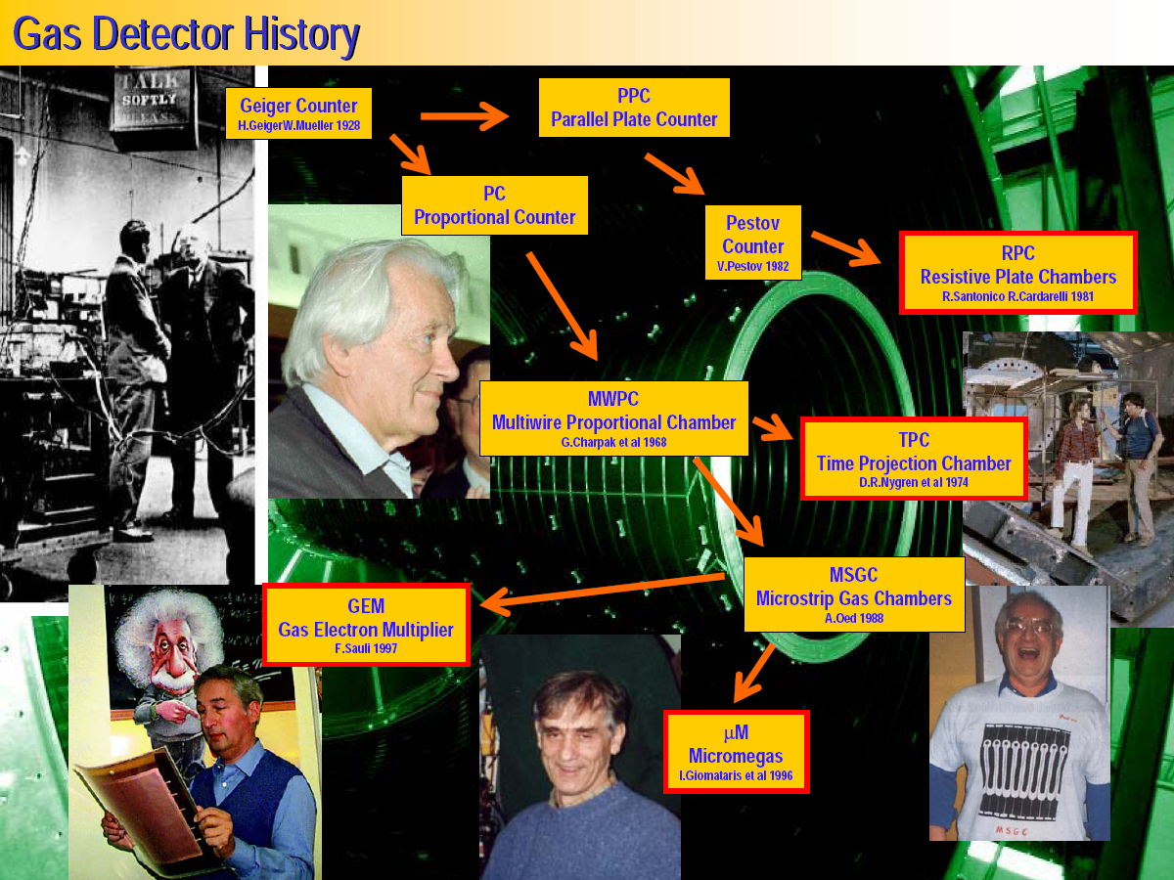
History of Gaseous Detector Developments
M. Hoch, 2004 Wire Chamber Conference

Slide 3
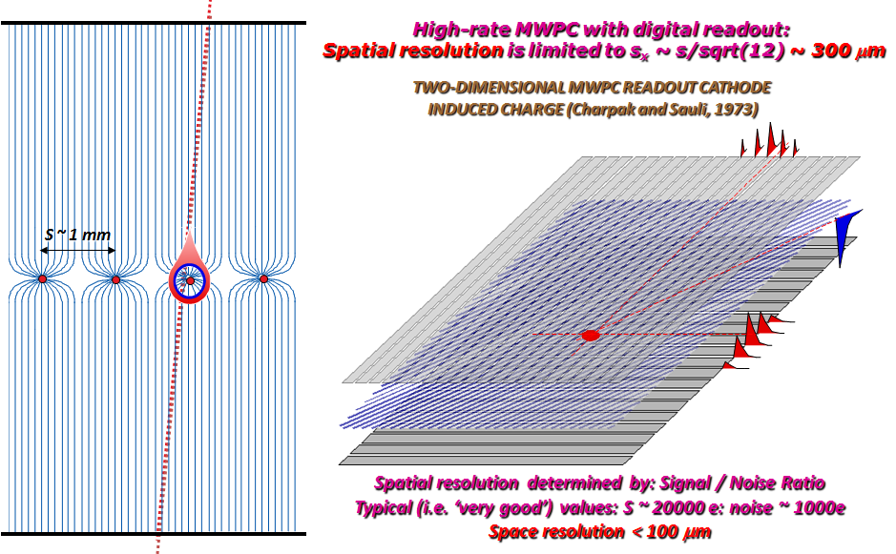
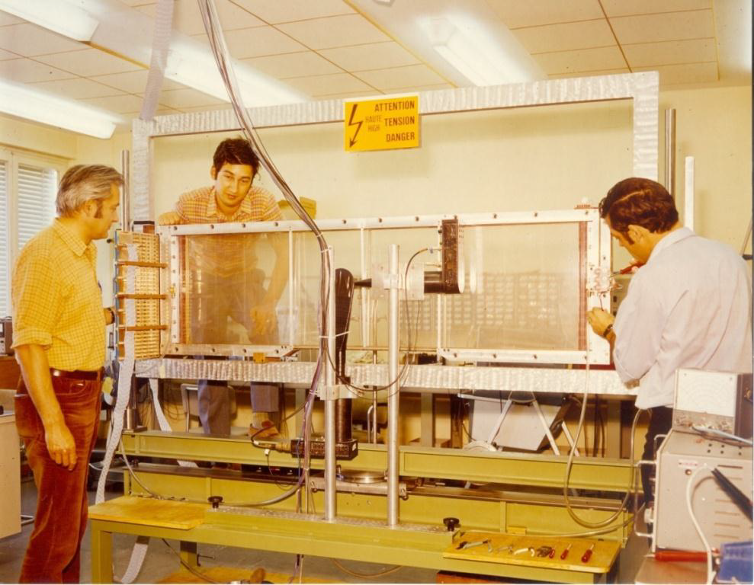

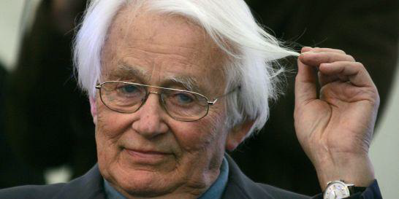
Multi-Wire Proportional Chamber (MWPC)
Gaseous proportional tracking detectors that revolutionized High Energy Physics
With Fabio Sauli et Jean Claude Santiard
The 1st “Large Wire Chamber”…
The invention revolutionized
particle detection, which
passed from the manual
to the electronic era.
Georges Charpak
1924 – 2010

Slide 4
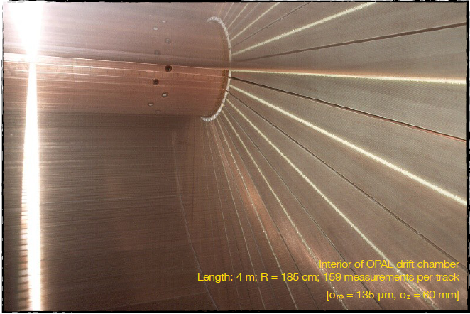
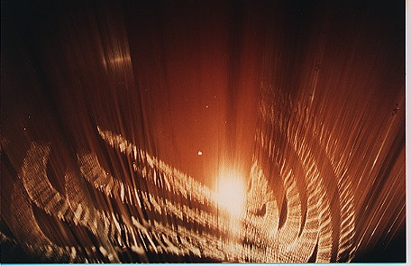
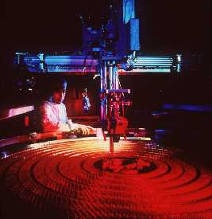
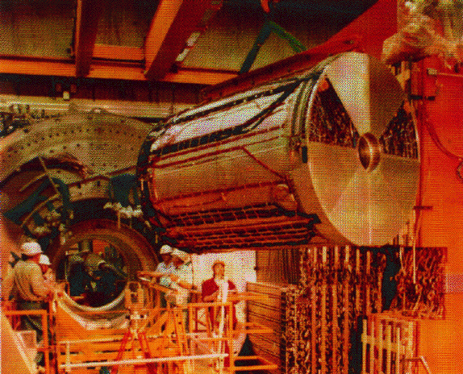
“Enormous Wire Chambers”: Wide-Spread Tool in HEP for > 40 Years

Slide 5
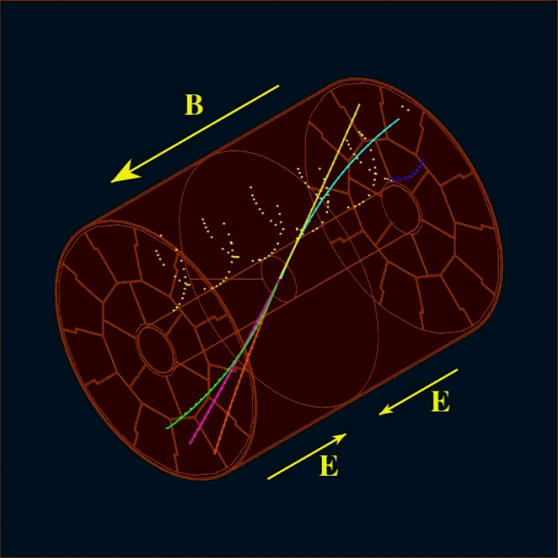
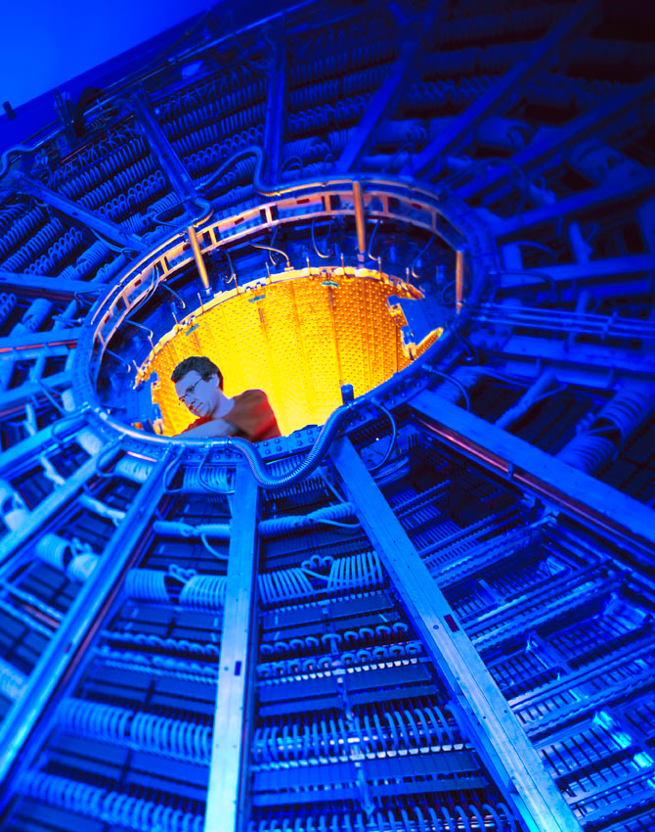
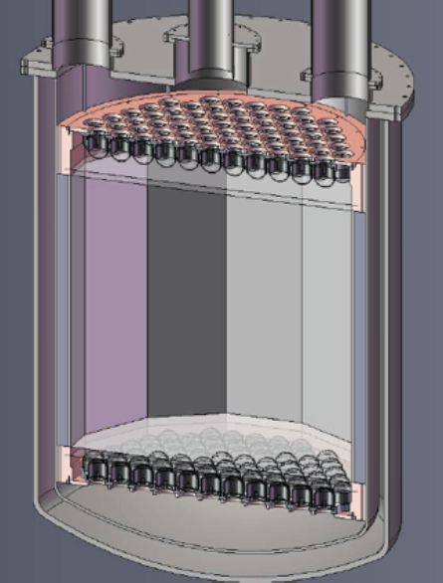
Time Projection Chamber (TPC)
Enabling New Technologies: The invention of the Time Projection Chamber in the late 70’s
E||B: drifting electrons curl
around B field lines: limited spread.
ALICE
LXe TPC
Readout
Gas volume
x
z
y
Powerfull tool for:
Lepton Colliders
Modern heavy ion collisions
Liquid and high pressure noble gases for neutrino and dark matter physics program
Separate two regions:
Long drift along z ~ 1-3 m;
Amplification at the end plate
Challenges:
Long drift time; limited rate capability

Slide 6
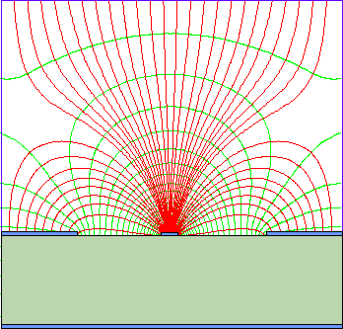
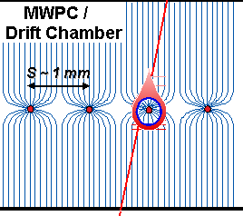
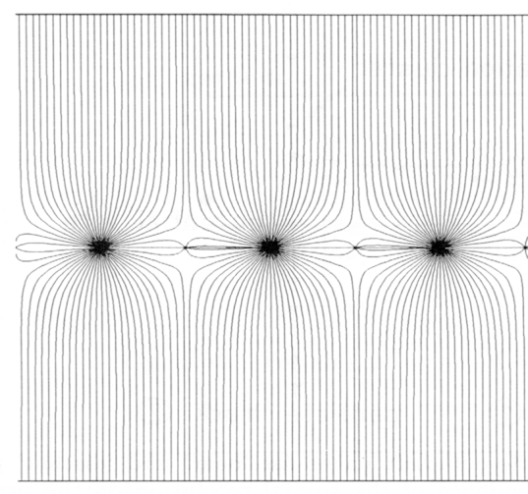

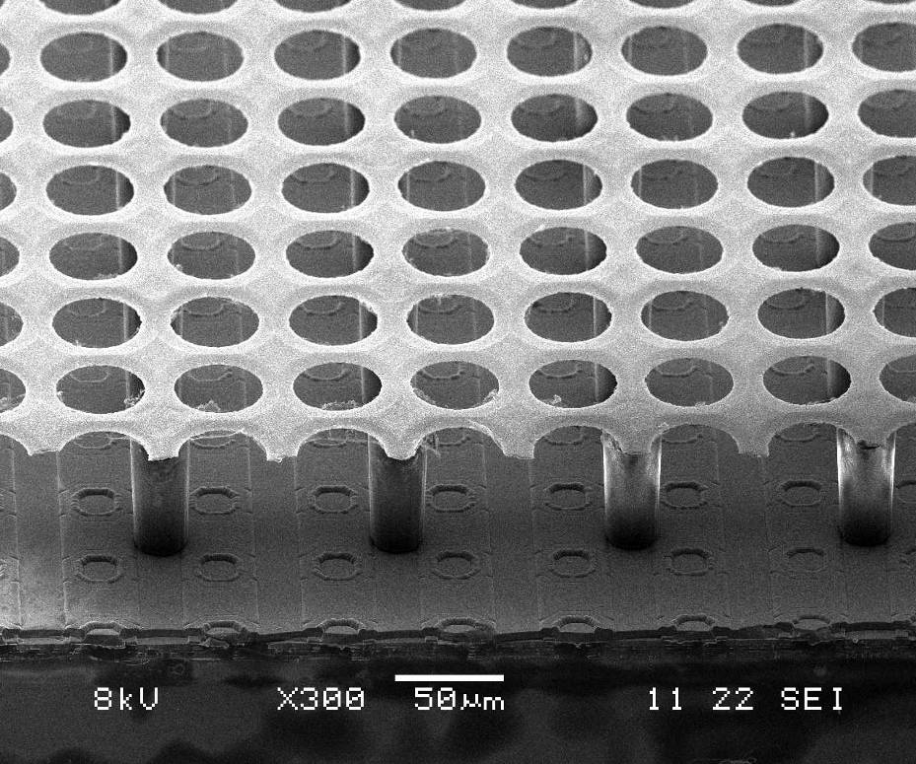
Advanced Concepts: Detectors @ High Luminosity
100 μm
Higher Rate, enormous occupancy:
1D easily saturated → 2D → 3D
Silicon detectors:
Strips →Pixels (2D)→ 3D-Si det.
& 3D electronics integration
Gaseous detectors
Wire Chamber → Wireless MPGD (2D)
→ InGrid/Timepix (3D)
10 μm
50 μm
Drift Chamber
140 μm
Micromegas:
TPC
Advances in Micro-electronics & Etching Technology → Micro pattern Gaseous Detectors
Ingrid

Slide 7
MPGD Developments: Historical Roadmap*
(*Many more micro-pattern structures were developed;
only widely spread technologies are shown)
MicroMEGAS (CEA Saclay, Y. Giomataris)
RD51
collaboration
MSGC (ILL, A. Oed)
GEM (CERN, F. Sauli)
RD28
1988
1996
1992
1997
2003
LEM (Periale)
THGEM(Chechik)
2008
1996
2000
2005
InGrid
μ-PIC (A. Ochi, T. Tanimori)
Capillary plate (Yamagata U., H. Sakurai)
From A.Ochi ADA2012@Kolkata (updated)

Slide 8
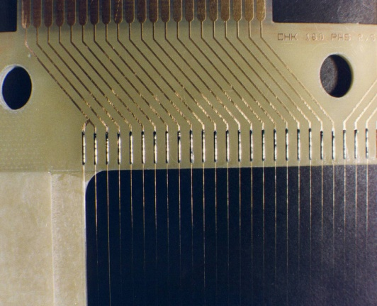
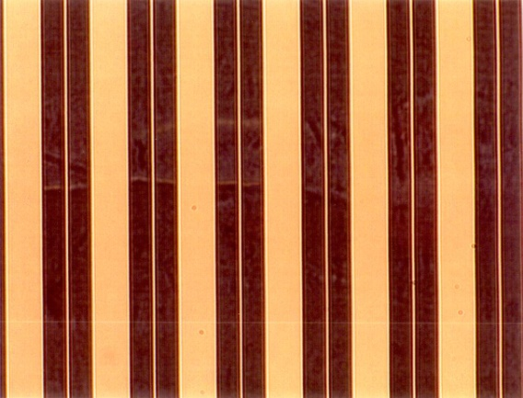
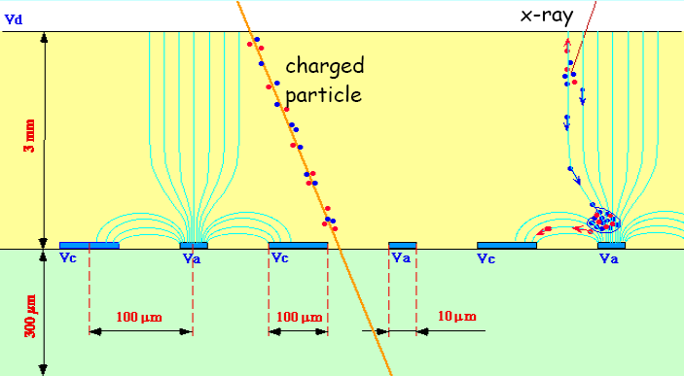
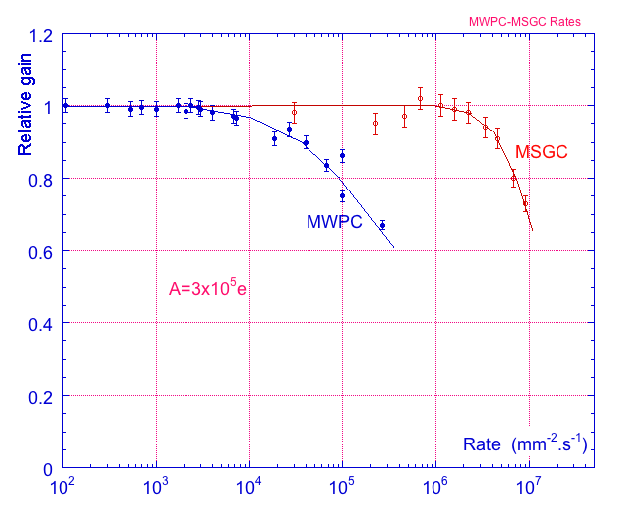
Micro-Strip Gas Chamber (MSGC)
MWPC
MSGC
Rate capability limit due to space
charge overcome by increased
amplifying cell granularity
100 μm
cathode
anode
cathode
10 μm
Typical distance between
wires limited to 1 mm
due to mechanical and
electrostatic forces
Typical distance
between anodes 200 μm
thanks to semiconductor
etching technology
A. Oed, Nucl. Instr. and Meth. A263 (1988) 351.

Slide 9
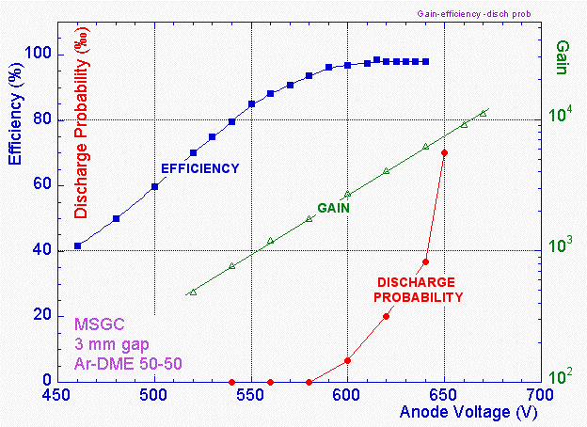
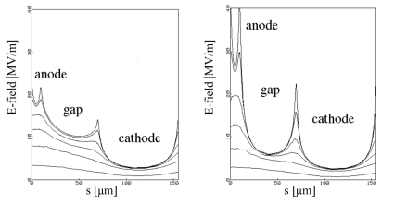
Micro-Strip Gas Chambers: Discharge Problems
Major processes leading at high rates to MSGC operating instabilities:
Substrate charging-up and time-dependent modification of the E field
→ slightly conductive support
Deposition of polymers (aging)
→ validation of gases, materials, gas systems
Discharges under exposure to highly ionizing particles
→ multistage amplification, resistive anodes
“Conductive” MSGC
Uncoated
MSGC
ON EXPOSURE TO α PARTICLES
Induced discharges are intrinsic property of all single stage micropattern detectors
in hadronic beams (MSGC turned out to be prone to irreversible damages)
A. Bressan et al, NIMA A424 (1999) 321.

Slide 10
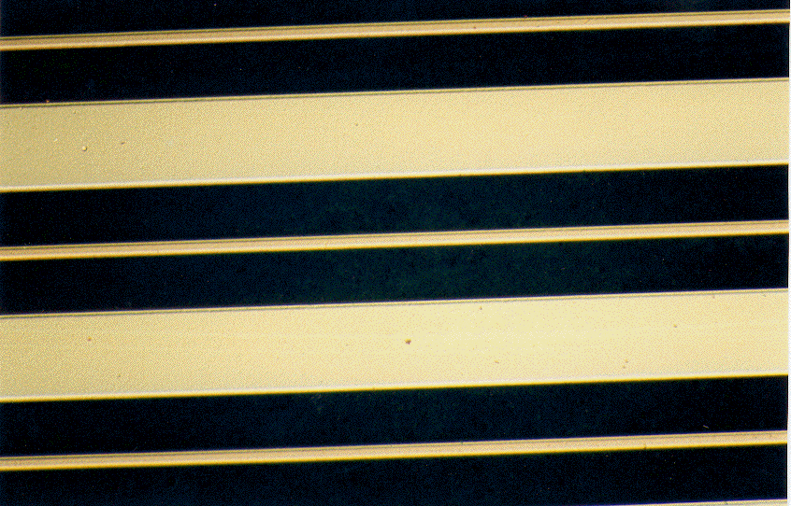
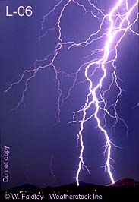
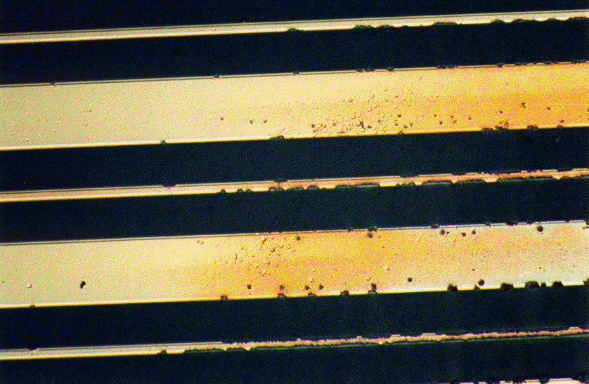
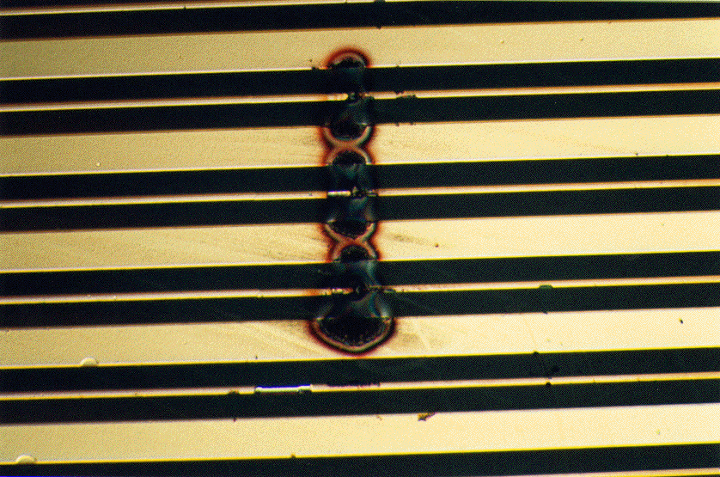
MSGC Discharge Problems
Discharge is very fast (~ns)
Difficult to predict or prevent
MICRODISCHARGES
Owing to very small distance between
anode and cathode the transition from
proportional mode to streamer can be
followed by spark, discharge, if the
avalanche size exceeds
RAETHER’S LIMIT
Q ~ 10⁷ – 10⁸ electrons
FULL BREAKDOWN
F. Sauli, http://www.cern.ch/GDD

Slide 11
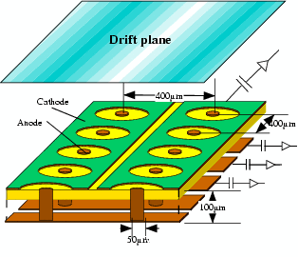
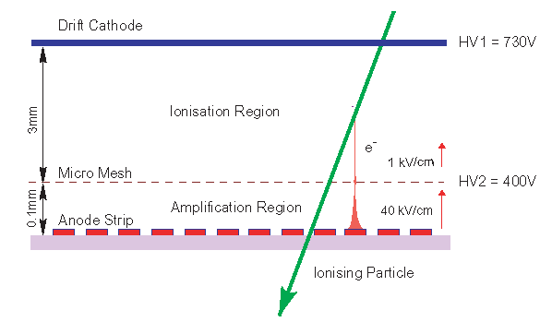
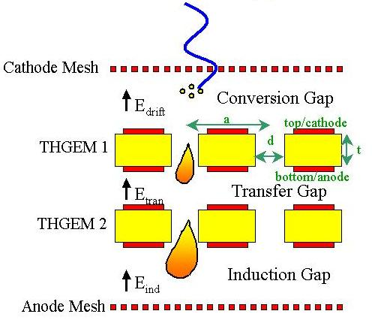
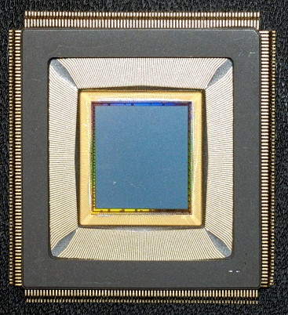
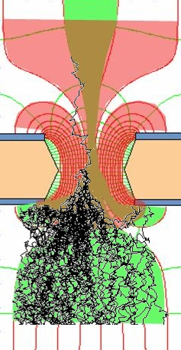
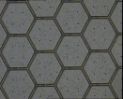
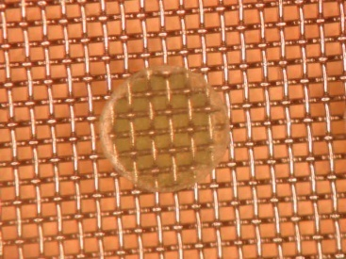

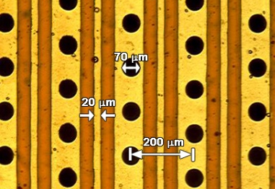
Micro-Pattern Gaseous Detectors: Technologies for Future Projects
Micromegas
GEM
Thick-GEM, Hole-Type Detectors and RETGEM
MPDG with CMOS pixel ASICs (“InGrid”)
Micro-Pixel Chamber (μPIC)
μPIC
CMOS high density
readout electronics
Ions
0.18 μm CMOS VLSI
40 %
60 %
Electrons
Micromegas
GEM
THGEM
MHSP
Ingrid

Slide 12

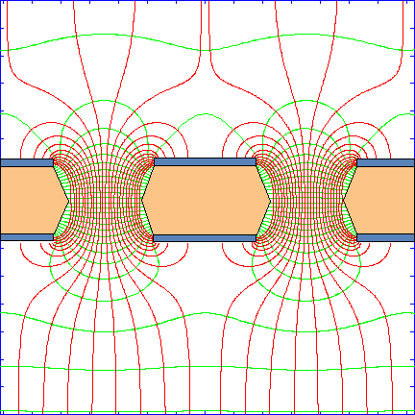
GEM (Gas Electron Multiplier)
Thin metal-coated polymer foil chemically pierced by a high density of holes
A difference of potentials of ~ 500V is
applied between the two GEM electrodes.
The primary electrons released by the
ionizing particle, drift towards the holes
where the high electric field triggers the
electron multiplication process.
I⁺
e⁻
Induction gap
e⁻
S1
S2
S3
S4
Electrons are collected on patterned readout board.
A fast signal can be detected on the lower
GEM electrode for triggering or energy discrimination.
All readout electrodes are at ground potential.
12
F. Sauli, Nucl. Instrum. Methods A386(1997)531
F. Sauli, http://www.cern.ch/GDD

Slide 13
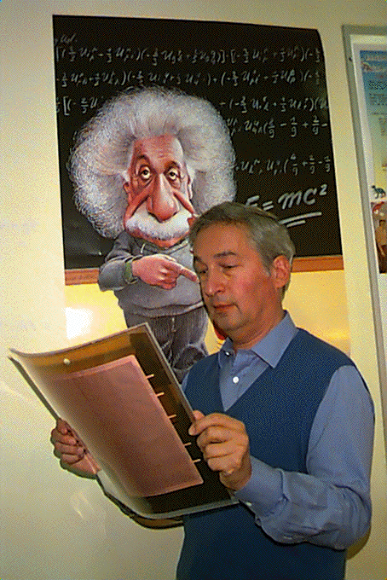
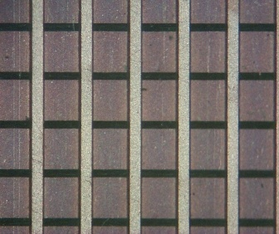
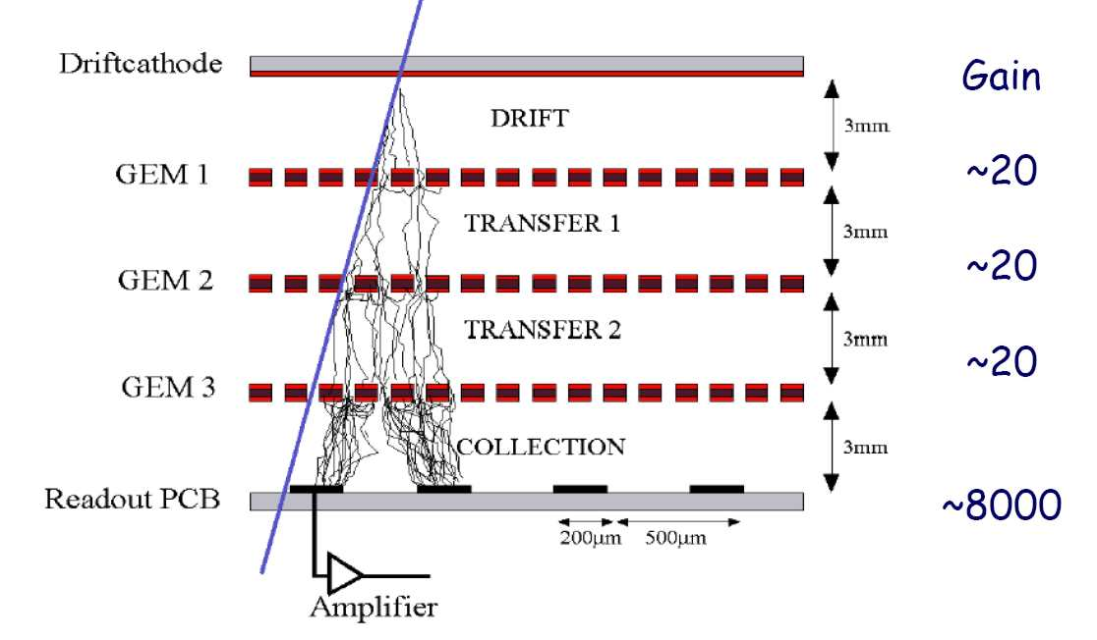
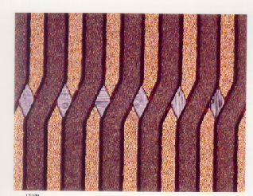
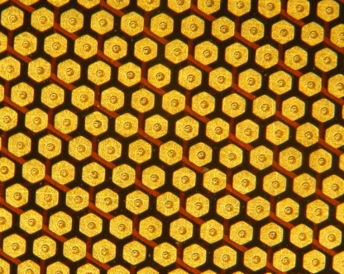
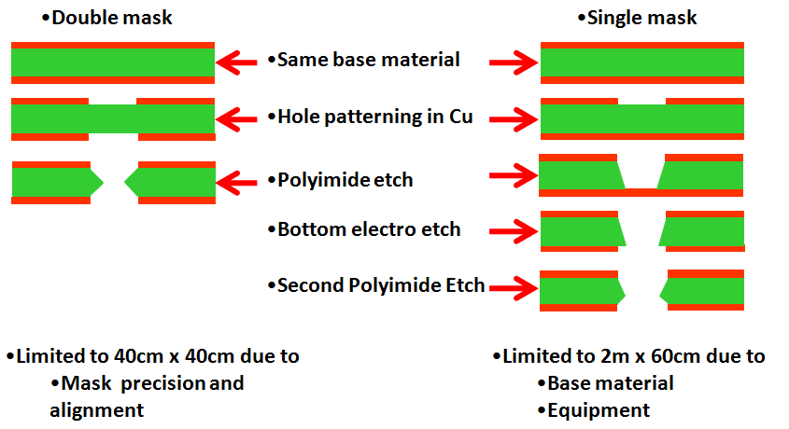
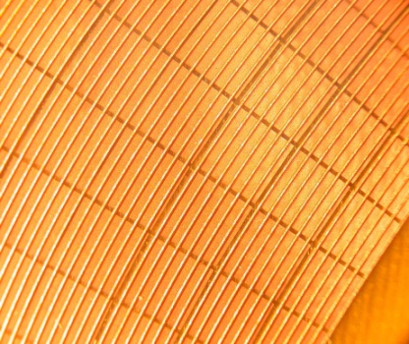
Gas Electron Multiplier (GEM)
F. Sauli, NIM A386(1997) 531;
F. Sauli, http://www.cern.ch/GDD
Full decoupling of amplification stage (GEM)
and readout stage (PCB, anode)
Cartesian
Compass, LHCb
2009: NEW: Single mask GEM production technique →
allow to extend GEM foils to ~ m² area
Small angle
Hexaboard, pads
MICE
1996:
2009:
Mixed
Totem

Slide 14
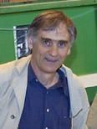
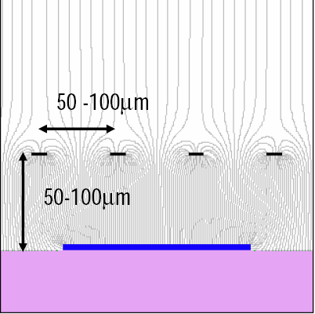
MICro MEsh GAseous Structure (MICROMEGAS)
Micromesh Gaseous Chamber: a
micromesh supported by 50-100 μm
insulating pillars
Multiplication (up to 10⁵ or more)
takes place between the anode and
the mesh and the charge is collected
on the anode (one stage)
Y. Giomataris et al, NIM A376(1996)29

Slide 15
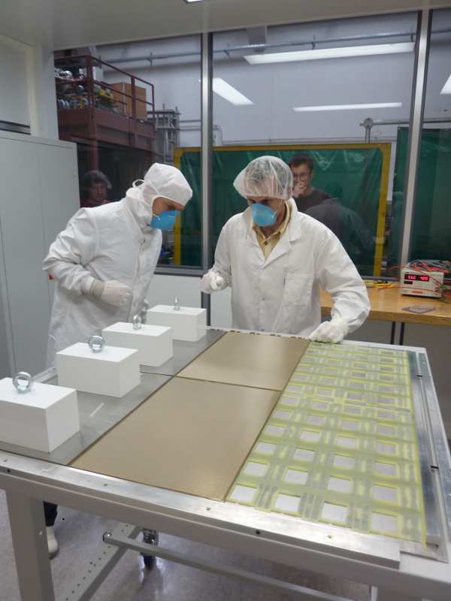
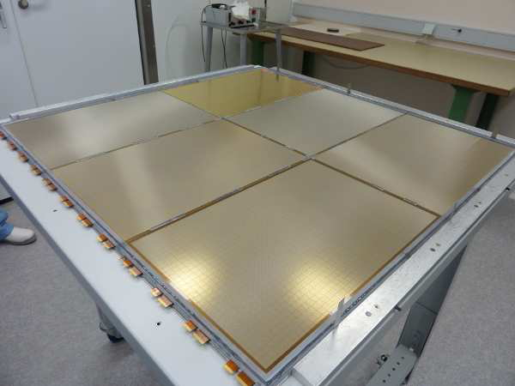
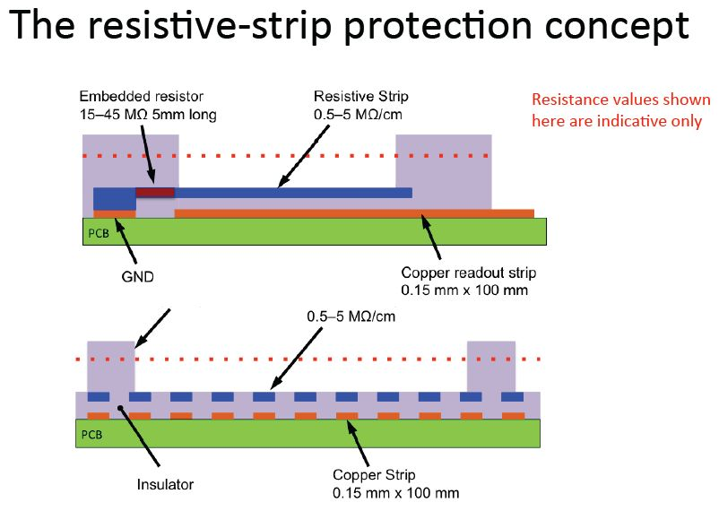

“Bulk Micromegas” Technology
Bulk Micromegas:
PCB
lamination
Mesh deposit
lamination
ILC DHCAL (Large area MM 1m² prototype:
(6 Bulk of 32 *48 cm²)
development
Since 2010: “Resistive Bulk Micromegas”
Technology
Spark neutralization and/or suppression
Resistive strip parallel to readout strips
Uniformity, robustness, easy fabrication,
large area detectors & small dead area→
“Full path of industrial production”

Slide 16



« MicroBulk » Micromegas
Thomas Papaevangelou, 2011 MPGD Conference

Slide 17


Pixel Readout of Micro-Pattern Gas Detectors
Gas Detector Readout by multi-pixel CMOS array (used as charge collecting anode)
CMOS readout concept → MEDIPIX2 / TIMEPIX Chips
Solid detector
Gas
detector
X-ray source
Medipix2/
TimePix chip
Ionizing
particle
Gas volume
+
Semiconductor
sensor
First studies of MPGDs with Medipix2:
M. Campbell et al, NIMA 540, 295 (2005).
M. Chefdeville et al, NIMA556(2006) 490
(NIKHEF-Saclay-CERN- Univ. Twente/MESA+)
-
Flip-chip
bump bonding
connections
Medipix2/Timepix
Amplification System (MPGD)
+
-
ILC-TPC: Ultimate Gas-Silicon Detector Integration

Slide 18

Thick-GEM Multipliers (THGEM)
Simple & Robust → Manufactured by standard PCB techniques
of precise drilling in G-10 (and other materials) and Cu etching
STANDARD GEM
10³ GAIN IN SINGLE GEM
THGEM
10⁵ gain in single-THGEM
Other groups developed
similar hole-multipliers:
Optimized GEM:
L. Periale et al.,
NIM A478 (2002) 377.
LEM: P. Jeanneret,
PhD thesis, 2001.
1 mm
0.1 mm rim
to prevent
discharges
C. Shalem et al, NIMA558 (2006) 475;
Double THGEM or THGEM/Micromegas
Effective single-electron detection
(high gas gain ~10⁵ (>10⁶) @
single (double) THGEM)
Few-ns RMS time resolution
Sub-mm position resolution
MHz/mm² rate capability
Cryogenic operation: OK
Gas: molecular and noble gases
Pressure: 1mbar - few bar
1,0E+07
1,0E+06
10⁶
1,0E+05
1,0E+04
Gain
1,0E+03
1,0E+02
1,0E+01
MM = 330 NeCF4 10%
1,0E+00
MM = 290 NeCF4 5%
DTHGEM NeCF4 10%
1,0E-01
DTHGEM NeCF4 5%
1,0E-02
0
200
400
600
800
1000
Δ
C. Azevedo et al.; arXiv: 0909.3191
V THGEM (V)

Slide 19





Micro-Pixel Chamber (μPIC) at Kobe University
μ-PIC：micro pixel gas chamber
Area: 10x10cm – 30x30cm
Readout pitch :400μm
Production using PCB technology
NEW: μ-PIC design with resistive
cathode:
Cathode patterns are formed by resistive material.
Large current from spark reduce the e-field, and spark will be quenched.
This design provide one promising possibility of MIP detector under hadronic background
Invented by A.Ochi, T.Tanimori (NIMA471 (2001) 264)
Application: X-ray imaging, Gamma camera,
Medical RI tracing
Surface pictures of resistive μPIC:

Slide 20




Micro-Pattern Gas Detectors Performance Summary
High Rate Capability
High Spatial Resolution
Excellent Radiation
Hardness
Good Time Resolution
High Gain
Good Energy Resolution
Ion Backflow Reduction
Photon Feedback
Reduction
GEM
~ 10⁶ Hz/mm²
Micromegas
GEM
THGEM
σ_{space} ~ 15-40 μm
GEM
σ _{time} ~ few ns
Micromegas:
THGEM
THGEM
Micromegas Aging:
~ 20 LHC years

Slide 21



LHC Detectors: Triumphs of Instrumentation
From basic ideas to complex detector systems →Design cycle of LHC > 20y!
Digital Cameras the
Size of Cathedrals

Slide 22



Gaseous Detectors in LHC Experiments
 | Vertex | Inner Tracker | PID/ photo- det. | EM CALO | HAD CALO | MUON Track | MUON Trigger
ATLAS | - | TRD (straws) | - | - | - | MDT (drift tubes), CSC | RPC, TGC (thin gap chambers)
CMS ----- TOTEM | - | - | - | - | - | Drift tubes, CSC ----- GEM | RPC, CSC ----- GEM
LHCb | - | Straw Tubes | - | - | - | MWPC | MWPC, GEM
ALICE | - | TPC (MWPC) | TOF(MRPC), PMD, HPMID (RICH-pad chamber), TRD (MWPC) | - | - | Muon pad chambers | RPC
ALICE TPC
Straw tubes
CMS CSC

Slide 23




Gaseous Detectors in LHC Experiments
ATLAS TGC
LHCb Outer
Tracker
ALICE HPMID
ALICE MRPC

Slide 24





ALICE Multi-Gap RPC: Timing Resolution
Relevant scale in HEP: t ~ L(m)/c ~ o(ns)
Traditional technique:
  Scintillator + PMT ~ o (100 psec)
Breakthrough with a spark discharge in gas
  Pestov counter → ALICE MRPC ~ 50psec
Multi-Gap Resistive Plate Chamber: Basic Principle
Technology | Time resolution
Pestov Counter | 30-50 ps
RPC | ~ 1-5 ns (MIP)
MultiGap RPC | ~ 50 ps (MIP)
GEM | ~ 1-2 ns (UV) ~ 5 ns (MIP)
Micromegas | ~ 700 ps (UV) ~ 2-5 ns (MIP)
C. Williams, CERN Detector Seminar
“ALICE Time of Flight Detectors”:
http://indico.cern.ch/conference
Display.py?confId=149006

Slide 25







GEM in the LHC Experiments: Tracking/Triggering Detectors
GEMs are used in the TOTEM (tracking and triggering) and LHCb Muon (triggering)
TOTEM GEMs:
LHCb Muon Trigger:
Rate - 5 kHz mm-2
Time resolution 4.5 ns (rms)
Radiation hard up to integrated charge of 20 mC mm-2 (15 LHCb years)
Coincidence
Chips
VFAT Hybrids
2D readout
(strips & pads)
11thCard
GEM
20x24 cm² GEM modules
Horse Shoe
Card
HV cables
Electronics cooling
Pad readout plane

Slide 26





Trends in Technology Enable Advances in Detectors
Segmentation
- Vertex elements with 20 μm and smaller pixels
- Calorimetry employing silicon elements
- Micro-Pattern Gaseous Detectors
Speed & Power
Faster electronics, low noise and low power
Integration
Microelectronics, mechanical complexity
Materials
Sensor, rad hard, robust, thin
Radiation immunity
Understanding, design, annealing
GEM:
“InGrid”:
Micromegas:
50 μm
140 μm

Slide 27




Challenges for Future Detectors: Experimental Opportunities

Slide 28







Advancing MPGD Concepts for Future Projects
Applications :
HEP and Nuclear Physics
Neutrino Experiments
Dark Matter
Ground-based Astroparticle
Space Experiments
Spin-off outside HEP field
(some) experimental opportunities:
SLHC (LHC luminosity upgrade)
→ radiation, pileup, backgrounds
ILC
→ high precision, hermeticity
Neutrino Facilities
→ sensitivity (mass, size), efficiency, purity
Dark Matter
→ purity, low bkg, large sensitive areas
Tracking
TPC readout
UV photon detection
Neutron detection

Slide 29





The High Energy Frontier: Beyond the LHC
LHC Terascale physics is underway
(LHC/sLHC long-term plan for
3000 fb⁻¹@14 TeV)
Lepton Collider is the essential
complement to the LHC (the next
highest priority machine)
sLHC: upgrade of the LHC
→Increase in luminosity by factor of 10
ILC: International Linear Collider
e+e- collider based on SRF
technology √s = 500 GeV – 1 TeV
CLIC
→ e+e- collider based on warm X-band technology (√s = 3 TeV)
Muon Collider
→ √s = 3 TeV
sLHC
ILC
μC
CLIC

Slide 30


MPGD Technologies for Energy Frontier (sLHC, LC)
Ongoing R&D Projects using MPGDs in the framework of HEP Experiments
 | Vertex | Inner Tracker | PID/ photo- det. | EM CALO | HAD CALO | MUON Track | MUON Trigger
ATLAS | GOSSIP/InGrid | GOSSIP/InGrid |  |  |  | Micromegas | Micromegas
CMS |  |  |  |  |  | GEM | GEM
ALICE |  | TPC (GEM) | VHPMID (CsI-THGEM)
Linear Collider |  | TPC(MM,GEM, InGrid) |  |  | DHCAL (MM,GEM,THGEM)
ATLAS Micromegas:
On a road to large-area detectors:
(1.2 * 0.6 m²)
CMS GEM:
Trapezoidal GEM Prototype (99 x 45-22 cm2)

Slide 31



Advancing Concepts: Vertex / Inner Tracking
r ~ 5 -10 cm From IP
ATLAS sLHC Inner Tracking
(r ~ 5 - 100 cm):
Baseline remains silicon
(Planar, 3D-silicon, Diamond)
GOSSIP & GridPix– ATLAS
R&D Project (2010-2013)
r ~ 70 -100 cm from IP
F. Hartjes, Detector R&D, March 2009
GOSSIP:
(1mm drift region)
Major R & D still
required for this
development

Slide 32




GridPix / GOSSIP for ATLAS Inner Tracker: Test-Beam Results
Test - Beam setup:
G1
G2
G3
GridPix
σ ~ 15 μm
Angular
Resolution
(GridPix):
Efficiency ~ 99%
At 11.5º incident angle an angle measurement accuracy
of 0.6º for the track projection would mean:
15% momentum measurement accuracy for P_{t} of 40 GeV
with one layer of the GasPixel tracker/L1 trigger!

Slide 33




Resistive Bulk Micromegas for the ATLAS Muon System Upgrade
Development of large-area muon chambers for the ATLAS upgrade for high-luminosity:
Rate: ≤15 kHz/cm²
Spatial resolution: ≤100 µm (up to track angles of 30 degrees); efficiency ~ 98 %
Trigger capability (time resolution: ≤10 ns)
No ageing over 20 years of HL-LHC
Efficiency
Gas Gain
Spatial
Resolution
Gain ≈ 5000

Slide 34



Resistive MM for the ATLAS Muon System Upgrade
The ATLAS Small Wheel Upgrade:
Equip Small Wheels with
128 MM (0.5–2.5 m²):
→ Combine precision and 2nd coordinate meas. and trigger functionality in a single device
Today:
MDT chambers (drift tubes) +
TGCs for 2nd coordinate (not visible)
2.4 m
CSC chambers
~ 1200 m² of Resistive MM
Resistive strip Micromegas has been chosen as the
baseline option for the upgrade of the Small Wheel:
Sector | Nbr sectors Nbr chambers/sector MM layers/chambers | MM layer area (containing rectangle) | Total Nbr MM layers (w/o spares) | Total MM PCB area | Manufacturing plan (preliminary)
Small | 8x2=16 4 4x2=8 | From ~0.68m² (696x980) To ~1m² (1420x730) | 512 | 0.88x512 = 450m² | Yrs 2015 +2016
Large | 8x2=16 4 4x2=8 | From ~0.96m² (1036X930) To ~1.9m² (2300x835) | 512 | 1.5x512= 768m² | Yrs 2015 +2016

Slide 35





GEMs for CMS High Eta Project (1.6 > η > 2.1)
GEM for CMS Collaboration:
GEMs for High Eta Project:
Rate capability : 10 kHz/cm²
Spatial resolution: ≤100 µm;
efficiency ~ 98 %
Trigger capability (time resolution:
~4-5 ns)
Excellent Long-Term Operation
Development and evaluation
of large size GEM detectors
for tracking and triggering
Assembly optimization
for cost reduction
Self-stretching technique:
assembly time reduction from
3 days → 2 hours
Triple-GEM Efficiency & Time Resolution:

Slide 36


GEMs for CMS High Eta Project (1.6 > η > 2.1)
Large Prototype: GE1/1
Beam Test @ RD51 setup
CMS missing redundant tracking capability
in high h-region (in particular, ME1/1-2/1):
Formally approved as a CMS R&D project
of interest (April 20, 2012)
About 1000 m² ;
216 triple-GEM detectors
Station | Nbr of modules | Module area (containing rectangle) | Total Nbr of modules (w/o spares) | Total GEM foil area (3ple GEMs) | Manufacturing plan (preliminary)
1 | 18x2x2=72 | ~0.43m² (440x990) | 72 | 0.43x72x3= 93m² | Yrs 2014+2015
2 | 36x2=72 (long) 36x2=72 (short) | ~2.4m² (1251x1911) ~1.6m² (1251x1281) | 144 | (2.4+1.6)x72x3= 864m² | Yrs 2015+1016

Slide 37
ALICE Upgrade: TPC Endplate with GEMs
Recent activity (since April 2012):
Total area: 32.5 m²
detector sizes from:
46 x 50 cm² to
88 x 112 cm²
Use single-mask GEM
technology
Goals and Requirements:
Replace MWPC with GEMs (Space-charge effects at 50 kHz Pb-Pb continuous readout too high with wires)
Limit GEM ion back-flow to 0.25% at gain 1500 (major R&D required)
Maintain excellent dE/dx resolution for particle Id and time stability

Slide 38




Beam Line Instrumentation
GEM-based TPC for beam monitoring:
Event-by-event particle tracking and
characterization of rare ion species
Ultra-light single GEM for low energy
antiproton beam profiling
S. Duarte Pinto et al., "GEM-based beam profile monitors for the antiproton decelerator," 2012 JINST 7 C03001.
F. García et al., "Prototype development of a GEM-TPC for the Super-FRS of the FAIR facility," NSS/MIC, 2011 IEEE, pp. 1788 - 1792.
Triple GEM neutron beam monitor
using polyethylene converter
G. Croci et al., "nGEM neutron diagnostic concept for high power deuterium beams," 2012 JINST 7 C03010.
F. Murtas et al., "Applications in beam diagnostics with triple GEM detectors," Nucl. Instr. & Meth., vol. 617, no. 1–3, p. 237–241, 2010.

Slide 39



MPGDs for Luminosity Monitoring
DAFNE e+e- Collider: triple GEM x-ray detector, derives luminosity from single brems-strahlung photons and/or
Bhabha-scattered e- from interaction point
F. Murtas et al., "Applications in beam diagnostics with triple GEM detectors," Nucl. Instr. & Meth., vol. 617, no. 1–3, p. 237–241, 2010.
Micromegas are considered to be used as ATLAS Luminosity monitors

Slide 40



The Higgs Model: Precision Measurements
After the discovery of a Higgs boson, the key task of is to establish the Higgs mechanism in
all elements as being responsible for EW symmetry breaking
For all particles receiving mass from the Higgs
mechanism it can be shown that the Higgs
coupling is proportional to particle mass
If discovered: precision needed
Model independent measurement of
absolute Higgs branching ratios
→Not possible at LHC
Top quark Yukawa coupling: (ttH) signal
seems out of reach at LHC
Higgs self-coupling (nearly) impossible
at the LHC
The LHC is certainly a discovery machine
→ absolute precision will come from a Linear Collider (Higgs Factory)
The origin of mass
The structure of vacuum

Slide 41


LC Detector Challenges: The Higgs is an Important Driving Factor
Model independent Higgs measurement →
excellent tracking momentum resolution
Recoil Mass to Z (Higgs-strahlung):
Physics at lepton colliders requires
precision “measurement of jets” →
most common approach is Particle Flow,
requires imaging calorimeters:
→Separate W and Z in their hadronic
decay modes

Slide 42








Advancing Concepts: Time Projection Chamber Tracking for the LC
Micromegas TPC for LC GEM TPC for LC
Micromegas + Resistive Pad Readout:
GEM +Pad Readout:
M. Dixit, Proc. of the MPGD Conf., Crete, June 2009
D. Attie, Proc. of the MPGD Conf., Crete, June 2009
P. Schade et al, NIM A628 (2011) 128

Slide 43


Slide 44




Advancing Concepts: MPGD + Timepix CMOS Readout for TPC Tracking
Electronic
Bubble Chamber
Triple GEM + Timepix (5 GeV electrons):
3GEMs + 2 Timepix Chips:
1.5 cm
Octopuce Board ( 8 “Ingrid” Detectors
Readout Matrix (~ 3* 6 cm²)
5 GeV electron tracks (B = 1 T)
Octopuce (8 InGrids);

Slide 45

InGrid/MM + Timepix ASIC: Studies with Single Chip in Bonn TPC

Slide 46

Pixel LC-TPC Consortium: Bonn, Saclay, NIKHEF, DESY, LAL, Kyiv University
NEXT MAJOR MILESTONE: Equip a Full LP module (~ 100 chips) with InGrids
→ During the 2 years → PROOF of PRINCIPE FOR Si TPC

Slide 47




Advancing Concepts: GEMs for ILC Digital Hadron Calorimetry
Both ILC and CLIC have adopted the Particle Flow approach to calorimetry
→ many technology choices available
Towards Large Area 100 cm x 100 cm GEM Detector for DHCAL !!!
Each of the GEM 100cmx100cm planes will consist of three 33cmx100cm unit chambers

Slide 48






Advancing Concepts: Micromegas for ILC Digital Hadron Calorimetry
During assembly: Bulk and ASIC sides
Large area Micromegas 1m² prototype:
(6 Bulk of 32 *48 cm^{2):}
MICROROC ASIC
Integrated spark protections
Low noise of 0.25 fC RMS
MIP performance in test beam:
Efficiency larger than 95 % at gas
gain of 1000 + multiplicity < 1.15
25k pions + absorber
pions
Advantages of DHCAL with MPGDs
For Particle Flow concept:
Finer segmentation 1 x 1 cm2 pads
vs Analog HCAL (3 x 3 cm2) → better
jet resolution
Calibration and monitoring is less
critical compared to AHCAL
muons
High efficiency for
all shaping time

Slide 49
Summary and Outlook
Summary and Outlook
Advances in photolithography and micro-processing techniques in the chip
industry during the past decade triggered a major transition in the field of
gas detectors from wire structures to micro-pattern devices.
MPGDs became a wide-spread tool for experiments at the ENERGY, INTENSITY and COSMIC FRONTIERs: for high-rate tracking over large sensitive areas, precision reconstruction of charged particles in the TPC, X-ray, UV and visible photon detection and neutron spectroscopy.
Industrial methods of MPGD production allows to extend technology
to ~ m² unit detectors → many potential MPGD applications within the
HEP and beyond
Modern, sensitive & low noise electronics (e.g. Timepix CMOS chip, etc …) will enlarge the range of applications
RD51 aims at facilitating the development of advanced gas-avalanche detector technologies and associated electronic-readout systems → Many successful common projects were initiated during the first years of collaboration

