Slide 1
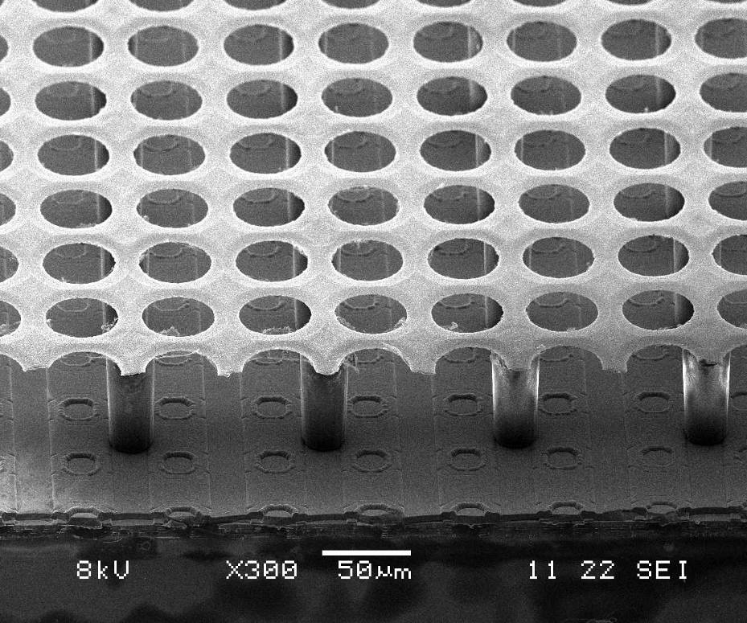
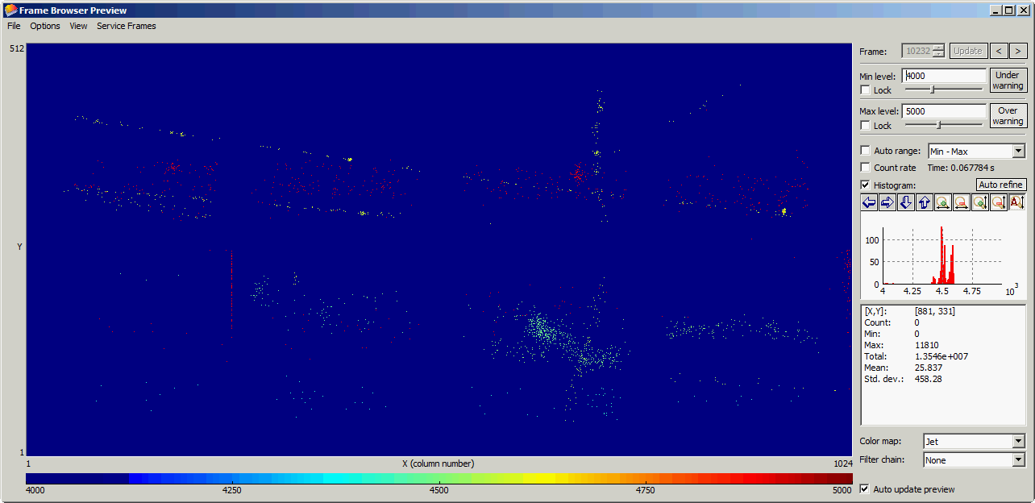
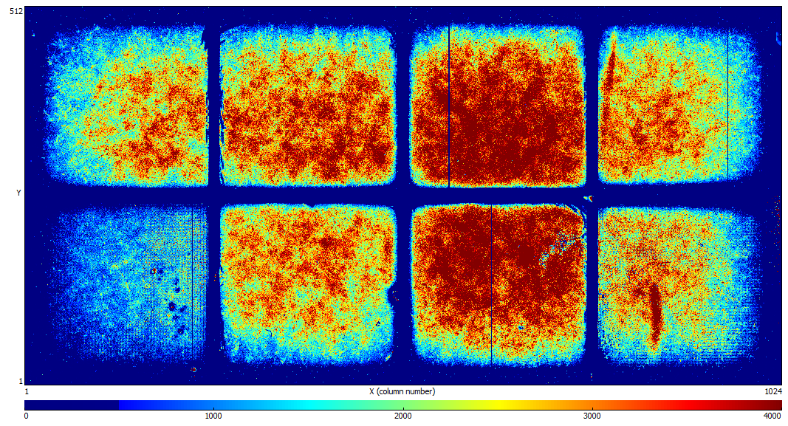
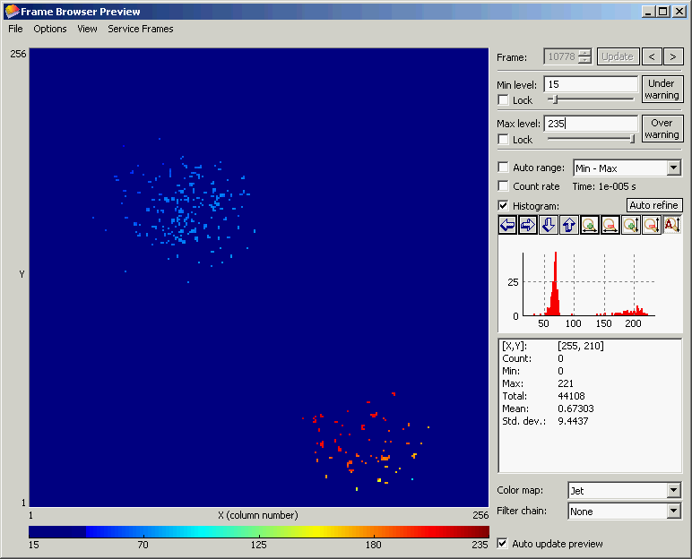

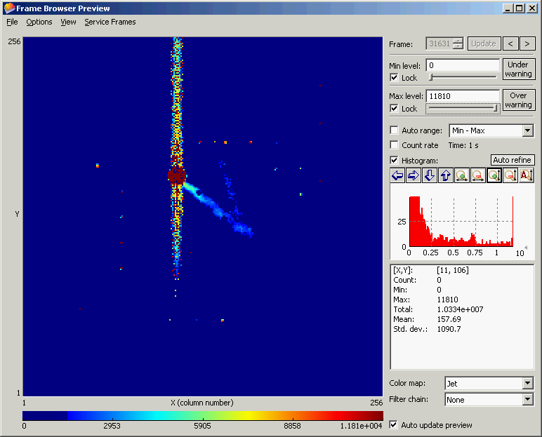
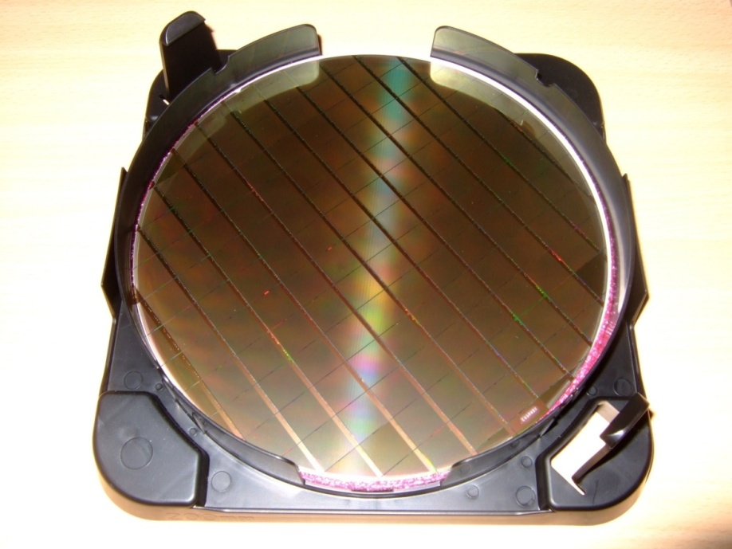
Ingrid
Recent InGrid Studies and DESY Test-Beam
Results with Octopuce
Maxim Titov, CEA Saclay, Irfu/SPP, France
University of Bonn: Y. Bilevych, C. Brezina, K. Desch, J.
Kaminski, T. Krautscheid, C. Krieger, M. Lupberger
NIKHEF: Jan Timmermann
CEA Saclay: David Attie, Xavier Coppolani, Andrii Chaus, Paul Colas, Maxim Titov
+ New Teams interested in Si Pixel –TPC R&D :
DESY Hamburg (T. Behnke et al.), LAL Orsay (S. Barsuk et al.), Kyiv University (O. Bezshyyko et al.)
Workshop LAL-Ukraine on instrumentation
LAL Orsay, France, May 22-24, 2013

Slide 2
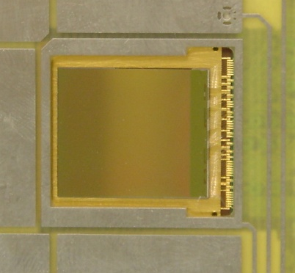
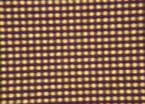
Pixel Readout of Micro-Pattern Gas Detectors
Gas Detector Readout by multi-pixel CMOS array (used as charge collecting anode)
CMOS readout concept → MEDIPIX2 / TIMEPIX Chips
Solid detector
Gas
detector
X-ray source
Medipix2/
TimePix chip
Ionizing
particle
Gas volume
+
Semiconductor
sensor
First studies of MPGDs with Medipix2:
M. Campbell et al, NIMA 540, 295 (2005).
M. Chefdeville et al, NIMA556(2006) 490
(NIKHEF-Saclay-CERN- Univ. Twente/MESA+)
-
Flip-chip
bump bonding
connections
Medipix2/Timepix
Amplification System (MPGD)
+
-
ILC-TPC: Ultimate Gas-Silicon Detector Integration

Slide 3
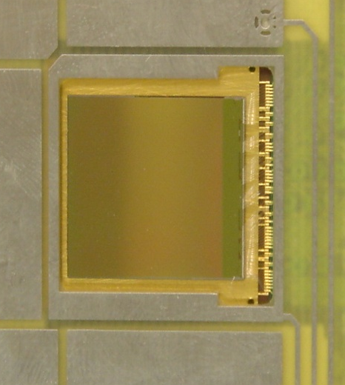
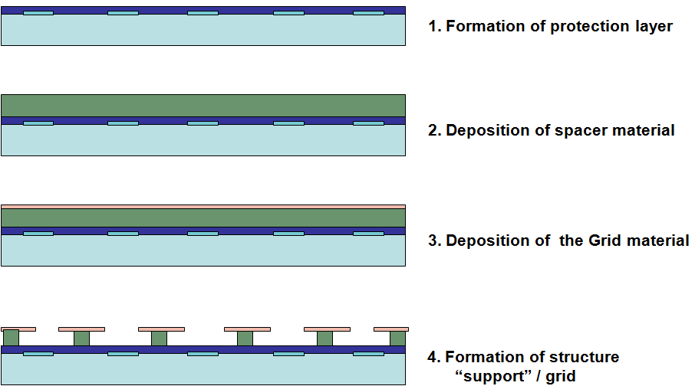
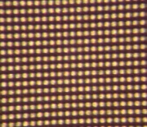
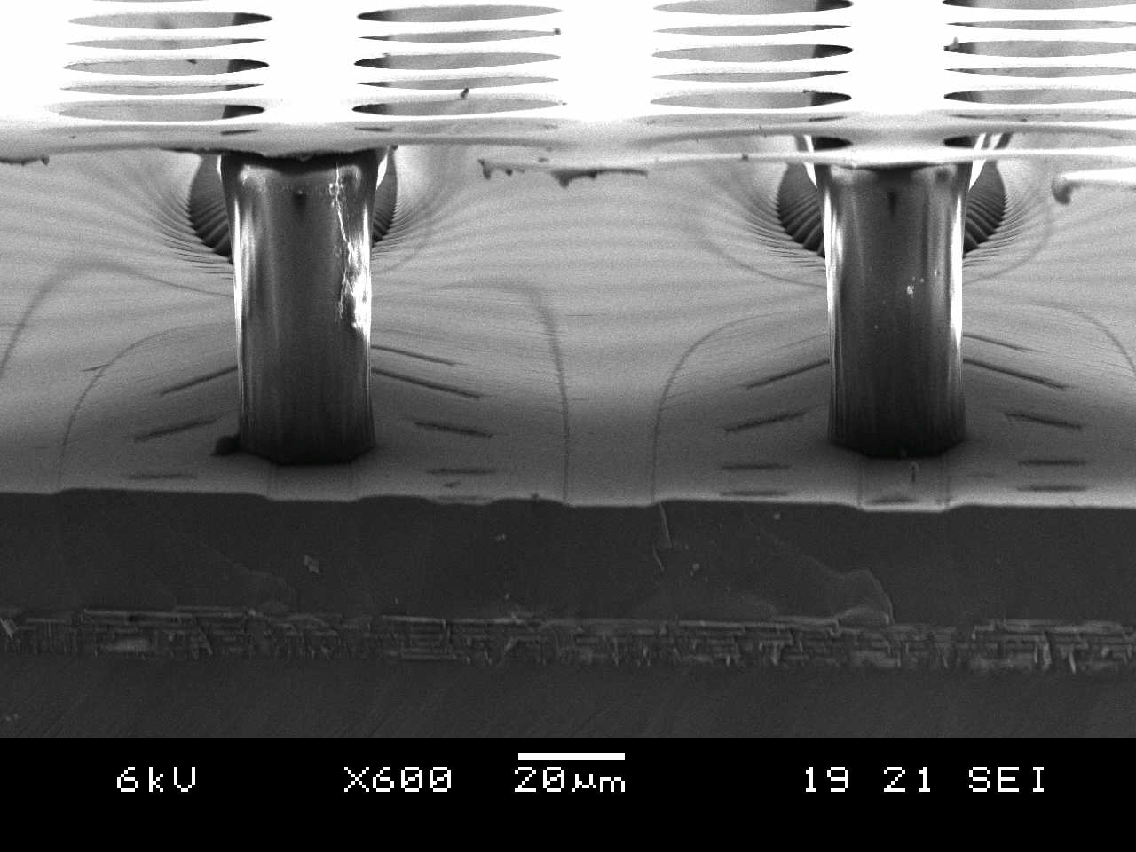

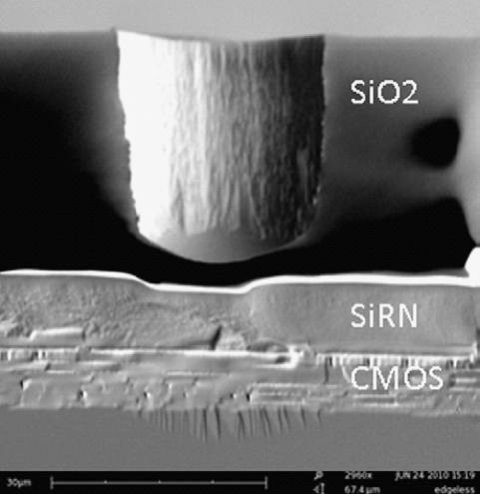
Integrated Electronics: Pixel Readout of Micro-Pattern Gas Detectors
3D Gaseous Pixel Detector → 2D (CMOS pixel chip readout) x 1D (drift time)
Through POST-PROCESSING INTEGRATE
MICROMEGAS directly on top of CMOS chip
Bump bond pads for Si-pixel
Detectors - Timepix or
Medipix2 (256 × 256 pixels
of size 55 × 55 μm2) serve
as charge collection pads.
(e.g. Si3N4)
(e.g. SU8)
Each pixel can be set to:
● TOT ≈ integrated charge
● TIME = Time between hit and shutter end
“InGrid” Concept:
50 - 80 μm
Protection Layer (few μm)

Slide 4
"InGrid" Detector: Single Electron Response and Discharges
Observe electrons (~220) from an
X-ray (5.9 keV) conversion one by one and count them
in micro-TPC (6 cm drift)
→ Study single electron response
Provoke discharges by introducing small amount of Thorium in the Ar gas - Thorium decays to Radon 222 which emits 2 alphas of 6.3 & 6.8 MeV
Chips survive thousands of discharges
1.5 cm
Fe⁵⁵
source
Saclay
NIKHEF
P. Colas, RD51 Collab. Meet.,
Jun.16-17, 2009, WG2 Meeting
M. Fransen, RD51 Collab. Meet.,
Oct.13-15, 2008, WG2 Meeting

Slide 5
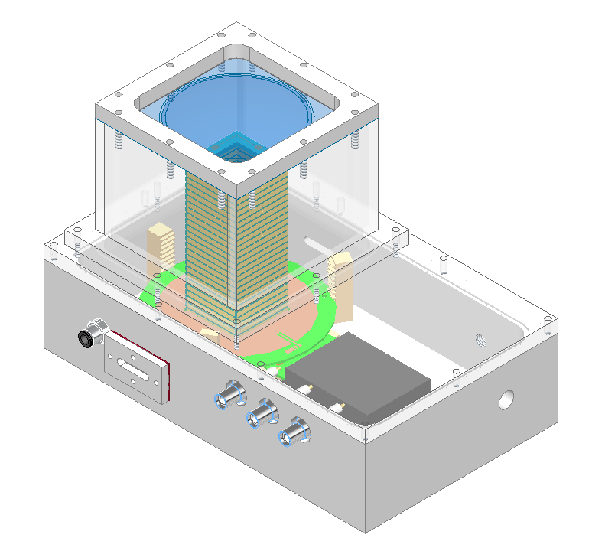
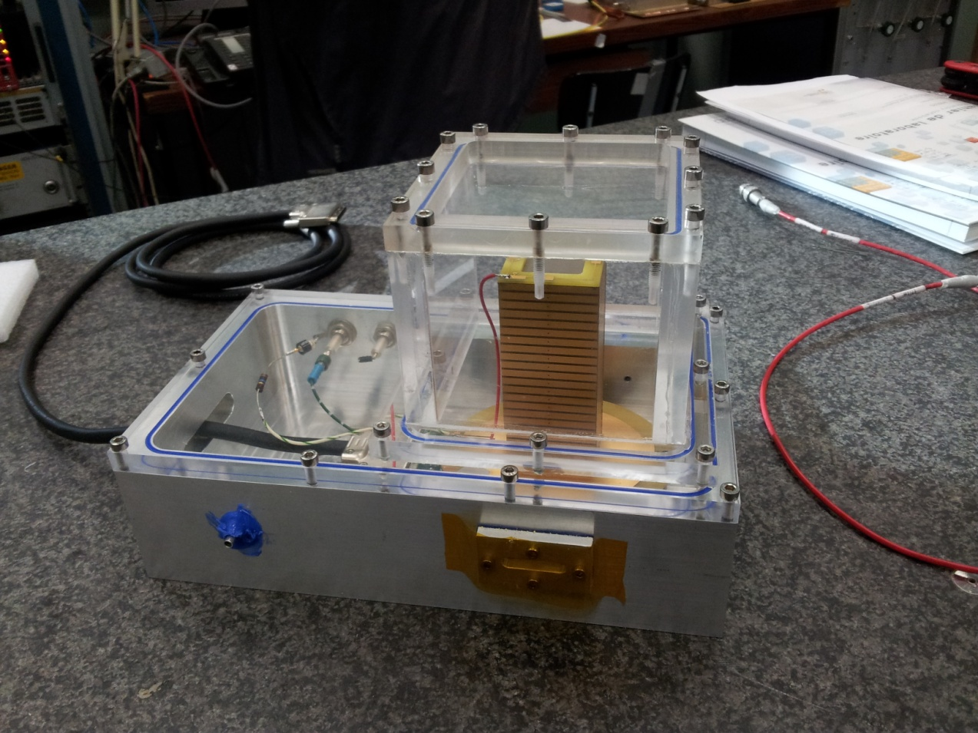
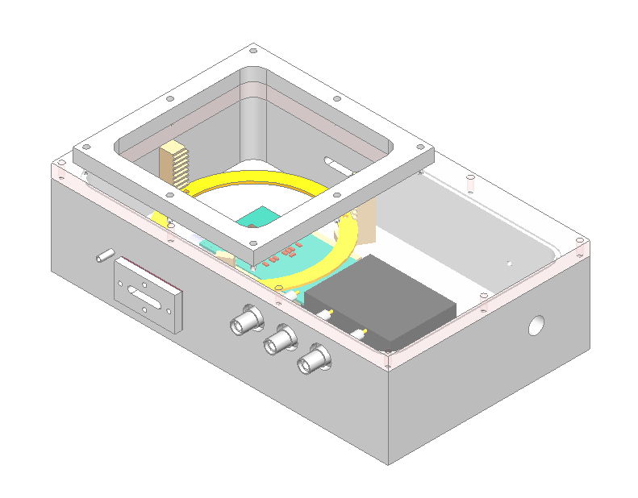
Saclay Micro-TPC with Timepix
Two micro-TPC boxes have been built
Drift distance in micro-TPC (~ 10 cm)
is large enough to allow study of single
electron response from Fe⁵⁵ source
Fe⁵⁵
Micro-TPC
TIMEPIX

Slide 6
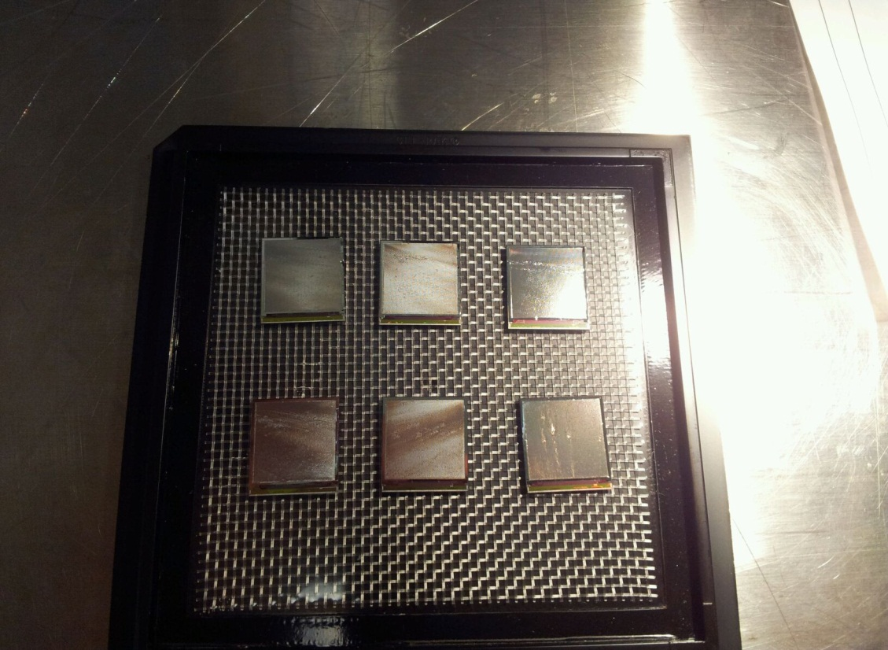
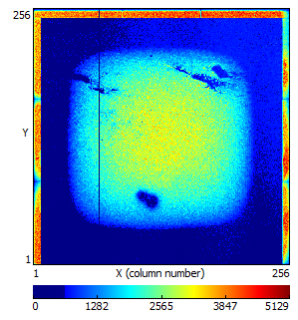
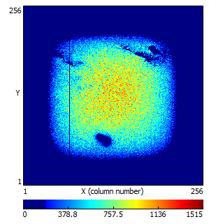
Studies of IZM “InGrid”s in the Saclay micro-TPC
Studies of acceptance tests of newly produced “InGrids”
See O. Bezshyyko talk → simulation
of “InGrid” performance
in micro-TPC and
and comparison with
with experimental measurements
Guard ring issue
in micro-TPC
Some noise and/or
discharges
Some local grid
issues

Slide 7
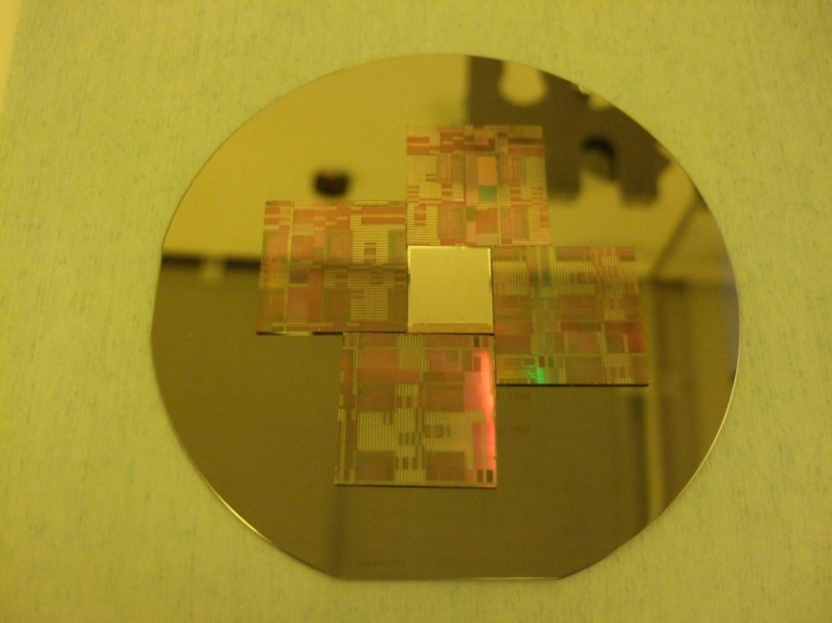
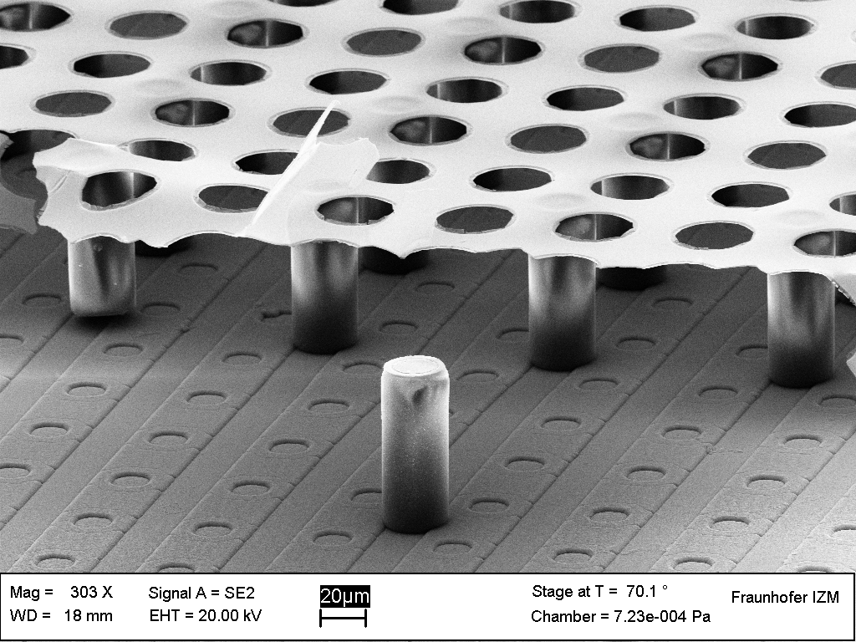
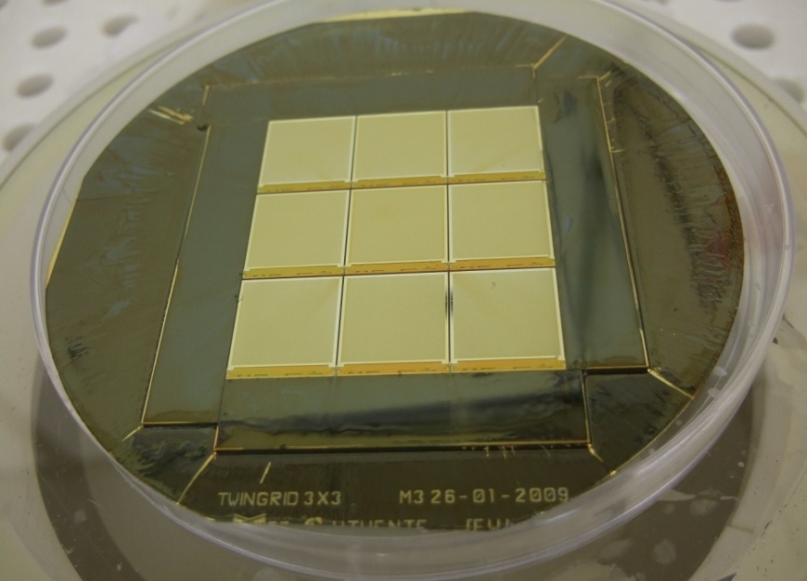
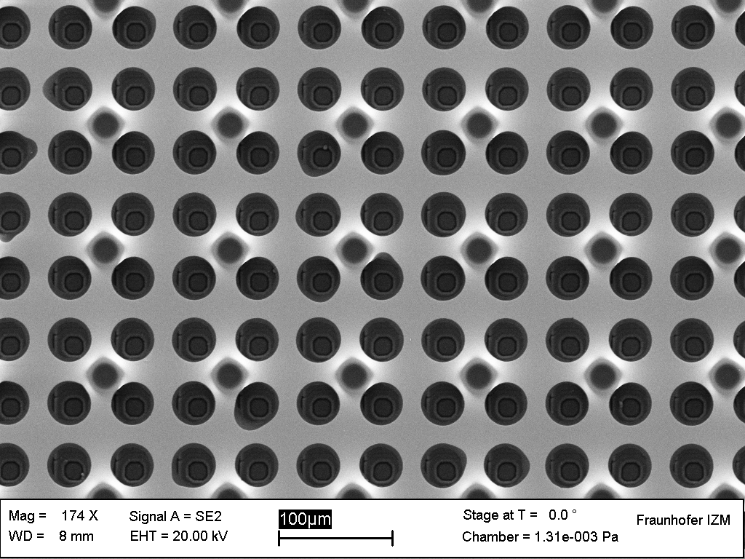
“InGrid’ Technology and “Driving” Developments
2005: Single “InGrid” Production
2011: Major Step Forward →
InGrid Production on a wafer level (107 chips)
2009: “InGrid” Production on a
3 x 3 Timepix Matrix

Slide 8
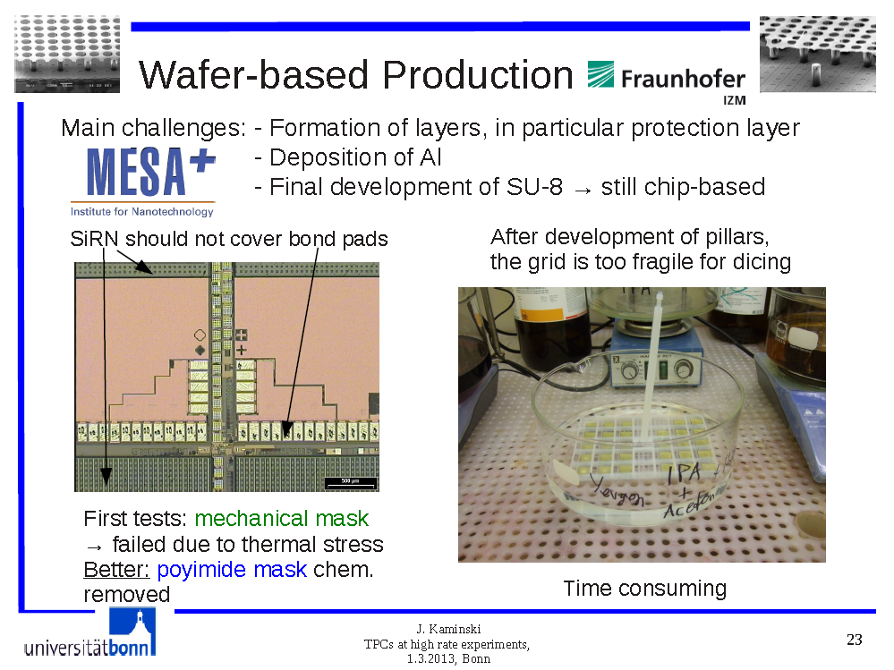

Slide 9
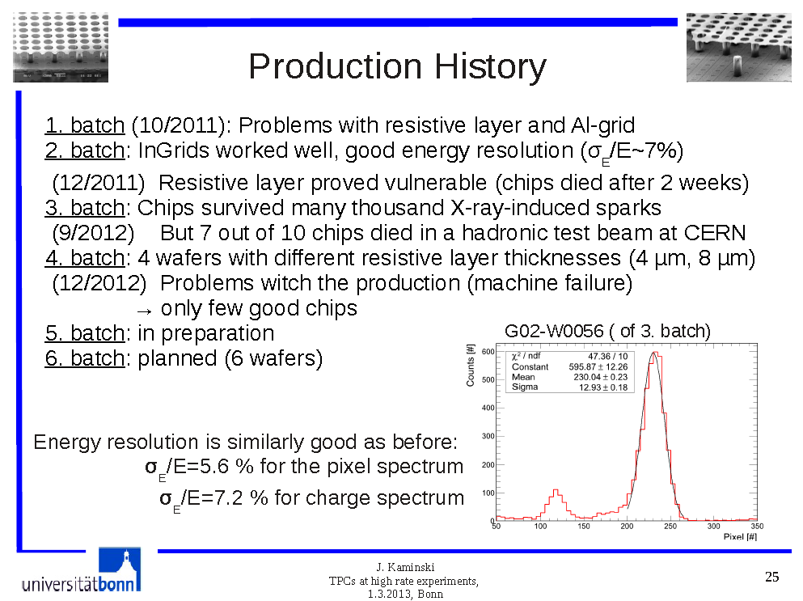

Slide 10

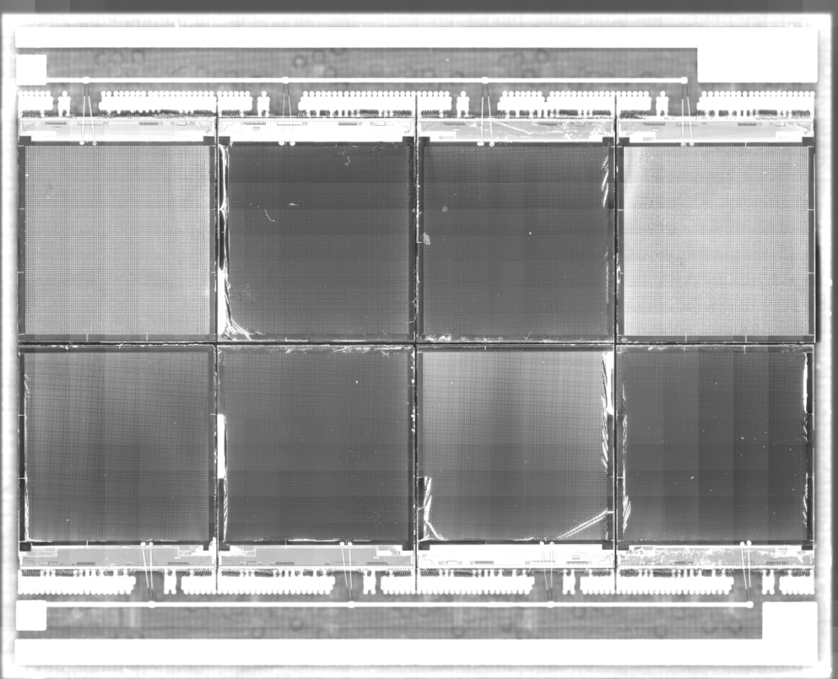
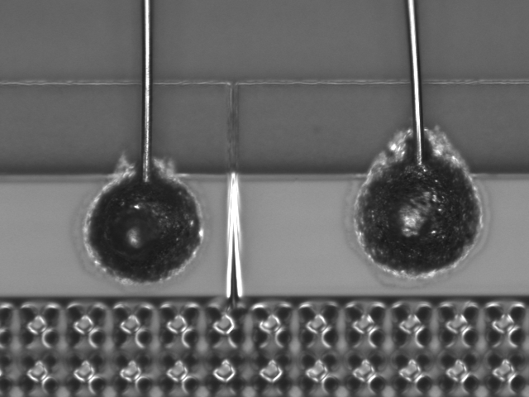
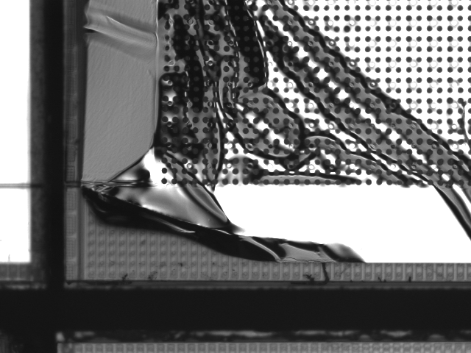
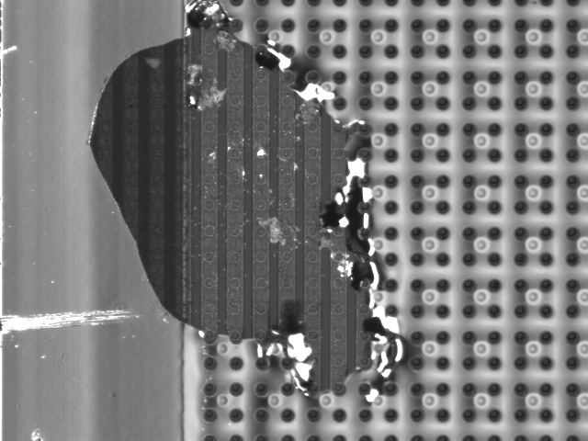
Saclay “Octopuce” (2009)
chip 4
chip 1
chip 5
chip 8
Non homogeneous area on the mesh of different chips
HV connections
“Grid irragularities”

Slide 11
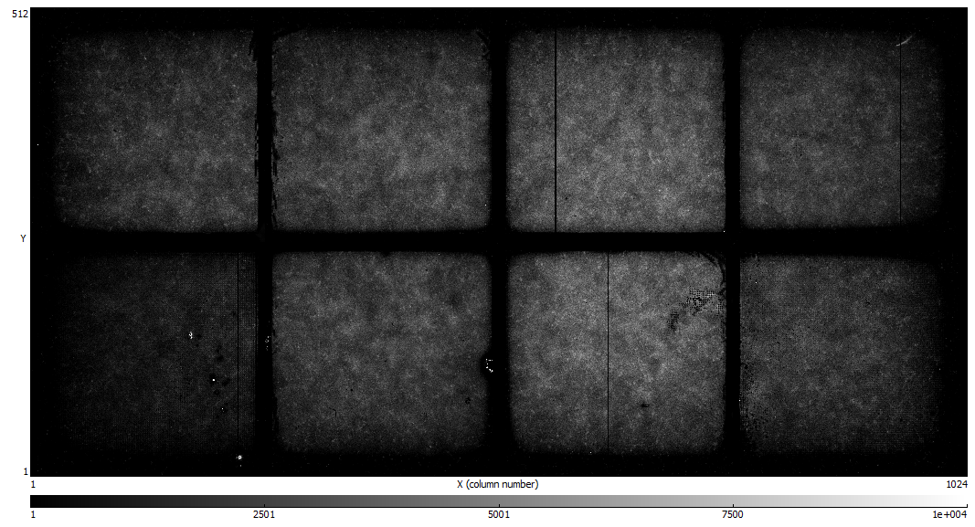
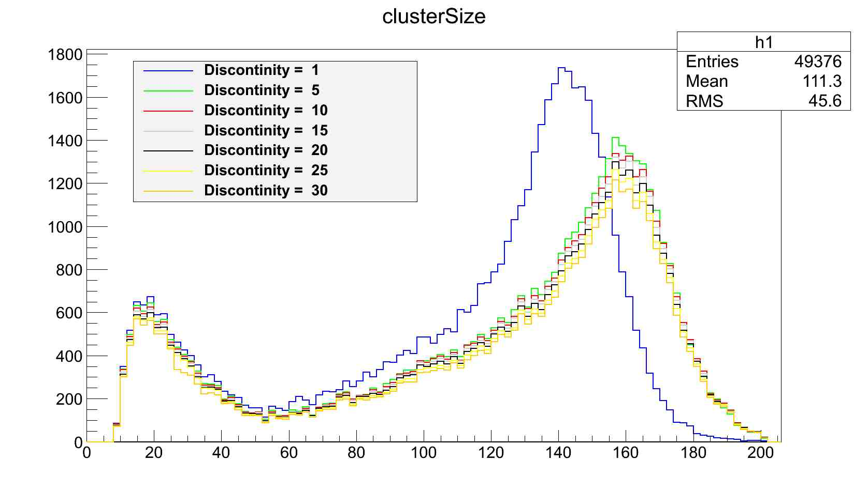
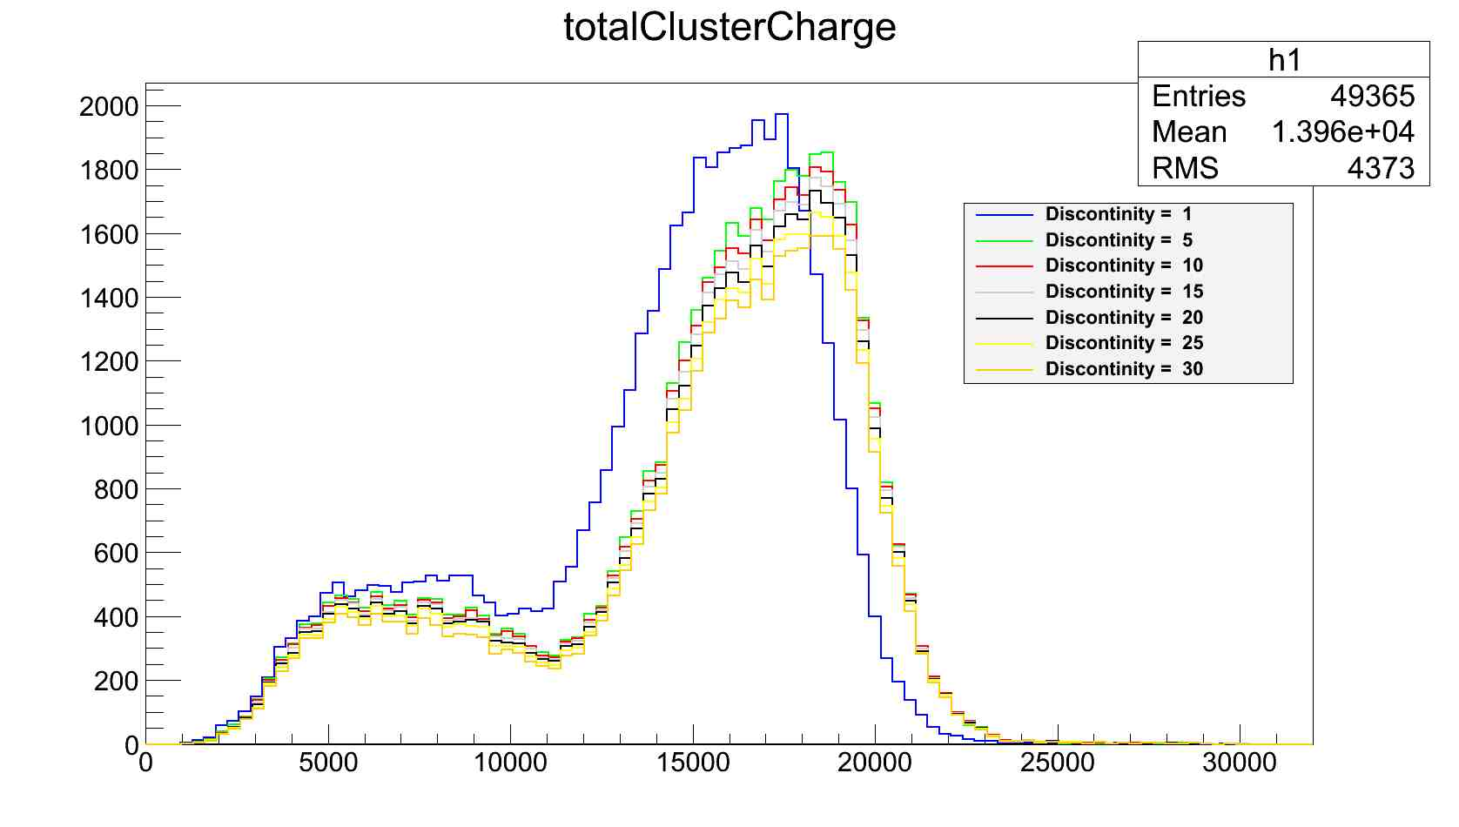
Saclay Octopuce & Fe55: Homogeneous Irradiation
Fe⁵⁵ Studies (26/07/2012):
He/Iso 80/20
Vmesh=390 V
Vdrift =3000 V
Chip 8
Chip 5
“Hot spots”
A.Chaus, D. Attie
Chip 4
Integrated picture for all 8 chips:
(discontinuity = distance
between pixels in the cluster)
Chip 1
(pixels)
(sum of
pixels TOT)
11

Slide 12
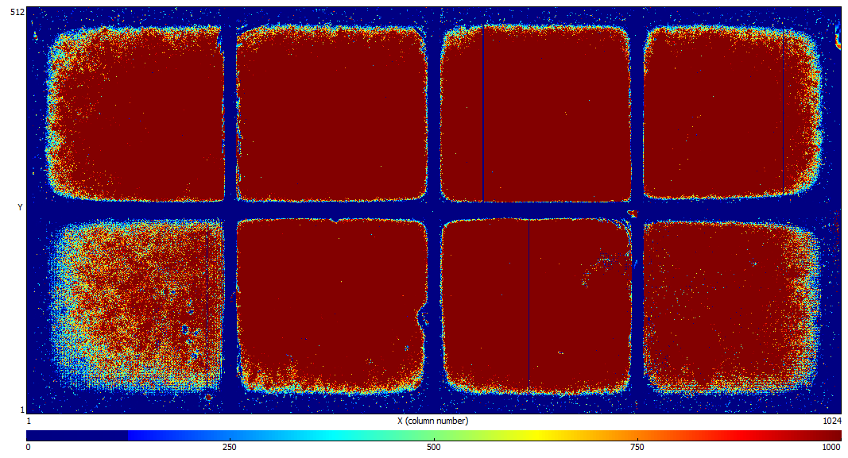
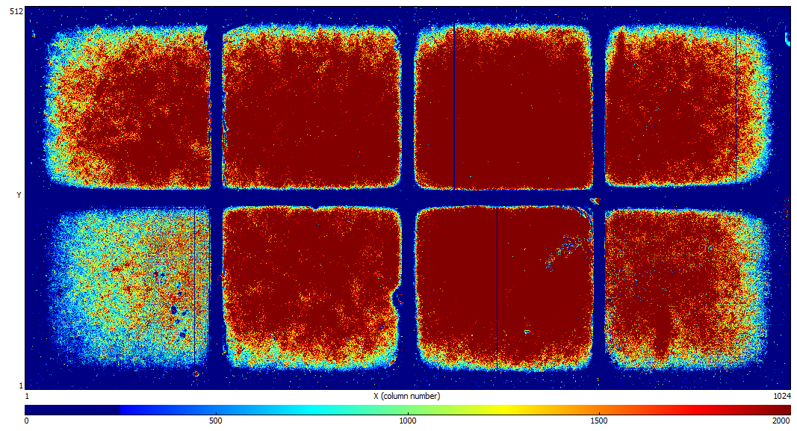
Saclay Octopuce: Uniformity of the Response (I)
THRESHOLD = 1000 COUNTS
THRESHOLD = 2000 COUNTS
Chip 8
Chip 5
Chip 1
Chip 4
THRESHOLD = 4000 COUNTS
A.Chaus, D. Attie
Non-sensitive (~ 1.5 mm)
areas between chips
Fe⁵⁵ Studies (26/07/2012):
He/Iso 80/20
Vmesh=390 V
Vdrift =3000 V

Slide 13
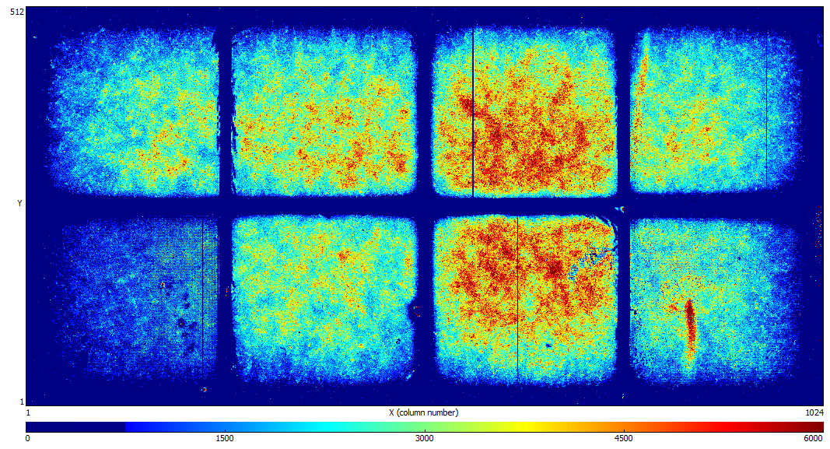
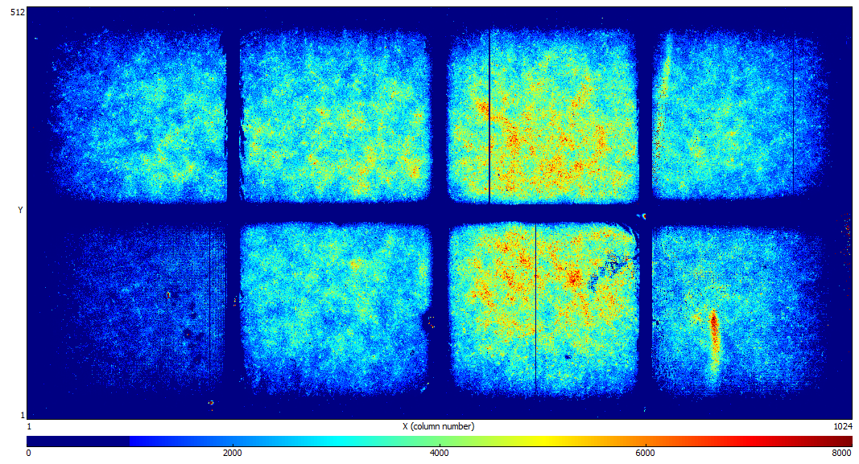
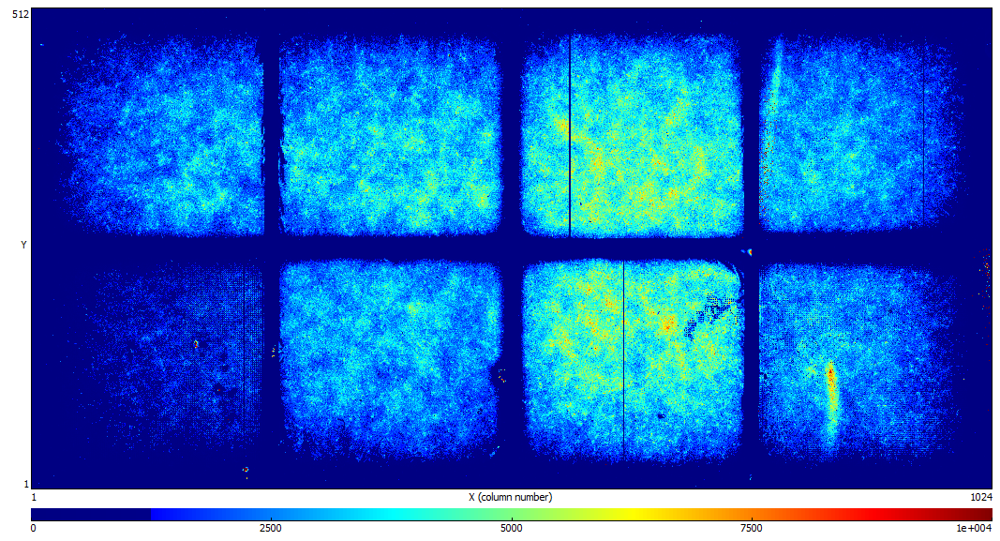
Saclay Octopuce: Uniformity of the Response (II)
THRESHOLD = 6000 COUNTS
THRESHOLD = 8000 COUNTS
A.Chaus, D. Attie
THRESHOLD = 10000 COUNTS
Non-sensitive (~ 1.5 mm)
areas between chips:
More studies required to understand:
if “dead” areas between chips decreases
with increased drift field;
“dead” area on the outer edge as a
function of the guard voltage

Slide 14
Saclay Octopuce: Cluster Size Distribution
Single electron sensitivity is very high for all (but 1 and 4) chips
A.Chaus, D. Attie
Expected number of primary electrons in He/Iso (80/20) ~ 165

Slide 15
Saclay Octopuce: Total Cluster Charge
Chips 1 and 4 have a lower response (same trend as for the cluster size distribution) →
Difference in amplification gap
Difference in threshold (too big to explain differences between 1 &4 and others)
A.Chaus, D. Attie
After equalization:
Chip number | Threshold level
1 | 337
2 | 335
3 | 340
4 | 335
5 | 330
6 | 327
7 | 330
8 | 320
Some differences in amplification gaps between different chips are seen by microscope
(studies are not conclusive, might come from different thickness of the glue under the chips)

Slide 16
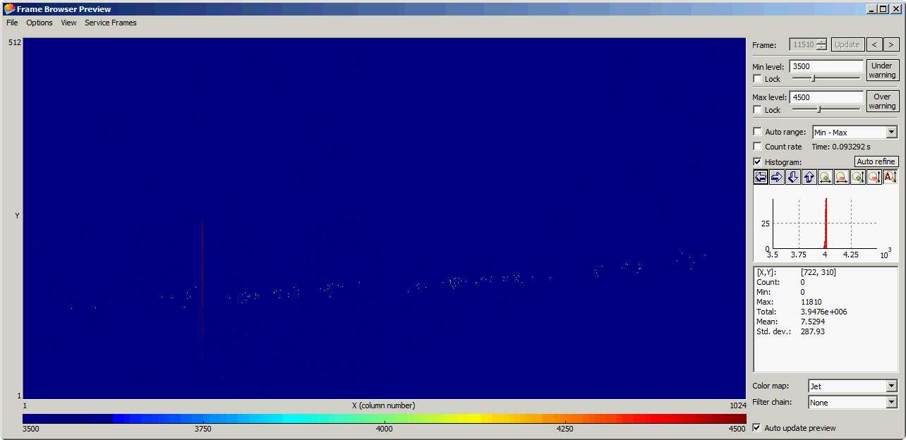
B = 0 T
He/iC₄H₁₀(80:20)
4 chips
DESY Test-Beam with Saclay Octopuce & Large Prototype TPC (Dec. 2010)
2 chips
B = 1T
He/iC₄H₁₀(80:20)

Slide 17
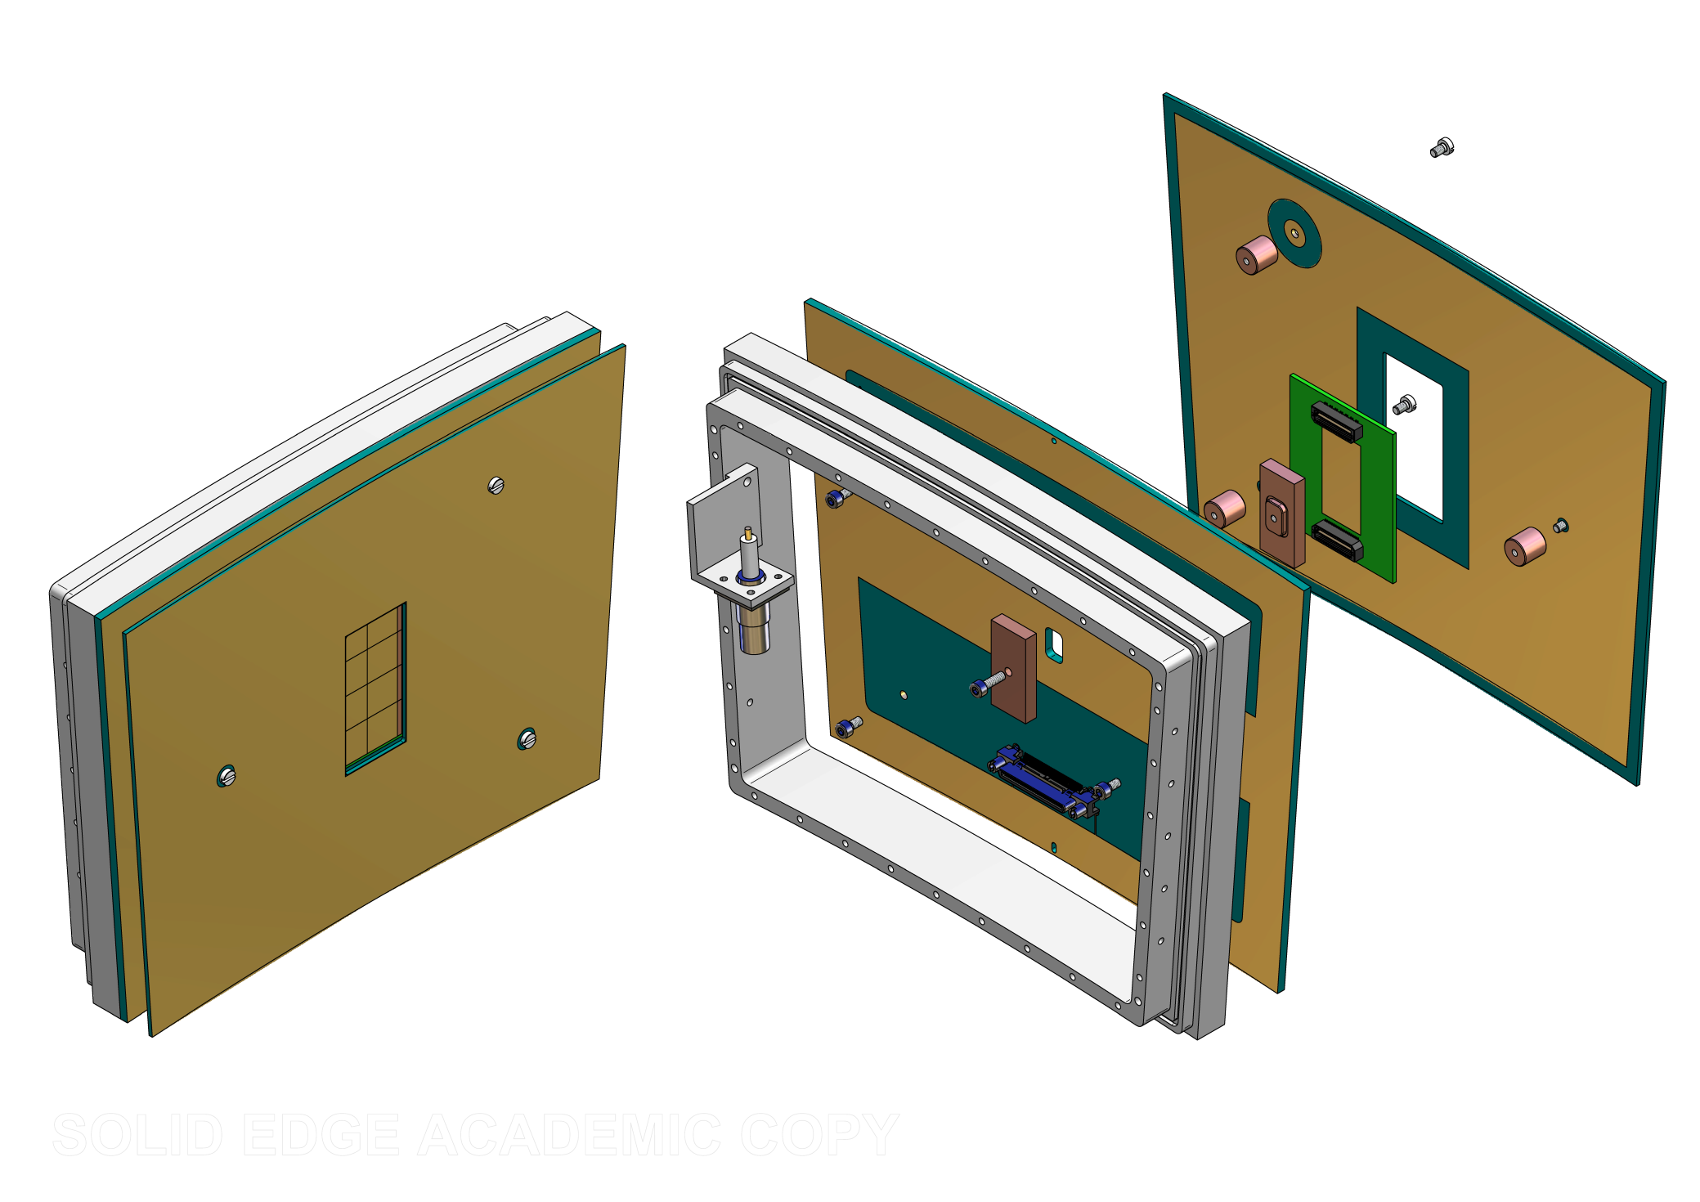
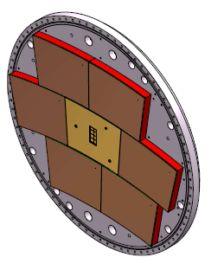
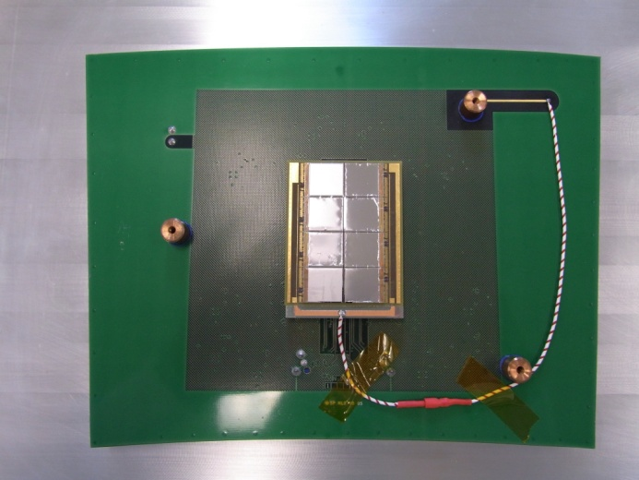
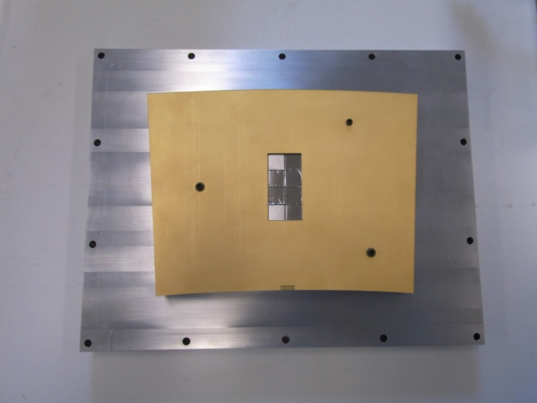
Saclay Octopuce in the Large Prototype TPC
Chips on a mezzanine board making wire bonding easier
Large Prototype compatible
Heat dissipator
Guard ring
Mother board
Mezzanine board
Timepix pane for Large Prototype TPC

Slide 18
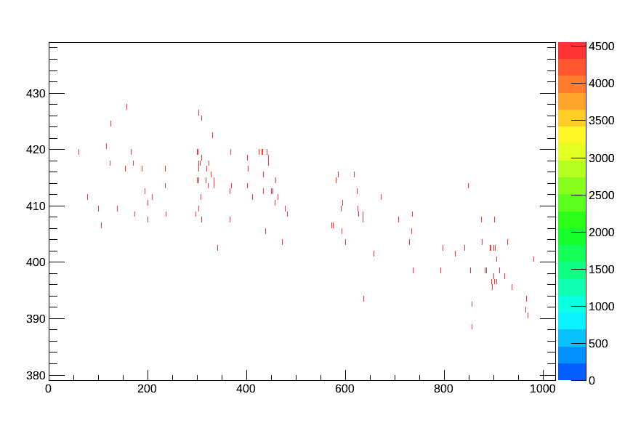
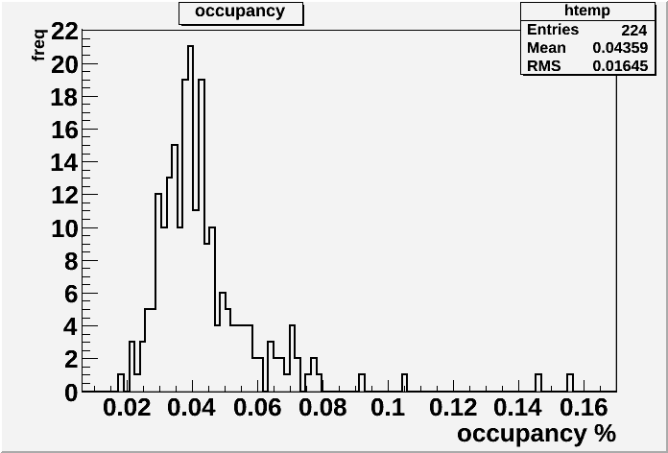
Saclay Octopuce in the Large Prototype TPC at 0 T
He/Iso 80/20
V_{mesh} = 380V
Time mode
Shutter Time: 100 μs, start given by beam trigger
Example of a typical event:
Occupancy is very low:
< 0.1 % (no noisy frames)

Slide 19
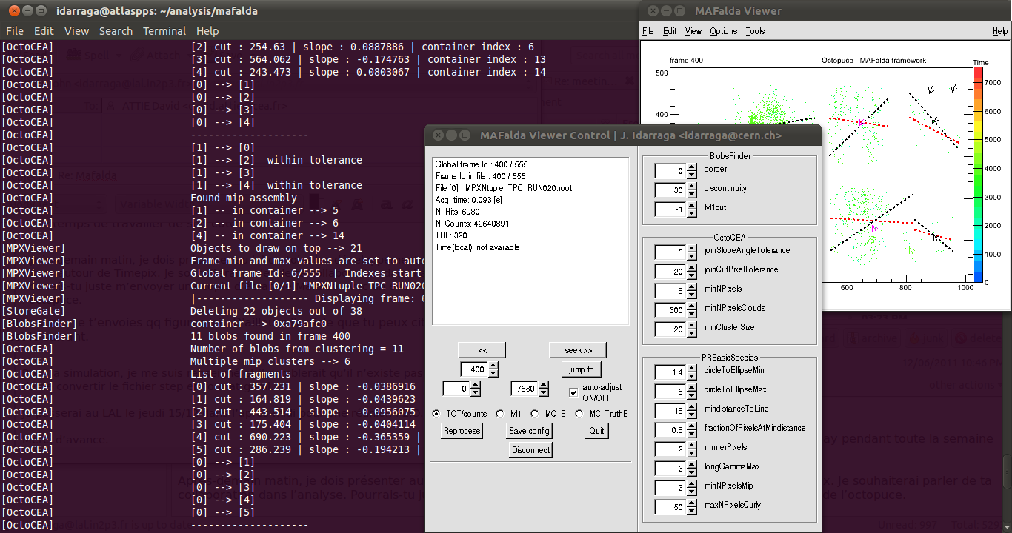
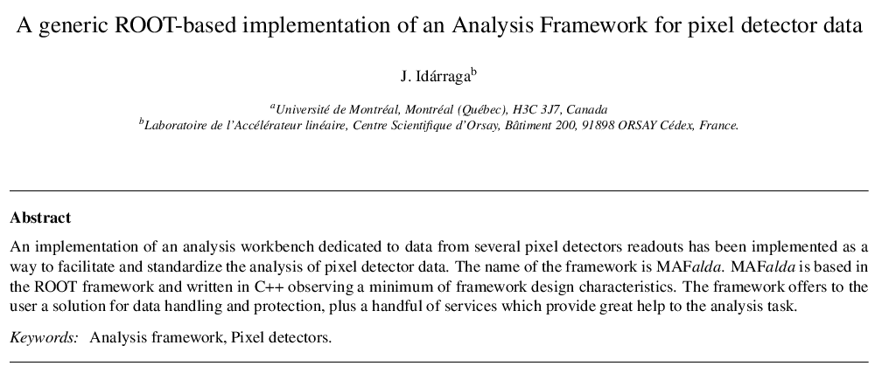
MAFalda: Medipix Analysis Framework
ROOT based analysis package developed by John Idarraga (LAL)
C++ classes including processors:
  OctoCEA (define in a few minutes)
  Pattern recognition of tracks for low threshold
Use MAFalda as the first step → implement reconstruction algorithm in Marlin TPC

Slide 20
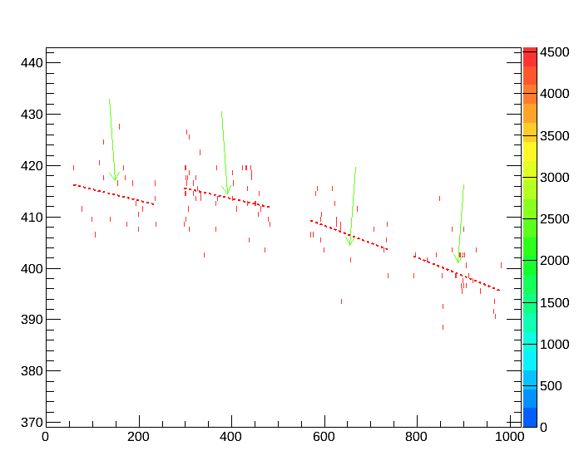
MAFalda: Cluster Finding and Track Segments (I)
Form cluster from the pixels with “discontinuity” < 40 pixels (each cluster
should contain > 12 pixels)
Calculate the linear regression with all points in the cluster (red dotted line)
Calculate residuals from the red line to each point (if > 80 % the points are within 20 pixels – this is the “track segment” !
A. Chaus

Slide 21
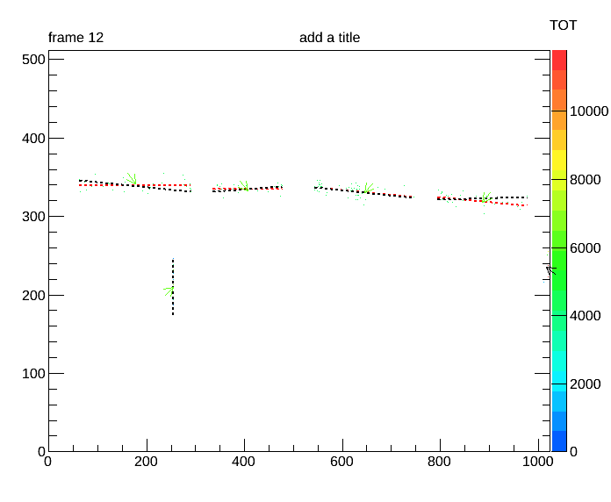
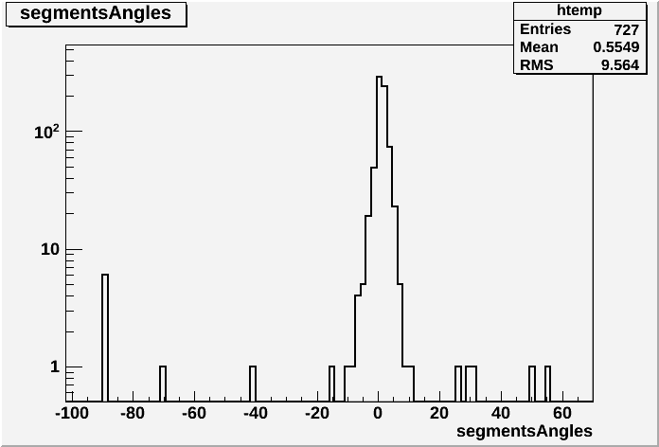
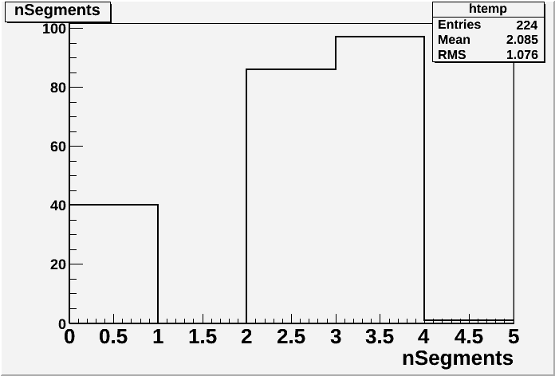
MAFalda: Cluster Finding and Track Segments (II)
Check incident angles of track segments
→ Take segments within +/-10 degrees
(electron beam is in the horizontal direction)
A.Chaus
Number of segments
per reconstructed track
(most tracks consists of
2-3 segments):

Slide 22

Track Reconstruction
A. Chaus
Reconstruct track from track segments (if more than 2 segments):
Apply data quality cuts to make sure all segments correspond to a given track
Perform a linear regression for all pixels on a track → reconstructed track (blue dotted line)
A.Chaus
Y = ax +b
b : 417.558 | a : -0.021984
b : 421.54 | a : -0.0199386
b : 428.789 | a : -0.0341787
b : 431.063 | a : -0.0362019

Slide 23

Track Reconstruction: Residuals
A. Chaus
An unbiased estimate of the single point resolution: σ = Sqrt(σ1 * σ2):
Perform fit to all pixels and calculate the distance between each pixel and the position
of the point of closest approach along the fitted track:
σ1 = Gaussian fit, when all pixels are included in the track fit
σ2 = Gaussian fit, omitting pixel under consideration from the track fit
in number
of pixels

Slide 24

DESY Test-Beam: Track Residuals
A. Chaus
Summary of residuals (σ = sqrt(σ1*σ2)) for different Z-coordinates:
(corresponds to the different positions of electron beam
passing through the Large Prototype TPC)

Slide 25


DESY Test-Beam: Saclay Octopuce
Track Residuals as a function of Z
(Large Prototype TPC)
A. Chaus
PRELIMINARY:
PRELIMINARY:
Very low statistics, behavior needs to be understood

Slide 26

History: “Octopuce”s with Timepix Readout
Saclay
Saclay
X-Rays
2010: Saclay “Octopuce” (InGrid/MM)
Module → studied in lab at DESY test-beam
2013: NIKHEF “Octopuce”(InGrid/MM):
some problems with shorts & readout
2013: Bonn 2 “Octopuce” Modules
(Ingrid/MM) and 3-GEM → studied with SRS Readout at DESY Test-Beam in April 2013
Bonn

Slide 27



Two Bonn “Octopuce”s (Triple-GEM & MM / InGrid) Studies at DESY Test-Beam
Triple-GEM
MM/InGrid
4 Timepix ASICs
4 Timepix ASICs
MM/InGrid Track Reconstruction: Residuals
Studies in LCTPC Prorotype:
Different magnetic fields
(0 and 1 T)
Different drift fields

Slide 28
Bonn “Octopuce” (MM / InGrid) Studies at DESY Test-Beam
B = 1 T; E = 230 V/cm
Theoretical limit:
σ = Dt√z,
Dt = 106 (Magboltz)
From fit (exp.):
σ0 =157.3
Dt = 100.3
Analysis in
MAFALDA
FRAMEWORK:
B = 0 T; E = 230 V/cm
Theoretical limit:
σ = Dt√z,
Dt = 320 (Magboltz)
From fit (exp.):
σ0 ∼ 0
Dt = 304.6

Slide 29
Pixel Readout for LC TPC: Present and Future
Short-Term Plans:
Improve SU8-based « InGrid « structure (less dead area, higher yield, protection)
Better understand and improve field distortion issues at the « InGrid » plane
(in between chips and at the borders of the Octopuce);
Develop simulation chain to compare momentum resolution, double track resolution, dE/dx and pattern recognition to pad-based readout and to optimize the geometry (e.g. minimize the needed chip coverage; improve electric field between chips and at the chip borders)
Long-Term Plans:
Improved chip functionality → Timepix3 → transfer InGrid process to Timepix3
Adapted readout system → high-speed SRS readout for Timepix(3)(8 &100 chips);
Improved mass production of InGrids → in collaboration with IZM, Berlin
Work on more realistic cooling and power pulsing;
Develop a backside connection technology both for LV/data and for the HV;

