Slide 1




Overview of Atlas Pixel Project
Abdenour Lounis^{1,2}
Meeting – 23 Mai 2013
Laboratoire de L'accélérateur Linéaire
Université Paris-SUD XI

Slide 2
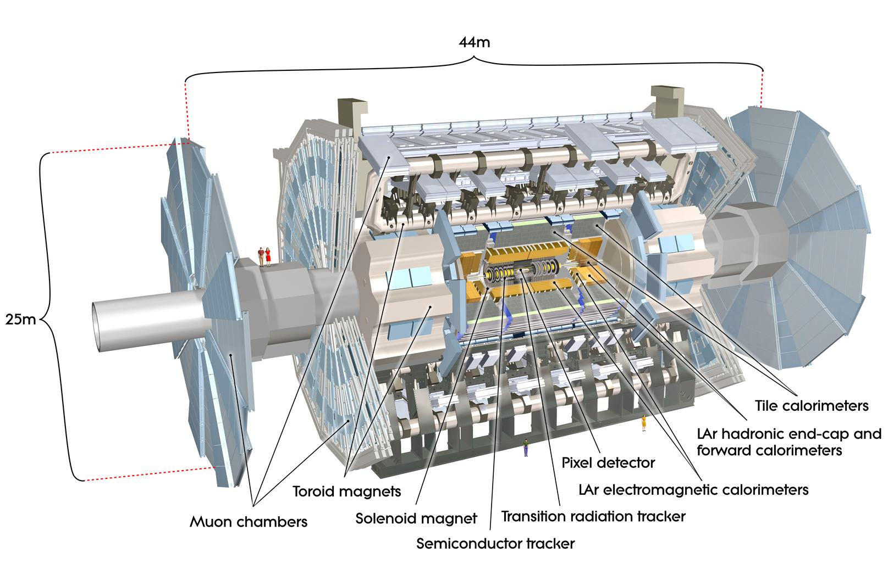
Plan
Illustration of the Vertex issues and position of the problem
The Actual detector design
The improvements for the future
What can we do for a better detection performance

Slide 3
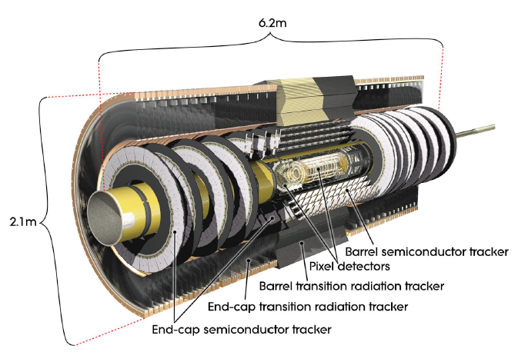
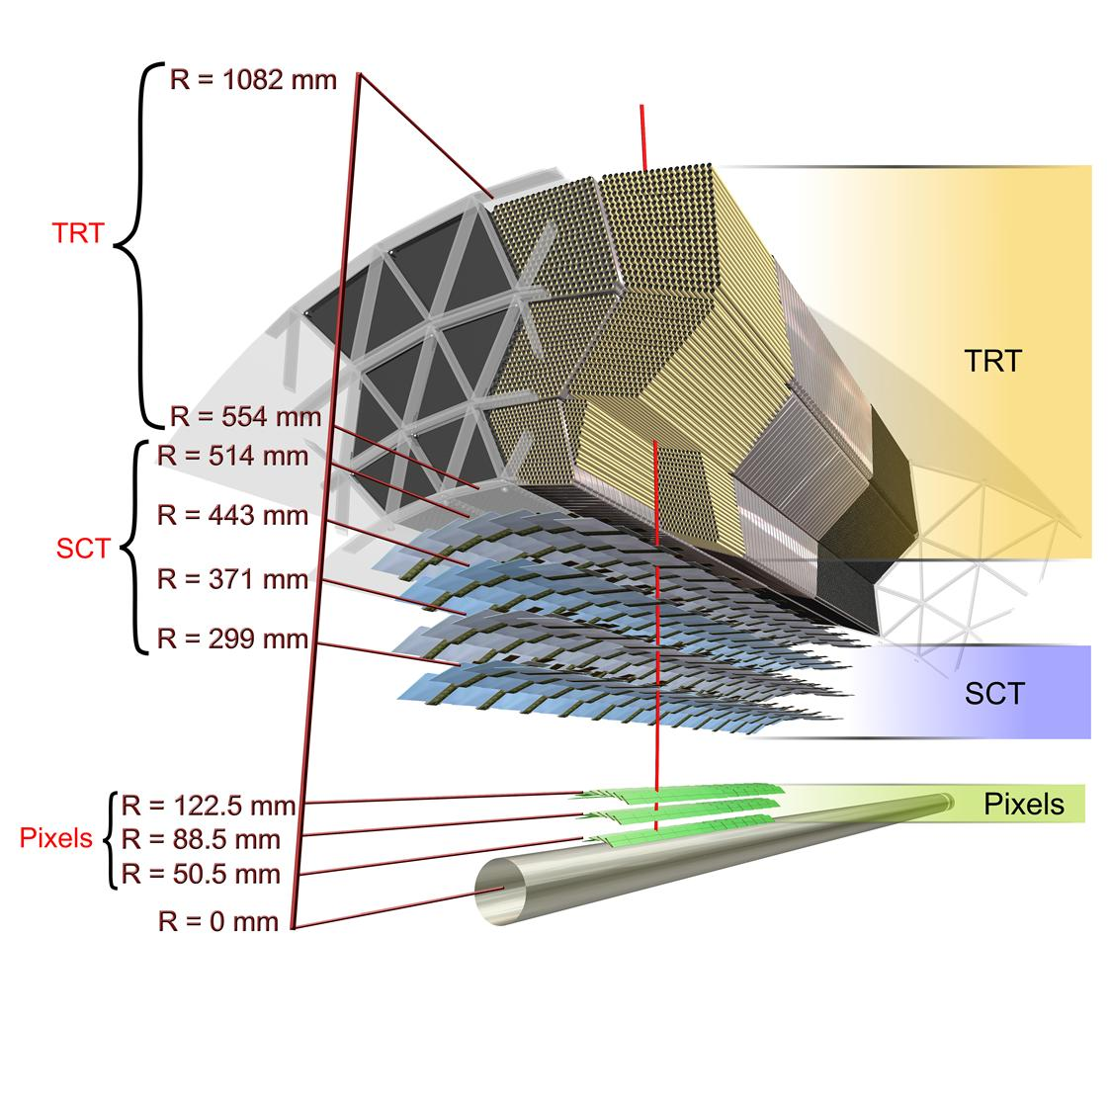
ATLAS Inner PIXEL detector
The present ATLAS pixel inner detector :
  This is the inner most detector
  3 layer design in barrel and disc region
  Barrel radii at 50.5, 88.5 and 122.5 cm from interaction point
  A total of 80 Million of Pixel channel
  1456 shingled modules (overlapping in the Z direction) on staves in the barrel region
  288 modules on double sided discs
  The present ATLAS module :
    Sensor Area : 10 cm²
    N-in-N design
    Sensor thickness 250 um
    Pixel Size FEI3 50 x 400 um
    Designed for 1X10¹⁵ n_{eq}/cm² (1 Mev/neutron)

Slide 4
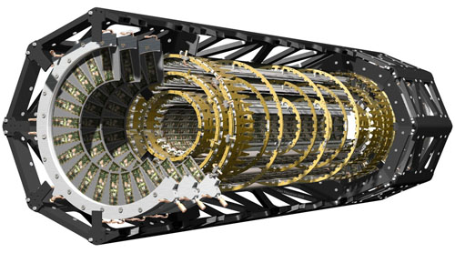
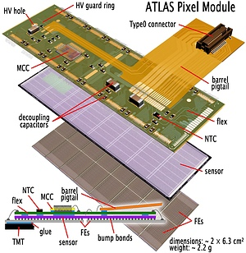
ATLAS experimental inner pixel detector:
ATLAS pixel detector: 80x10⁶ pixels (1.7 m²)
1744 pixel modules with 46080 pixels/mod.
Each chip: 50x400 μm² ⟹ σ_{pos}=14/115 μm
30 cm
80,cm

Slide 5
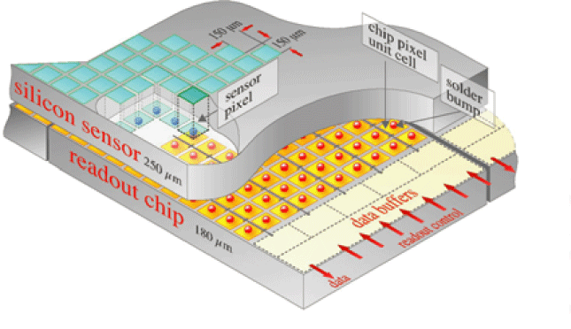
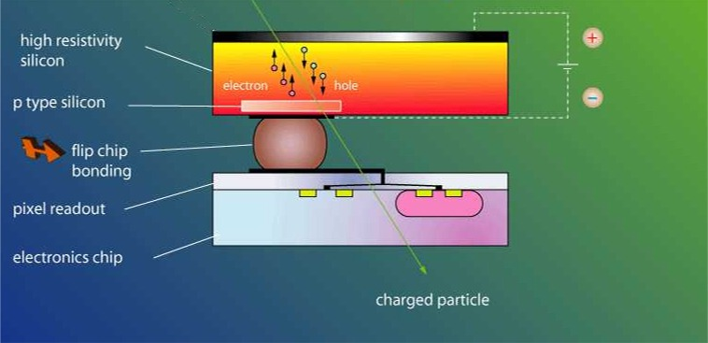
The Planar Pixel Detector
Silicon detectors are used for the tracking system of ATLAS experiment. Higher granularity in the tracker is required from the increased number of events per beam crossing.
The planar pixel detector is one of the popular types of Silicon detectors. It is used practically in all nuclear and high-energy physics experiments to register position and ionization energy information of charged particles.
Schematic representation of a hybrid detector.
4
Notes:
Silicon detectors are used for the tracking system of ATLAS experiment.

Slide 6
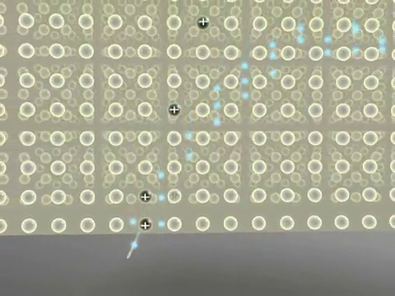
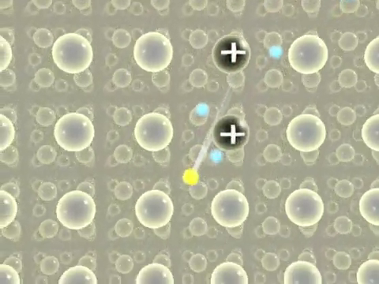
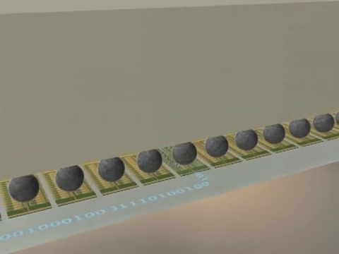
Working Principle of a Silicon Pixel Detector.
Electron– hole pairs resulting from the ionization of the crossing charged particle travel to the electrodes on the sensor planes.
Drifting of the electrons
The segmentation into individual pn-junctions makes it possible to collect the charges on a small number of pixels only, where they capacitively couple to the Al readout pixels.
Creation of electron-hole pairs
The latter are connected to the readout electronics, where the intrinsic signal is shaped and amplified.
Readout of the signal
Notes:
The charged particle passing through the sensor creates electron–hole pairs which will drift to the electrodes under a high electric field.

Slide 7
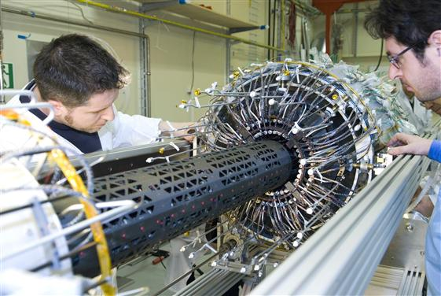
The Pileup Issue
Some interesting vertex views

Slide 8
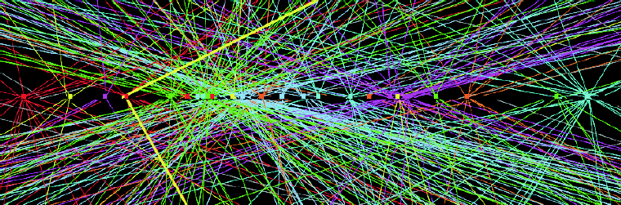
1 Motivation
The efficiency of the innermost layer will go down with pile-up. (At 2.2x10³⁴ cm² s⁻¹, the inefficiency of the innermost layer will be around 5%.)
Heavy flavor tagging (B) will be seriously degraded by pileup.
We should improve the track reconstruction and vertexing to maintain detector performance
First operation: add new layer to the pixel detector : INSERTABLE B LAYER PROJECT
Z→μμ event from 15 April 2012, L = 4 · 10³³ cm⁻² s⁻¹, 25 vertices

Slide 9
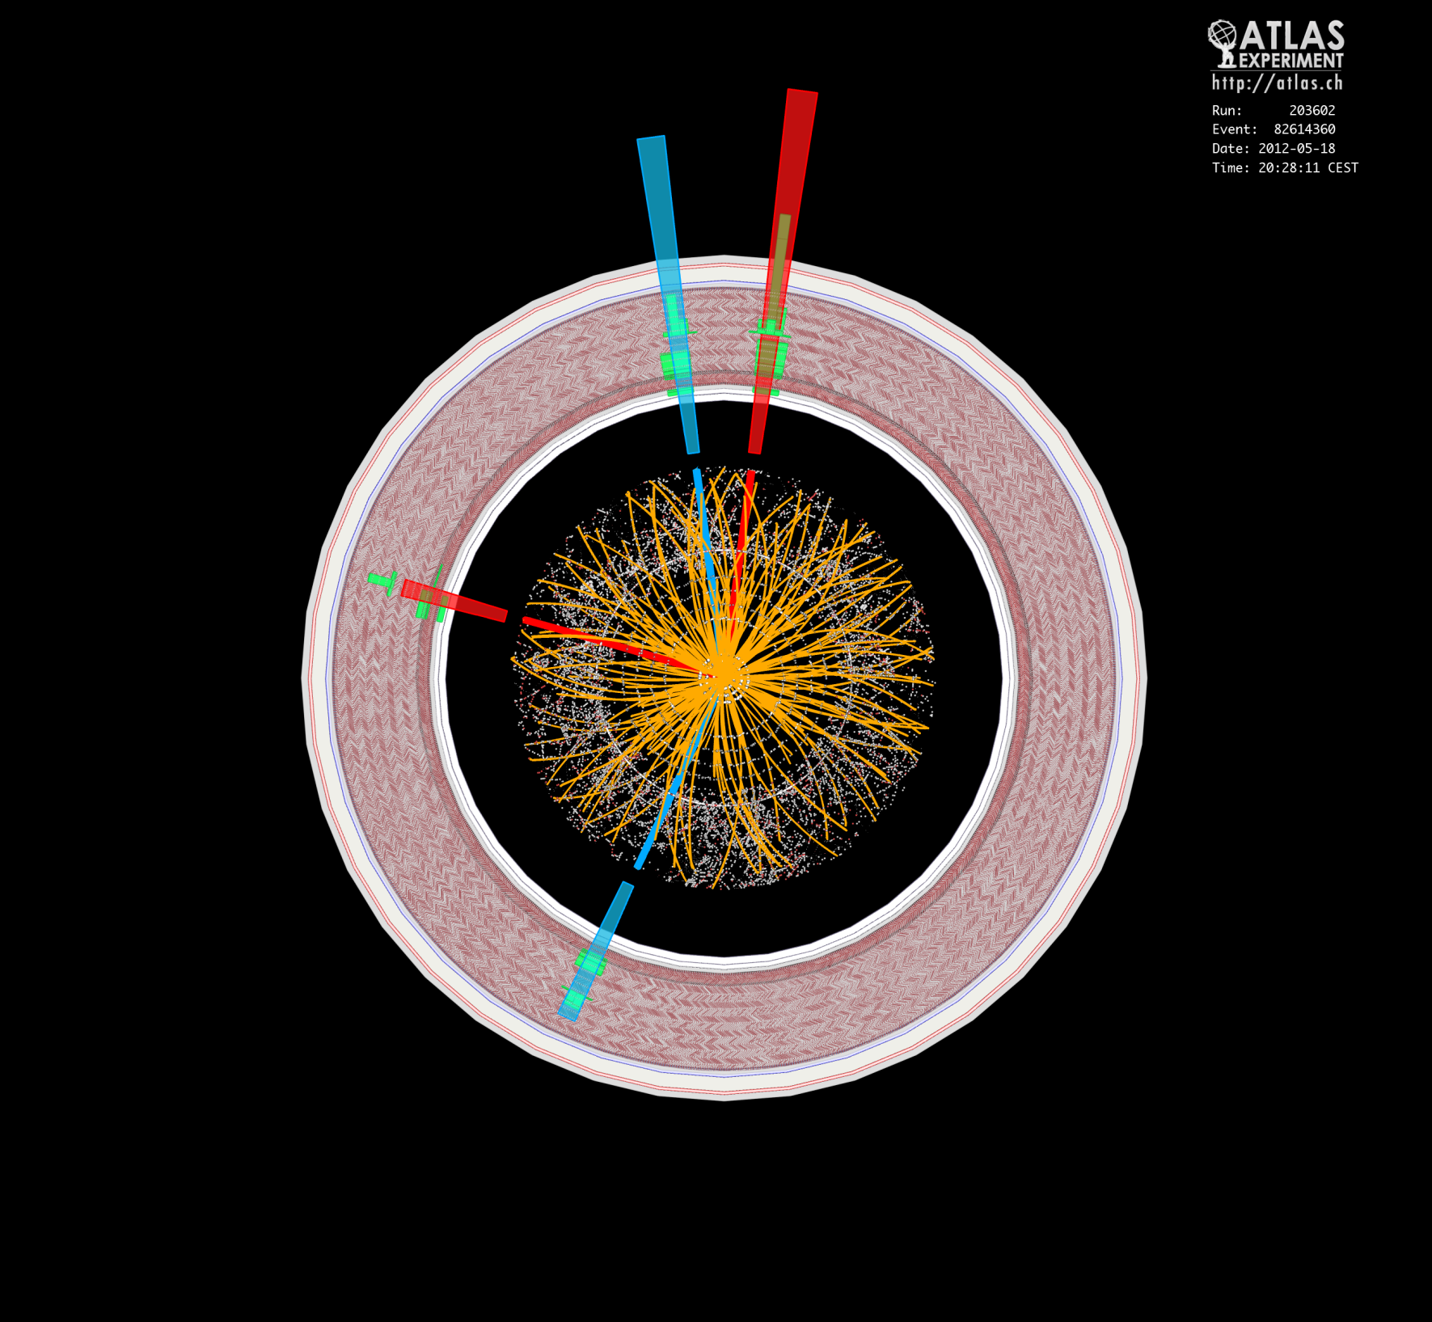
Position of the problem
Event display of a H -> 4e candidate event with m(4l) = 124.5 (124.6)
GeV without (with) Z mass constraint. The masses of the lepton pairs are 70.6 GeV and 44.7 GeV. The event was recorded by ATLAS on 18-May-2012, The tracks and clusters of the two electron pairs are colored red and blue, respectively.

Slide 10
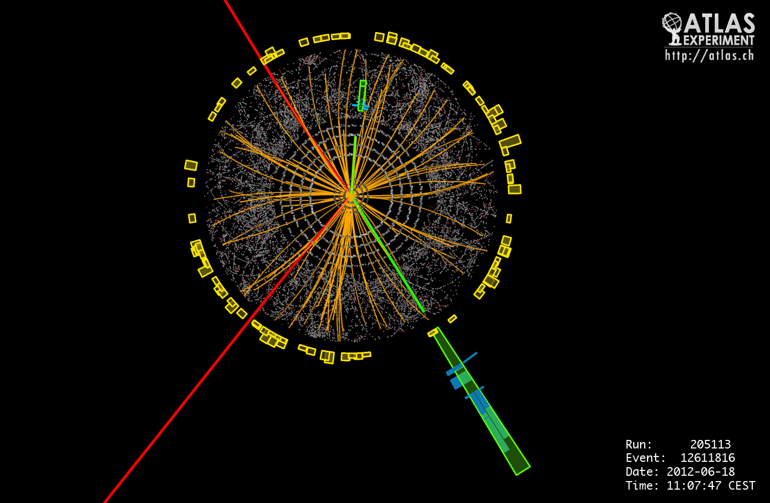
Event display of a H -> 2e2mu candidate event with m(4l) = 122.6 (123.9) GeV without (with) Z mass constraint. The masses of the lepton pairs are 87.9 GeV and 19.6 GeV. The event was recorded by ATLAS on 18-Jun-2012, 11:07:47, Muon tracks are colored red, electron tracks and clusters in the LAr calorimeter are colored green.

Slide 11
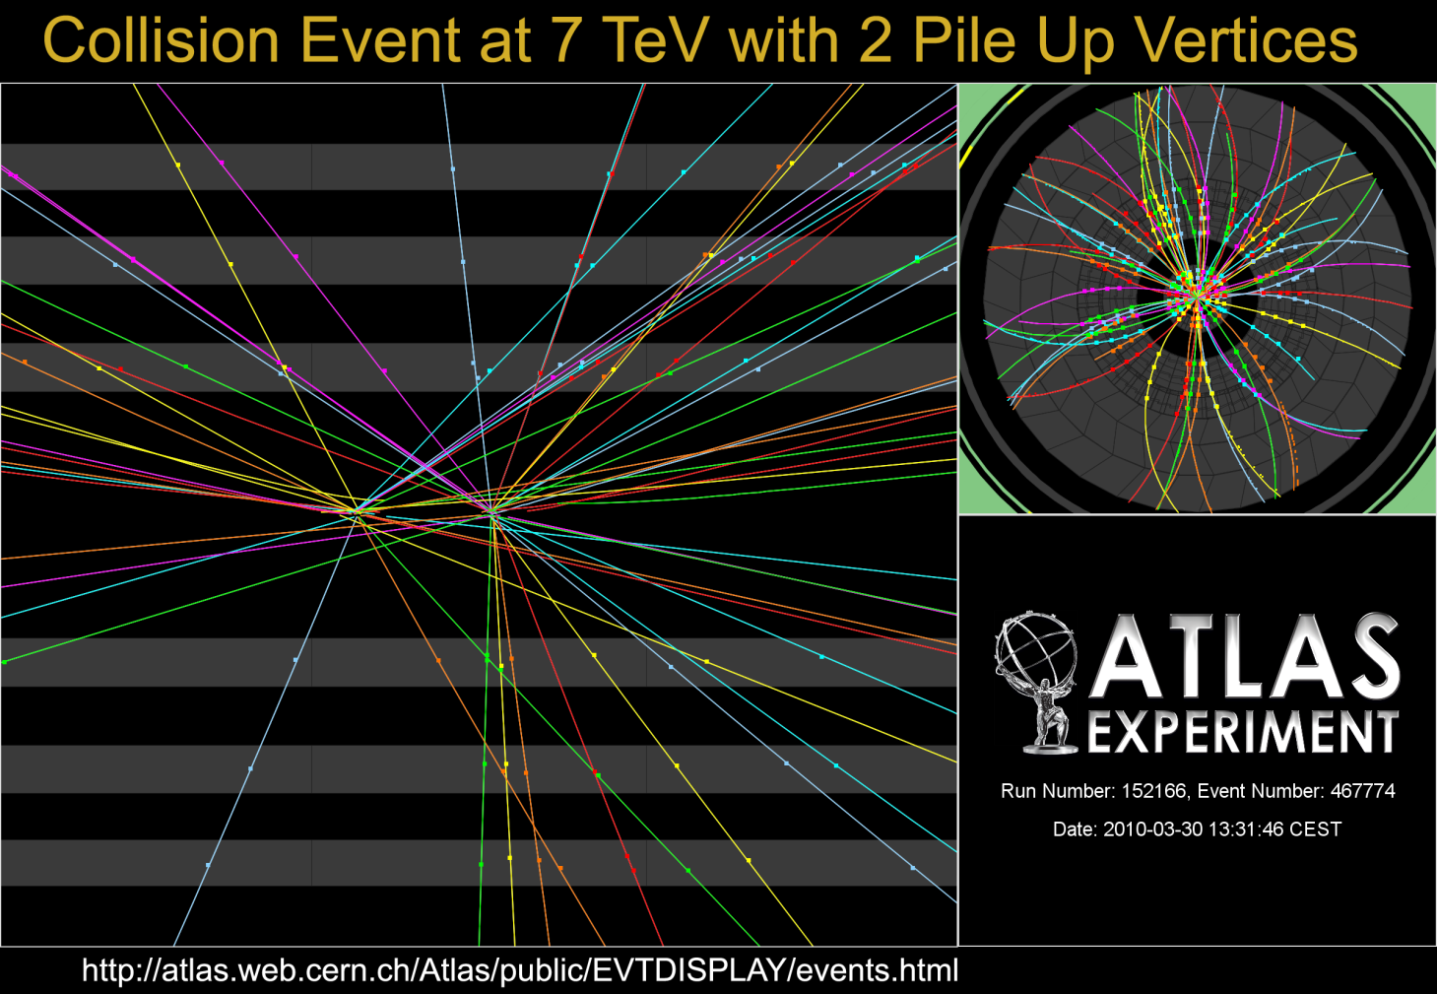
early 7 TeV collision event with two reconstructed primary vertices (pileup),
collected in the first 7 TeV fill on 30 March 2010. The longitudinal distance between
the vertices amounts to approximately 2.5 cm.

Slide 12

The situation is more
Complicated with increasing the
Number of pileup collision!!
This is a pile-up event, in which
separate collisions occurred
(vertices at the dots) when two
bunches of LHC protons crossed each other inside ATLAS.
There are about 100 billion protons
in a bunch, so four collisions is
not all that many--except
that protons are incredibly small.
In fact, most protons miss each
other in a bunch crossing. Currently, there are about four million bunch crossings per second and this is being increased the LHC ramps up.

Slide 13
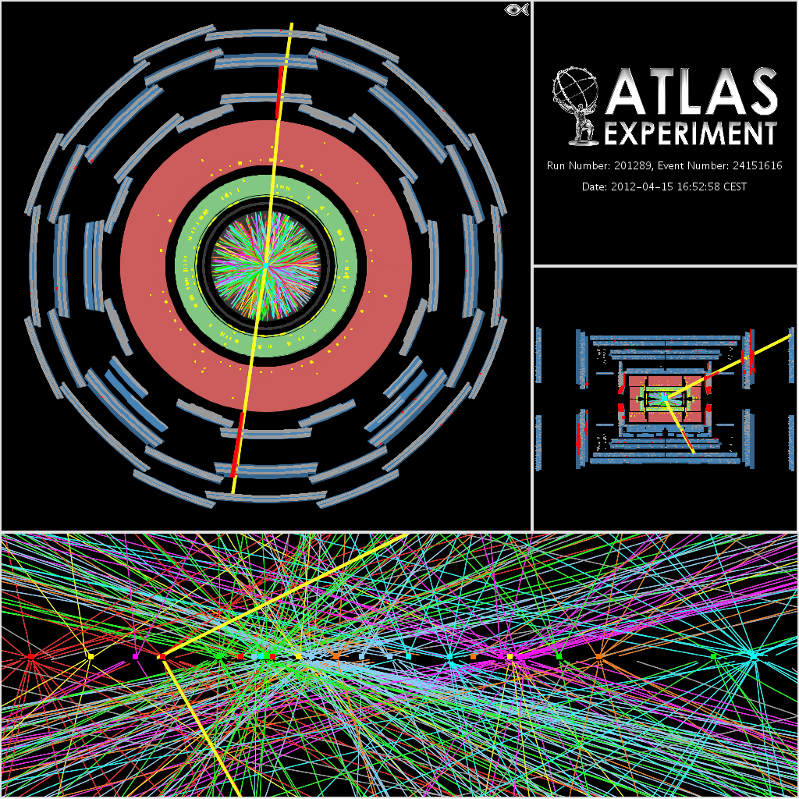
Candidate Z boson event in the
dimuon decay with 20 reconstructed
vertices. This event was recorded on
September 14th and is typical for the
2011 environment with high pileup.
For this display the track p_{T} threshold
is 0.4 GeV and all tracks are required to
have at least 2 Pixel and 7 SCT hits.
The vertices shown are reconstructed
using tracks with p_{T} greater than 0.4 GeV.

Slide 14
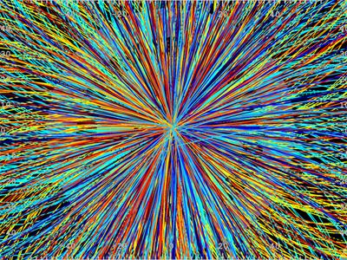
Next step for LHC:
Novel Machine called
HL-LHC:
To extend its discovery
potential, the LHC will
need a major upgrade
around 2020 to increase
its luminosity
(rate of collisions) by a
factor of 10 beyond its
design value. As a highly complex and optimized machine,
such an upgrade of the
LHC must be carefully
studied and requires
about 10 years to
implement. The novel machine
configuration, called High
Luminosity LHC (HL-LHC), will rely on a number of key innovative
technologies, representing
exceptional technological
challenges, such as cutting-edge
13 Tesla superconducting
magnets, very compact and
ultra-precise superconducting
cavities for beam rotation,
and 300-metre-long high-power
superconducting links with zero
energy dissipation.

Slide 15
The Irradiation issue
R&D on Sensor itself

Slide 16
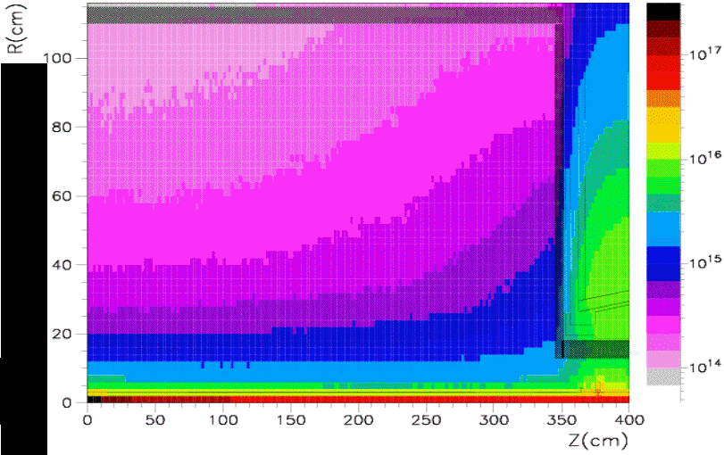
2) Irradiation issue
High level of irradiation
Luminosity of up to 0.5 x10³⁴ cm² s⁻¹
resulting fluence: 2 . 10¹⁶ neq cm-² at
3.7 cm radius
5000-10000 Tracks/BC => occupancy!
pile-up: 400 events/BC
Current Pixel region
Pixel Layer Position

Slide 17
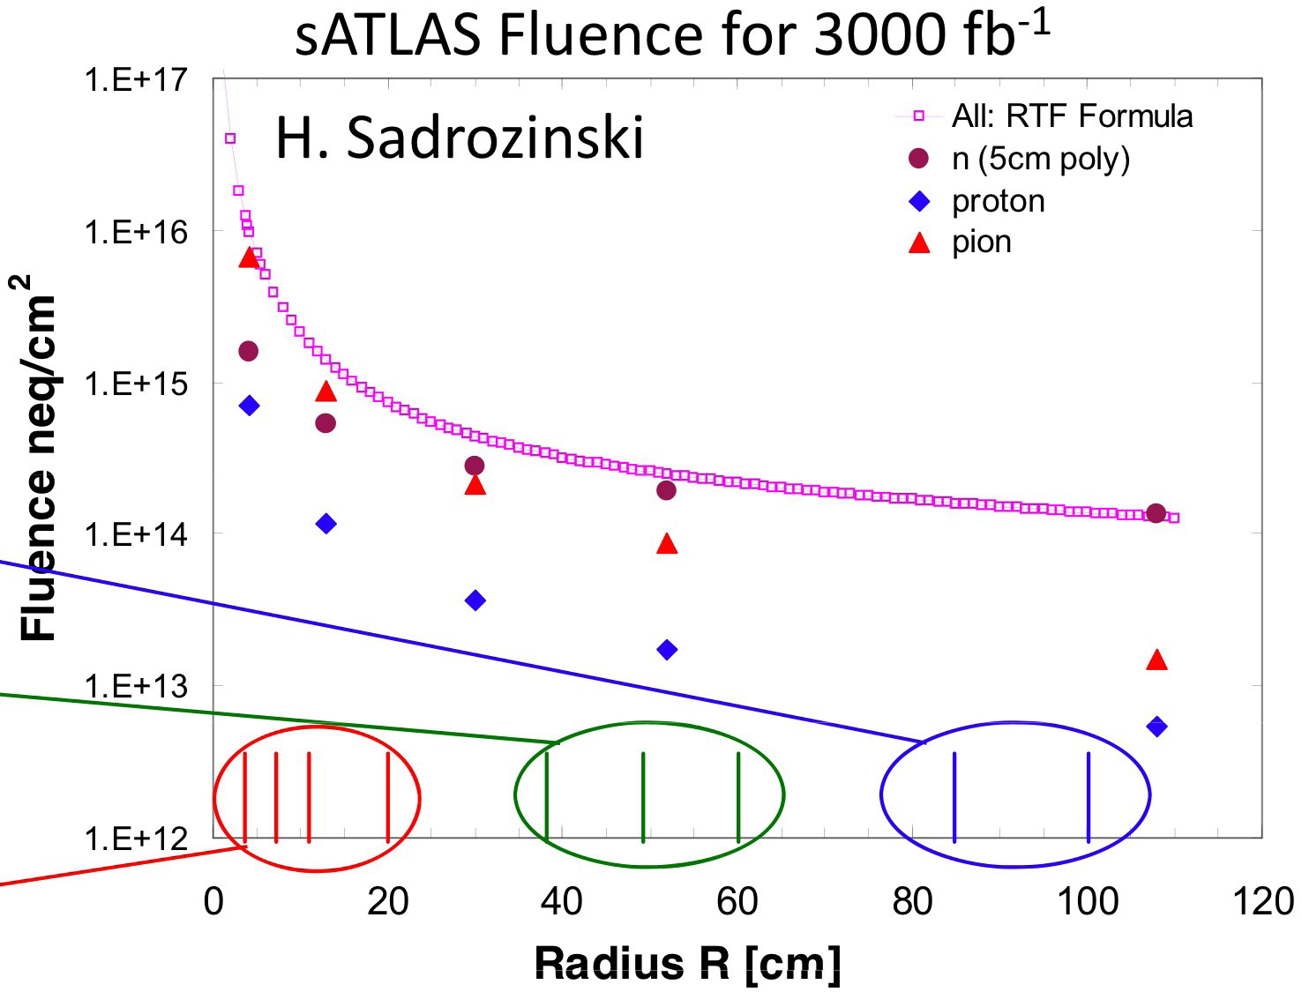
Expectations from Simulations
Strawman Strips
Strawman Strips
Strawman Pixel

Slide 18
Radiation Damage
  Inversion of substrate doping concentration with radiation fluence
  Remark : Such phenomena may be observed only for n-doped substrate
The parameterization of the effective doping concentration is given by :
Change of the doping concentration has consequences for the operating voltage needed for total depletion.
Doping concentration vs. fluence
Lindström
1999
NIMPR

Slide 19
Radiation levels and signal loss
Strip
Pixel layers
3000 fb-1

Slide 20


The Project Purpose
New Hard-Radiation Planar Silicon Pixel Sensors ‘’
for ATLAS up-grade Experiment
Withstanding harsh radiation-loaded environment (sensor and Readout electronics)
Presenting good interpixel isolation
Ensuring satisfactory electrical behavior during all their life span
Improving the charge collection efficiency (less charge trapping)
Allowing high signal to noise ratio (Low noise electronics a MUST)
Offering optimized design (with minimal size, thickness) for stable performance
Requiring simple technology for low cost (single-sided process = one mask)
Notes:
Such detectors must be able to :

Slide 21
Key Elements for Planar Pixel Sensor R&D for HL-LHC
Hybrid Pixel Sensor
  Structure (substrate, configurations, bias & multi-guard rings, electrode geometry, passivation, design rule, readout)
  Key parameters (full depletion voltage V_{FD}, breakdown voltage V_{BD}, leakage current, interpixel capacitance)
Radiation Damage
  Inversion of substrate doping concentration
  Inversion of space-charge sign only for n-doped substrate
  Inversion of the full depletion voltage
  Increase of trapping and recombination
  Increase of leakage current
  Formation of electron inversion layer at the interface Si-SiO₂
  Formation of a double junction & a double-peak of electric field
Cutting Damage
  Amorphisation of the detector edge due to the dicing operation
Actual Solutions & New Trends
  Implantation Isolation Interstrip
    P-stop (blocking implant)
    Standard P-spray
    Moderated P-spray
    Trench structures
  Thinning substrate
  Reducing dead (inactive) edge zone
  Oxygenated substrate
  Our work :Testing new designs with TCAD simulation

Slide 22
Where are we ?
Planar Pixel Sensors :
Planar Pixels: Where do we stand?
Current pixel detector is using n-in-n planar pixel design proven to be rad-hard up to at least 2 . 10¹⁵ neq cm⁻²
CCE decreases with fluence, but sensors will yield signals
to above 10¹⁶ neq cm⁻²
We know that : 6-8 ke- after 1 . 10¹⁶ neq cm⁻² at around 500 V bias and up to 15 ke- (!) after 1 . 10¹⁶ neq cm⁻² at 1900 V bias
Current readout not suited for data rates at > 2 . 10³⁴ cm-² s-¹
Improve Material budget to improve track reconstruction with respect to current detector, especially for the inner layer(s):
Go to Thinner sensors?

Slide 23
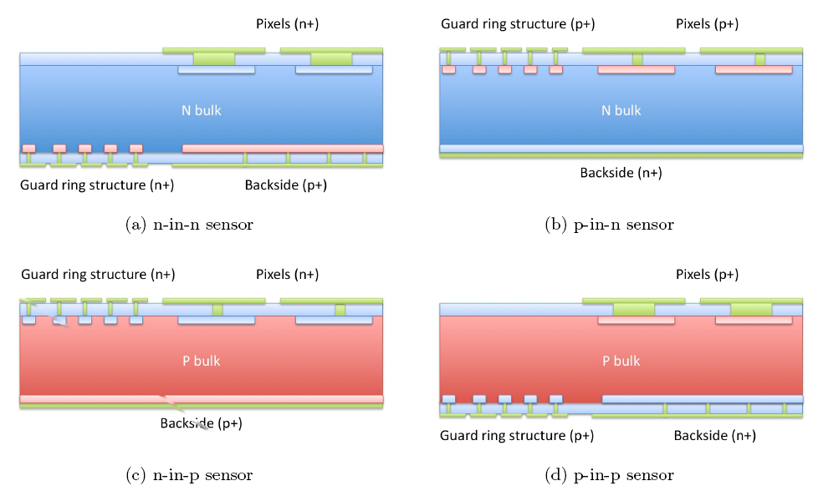
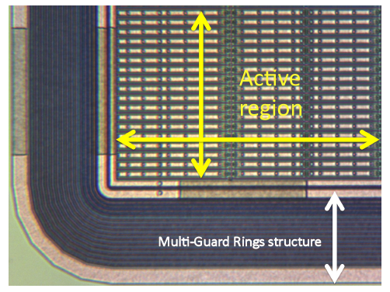
Different possible configurations of the planar pixel sensors
Hybrid Pixel Sensor : “ The Structure “
 The n-in-n configuration was chosen for ATLAS.
Double-sided detectors (two masks are required)
n-in-n
Benoit 2011 Ph.D. Thesis
Certain design features should protect against early breakdowns . The Multi-Guard Rings Structure is a
set of self-biased ring-shaped electrodes with associated implants surrounding the active area of the sensor
used to stabilize the bias drop from pixels to edges of the detector and thus limiting the field intensity which
prevent breakdown when operating at high bias voltage.
Single-sided detectors (only one mask is required in the process)
n-in-p
Guard ring structure used in the ATLAS pixel sensor
Notes:
Several configurations of the planar pixel sensors are existing

Slide 24
Layout Parameters
Hybrid Pixel Sensor : “ The Structure “
The figure shows the geometry of the three structures simulated. The first one is the ATLAS actual pixel sensor, an n-in-n structure. The two others are n-in-p designs proposed as candidate for IBL and super LHC pixel sensor replacement.
Benoit
2011
Ph.D. Thesis
Multi-guard ring structures used for simulation, obtained from process simulation
Notes:
Different design configurations were tested in order to improve the sensor performances

Slide 25
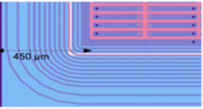


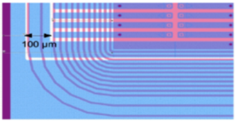
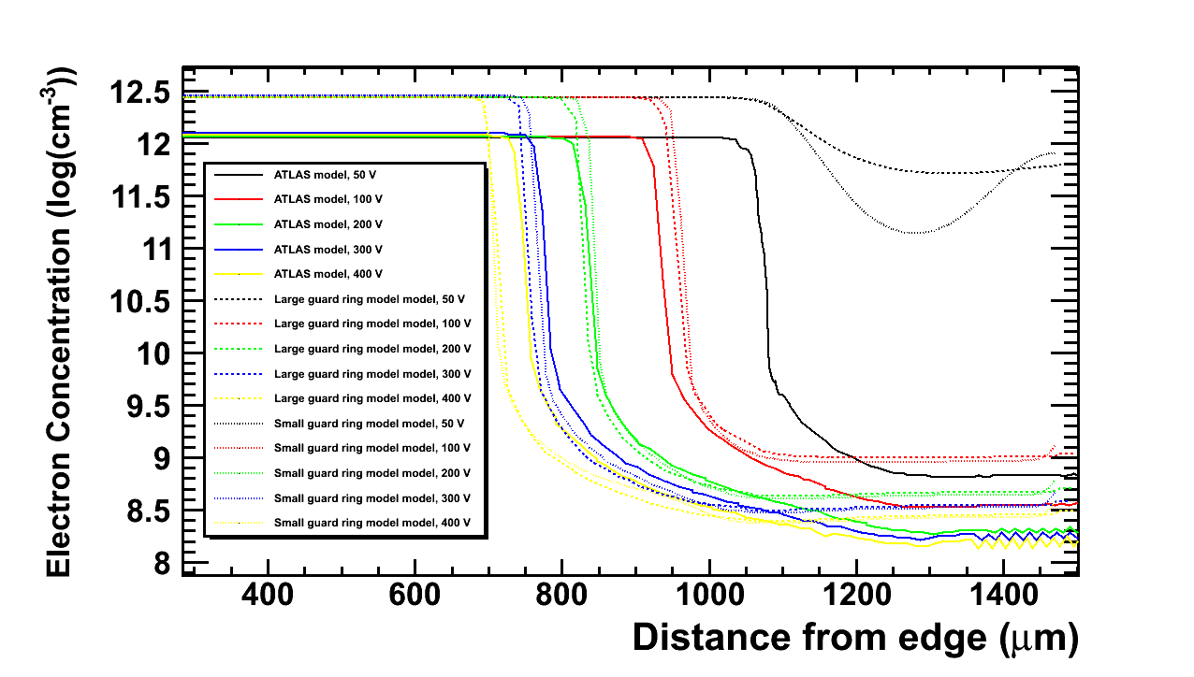
Implications performed already on current design
Geometry
Slim edge (100 µm): Number of guard rings limited from 16 to 13
Guard rings shifted underneath last pixel
Long edge pixel (500 µm)
Slim edge ~100 µm inactive edge
Thinner substrate: 200 µm
2D electric field simulations with boundary conditions with irradiation models
Functionality
Electrical field deformation on the edge simulated
Minor effect after irradiation as the bulk of the charge is collected in the pixel implant
Simulation of a combined model for irradiation defects, trapping and diffusion
Silvaco TCAD used for geometry, field and radiation damage simulation

Slide 26
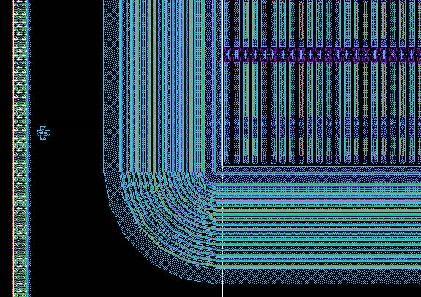
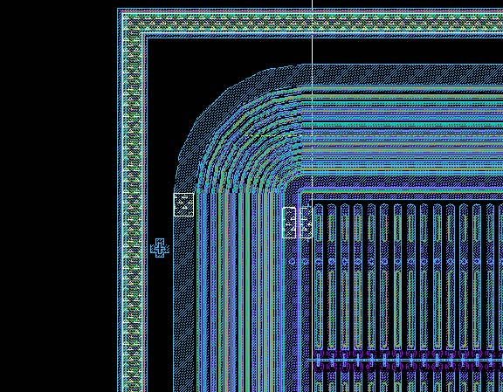
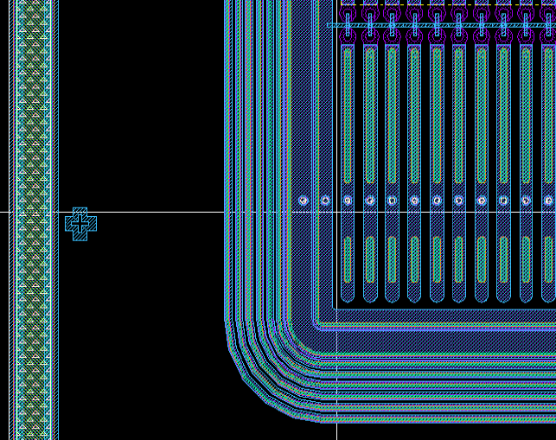
DESIGNS PREDICTED BY LAL Orsay Pixel Group
SLIM EDGE FEI4 SENSORS
635 μm
19 rings
For the modules of the ATLAS
Insertableb-Layer no shingling
is allowed: the sensors are required
to have inactive edges < 450 μm.
FE I3
515 μm
15 rings
240 μm
8 rings

Slide 27
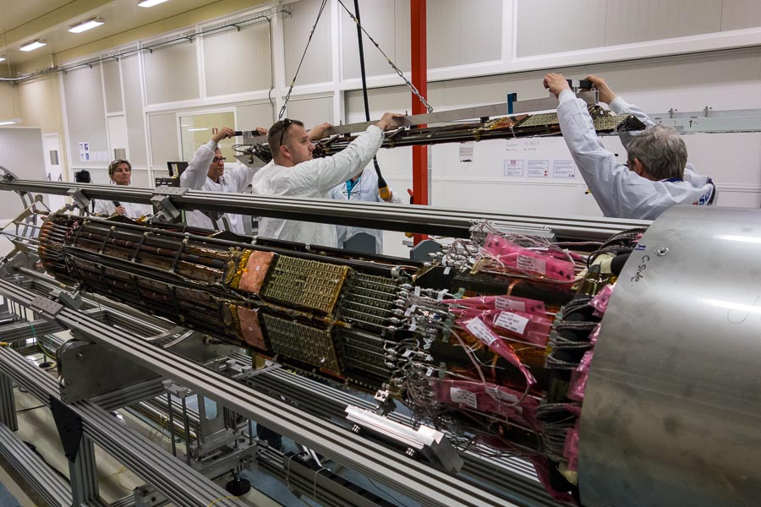
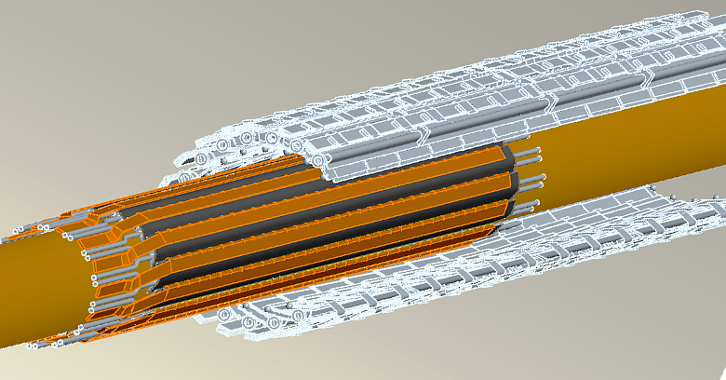
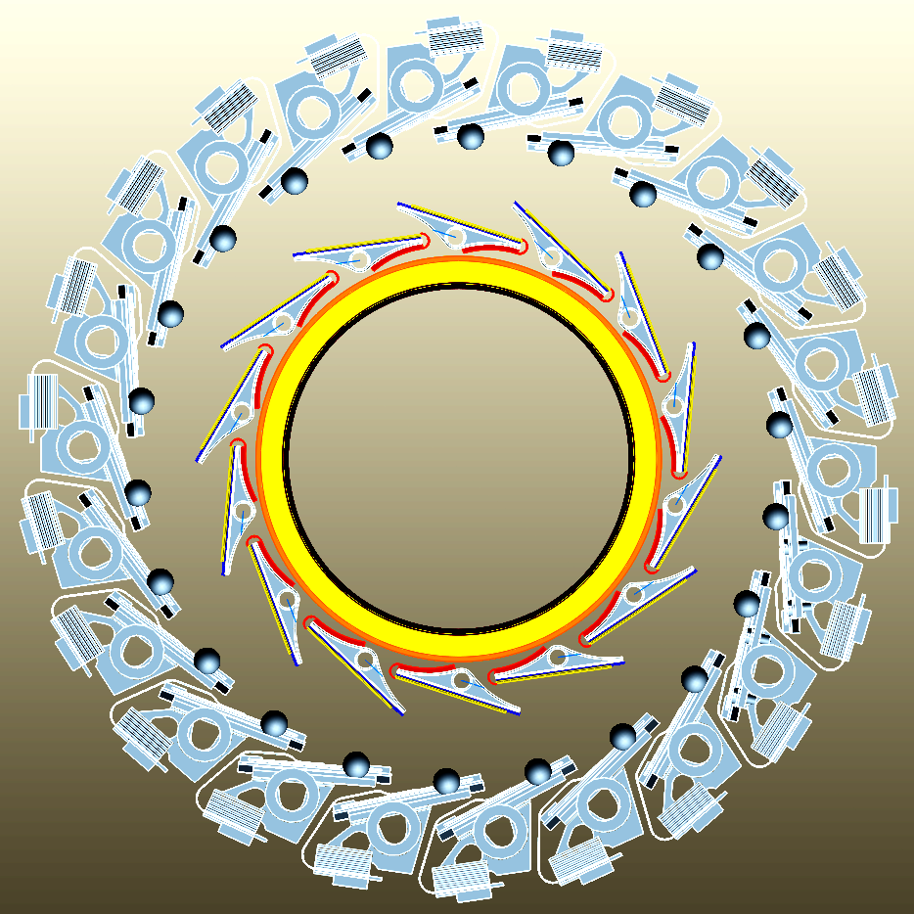
ATLAS upgrade : phase – 0: Long shut Down 2013-2014 / LAL Contribution
The current B-layer will become inefficient
after phase-1 (beyond nominal luminosity):
data bandwidth, radiation damages, …
The idea is, instead of replacing the B-layer,
which is quiet not obvious and risky to
add a new B-layer inside the present one.
3 pixel layers → 4 pixel layers
Insert the new layer inside the current beam pipe (Insertable B-Layer → IBL)
using a smaller beam pipe.
Existing B-layer
Newbeam pipe
IBL mounted on beam pipe

Slide 28
LAL Pixel Group implications in ATLAS upgrade

Slide 29

R&DLAL implications for UPGRADE
Implications on current design
Simulation-side outline and activities
  Synopsys 3d simulations
  Edgeless detectors study
  Radiation hardness and field boundary conditions investigation
Experimental studies
  Detector characterization
  Calibration and surface tests
  Dopant profile measurements
    SIMS
    SRP
    Scanning spreading resistance microscopy

Slide 30
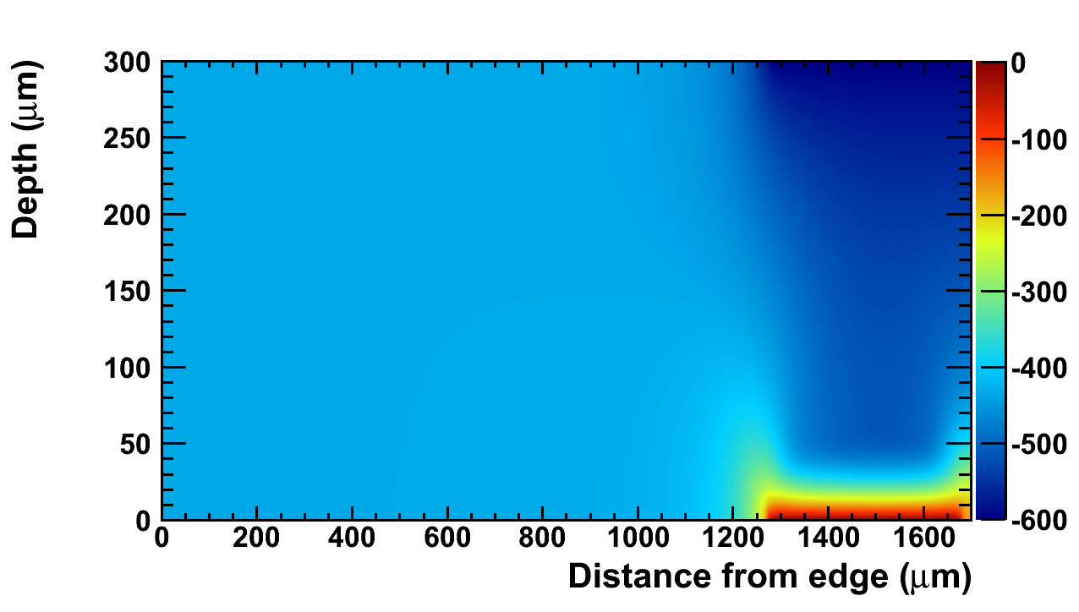
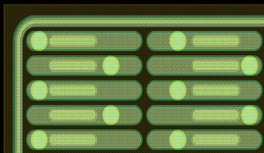
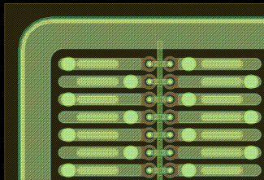
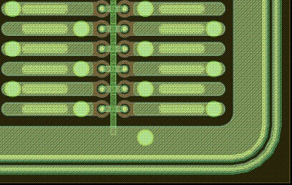

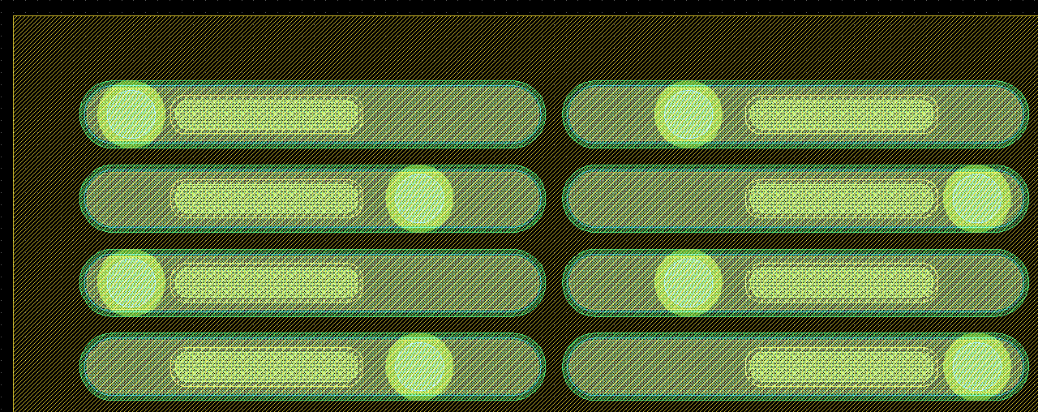
Simulation-side outline and activities
Tools
Passing to 3D Simulations
Migrating from SILVACO TCAD to Synopsys
Both process simulation and irradiation model integration
IBL Voltage simulation (600V - 5 x10¹⁵n_{eq}cm⁻²)
1 Guard Ring
Radiated IBL structures simulation
Charge sharing and electrical field distributions
Defects modeling and model testing
Intentions
Bias Rail
Validate Edgeless VTT geometry and radiation hardness
Geometry and fabrication process flow simulation
Detailed investigation of electrical field on detector edge
Charge propagation in the substrate and boundary conditions effects
Radiation hardness modeling and simulation
Guard Ring + Bias Rail
No Guard Ring or Bias Rail

Slide 31
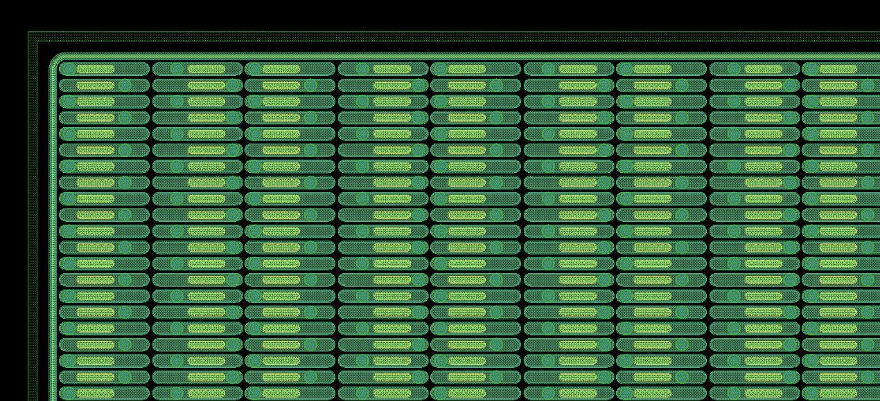
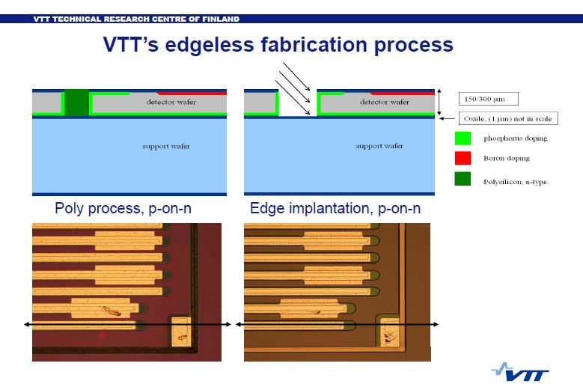
Toward No edge pixel ?
Edgless structures

Slide 32
Radiation hardness and field boundary conditions investigation
Edgeless detectors have been produced
But
Extensive test and validation needed
Operational stability
Radiation Hardness
Temperature effects
3d Simulations using Synopsys for defect generation
Two main models to consider:
  impact ionization
  trap-to-band tunneling
Simulation Calibration using irradiated detectors
Charge collection efficiancy is expected to drop, bias voltage needs to be increased

Slide 33
Detector Characterization – Experimental Studies
Clean room with two experimental stations (20 m²)
  Probe station for I-V and C-V characterization
  Laser System coupled with translocation table for mapping, tuning, charge sharing and threshold studies
Ability for testing irradiated detectors in vacuum chamber
Acquisition of new automated probe testing platform for detector characterization
Dopants profile measurements for simulation calibration with :
  Secondary ions spectroscopy
  Spreading resistance method
  Conductive atomic force microscopy (under development)

Slide 34
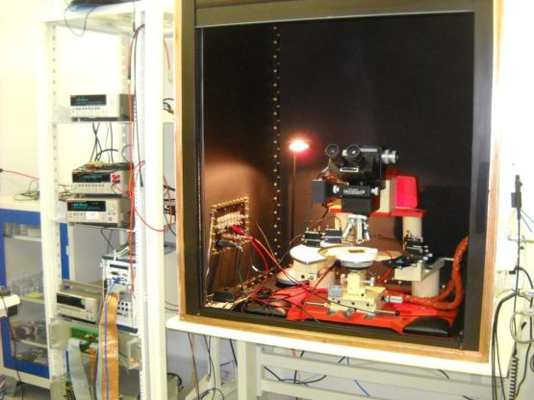
Experimental station 1
Optical microscope with electrical probes
Redesigned thermal chuck for low temperature testing
Humidity evacuation system
Semi-automatic testing
  Manual probing
  Automated data-taking
Drawbacks
Cannot test large surface structures
No possibility to establish a response map
Temperature limitations, can not over-cool

Slide 35
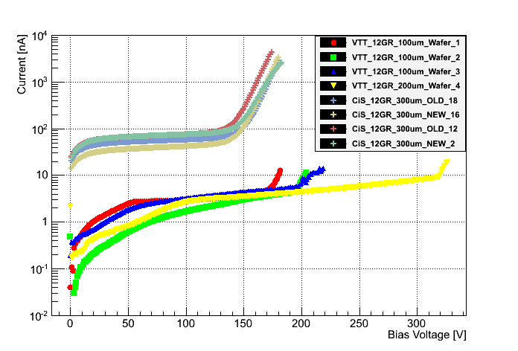
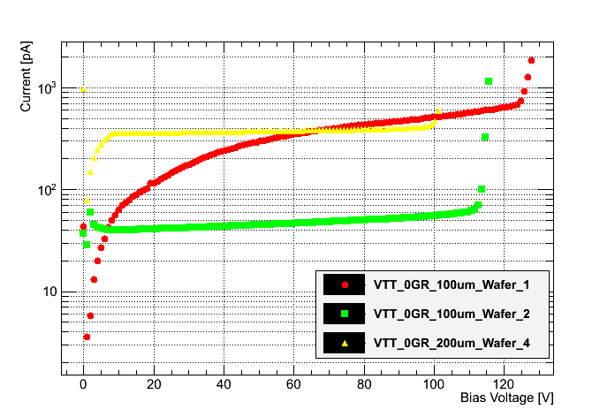
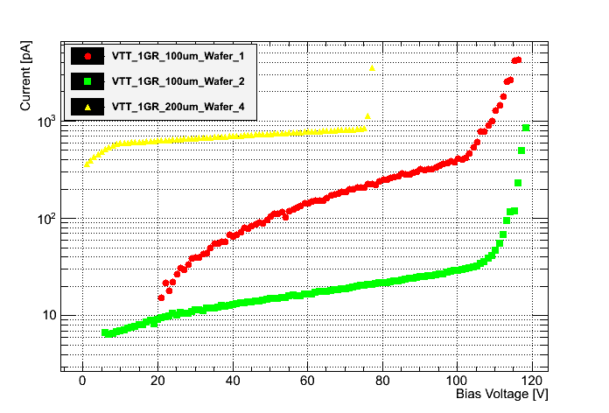
Experimental station 1
VTT vs CiS IV for 12 GR
(Cis 300μm, VTT 100-200μm )
VTT edgeless IV (100-200μm)
VTT 1 GR IV (100-200μm)
Break down voltage for VTT Detectors

Slide 36
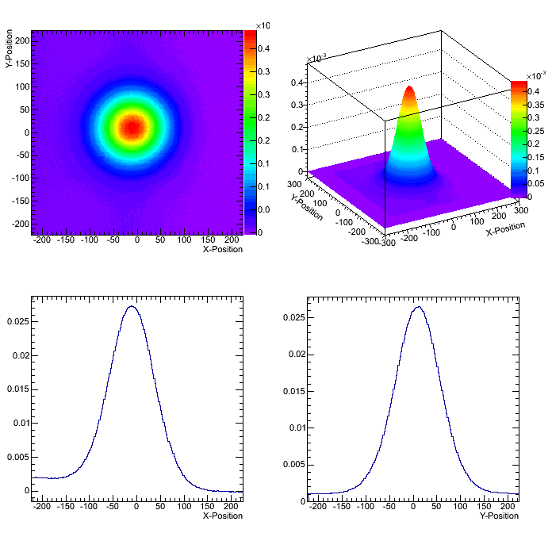
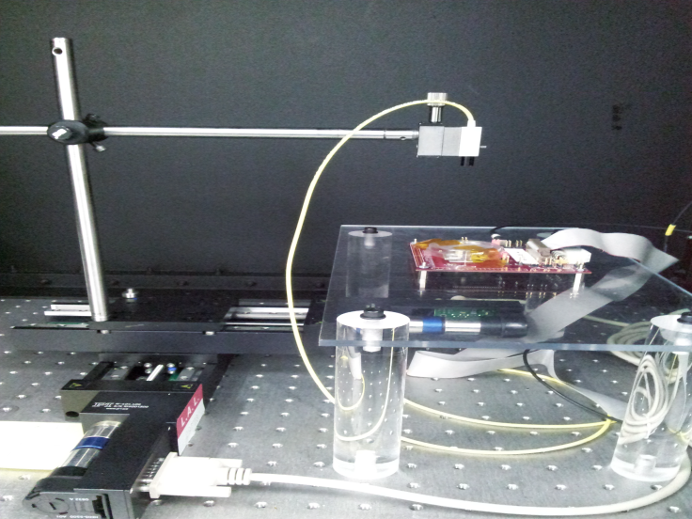
Laser Testing Station
1060 nm laser diode corresponding to 800μm trajectory in silicon)
X—Y translation table with 5μm stepping
USB pix test board
Gaussian unfocalized pulsed laser beam (1-3 kHz)
Fully automated set-up
Beam Shape
Active area threshold mapping
Charge sharing mapping
• Studies before & after irradiation
• Comparison between Beta source & LASER results
For VTT Edgeless sensors studies can be carried out after being interconnected to the 3d integrated readout electronics

Slide 37
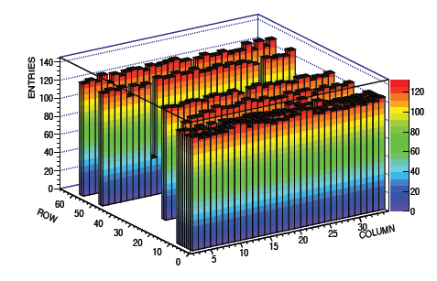
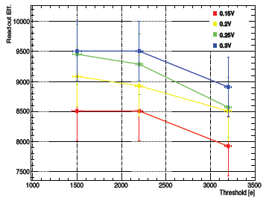
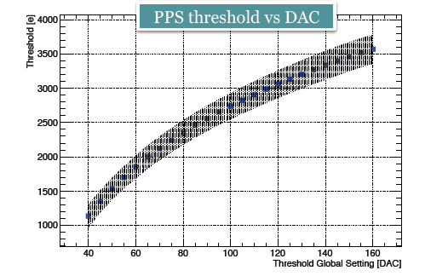
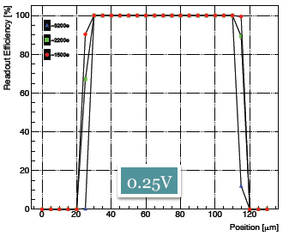
Laser Testing Station
TOP: Threshold vs events count
Bottom: One pixel pulse resolution
PPS pixel Mapping
ACD Threshold Tuning

Slide 38
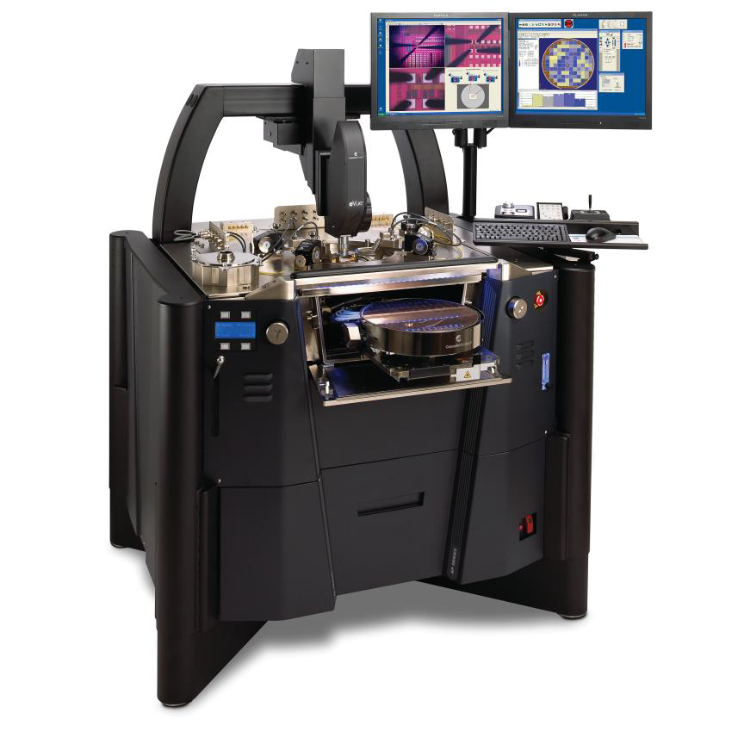
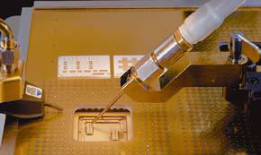
The Captinnov platform
Main Characteristics:
Large mobile sample carrier (300 mm) with full wafer capability
Hermitic measurement chamber enclosed in a dark faraday cage
Optical microscope with camera
Precise positioning and pressure (reduced risk of damage to thee device)
Capabilities and features:
Totally automatic measuring procedure
Complete system with integrated software-hardware
Extended temperature rage (-60C to 300C)
Large surface testing and mapping

Slide 39
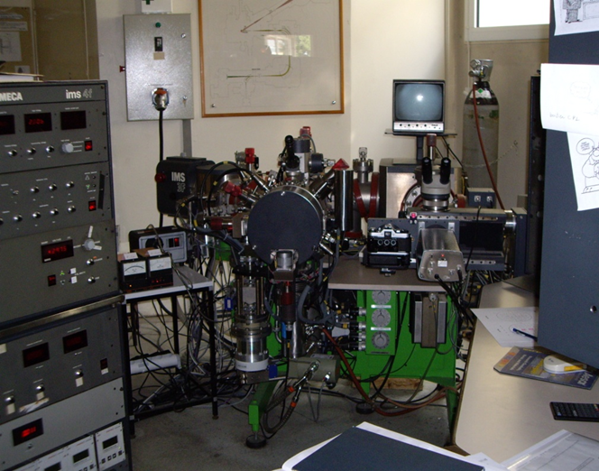

Dopants profiles - SiMS
  Analytical technique to characterize the impurities in the surface and near surface (~30μm) region
  Relies on sputtering of a primary energetic ion beam (0.5-20 keV) on sample surface and analysis of produced ionized secondary particles by mass spectrometry
  Good detection sensitivity for many elements: it can detect dopant densities as low as 10¹⁴ cm⁻³
  Allows multielement detection, has a depth resolution of 1 to 5 nm and can give a lateral surface characterization on a scale of several microns
  Destructive method, since the act of the removing material by sputtering leaves a crater in a sample
  It determines the total dopant density profile
Easily accessible
SIMS system @ CNRS-Meudon (Cameca IMS 4F)

Slide 40


Dopants profiles – SRP
Analytical technique to characterize the majority carrier and active dopant concentration profiles in semiconductor structures
Procedure
Pair of specially conditioned point contact probes which are stepped across the bevel surface of the semiconductor sample
Resistance between two probes is measured at each step
Resulting data computer processed into detailed carrier concentration and resistivity profiles from which dopant concentration profiles can be deduced
Costly Technic carried out by Evans Analytical Group
No full control of used parameters
Development of in-house alternatives
Pros: Very high dynamic range (10¹² – 10²¹ cm⁻³)
Capable of profiling very shallow junctions (nm regime)
Conns: Destructive method

Slide 41


Dopants profiles
n⁺/n
p⁺/n
N+ implant characteristics
  SIMS peak conc. N_{n} ~ 1x10¹⁹ cm⁻³
SRP peak conc. N_{n} ~ 8x10¹⁸ cm⁻³
P+ implant characteristics
  SIMS peak conc. N_{p} ~ 3x10¹⁹ cm⁻³
  SRP peak conc. N_{p} ~ 5x10¹⁸ cm⁻³
Measurements on n-on –n wafers
Good overall SiMS SRP agreement
Not all implanted dopant atoms are integrated in lattice positions, not all electrically active

Slide 42



Dopants profiles - Scanning Spreading Resistance Microscopy (SSRM)
Atomic Force Microscopy with conductive Tip operated in contact mode
Tip deflection measured by laser reflection and interferometry
Probing Van der Waals forces, dipole-dipole interactions, electrostatic forces and other long range effects probed (order of 100 to 200 nm)
Current injection throng tip, measured from the conductive substrate
Data processing computer establishes a detailed x-y cartography
High special accuracy
Destructive method
Combines dopant and electrical profiling
Under Development

Slide 43

Preparing the Future
3D integration Challenge

Slide 44




What is 3D Integration ?
It’s the way to achieve an electronic system or a component by using the third dimension (Z) instead of only the two first dimensions (X & Y)
3D Integration key drivers :
  Form factor decrease
    Miniaturization of final device (X,Y,Z)
  Performances improvement
    Decrease R, C, signal delay
    Increase device bandwidth
    Decrease power consumption
  Cost decrease
    Si surface decrease
    Hetergenous dedicated layers
Source : A. Jouve / Brewer Science / 3D IC 2009
EVG 520 bonder
Wafer bonded with temp. glue

Slide 45


3D Integration of silicon sensors and FE electronics
3D integration and TSVs
Motivation in industry
Motivation for pixel detectors in HEP
Our R&D project : OMEGAPIX
(130 nm CMOS IBM : Tezzaron-Chartered
(65 nm TSMC via CERN )
Si pixel sensor
BiCMOS analogue
CMOS digital

Slide 46




3D Electronic Project: A European-US Consortium
In late 2008 FERMILAB organized a consortium of 15 institutions to fabricate 3D integrated circuits
using the Tezzaron/Chartered process (Chicago).
– Chartered uses a via middle process to add vias to 130nm CMOS process
– Tezzaron performs 3D stacking using Cu-Cu thermo compression bonding
I- Fabrication of a Super Contact
6 um
III- Flip 2nd wafer on
top of second wafer Bond 2nd wafer to 1st wafer using Cu-Cu thermocompression bond
III- Thin 2nd wafer to about 12um to expose super via
- Add metallization
to back of 2nd wafer for bump or wire bond
II- Complete BEOL process

Slide 47




How the Front end electronics will look likes
Top Die
C2C Cu Pillars
Silicon Interposer
Thinned wafer (120 µm)
Substrate
Chip to substrate copper pillars
TSV
AR 2, 60x120µm
Visite au LETI AVRIL 20/04/2012
CEA-LETI

Slide 48
Via Last AIDA project: LAL + LPNHE
Bump bonding
TSVs module
back side
front side
front end chip (65 nm)
100 μm
First proposal
Bonding …
150 μm or less
sensor
HV
100 μm
front side
back side
front end chip (65 nm)
TSV
Interconnexions
150 μm or less
sensor
second proposal
HV

Slide 49
CONCLUSIONS
LAL Orsay Pixel Group is involved in many aspect of ATLAS upgrade activities
  Has contributed to improve actual pixel design
  Contribute to the validation of the IBL project
  Prepare the future phase of ATLAS High Luminosity in pushing further
    The innovation in planar pixel sensor itself
    3D simulation, Clean Room Characterizations, integration of sensors to electronics, Laser Test setp-Up
    Readout-Electronics in 3D and in 65 nm Technology
    Contributors : N. Dinu Research Engineeer
    Ahmed Bassalat PhD Student (IBL at CERN)
    Aboud Fallou, Mechanical Engineer (IBL at CERN)
    Evangelos Gkoukousis (Phd Student)
    Francois Vagnucci, Technician, Mechanics
    Omega Pole of Microelectronics
    Who Contributed and left : M. Benoit, Phd (now at CERN)
    John Idarraga (Postdoc, Now at CERN)
    Vladimir Linhard (Postdoc, Now in Prague, Czech)

Slide 50
Backups

Slide 51




Dopants profiles - Scanning Spreading Resistance Microscopy (SSRM)
Wafer dicing with precise equipment (possible sample sizes comparable to pixel dimensions)
3 stage polishing (bevel polishing, abrasive polishing, diamond liquid and colloidal liquid polishing)
Mechanical profiling (order of surface structure 100μm )
Metallization on bottom surface
Atomic force microscopy
Close electric field measurement
Under Development
Mechanical profile
Electrical profile measurements
Sample 1 (diced) R= 7,9.10⁵Ω
Sample 2 (undiced) R= 1,26.10⁸Ω
Sample 3 (diced) R= 3,1.10⁸Ω

Slide 52
VTT Detectors Characteristics
Active Area: 4800 x 3360 μm²
Array: 96 x 24 (ϕ,z)
Pixel Size : 35 x 200 μm²
Thickness: 100 & 200 μm

Slide 53
SiMS Details
Phosphorus detection
  Primary ion beam
    Electropositive Cs⁺ ions
    Beam extraction energy : 10 kV
    Beam impact energy on sample : 14.5kV
    Incident angle: 27°
  Sample accelerating potential
    - 4500 V
  Detection mode
    Electronegative ions (P, Sb, As, in Si)
Boron detection
  Primary ion beam
    Electronegative O₂⁺ ions
    Beam extraction energy : 10 kV
    Beam impact energy on sample: 5.5kV
    Incident angle: 46°
  Sample accelerating potential
    + 4500 V
  Detection mode
    Electropositive ions (B, Al in Si)

Slide 54
SiMS Setup Description
Primary ion source (1&2)
  Duoplasmatron (e.g. O₂⁺, O⁻)
  Surface ionization source (e.g. Cs⁺)
Primary ion column
  Mass filters that transmits only ions with a specified m/z ratio
  Electrostatic lenses and apertures control the intensity and width of the primary beam
Secondary ion extraction and transfer (3&4)
  Mass spectrometer components @ ground
  Sample @ high voltage (accelerating. potential)
Ion energy analyzer (5)
  Electrostatic energy analyzer bend lower energy ions more strongly than higher energy ions
Mass analyzer (6)
  Magnetic or quadrupole
Secondary ion detectors (7&8)
  Ion counting electron multiplier
  Faraday cup
  Two ion image detectors

Slide 55




Scannong Spreading Microscopy Samples
Two uniformly doped wafers in surface and volume
Two wafers with implant zones
type n+
d = 2’’
e = 260µm
c = 2.10¹⁹ cm⁻³
< 1 0 0 >
type n+
d = 4’’
e = 500µm
c = 2.10¹⁹ cm⁻³
< 1 0 0 >
type p
d = 6’’
e = 790µm
c = 10¹² cm⁻³
< 1 0 0 >
type n
d = 4’’
e = 380µm
c = 10¹² cm⁻³
< 1 1 1 >
Samples
Detectors

Slide 56


Sample Discription
Sample 1 :
Sample 2 :
Sample 3:
Sample 4 :
260 µm
∼
6mm
6mm
500 µm
∼
6mm
6mm
P+ (600nm)
c= 10¹⁷cm⁻³
790 µm
∼
10¹² cm⁻³
6mm
7 mm
N+ (1µm)
c= 10¹⁹cm⁻³
P+ (500nm)
c= 10¹⁷cm⁻³
P+ (300nm)
c= 10¹⁷cm⁻³
380µm
N+
2-P+
1-P+
∼
10¹² cm⁻
6mm
6mm

Slide 57

Upgrade phases
To cope with luminosity upgrade :
Insertion of an additional layer between new beam pipe and present innermost layer
Radius : ~3.5 mm (area 0.2 m²)
Energy $\sqrt{s}=13−14 TeV, bunch spacing 25 ns$
Expected fluence: L= 3-4 10¹⁵ neq/cm² (for 1000 fb⁻¹)
65 nm Technology readout chip : FEI4
LHC Phase 1 : Energy $\sqrt{s}=14 TeV, bunch spacing 25 ns$, fluence: L= 1 10³⁴ cm⁻² s⁻¹
to 2018 : Injector and LHC Phase 1 upgrade to full luminosity
LHC Phase 2) luminosity upgrade 2-3 x10 ³⁴ cm⁻² s⁻¹
Year 2022 : HL-LHC Accelerator upgrade and full new silicon tracker
Expected integrated fluence ~ 1x10¹⁶ neq/cm², fluence:L= 3-4 10¹⁵ neq/cm² (for 1000 fb⁻¹)

Slide 58
ATLAS planned upgrades
Element | Phase 0&1 (now through LS2) | Phase2 (after LS2)
Tracking | 4th barrel pixel layer (IBL), new pixels services (nSQP), New evaporative cooling plant, CO2 cooling plant for IBL, FTK level 1+ tracking. New tracking detector at 220 m (AFP) | Major revision, new Inner Detector, including possible LVL1 trigger capability + all new services
Calorimetry | Change all power suppliers, New LVL1 trigger electronics LAr. Additional better trigger capability for muons in the Hadron Tiles calorimeter. | New Front and back-end electronics, including trigger. New Forward calorimeter if proven necessary. Fix LAr hadronic cold electronics if necessary.
Muon System | Install EE-chambers staged. Add additional chambers in key positions inside the barrel. Sharpen LVL1 muon trigger. New muon small wheels. | Increase trigger capability in the big wheels, add additional trigger inner layers in the barrel. New front-end electronics
Trigger/DAQ | New LVL1 trigger processors which make use of better detector granularity. Add a trigger level (FTK) between LVL1 and LVL2. | Major revision
Common systems | New forward pipes in Aluminum, new small radius Be beam pipe. More neutron shielding in the forward region and in between caverns. UPS extension. Consolidate cryogenics. | New TAS and forward shielding. Major infrastructure consolidation, including safety systems

Slide 59

Upgrade sequences
LHC startup, = 900 GeV
4x
, bunch spacing 50 ns
=7~8 TeV, L=6x10³³ cm⁻² s⁻¹, bunch spacing 50 ns
~20-25 fb⁻¹
Go to design energy, nominal luminosity
=13~14 TeV, L~1x10³⁴ cm⁻² s⁻¹, bunch spacing 25 ns
, bunch spacing 25 ns
~75-100 fb⁻¹
Injector and LHC Phase-1 upgrade to full design luminosity
=14 TeV, L~2x10³⁴ cm⁻² s⁻¹, bunch spacing 25 ns
, bunch spacing 25 ns
~350 fb⁻¹
HL-LHC Phase-2 upgrade, IR, crab cavities?
?, IR
=14 TeV, L=5x10³⁴ cm⁻² s⁻¹, luminosity levelling

