Slide 1
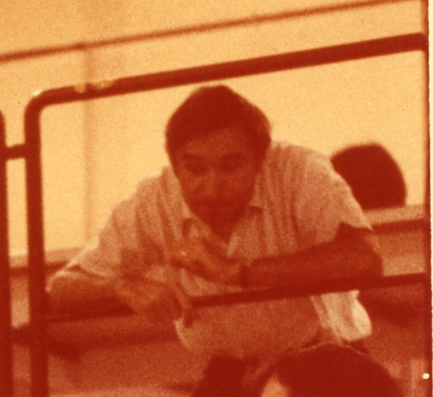
CELLO
CELLO (Spokesman Jacques Hassinski, 1983-1986)
Wim de Boer

Slide 2
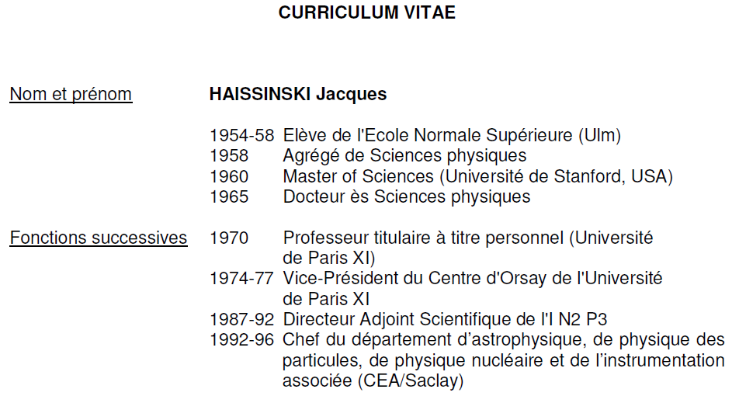

Slide 3
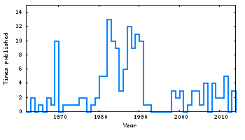
Publications of Jacques Haissinski versus time
CELLO
TIME

Slide 4
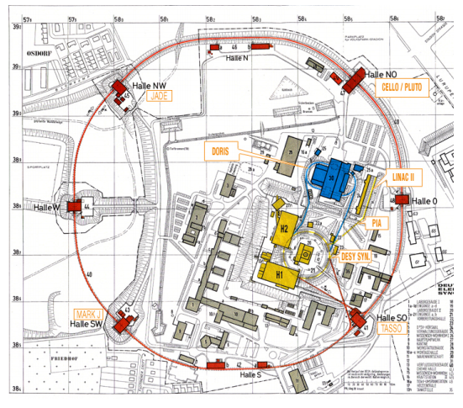
PETRA: e+e- collider with 14-45 GeV Ecms
Design 1974 as
successor of DORIS
2.3 km ring max.
After November
Revolution in 1974
high speed construction:
Ready in 1978.
Lumi. 4.10³¹cm⁻¹s⁻¹
Mini-beta scheme:
compensating
solenoids CELLO,
TASSO,JADE
(each half the
field of CELLO,
L3 no solenoid)
Notes:
Berlin airport construction since 2006.

Slide 5
PETRA Collaborations of 60-90 physicists
(considered very large)
Data taking in 1979. Discovery of gluon Aug. 1979
(not mentioned in proposal at all, but predicted by
J. Ellis, M.K. Gaillard, G.G. Ross, NPB 111, 253 (1976))
Announced at the Lepton/Photon Symposium held at Fermilab
in August 1979. Press: new particle discovered at Fermilab.
Hoped for discovery of top, scanning at highest energy
in steps of 0.03 GeV
Notes:
Absence of italian, word gluon not mentioned in PETRA proposal, but proposed by ellis,

Slide 6
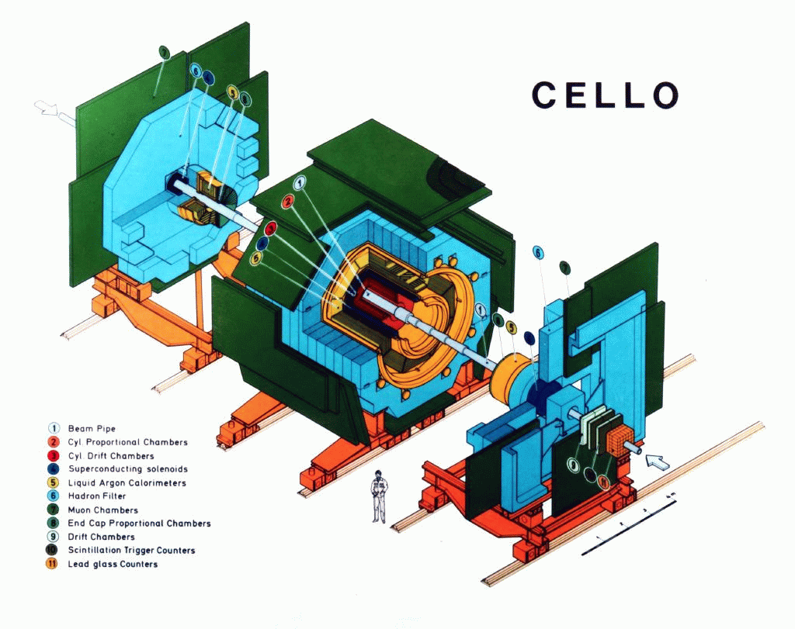
Characteristics:
Thin Wall single layer SC magnet (1.3 T, 0.5 X₀) Desportes, Le Bars, Mayaux
Tracking with proportional
chambers and drift chambers
Liquid Argon calorimeter

Slide 7
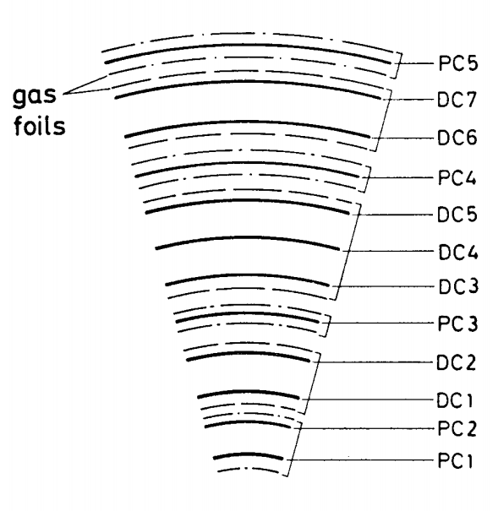
The CELLO Tracker
PC: z-coor.,
fast track trigger
DC: good momentum
resolution

Slide 8
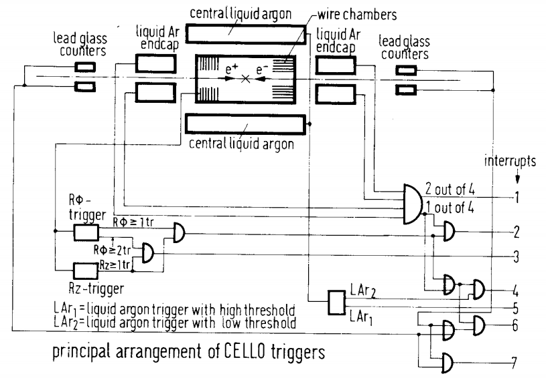
CELLO Trigger Scheme

Slide 9
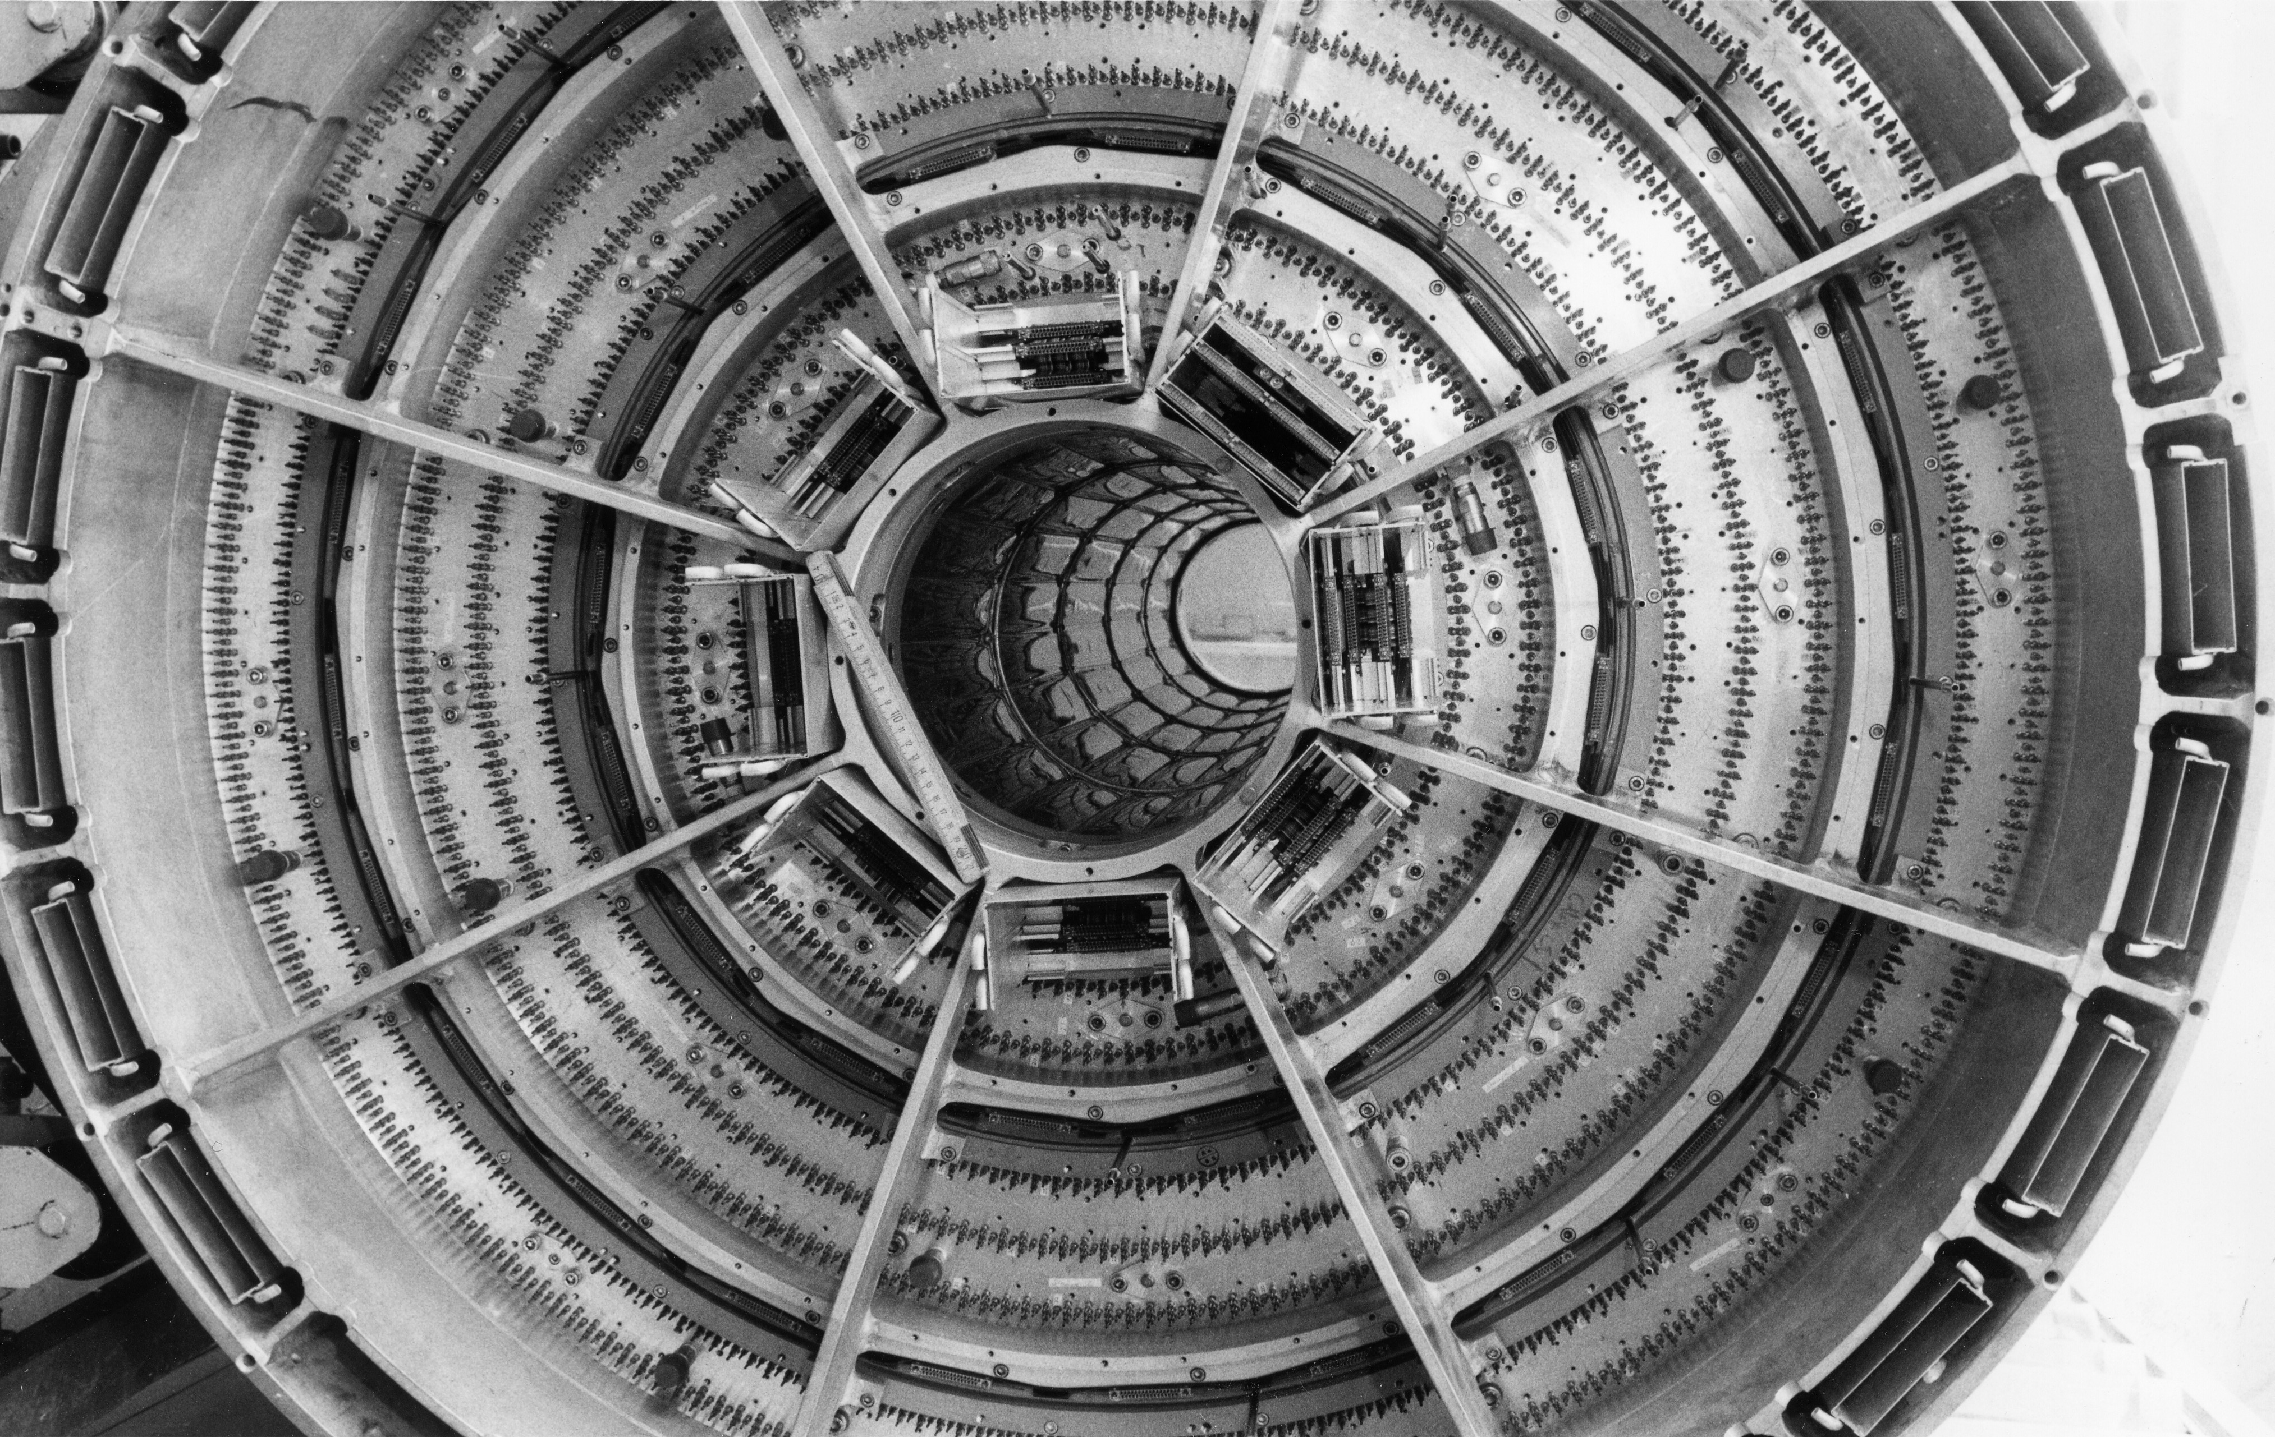
CELLO Central Tracker mounted

Slide 10
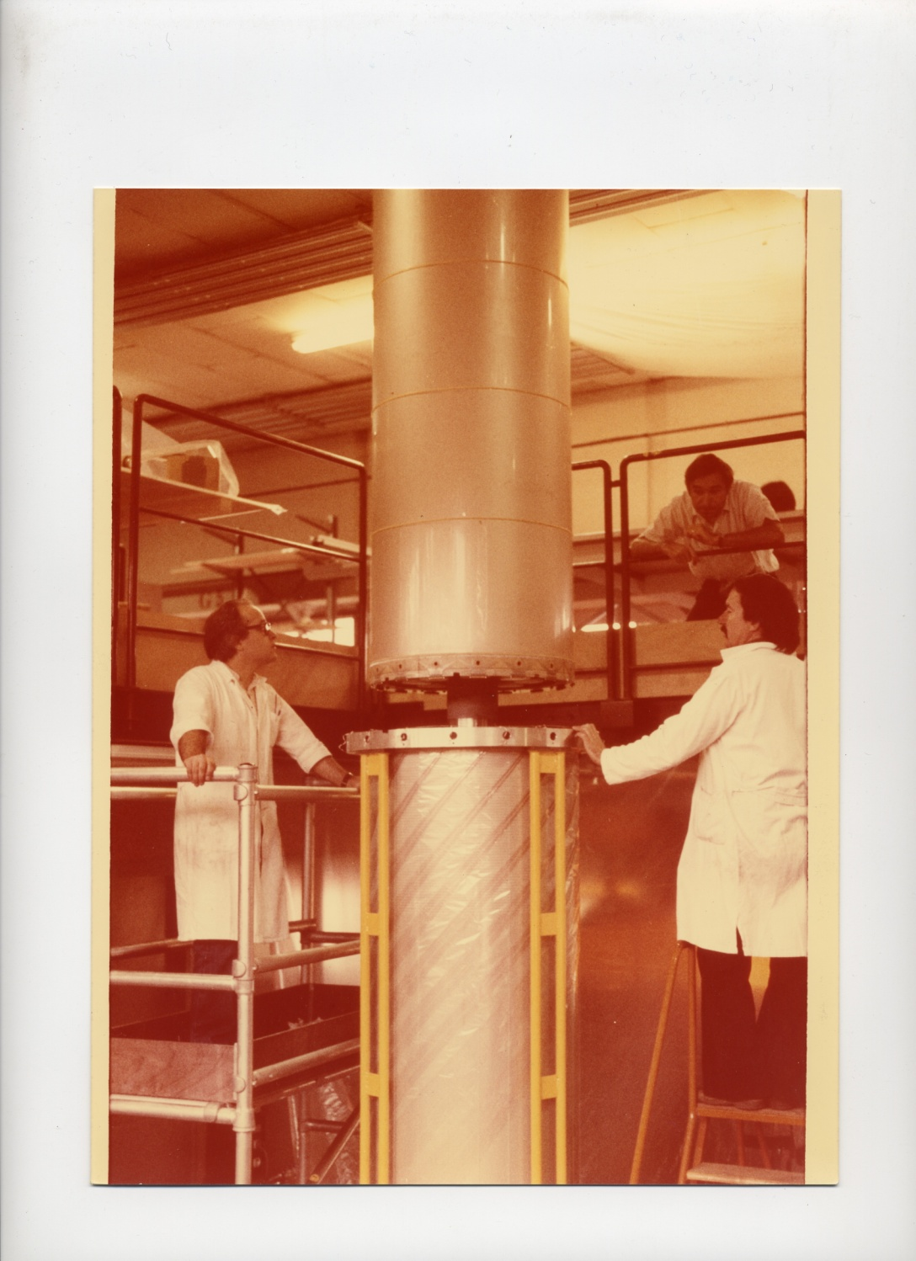
Mounting the prop. chambers at Orsay

Slide 11
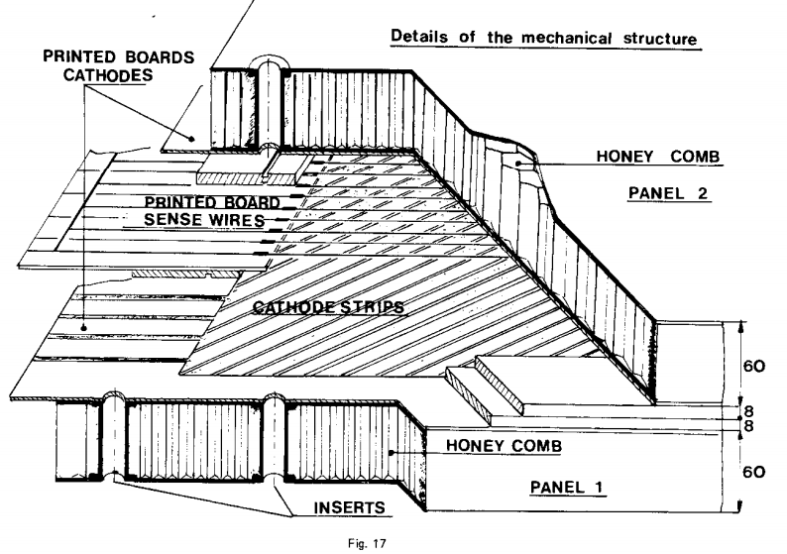
Orsay prop. chamber

Slide 12
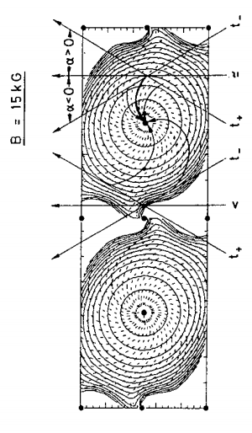
CELLO Drift Chamber Cell

Slide 13
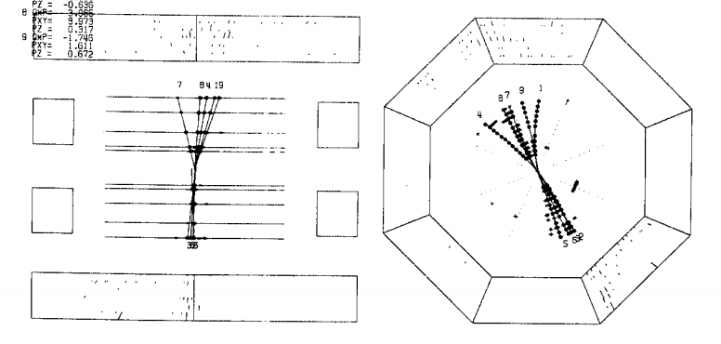
CELLO Event Display

Slide 14
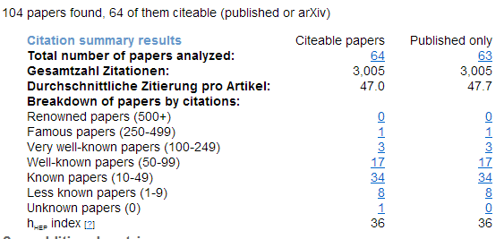
CELLO Publications

Slide 15
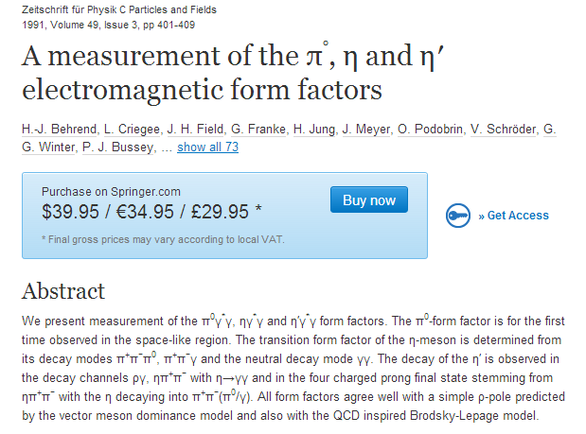
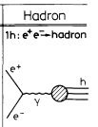
350 citations

Slide 16
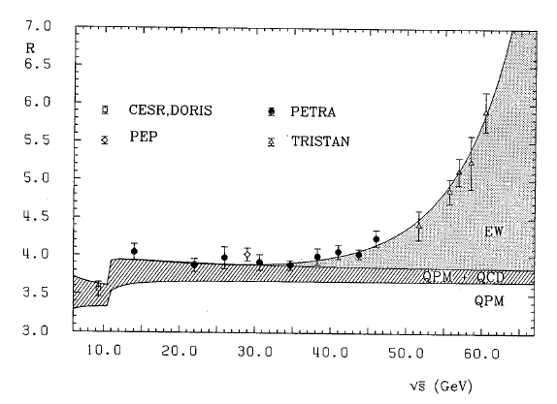
Z-resonance before LEP precision data
CELLO Coll., PLB 183(1987) 400
EW fit values from e+e-
M_{Z}=89.4±1.3 GeV, sin²θ_{W}=0.220±0.0023, α_{s} (M_{Z})=0.125±0.015

Slide 17
WHY α_{S} IMPORTANT FOR
Cosmology?

Slide 18
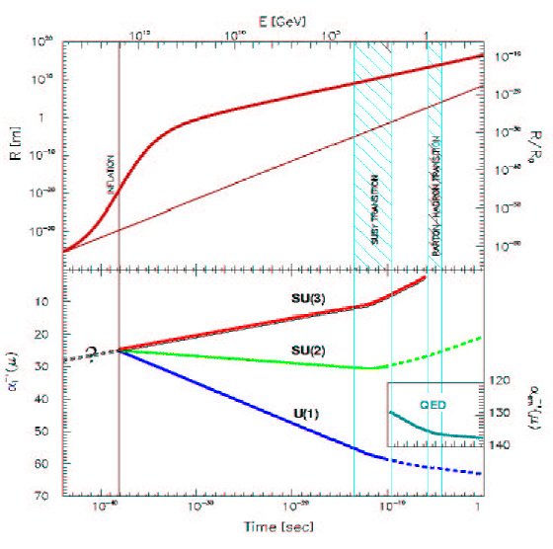
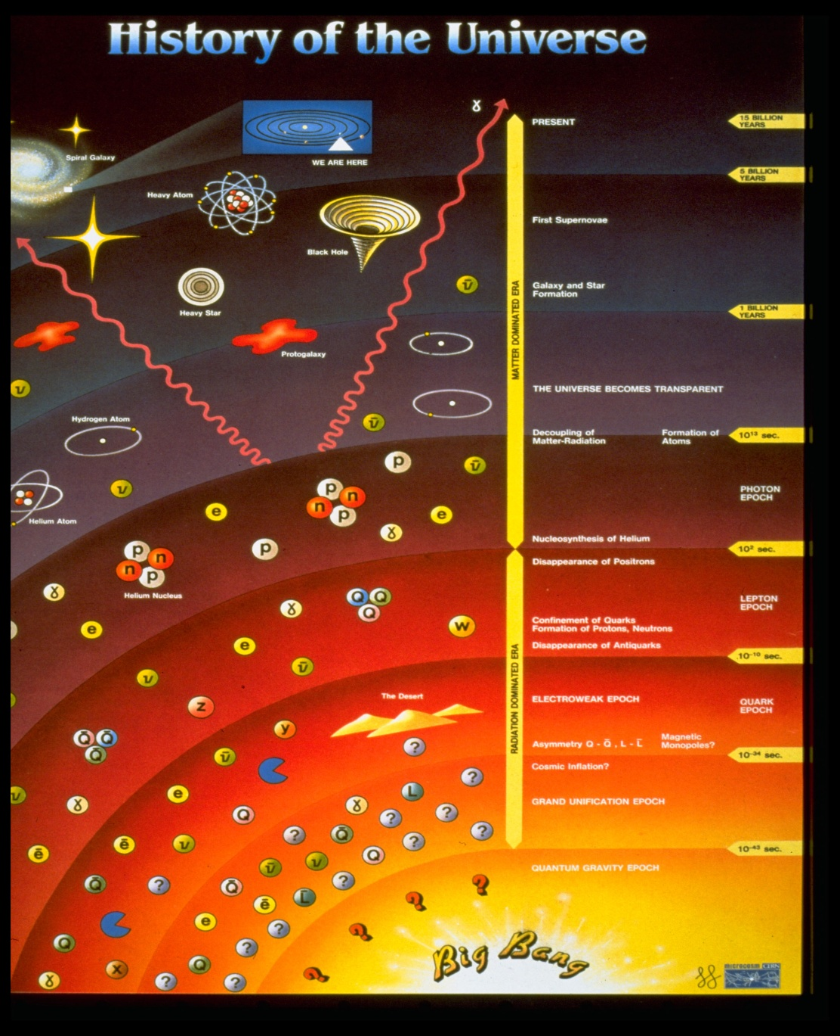
Time evolution of Universe

Slide 19
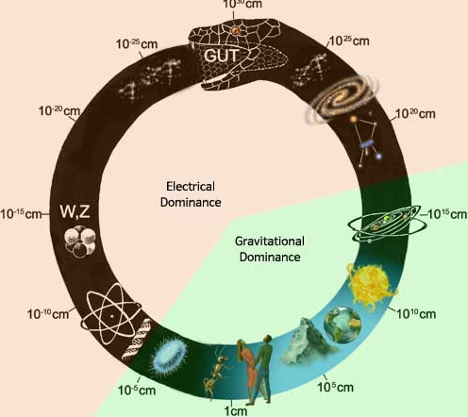
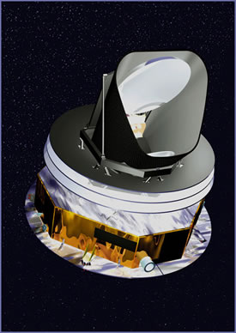
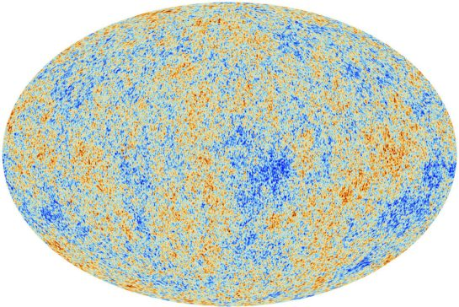
The ouroborus
http://emergent-culture.com
Notes:
The ouroborus or snake eating its tail is an ancient symbol of cyclical process. A cycle juncture is where the head meets the tail. This model places attractive forces and scale in relation to the ouroboric symbol. The smallest and largest scales meet at the cycle juncture. -

Slide 20
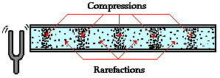
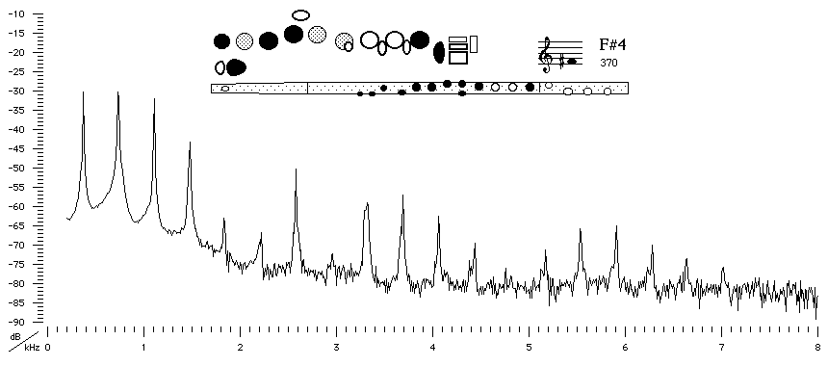
Acoustic waves ARE density fluctuations
Modern Flute

Slide 21
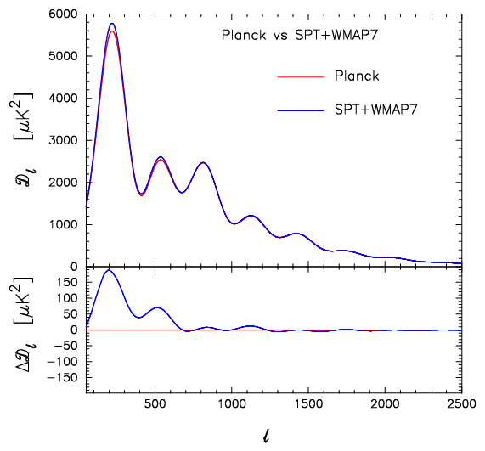
Sound of Big Bang after 380.000 years (transposed by 50 octaves)
@Mark Whittle
A
220 Hz
Frequency (in Hz)

