Slide 1
INFN-LNF
future programs
Andrea Ghigo

Slide 2
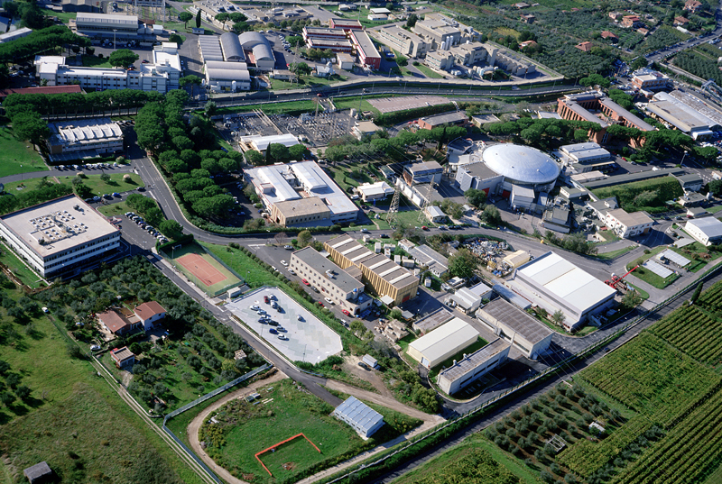

INFN Frascati National Labs (LNF)

Slide 3
Accelerator Division Main Projects
DAΦNE
SPARC-LAB
SuperB proposal
IRIDE proposal
ELI-NP (Romania) / STAR (Cosenza)
Collaborations: LC/CLIC, HL-LHC, TLEP
FP7 European projects
  FEL
  Plasma acceleration
  Thomson Scattering
  FLAME
  TeraHertz

Slide 4
LNF
DAFNE-light
DAFNE
LINAC
BTF
The DAΦNE Φ-Factory complex

Slide 5
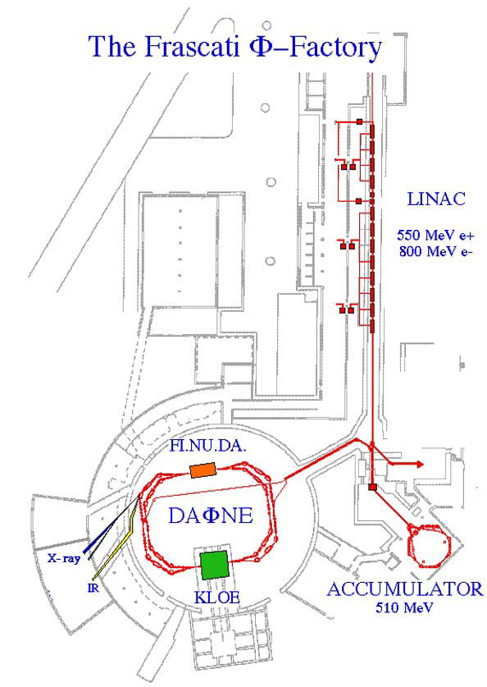
DAΦNE
The Φ-Factory complex
Abundant production of Φ particles coming from the annihilation of electrons and positrons at the energy of the Φ- resonance.
Synchrotron
Radiation Lines
BTF
UV 2 - 10 eV
X-ray 900 - 3000 eV
KLOE Experiment
IR 1.24 meV - 1.24 eV

Slide 6
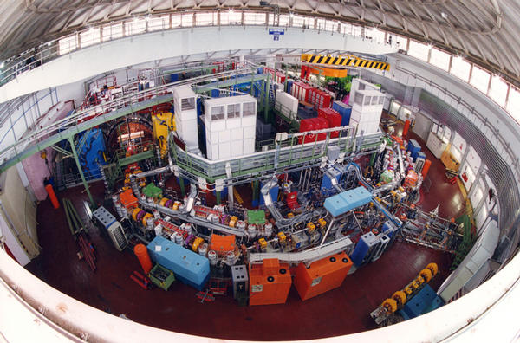
DAΦNE – LNF - FRASCATI
e+ e-
E = 0.51 GeV
L = 1.5 10³² cm⁻² sec⁻¹
BTML 2013 13/09/13 Orsay

Slide 7
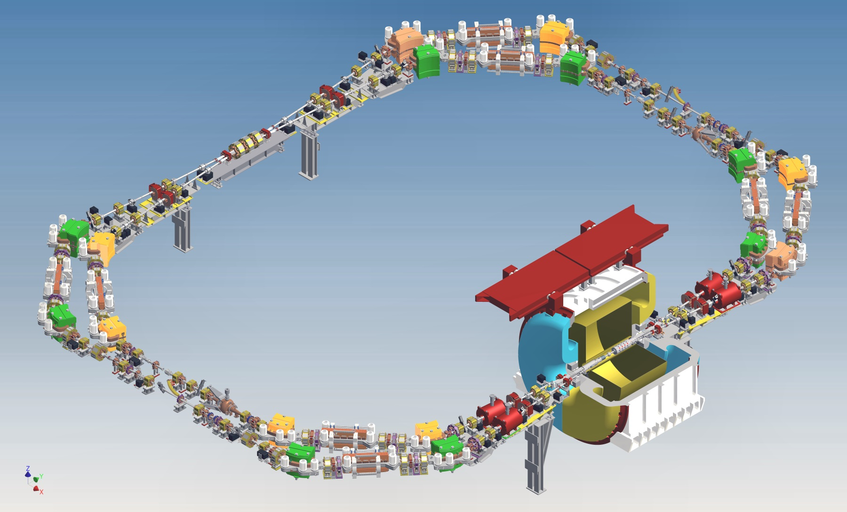
DAΦNE Rings Layout

Slide 8
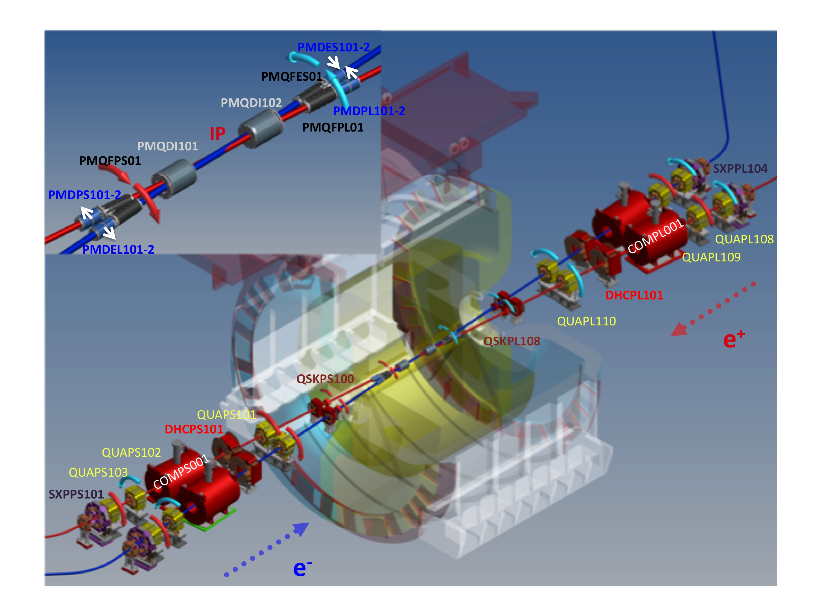
DAΦNE IR for the KLOE-2 run

Slide 9
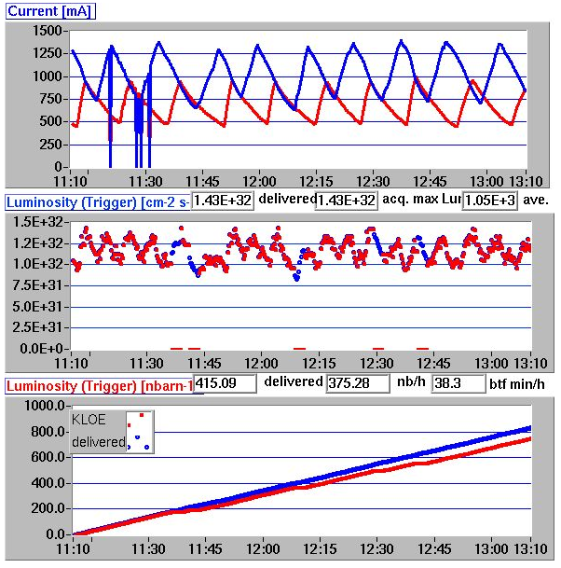
Integrated luminosity
L_{∫1 hour} = 0.415 pb⁻¹
L_{∫day} ≈ 10. pb⁻¹
KLOE is taking data
Acquired and delivered L are comparable
L_{∫1 hour} is the highest measured with KLOE-2
27/11/2012

Slide 10
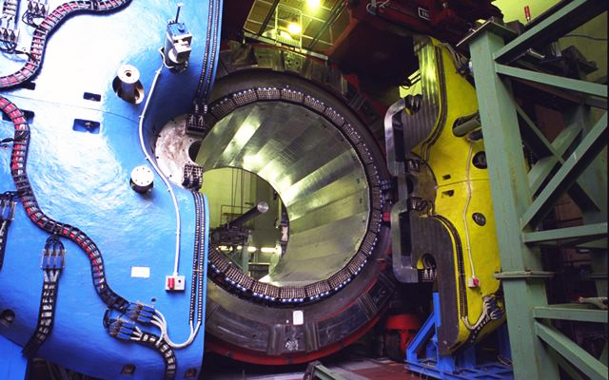
KLOE Experiment Detector: magnet and calorimeter

Slide 11
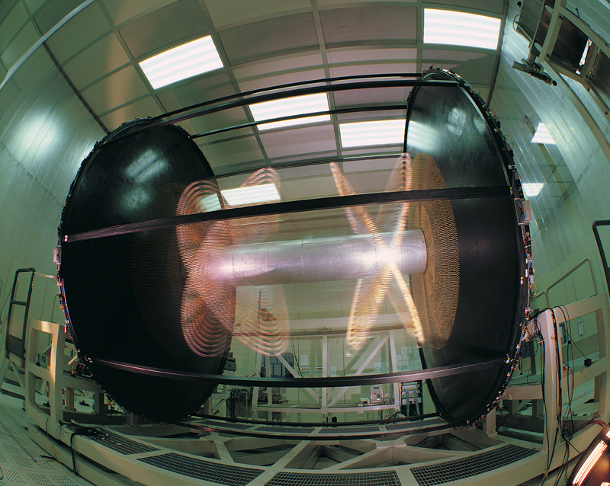
KLOE Experiment Detector: wire chamber

Slide 12
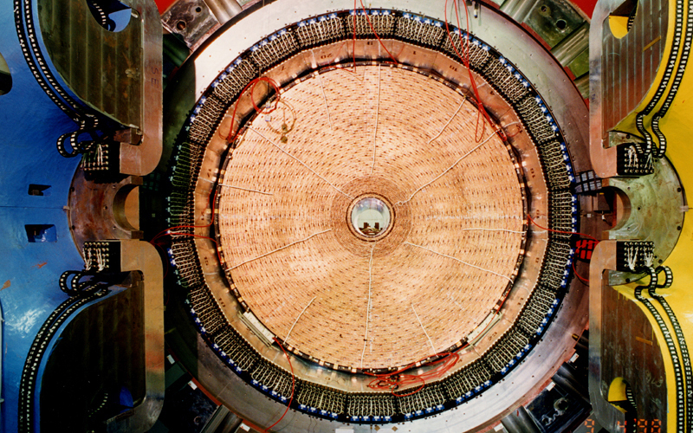
KLOE Experiment Detector

Slide 13
KLOE-2 Physics Program
“Natural” extension of the KLOE program in the field of flavour and hadronic physics, with some additions, such as γγ interactions, or searches for new light gauge bosons. EPJC 68, 619-681 (2010)
Studies on CPT and QM violation with neutral kaons interferometry
Tests of Lepton Flavor Violation with K_{e2} decays
Studies on C, P, CP violation using rare η and K_{S} decays
Tests of Chiral Perturbation Theory with η, η’ , and K_{S} decays
Searches for signals of a Secluded Gauge Symmetry
Most of them involve decay processes at or very close the
interaction point 
Charged vertex efficiency near the IP
Acceptance for photons emitted at low polar angles

Slide 14
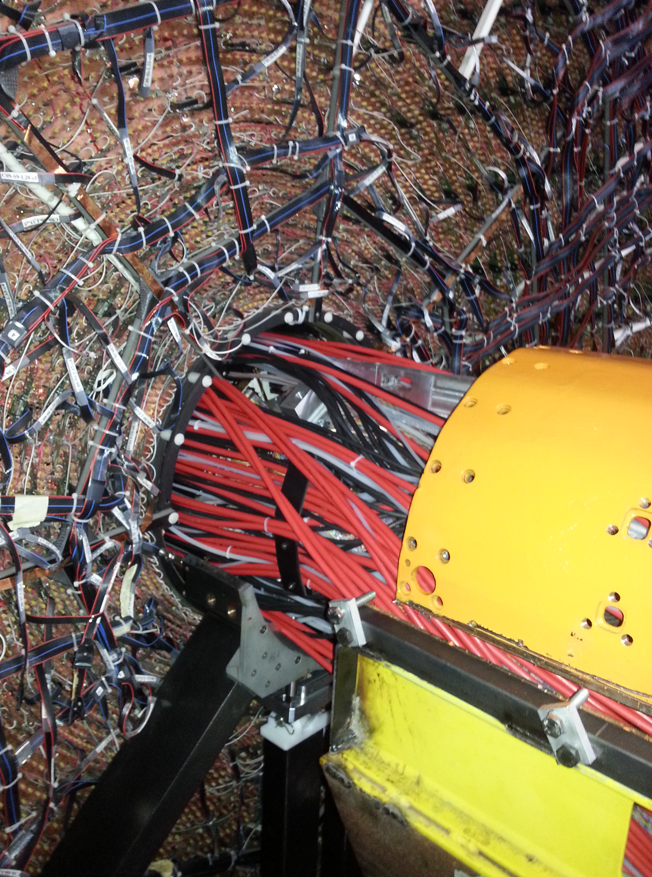
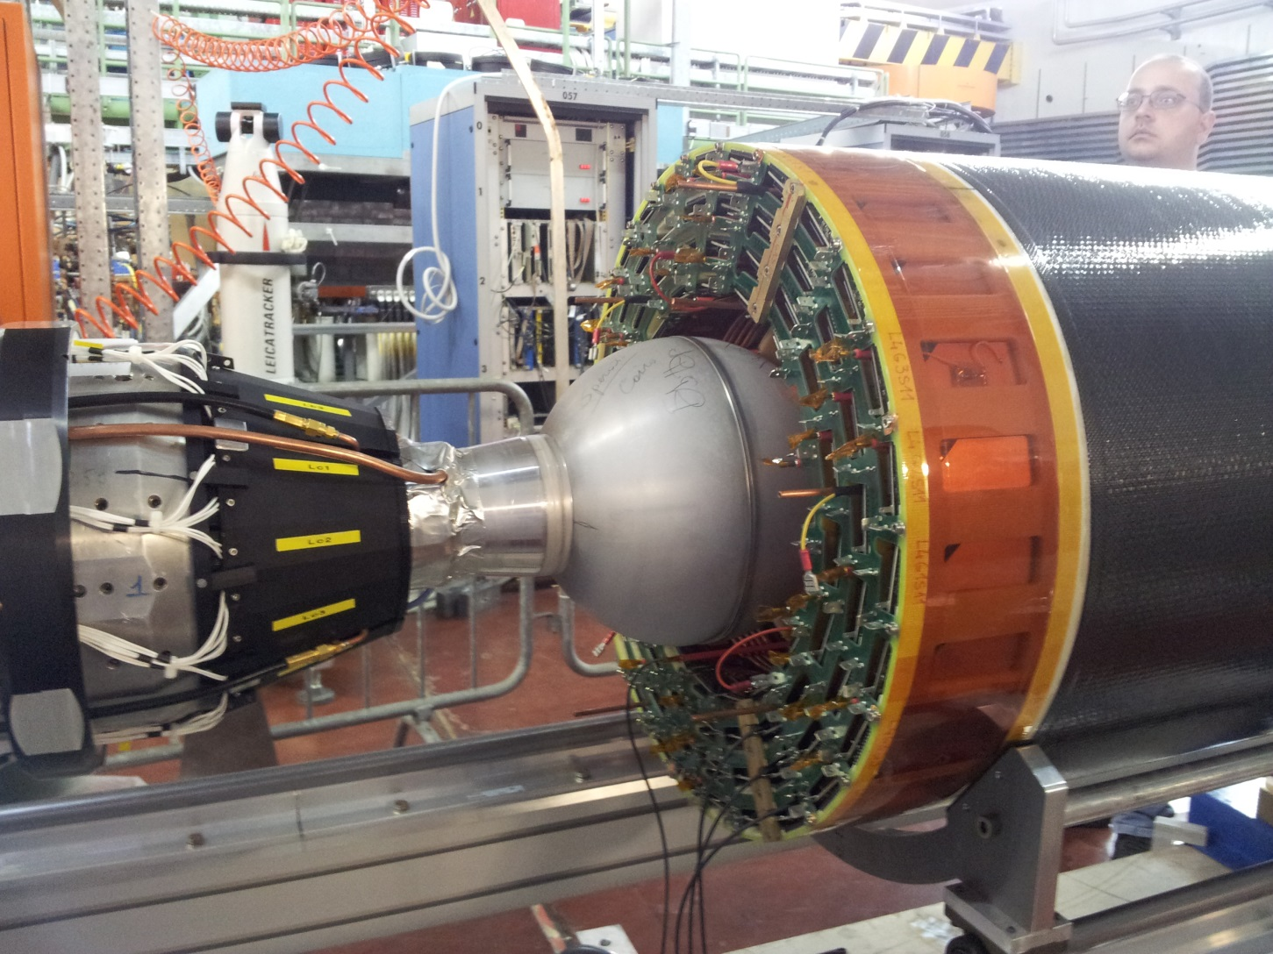
New KLOE vertex detector

Slide 15
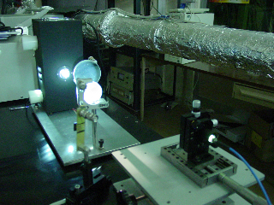
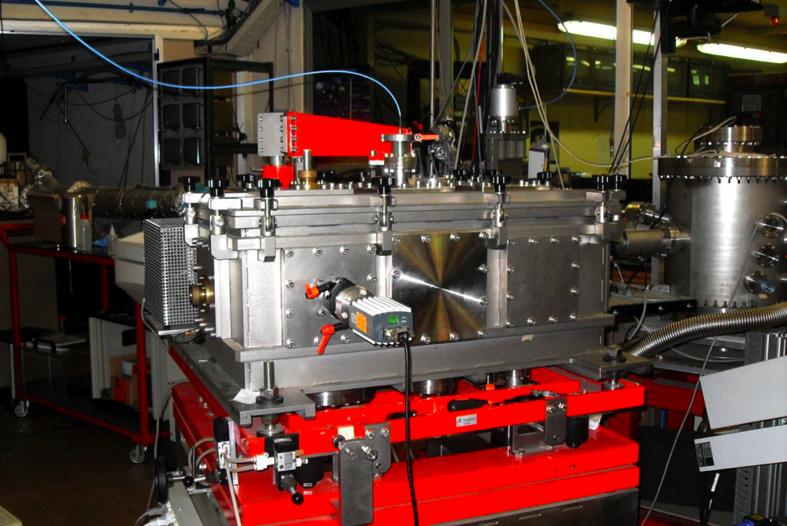
Activities at the DAΦNE-Light Beamlines
The IR ,the Soft X-ray and the UV-VIS beamlines are already open to users . Beamtime was given to Italian and EU users, in the framework of the INFN-Group V experiments, of collaborations with Italian Universities, of the Transnational Access to Research Infrastructures FP7 CALIPSO. program and of collaborations using F.A.I. (2013/2015).
A new proposal C.A.Li.P.S.O. has been accepted for the period 2013-2015
The two new XUV beamlines are both ready for commissioning.
IR synchrotron beamline
IR imaging detector and IR microscope
Clean room to support users biology experiment
UV synchrotron source
UV monochromator

Slide 16
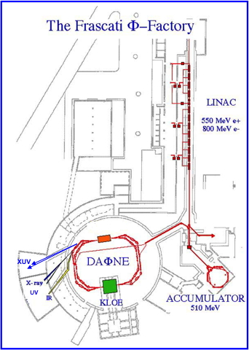
Beamlines @
DAΦNE-Light
SINBAD - IR beamline
DXR1 - Soft x-ray beamline
DXR2 - UV setup
Open to Italian and EU users
DXR2 - New VUV setup ready for experiments
2 new XUV beamlines
Low Energy Beamline (35-200 eV) High Energy Beamline (60-1000 eV) ready for experiments

Slide 17
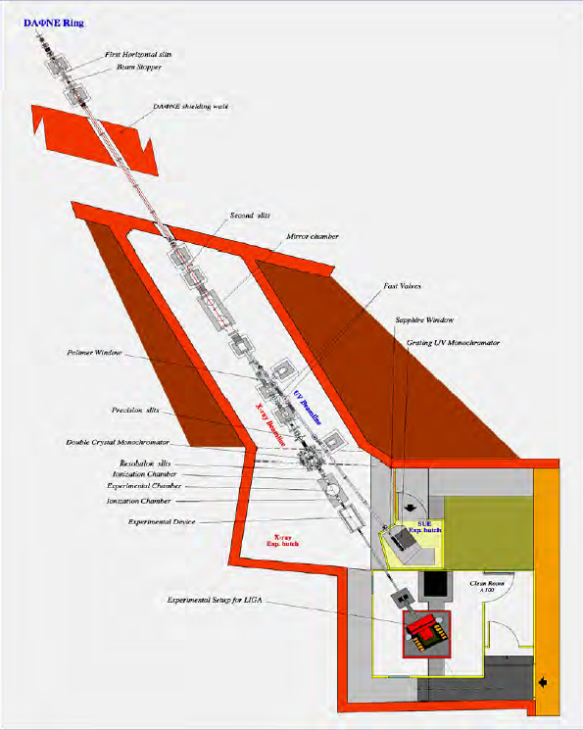
DXR1 Soft X-ray and VUV Beamlines
- Wiggler soft x-ray beam line
- Critical energy E_{c} = 284 eV
Working range 0.9 - 3.0 keV
- Soft X-ray absorption spectroscopy and tests of soft x-ray optics and detectors.
Wiggler UV branch line-deflection by a grazing incidence gold coated mirror (about 2°)
VUV-VIS beamline new setup 2 -10 eV (650nm - 120nm)
-Space applications
-Astrobiology and photo-biology
-Optical technology
-Detector technology
-Instrumentation testing and calibration
-Optical properties of materials
UV-VIS branch line
Soft X-ray beamline

Slide 18
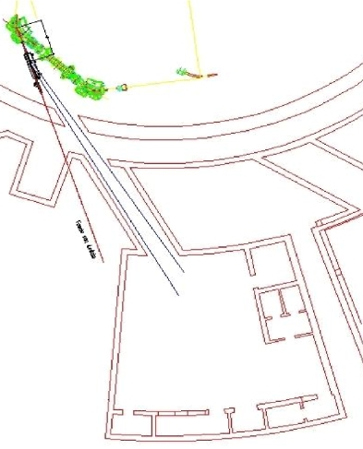
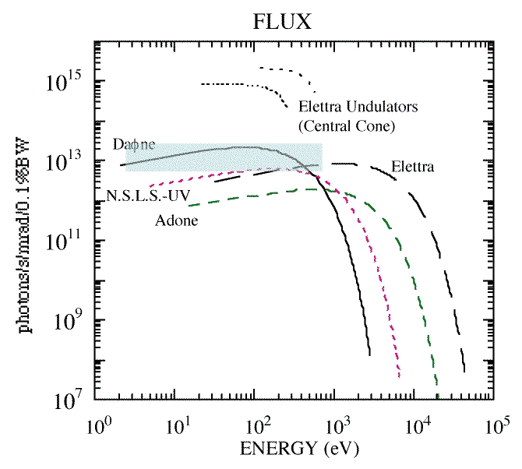
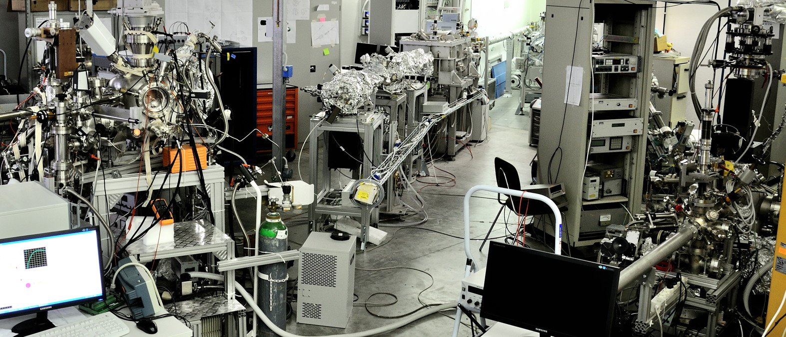
New XUV beamlines
Fields of interest:
Biology
Surface Science
Material Science
R&D studies of INFN interest
LEB (35-200 eV)
HEB (60-1000 eV)
IMCA-NTA INFN project: Innovative Materials and Coatings for Accelerators
R&D of new materials and thin films useful to minimise beam instabilities due to ‘e-cloud’.
Material science and tests of relevance for e-cloud studies in collaborations with CERN, DESY (PETRA 3), Brookhaven (RICH) etc.

Slide 19
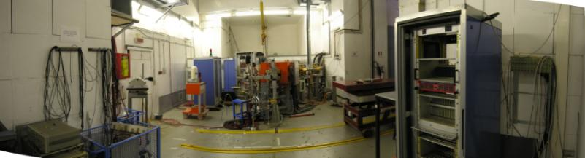
Beam Test Facility (BTF) Infrastructure
@DAFNE Linac
The Frascati Beam Test Facility infrastructure is a beam extraction line optimized to produce electrons, positrons, photons and neutrons mainly for HEP detector calibration purposes. The quality of the beam, energy and intensity is also of interest for experiments (~ 20% of the users) studying the electromagnetic interaction with matter

Slide 20
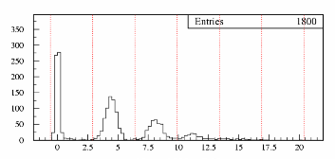
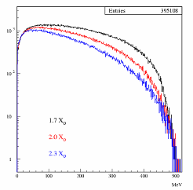
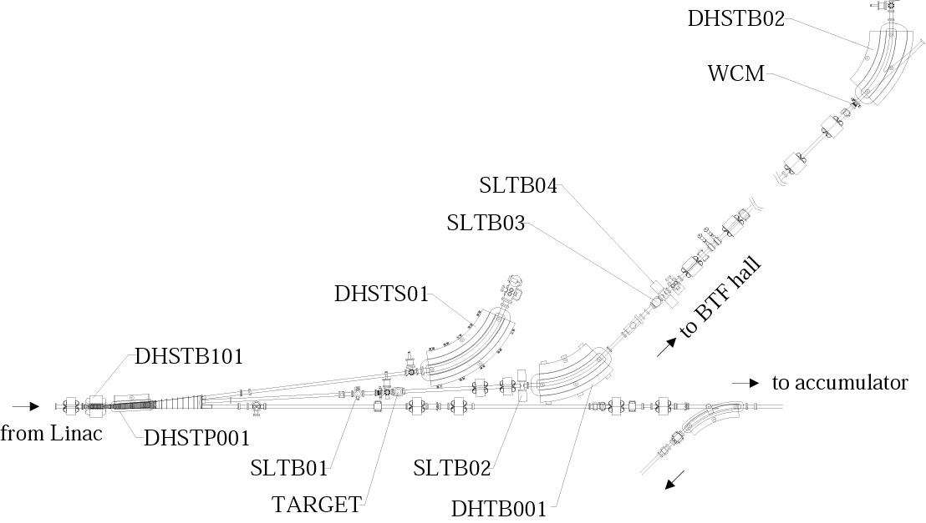
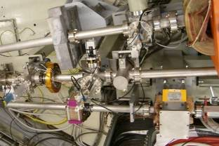
BTF layout
0
1e-
2e-
3e-
BTF Hall
Spectrum@target output
momentum
analyzer
momentum
selection
LINAC
tunnel
To main rings

Slide 21
Beam Test Facility e⁺/e⁻characteristic
parasitic dedicated
Number (particles/pulse) 1÷10⁵ 1÷10¹⁰
Energy (MeV) 25-500 25÷750
Repetition rate (Hz) 20-50 50
Pulse Duration (ns) 10 1 or 10
p resolution 1%
Spot size (mm) s_{x,y} ≈ 2 (single particle)
Divergence (mmrad) s’_{x,y} ≈ 2 (single particle)
HEP detector calibration and setup
Low energy calorimetry & resolution
Low energy electromagnetic interaction studies
High multiplicity efficiency
Detectors aging and efficiency
Beam diagnostics
Main applications

Slide 22
LNF
The SPARC-LAB complex
FLAME
SPARC-LAB

Slide 23
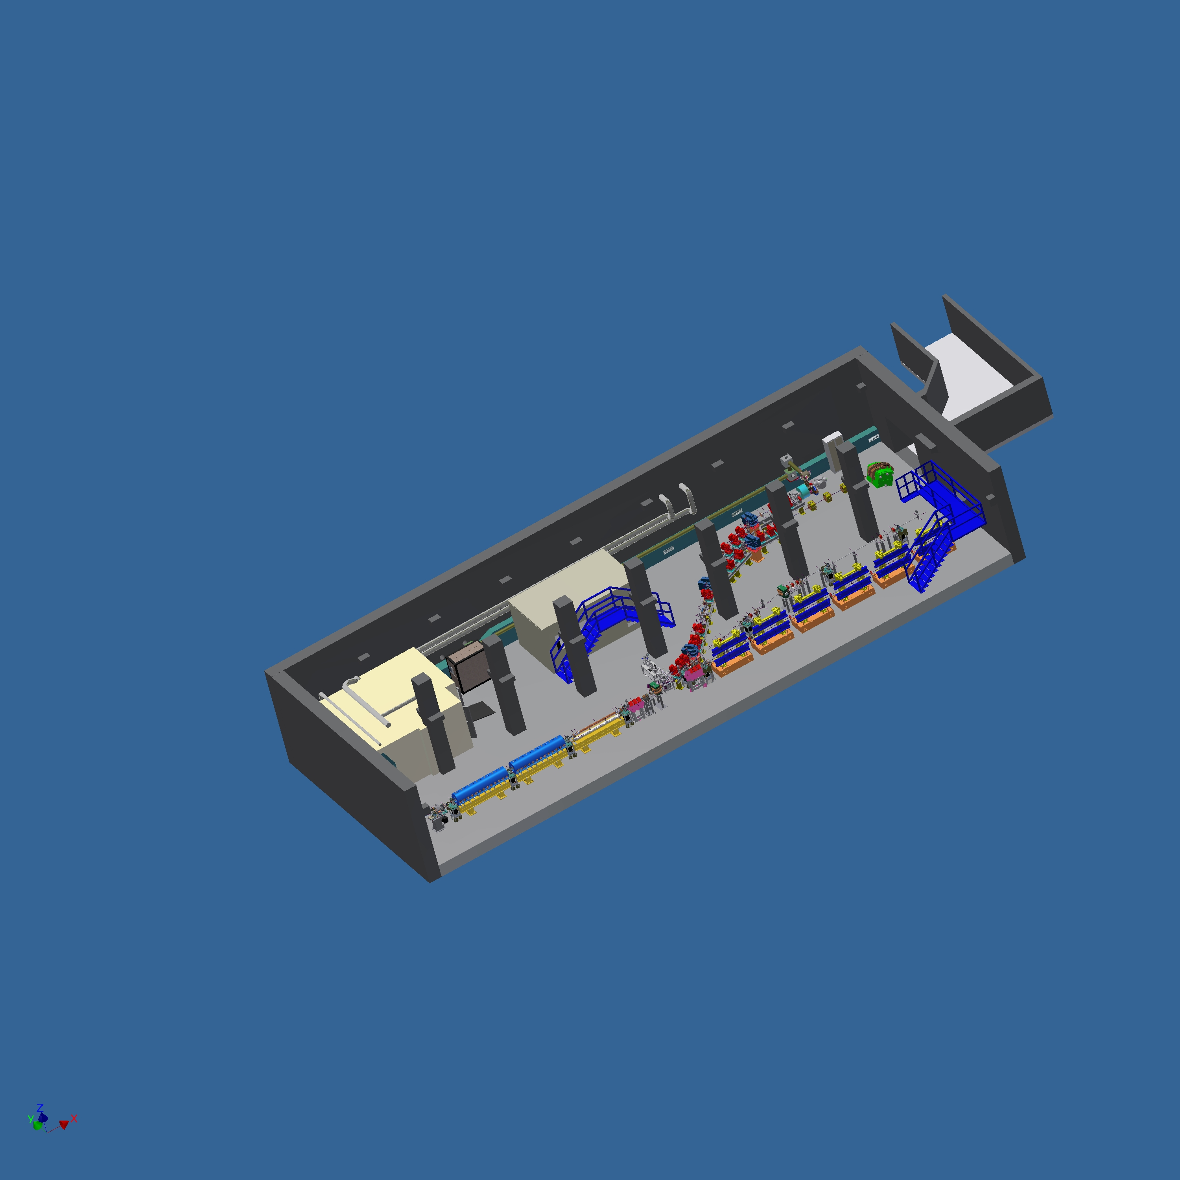
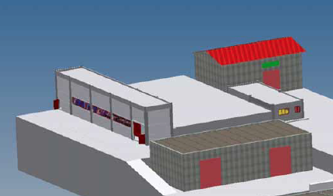

SPARC_LAB
Sources for Plasma Accelerators and Radiation Compton with Lasers And Beams
A facility based on
the unique combination of
high brightness electron beams with
high intensity ultra-short laser pulses

Slide 25
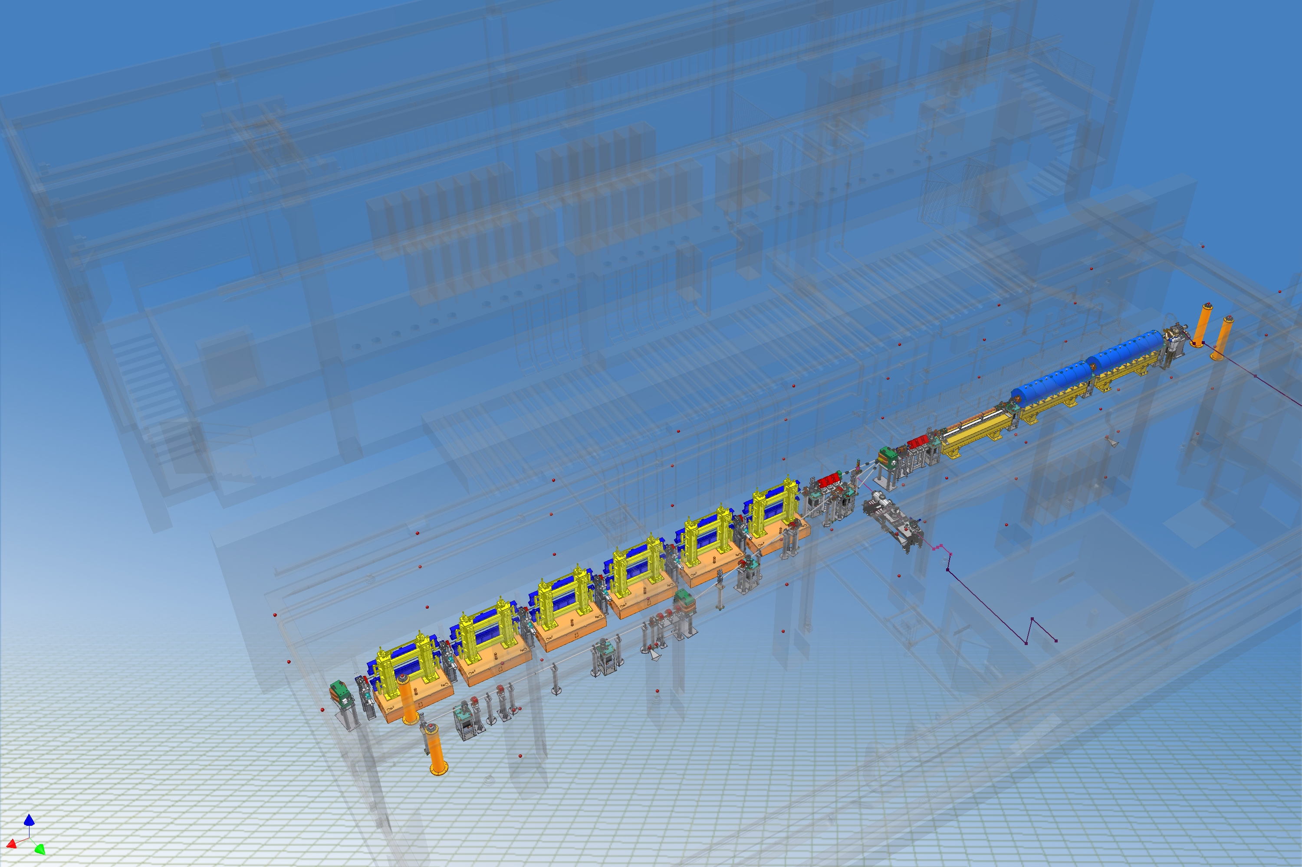
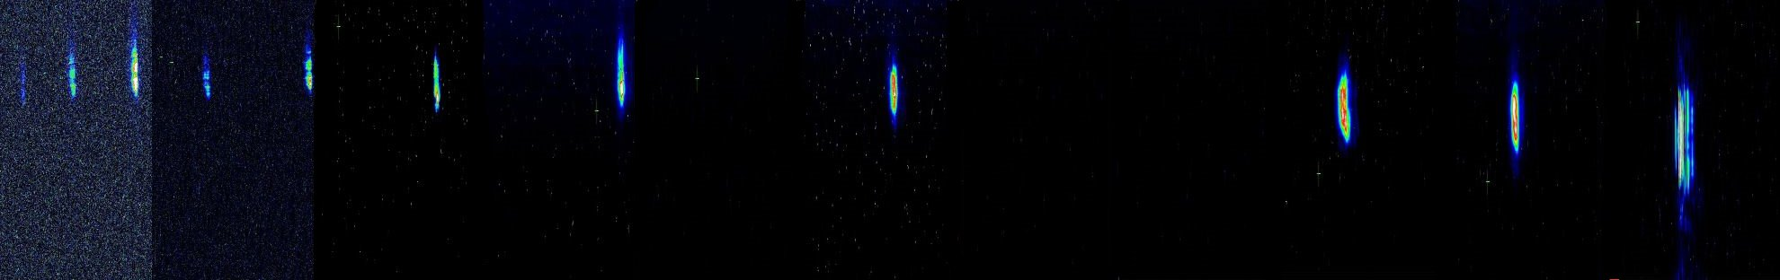
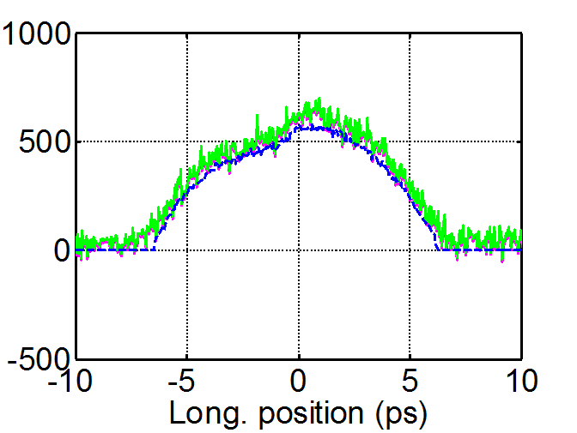
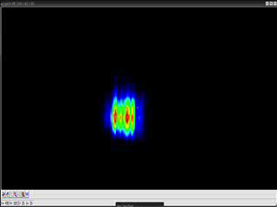
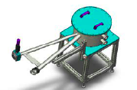
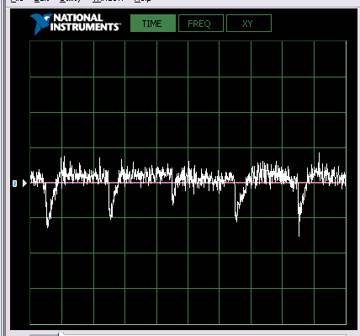


SPARC FEL
150 MeV S-band linac
Velocity Bunching
Diagnostic and Matching
Undulators
λ_{u} = 2.8 cm
K_{max} = 2.2
λ_{r} = 500 nm
12 m
11h 10h 9h 8h 7h 6h 5h 4h 3h 2h 1h
11h 10h 9h 8h 7h 6h 5h 4h 3h 2h 1h
Long Solenoids
S-band Gun
15 m
Seeding
THz Source

Slide 26
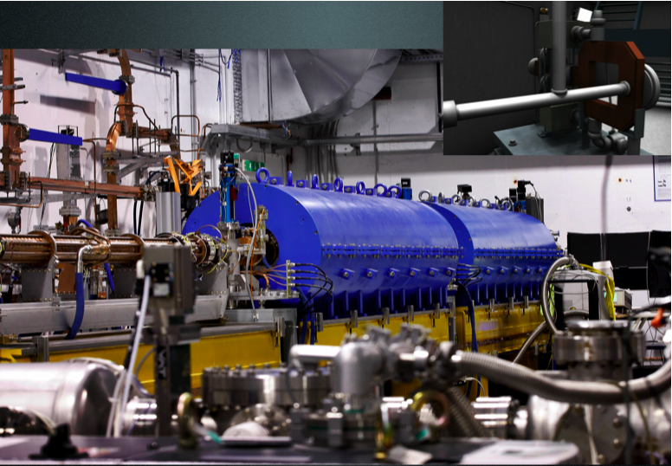
SPARC Photoinjector
E= 150 - 200 MeV
Q= .1 - 1 nC
ε_{x,y}= 1 mm*mrad

Slide 27
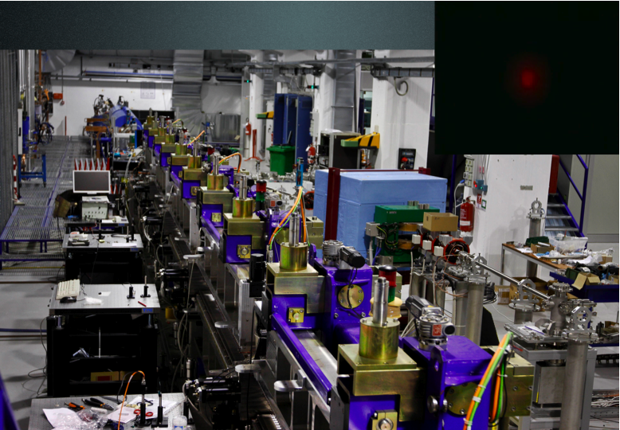
FEL undulators and THz line

Slide 28
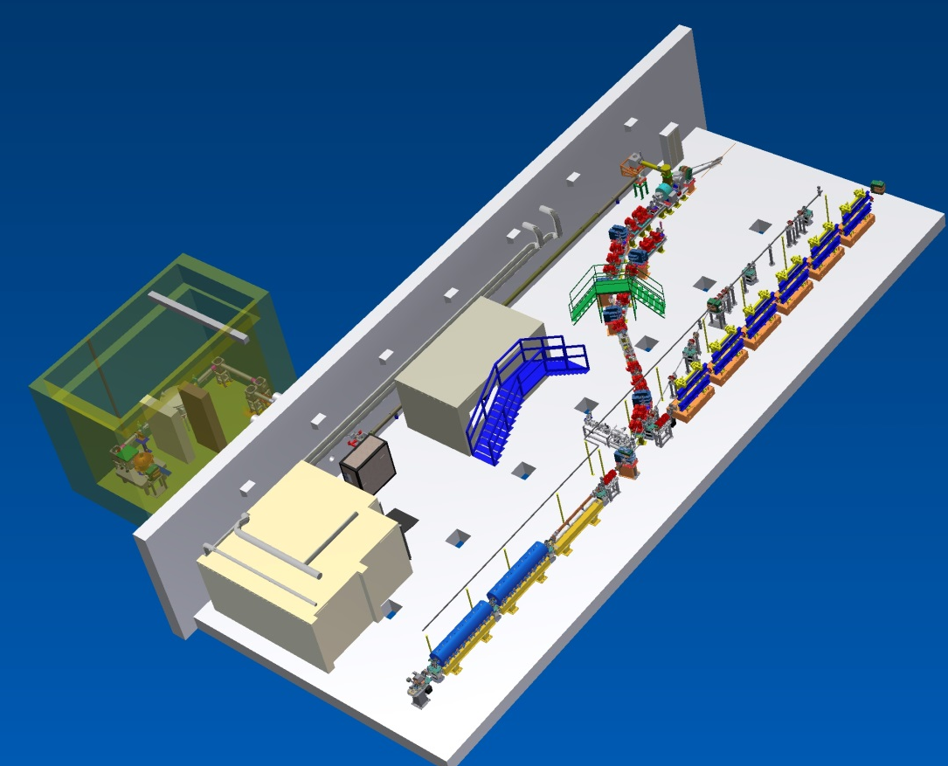
Thomson Scattering Line

Slide 29
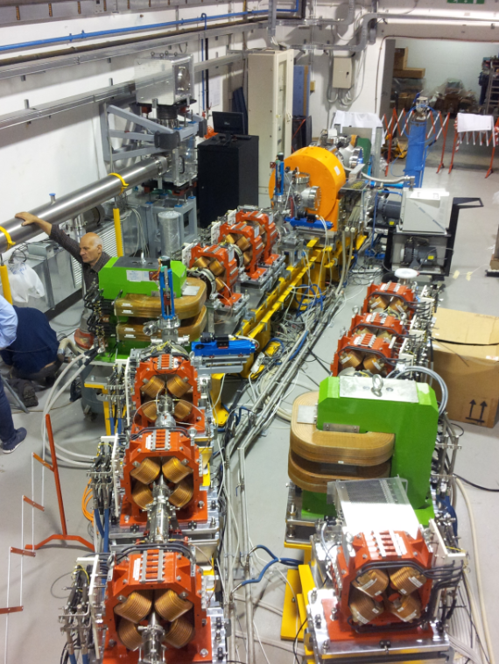
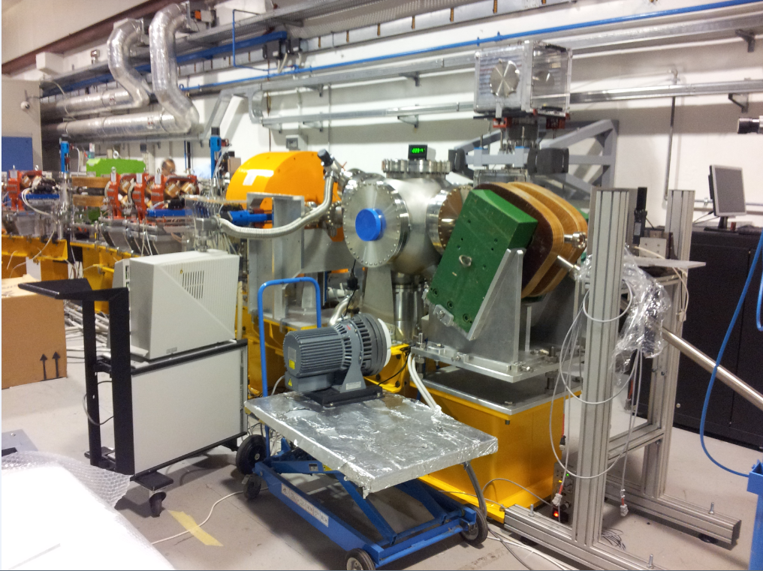
Thomson Scattering Line

Slide 30

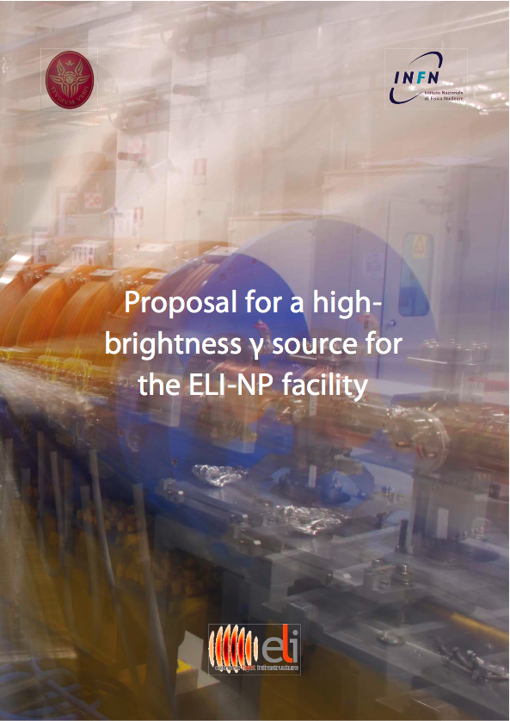
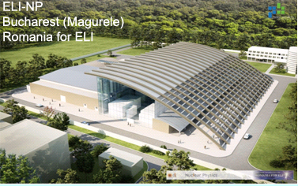
ELI-NP proposal
INFN – CNRS – STFC – ALBA
+European High Tech firms

Slide 31
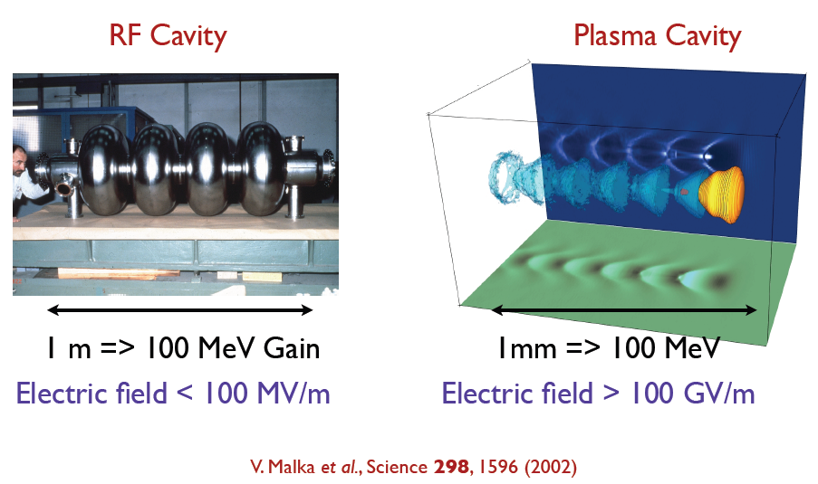
Self-
injection
Plasma
accelerators:
Transform transverse fields into longitudinal fields
Laser driven
e- driven
p driven
Dielectric wakefields
External
injection
Demonstrated accelerating Gradients up to 3 orders of magnitudes beyond presently used RF technologies.

Slide 32
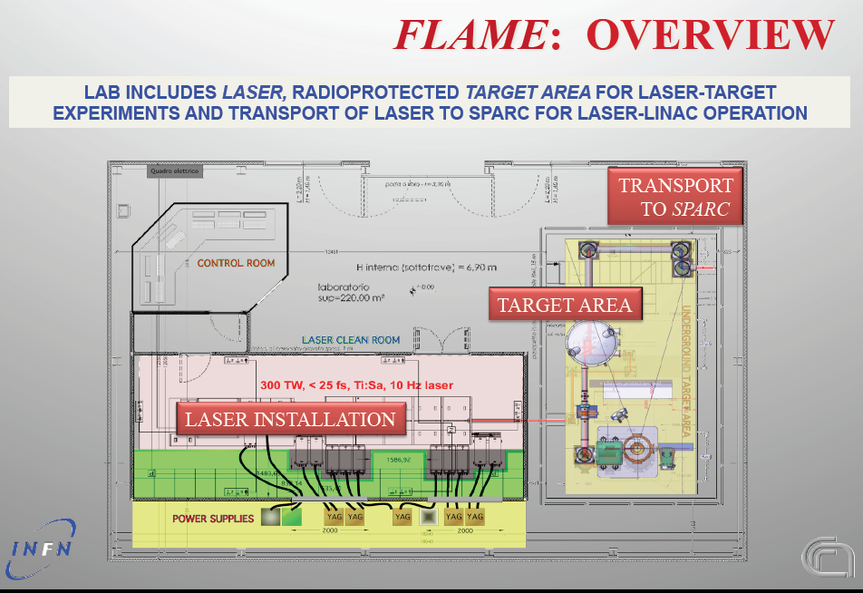
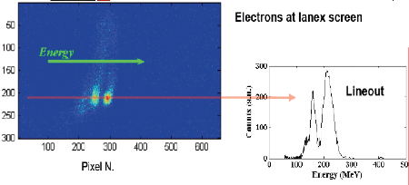
FLAME:Frascati Laser for Acceleration
and Multidisciplinary Experiments
FLAME Laser, gas-jet target, beam transport fully commissioned in 2012.
-250 TW achieved.
-Beam focused into gas cell for plasma acceleration.

Slide 33
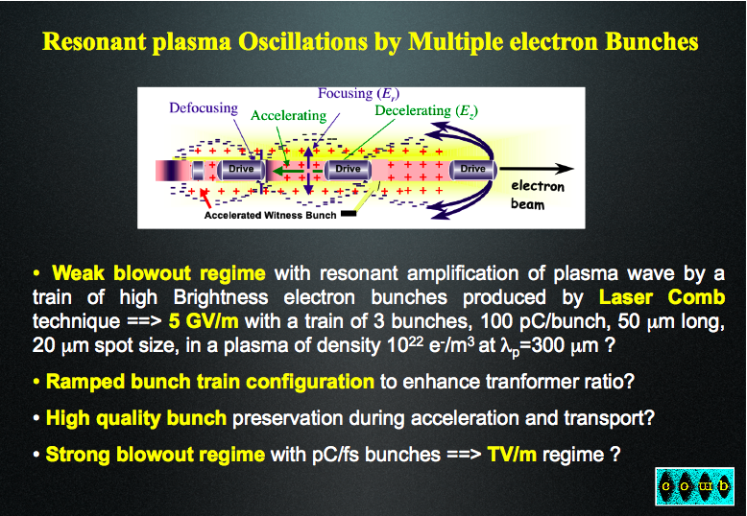

Slide 34
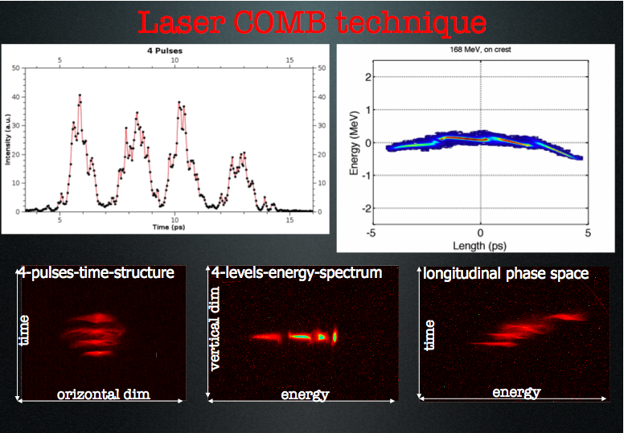

Slide 35
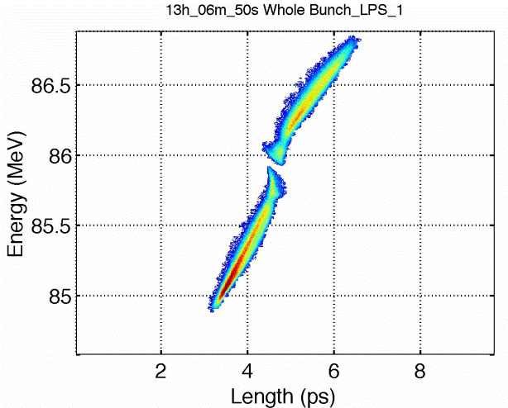
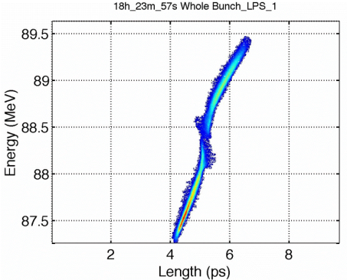
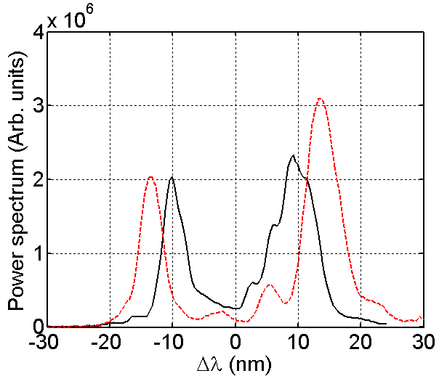
Two color FEL experiment
ΔE (MeV) | 1.01 (0.03)
Δλ (nm) | 20.7 (1.7)
ΔE_{th} (MeV) | 1.07 (0.09)
ΔE (MeV) | 1.14 (0.06)
Δλ (nm) | 26 (3)
ΔE_{th} (MeV) | 1.35 (0.14)
Tunability
BTML 2013 13/09/13 Orsay

Slide 36
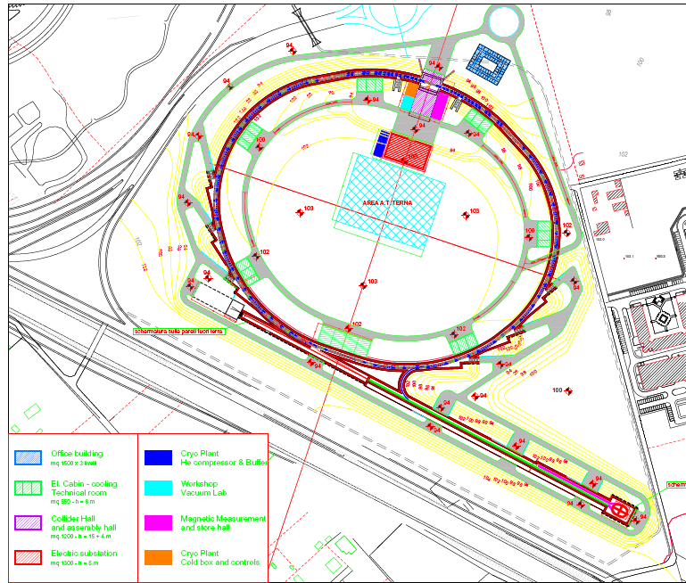
Layout
SuperB @ Tor Vergata University campus
Main parameters
Parameter | SuperB
 | HER (e⁺) | LER (e⁻)
Luminosity (cm⁻²s⁻¹) | 10³⁶
C (m) | 1200
E (GeV) | 6.7 | 4.18
Crossing angle (mrad) | 60
Piwinski angle | 20.8 | 16.9
I (mA) | 1900 | 2440
ε_{x/y} (nm/pm) (with IBS) | 2/5 | 2.5/6.2
IP σ_{x/y} (mm/nm) | 7.2/36 | 8.9/36
σ_{l} (mm) | 5 | 5
N. bunches | 978
Part/bunch (x10¹⁰) | 5.1 | 6.6
σ_{E}/E (x10⁻⁴) | 6.4 | 7.3
bb tune shift (x/y) | 0.0026/0.107 | 0.004/0.107
Beam losses (MeV) | 2.1 | 0.86
Total beam lifetime (s) | 254 | 269
Polarization (%) | 0 | 70-80
RF (MHz) | 476
IP
Main Rings
LER Spin Rotators
FEL Hall
Injection & RF section
Linac complex

Slide 37
I R I D E

Slide 38
Thanks for your attention

