Slide 1
Roadmap & Status
StratusLab Users Meeting
12 December 2013

Slide 2
Priorities for Evolution
Interfaces
Adopt CIMI as the standard interface to services
Provide complete browser interface for all services
Simplicity, Scalability, & Robustness
Direct use of libvirt as VM manager
Distributed database (Couchbase) as information ‘bus’
Better services for system administrators
Improved overview and monitoring of infrastructure
Fine-grained accounting for all resources
Migration control

Slide 3
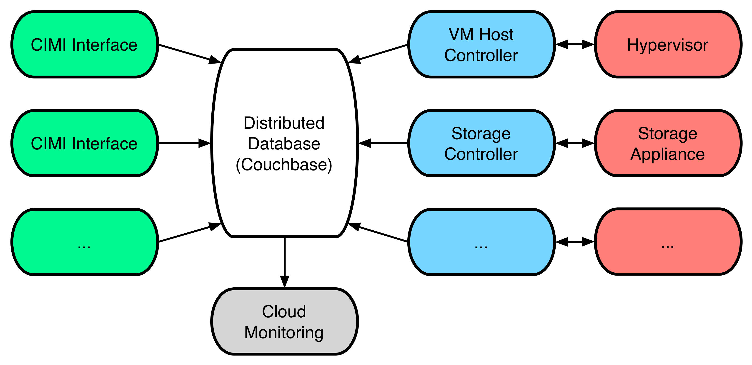
New Architecture

Slide 4
CIMI Status
Implementation
Authn and authz services integrated into CIMI server
Core resource control patterns implemented
Basic volume management validated
Working on putting machine management in place
Web Browser Interface
Core implementation available
Initial interface intended mainly for admins, but OK for users as well
See screenshots…

Slide 5
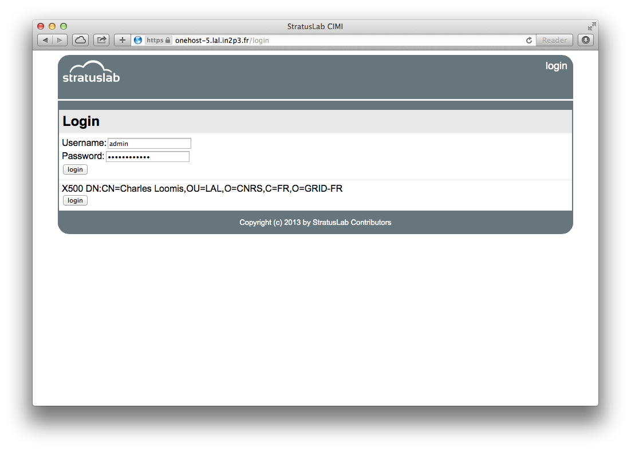
CIMI Web Interface

Slide 6
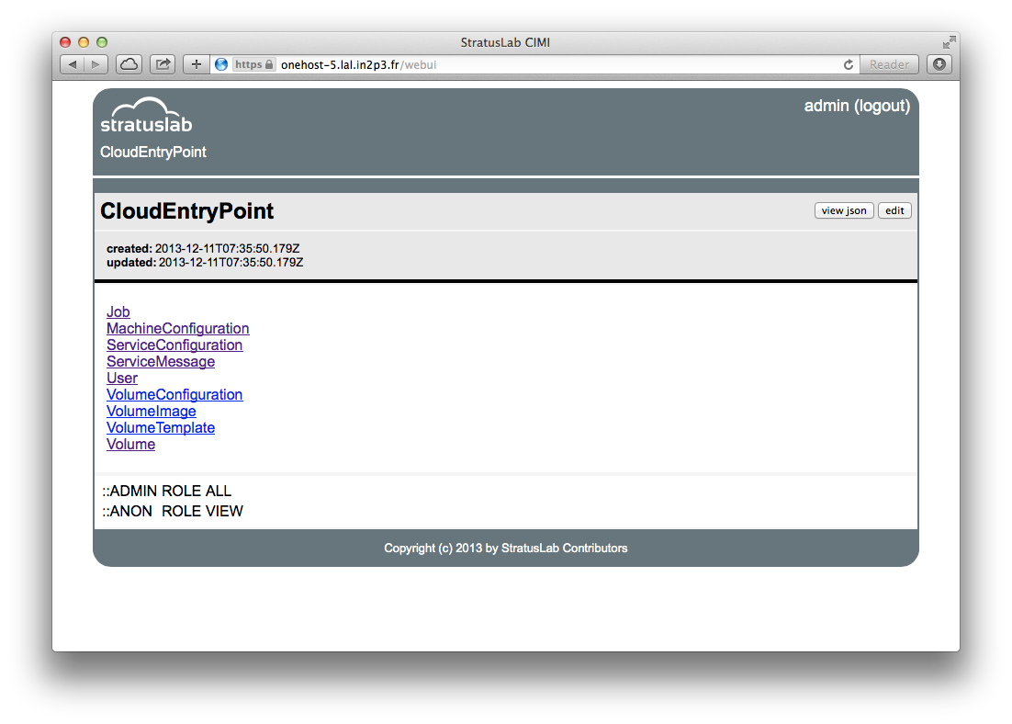
CIMI Web Interface

Slide 7
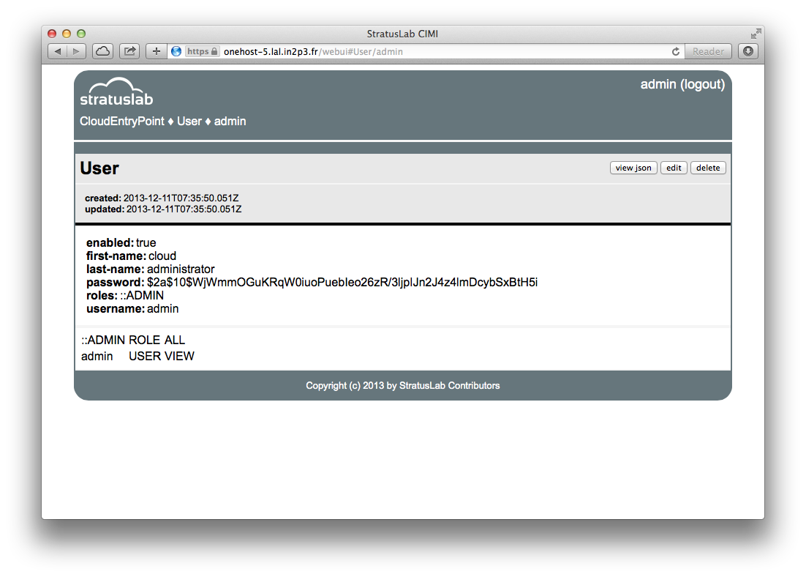
CIMI Web Interface

Slide 8
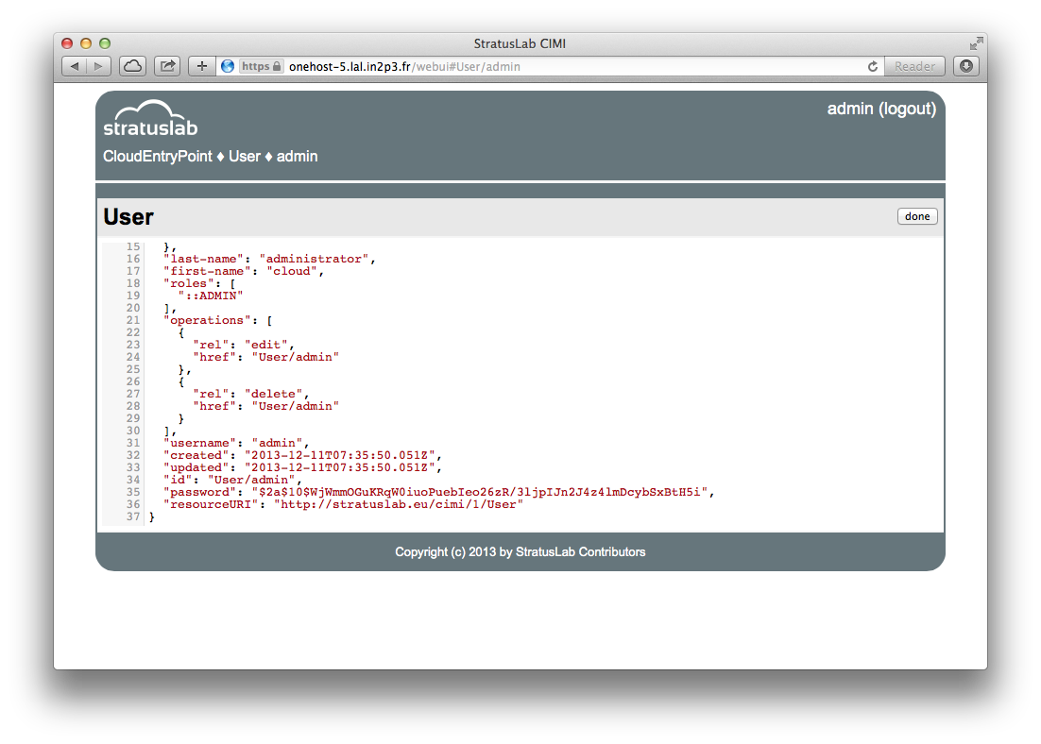
CIMI Web Interface

Slide 9
Monitoring & Accounting
Available Resources
“Load” page will continue to be available
Pages included in CIMI will provide better service information
Usage Information
Implementation providing machine, CPU, … summaries available
Needs machine control via CIMI for full integration

Slide 10
SlipStream
SlipStream Deployed
Can define appliances and systems via web interface
Deploy and control instances of those appliances and systems
Permits federation of different cloud resources
Initially: LAL (StratusLab), CC-IN2P3 (OpenStack), LLR (StratusLab)
Information
Need to register in SlipStream to create account
Must provide cloud credentials for clouds you want to use
Endpoint: https://slipstream.stratuslab.eu
Docs: https://slipstream.stratuslab.eu/documentation

Slide 11
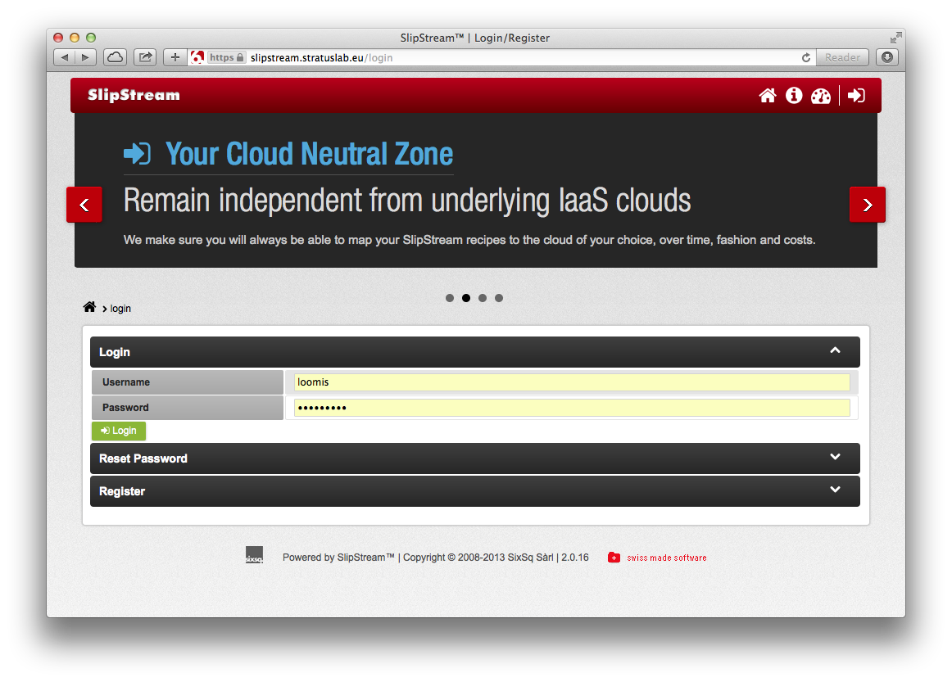
SlipStream Login Page

Slide 12
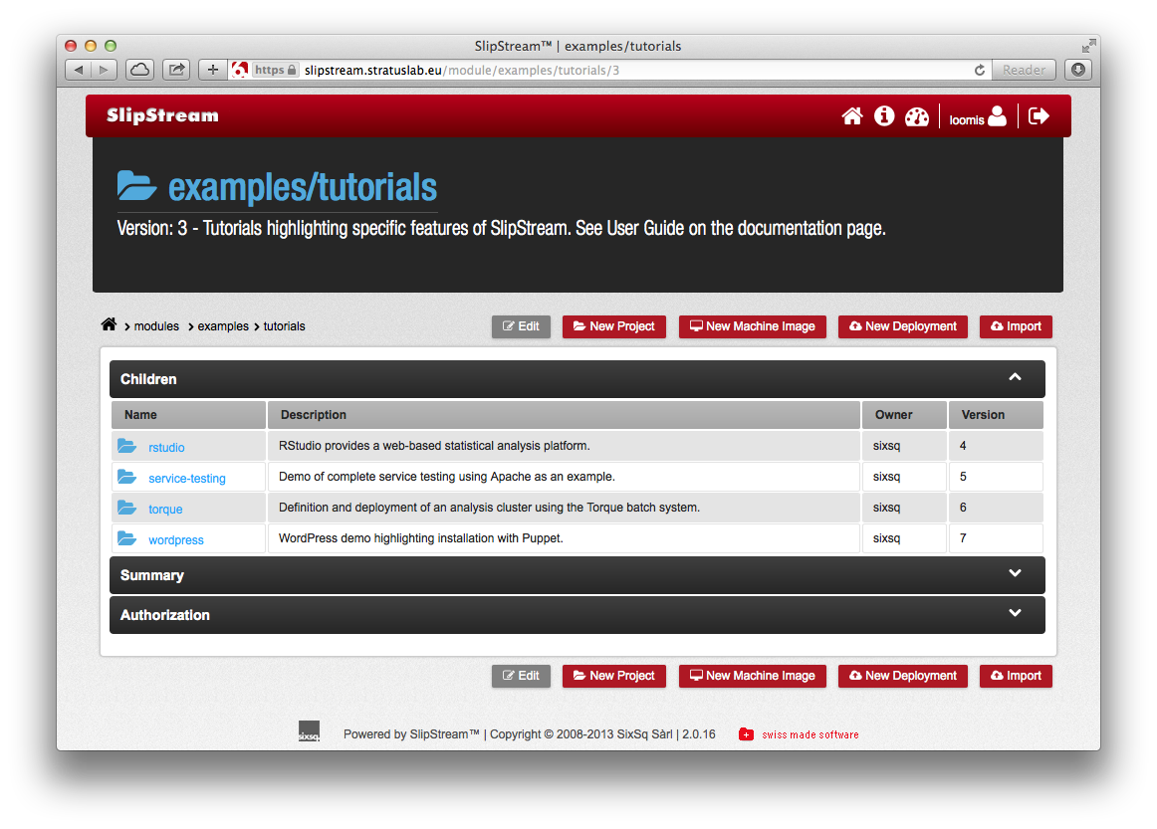
SlipStream Login Page

Slide 13
Storage
Storage
Need to support variety of storage systems and capabilities
Improve management of storage
Already support LVM/NFS, FS/NFS, NetApp/iSCSI, LVM/iSCSI
Ceph
High-performance, robust block storage service
IBCP has created storage plugin to use Ceph
Verified with 13.10.0, but requires custom kernel

Slide 14
Releases
13.10.0
Released in October
Primarily bug fix release
Changes for Couchbase and CIMI support, but not visible to users
13.12.0 → 14.02.0
No technical obstacles, but…
Time needed to implement roadmap, touches most everything

