Slide 1
Introduction of the
JUNO Experiment
Jun CAO
Institute of High Energy Physics
GDR neutrino 2014, LAL, Orsay, June 16, 2014

Slide 2
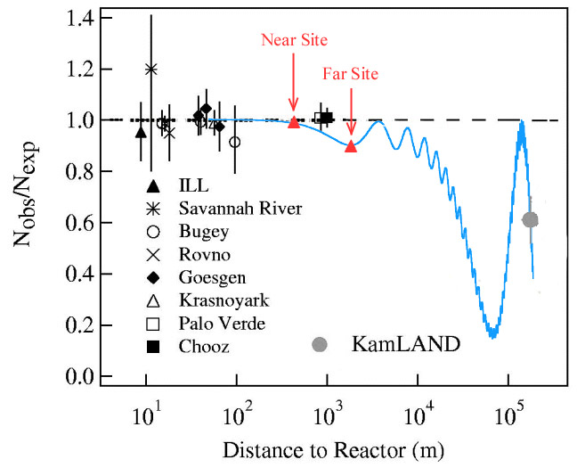
The JUNO Experiment
Jiangmen Underground Neutrino Observatory, a multiple-purpose neutrino experiment, approved in Feb. 2013. ~ 300 M$.
Daya Bay
JUNO
20 kton LS detector
3% energy resolution
Rich physics possibilities
  Reactor neutrino
  for Mass hierarchy and precision measurement of oscillation parameters
  Supernovae neutrino
  Geoneutrino
  Solar neutrino
  Sterile neutrino
  Atmospheric neutrino
  Exotic searches
Talk by Y.F. Wang at ICFA seminar 2008, Neutel 2011; by J. Cao at Nutel 2009, NuTurn 2012 ;
Paper by L. Zhan, Y.F. Wang, J. Cao, L.J. Wen, PRD78:111103, 2008; PRD79:073007,2009

Slide 3
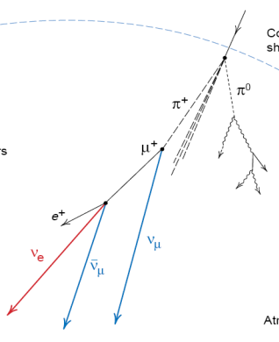
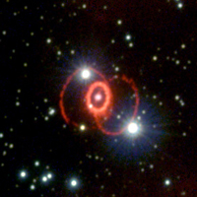
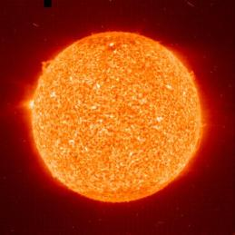
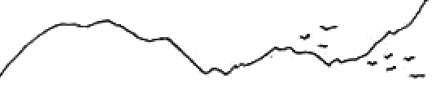
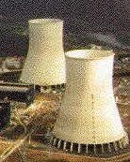
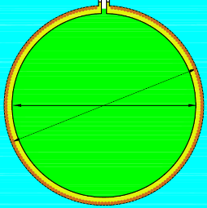
Neutrino Rates
Supernovae ν
~ 5k in 10s for 10kpc
Atmospheric ν
~ 4/day
打石山
Solar ν
tens/day
700米
700 m
Cosmic muons
~ 250k/day
0.003 Hz/m²
210 GeV
53 km
20k ton LS
Geo-neutrinos
1-2/day
reactor ν, ~ 60/day

Slide 4
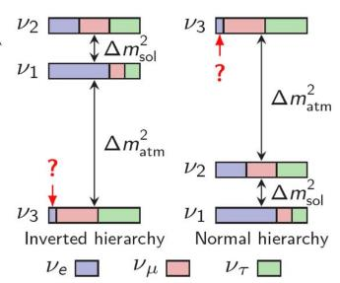
Neutrino Oscillation
In a 3-ν framework
Unknowns:
δ_{CP}
Mass Hierarchy
θ₂₃ octant
θ₂₃ ~ 45°
Atmospheric Accelerator
θ₁₃ ~ 9°
Reactor
Accelerator
θ₁₂ ~ 34°
Solar
Reactor
0νββ

Slide 5
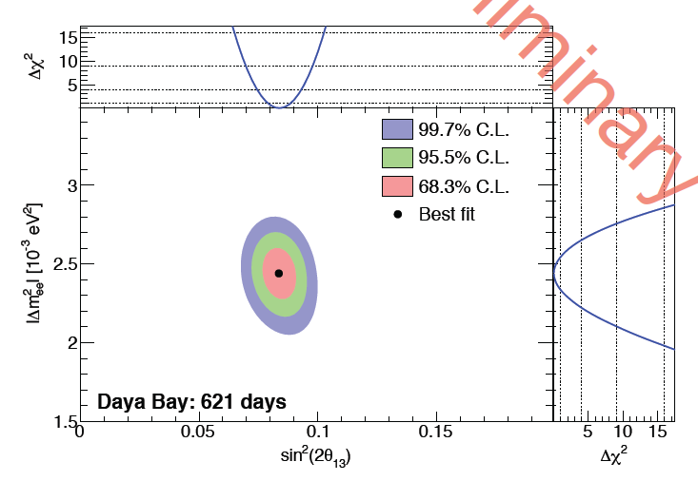






Latest Results from Daya Bay
217 days data (2013)
$$\sin^{2}{2θ_{13}={0.090}_{−0.009}^{+0.008}}$$
$$\left|∆m_{ee}^{2}\right|={2.59}_{−0.20}^{+0.19}×{10}^{−3} {\text{eV}}^{2}$$
621 days data (Neutrino 2014)
$$\sin^{2}{2θ_{13}=0.084±0.005}$$
$$\left|∆m_{ee}^{2}\right|={2.44}_{−0.11}^{+0.10}×{10}^{−3} {\text{eV}}^{2}$$
$$∆m_{ee}^{2}\sim 0.7∆m_{31}^{2}+0.3∆m_{32}^{2}$$
$$∆m_{μμ}^{2}\sim 0.3∆m_{31}^{2}+0.7∆m_{32}^{2}+CP$$

Slide 6
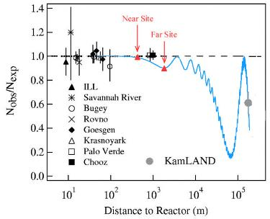
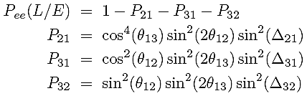
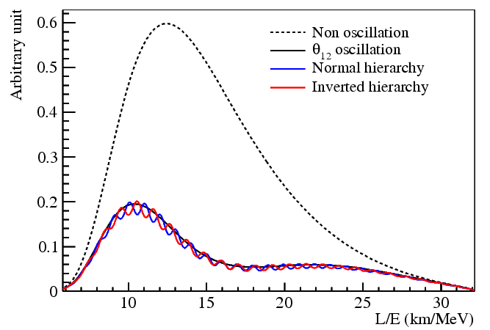
Determine MH with Reactors
4 MeV ‾ν_{e}
S.T. Petcov et al., PLB533(2002)94
S.Choubey et al., PRD68(2003)113006
J. Learned et al., PRDD78 (2008) 071302
L. Zhan, Y. Wang, J. Cao, L. Wen,
PRD78:111103, 2008, PRD79:073007, 2009
Precision energy spectrum measurement: interference between P₃₁ and P₃₂
Relative measurement
Further improvement with Δm²_{μμ} measurement from accelerator exp.
Absolute measurement

Slide 7
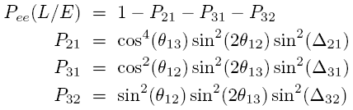
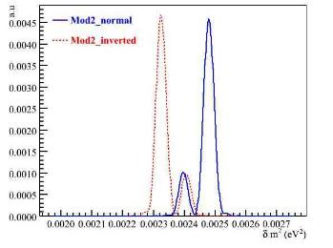
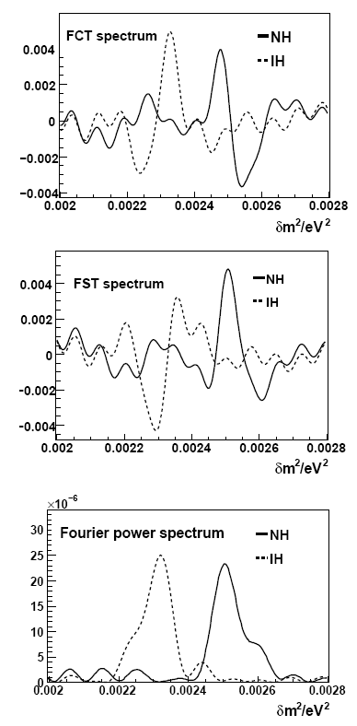
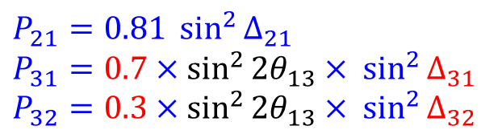
Interference: Relative Measurement
$$P_{21}=0.81 \sin^{2}{∆_{21}}$$
$$P_{31}=0.7×\sin^{2}{{2θ}_{13}}× \sin^{2}{∆_{31}}$$
$$P_{32}=0.3×\sin^{2}{{2θ}_{13}}× \sin^{2}{∆_{32}}$$
The relative larger (0.7) oscillation and smaller (0.3) oscillation, which one is slightly (1/30) faster?
Take Δm²₃₂ as reference, after a Fourier transformation
  NH: Δm²₃₁ > Δm²₃₂ , Δm²₃₁ peak at the right of Δm²₃₂
  IH: Δm²₃₁ < Δm²₃₂ , Δm²₃₁ peak at the left of Δm²₃₂

Slide 8
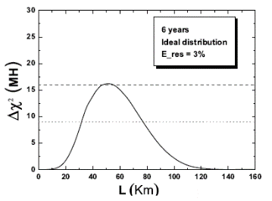
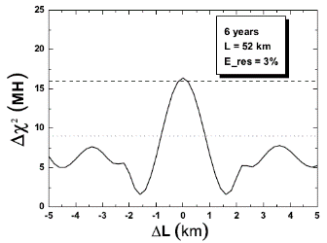
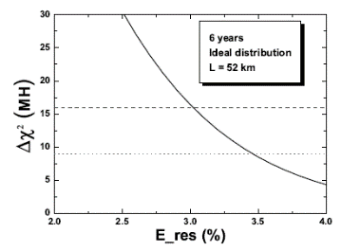
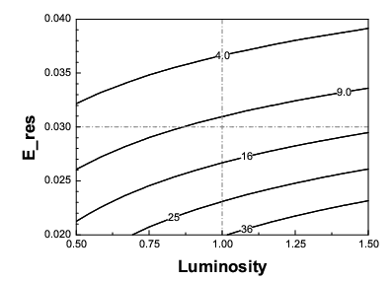
Requirements
Proper baseline: 45-60 km
Equal baselines
3% Energy resolution
100k events=20 kton×35 GW×6 year

Slide 9
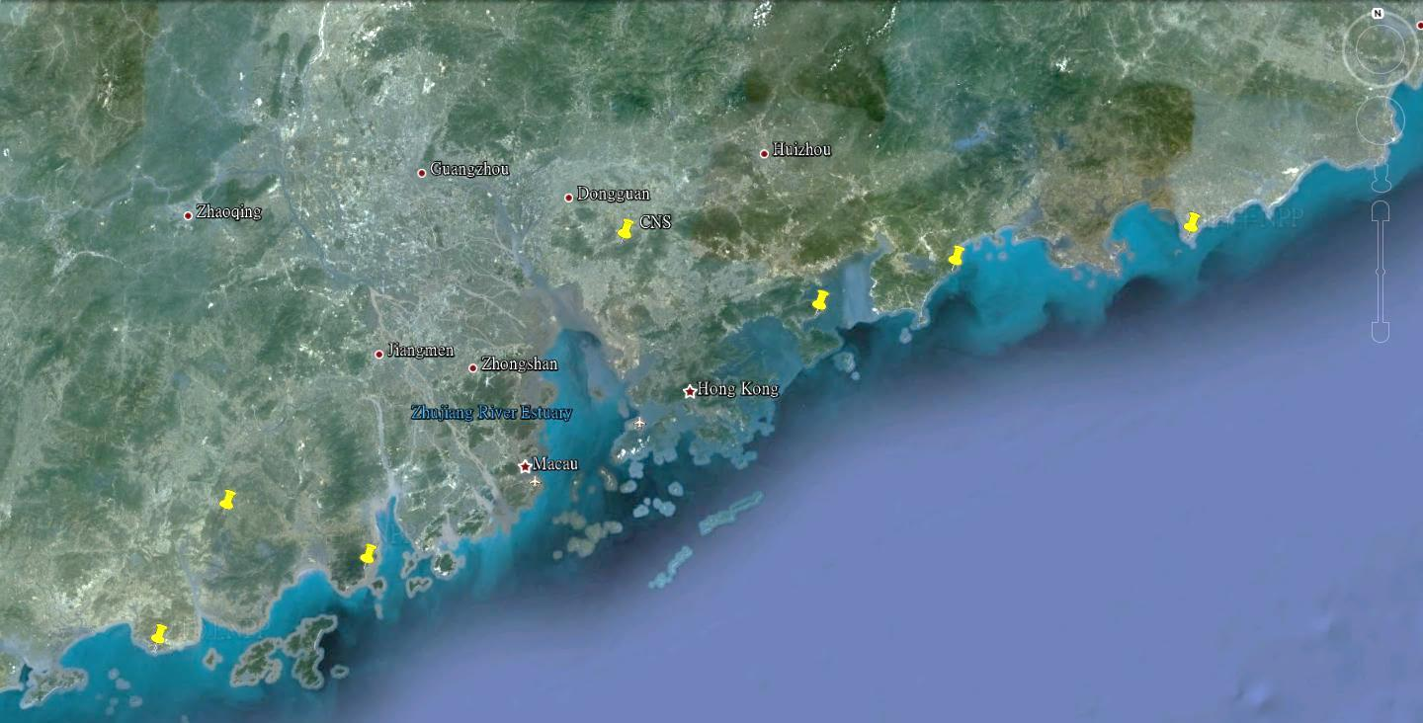

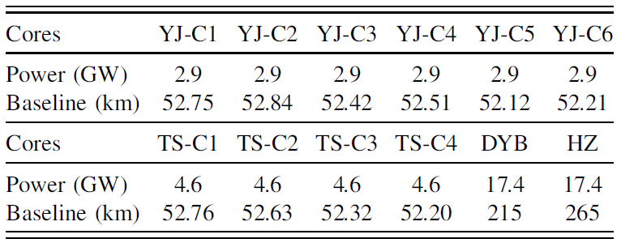
Location of JUNO
NPP | Daya Bay | Huizhou | Lufeng | Yangjiang | Taishan
Status | Operational | Planned | Planned | Under construction | Under construction
Power | 17.4 GW | 17.4 GW | 17.4 GW | 17.4 GW | 18.4 GW
Overburden ~ 700 m
by 2020: 26.6 GW
Previous site candidate
Kaiping,
Jiang Men city,
Guangdong Province
Guang Zhou
2.5 h drive
Lufeng
NPP
Shen Zhen
Huizhou
NPP
Daya Bay NPP
Zhu Hai
Hong Kong
53 km
Macau
53 km
Taishan NPP
Yangjiang NPP

Slide 10
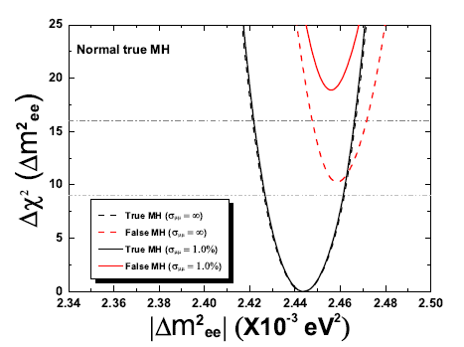
Sensitivity on MH and mixing parameters
JUNO MH sensitivity with 6 years' data:
Ref: Y.F Li et al, PRD 88, 013008 (2013) | Relative Meas. | ^{(a)}Use absolute Δm²
Ideal case | 4σ | 5σ
^{(b)}Realistic case | 3σ | 4σ
If accelerator experiments, e.g NOvA, T2K, can measure Δm²_{μμ} to ~1% level
Take into account multiple reactor cores, uncertainties from energy non-linearity, etc
 | Current | JUNO
Δm²₁₂ | ~3% | ~0.5%
Δm²₂₃ | ~4% | ~0.6%
sin²θ₁₂ | ~7% | ~0.7%
sin²θ₂₃ | ~15% | N/A
sin²θ₁₃ | ~6%→ ~4% | ~ 15%
Probing the unitarity of U_{PMNS} to ~1%
more precise than CKM matrix elements !

Slide 11
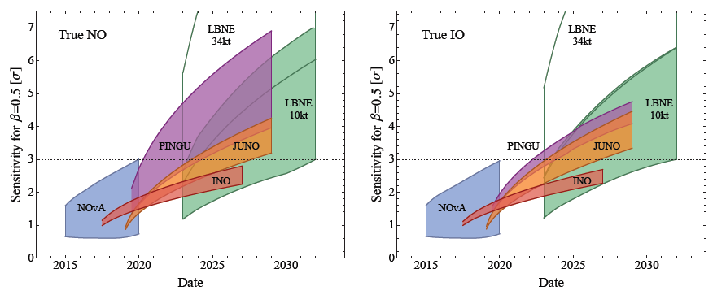
Other Experiments/Proposals for MH
M. Blennow et al., JHEP 1403 (2014) 028
NOvA, LBNE: δ
PINGU, INO: θ₂₃=40-50°
JUNO: 3%-3.5%
  JUNO: Competitive in schedule and Complementary in physics
  Have chance to be the first to determine MH
  Independent of the CP phase and θ₂₃ (Acc. and Atm. do)
  Combining with other experiments can significantly improve the sensitivity
  Well established liquid scintillator detector technology

Slide 12
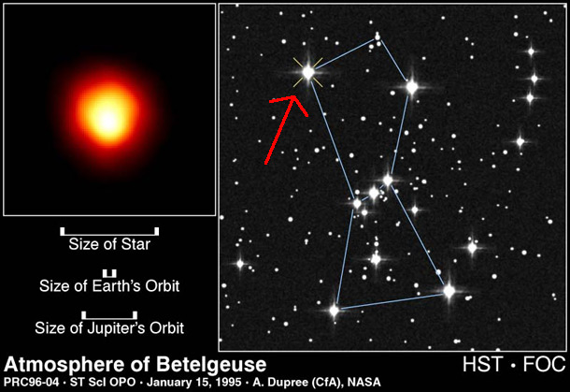
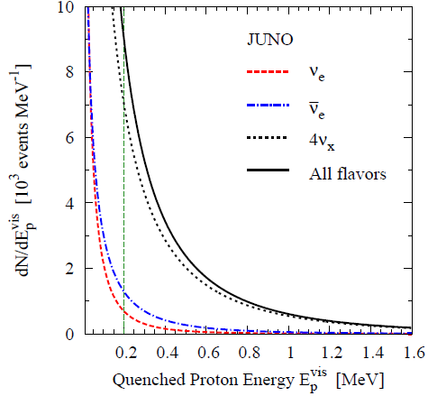
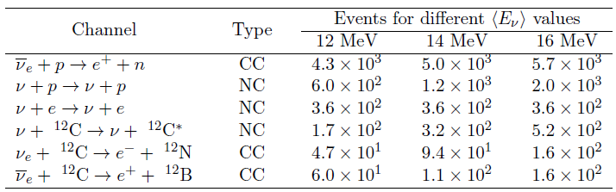
Supernova Neutrinos
Less than 20 events observed so far
Assumptions:
  Distance: 10 kpc (our Galaxy center)
  Energy: 3×10⁵³ erg
  L_{ν} the same for all types
Possible candidate
Estimated numbers of neutrino events in JUNO (preliminary)
event spectrum of ν-p scattering (preliminary)
LS detector vs. Water Cerenkov detectors:
much better detection to these correlated events
→ Measure energy spectra & fluxes of almost all types of neutrinos

Slide 13
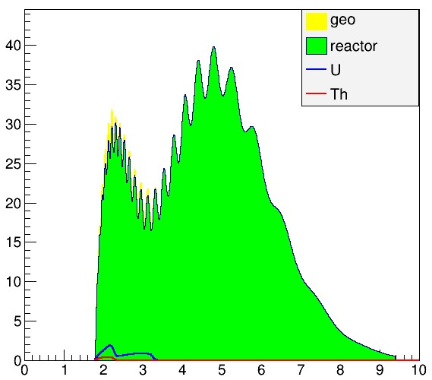
Other Physics
Geo-neutrinos
  Current results
  KamLAND: 30±7 TNU (PRD 88 (2013) 033001)
  Borexino: 38.8±12.2 TNU (PLB 722 (2013) 295)
  Statistics dominant
  Desire to reach an error of 3 TNU
  JUNO: ×10 statistics
    Huge reactor neutrino backgrounds
    Expectation: ? ±10%±10%
Solar neutrino
  Metallicity? Vacuum oscillation to MSW?
  need LS purification, low threshold
  background handling (radioactivity, cosmogenic)
Atmospheric neutrino
  measure ν energy instead of leptons’ in LS. ~ 2σ for MH in 10 years
Diffuse supernovae ν, Sterile ν, Indirect dark matter, Nucleon decay, etc.

Slide 14
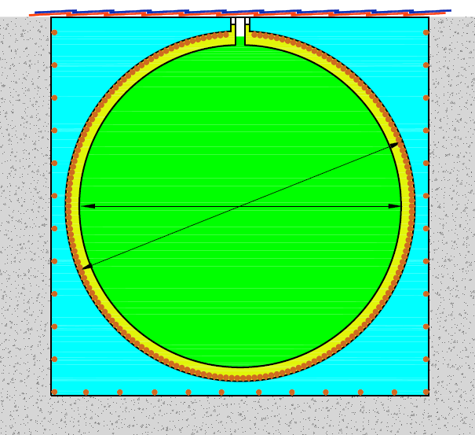
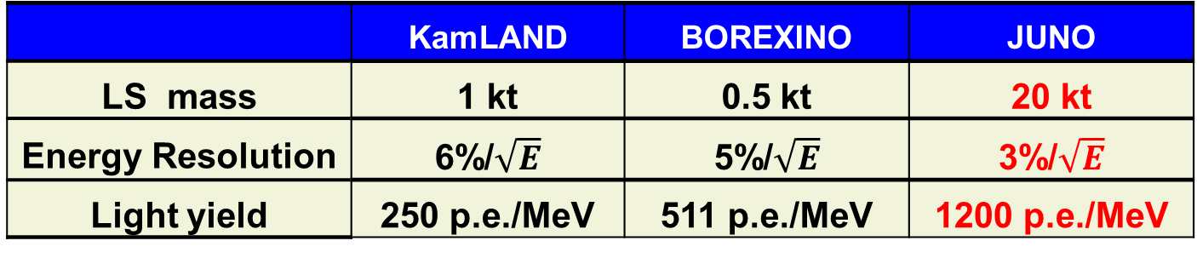
High-precision, giant LS detector
Muon detector
Steel Tank
20 kt LS
coverage: ~77%
~18000 20” PMTs
~20kt water
Acrylic tank: Φ∼35.4m
Stainless Steel tank: Φ∼39.0m
~6kt MO
JUNO
~1500 20” VETO PMTs
5m
 | KamLAND | BOREXINO | JUNO
LS mass | 1 kt | 0.5 kt | 20 kt
Energy Resolution | 6%/$\sqrt{E}$ | 5%/$\sqrt{E}$ | 3%/$\sqrt{E}$
Light yield | 250 p.e./MeV | 511 p.e./MeV | 1200 p.e./MeV

Slide 15
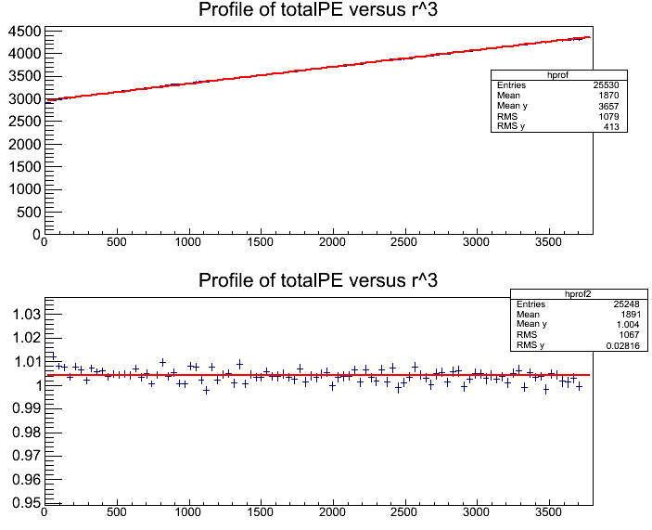
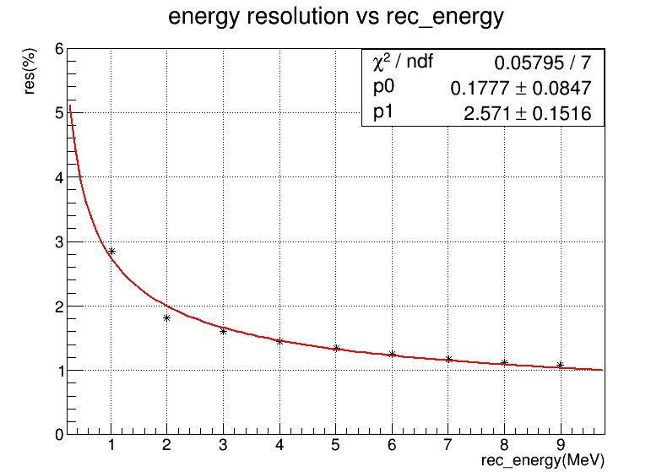
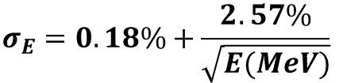
Energy Resolution
JUNO MC, based on DYB MC (p.e. tuned to data), except
  JUNO Geometry and 77% photocathode coverage
  High QE PMT: maxQE from 25% -> 35%
  LS attenuation length (1 m-tube measurement@430 nm)
    from 15 m = absoption 30 m + Rayleigh scattering 30 m
    to 20 m = absorption 60 m + Rayleigh scattering 30 m
Energy reconstruction with an ideal vertex reconstruction
Uniformly Distributed Events
$$σ_{E}=0.18\%+\frac{2.57\%}{\sqrt{E(MeV)}}$$
R³
After vertex-dep. correction

Slide 16
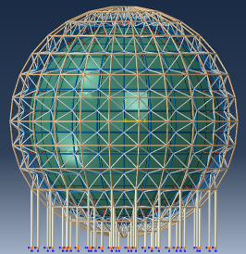
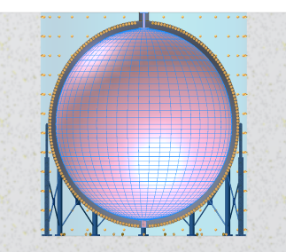
JUNO Central Detector
Some basic numbers:
  Target: 20 kt LS
  Backgrounds/reactor signal with 700 m overburden: Accidentals (~10%), ⁹Li/⁸He (<1%), fast neutrons (<1%)
A huge detector in a water pool:
  Default option: acrylic tank (D~35m) + SS truss
  Alternative option: SS tank (D~39m) + acrylic structure + balloon
Challenges:
  Engineering: mechanics, safety, lifetime, …
  LS: high transparency, low background
  PMT: high QE, high coverage
Design & prototyping underway

Slide 17
Liquid Scintillator in JUNO
Recipe
LAB+PPO+bisMSB (no Gd-loading)
Increase light yield
  Optimization of fluors concentration
Increase transparency
  Good raw solvent LAB
    Improve production processes: cutting of components, using Dodecane instead of MO, improving catalyst, etc
  Online handling/purification
    Distillation, Filtration, Water extraction, Nitrogen stripping, …
Reduce radioactivity
  Less risk, since no Gd
  Instrinsic singles < 3Hz (above 0.7MeV), if ⁴⁰K/U/Th <10⁻¹⁵ g/g
DYB
KamLAND
Linear Alky Benzene (LAB) | Atte. Length @ 430 nm
RAW | 14.2 m
Vacuum distillation | 19.5 m
SiO₂ coloum | 18.6 m
Al₂O₃ coloum | 22.3 m
LAB from Nanjing, Raw | 20 m
Al₂O₃ coloum | 25 m

Slide 18
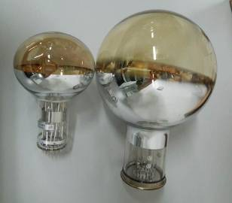
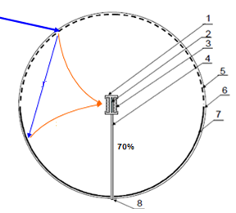
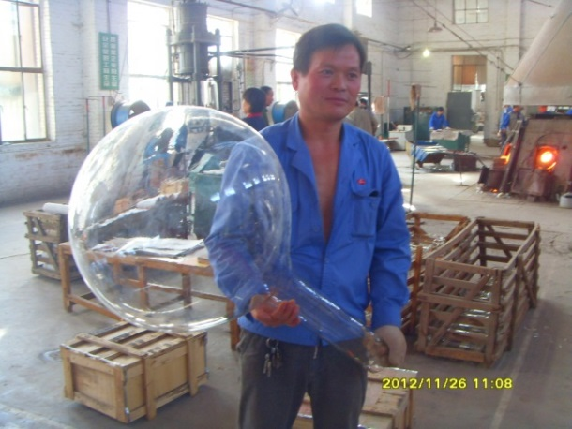
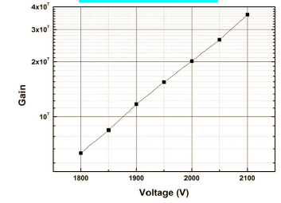
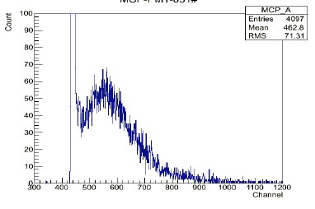
High QE PMT Effort in JUNO
High QE 20” PMTs under development:
  A new design using MCP: 4π collection
MCP-PMT development:
  Technical issues mostly resolved
  Successful 8” prototypes
  A few 20” prototypes
Alternative options: Hamamatsu or Photonics
 | R5912 | R5912-100 | MCP-PMT
QE@410nm | 25% | 35% | 25%
Rise time | 3 ns | 3.4ns | 5ns
SPE Amp. | 17mV | 18mV | 17mV
P/V of SPE | >2.5 | >2.5 | ~2
TTS | 5.5ns | 1.5 ns | 3.5 ns
Gain
SPE

Slide 19
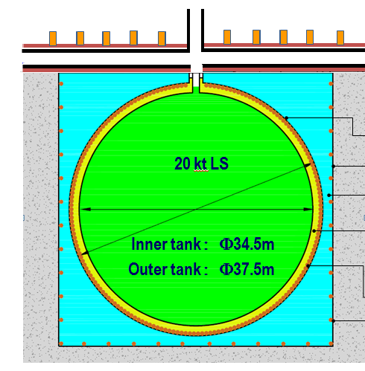
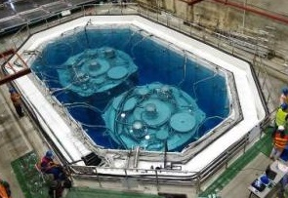
JUNO Muon VETO detector
Top tracker
(OPERA Target Tracker)
Tracker Support
Water Cerenkov Detector
Tyvek composite film
PMT support
Water Pool liner
Earth Magnetic shielding
Daya Bay Water pool
  2.5 m shielding
  99.8% detection eff. for through-going muon

Slide 20
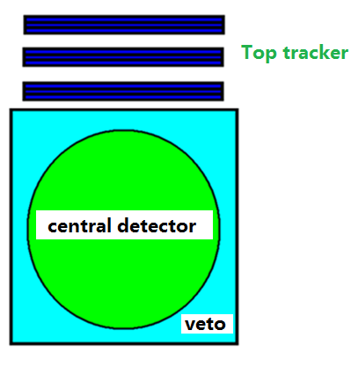
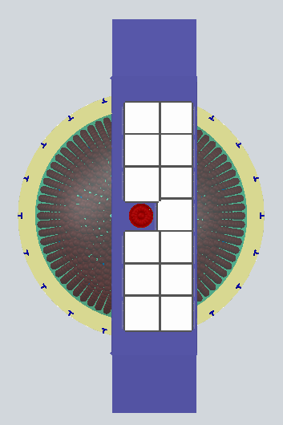
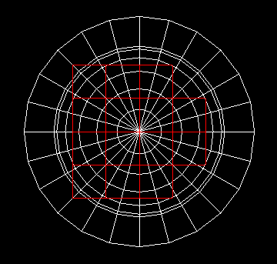
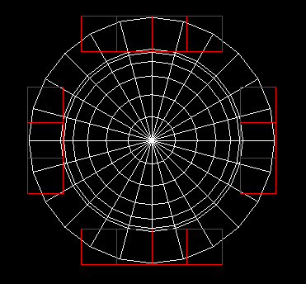
OPERA Target Tracker
Several options have been considered (RPC, LS tube, …) before we realized the OPERA tracker possibility
OPERA target tracker: 2783 m² (x-y readout)
56 x-y walls (6.7m×6.7m each)
JUNO need accurate muon track (single and muon bundle) to reject cosmogenic backgrounds
Covered area is about 630m²
Challenge: radioactivity induced singles

Slide 21
Readout Electronics and Trigger
Challenges for large detector: long cable
Charge and timing info. from 1 GHz FADC
Main Choice to be made: in water or on surface
Total No. channel | 20,000
Event rate | ~ 50 KHz
Charge precision | 1 – 100 PE: 0.1 – 1 PE; 100-4000PE: 1-40PE
Noise | 0.1 PE
Timing | 0-2us: ~ 100 ps
An option to have a box in water:
  ~100 ch. per box
  Changeable in water
  Global trigger on surface

Slide 22
Background
Assumptions:
Overburden is 700m
  E_{μ} ~ 211 GeV, R _{μ} ~ 3 Hz
Single rates from LS and PMT are
< 5 Hz, respectively
Good muon tracking and vertex reconstruction
Similar muon efficiency as DYB
 | Daya Bay | Daya Bay II
Mass (ton) | 20 | 20,000
E_{m} (GeV) | ~57 | ~211
L_{m} (m) | ~1.3 | ~ 23
R_{m} (Hz) | ~21 | ~3.8
R_{singles} (Hz) | ~50 | ~10
 | B/S @ DYB EH1 | B/S @ DYB II | Techniques needed for DYB II detector
Accidentals | ~1.4% | ~10% | Low PMT radioactivity; LS purification; prompt-delayed distance cut
Fast neutron | ~0.1% | ~0.4% | High muon detection efficiency (similar as DYB)
⁹Li/⁸He | ~0.4% | ~0.8% | Muon tracking; If good track, distance to muon track cut (<5m) and veto 2s; If shower muon, full volume veto 2s

Slide 23
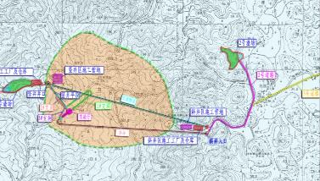
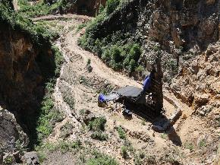
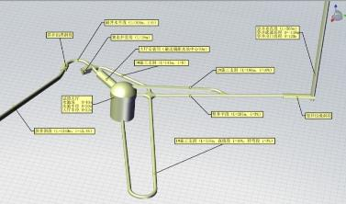
JUNO: Brief schedule
Civil preparation：2013-2014
  Current status: site survey completed. Civil design on-going.
Civil construction：2014-2017
Detector R&D：2013-2016
Detector component production：2016-2017
PMT production：2016-2019
Detector assembly & installation：2018-2019
Filling & data taking：2020
600m bore hole

Slide 24
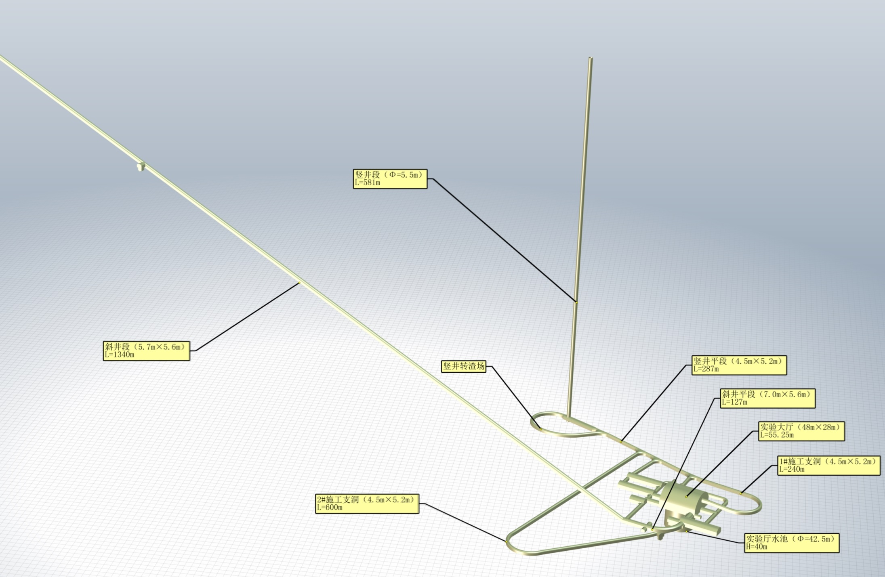

Civil Construction
A 600m vertical shaft
A 1300m long tunnel(40% slope)
A 50m diameter, 80m high cavern

Slide 25



Layout

Slide 26
Entrance Layout
Dorm
LS storage, mixing & purification
Office & control room
Cable car
Dorm
Un-loading zone
Tunnel entrance, Assembly ➔ exhibition
Storage

Slide 27


Project Progresses
Progresses since 2013
600m vertical shaft
1300m tunnel(40% slope)
First get-together meeting
Geological survey and preliminary civil design done
Funding(2013-2014) review approved by CAS
2013
2014
Now
Kaiping Neutrino Research Center established
Civil/infrastructure construction bidding
Great support from CAS: “Strategic Leading Science & Technology Programme”, CD1 approved
Yangjiang NPP started to build the last two cores
Expected in 2014
Ground-breaking (civil construction takes 3 years)
Publish a physics book and CDR
Form international collaboration

Slide 28

International collaboration
Strong interests from Czech, France, Germany, Italy, Russia, U.S …
The proto-collaboration welcome new collaborators
Establish the international collaboration this year

Slide 29
Summary
JUNO was approved in Feb. 2013 w/ ~300 M$ budget
Very rich physics possibilities
Preparation proceeds very well
  Detector R&D
  Physics book and CDR
  Geological survey done. Civil bidding done.
  → aim at groundbreaking this year.
Strong international collaboration

Slide 30


Slide 31
Thanks!

Slide 32




Slide 33



Challenges: Energy non-linearity
Non-linear energy response in Liquid scintillator
  Quenching (particle-, E- dep.)
  Cerenkov (particle-, E- dep.)
  Electronics (possible, E- dep.)
Self-calibration of the spectrum: multiple oscillation peaks can provide good constraints to non-linearity → possibly mitigate the requirement to be <2%
e.g Daya Bay
F. P. An et al, PRL 112, 061801 (2014)
Neutrino 2014
Uncertainty improved to be <1%
Y.F.Li et al, PRD 88, 013008 (2013)

