Slide 1
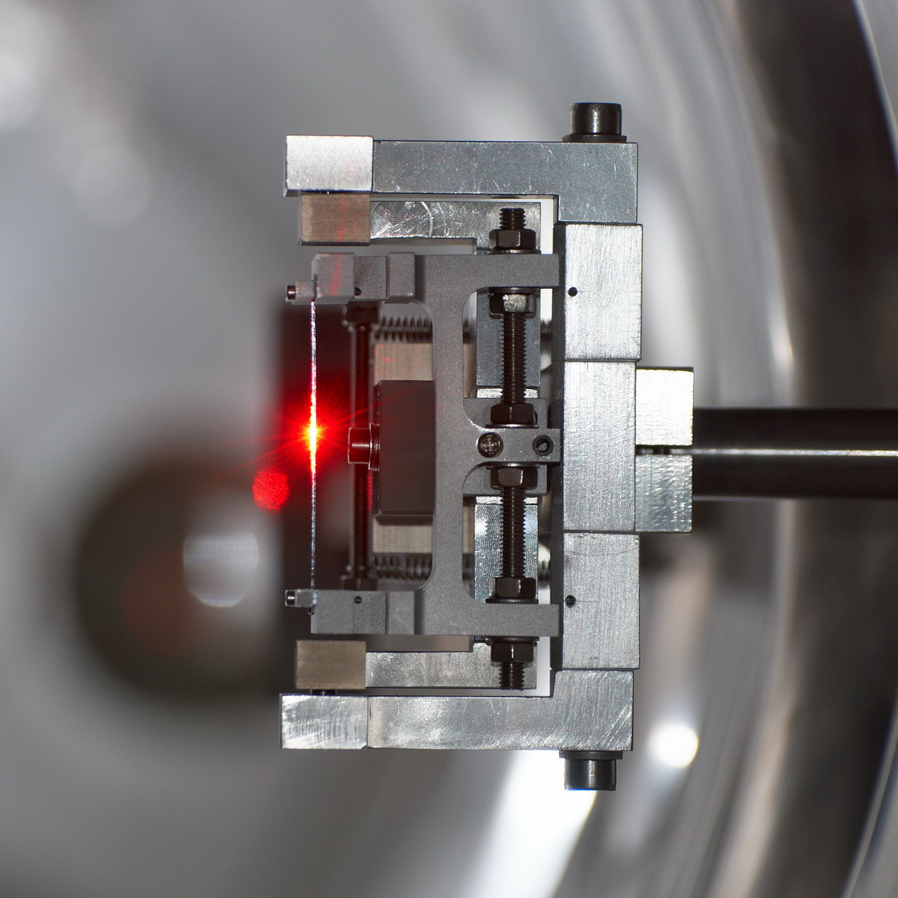
Beam extraction with crystals, the CRYSBEAM project
Gianluca Cavoto (INFN Roma)
LAL seminar - Orsay – Jul 3rd 2014

Slide 2
Outline
Goal(s) of CRYSBEAM
  Efficient crystal extraction of a multi-TeV hadron beam for fixed target experiments
State of the art of crystals on accelerators
  Crystal collimation and the UA9 experiment at CERN
What new CRYSBEAM will bring
  Cutting-edge technology in crystal and particle detectors
Plans
CRYSBEAM is funded by a ERC Consolidator Grant GA 615089
(FP7 IDEAS action) with a 2M euro budget
for the period May 2014- May 2019
INFN is the Host Institution

Slide 3
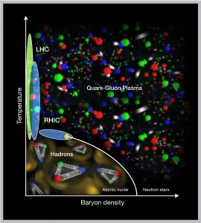
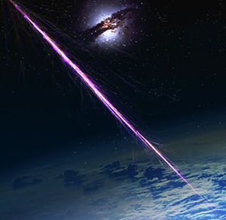
Physics with a multi-TeV hadron beam
QCD at unprecedented laboratory energies and momentum transfers
Proton spin physics
Quark-gluon plasma excitation in the target rest frame
Diffractive physics
… and more with secondary beams
Phase diagram of hadronic matter
”Physics opportunities of a fixed-target experiment using LHC beams”
S. J. Brodsky, F. Fleuret, C. Hadjidakis, and J. P. Lansberg, Phys. Rep. 522 (2013) 239-255.
What is the nature of
the cosmic rays?
Which the nature of dark matter ?
  Study interaction of hadrons with different targets
Cosmic ray shower

Slide 4
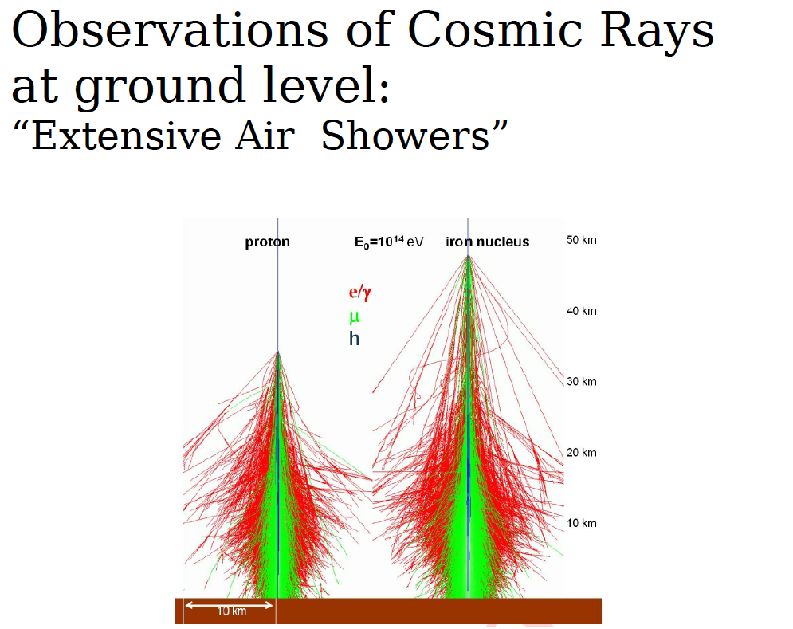
Ultra High Energy Cosmic Rays

Slide 5
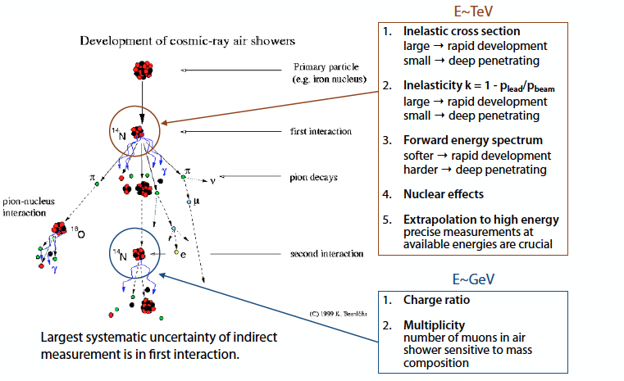
Hadronic interaction in air showers
G.Mitsuka (LHCf coll)
Accelerator based experiments to unravel this
(LHC-f, NA61 at CERN,…)

Slide 6
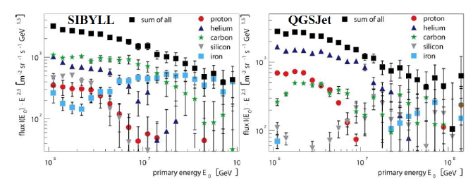
Uncertainty in hadronic physics
  Cosmic ray experiment observation depends on
  detailed MonteCarlo code to disentangle primary ray nature
KASCADE collaboration
Measuring cross section at various energies (100 GeV-10 TeV) on atmosphere-like
target can help in those MC calibration

Slide 7
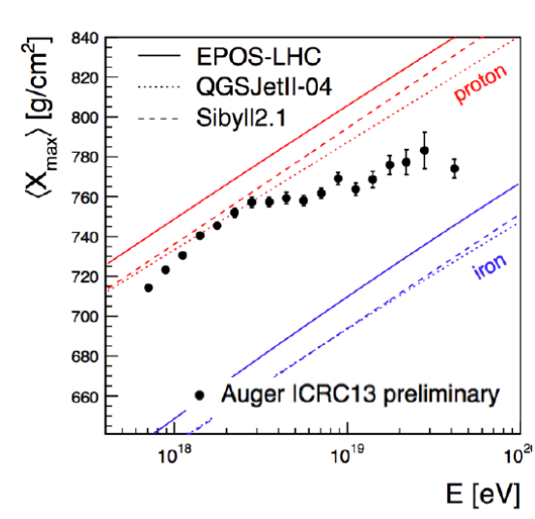
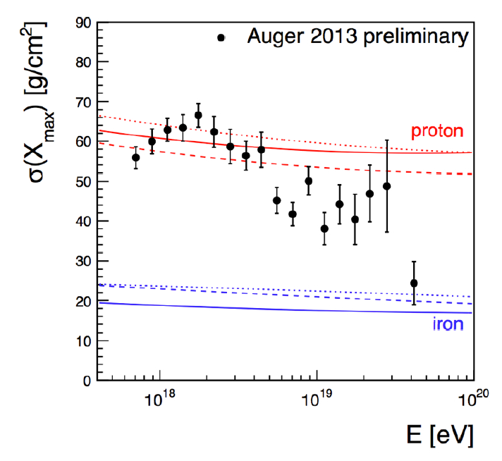
CR Mass composition
Pierre Auger Observatory
Shower maximum position
Cross section
Data interpretation depends on MC used to described the shower

Slide 8
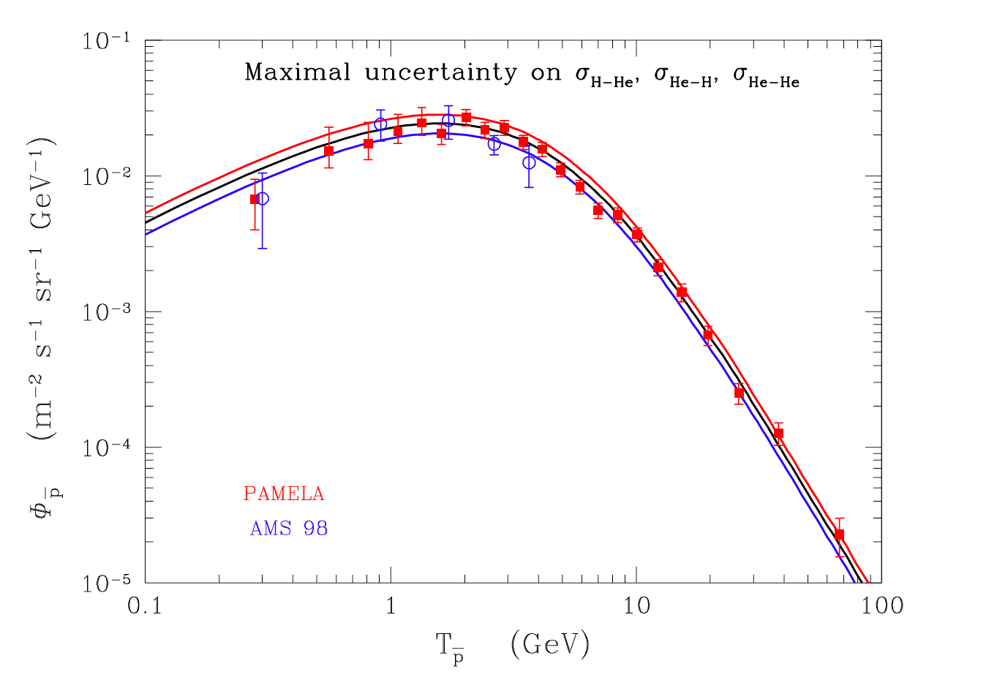
Propagation of Cosmic Rays in Galaxy
Evidence of anti-matter excess in Cosmic rays (PAMELA, AMS-02, etc.)
  Is this a sign of Dark Matter annihilating in our Galaxy?
It might only be due to cosmic rays interaction in interstellar medium
  Improve propagation models with more precise cross section measurement
    (B/C spallation, anti-proton production from He target,…)
  Measure
  cross sections
  in the 1 GeV – 10 TeV range
F. Donato et al. ApJ 2001, PRL 2009
Anti-proton
flux

Slide 9
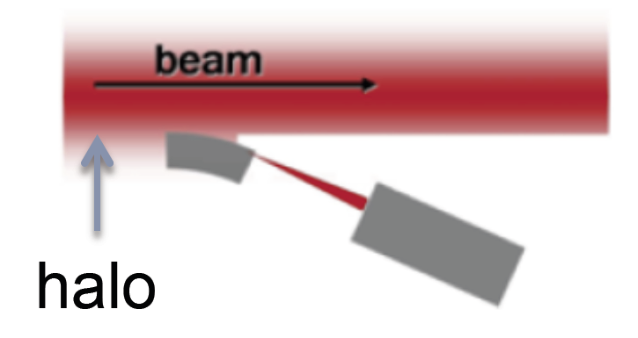
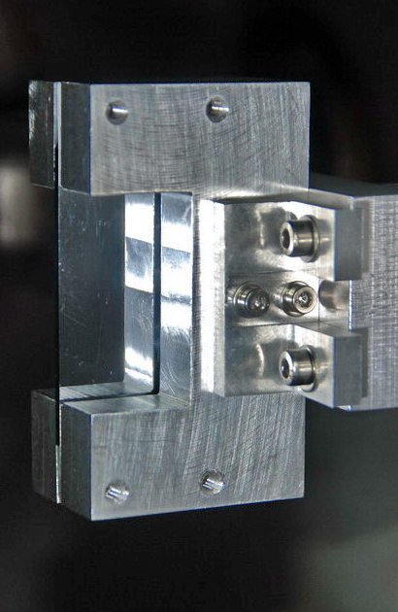
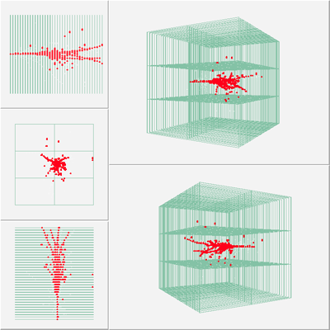
CRYSBEAM basic idea
PARASITIC EXTRACTION of BEAM with a bent crystal in channeling orientation
Low background, continuous extraction of the beam halo
10⁸ particle per second might be possible
Core
absorber
Instrumented (“smart”)
absorber to measure the
hadronic shower structure
Crystal
CALICE
Digital HCAL
UA9 crystals

Slide 10
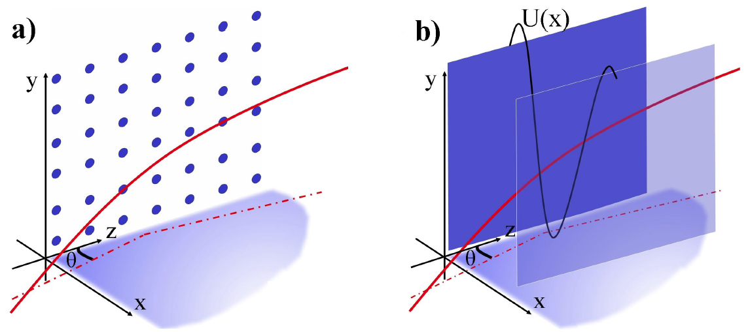
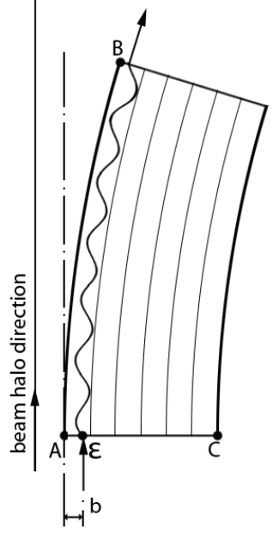
Crystal channeling, a coherent interaction
Charged particle direction
within a critical angle
relative to the atomic planes.
Trapped in the lattice electric potential U(x).
If crystal
mechanically bent,
Critical angle
Potential well depth ~Z
[22.7 eV for (110) Si]
particles still oscillate
inside the “channel”.
Particle momentum
and velocity
Particles emerge
deflected and
parallel
(low divergence).
at E ~ 100 GeV

Slide 11
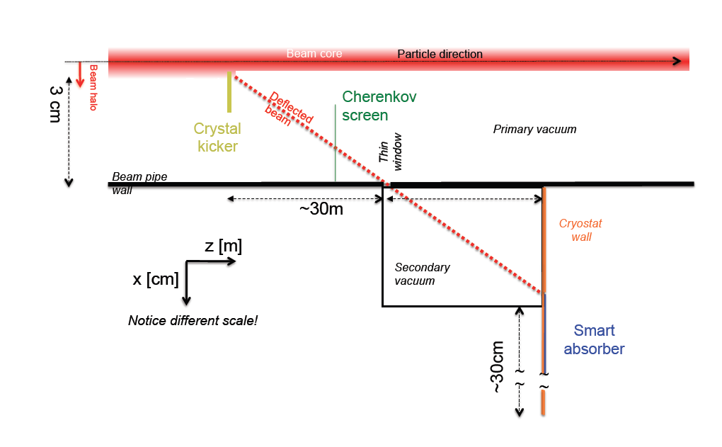
CRYSBEAM conceptual layout
  Crystal kick about 1 mrad technically feasible.
  Detection and timing of deflected/extracted beam at the vacuum/air interface with a detector based on Cherenkov light emission.
  Instrumented beam dump in air.

Slide 12
Requirements and methods of CRYSBEAM
 | ELEMENT | REQUIREMENTS | METHODS
 | Crystal Kicker | Orient lattice planes parallel to the beam within θ_{C}(7 TeV) ≈ 2 μrad with high repeatability inside the vacuum beam pipe. | Finely polished, low miscut silicon crystals. Goniometer for ultra-high vacuum.
 | Cherenkov Screen | For deflected particles measure flux at 5%, timing <1ns, beam-spot ≈ 250 μm in the beam pipe vacuum. | Fused silica slab transverse to beam. Cherenkov light internally reflected through optical micro-guide to multi-channel plate PMT.
 | Smart Absorber | Measure particle cross sections on nucleus A σ_{tot}(p-A) and σ_{tot}(Pb-A) as in Cosmic rays collisions | Several active scintillator layers to follow the hadron shower evolution. In case of Liquid He or liquid N₂ target thin-wall cryostat is required

Slide 13
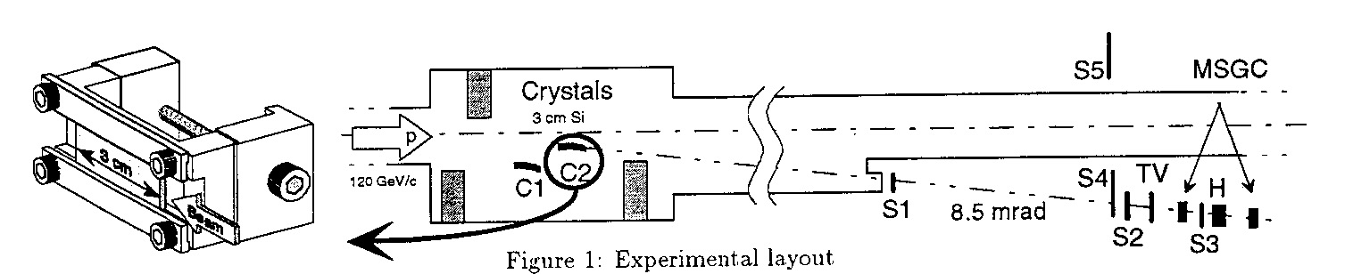
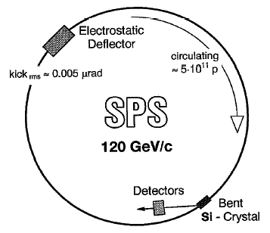
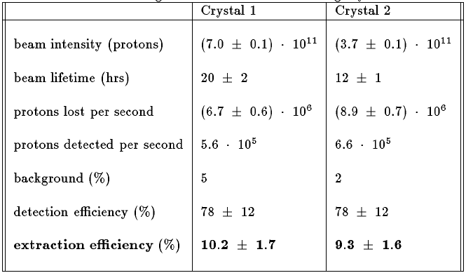
SPS extraction, RD-22 experiment
The RD22 Collaboration, CERN DRDC 94-11
Crystal used in other accelerators (U70) in the o(100 GeV) energy range

Slide 14








The UA9 experiment at CERN

Slide 15
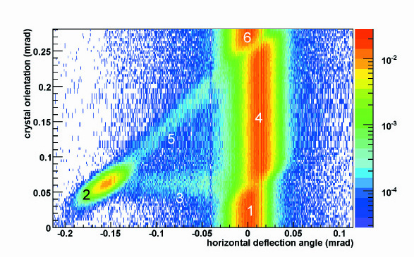
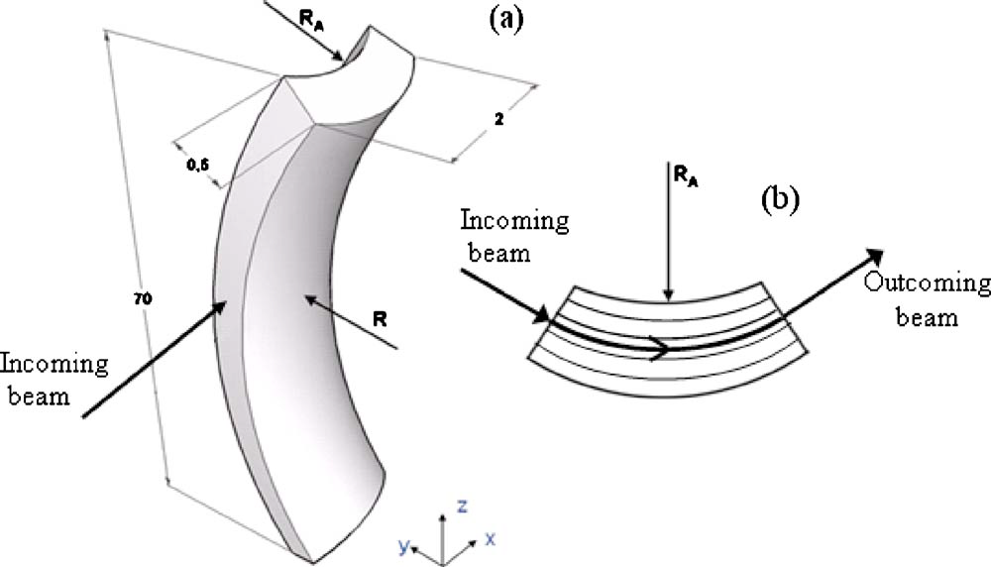
Coherent interaction studies at H8
UA9 leader in producing and testing crystals
  H8 beam test, X-ray diffraction, RBS, …
W. Scandale et al, PRL 98, 154801 (2007)
“strip crystal”
6. amorphous
5. Volume Capture
4. Volume Reflection P=95÷97%
Primary
curvature
2. Channeling
P=50÷85 %
3. dechanneling
1. amorphous
Anticlastic deformation to impart bending
Also quasi-mosaicity used (wider crystals)

Slide 16
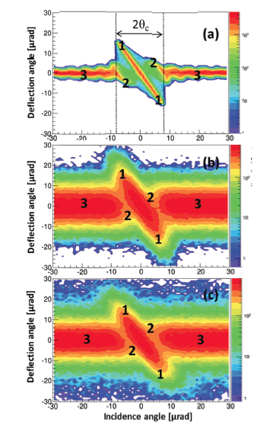
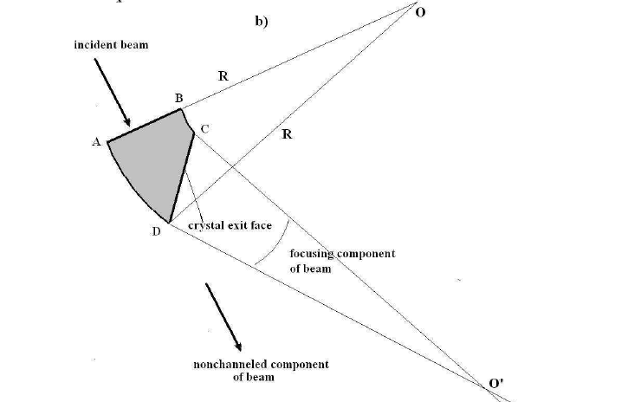
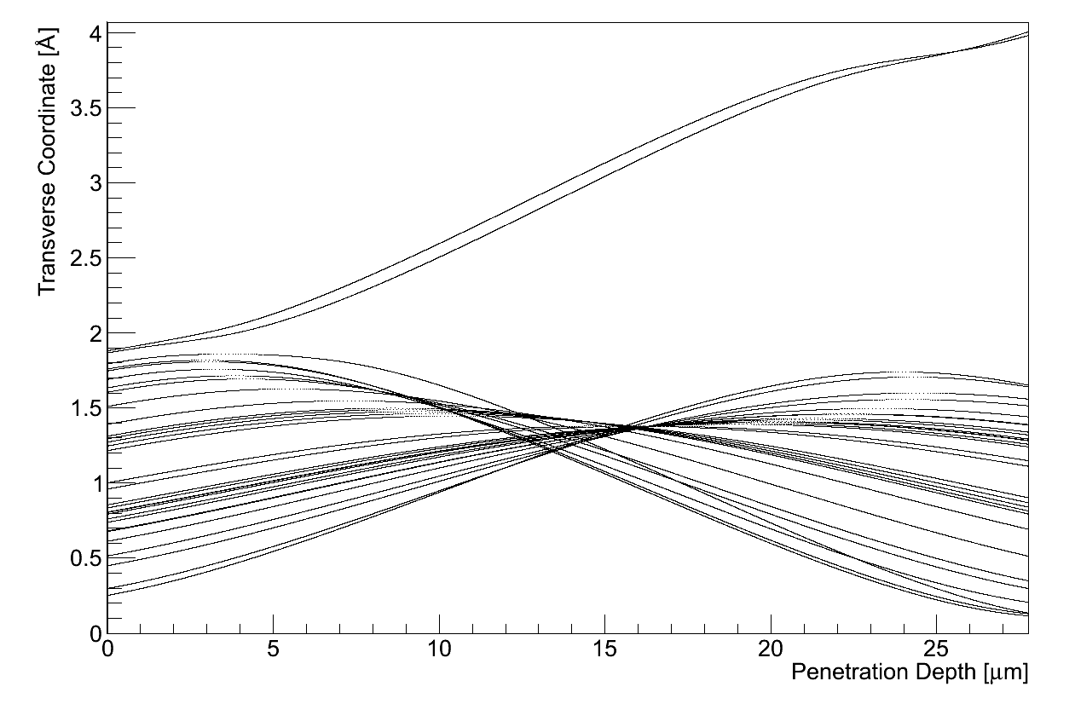
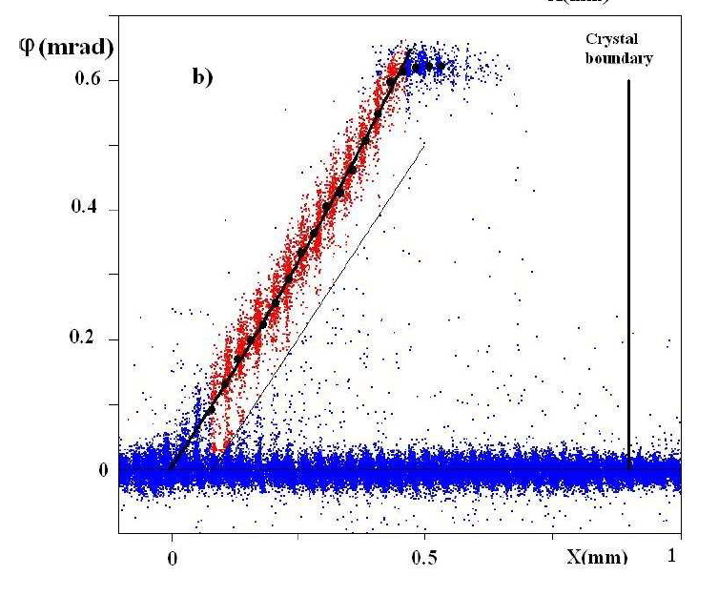
Some recent results on exotic crystals
W.Scandale et al. Phys.Lett. B 734 (2014) 1-6
W.Scandale et al. Phys.Lett.B, 733 (2014) 366-372
Mirror
crystals
theory
Focusing/
defocusing
crystals
data
Deflection
Thin (~10 μm)
straight crystal
(a “membrane”)
MC
Incident beam transverse position
Crystal manufacturing and coherent interactions models are well mastered by UA9 collaboration

Slide 17
Crystal collimation idea
Bent crystals as primary collimator
  Large kick angle even at high energy
  Reduced hard interaction
    (diffraction, ion fragmentation, ion em dissociation…)
  Reduced impedance
    Reduced number of secondary collimators, larger gaps
At a price of
  Relatively small acceptance
  All the losses on a single absorber

Slide 18
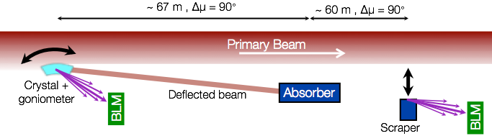
Crystal collimation at SPS
Extensive tests with
120-270 GeV protons
and Pb ions
  150 μrad deflection
  θ_{C} ∼ 20-13 μrad
  Single bunch and multi-bunch dedicated beams
Fast and reproducible crystal alignment
Clear loss reduction with respect to an amorphous orientation
  Up to x20 reduction
Dispersion suppressor

Slide 19
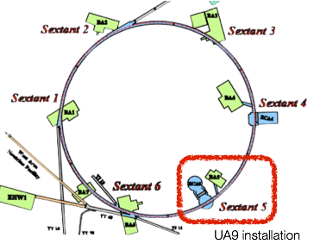
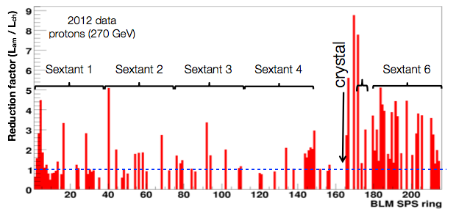
Losses around the SPS ring
Consistent reduction in the whole ring
Efficient crystal (i.e. almost all particles are channeled)
means low background in the machine

Slide 20
The UA9 test on LHC
goniometer
(Cherenkov)
  Integration of the crystals in the existing collimation system:
    installation of the equipment in IR7
    use of existing collimators (as absorbers) and BLMs.
    Simultaneous test of horizontal and vertical collimation.
absorbers
Diamonds
BLM
Courtesy of Jerome Lendaro
In close collaboration with CERN Collimation Group

Slide 21
Prediction for the LHC test
*D. Mirarchi, S. Redaelli, W. Scandale, V. Previtali:
Layouts for Crystal Collimation Tests at the LHC, MOPWO035, IPAC13.
  Layout optimized with complete
  tracking simulation
    Vertical crystal: DCUM 19918,
    horizontal crystal: DCUM 19842
    Crystal parameters:
    bending angle 50 μrad,
    length 0.4 cm
    local cleaning inefficiency is
    reduced by 5÷10 times
    in the dispersion suppressor

Slide 22
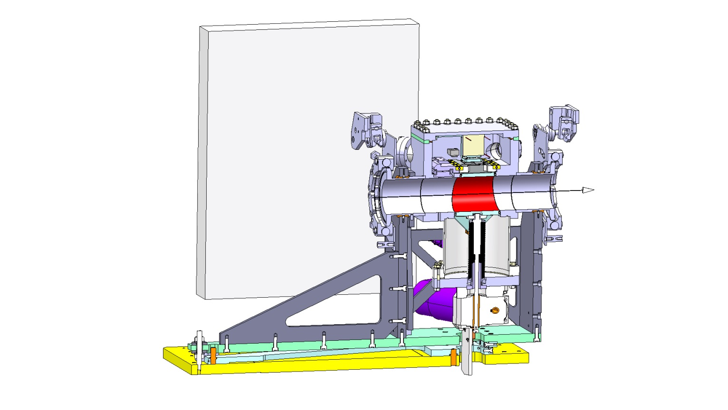
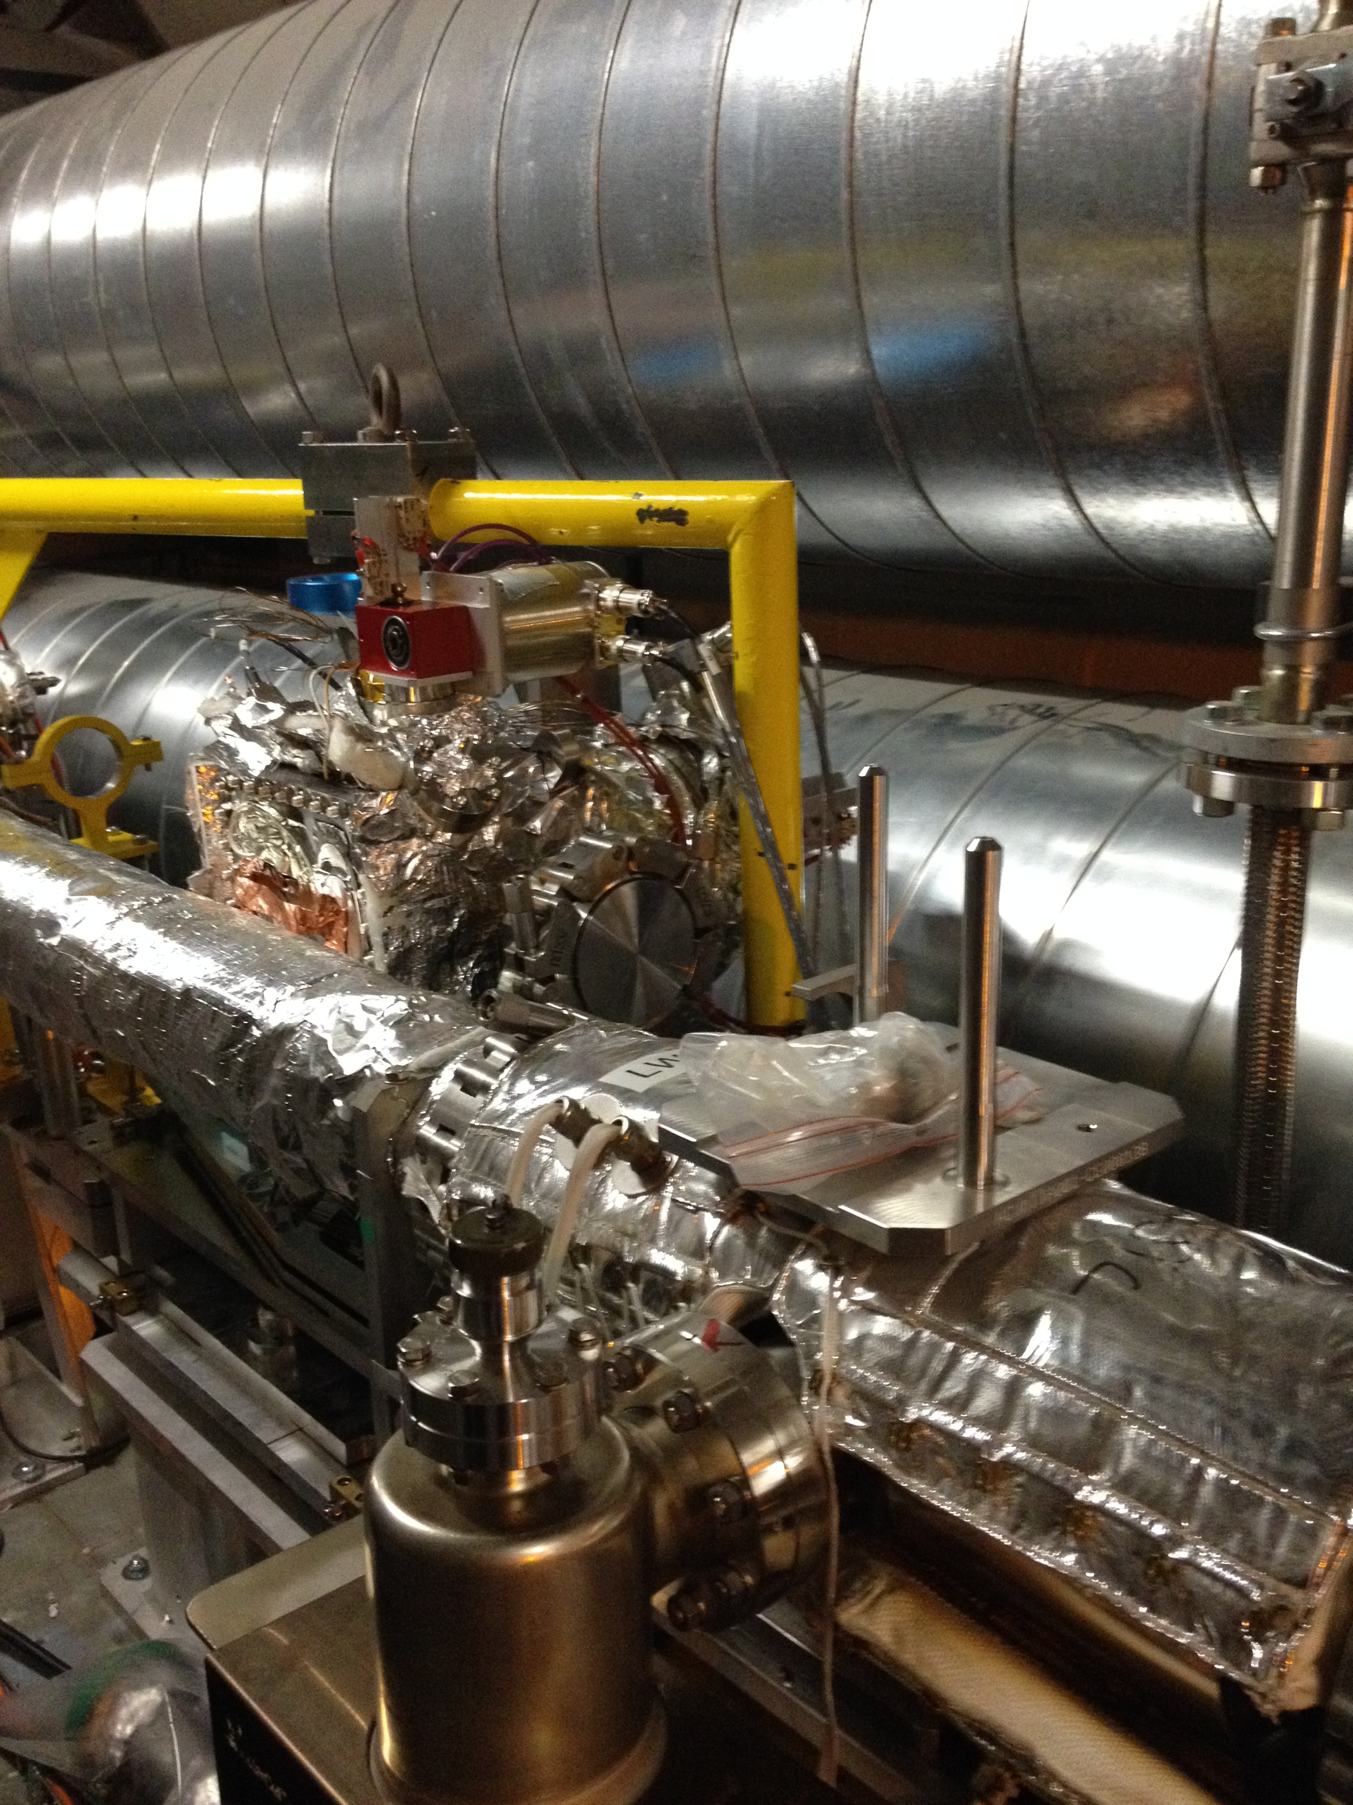
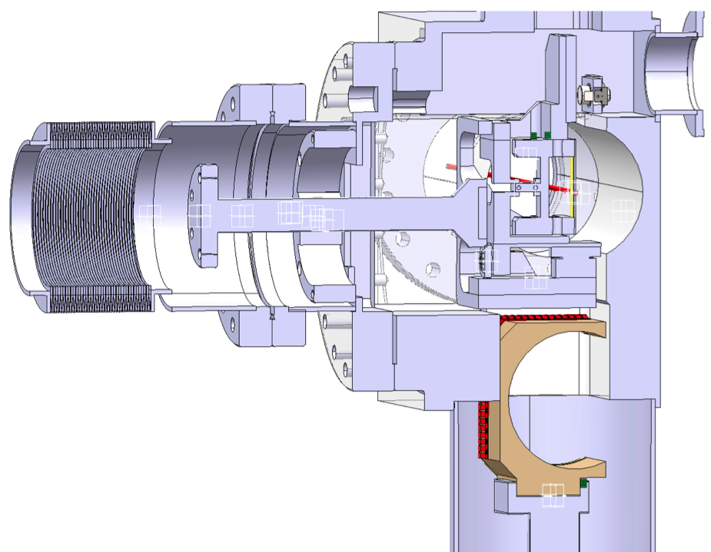
Piezo-goniometer installed on LHC
Designed at CERN EN-STI group, realized by CINEL
A.Masi
RF contacts
Linear Stroke: 60 mm
Linear resolution: 5 um
Total angular range : ±10 mrad
Angle resolution: 0.1 µrad
Angle accuracy: ±1 urad
On the beam pipe a copper and NEG coating could be applied
Movable beam pipe section
Stepping motor (linear movement)
Operational
position
Movable beam pipe section
New version under study
Piezo-electric material with higher Curie point (>200 deg) under investigation

Slide 23
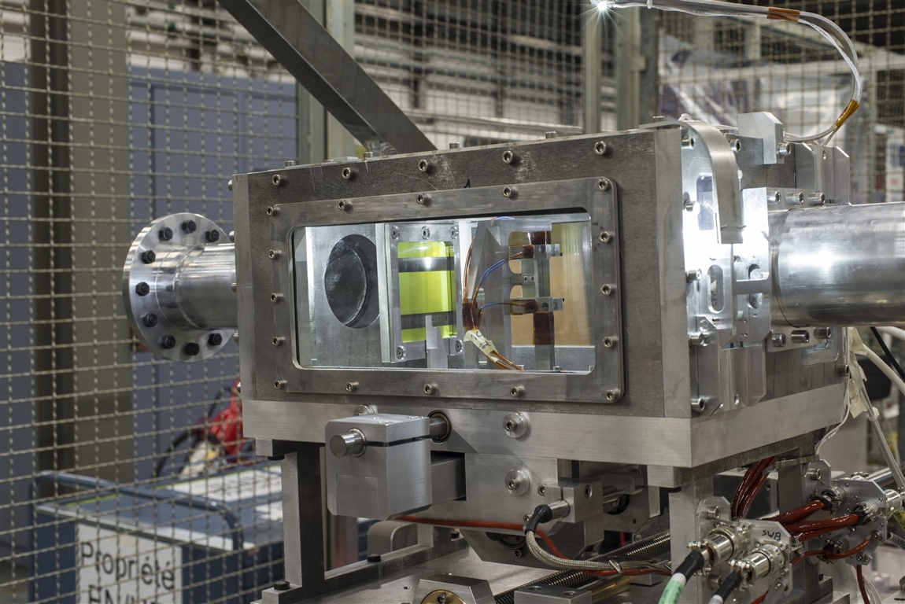
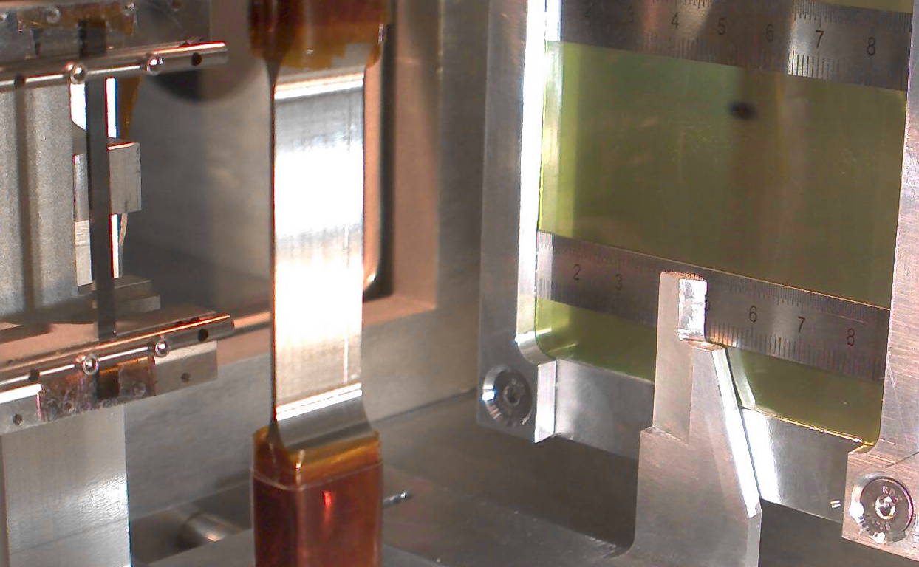
Crystal resistance to irradiation
IHEP U-70 (Biryukov et al, NIMB 234, 23-30)
  70 GeV protons,
  50 ms spills of 10¹⁴ protons every 9.6 s,
  several minutes irradiation
  channeling efficiency unchanged.
SPS North Area - NA48 (Biino et al, CERN-SL-96-30-EA)
  450 GeV protons,
  2.4 s spill of 5 x 10¹² protons every 14.4 s,
  one year irradiation, 2.4 x 10²⁰ protons/cm² in total,
  channeling efficiency reduced by 30%.
HRMT16-UA9CRY (HiRadMat facility, November 2012):
  440 GeV protons, up to 288 bunches in 7.2 μs,
  1.1 x 10¹¹ protons per bunch (3 x 10¹³ protons in total)
  ➔ comparable to asynchronous beam dump in LHC
  no damage to the crystal after accurate visual inspection
  more tests planned to assess possible crystal lattice damage
  accurate FLUKA simulation of energy deposition and residual dose

Slide 24
The CRYSBEAM challenges

Slide 25
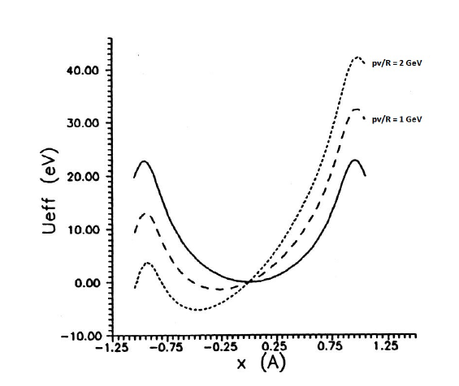
Critical Radius for channeling
Given a deflection angle Φ
Φ = L/R
where R is crystal curvature radius and
L is the crystal length
Critical radius
to have an efficient
channeling
Effective potential
in presence
of centrifugal
force
(bending)

Slide 26
Channeling efficiency versus Rc
Experiment (H8 and SPS):
  Si bent crystal (L = 0.2cm)
  (1 1 0) plane
  400 GeV/c protons
E. Bagli et al., Eur. Phys. J. C (2014) 74:2740
High efficiency zone
R > 10 Rc
Si (110):
R_{c} = 12m at pβ = 7 TeV
Ge (110):
R_{c} = 7m at pβ = 7 TeV
~1 mrad deflection requires ~12cm long Si crystal
(or 7 cm long Ge crystal)
Much longer than what UA9 tested and used so far

Slide 27
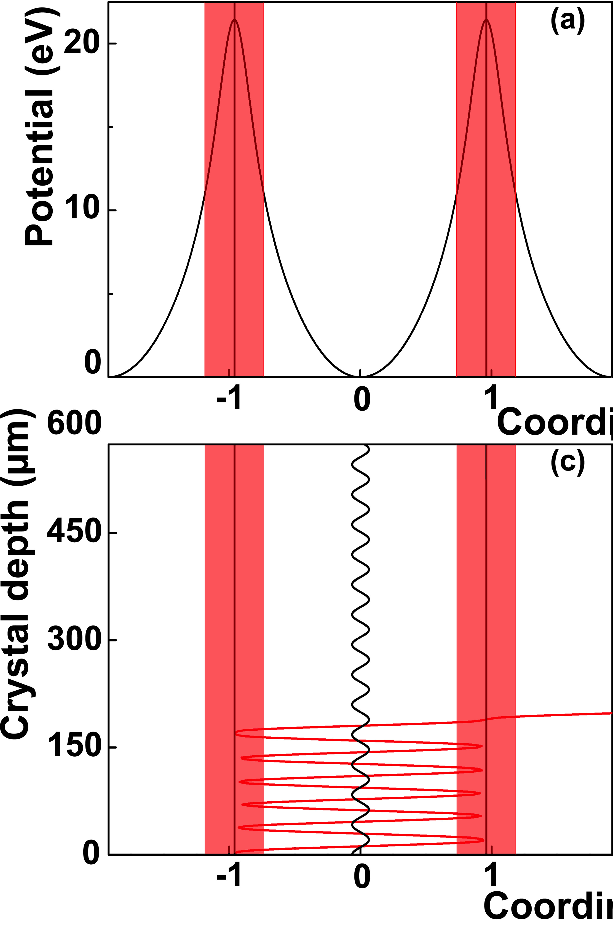
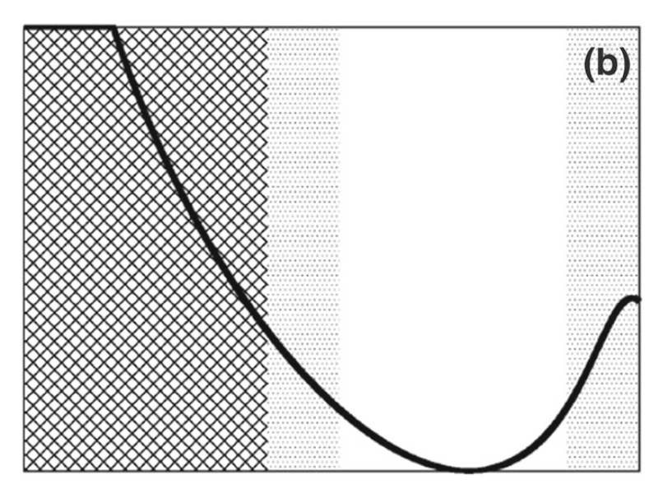
Dechanneling effects
Scandale et al., PLB 680, 129 (2009)
Nuclear (L_{n}) and electronic (L_{e}) dechanneling affecting
channeling efficiency
Interaction
with nuclei
Stable
L_{n} ~ sqrt(p) : at 7 TeV L_{n} ~ 0.6 cm
L_{e} ~ p : at 7 TeV L_{e} ~ 400cm
Interaction
with electrons
R =3Rc
Unstable
bending
N_{u}/2
N_{u}/2
E. Bagli et al., Eur. Phys. J. C (2014) 74:2740

Slide 28

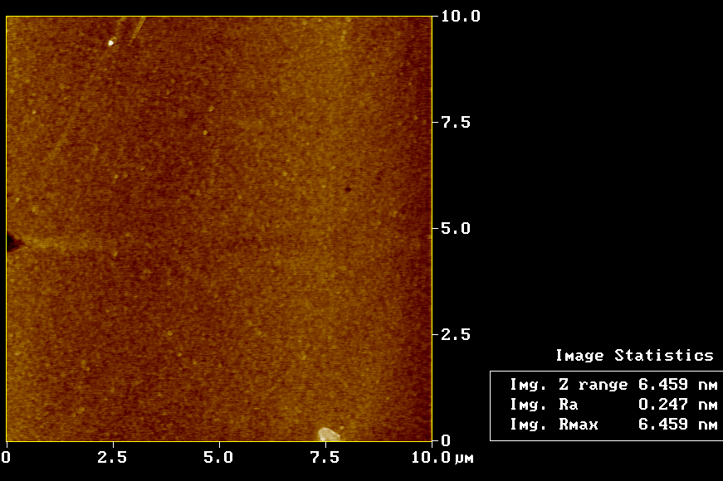
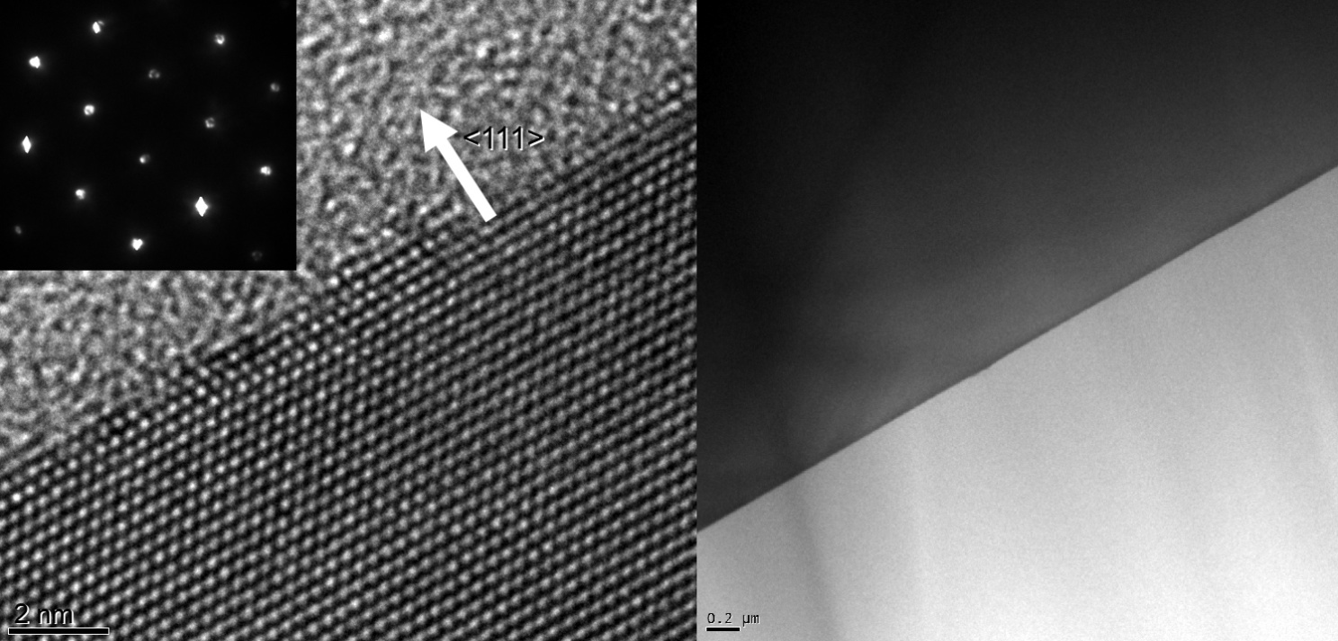
Silicon crystal production and testing
Anisotropic chemical etching
  Sub-surface damage free crystal
University of Ferrara and
INFN Ferrara
Lateral surface (AFM)
Entry surface (HRTEM)
^{JPD 41 (2008) 245501}
Sub-nm roughness was achieved

Slide 29
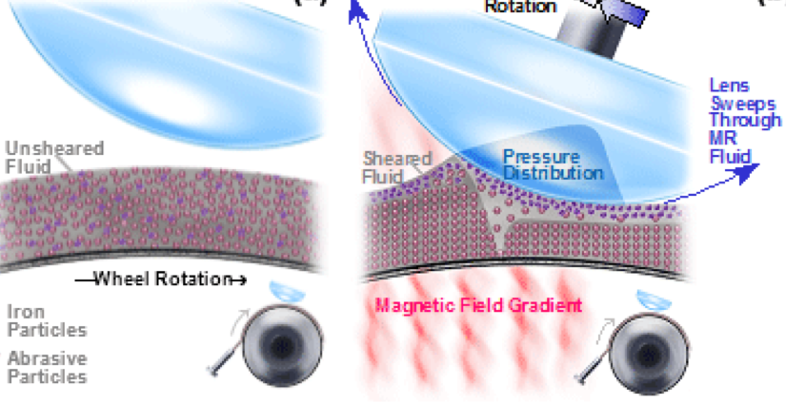
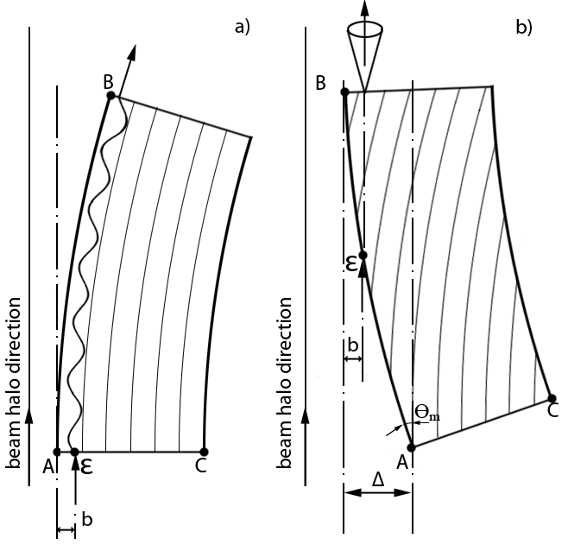
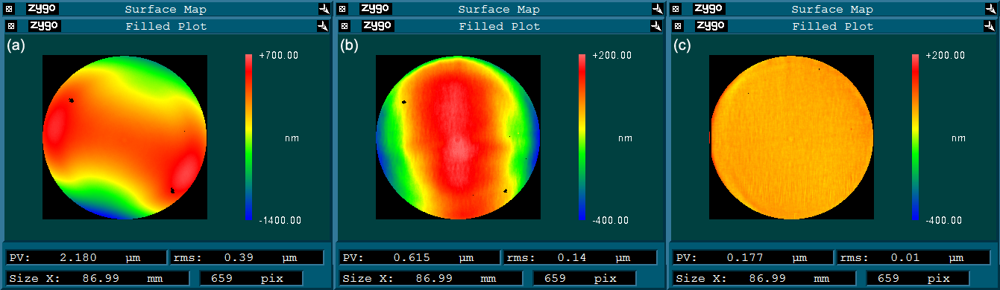
Challenges for crystal production
6 inch wafer micro-machining
Low miscut wafer
  Use magneto-rheologic finishing
Initial surface of the wafer
PV 2.18 um
RMS 0.39 um
Surface after first lapping
PV 0.615 um
RMS 0.14 um
Final Surface
PV 0.177 um
RMS 0.01 um
Dislocation (1D and 2D)
might be a problem for long crystals
Ge is now a viable alternative

Slide 30
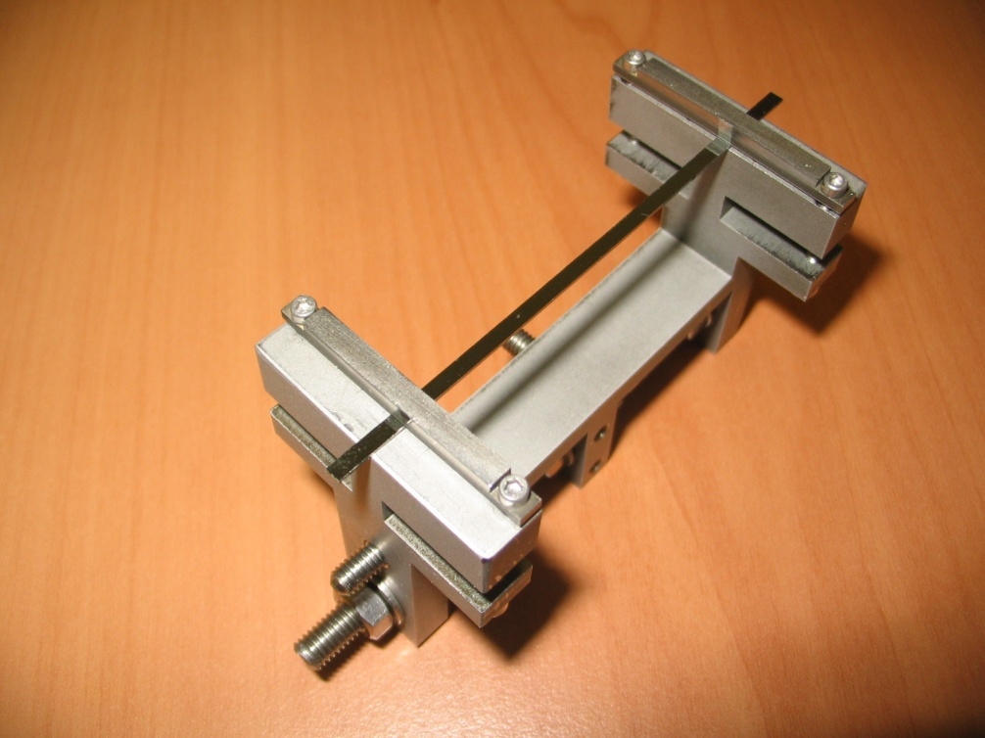
New Holder technology
UA9 LHC crystal
For a very long crystal (~10 cm), a new holder needs to be designed!
  Assisted curvature
  with tensile layer
  deposition
  INFN Ferrara labs
  has infrastructures and know-how
beam
High grade titanium
holder for SPS and LHC
crystals

Slide 31

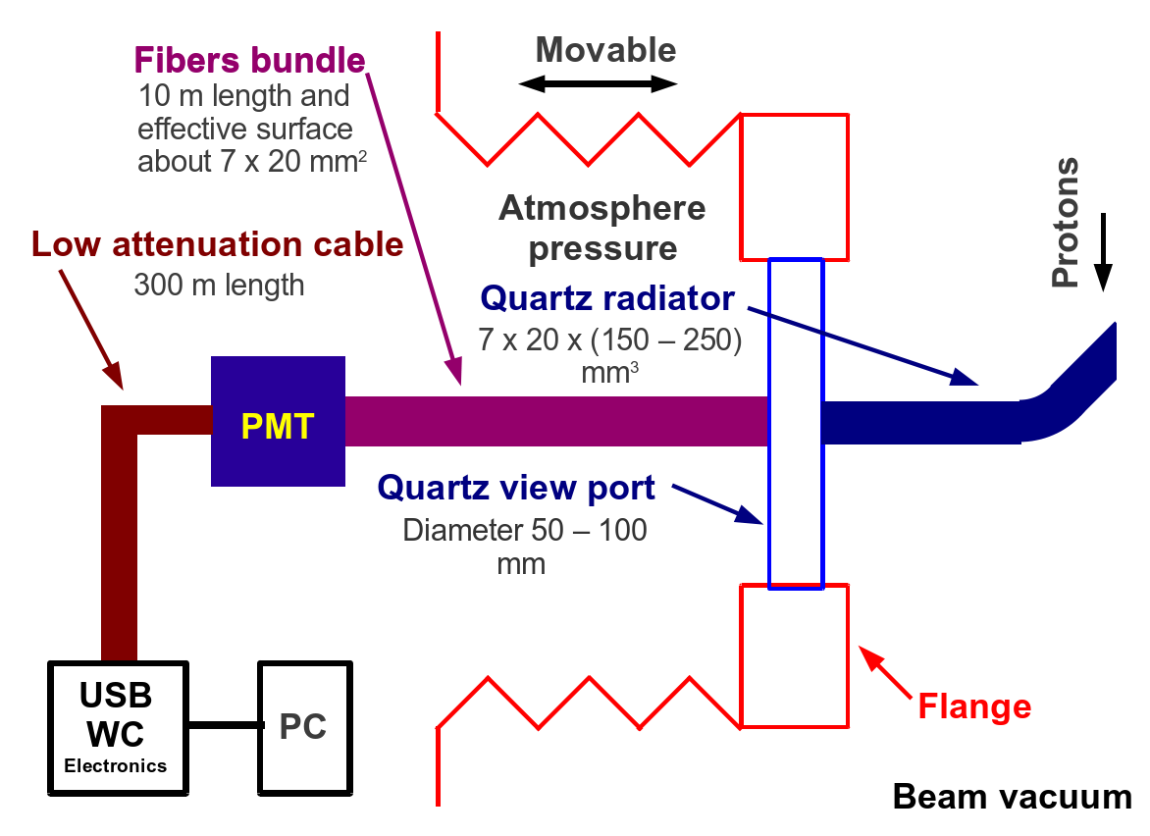
Cherenkov detectors
  Exploit Cherenkov radiation in fused silica to count deflected particle, measure their time and – with segmentation – beam spot.
Test at INFN LNF BTF
UA9 Cherenkov proton flux counter
5-10% resolution
on number
of incident
protons (100)
achieved
UA9 CpFM
Single electron
signal clearly
visible
To be installed and tested in SPS UA9 experimental area

Slide 32
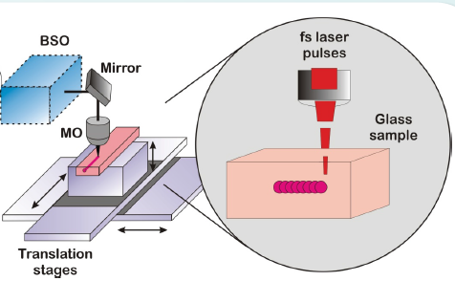
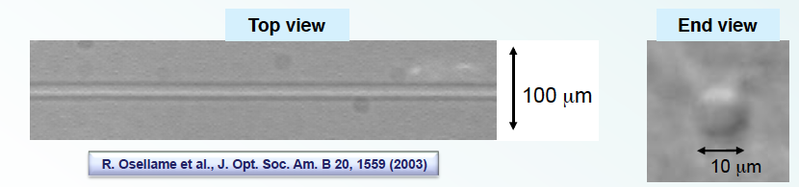
Radiator with position sensitivity
Ultra-fast high power laser writes waveguides!
  Use to build quantum-optics device
    “write” several
    optical waveguide
    to trap Cherenkov light
    (as a bundle of fibers)
    Connect each waveguide
    to a separate light sensor
    (SiPM, APD,…)
    Position information
    given by which channel fires
      Instrumented beam silica
      thin window

Slide 33
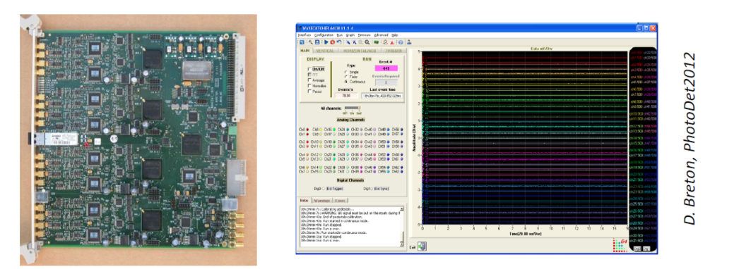
Timing resolution
Sub-ns timing resolution:
  prompt light emission (Cherenkov light)
  low light dispersion (short propagation distance)
  High resolution front-end electronics
LAL (Orsay) WaveCatcher
  A waveform digitizer
  3.2 Gs/s sampling rate
  12 bits
  < 10ps rms sampling time
  precision
UA9 already uses this electronics

Slide 34
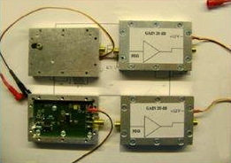
Diamonds as BLM
Fast beam loss close to crystal might be important to monitor crystal behaviour.
  Sensor based on synthetic diamond already used at LHC
  CRYSBEAM: build an ad-hoc fast electronic chain (preamp+fast disc+FPGA)
Rad Hard Electronics
Diamond
HV-amp
10 m
16 channel mother board
FPGA
LHC
BEAM
PIPE
16 ch
Nim Module
Ethernet output
R&D interesting for collimation as well

Slide 35
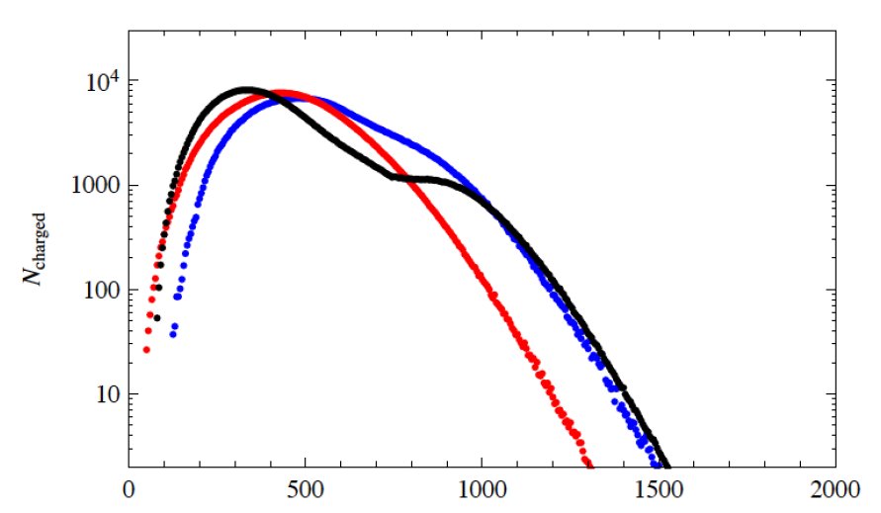
Shower of Cosmic Rays in a lab
SYBILL simulation (number of charged particle as a function of depth)
  air shower with density ρ =1 g/cm³)
No need to fully contain
longitudinally and transversely
the shower
7 TeV proton
3 showers
Critical measurement
  Position of first interaction
  Position of shower
  maximum
Depth Z [cm]
Optimization of the number of active layers
Impose constraint given by available space

Slide 36
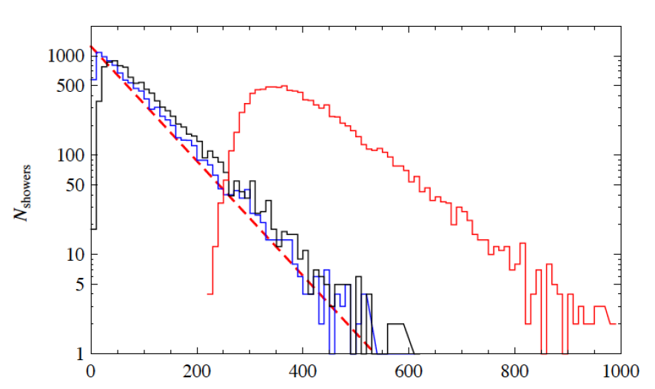
Hadronic shower parameters
Depth where 10 particles are
registered (blue histo)
Depth where 100 particles are
registered (black histo)
Position of shower maximum
(red histo)
First interaction distribution
(dashed line)
Depth Z [cm]

Slide 37
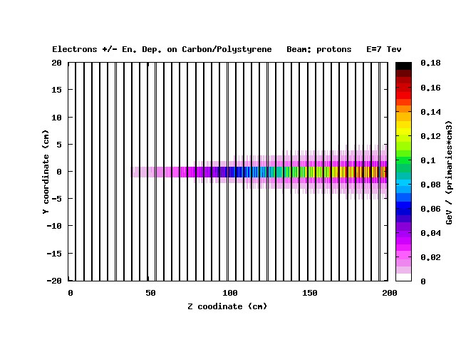
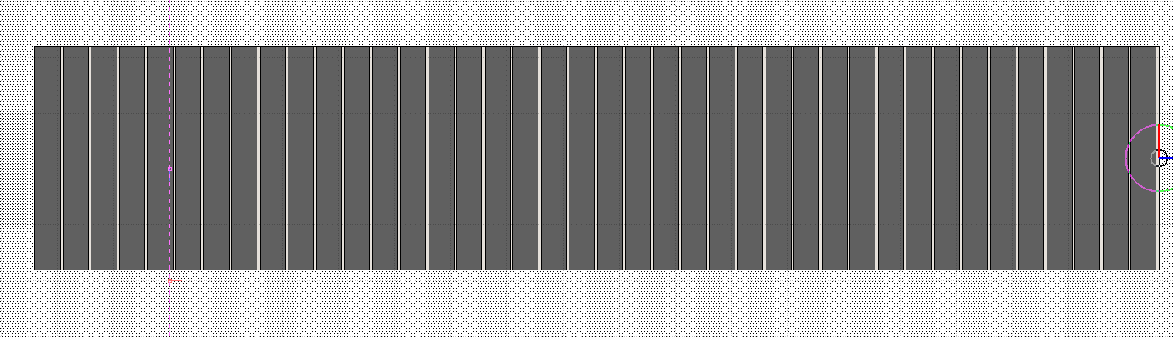


FLUKA simulations
Detailed tool to study geometry and algorithm
to extract cross section information [ σ_{tot} = 1/(n λ_{int})]
Carbon layers: 43 mm / Scint layers: 7 mm
7TeV protons
0.5 cm
10 cm
20 cm
150 cm
50 cm

Slide 38
Plans

Slide 39
CRYSBEAM objectives
Produce crystals with a large bending angle (a few mrad)
  Even larger bending for SPS test
Test them in the North Area to characterize their performance
  Reuse UA9 expertise and infrastructure
Propose a scenario for the halo extraction in the SPS, using the UA9 existing infrastructure
  LSS5 region
Test and characterize the halo extraction scheme in the SPS
    Extracted beam characterization with BLM and particle detectors
  Cross section measurement of interest for CR physics might be possible
    even SPS energies can be interesting
Propose of a scenario for an extraction test in LHC

Slide 40


SPS extraction test in LSS5
Location of
the extraction
test-bed in SPS
under study.
Vertical extraction
(towards to the
ceiling of the tunnel)
might be possible
Take out RP2

Slide 41

A broader physics reach, AFTER@LHC
    There is a wider physics case for a LHC fixed target experment
      High precision study of hadronic physics with either proton or ions
      extracted and sent to different targets
This goes beyond CRYSBEAM activity
  A more complex (and bigger) experiment is needed!
    But crystal extraction could be the first piece for this
  A Letter of Intent for CERN is in preparation

Slide 42
Conclusions
  Experience of crystals with accelerator is well consolidated at CERN with UA9
    Crystal collimation is as an option for high luminosity in LHC
    UA9 will cooperate with the Collimation Team in the frame of the Hi-Lumi Programme
    Test of crystal-assisted collimation could be extended to high-intensity operation
  CRYSBEAM (and INFN) propose to demonstrate
  multi-TeV crystal extraction is feasible
    CRYSEBAM proposes experiments relevant for Cosmic Rays physics to demonstrate this technique is valid
    CRYSBEAM goals can be included within the UA9 collaboration (INFN proposal)
AFTER@LHC is considering fixed-target experiments at multi-TeV energies (Letter of intent in preparation)

Slide 43
Additional back-up slides

Slide 44





UA9 LNF BTF test
4 Cherenkov bars (L and I shape)
47º end of the bars
MCP-PMT
Fibers bundle
PMTs black boxes
Fibers bundle
44

Slide 45

UA9 CpFM linearity
Measured CpFM charge (normalized on the charge of single p.e.) as a function of BTF calorimeter charge

Slide 46


Germanium technology is mature alternative
SPS-H8-CERN 400 GeV Proton
Plannar channeling efficiency
First axial channeling in Ge
De Salvador et al. JAP (2013)
De Salvador et al. APL (2011)
Vertical Deflection [μrad]
Horizontal Deflection [μrad]

Slide 47

Silicon strip manufacturing
Established fabrication technique
a) Starting material: (110) silicon wafer
b) LPCVD deposition of silicon nitride thin layer
c) Silicon nitride patterning (photolithography)
d) Etching of Si in KOH solution, silicon nitride acts as masking layer
e) Silicon strips release
Revisitation needed!
f) Removal of silicon nitride

Slide 48

Development of a hadronic shower

Slide 49
Conceptual experiments
Segmented absorber
Active layers (pixelated?)
to measure shower properties
Extracted beam
Q: are shower properties
sensitive to cross section
on absorber material?
(test with FLUKA and SYBILL)
1
Target material can be
changed.
Measure
(in a narrow solid angle)
exclusive cross-section
(anti proton, B, C,..)
Detector can be moved
at different angles
Extracted beam
2
target
“single-arm”
detector

Slide 50
Conceptual experiments (2)
Incoming flux
detector
“diffracted particle”
Dispersive region
of the accelerator:
Detected diffracted
particles
3
Thin absorber
Use the accelerator as a spectrometer to measure the momentum of
diffractive particles
With two stations, measure angle and momentum
Direct measurement of diffractive cross section on absorber materials

