Slide 1

The Frascati Beam-Test Facility: ten years experience and prospects for the future.
Séminaire du Laboratoire de L’Accélérateur Linéaire
Bruno Buonomo¹, Luca Foggetta¹, Paolo Valente²
¹ INFN Laboratori Nazionali di Frascati
² INFN Roma

Slide 2
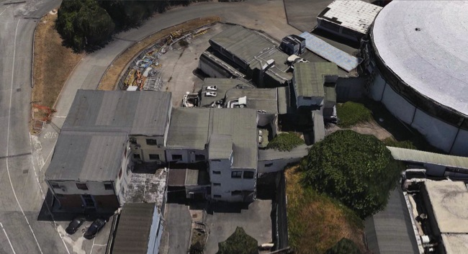
Outline
How it works
What is used for
What we’ve learned
Plans for the future

Slide 3
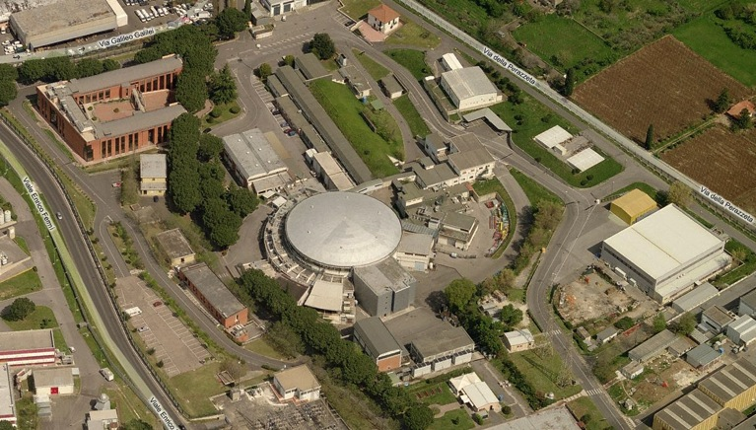
INFN Frascati Laboratory (LNF)
Synchrotron light
DAFNE
LINAC
BTF
Damping ring

Slide 4
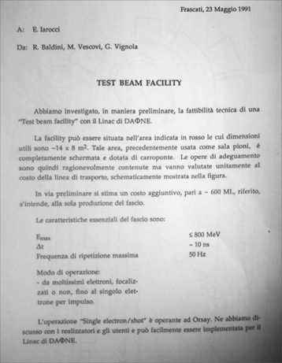
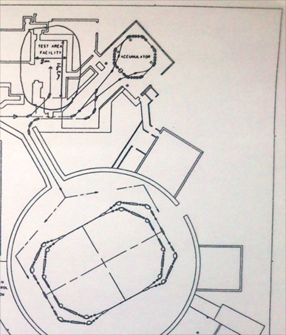
The beginning
A general purpose beam-test area was foreseen already in the original design of DAFNE, the Frascati collider replacing ADONE (switched off Apr. 26th, 1993)
F. Sannibale and G. Vignola DAFNE technical note LC-2/1991

Slide 5
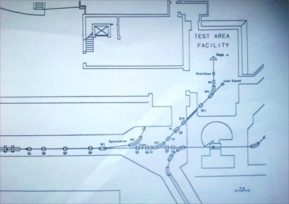
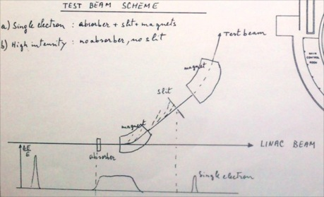
The concept
The original idea of BTF was already to have two distinct operation modes:
Single particle mode
Extraction of the primary beam
The idea was to use the LINAC beam only when not injecting, thus sharing the same transfer line to the damping ring

Slide 6
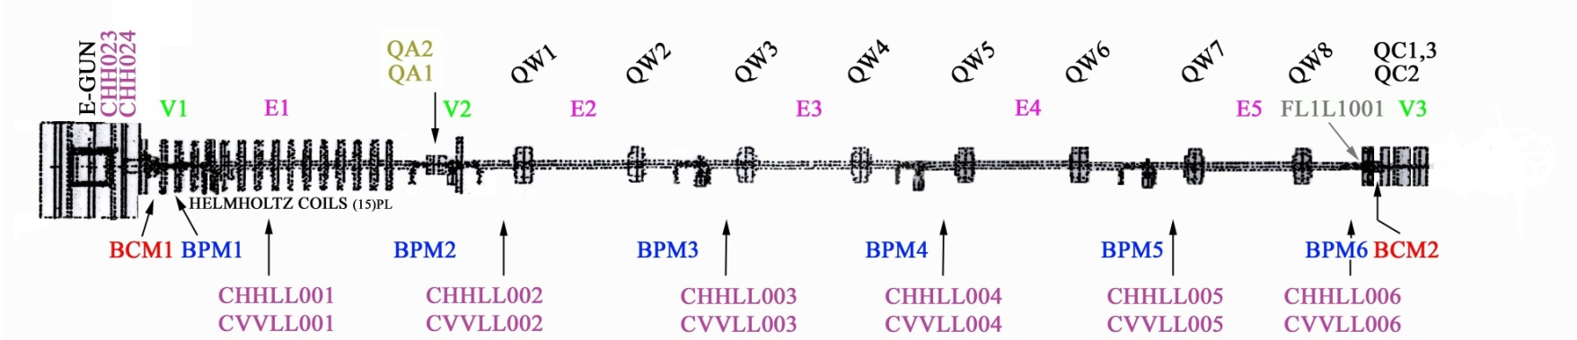
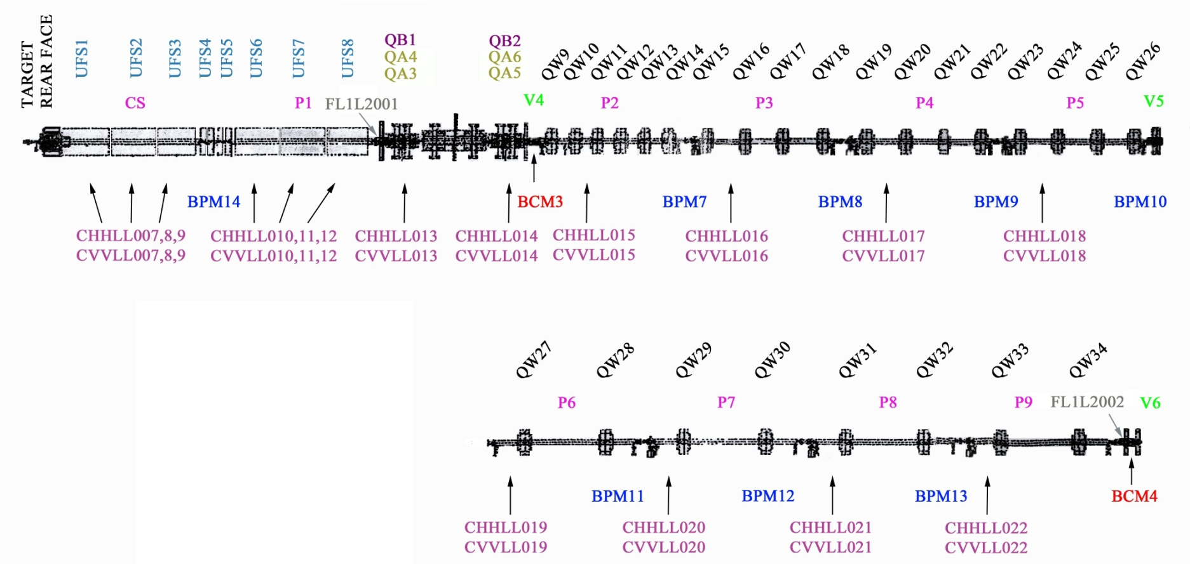
DAFNE LINAC/1
High current
High energy

Slide 7
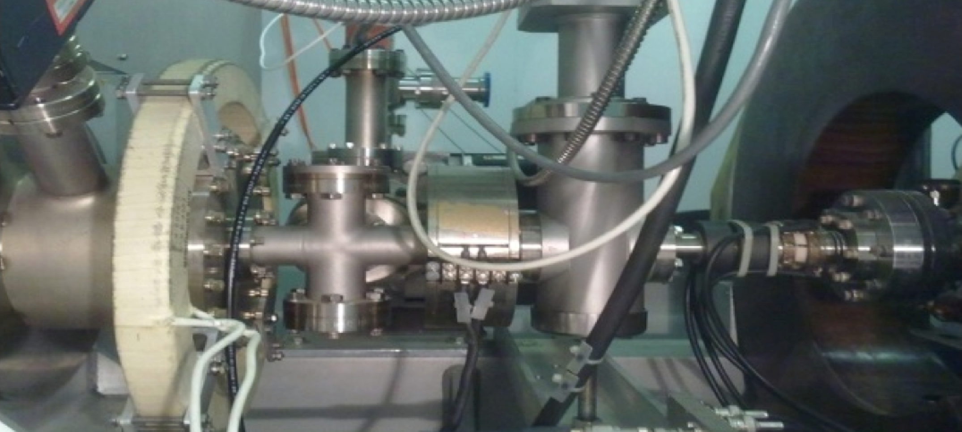
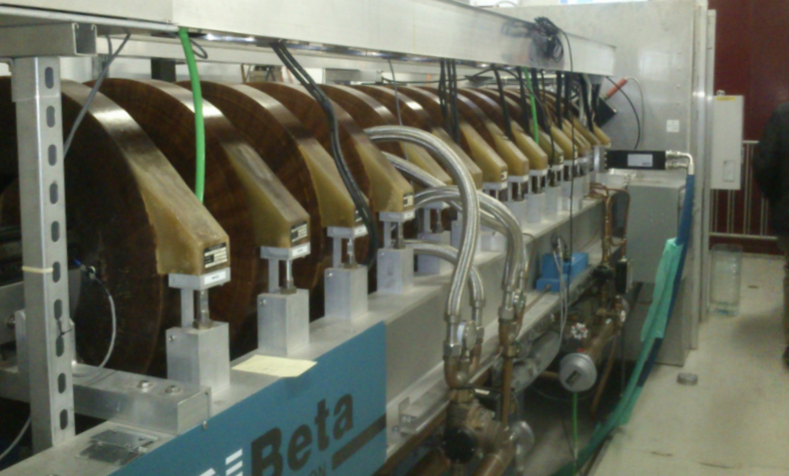
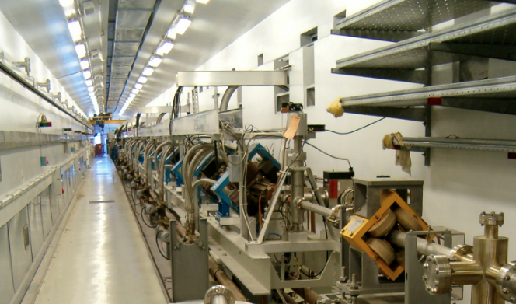

Slide 8
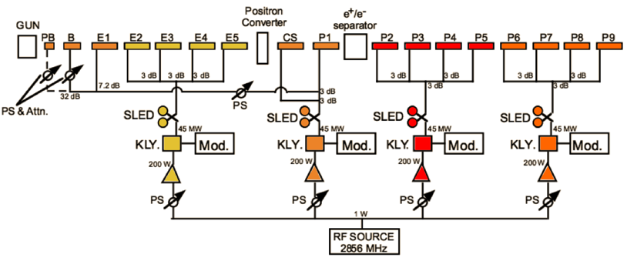
DAFNE LINAC/2
RF frequency | 2856 MHz
Accelerating structure | SLAC-type, CG, 2π/3
RF source | 4×45 MWp SLED-ed klystrons TH2128C
RF frequency | 2856 MHz
Accelerating structure | SLAC-type, CG, 2π/3
RF source | 4×45 MWp SLED-ed klystrons TH2128C
26 MeV/m
17 MeV/m
B
A
C
D

Slide 9
DAFNE LINAC/3
Parameter | Design | Operational
RF frequency | 2856 MHz
Accelerating structure | SLAC-type, CG, 2π/3
RF source | 4×45 MWp SLED-ed klystrons TH2128C
Electron beam final energy | 800 MeV | 510 MeV
Positron beam final energy | 550 MeV | 510 MeV
Positron conversion energy | 250 MeV | 220 MeV
Beam pulse rep. rate | 25/50 Hz | 25/50 Hz
Beam macropulse length | 10 nsec | 1.4 to 40 nsec
Gun current | 8 A | 8 A
Electron beam spot on positron converter | 1 mm | 1 mm
electron current on positron converter | 5 A | 5.2 A
norm. Emittance (mm. mrad) | 1 (electron) 10 (positron) | < 1.5
rms Energy spread | 0.5% (electron) 1.0% (positron) | 0.5% (electron) 1.0% (positron)
Max output electron current | >150 mA | 500 mA
Max output positron current | 36 mA | 85 mA
Transport efficiency From CS to linac end | 90% | 90%
RF
Energy
Timing
Converter
Spread
Current
Parameter | Design | Operational
RF frequency | 2856 MHz
Accelerating structure | SLAC-type, CG, 2π/3
RF source | 4×45 MWp SLED-ed klystrons TH2128C
Electron beam final energy | 800 MeV | 510 MeV
Positron beam final energy | 550 MeV | 510 MeV
Positron conversion energy | 250 MeV | 220 MeV
Beam pulse rep. rate | 25/50 Hz | 25/50 Hz
Beam macropulse length | 10 nsec | 1.4 to 40 nsec
Gun current | 8 A | 8 A
Electron beam spot on positron converter | 1 mm | 1 mm
electron current on positron converter | 5 A | 5.2 A
norm. Emittance (mm. mrad) | 1 (electron) 10 (positron) | < 1.5
rms Energy spread | 0.5% (electron) 1.0% (positron) | 0.5% (electron) 1.0% (positron)
Max output electron current | >150 mA | 500 mA
Max output positron current | 36 mA | 85 mA
Trasport efficiency from capture section to linac end | 90% | 90%

Slide 10
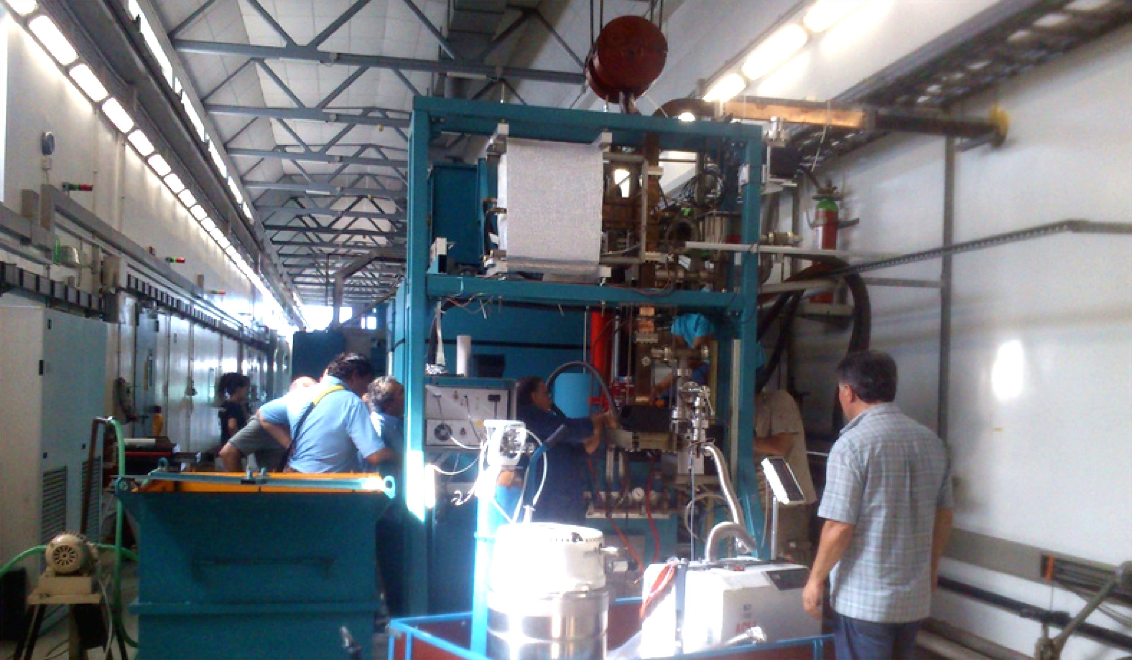
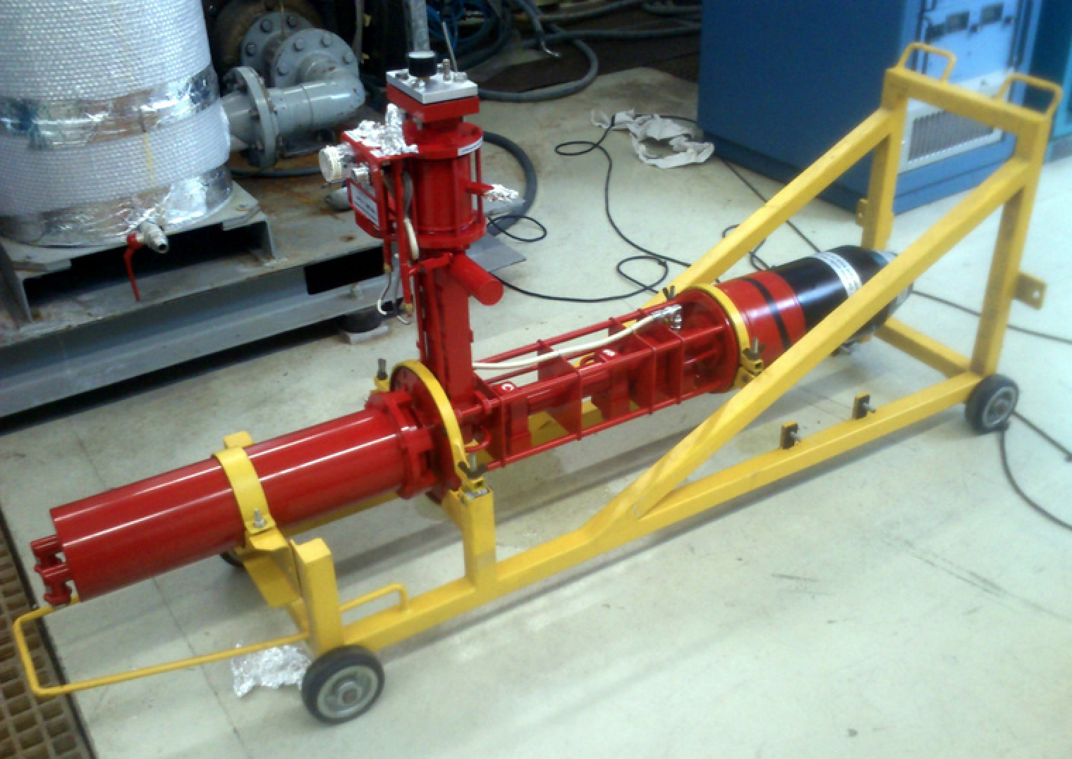
Klystron replacement

Slide 11
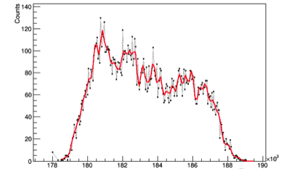
LINAC pulse
0.5 nC = 50 mA average current
10⁸ electrons × about 30 micro-bunches
14 ps FWHM
350 ps
25 Hz typical repetition rate
50 Hz maximum
10 ns
1 bunch/s sent to a spectrometer line for energy monitoring
(45° dipole + metallic strip detector)
Real time structure of bunch
(diamond detector: micro-bunch structure convoluted with detector resolution, trigger jitter…)

Slide 12
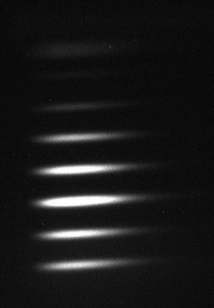
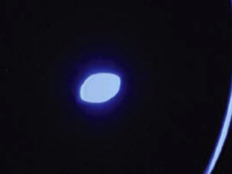
Beam emittance
Measured emittance:
  √<x²>=4 mm
  √<x’²>=1.7 mrad
  √(<x>²<x’>²-<xx’>²)=4 mm⋅mrad
  Energy = 508 MeV
<2 mm spot
N. Delerue et al., PAC’09 TH5RFP065

Slide 13
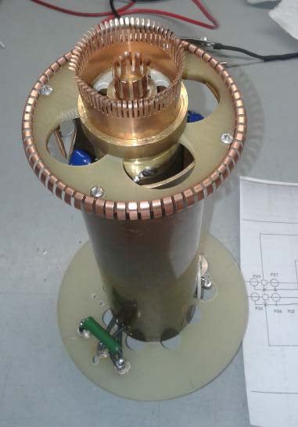
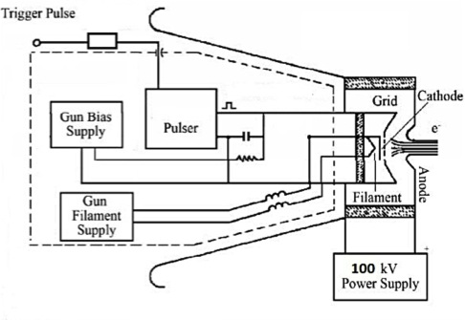
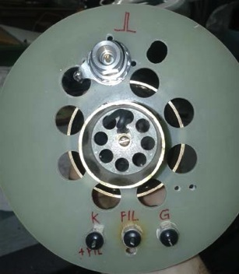
LINAC gun

Slide 14
BTF operating modes
Starting from 10⁷-10¹⁰(10⁹) electrons (positrons) from the DAFNE LINAC, with E_{max}=550/750 MeV and Δt=1.5-40 ns, it operates mainly in two different intensity regimes:
  High intensity: primary beam driven to the experimental hall, between 250 MeV and E_{max}, tuned with collimators
  Single particle/bunch (Poisson distribution) between few tens of MeV and E_{max}, created intercepting the beam with a variable depth copper target, selecting the energy and collimating.
Intermediate intensity (<10⁵ particles/bunch) is also achievable (see next slides)
Primary beam fixed to E=510 MeV and Δt=10 ns during operations of DAFNE collider

Slide 15
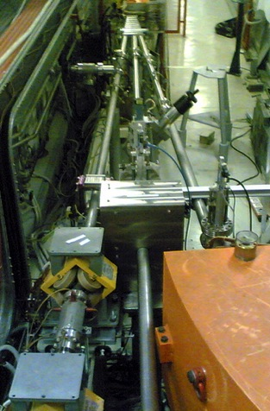
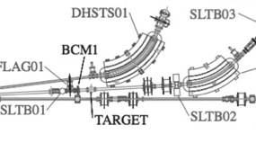
Beam attenuation/1
Copper target
Optimized shielding to reduce e.m. background

Slide 16
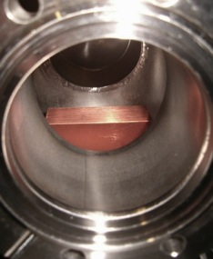
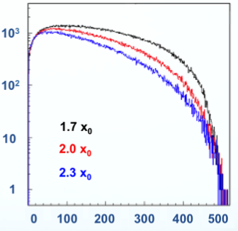
Beam attenuation/2
Copper target
Variable depth: 1.7, 2.0, 2.3 x₀
Shower energy distribution
+ angular cut due to
beam-line + collimators
acceptance

Slide 17
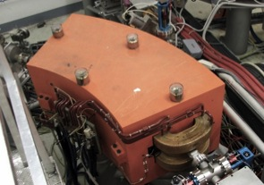
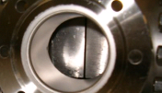
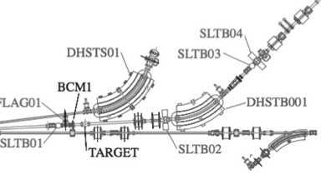
Momentum selection
42° momentum selection dipole
Tungsten collimators
Linac
spectrometer

Slide 18
Momentum resolution/1
Momentum resolution is mainly determined by down-stream horizontal slits
Also depends on the incoming beam divergence (different entrance point and angles in the magnetic field determine different paths for the same momentum):
  Up-stream horizontal collimator to reduce this contribution

Slide 19
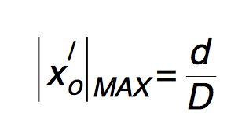
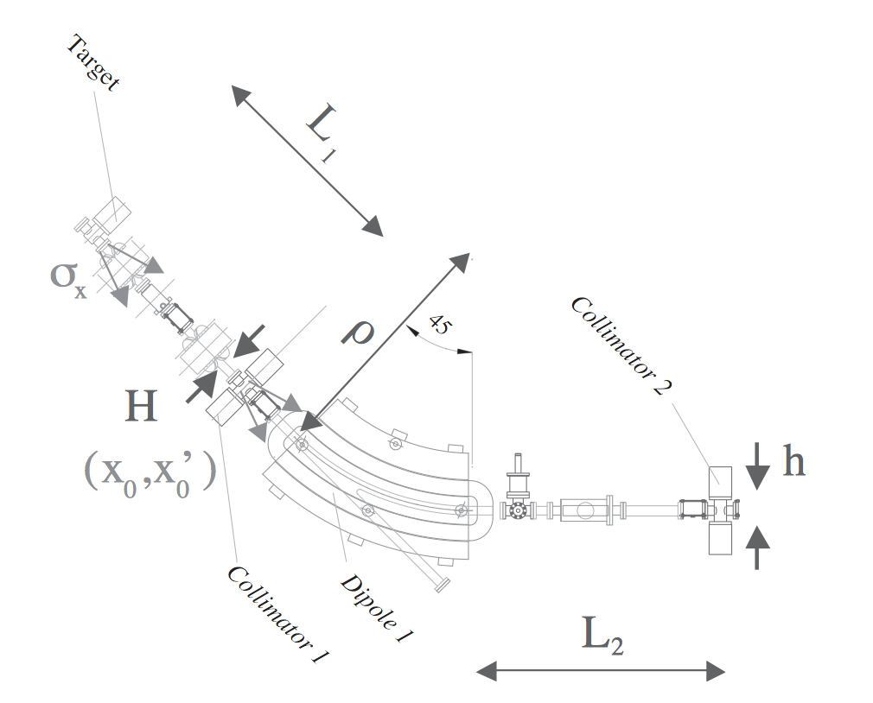


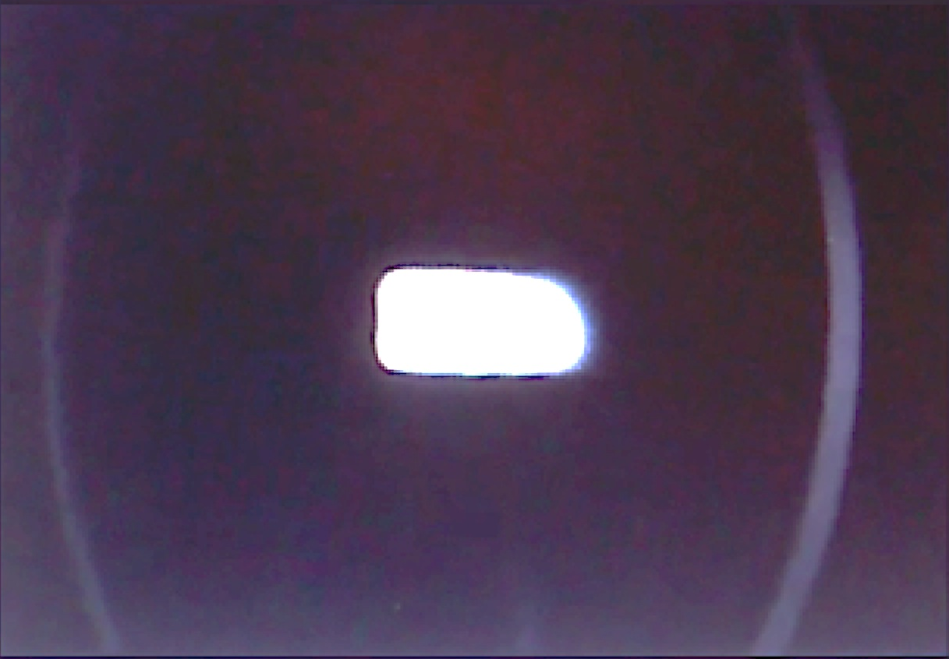


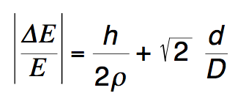
Momentum resolution/2
Maximum input divergence:
Aperture d, Thickness D
D
d
Resolution:
ρ = 2.2 m
1% for D=15 cm, h=d=1 mm

Slide 20
Intensity fine tuning
Adjustment of the number of particles can be achieved:
  Without changing the momentum resolution:
    Modulating the LINAC current [not possible in ‘parasitic mode’, very rough]
      Act on transport optics or modulators power/phase
    Choosing another target depth [step change but reproducible]
    Closing/Opening the down-stream vertical collimators [fine but small range]
    Closing/Opening the up-stream vertical collimators
  Also changing the momentum resolution:
    Closing/Opening the horizontal collimators

Slide 21
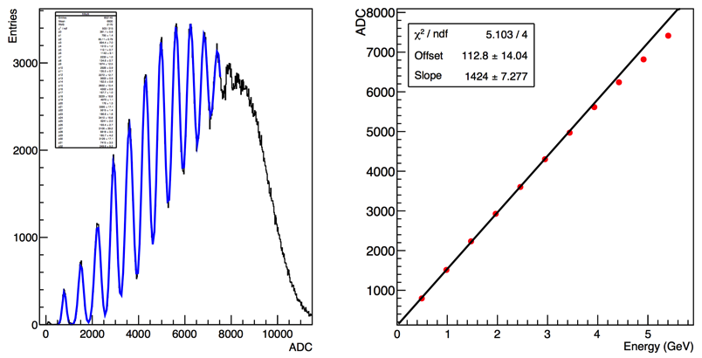
Single particle regime
SiPM saturation
Courtesy: TWICE-Insulab

Slide 22
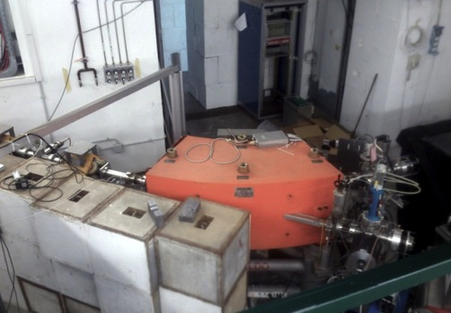
BTF line
45° line
Equipped with detector testing gadgets:
  Remote-control table
  Beam spot and intensity diagnostics for medium and low intensity beam
Straight line
More background
Used mainly for high-intensity;
  neutron photo-production
  equipped with fluorescence flag
Actually, the two lines are almost identical:
Be-flange, WCM, camera, moveable flag
Pre-vacuum and ionic pump, gate valve, pressure gauge

Slide 23
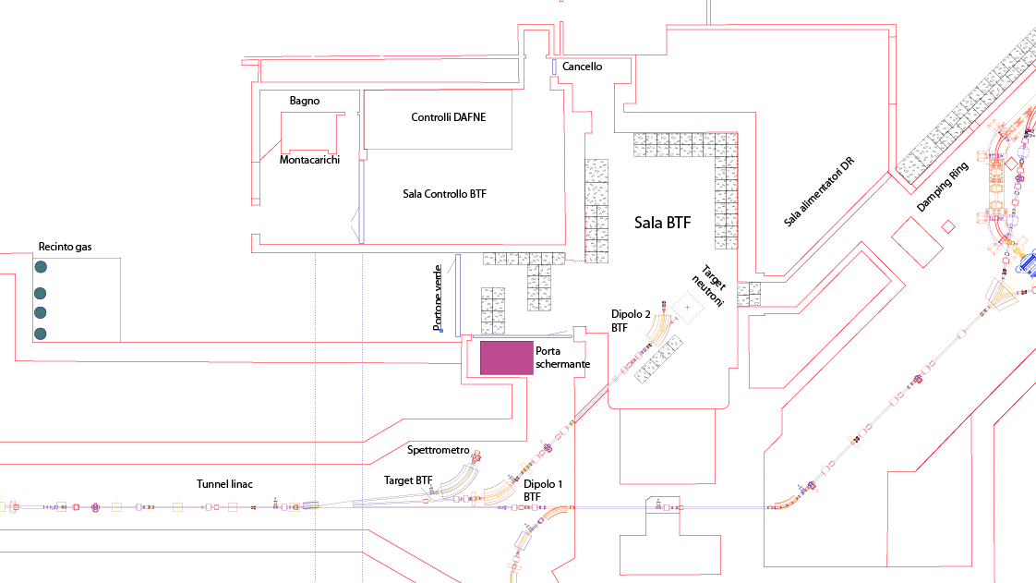
BTF area/1
6,5 m
11,5 m
5,5 m

Slide 24
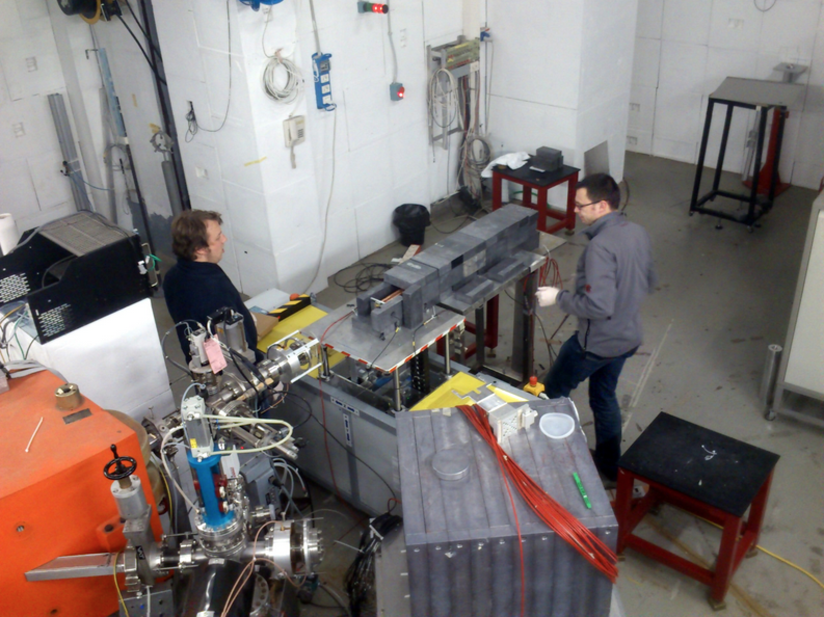
BTF area/2

Slide 25
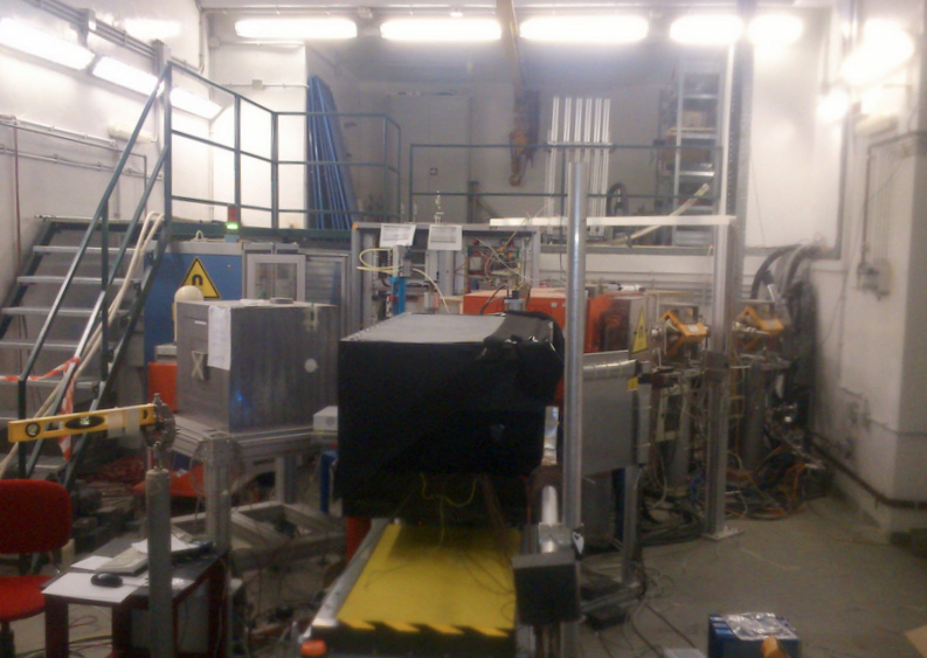
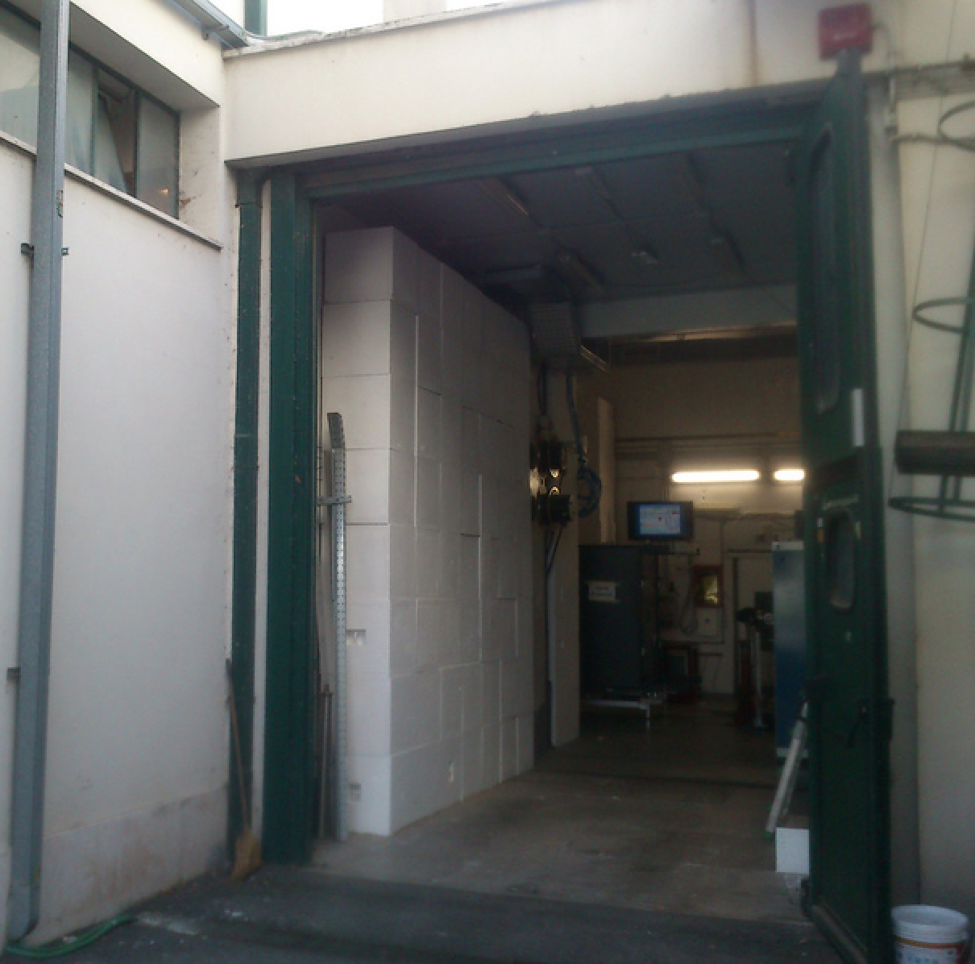
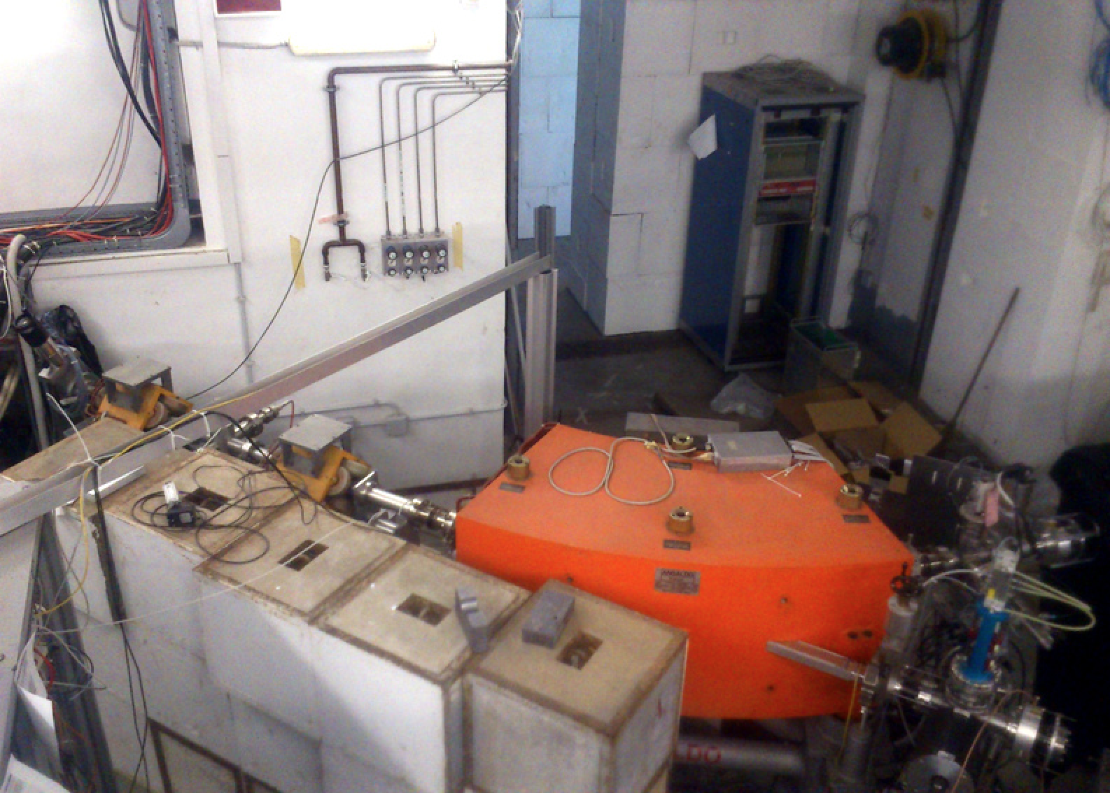
BTF area/3

Slide 26
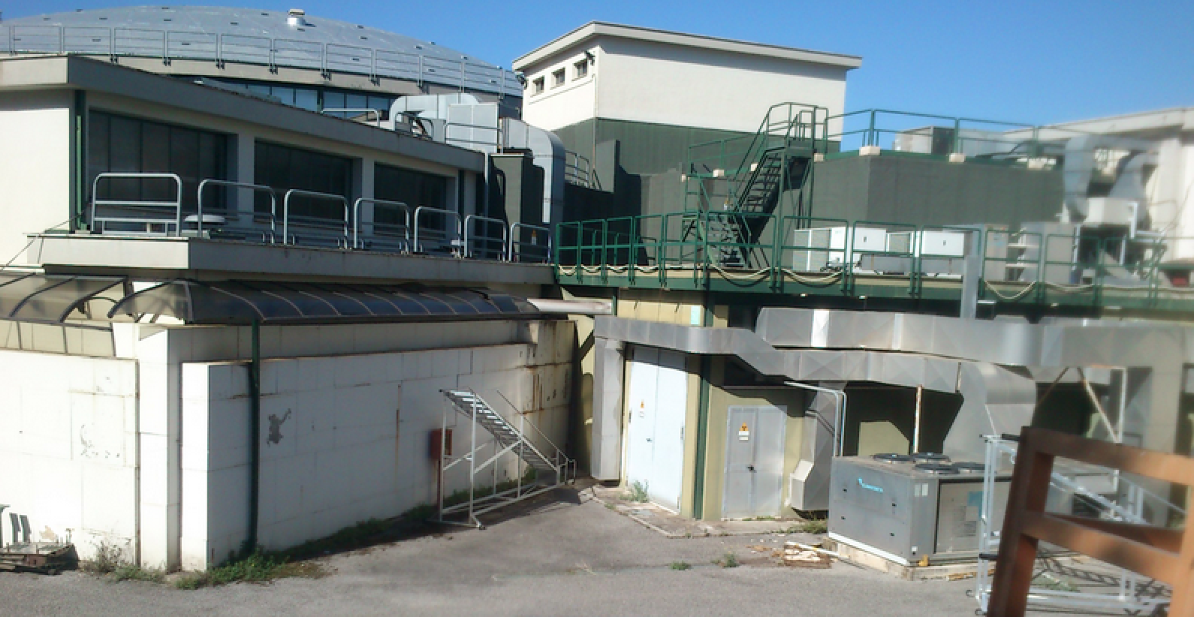
BTF area/4
BTF CR
BTF hall
Damping ring
Pumps room

Slide 27
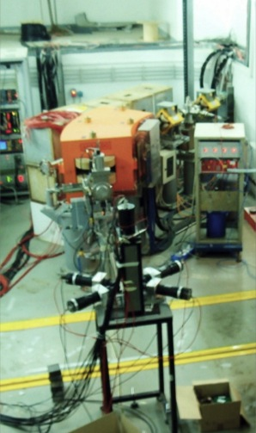
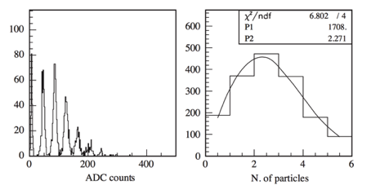
Commissioning
Lead/scintillating fiber “spaghetti” calorimeter, read by a single PMT
Scintillator palettes read on both sides for beam “centering”
G. Mazzitelli et al., Nucl. Instrum. Meth. A 515 516 (2003)
First users in 2003
Regular call and user shifts since 2004

Slide 28
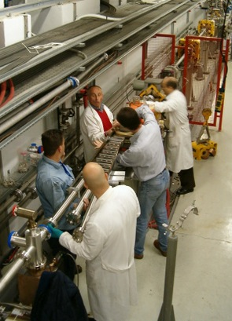
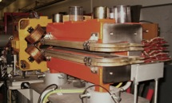
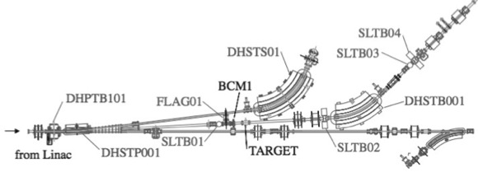
Separation of BTF line/1
Sharing the transfer-line with the collider injections implied a low duty-cycle, especially during topping-up. In order to separate the BTF line from the damping ring transfer-line, a 3-way selection system installed in April 2004:
New, thin beam-pipe with 3 exits
DC dipole 3° + pulsed dipole 3° driving bunches at:
  0° to damping ring
  3° to BTF line
  1 bunch/s to 6° to Linac spectrometer
Energy selecting magnet operated at reduced current: 42° instead of 45°
  Linac
  spectrometer
  BTF line
  to/from DR

Slide 29
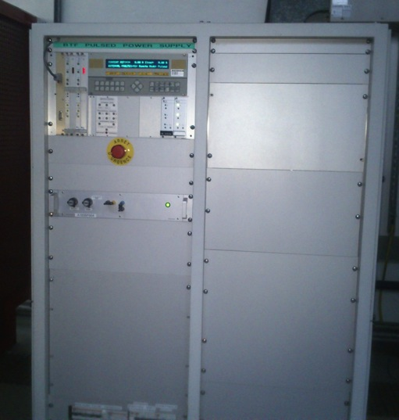
Separation of BTF line/2
2006:
DC/pulsed power converter
Ramp up <10 ms
Flat top [5, 960 ms]
  Linac
  spectrometer
  BTF line
  to/from DR
Sequence of bunches to BTF line also during injections

Slide 30
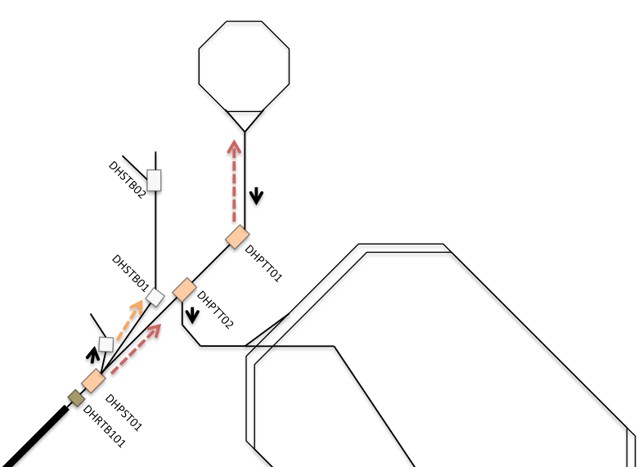
Timing
Accumulator
BTF line
Main rings
Spectrometer
25 or 50 Hz repetition rate
Last bunch every second always to spectrometer line
DAΦNE phases of the complex LINAC, BTF and DAΦNE:
LINAC = LINAC shots are delivered at 25(50) pulse per second and dumped at the end of TL
LINAC+BTF = LINAC shots are delivered with a selectable duty cycle to BTF from 1 to 24(49) pulse per second. The remaining are dumped at the end of the TL
GLOBAL = LINAC shots are delivered with a variable duty cycle to BTF in dependance of the injection parameter in ACCUMULATOR
  NO INJECTION => selectable from 1 to 24(49) pulse per second
  INJECTION => the injection needs are DAΦNE CR controlled. Typically an injection sequence pulses at 2Hz, taking from 1 up to 7 LINAC bunches per sequence. BTF delivers 22 down to 10 bunches/s

Slide 31
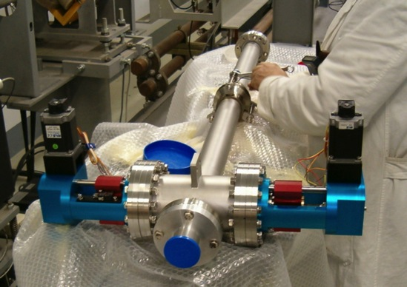
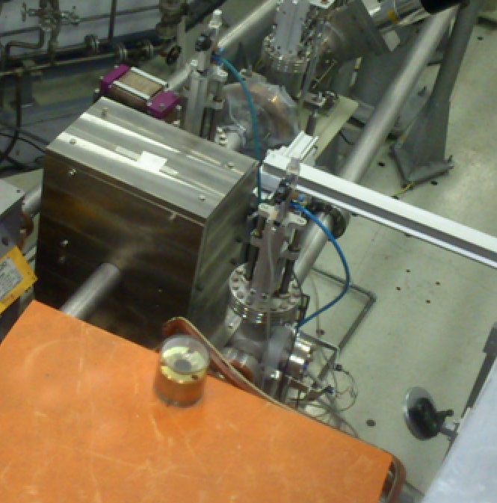
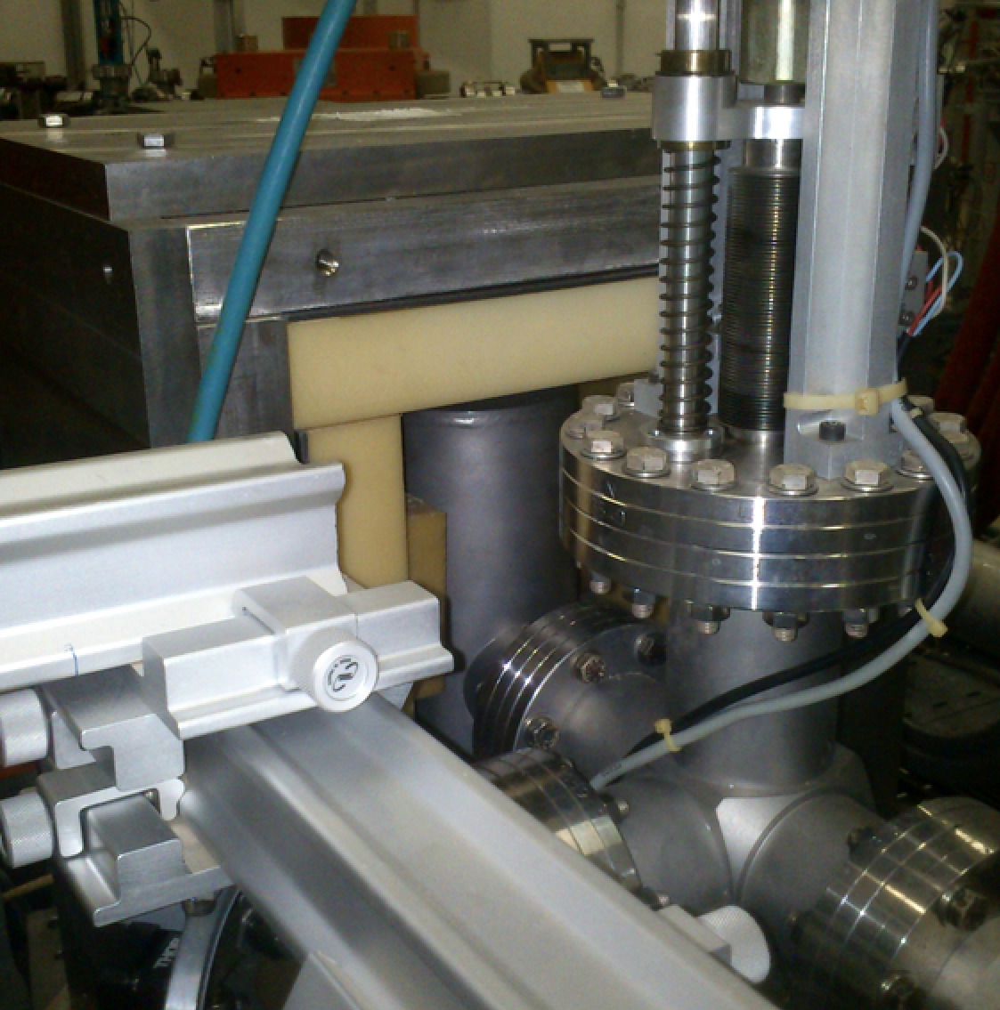
Separation of BTF line/3
In addition:
Added new slits for vertical collimation after energy selection (for better beam definition): SLTB03
Added new slits for horizontal collimation before the energy selection (for improving the resolution): SLTB02
Target moved to the BTF line and shielded to reduce background
Lead + Polyethylene (Boron loaded)

Slide 32
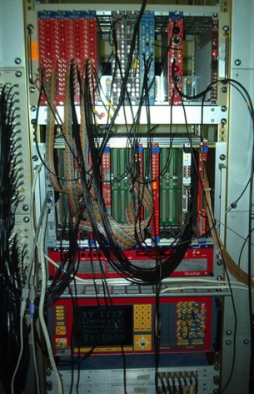

Diagnostics and equipment
Available at the end of 2003:
  a basic DAQ system (ADC, TDC, scaler) with single board computer and data logging
  Motorized table
  Gas lines
  Consoles for beam control
  KLOE calorimeter prototype (14 cells, 5 samples) for low energy monitoring
  Cerenkov quartz counter for high intensity monitor
  X-Y scintillating fiber “hodoscope”
KLOE calorimeter, 80 MeV electrons

Slide 33









Diagnostics
High intensity
Integrating current toroid
Fluorescence flag
Medium-low intensity
Scintillating fibers hodoscope
Silicon micro-strip detectors
(currently under maintenance)
More in “Recent improvements” slides…

Slide 34


Gas/Vacuum
Vacuum system:
BTF connected to LINAC-transfer line vacuum, down to ~10⁻¹⁰ mbar.
Beam exit: flange with 500μm-thick Be window (minimize the multiple scattering). The overall BTF vacuum is provided via 60-120 l/s ion pumps.
Not so handy for users: new pipe end design with internal gating valves equipped with pre-vacuum service for different line extensions. Mylar windows to match pre-vacuum down to 10⁻⁶ mbar also available. Also pumping has been revised.
Gas system:
4 Gas lines available to the users, recently upgraded: low pressure, high pressure hydrocarbons, and two lines for CO₂/Ar/N/He and similar gases

Slide 35




Recent improvements: exit windows
2 mm Aluminum flange
Kapton window
(poor vacuum)
0.5 mm Beryllium window
(high vacuum)
Mechanical protection +
Integration of ICT monitor, gate valve and pre-vacuum supply.
YAG flag+remote CCD camera.

Slide 36



2011-2014: AIDA
BTF beam-line equipped with:
  Remotely controlled 2-axis trolley, fully operational
  GEM tracker for precise measurement of beam position and size (in 1 coordinate: 100 μm resolution only along the drift), fully integrated and operational
  Multi-purpose DAQ for the users, sensors, diagnostics, rad. monitors, etc.
  [see next slides on facility improvements]
Calibration with LYSO calorimeter (5×5 matrix) for precise energy measurement and particle counting at low energy
Beam energy spread from comparison of 1 electron and N electron energy resolution

Slide 37


Recent improvements: remote trolley
Old table, some mm precision
<0.1 mm accuracy, PC controlled, 2-axis trolley
+ small angular stage (20 μrad)

Slide 38

Recent improvements: diagnostics
Silicon pixel (Medipix)
GEM Time-projection chamber

Slide 39






Medipix/1
FWHM 6.8 × 3.0 mm
FWHM 4.0 × 2.8 mm
FWHM 2.4 × 1.8 mm
2 mrad RMS
1.4 mrad RMS

Slide 40
Medipix/2
≈1.5 10⁵ electrons
25 Hz repetition rate
1 s integration time
Medipix counts
Beam intensity (uncalibrated)

Slide 41



GEM TPC/1
Particle
conversion
Particle
conversion
t_{drift}
Gain
Gain
Readout
Readout
Standard Triple-GEM detector
Triple-GEM as time-projection chamber

Slide 42








GEM TPC/2
5 cm
4 cm
Top
Front
Side
Vertical
4 cm
5 cm
Horizontal

Slide 43



GEM TPC/3
XY configuration (hit)
16x8 (XY) pads configuration
3x6 mm² - submm resolution
Z configuration (time)
6μs max drift => 80 μm resolution
Clocking: 15 Hz gated OK
Positron beam, 477 MeV
Channeling on straight crystals fan
S. Petrovic et al.
No channeling
Channeling

Slide 44

Improvements of control system/1
The online monitor of BTF diagnostics is integrated in the DAFNE general control system
Many additional devices have been added during the last years:
  New motorized trolley, remotely controlled
  GEM TPC acquisition system
  Slits/collimators/target motors and encoders
  WCM’s oscilloscope readout
calorimeter
XY beam
profile
detector
Significant work already done and still under way on controls, in close collaboration [or by] the !CHAOS project
The BTF line (magnets, controls, diagnostics, tools) will be the first real application of !CHAOS
First commissioning done successfully

Slide 45




Improvements of control system/2
Acquisition and logging of digital scopes
Acquisition and logging of digital cameras

Slide 46




Photon tagging/1
Bremsstrahlung
photon
silicon detectors
silicon tagging
target
dipole magnet
Incoming electron
Be window
Designed and built in close collaboration with the AGILE collaboration with the main purpose ot the AGILE scientific payload calibration:
  Silicon trackers + calorimeter

Slide 47




Photon tagging/2
10
20
50
100
200
500 MeV
400× Crab Nebula

Slide 48

Photon tagging/3
Some issues of this system
In order to have useful tagged photons, need to select clean single electron tracks:
  Offline reconstruction mandatory
  Low beam intensity, 3-4 electrons/bunch
  Low useful rate, <0.5 Hz after selection (few % efficiency)
    At low energy:
      Low efficiency due to not linear “binning” in energy
      Cut-off due to acceptance of tagging modules (detectors outside the vacuum pipe)
    At high-energy:
      Low efficiency due to 1/E spectrum
      More sensitive to spurious events due to off-momentum or off-angle electrons
Due to the peculiar geometry, uneven distribution of photon energies, in particular issue with:
  Geometric overlap of electrons radiating an intermediate energy photon and off-central electrons

Slide 49

Neutron source/1
Why photo-production? Because it’s more convenient up to 10¹⁶ n/s (at the target)
Number of neutrons proportional to the electron beam power:
  P = rate×energy =[N×f]×E
    N = number of particles per bunch (let’s consider 1×10¹⁰)
    f = frequency (up to 49 Hz)
    E = beam energy (usually 510, up to 800)
  Maximum power: 40 W at 510 MeV
  500 MeV
  Very simple estimate of neutron yield from Swanson’s empirical formula
    10¹¹ n/s for Tungsten
    -20% on Lead, +50% on Uranium

Slide 50




Neutron source/2
n@BTF project
  Simulated and designed an optimized target (W cylinder d=70 mm, l=60 mm) and shielding system (lead and polyethylene)
  Preliminary measurements of the neutron field and photon background
Isolethargic fluence
10 eV
1 keV
1 MeV
100 MeV

Slide 51



Neutron source/3
At 90° better n/γ ratio

Slide 52


Neutron source/4
Bonner Sphere Spectrometer equipped with Dysprosium activation foils (Dy-BSS)
Response matrix previously tested in reference neutron fields, ±2% overall uncertainty

Slide 53


Neutron source/5
Lethargic spectrum (dΦ/dE)*E normalized to total flux
Calculation uncertainty 3%
Measurement total error 4%
Good data/simulations agreement

Slide 54

Neutron source summary
At 1.5 m distance:
8×10⁻⁷ n/cm²/pr ±3%
Flux = 4.5×10⁵ n/cm²/s
Equivalente dose = 45 mSv/h
d (m) | ×10⁻⁷ n/cm²/pr
0.5 | 58
1 | 15
1.5 | 8
Total photon flux = 5×10⁻⁵ γ/cm²/pr
d (m) | ×10⁻⁵ n/cm²/pr
0.5 | 63
1 | 5.7
1.5 | 1
Instantaneous dose rate with present shielding do not allow to run at 50 Hz nor 25 Hz

Slide 55



Recent improvements: bunch width
Driven by the need of AMY experiment of shortening the beam pulse duration in order to look for micro-wave continuous (isotropic and un-polarized) emission from plasma in extensive air showers

Slide 56



New electron gun pulser
Kentech PG750 pulser
  improving stability and reliability
  new possible matching condition
  fine tuning of the gun pulse
New software developed and implementated
Gun equipment control via new ETH fiber+GPIB
Amplitude : adjustable from 300 to 750 V in steps of 30 V
Pulse width 1.5 to 40 ns in steps on 0.5 ns
Pulse shape: rectangular
Flatness +/- 10%
Max. repetition rate 50 Hz
Jitter ~20 ps

Slide 57


Energy spread vs. bunch width
At 500 MeV, electrons
10 ns 100 mA
40 ns 150 mA

Slide 58

BTF users/1
Mainly, two kinds of users:
  Test of detectors or beam diagnostics
    Any kind of detector: calorimeter,s scintillators, fibers, drift chambers, micro-pattern gas detectors (GEM, MSGC), RPC, diamond, silicon pixels, silicon micro-strips, fluorescence detectors, Cerenkov, RICH, …
  Real experiments using the electron or positron beam
    Thermo-acoustic expansion of materials due to ionizing particles (RAP)
    Absolute air and Nitrogen fluorescence yield (AIRFLY)
    Microwave emission from e.m. showers (AMY)
    Electron and positron channeling, parametric radiation

Slide 59
BTF users/2
Year | Beam-days
2002 | 30
2003 | 150
2004 | 282
2005 | 364
2006 | 244
2007 | 224
2008 | 193
2009 | 256
2010 | 230
2011 | 105
2012 | 316
2013 | 160
2014 | 260
At least 20 teams/year
Average of 10 days/team
Average of 200 beam-days/year
Typically, two calls/year (Nov. and May)
TARI funding (HadronPhysics)
40% of rejection in 2013
20% of rejection in 2014

Slide 60

Users by institution
Share of the 30% of the total users (2011-2014)
70% from INFN and other Italian institutions (University, Astrophysics, CNR, …)

Slide 61















BTF Users selection/1
C
MEG

Slide 62

















BTF Users selection/2
C

Slide 63


BTF costs
Power:
All complex: 2.7 MW × 200 days ≈2 MEur, ≈15% of power for LINAC+BTF (cooling, magnets included)
Personnel for entire LINAC + BTF:
Researcher/Engineer: 2 + 1
Technicians: 9
1 (expert) operator always on shift in the 24/7 DAFNE crew dedicated for linac operations
Power≈300 kEur/year + dedicated personnel + services

Slide 64

Where do we go from here?

Slide 65


First “upgrade”: constant improvement
Only considering 2012-2014:
Remotely controlled motorized trolley operational
New rotational and linear stage
Improved beam position diagnostics (GEM TPC, Medipix)
Improved shielding for high intensity
Neutron beam monitors (servizio FISA) for high intensity
Cooling system isolated from other DAFNE sub-systems (only linked to LINAC) and revised
Gas system refurbished
Network, DAQ and controls revised and fully operational
Diagnostics on virtual machine service based on DELL CentOS
Vacuum system improved (2×10⁻⁹ mbar)
New remote YAG flag
New end-flange with WCM and protection
Beam transport and timing optimized: 1.4 to 40 ns bunches
Started implementation of !CHAOS control system: BTF live collection system

Slide 66
Further improvements/1
Room for improvement mainly – of course – for detectors development and testing:
  Extend energy range:
    Towards lower energy for detector testing, especially for astro-particles
    Towards high energy for
      Higher neutron yield and more fast neutrons
      Lower multiple scattering, better spot
      Physics case: electron and positron fixed-target experiments
  Improve diagnostics quality (much done with AIDA, more is possible)
  Exploit time structure of beam (and improve it)
  Exploit the possibility of high intensity and more particles (photons,neutrons)
  Exploit the flexibility and ease of use (and improve it)
  And…

Slide 67
Further improvements/2
Since duty-cycle is already quite high:
  Increase the number of beam lines
  Enlarge the experimental area
  Improve beam quality
    Background: more/better shielding
    Beam divergence: more/better collimation
    Beam size: better/more flexible optics
  Improve timing
  Increase intensity

Slide 68
Future plans/1
  1. Improve the shielding
  2. Add a second beam-line
  3. Add a pulsed magnet to select 2nd line bunch-by-bunch
  4. Have two separated experimental halls for the two lines
  5. Move the control room upstairs to gain space in the experimental hall(s)
  Increase the LINAC energy

Slide 69
Future plans/2
  7. Low-energy electron/positron beams
    Improve low-energy diagnostics (LYSO calorimenter, AIDA)
    Improve background
  8. Improve high-resolution tracking:
      New high-resolution tracking telescope: Si-pixel
  9. Improve photon tagging, changing the design:
      Build/re-use a different dipole magnet
      Build an optimized vacuum chamber
      Design and build tagging detectors with:
        Optimized geometry
        In vacuum
        Simpler and with a smaller number of channels
  10. Further increase the bunch width (from 40 ns to 100-200 ns)

Slide 70

Improved shielding/1
Limitation on full intensity operations due to gap in the additional shielding walls of the hall
Crucial for neutron production, e.m. interaction tests (e.g. microwave, fluorescence production by electrons)
Also important for intermediate intensity long-term operations
Partially cover the area with a ceiling made of concrete beams ≈1 m depth

Slide 71


Improved shielding/2
T-shaped concrete beams

Slide 72


A possible scheme for the 2nd line
Present
layout
New layout
Additional beam-line
Change configuration of the focussing quads
New tracking telescope, Si pixel, 3+3 planes, baseline ≈ 1 m
Use GEMs on other line
LYSO matrix calorimeter for low energy measurement

Slide 73



Upgrade of photon tagging/1
Present system, based on active Bremsstrahulung target and tagging detectors inside the last dipole yoke suffers of some limitations:
Requires a clean, single electron track in the active target
Requires a single cluster in the tagging modules
Inefficiency due to:
  High divergence due to scattering in the target and air;
  Showering/scattered tagging electron
  Limited active area of tagging modules inside the magnet;
False positive:
  Photon tagged but absorbed/converted along the path
  Background electrons (or photons), hitting the tagging modules from outside

Slide 74

Upgrade of photon tagging/2
Energy resolution degrades quickly, ≈1/E(γ):
  From 2% at 420 MeV to 40% at 40 MeV
In addition:
Spurious events with anomalous reconstructed energy (w.r.t. expected one)
Spurious events due to:
Photon emitted by one electron, but tagging detectors hit by another (in the same bunch)
Photon converts in a pair, and one electron hits the tagging detectors
Tagging electron showering and tagging detectors hit from secondary particle

Slide 75


Upgrade of photon tagging/3
Proposal: re-design an open-yoke (C-shaped in place of H-shaped magnet) and place tagging detectors in the focal plane and in vacuum
Preliminary study:
2% resolution down to 50 MeV with 5 mm granularity and 100-200 channels
Present system: 5736 channels Si micro-strips
But:
With quite a long dipole
With a strong field (1.5 T)
Applications: calorimeters, bolometers, γ detectors tests

Slide 76

LINAC energy upgrade/1
15 m in the final part of the LINAC
Add 4 more accelerating sections (3 m) fed by 2 modulators + 2 SLED-ed klystrons to reach the 1 GeV range (for electrons)
Similar to what discussed in
R. Boni, arXiv:0402081 [physics]

Slide 77


LINAC energy upgrade/2
In SLAC structures, L=3 m, t=0.57 Np, R_{sh}=53MΩ/m:
U₀[MeV] ≈ 10.4*(P_{in}[MW])^{½}
830 MeV e+
1070 MeV e-

Slide 78


Search for dark photon/1proposal
Search for an extra U(1) gauge symmetry and a corresponding gauge boson: “dark photon" or U boson or heavy photon (γ’ or A’) in electron fixed-target experiments
‘90s experiments dumping an electron beam
Experiments in Mainz (A1) and JLAB (APEX and HPS) with a new approach: thin target, look for lepton pairs, in case with a displaced vertex

Slide 79


Search for dark photon/2
Thin target experiment proposed in Frascati (PADME), exploiting the high-intensity positron beam in order to use e+ e- annihilation diagram (in addition to the Bremsstrahlung one).
Look also for missing energy in a model-independent way (decay to invisibles)

Slide 80


Search for dark photon/3
Decays to lepton pairs
Decays to invisible
Energy ~√E
PADME
Energy
Duty cycle
e⁺ 550 MeV
e⁺ 750 MeV
e⁺ 1 GeV
Duty cycle
  PADME experiments seem to have good discovery/exclusion potential, can be improved by upgrading the LINAC:
    Higher energy gives access to higher masses, both in visible and invisible decays
    Increased bunch width, higher rep. rate (higher duty cycle) give access to lower couplings

Slide 81
Search for dark photon/4
Decays to lepton pairs
A classical beam-dump (thick target) experiment could be competitive in Frascati (PADME), using the electron beam at maximum intensity and energy (750 MeV)
Sensitivity can be improved by both upgrading the LINAC energy and increasing the duty cycle (bunch width and/or repetition rate)
Energy
Duty cycle
PADME
DUMP
Energy
Duty cycle

Slide 82
Lessons from 10+ years of BTF
The idea was there since from the beginning (Vignola, Sannibale), the commissioning required enthusiasm and ingenuity (and relatively few resources)
A process of constant improvement with many small modifications/add-ons
A few larger upgrades have required more significant resources:
  Decoupling from DAFNE injection: large effort from the entire Accelerator Division.
  High efficiency and long-term running: not transparent to the DAFNE operations, also impacts on resources of the AD.
  Tagged photon beam: difficult to handle & maintain, but still interesting, especially for calibration applications. An optimized setup can largely increase efficiency.
  Neutron beam:
    Very interesting, but difficult wrt diagnostics, beam control.
    Strong limitation from the radio-protection issues.
Users community/beam usage:
  Interested remains high in single particle for detector testing but…
  … increasing interest in low energy with low background.
  … increasing interest in high intensity electron and positron beams.

Slide 83


Conclusions
We think the BTF has gained its own place among European beam facilities
We aim at improving the quality and capability of the facility
We would like to contribute to the future of the lab. also for fundamental physics program
At least 20 teams/year (up to 32), 8 days/team on average
Average of 220 beam-days/year (about 2000 effective beam-hours)
Typically, two calls/year (November and May)
40% of rejection in 2013, 20% in 2014

Slide 84

Acknowledgements
Staff
Paolo Valente, scientific responsible
Bruno Buonomo, technical responsible
  All the linac technical staff
Luca Foggetta, operations and run coordinator, diagnostics, acquisition and controls, services, …
Maria Rita Ferrazza, Francesca Casarin, Manuela Giabbai,
administration support
  Luca Ceccarelli, undergraduate student, user support
Andrea Ghigo, Accelerator Division head
Catia Milardi, all DAFNE operations team
Courtesy Theo Demma
Related projects
AIDA, beam-test facilities FP7 EU project: G. Mazzitelli, F. Murtas, G. Claps
n@BTF, NESCOFI, neutron studies, dosimetry, radio-protection: R. Bedogni, A. Esposito
IRIDE-neutrons: R. Faccini, A. Pietropaolo, L. Quintieri, et al.
!CHAOS, innovative control systems: A. Stecchi, et al.

Slide 85

http://www.lnf.infn.it/acceleratori/btf
http://wiki.infn.it/strutture/lnf/da/btf/beam_characteristics
http://www.lnf.infn.it/acceleratori/btf/docs/NIM515_3.pdf
https://agenda.infn.it/event/btf2014
Thank you!

Slide 86
Cathode parameters
Cathode Area 2.0 cm²
Max emission current 12 A
Heater 5.8 A, 6 V
With a gun current of 7 A,
80% can be captured and accelerated
Parameters | Characteristics
Gun type | Thermionic triode electron gun
Cathode | Y796 (EIMAC) dispenser
Filament heating power | 35 W
Acceleration potential | 120 kV
Beam current | 12 A
Emission current density | 10 A/cm2
Grid bias voltage | 0 - 500 V

Slide 87


Slide 88


LINAC and BTF staff in 2003
First users test:
tile calorimeter calibration

Slide 89
The SLAC structure
Parameter | Symbol | Unit | Value
Frequency | ω/2π | MHz | 2856
Length | L | m | 3.048
Cell Radius | b | cm | 4.17--4.09
Iris Radius | a | cm | 1.31--0.96
Cell Length | d | cm | 3.50
Phase Advance per Cell | ψ | - | 2π/3
Disc Thickness | h | cm | 0.584
Quality Factor | Q | - | 13,000
Shunt Impedance per Meter | r_{l} | MΩ/m | 52--60
Filling Time | t_{f} | nsec | 830
Group Velocity | v_{gr} | % c | 2.0--0.65
Attenuation | τ | “nepers” | 0.57
Typical Unloaded Gradient | G₀ | MV/m | 21
Typical Input Power | P₀ | MW | 45
Notes:
Shunt impedance 57 Mohm/m per le nostre considerando
30 MW di input load energy 58.1 MeV
78 MeV con 56 MW input

Slide 90

Klystron data sheet
PARAMETER | Unit | TH2128C | 5045
Center Frequency | MHz | 2856 | 2856
Peak output power | MW | 45 | 65
Peak average power | KW | 10 | 90
RF pulse width | µs | 4.5 | 3.5
Peak beam voltage | kV | 320 | 350
Peak beam current | A | 360 | 414
Microperveance | µA/V3/2 | 2.0 | 2.0
Heater voltage | V | 20∼30 | 15
Heater current | A | 20∼28 | 35
Focusing currents | A | 40 | 15
Peak driver power | W | 200 | 350
Gain | dB | 54 | 53
Efficiency | % | 43 | 45
Pulse repetition rate | Hz | 50 | 120
PARAMETER | Unit | TH2128C | 5045
Center Frequency | MHz | 2856 | 2856
Peak output power | MW | 45 | 65
Peak average power | KW | 10 | 90
RF pulse width | µs | 4.5 | 3.5
Peak beam voltage | kV | 320 | 350
Peak beam current | A | 360 | 414
Microperveance | µA/V3/2 | 2.0 | 2.0
Heater voltage | V | 20∼30 | 15
Heater current | A | 20∼28 | 35
Focusing currents | A | 40 | 15
Peak driver power | W | 200 | 350
Gain | dB | 54 | 53
Efficiency | % | 43 | 45
Pulse repetition rate | Hz | 50 | 120

Slide 91

Pulse compression
Room-temperature accelerator structures require a short pulse of high RF power to reach their desired gradients.
Klystrons run efficiently when they produce a long pulse of relatively low power (minimize inefficiency from modulator rise/fall time etc).
Matching these different time structures is done by pulse compression.
Pulse compression in turn relies on the magic of the 3-db directional coupler to succeed.
The 3-db coupler is a passive device with 4 input/output ports
passing thru a central nexus:
The key feature of the coupler is
that the diagonal pathways are longer by 90° than the straight pathways.

Slide 92
SLED pulse compression
Resonant
Cavities
Klystron
Power from port 1 will be split and flow equally to ports 2 and 3, but with a phase shift.
If equal power is introduced at ports 1 and 4, but with a 90° phase shift between them, it will flow entirely to either port 2 or port 3.
If power is introduced at port 1, and perfect reflectors are placed at the end of lines 2 and 3, the reflected power will recombine constructively at port 4 (if the reflectors are placed the same distance from the center of the coupler.

Slide 93

SLED pulse compression
Power from the klystron goes to 2 resonant cavities for storage
because the cavity coupler reflects almost all power, there’s a surge of reflected energy which goes to the accelerator.
As the SLED system fills, its emitted power destructively interferes with the klystron reflected power.
At some point in the klystron pulse, the phase of the klystron is reversed so that the stored energy interferes constructively…

Slide 94
SLED limitations
Factor of 3 amplitude limit (factor of 9 power limit)
For large amplitude gains, efficiency is low
  Large value of t₁ required w.r.t. t_{c}
  Long time when most RF power is reflected, not stored
Output pulse not flat
  Exponential character due to standing-wave SLED character

Slide 95




Diagnostics - ICT
Waveform generator: Agilent Arbitrary waveform Generator 33250A
Oscilloscope: Tektronix TDS 3054C
WCM: Bergoz Integrating Current Transformer (ICT-122-070-05:1)
WCM response:
∫Vds : μ= 167 pVs σ= 5 pVs
I_{ped}= -59 pVs
I_{wcm}= ∫Vds- I_{ped}= 226 pVs
Q_{out}= I_{wcm}/R= 4.52 pC
RATIO:
Theoretical ICT ratio = 0.1
R (ratio)= Q_{out}/Q_{in}= I_{wcm}/I_{imp}= 0.098
ΔR= √((σ_{wcm}/I_{imp})²+((I_{wcm}*σ_{imp})/I_{imp}²)²)= 0.002

Slide 96




Low intensity example
(γ veto inefficiency at low energy, NA62)
P₁
H1
H₂
P₂
fascio
F₁
F₂
Events
H2
1 e
H1
F1
P₁
F2
B
Calorimeter
Pb/fibers
F₁·F₂
F₁•F₂•H₁•H₂
A
Energy (MeV)

Slide 97

Low intensity example
(γ veto inefficiency at low energy, NA62)
P₁
H₁
H₂
P₂
beam
F₁
F₂
Measured
FC 68.27% CL
Inefficiency
1-ε = (7.3^{+4.1}_{-3.3})  10⁻⁵
E_{A+B} < 50 MeV
Threshold E_{A+B}(MeV)

Slide 98





Lead glass (OPAL)
Calorimeter
Pb/Scintillating fibers
Calorimeter
Pb/Scintillator tiles+WLS
Inefficiency
E_{meas}< 50 MeV
No mis-tagging
68.27% FC CLs
Energy (MeV)

Slide 99

Fiber prototype energy resolution
Perform Gaussian fits to 1e⁻ peak (±1.5s) after run-by-run calibration
Example fits
Side A+B
● Side A
■ Side B
⬧ Side A+B
483 MeV
350 MeV
Resolution σ_{E}/E [%]
203 MeV
E [MeV]
E [MeV]
Using information from both sides:
σ_{E}
5.1%
=
⊕ 4.4%
E
√E [GeV]

Slide 100

NA62 small angle calorimeter test 2013
SAC main characteristics
70 lead scintillator sandwiches
1.5mm lead
1.5mm scintillator
Kuraray Y-11(250) 1mm fibers
20.5x20.5 cm² front face
4 Hamamatsu R6427 PMT
Readout scheme
FADC
SAC
RO PC
Ch 0,1,2,3: SAC
Electron energy: 570MeV to 606 MeV 24 spills per second 10ns spill
Everything readout by a 1 GHz FADC (including the trigger scintillators)
External triggering from the BTF
No trigger bias and possibility for offline study

Slide 101



NA62 small angle calorimeter test 2013
Linearity
Energy resolution
Linearity of the response seem to be quite good single impact point!
No scanning of the front surface

Slide 102

NA62 small angle calorimeter test 2013
1e⁻ tagged
The events below 1e peak doesn't look exactly as inefficient events
  They are above the no-activity in SAC – 5 pC
  That kind of activity seem to present also under the 1-2-3-x electrons peaks
  No inefficient events below 5pc leads to an inefficiency estimate:
5 pC cut: inefficiency < 6x10⁻⁵

Slide 103

Test of LYSO calorimeter

Slide 104

Beam size vs. energy

Slide 105

Beam energy spread

Slide 106

UA9 Cherenkov detector test
LAL Cerenkov
INFN Cerenkov
BTF Remote
Control Table
BTF Calorimeter

Slide 107

UA9 Cherenkov detector test
Charge signal normalized to number of incident electron and electron path length in the radiator (arbitrary units)
- 47º
The width of the peak is compatible with the numerical aperture of the fibers
Radiator rotation angle

Slide 108





RAP
Study of thermo-acustic effect on cryogenic resonant antenna due to charged particles (background to GW detectors like Nautilus)
Runs in 2003, 2005 and 2009

Slide 109




AIRFLY
2003: first run
Fluorescence yield relative to Cerenkov
2008:
Absolute fluorescence yield measurement

Slide 110


AMY

Slide 111






AMY

Slide 112

Radio-protection walls

Slide 113



ANSI
Channeling of low energy positrons
in straight fan-like crystals

Slide 114

AGILE payload

Slide 115



Emittance measurement
Measured emittance @ 508 MeV:
  √<x²>=4 mm
  √<x’²>=1.7 mrad
  √(<x>²<x’>²−<xx’>²)=4 mm⋅mrad

