Slide 1
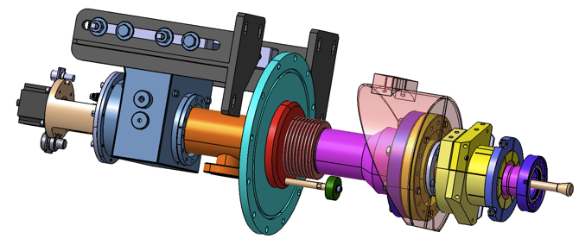
XFEL Couplers Production
Walid KAABI- LAL/CNRS
Notes:
How to edit the title slide
Upper area: Title of your talk, max. 2 rows of the defined size (55 pt)
Lower area (subtitle): Conference/meeting/workshop, location, date,
your name and affiliation,
max. 4 rows of the defined size (32 pt)
Change the partner logos or add others in the last row.

Slide 2
Outlines:
Introduction
Production monitoring at companies
Couplers preparation and RF conditioning at LAL
Status of the XFEL couplers production

Slide 3
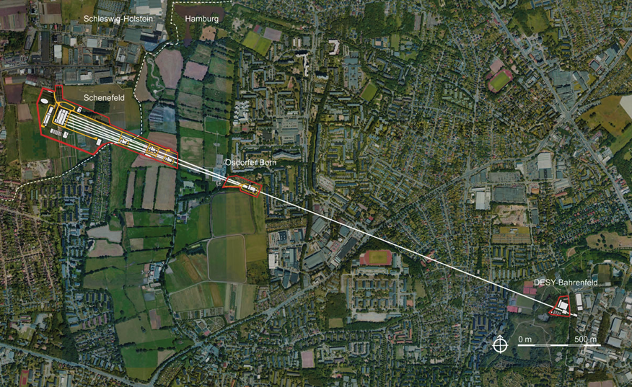
Introduction
1.3 Km e- cold linac reaching up to 17GeV

Slide 4






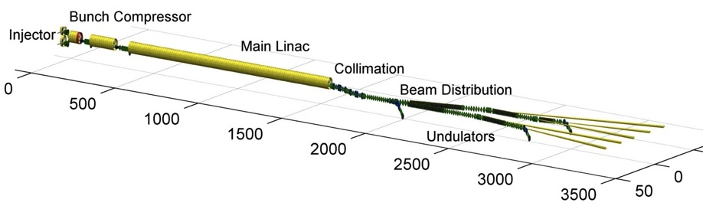












Introduction

Slide 5
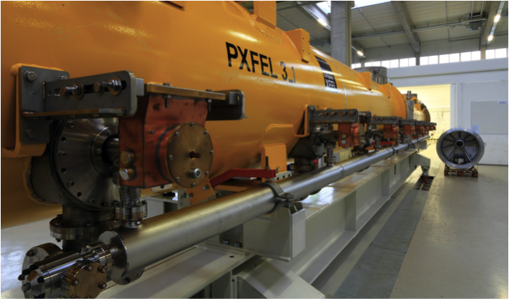
Introduction
Linac composed of 100 Cryomodules, equipped with 8 couplers each → 800 Couplers needed

Slide 6

Introduction

Slide 7
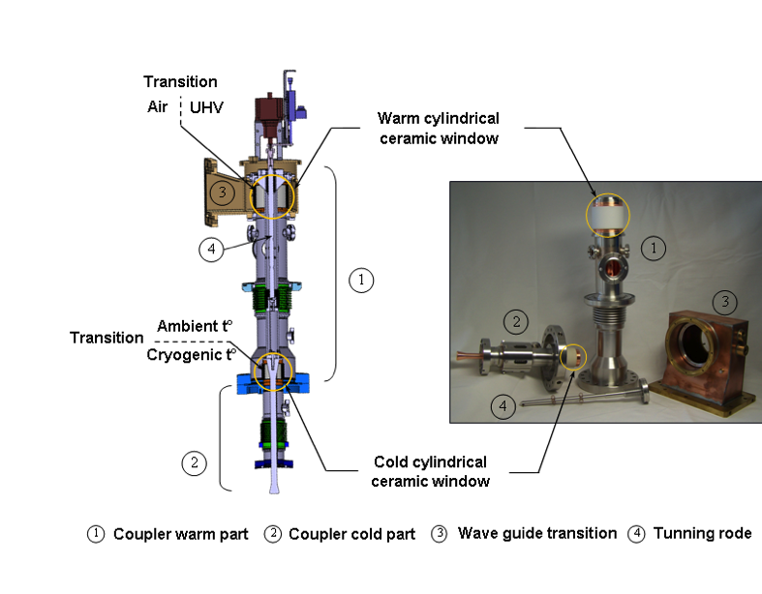
Introduction

Slide 8
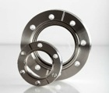
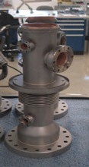
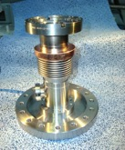

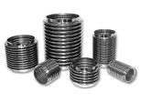
Production monitoring at companies
At Thales site:
1st step: parts assemblies by brazing:
2nd step: RF Surfaces copper plating of the assembled parts:

Slide 9
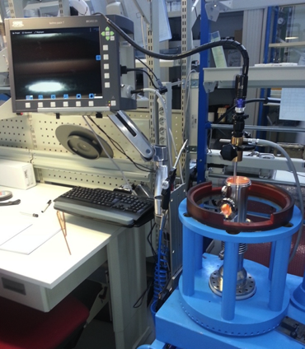
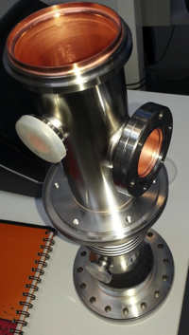
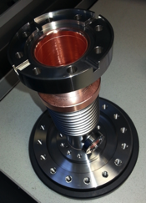
Production monitoring at companies
Weekly inspection meetings organized at Thales-Thonon to control parts copper plating quality
Cold part
Warm part

Slide 10
Production monitoring at companies
At RI site:

Slide 11
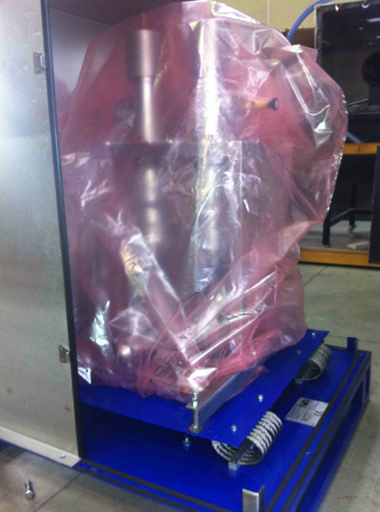

Production monitoring at companies
Shipment to LAL

Slide 12
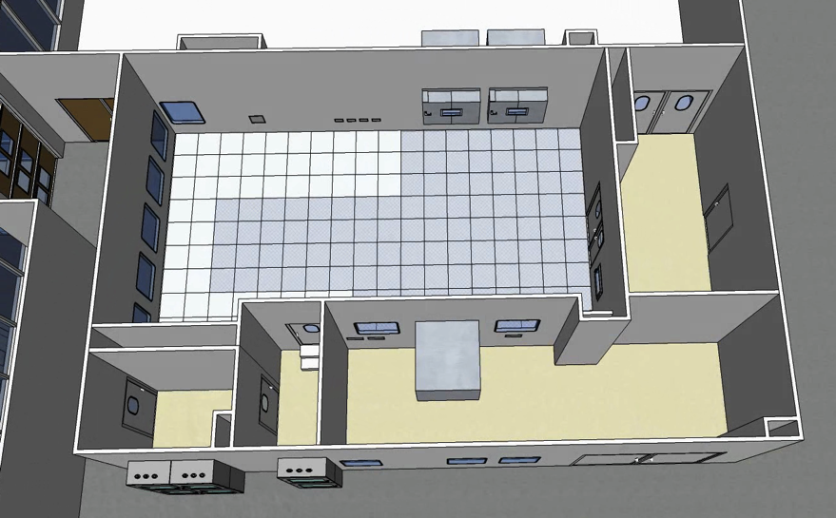
Couplers preparation and RF conditioning at LAL
ISO 5 clean room
ISO 7 clean room
Changing room
Airlock staff
Control room

Slide 13
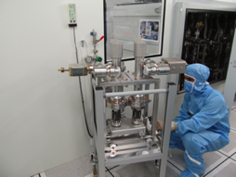
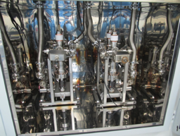
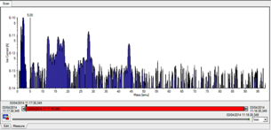
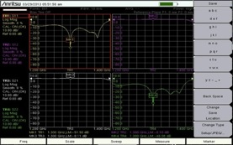
Couplers preparation and RF conditioning at LAL
RGA spectrum recording
Leak test after reception
75h baking cycle at 130°C
Antenna tuning
Actuators assembly
Capacitors assembly
WGBs assembly

Slide 14
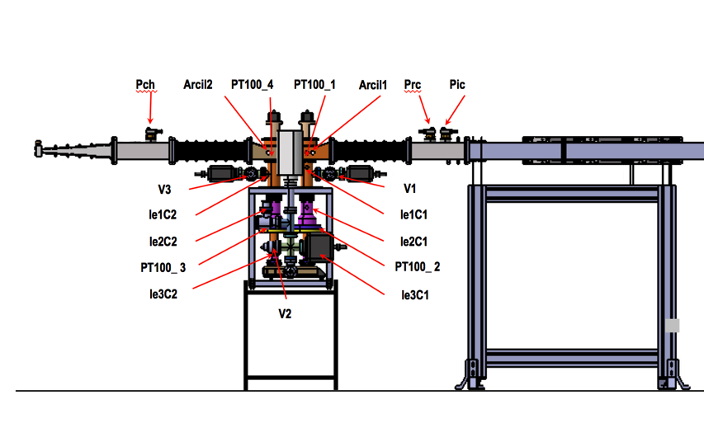
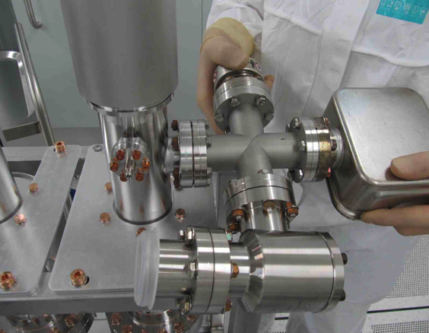
Couplers preparation and RF conditioning at LAL

Slide 15
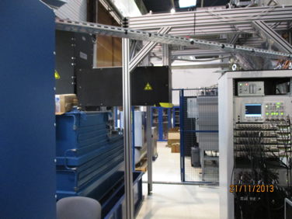
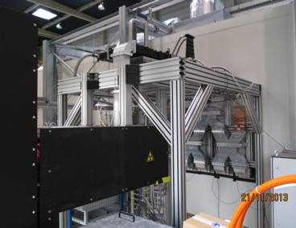
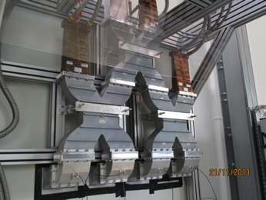
Couplers preparation and RF conditioning at LAL

Slide 16
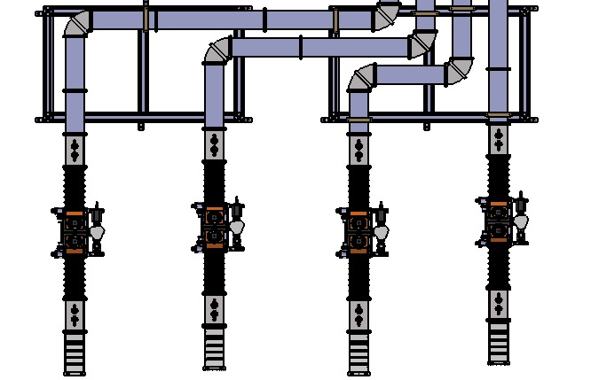
Couplers preparation and RF conditioning at LAL
PicC
PicB
PicA
PicD
PrcC
PrcA
PrcD
PrcB
Arcil1D
Arcil1C
Arcil1B
V1A
Arcil1A
V1D
V1C
V1B
V2D
V2C
V2B
V2A
Arcil2D
V3C
Arcil2C
Arcil2B
V3A
Arcil2A
V3D
V3B
PchC
PchB
PchA
PchD
Ligne D
Ligne C
Ligne B
Ligne A

Slide 17
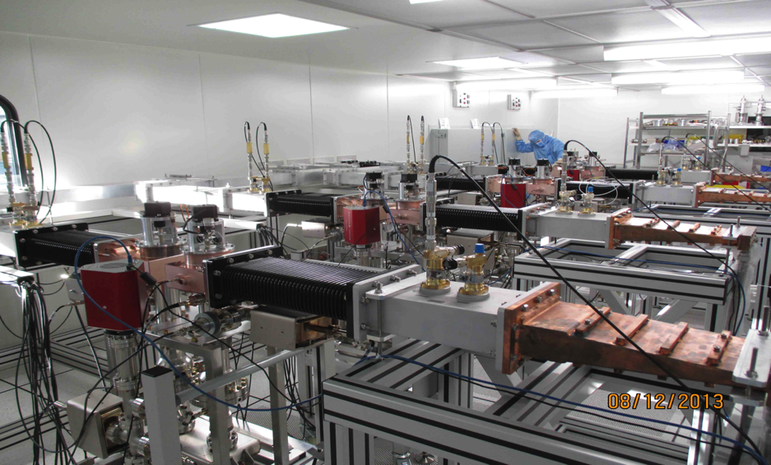
Couplers preparation and RF conditioning at LAL

Slide 18
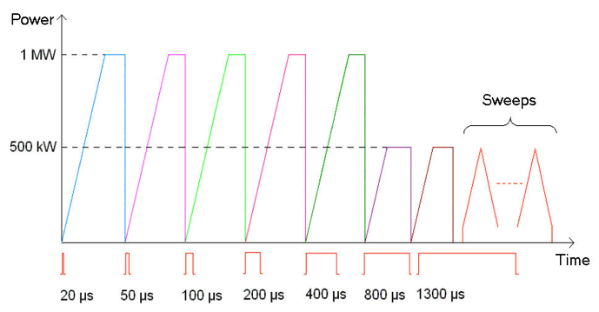
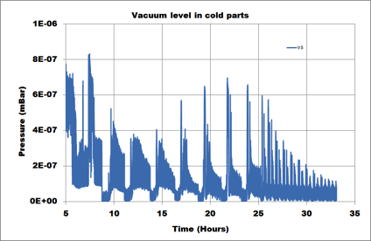
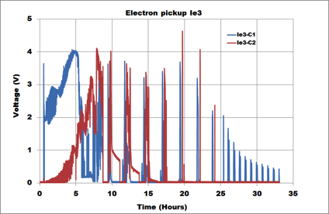
Couplers preparation and RF conditioning at LAL

Slide 19
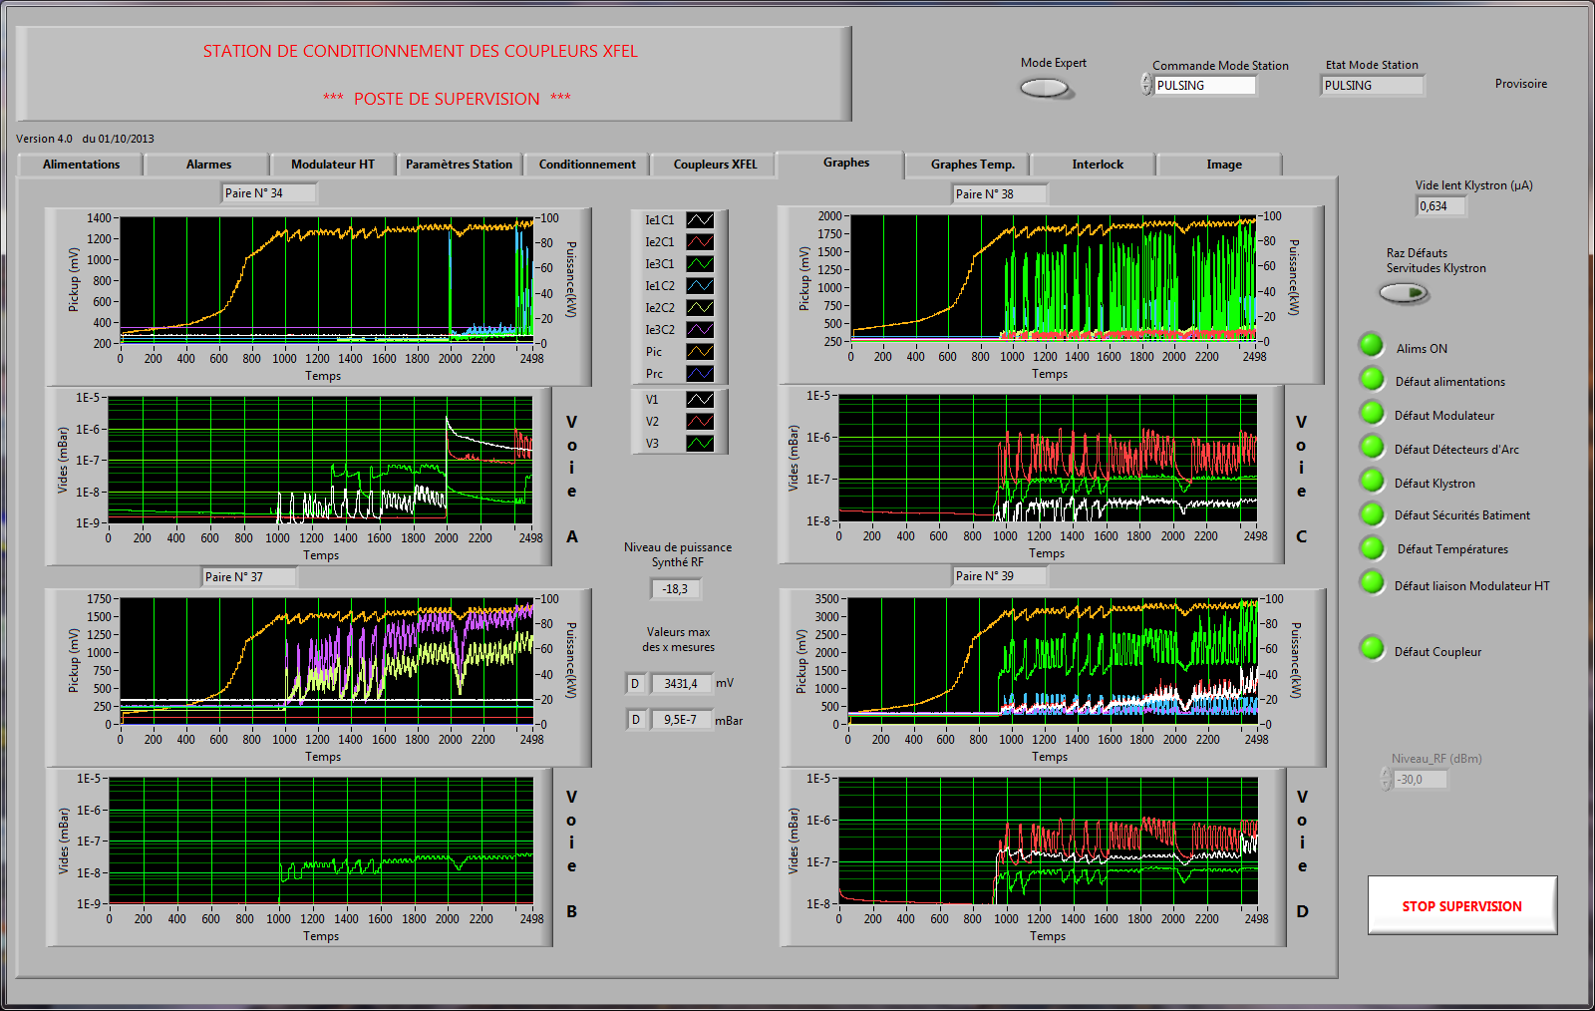
Couplers preparation and RF conditioning at LAL

Slide 20
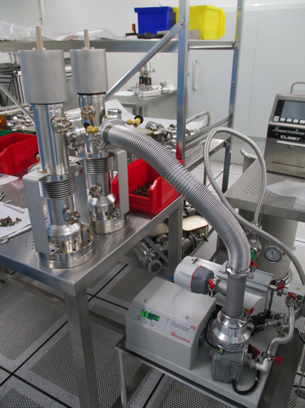
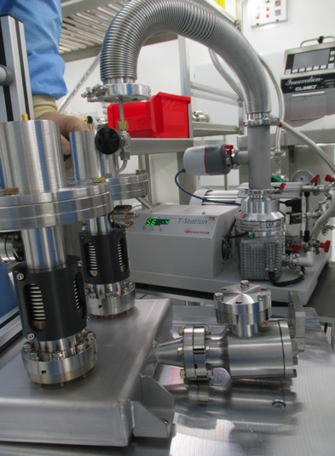
Couplers preparation and RF conditioning at LAL

Slide 21
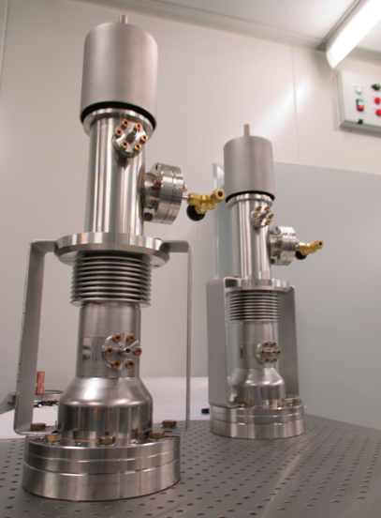
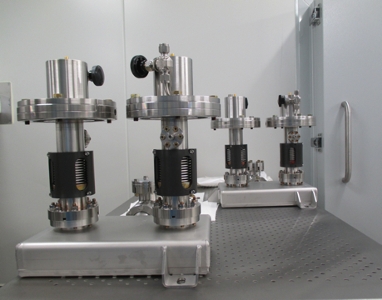
Couplers preparation and RF conditioning at LAL

Slide 22
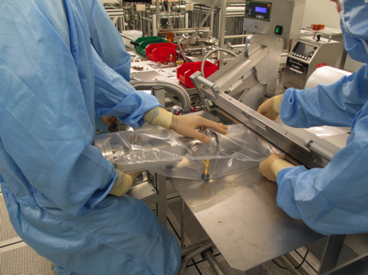
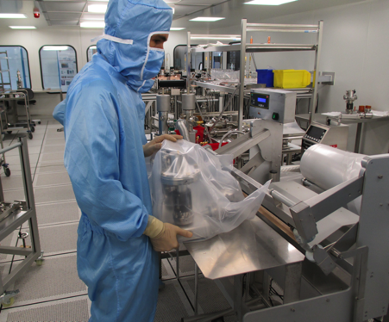
Couplers preparation and RF conditioning at LAL

Slide 23
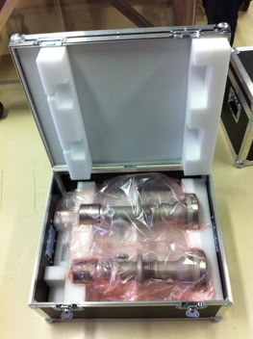
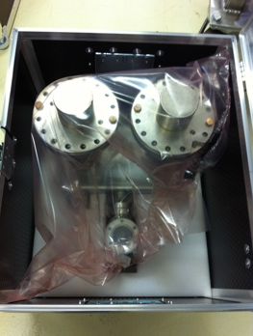
Couplers preparation and RF conditioning at LAL

Slide 24
Status of the XFEL couplers production
192 XFEL couplers were already delivered to IRFU (up to Module 24).
A buffer of 4 modules is available at the module assembly facility (IRFU/CEA).
The nominal rate of 8 coupler/week delivered from LAL to IRFU was reached beginning March 2014, however still some instability in the deliveries from companies.
First couplers were tested successfully in cryo-modules (11 modules already tested at DESY).
According to the current delivery rate, the last couplers will be delivered at mid 2016.

Slide 25
Thanks for your attention.

