Slide 1
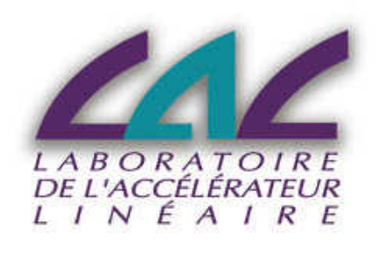
COsmic Ray Telescope at Orsay (CORTO)
Andrii Natochii
CORTO team:
V. Puill, L. Burmistrov, V. Chaumat, D. Breton, F. Campos, C. Cheikali, J. Maalmi, J. Peyre, A. Stocchi, C. Sylvia, J.F. Vagnucci, E. Bals, B. Genolini, X. Grave, Mimae Kim, D.W. Kim
Taras Shevchenko National University of Kyiv
The Linear Accelerator Laboratory at Orsay

Slide 2
Main steps of the presentation:
Introduction
CORTO
MRPC
Last results
Problems
Upgrade
New results
Efficiency map of the MRPC
2D Scanning Device for CORTO
First prototype
Final version
Software and controlling system
Conclusion

Slide 3
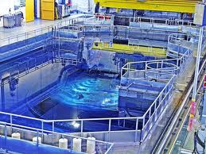
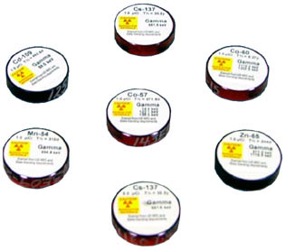
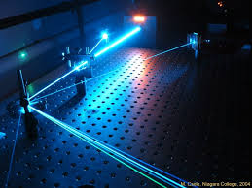
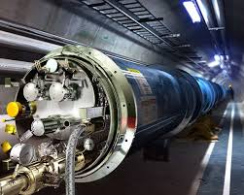
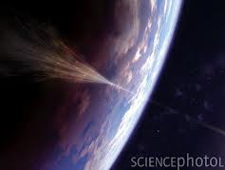
Introduction
How to test a new detector in HEP at first steps and to characterize its response function?
Nuclear Reactor
Radioactive Sources
Laser
Particle Accelerator
Cosmic Rays

Slide 4
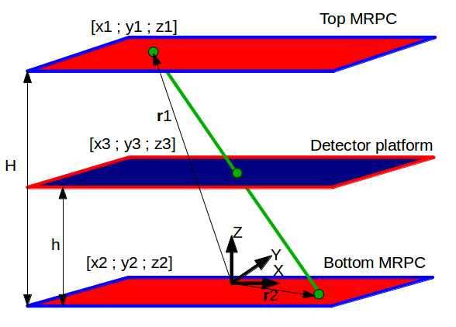
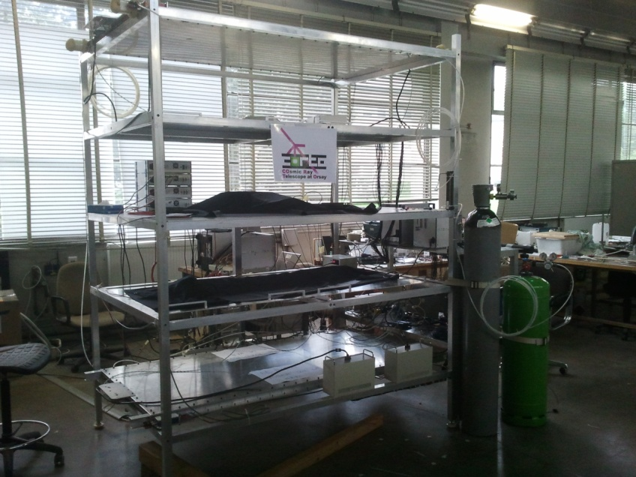
CORTO
Main task is to reconstruct muon tracks.
CORTO (2013)
Structure:
1) two positional sensitive strip gas detectors (MRPC)
(1 m x 2 m x 5 cm), which provide the track reconstruction.
2) read-out electronics: NINO Application-Specific Integrated Circuits (ASIC), WaveCatchers, interface cards.
3) gas supply system for MRPCs.

Slide 5
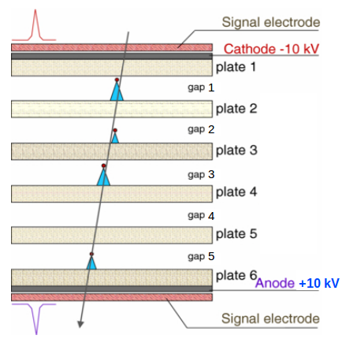
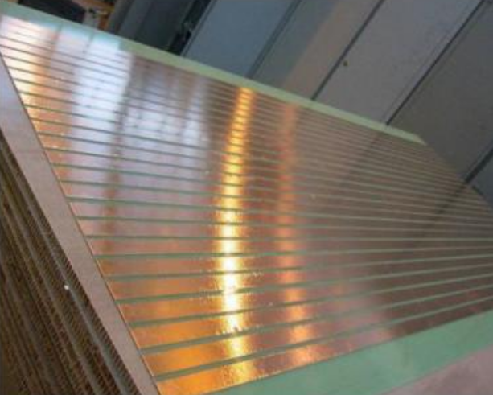
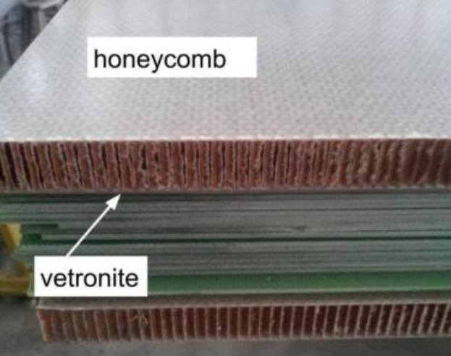
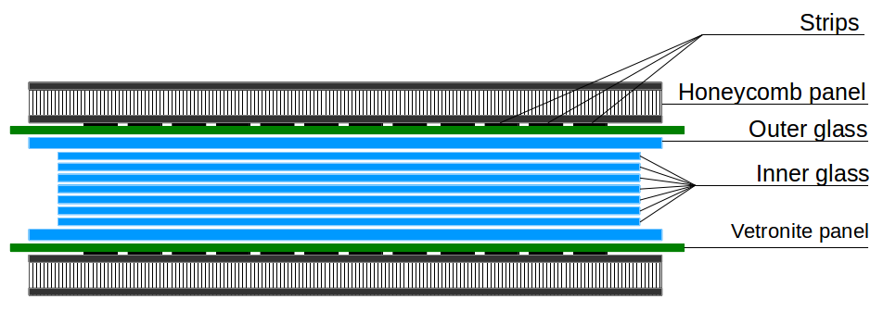
MRPC (Multigap Resistive Plate Chamber)
Provide the track reconstruction

Slide 6
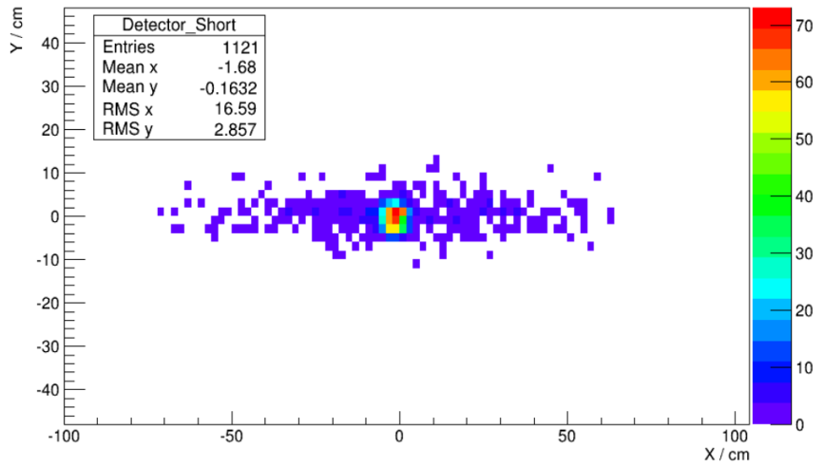
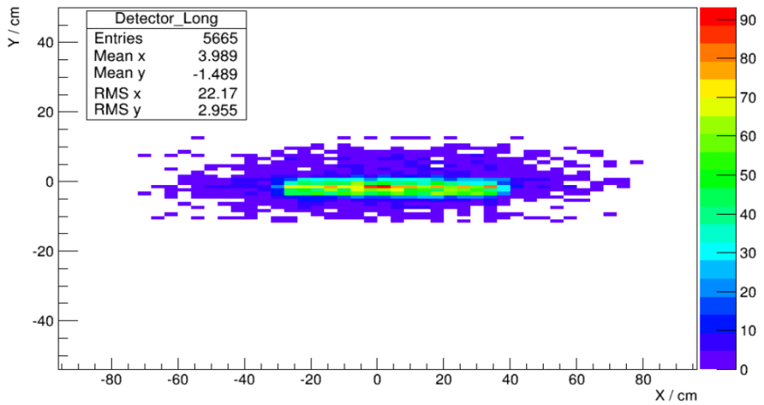
Last results (2013)
A time resolution of 250 ps (for a bias voltage of 16 kV), coordinate resolution along the X direction of 1.8 cm and along the Y direction of 2.1 cm.
Last configuration:
- Two MRPCs.
- One read-out board of WaveCatcher
(48 channels).
- Signals rate is ~ 100 Hz for coincidences between those two MRPCs.
The two-dimensional histograms of the reconstructed position of “Short” (top picture) and “Long” (bottom picture) detectors.

Slide 7
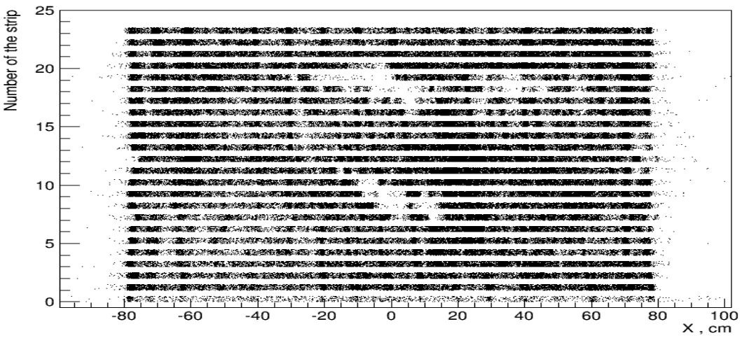
Problems
SOLVED
Too high rate of MRPC signals (should be ~ 50 Hz).
Not nominal time resolution (should be ~ 100 ps).
Not uniformly distribution of efficiency on each MRPC:
IN PROCESS
SOLVED
Reconstructed hits from bottom MRPC (2013).

Slide 8
Upgrade
In 2014 was added third MRPC for CORTO.
Three boards of WaveCatcher (total number of the channels is 48 x 3 = 144).

Slide 9
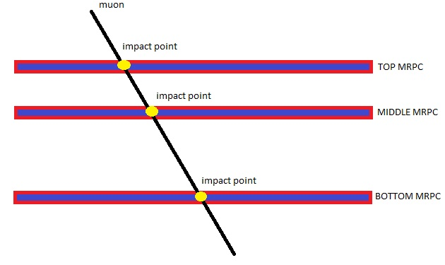
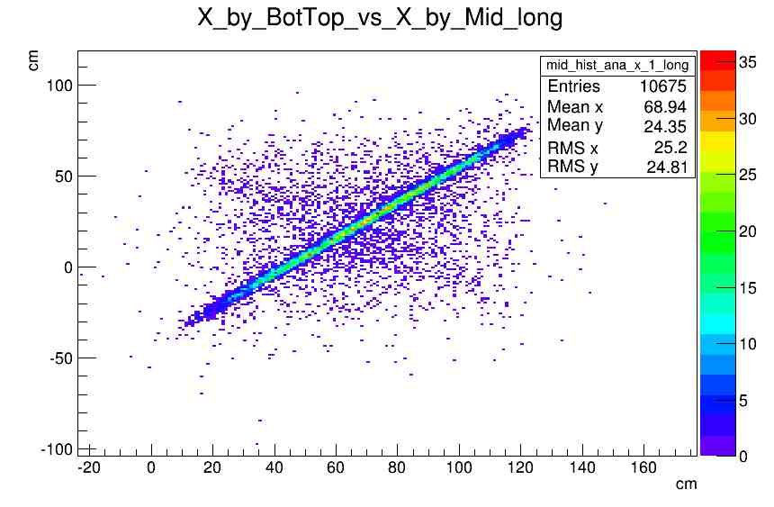
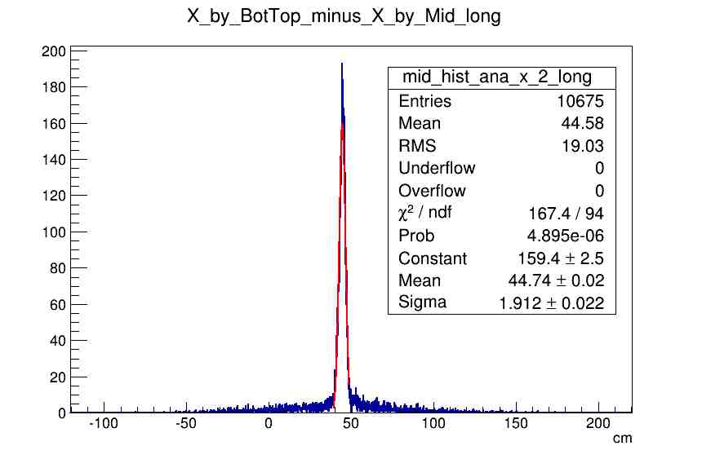
New results
Reconstruction of Middle MRPC position using Top and Bottom MRPCs (without channels calibration).
CORTO scheme (2014)

Slide 10
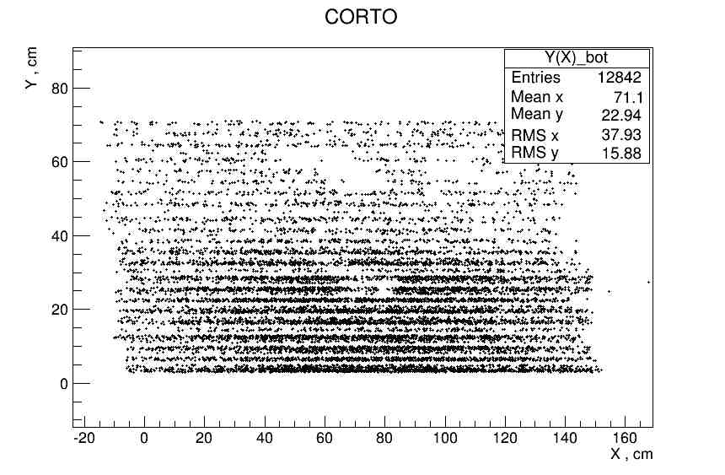
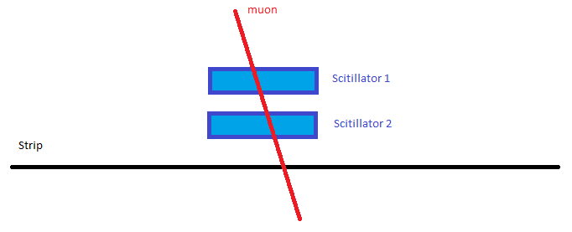
Efficiency map of the MRPC
Still have few gaps of the MRPC efficiency =(
Solution
Reconstructed hits from bottom MRPC (2014).
Efficiency checking

Slide 11
2D Scanning Device for CORTO (2D SDC)

Slide 12
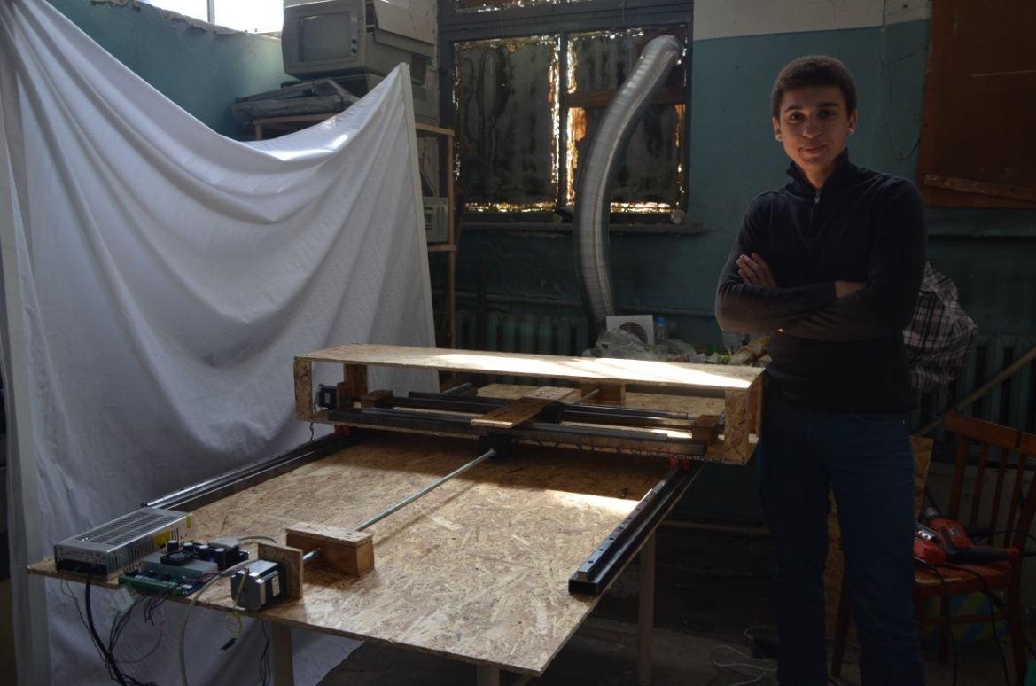
First Ukrainian Prototype

Slide 13
Final version of 2D SDC at LAL
Main parameters:
- Position accuracy less than 0.1 mm
- Linear speed around 5 mm/s;
- Maximum tested weight is 20 kg

Slide 14
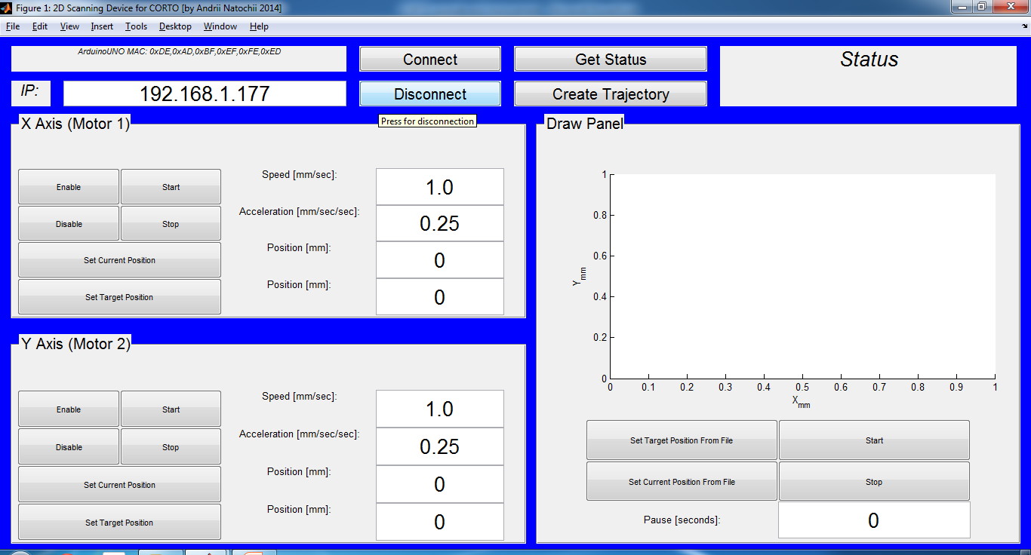
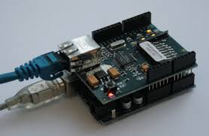
Software and controlling system
Arduino UNO with Ethernet Shield
Software window (GUI).
Controlling components:
Two stepper motors (NEMA23), two microstepping drivers (LeadShine), two power supplies (5V/3A & 24 V/5A), microcontroller (Arduino Uno), Ethernet Shield for ethernet connection and remotely controlling.

Slide 15
Conclusion
During this year we have done a lot of important steps for CORTO improvement:
Third MRPC, Three WaveCatcher cards, 2D SDC
All this things will help us to prepare the CORTO for it’s main mission – to test different types of detectors, knowing MRPC accuracy and efficiency.

Slide 16
Acknowledgment
Thanks a lot for helping and professional advice:
Véronique Puill
Leonid Burmistrov
Jean François Vagnucci
Dominique Breton
All CORTO team
And guys from central LAL engineering atelier and from LAL tool shop

