Slide 1
Ultra-Fast Silicon Detector
The “4D” challenge
A parameterization of time resolution
The “Low Gain Avalanche Detectors” project
Laboratory measurements
UFSD: LGAD optimized for timing measurements
WeightField2: a simulation program to optimize UFSD
First measurements
Future directions
Nicolo Cartiglia
With
INFN Gruppo V, LGAD group of RD50, FBK and Trento University, Micro-Electronics Turin group
Rome2 - INFN.

Slide 2
Acknowledgement
This research was carried out with the contribution of the Ministero degli Affari Esteri, “Direzione Generale per la Promozione del Sistema Paese” of Italy.
This work is currently supported by INFN Gruppo V, UFSD project (Torino, Trento Univ., Roma2, Bologna, FBK).
This work was developed in the framework of the CERN RD50 collaboration and partially financed by the Spanish Ministry of Education and Science through the Particle Physics National Program (F P A2010−22060−C 02−02 and FPA2010 − 22163 − C02 − 02).
The work at SCIPP was partially supported by the United States Department of Energy, grant DE-FG02-04ER41286.
Notes:
2

Slide 3
The 4D challenge
Is it possible to build a detector with concurrent excellent time and position resolution?
^{Can we provide} in the same detector and readout chain:
Ultra-fast timing resolution [ ~ 10 ps]
Precision location information [10’s of μm]

Slide 4
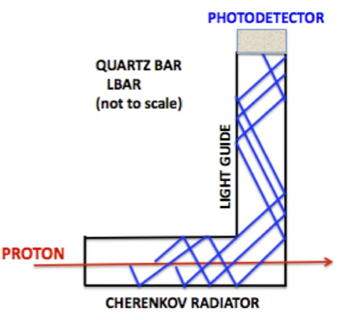
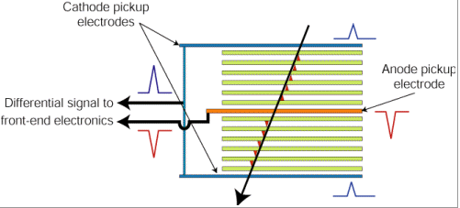
State-of-the-art Timing Detectors
Timing detectors exploit very fast physics processes such as
Cherenkov light emission or electronic avalanches to create prompt signals
σ_{t} ~ 20-30 ps
σ_{x} ~ 1-2 mm
CMS/ATLAS
ALICE
These detectors measure time very accurately but locate particles with the precision of ~ 1 mm
Good timing is obtain by using a gain mechanism, either in the detector or in the electronics

Slide 5
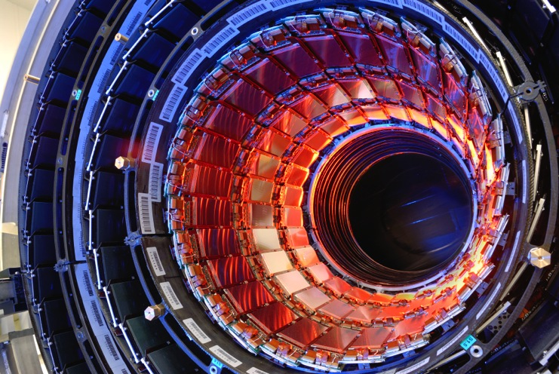
State-of-the-art Position Detectors
Extremely good position detectors are currently in use in every major high energy physics experiment:
Millions of channels
Very reliable
Very radiation hard
The timing capability is however
limited to ~ 100-150 ps
(NA62 @CERN)
σ_{t} ~ 100-150 ps
σ_{x} ~ 20-30 μm

Slide 6
A time-tagging detector
(a simplified view)
Time is set when the signal crosses the comparator threshold
The timing capabilities are determined by the characteristics of the signal at the output of the pre-Amplifier and by the TDC binning.

Slide 7
Noise source: Time walk and Time jitter
Time walk: the voltage value V_{th} is reached at different times by signals of different amplitude
Jitter: the noise is summed to the signal, causing amplitude variations
Due to the physics of signal formation
Mostly due to electronic noise
σ_{Total}² = σ_{Jitter} ² + σ _{Time Walk} ² + σ_{TDC}²

Slide 8
Time Resolution and slew rate
Using the expressions in the previous page, we can write
where:
- S/t_{r} = dV/dt = slew rate
- N = system noise
- V_{th} = 10 N
Assuming constant noise, to minimize time resolution
we need to maximize the S/t_{r} term
(i.e. the slew rate dV/dt of the signal)
➔ We need large and short signals ⬅
Notes:
8

Slide 9
Signal formation in silicon detectors
We know we need a large signal, but how is the signal formed?
What is controlling
the slew rate?
A particle creates charges, then:
The charges start moving under the influence of an external field
The motion of the charges induces a current on the electrodes
The signal ends when the charges reach the electrodes

Slide 10
How to make a good signal
Signal shape is determined by Ramo’s Theorem:
Weighting field
Drift velocity
A key to good timing is the uniformity of signals:
Drift velocity and Weighting field need to be as uniform as possible

Slide 11
Drift Velocity
➔ Highest possible E field to saturate velocity
➔ Highest possible resistivity for velocity uniformity
We want to operate in this regime

Slide 12
Weighting Field: coupling the charge to the electrode
Strip: 100 μm pitch, 40 μm width
Pixel: 300 μm pitch, 290 μm width
Bad: almost no coupling away from the electrode
Good: strong coupling almost all the way to the backplane
The weighting field needs to be as uniform as possible, so that the coupling is always the same, regardless of the position of the charge

Slide 13
Non-Uniform Energy deposition
Landau Fluctuations cause two major effects:
Amplitude variations, that can be corrected with time walk compensation
For a given amplitude, the charge deposition is non uniform.
These are 3 examples of this effect:

Slide 14
What is the signal of one e/h pair?
(Simplified model for pad detectors)
Let’s consider one single electron-hole pair.
The integral of their currents is equal to the electric charge, q:
However the shape of the signal depends on the thickness d:
thinner detectors have higher slew rate
Thin detector
d
+
-
i(t)
Thick detector
D
+
-
t
One e/h pair generates higher current in thin detectors
Weighting field

Slide 15
Large signals from thick detectors?
(Simplified model for pad detectors)
Thick detectors have higher number of charges:
d
+
-
+
-
However each charge contributes to the initial current as:
+
-
D
+
-
+
-
+
-
+
-
The initial current for a silicon detector does not depend on how thick (d) the sensor is:
Number of e/h = 75/micron
velocity
Initial current = constant
Weighting field

Slide 16
Thin vs Thick detectors
(Simplified model for pad detectors)
Thin detector
d
+
-
+
-
i(t)
+
-
S
Thick detector
D
+
-
+
-
+
-
+
-
tr
Thick detectors have longer signals, not higher signals
Best result : NA62, 150 ps on a 300 x 300 micron pixels
How can we do better?

Slide 17
Possible approaches
We need to minimize this expression:
  APD (silicon with gain ~ 100): maximize S
    Very large signal
  Diamond: minimize N, minimize t_{r}
    Large energy gap, very low noise, low capacitance
    Very good mobility, short collection time t_{r}
  LGAD (silicon with gain ~ 10): minimize N, moderate S
    Low gain to avoid shot noise and excess noise factor
Notes:
17

Slide 18
The APD approach
The key to this approach is the large signal: if your signal is large enough, everything becomes easy.
So far they reported:
Excellent time resolution
Good radiation resistance up to < 10¹⁴ neq/cm²
They will propose a system for the CT-PPS
See:
https://indico.cern.ch/event/363665/contribution/7/material/slides/0.pdf

Slide 19
The Diamond approach - I
Diamond detectors have small signal: two ways of fighting this problem
1) Multilayer stack
2) Grazing
The signal is increased by the sum of many layers while it keeps very short rise time
Best resolution:
~ 100 ps
The particle crosses the diamond sensor along the longitudinal direction

Slide 20
The Diamond approach - II
TOTEM collaboration: couple diamond detector with a tailored front-end and a full digitizing readout (SAMPIC, Switching Capacitor Sampler)
Excellent results at a very recent testbeam with ~ 4.5 x 4.5 mm² detectors
The result allows TOTEM to introduce timing measurement is their Roman Pot set-up:
Vertical top pots used for timing

Slide 21
The “Low-Gain Avalanche Detector” approach
Is it possible to manufacture a silicon detector that looks like a normal pixel or strip sensor, but with a much larger signal (RD50)?
750 e/h pair per micron instead of 75 e/h?
Finely Segmented
Radiation hard
No dead time
Very low noise (low shot noise)
No cross talk
Insensitive to single, low-energy photon
Many applications:
Low material budget (signal in 30 micron == signal 300 micron)
Excellent immunity to charge trapping (larger signal, shorter drift path)
Very good S/N: 5-10 times better than current detectors
Good timing capability (large signal, short drift time)

Slide 22
Gain in Silicon detectors
Gain in silicon detectors is commonly achieved in several types of sensors. It’s based on the avalanche mechanism that starts in high electric fields: E ~ 300 kV/cm
Charge multiplication
Gain:
= strong E dependance
~ 0.7 pair/μm for electrons,
~ 0.1 for holes
E ~ 300 kV/cm
-
-
-
-
-
-
-
Concurrent multiplication of electrons and holes generate very high gain
+
+
+
+
+
-
-
-
-
-
-
Silicon devices with gain:
APD: gain 50-500
SiPM: gain ~ 10⁴
-
+
+
+
+
+
+
-
+
-
-
-
+

Slide 23
How can we achieve E ~ 300kV/cm?
1) Use external bias: assuming a 300 micron silicon detector, we need V_{bias} = 30 kV
Not possible
30 kV !!
2) Use Gauss Theorem:
E = 300 kV/cm ➔ q ~ 10¹⁶ /cm³

Slide 24
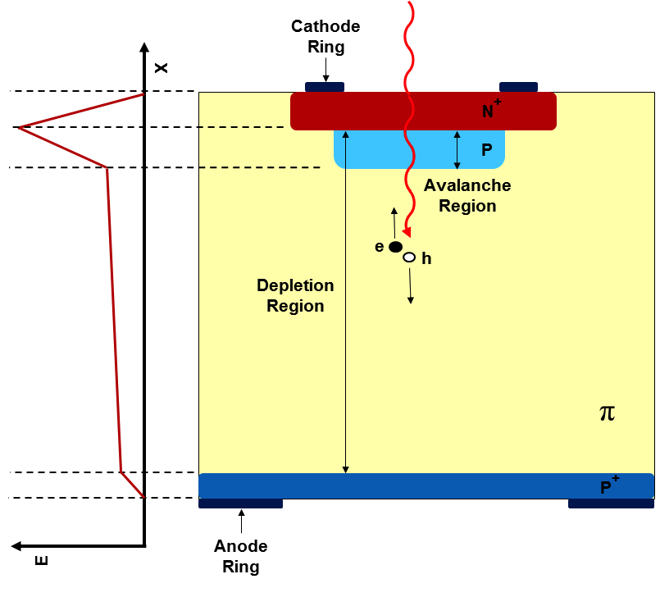
Low Gain Avalanche Detectors (LGADs)
The LGAD sensors, as proposed and manufactured by CNM
(National Center for Micro-electronics, Barcelona):
High field obtained by adding an extra doping layer
E ~ 300 kV/cm, closed to breakdown voltage
High field
Gain layer

Slide 25
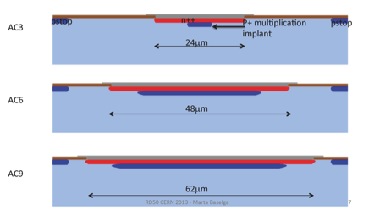
LGADs Pads, Pixels and Strips
The LGAD approach can be extended to any silicon structure,
not just pads.
This is an example of LGAD strips

Slide 26
Sensor: Simulation
We developed a full sensor simulation to optimize the sensor design
WeightField2, F. Cenna, N. Cartiglia 9th Trento workshop, Genova 2014
Available at http://personalpages.to.infn.it/~cartigli/weightfield2
It includes:
Custom Geometry
Calculation of drift field and weighting field
Currents signal via Ramo’s Theorem
Gain
Diffusion
Temperature effect
Non-uniformdeposition
Electronics

Slide 27
WeightField2: a program to simulate silicon detectors

Slide 28
WeightField2: output currents

Slide 29
WeightField2: response of the read-out electronics

Slide 30
How gain shapes the signal
Gain electron: absorbed immediately
Gain holes:
long drift home
-
+
Initial electron, holes
-
+
+
-
Electrons multiply and produce additional electrons and holes.
Gain electrons have almost no effect
Gain holes dominate the signal
➔ No holes multiplications

Slide 31
Interplay of gain and detector thickness
The rate of particles produced by the gain does not depend on d (assuming saturated velocity v_{sat})
Gain
Particles per micron
v
Gain
+
-
➔ Constant rate of production
However the initial value of the gain current depends on d
(via the weighing field)
➔ Gain current ~ 1/d
A given value of gain has much more effect on thin detectors

Slide 32
Gain current vs Initial current
!!!
➔ Go thin!!
(Real life is a bit more complicated, but the conclusions are the same)
Full simulation
(assuming 2 pF detector capacitance)
300 micron:
~ 2-3 improvement with gain = 20
Significant improvements in time resolution require thin detectors

Slide 33
Ultra Fast Silicon Detectors
UFSD are LGAD detectors optimized to achieve the best possible time resolution
Specifically:
Thin to maximize the slew rate (dV/dt)
Parallel plate – like geometries (pixels..) for most uniform weighting field
High electric field to maximize the drift velocity
Highest possible resistivity to have uniform E field
Small size to keep the capacitance low
Small volumes to keep the leakage current low (shot noise)

Slide 34
First Measurements and future plans
LGAD laboratory measurements
Doping concentration
Gain
Time resolution measured with laser signals
LGAD Testbeam measurements
Landau shape at different gains
Time resolution measured with MIPs

Slide 35
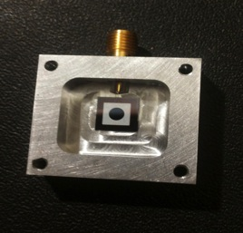
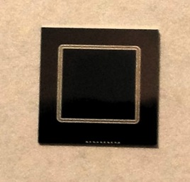
LGAD Sensors in Torino
Run | Sensor | P-Layer Implant (E=100 KeV) | Gain | V_{break} | Metal Layer
6474 | W8_B4 | ? | ~ 10 | > 500 V | DR
6474 | W8_C6 | ? | ~ 10 | > 500 V | DC
6474 | W9_B6 | No implant | No Gain | > 500 V | DR
7062 | W1_F3 | 1.6 x 10¹³ cm⁻² | ~ 1-2 | > 500 V | DR
7062 | W3_H5 | 2.0 x 10¹³ cm⁻² | ~ 10 | > 500 V | DR
7062 | W7_D7 | No implant | No Gain | > 500 V | DR
Thickness:
300 μm
DC
DR

Slide 36
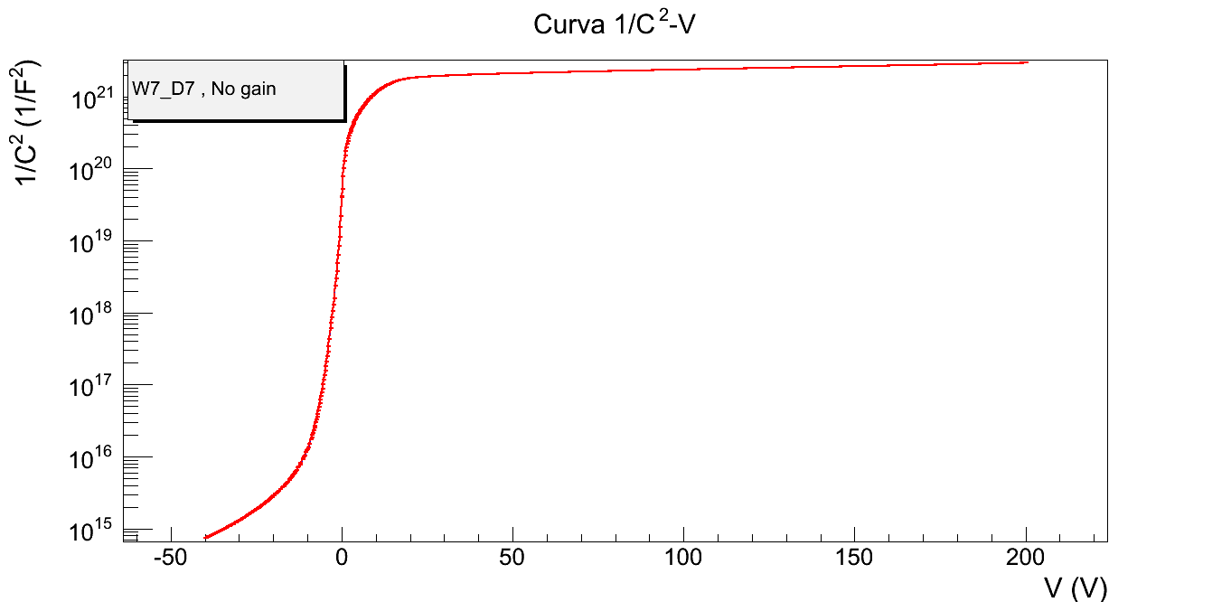
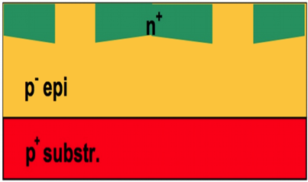
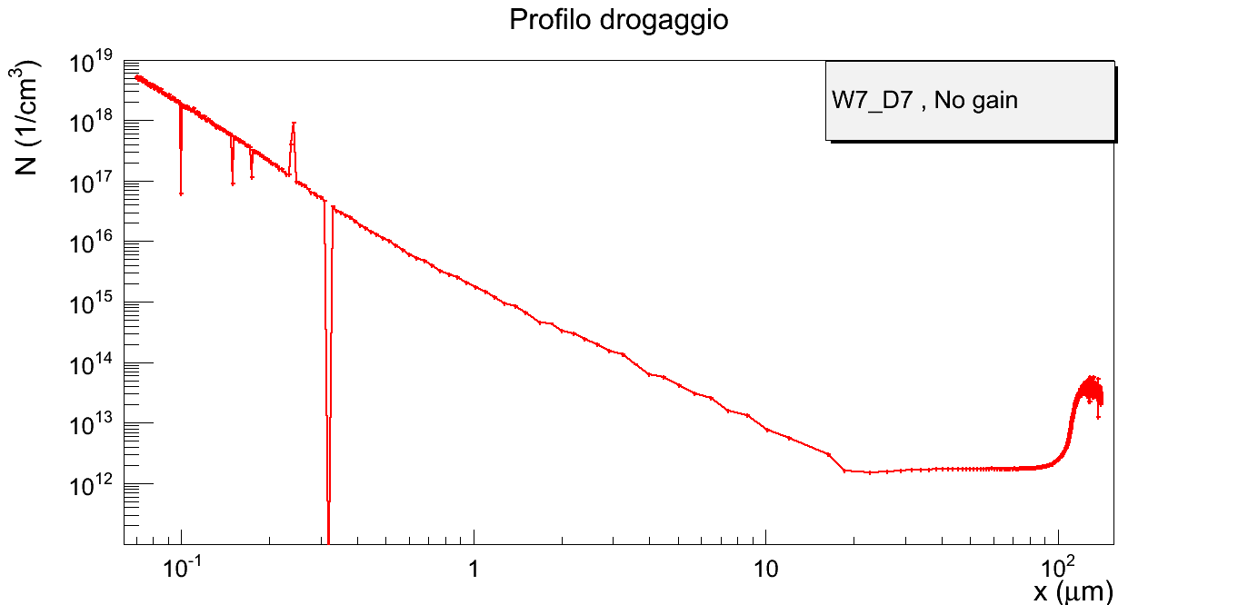
Doping profile from CV measurement - I
No-gain sensor
Doping profile
Doping

Slide 37
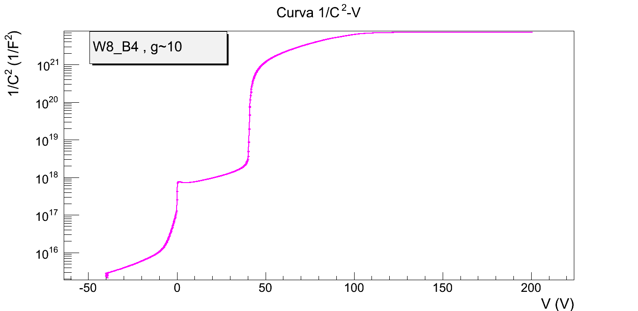
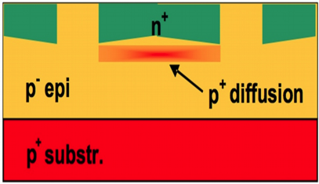
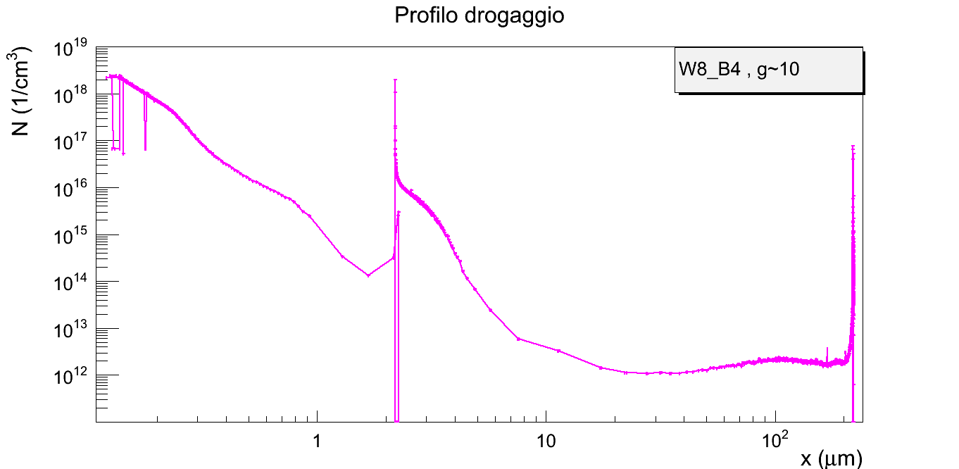
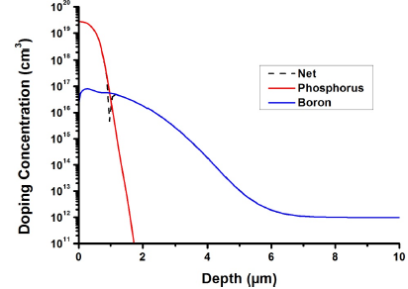
Doping profile from CV measurement - II
Gain sensor
Ideal doping profile
Doping profile
This “bump” creates the high field needed for the gain

Slide 38
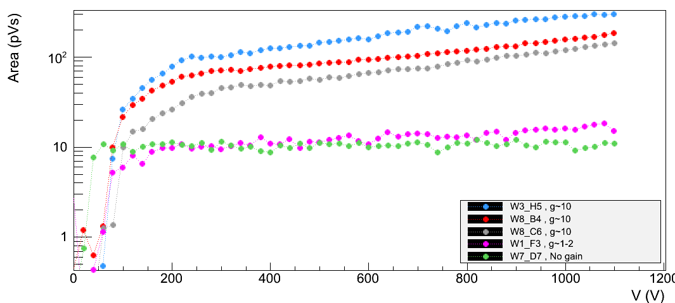
Signal amplitude
Using laser signals we are able to measure the different responses of LGAD and traditional sensors
Gain ~ 10
Reference sensor

Slide 39
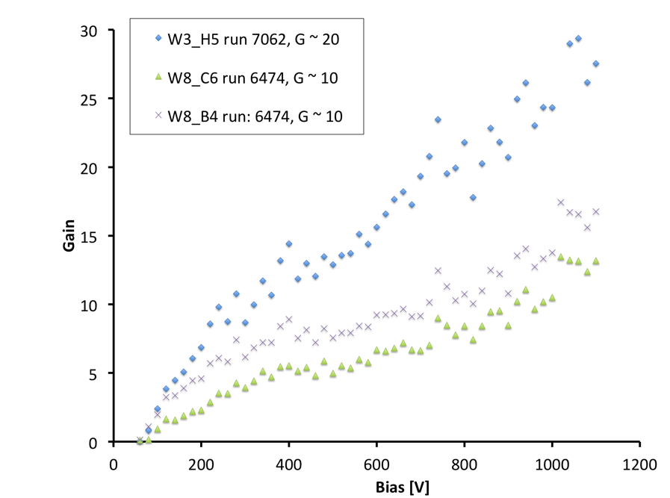
Gain
The gain is estimated as the ratio of the output signals of LGAD detectors to that of traditional one
The gain increases linearly with Vbias (not exponentially!)
Gain ~ 20
Gain ~ 10
Digitizer
2 sensors
Laser split into 2

Slide 40
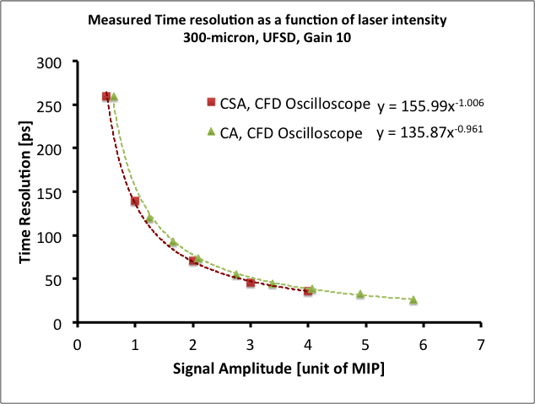
Laser Measurements on CNM LGAD
We use a 1064 nm picosecond laser to emulate the signal of a MIP particle (without Landau Fluctuations)
The signal output is read out by either a Charge sensitive amplifier or a Current Amplifier (Cividec)
σ_{t} ~ 140 ps @ 800 Volts

Slide 41
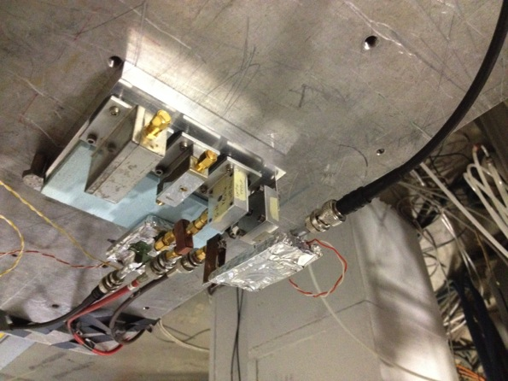
Testbeam Measurements on CNM LGAD
In collaboration with Roma2, we went to Frascati for a testbeam using 500 MeV electrons
As measured in the lab, the gain ~ doubles going from 400 -> 800 Volt.
300 micron thick, 5 x5 mm pads
The gain mechanism preserves the Landau amplitude distribution of the output signals

Slide 42
100 GeV pion Testbeam with CNM LGAD
Teasbeam data understood as the sum of 1MIP, 2 MIP or 3 MIP
Very linear behavior of UFSD with increasing charge
300 micron thick, 5 x5 mm pads

Slide 43
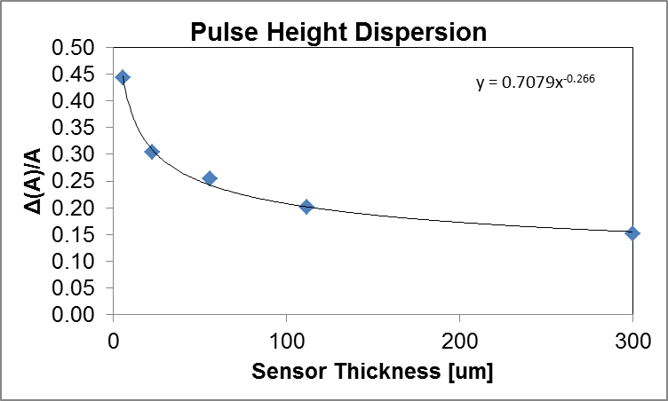
Properties of the Landau distributions
The ratio sigma/MPV is constant as a function of multiplication
indicating that the excess noise factor is not playing a role yet
According to our fits, the Landau have a smaller width than what is proposed by the parameterization of Meroli et al.
Pulse Height Dispersion
Sigma/MPV
ΔA/A = 0.7079d^{-0.266}
Sigma/MPV

Slide 44
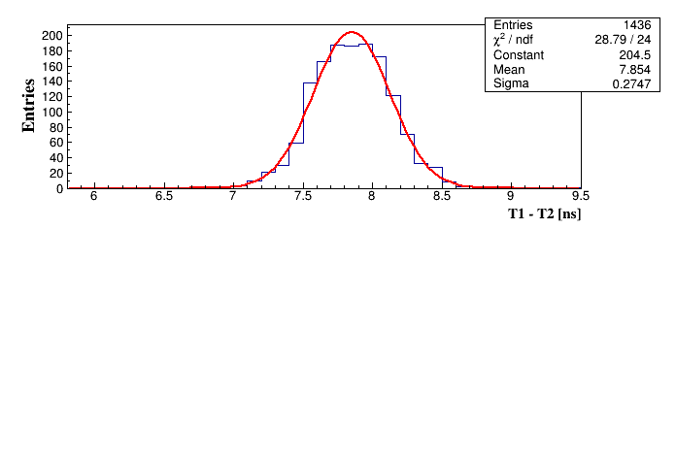
Testbeam Measurements on CNM LGAD
Time difference between two LGAD detectors crossed by a MIP
Tested different types of electronics (Rome2 SiGe, Cividec),
Not yet optimized for these detectors
σ_{t} ~ 190 ps @ 800 Volts

Slide 45
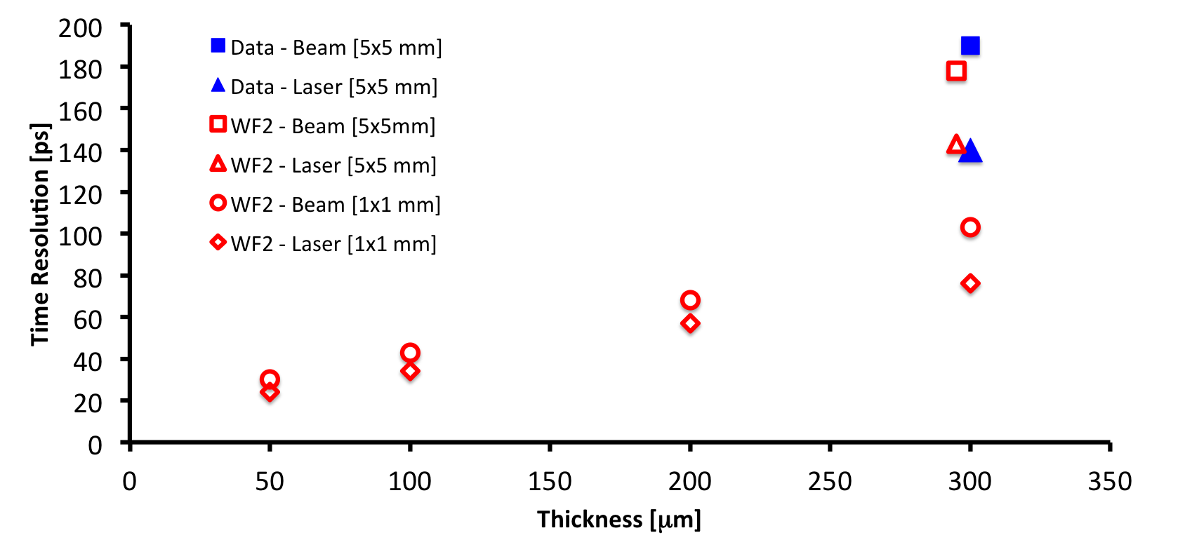
Present results and future productions
With WF2, we can reproduce very well the laser and testbeam results.
Assuming the same electronics, and 1 mm² LGAD pad with gain 10, we can predict the timing capabilities of the next sets of sensors.
Current Test beam results and simulations
Effect of
Landau
fluctuations
Next prototypes

Slide 46
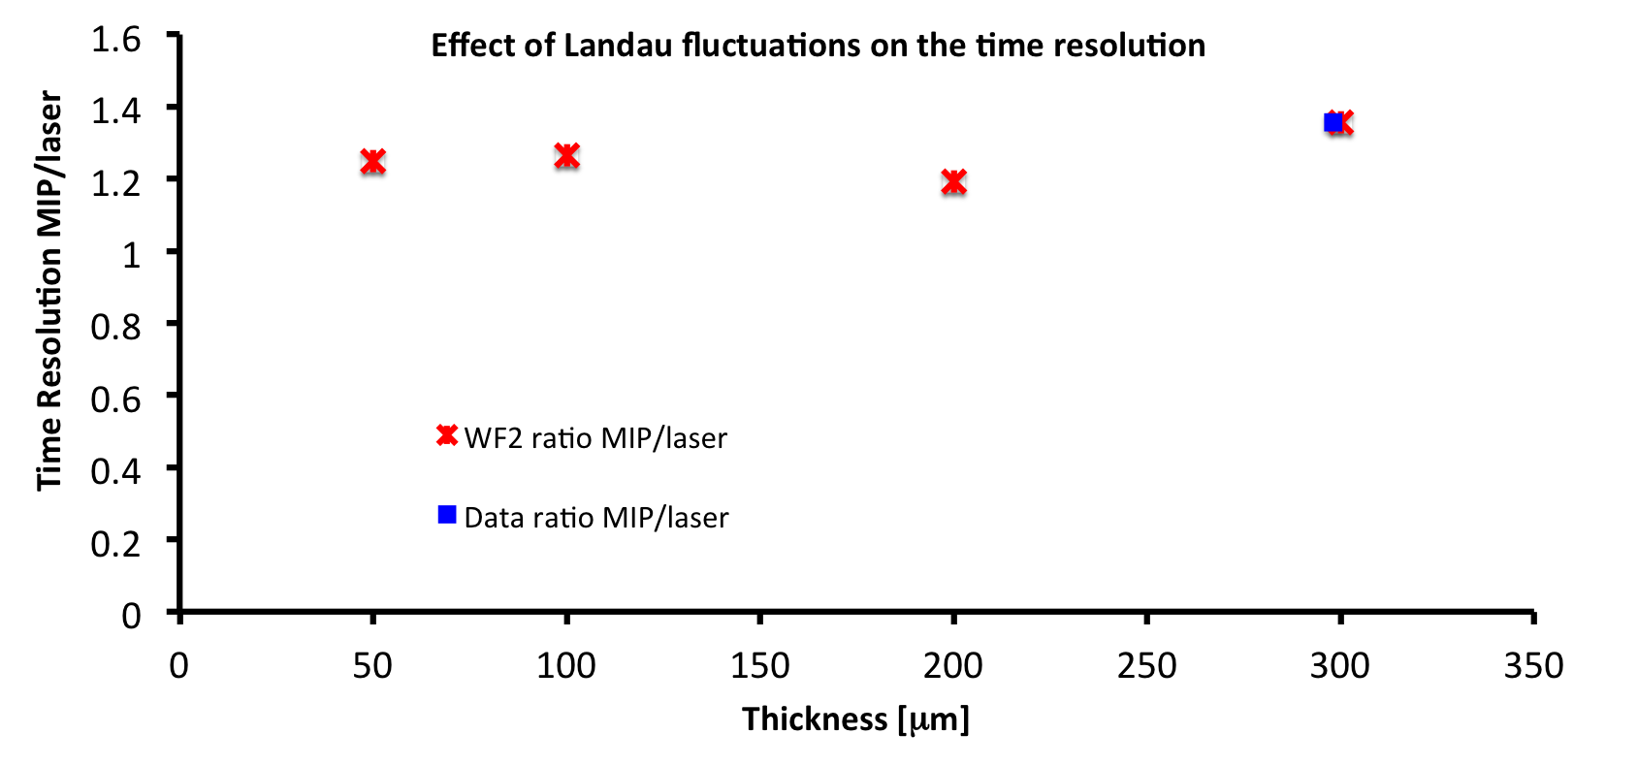
Effect of Landau Fluctuations on the time resolution
The effect of Landau fluctuations in a MIP signal are degrading the time resolution by roughly 30 % with respect of a laser signal
Current Test beam results and simulations
Next prototypes

Slide 47
Irradiation tests
The gain decreases with irradiations:
at 10¹⁴ n/cm² is 20% lower
➔ Due to boron disappearance
What-to-do next:
1) Planned new irradiation runs (neutrons, protons), new sensor geometries
2) Use Gallium instead of Boron for gain layer (in production now)
3) Design the UFSD to have a gain higher than we need, ~ 30 at 500 V.
- We use UFSD at gain 10-15, at 200 Volt
- When radiation damage lowers the gain, we increase Vbias to compensate
Digitizer

Slide 48
Merging timing with position resolution
Electrode segmentation makes the E field very non uniform, and therefore ruins the timing properties of the sensor
We need to find a geometry that has very uniform E field, while allowing electrode segmentation.

Slide 49
1) Segmentation: buried junction
Separate the multiplication side from the segmentation side
Move the gain layer to the deep side
Parallel plate geometry
Segmented geometry
n-in-p
p-in-p
For a 100 μm detector, the current does not change
Moving the junction on the deep side allows having a very uniform multiplication, regardless of the electrode segmentation

Slide 50
2) Segmentation: AC coupling
Standard n-in-p LGAD, with AC read-out
AC coupling
n+ electrode
gain layer
p++ electrode
The signal is frozen on the resistive sheet, and it’s AC coupled to the electronics
AC coupling
Detector
Detector
Detector
Detector
Detector
Detector

Slide 51
3) Segmentation: splitting gain and position measurements
The ultimate time resolution will be obtained with a custom ASIC. However we might split the position and the time measurements

Slide 52
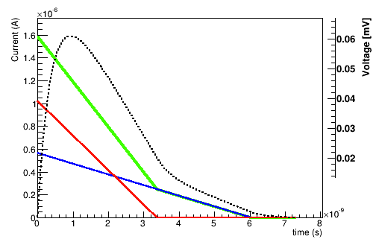
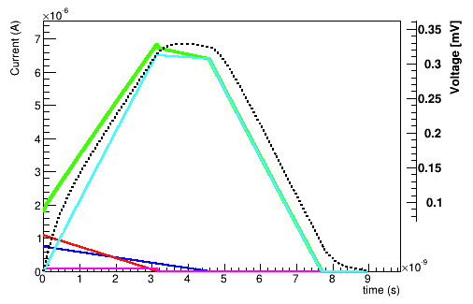
Electronics
To fully exploit UFSDs, dedicated electronics needs to be designed.
The signal from UFSDs is different from that of traditional sensors
300 μm
300 μm
Gain
Initial
Oscilloscope
Simulated Weightfield2
Pads with no gain
Charges generated uniquely by the incident particle
Pads with gain
Current due to gain holes creates a longer and higher signal
2 sensors

Slide 53
Interplay of Τ_{Col} and τ = R_{in} C_{Det}
Detector Capacitance C_{Det}
Input impedance R_{in}
Collection
time Τ_{Col}
R_{in} C_{Det}
There are two time constants at play:
Τ_{Col} : the signal collection time (or equivalently the rise time)
τ = R_{in} C_{Det} : the time needed for the charge to move to the electronics
τ < Τ_{Col}
τ ~ Τ_{Col}
τ > Τ_{Col}
Signal
Electronics
τ/Τ_{Col} increases ➔ dV/dt decreases
➔ Smoother current
Need to find the optimum balance

Slide 54
What is the best “time measuring” circuit?
V
Constant Fraction Discriminator
The time is set when a fixed fraction of the amplitude is reached
10%
t
V
Time over Threshold
The amount of time over the threshold is used to correct for time walk
V_{th}
t₁ t₂
t
V
Multiple sampling
Most accurate method, needs a lot of computing power: SAMPIC!!
t

Slide 55
Noise - I
Real life
Noise Model
Detector Bias
Detector
Bias
Resistor
Series
Resistor
Amplifier
C_{Bias}
R_{Bias}
e_{N_Amp}
Bias Resistor
i_{N_Det}
R_{S}
e_{N_S}
C_{Det}
i_{N_Bias}
i_{N_Amp}
Detector C_{det}
C_{C}
R_{S}
R_{Bias}
Digitizer
This term, the detector current shot noise, depends on the gain
2 sensors
Laser split into 2
low gain!
This term dominates for short shaping time

Slide 56
Noise - II
Real life
Detector Bias
C_{Bias}
R_{Bias}
Bias Resistor
Detector C_{det}
C_{C}
R_{S}
NOISE DUE TO GAIN:
Excess noise factor:
low gain, very small k
Laser split into 2
k = ratio h/e gain
Low leakage current and low gain (~ 10) together with short shaping time are necessary to keep the noise down.

Slide 57
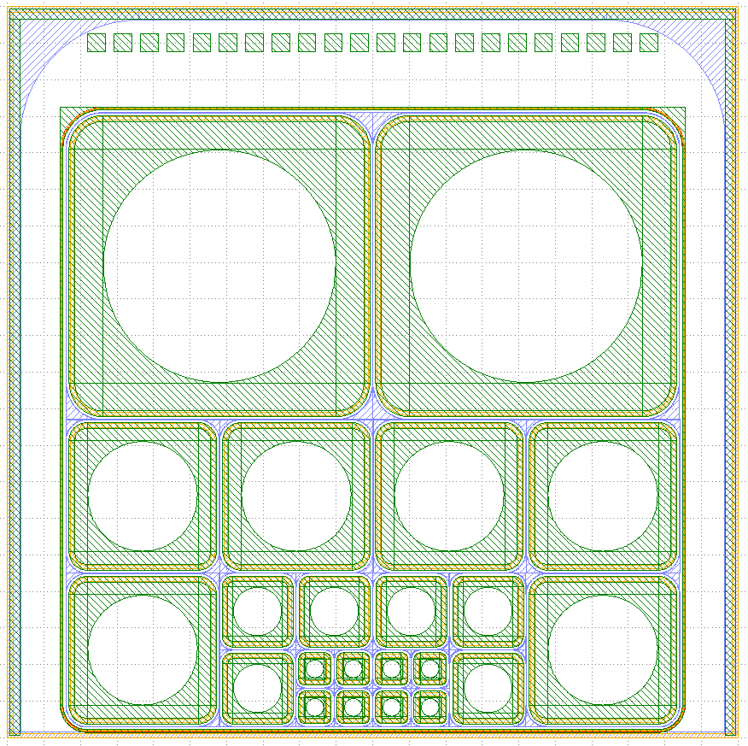
Next CNM productions
5 mm
These new productions will allow a detailed exploration of the UFSD timing capabilities, including border effects between pads, and distance from the sensor edge.
2.5 mm
1.25 mm
Timescale:
Spring 2015: 200 micron
Summer 2015: 100 micron
Summer 2015: 50 micron
0.6 mm

Slide 58
Next Steps
Wafer Production
    200 micron thick sensors by Spring-2015
    100 and 50 micron thick sensors by Summer 2015.
Production of UFSD doped with Gallium instead of Boron.
Study of reversed-UFSD started for the production of pixelated UFSD sensors (FBK, Trento).
UFSD are included in the CMS TDR CT-PPS as a solution for forward proton tagging
Use of UFSD in beam monitoring for hadron beam. INFN patent and work on-going
Interest in UFSD for 4D tracking at high luminosity
Testbeam analyses just started. Results coming soon…

Slide 59
UFSD – Summary
We are just starting to understand the timing capability of UFSD
Low-gain avalanche diodes (LGAD) offer silicon sensors with an enhanced signal amplitude: UFSD are LGAD detectors optimized for timing resolution.
Several options under studies to obtain concurrently excellent space and time resolutions.
We developed a program, Weightfield2 to simulate the behaviors of LGAD and optimized them for fast timing (available at http://personalpages.to.infn.it/~cartigli/Weightfield2.0/)
Timescale: 1 year to asses UFSD timing capabilities

Slide 60
Presented at IEEE, oral and posters, presentations
Poster Session IEEE N26-13
Poster Session IEEE N11-8

Slide 61
Additional references
Several talks at the 22nd, 23rd and 24th RD50 Workshops:
23rd RD50: https://indico.cern.ch/event/265941/other-view?view=standard
22nd RD50: http://panda.unm.edu/RD50_Workshop/
9Th Trento Workshop, Genova, Feb 2014.
F. Cenna “Simulation of Ultra-Fast Silicon Detectors”
N. Cartiglia “Timing capabilities of Ultra-Fast Silicon Detector”
Papers:
[1] N. Cartiglia, Ultra-Fast Silicon Detector, 13th Topical Seminar on Innovative Particle and Radiation Detectors (IPRD13), 2014 JINST 9 C02001, http://arxiv.org/abs/1312.1080
[2] H.F.-W. Sadrozinski, N. Cartiglia et al., Sensors for ultra-fast silicon detectors, Proceedings "Hiroshima" Symposium HSTD9, DOI: 10.1016/j.nima.2014.05.006 (2014).

Slide 62
Backup

Slide 63
The “Low-Gain Avalanche Detector” project
Is it possible to manufacture a silicon detector that looks like a normal pixel or strip sensor, but
with a much larger signal (RD50)?
730 e/h pair per micron instead of 73 e/h
Finely segmented
Radiation hard
No dead time
Very low noise (low shot noise)
No cross talk
Poster Session IEEE N26-13

Slide 64
How can we progress? Need simulation
We developed a full simulation program to optimize the
sensor design, WeightField2, (http://cern.ch/weightfield2 )
It includes:
Custom Geometry
Calculation of drift field and weighting field
Currents signal via Ramo’s Theorem
Gain
Diffusion
Temperature effect
Non-uniform deposition
Electronics
Poster Session IEEE N11-8

Slide 65
State-of-the-art Position Detectors
Extremely good position detectors are currently in use in every major high energy physics experiment:
Millions of channels
Very reliable
Very radiation hard
The timing capability is however
limited to ~ 100-150 ps
(NA62 @CERN)
σ_{t} ~ 100-150 ps
σ_{x} ~ 20-30 μm

Slide 66
Why low gain? Can we use APD or SiPM instead?
My personal conclusion: I think it’s possible to obtain very good timing: APDs, SiPMs have very high gain, so they are excellent in “single shot” timing.
However, we are seeking to obtain something more powerful: a very low noise, finely pixelated device, able to provide excellent timing in any geometry, and also able to work in the presence of many low energy photons without giving fake hits.
These requirements make the use of high gain devices challenging

Slide 67
Comparison Data Simulation
MIP
Alpha from Top
Alpha from bottom
V bias
200
300
400
500
600

Slide 68
CNM LGADs mask
CNM, within the RD50 project, manufactured several runs of LGAD, trying a large variety of geometries and designs
This implant controls the value of the gain
Wafer Number | P-layer Implant (E = 100 keV) | Substrate features | Expected Gain
1-2 | 1.6 × 10¹³ cm⁻² | HRP 300 (FZ; ρ>10 KΩ·cm; <100>; T = 300±10 µm) | 2 – 3
3-4 | 2.0 × 10¹³ cm⁻² | HRP 300 (FZ; ρ>10 KΩ·cm; <100>; T = 300±10 µm) | 8 – 10
5-6 | 2.2 × 10¹³ cm⁻² | HRP 300 (FZ; ρ>10 KΩ·cm; <100>; T = 300±10 µm) | 15
7 | (---) PiN Wafer | HRP 300 (FZ; ρ>10 KΩ·cm; <100>; T = 300±10 µm) | No Gain

Slide 69
Electronics: What is the best pre-amp choice?
Energy deposition in a 50 mm sensor
Current Amplifier
Fast slew rate
Higher noise
Sensitive to Landau bumps
Current signal in a 50 mm sensor
Integrating Amplifier
Slower slew rate
Quieter
Integration helps the signal smoothing

Slide 70
Details of AC coupling - I
R_{Ampl}
C _{AC}
R_{Sheet}
Detector
Detector
Detector
Detector
Detector
Detector
Only a small part of the detector is involved
Additional Rise time ~ R_{Ampl} * C_{detector} ~ 100 Ω ∗ 1pF ~ 100 ps
Freezing time ~ R_{Sheet} * C_{AC} ~ 1kΩ ∗ 100pF ~ 100 ns

Slide 71
Details of AC coupling - II
AC coupling
n++ electrode
In the n-in-p design, the resistivity of the sheet is hard to control, as the doping of the n++ and p+ layers determine the gain, so the values cannot be chosen as we like.
gain layer p+
p++ electrode
AC coupling
p++ electrode
Gain layer p+
In the p-in-p design, the resistivity of the sheet is easier to control
n++ electrode

