Slide 1


Future Circular Colliders
M. Benedikt
gratefully acknowledging input from FCC global design study team,
Y. Wang and W. Chou

Slide 2
Outline
Motivation
High-energy circular proton colliders
  Parameters & challenges
High-energy circular lepton colliders
  Parameters & challenges
Status of FCC collaboration

Slide 3

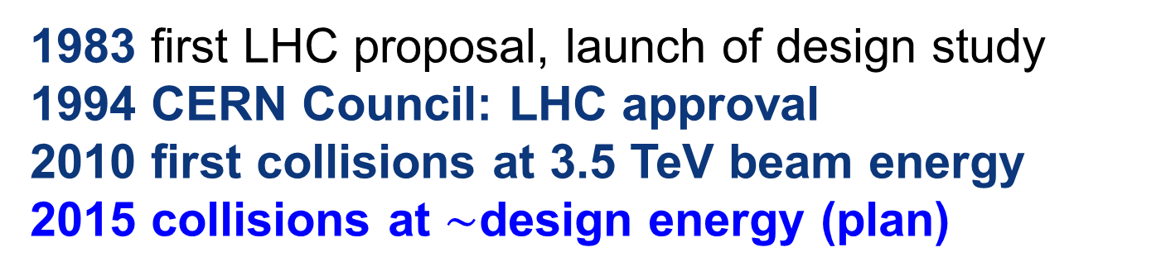
LHC evolution
LHC history
1983 first LHC proposal, launch of design study
1994 CERN Council: LHC approval
2010 first collisions at 3.5 TeV beam energy
2015 collisions at $\sim$design energy (plan)
now is the time to plan for 2040!

Slide 4

Hadron collider motivation:
pushing the energy frontier
A very large circular hadron collider seems the only approach to reach 100 TeV c.m. collision energy in coming decades
Access to new particles (direct production) in the few TeV to 30 TeV mass range, far beyond LHC reach.
Much-increased rates for phenomena in the sub-TeV mass range →increased precision w.r.t. LHC and possibly ILC
M. Mangano
The name of the game of a hadron collider is energy reach
Cf. LHC: factor ~4 in radius, factor ~2 in field → O(10) in E_{cms}
$$E∝B_{dipole}{×ρ}_{bending}$$

Slide 5
Strategic Motivation
European Strategy for Particle Physics 2013:
  “…to propose an ambitious post-LHC accelerator project….., CERN should undertake design studies for accelerator projects in a global context,…with emphasis on proton-proton and electron-positron high-energy frontier machines..…”
ICFA statement 2014:
  ”…. ICFA supports studies of energy frontier circular colliders and encourages global coordination.….”
US P5 recommendation 2014:
  ”….A very high-energy proton-proton collider is the most powerful tool for direct discovery of new particles and interactions under any scenario of physics results that can be acquired in the P5 time window….”

Slide 6

Future Circular Collider Study
GOAL: CDR and cost review for the next ESU (2018)
International FCC collaboration (CERN as host lab) to study:
pp-collider (FCC-hh) → main emphasis, defining infrastructure requirements
80-100 km infrastructure in Geneva area
e⁺e⁻ collider (FCC-ee) as potential intermediate step
p-e (FCC-he) option
~16 T ⇒ 100 TeV pp in 100 km

Slide 7
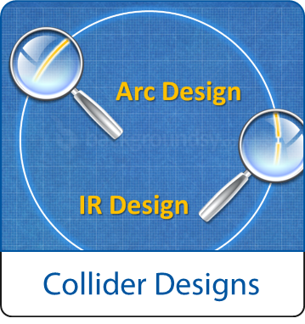
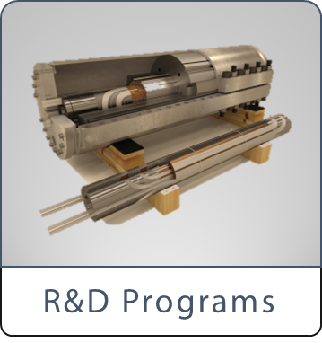
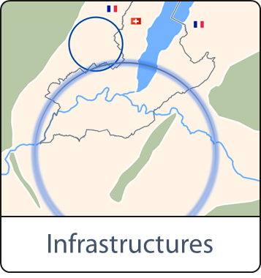
FCC Scope:
Accelerator and Infrastructure
FCC-hh: 100 TeV pp collider as long-term goal
→ defines infrastructure needs
FCC-ee: e⁺e⁻ collider, potential intermediate step
FCC-he: integration aspects of pe collisions
Push key technologies
in dedicated R&D programmes e.g.
16 Tesla magnets for 100 TeV pp in 100 km
SRF technologies and RF power sources
Tunnel infrastructure in Geneva area, linked to CERN accelerator complex
Site-specific, requested by European strategy

Slide 8

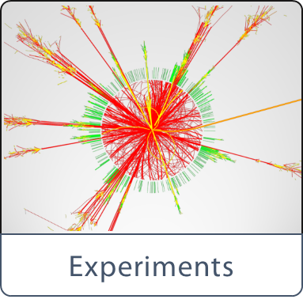

Scope: Physics & Experiments
Elaborate and document
- Physics opportunities
- Discovery potentials
Experiment concepts for hh, ee and he
Machine Detector Interface studies
Concepts for worldwide data services
Overall cost model
Cost scenarios for collider options
Including infrastructure and injectors
Implementation and governance models

Slide 9
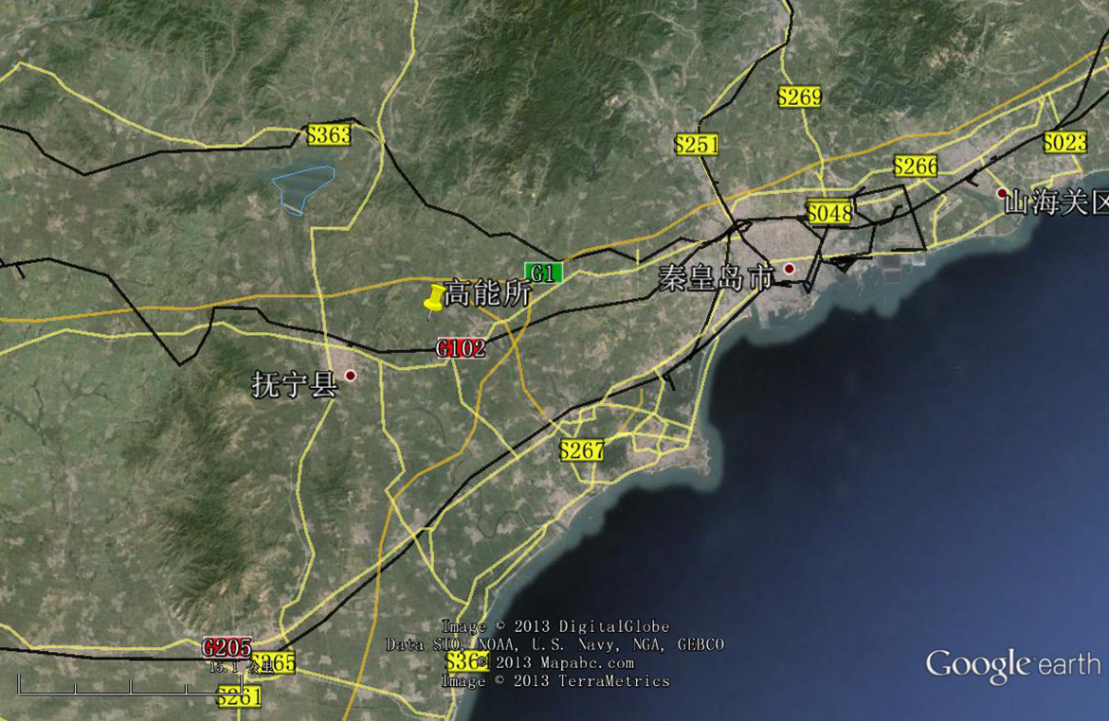
CepC/SppC study (CAS-IHEP) 54 km (baseline)
e⁺e⁻ collisions ~2028; pp collisions ~2042
Qinhuangdao (秦皇岛）
CepC, SppC
50 km
100 km
easy access
300 km east
from Beijing
3 h by car
1 h by train
“Chinese Toscana”
Yifang Wang

Slide 10


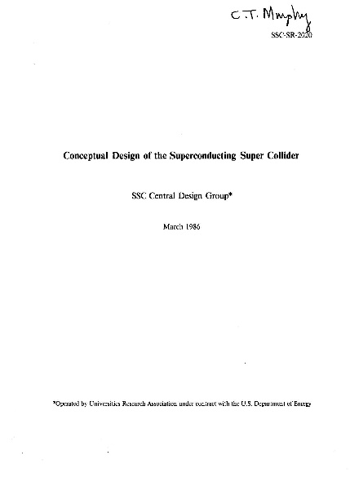
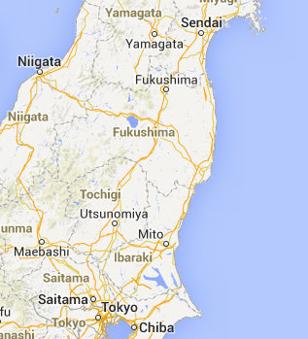
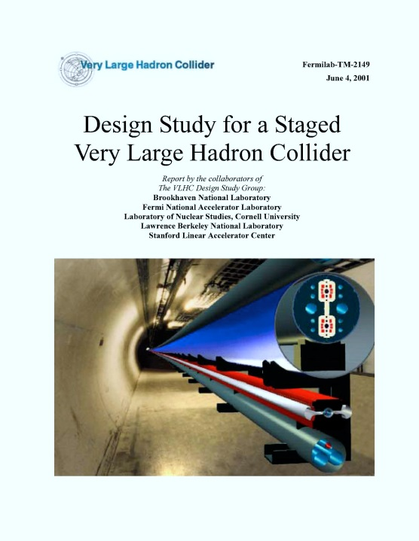
Previous studies in Italy (ELOISATRON 300km), USA (SSC 87km, VLHC 233km), Japan (TRISTAN-II 94km)
ex. ELOISATRON
ex. SSC
Supercolliders Superdetectors: Proceedings of the 19th and 25th Workshops of the INFN Eloisatron Project
SSC CDR 1986
ex. TRISTAN II
Many aspects of machine design and R&D non-site specific.
Exploit synergies with other projects and prev. studies
Tristan-II
option 2
ex. VLHC
F. Takasaki
H. Ulrich Wienands, The SSC Low Energy Booster: Design and Component Prototypes for the First Injector Synchrotron, IEEE Press, 1997
VLHC Design Study Group Collaboration
June 2001. 271 pp.
SLAC-R-591, SLAC-R-0591, SLAC-591,
SLAC-0591, FERMILAB-TM-2149
Tristan-II
option 1
http://www.vlhc.org/

Slide 11
CERN Circular Colliders and FCC
1980
1985
1990
1995
2000
2005
2010
2015
2020
2025
2030
2035
20 years
Constr.
Physics
LEP
Design
Proto
Construction
Physics
LHC
Design
Construction
Physics
HL-LHC
FCC
Design
Proto
Construction
Physics
CDR by end 2018 for strategy upade

Slide 12
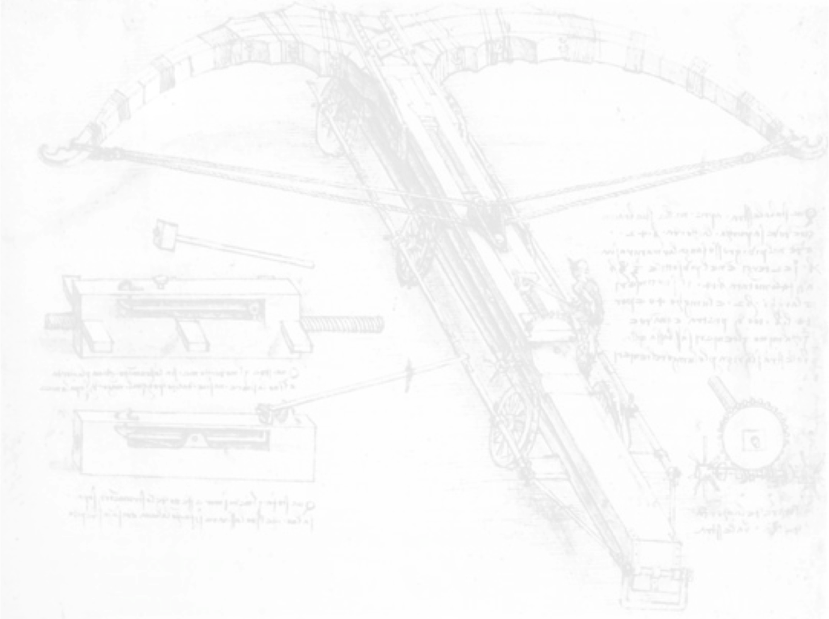

CEPC-SPPC Timeline (preliminary)
2nd Milestone: R&D funding in the government’s new 5-year plan (2016-2020)
CEPC
 |  | 2015 |  |  |  |  | 2020 |  |  |  |  | 2025 |  |  |  |  | 2030 |  |  |  |  | 2035
Pre-studies (2013-2015)
R&D Engineering Design (2016-2020)
Construction (2021-2027)
Data taking (2028-2035)
1st Milestone: Pre-CDR (by the end of 2014)
SPPC
 |  | 2020 |  |  |  |  |  |  | 2030 |  |  |  |  |  |  |  |  | 2040
R&D (2014-2030)
Engineering Design (2030-2035)
Construction (2035-2042)
Data taking (2042-2055)

Slide 13
CEPC-SPPC Pre-CDR (March 2015)

Slide 14
Hadron collider parameters
Parameter | FCC-hh |  | SPPC | LHC | HL LHC
collision energy cms [TeV] | 100 |  | 71.2 | 14
dipole field [T] | 16 |  | 20 | 8.3
# IP | 2 main & 2 |  | 2 | 2 main & 2
bunch intensity [10¹¹] | 1 | 1 (0.2) | 2 | 1.1 |  | 2.2
bunch spacing [ns] | 25 | 25 (5) | 25 | 25 |  | 25
luminosity/Ip [10³⁴ cm⁻²s⁻¹] | 5 | 25 | 12 | 1 |  | 5
events/bx | 170 | 850 (170) | 400 | 27 |  | 135
stored energy/beam [GJ] | 8.4 |  | 6.6 | 0.36 |  | 0.7
synchr. rad. [W/m/apert.] | 30 |  | 58 | 0.2 |  | 0.35

Slide 15
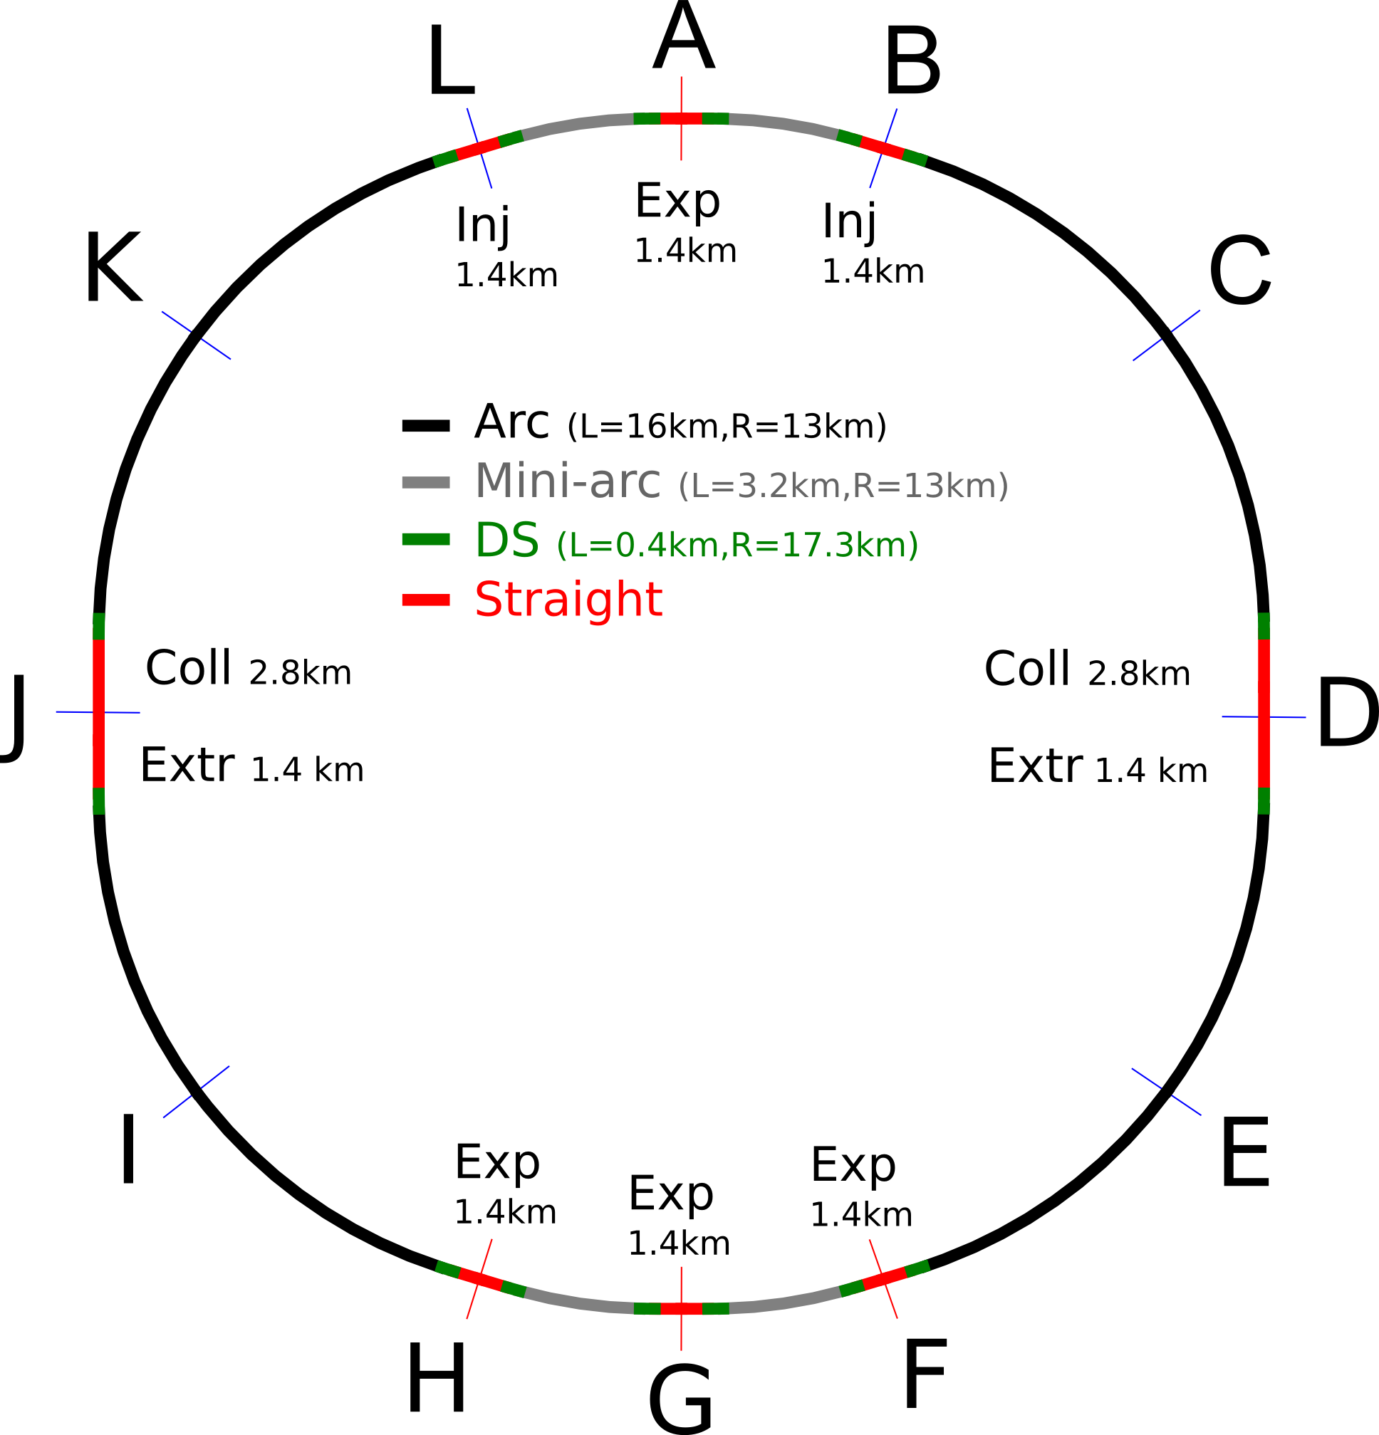
FCC-hh preliminary layout
100 km layout for FCC-hh
(different sizes under investigation)
Two high-luminosity experiments (A and G)
Two other experiments (F and H) grouped with main experiment in G
Two collimation lines
Two injection and two extraction lines
Orthogonal functions for each insertion section

Slide 16
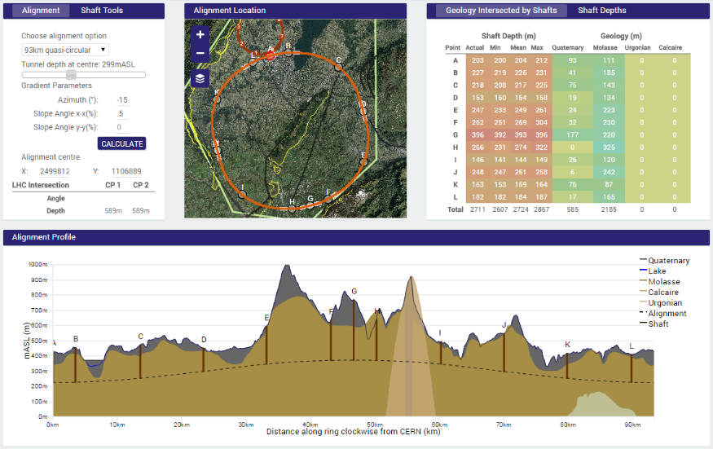
Site investiagations
90 – 100 km fits geological situation well,
LHC suitable as potential injector

Slide 17
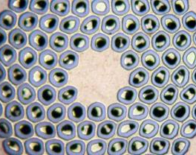
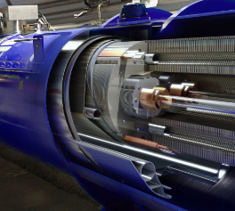
Key Technology R&D - HFM
Nb₃Sn
16 T
Conductor R&D
Magnet Design
Increase critical current density
Obtain high quantities at
required quality
Material Processing
Reduce cost
Develop 16T short models
Field quality and aperture
Optimum coil geometry
Manufacturing aspects
Cost optimisation

Slide 18
Superconductor performance
Nb3Sn T = 4.5 K
Critical surface FCC
LHC at 1.9 K
16 T
HL-LHC
5400 mm²
3150 mm²
Different technology
~1.7 times less SC
Nb-Ti
Not possible
~10% margin
HL-LHC
~10% margin
FCC ultimate

Slide 19
FCC magnet technology program
Main Milestones of the FCC Magnets Technologies
Milestone | Description | 15 | 2016 |  | 2017 |  | 2018 |  | 2019 |  | 2020 |  | 21
M0 | High J_{c} wire development with industry
M1 | Supporting wound conductor test program
M2 | Design & manufacture 16T ERMC with existing wire
M3 | Design & manufacture 16 T RMM with existing wire
M4 | Procurement of 35 km enhanced wire
M5 | Design & manufacture 16T demonstrator magnet
M6 | Procurement 70 km of enhanced high J_{c} wire
M7 | EuroCirCol design 16T accelerator quality model
 | Manufacture and test of the 16 T EuroCirCol model
ERMC (16 T mid-plane field) RMM (16 T in 50 mm cavity) Demonstrator (16 T, 50 mm gap)

Slide 20
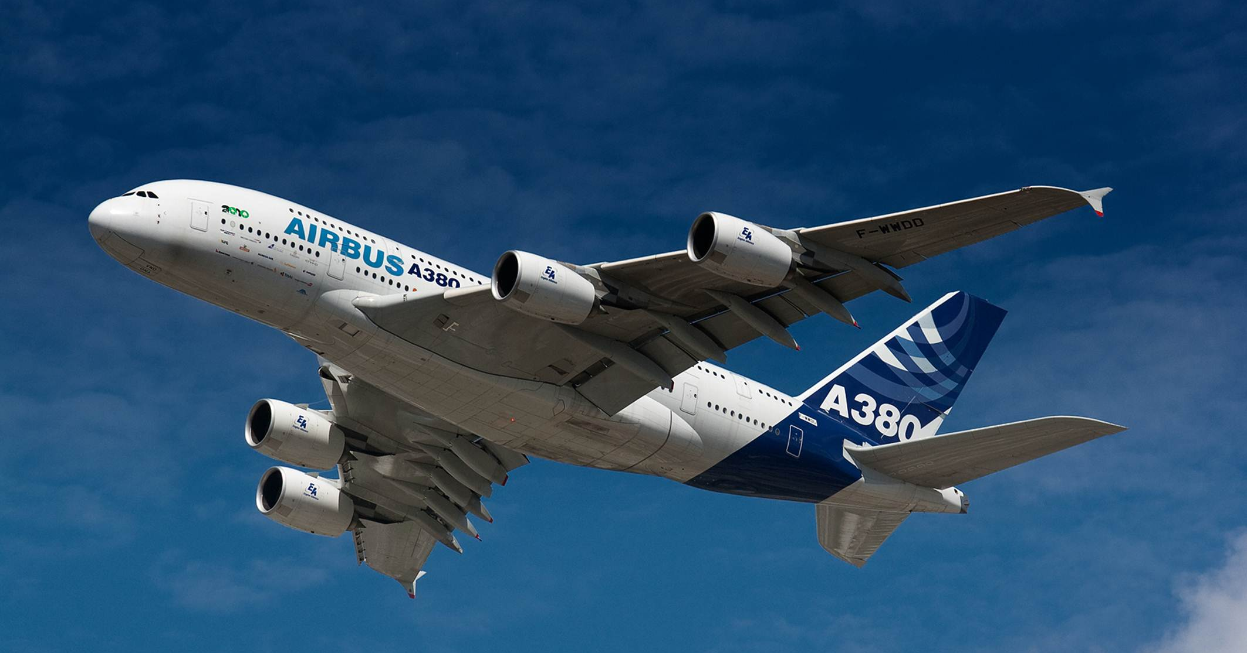
Unprecedented beam power
  Stored beam energy: 8 GJ/beam (0.4 GJ LHC) = 16 GJ total
  ➔ equivalent to an Airbus A380 (560 t) at full speed (850 km/h)
  Collimation, beam loss control, radiation effects: important
  Injection/dumping/beam transfer: critical operations
  Magnet/machine protection: to be considered early on

Slide 21
Cryo power for cooling of SR heat
contributions: beam screen (BS) & cold bore (BS heat radiation)
Overall optimisation of cryo-power, vacuum and impedance
Termperature ranges: <20, 40K-60K, 100K-120K
Ph. Lebrun
L. Tavian
V. Baglin
300MW
200MW
100MW
Multi-bunch instability growth time: 25 turns 9 turns (ΔQ=0.5)

Slide 22
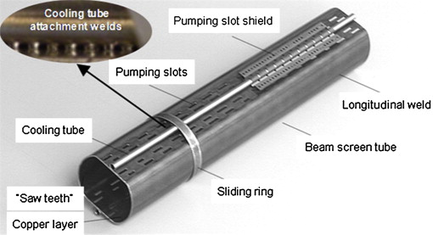
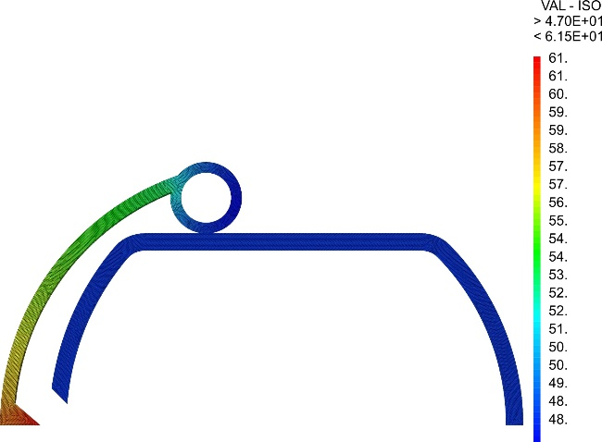
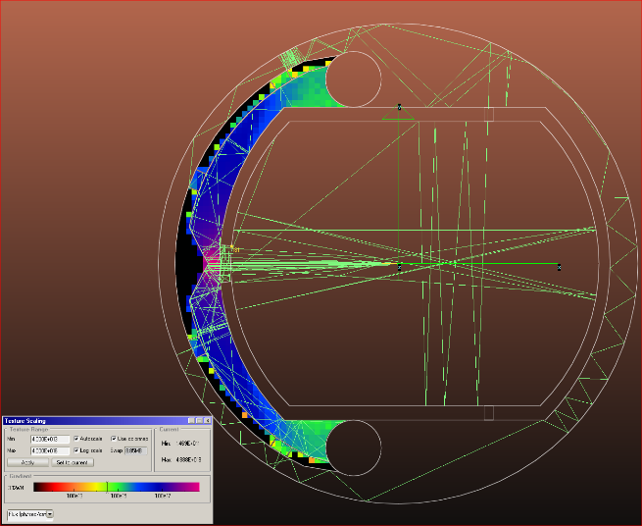
Synchrotron radiation/beam screen
High synchrotron radiation load (SR) of protons @ 50 TeV:
~30 W/m/beam (@16 T)
5 MW total in arcs (LHC <0.2W/m)
New type of ante-chamber
absorption of synchrotron radiation
avoids photo-electrons, helps vacuum
LHC beam screen
Photon distribution
Heat transport
R. Kersevan, C. Garion, L. Tavian, et al.

Slide 23
FCC-hh luminosity goals & phases
Two parameter sets for two operation phases:
  Phase 1 (baseline): 5 x 10³⁴ cm⁻²s⁻¹ (peak),
  250 fb⁻¹/year (averaged)
    2500 fb⁻¹ within 10 years (~HL LHC total luminosity)
  Phase 2 (ultimate): ~2.5 x 10³⁵ cm⁻²s⁻¹ (peak),
  1000 fb⁻¹/year (averaged)
  ➔ 15,000 fb⁻¹ within 15 years
  Yielding total luminosity O(20,000) fb⁻¹ over ~25 years of operation

Slide 24
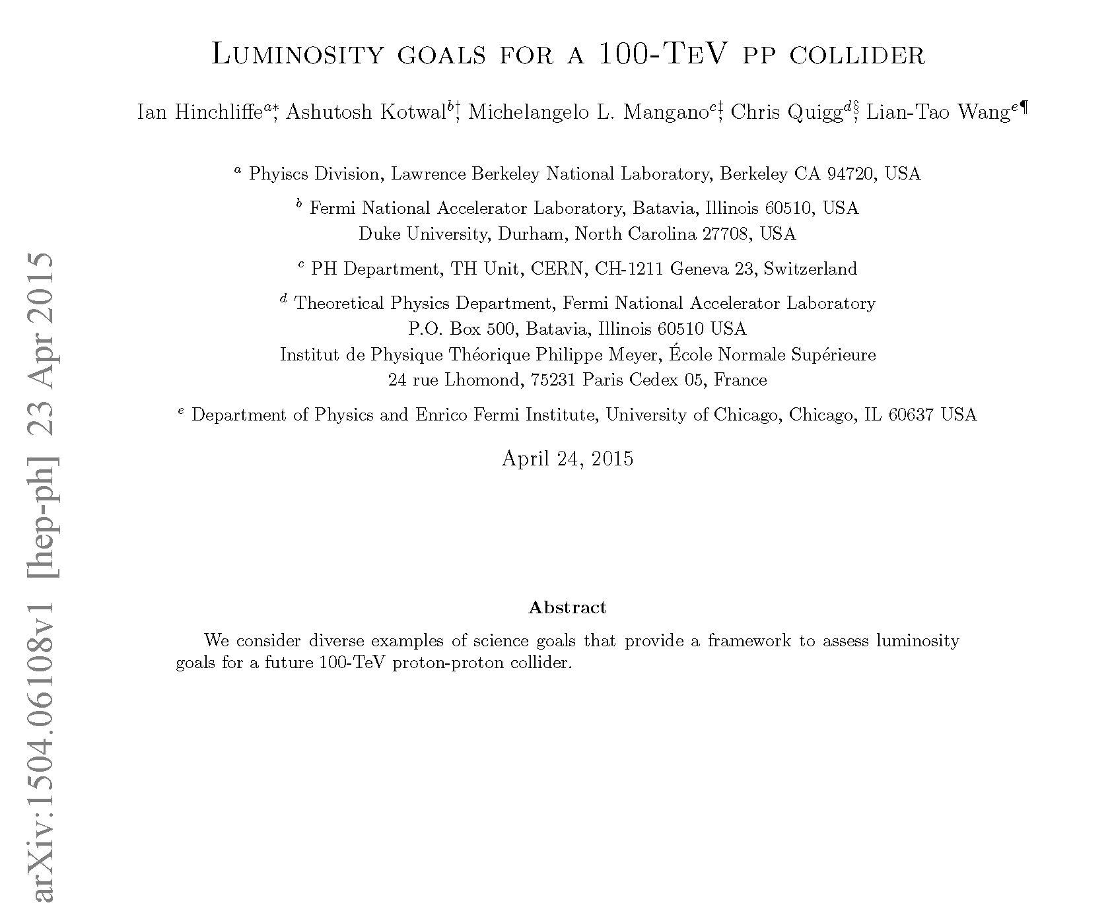
20 ab⁻¹ OK for physics

Slide 25
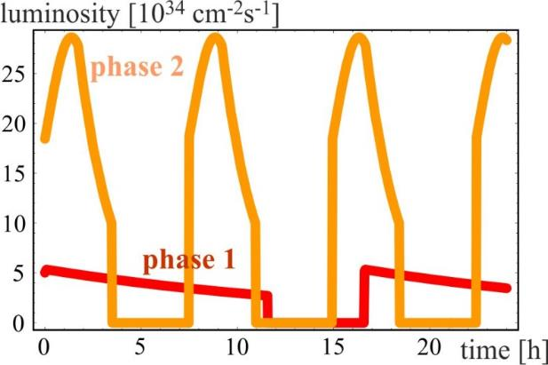
Luminosity evolution
radiation damping: τ~1 h
  for both phases:
  beam current 0.5 A unchanged!
  total synchrotron radiation power ~5 MW.
phase 1: β*=1.1 m, ΔQ_{tot}=0.01, t_{ta}=5 h
phase 2: β*=0.3 m, ΔQ_{tot}=0.03, t_{ta}=4 h

Slide 26
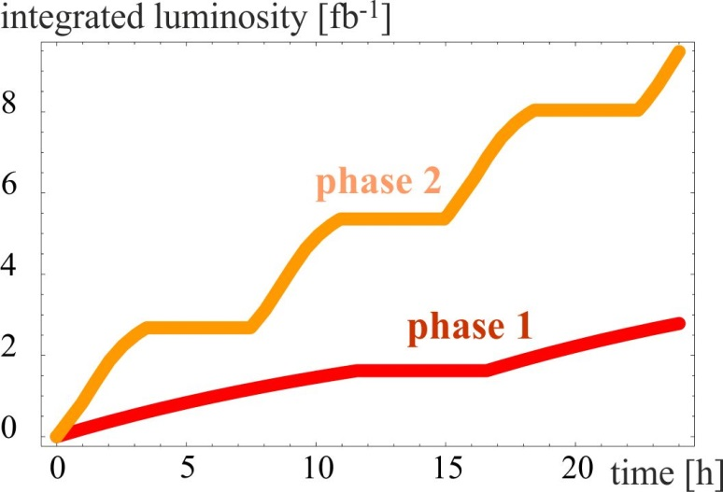
integrated luminosity / day
phase 1: β*=1.1 m, ΔQ_{tot}=0.01, t_{ta}=5 h
phase 2: β*=0.3 m, ΔQ_{tot}=0.03, t_{ta}=4 h

Slide 27
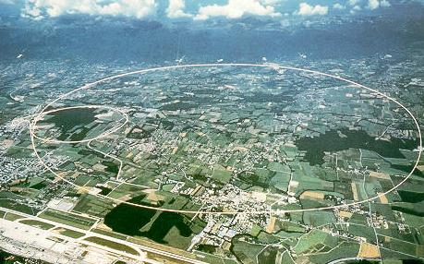
LEP – highest energy e⁺e⁻ collider so far
circumference 27 km
in operation from 1989 to 2000
maximum c.m. energy 209 GeV
maximum synchrotron radiation power 23 MW

Slide 28
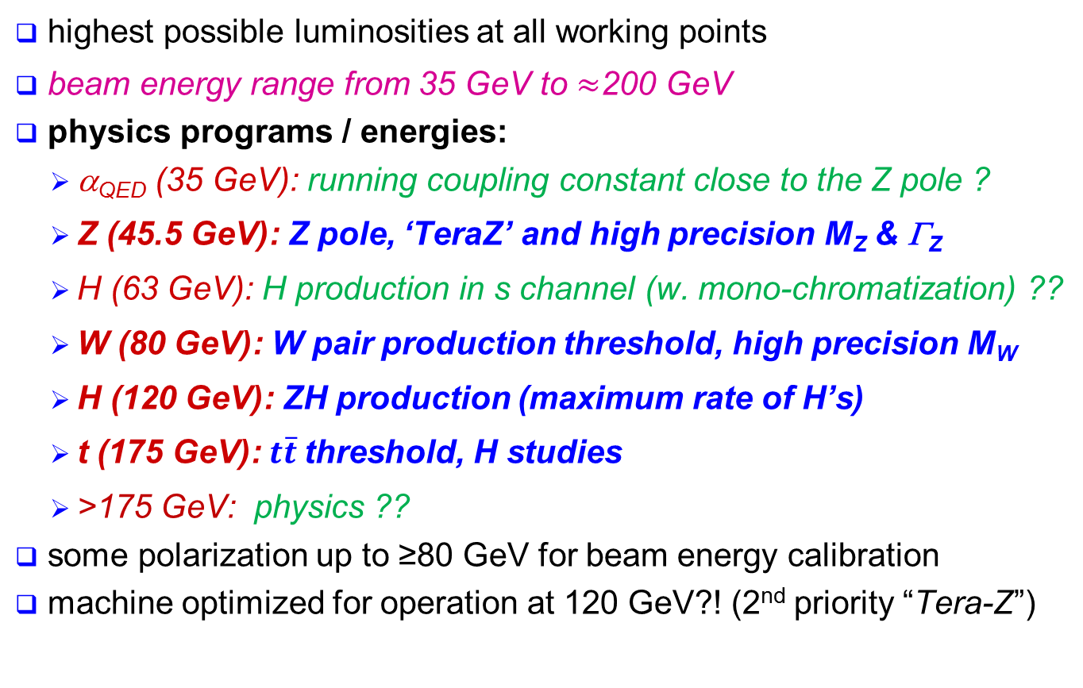
Lepton collider physics areas
highest possible luminosities at all working points
beam energy range from 35 GeV to $≈$200 GeV
physics programs / energies:
  α_{QED} (35 GeV): running coupling constant close to the Z pole ?
  Z (45.5 GeV): Z pole, ‘TeraZ’ and high precision M_{Z} & Γ_{Z}
  H (63 GeV): H production in s channel (w. mono-chromatization) ??
  W (80 GeV): W pair production threshold, high precision M_{W}
  H (120 GeV): ZH production (maximum rate of H’s)
  t (175 GeV): $t\overline{t}$threshold, H studies
  >175 GeV: physics ??
some polarization up to ≥80 GeV for beam energy calibration
machine optimized for operation at 120 GeV?! (2nd priority “Tera-Z”)
A. Blondel, P. Janot, et al.

Slide 29
Lepton collider key parameters
parameter | FCC-ee |  |  | CEPC | LEP2
energy/beam [GeV] | 45 | 120 | 175 | 120 | 105
bunches/beam | 13000- 60000 | 500- 1400 | 51- 98 | 50 | 4
beam current [mA] | 1450 | 30 | 6.6 | 16.6 | 3
luminosity/IP x 10³⁴ cm⁻²s⁻¹ | 21 - 280 | 5 - 11 | 1.5 - 2.6 | 2.0 | 0.0012
energy loss/turn [GeV] | 0.03 | 1.67 | 7.55 | 3.1 | 3.34
synchrotron power [MW] | 100 |  |  | 103 | 22
RF voltage [GV] | 0.2-2.5 | 3.6-5.5 | 11 | 6.9 | 3.5
FCC-ee: 2 separate rings CEPC baseline: single beam pipe like LEP
Dependency FCC-ee: crab-waist vs. baseline optics and 2 vs. 4 IPs

Slide 30
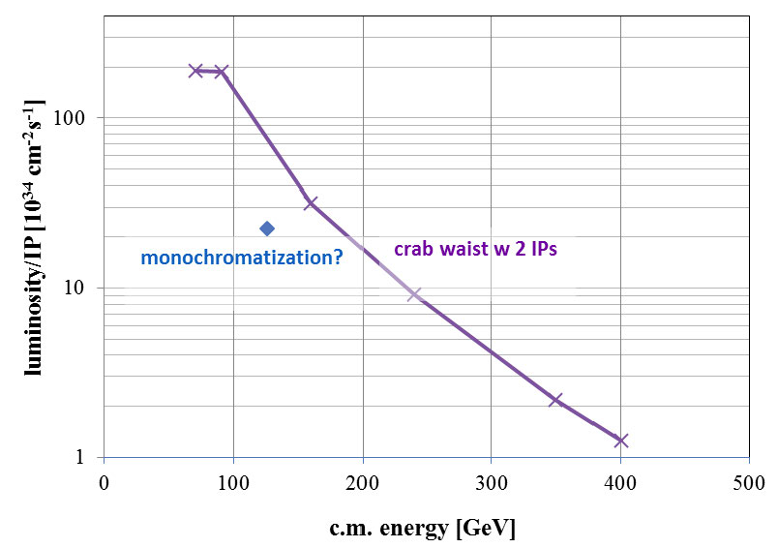

e⁺e⁻ luminosity vs. c.m. energy
FCC ee
α_{QED}
Z
H?
WW
HZ
$$t\overline{t}$$
?
CEPC

Slide 31
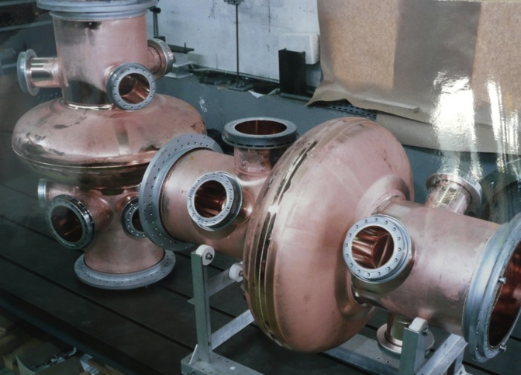
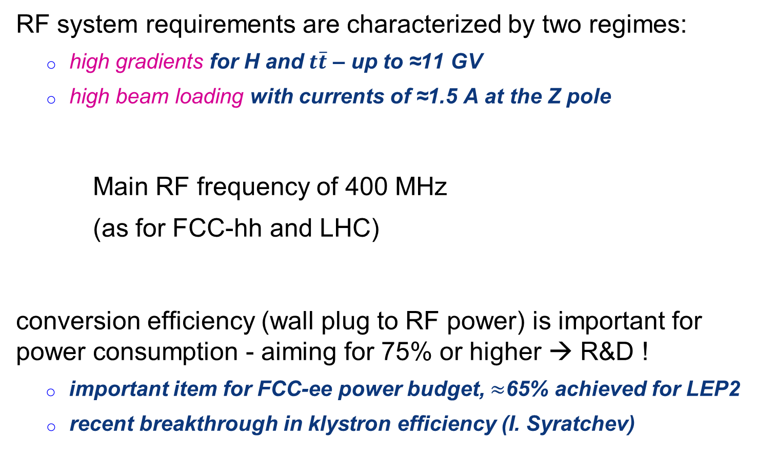
FCC-ee SC RF system
RF system requirements are characterized by two regimes:
  high gradients for H and $t\overline{t}$ – up to ≈11 GV
  high beam loading with currents of ≈1.5 A at the Z pole
Main RF frequency of 400 MHz
(as for FCC-hh and LHC)
conversion efficiency (wall plug to RF power) is important for power consumption - aiming for 75% or higher → R&D !
  important item for FCC-ee power budget, $≈$65% achieved for LEP2
  recent breakthrough in klystron efficiency (I. Syratchev)
LHC cavities (400 MHz)

Slide 32
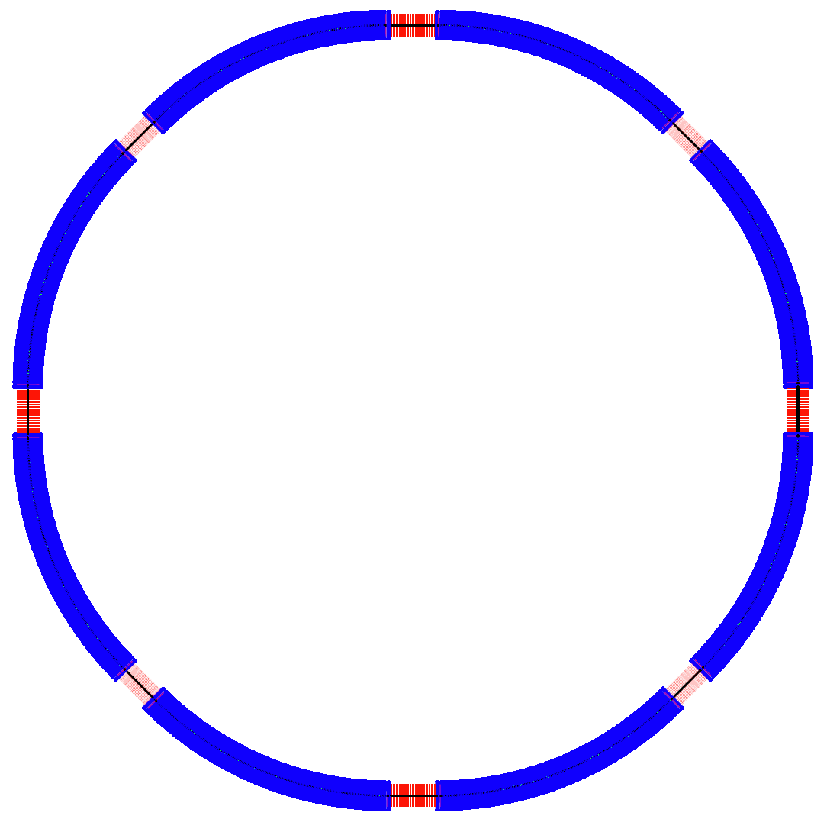
CEPC Lattice Layout (September 24, 2014)
½ RF
½ RF
One RF station:
650 MHz five-cell SRF cavities;
4 cavities/module
12 modules, 10 m each
RF length 120 m
4 straights, 849.6 m (944 m) each
P.S.
IP1
RF
RF
4 IPs, 1038.4 m (944 m) each
8 arcs, 5852.8 m each
IP4
D = 17.3 km
RF
IP2
RF
C = 54.374 km
IP3
RF
RF
P.S.
P.S.
½ RF
½ RF

Slide 33
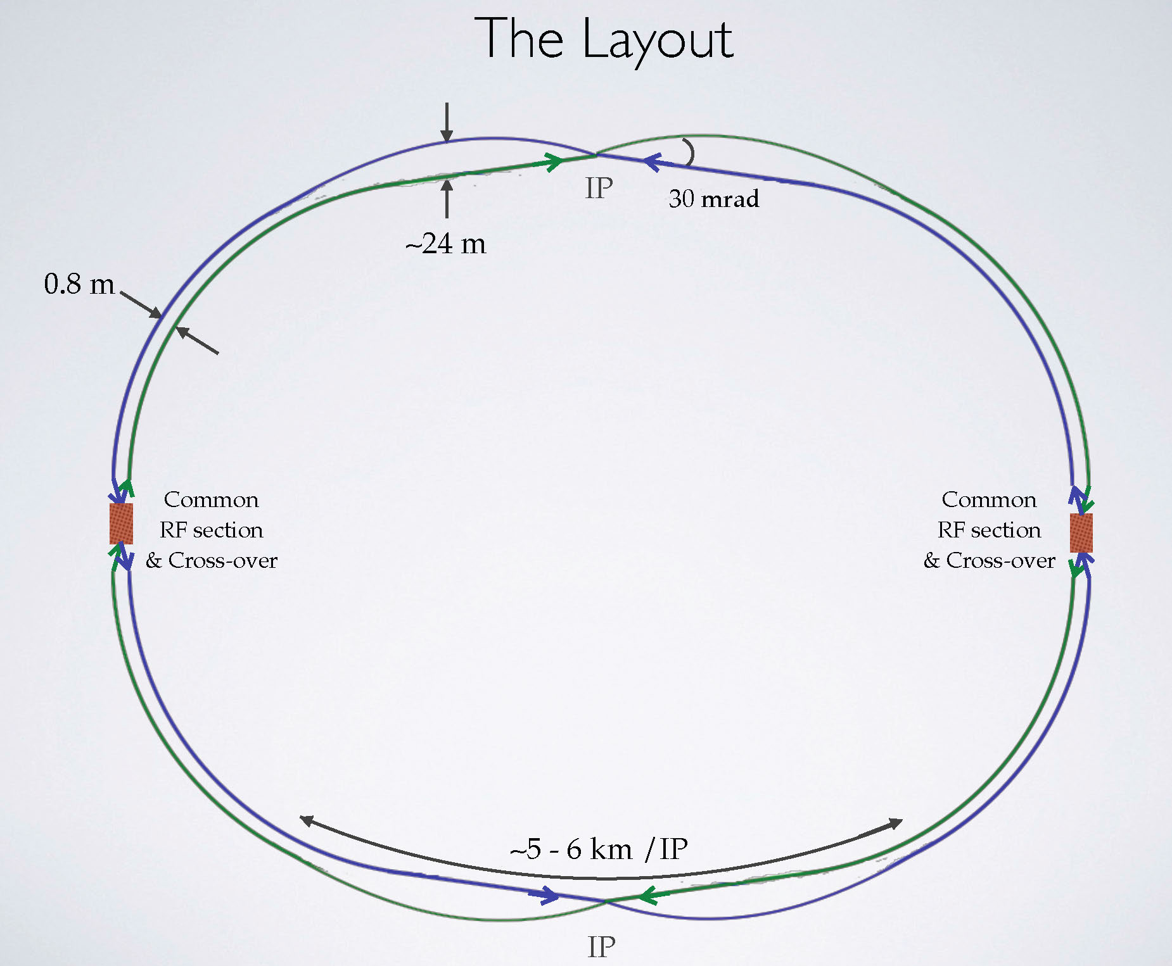
FCC-ee layout option
a bypass for the injector?
asymmetric layout -
less bending for incoming beam, stronger bending for outgoing beam; reduced synchrotron radiation towards the IP
K. Oide

Slide 34

SuperKEKB = FCC-ee demonstrator
beam commissioning will start in 2015
K. Oide et al.
top up injection at high current
β_{y}* =300 μm (FCC-ee: 1 mm)
lifetime 5 min (FCC-ee: ≥20 min)
ε_{y}/ε_{x} =0.25% (similar to FCC-ee)
off momentum acceptance (±1.5%, similar to FCC-ee)
e⁺ production rate (2.5x10¹²/s, FCC-ee: <1.5x10¹²/s (Z crab waist)
SuperKEKB goes beyond FCC-ee, testing all concepts

Slide 35
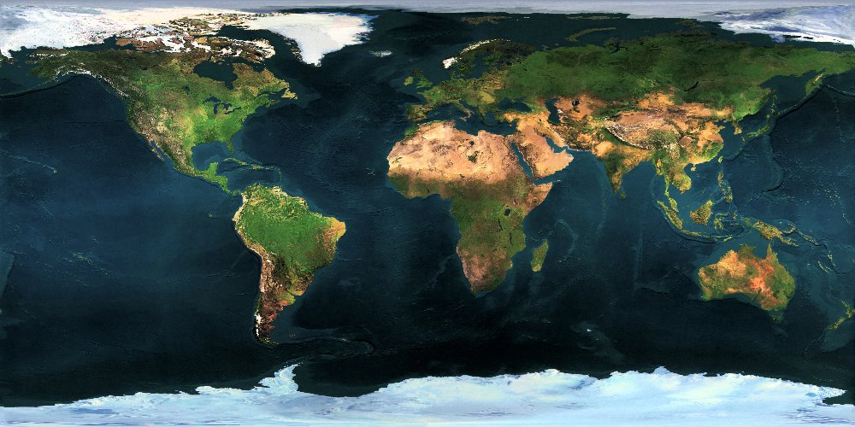























Collaboration Status
FCC International Collaboration
58 institutes
22 countries + EC
Status: July 30, 2015

Slide 36
FCC Members
58 collaboration members & CERN as host institute, 8 July 2015
ALBA/CELLS, Spain
Ankara U., Turkey
U Belgrade, Serbia
U Bern, Switzerland
BINP, Russia
CASE (SUNY/BNL), USA
CBPF, Brazil
CEA Grenoble, France
CEA Saclay, France
CIEMAT, Spain
CNRS, France
Cockcroft Institute, UK
U Colima, Mexico
CSIC/IFIC, Spain
TU Darmstadt, Germany
DESY, Germany
TU Dresden, Germany
Duke U, USA
EPFL, Switzerland
GWNU, Korea
U Geneva, Switzerland
Goethe U Frankfurt, Germany
GSI, Germany
Hellenic Open U, Greece
HEPHY, Austria
U Houston, USA
IFJ PAN Krakow, Poland
INFN, Italy
INP Minsk, Belarus
U Iowa, USA
IPM, Iran
UC Irvine, USA
Istanbul Aydin U., Turkey
JAI/Oxford, UK
JINR Dubna, Russia
FZ Jülich, Germany
KAIST, Korea
KEK, Japan
KIAS, Korea
King’s College London, UK
KIT Karlsruhe, Germany
Korea U Sejong, Korea
MEPhI, Russia
MIT, USA
NBI, Denmark
Northern Illinois U., USA
NC PHEP Minsk, Belarus
U. Liverpool, UK
U Oxford, UK
PSI, Switzerland
Sapienza/Roma, Italy
UC Santa Barbara, USA
U Silesia, Poland
TU Tampere, Finland
TOBB, Turkey
U Twente, Netherlands
TU Vienna, Austria
Wroclaw UT, Poland

Slide 37
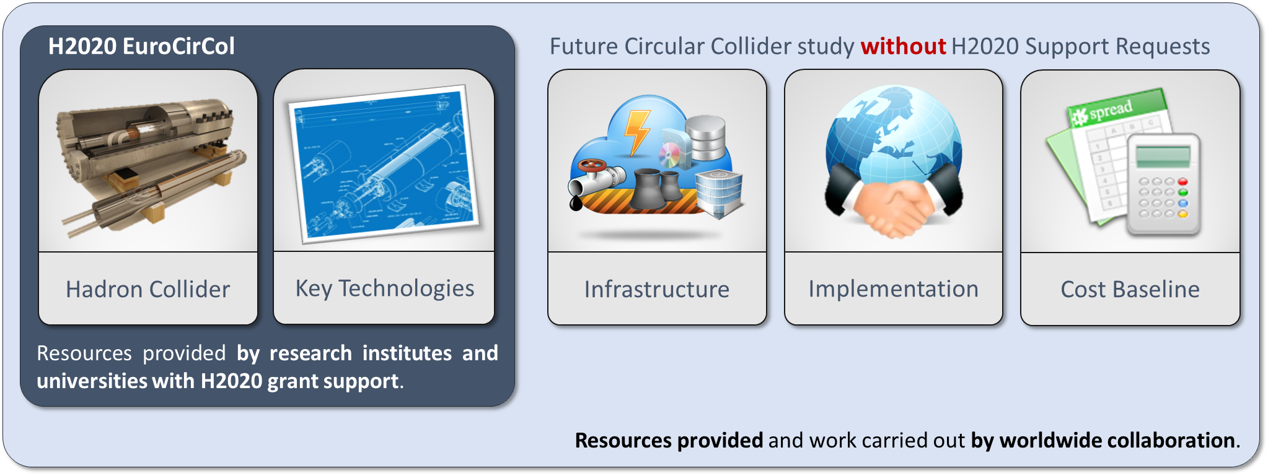
EuroCirCol EU Horizon 2020 Grant
EC contributes with funding to FCC-hh study
Core aspects of hadron collider design: arc & IR optics design, 16 T magnet program, cryogenic beam vacuum system
Recognition of FCC Study by European Commission.

Slide 38
EuroCirCol Consortium + Associates
CERN | IEIO
TUT | Finland
CEA | France
CNRS | France
KIT | Germany
TUD | Germany
INFN | Italy
UT | Netherlands
ALBA | Spain
CIEMAT | Spain
STFC | United Kingdom
UNILIV | United Kingdom
UOXF | United Kingdom
KEK | Japan
EPFL | Switzerland
UNIGE | Switzerland
NHFML-FSU | USA
BNL | USA
FNAL | USA
LBNL | USA
Japan
KEK
Finland
TUT
United Kingdom
STFC, UNILIV, UOXF
Netherlands
UT
Germany
KIT, TUD
France
CEA, CNRS
CERN
Switzerland
EPFL, UNIGE
Italy
INFN
Spain
ALBA, CIEMAT
Consortium Beneficiaries, signing the Grant Agreement

Slide 39
Conclusions
High energy circular colliders are a powerful option for future accelerator-based HEP!
We now need to urgently prepare for post-LHC period, and there are strongly rising activities worldwide.
The design of high energy circular colliders presents many challenging R&D requirements in SC magnets, beam handling, SRF and several other technical areas.
Global collaboration in physics, experiments and accelerators and the use of all synergies is essential to move forward.

Slide 40
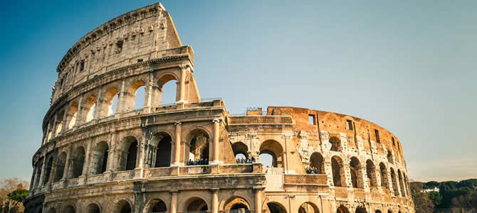





FCC Week 2016
Rome, 11-15 April 2016

